Slide 1
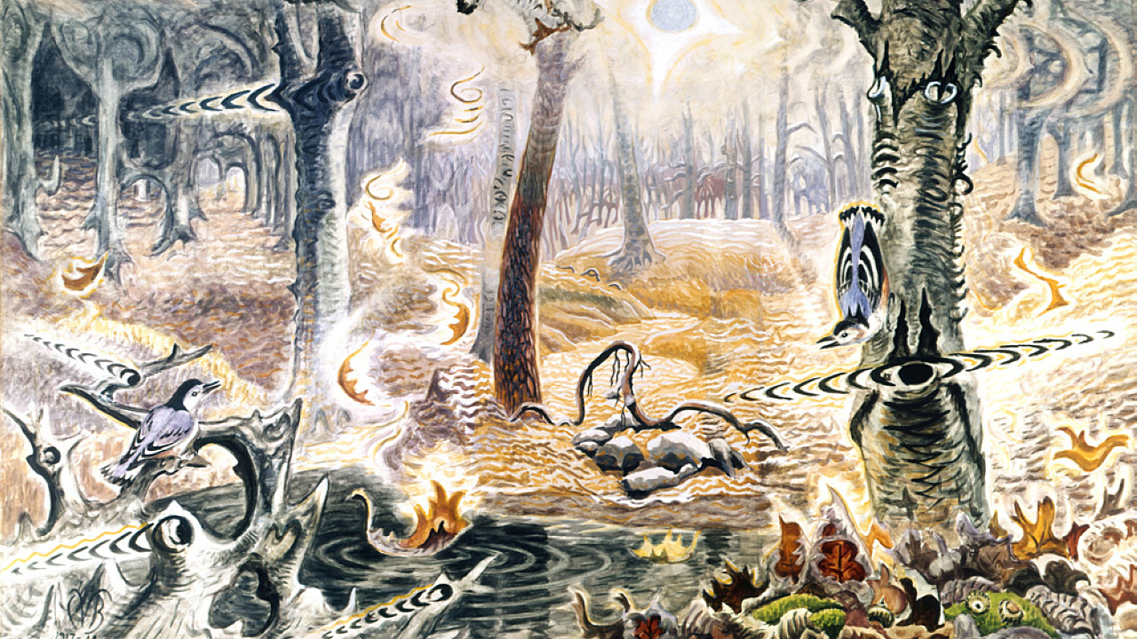
Music, Brains, Drugs & The Beatles
David Hattner, Portland Youth Philharmonic
Bill Griesar, PSU/OHSU/Northwest Noggin
Jeff Leake, PSU/NW Noggin
Charles Burchfield, Autumnal Fantasy

Slide 2
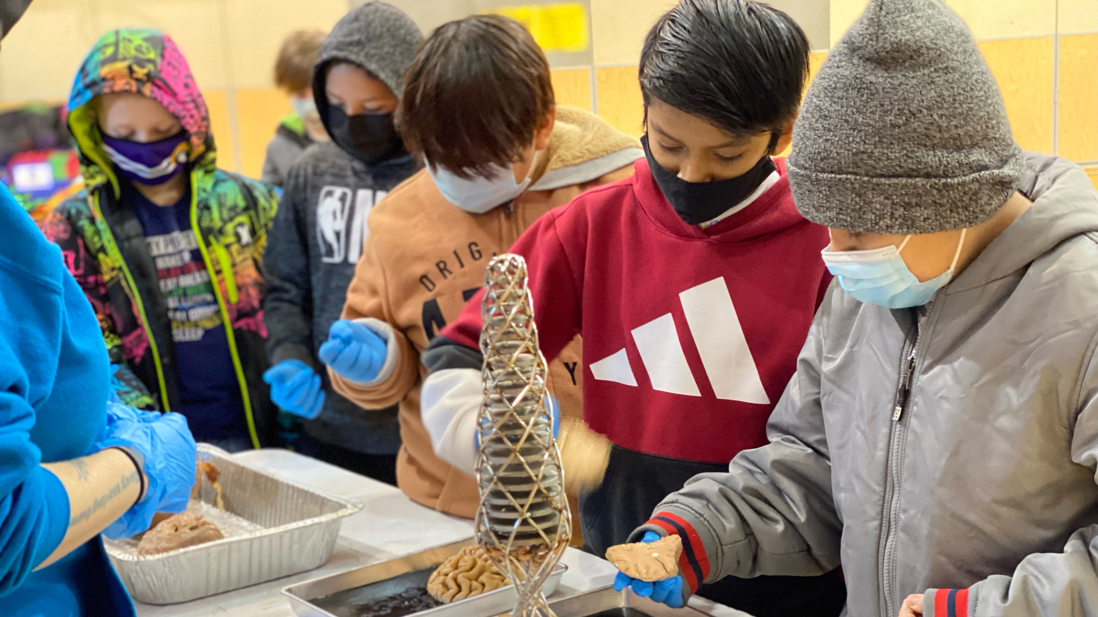
Northwest Noggin
Community outreach 🎨🧠🤝
Interdisciplinary neuroscience
We’ve met 85,000+ people 🤯
ALL VOLUNTEER ❤️
14 years! 😎
nwnoggin.org

Slide 3
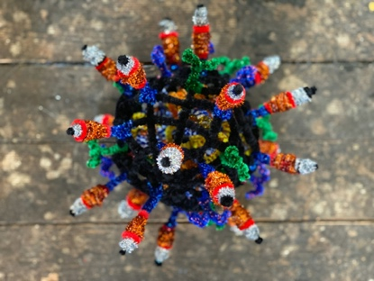
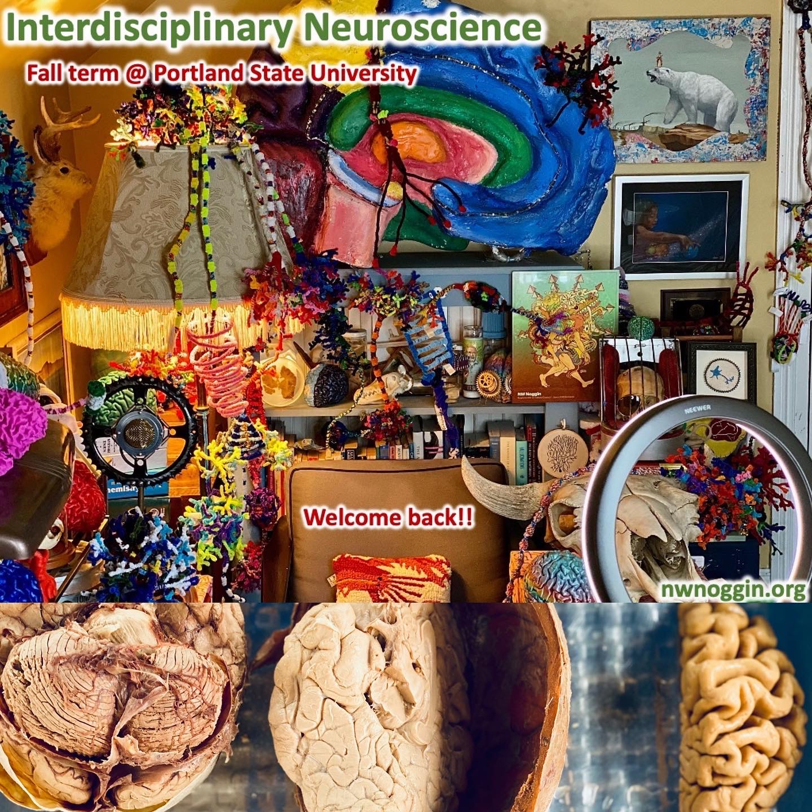
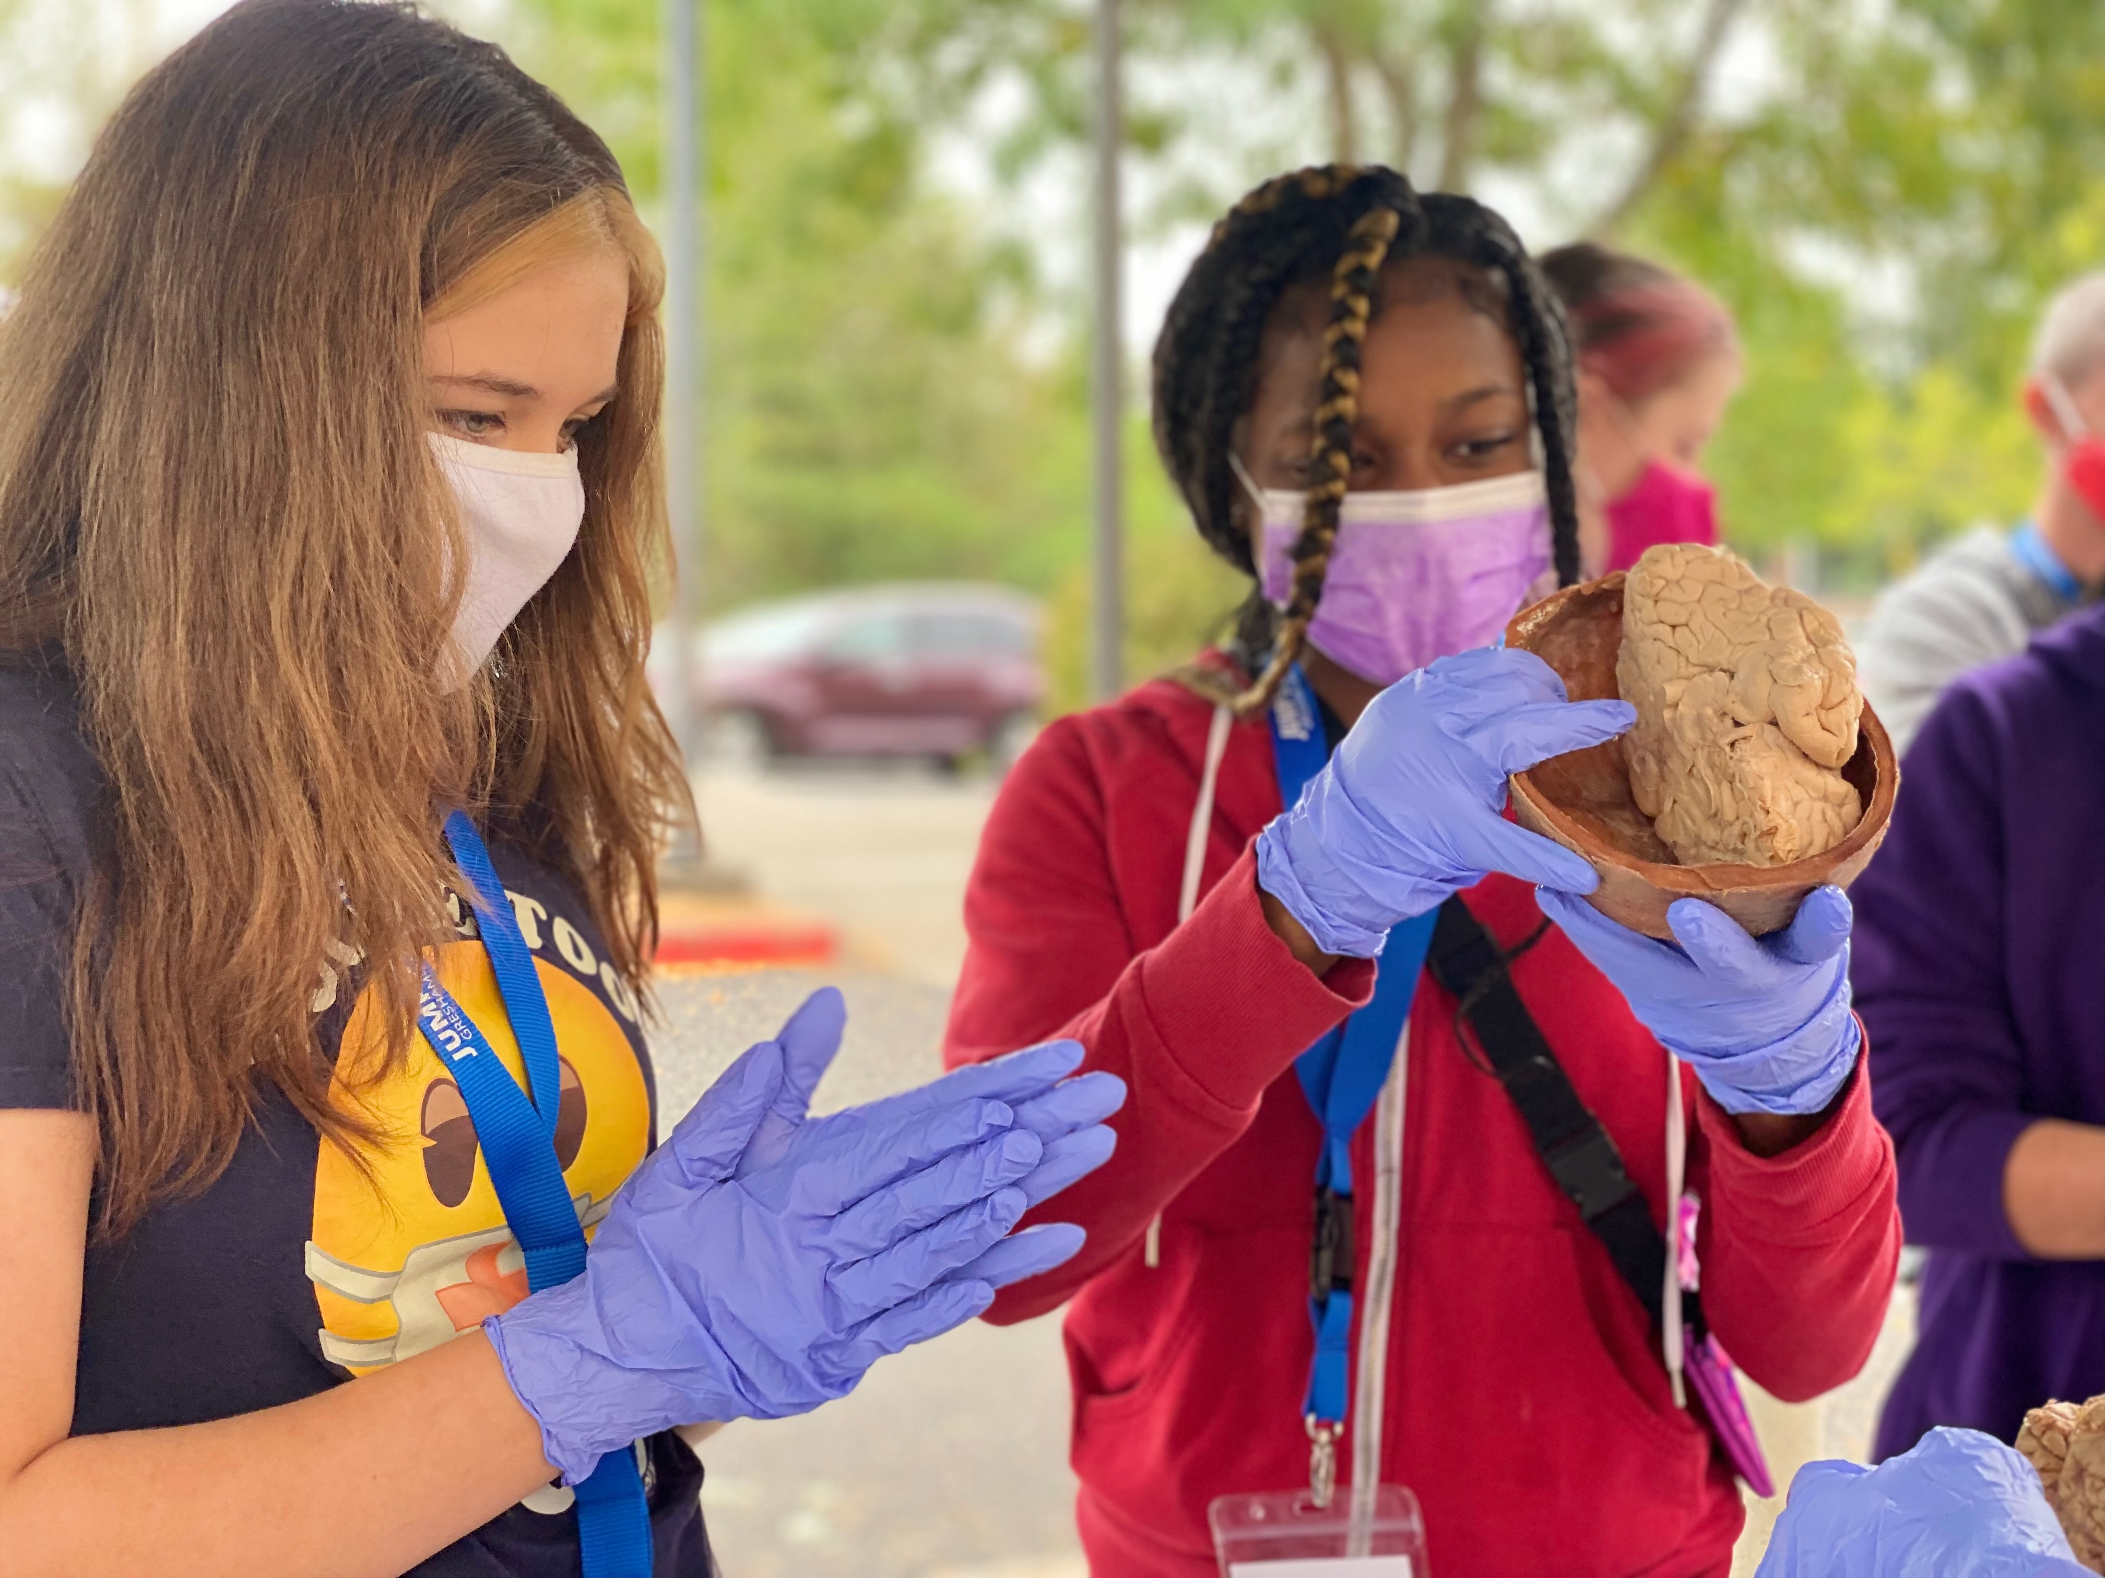
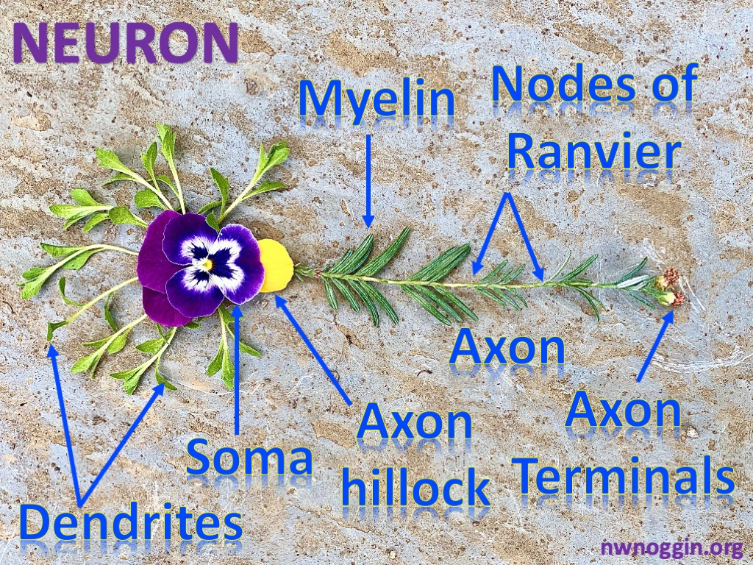

Art & Brains!
nwnoggin.org

Slide 4
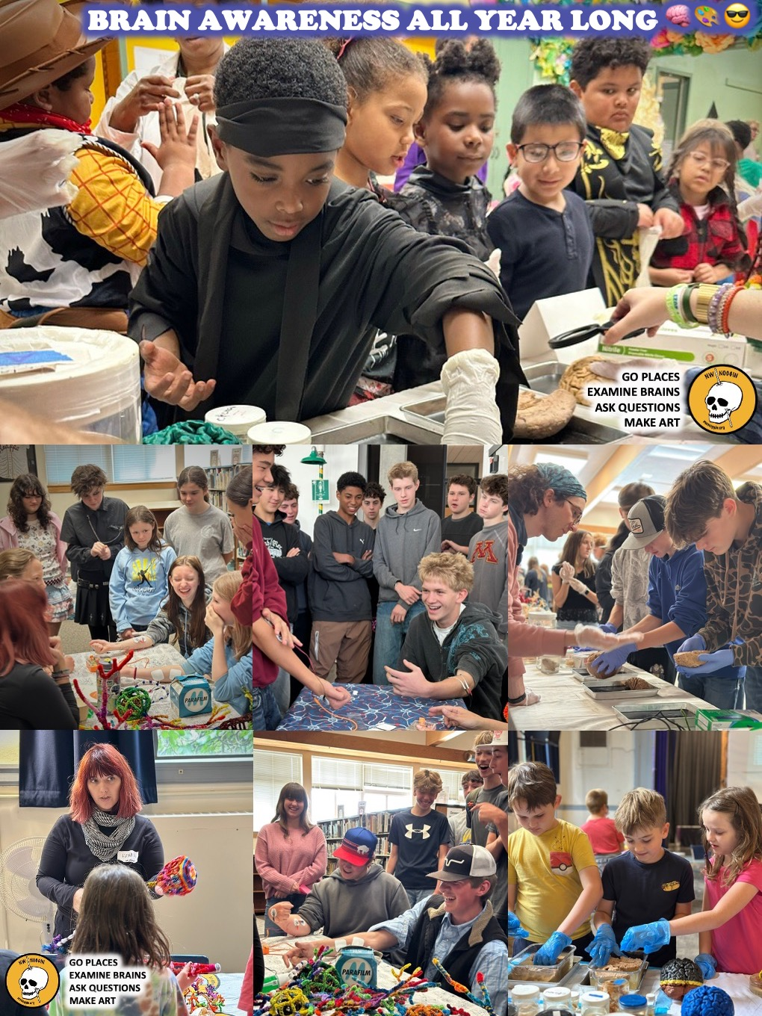

WE GO PLACES!

Slide 5
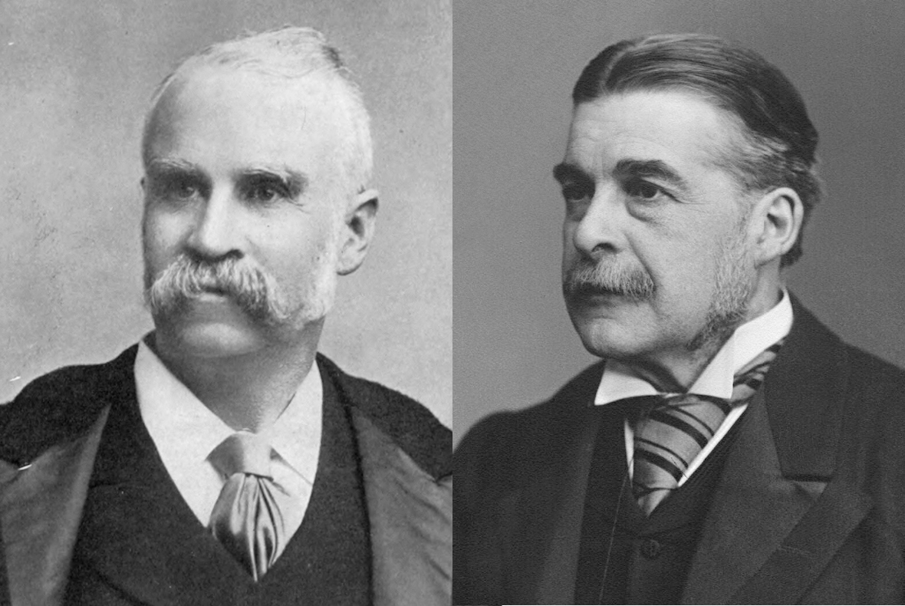
Gilbert & Sullivan

Slide 6
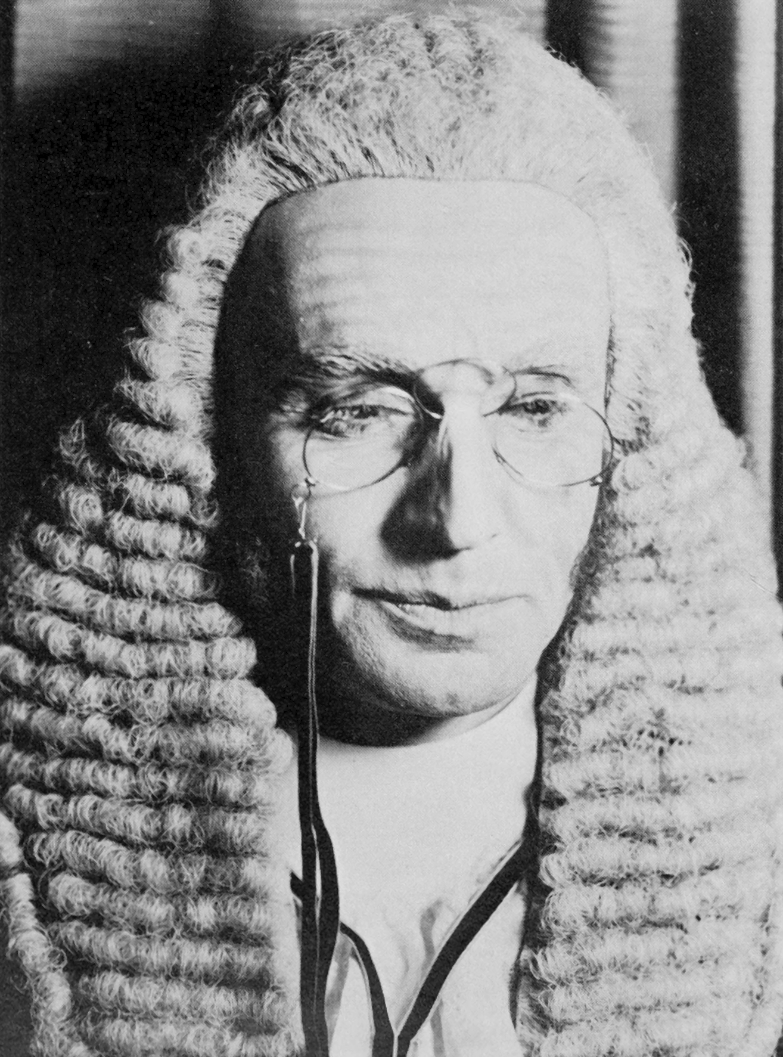
The Lord Chancellor
"When I went to the bar"
When I went to the Bar as a very young man,
(Said I to myself — said I),
I'll work on a new and original plan,
(Said I to myself — said I),
I'll never assume that a rogue or a thief
Is a gentleman worthy implicit belief,
Because his attorney has sent me a brief,
(Said I to myself — said I).

Slide 7
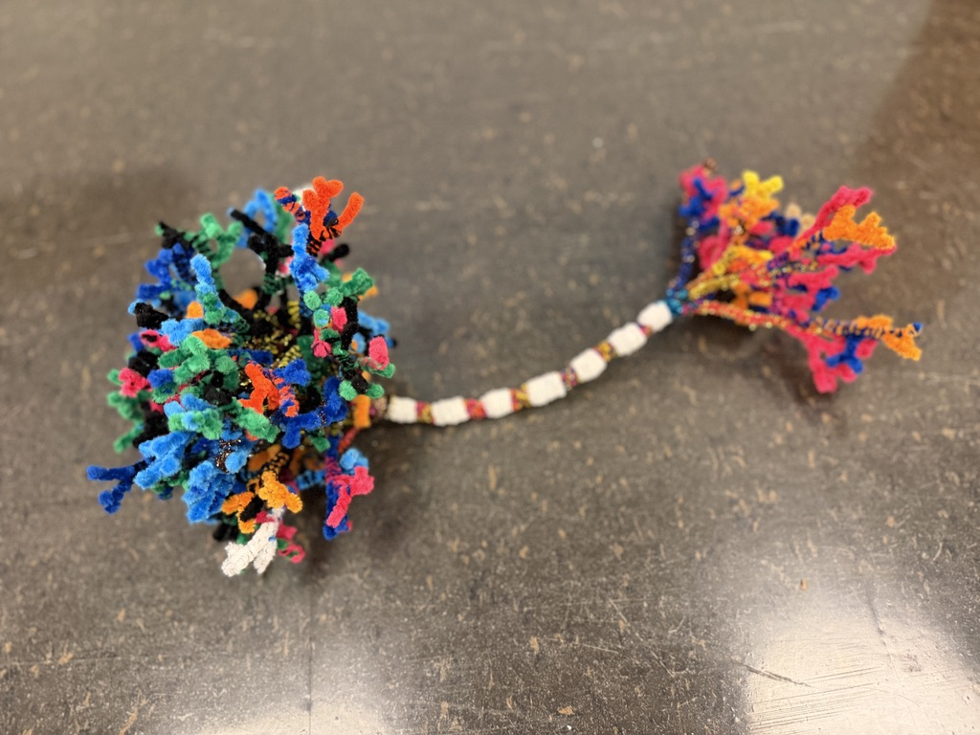

Your brain: made of cells
GO PLACES
EXAMINE BRAINS
ASK QUESTIONS
MAKE ART
Neurons carry electrical messages

Slide 8
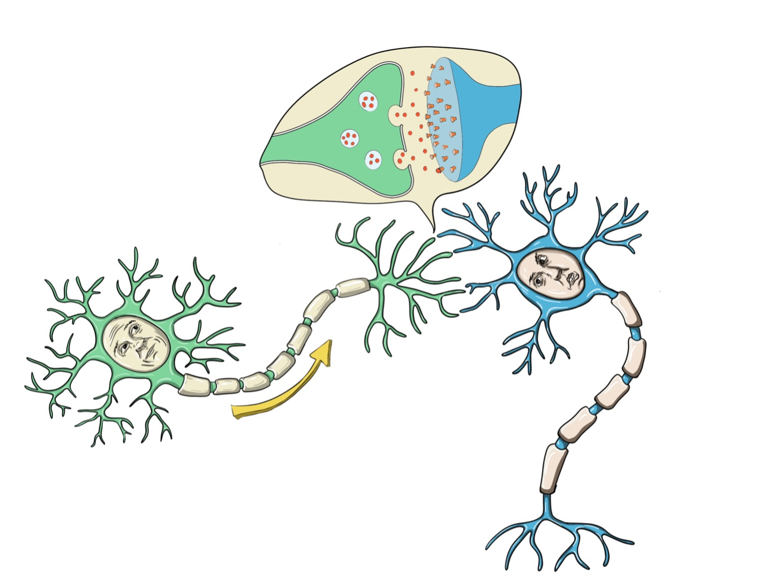
Neurons connect chemically across synapses
Many drugs (*chemicals!*) act here, at synapses
Neurotransmitters
Illustration by Jeff Leake
GO PLACES
EXAMINE BRAINS
ASK QUESTIONS
MAKE ART

Slide 9
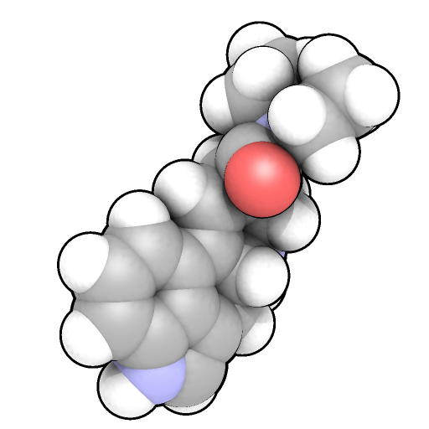
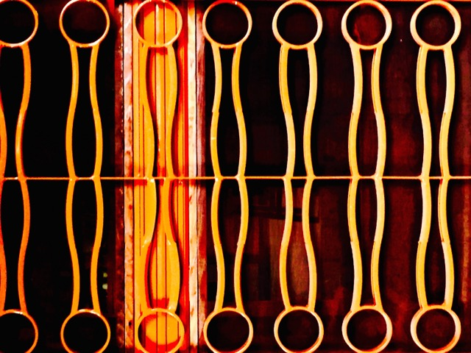
All cells have membranes
Neurotransmitter
or drug
Outside cells, including neurons
Many drugs, including
psychedelics, cannot get
through, but instead act
at RECEPTORS to affect
neuron function…
Drugs (chemicals) attach
(or “bind”) to receptors,
changing the activity of
affected neurons...
RECEPTOR: “Protein machine”
Inside cells

Slide 10
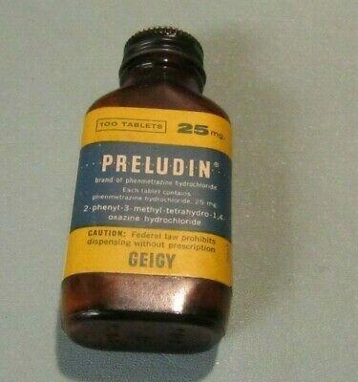
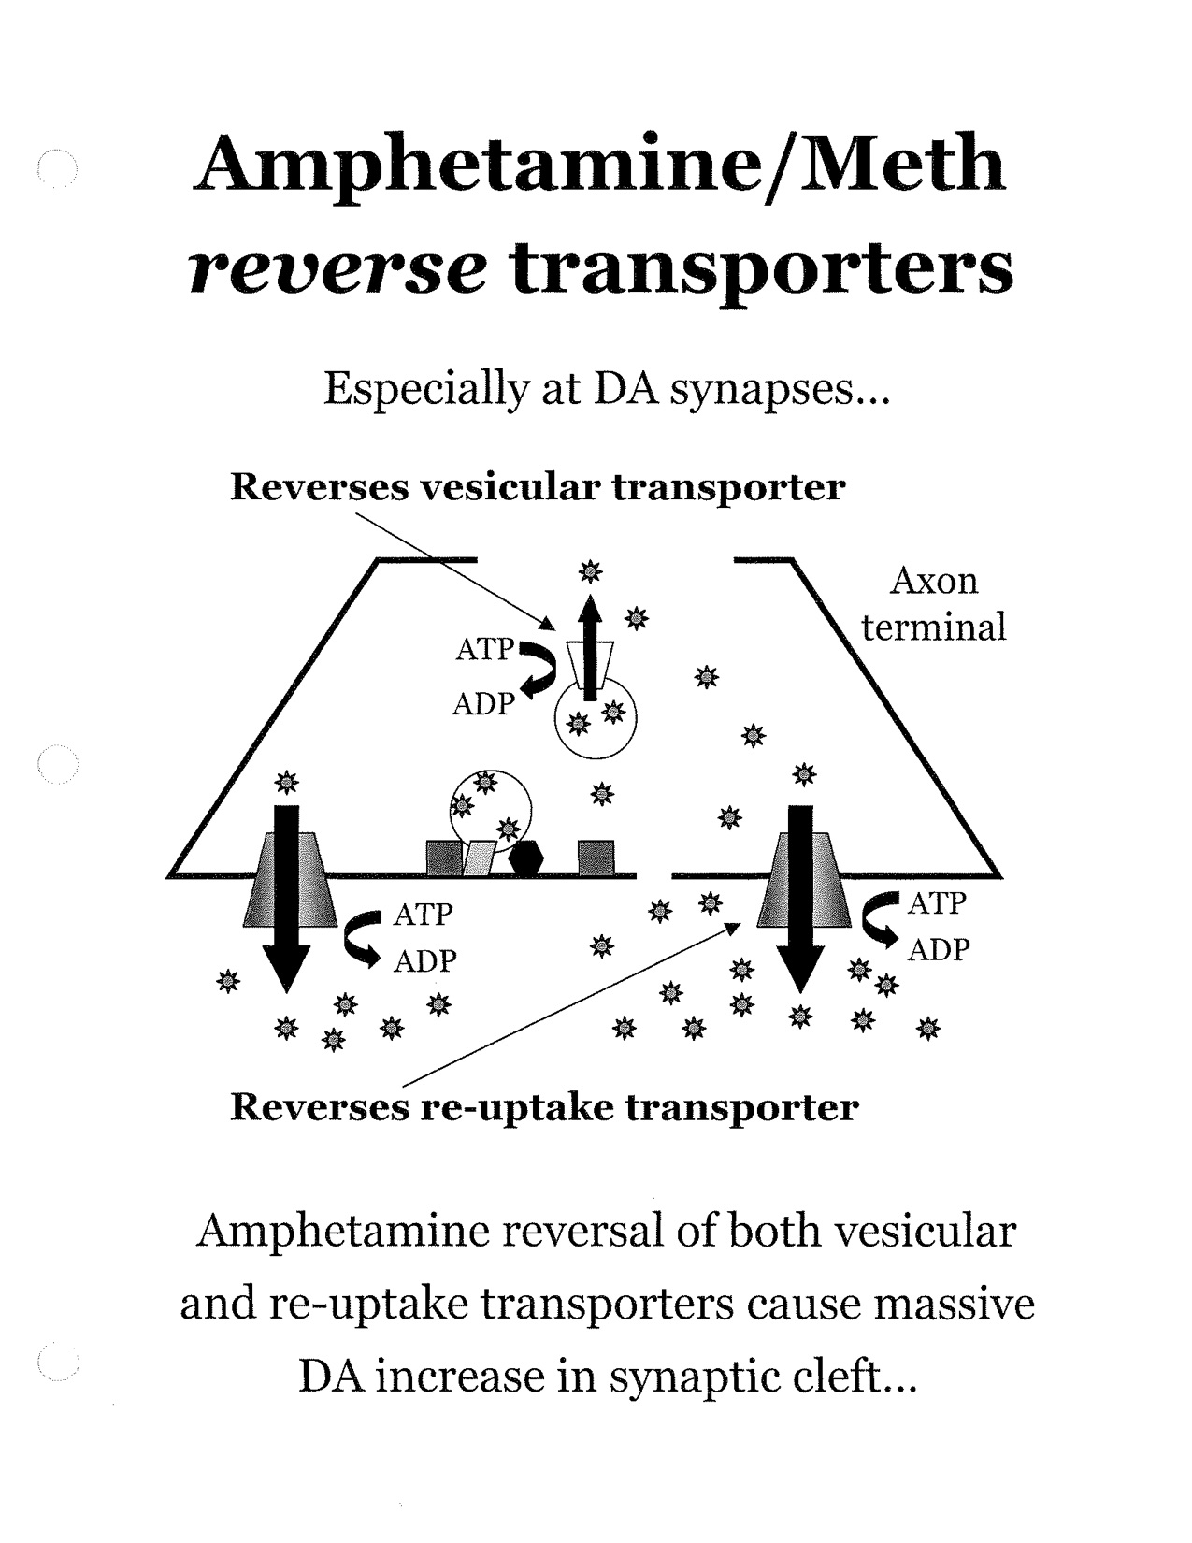
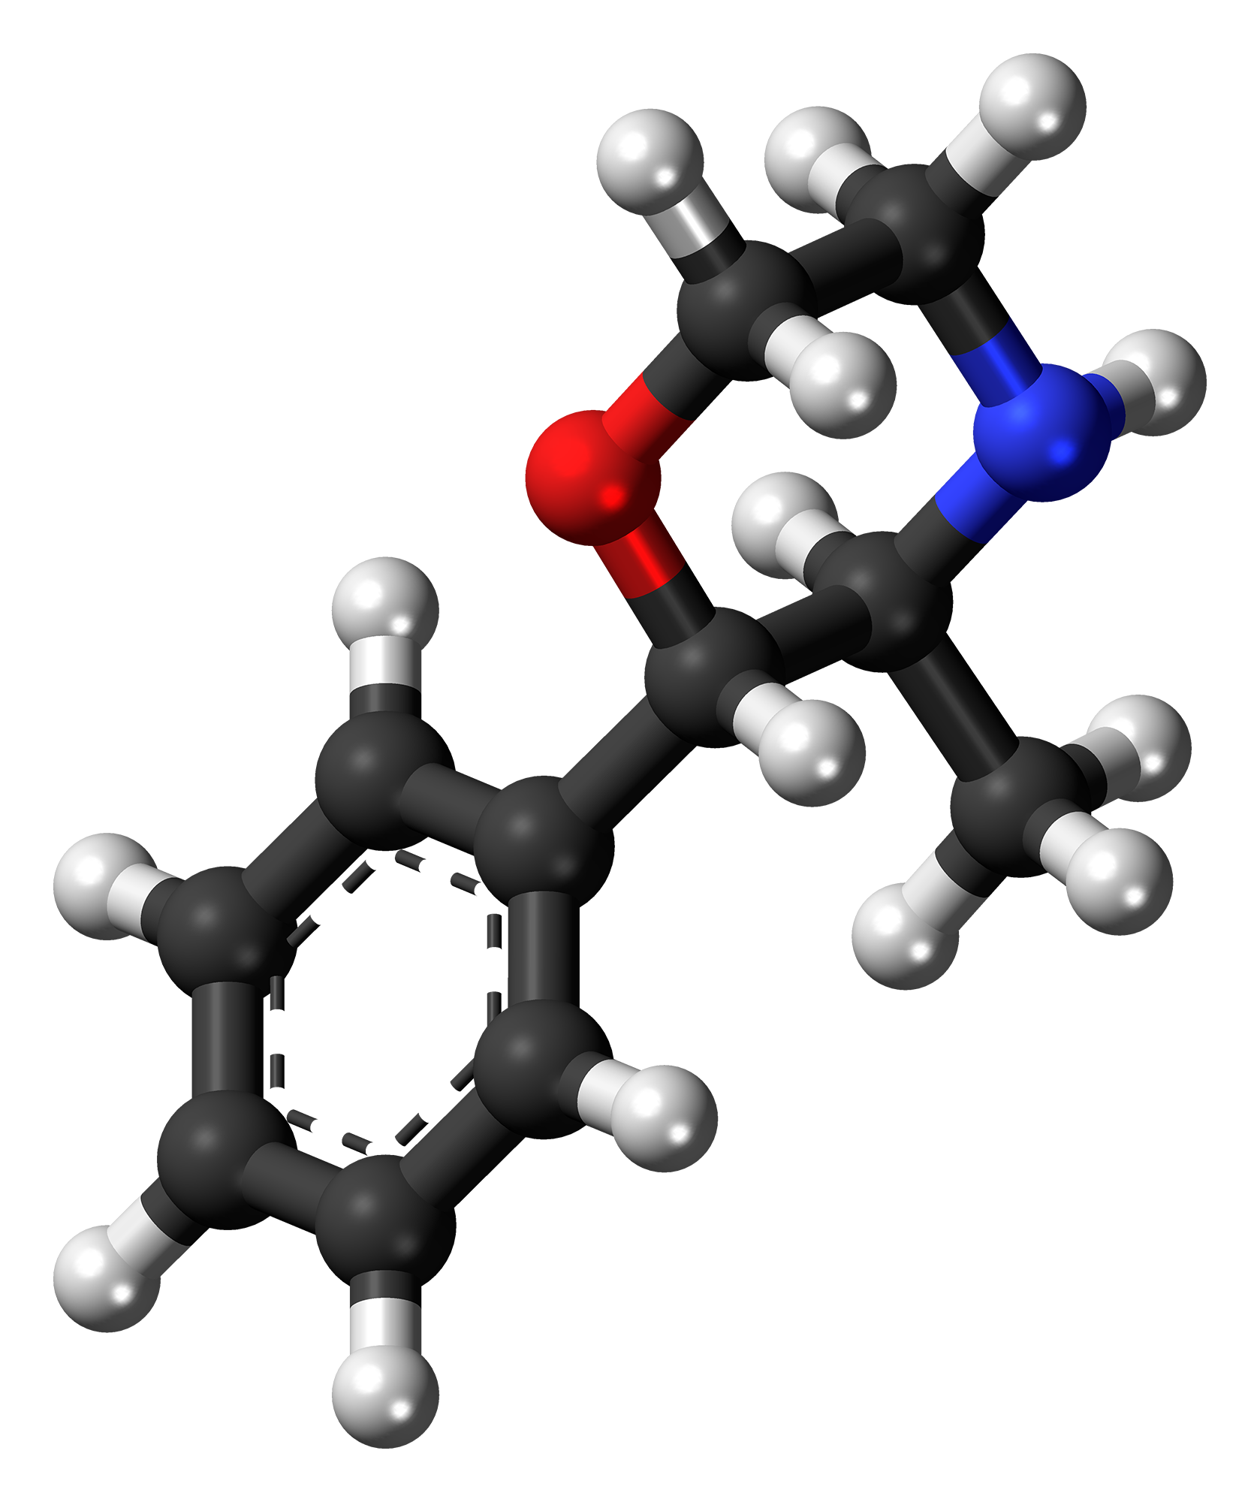
Preludin
Phenmetrazine
Hydrochloride
INCREASES DOPAMINE
“Anorectic” drug
Appetite suppressant
“Sympathomimetic”
GO PLACES
EXAMINE BRAINS
ASK QUESTIONS
MAKE ART

Slide 11
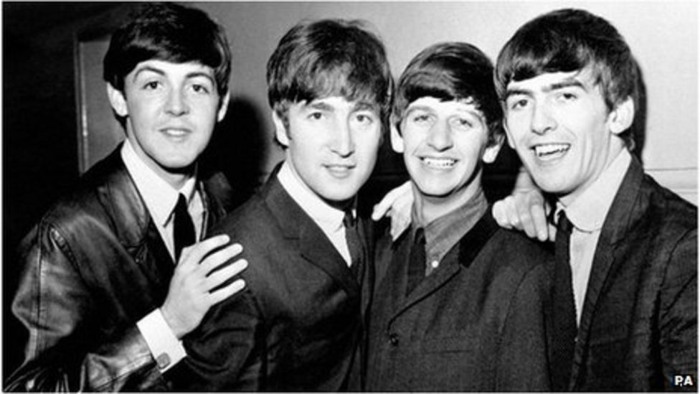
The Beatles 1963
Please Please Me
Tell Me Why
You Can’t Do That

Slide 12
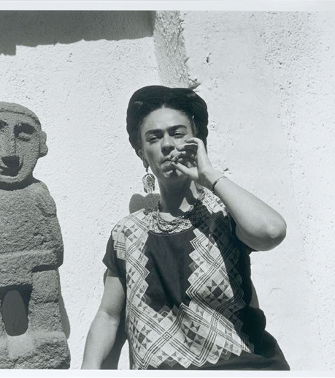
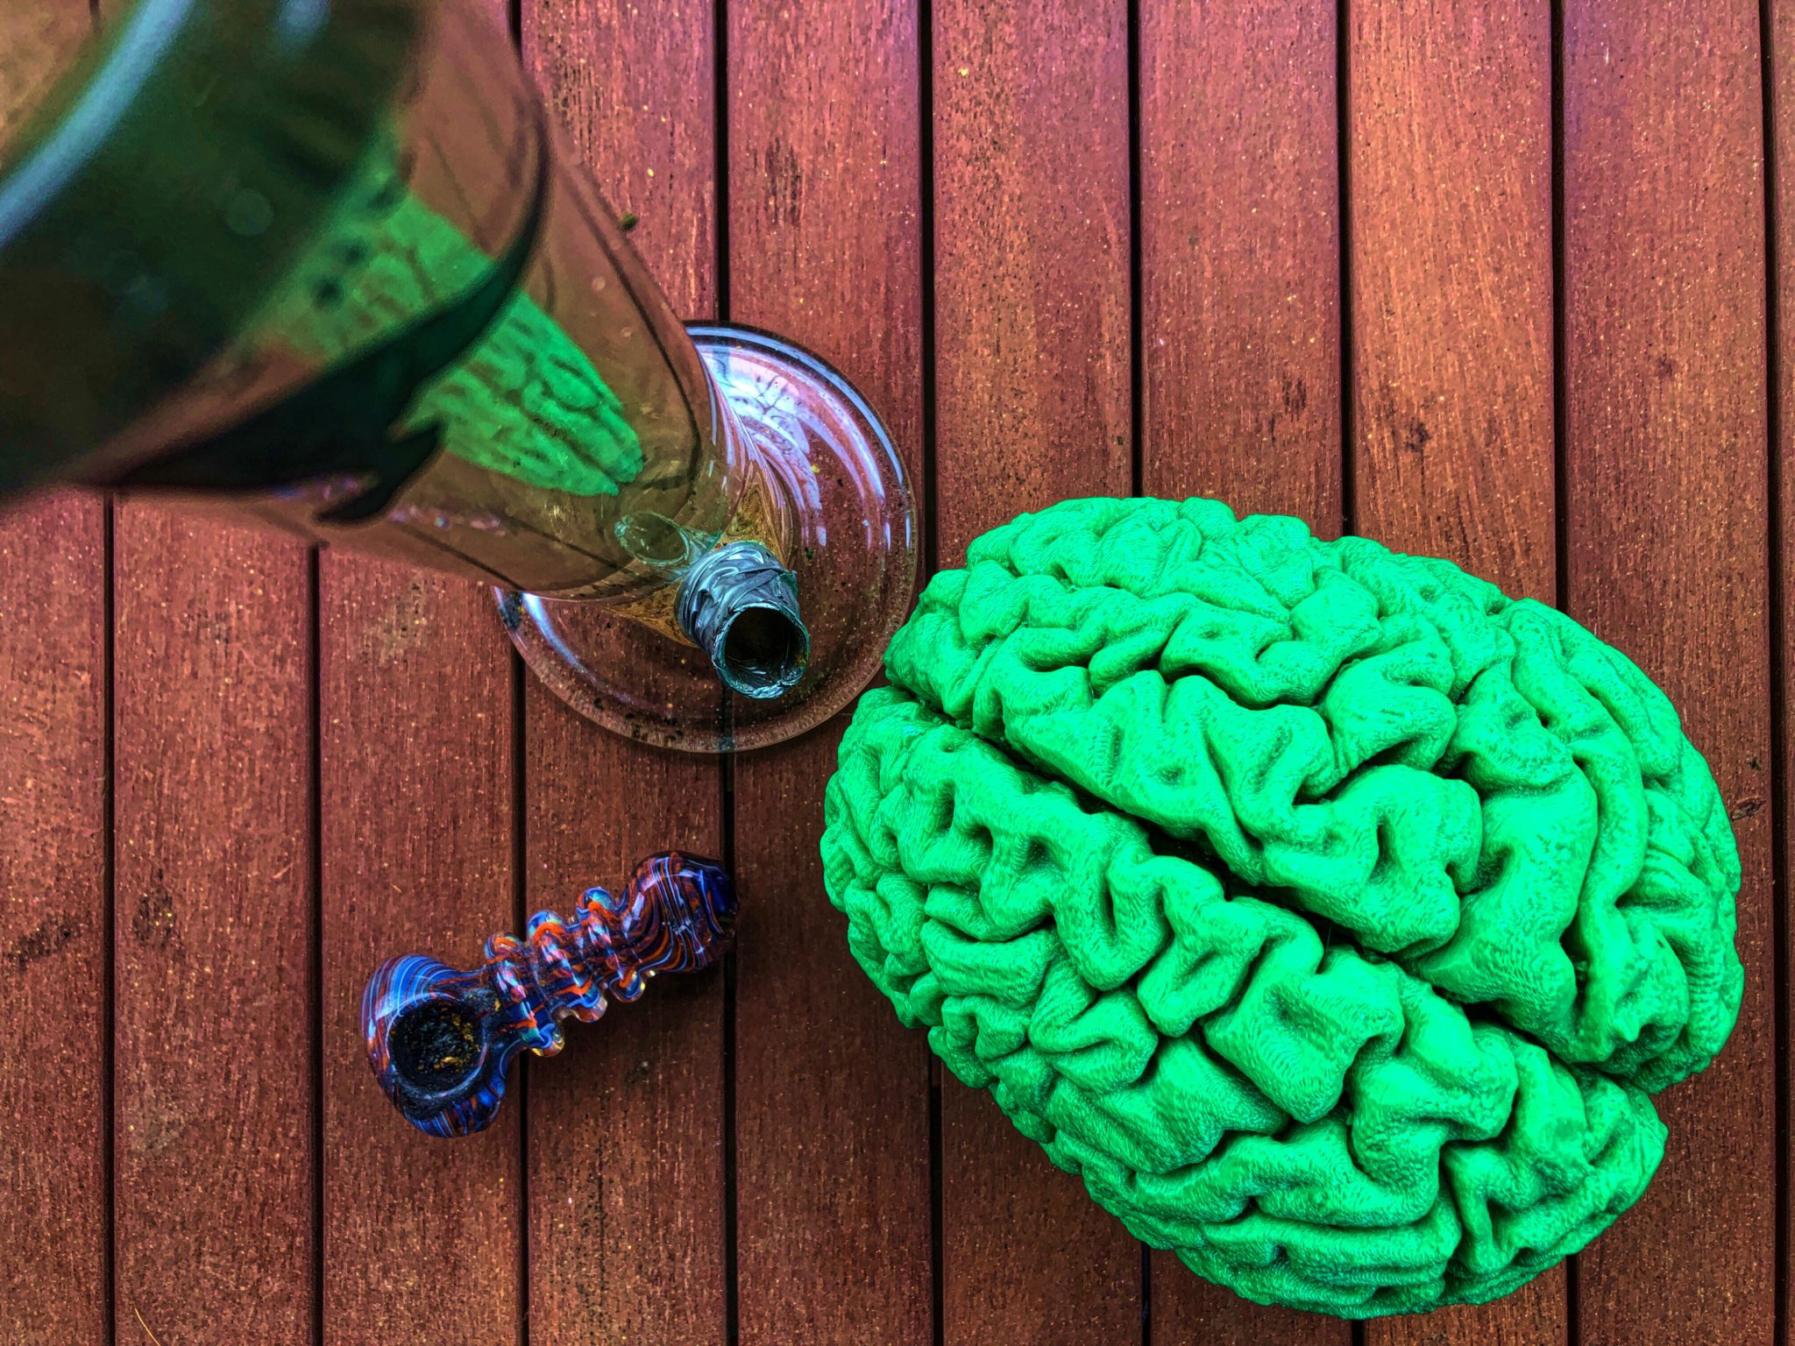
CANNABIS

Slide 13
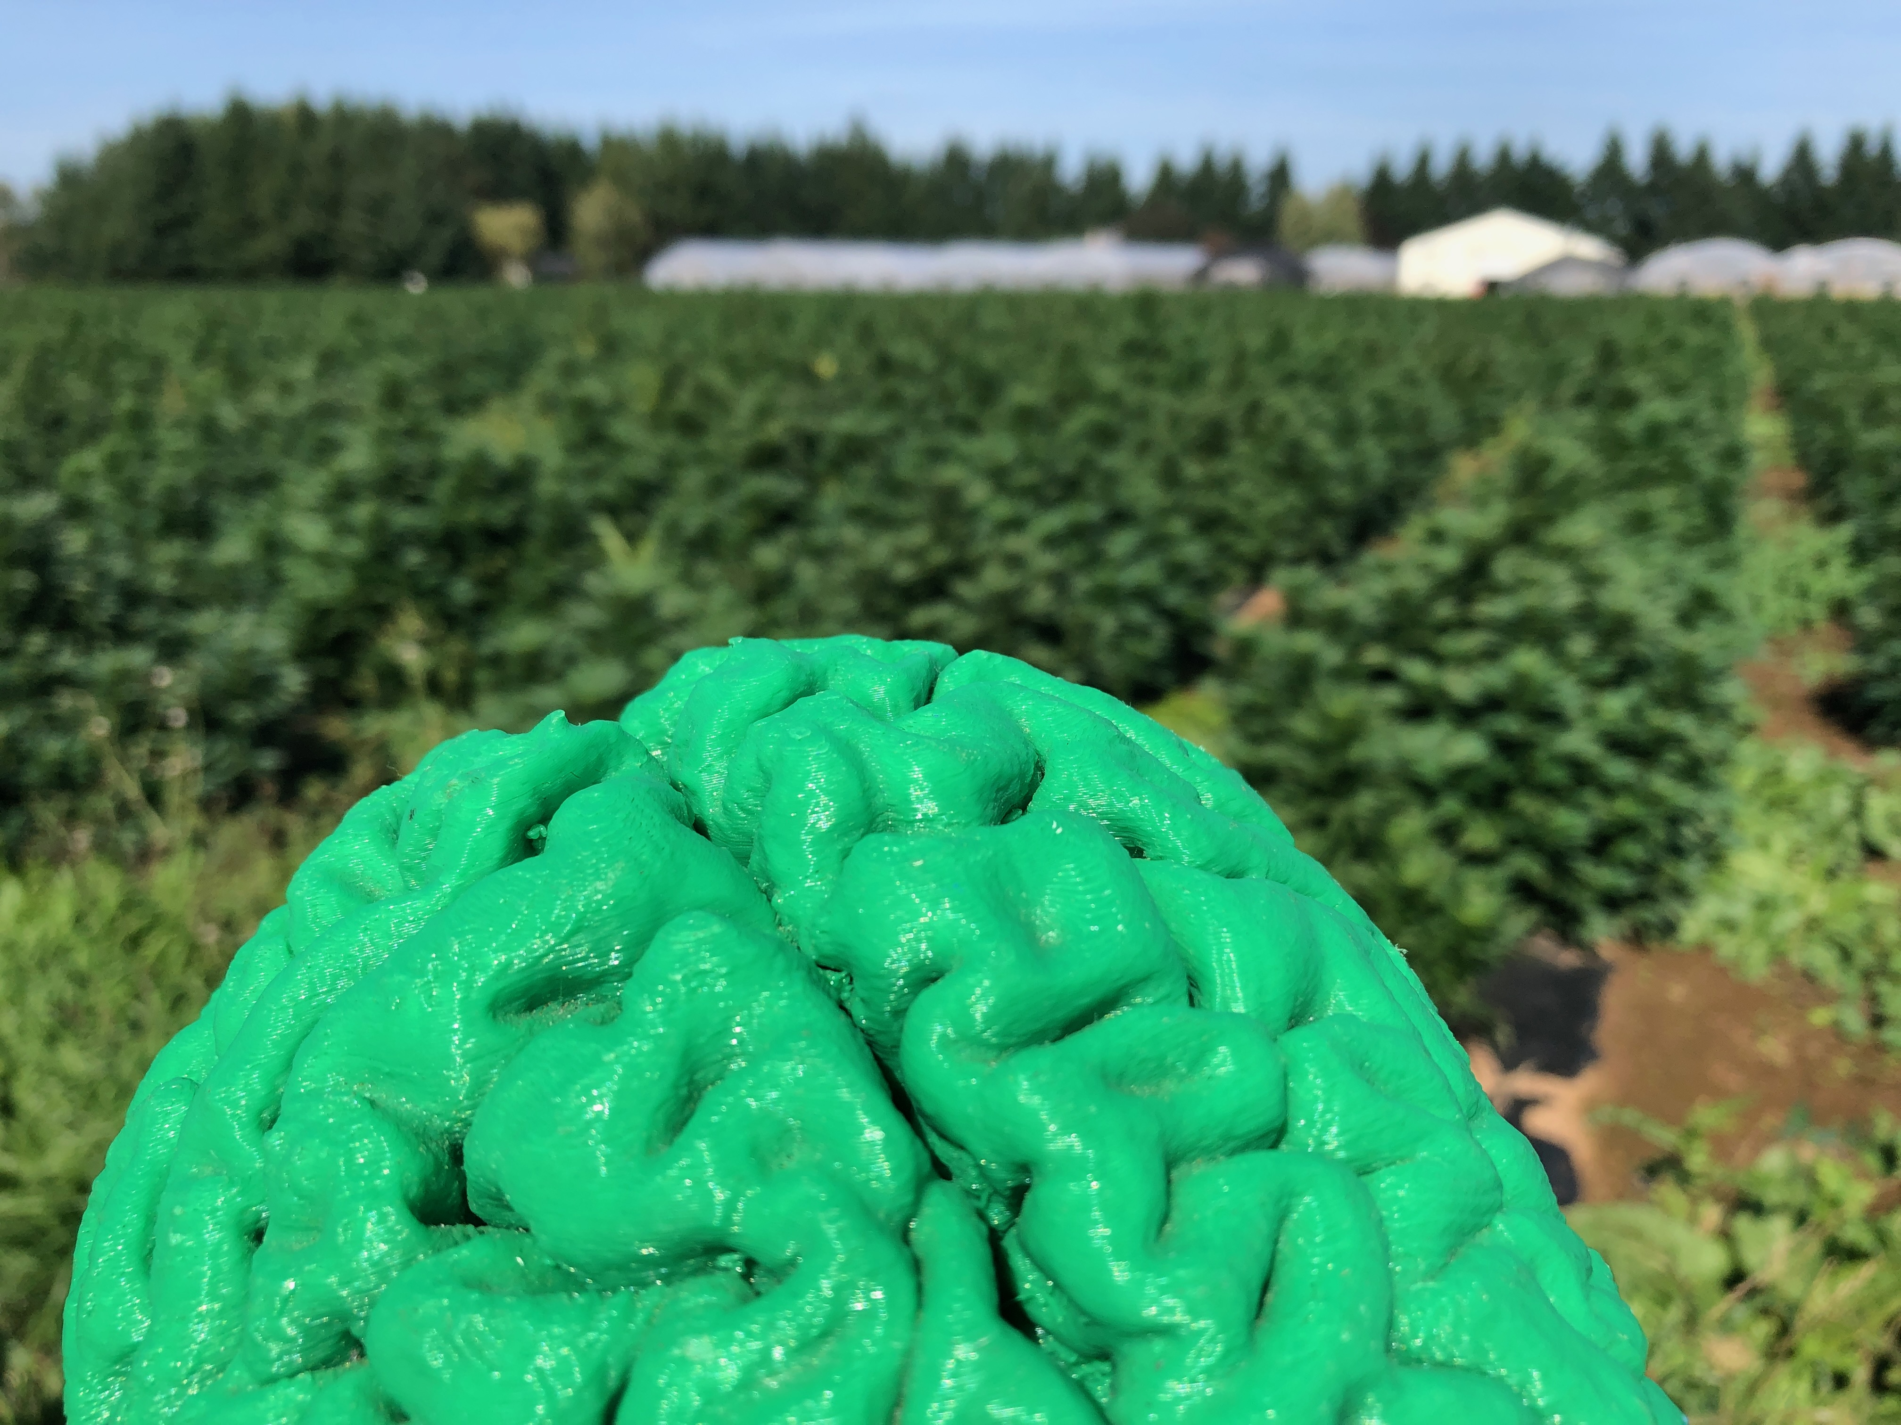
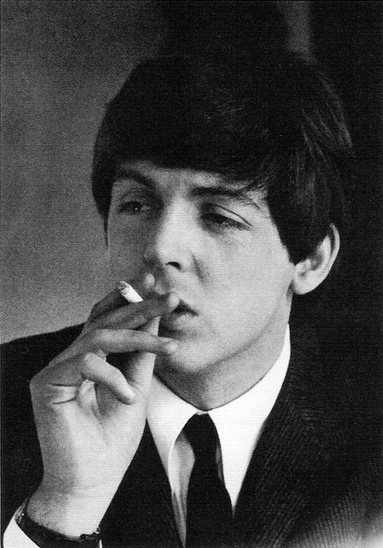
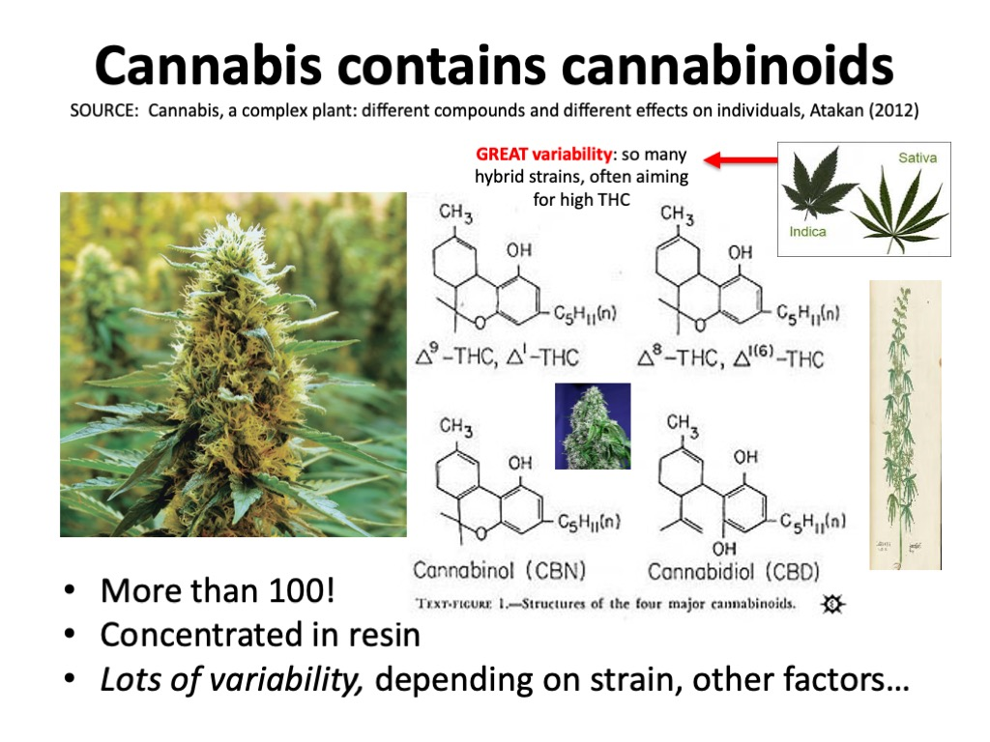

Slide 14
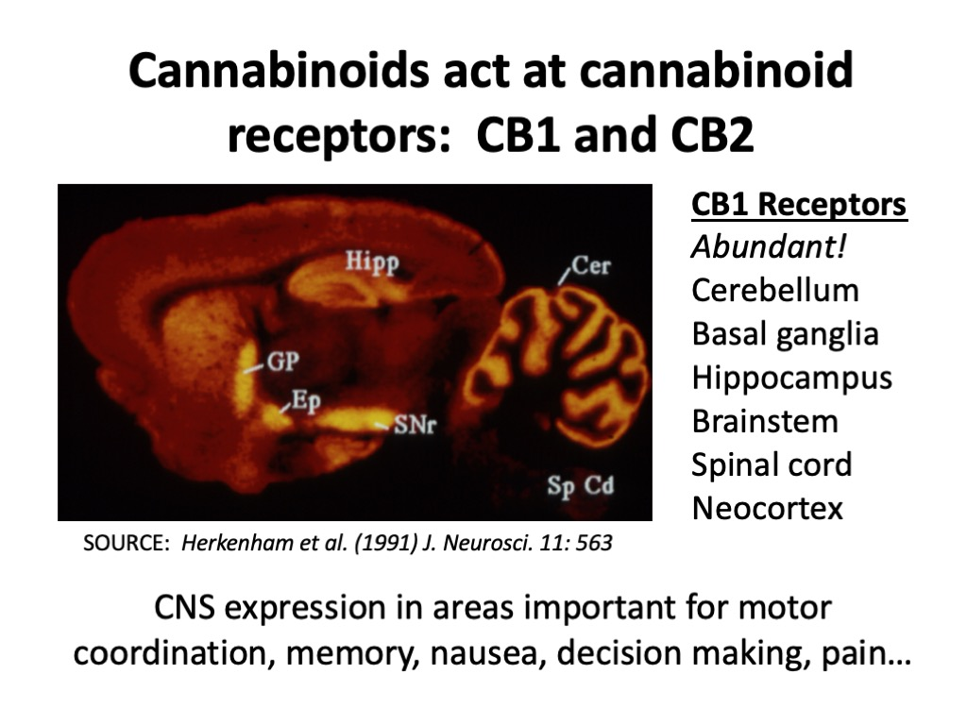
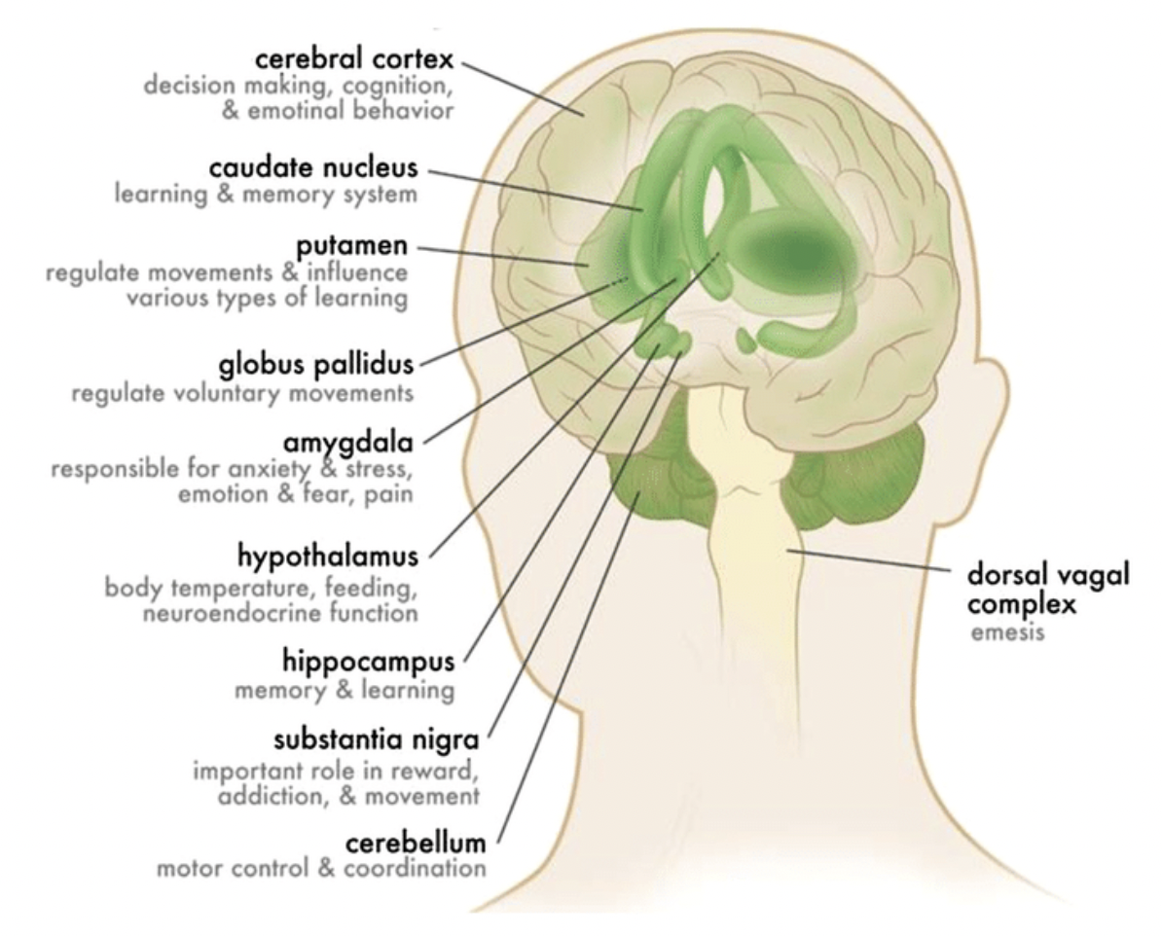
CB1 Receptors
Neocortex
Basal ganglia
Amygdala
Hypothalamus
Hippocampus
Cerebellum
Susan R. B. Weiss, Katia D. Howlett, Ruben D. Baler (2017)

Slide 15
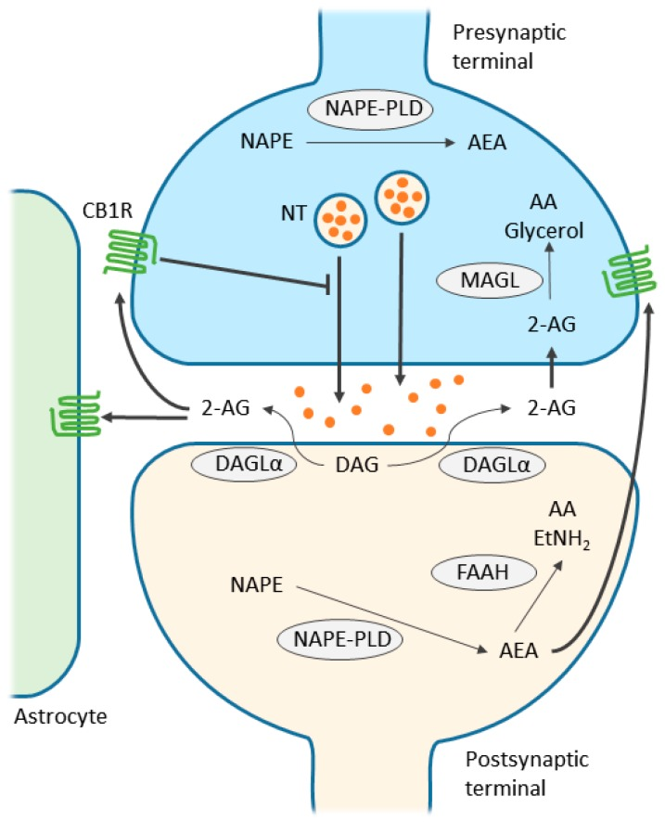
Endocannabinoids are NOT STORED IN VESICLES (as lipids, they would just leak out). They are synthesized and released POST-SYNAPTICALLY, and act at CB1 receptors located on PRE-SYNAPTIC axon terminal membranes!

Slide 16
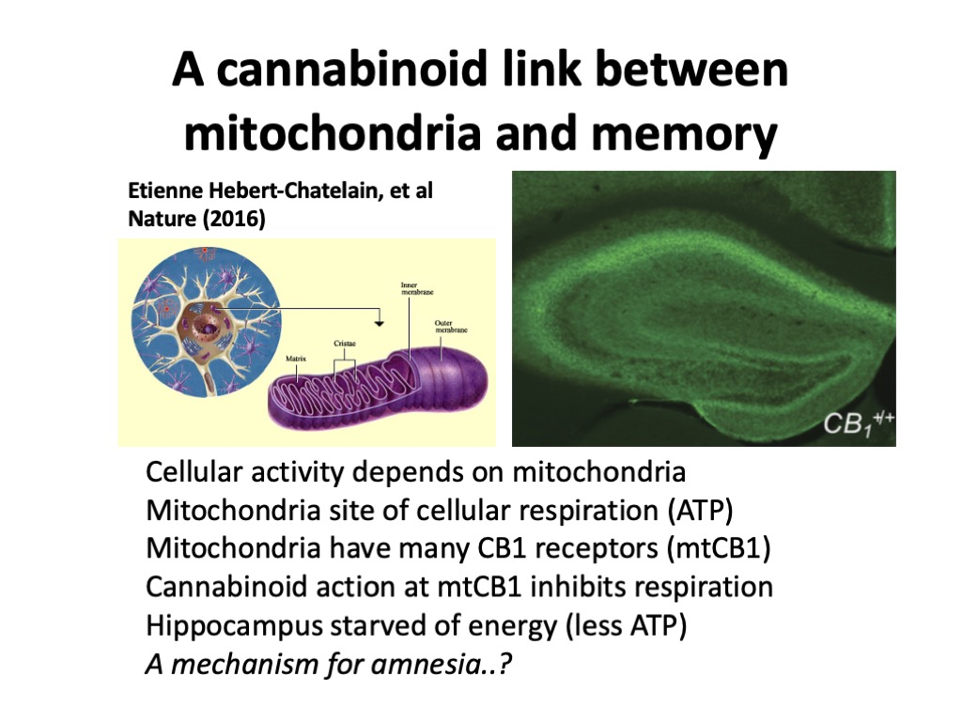

Slide 17
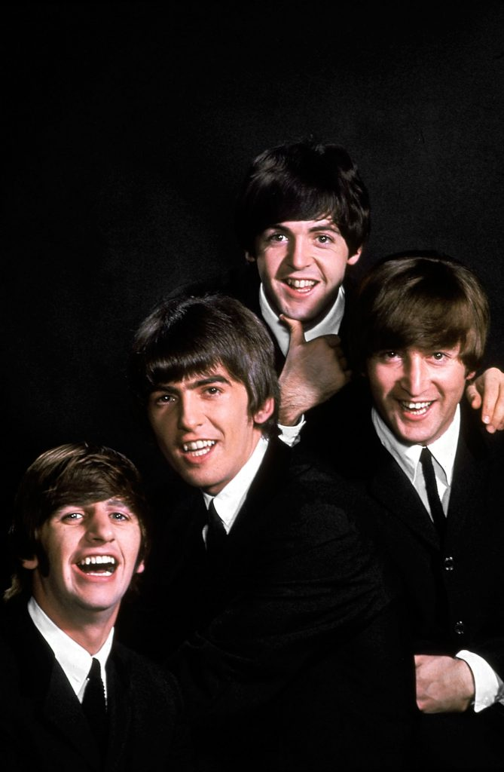
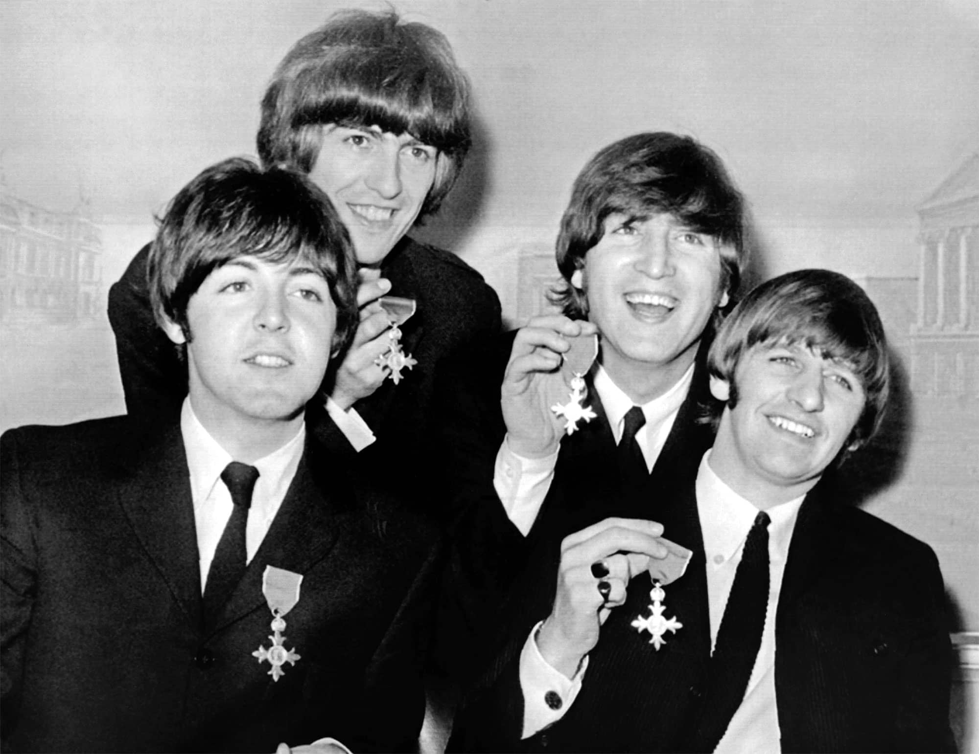
The Beatles
1964
I Don’t Want to Spoil the Party
I'll Follow the Sun
Eleanor Rigby
In My Life
If I Needed Someone
1965

Slide 18
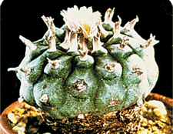
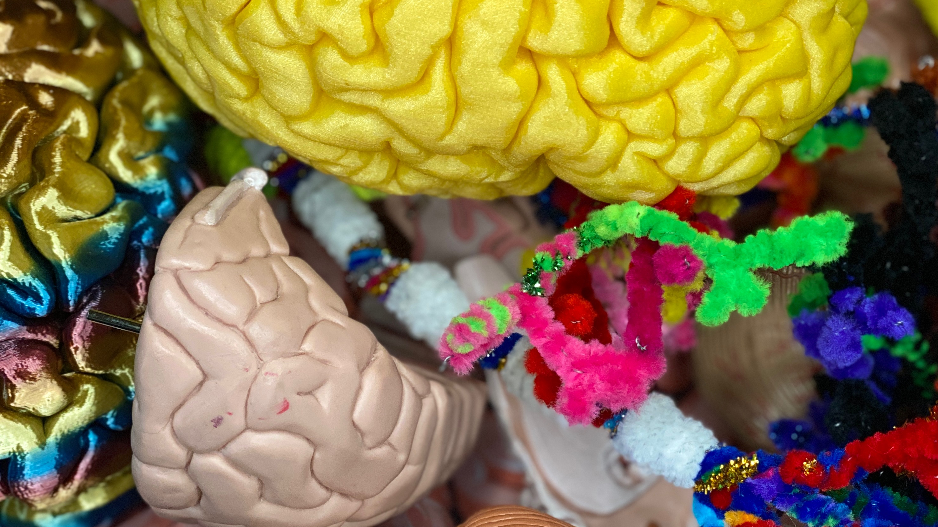
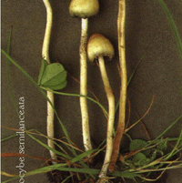
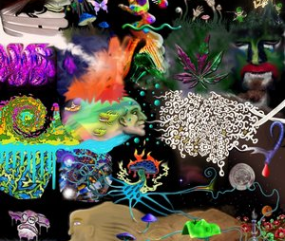
Psychedelics
Chemicals that produce unusual perceptual and cognitive distortions.
Many derived from plants, though some are synthetic.
Mescaline, psilocin, DMT, LSD

Slide 19
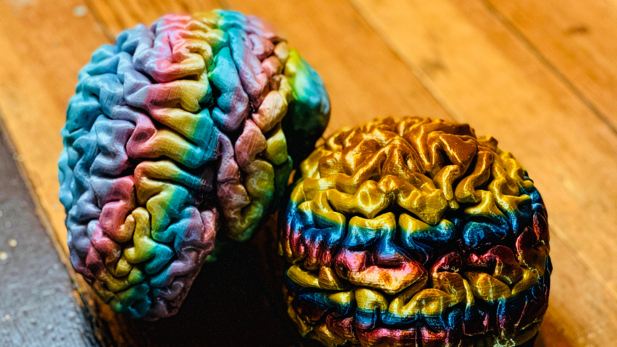
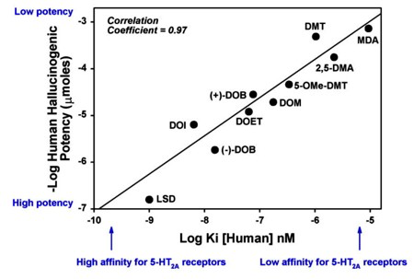
Most psychedelics are agonists at ONE type of SEROTONIN receptor (5-HT2A)
Wenjie Xiao, William
E. Fantegrossi (2006)
Potency linked directly to hallucinogenic effects

Slide 20
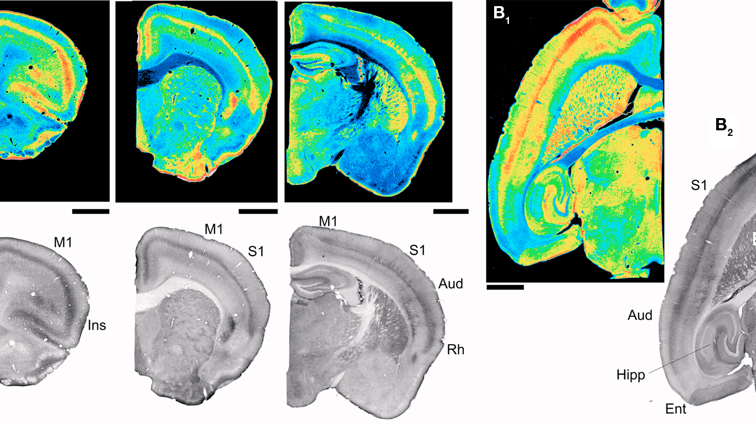
Where are these receptors?
Neocortex
  Layer V
Olfactory cortex
Hippocampus
Basal ganglia
Thalamus
Cerebellum
Brainstem
Spinal cord

Slide 21
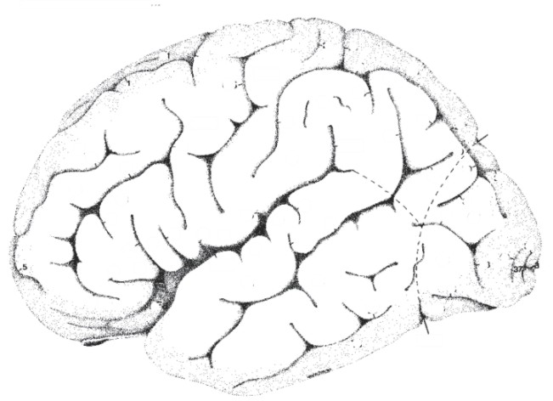
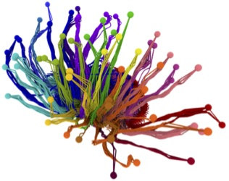
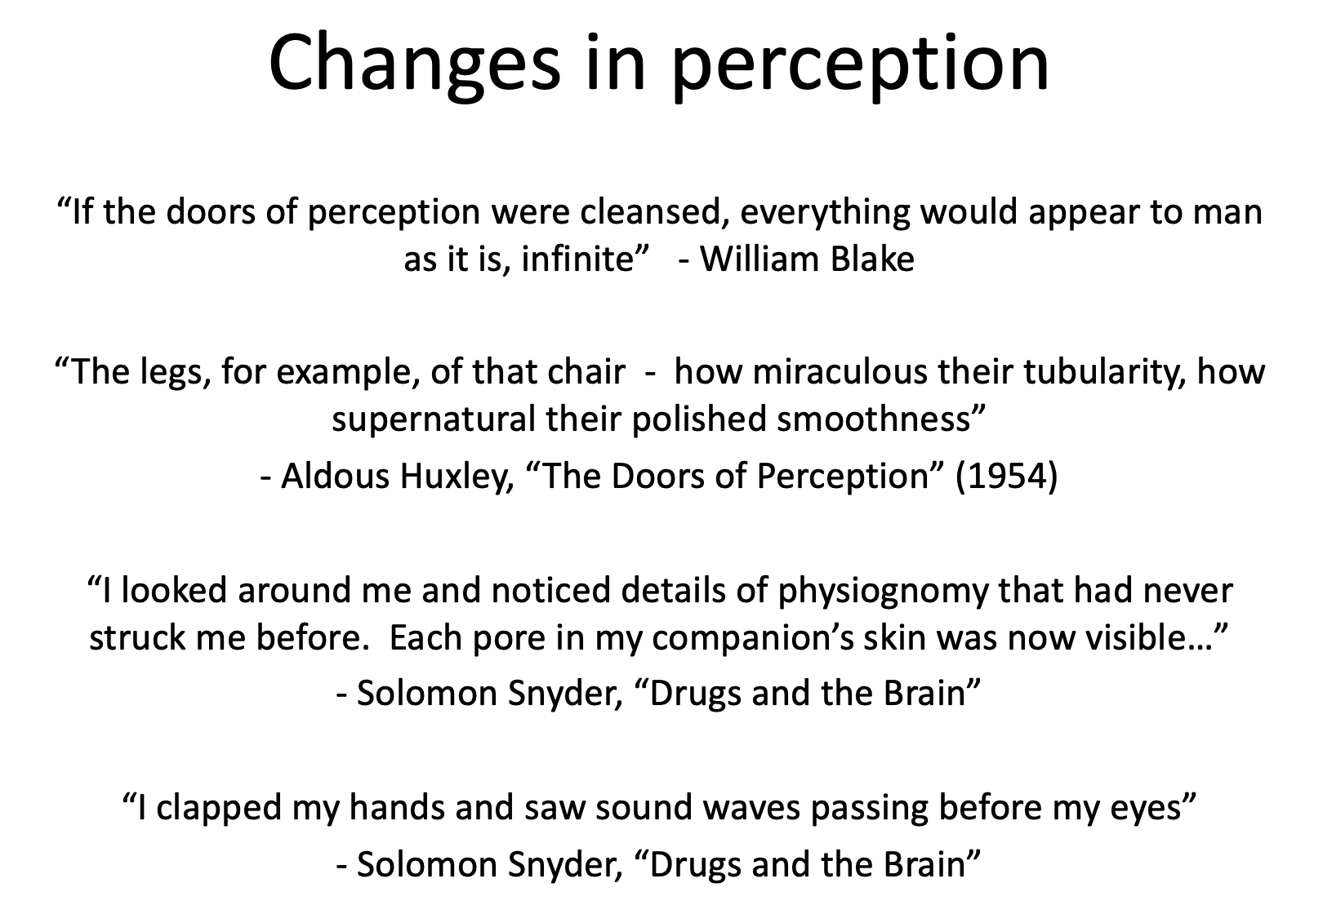
Psychedelics
affect the “gating”
of sensory input
Cortex
Thalamus
Image courtesy of the Allen Institute for Brain Science

Slide 22

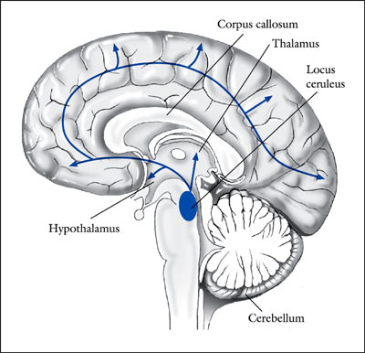
Psychedelics Enhance
Sensory Responses in the Locus Coeruleus (LC) via
5-HT_{2A} Receptors
“...it is of interest that the systemic administration
of LSD, mescaline, or other psychedelic hallucinogens in rats,
although decreasing spontaneous activity, produces a paradoxical
facilitation of the activation of LC neurons by sensory stimuli…”
(Aghajanian 1980; Rasmussen & Aghajanian 1986)
Ordinary
stimuli become
extraordinary

Slide 23
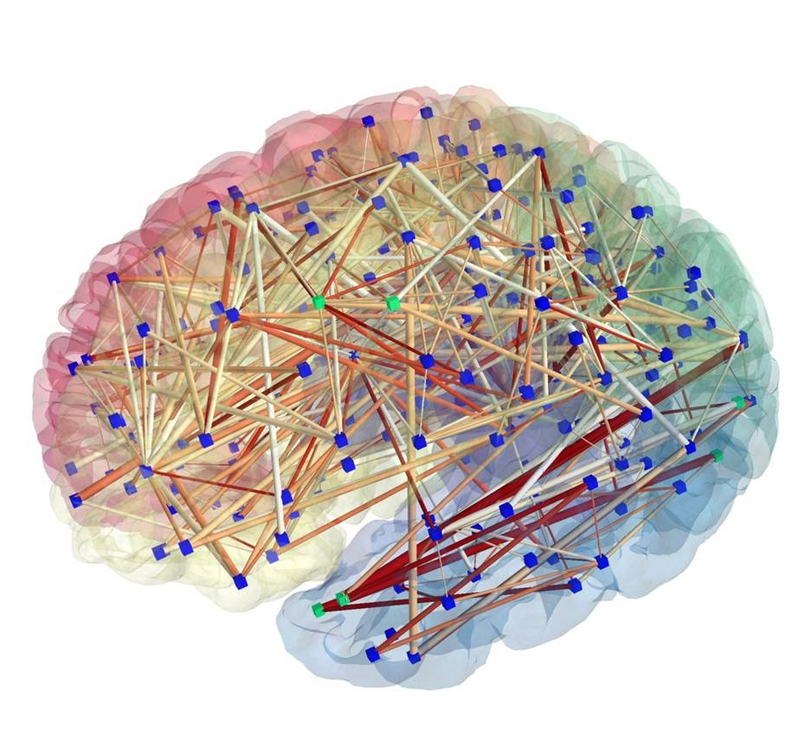
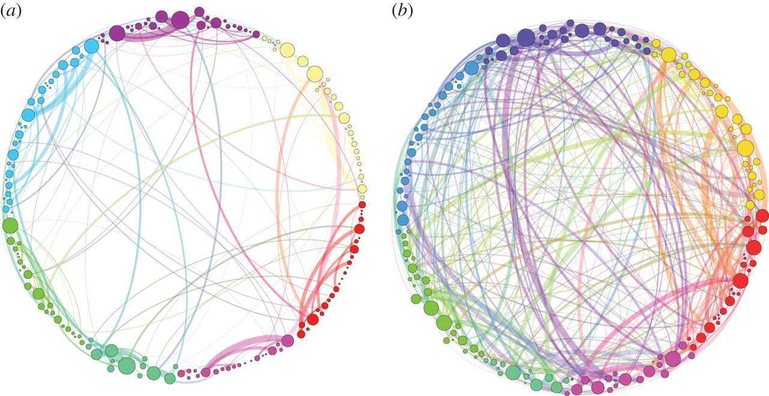
Greater functional connectivity
Homological scaffolds of brain functional networks, G. Petri, et al (2014)
“there is an increased integration between cortical regions in the psilocybin state…One possible by-product of this greater communication across the whole brain is the phenomenon of synesthesia which is often reported in conjunction with the psychedelic state…”

Slide 24
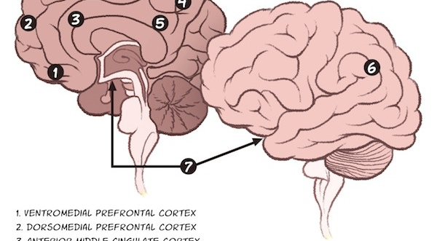
“Default mode” network
Decreased coordination
while on psychedelics
Critical for…
Self-reflection
Self awareness
Rumination
BUT: increased plasticity

Slide 25
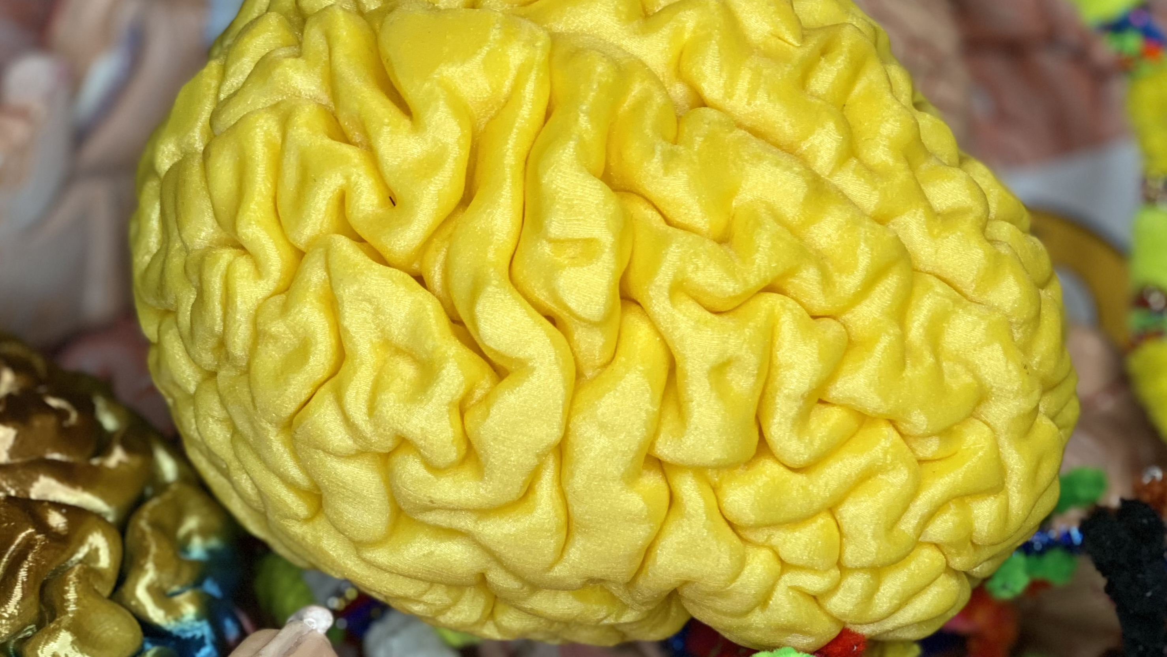
“We all live in a yellow submarine…”

Slide 26
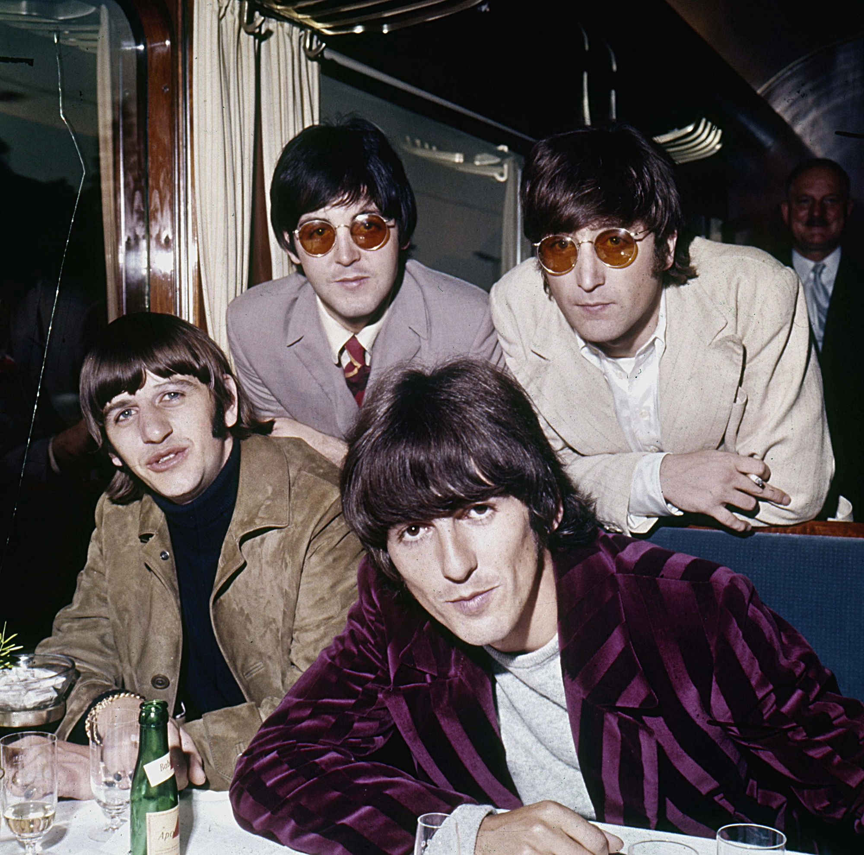
The Beatles
1966
Got To Get You Into my Life *
Yellow Submarine
I'm Only Sleeping
I Want to Tell You
* about cannabis 🌲

Slide 27
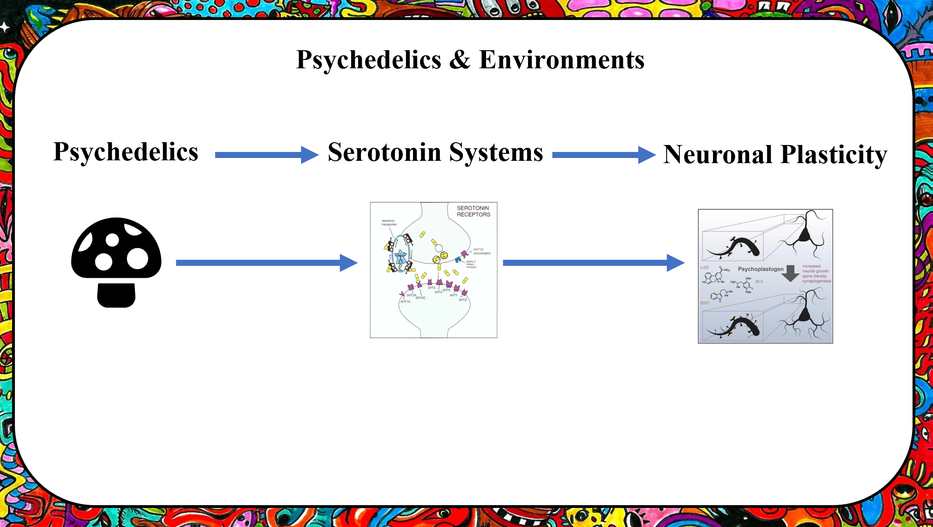
Psychedelics & Environments

Slide 28
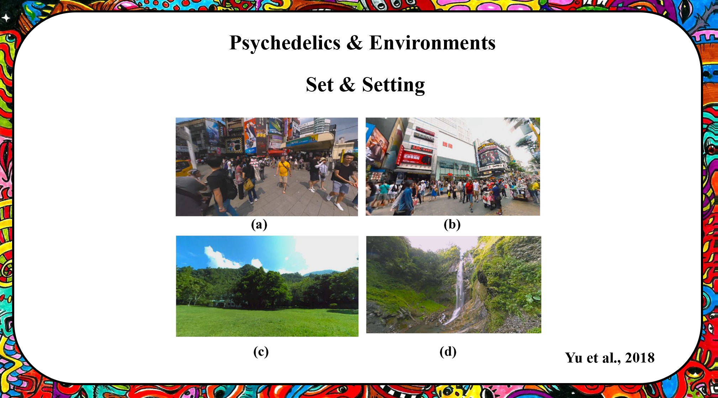

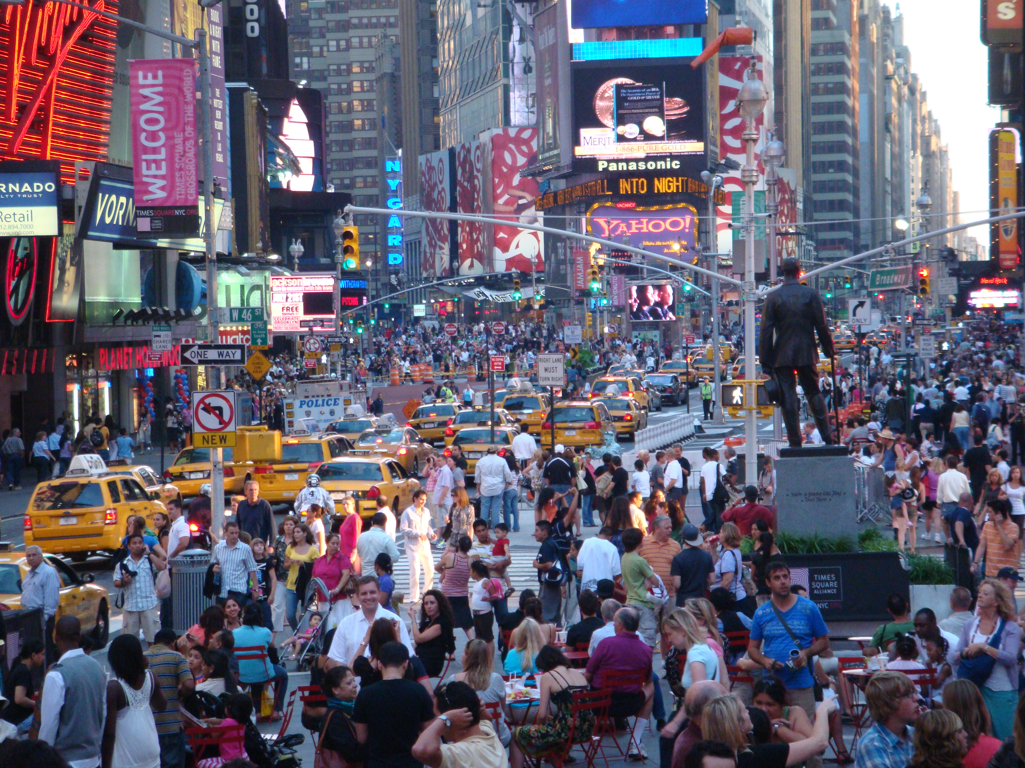
Psychedelics & Environments
Set & Setting

Slide 29
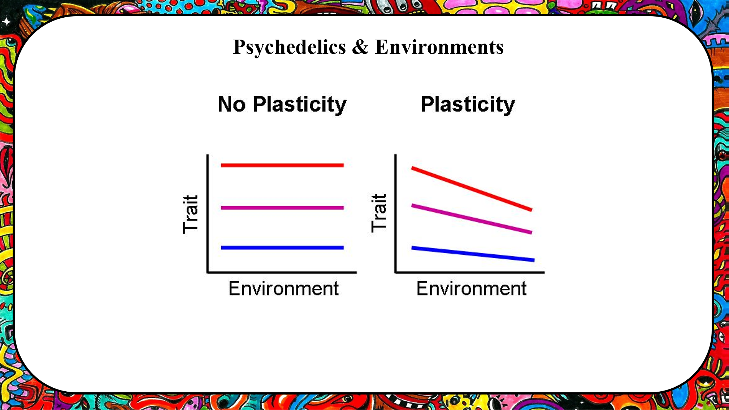
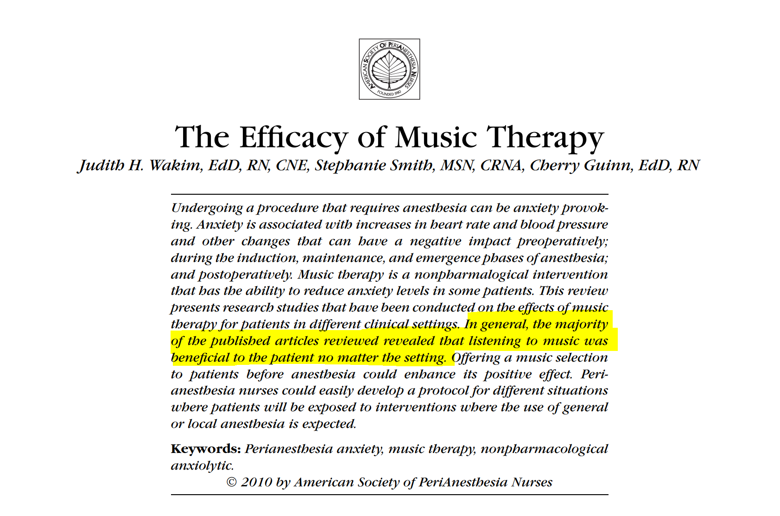
Psychedelics & Environments

Slide 30
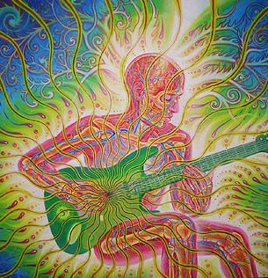


Slide 31

The Beatles
1967/8
Magical Mystery Tour
I am the Walrus
Blue Jay Way
All Together Now
Another year later…

Slide 32

Robert Crumb “LSD”

Slide 33


Is there a link between creativity and hallucinogens?
Distortion of body extremities is illustrated in a sophisticated way by a professional painter. This drawing was executed by a well-known Czech artist after the recovery from LSD intoxication.
Mandalas created before (left) and during (right) an LSD session conducted in 1972 at the Maryland Psychiatric Center
In 1952 Lászlo Mátéfi described how an experimental subject under the influence of a hallucinogen experienced a discrepancy between his intention and performance while making a portrait:
I see the object correctly but draw it falsely; my hands won't follow it.... This desire to paint is harder and harder for me to perform since the expanse of my experience pulls me more and more into it. Myself, the drawing, and the surroundings create a unity--and that hinders me because I cannot concentrate on the model. I have the need to bring everything including the painted picture into the surface of the image. Had the painting process been more of a technical success, I would have been able to produce a fantastically good work

Slide 34


Stanislaw Witkacy “Teodora Bialynickiego-Birul” 1929
Witkacy made this portrait under the influence of mescaline.
Witkacy made this portrait under the influence of peyote.
Stanislaw Witkacy “Neny Stachurskiej” 1929

Slide 35
"I didn't take LSD, I didn't want to be that far from my senses”-Peter Blake
Marijke Dunham, outfits for the Beatles
“Drugs were a big part of it, the aesthetic has a bad name due to that. I mean Van Gogh painted his strange paintings and there’s been no mention of drugs, but drugs definitely had an influence as far as the cause was concerned, with the strange moving lines, definitely … and since I’m not ashamed about it I don’t have to hide it. That’s where it comes from.” -Marijke Dunham
The Beatles – Sgt. Pepper’s Lonely Hearts Club Band
(1967, designed by Peter Blake and Jann Haworth

Slide 36




