Slide 1

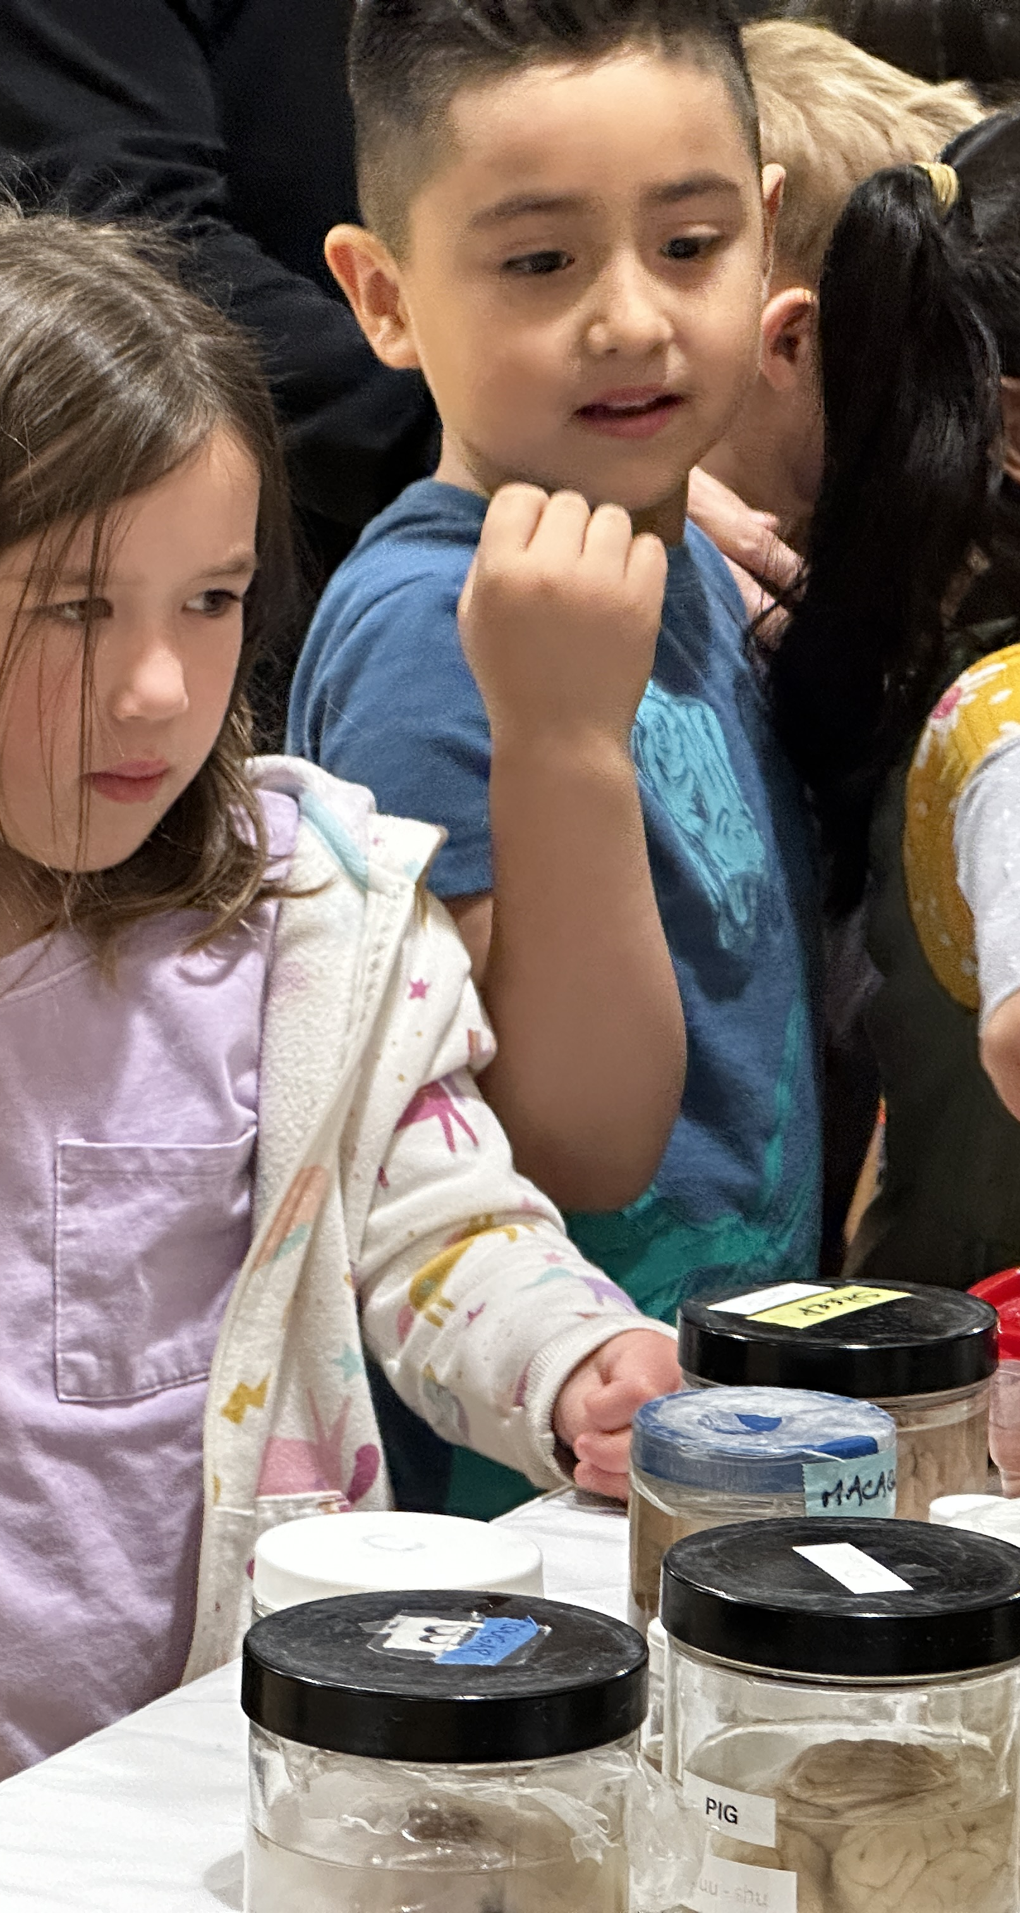
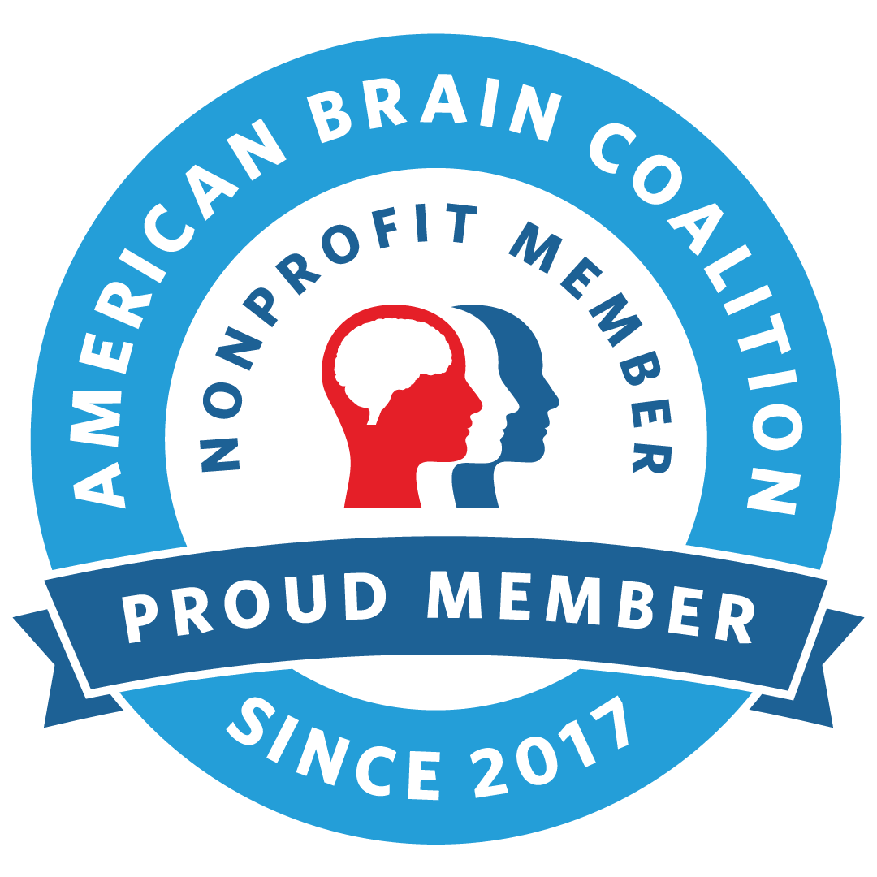
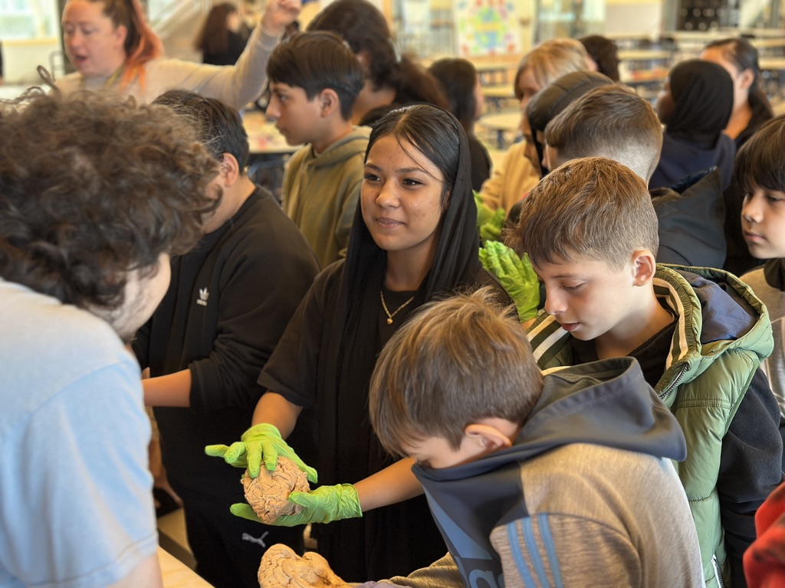
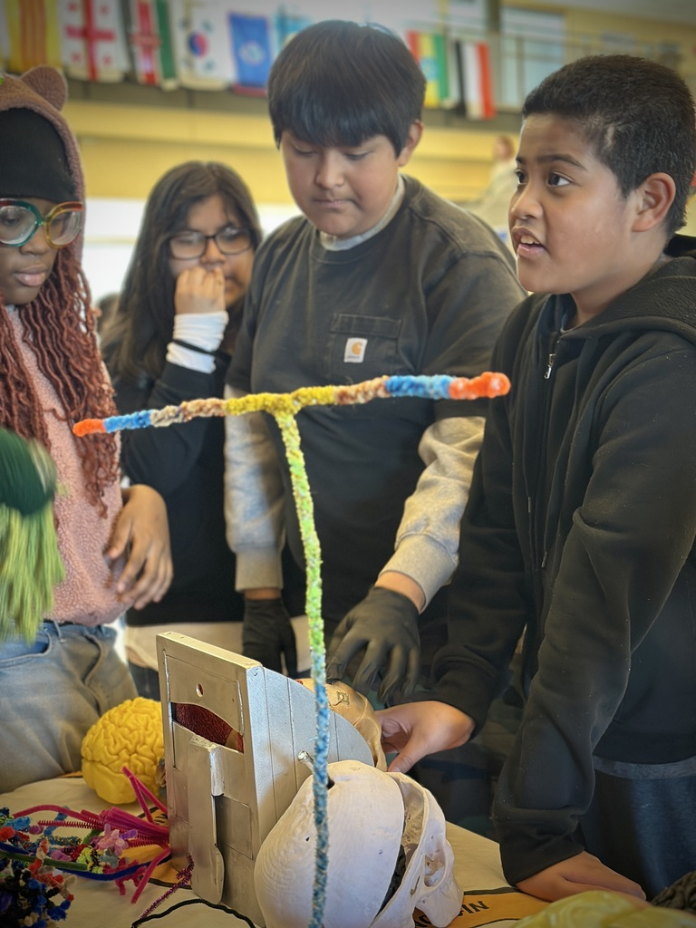
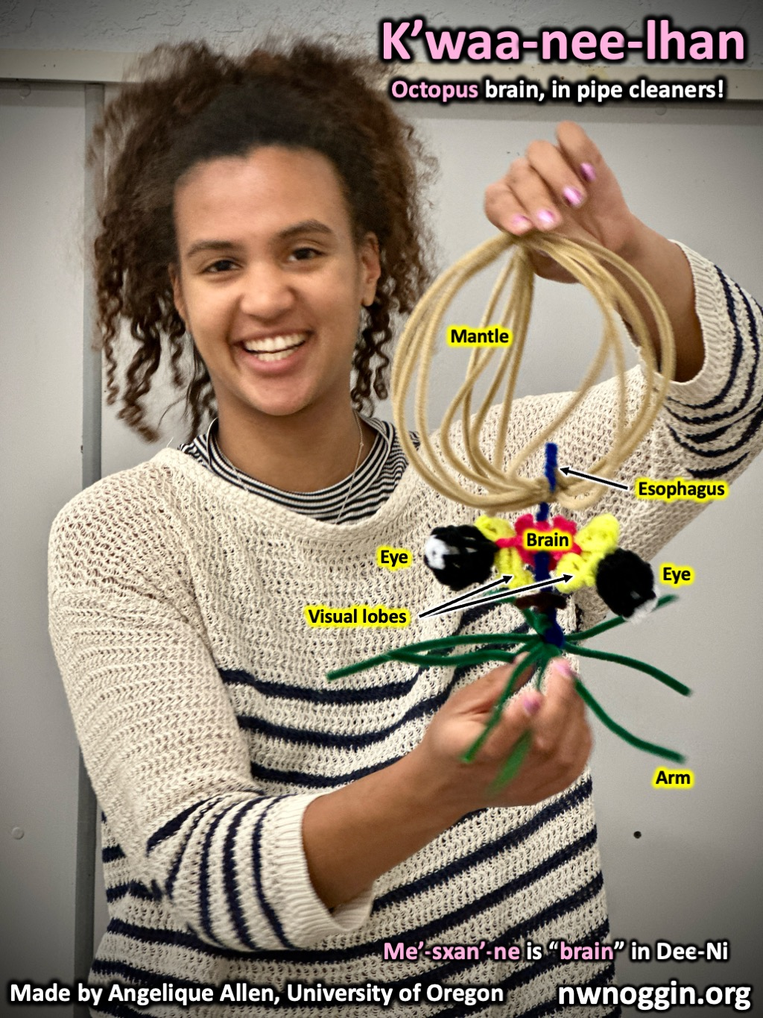
Northwest
Noggin
BRAINs LEARN WHAT BRAINS DO: AI and the brain

Slide 2
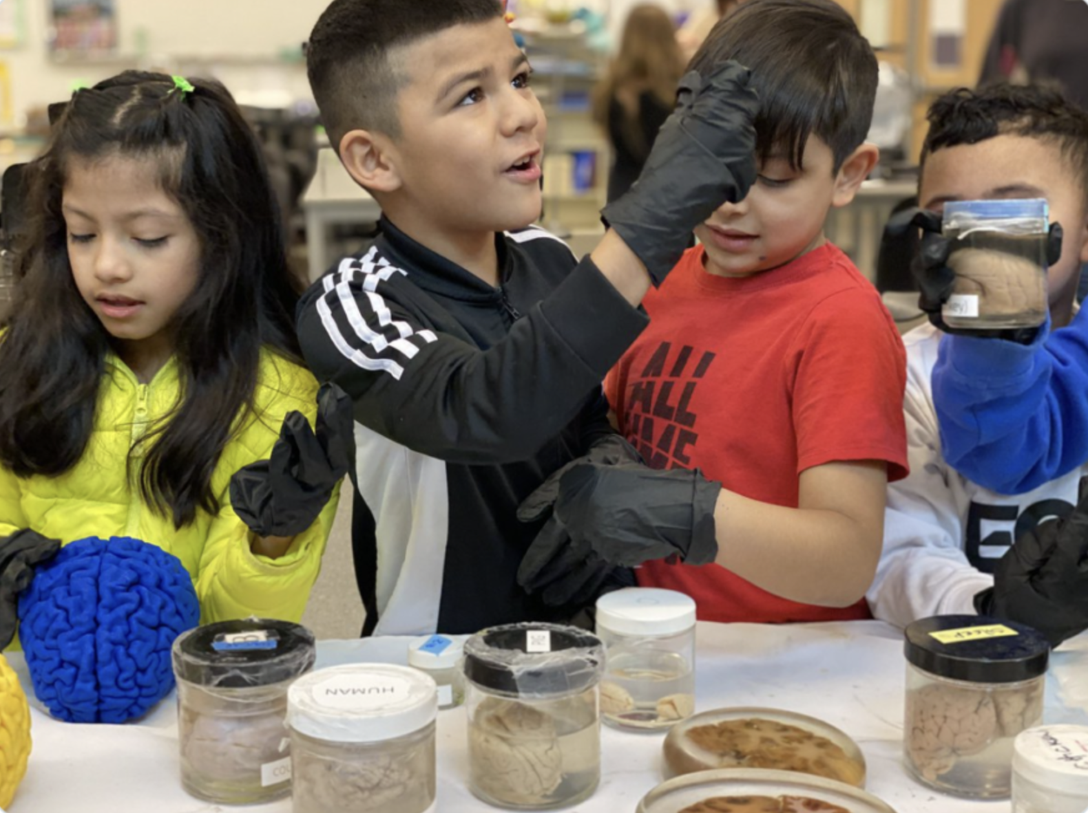
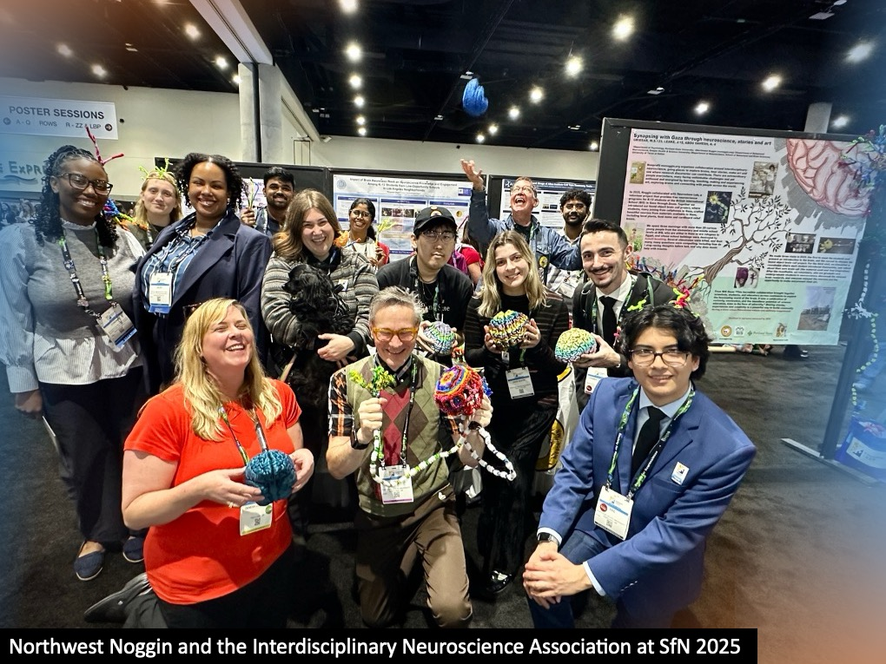
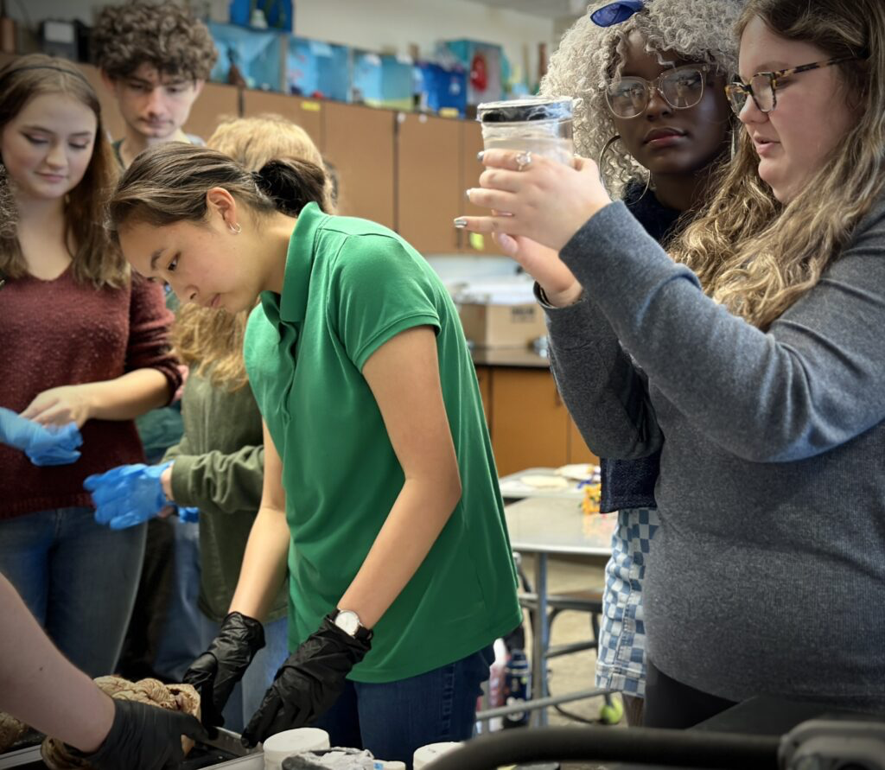
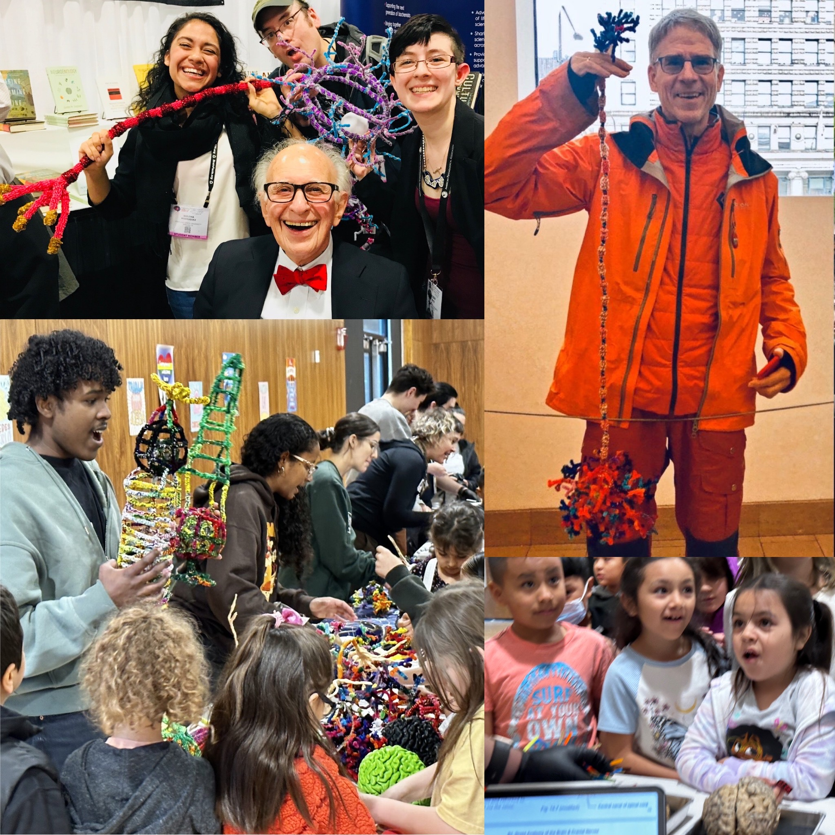
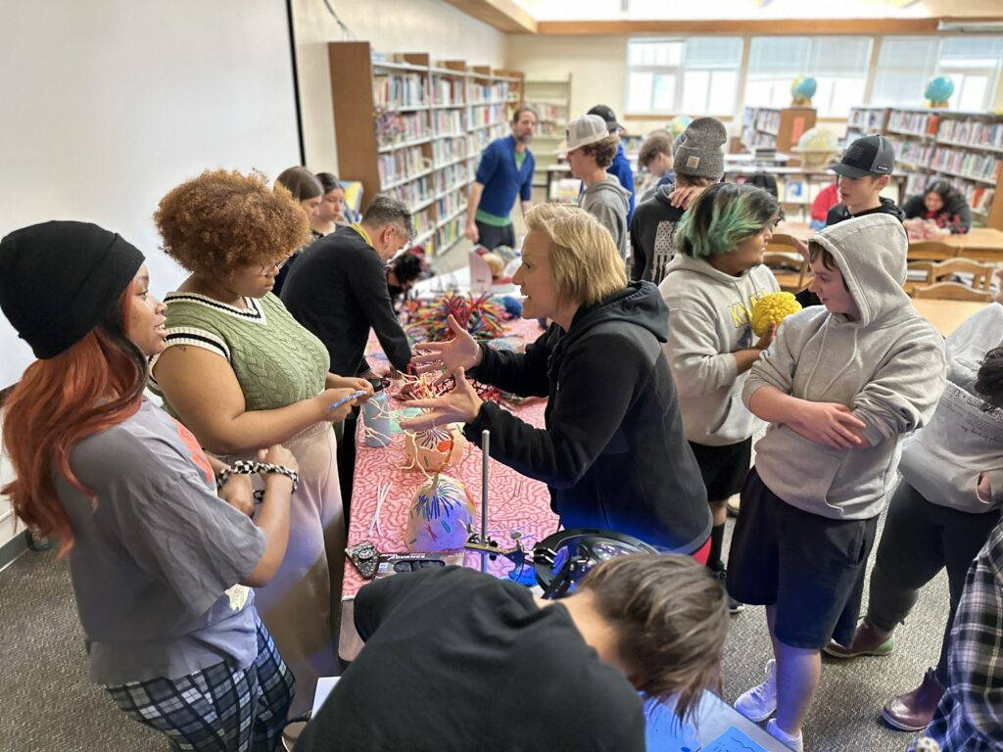
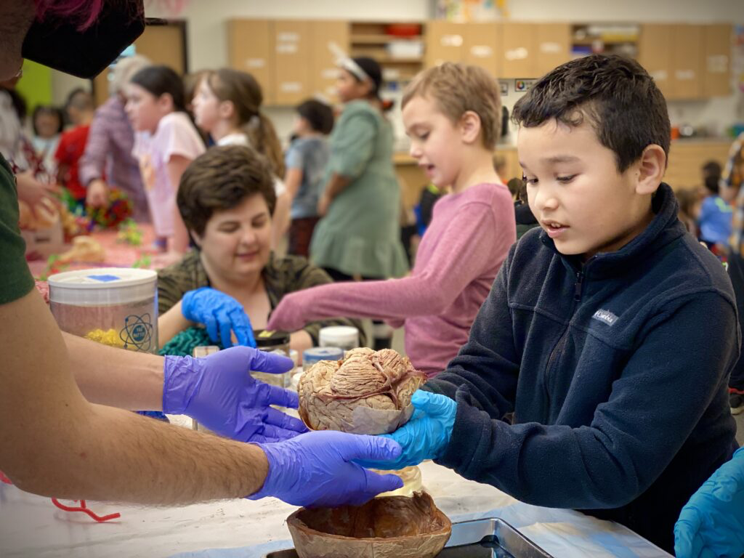
NOGGIN IS ALL VOLUNTEER
ALL VOLUNTEER
ALL OF US. FOR FOURTEEN years (SINCE 2012)!
NO ADMISSION - NO TUITION - open to everyone
85,000+ public K12 students/community members
local/national/international collaborators
ALL OF US. FOR FOURTEEN years (SINCE 2012)!
NO ADMISSION - NO TUITION - open to everyone
80,000+ public K12 students/community members
local/national/international collaborators

Slide 3

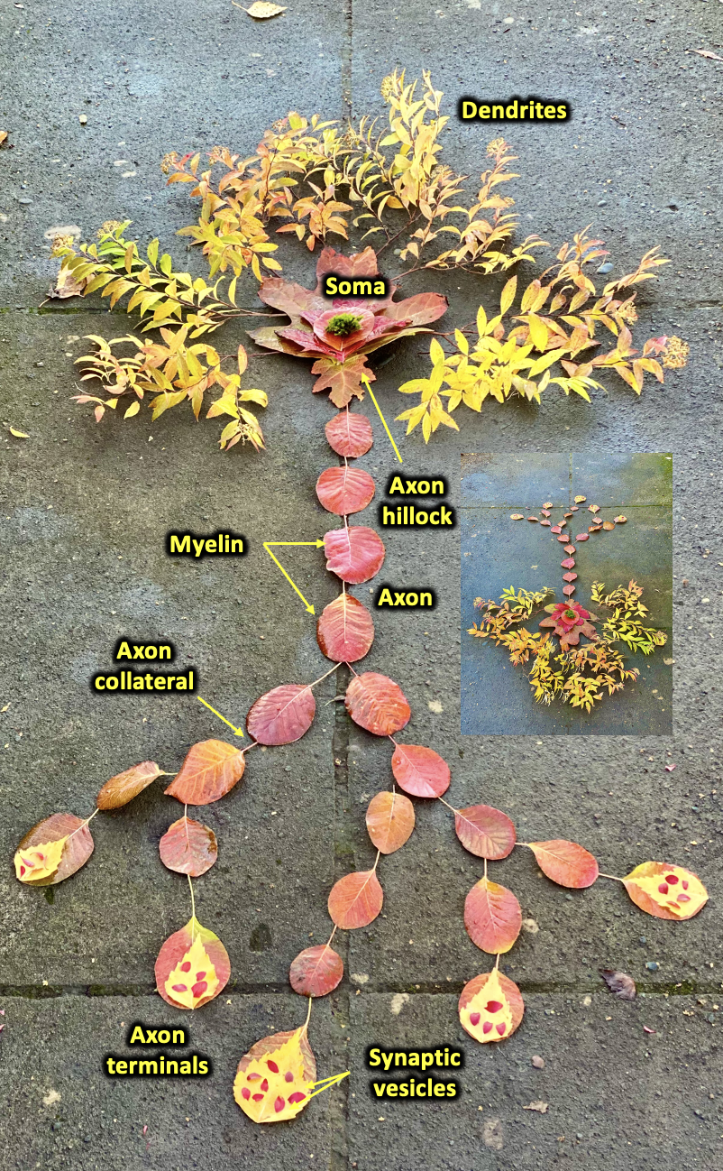
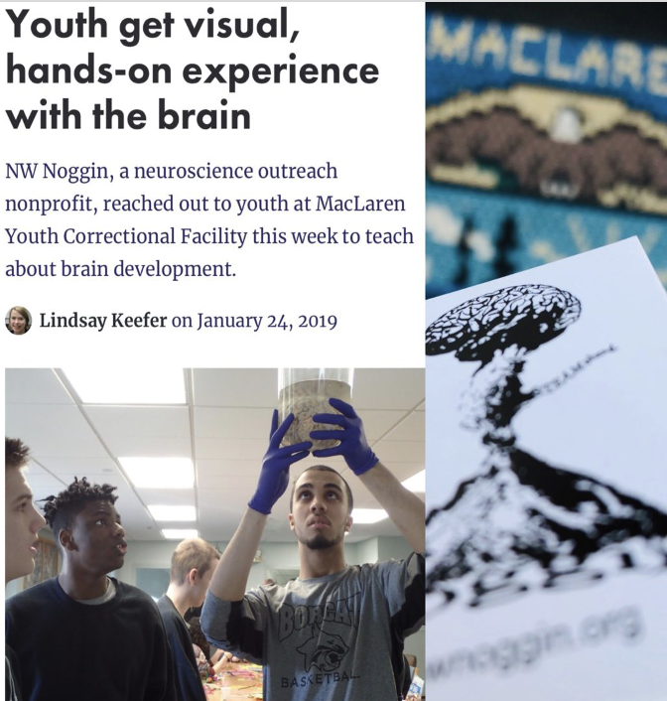
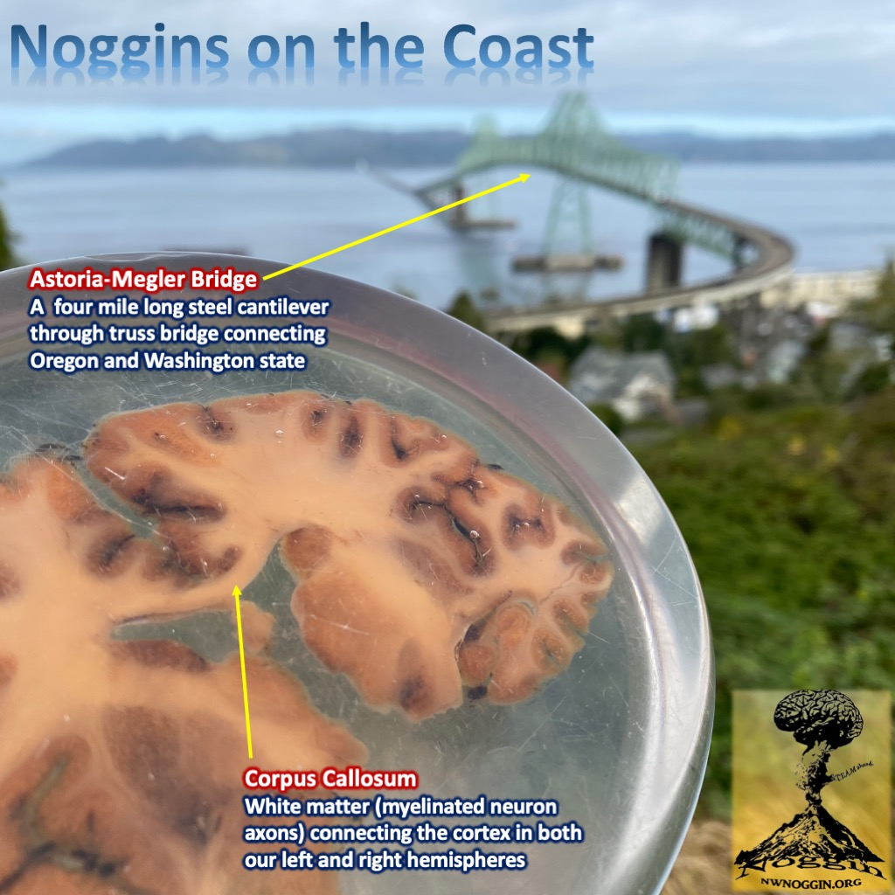
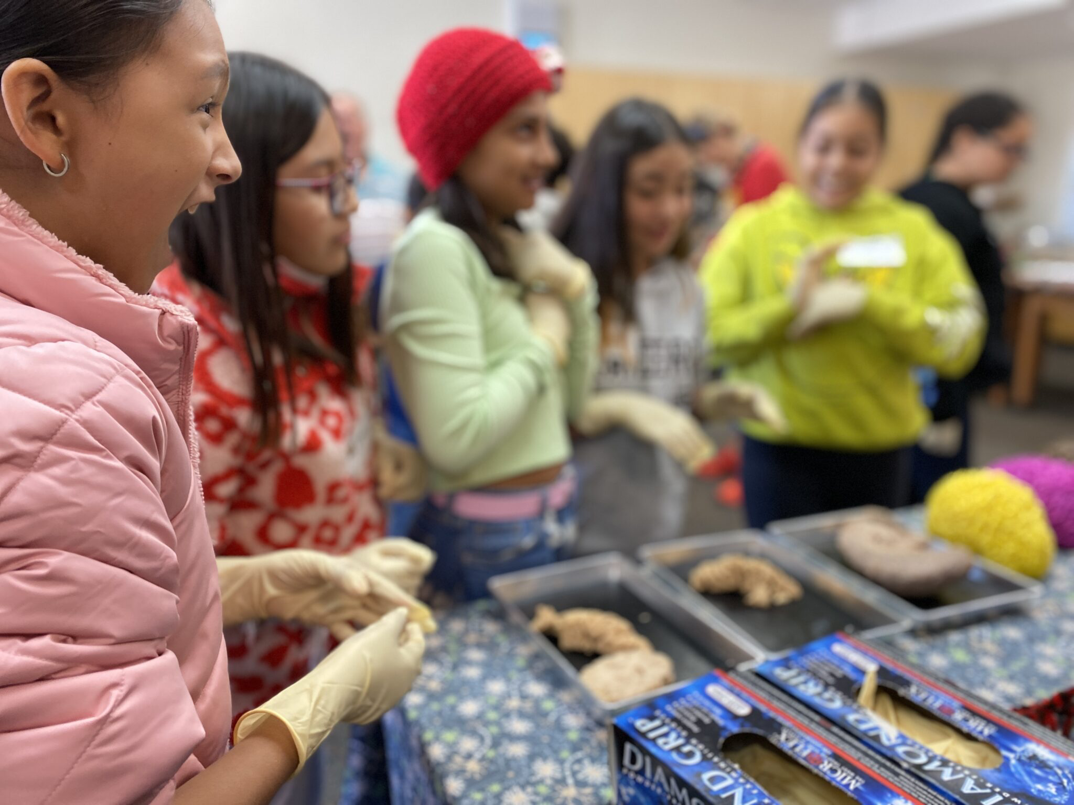
Siletz, Amity & Willamina, OR
Pop: 4000
Davenport, WA
Pop: 1700
GO PLACES
-where STEM programs DON’T GO
-where money and resources don’t go
-RURAL AND URBAN K-12 public schools
-houseless youth nonprofits
-MUSEUMS, Pubs, coffee shops
-correctional facilities
A few places
we’ve been
Astoria, OR
Pop: 10,000
La Grande, OR
Pop: 13,000
Meservy Meadows, OR Pop: ~40
Sisters, OR
Pop: 3081
Heppner & Ione, OR
Pop: 1240

Slide 4
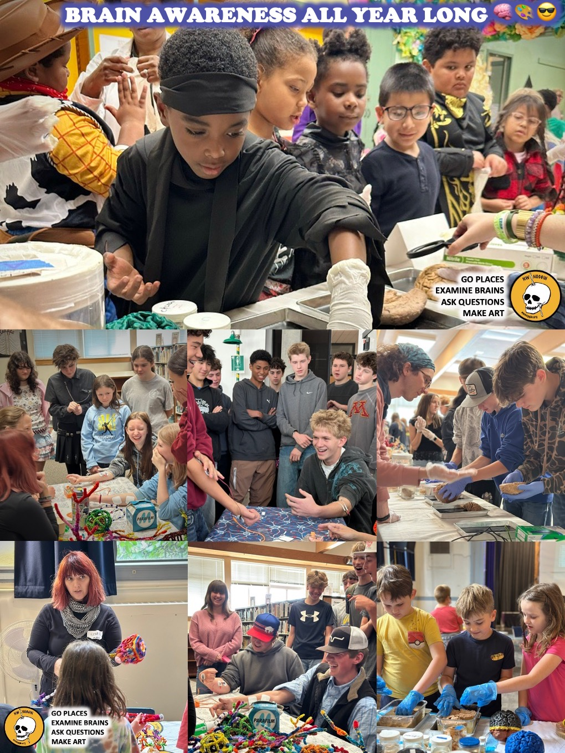
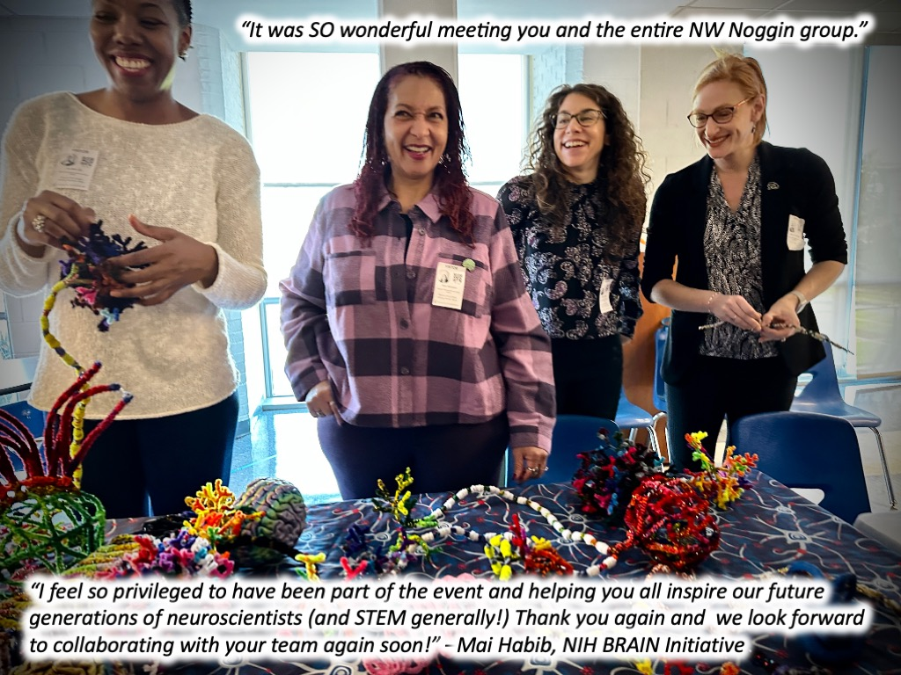
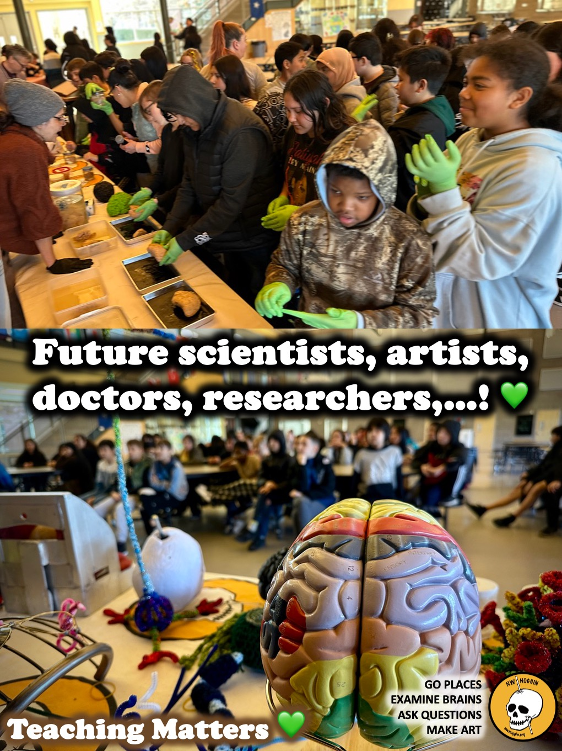
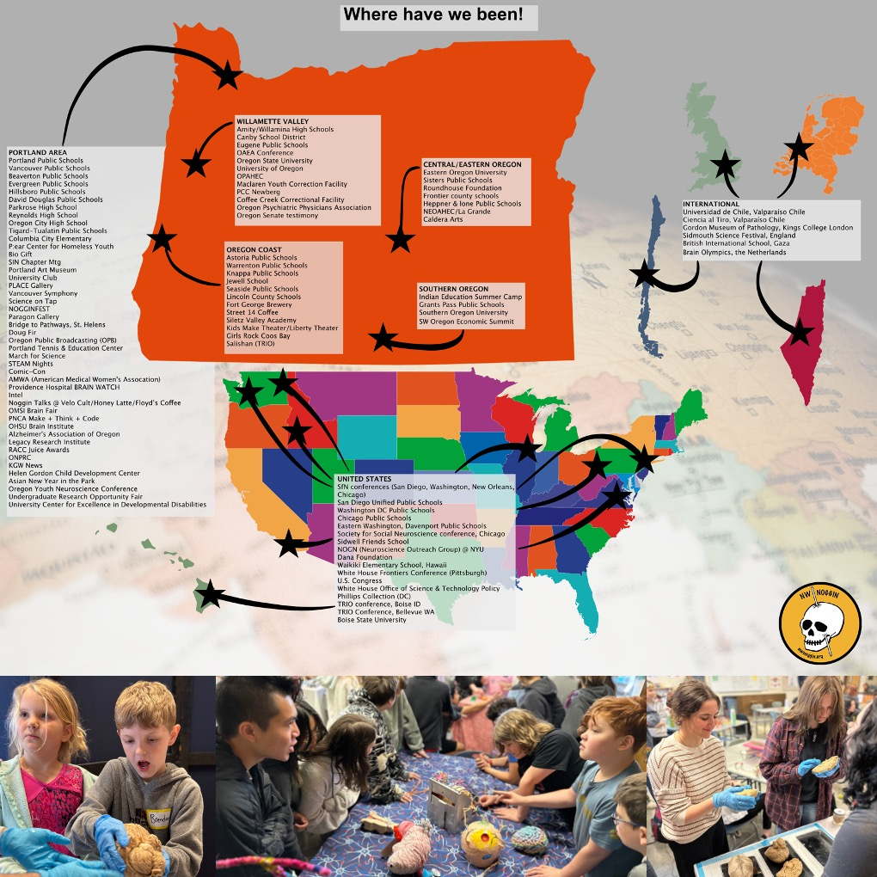
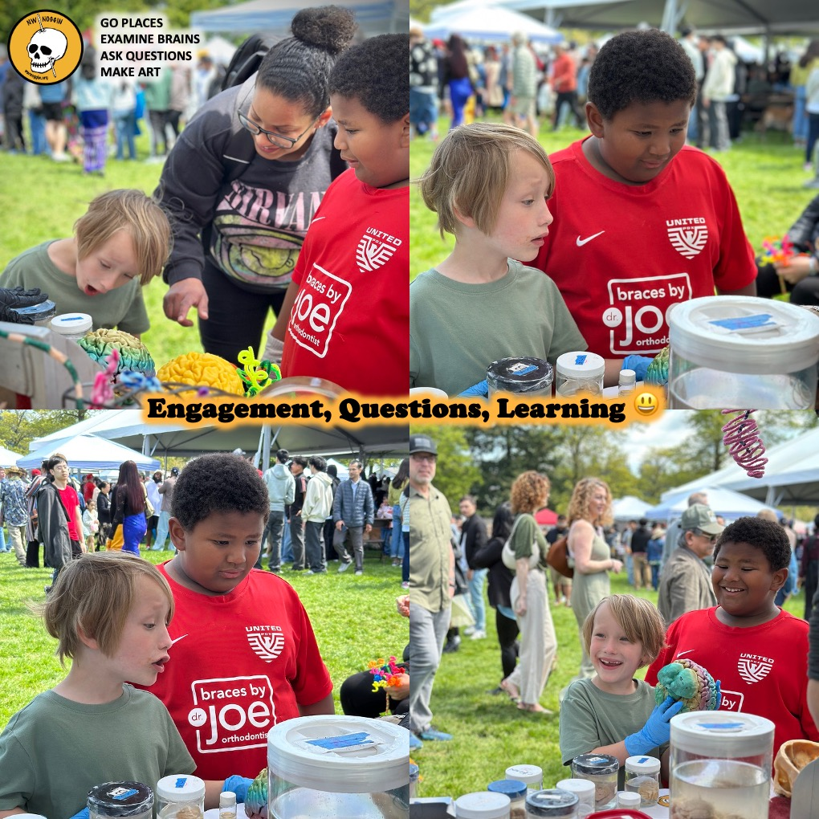
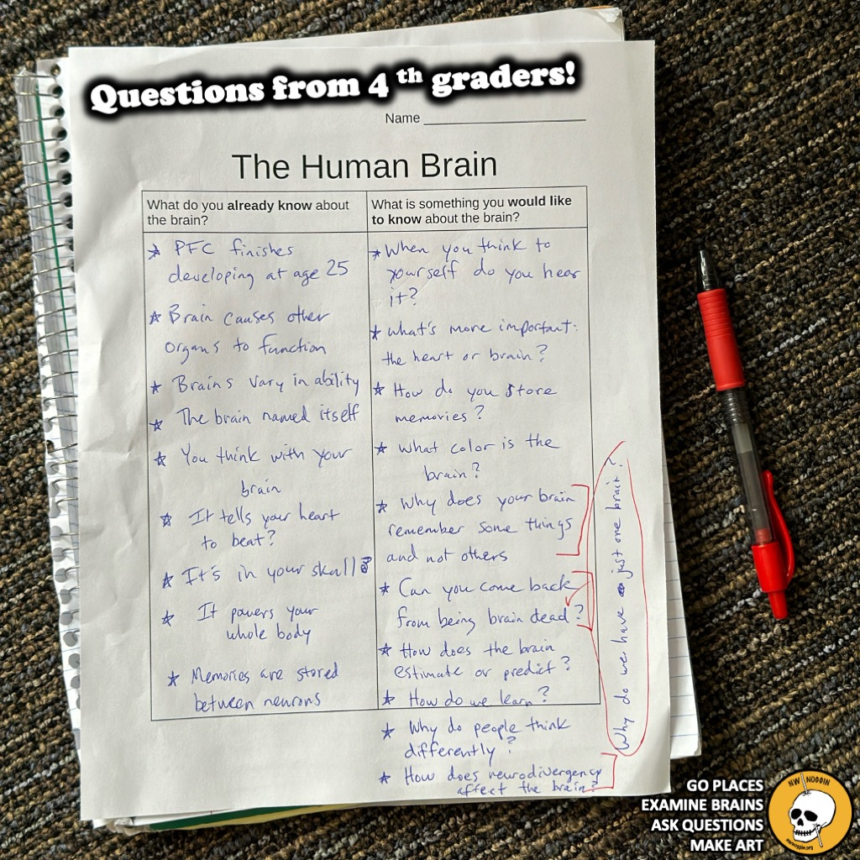
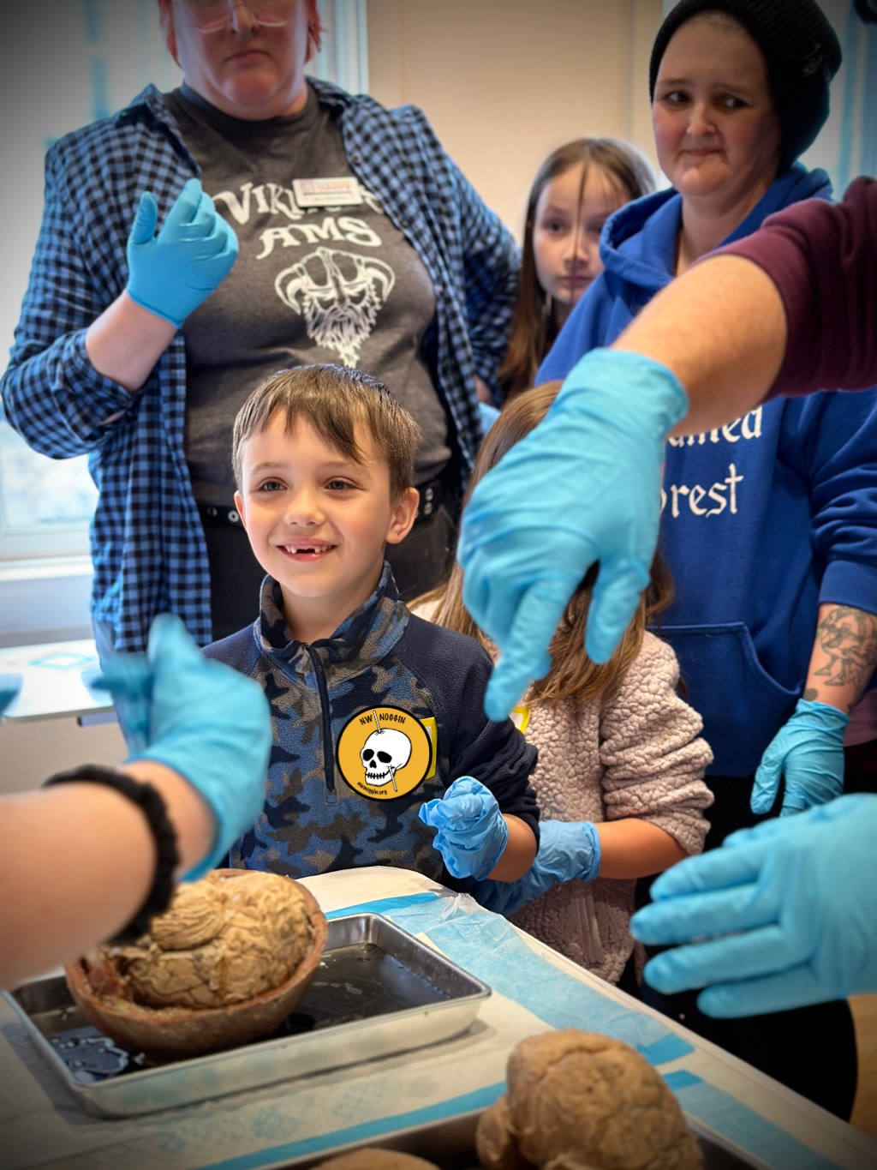
WE GO PLACES!
MORE places
we’ve been!!

Slide 5
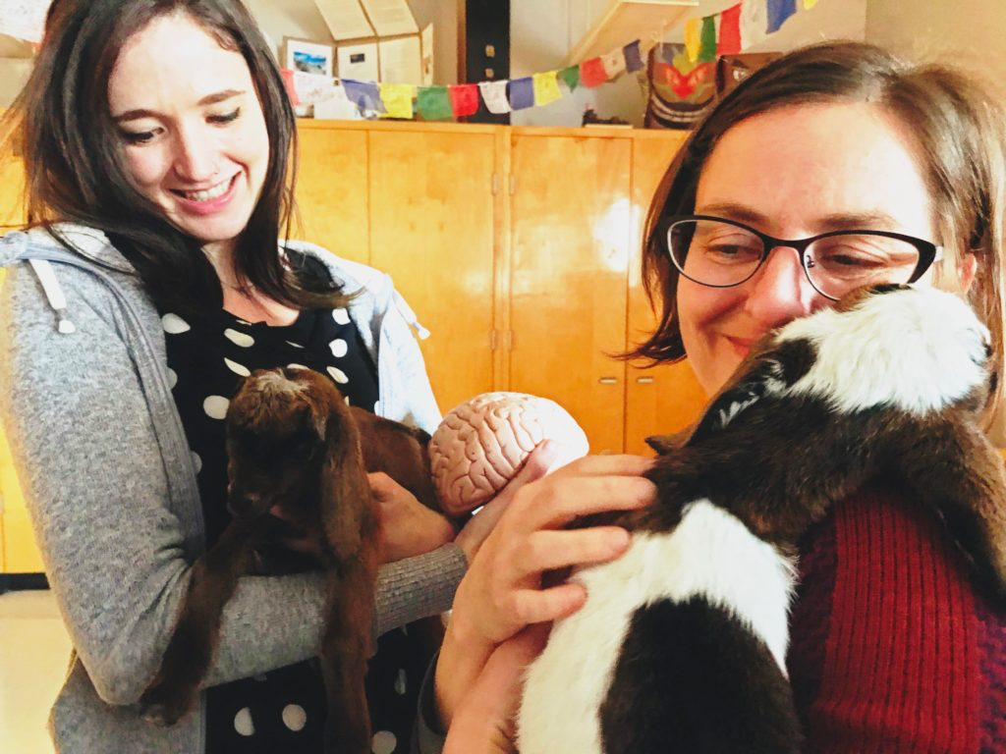
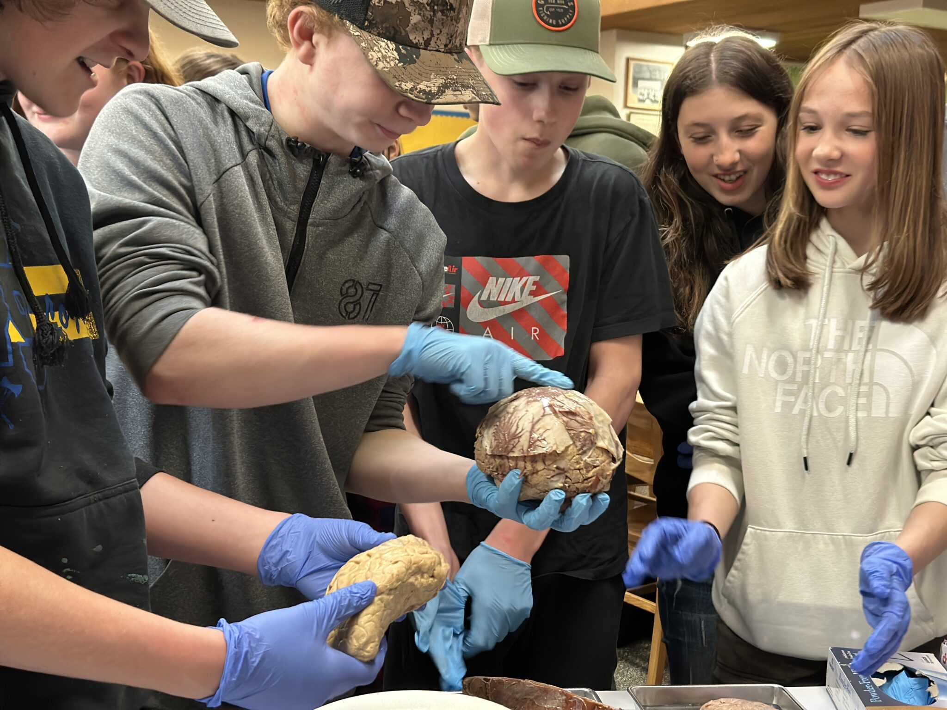
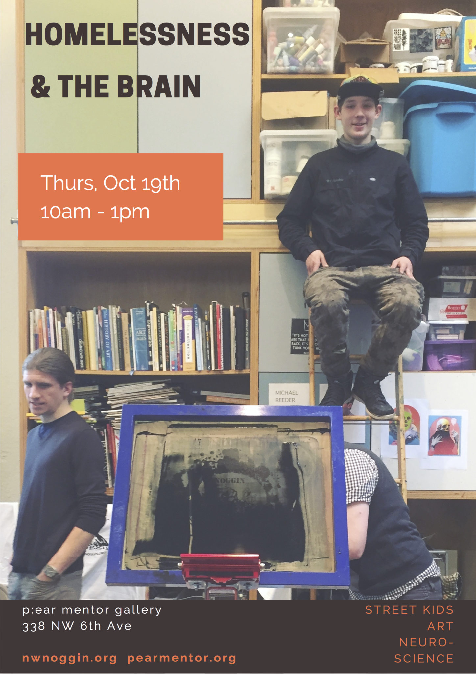
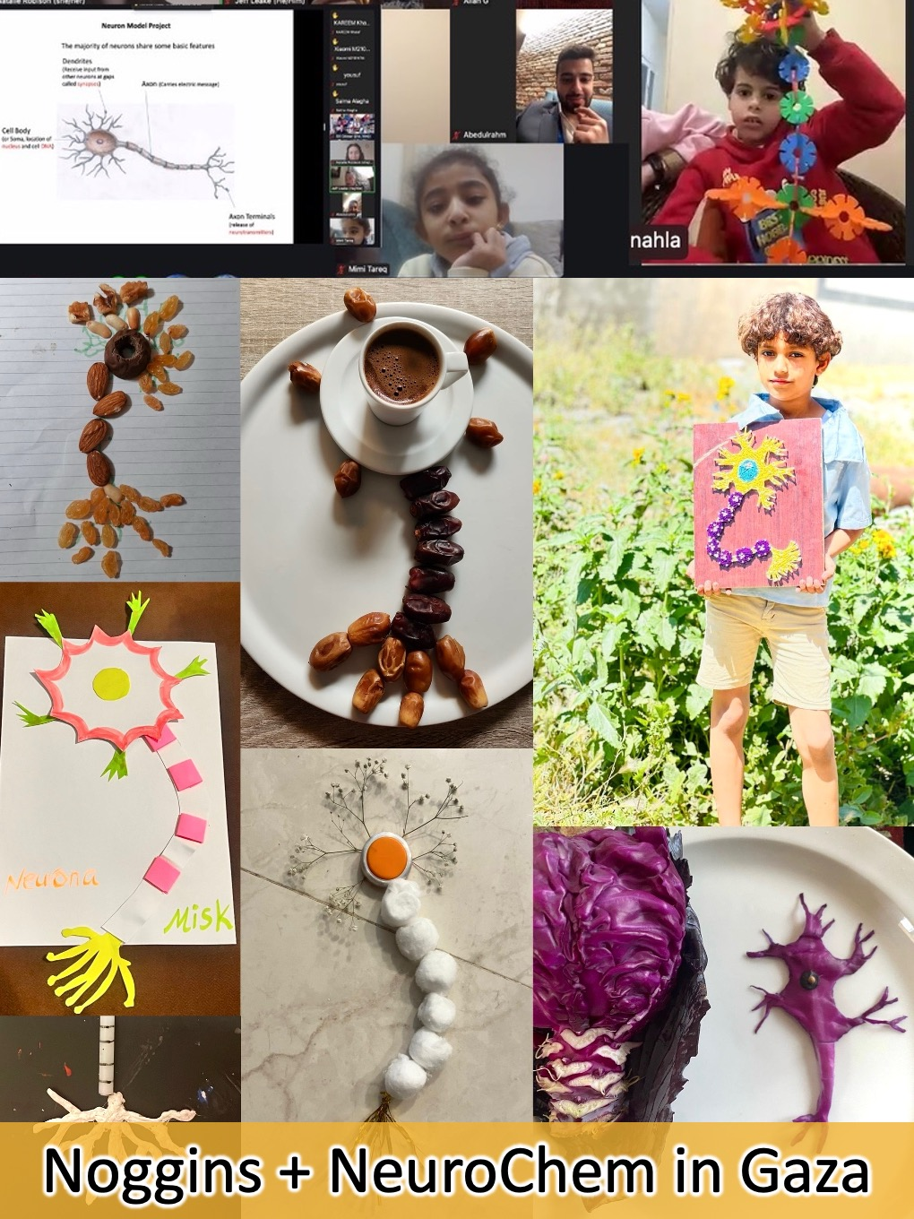
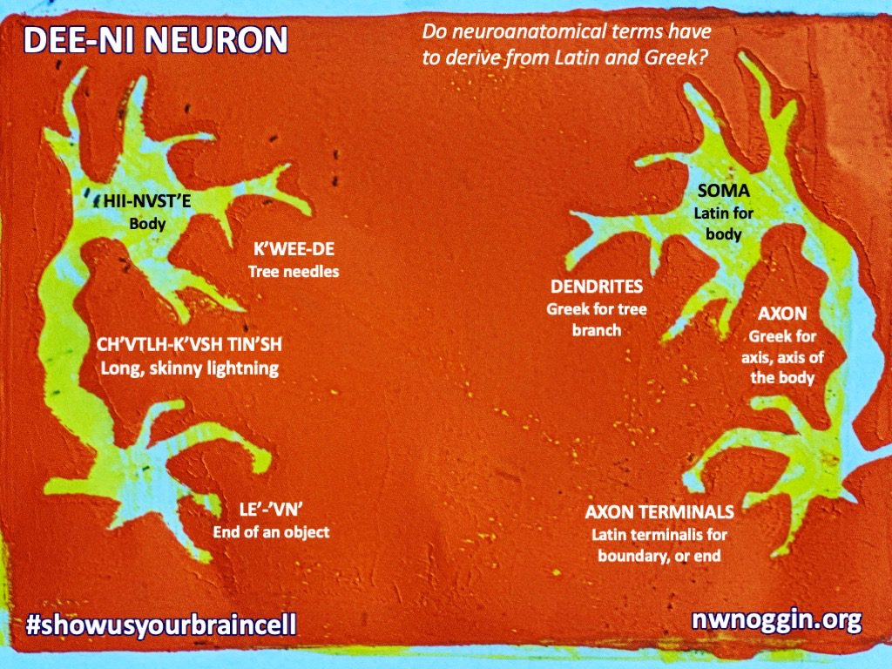
LISTEN
Heppner, OR
-lived experiences
-relevant knowledge
-seeing other people
Knappa, OR
Siletz, OR
Portland, OR

Slide 6
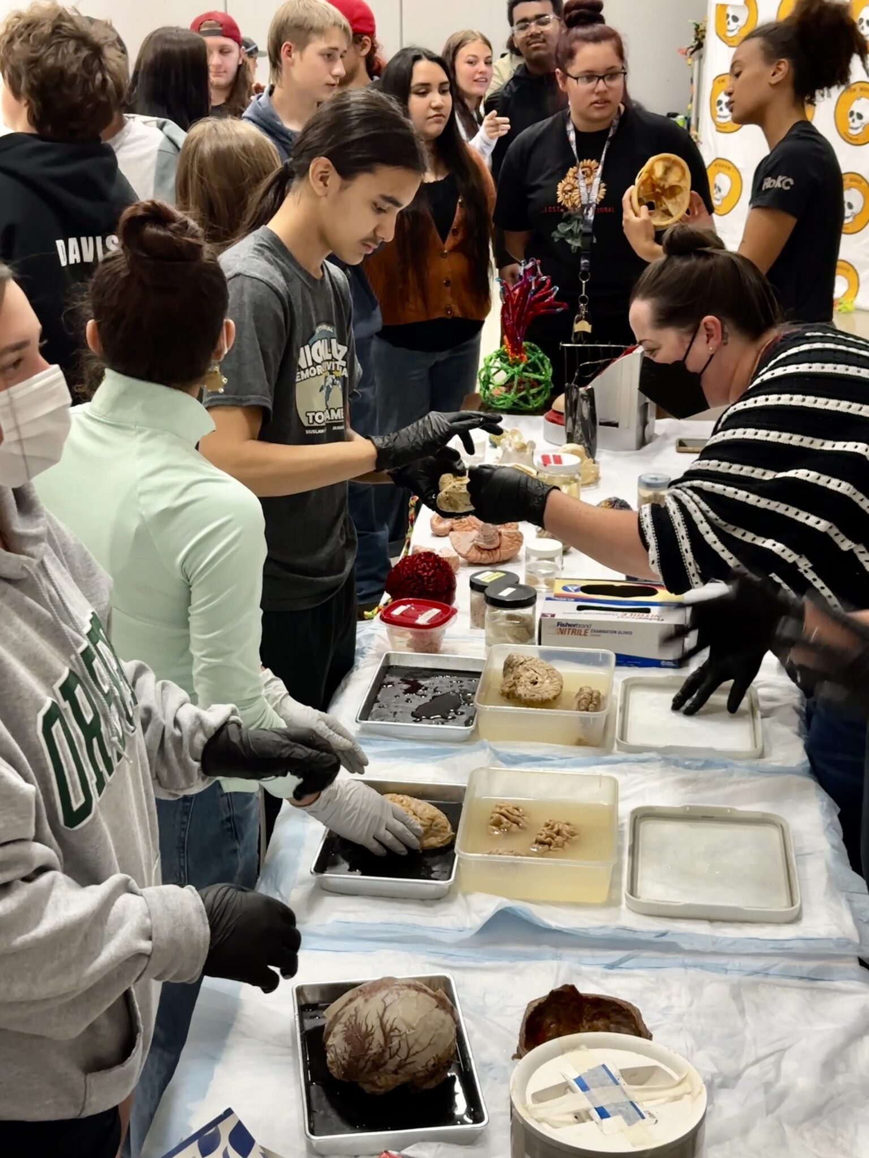
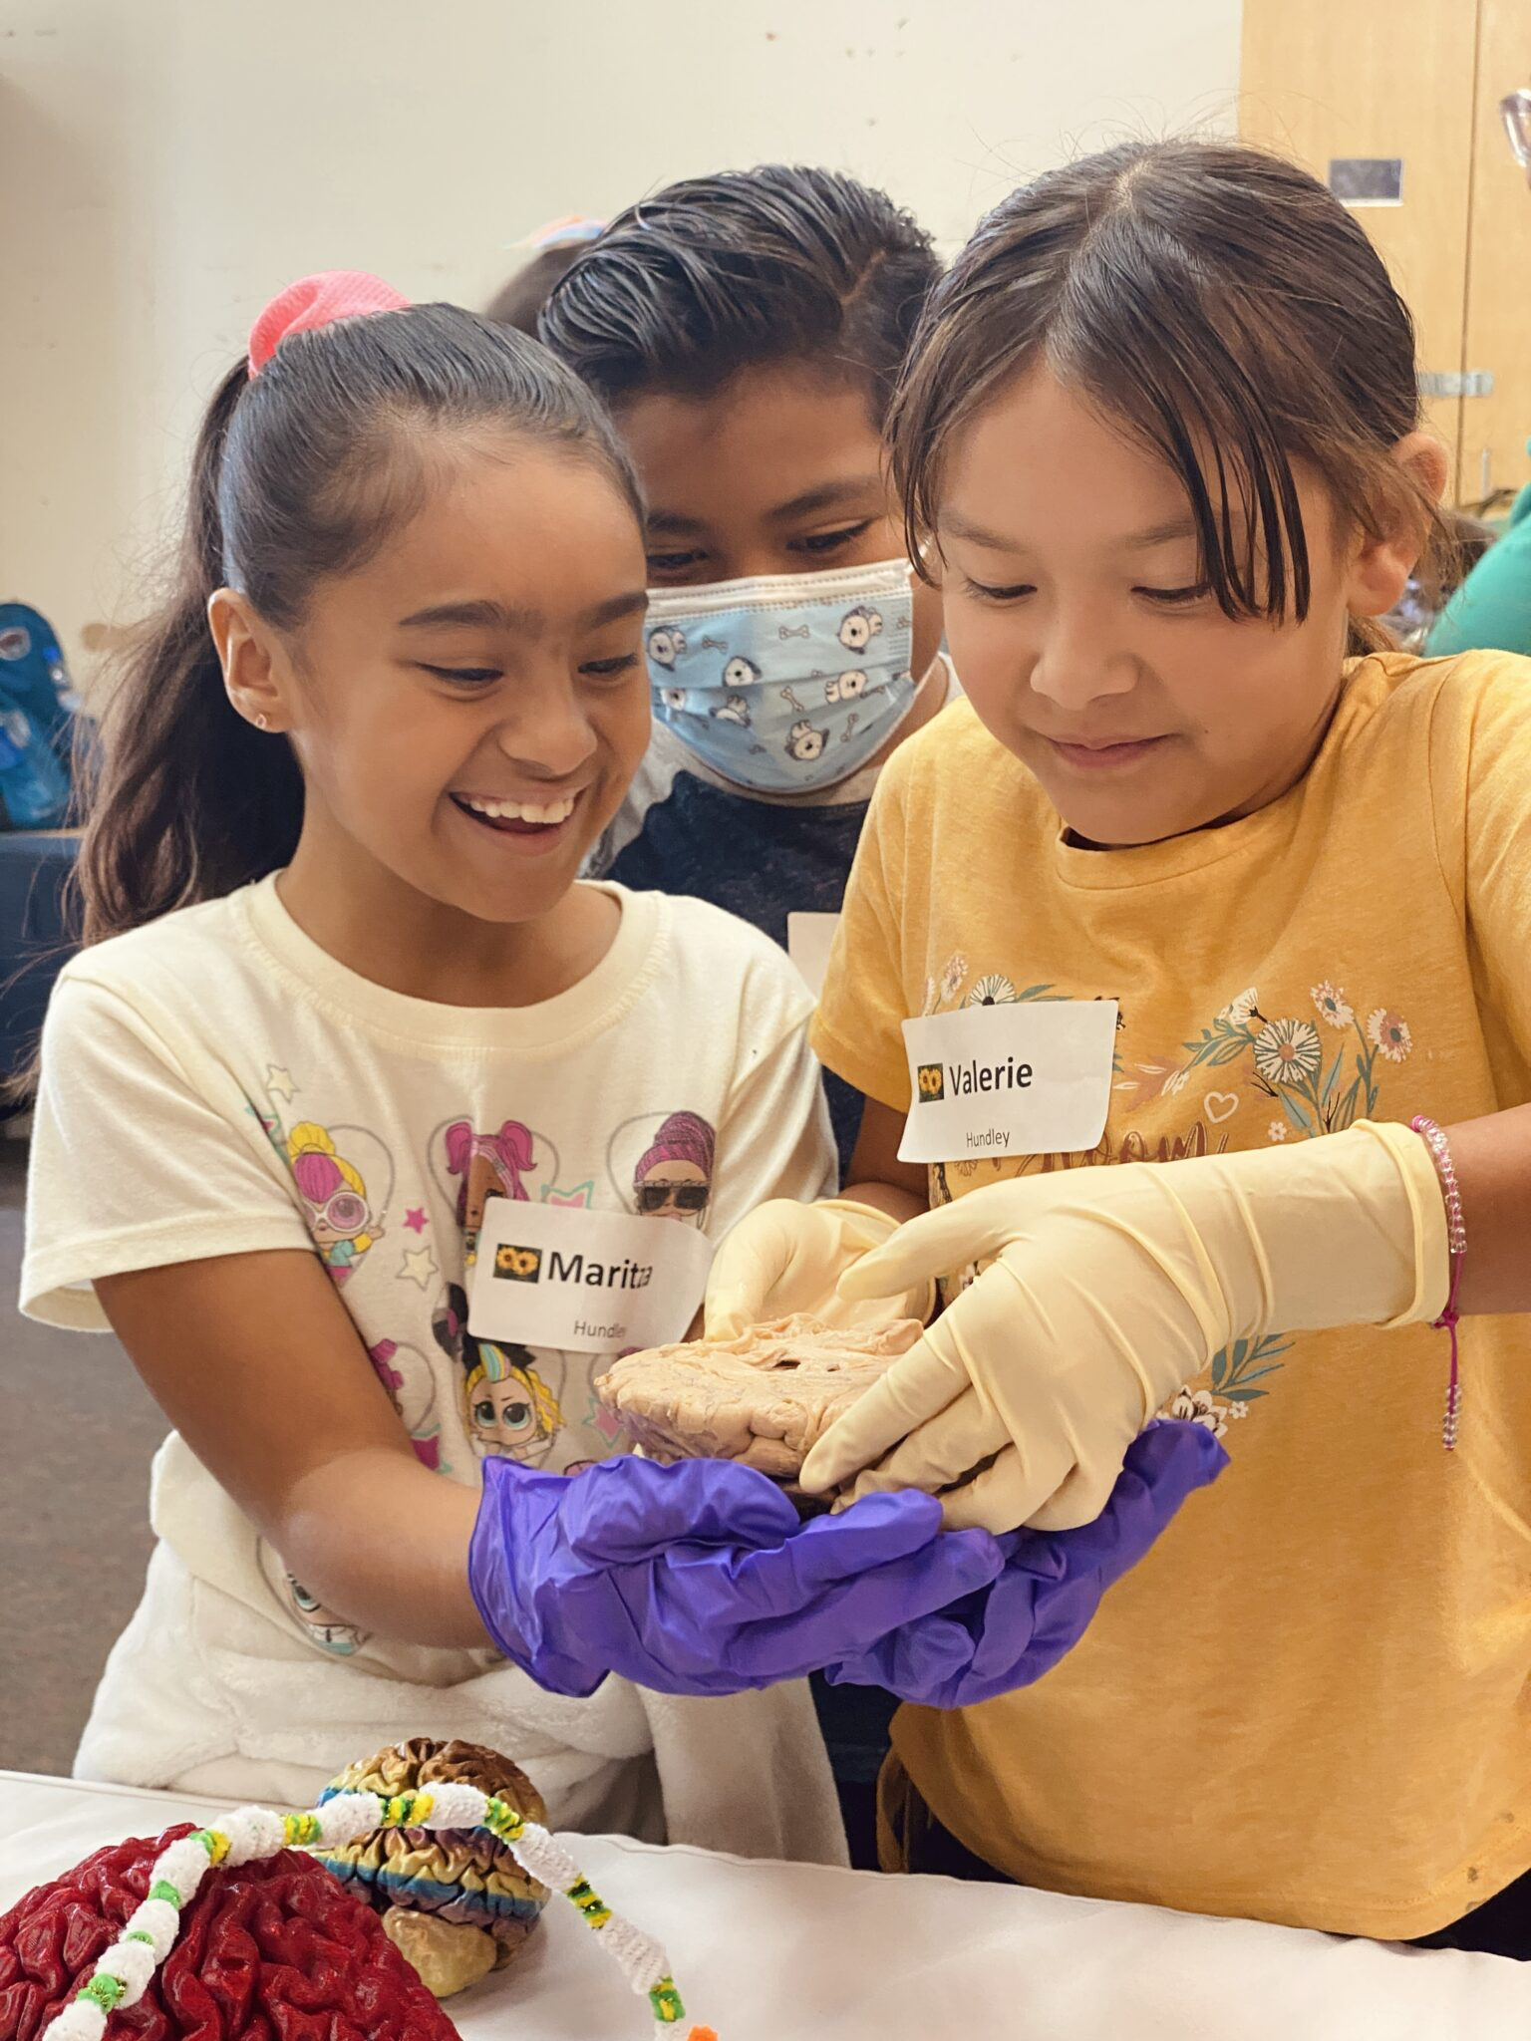
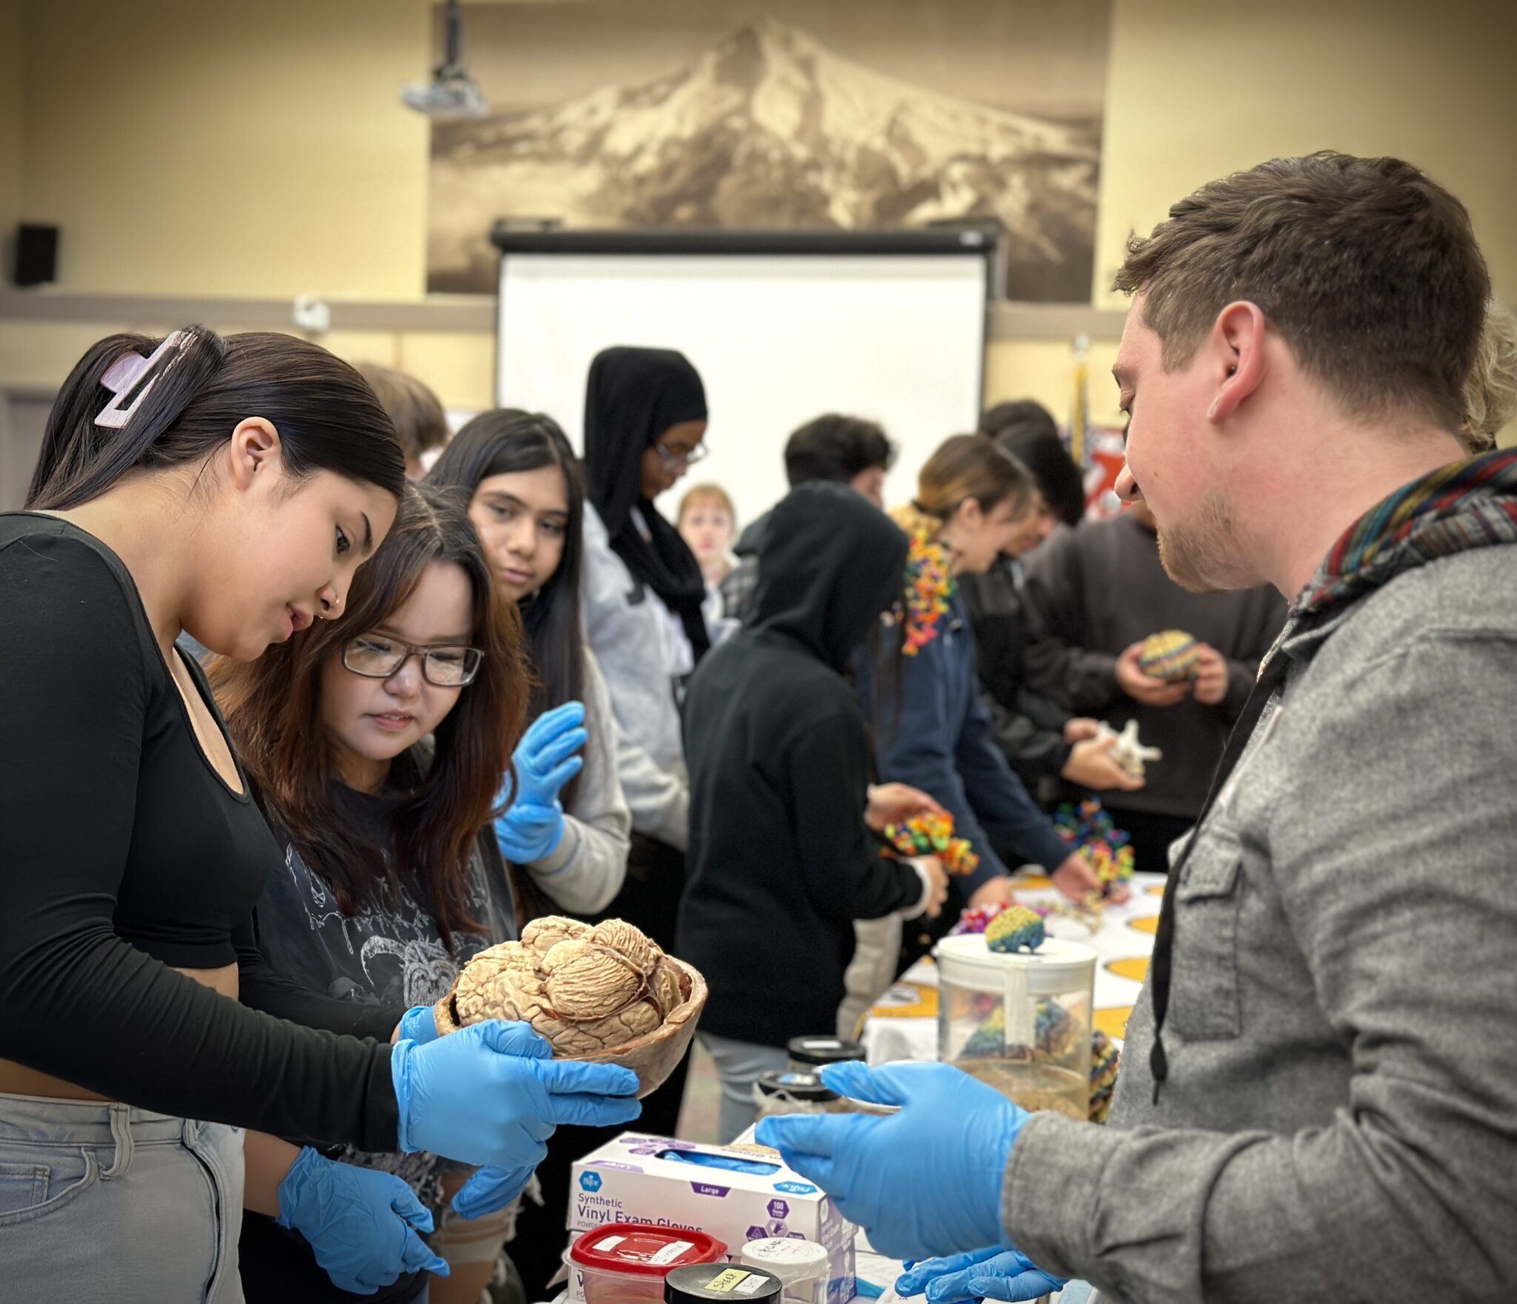
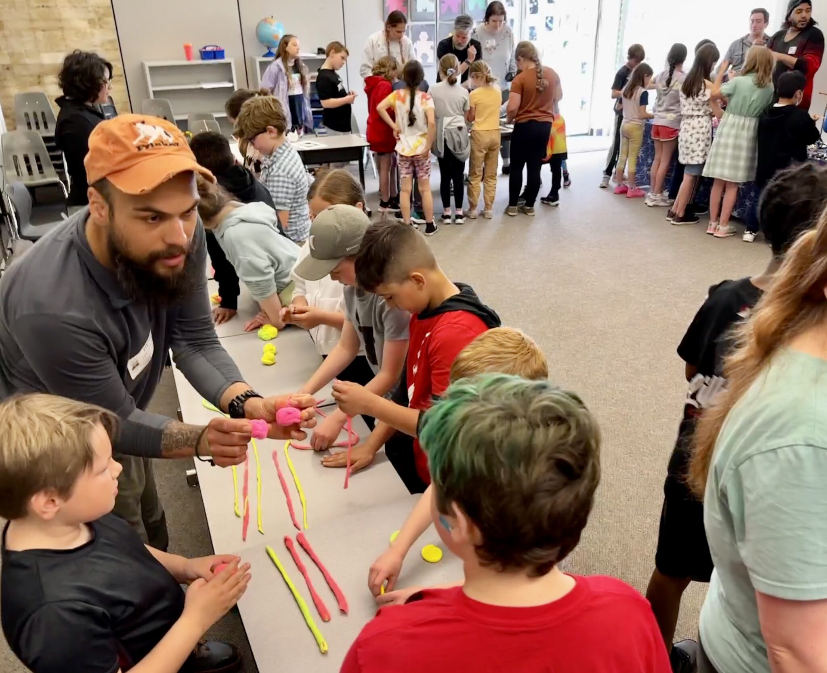
SHARE STORIES
-Empower MORE voices
-Broaden the conversation (MORE “DATA!”)
-Make public investment in research relevant
-Invite new participants, perspectives & brains

Slide 7

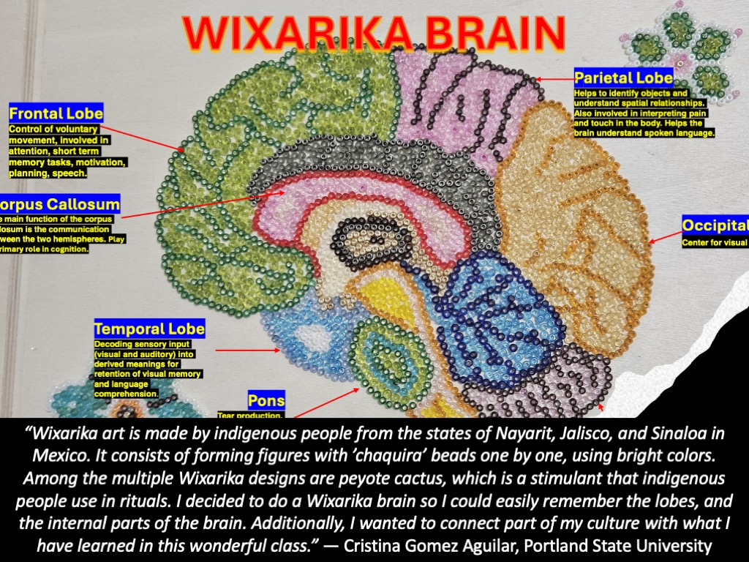
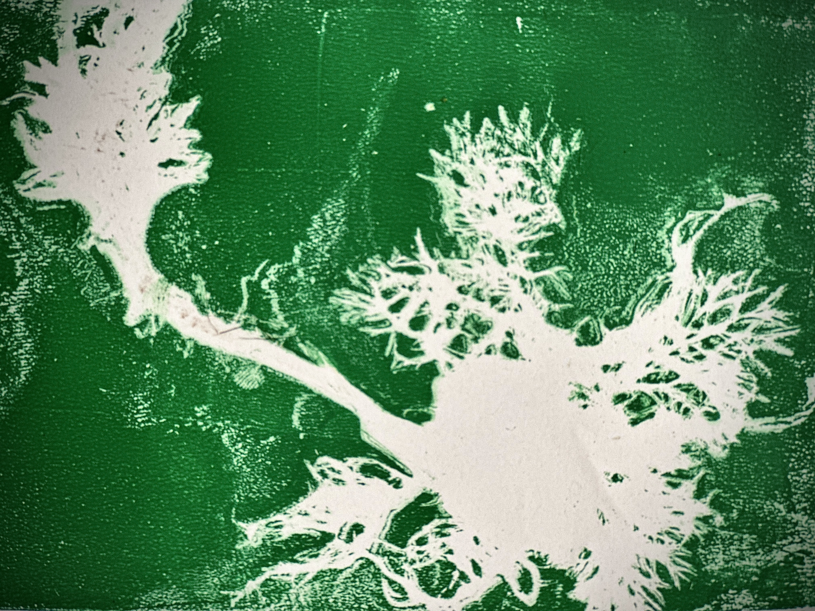
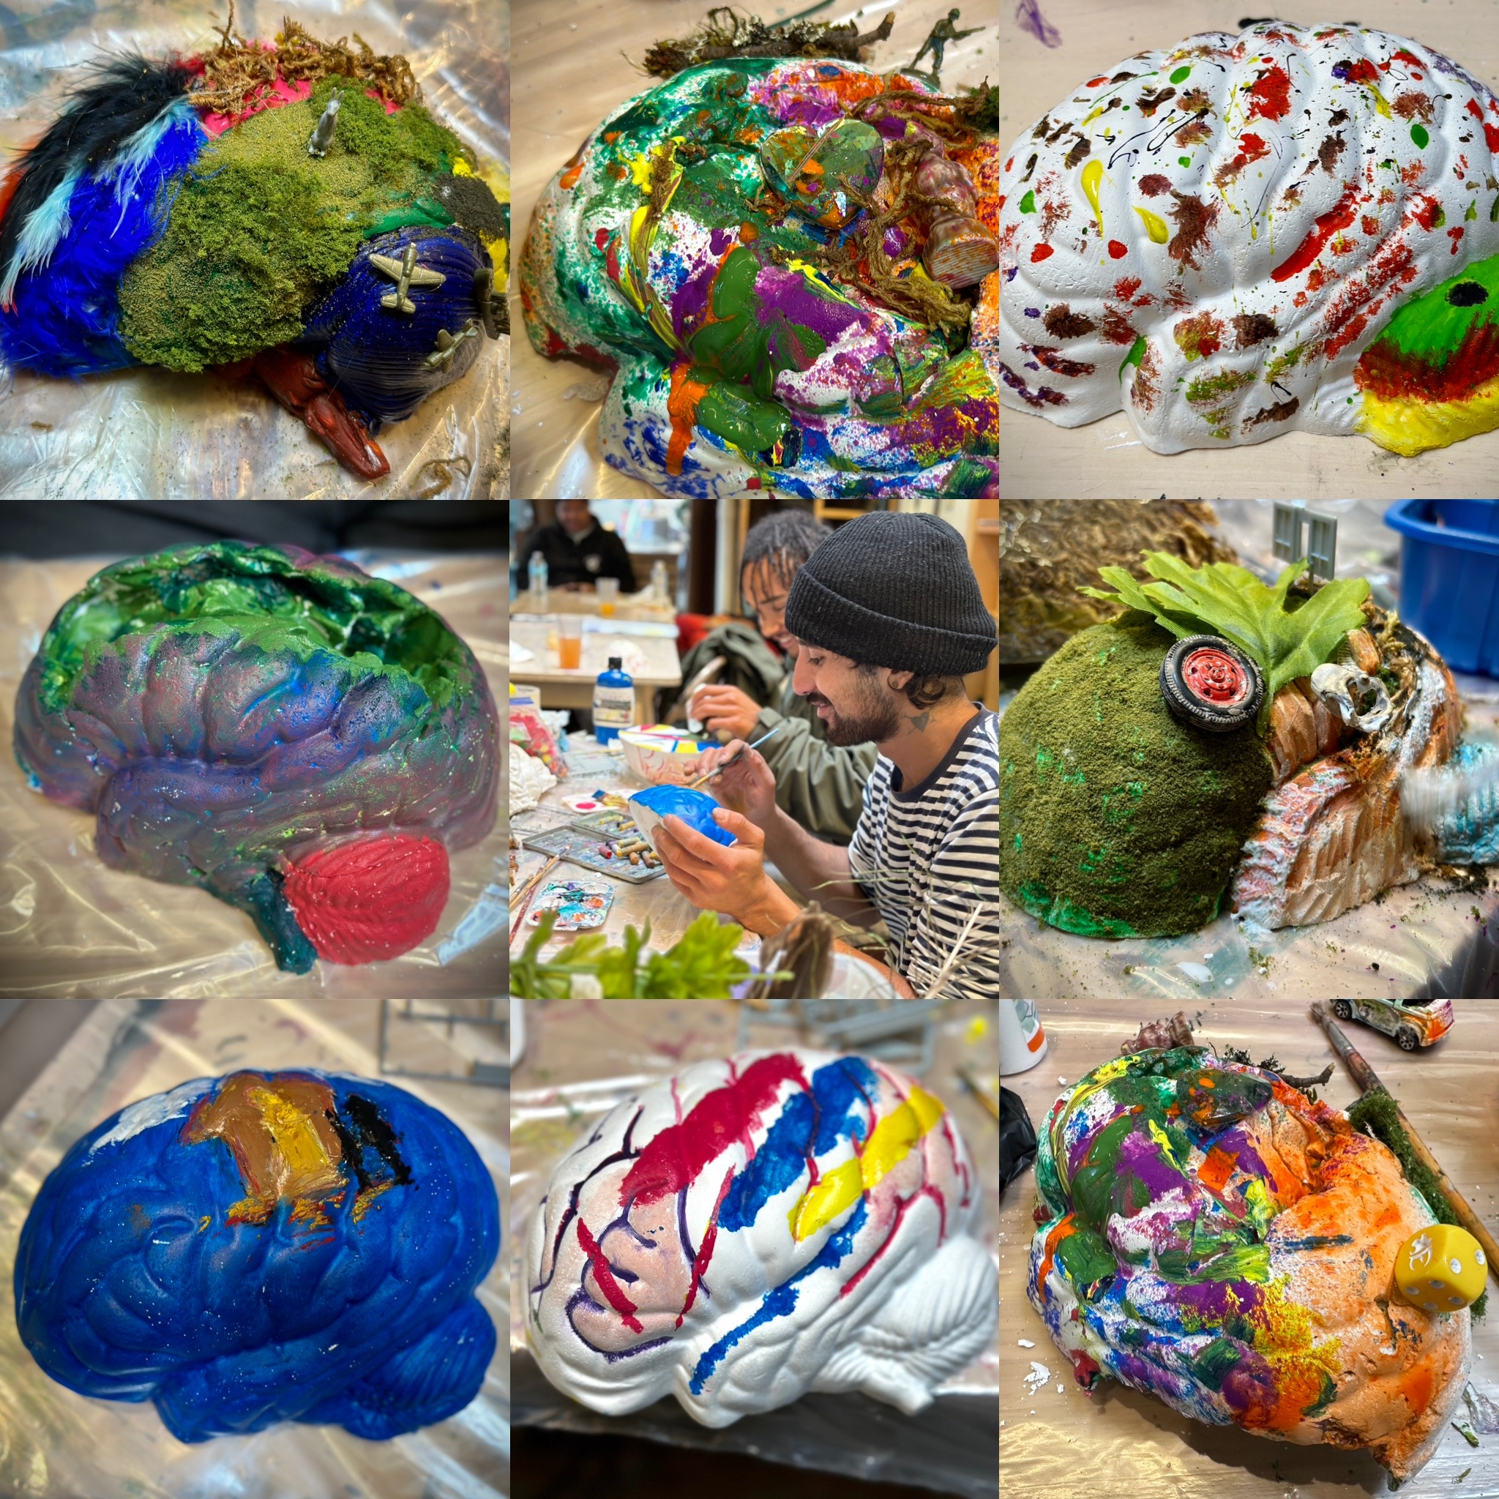
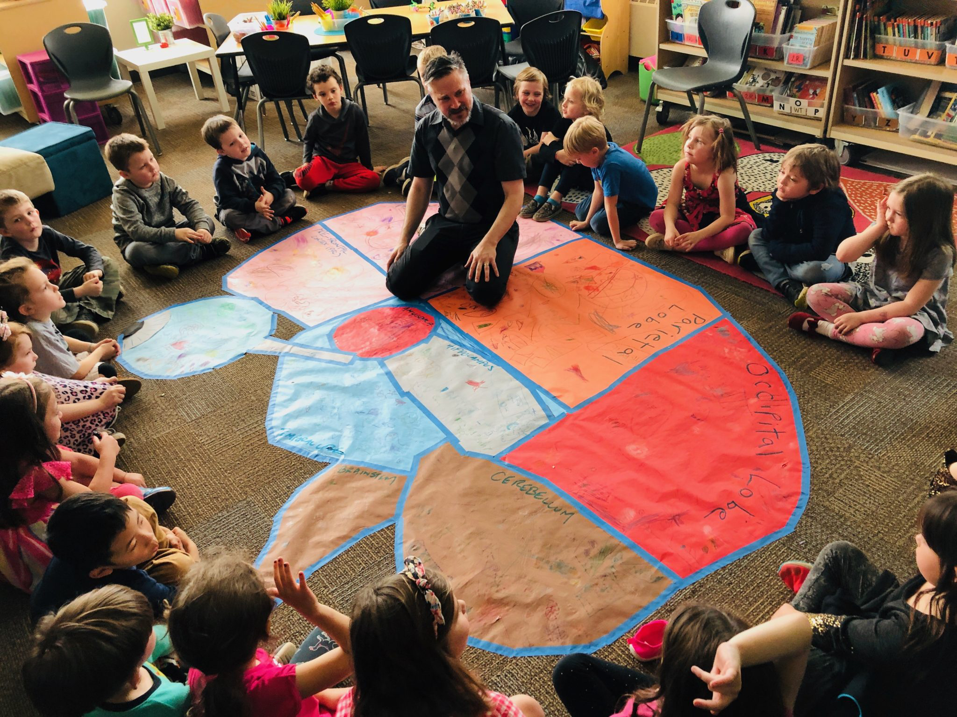
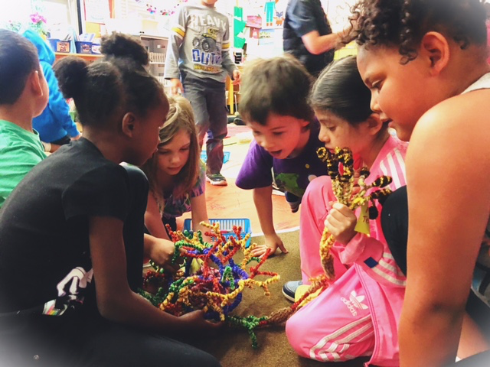
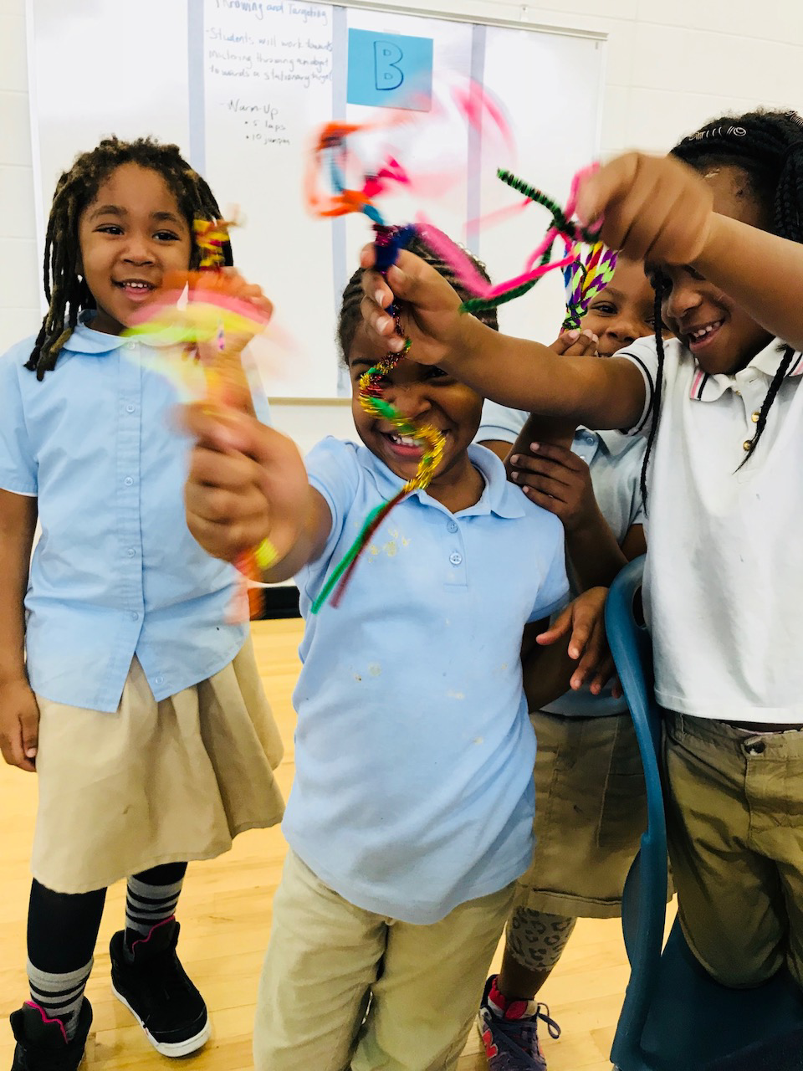
MAKE ART
-Engagement
-Personal relevance
-self-awareness AND EMPATHY
-ADAPTATION AND PLASTICITY

Slide 8
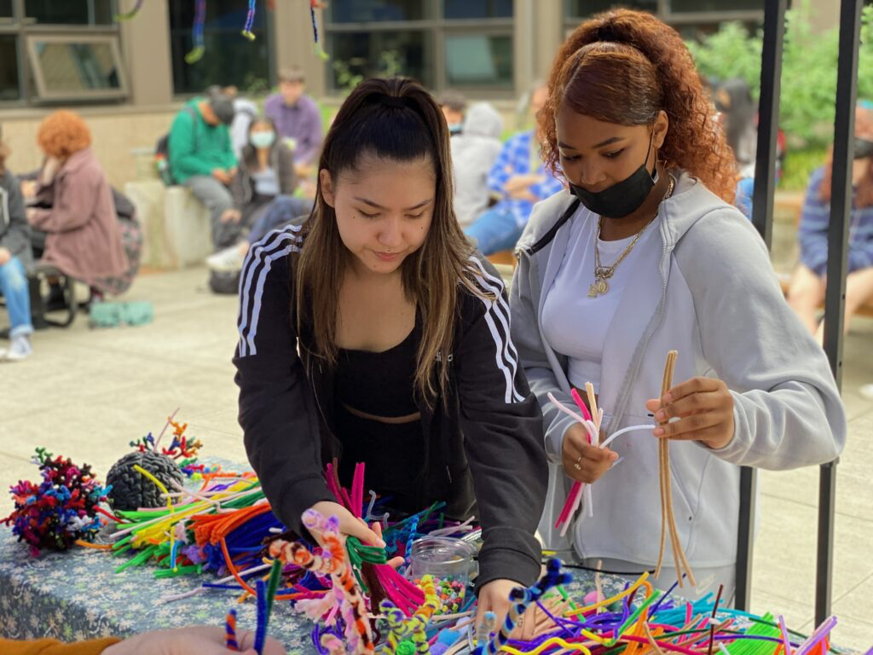


Slide 9
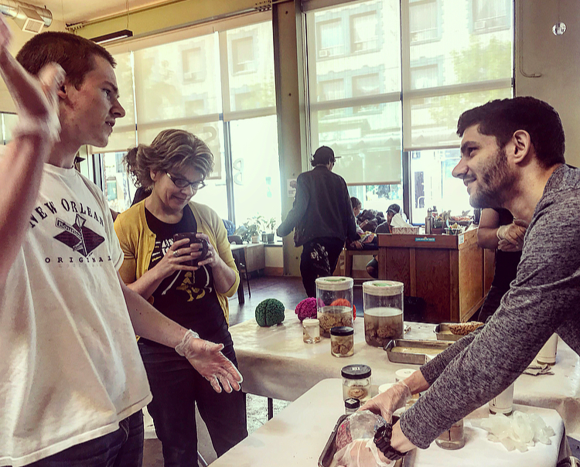
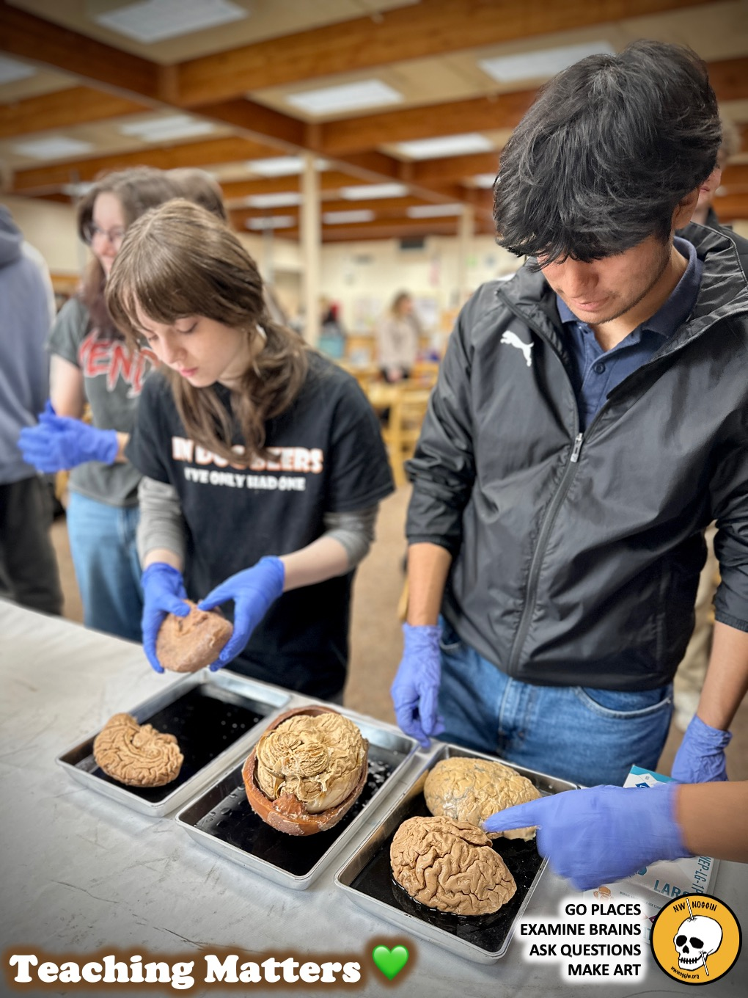
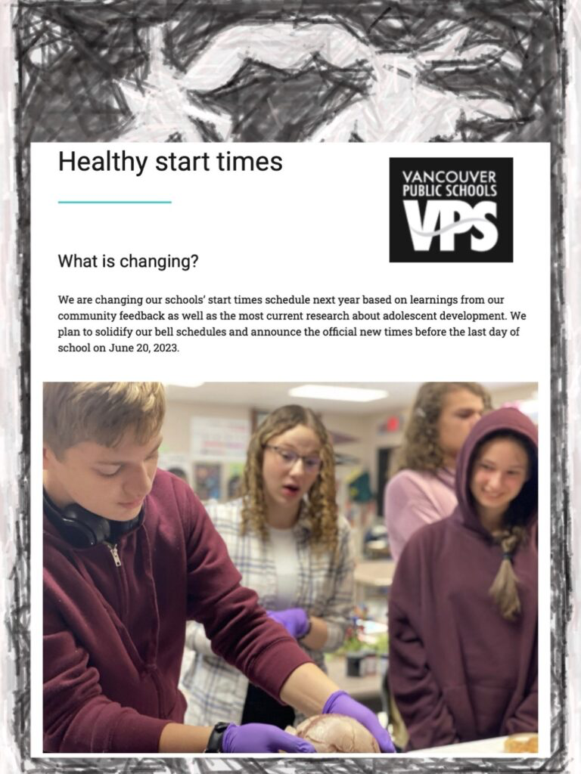
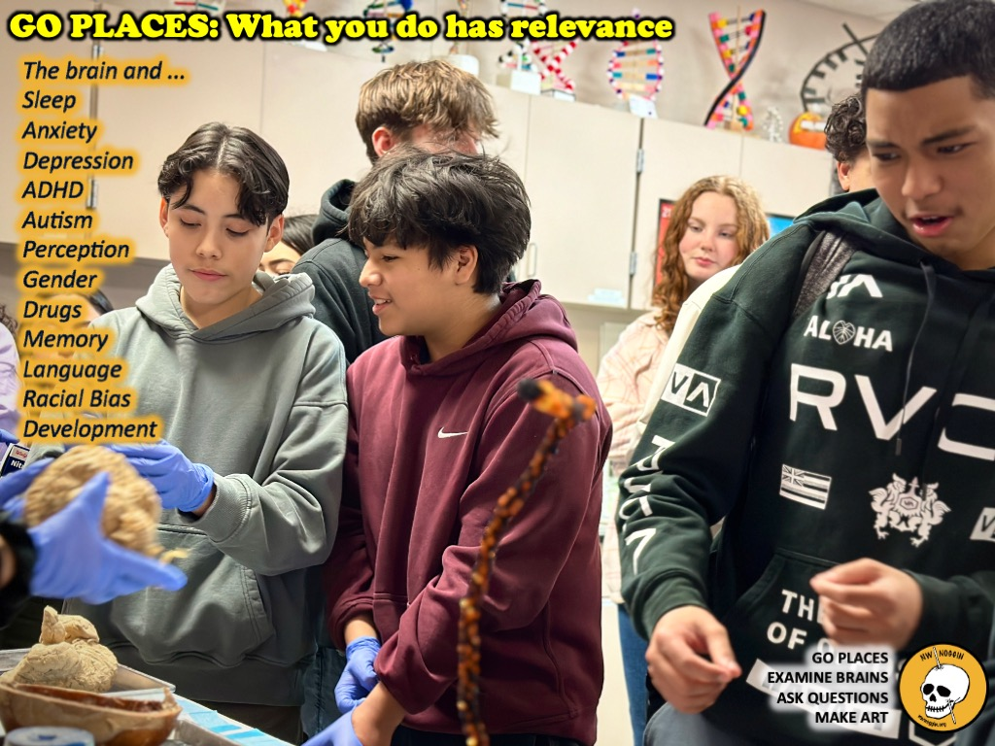
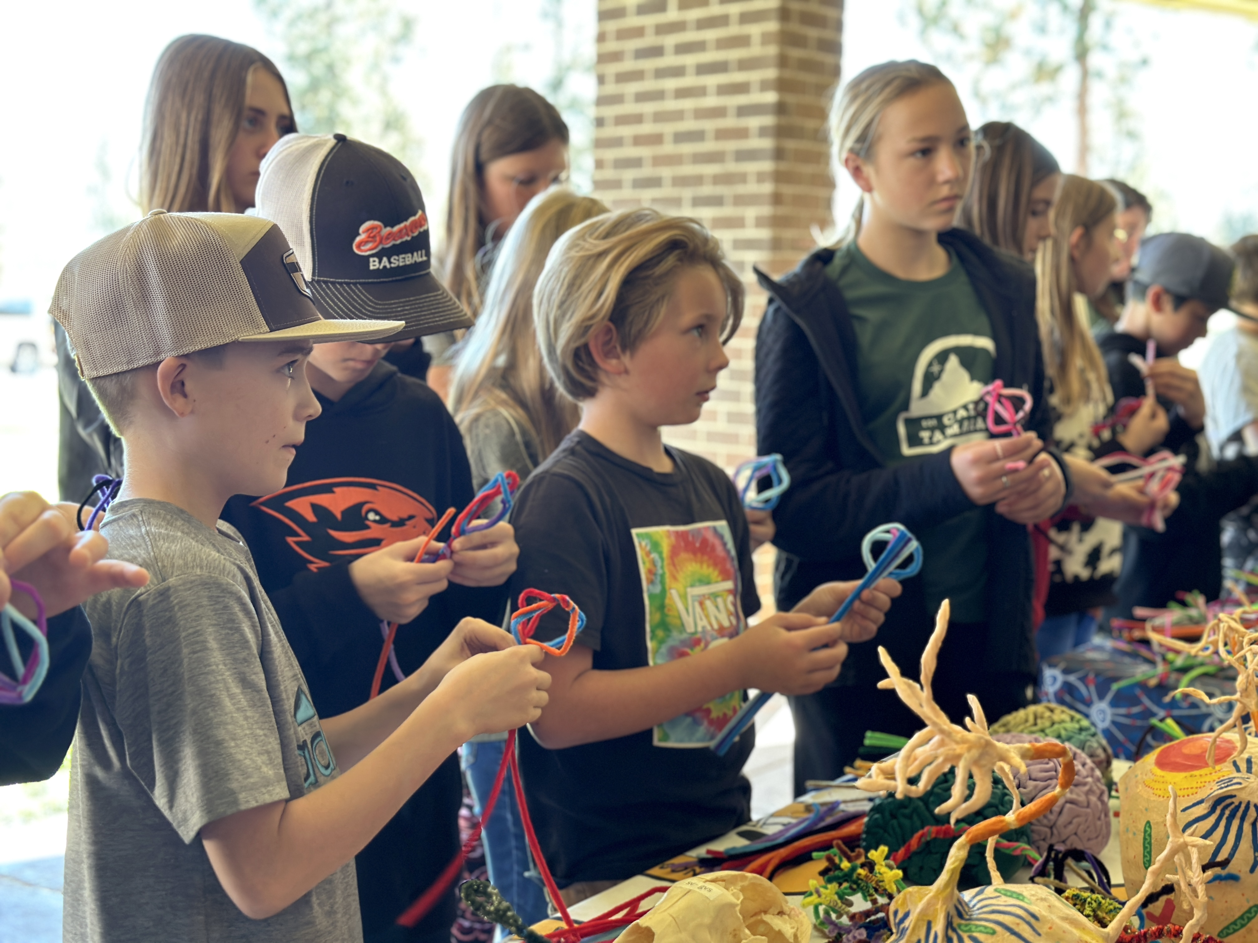
INFORM POLICY
-Research topics are popular!
-Interdisciplinary/STEAM approaches WORK
-1. School start times for adolescents
-2. Permanent standard time
-3. Housing first

Slide 10
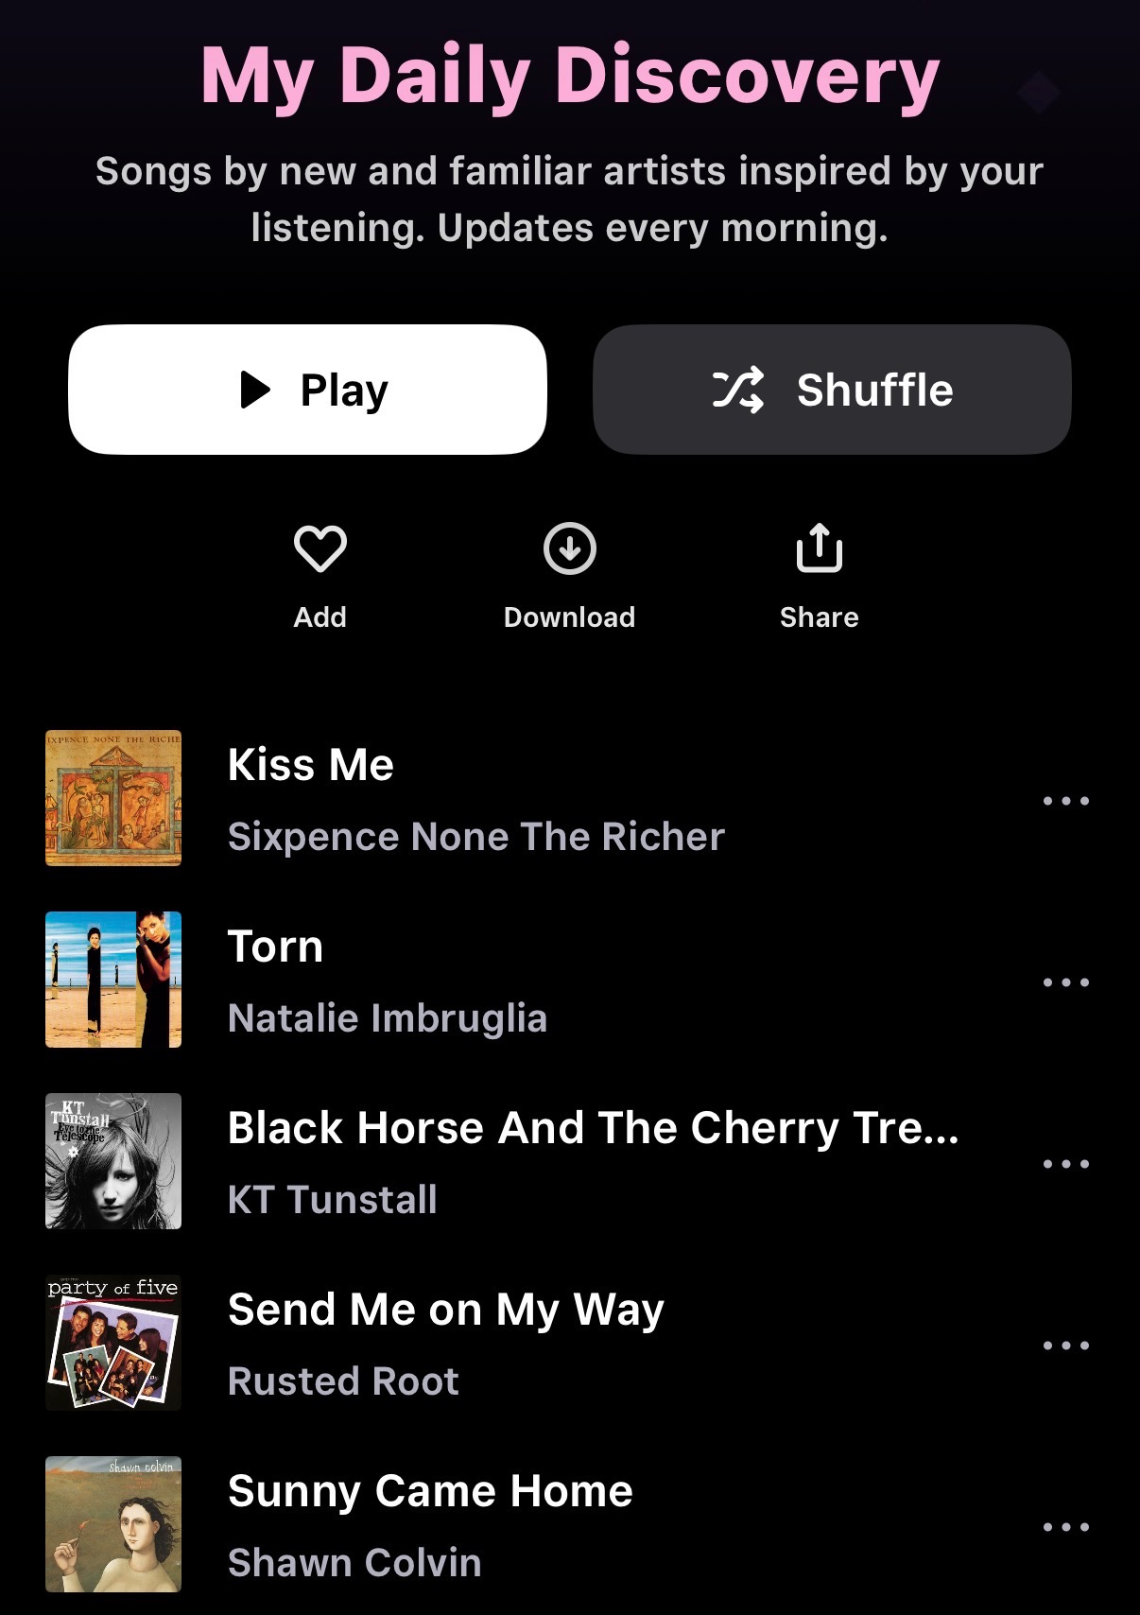
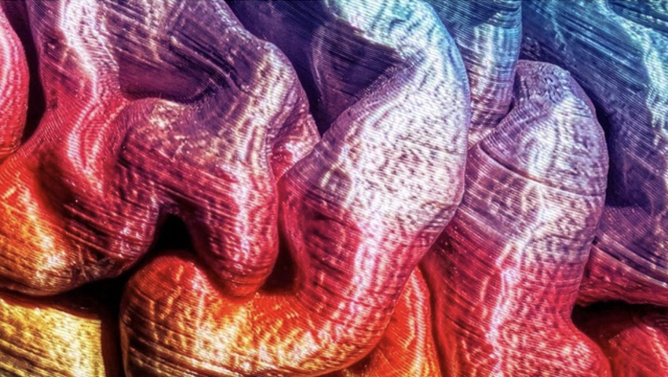
What is AI?
ARTIFICIAL INTELLIGENCE (AI) uses algorithms
to seek patterns in huge amounts of data,
and learn from those patterns to
make predictions.
LEARN MORE: What is artificial intelligence (AI)?
https://www.ibm.com/think/topics/artificial-intelligence
Machine Learning
Models that make predictions based on data
Deep Learning
More complex neural networks that find patterns; unsupervised
Neural Networks
A machine learning technique that models the organization of the brain to find patterns in data;
Often supervised (inputs/outputs provided)
Generative AI (including LLMs)
Deep learning systems that create original content; unsupervised

Slide 11
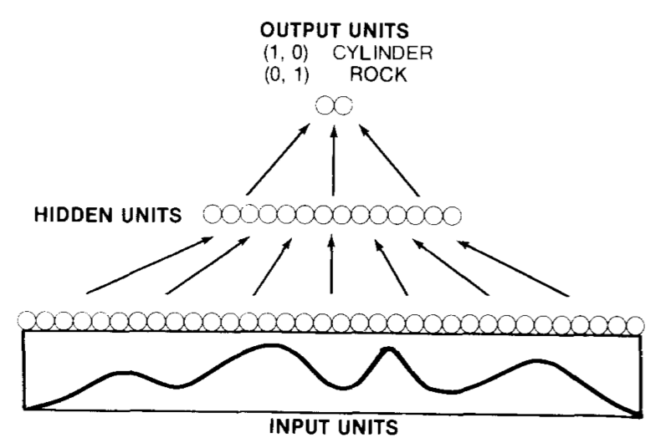
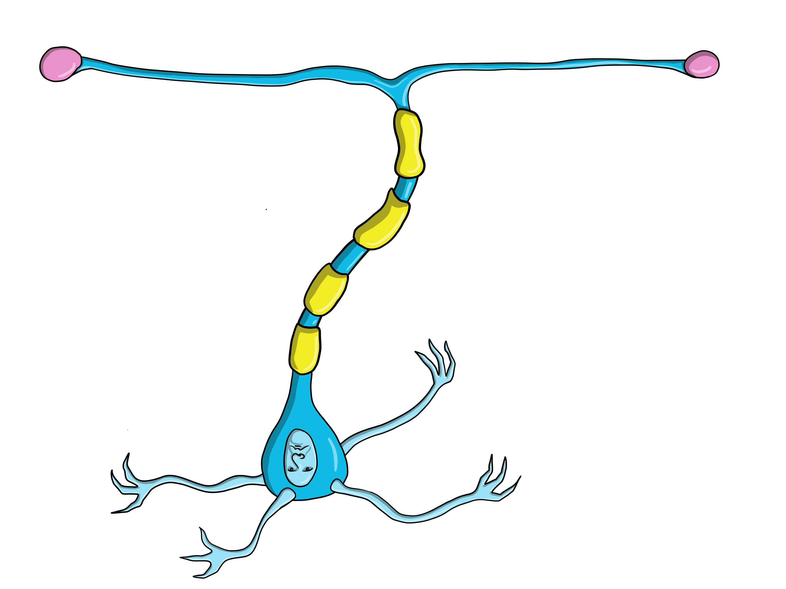
“Mines” vs. rocks
MINE
ROCK
MOTOR OUTPUT
Motor neurons
My first exposure
to AI - exciting!
MIDDLE LAYER
Interneurons
SENSORY INPUT
Auditory neurons
“A neural network learning procedure has been applied to the classification of sonar returns from two undersea targets, a metal cylinder and a similarly shaped rock. Networks with an intermediate layer of hidden processing units achieved a classification accuracy as high as 100% on a training set of 104 returns…networks correctly classified up to 90.4% of…returns not contained in the training set....Network performance & classification strategy was comparable to that of trained human listeners.” - Analysis of hidden units in a layered
network trained to classify sonar targets (1998)

Slide 12
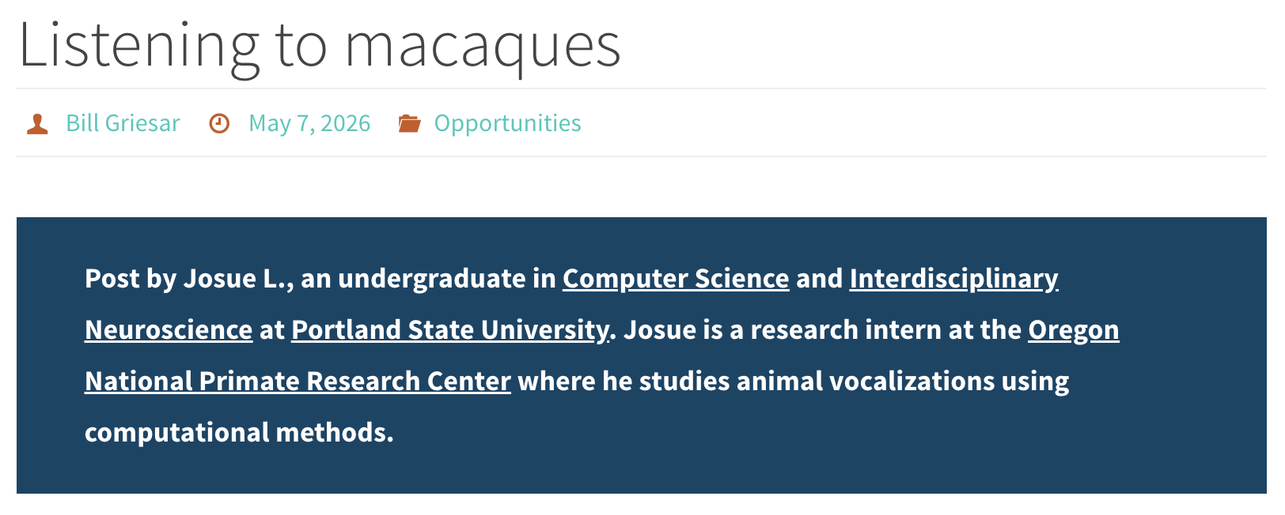

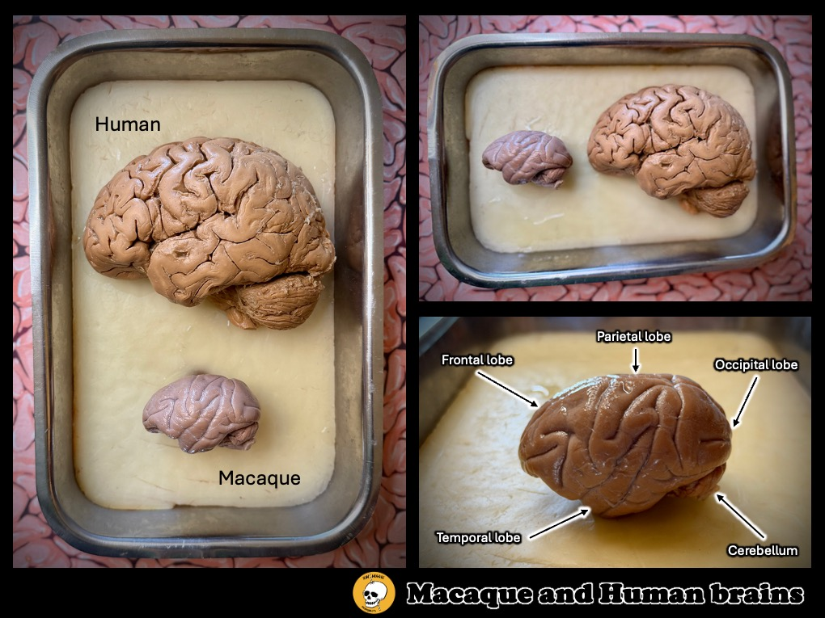
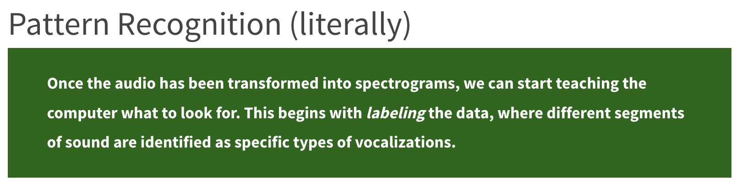

A COOL NEW USE of Ai
Check it out here: https://nwnoggin.org/2026/05/07/listening-to-macaques/
GO PLACES
EXAMINE BRAINS
ASK QUESTIONS
MAKE ART

Slide 13
AI is ubiquitous, and people now use generative AI every day. Sometimes we use it intentionally (for example, we type a specific request into ChatGPT) though in many cases we use it unintentionally (e.g., we read an "AI summary" of a Google search). There are situations where AI technology can be helpful.
BUT…WHOSE DATA?
Underrepresented populations
Predictions based on available data; who is missing?
Lack of context
AI has no global understanding of the why;
trained brains still required to assess
Hallucinations
AI makes shit up
EXAMPLE: “AI improves diagnostic sensitivity, prioritizes critical cases, and optimizes radiology workflows. Clinical uses span triage, image classification, report generation, and administrative task automation. However, challenges persist, including …lack of external validation, demographic bias, and inconsistent regulatory frameworks. Vision-language models expand AI capabilities but show reduced accuracy in under-represented populations and lack contextual clinical reasoning.” - AI in radiology (2026)

Slide 14



Overfitting
"...research on artificial neural networks has shown that during learning, such networks face a ubiquitous problem: that of overfitting to a particular dataset, which leads to failures in generalization and therefore performance on novel datasets. Notably, the techniques that researchers employ to rescue overfitted artificial neural networks generally involve sampling from an out-of-distribution or randomized dataset. The overfitted brain hypothesis is that the brains of organisms similarly face the challenge of fitting too well to their daily distribution of stimuli, causing overfitting and poor generalization. By hallucinating out-of-distribution sensory stimulation every night, the brain is able to rescue the generalizability of its perceptual and cognitive abilities and increase task performance.....” – Erik Hoel, The overfitted brain: Dreams evolved to assist generalization (2021)

Slide 15

The WRONG BET
Open AI/Microsoft, google, anthropic… decided that we just needed More ”compute” (i.e., more networks/more expensive nvidia chips) and more data (of questionable quality, stolen from *Everywhere*)
Does a terrible job, because of “garbage in/garbage out,” and lack of contextual narrative (what belongs and what does not - ALSO why?). Not just more network nodes – needs experience-based evaluation.
Ai company “solution”: Reinforcement learning from human feedback (or RLHF), a.k.a. pay people a pittance, mostly in the global south, to correct/supervise inaccurate and often appalling ai output!

Slide 16


Highly recommend

Slide 17


AI is a hallucinating suck up
Leading Generative AI companies like Microsoft have admitted that “these (Gen AI) systems are built to be persuasive, not truthful (…) This means that outputs can look very realistic but include statements that aren’t true” (Weise & Metz, 2023, cited in Barassi, 2025). This is known as AI hallucination. In addition, Gen AI is prone to confirm existing biases, engaging in what researchers call algorithmic sycophancy.
“A critical limitation of current LLMs is the generation of plausible but factually incorrect information, known as ‘hallucinations'. These errors are not accidental but statistical: many models are optimised to maximise response fluency, prioritising plausible ‘guesses' over admitting uncertainty.…”
AI hallucination risks and mitigation strategies (2026)

Slide 18



BRAINS learn what brains do
So if you use ChatGPT, for example, to write a paper, compose an email, or complete a project, your brain only learns how to format a query for ChatGPT.

Slide 19

SCALED DOWN CONNECTIVITY
"We assigned participants to three groups: LLM group, Search Engine group, and Brain-only group, where each participant used a designated tool (or no tool in the latter) to write an essay. We conducted 3 sessions with the same group assignment for each participant.
In the 4th session we asked LLM group participants to use no tools (LLM-to-Brain), and Brain-only group participants to use an LLM (Brain-to-LLM). We used EEG to record ' brain activity in order to assess cognitive engagement and cognitive load, and gain a deeper understanding of neural activations during the essay writing task.
Brain connectivity systematically scaled down with the amount of external support: the Brain‑only group exhibited the strongest, widest‑ranging networks, Search Engine group showed intermediate engagement, and LLM assistance elicited the weakest overall coupling.”

Slide 20
“Negative learning effects”
"A key question is how generative AI affects learning—how humans acquire new skills as they perform tasks. Learning is critical to long-term productivity, especially since generative AI is fallible and users must check its outputs. We study this question via a field experiment where we provide a thousand high school math
students with access to generative AI tutors.
To understand the differential impact of tool design on learning, we deploy two AI tutors: one that mimics a standard ChatGPT interface (“GPT Base”) and one with prompts designed to safeguard learning (“GPT Tutor”)…our results show that having GPT-4 access while solving problems significantly improves
performance (48% improvement for GPT Base and 127% for GPT Tutor).
However, we additionally find that when access is subsequently taken away, students actually perform worse
than those who never had access (17% reduction in grades for GPT Base)—i.e., unfettered access to GPT-4 can harm educational outcomes. These negative learning effects are largely mitigated by the safeguards in GPT Tutor. Without guardrails, students attempt to use GPT-4 as a “crutch” during practice problem sessions, and subsequently perform worse on their own. Thus, decision-makers must be cautious about design choices underlying generative AI deployments to preserve skill learning and long-term productivity..”
- Generative AI Without Guardrails Can Harm Learning (2025)

Slide 21



Skill loss concerns
SOURCE: More than 80% of physicians use AI professionally: AMA survey

Slide 22



LESS CAPABLE BRAINS
IMAGE: https://www.pixar.com/wall-e
"...we observed an important effect of GPS use over time, whereby greater GPS use since initial testing was associated with a steeper decline in hippocampal-dependent spatial memory...”
- Habitual use of GPS negatively impacts spatial memory during self-guided navigation
"Our observation supports the assumption that externalization of spatial navigation to technological device (GPS in AR glasses) can decrease the functional coupling between hippocampus and associated brain regions...” - Could Prolonged Usage
of GPS Navigation Implemented in Augmented Reality Smart Glasses Affect Hippocampal Functional Connectivity?
GPS is not technically AI,
but again: Brains learn
what brains do…

Slide 23



ENVIRONMENTAL degradation
"... When tech giants build massive AI data centers, where do they choose to put them? This study reveals a disturbing pattern: companies consistently dump pollution on Black and Brown neighborhoods while building cleaner facilities in white communities. We call this ‘digital redlining’ - a modern twist on the racist housing policies that segregated American cities decades ago....”
- Digital redlining: AI Infrastructure and Environmental Racism in Contemporary America (2025)
https://www.msn.com/en-gb/money/general/memphis-ai-data-center-fuels-pollution-fight-in-black-neighborhood/ar-AA29OrVW
“The stench of rotten eggs and burning debris fills the
air in Boxtown, a predominantly Black neighborhood in Memphis. Just a few miles away, a power plant fuels
one of SpaceXAI's data centers, which are
popping up all over Tennessee…”
"... results reveal that AI activities, especially in high-intensity regimes, are significantly associated
with increased CO2 emissions and environmental degradation...” - The Two Tales of AI: A Global assessment of the environmental impacts of artificial intelligence (2025)

Slide 24



Your brain is unique
We BEGIN with ~125 – 150 Billion neurons
End up with 86 billion in the average adult!
Formation of networks, based on experience
Perceptions, Memories,
Expectations, Habits,
Biases, Schema,
Jumping to conclusions
YOU ARE NEURAL NETWORKS

Slide 25



Brains develop
How are you perceived?
What experiences shape you?
What opportunities do you have?
What are the social rules for you?
Adult brains become more fixed: Network in habits and biases
young brains are more plastic, changeable, and respond to now
And the world always changes
We need brains that are changing TODAY

Slide 26


Enrichment matters
Marian diamond research
More enrichment, more pathways, more possibility,…
AVOID OVERFITTING
Less standardized testing
Fewer textbooks, more art
Siletz Valley

Slide 27





Grants Pass

Slide 28


Plasticity is possible
brains (Including adult brains) can ADAPT!
Fixed networks require less energy to maintain AS IS
Plasticity (CHANGE) takes energy, effort and growth
The perineuronal net and the control of CNS plasticity,
Difei Wang & James Fawcett, Cell & Tissue Research (2012)

Slide 29



MOTIVATION MATTERS
SOMETHING RELEVANT/novel INCREASES AROUSAL And Attention
Dopamine released, Plasticity restored, learning occurs
“Although we speculate there is a wide range of factors, one such biological factor that may…trigger PNN plasticity is dopamine.” - Net gain and loss: influence of natural rewards and drugs of abuse on perineuronal nets (2022)

Slide 30


MOTIVATION MATTERS
Grants Pass

Slide 31



Portland, OR
Astoria, OR

Slide 32



Chief executive officer of Nvidia

Slide 33




USE YOUR OWN BRAIN
If you’re motivated, intrigued, curious, engaged, your brain is more plastic.
Change your environment: go PLACES (w/o GPS!)
Welcome new brains, from more backgrounds
Listen to what young people have to say
Provide resources and enrichment
Promote ADULT plasticity
Make art
AVOID GENERATIVE AI

Slide 34





Slide 35


INVEST IN THESE “DATA CENTERS” ☺: Libraries, community colleges, students, teachers, BRAINS 🧠
“It also takes a lot of energy to train a human…
It takes, like, 20 years of life and all of the food you eat during that time before you get smart.”
–Sam Altman, Open AI 🙄🙄🙄

Slide 36



Let’s make something!

