Slide 1
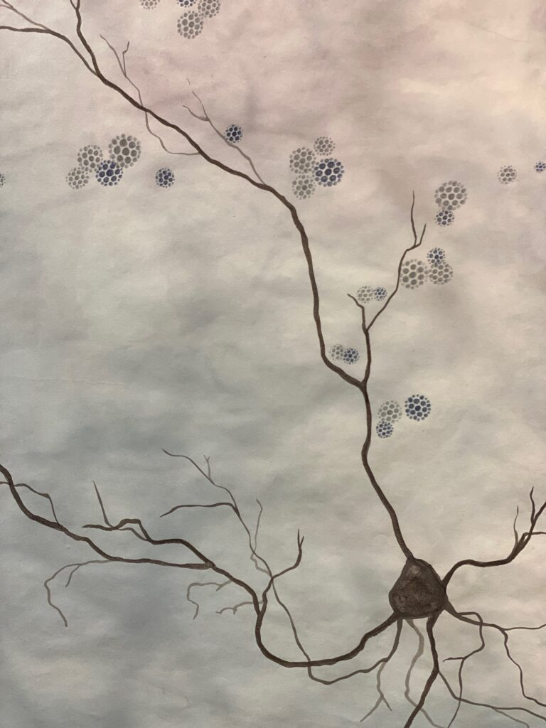
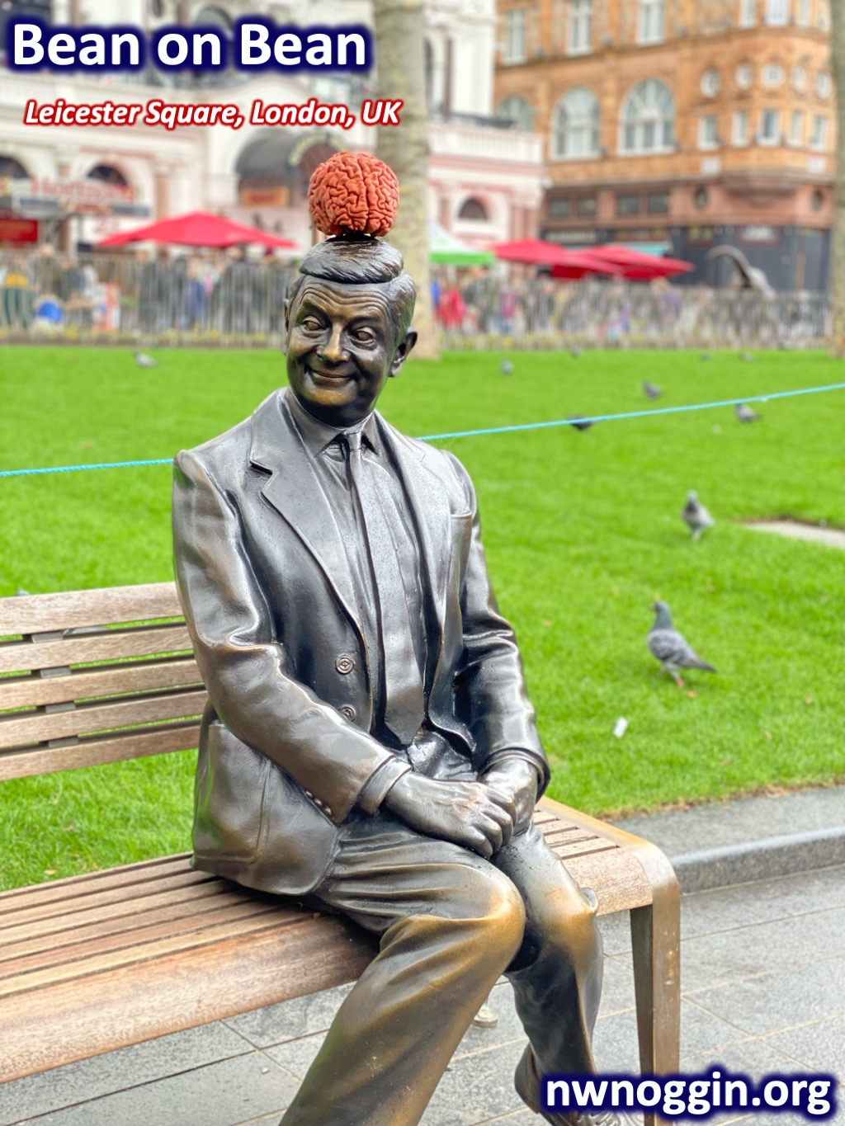

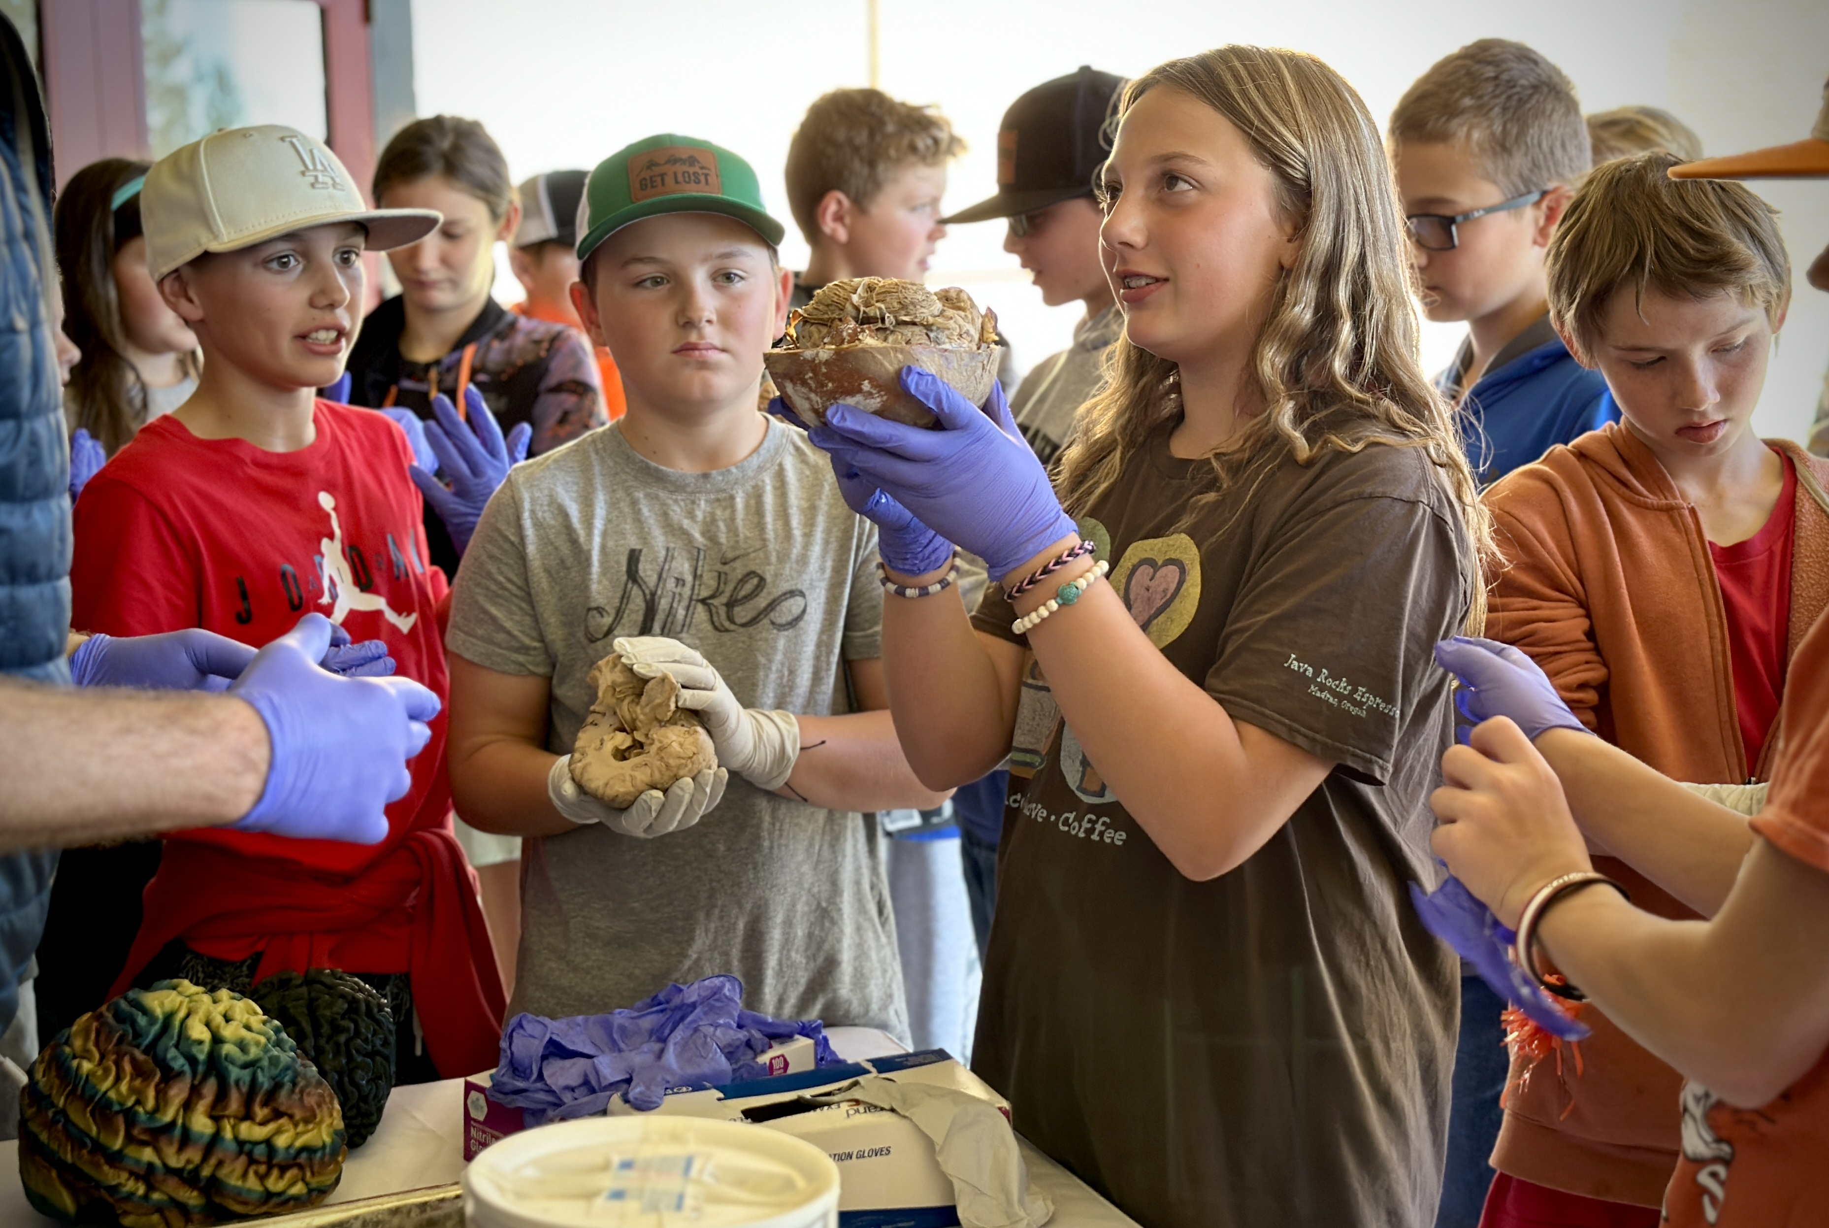
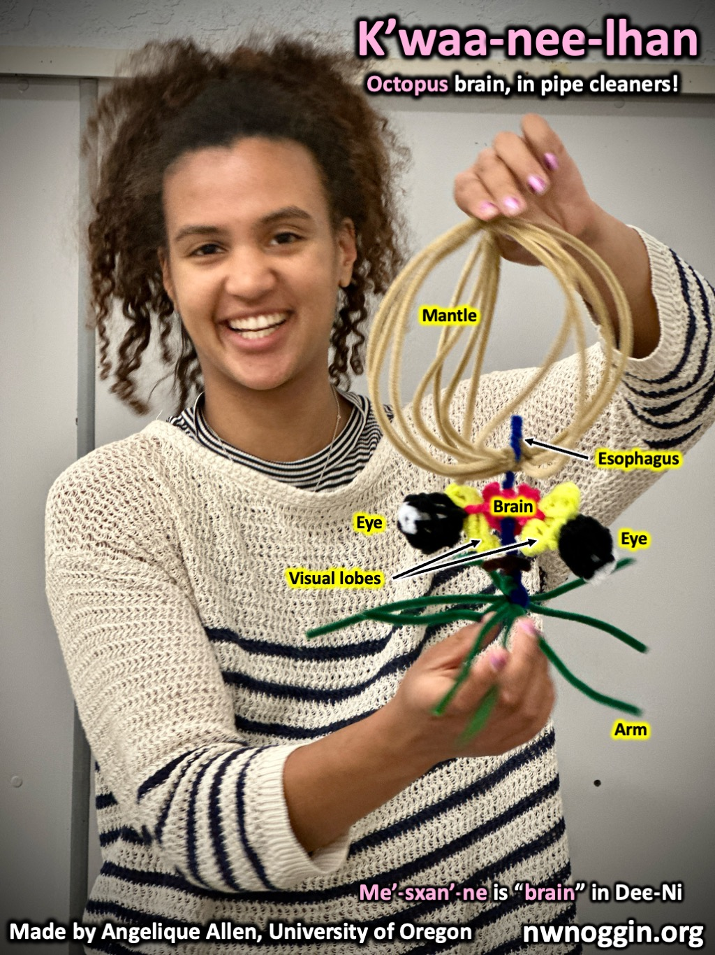
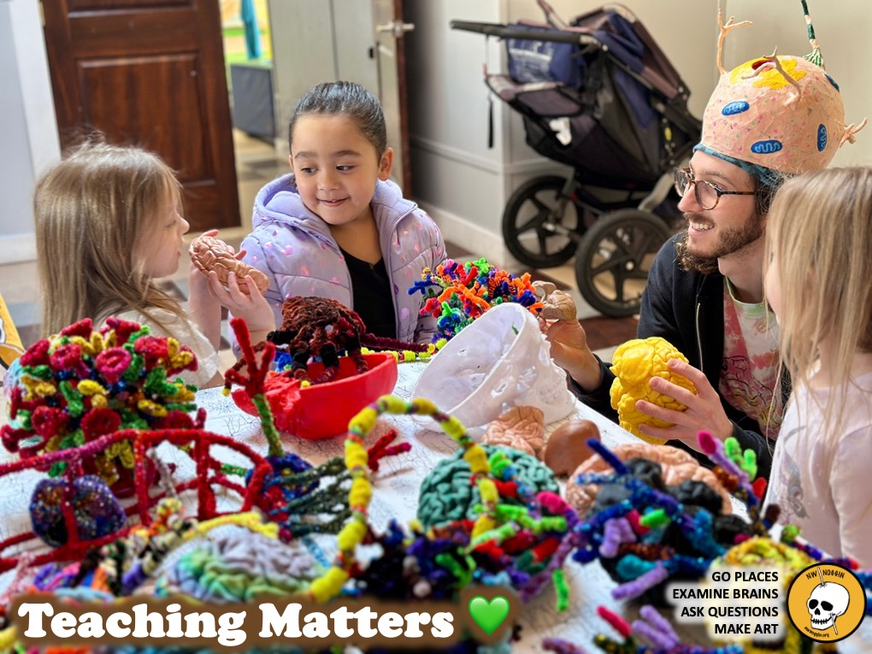
Northwest
Noggin
Café Scientifique,
Sidmouth, Devon UK, June 2025
ENGAGING BRAINS!

Slide 2
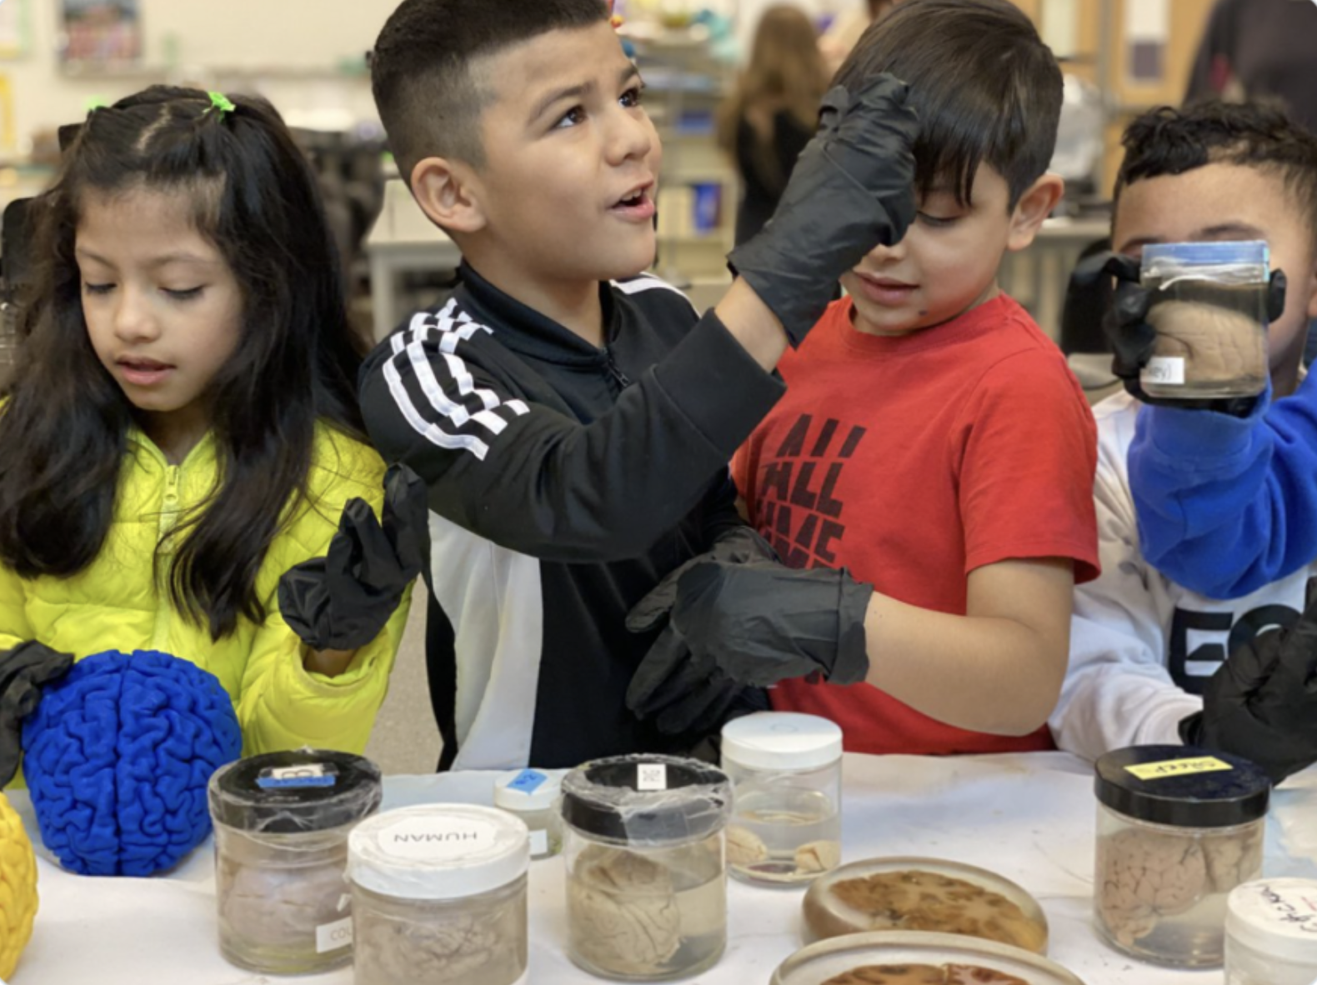
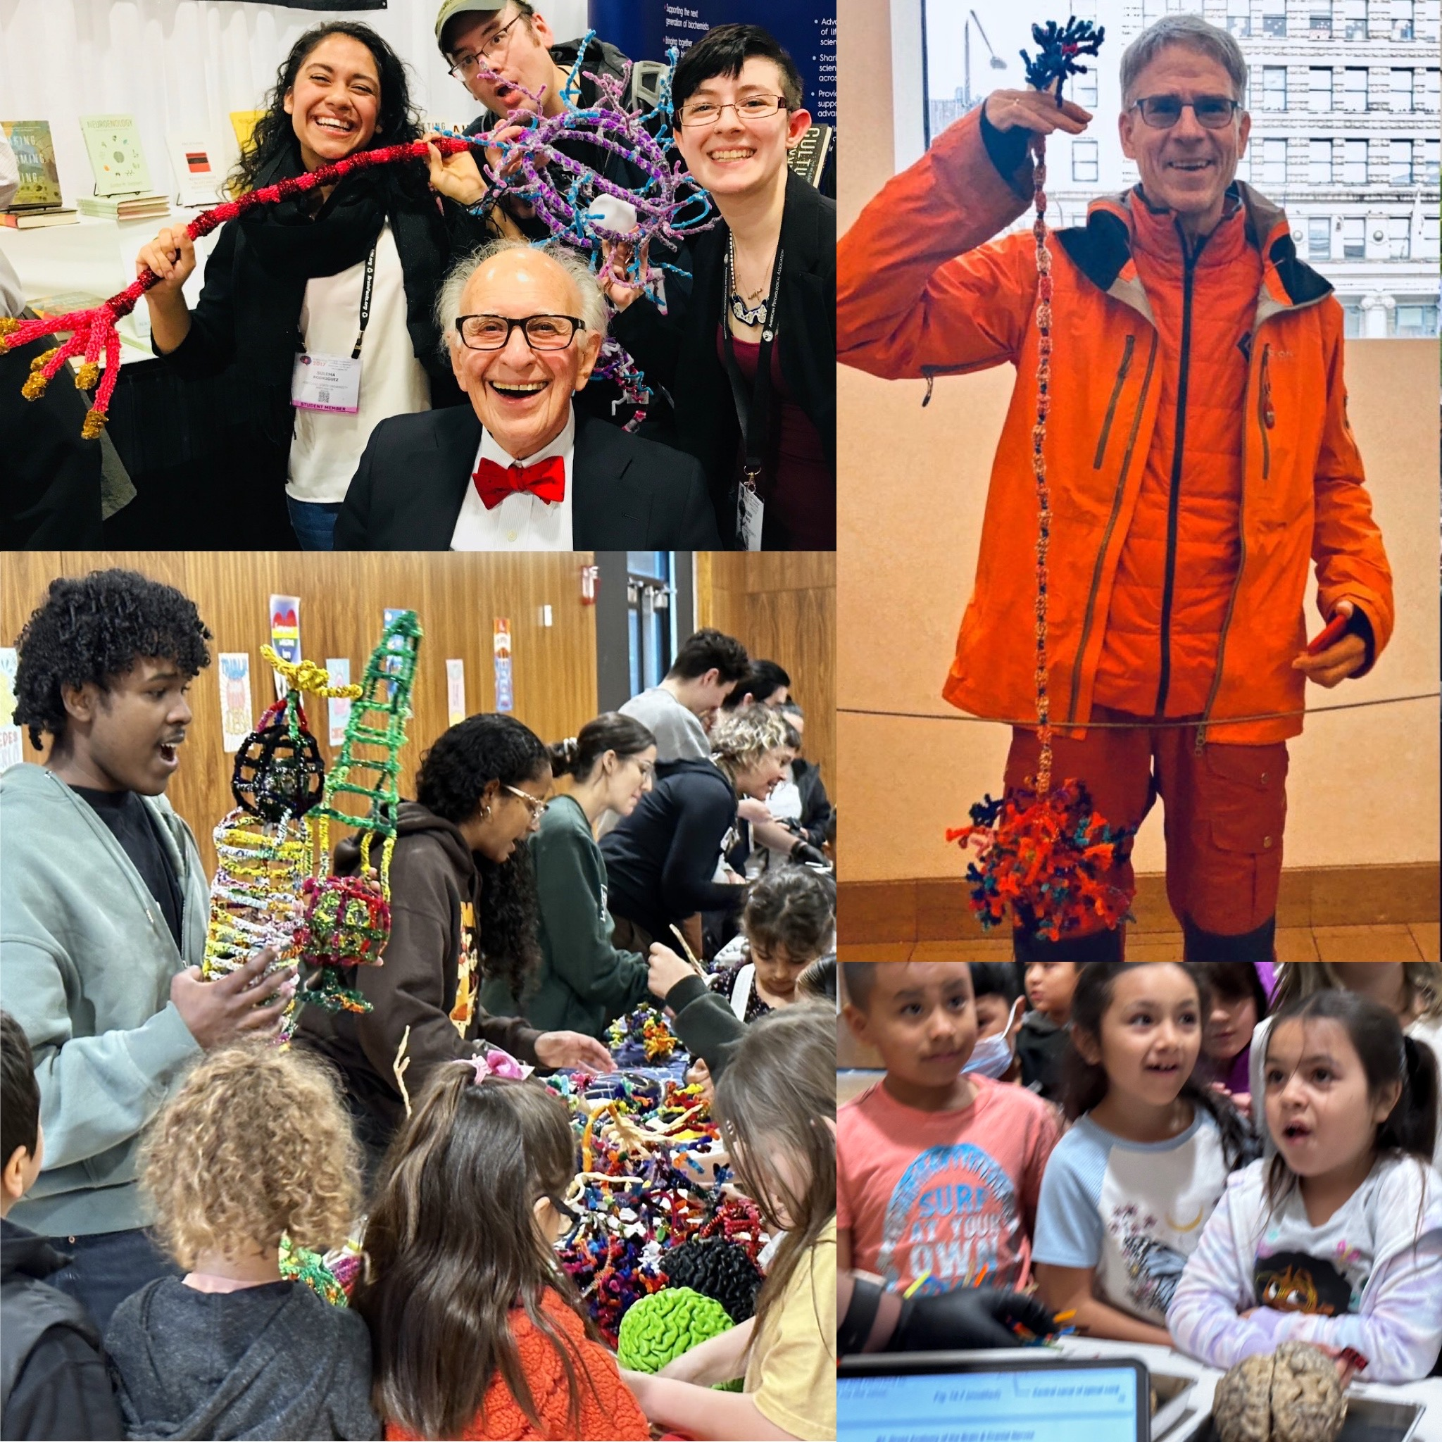
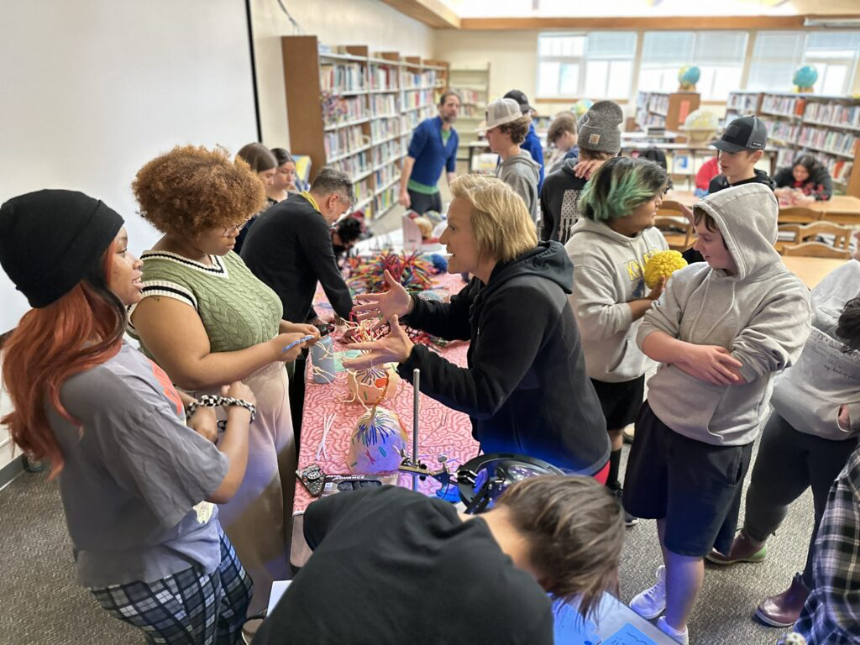
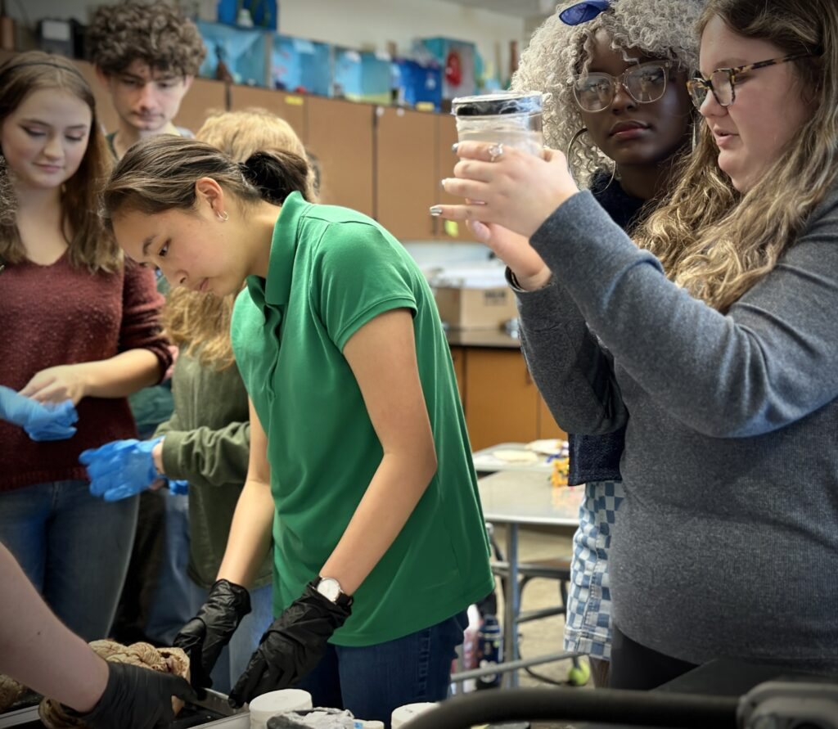
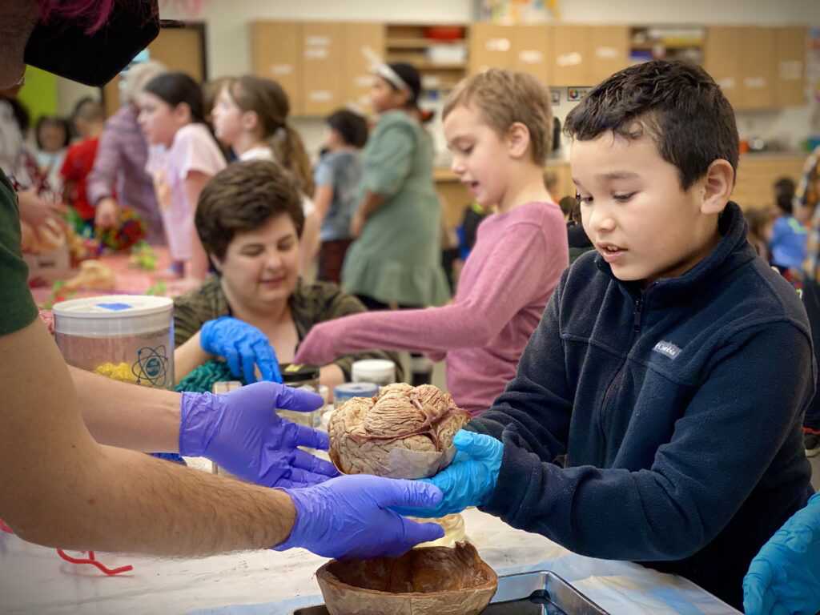
ALL VOLUNTEER
THIRTEEN years (SINCE 2012)!
NO ADMISSION - NO TUITION - open to everyone
75,000+ PUBLIC* K-12 students/community members
local/national/international collaborators
* US public: free, underfunded schools

Slide 3
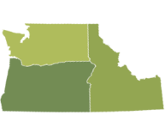
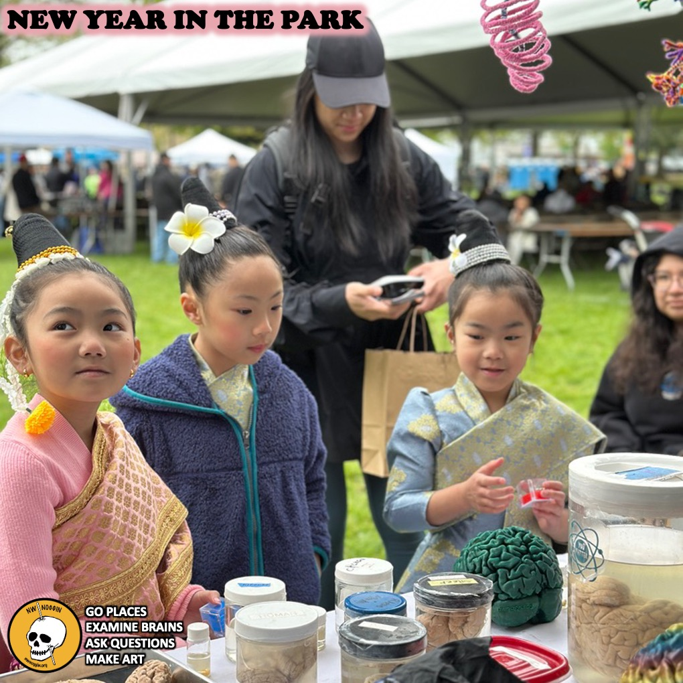
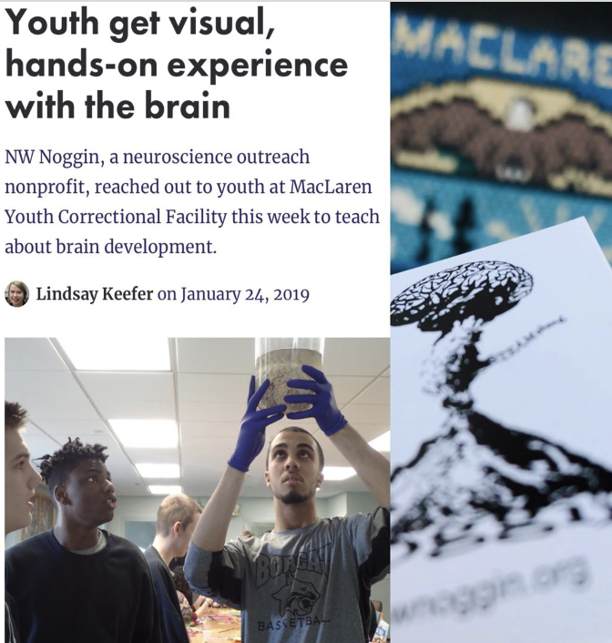
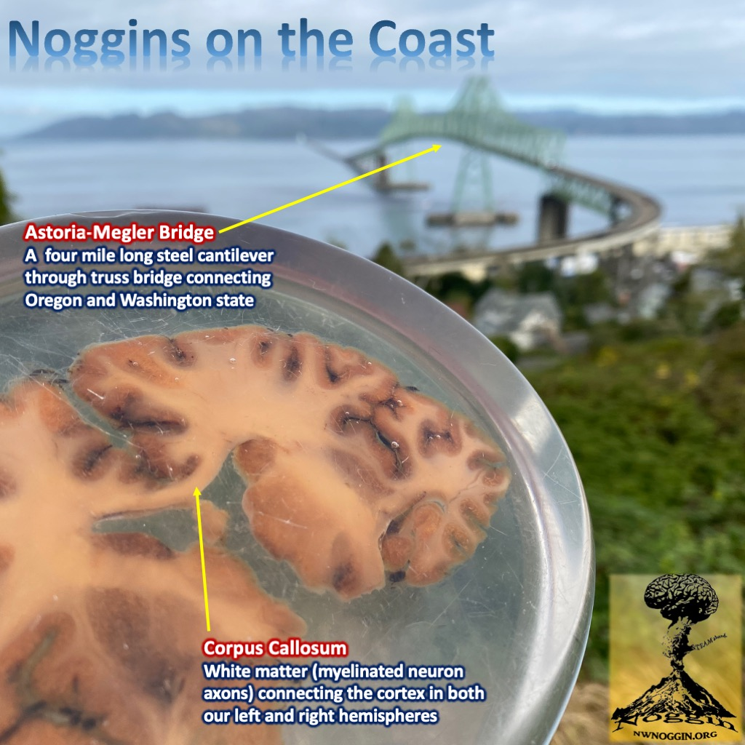
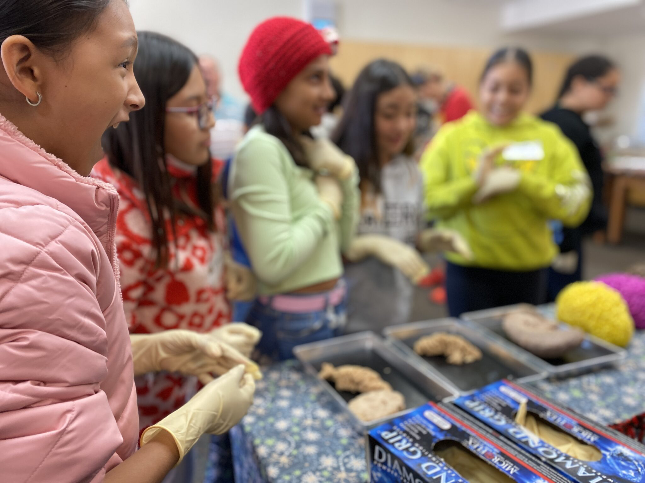
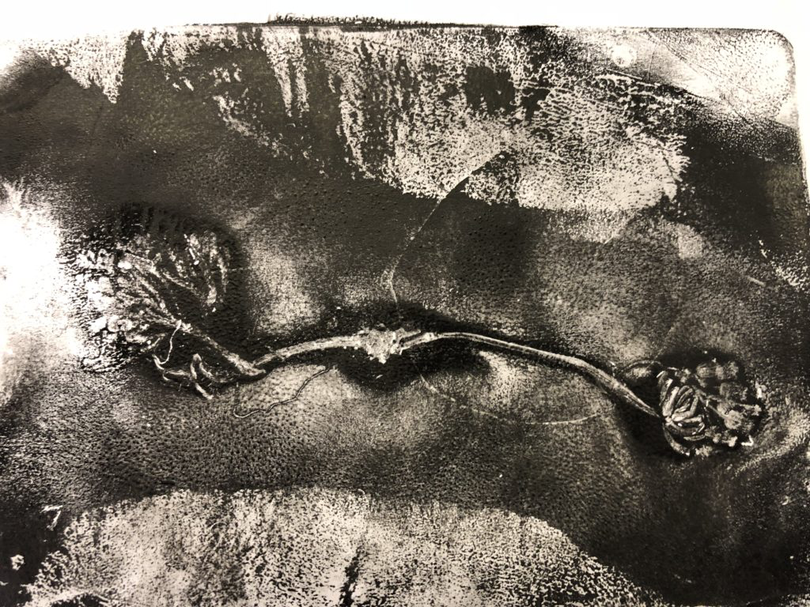
Siletz, Amity & Willamina, OR
Pop: 4000
Davenport, WA
Pop: 1700
GO PLACES
Astoria, OR
Pop: 10,000
A few places
we’ve been
-where STEM programs DON’T GO
-where money and resources don’t go
-K-12 public schools (underfunded, FREE!)
-rural and Urban communities
-houseless youth nonprofits
-correctional facilities
La Grande, OR
Pop: 13,000
Meservy Meadows, OR Pop: ~40
Sisters, OR
Pop: 3081
Heppner & Ione, OR
Pop: 1240

Slide 4
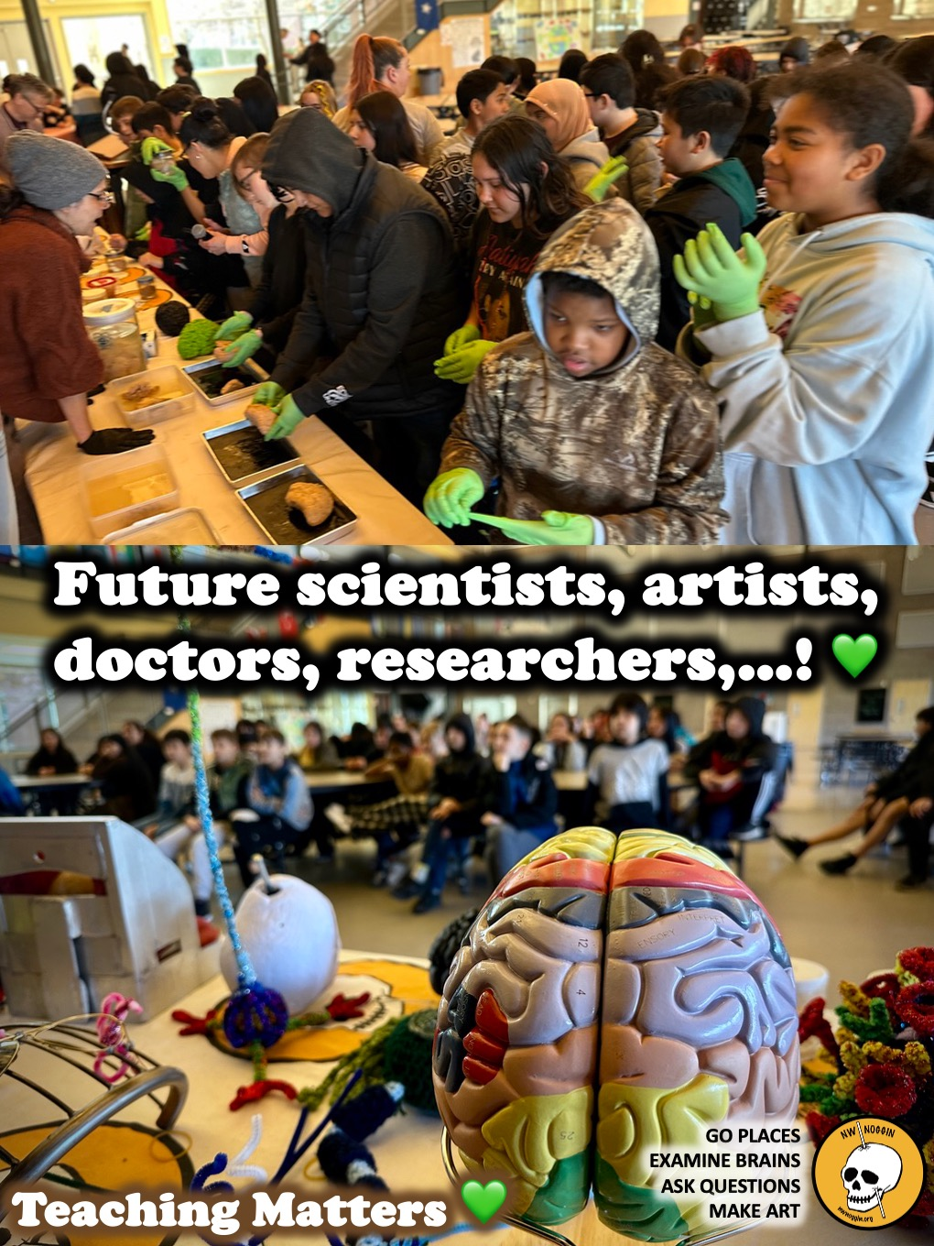
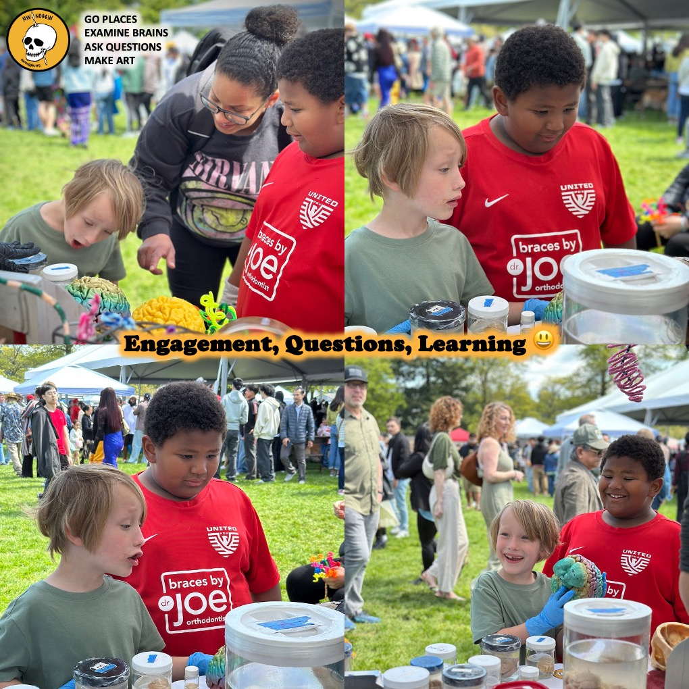

Slide 5
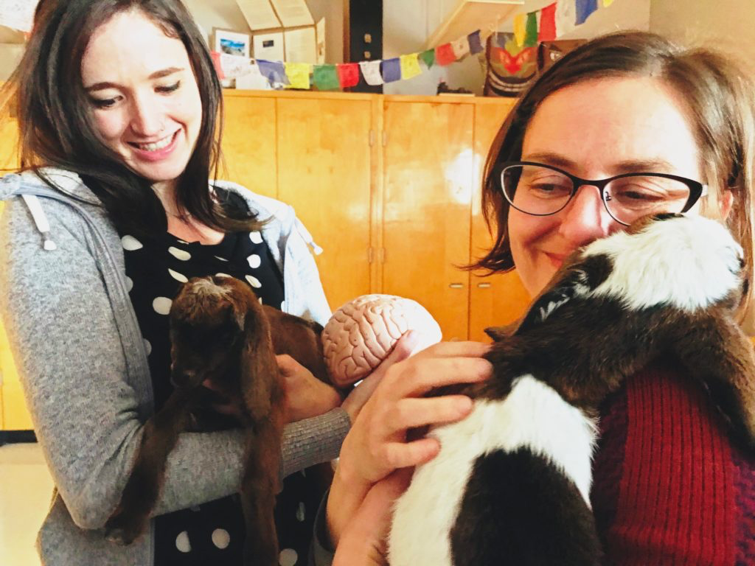
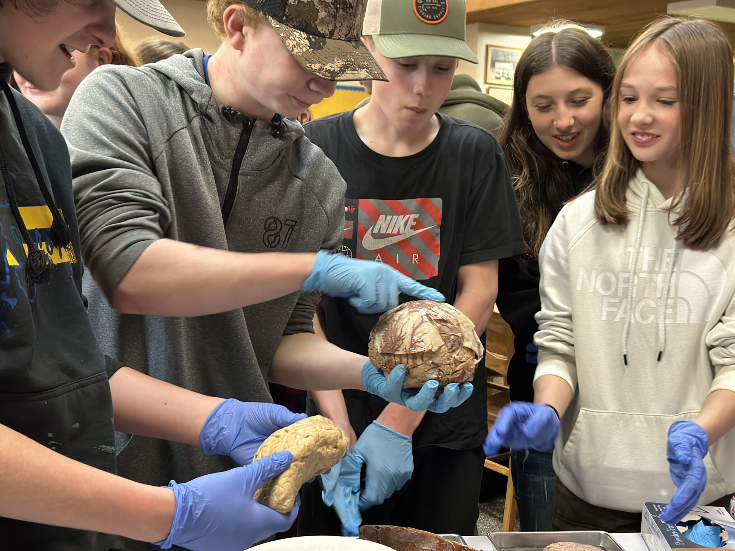
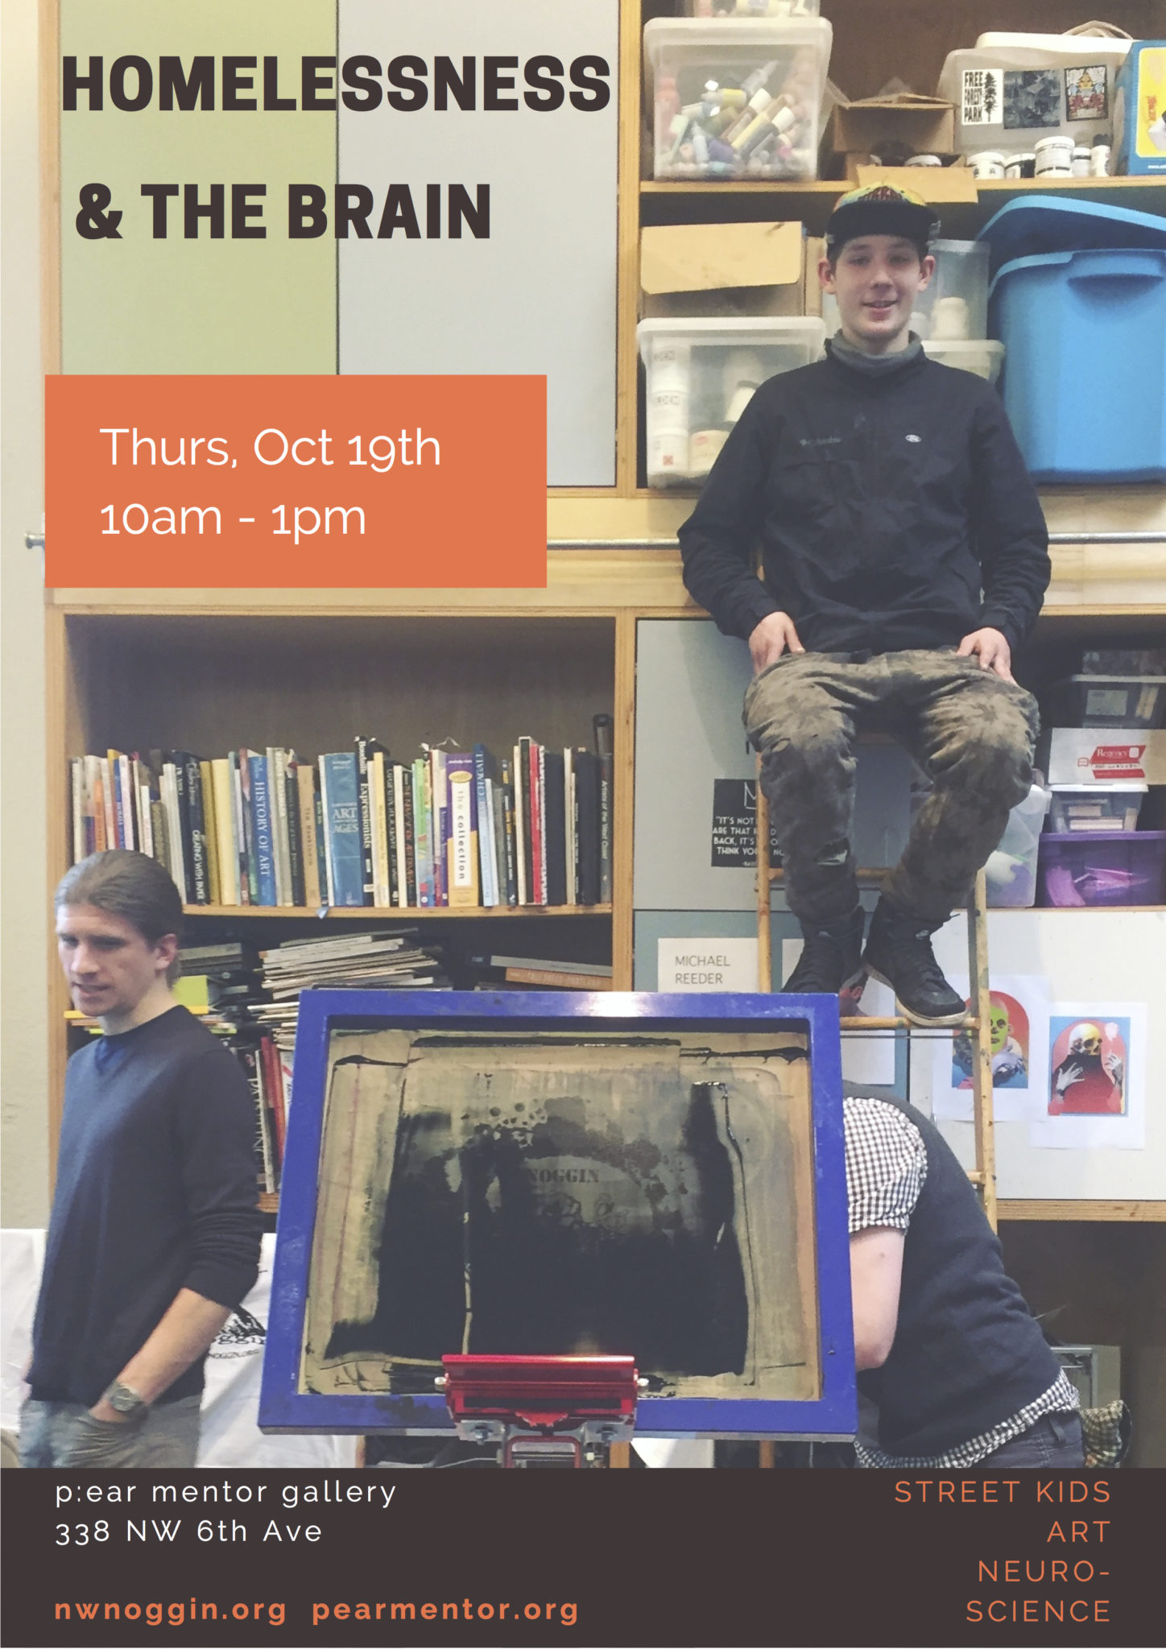
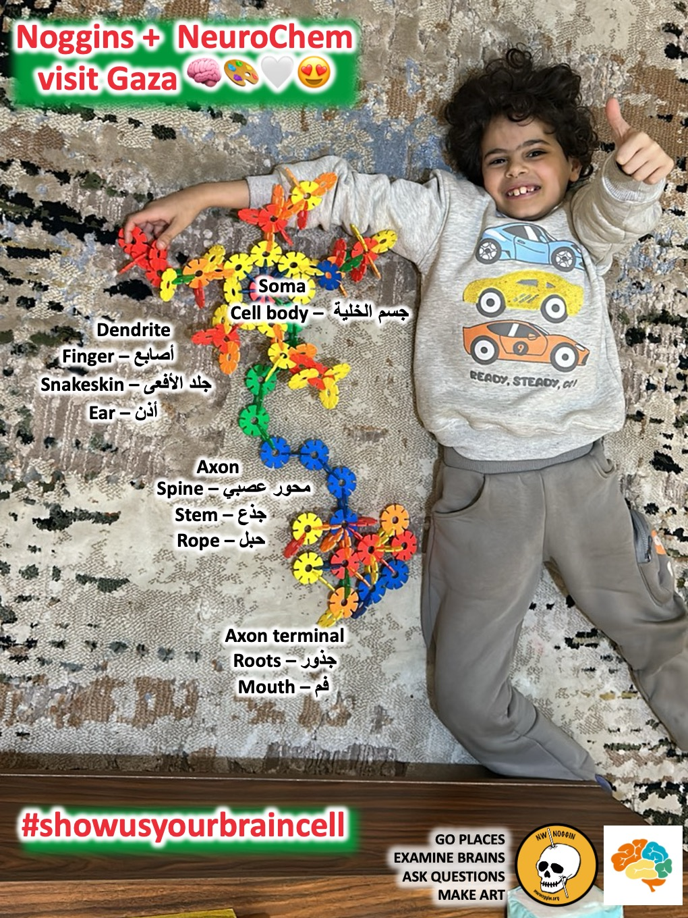
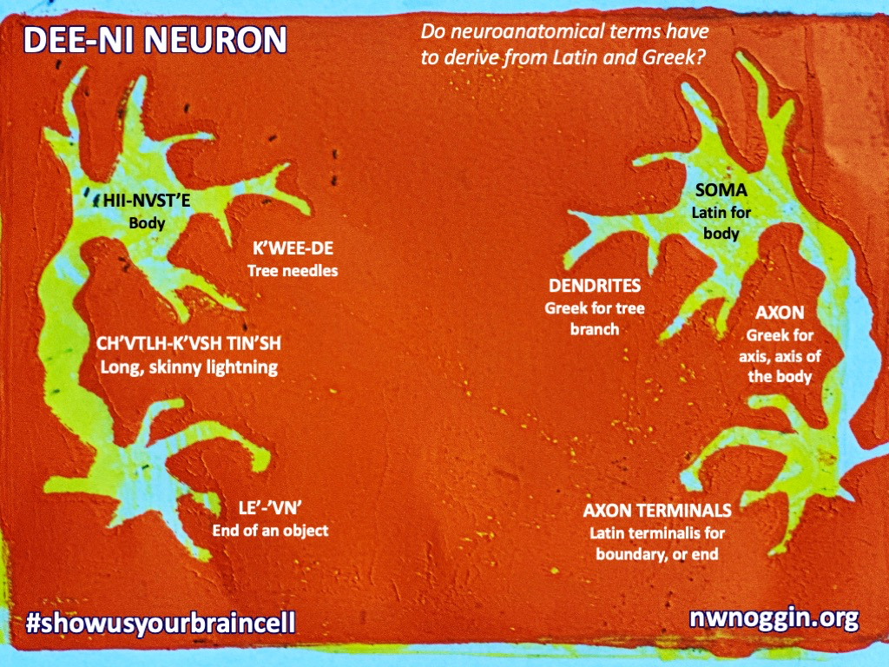
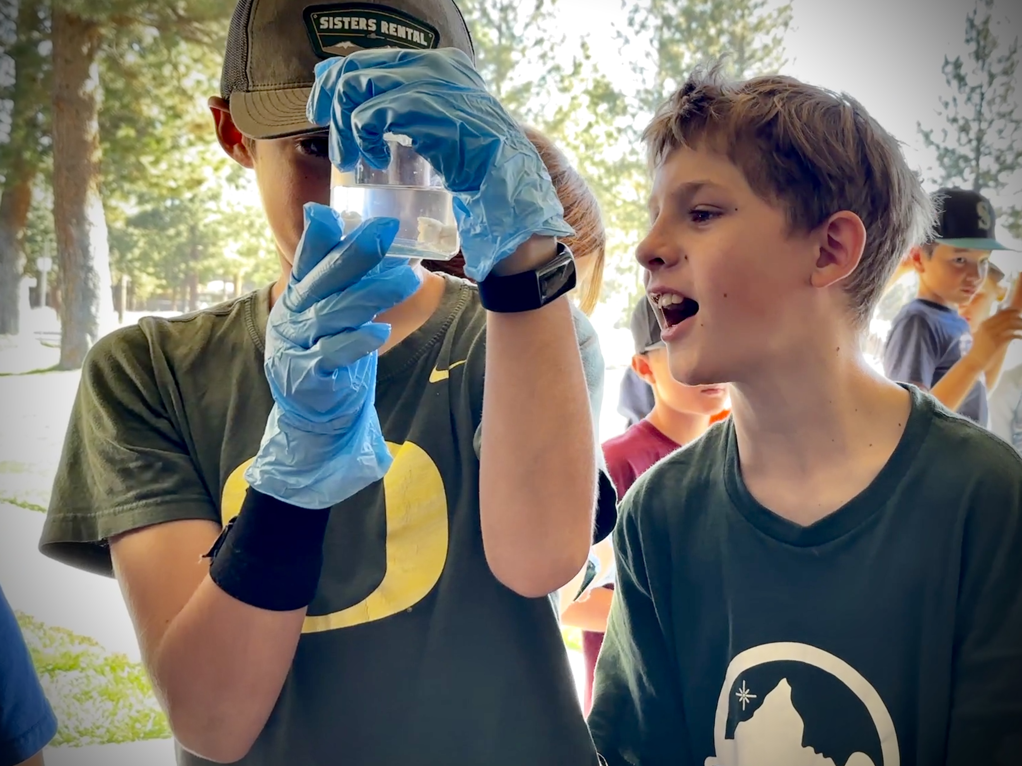
LISTEN
Heppner, OR
-lived experiences
-relevant knowledge
-seeing other people
Knappa, OR
Sisters, OR
Siletz, OR
Portland, OR
Portland, OR

Slide 6
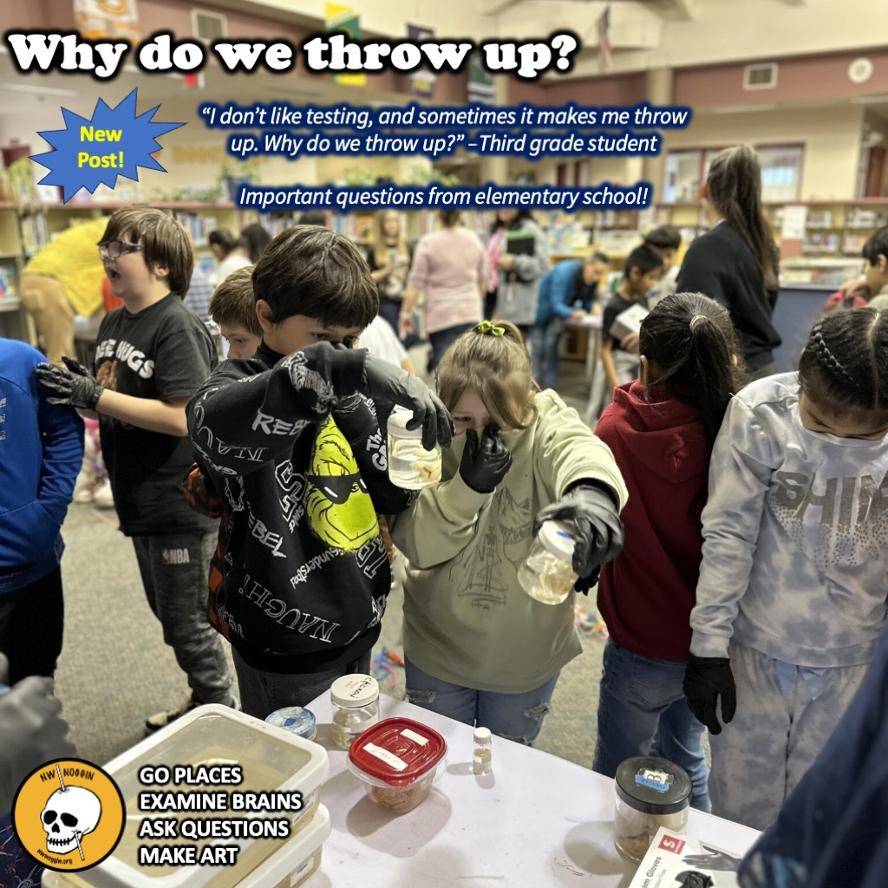
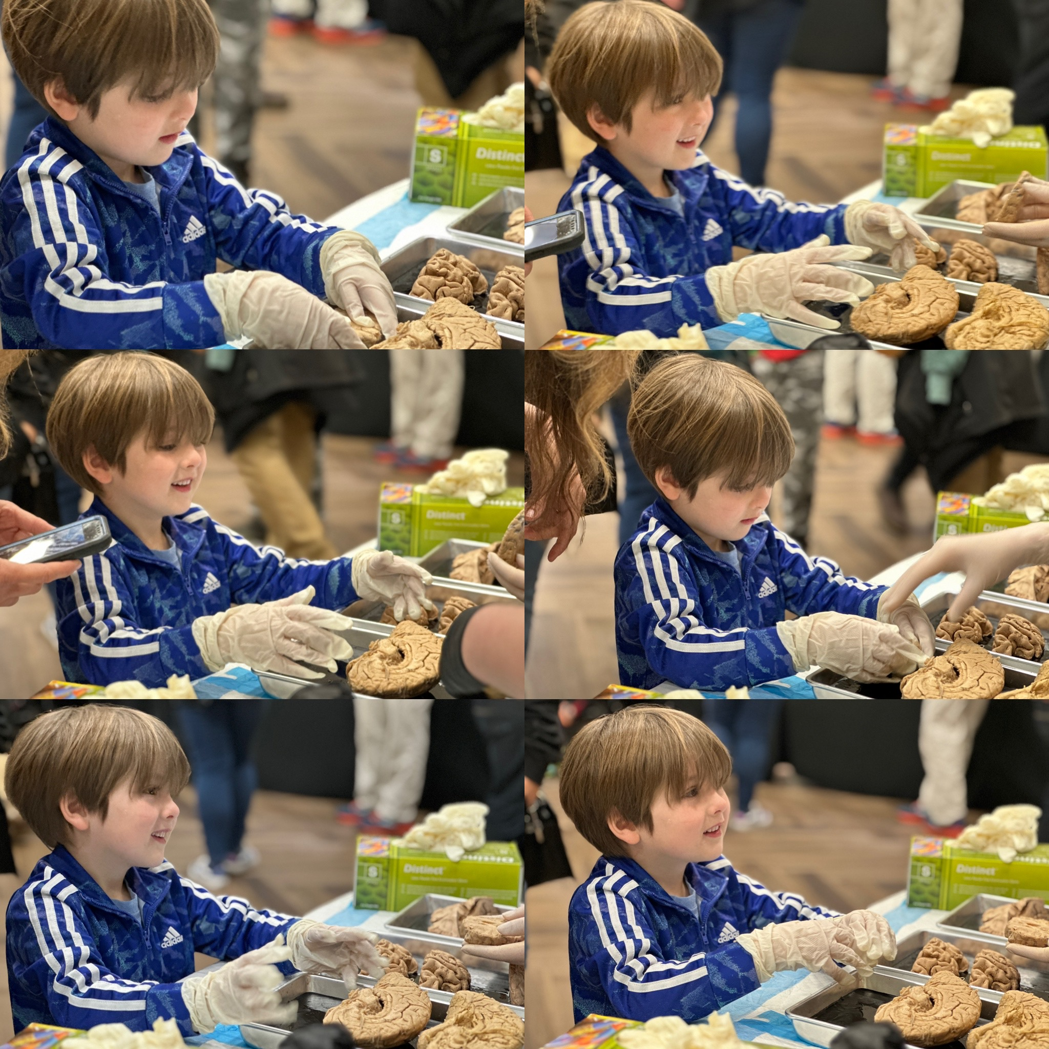
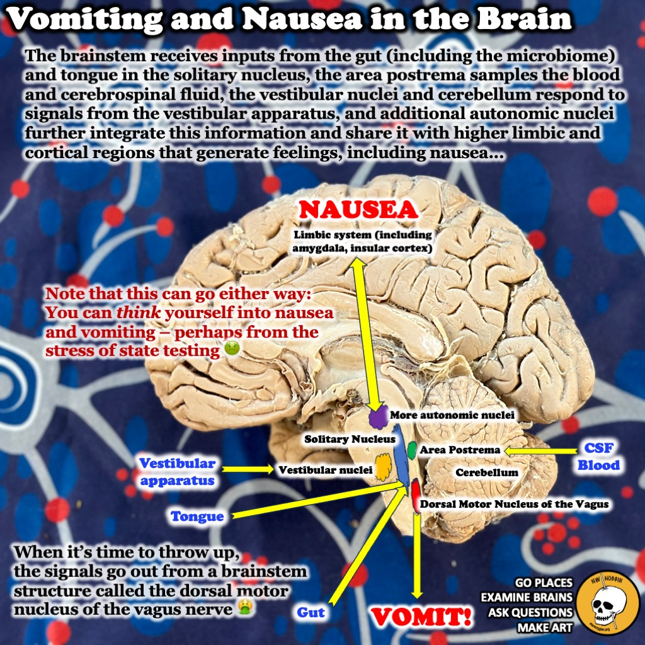

Slide 7
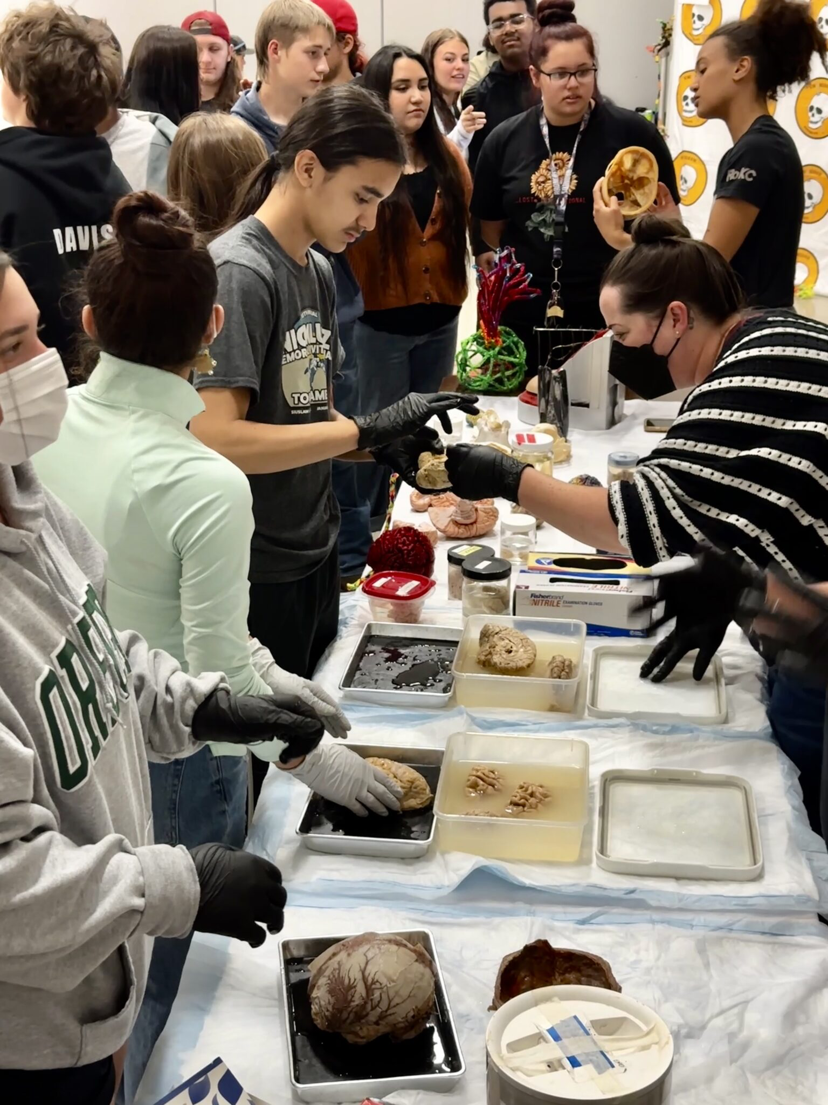
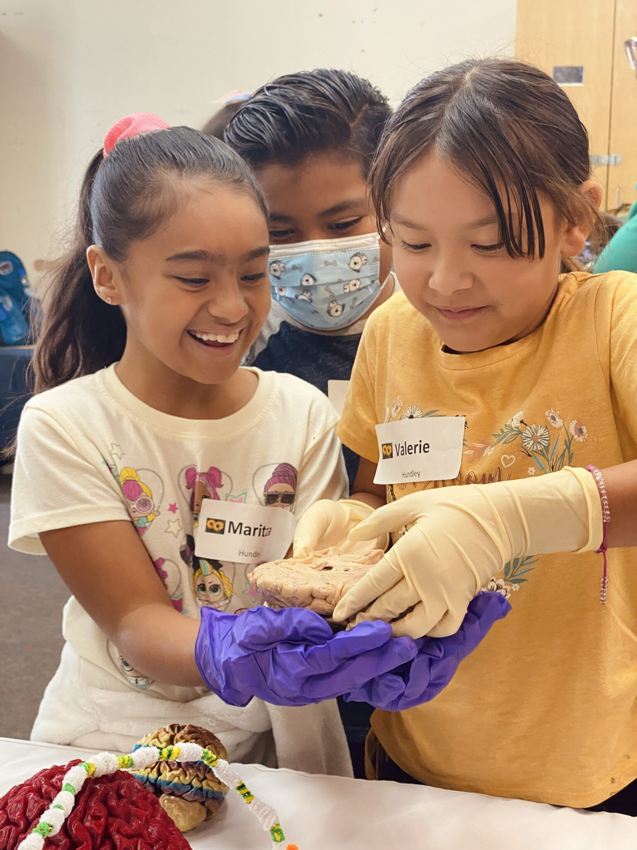
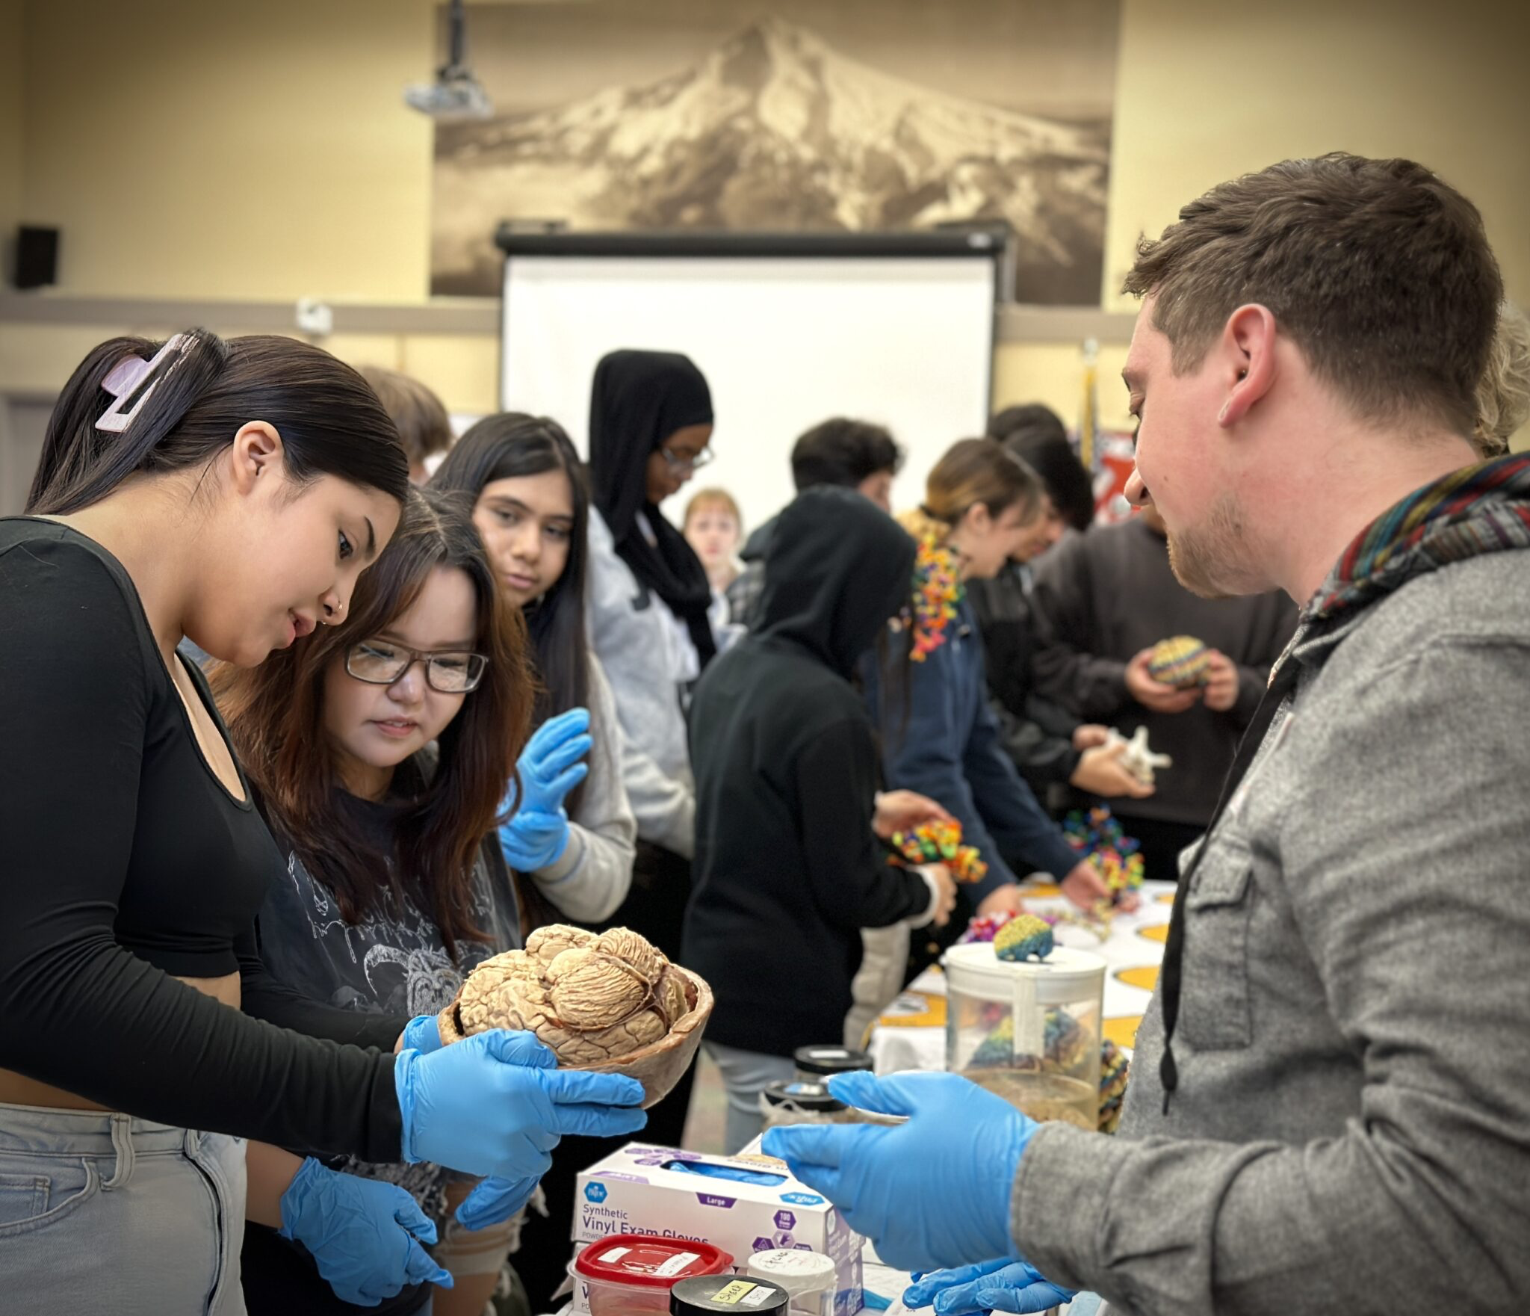
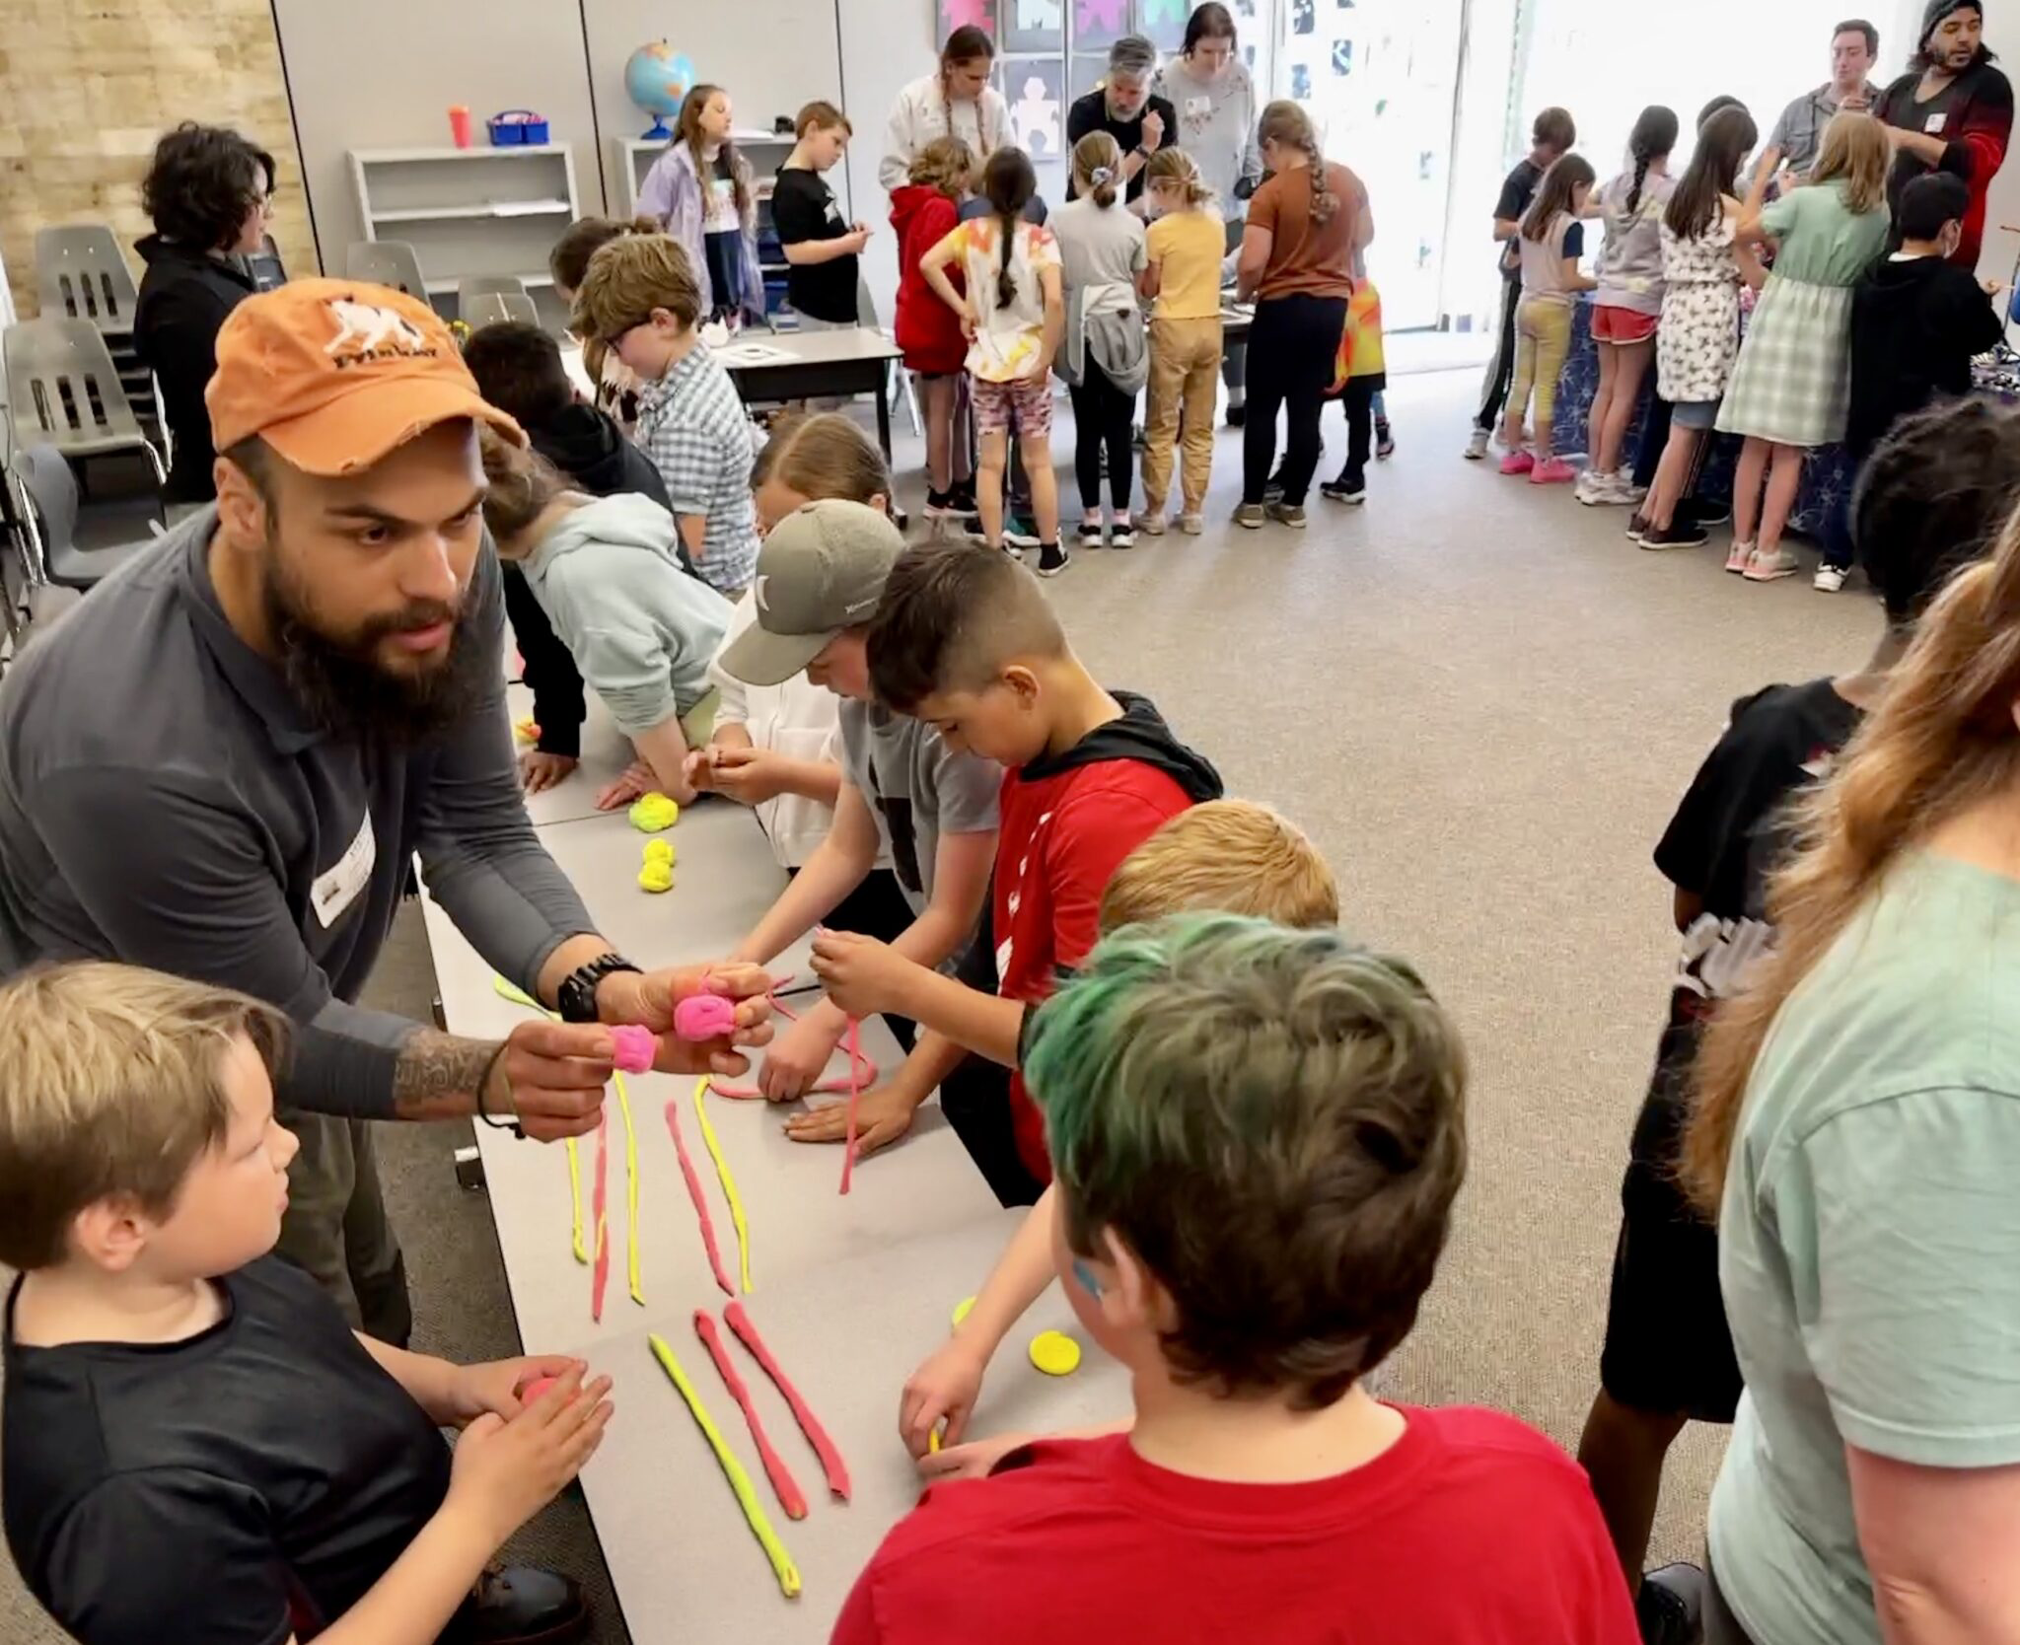
SHARE STORIES
-Empower new voices
-Broaden the conversation
-Make public investment in research relevant
-Invite new participants, perspectives & brains

Slide 8
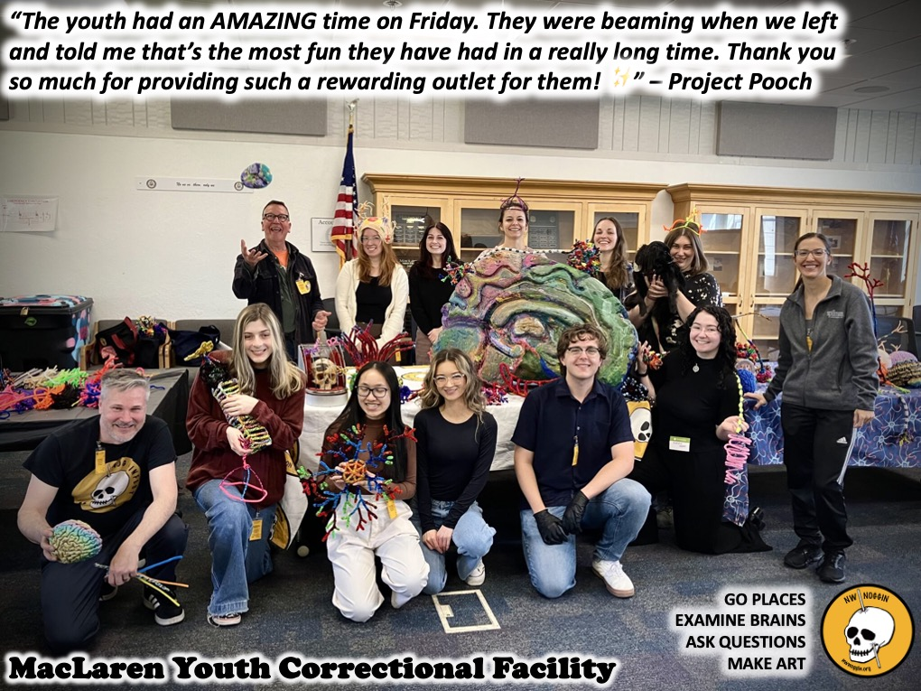
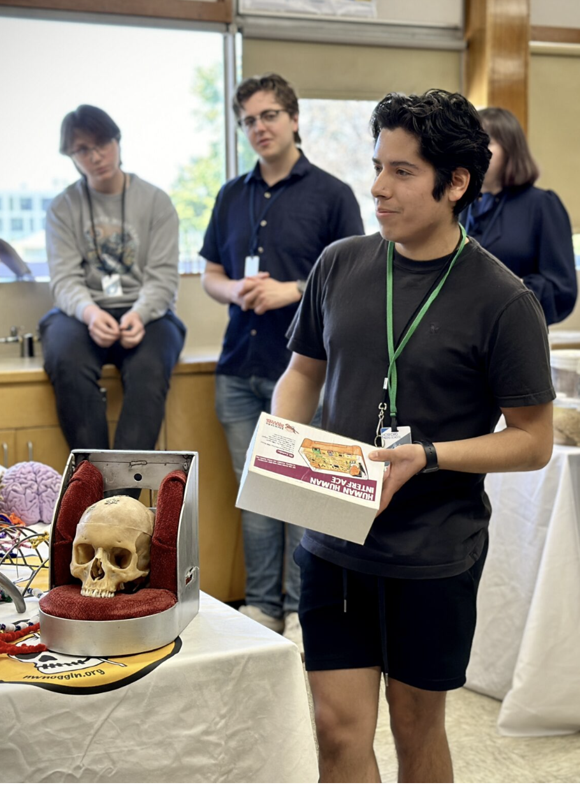
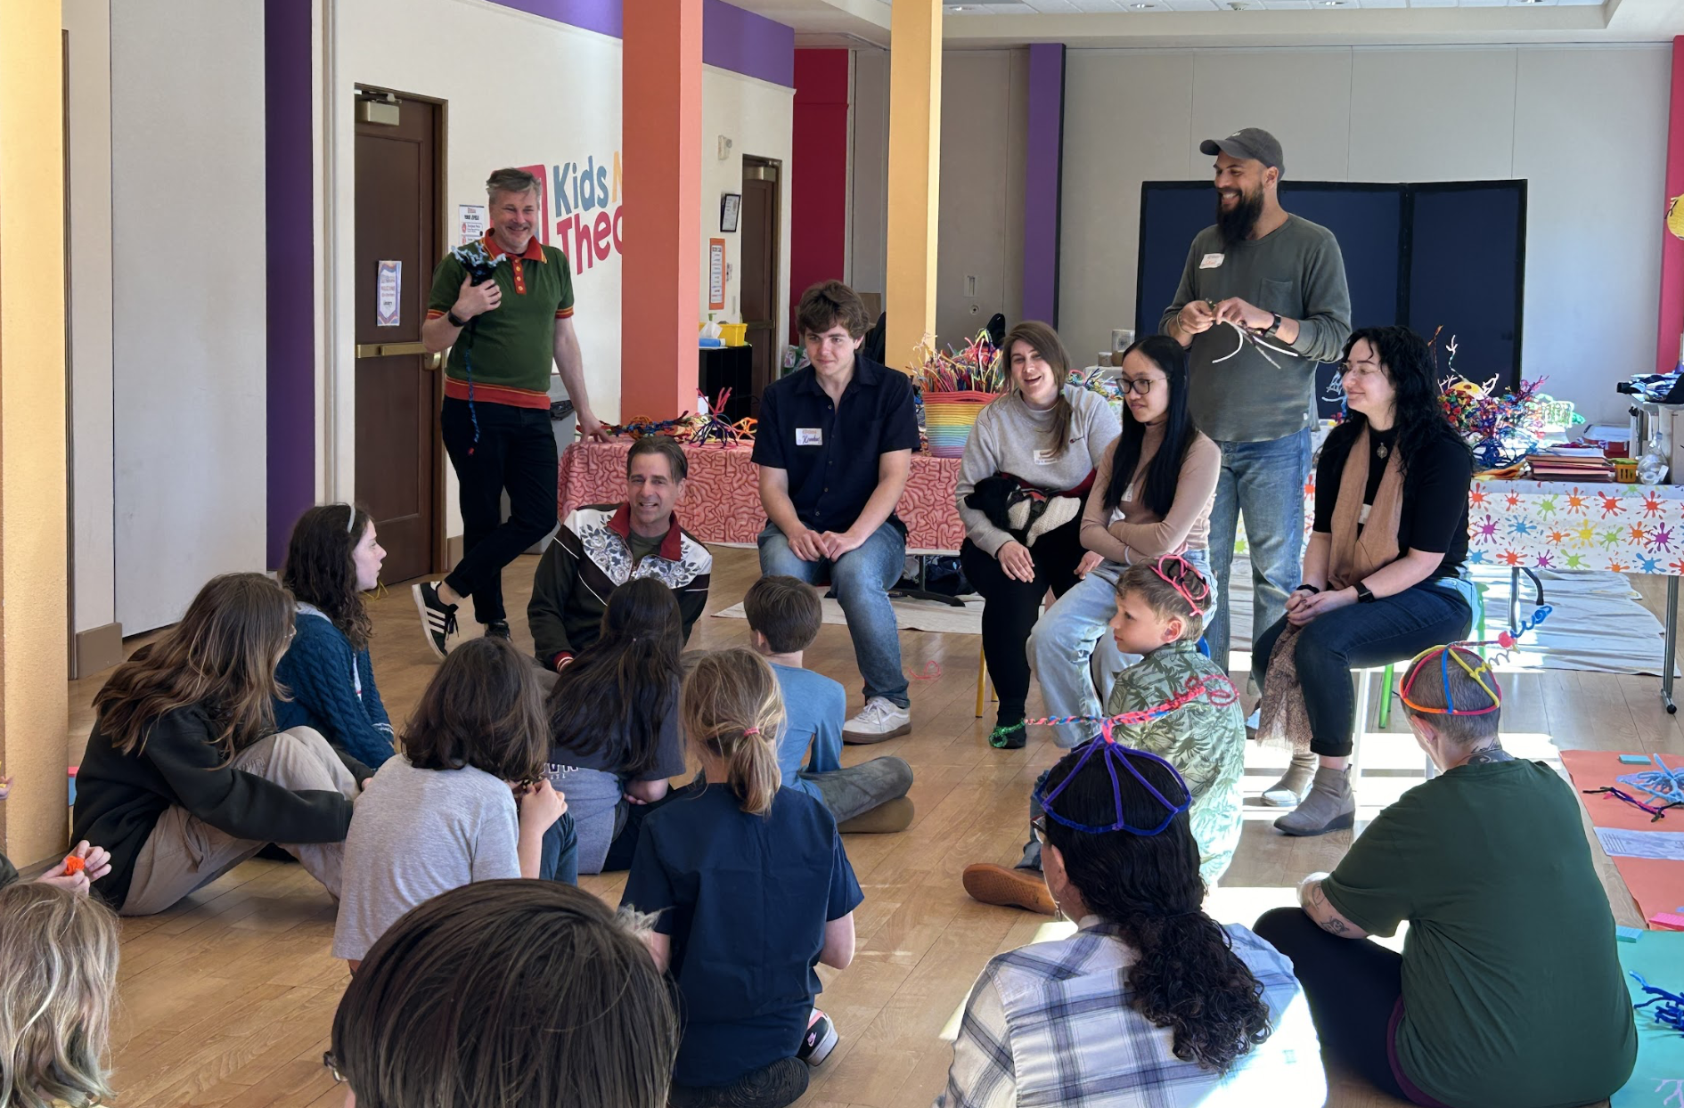
Portland, OR
Astoria, OR

Slide 9
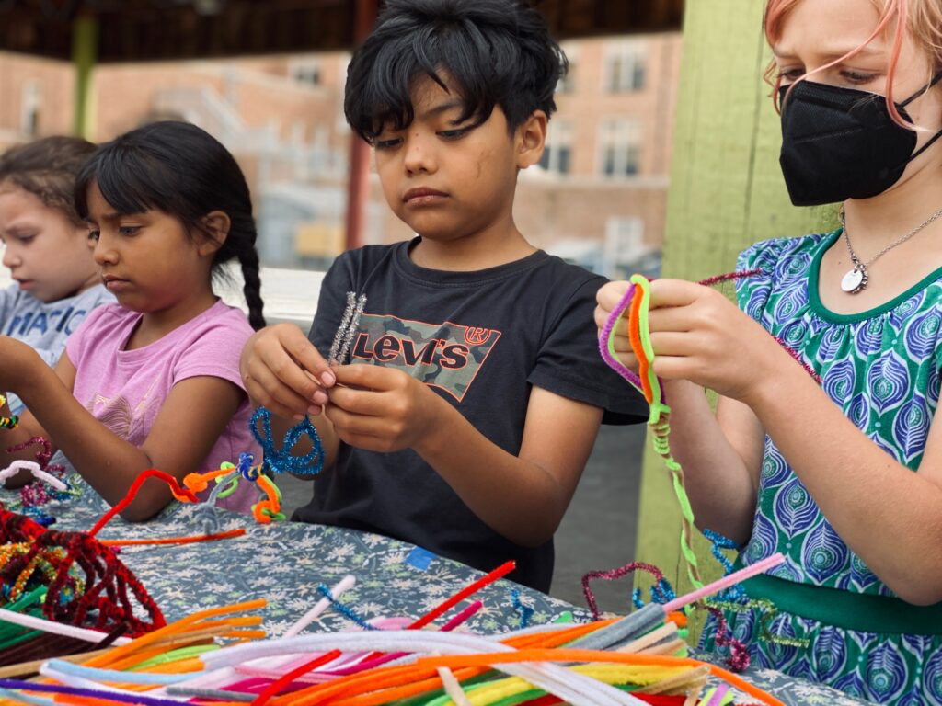
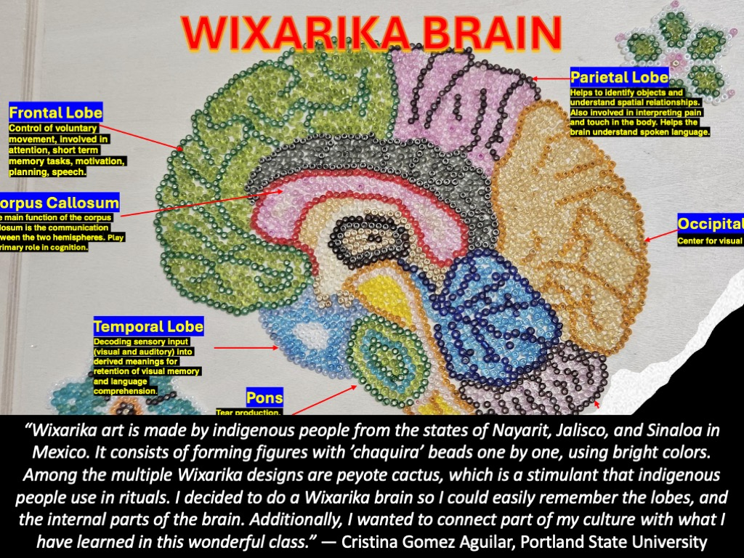
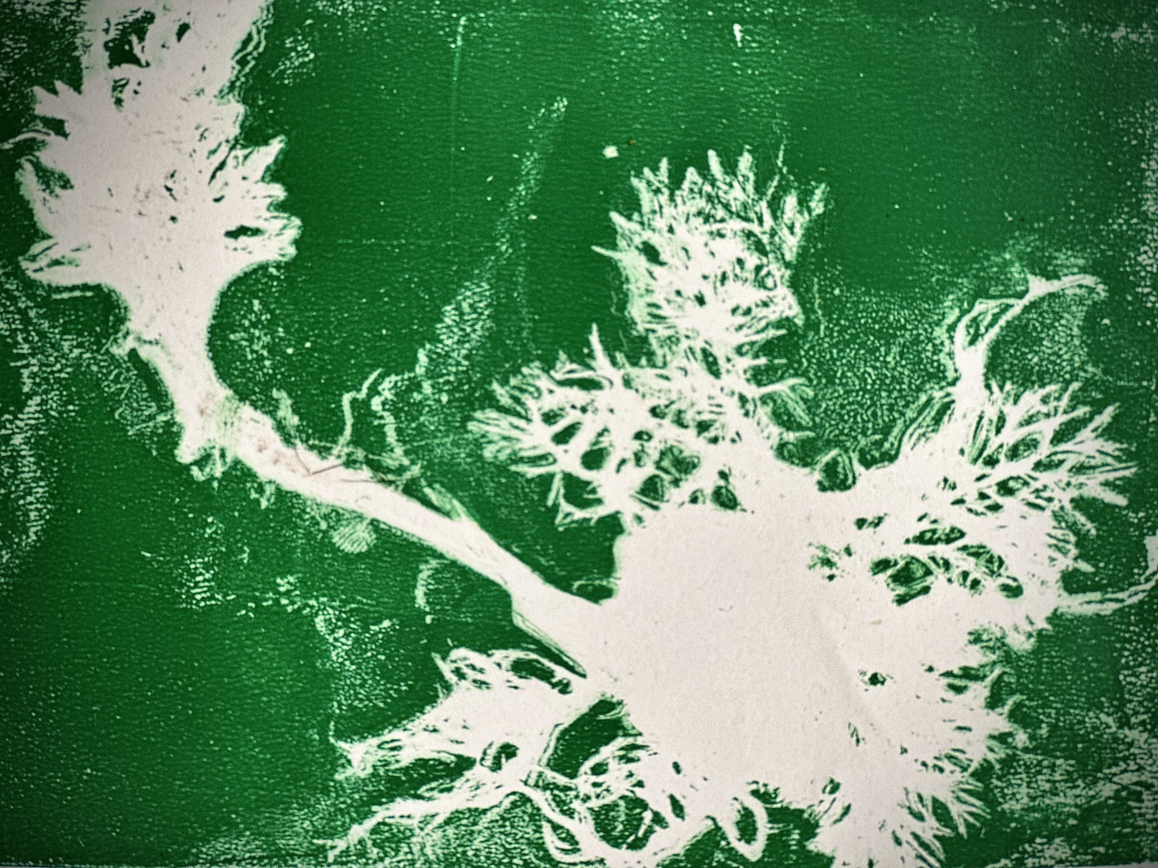
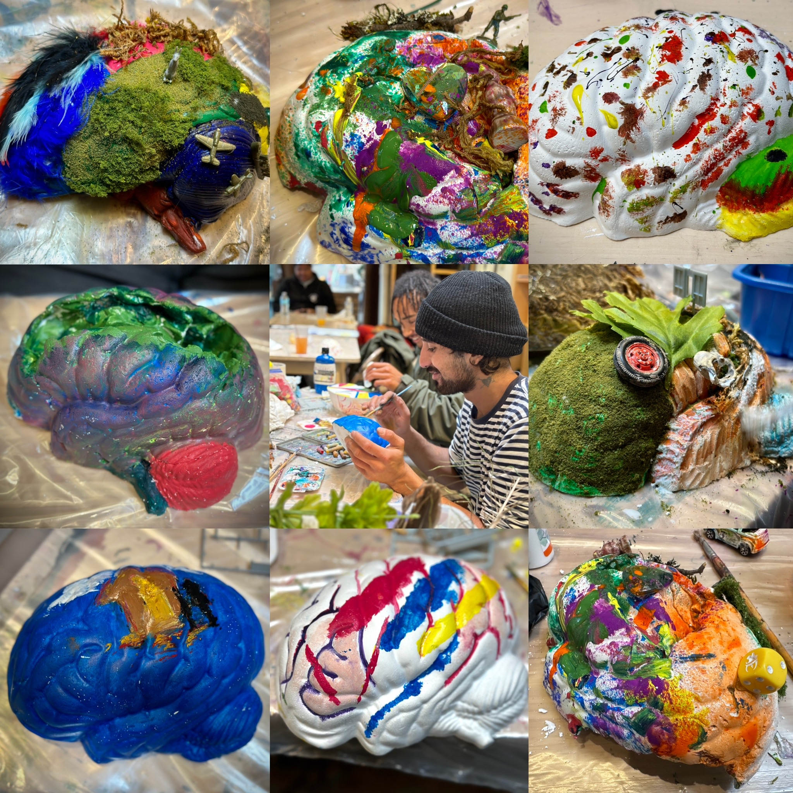
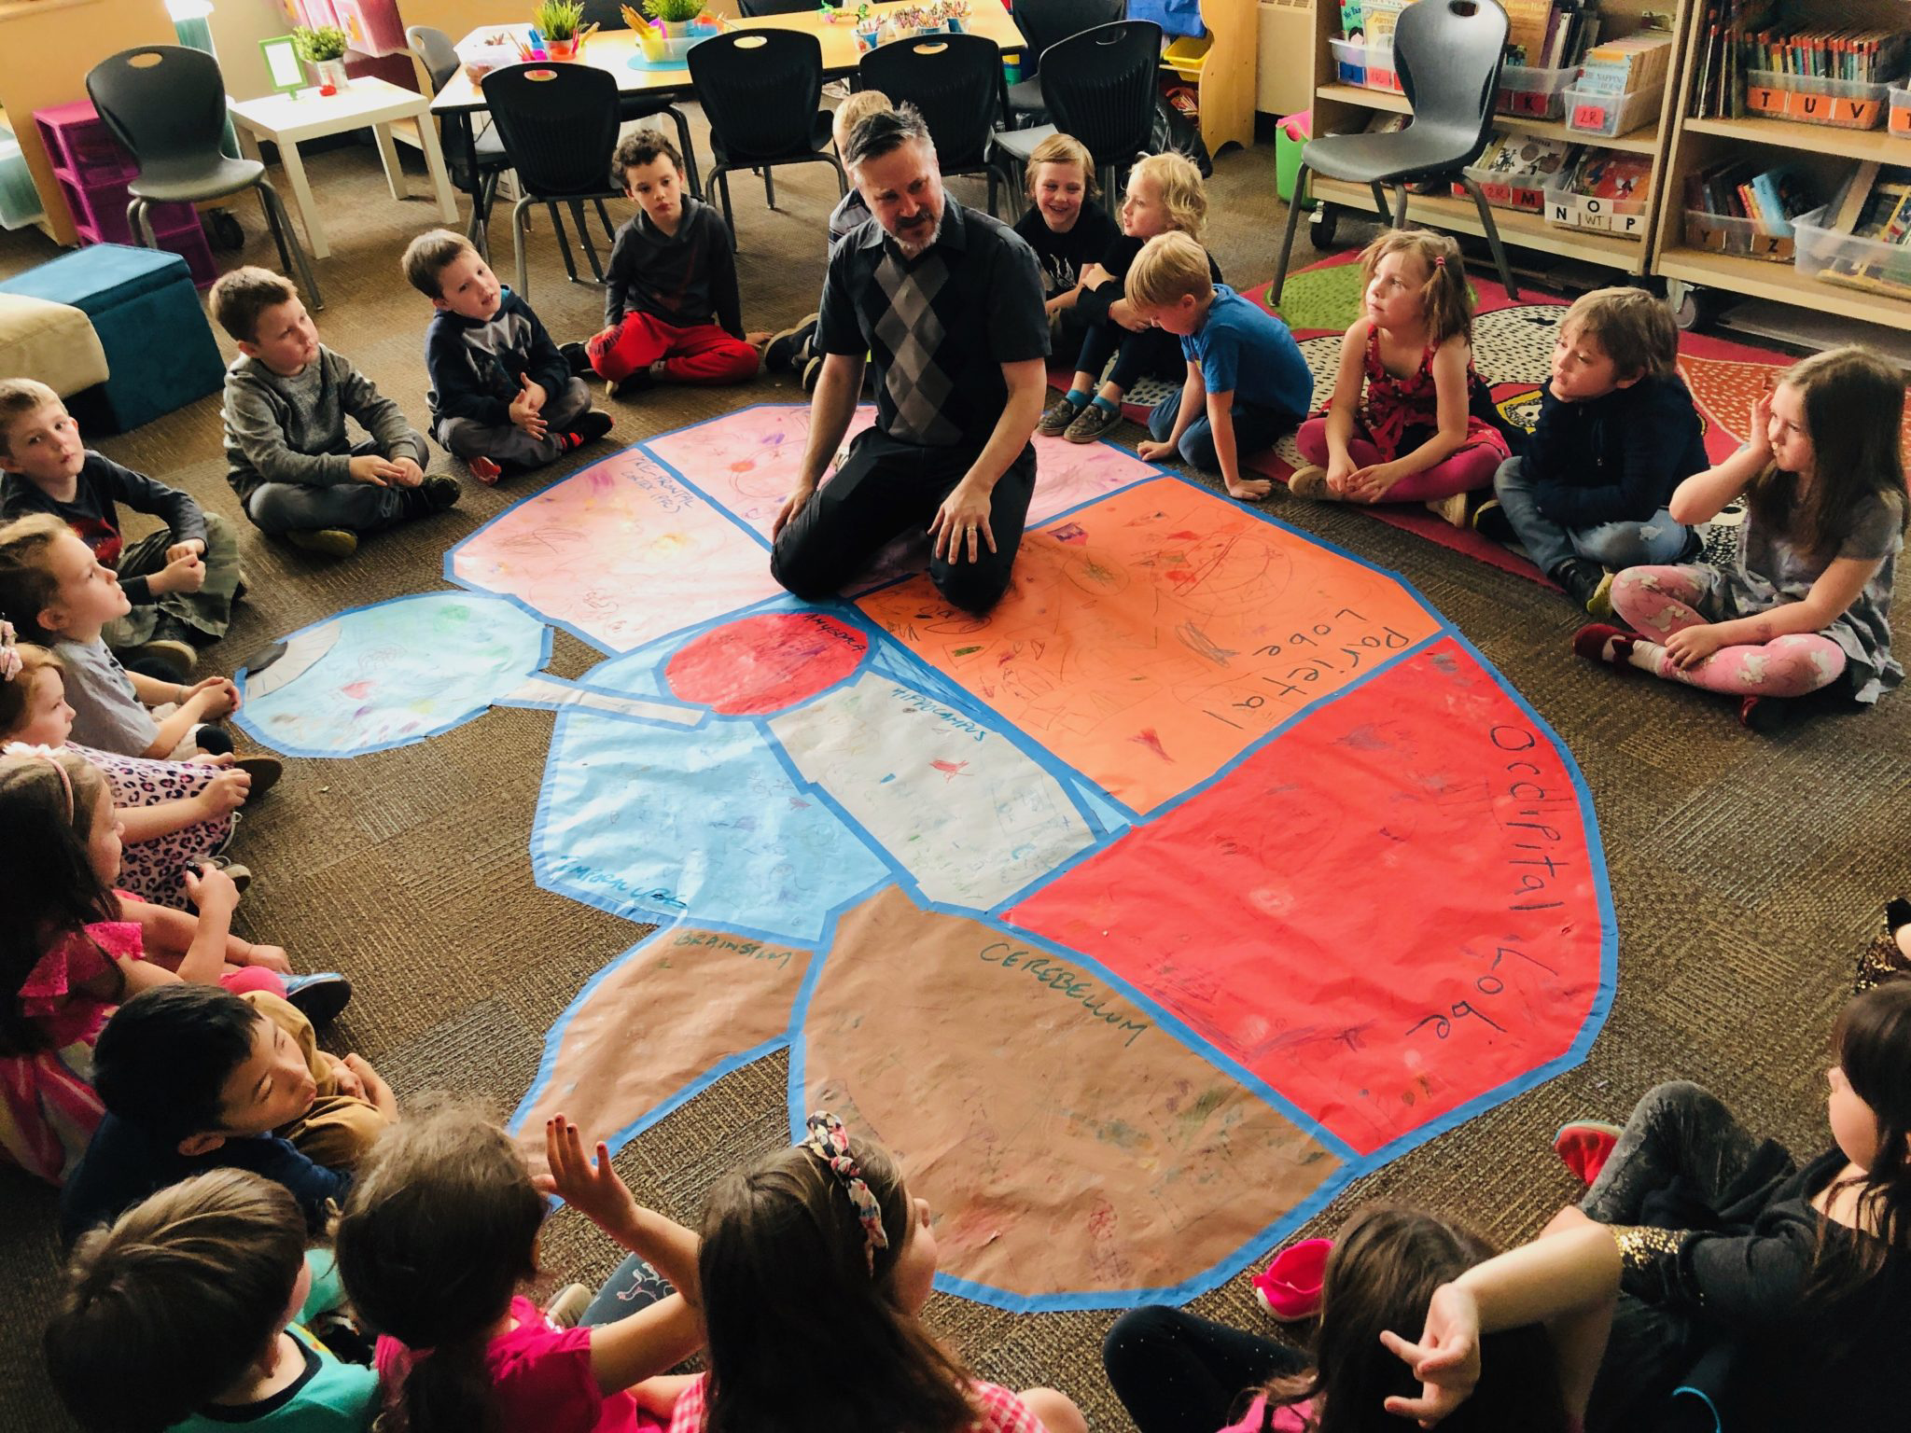
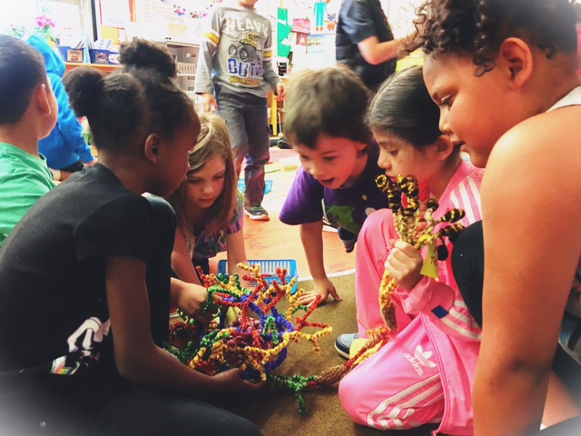
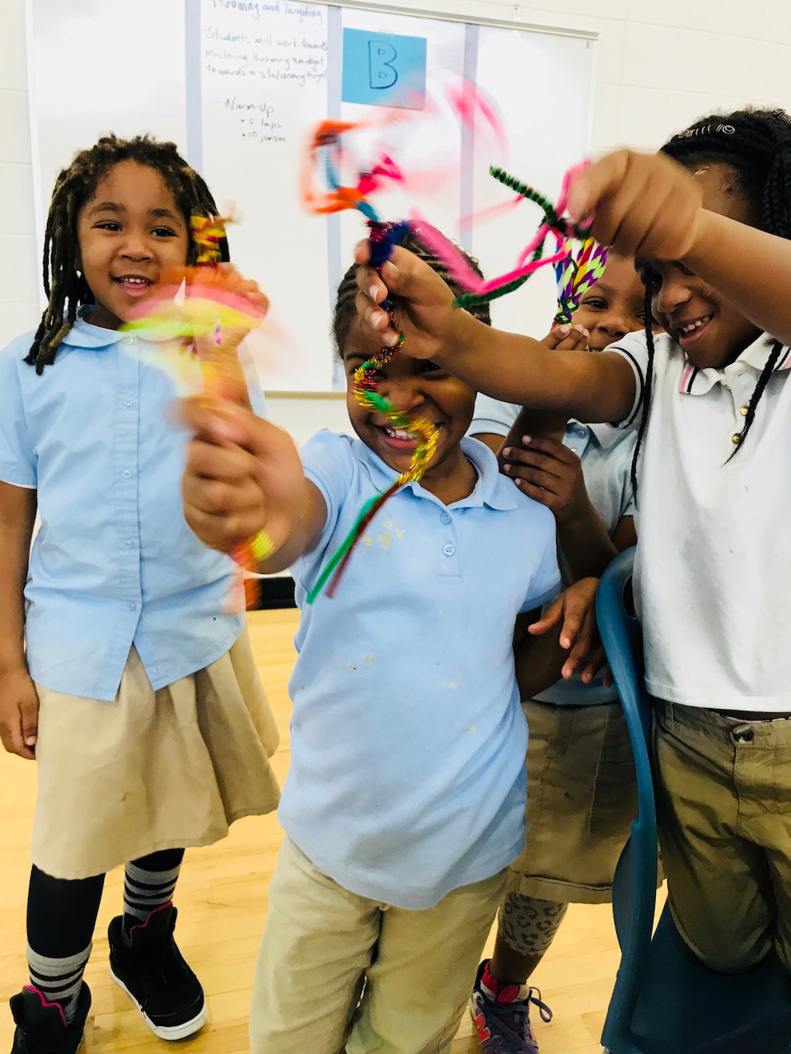
MAKE ART
-Engagement
-Personal relevance
-self-awareness AND EMPATHY

Slide 10
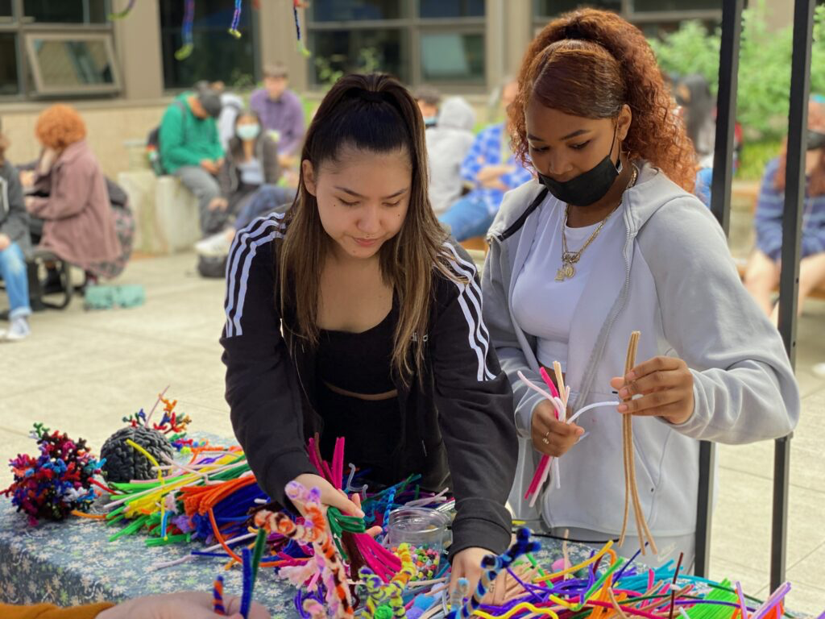


Slide 11
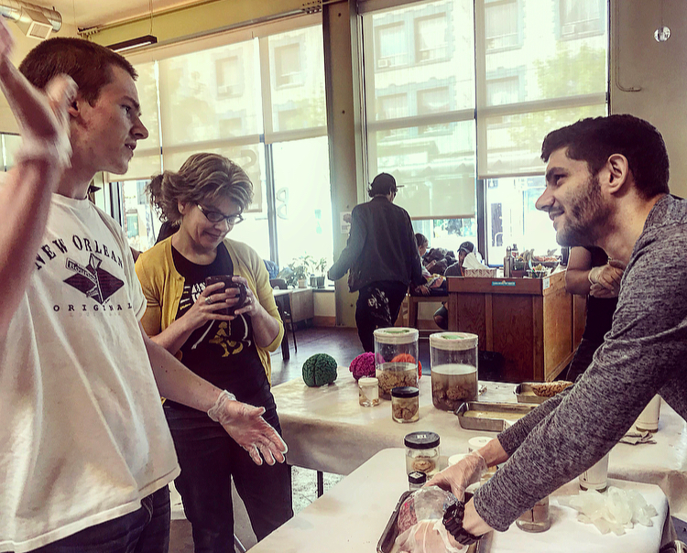
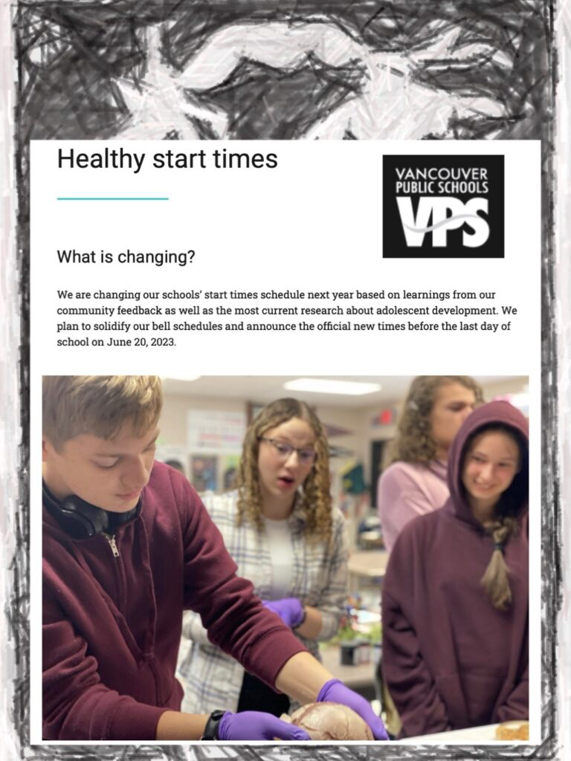
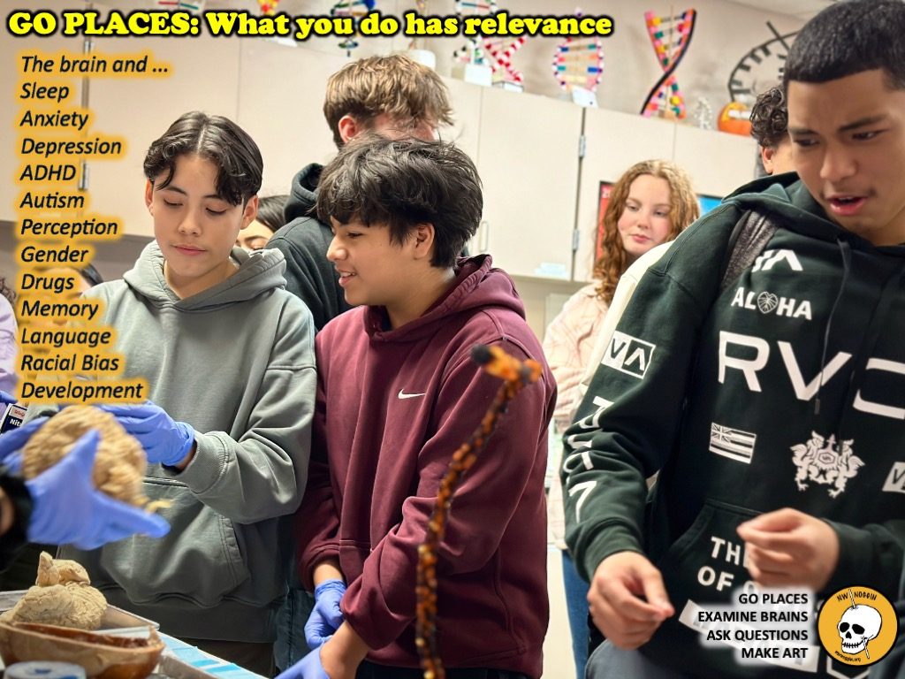
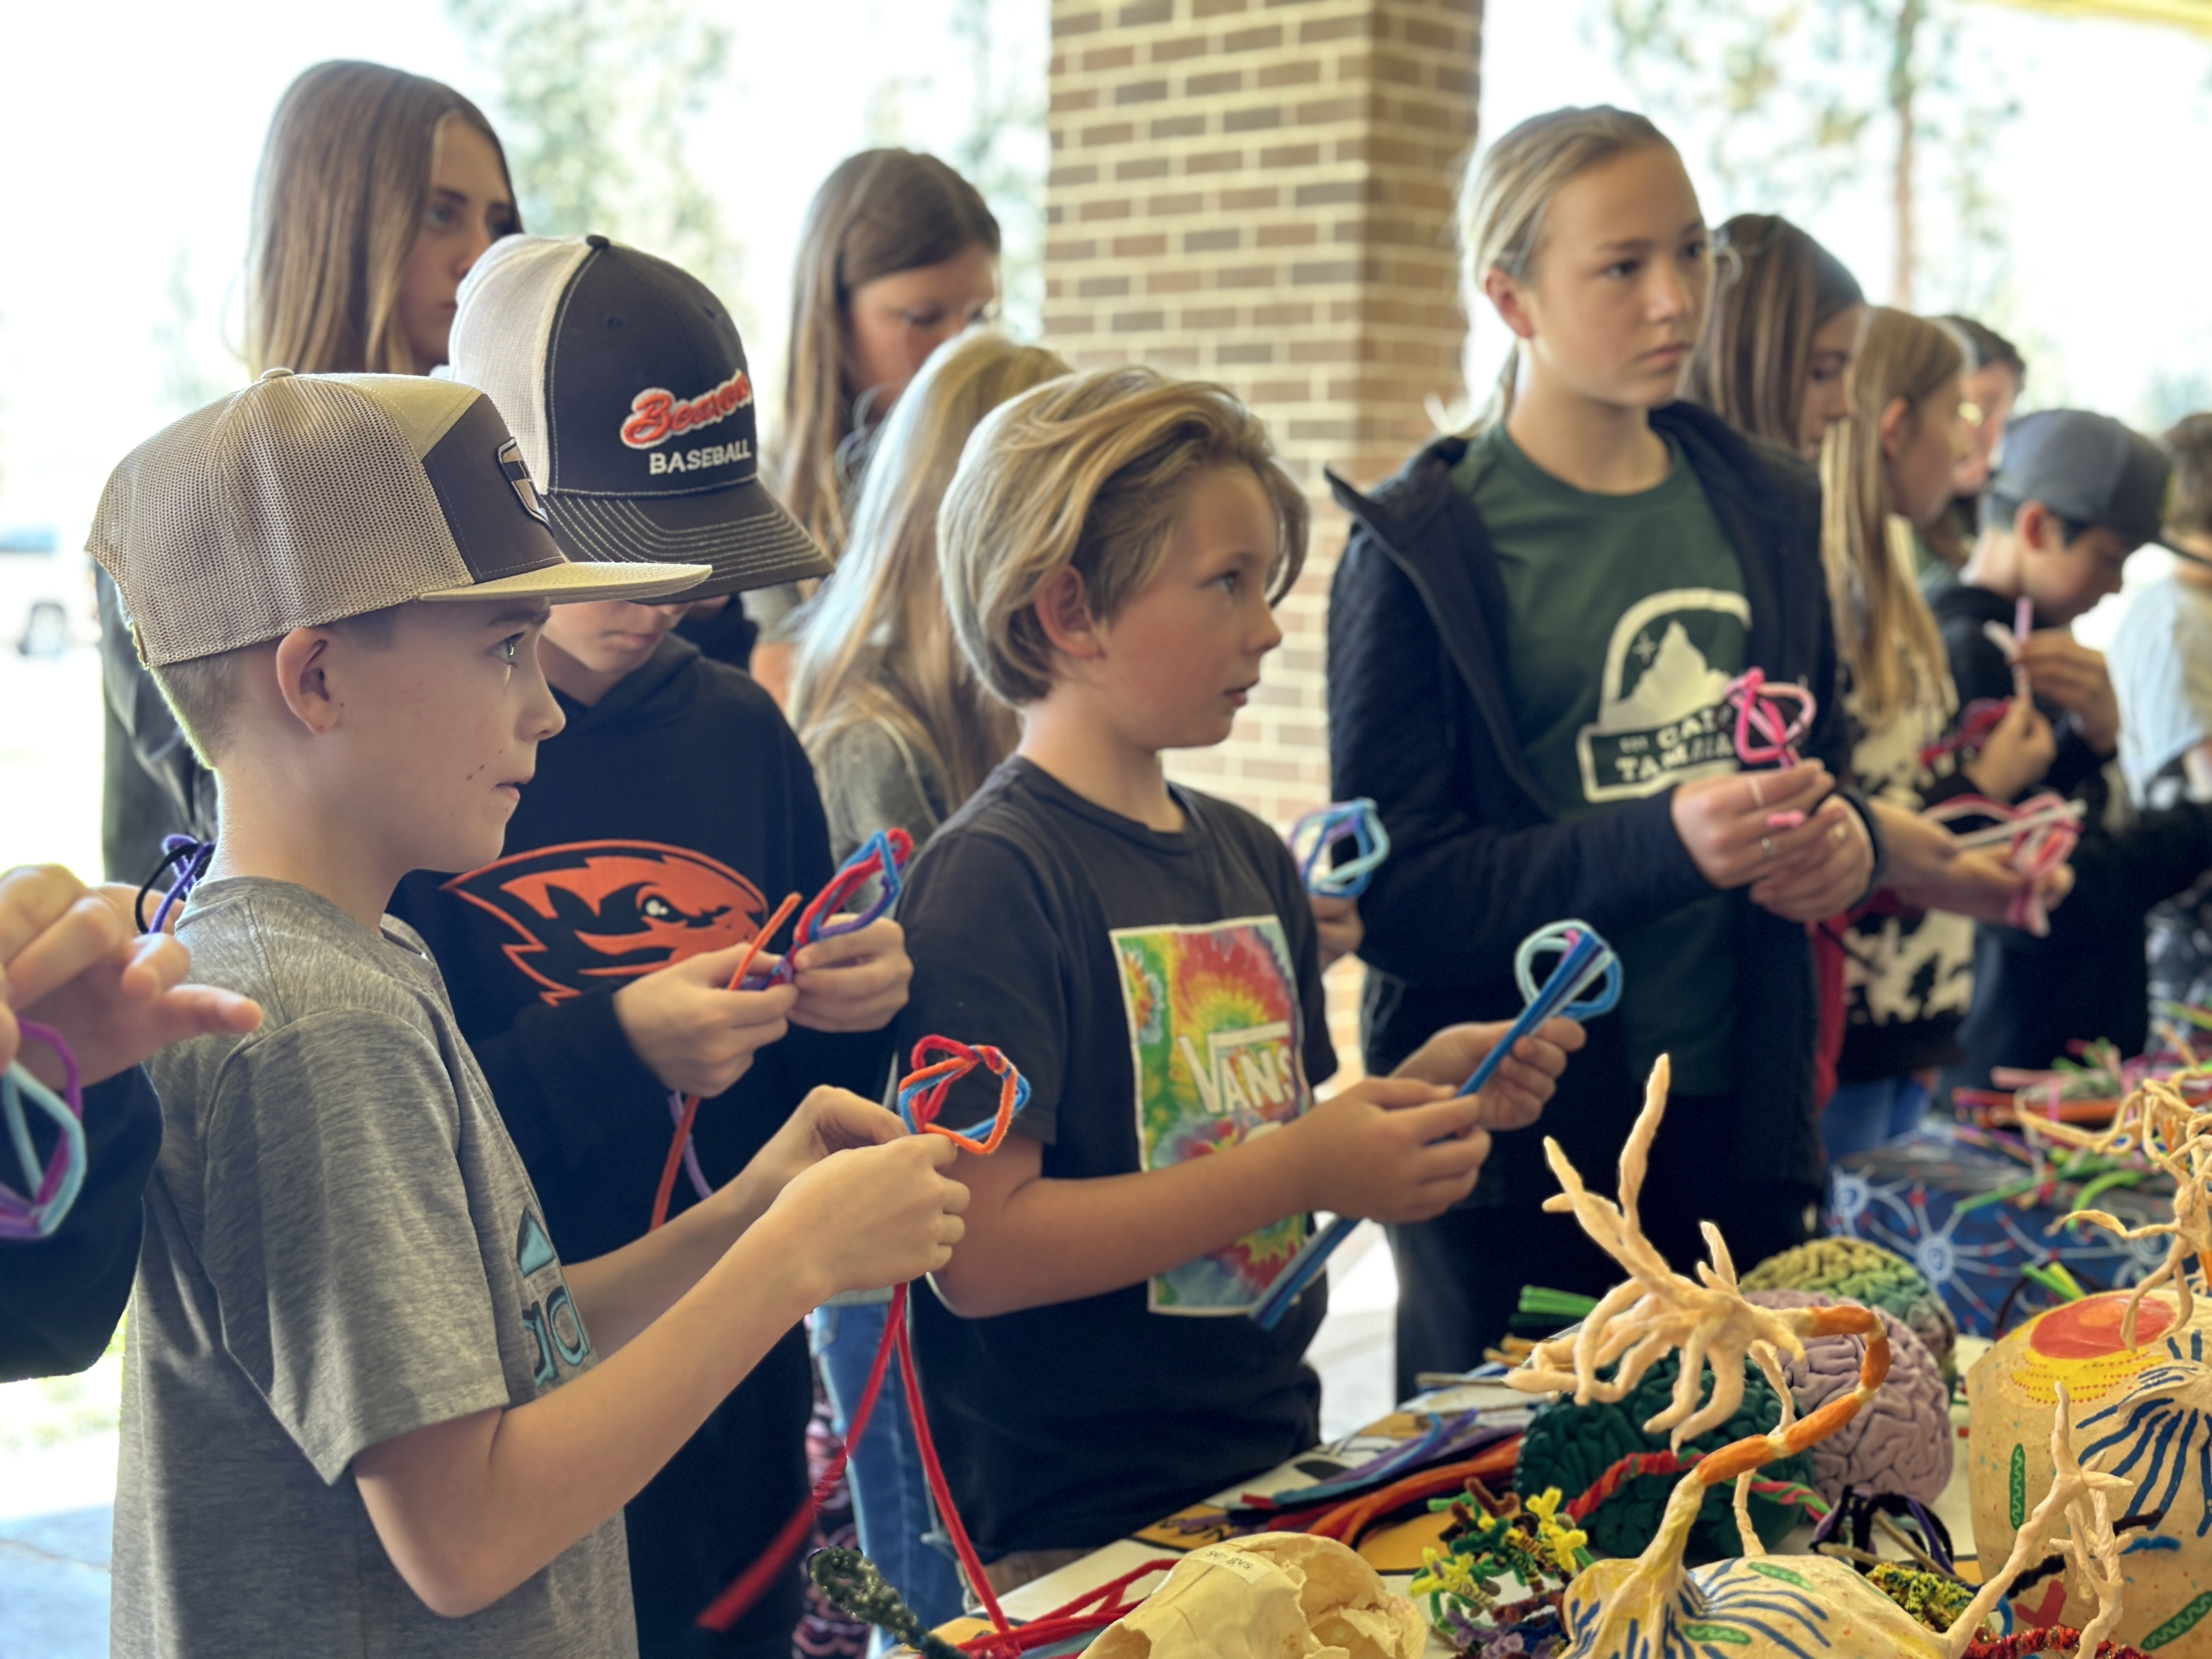
INFORM POLICY
-Research topics are popular!
-Interdisciplinary/STEAM approaches WORK
-1. School start times for adolescents
-2. Permanent standard time
-3. economic development

Slide 12
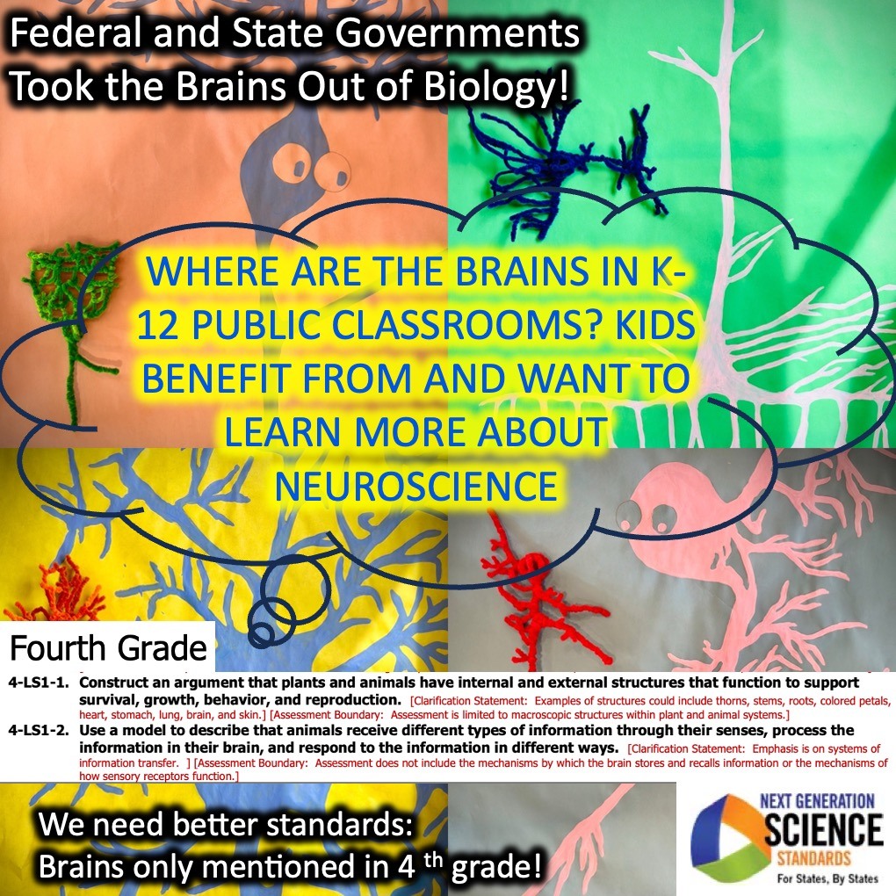
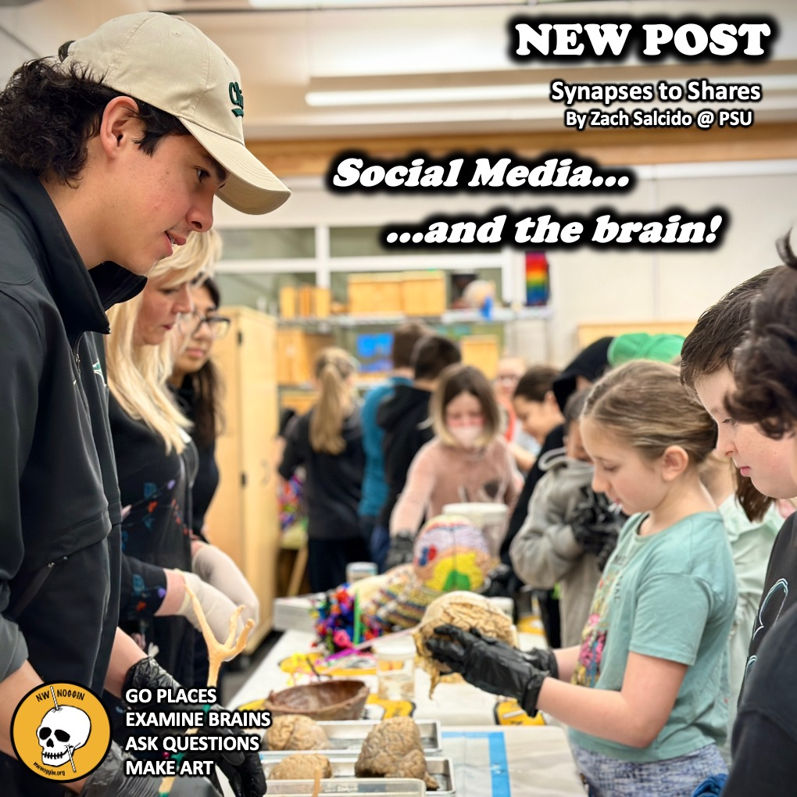
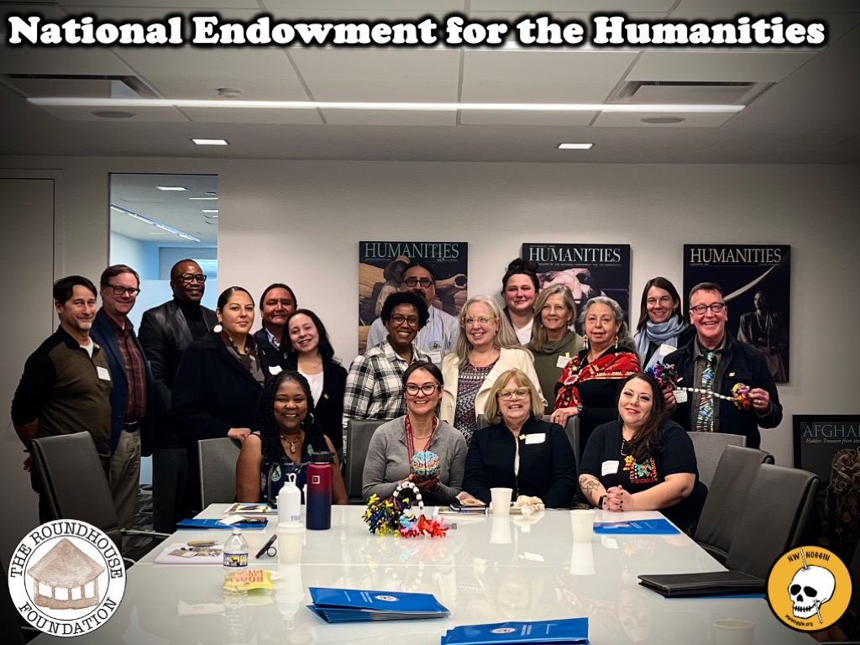

Slide 13
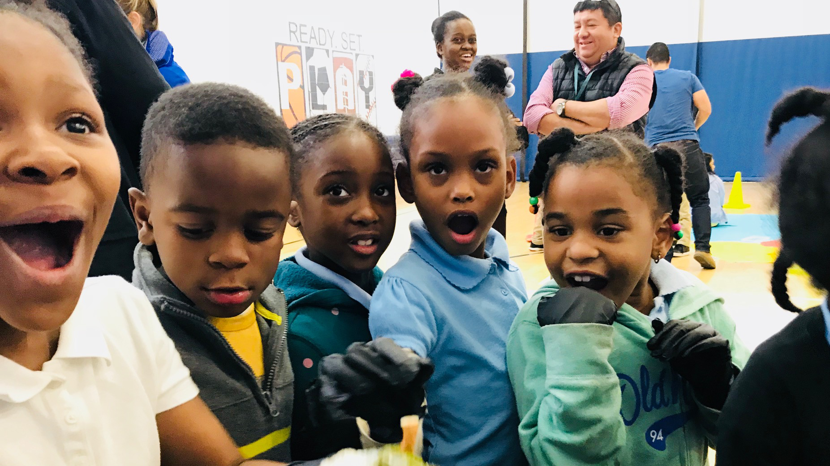
Brain research is compelling
*PEOPLE ARE INTERESTED
*THEY WANT to hear about it, and be included

Slide 14




engaging brains
If you’re motivated, intrigued, curious, engaged, your brain is more plastic.
Change your environment: go PLACES
Welcome new brains, from more backgrounds
Listen to what young people have to say
Provide resources and enrichment
Promote ADULT plasticity
Make art

Slide 15



Let’s make something!

