Slide 1
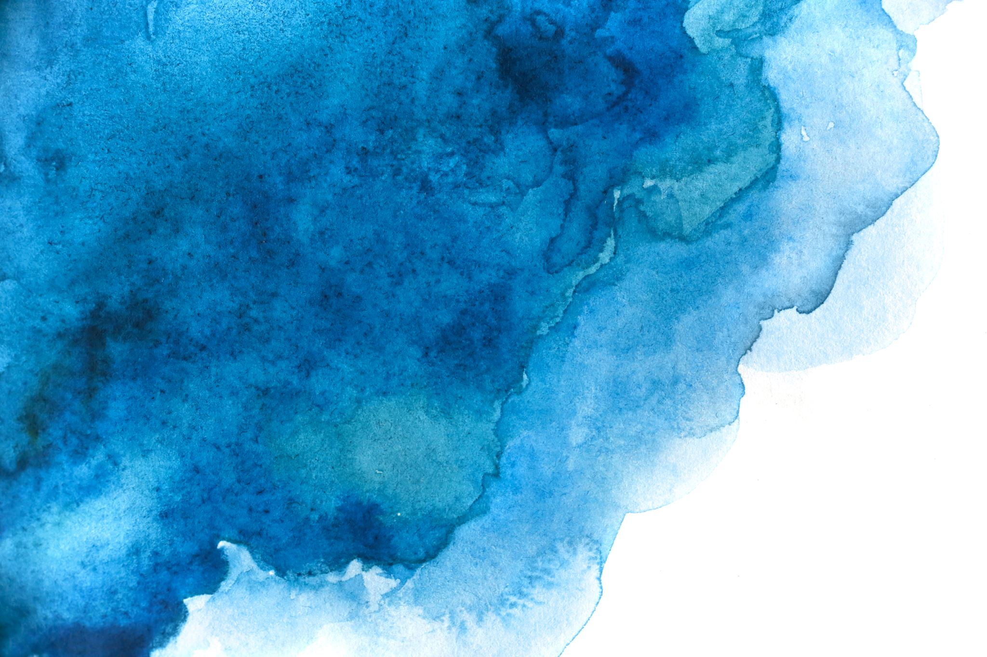
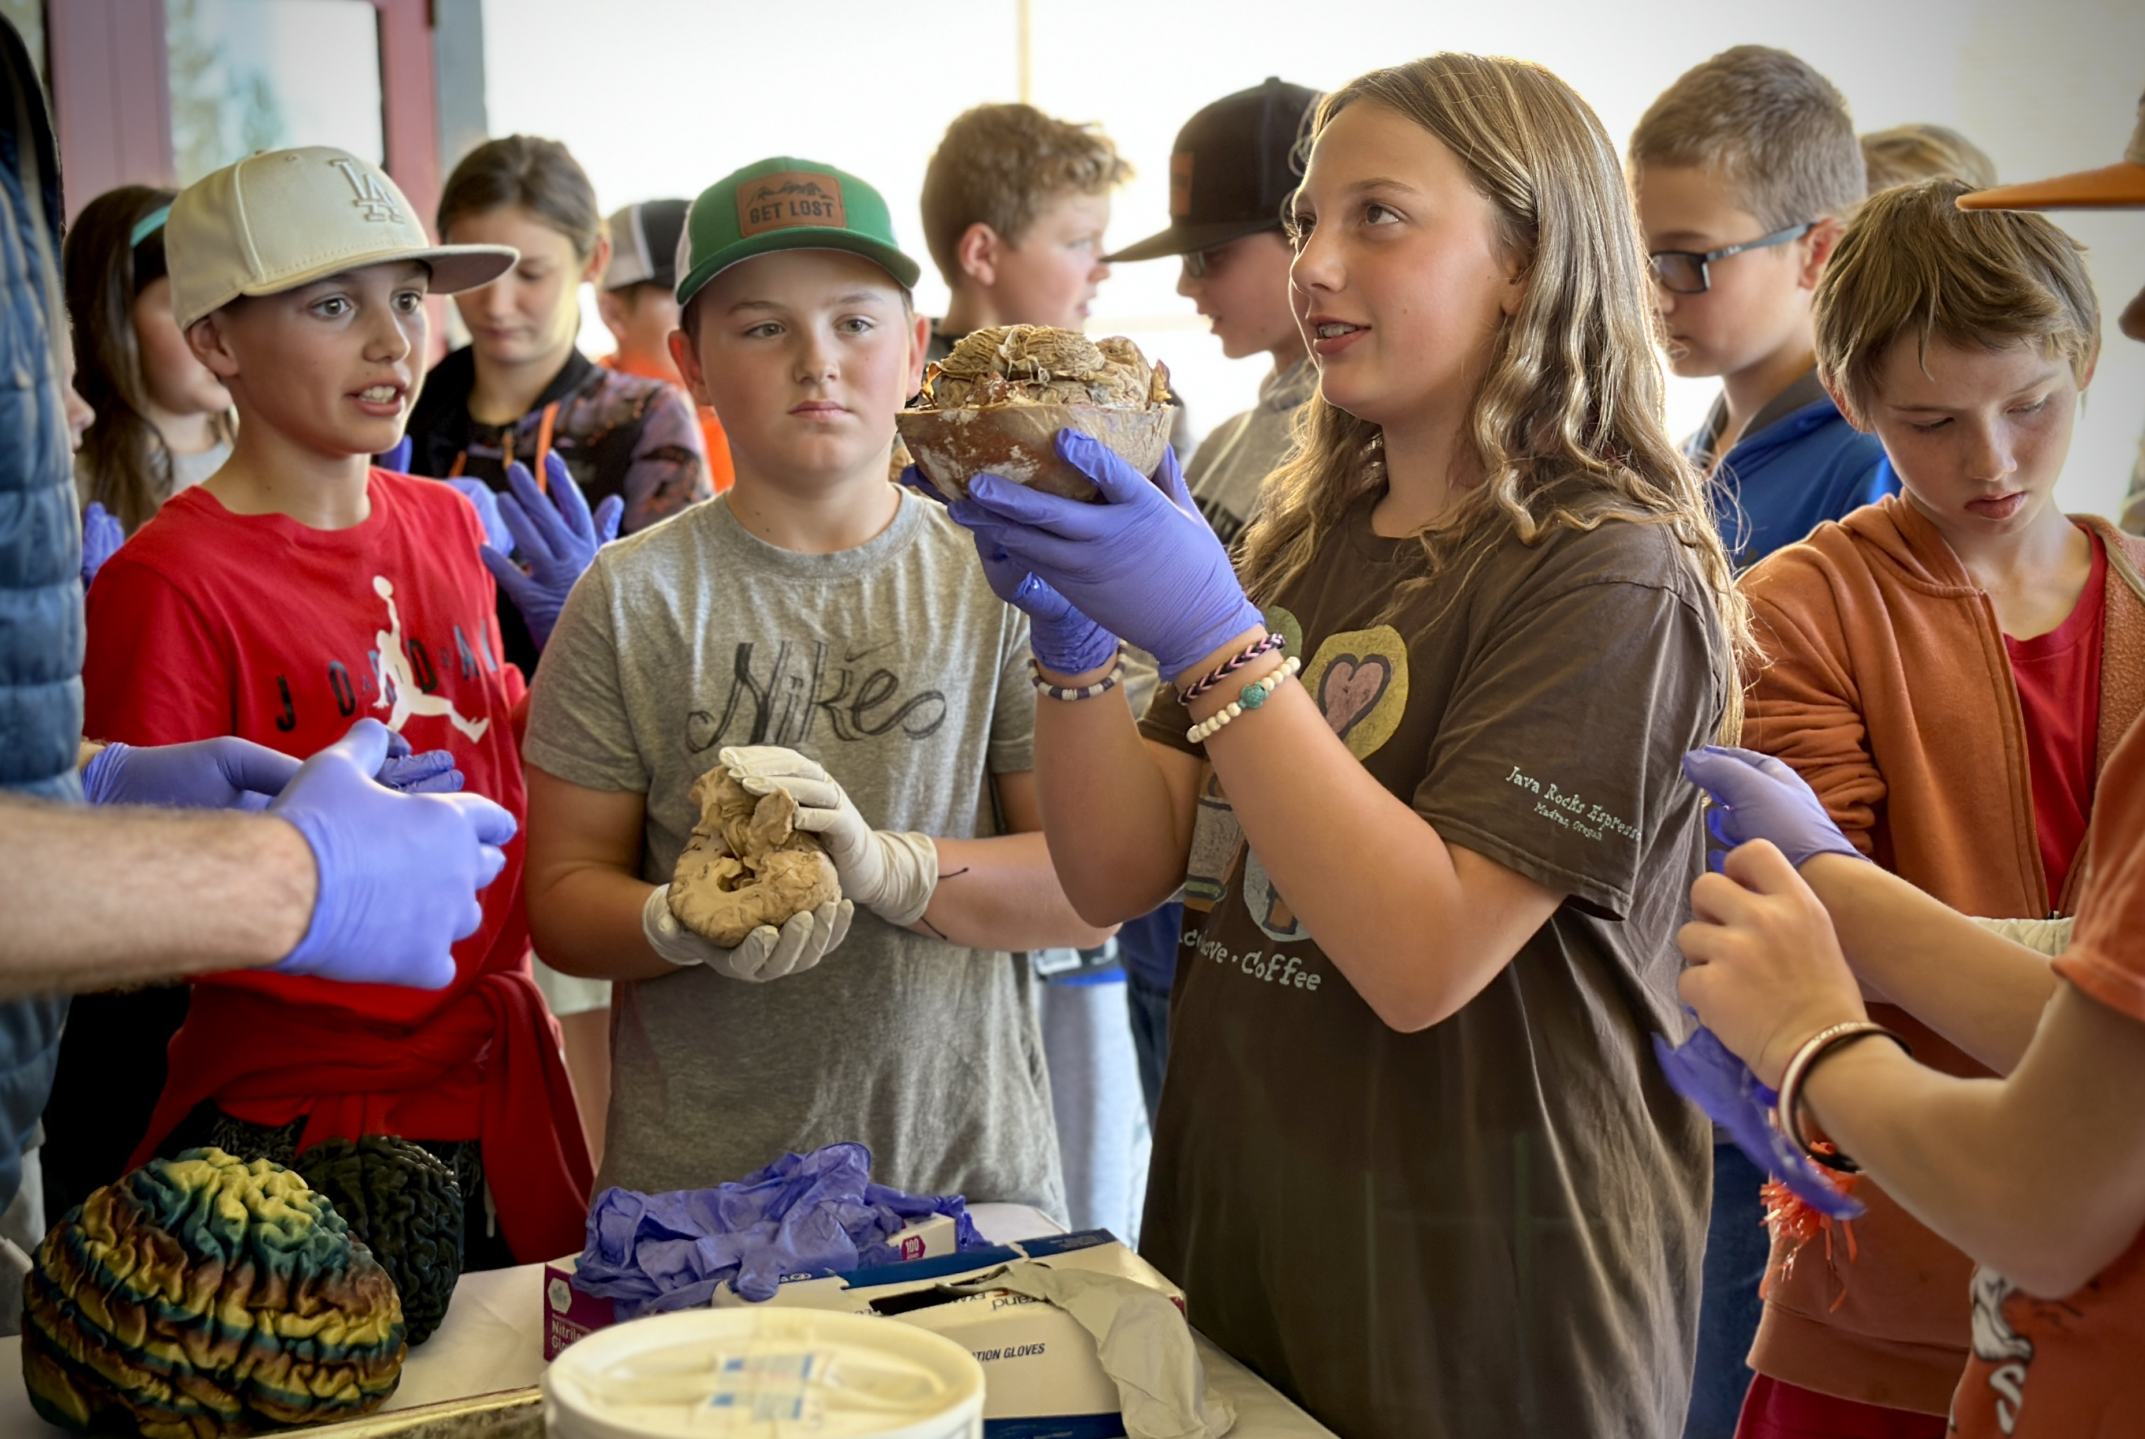
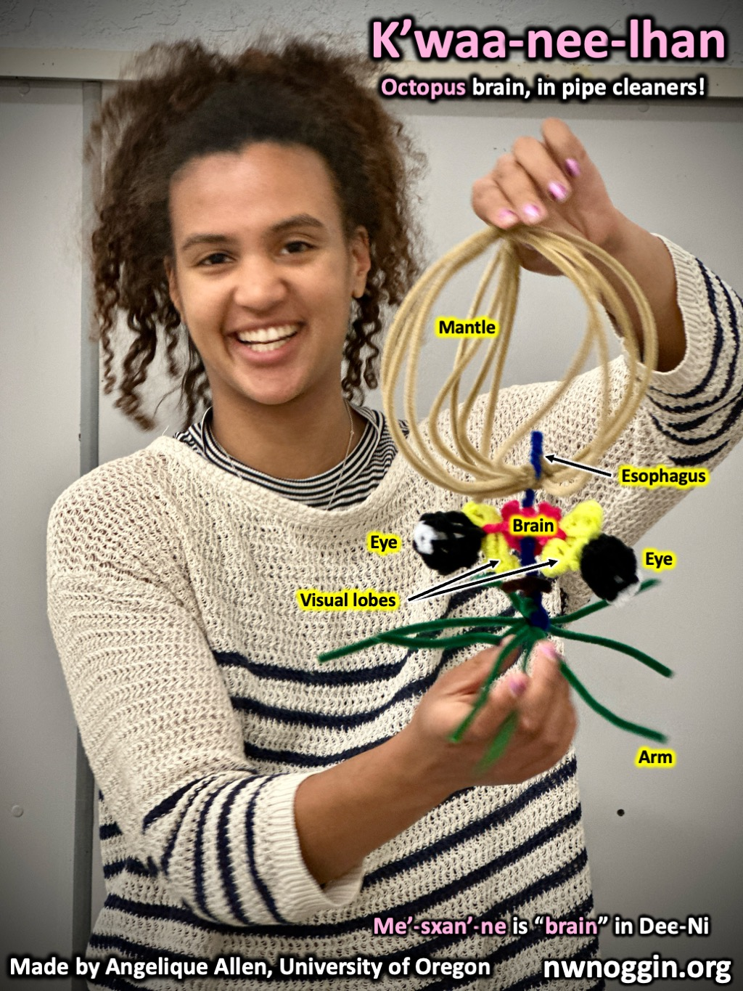
Northwest
Noggin
2025 Oregon Psychiatric
Physicians Association Conference
Exploring the neuroscience of drug use disorders: the brain, policy and art

Slide 2
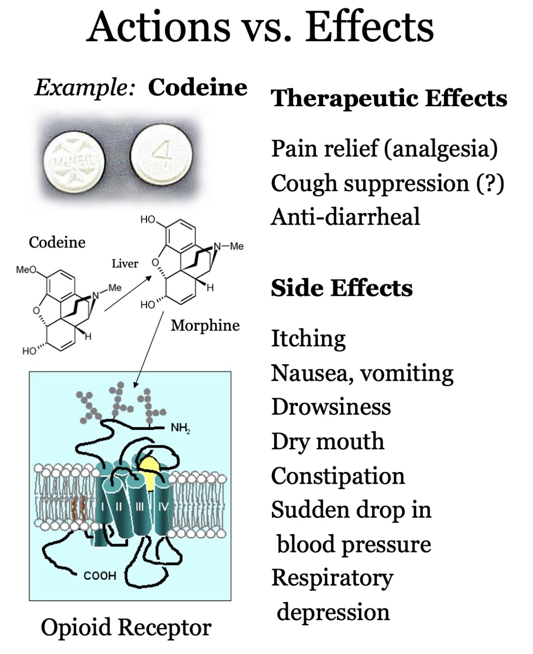
What is a drug?
What is a drug use disorder?
“Drugs are chemical substances that can change how
your body and mind work.” – National Library of Medicine
DRUG ACTIONS: Drugs produce specific changes
when they bind to a target molecule in your brain and/or body,
often a specific protein called a RECEPTOR. Receptors are
often embedded in your cell's membranes, and they
RECEIVE (bind to) other chemicals, including
neurotransmitters and DRUGS.
DRUG EFFECTS: Drug actions at specific sites can
affect areas of the nervous system that underlie cognition,
perception, behavior and mood.
DRUGS OFTEN ACT AT MULTIPLE MOLECULAR SITES
(MULTIPLE ACTIONS), THEREFORE THEY OFTEN
HAVE MULTIPLE EFFECTS

Slide 3
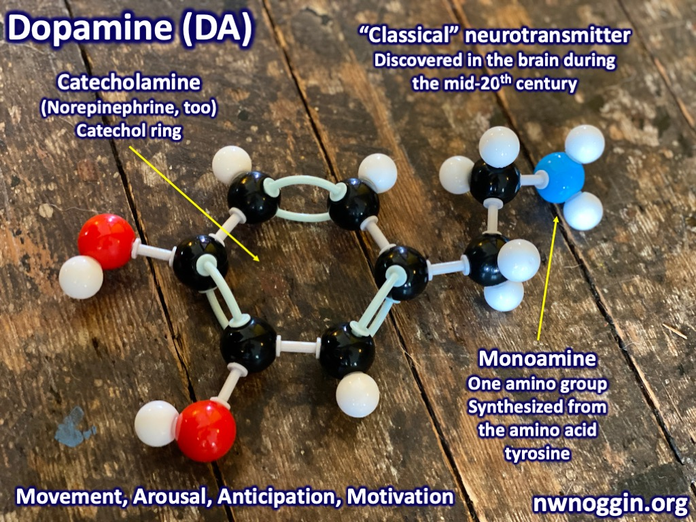
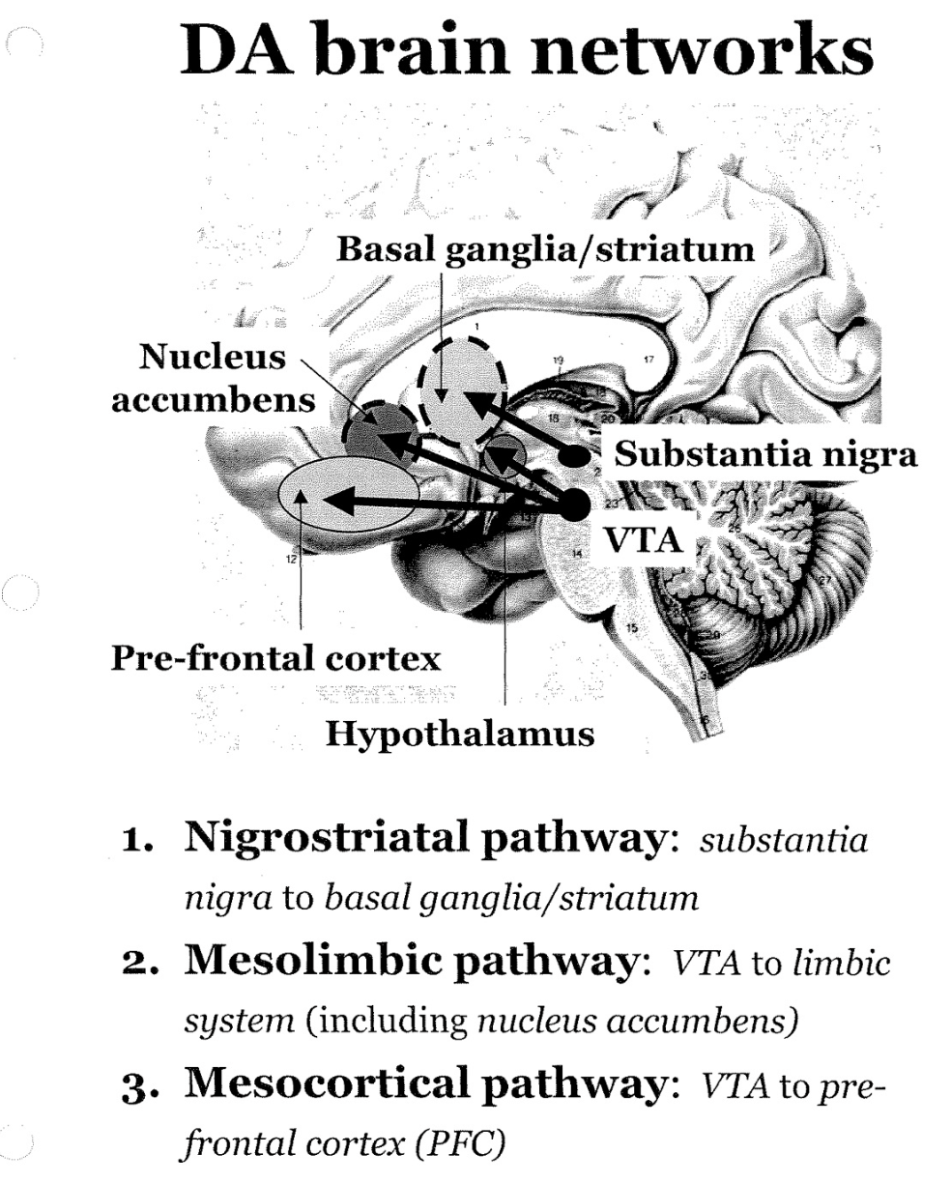
Drugs take advantage of EXISTING networks for Brain reward
“An evolutionarily conserved neurobiological strategy for survival is the
motivation to seek out positive rewarding stimuli (e.g., food and sex) and to
avoid negative aversive ones (e.g., pain and environmental threats). Dopamine
is a key neurotransmitter underlying the motivation to seek positive stimuli
and avoid negative stimuli…”-Nora Volkow & Carlos Blanco (2023)
FIGURING THINGS OUT
PATTERN SEEKING
NOVELTY

Slide 4
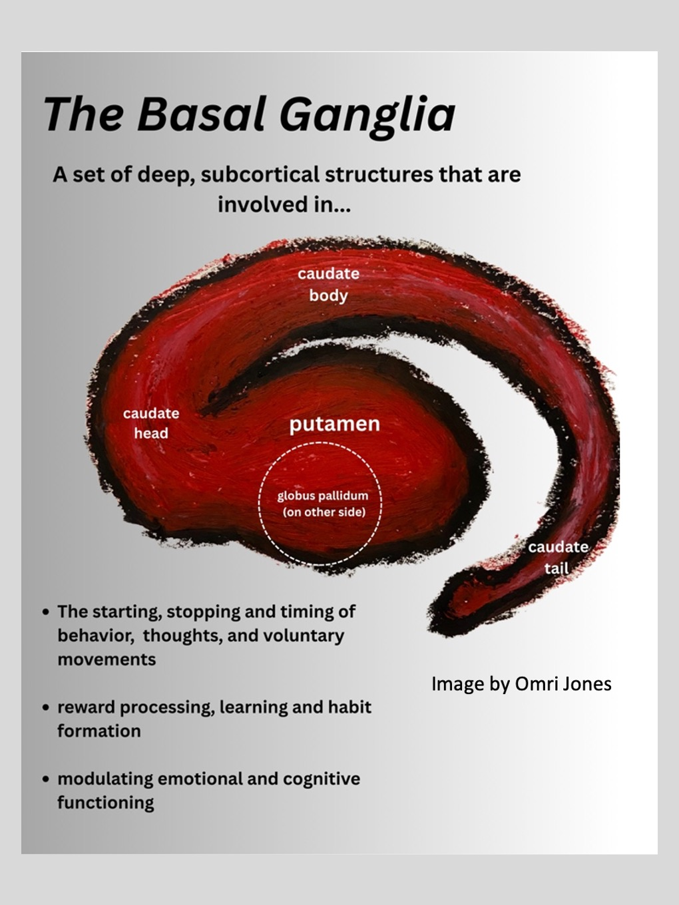
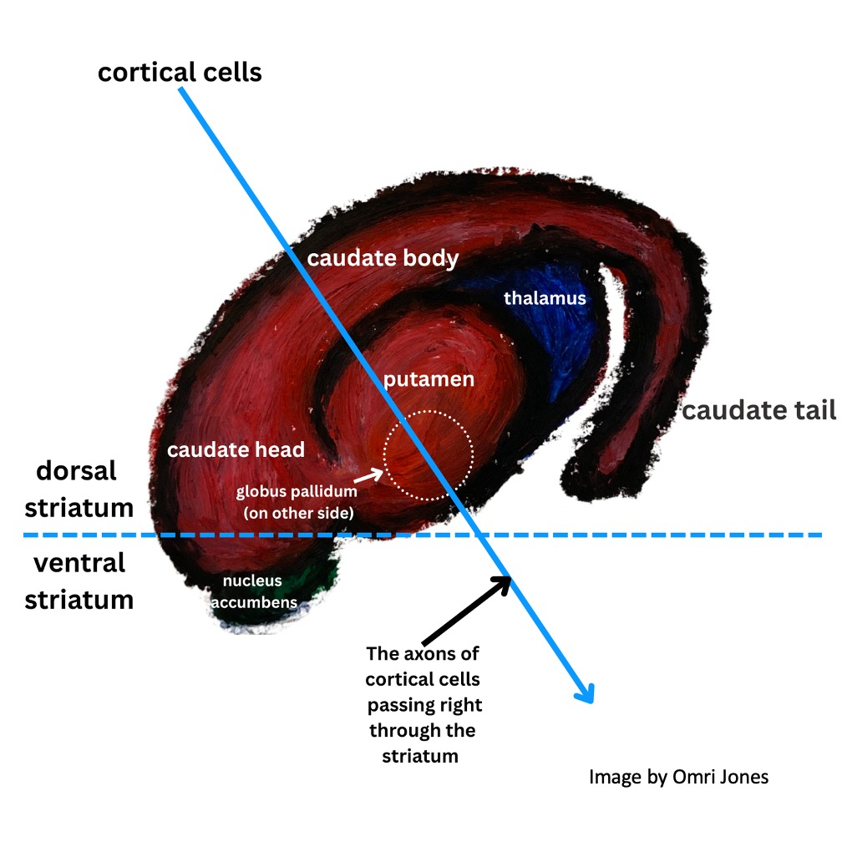
The Basal Ganglia
Basal ganglia in pastels
Interdisciplinary neuroscience

Slide 5
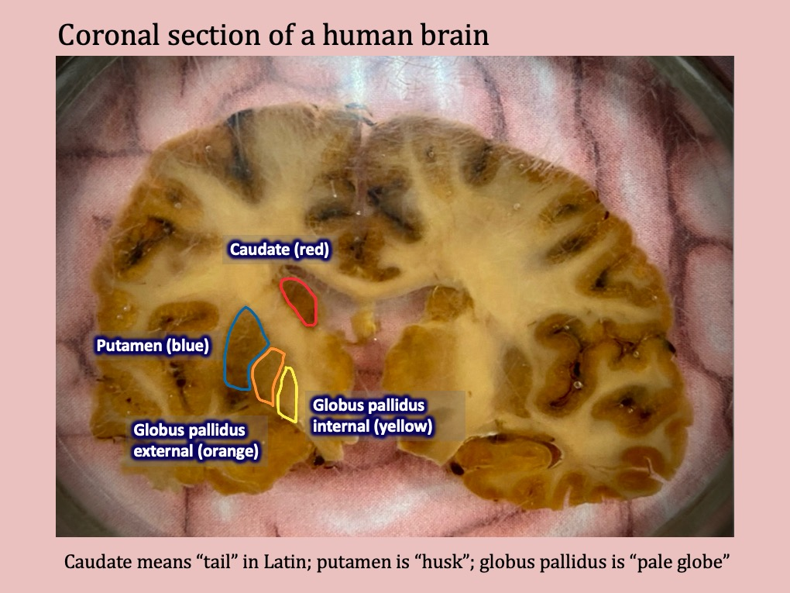
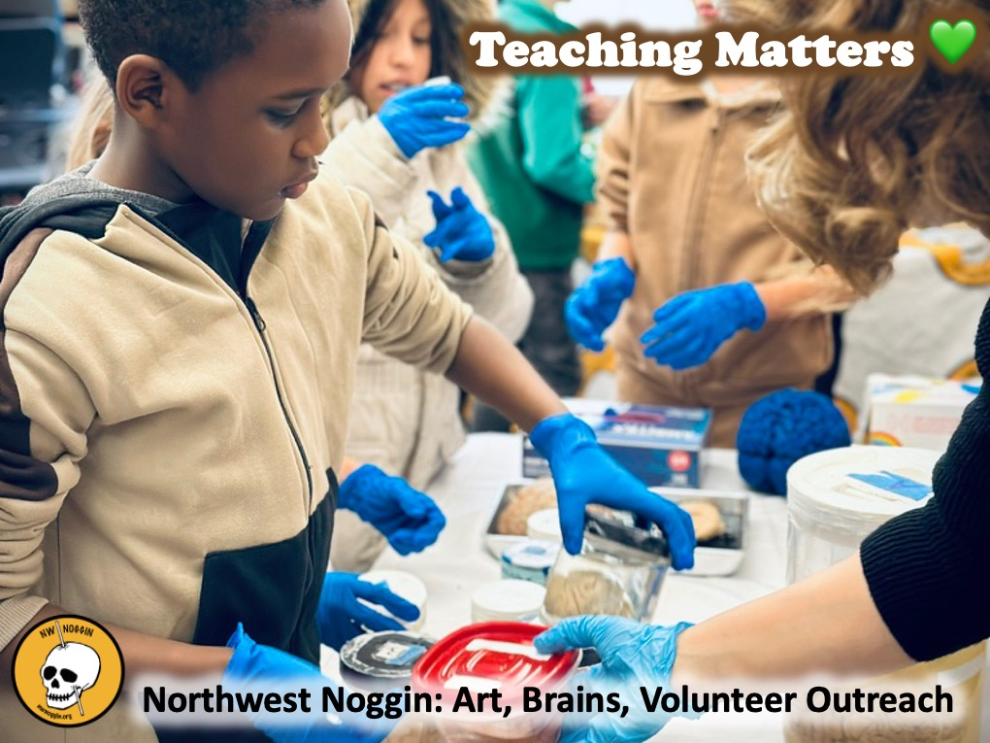
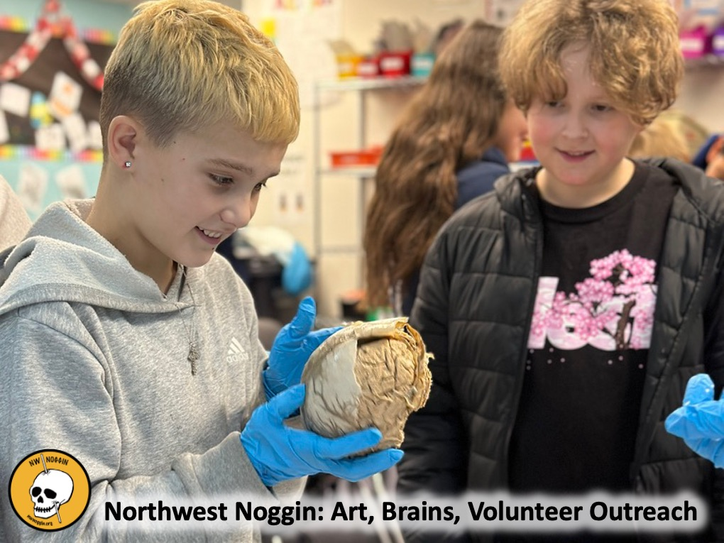
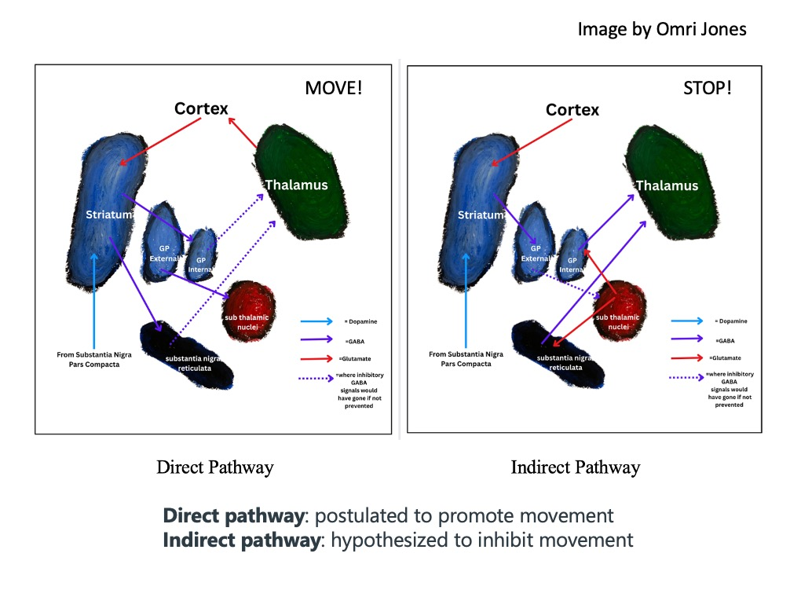
The Basal Ganglia
LEARN MORE:
There’s a tail in your brain!
https://nwnoggin.org/2025/02/24/theres-a-tail-in-your-brain/

Slide 6
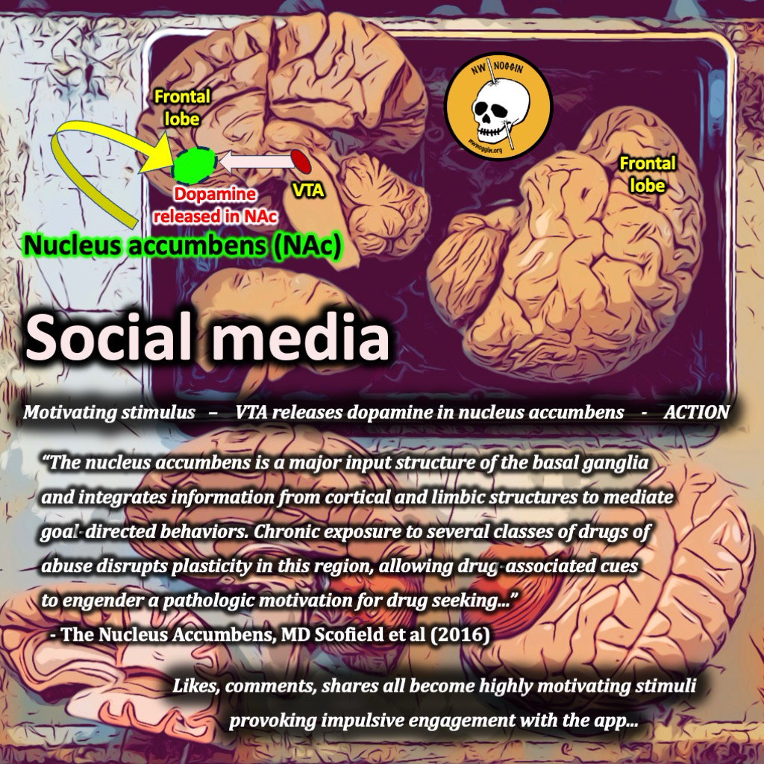
Different mechanisms, but magnitude and speed matter for use disorders
“…every drug with addictive potential
increases dopamine in the nucleus accumbens… Different classes of drugs increase dopamine
via distinct molecular targets and mechanisms,
with resultant differences in the magnitude
and the speed of dopamine increase, which
in turn are factors that contribute toa drug’s
addictive liability…”- Volkow & Blanco (2023)
Cocaine: blocks 5-HT, DA, NE re-uptake
Methamphetamine: reverses vesicular transporters (esp. DA)
Alcohol: agonist @ GABA-A, antagonist at Glutamate NMDA,
increased DA and opioid activity, non-specific effects
Opioids: agonist at opioid receptors, erase injury information
from perceptual maps in cortex, increase DA
Cannabinoids: agonist at CB1 and CB2, decrease GABAergic
inhibition of DA neurons in VTA
Psychedelics: agonist at 5-HT2A, but messy drugs,
some DA increase

Slide 7
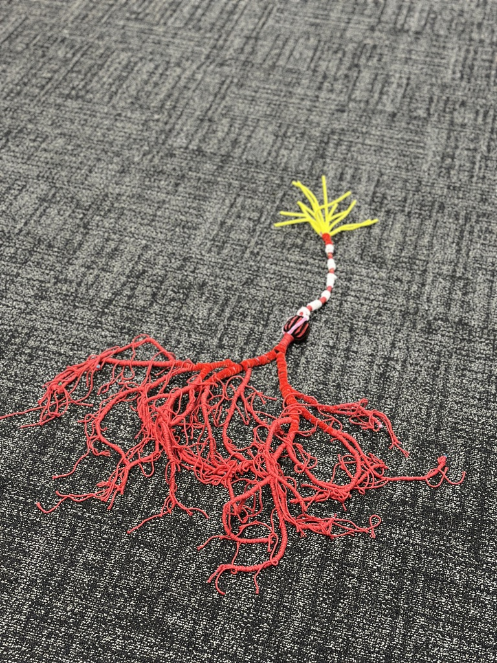
Repeated drug exposure shifts dopamine release to predictive cues
“…Once the experience from drug reward has been turned into a conditioned
memory, the cues by themselves drive the desire for the drug and energize the
dopamine motivational circuit that propels the behaviors to pursue it…”
-Nora Volkow & Carlos Blanco (2023)
The bar, the people you drank with, …
Conditioned place preference experiments
CONSIDER:
Drug treatment followed by release without
resources back into the same community, location,…
People at their most vulnerable, with largest DA
responses to drug-related stimuli

Slide 8
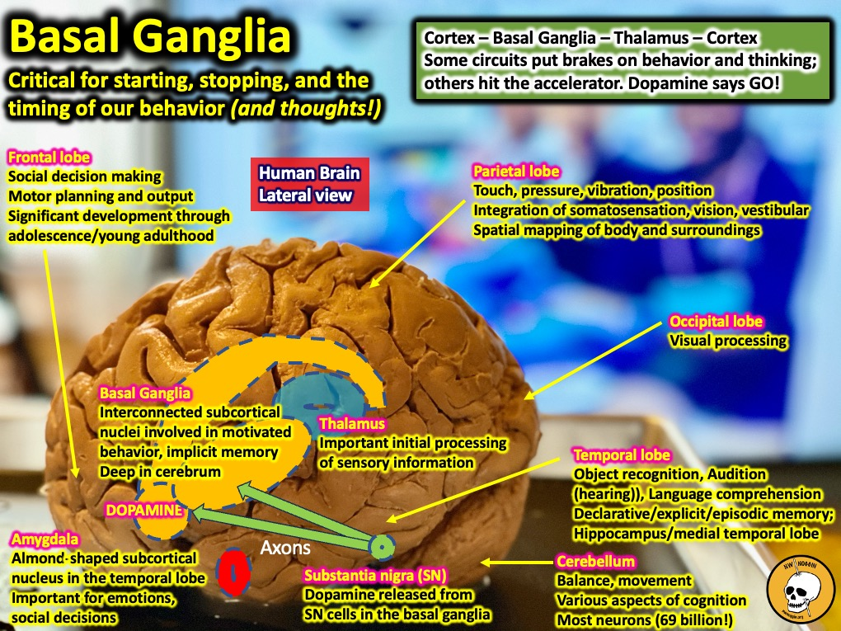
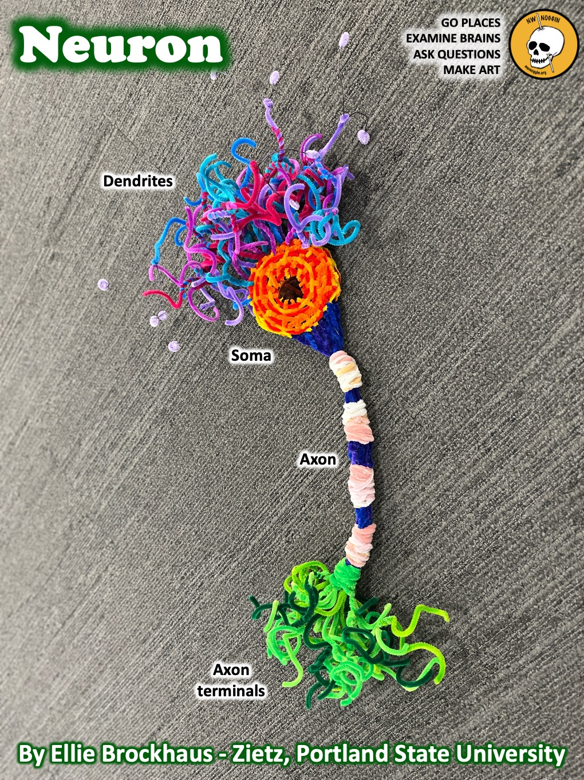
Risk Factors include age of exposure
“…Several biological and social factors have been associated with increased
risk of SUDs, including male sex, genetics, younger age of substance use initiation,
childhood adverse experiences, and psychiatric comorbidities. Drug availability
and social norms around substance use are also important contributing
risk factors…” -Nora Volkow & Carlos Blanco (2023)
ALSO:
Microbiome?
Expectations?
Sleep?

Slide 9
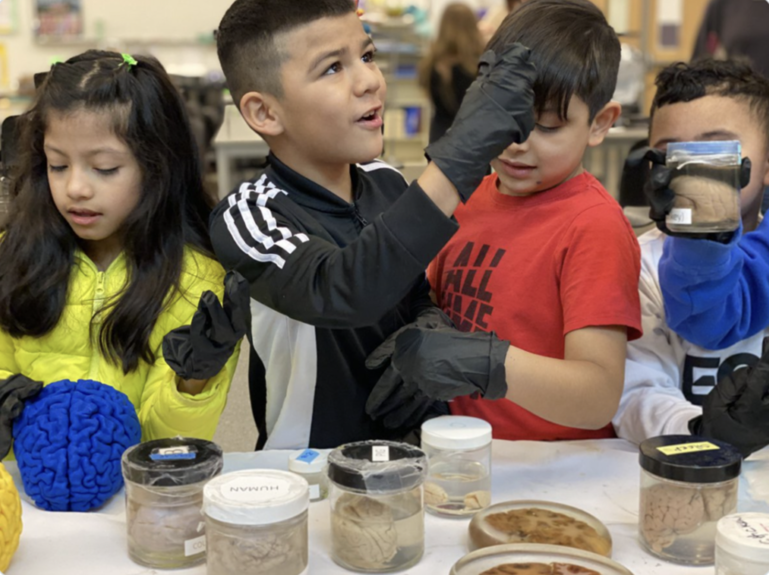
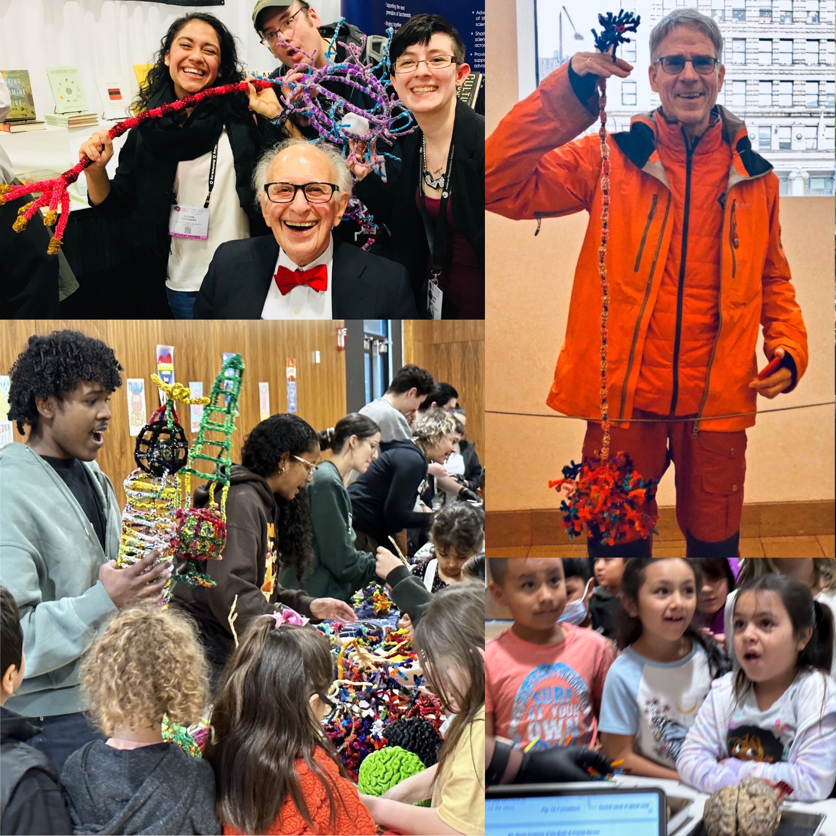
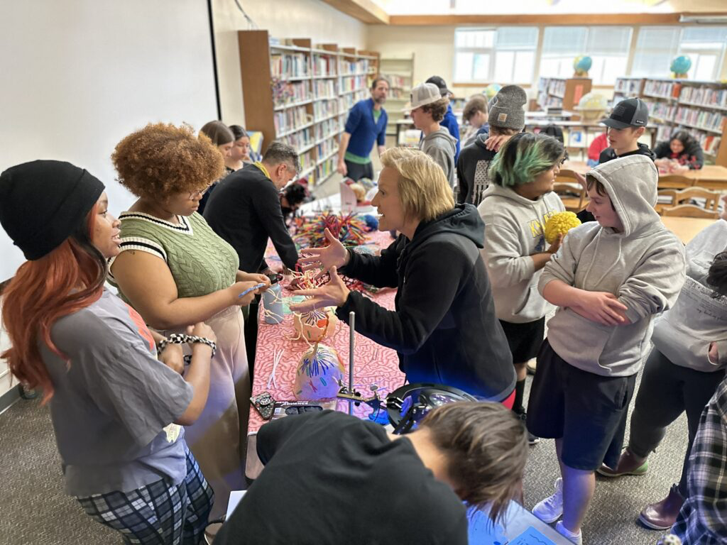
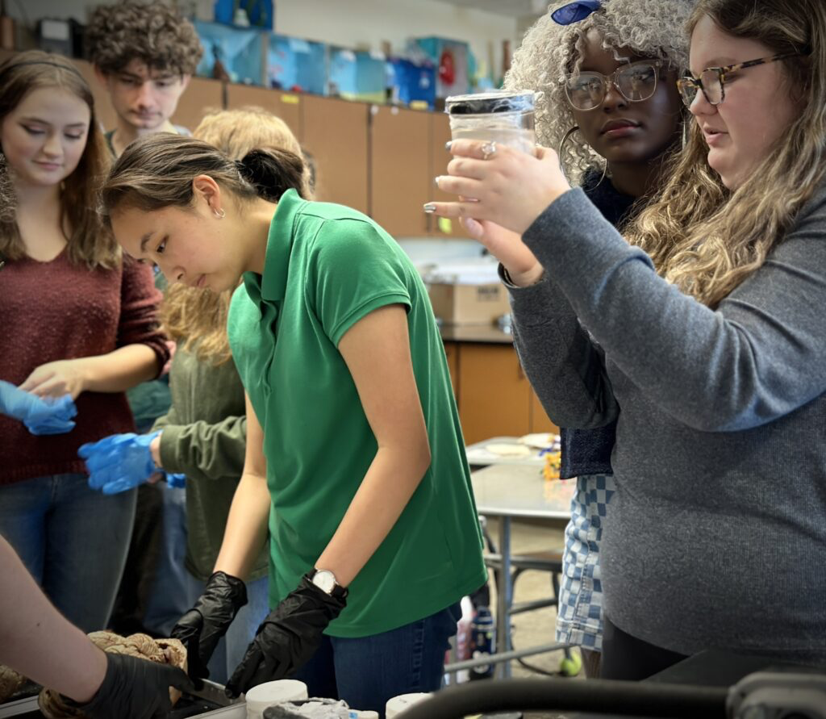
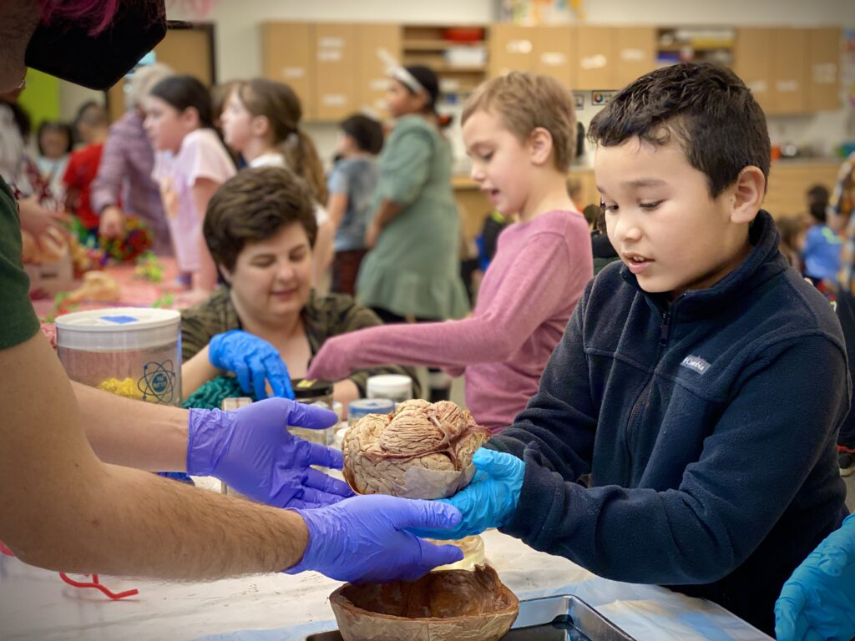
ALL VOLUNTEER
THIRTEEN years (SINCE 2012)!
NO ADMISSION - NO TUITION - open to everyone
75,000+ public K12 students/community members
local/national/international collaborators

Slide 10
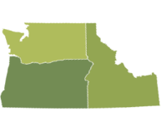
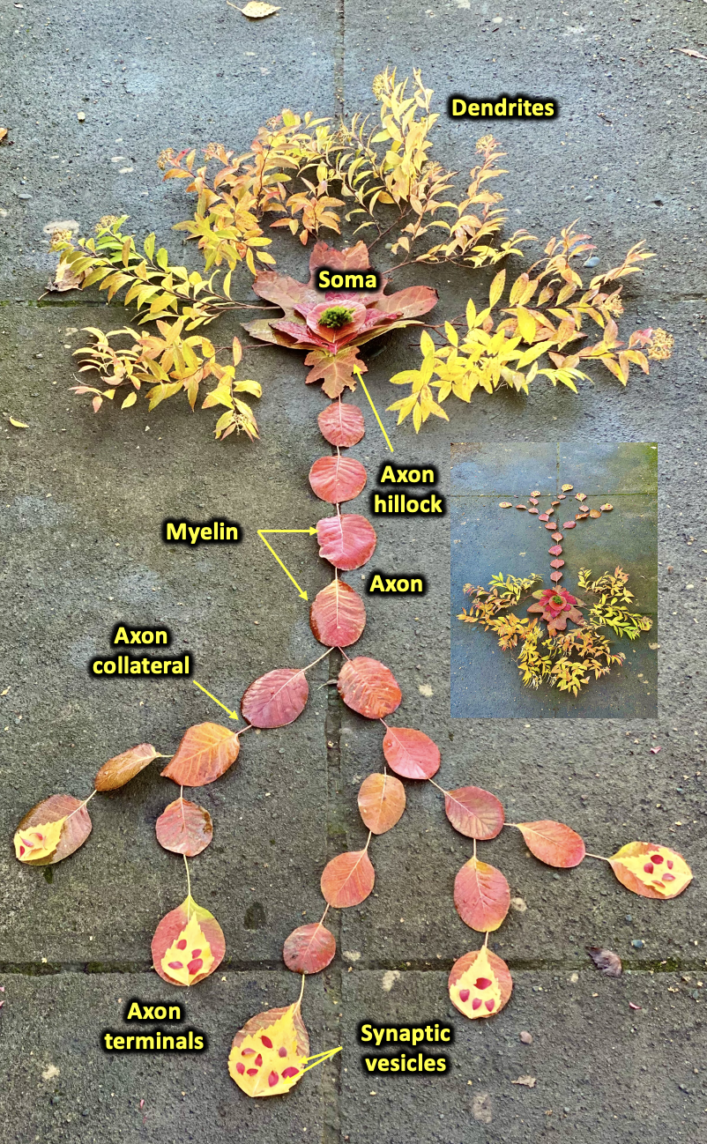
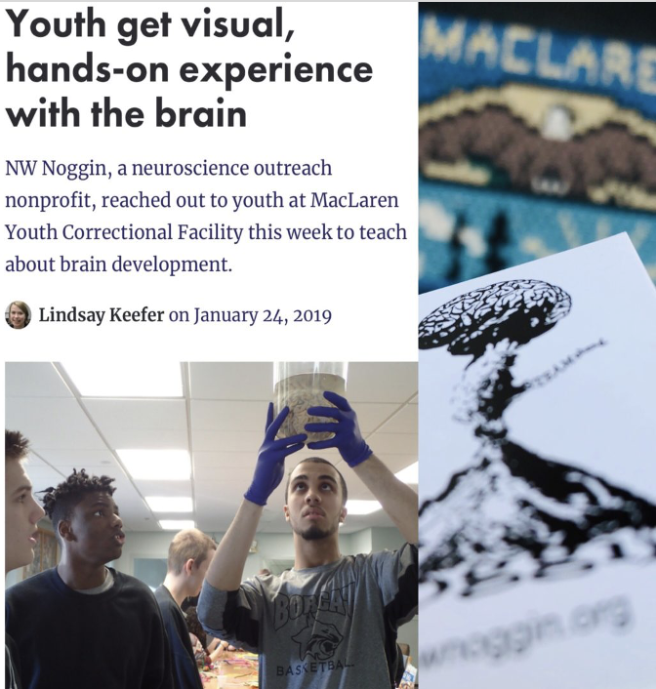
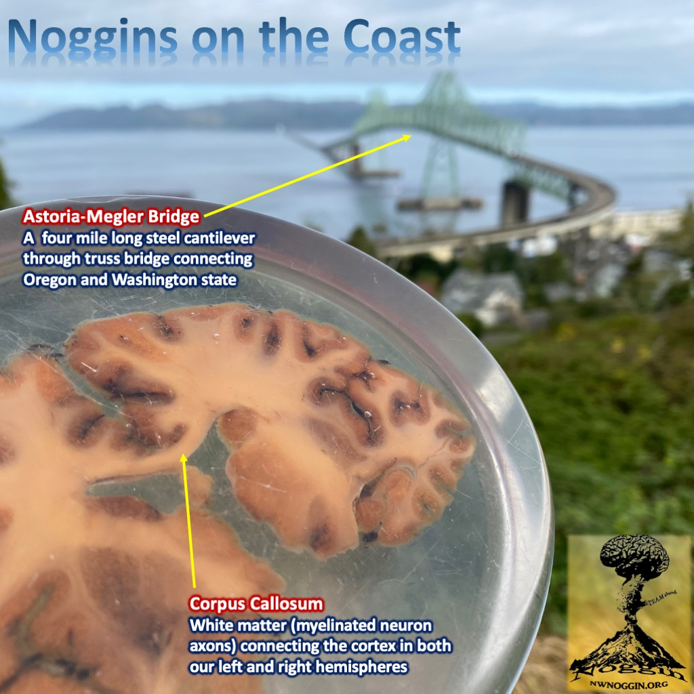
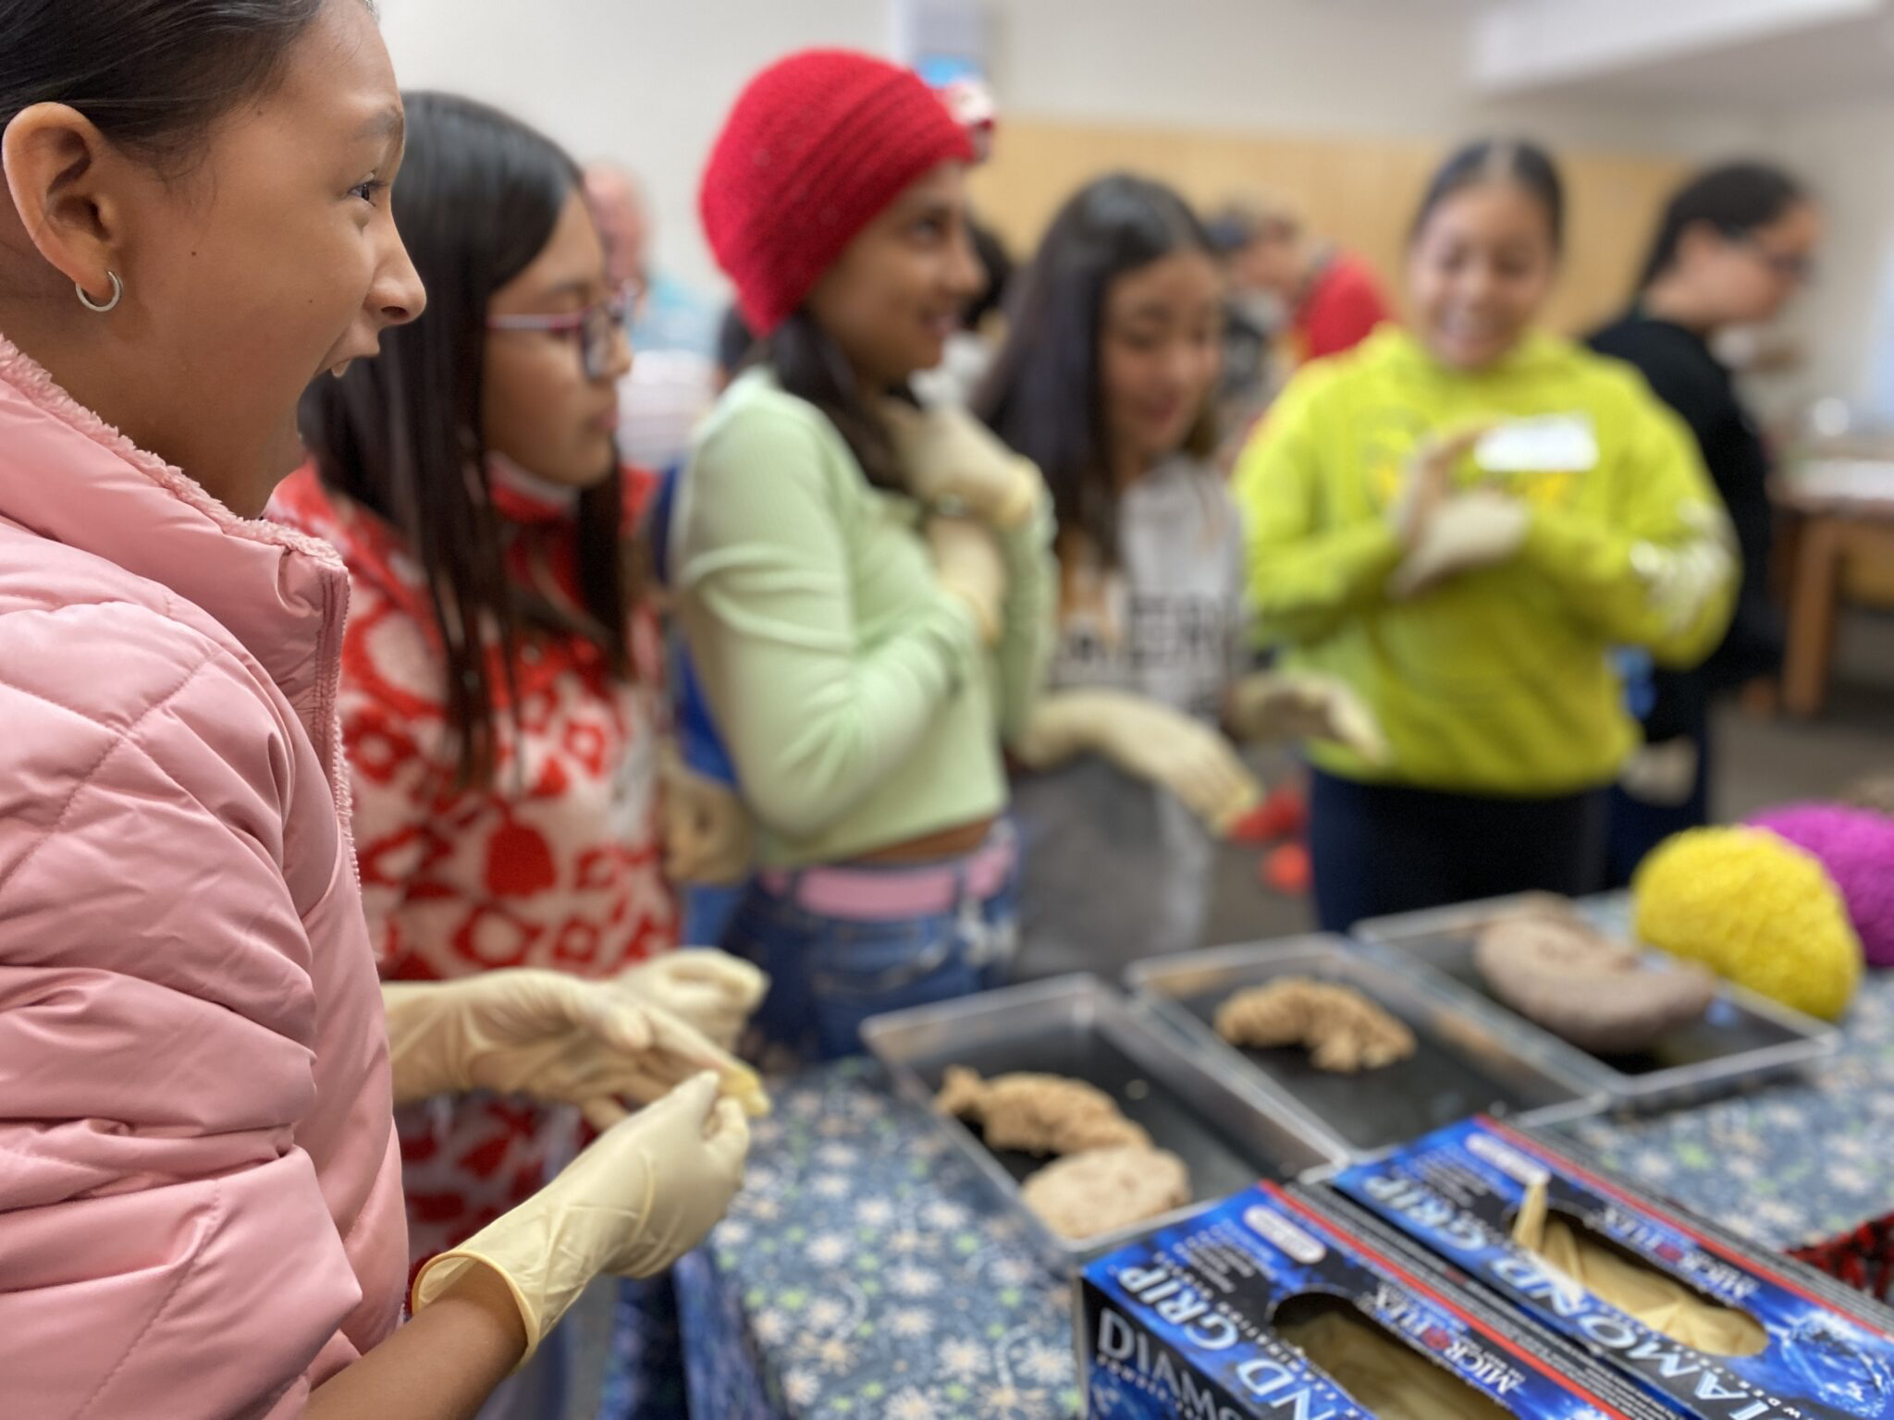
Siletz, Amity & Willamina, OR
Pop: 4000
Davenport, WA
Pop: 1700
GO PLACES
Astoria, OR
Pop: 10,000
A few places
we’ve been
-where STEM programs DON’T GO
-where money and resources don’t go
-K-12 public schools
-rural and Urban communities
-houseless youth nonprofits
-correctional facilities
La Grande, OR
Pop: 13,000
Meservy Meadows, OR Pop: ~40
Sisters, OR
Pop: 3081
Heppner & Ione, OR
Pop: 1240

Slide 11
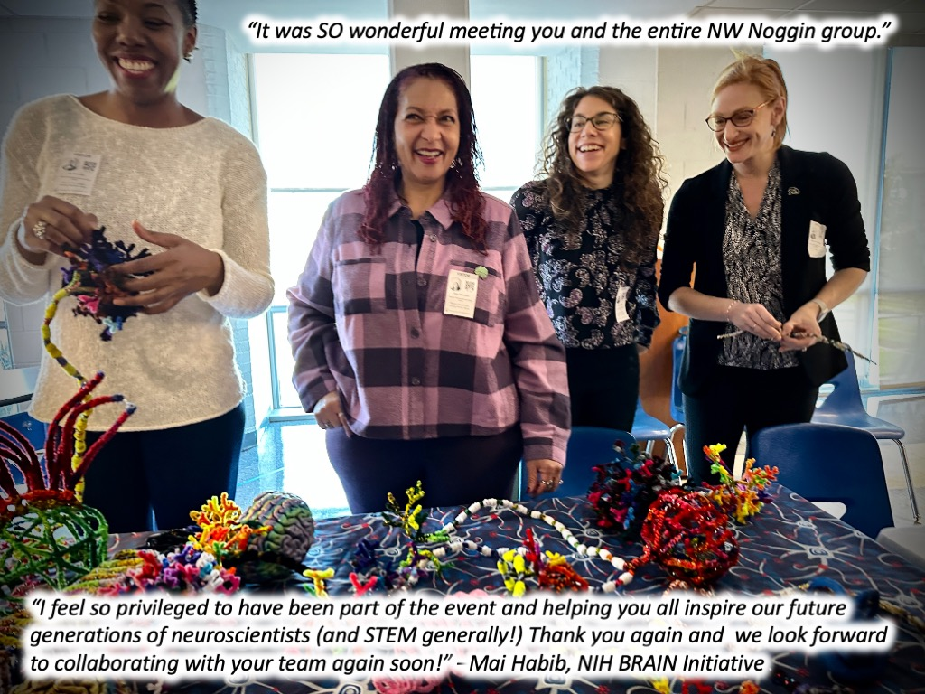
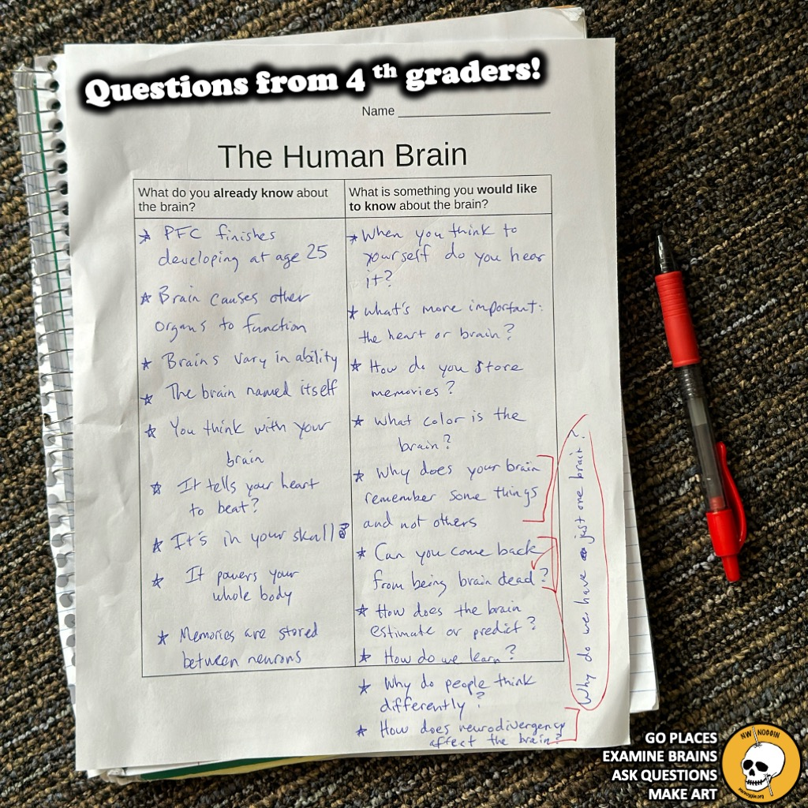
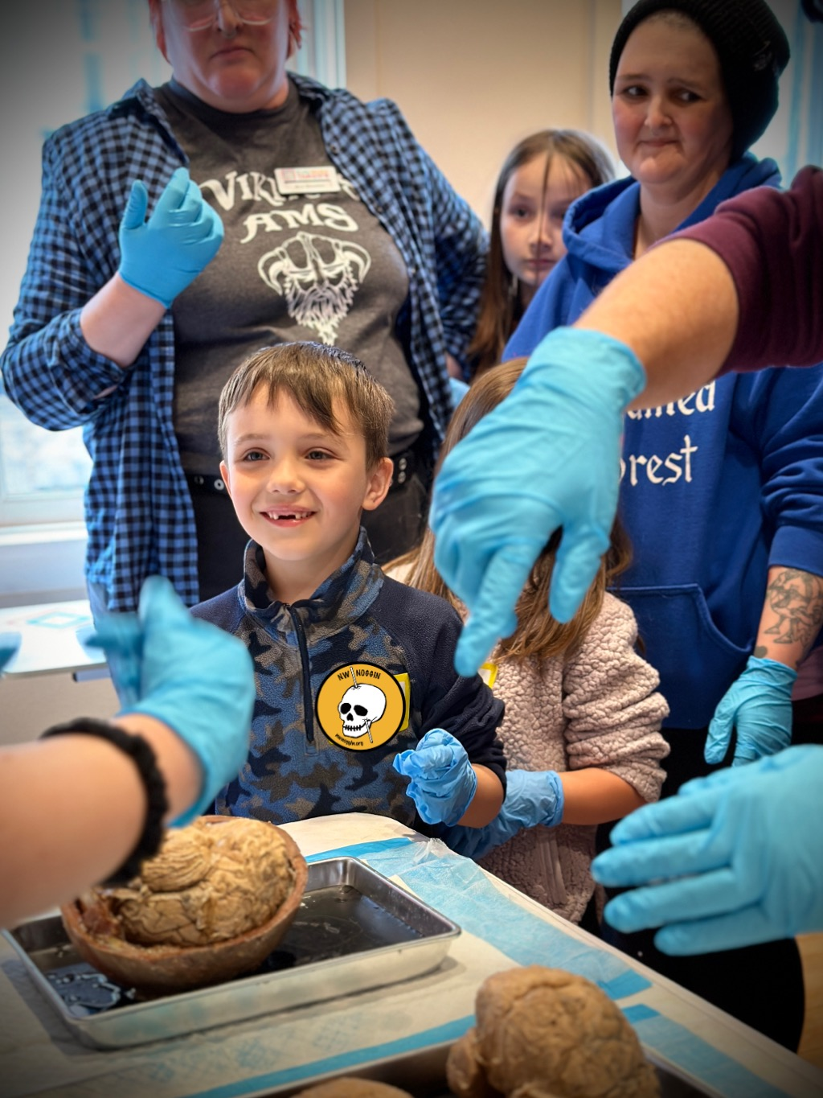

Slide 12
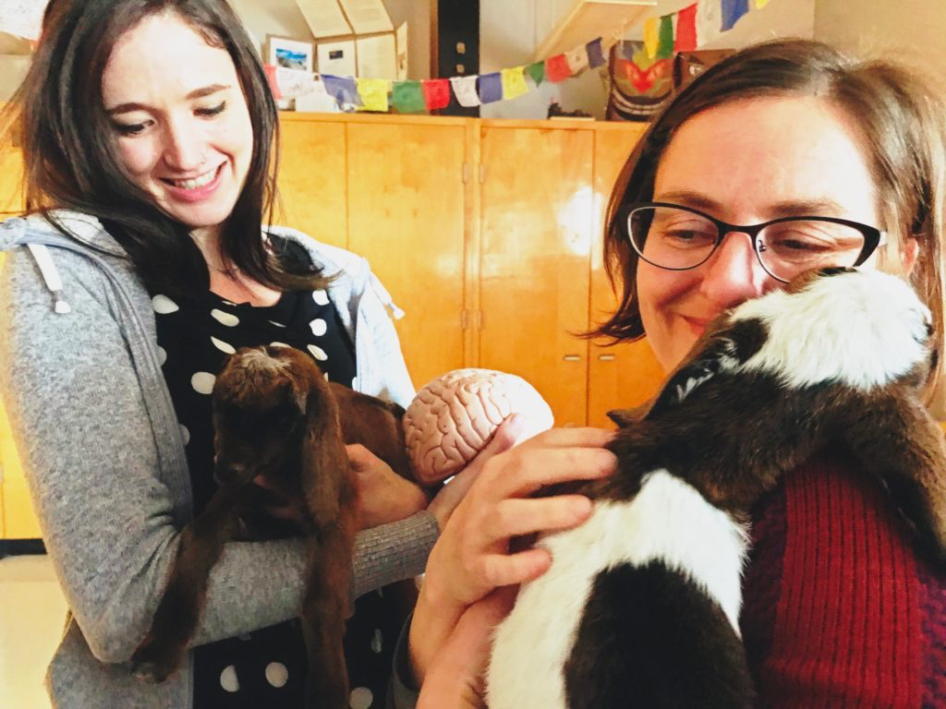
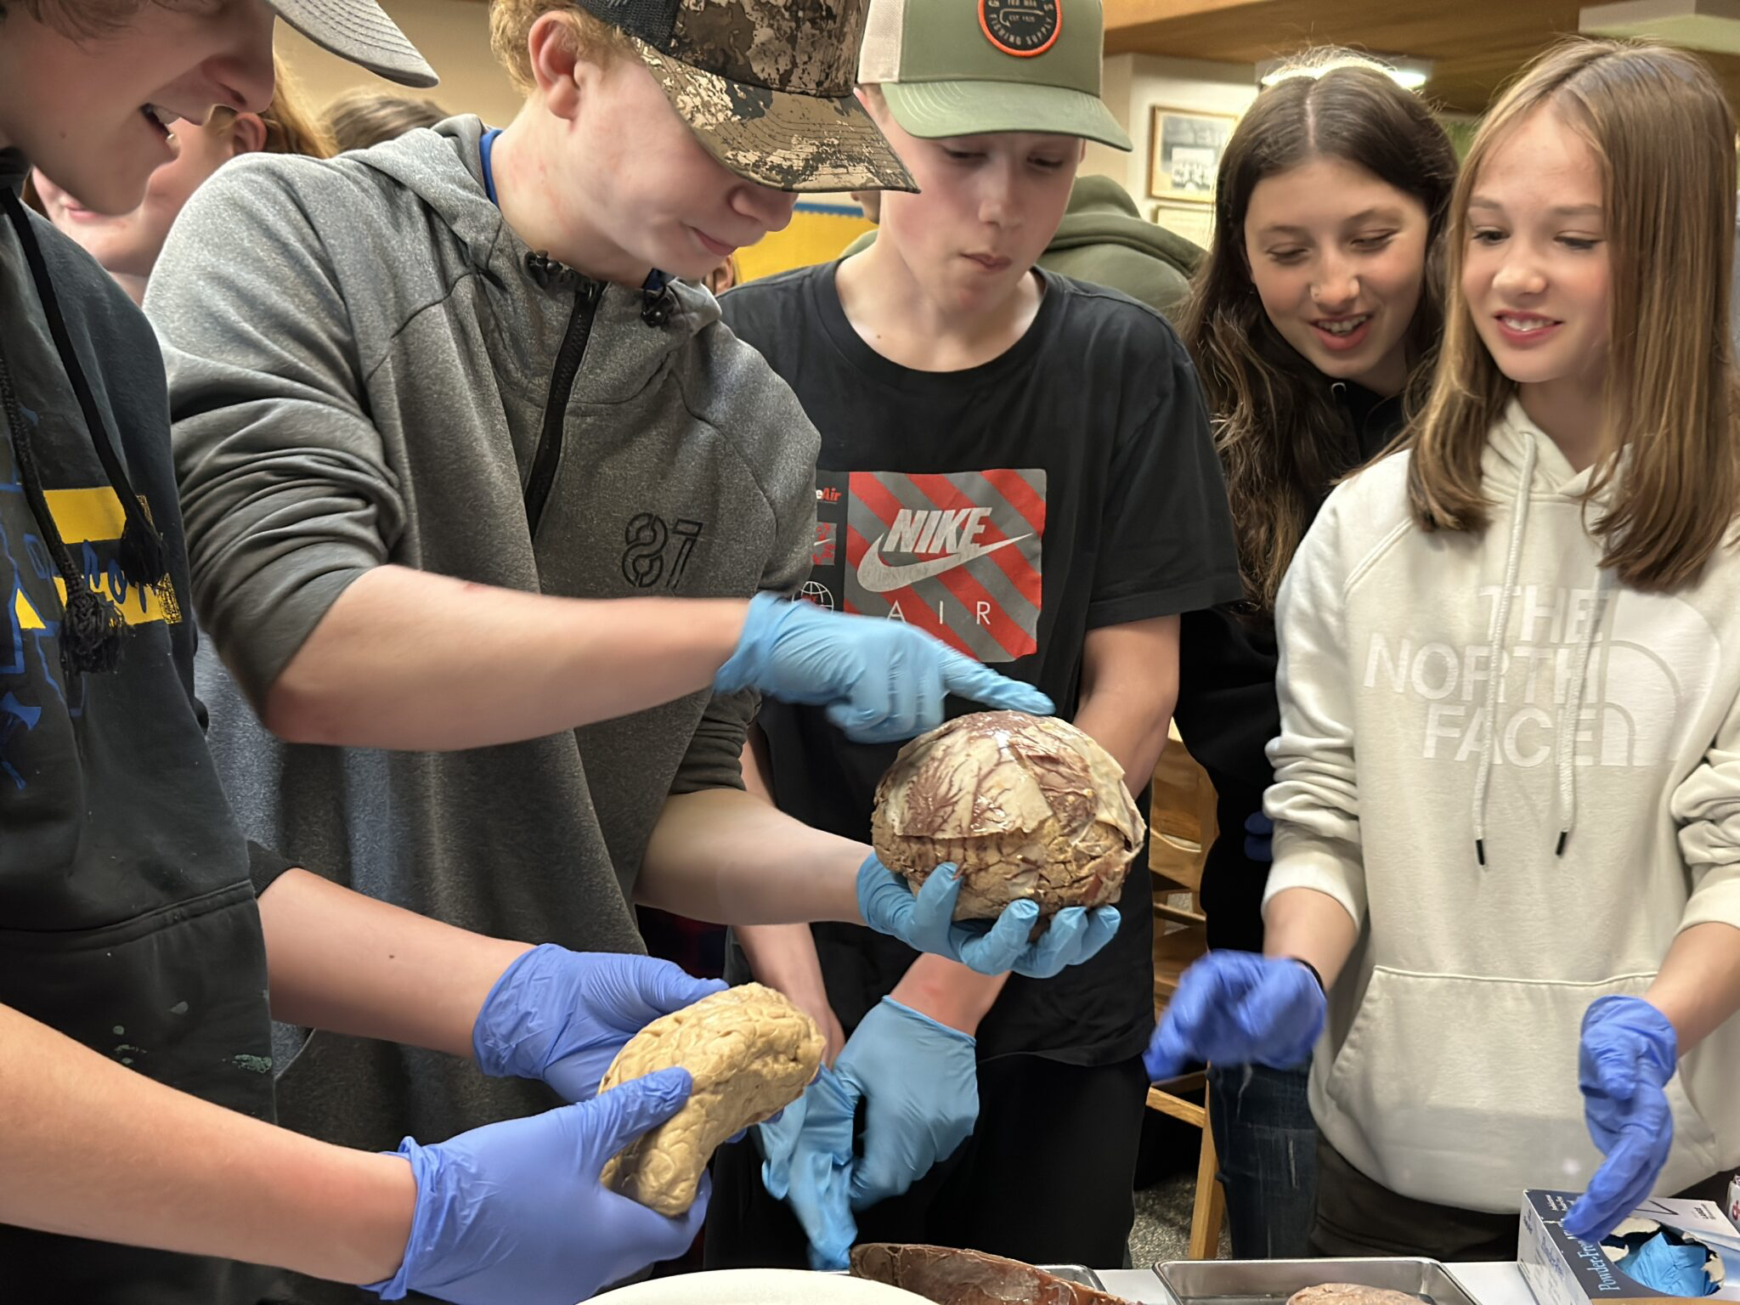
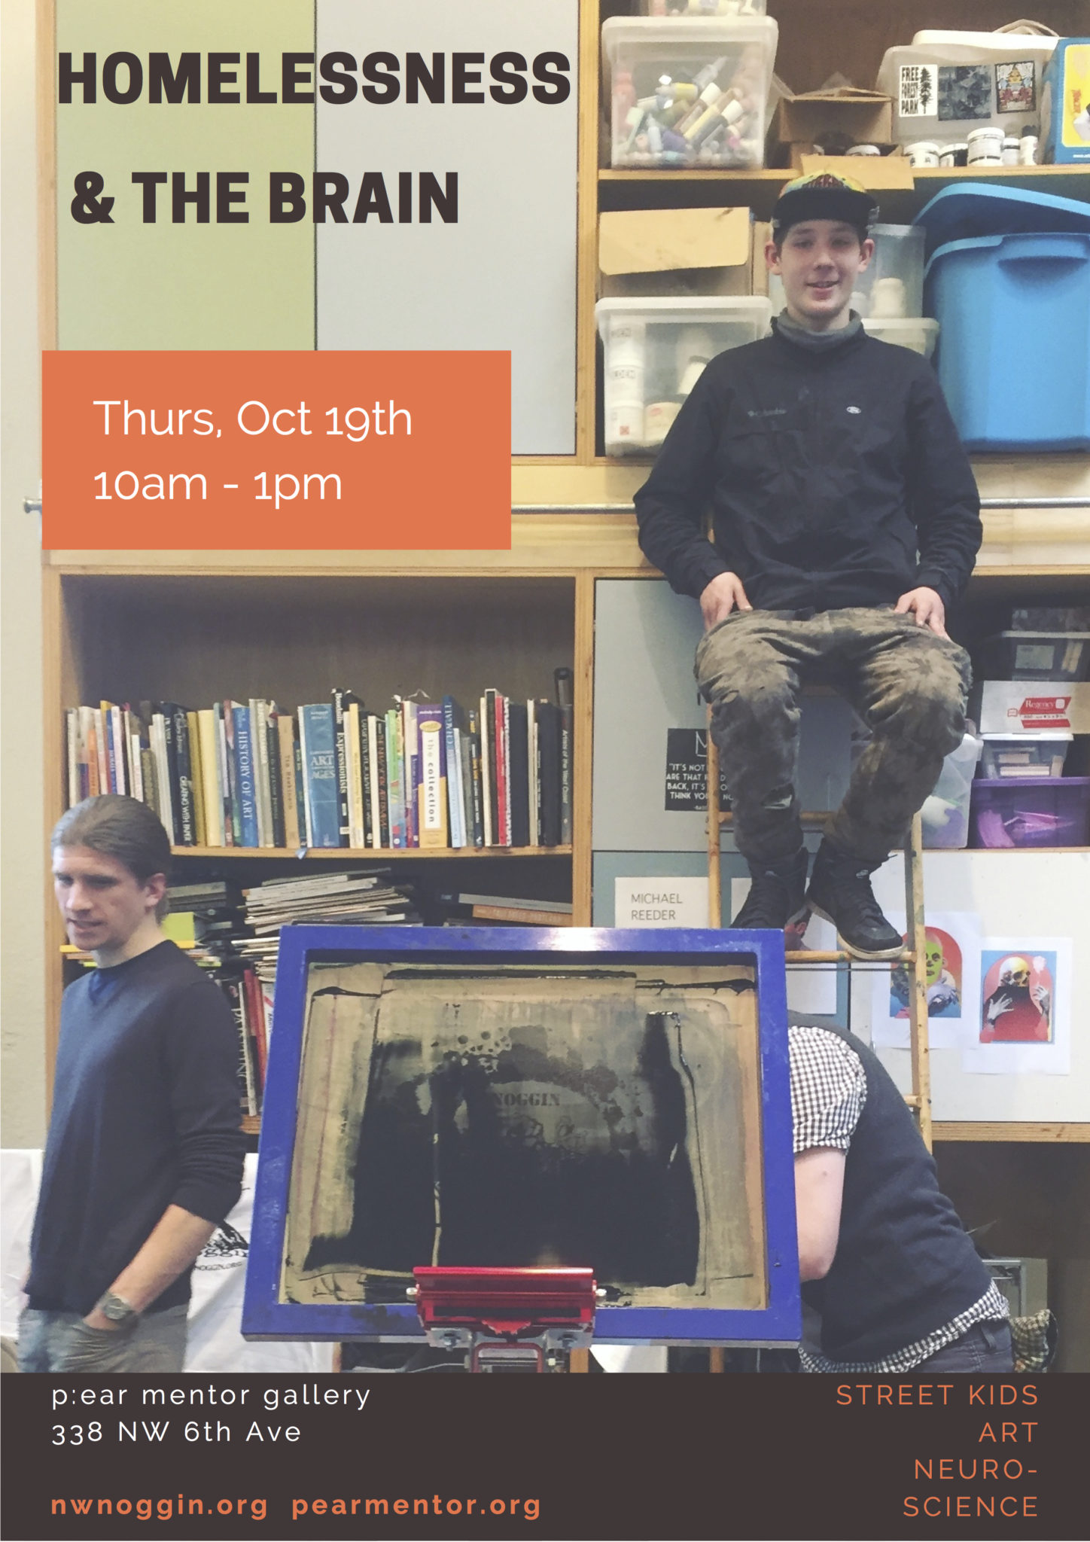
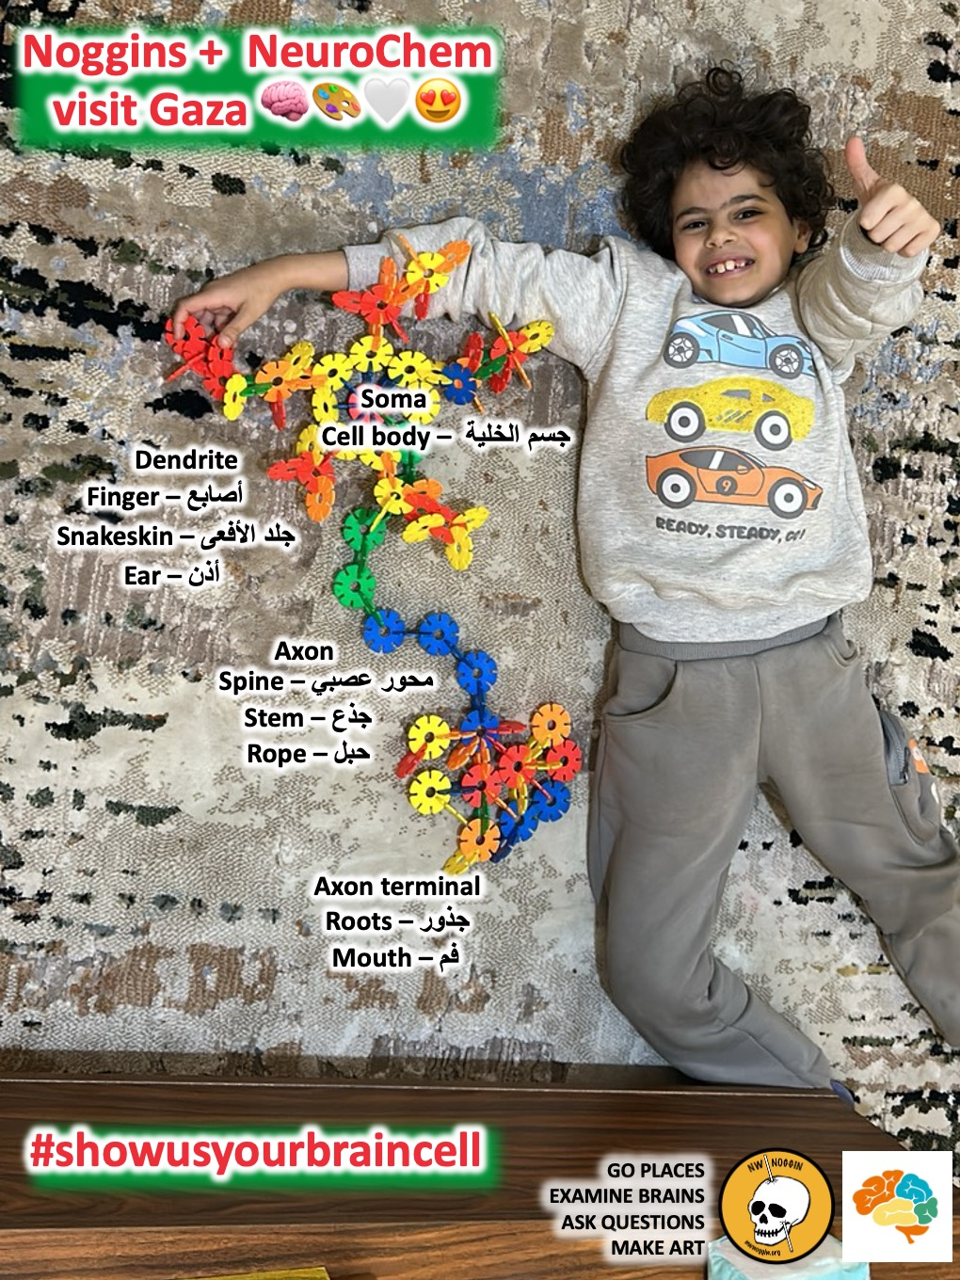
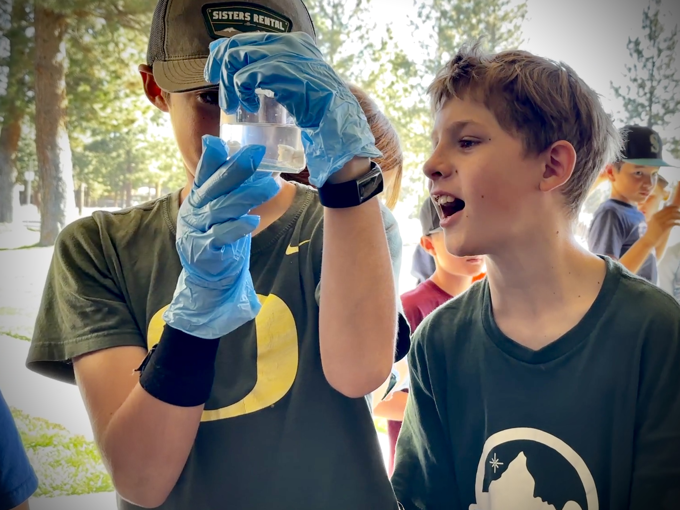
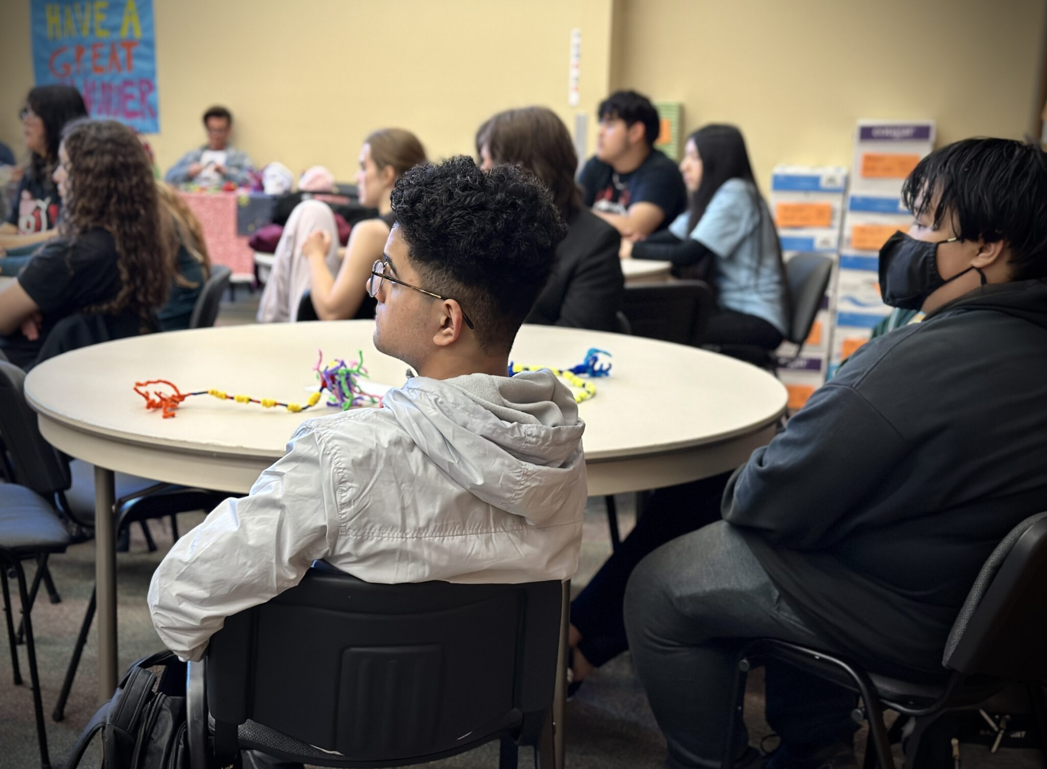
LISTEN
Heppner, OR
-lived experiences
-relevant knowledge
-seeing other people
Knappa, OR
Sisters, OR
Siletz, OR
Portland, OR
Portland, OR

Slide 13
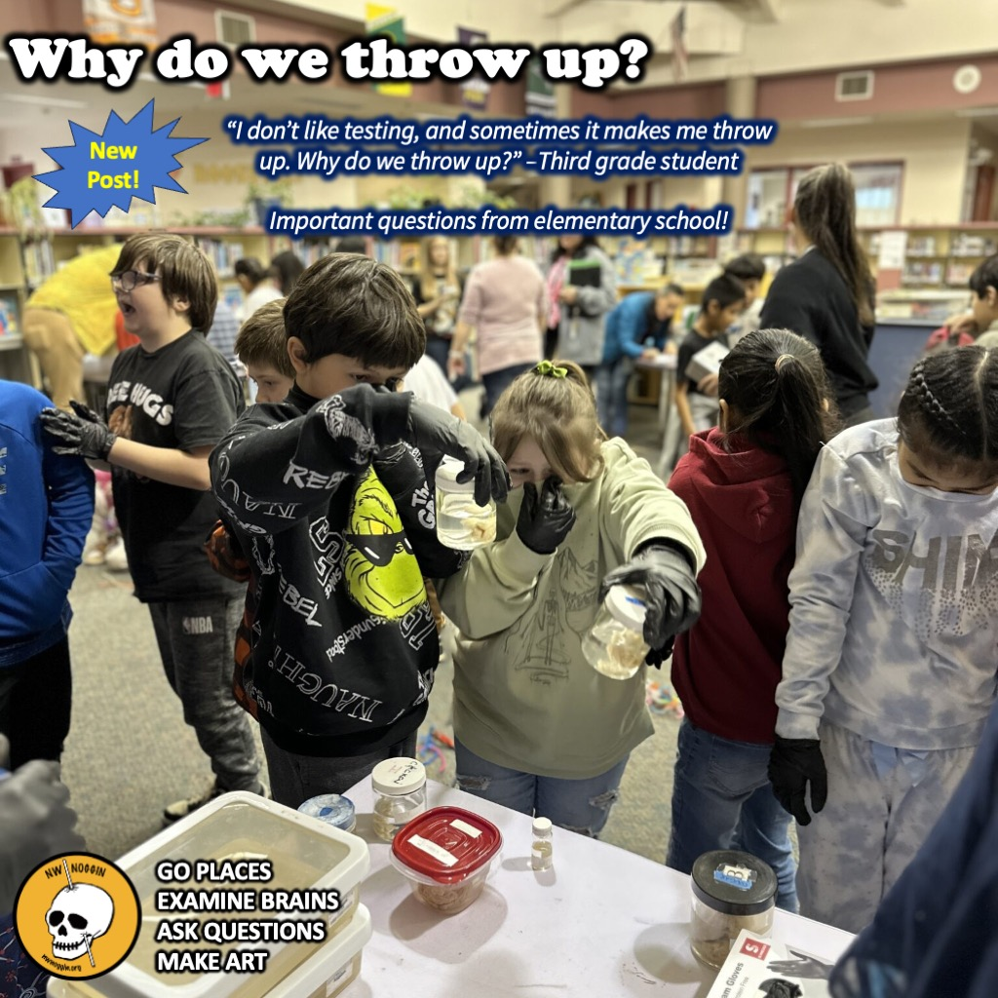
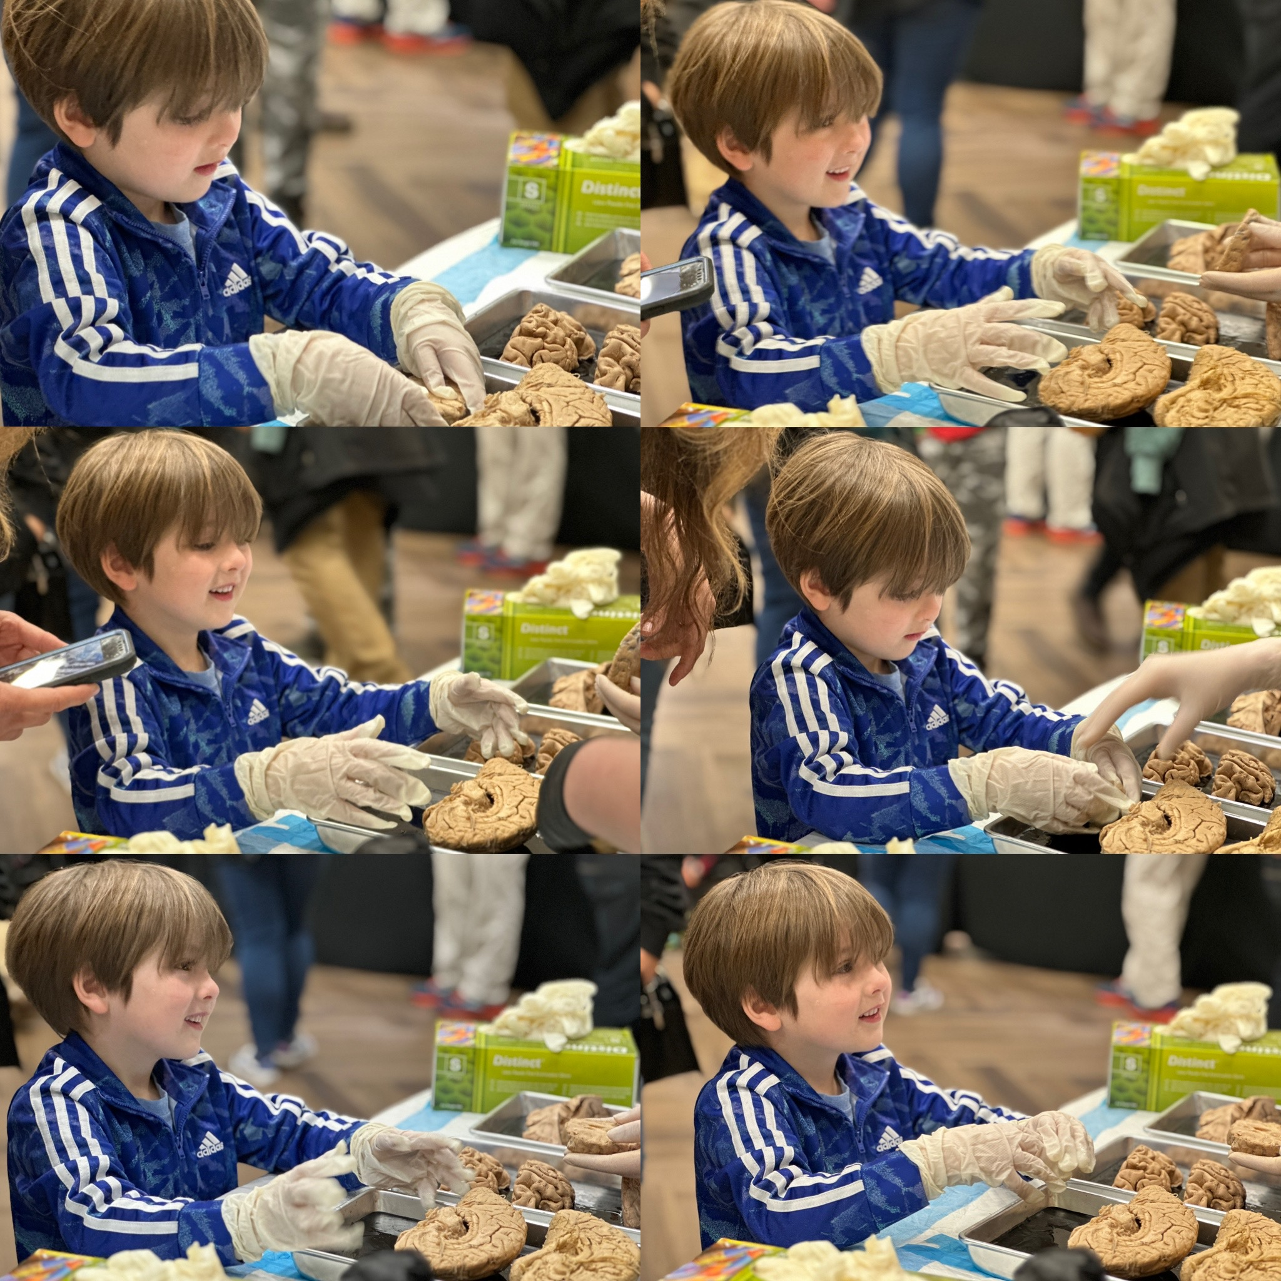
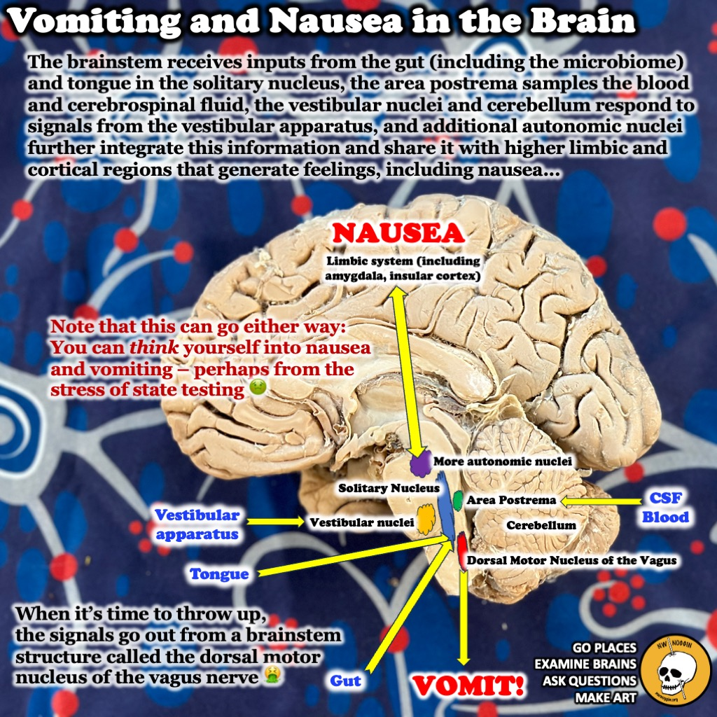

Slide 14
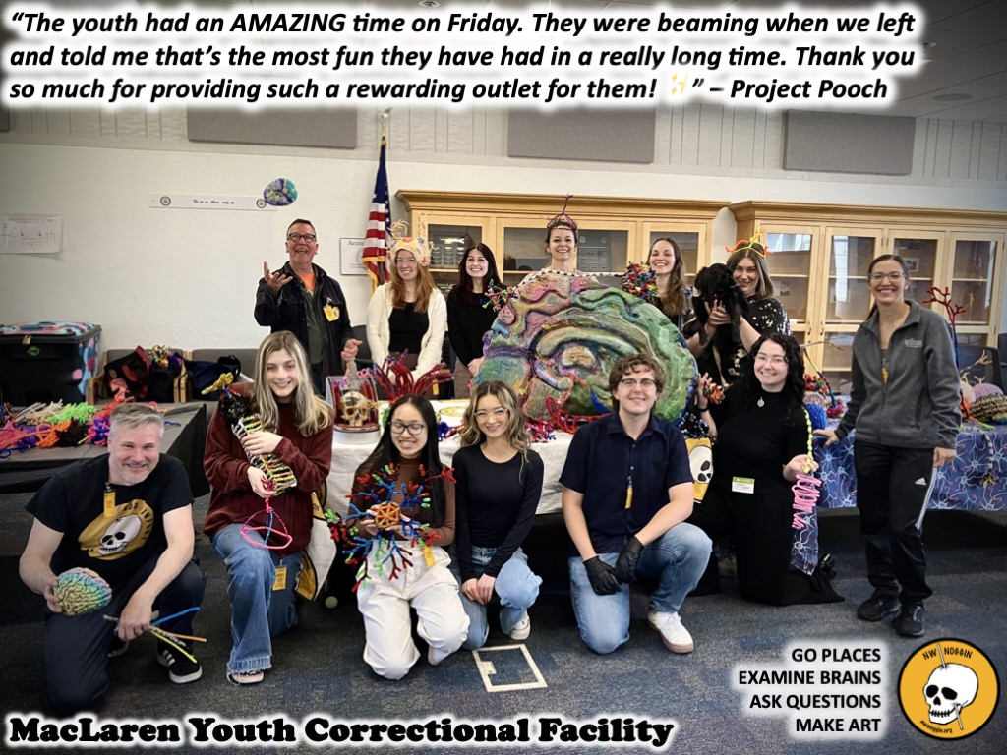
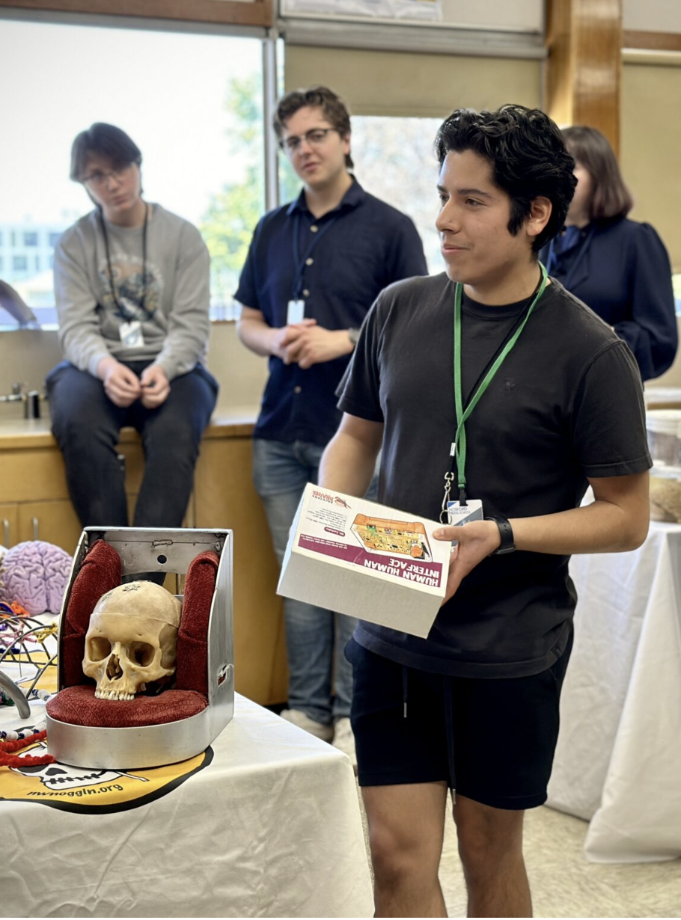
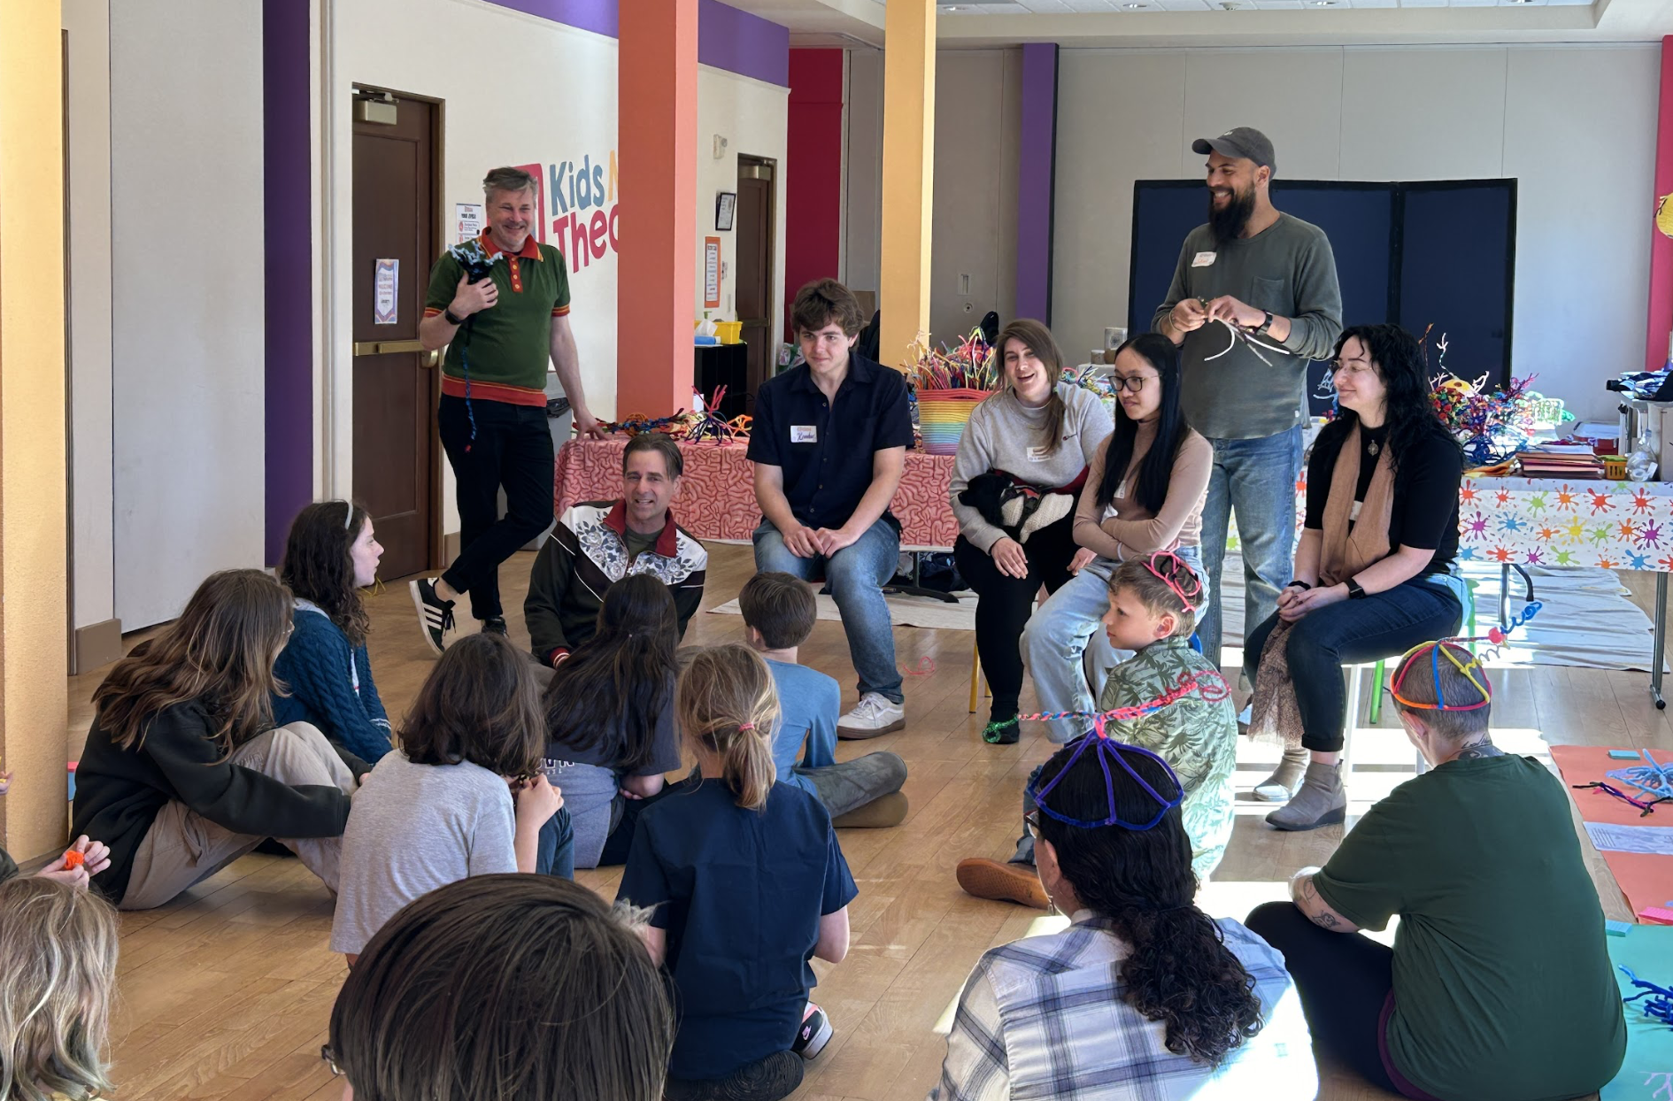
Portland, OR
Astoria, OR

Slide 15
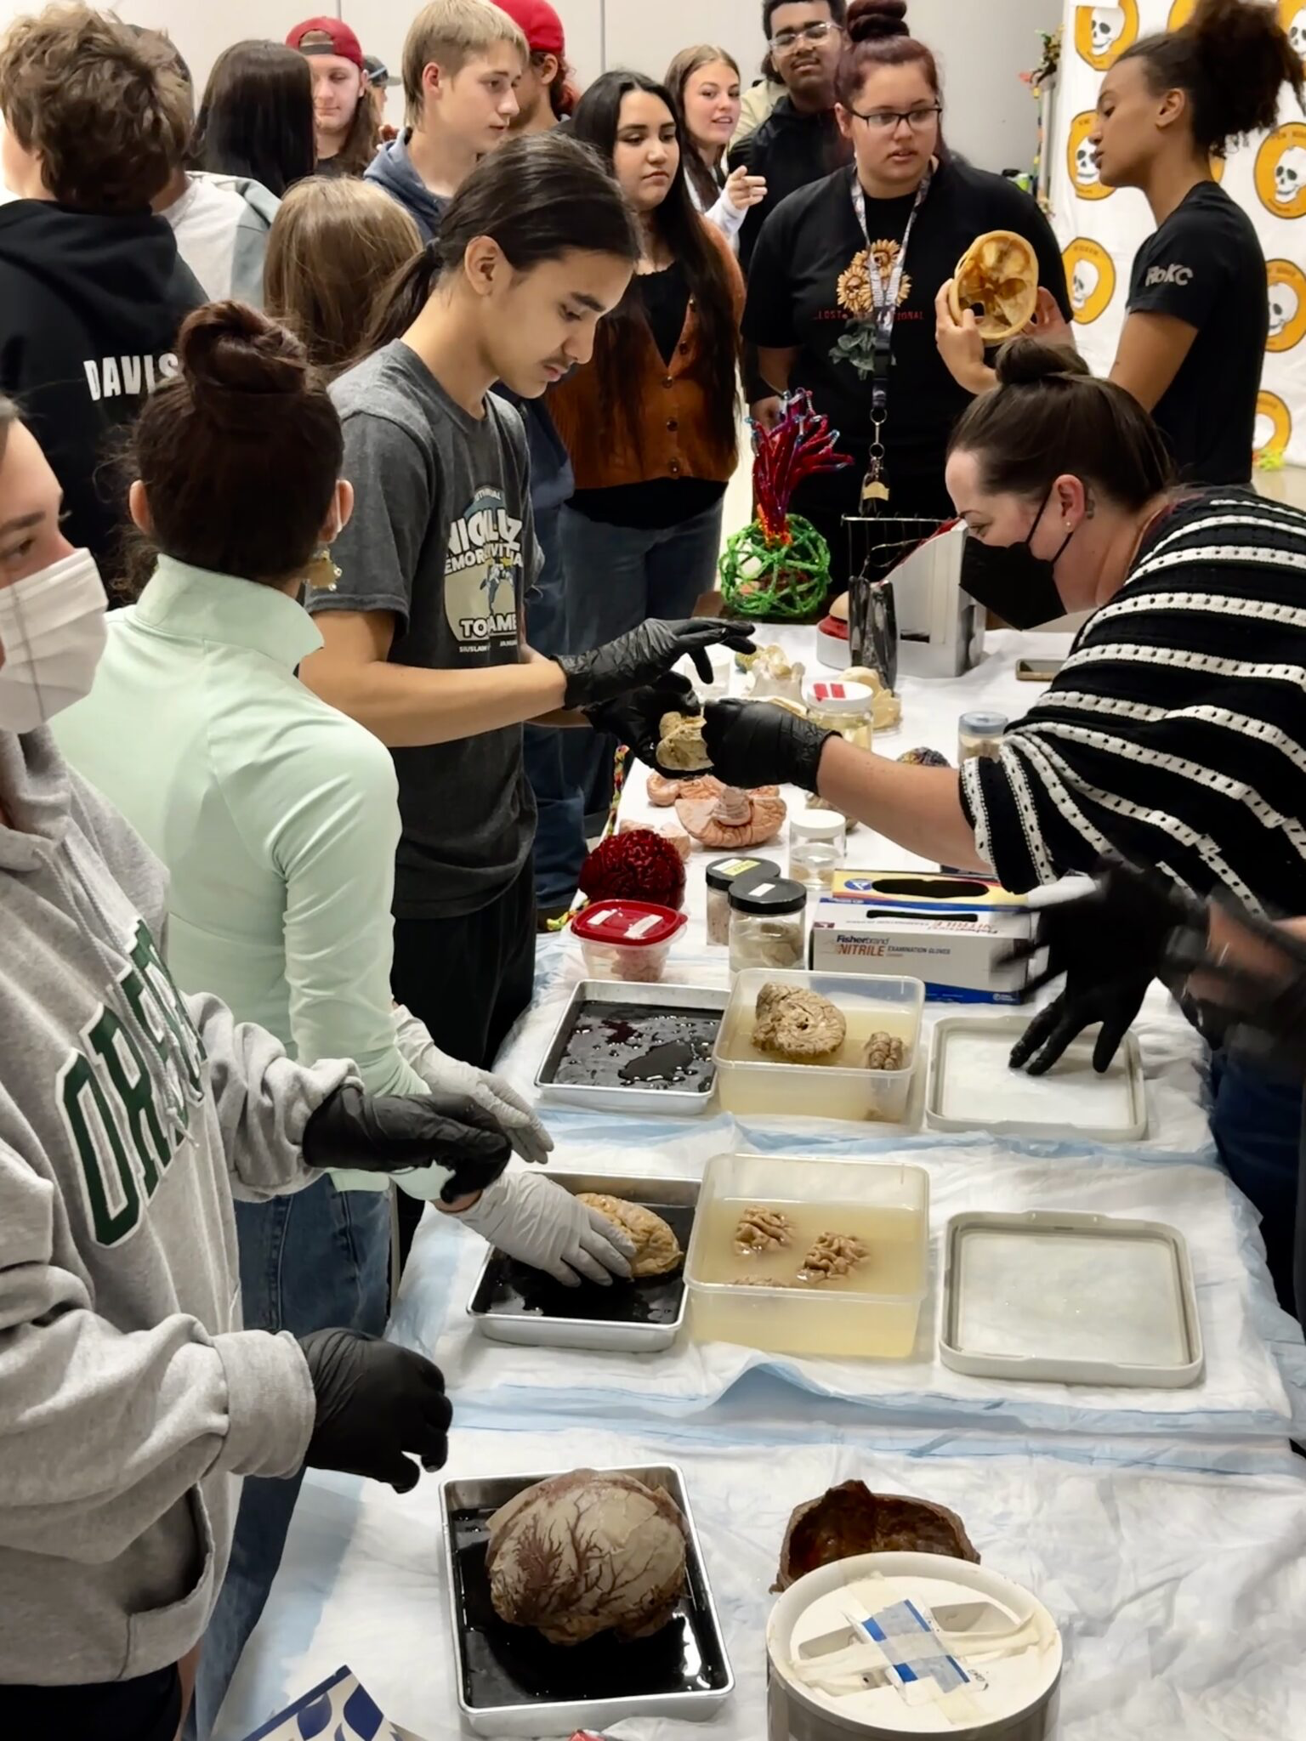
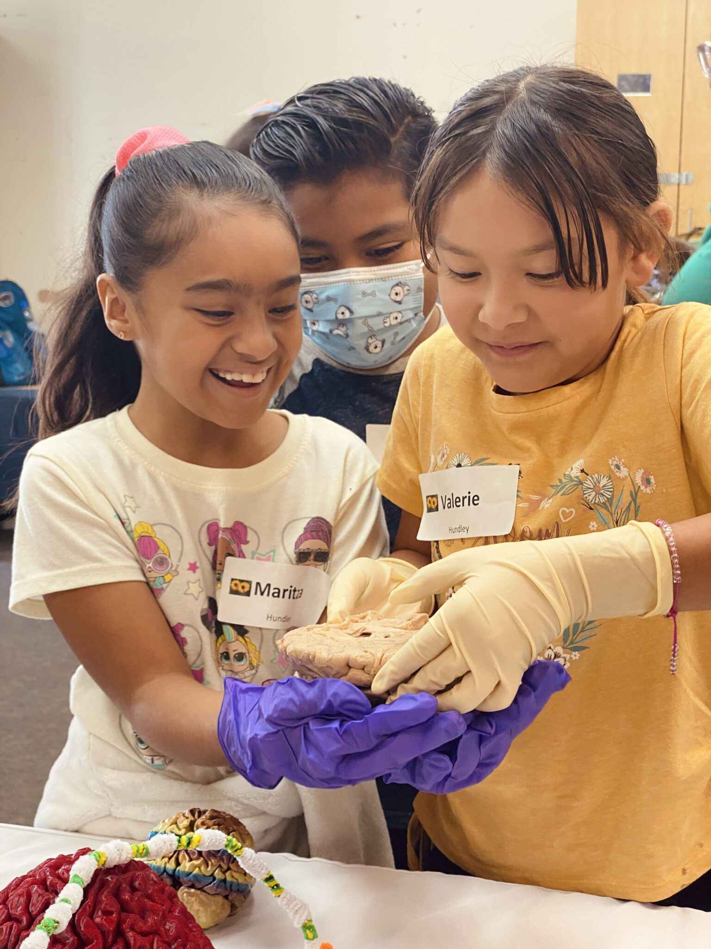
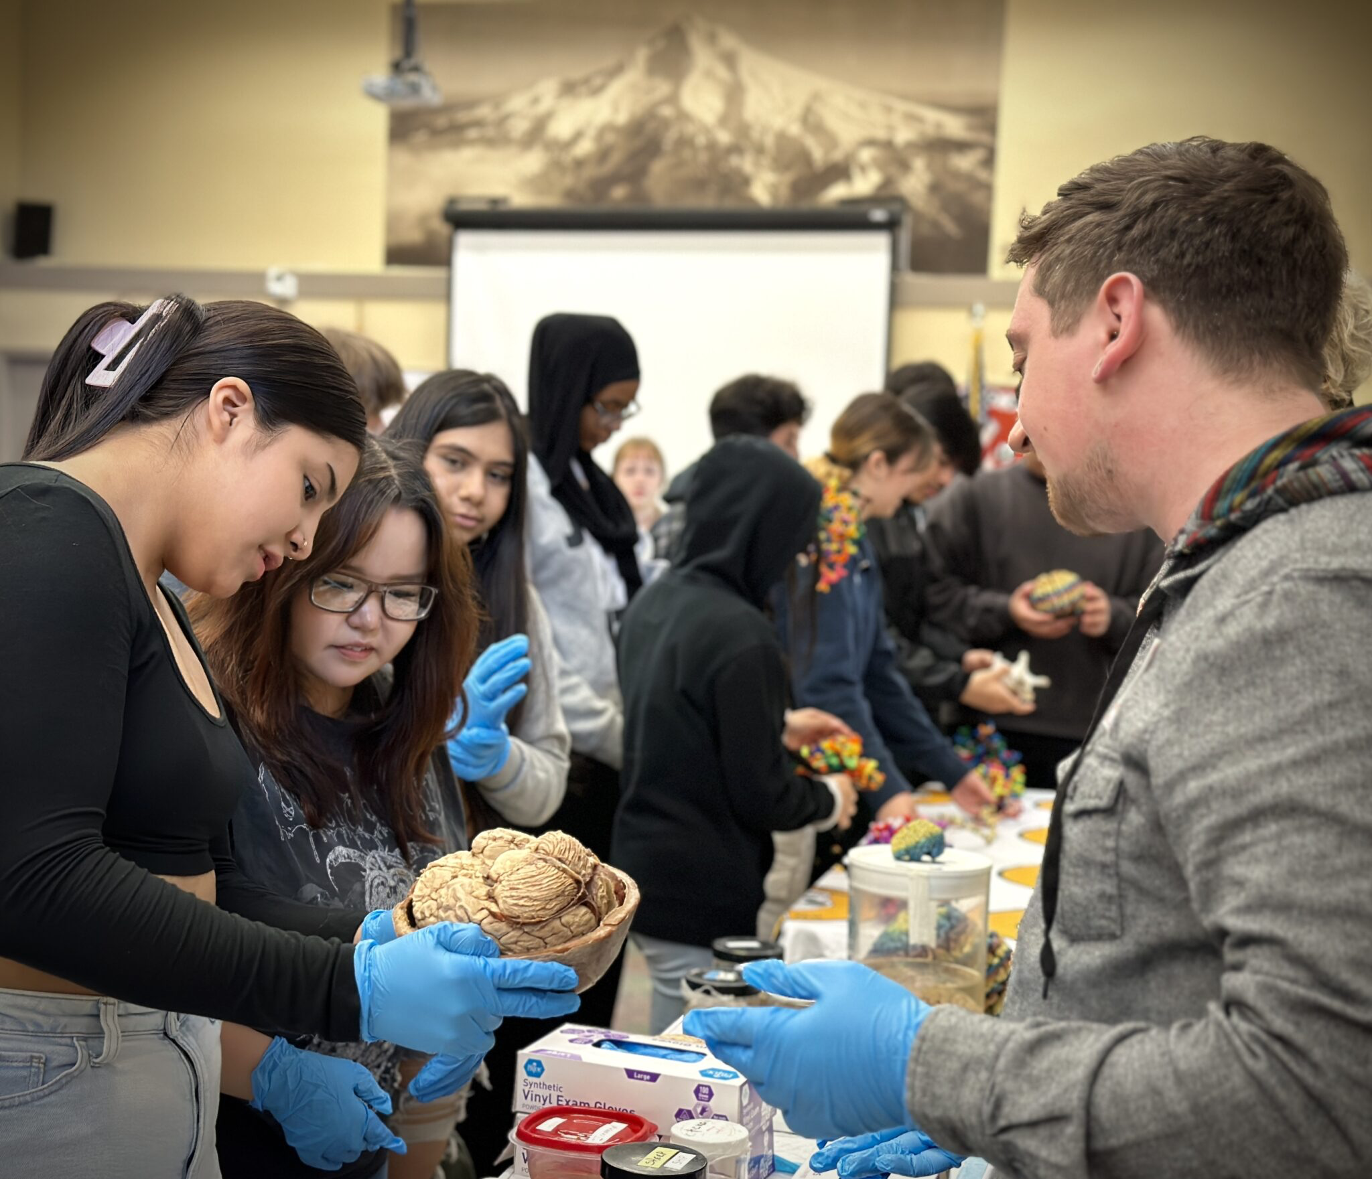
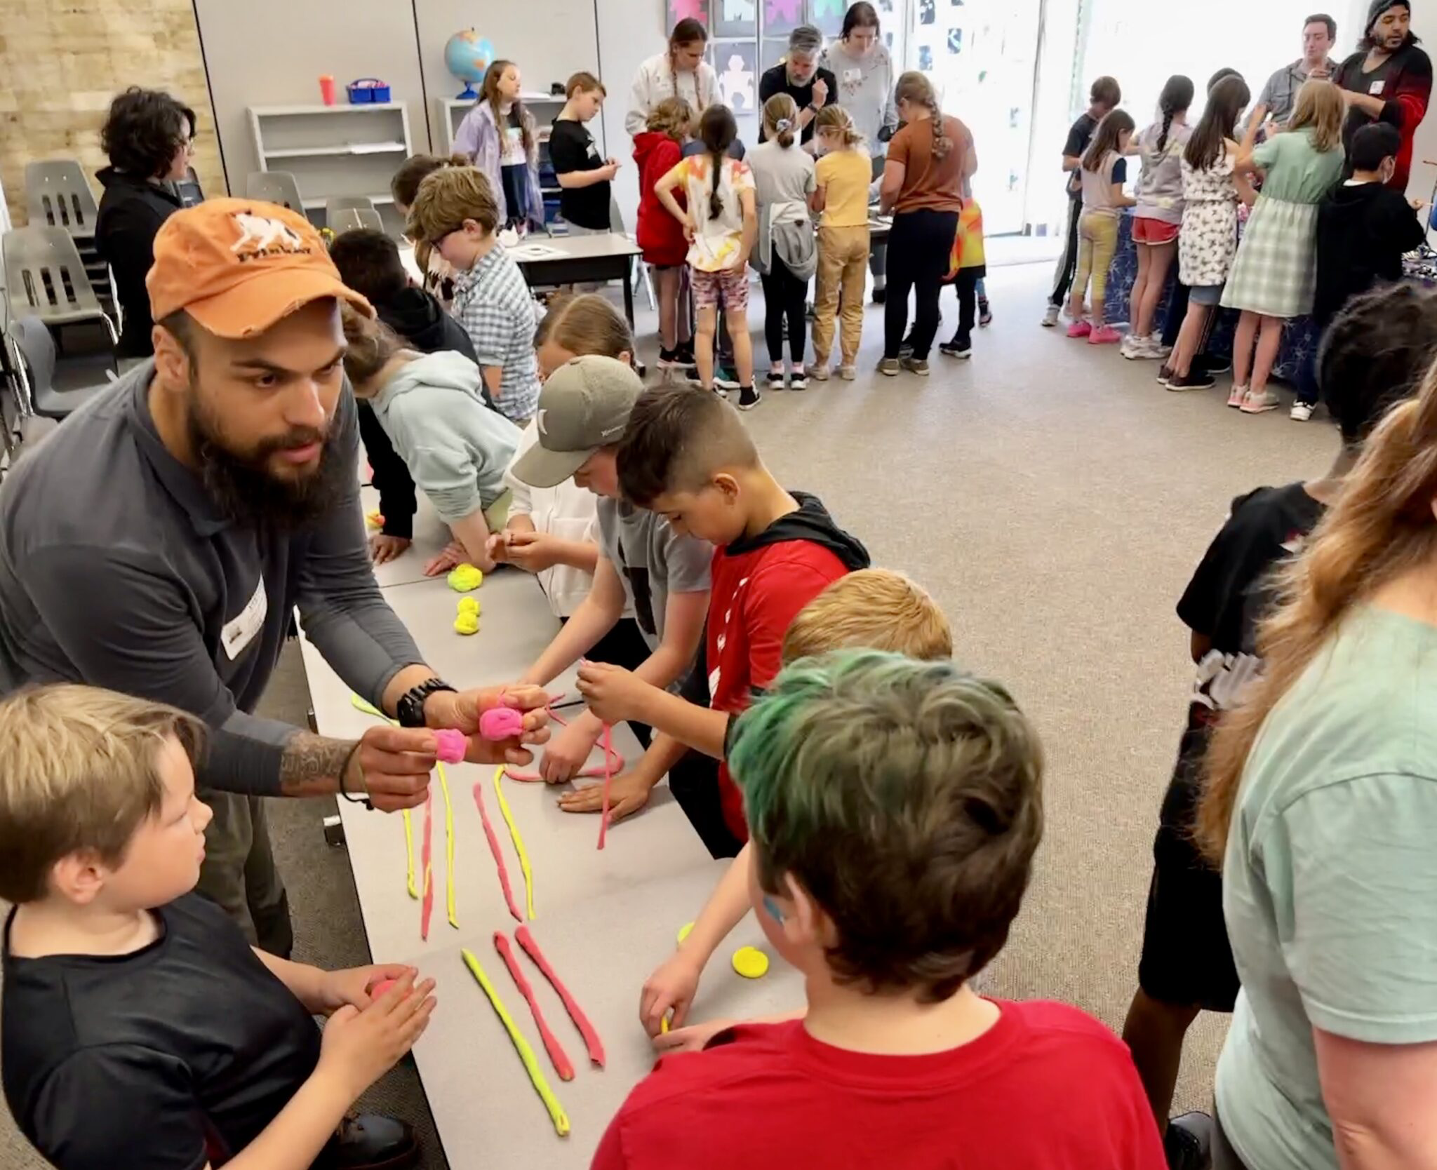
SHARE STORIES
-Empower new voices
-Broaden the conversation
-Make public investment in research relevant
-Invite new participants, perspectives & brains

Slide 16
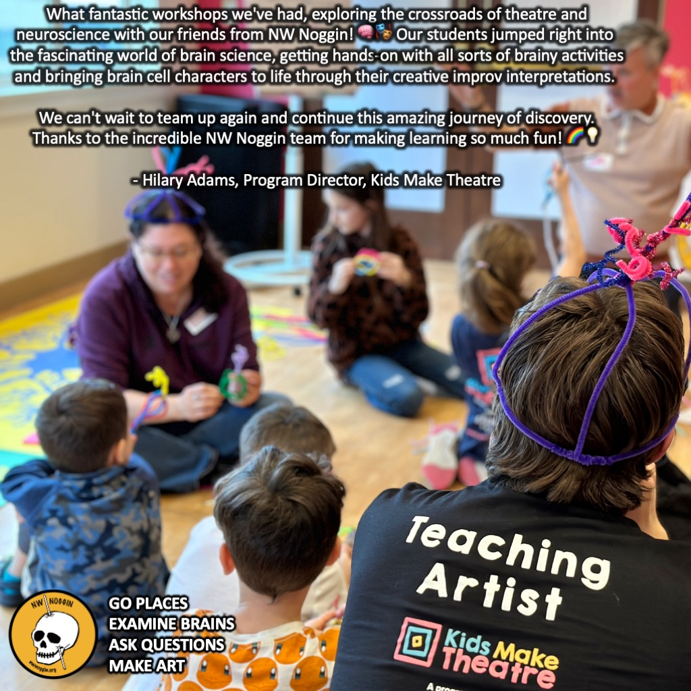
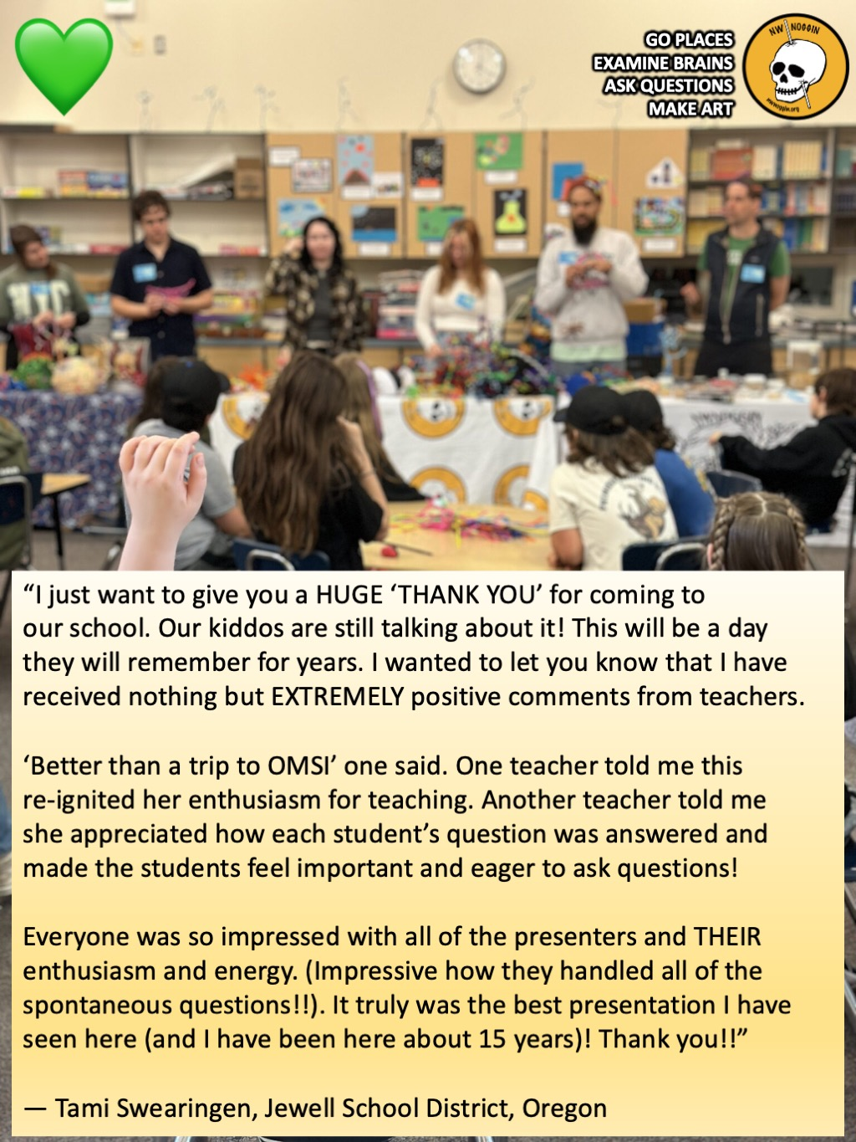

Slide 17
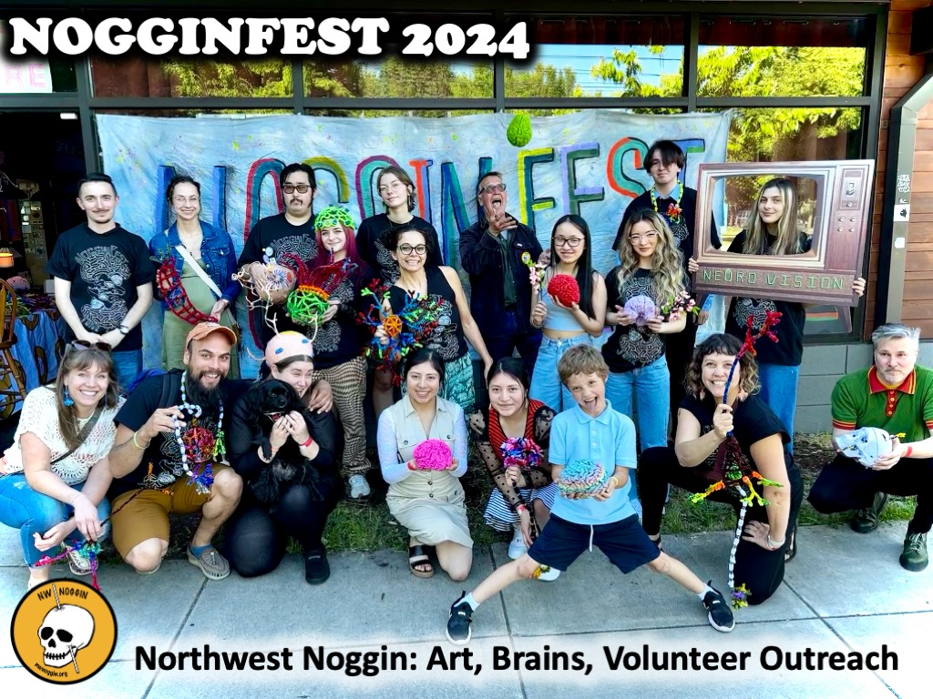
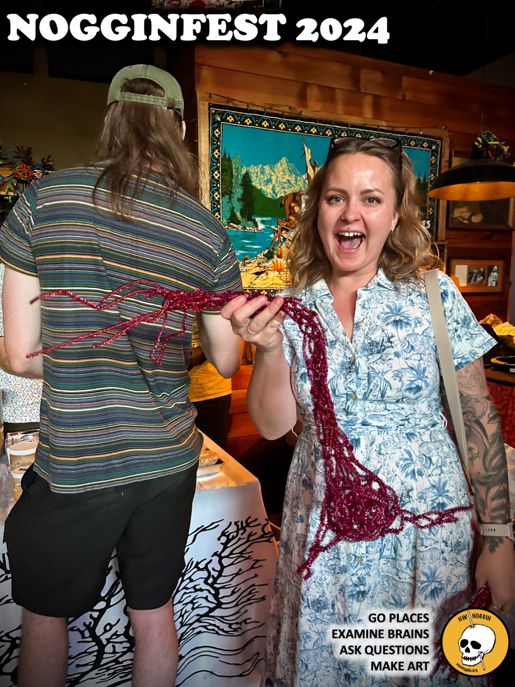
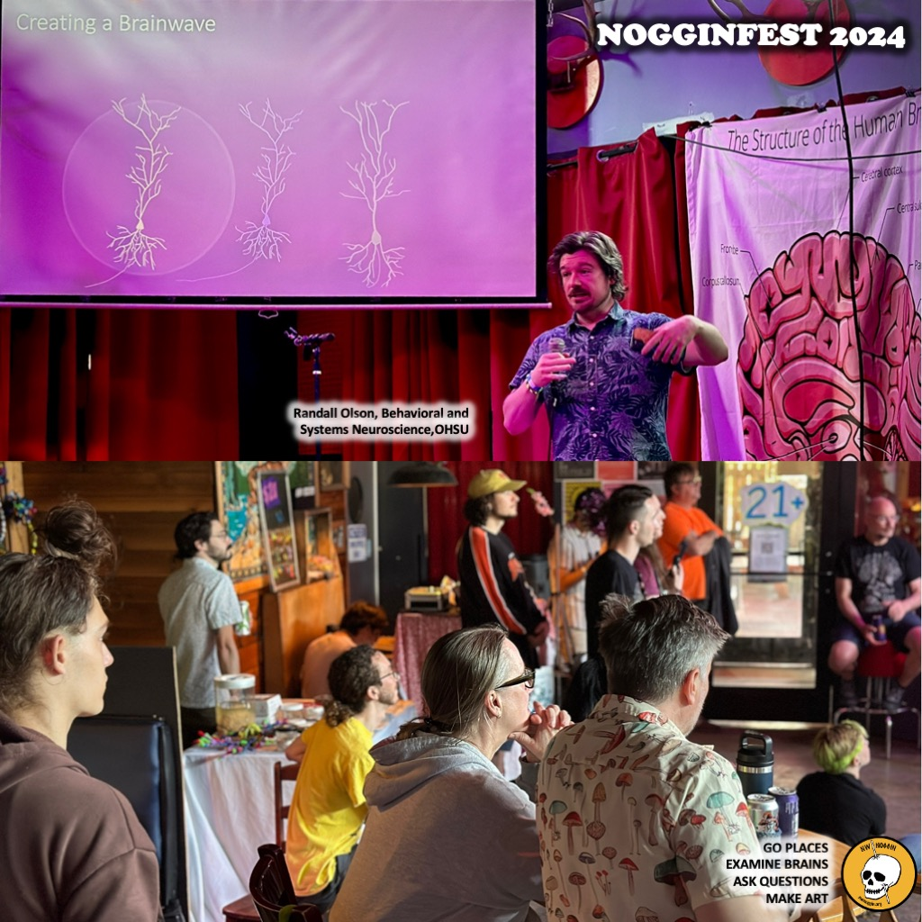
The largest student-run, accessible,
all ages, FREE public celebration of music,
art, brain research and interdisciplinary
neuroscience in the Pacific Northwest!
2025!!!

Slide 18
MAKE ART
-Engagement
-Personal relevance
-self-awareness AND EMPATHY

Slide 19
INFORM POLICY
-Research topics are popular!
-Interdisciplinary/STEAM approaches WORK
-1. School start times for adolescents
-2. Permanent standard time
-3. Housing first

Slide 21
Brain research is compelling
*PEOPLE ARE INTERESTED
*THEY WANT to hear about it, and be included
*LARGe institutions get funding, but don’t ALWAYS
go places, listen, share stories accessibly or
make or support art AND engagement

