Slide 1
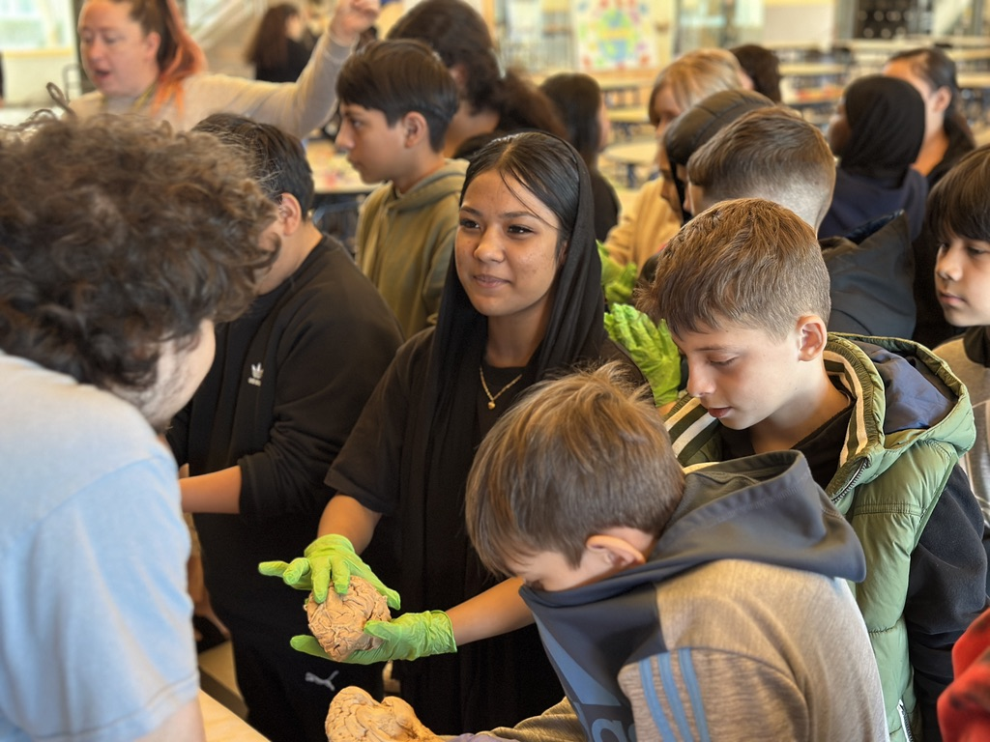
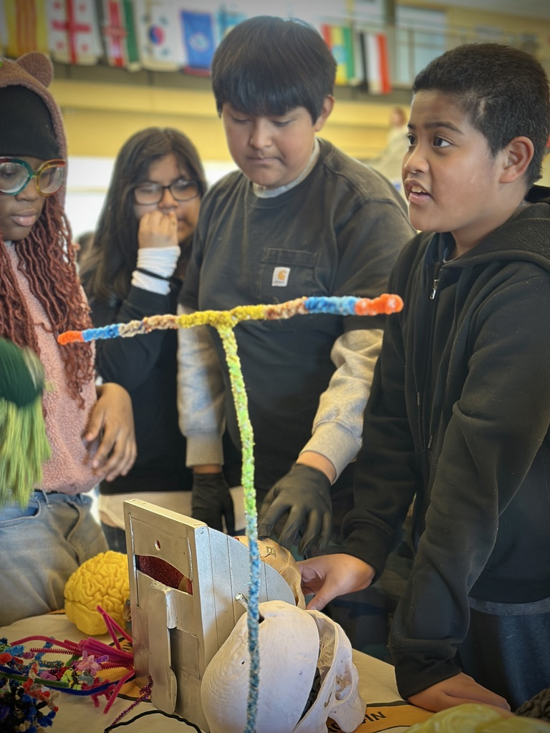
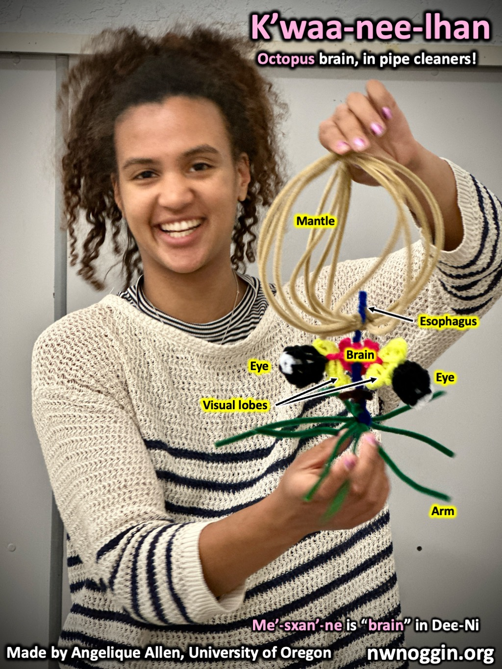
Northwest
Noggin
Engaging community through neuroscience research and art!

Slide 2
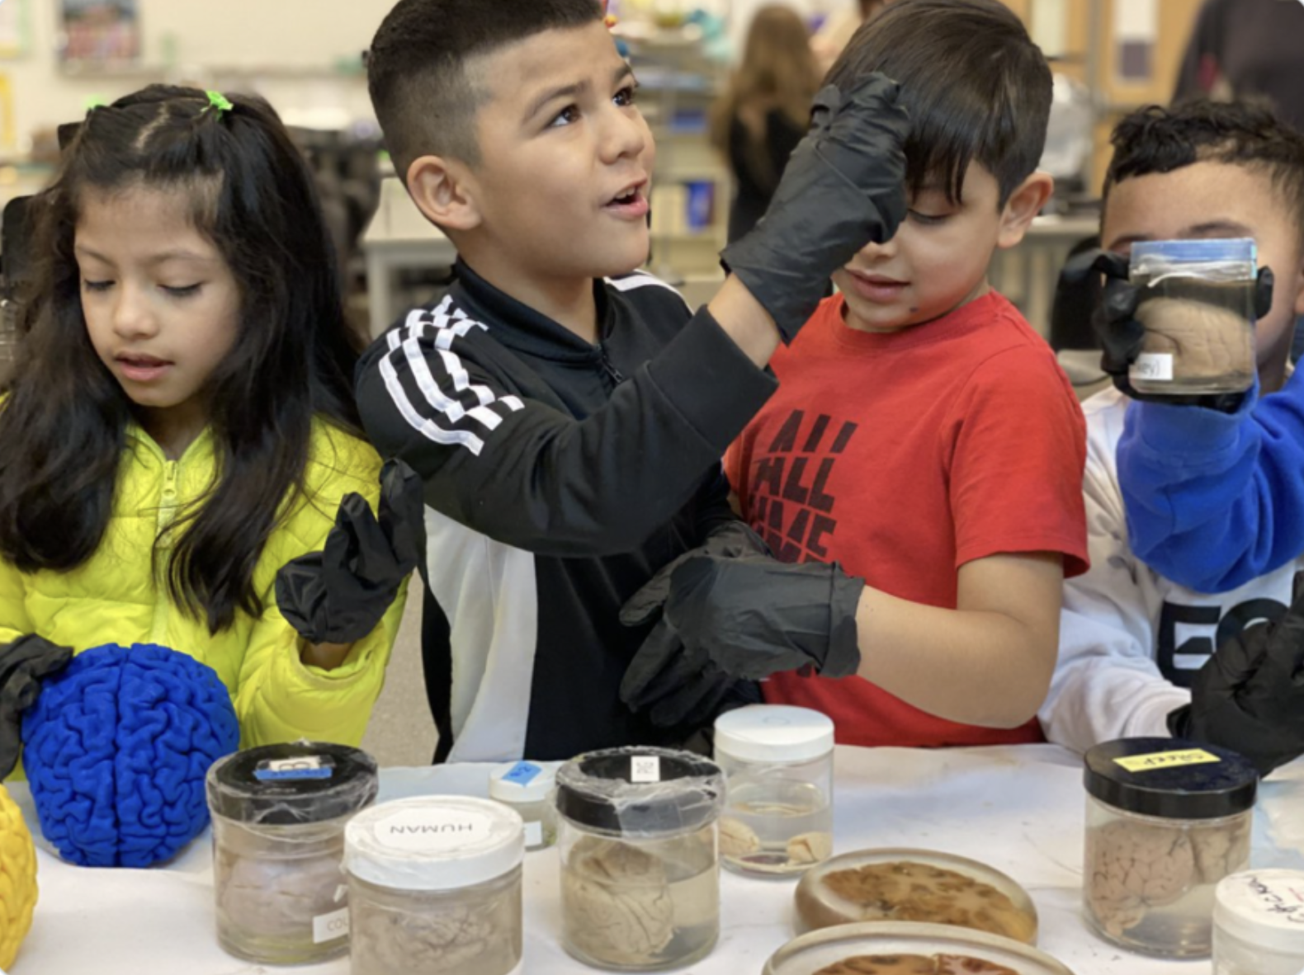
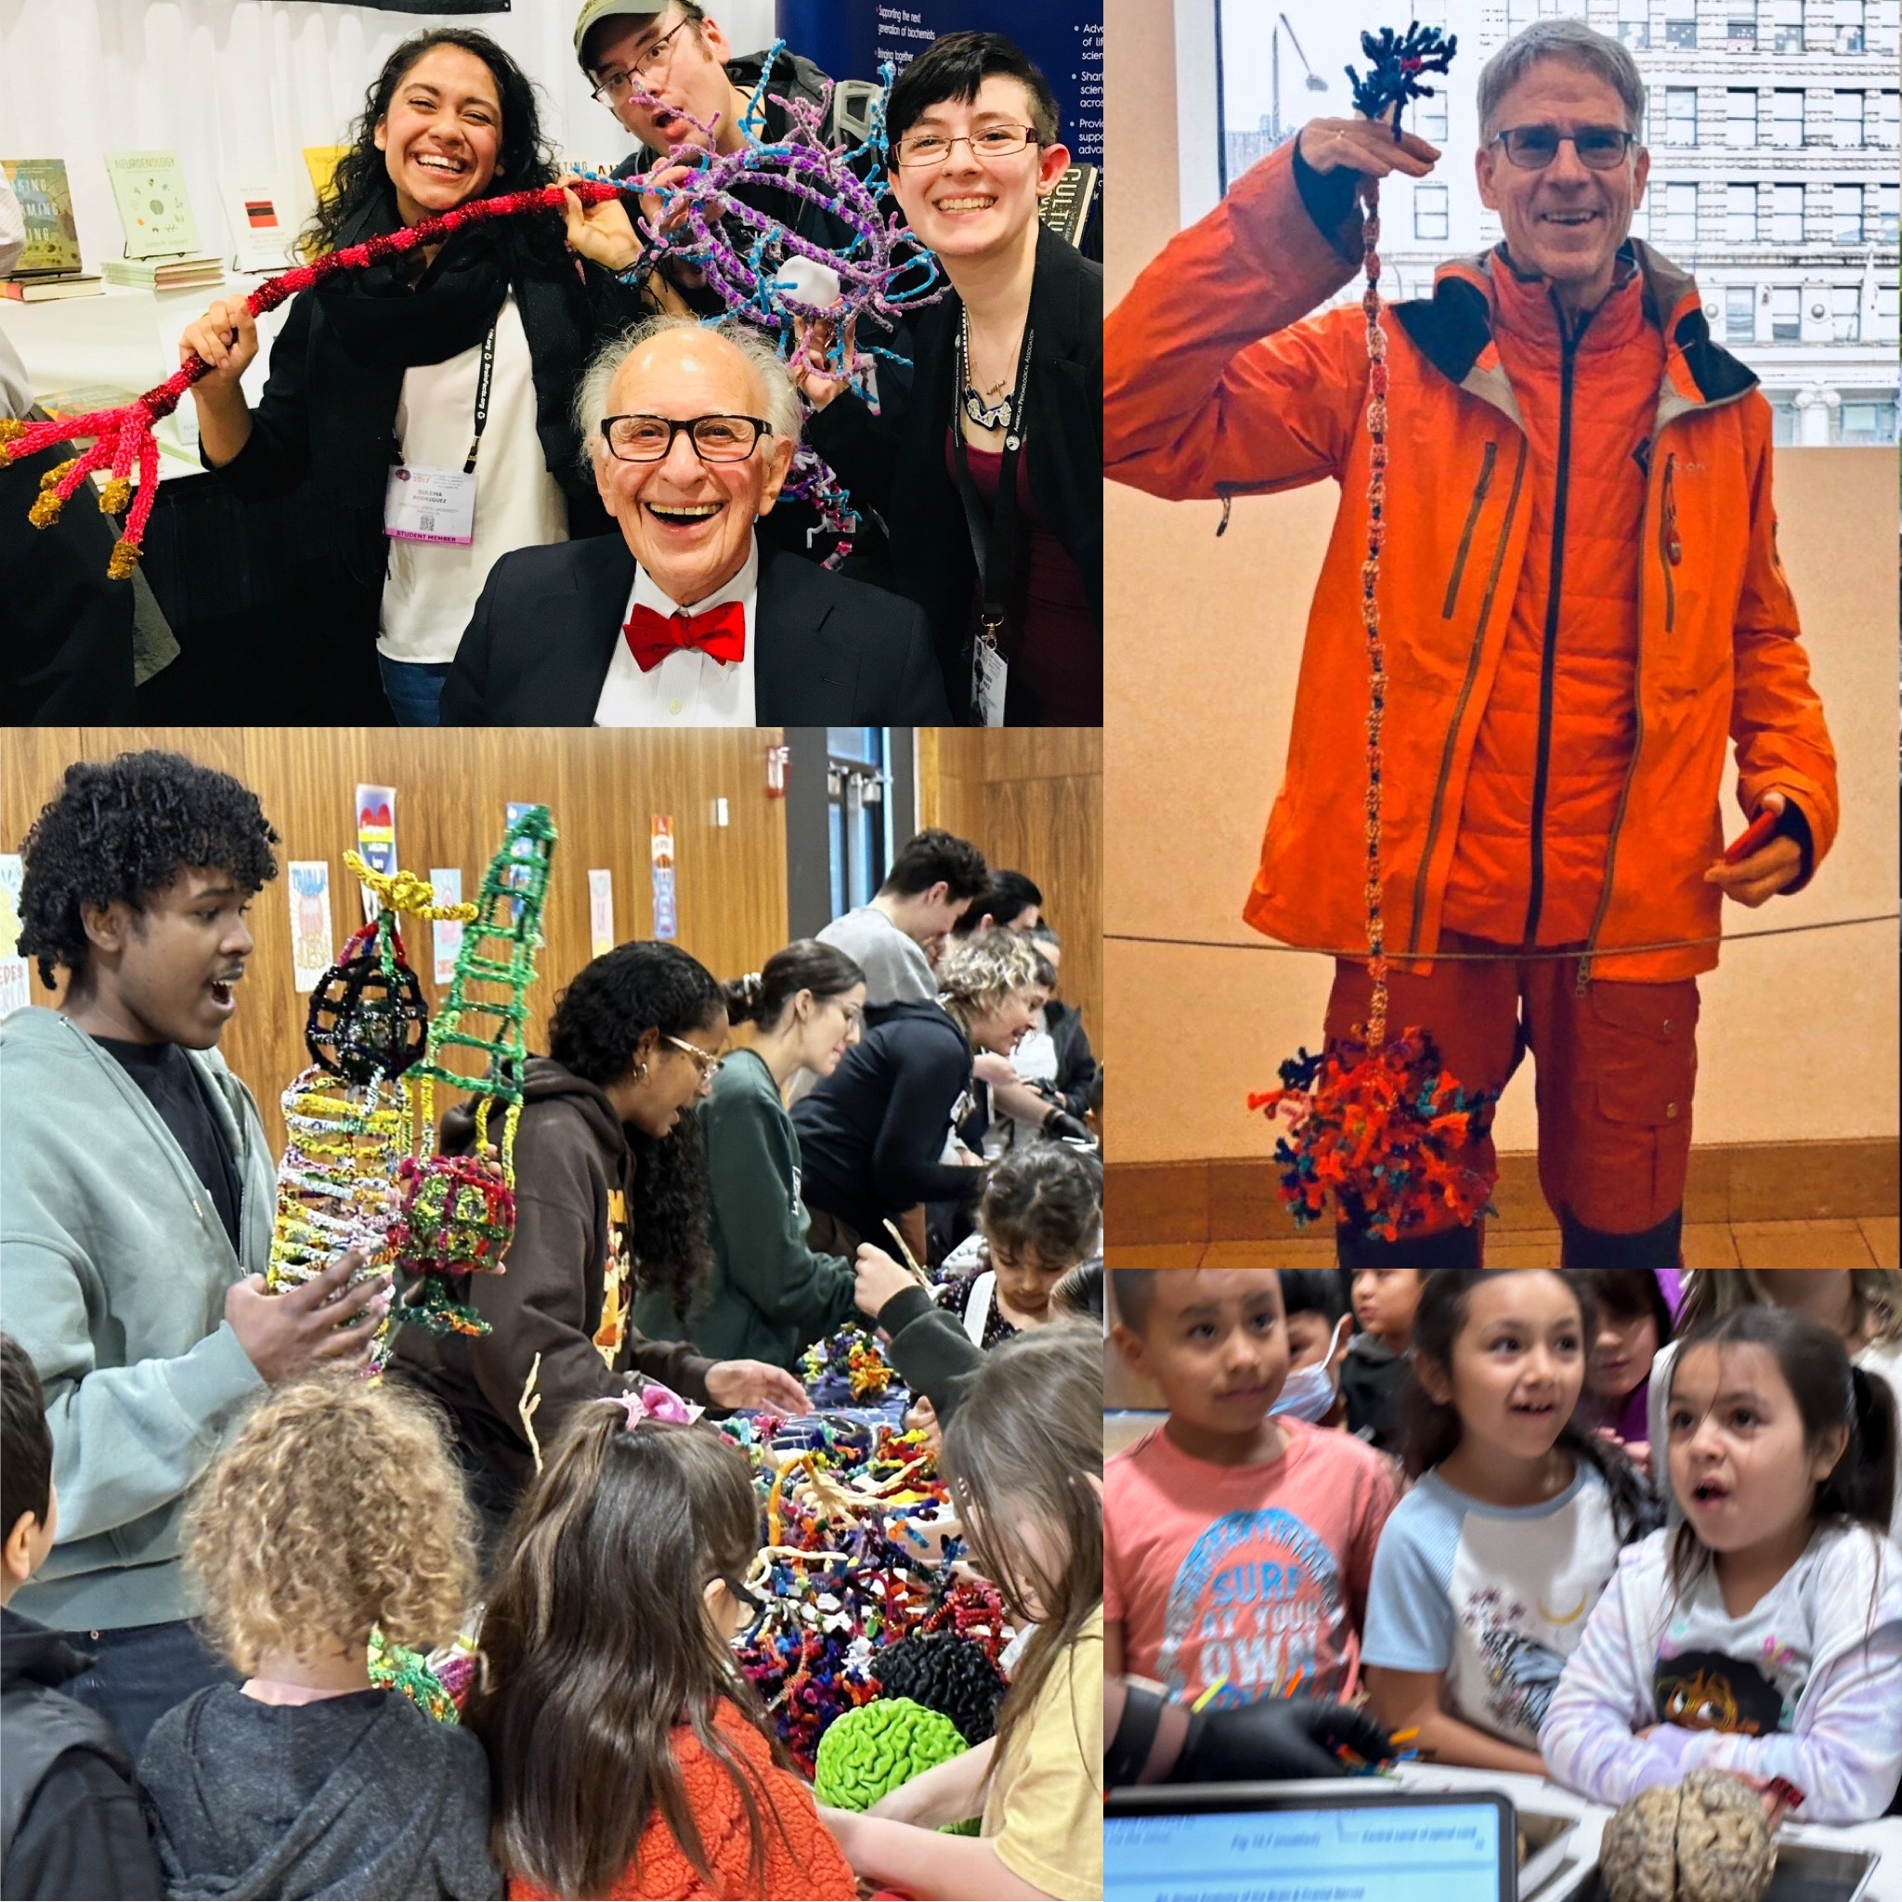
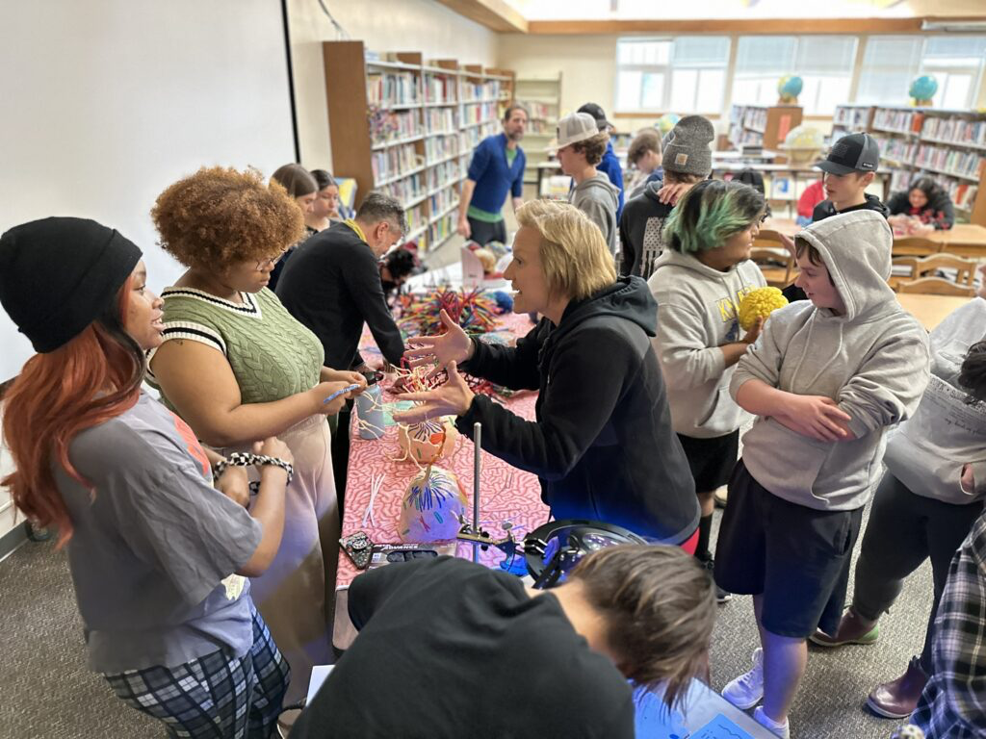
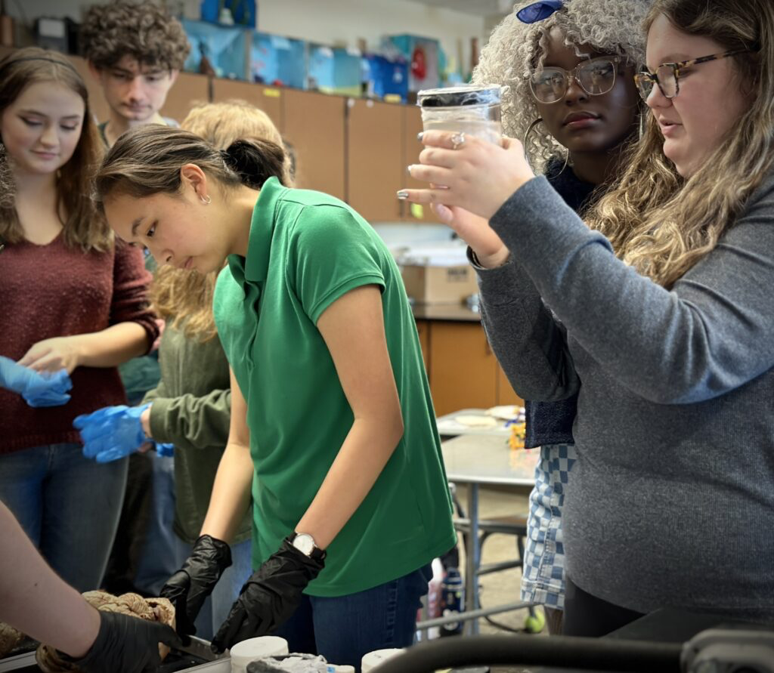
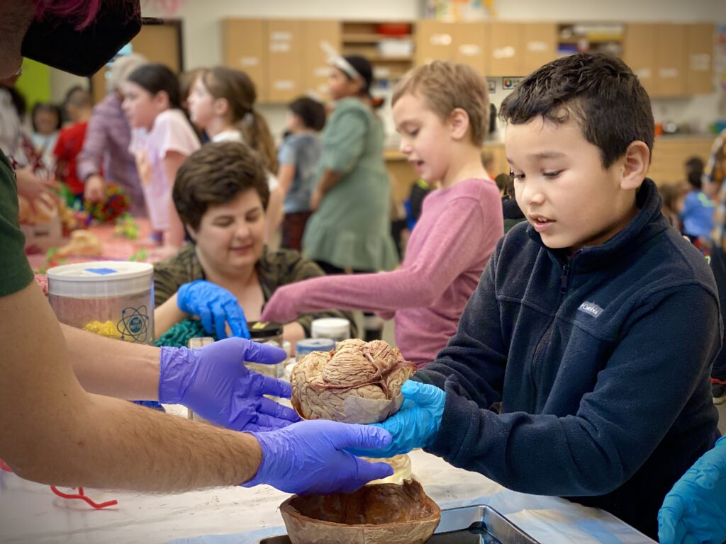
ALL VOLUNTEER
THIRTEEN years (SINCE 2012)!
NO ADMISSION - NO TUITION - open to everyone
75,000+ public K12 students/community members
local/national/international collaborators

Slide 3
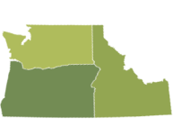
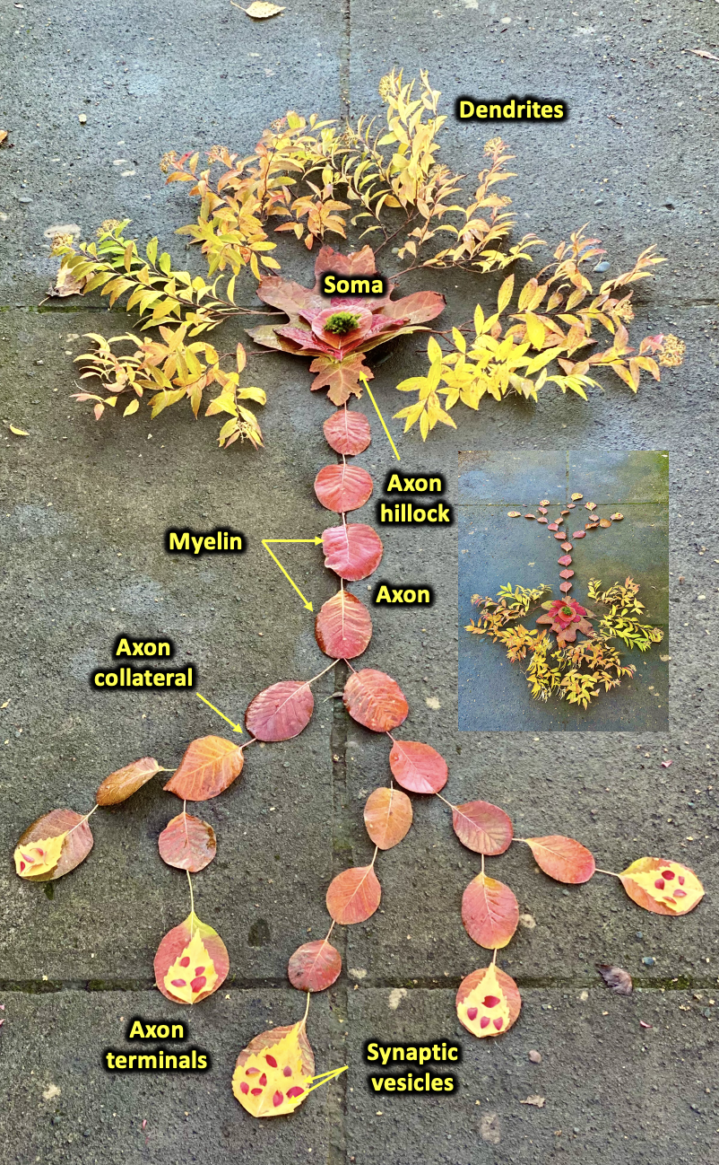
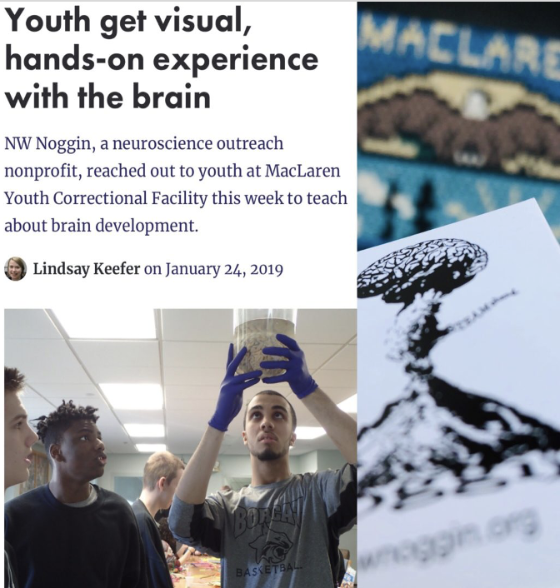
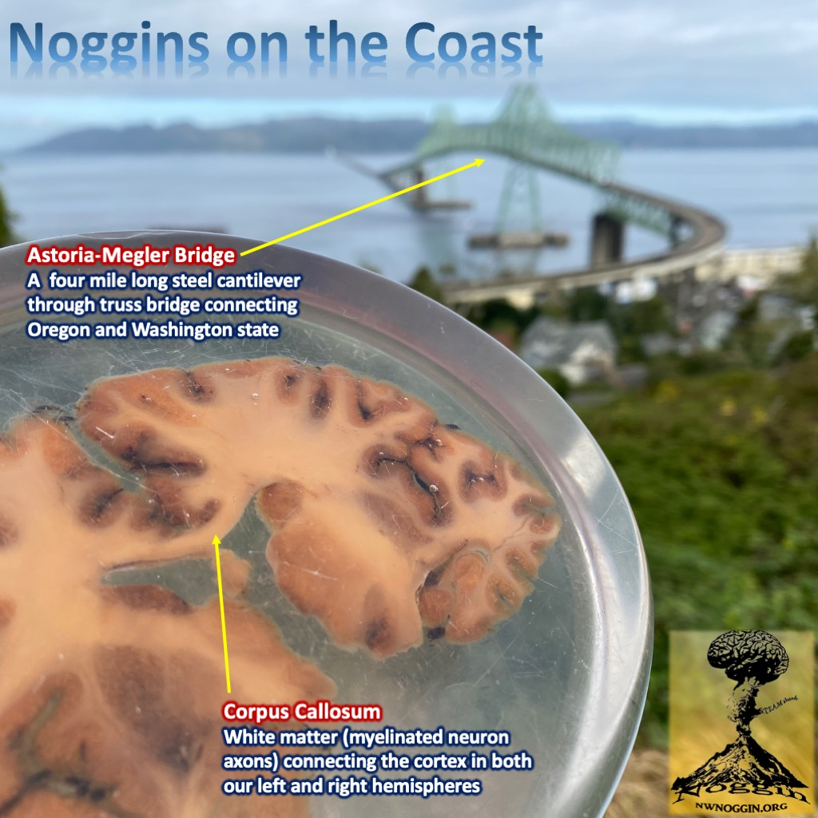
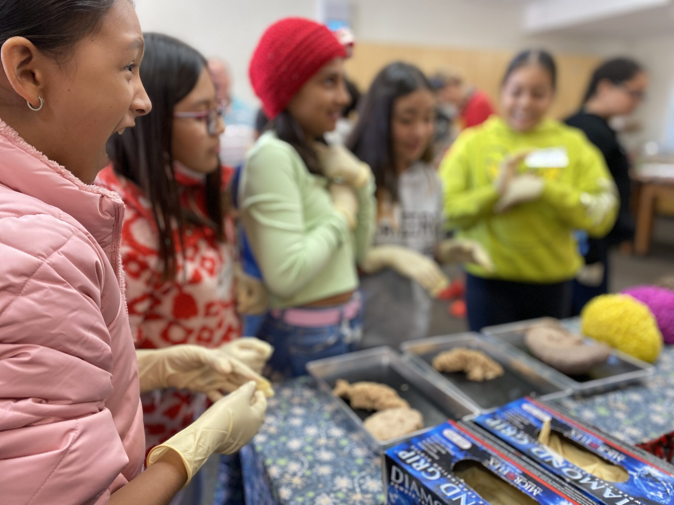
Siletz, Amity & Willamina, OR
Pop: 4000
Davenport, WA
Pop: 1700
GO PLACES
Astoria, OR
Pop: 10,000
A few places
we’ve been
-where STEM programs DON’T GO
-where money and resources don’t go
-K-12 public schools
-rural and Urban communities
-houseless youth nonprofits
-correctional facilities
La Grande, OR
Pop: 13,000
Meservy Meadows, OR Pop: ~40
Sisters, OR
Pop: 3081
Heppner & Ione, OR
Pop: 1240

Slide 4
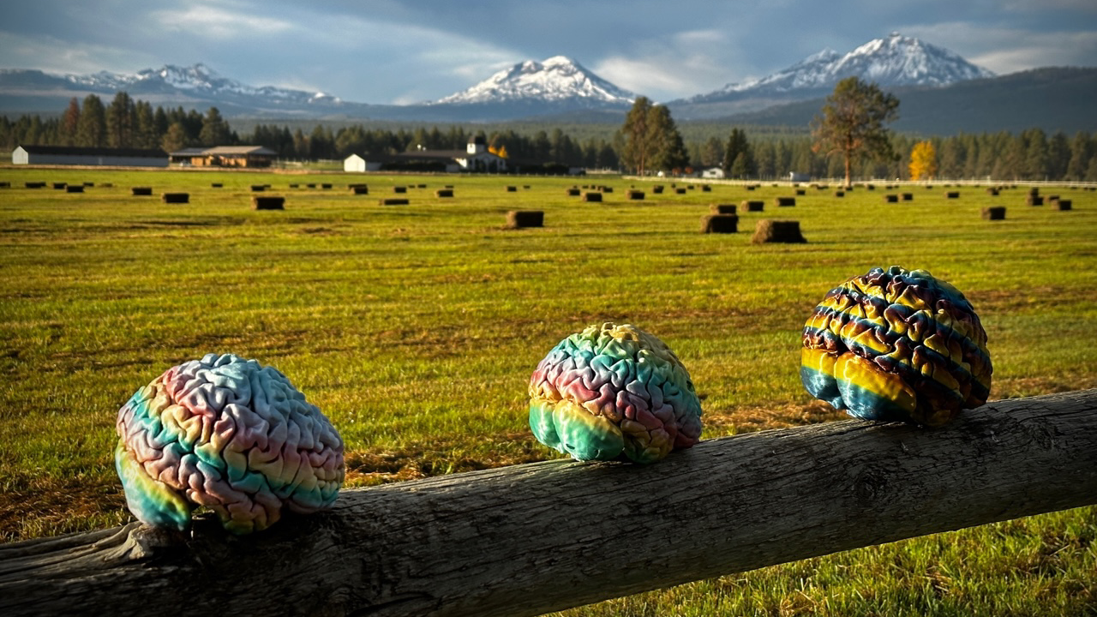
GO PLACES
Sisters, Oregon

Slide 5
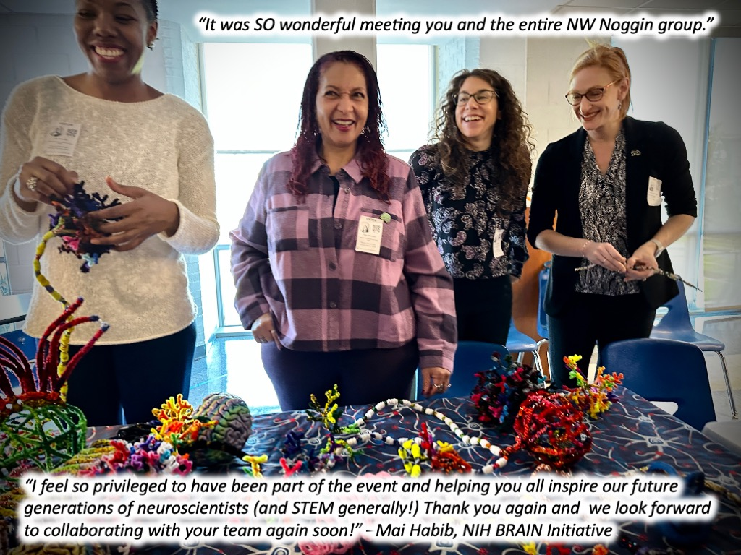
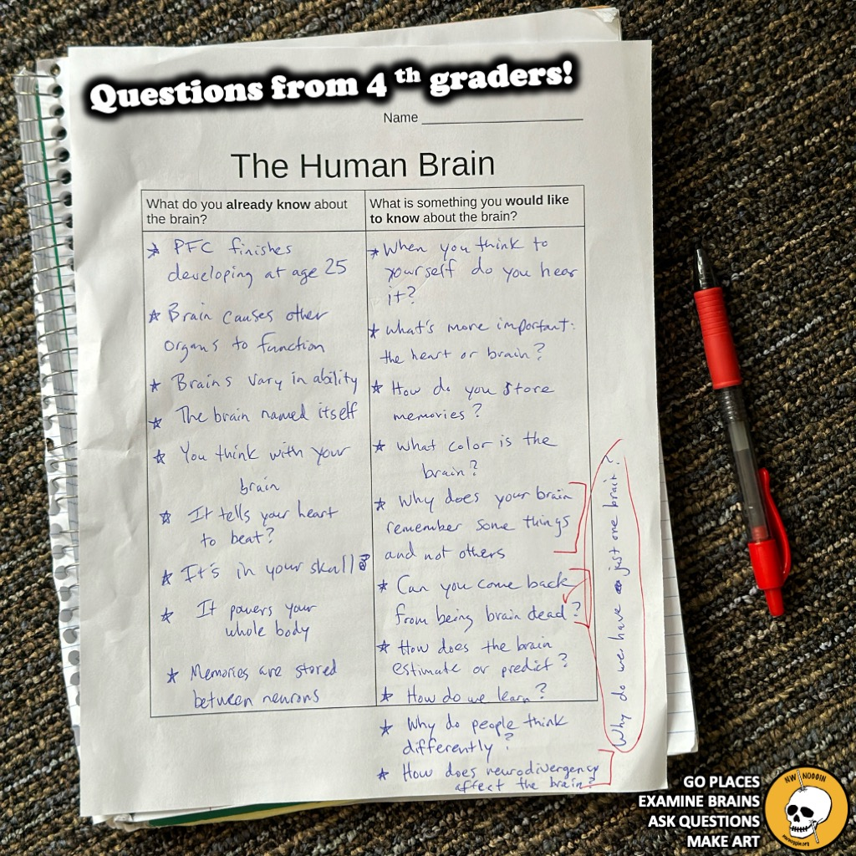
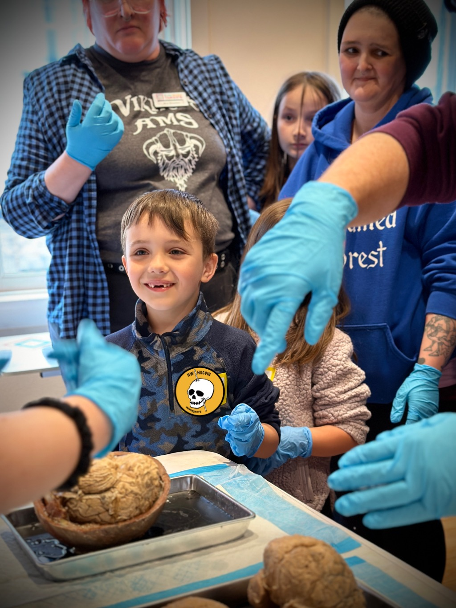

Slide 6
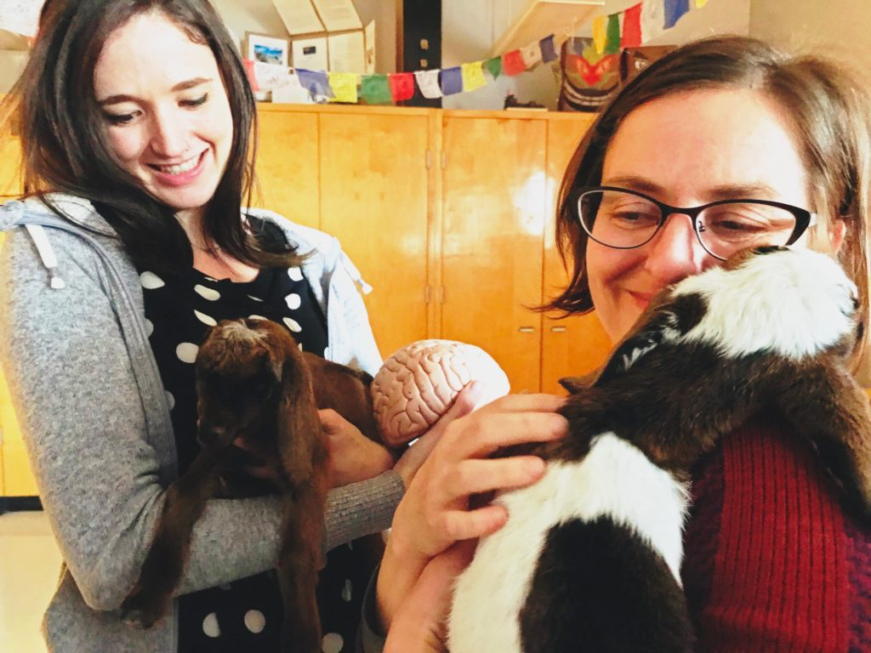
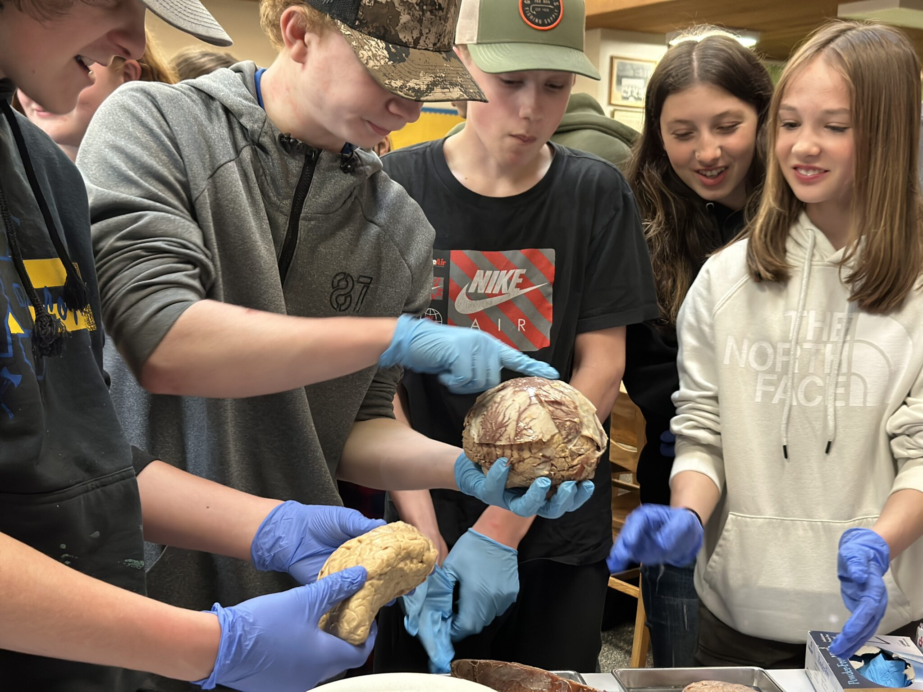
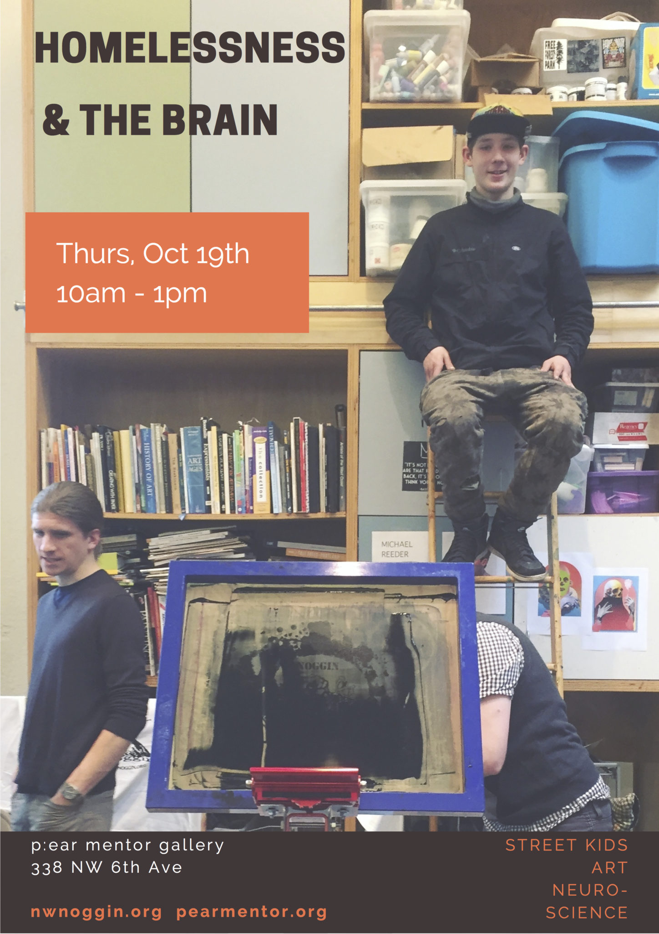
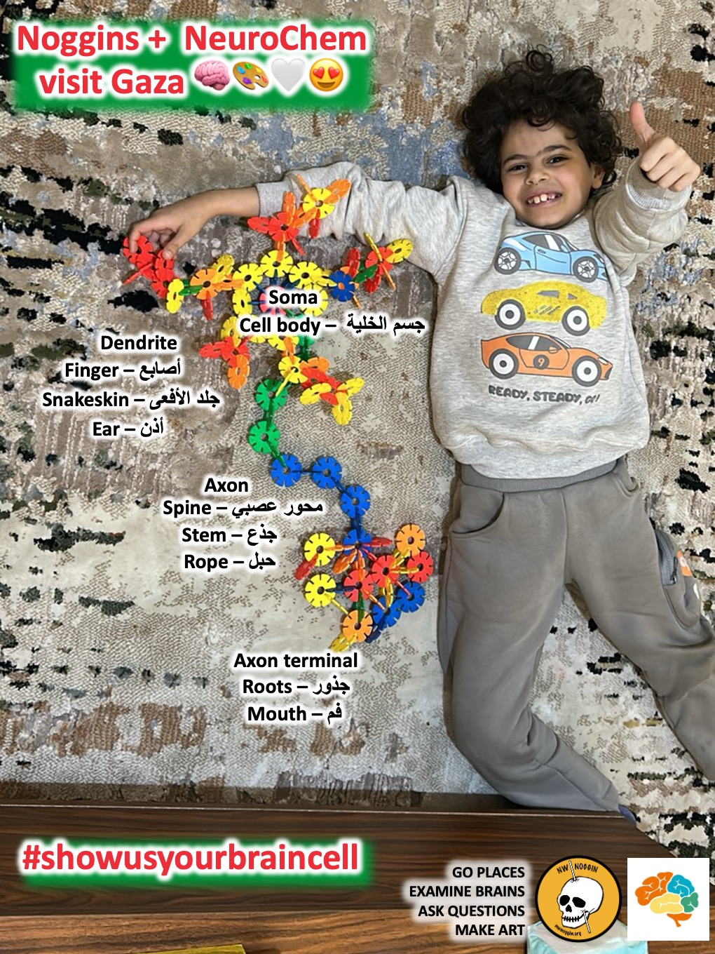
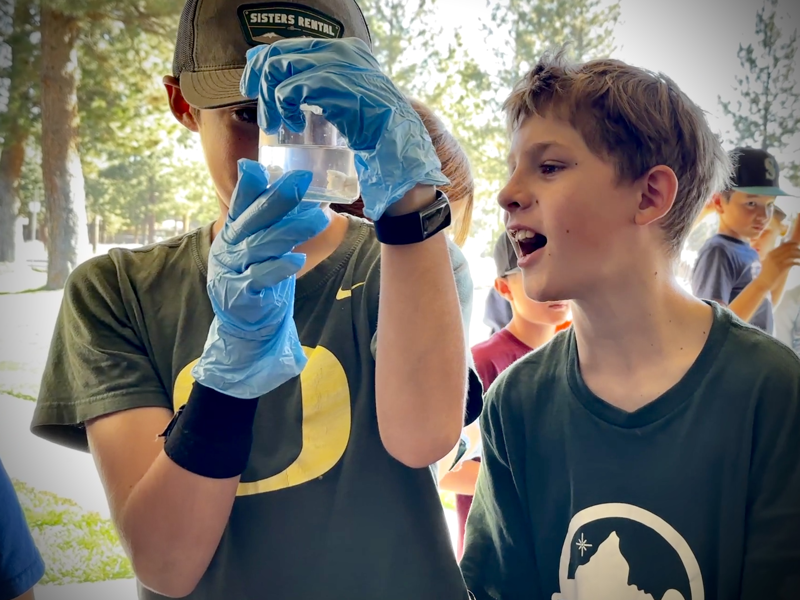
LISTEN
Heppner, OR
-lived experiences
-relevant knowledge
-seeing other people
Knappa, OR
Sisters, OR
Siletz, OR
Portland, OR
Portland, OR

Slide 7
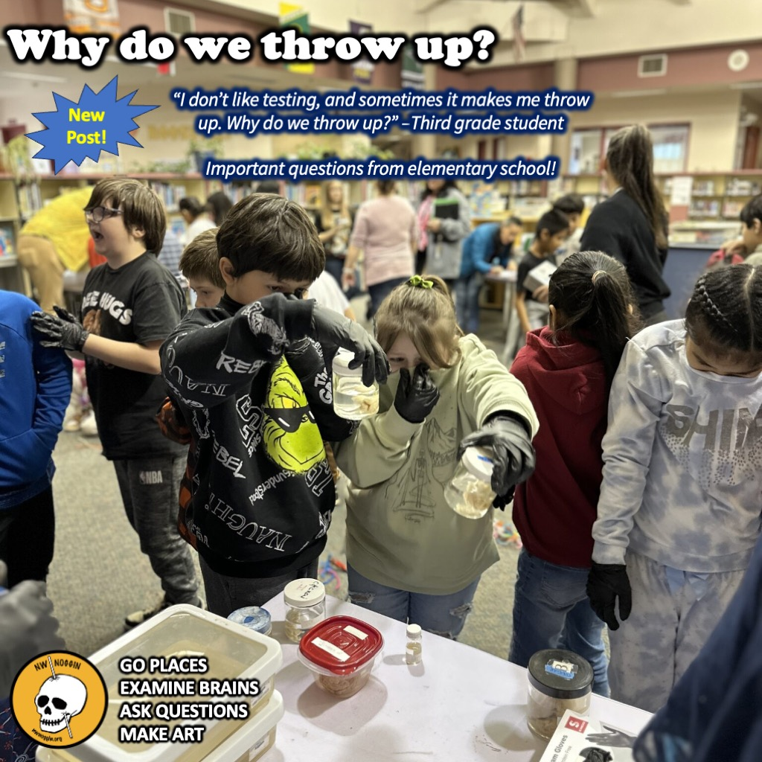
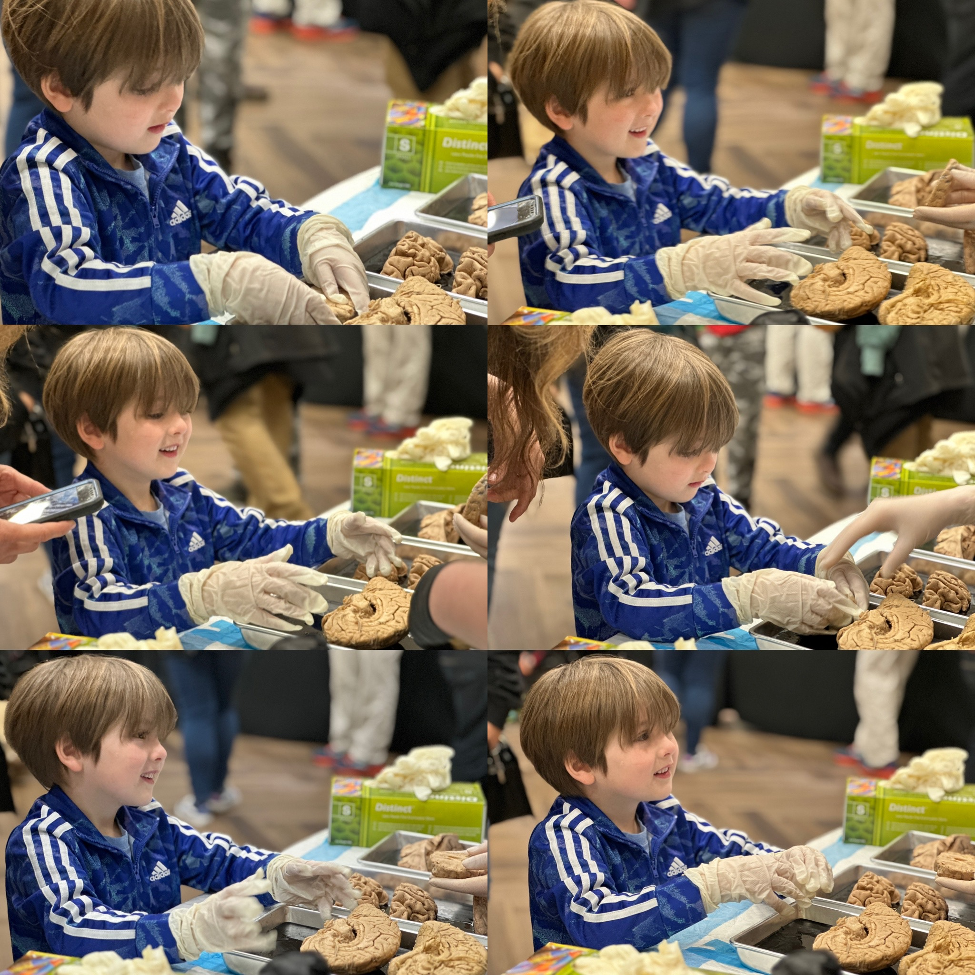
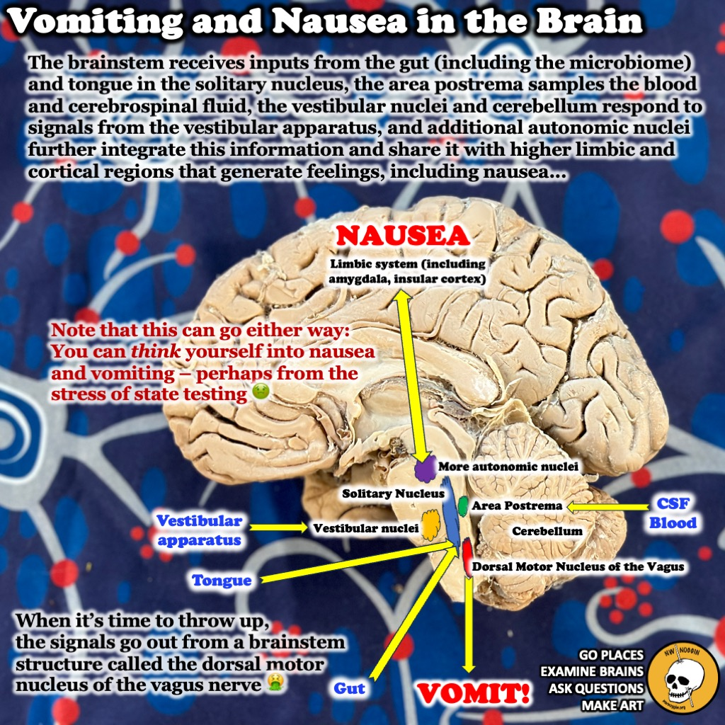

Slide 8
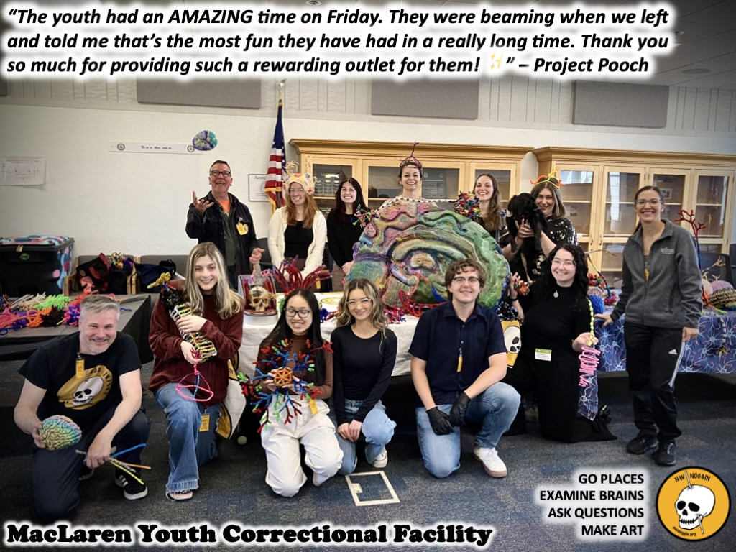
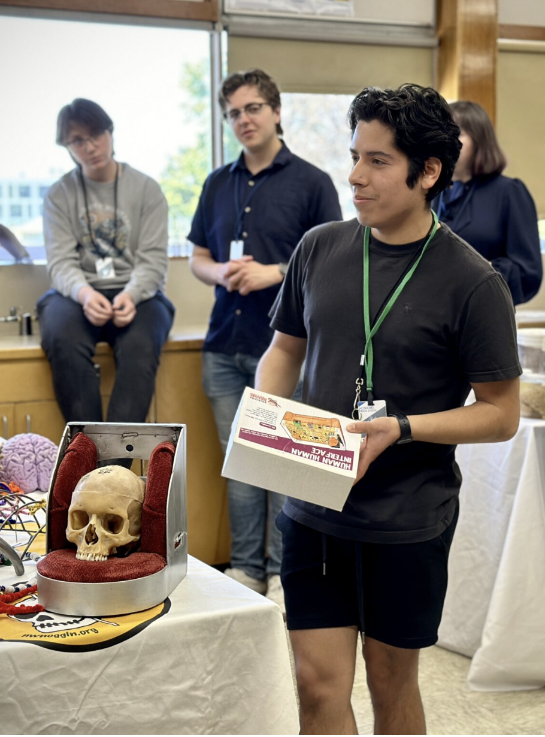
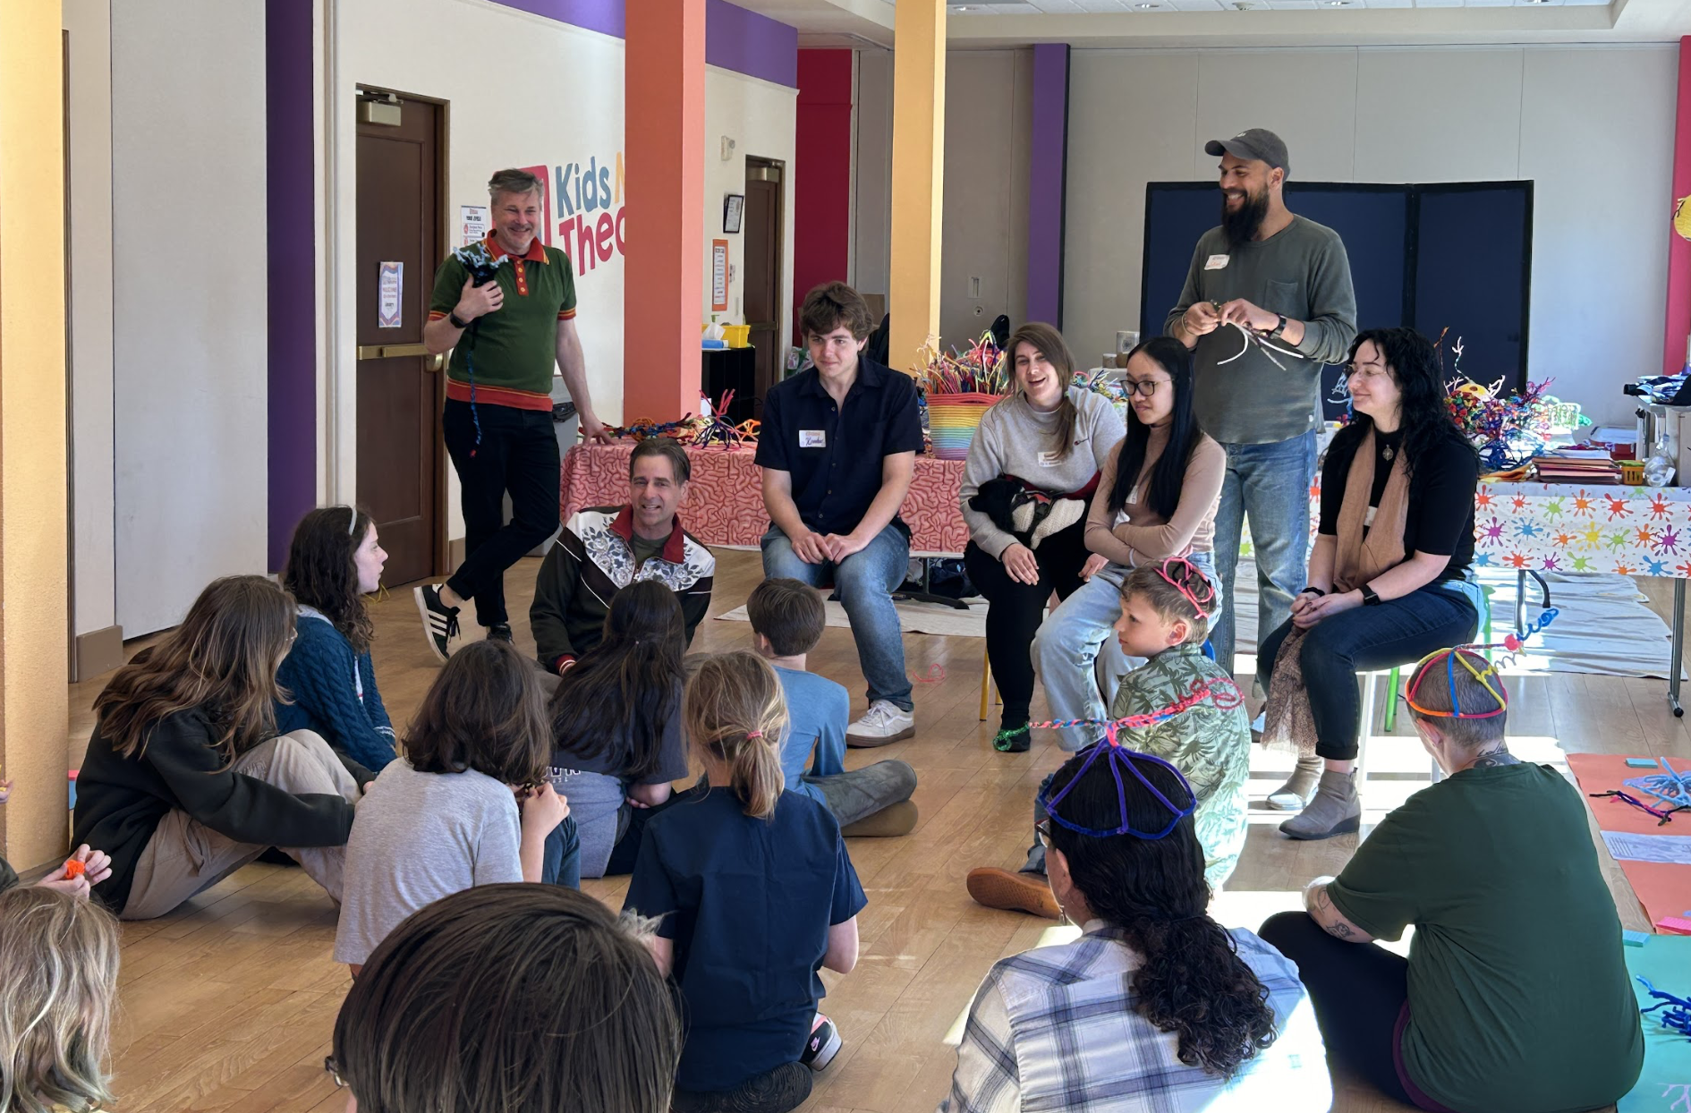
Portland, OR
Astoria, OR

Slide 9
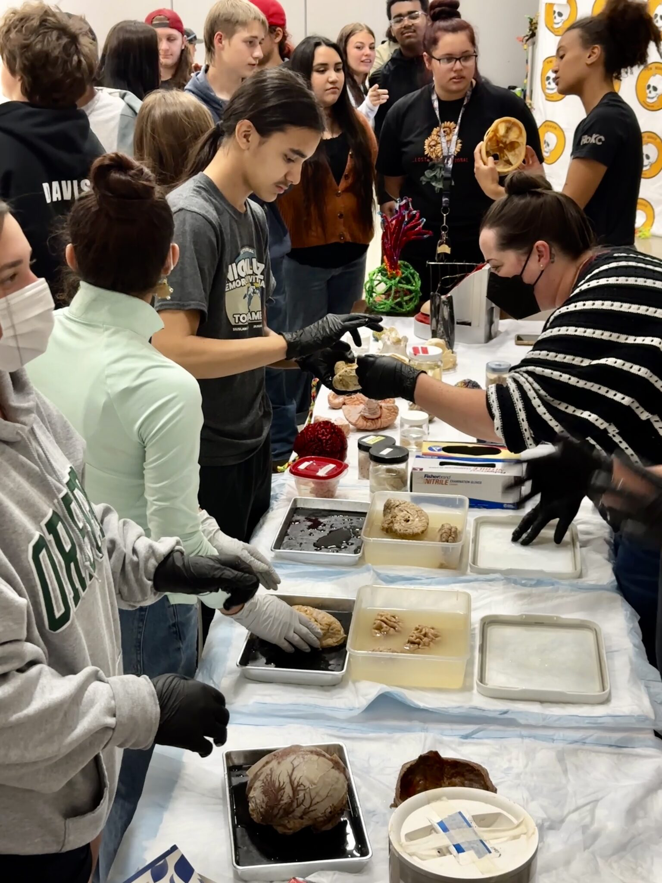
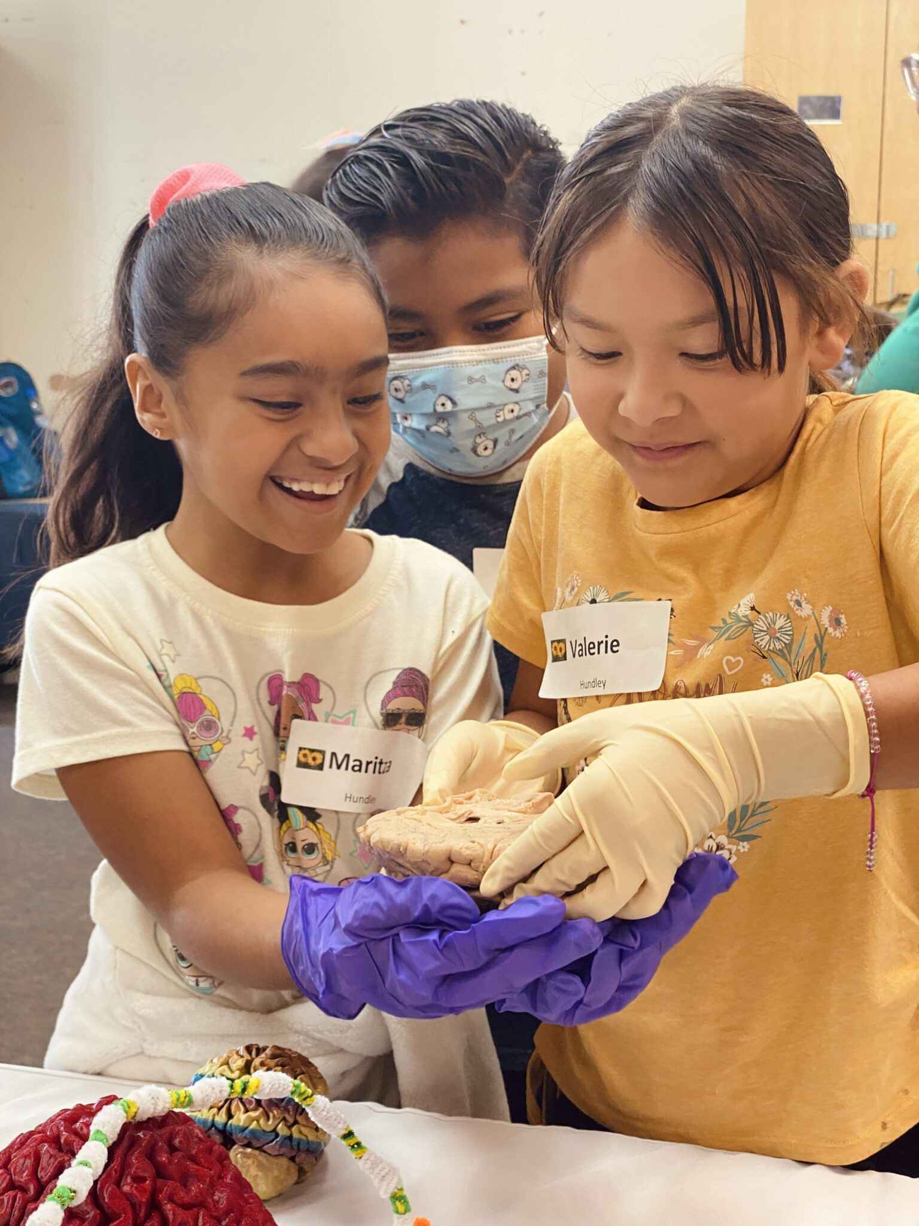
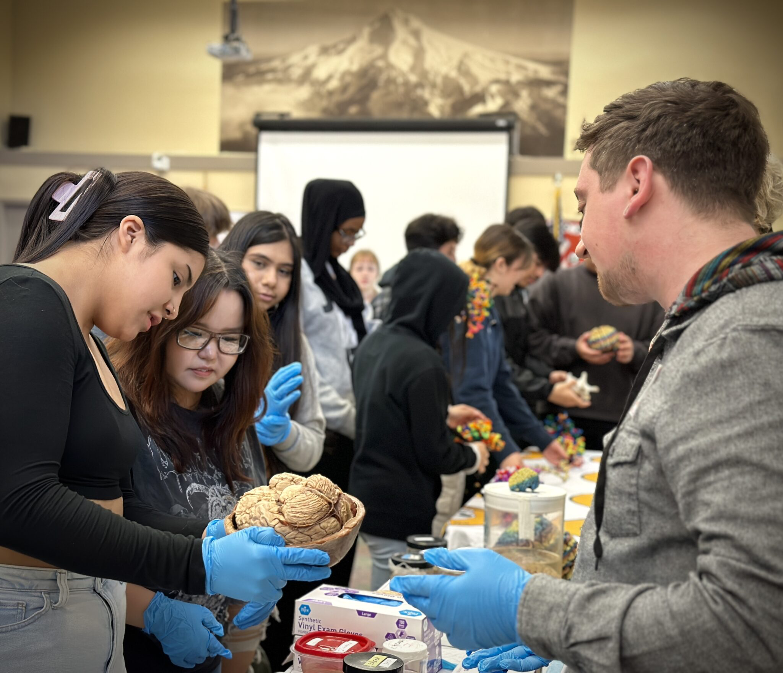
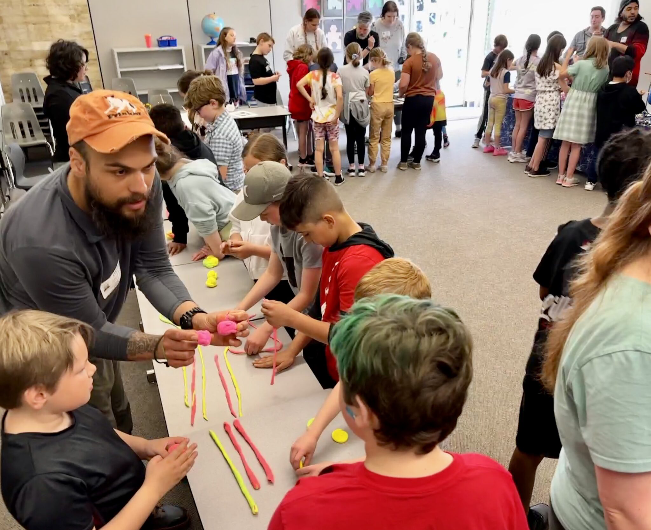
SHARE STORIES
-Empower new voices
-Broaden the conversation
-Make public investment in research relevant
-Invite new participants, perspectives & brains

Slide 10
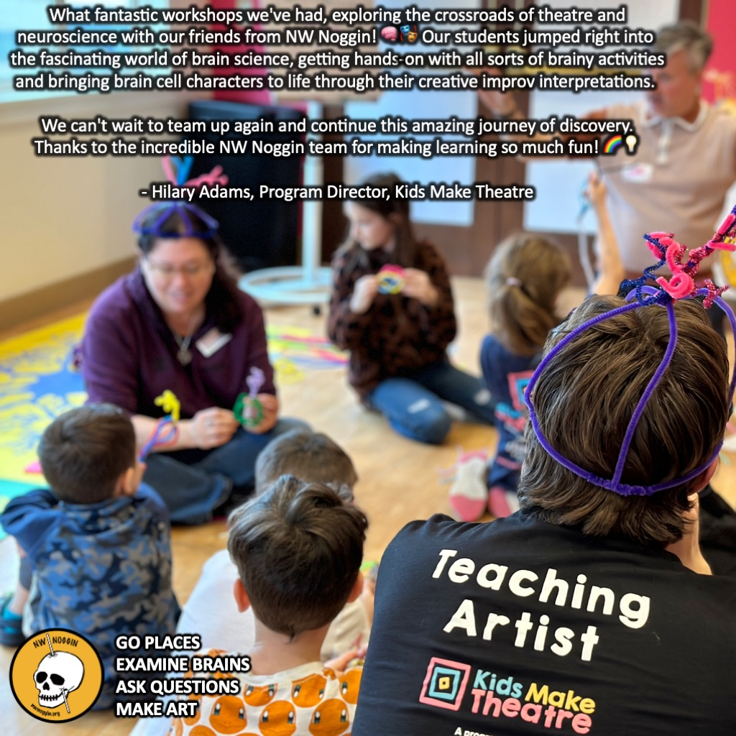
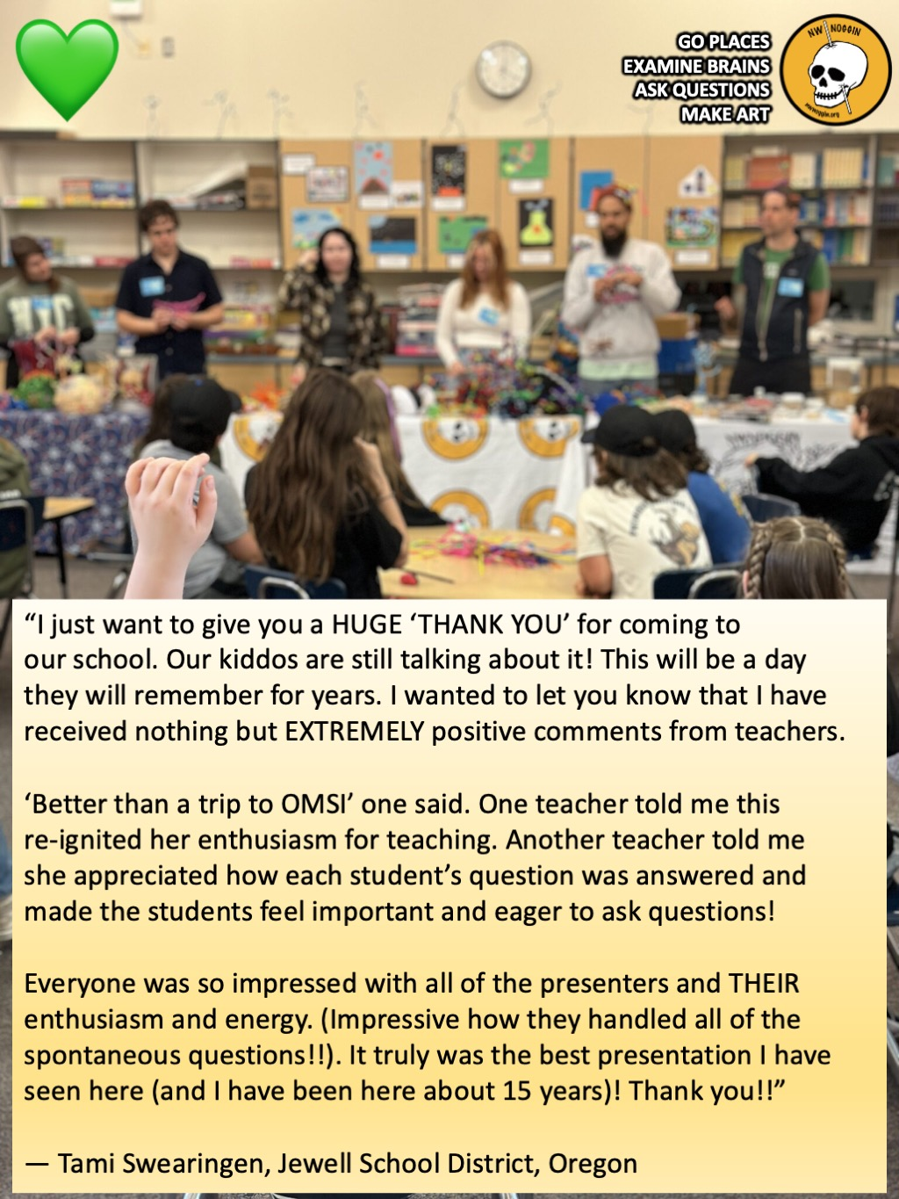

Slide 11
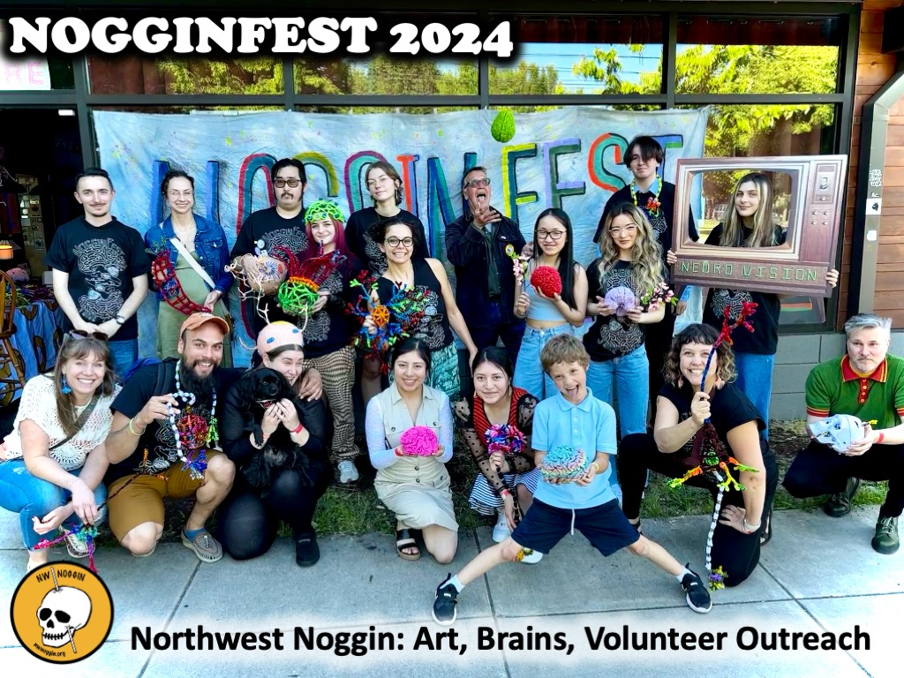
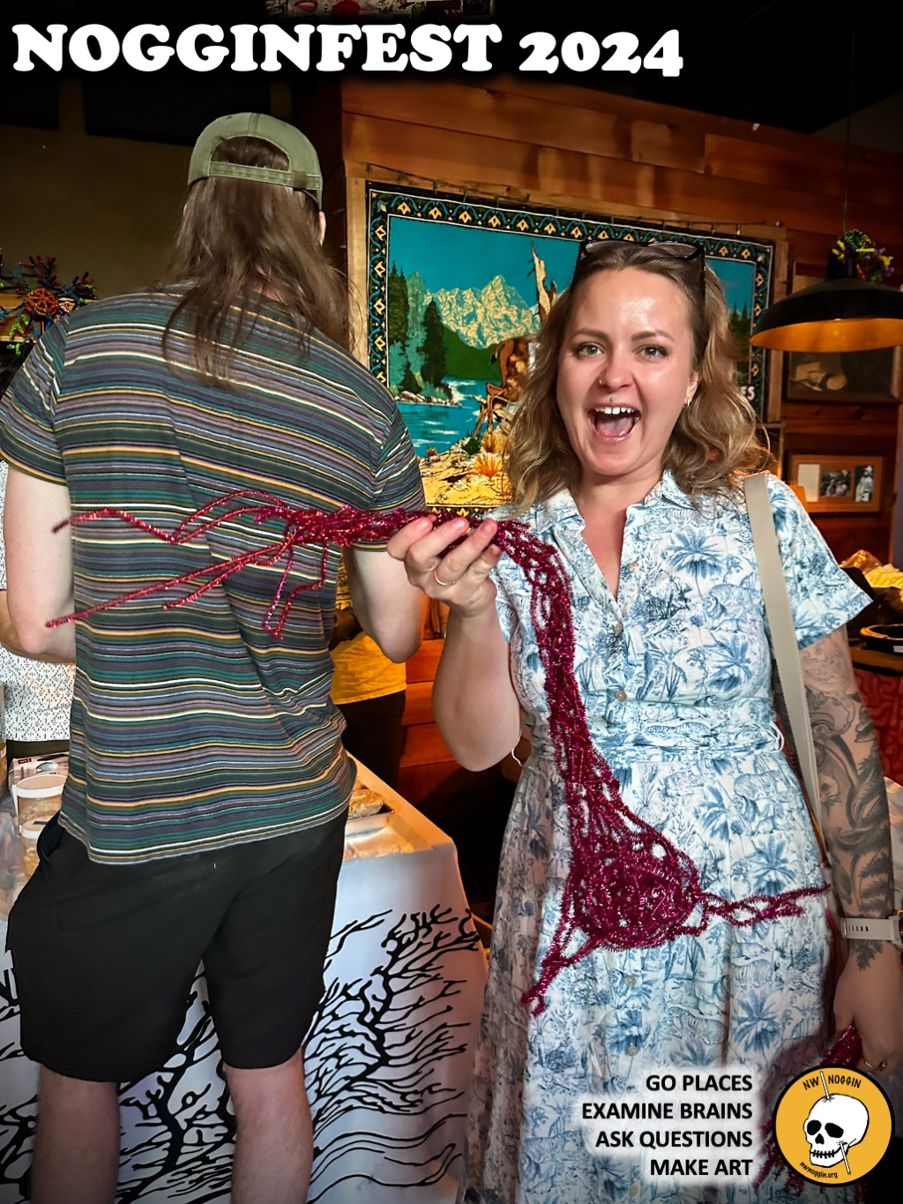
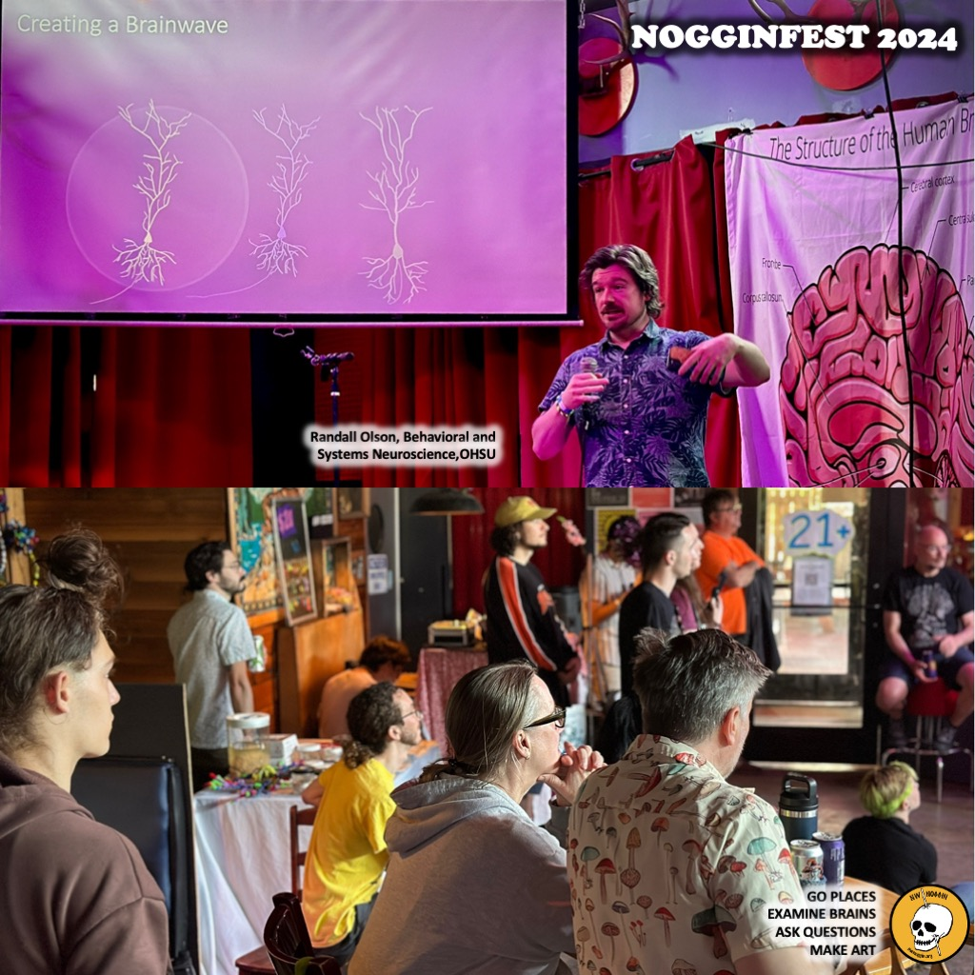
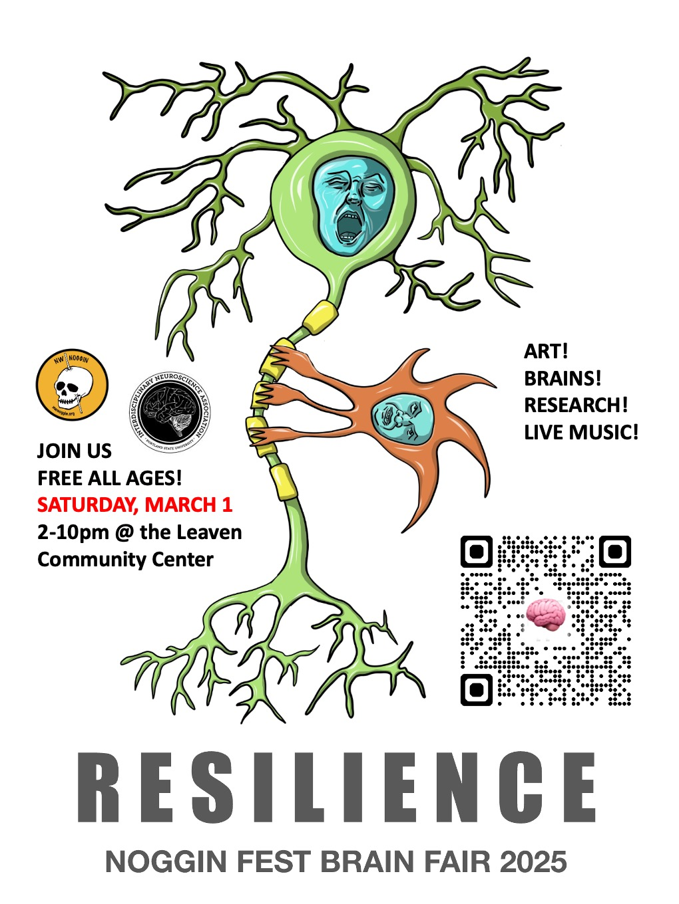
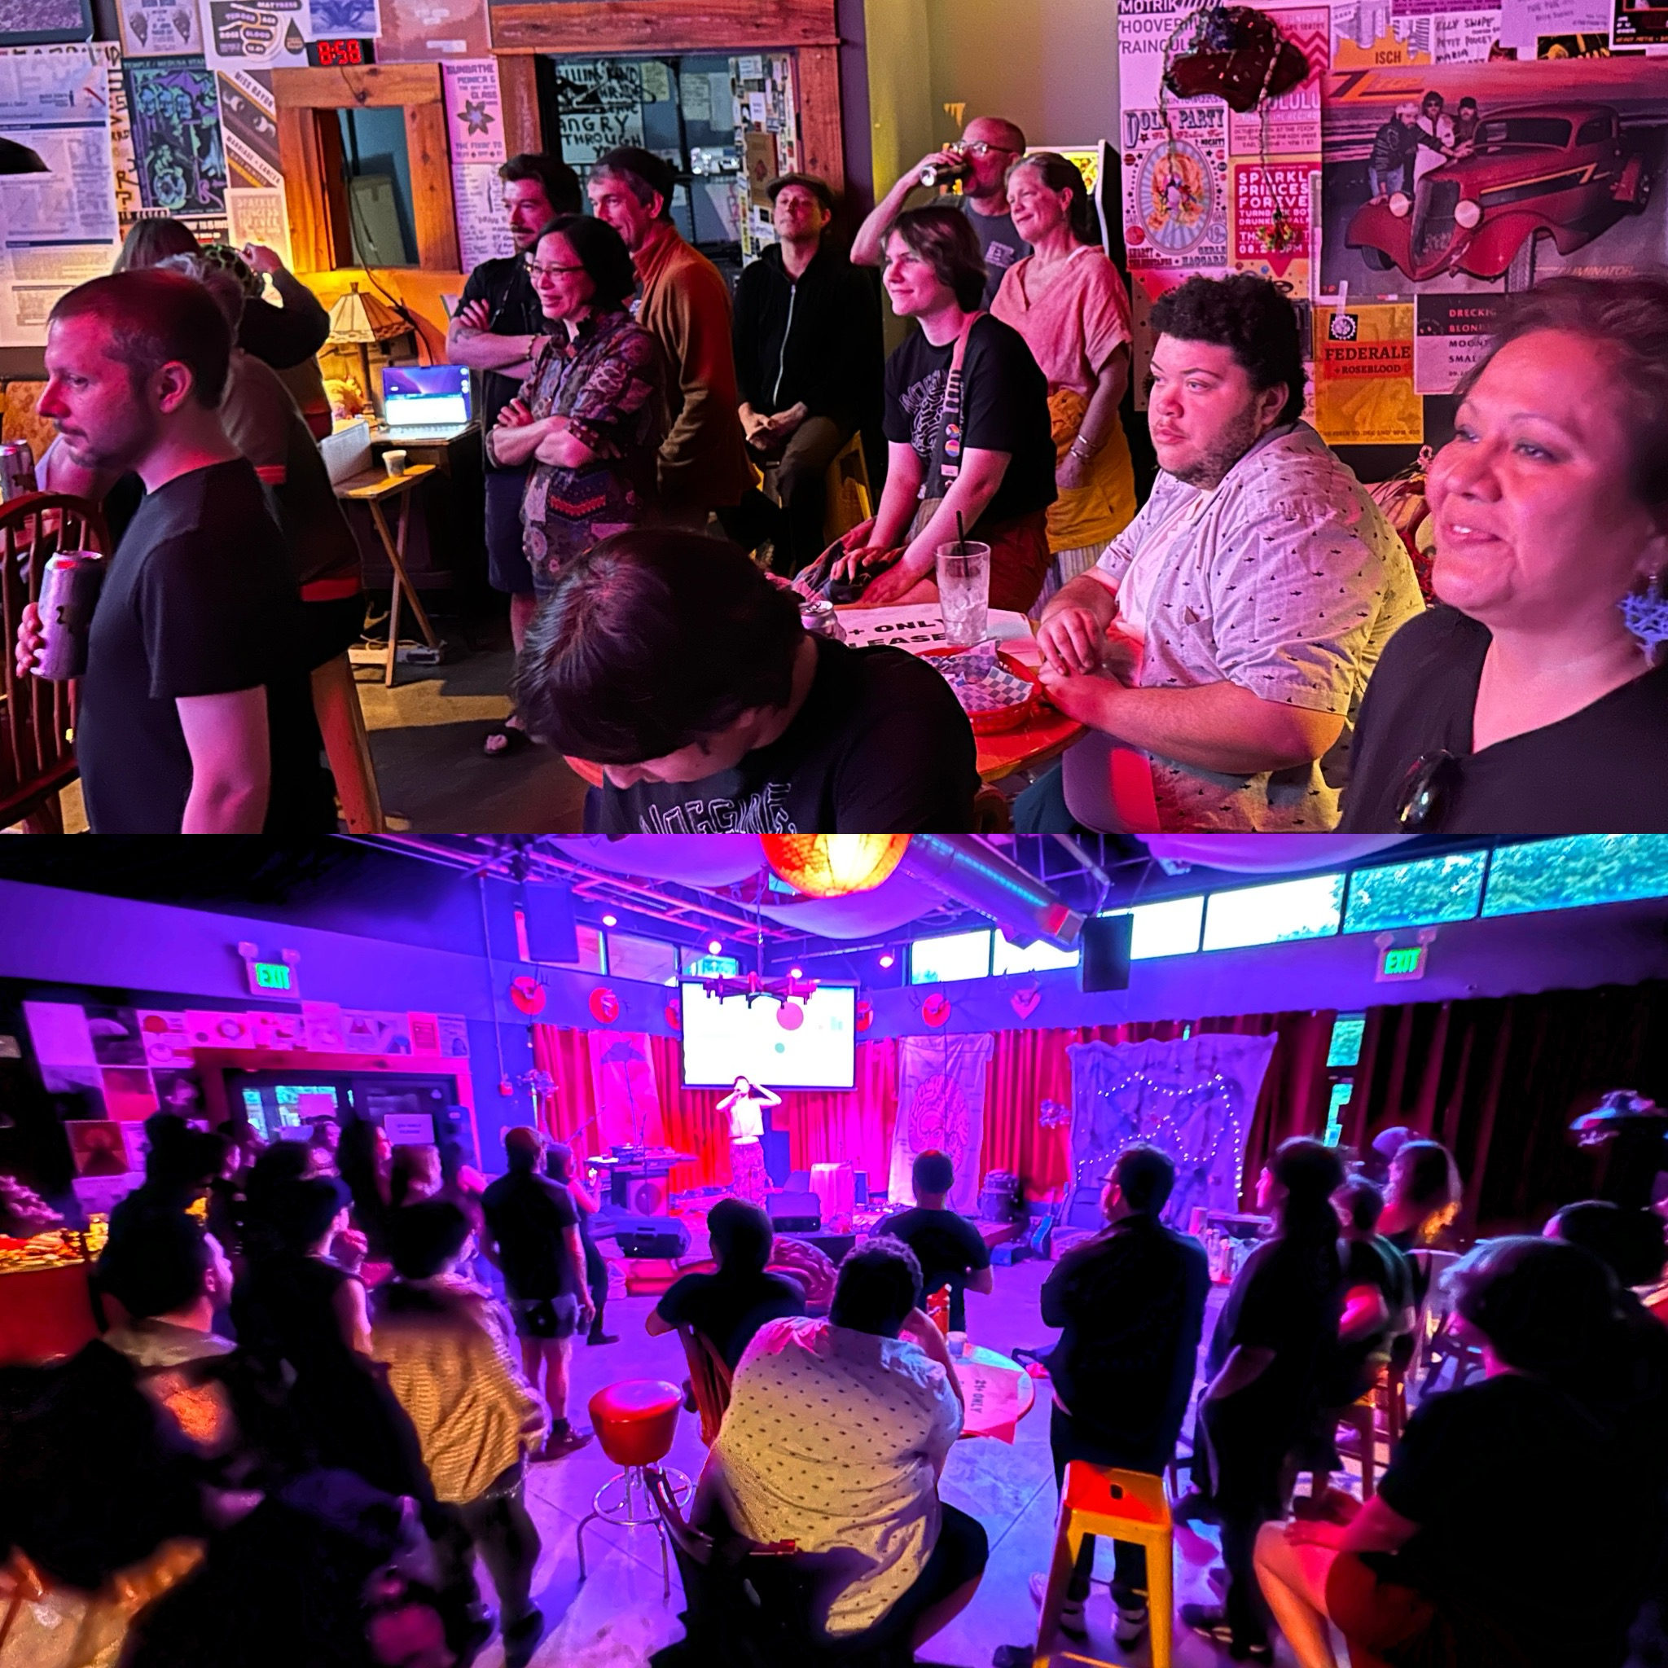
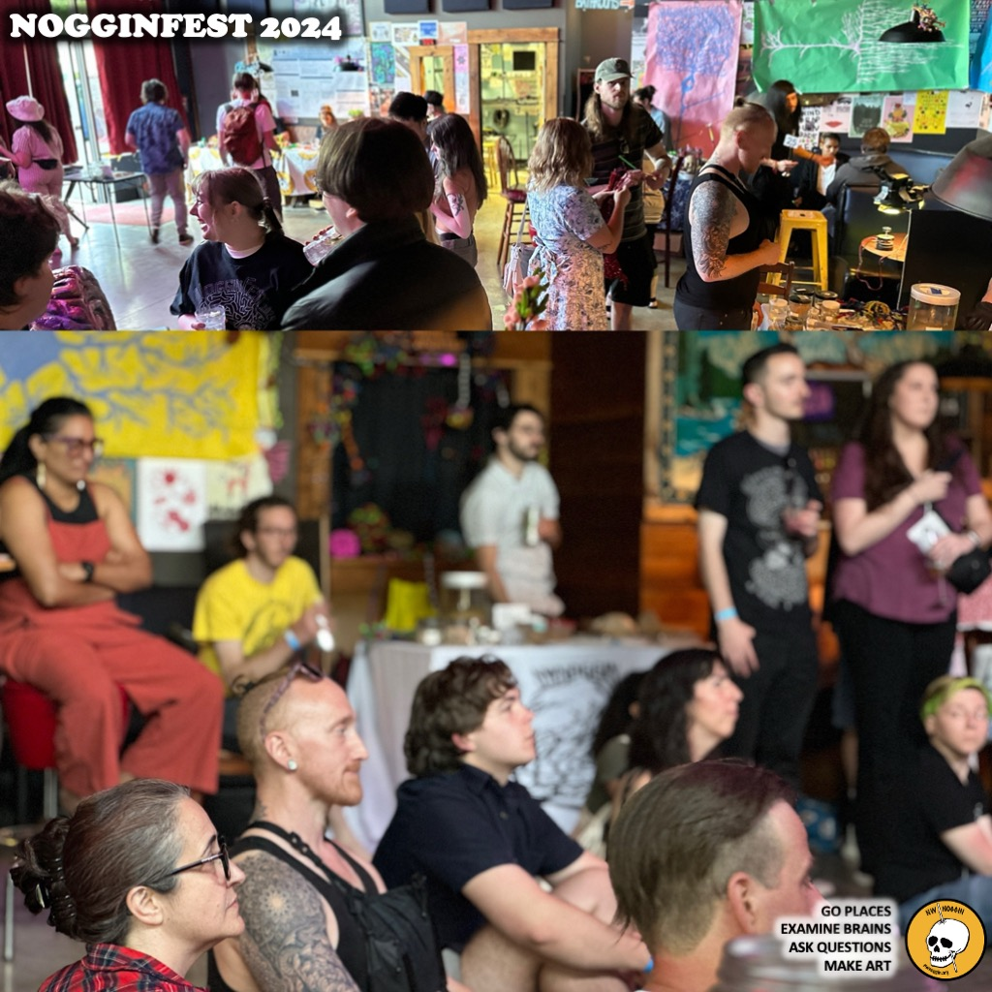
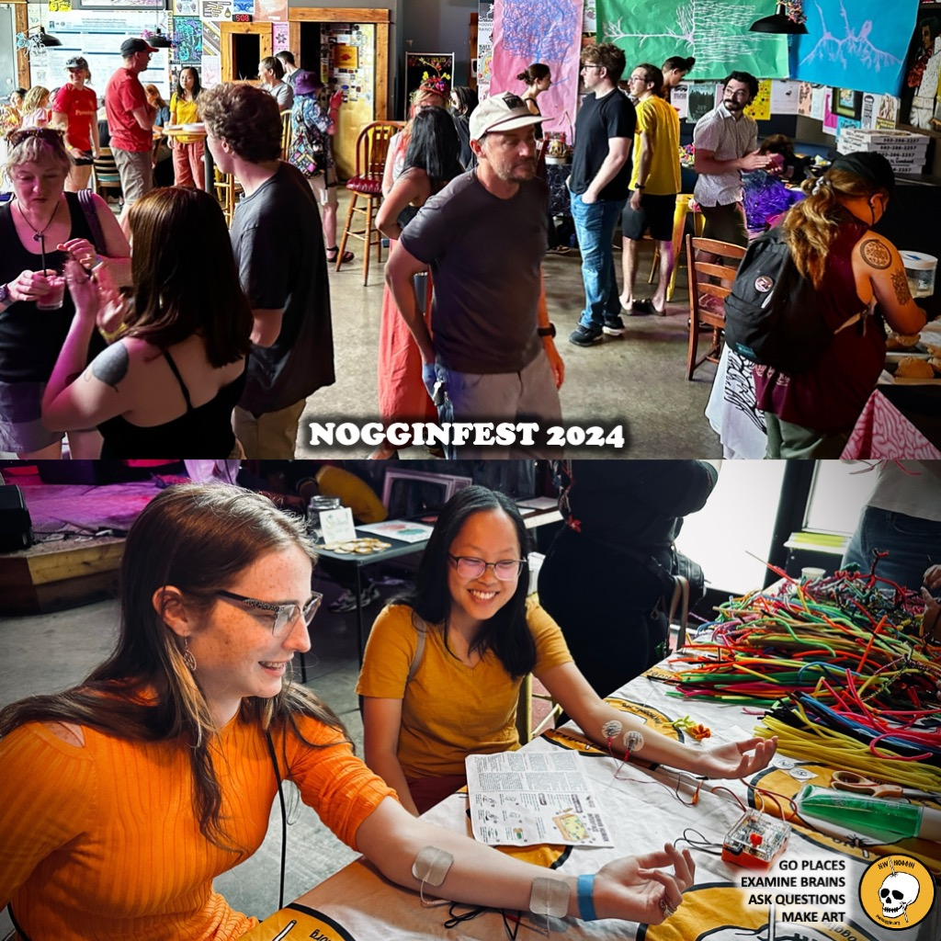
The largest student-run, accessible,
all ages, FREE public celebration of music,
art, brain research and interdisciplinary
neuroscience in the Pacific Northwest!

Slide 12
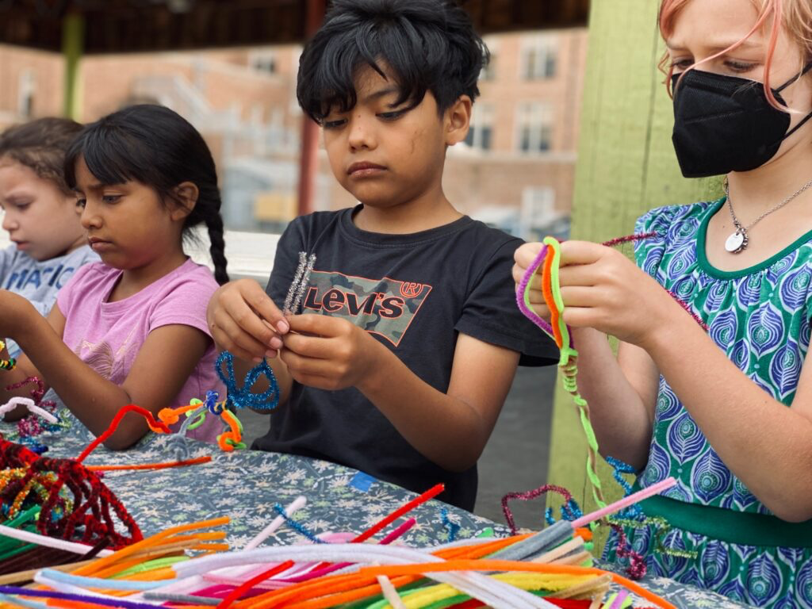
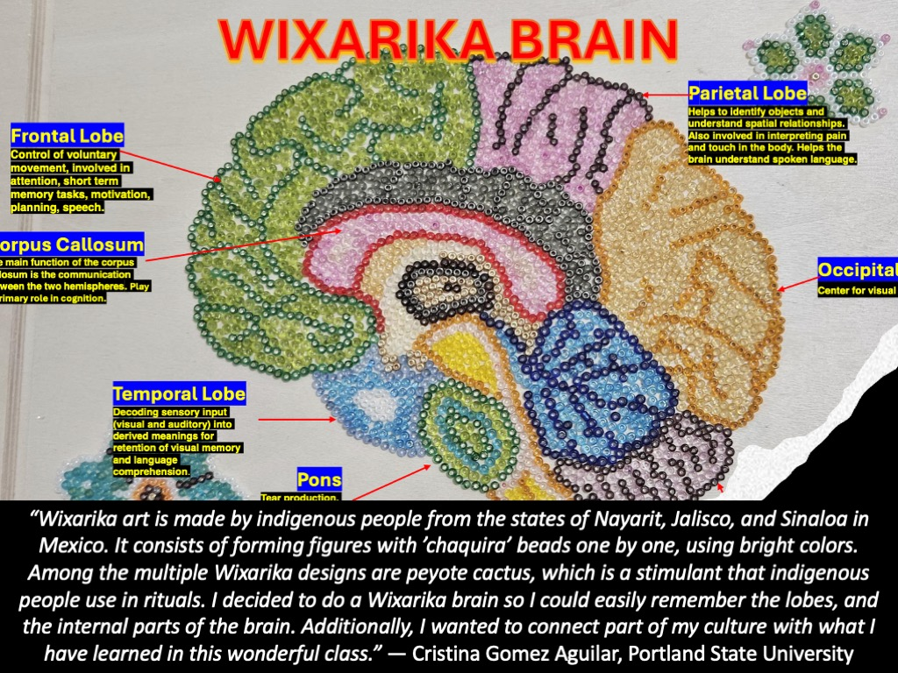
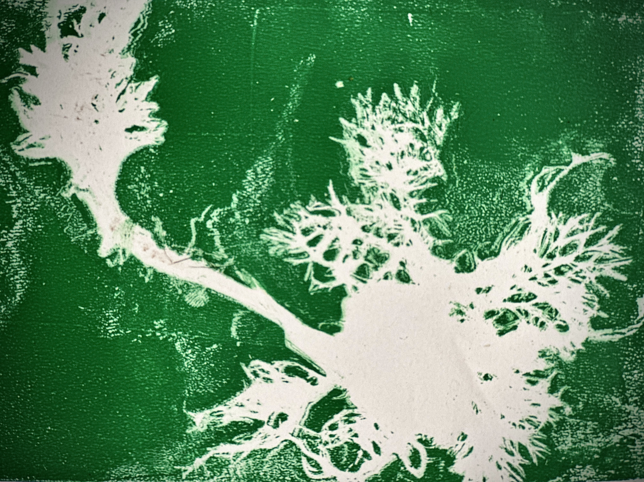
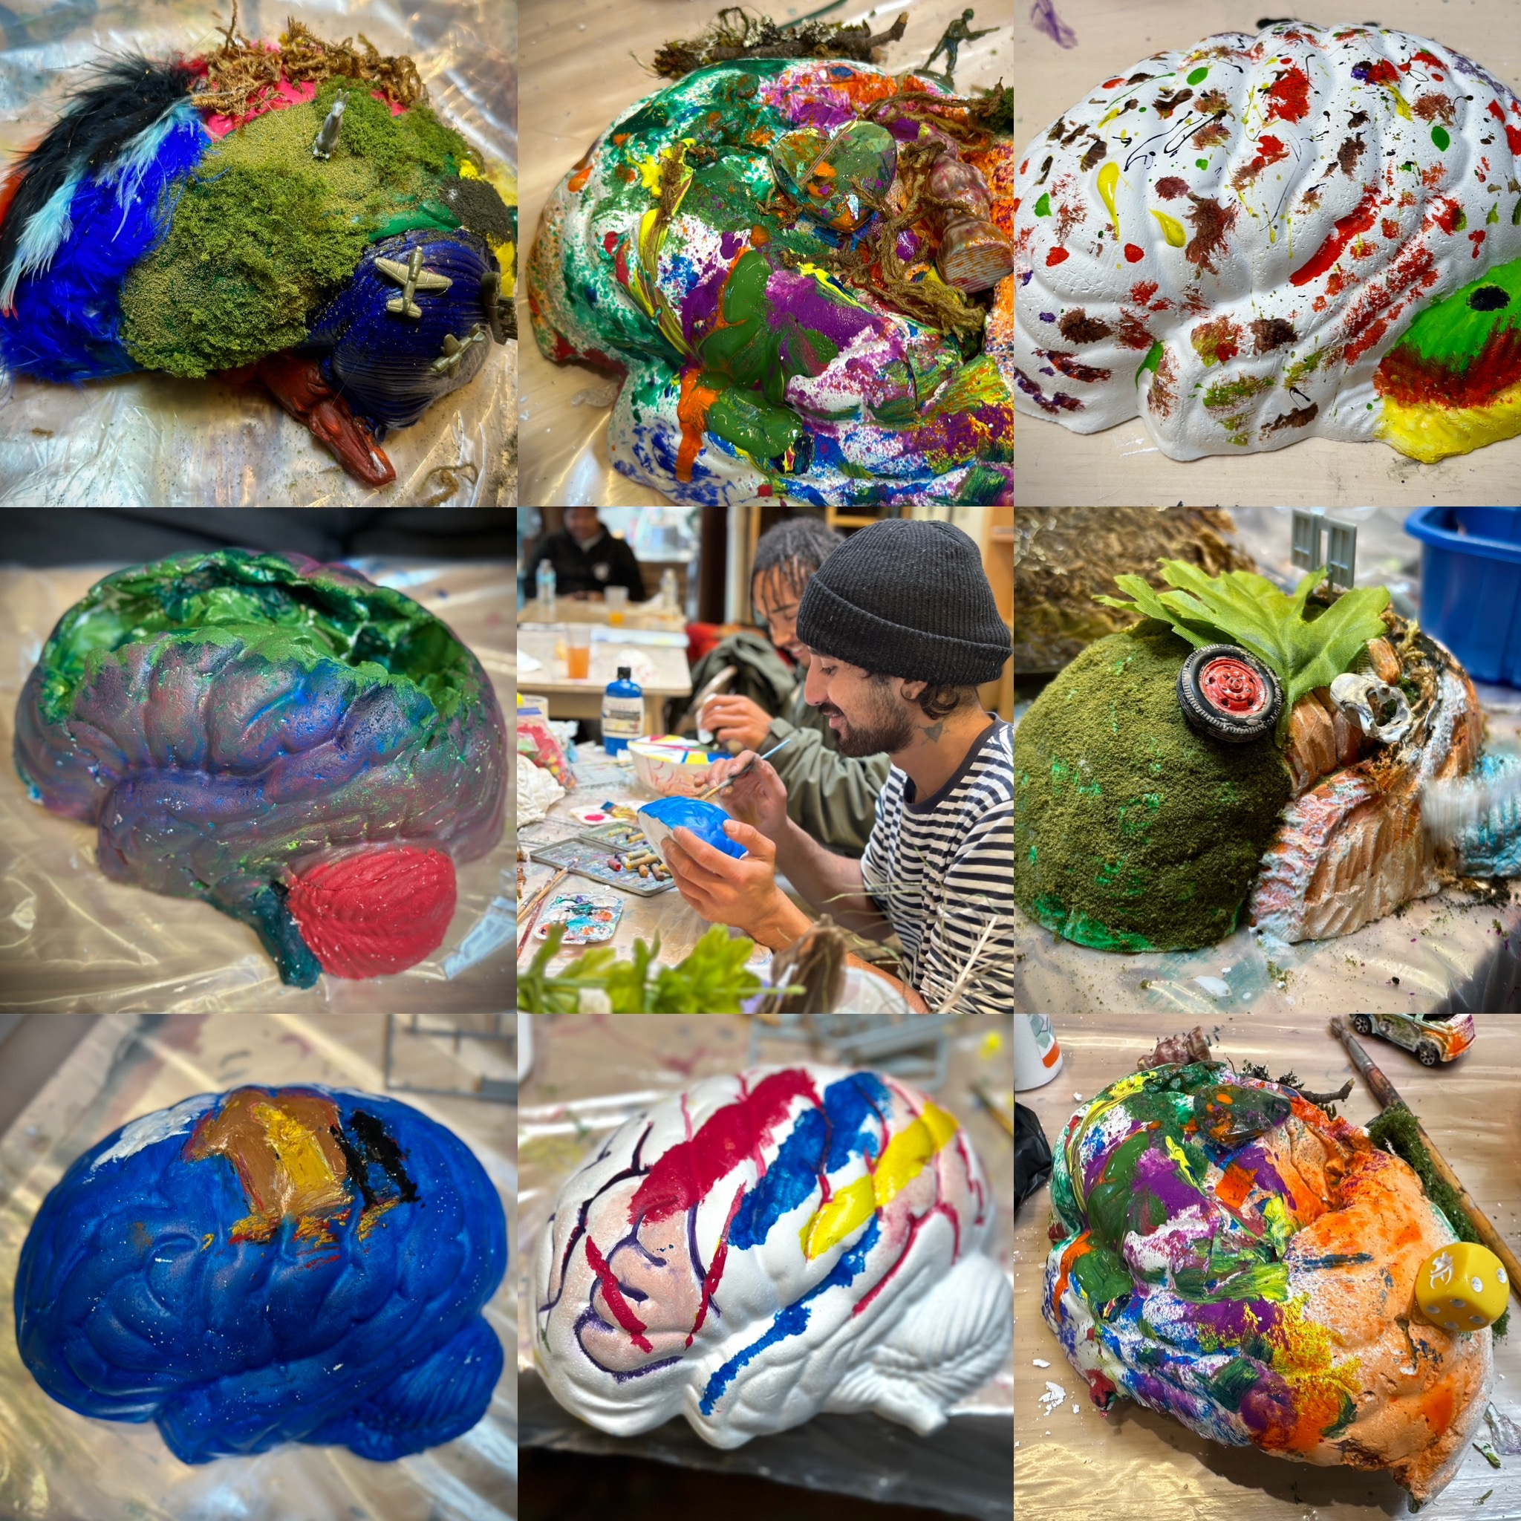
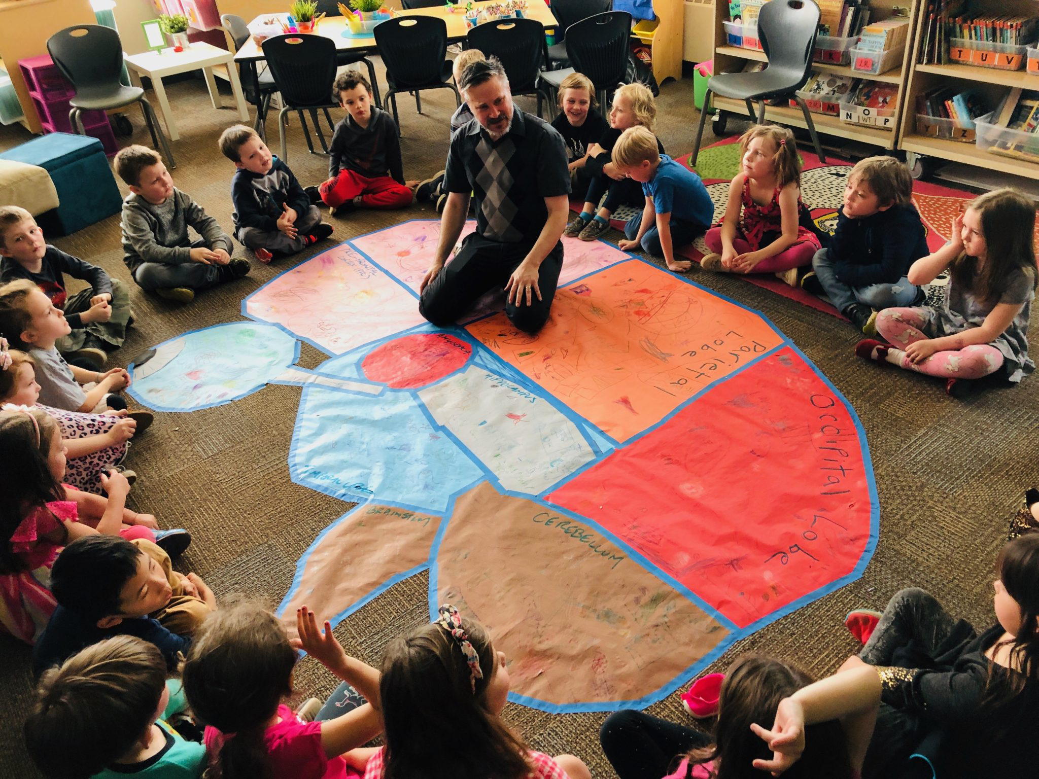
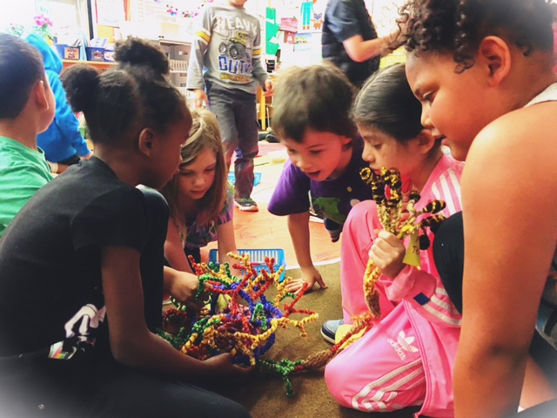
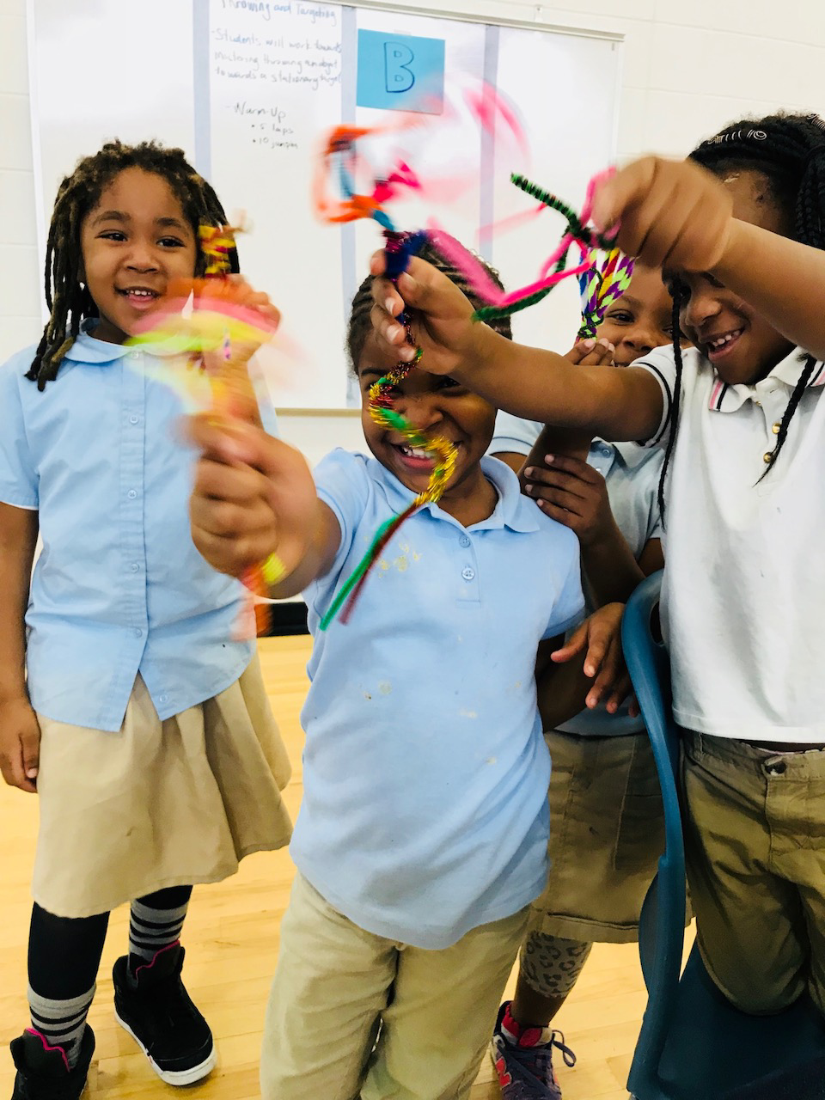
MAKE ART
-Engagement
-Personal relevance
-self-awareness AND EMPATHY

Slide 13
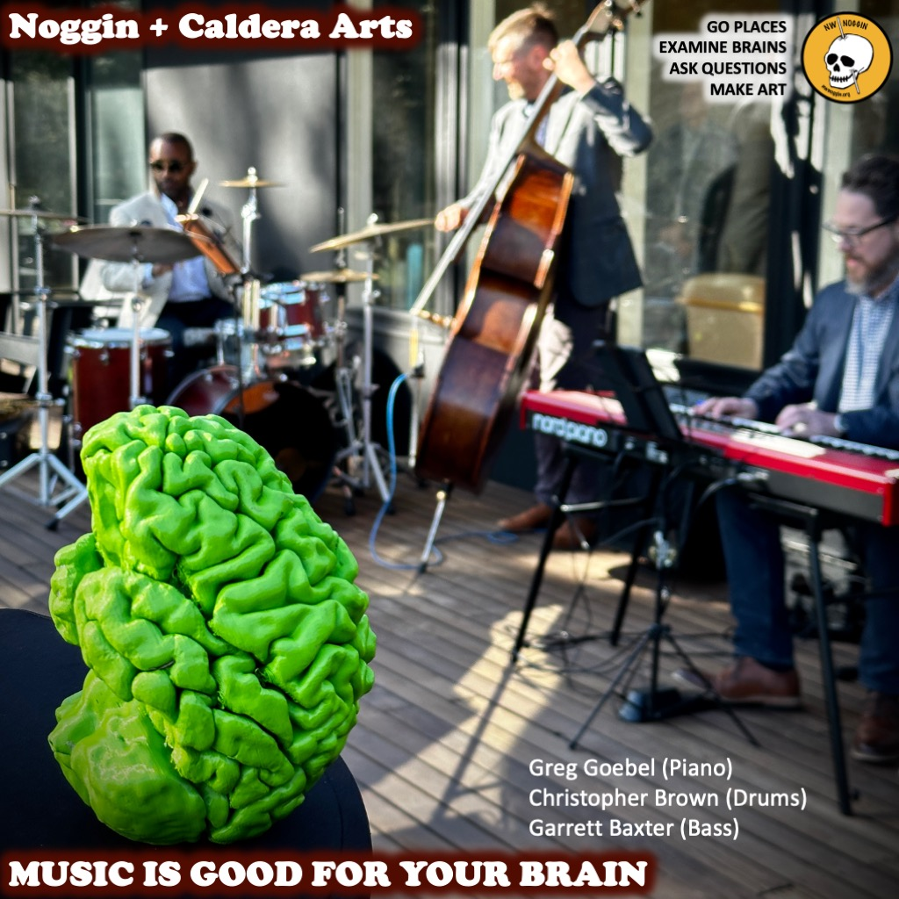
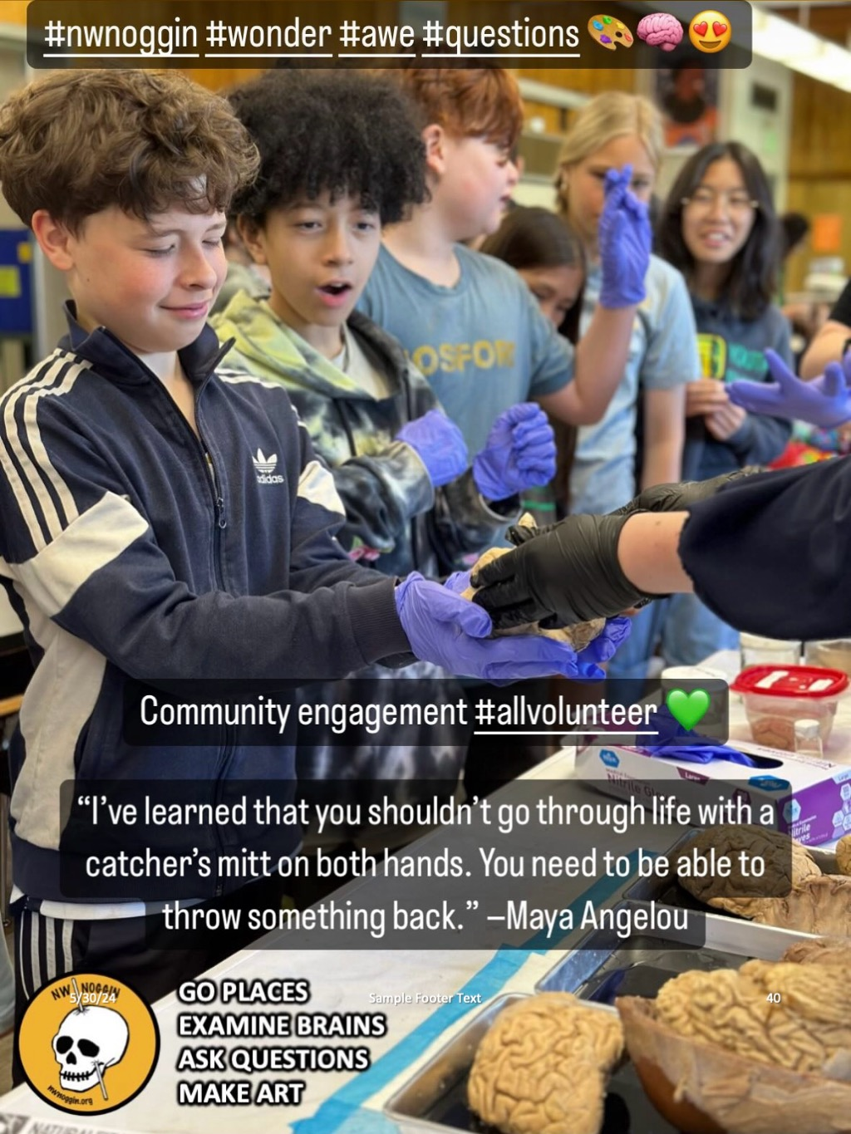

Slide 14
INFORM POLICY
-Research topics are popular!
-Interdisciplinary/STEAM approaches WORK
-1. School start times for adolescents
-2. Permanent standard time
-3. Housing first

Slide 16
Brain research is compelling
*PEOPLE ARE INTERESTED
*THEY WANT to hear about it, and be included
*LARGe institutions get funding, but don’t ALWAYS
go places, listen, share stories accessibly or
make or support art AND engagement

