Slide 1
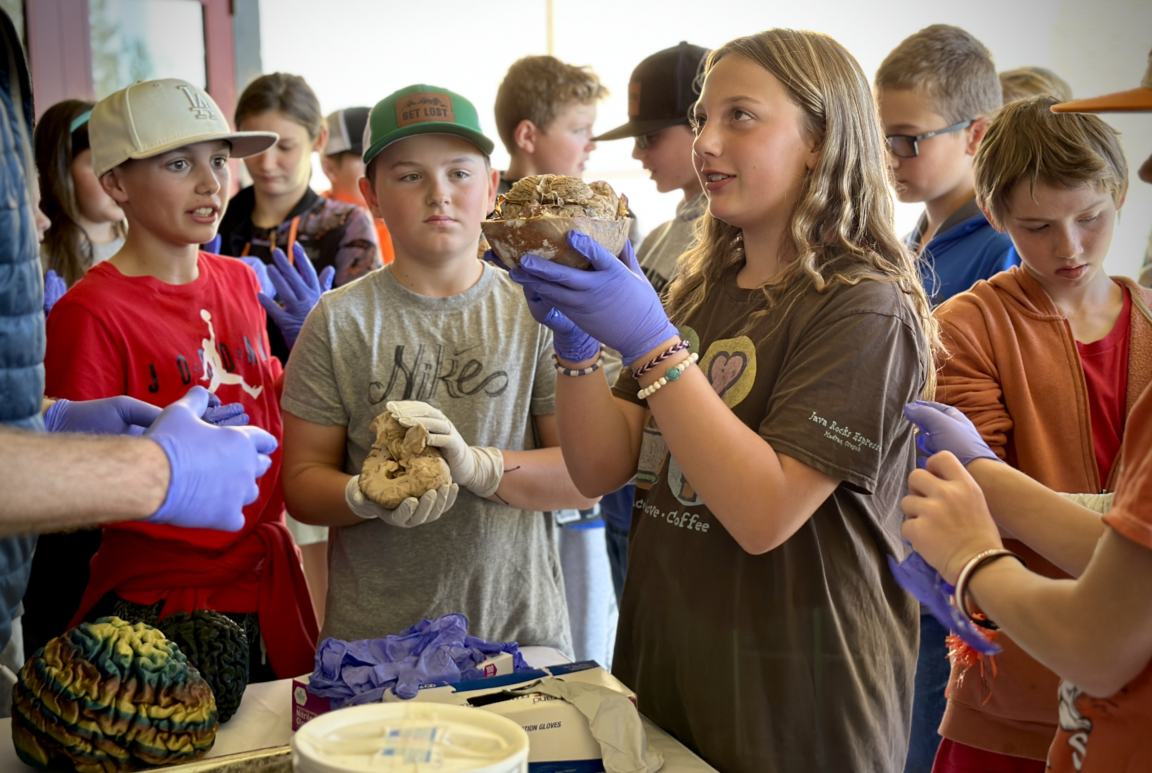
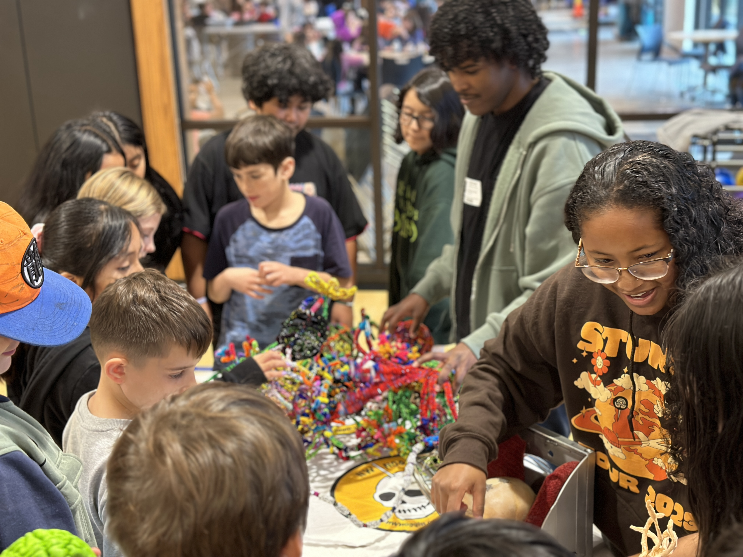
Northwest
Noggin
Engaging community through neuroscience research and art!

Slide 5
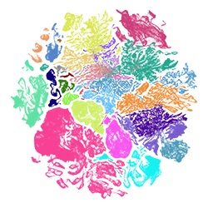
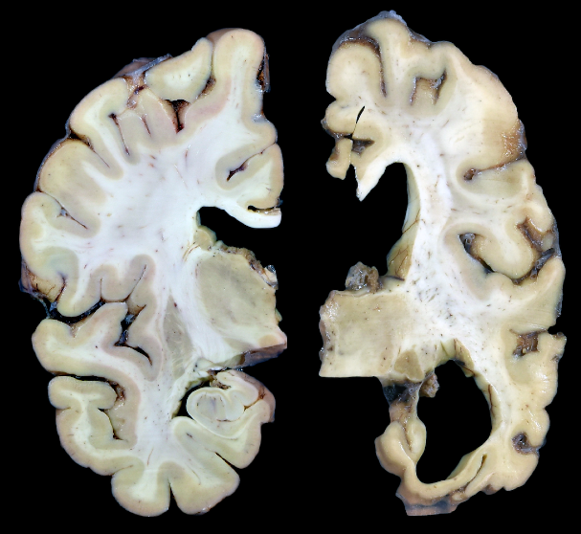
Alzheimers

Slide 7
Northwest
Noggin
Engaging community through neuroscience research and art!

Slide 8
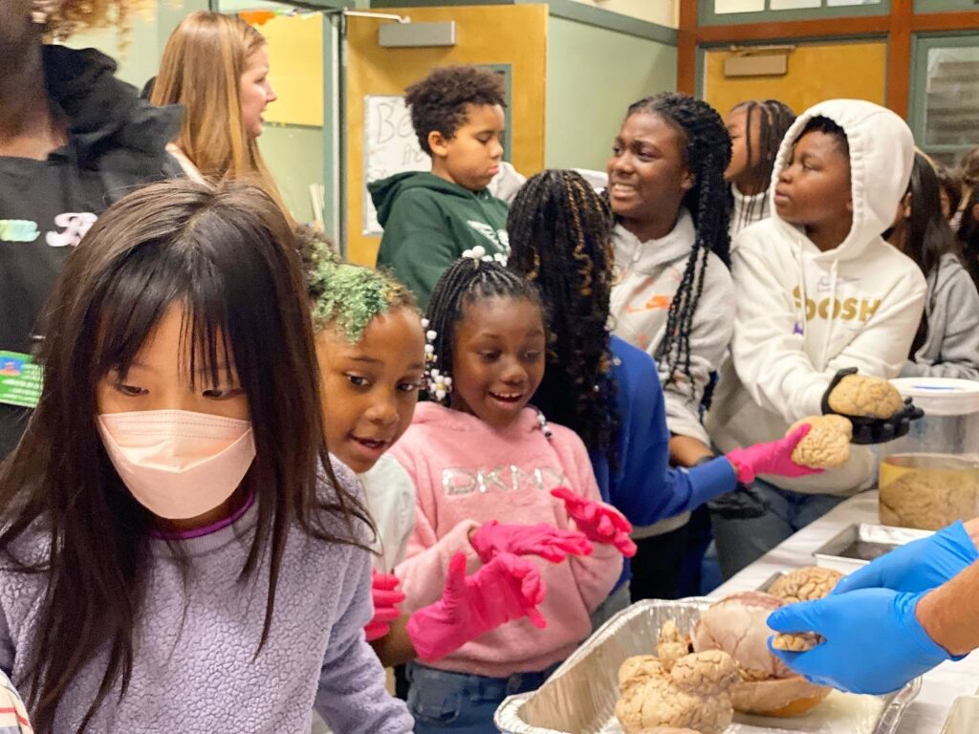
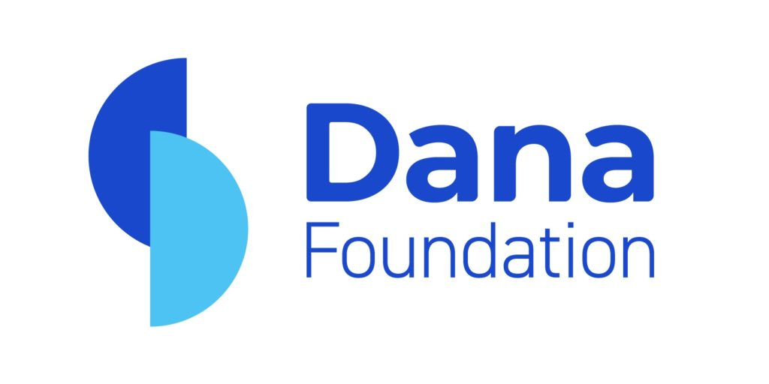
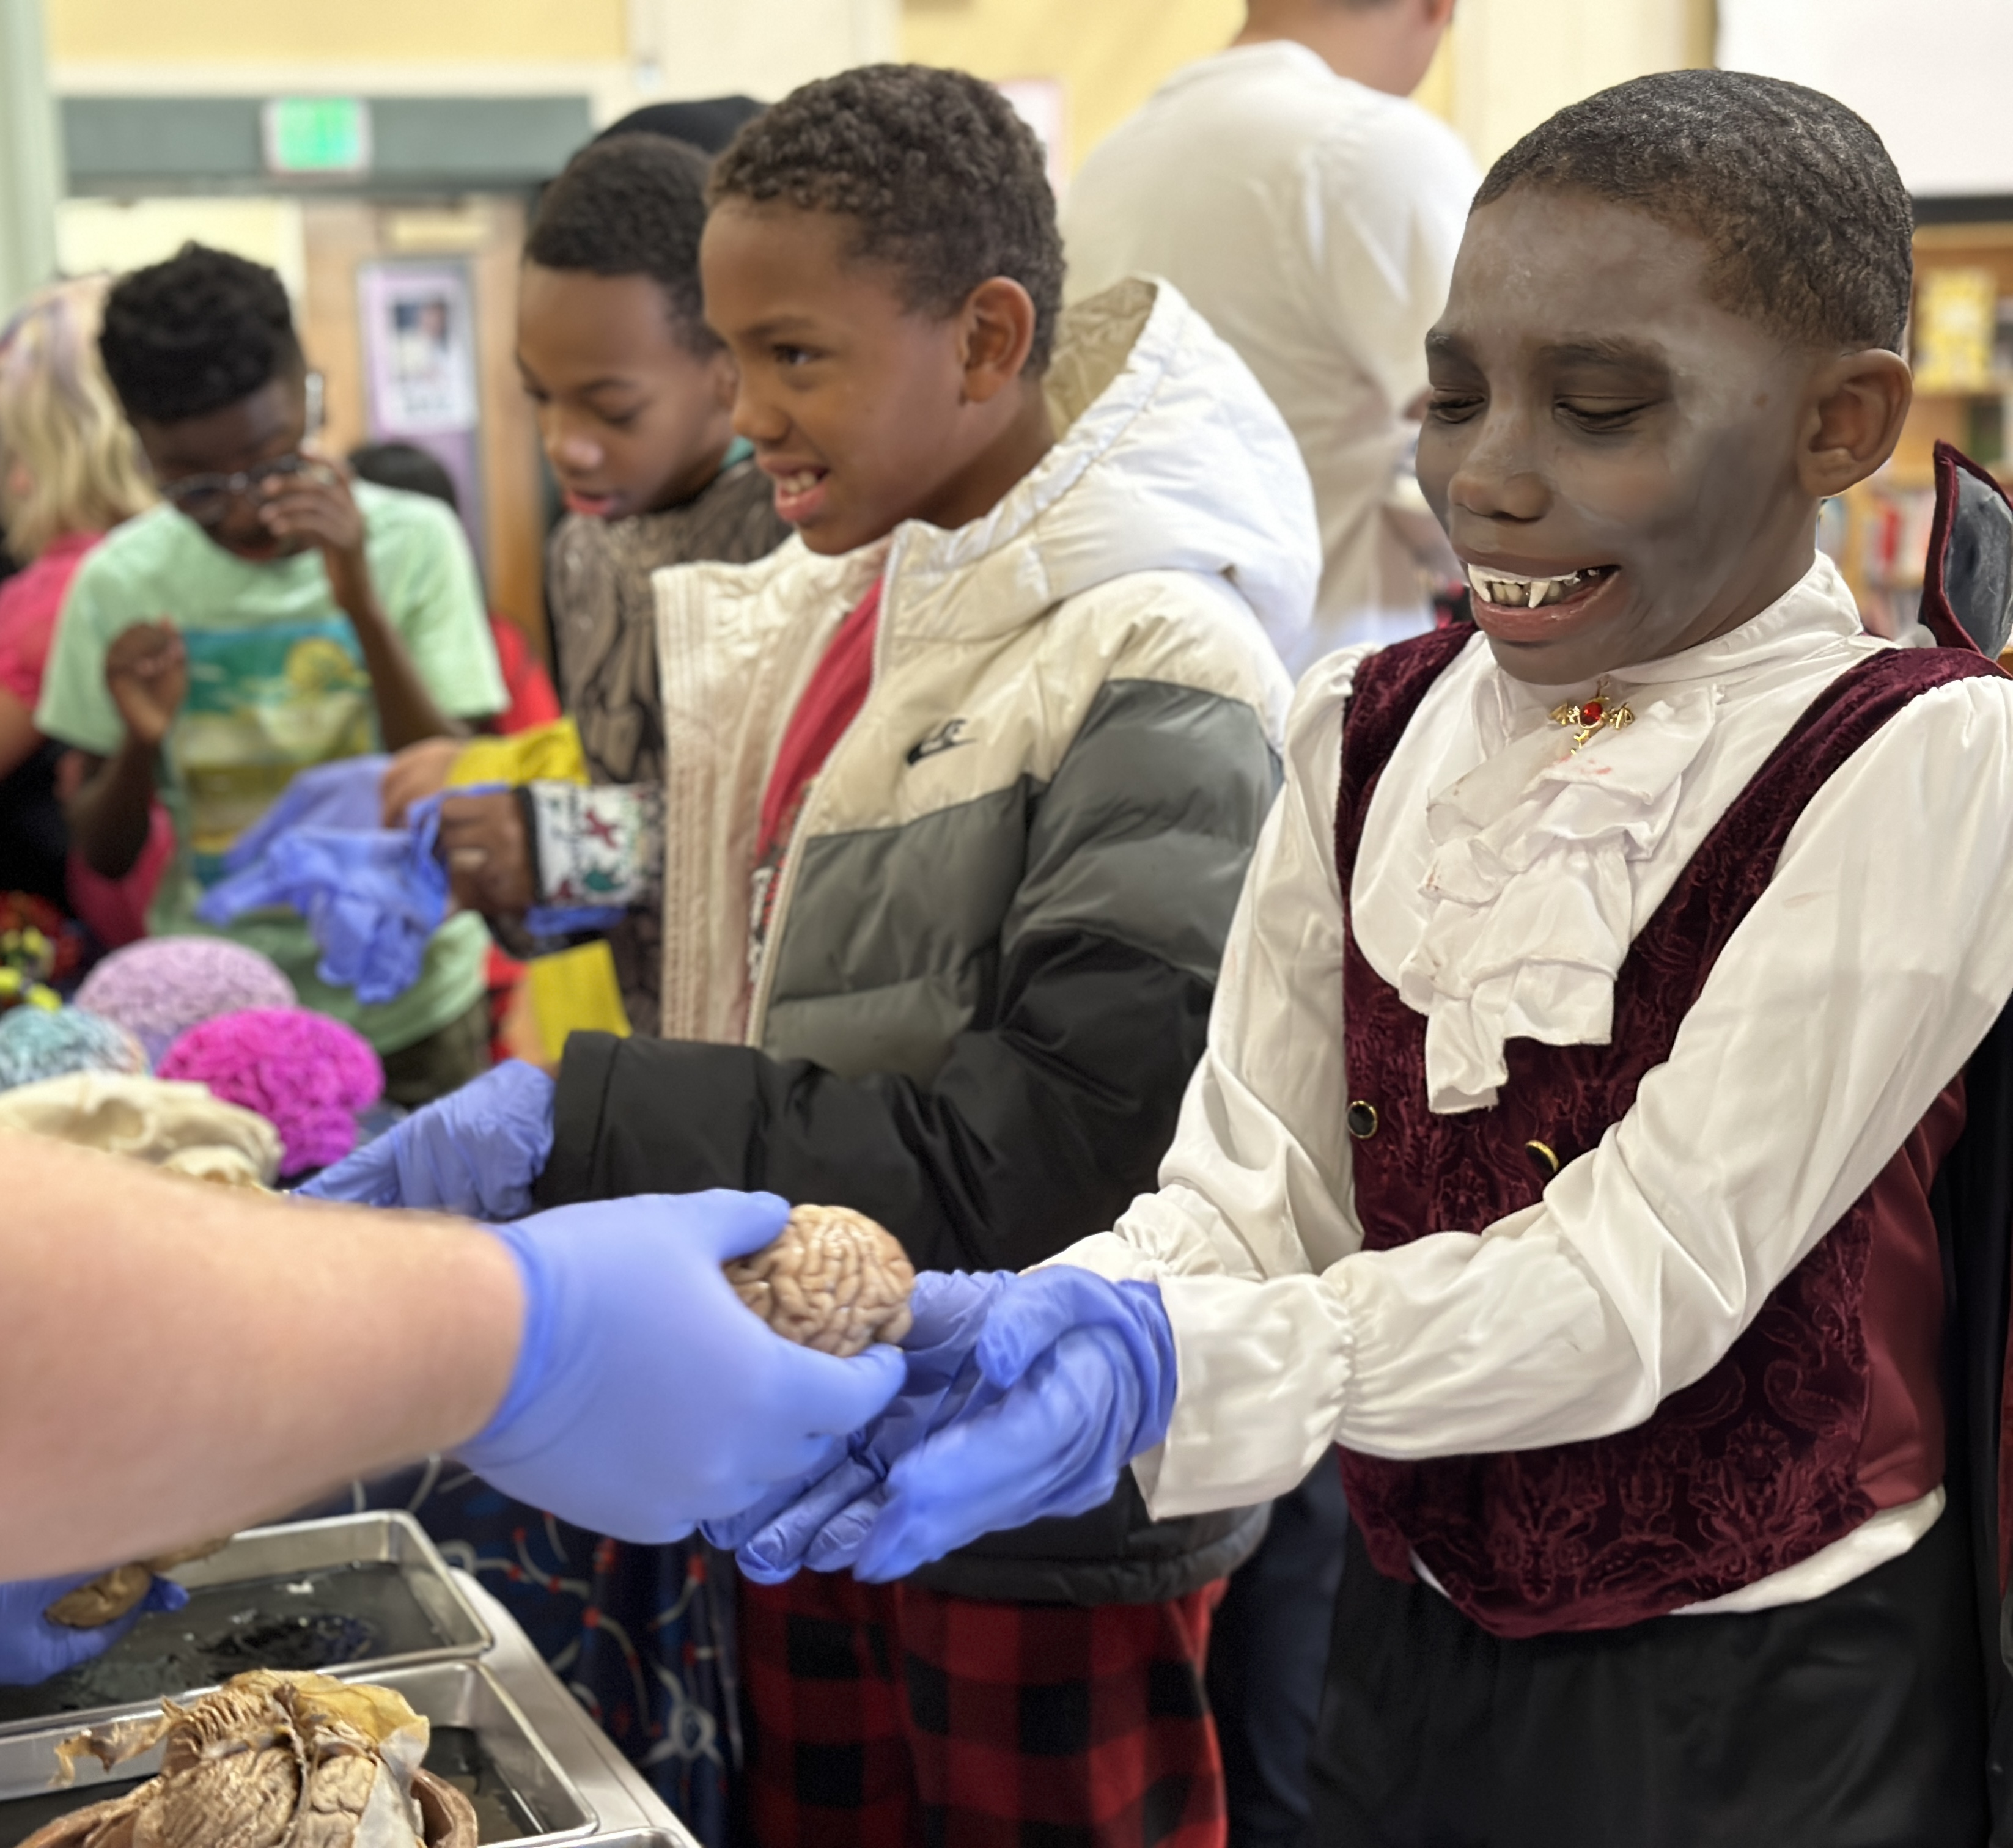
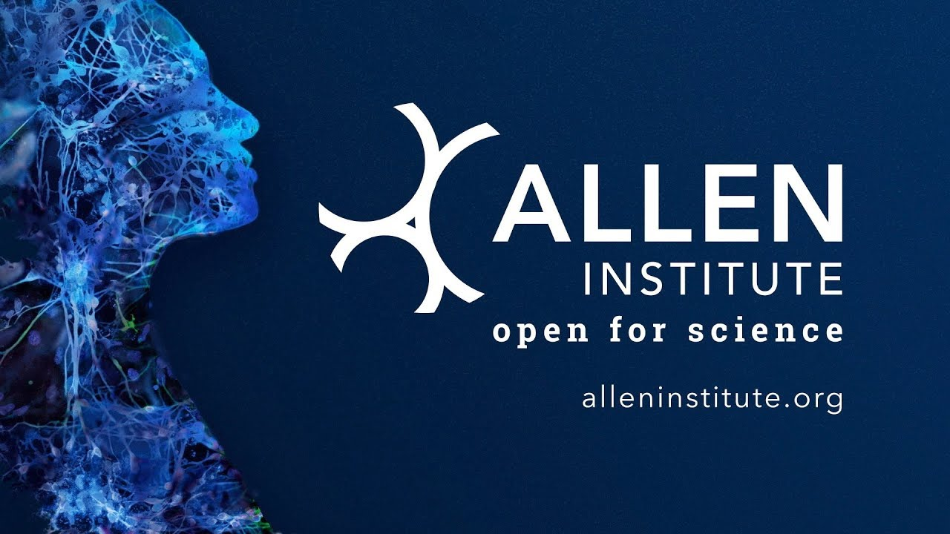
Thank you
DR. PAUL ARAVICH,
Eastern Virginia Medical School
(“the brains”)

Slide 9
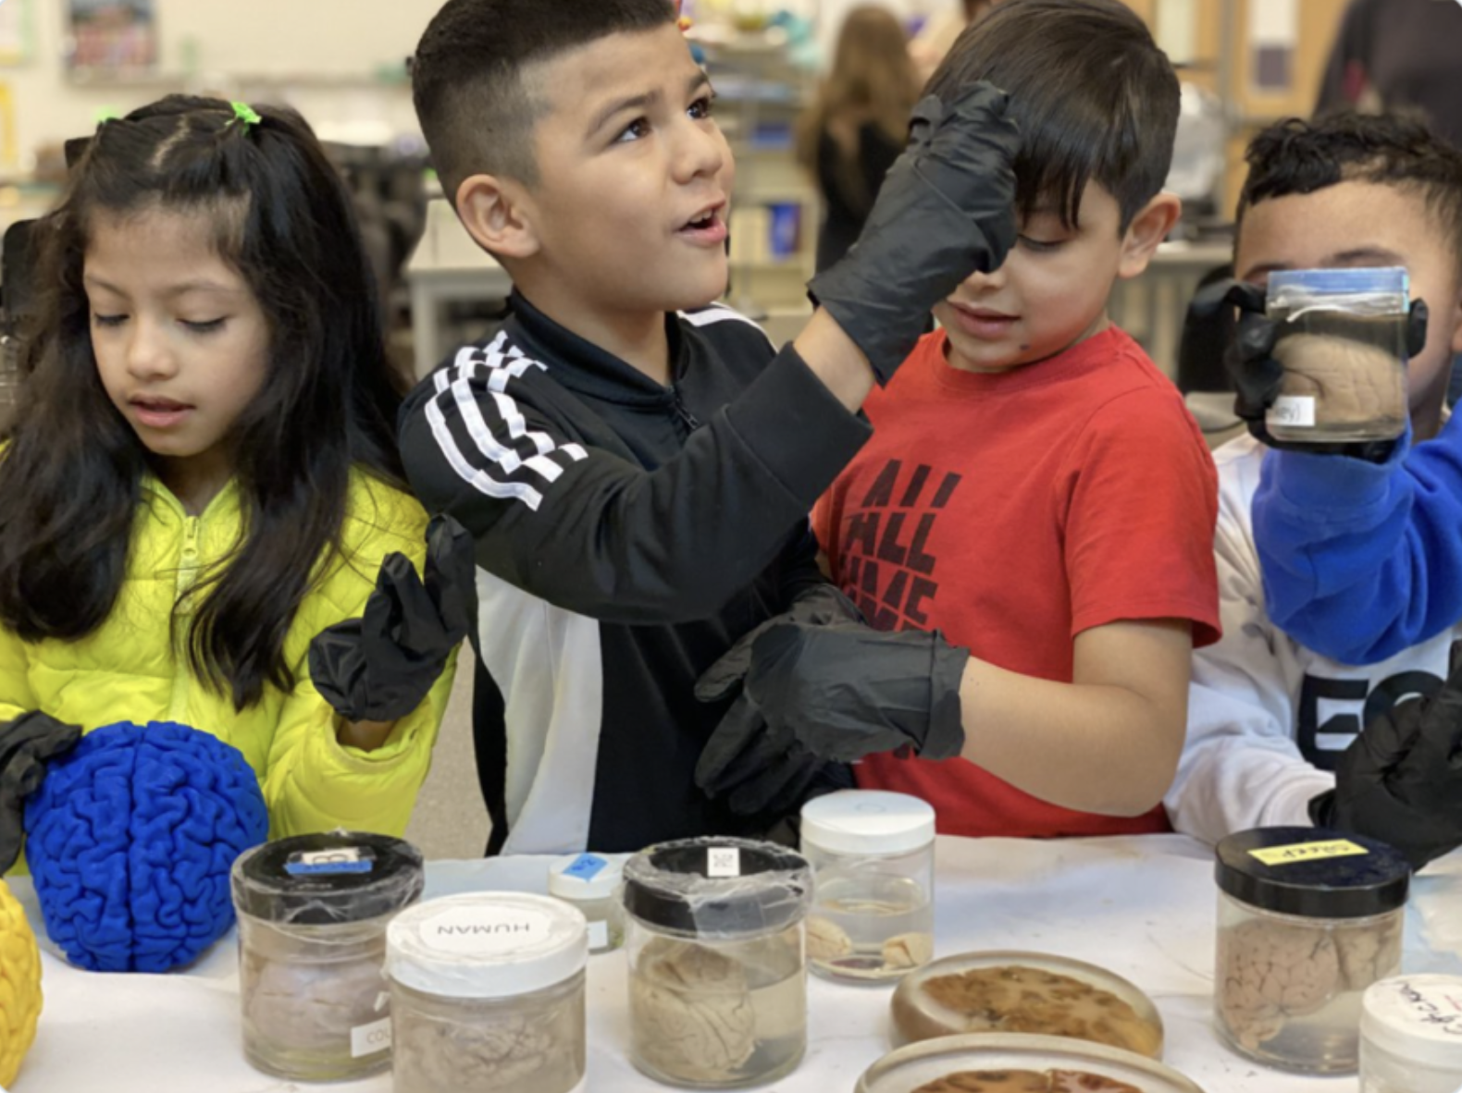
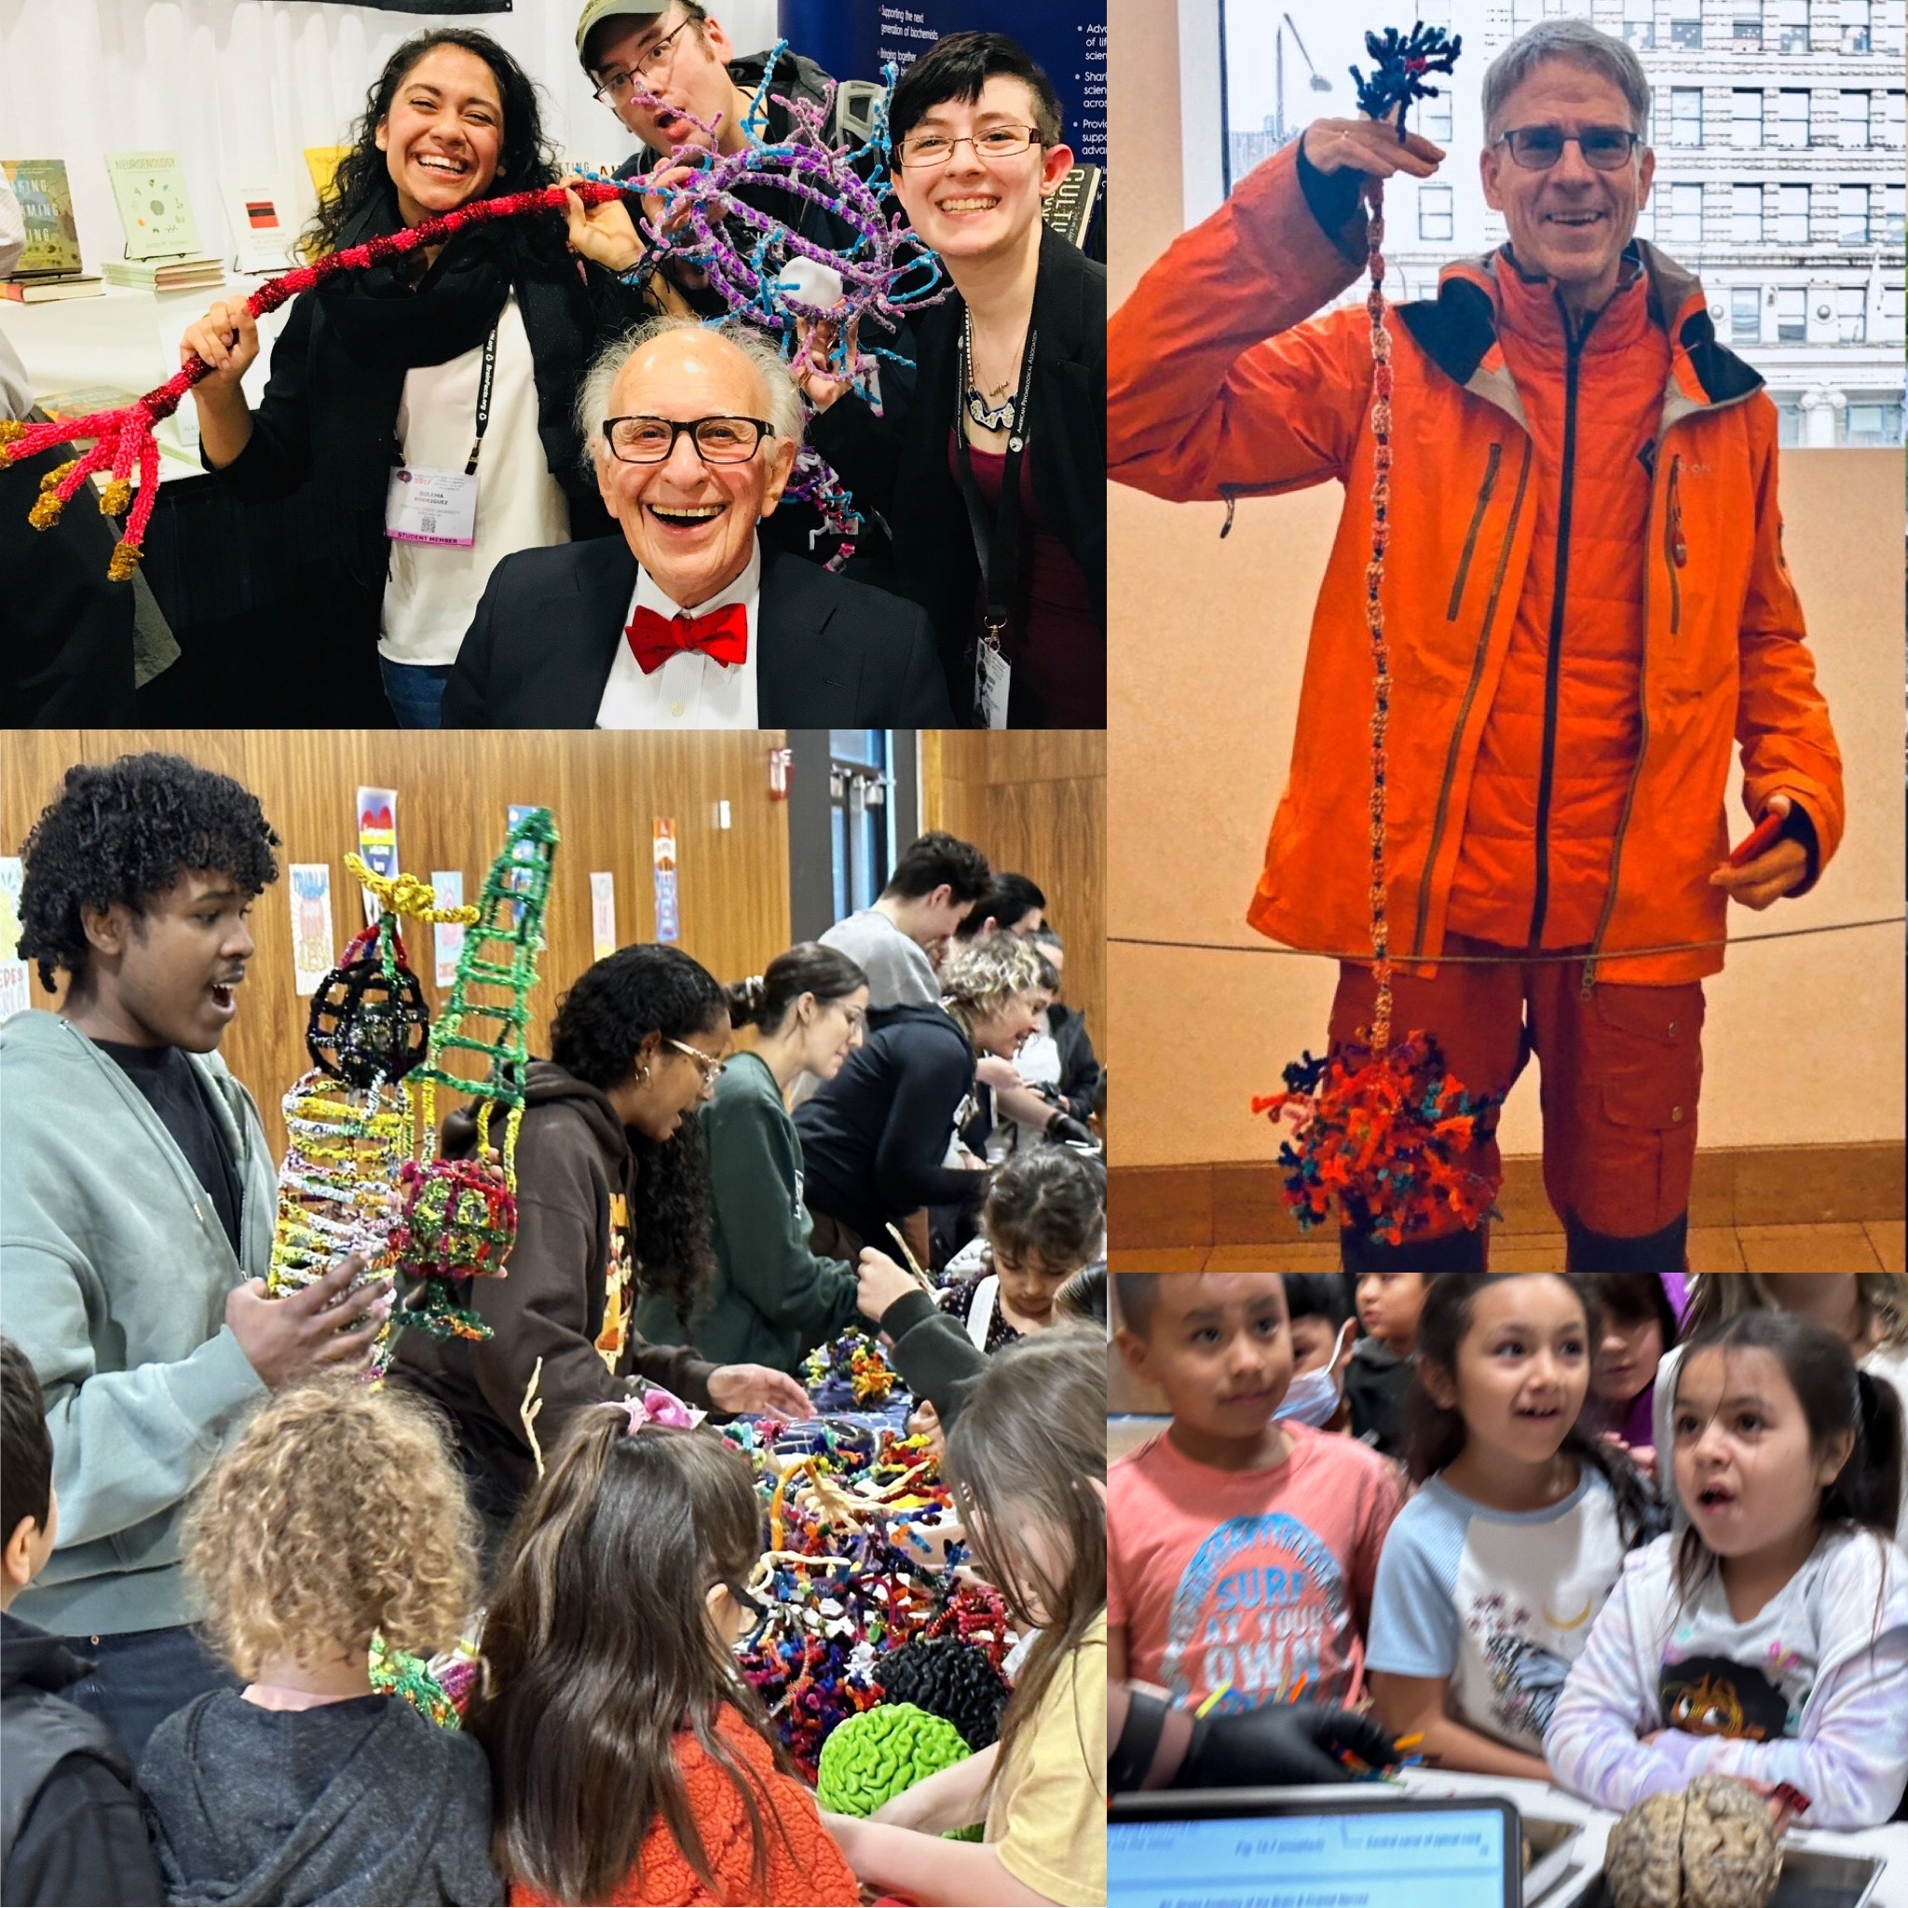
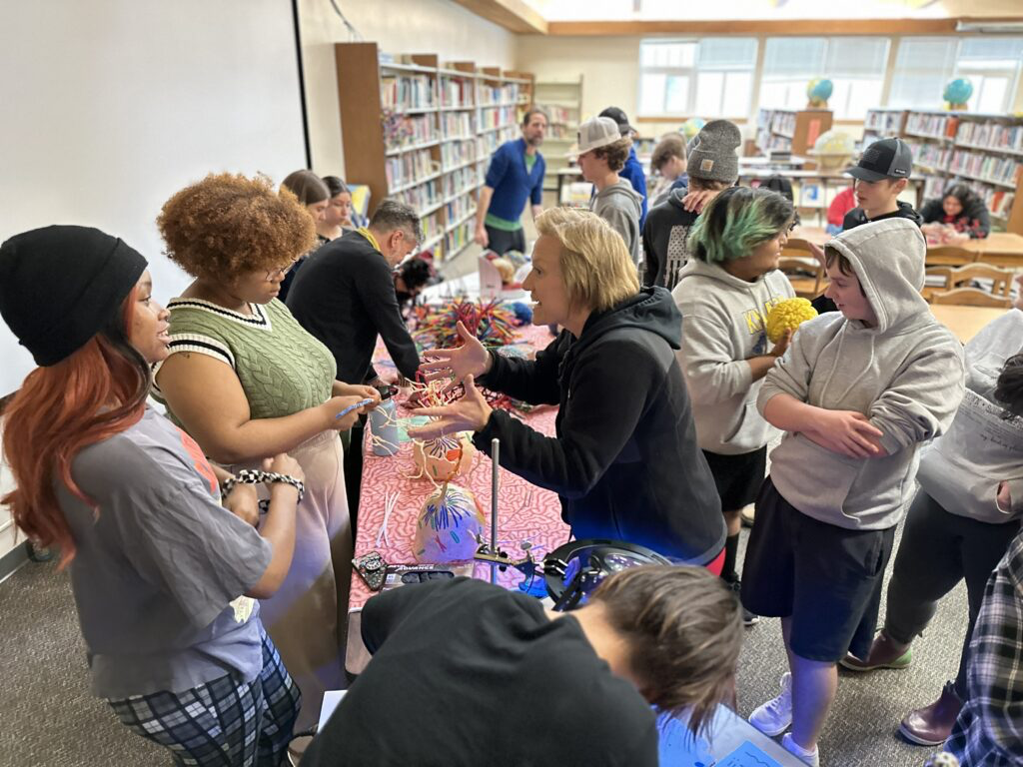
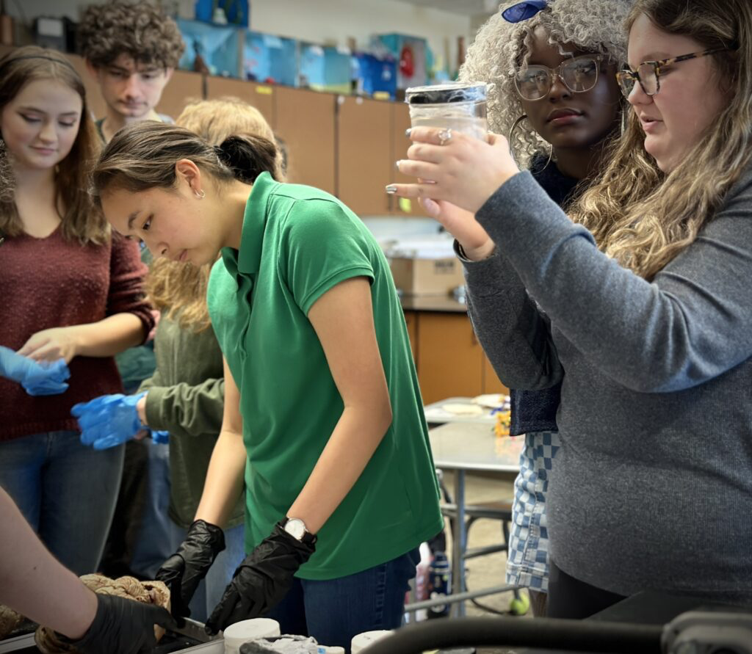
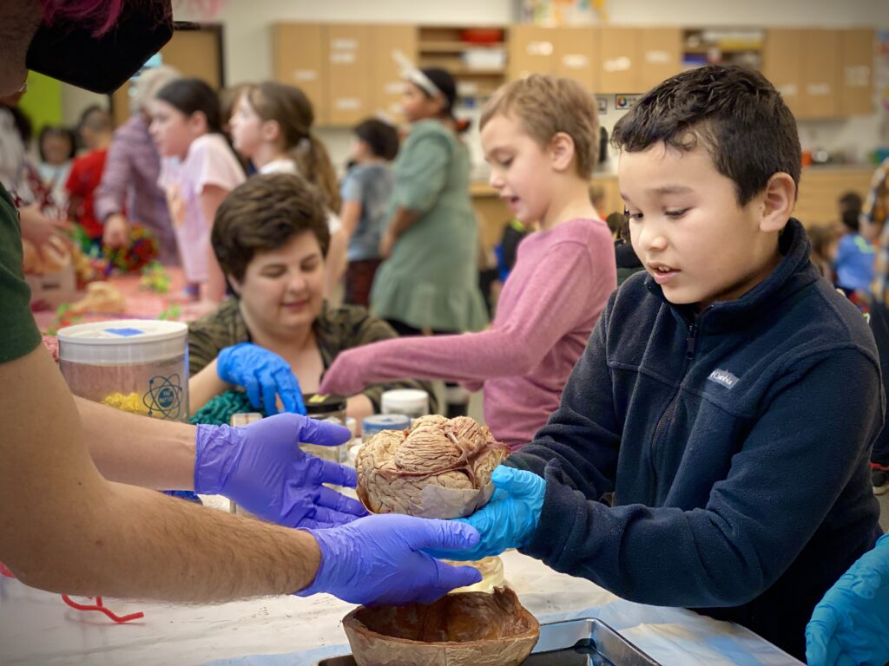
ALL VOLUNTEER
Eleven years (SINCE 2012)!
NO ADMISSION - NO TUITION - open to everyone
65,000+ public K12 students/community members
local/national/international collaborators

Slide 10
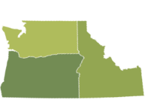
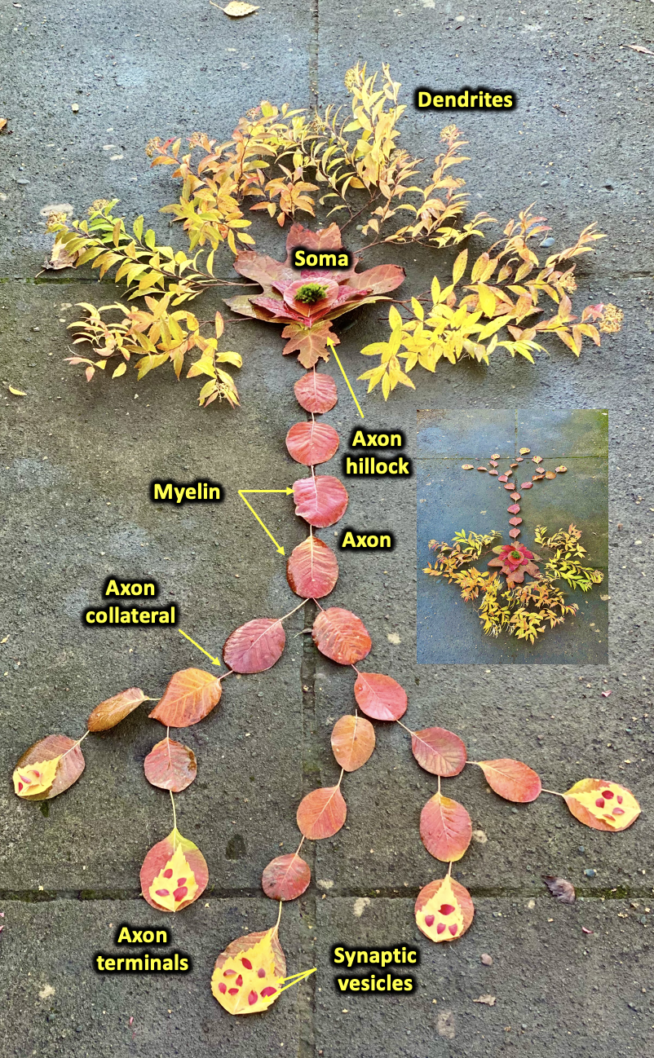
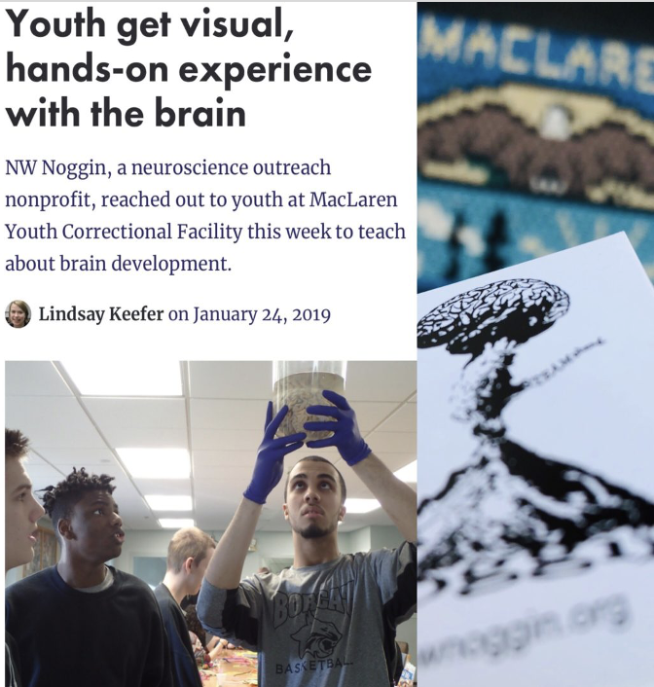
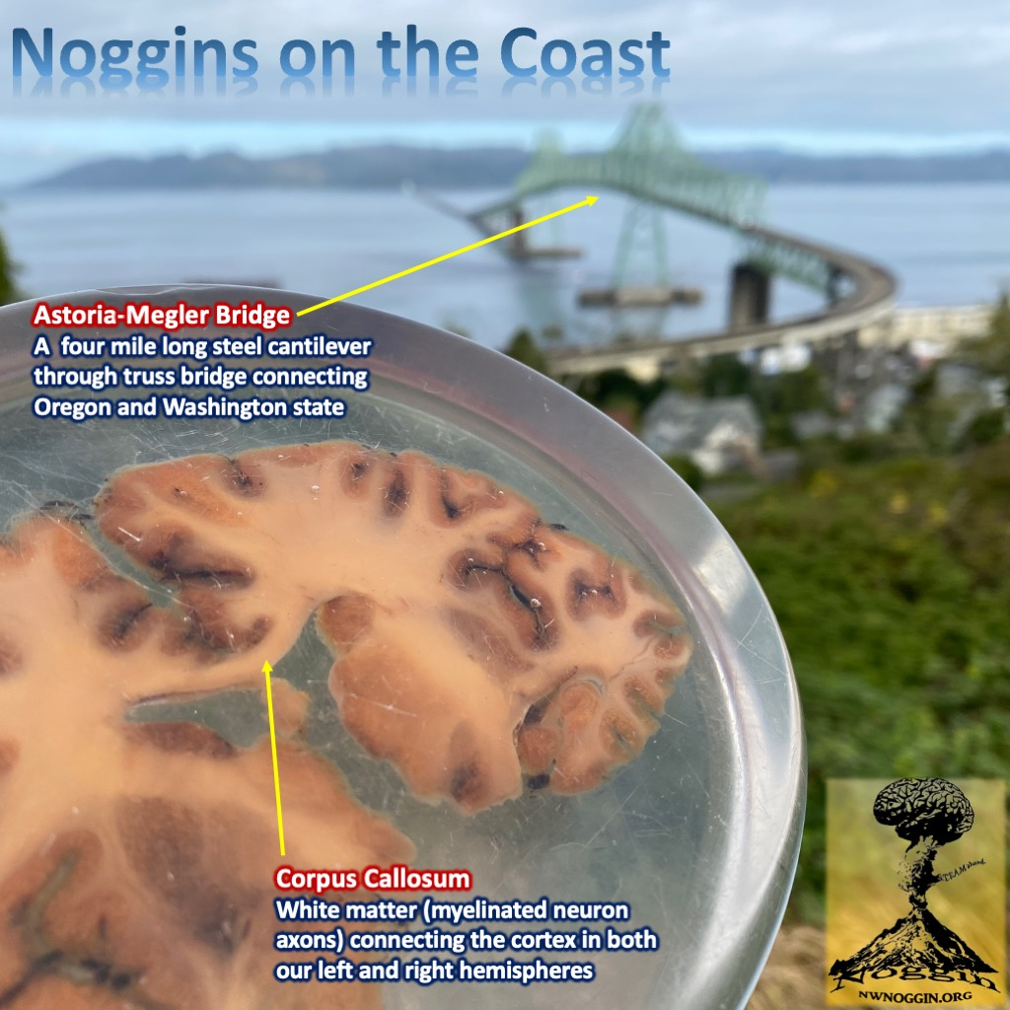
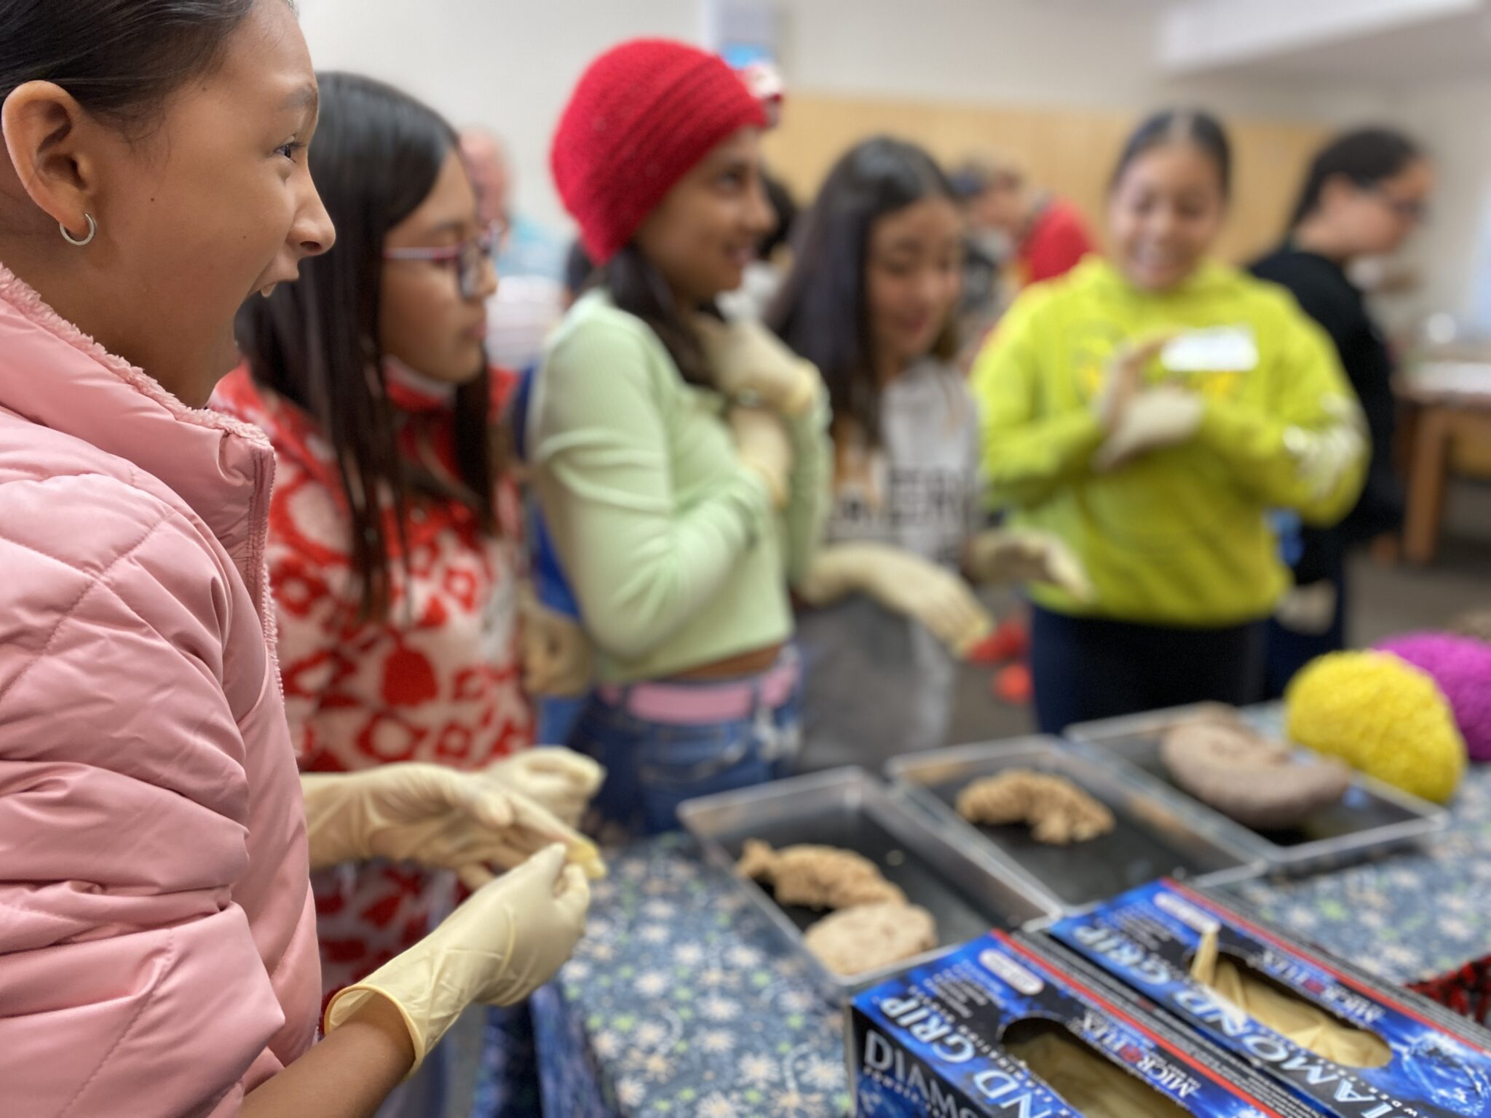
Siletz, Amity & Willamina, OR
Pop: 4000
Davenport, WA
Pop: 1700
GO PLACES
Astoria, OR
Pop: 10,000
A few places
we’ve been
-where STEM programs DON’T GO
-where money and resources don’t go
-public K-12 schools
-rural and Urban communities
-houseless youth nonprofits
-correctional facilities
La Grande, OR
Pop: 13,000
Meservy Meadows, OR Pop: ~40
Sisters, OR
Pop: 3081
Heppner & Ione, OR
Pop: 1240

Slide 11
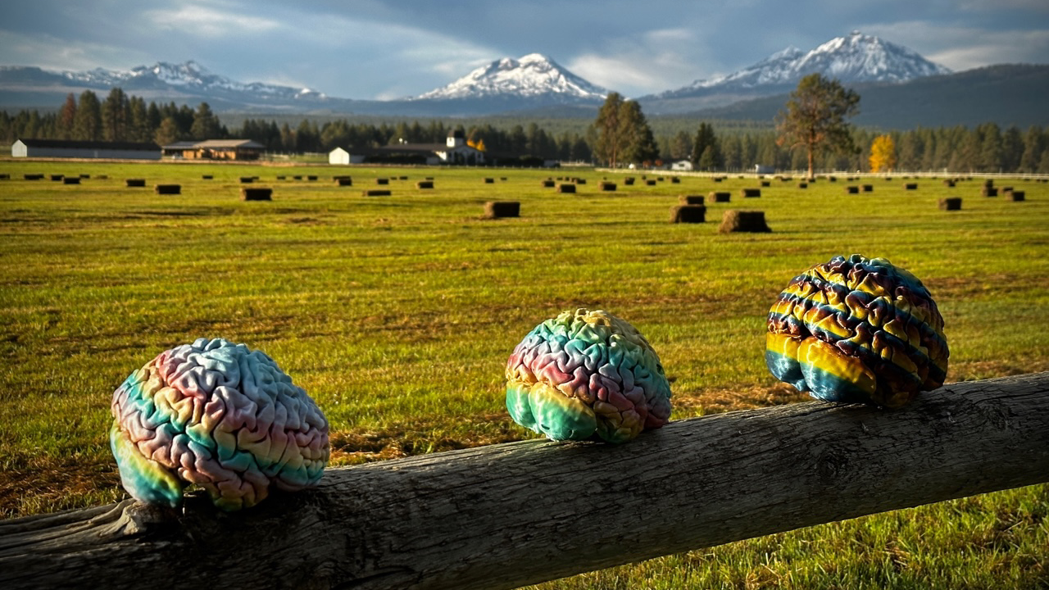
GO PLACES
Sisters, Oregon

Slide 12
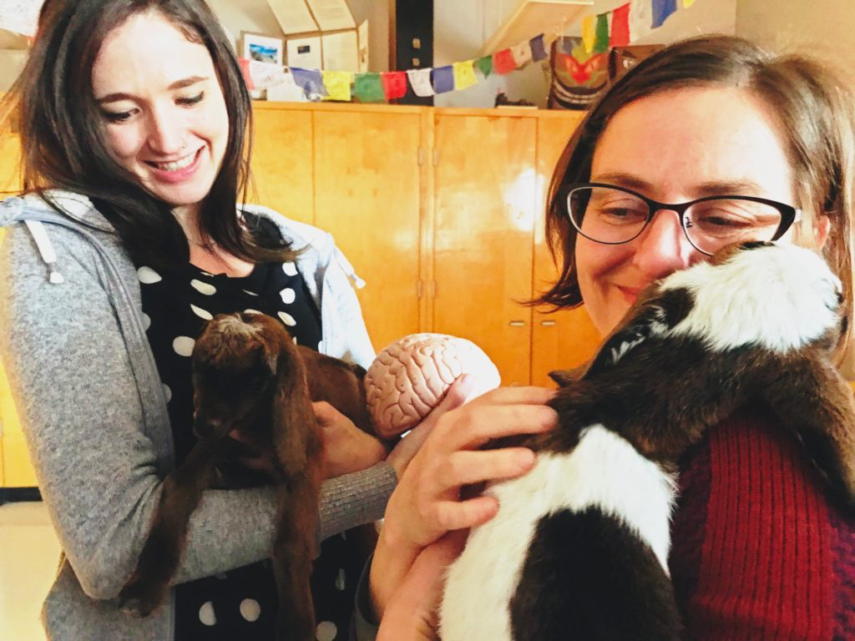
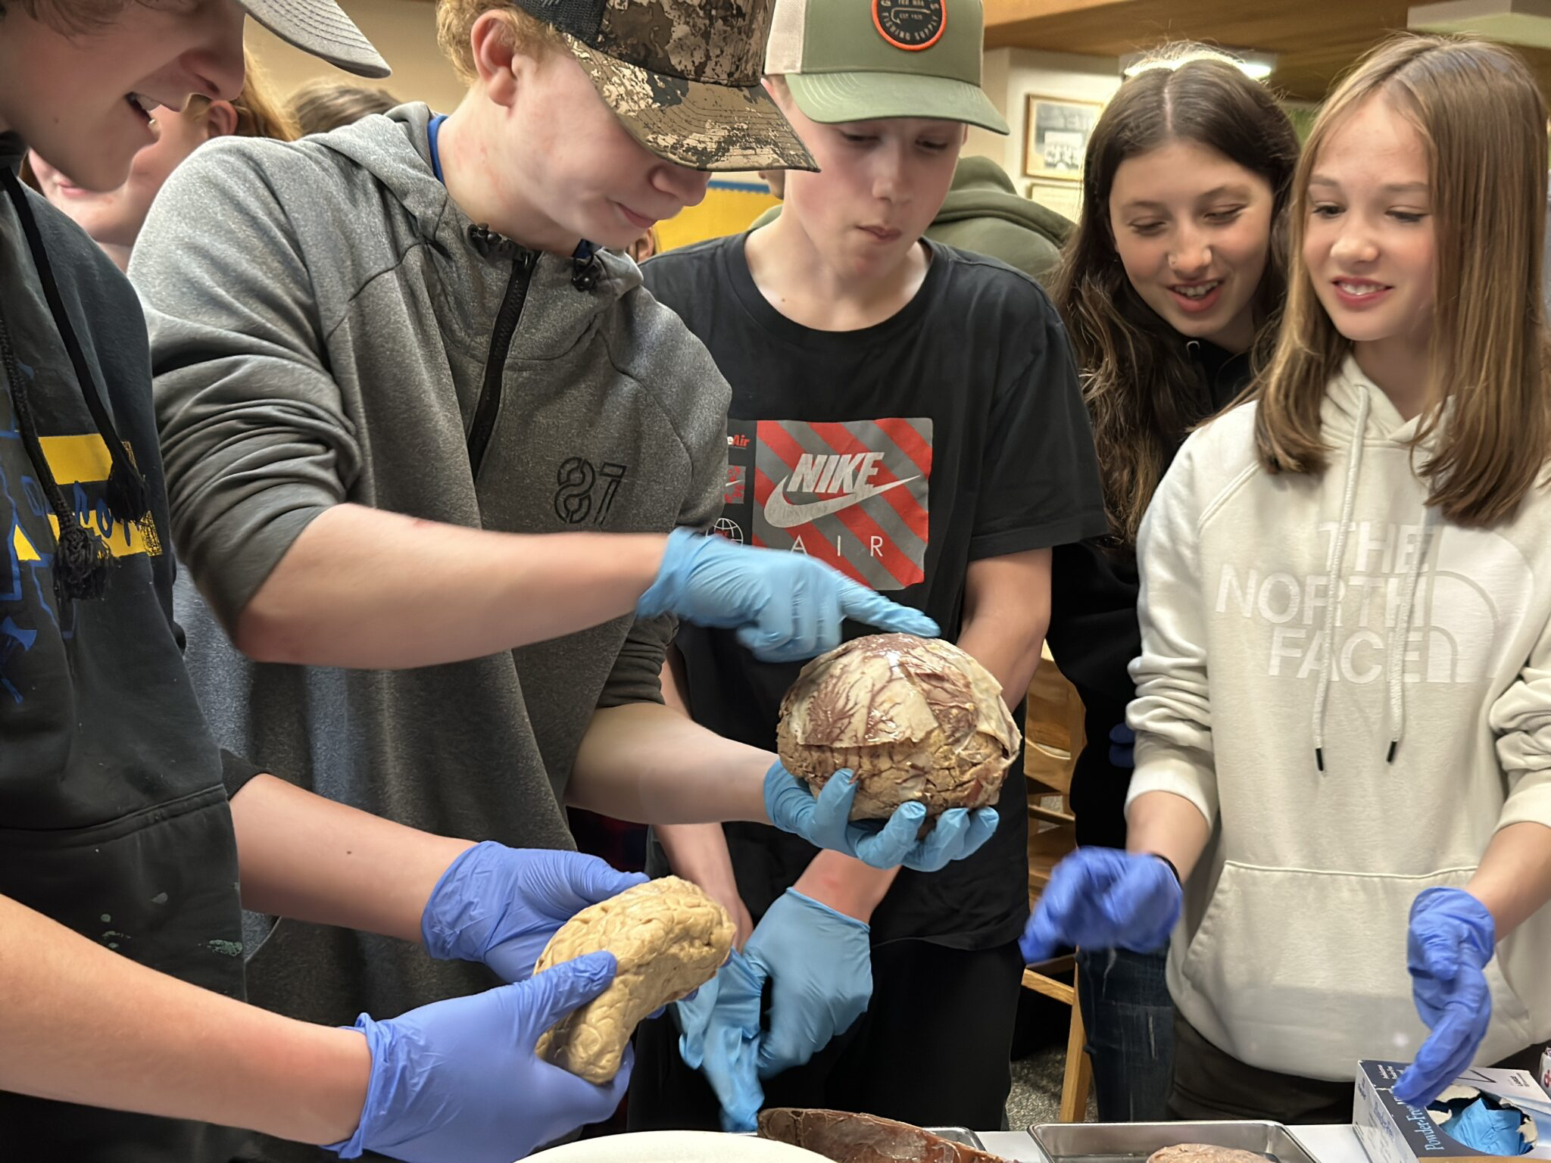
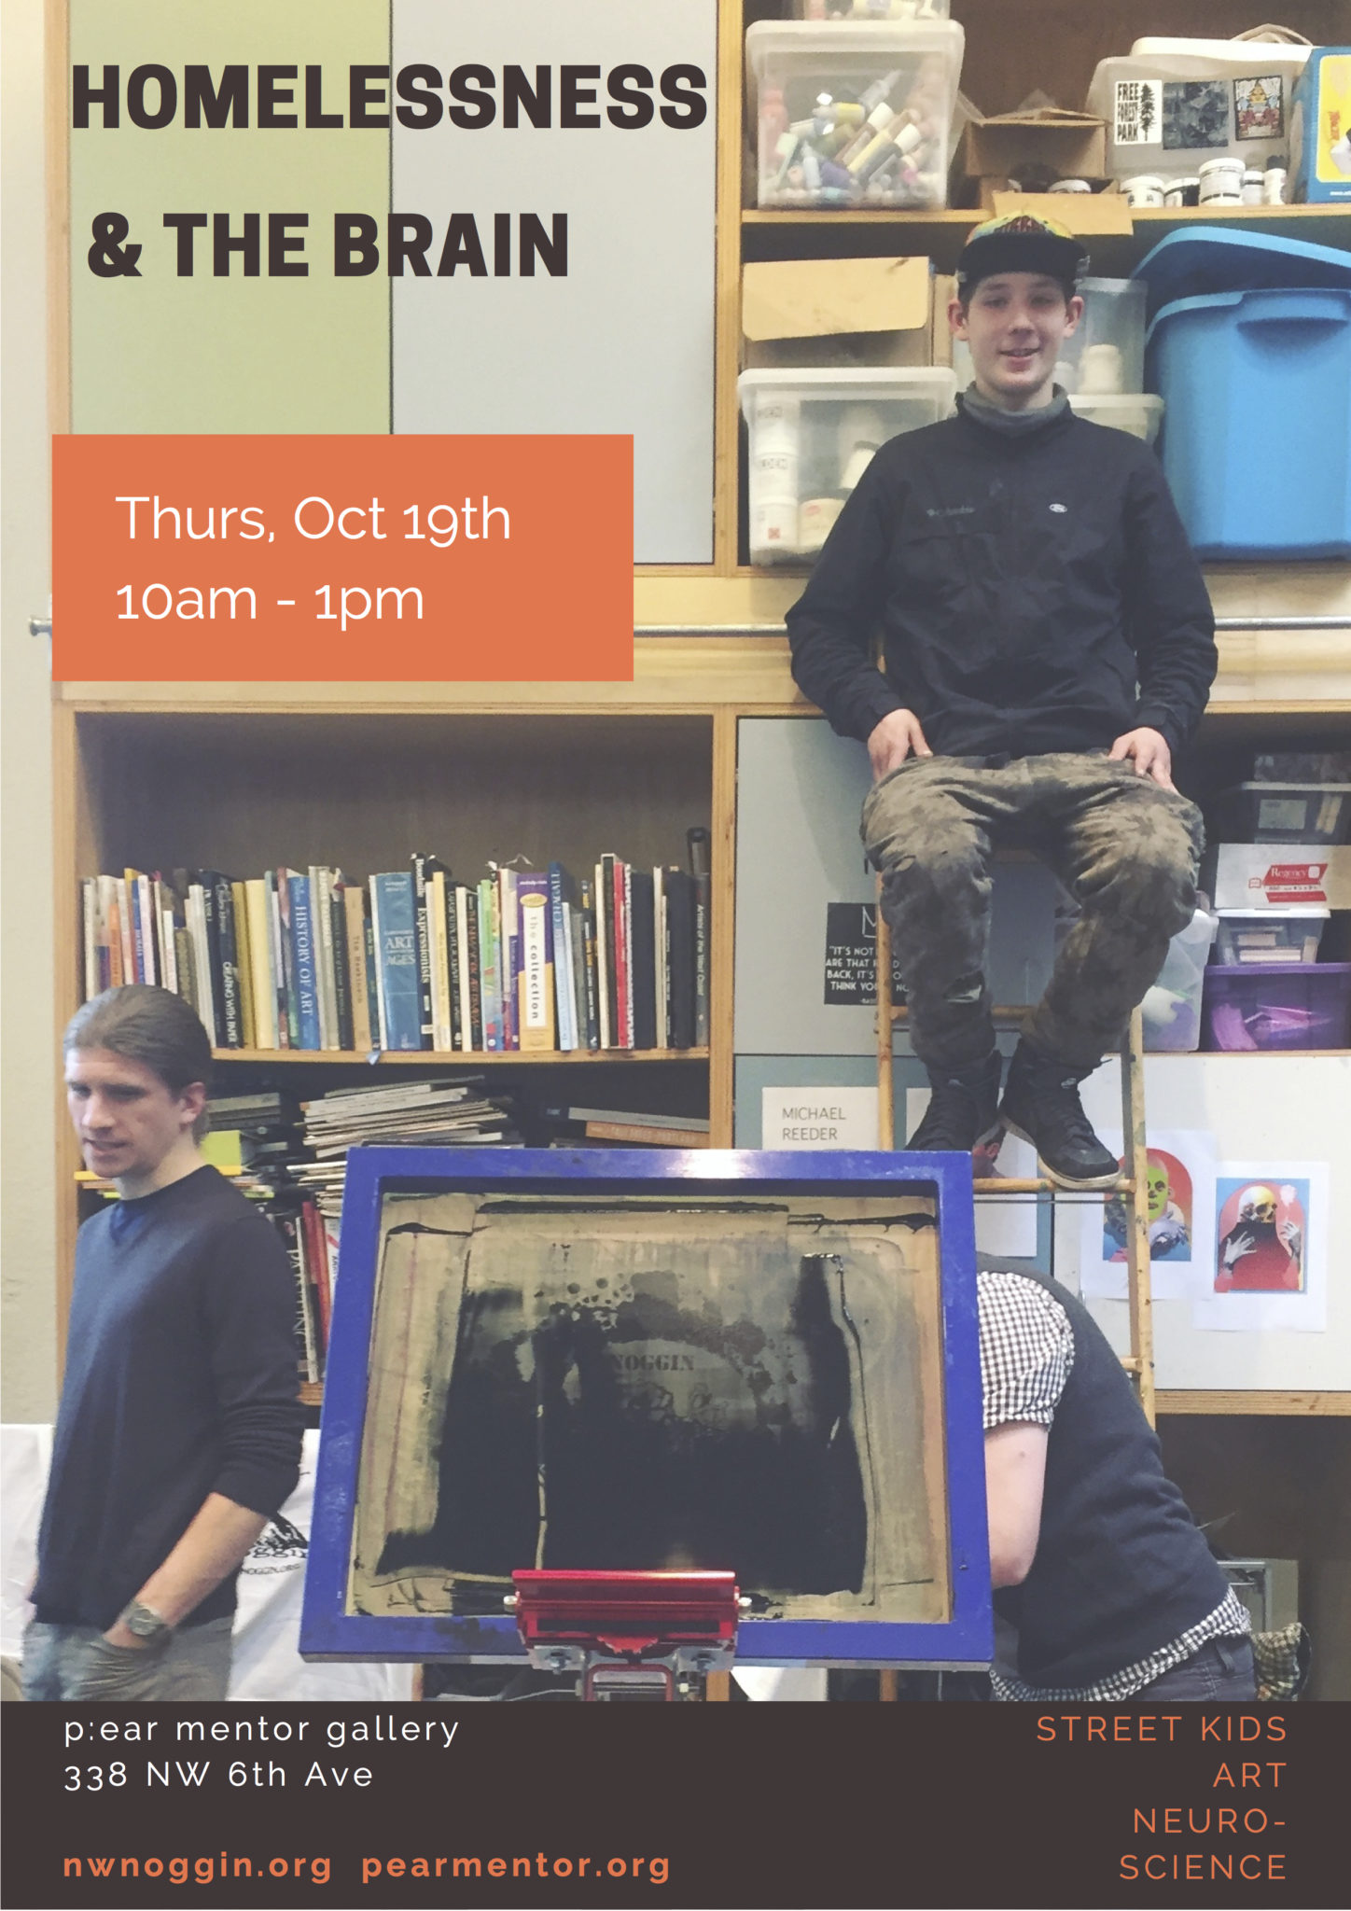
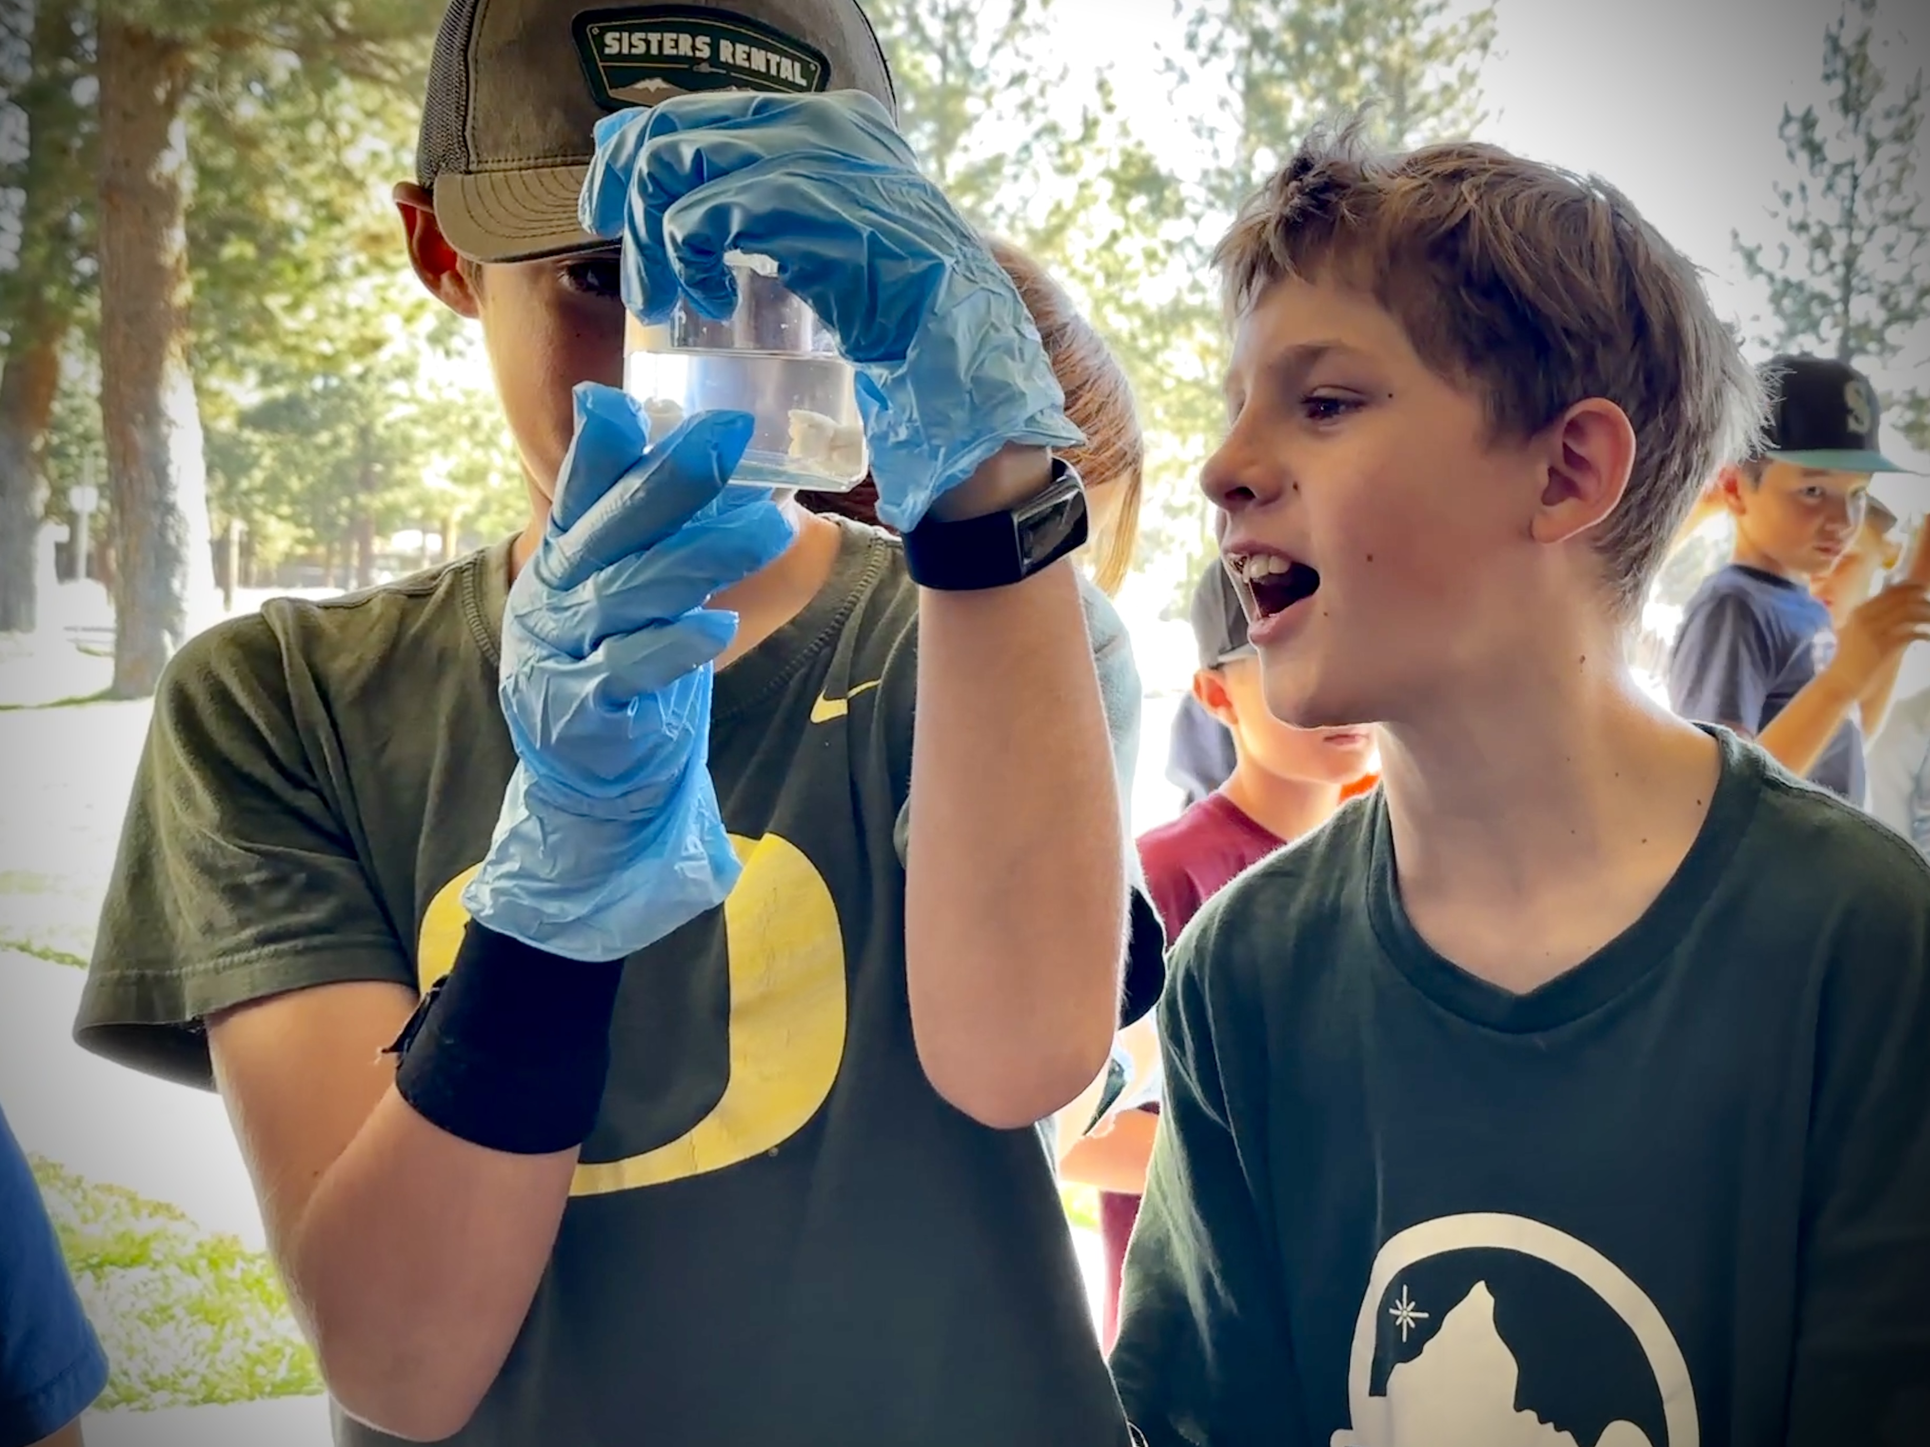
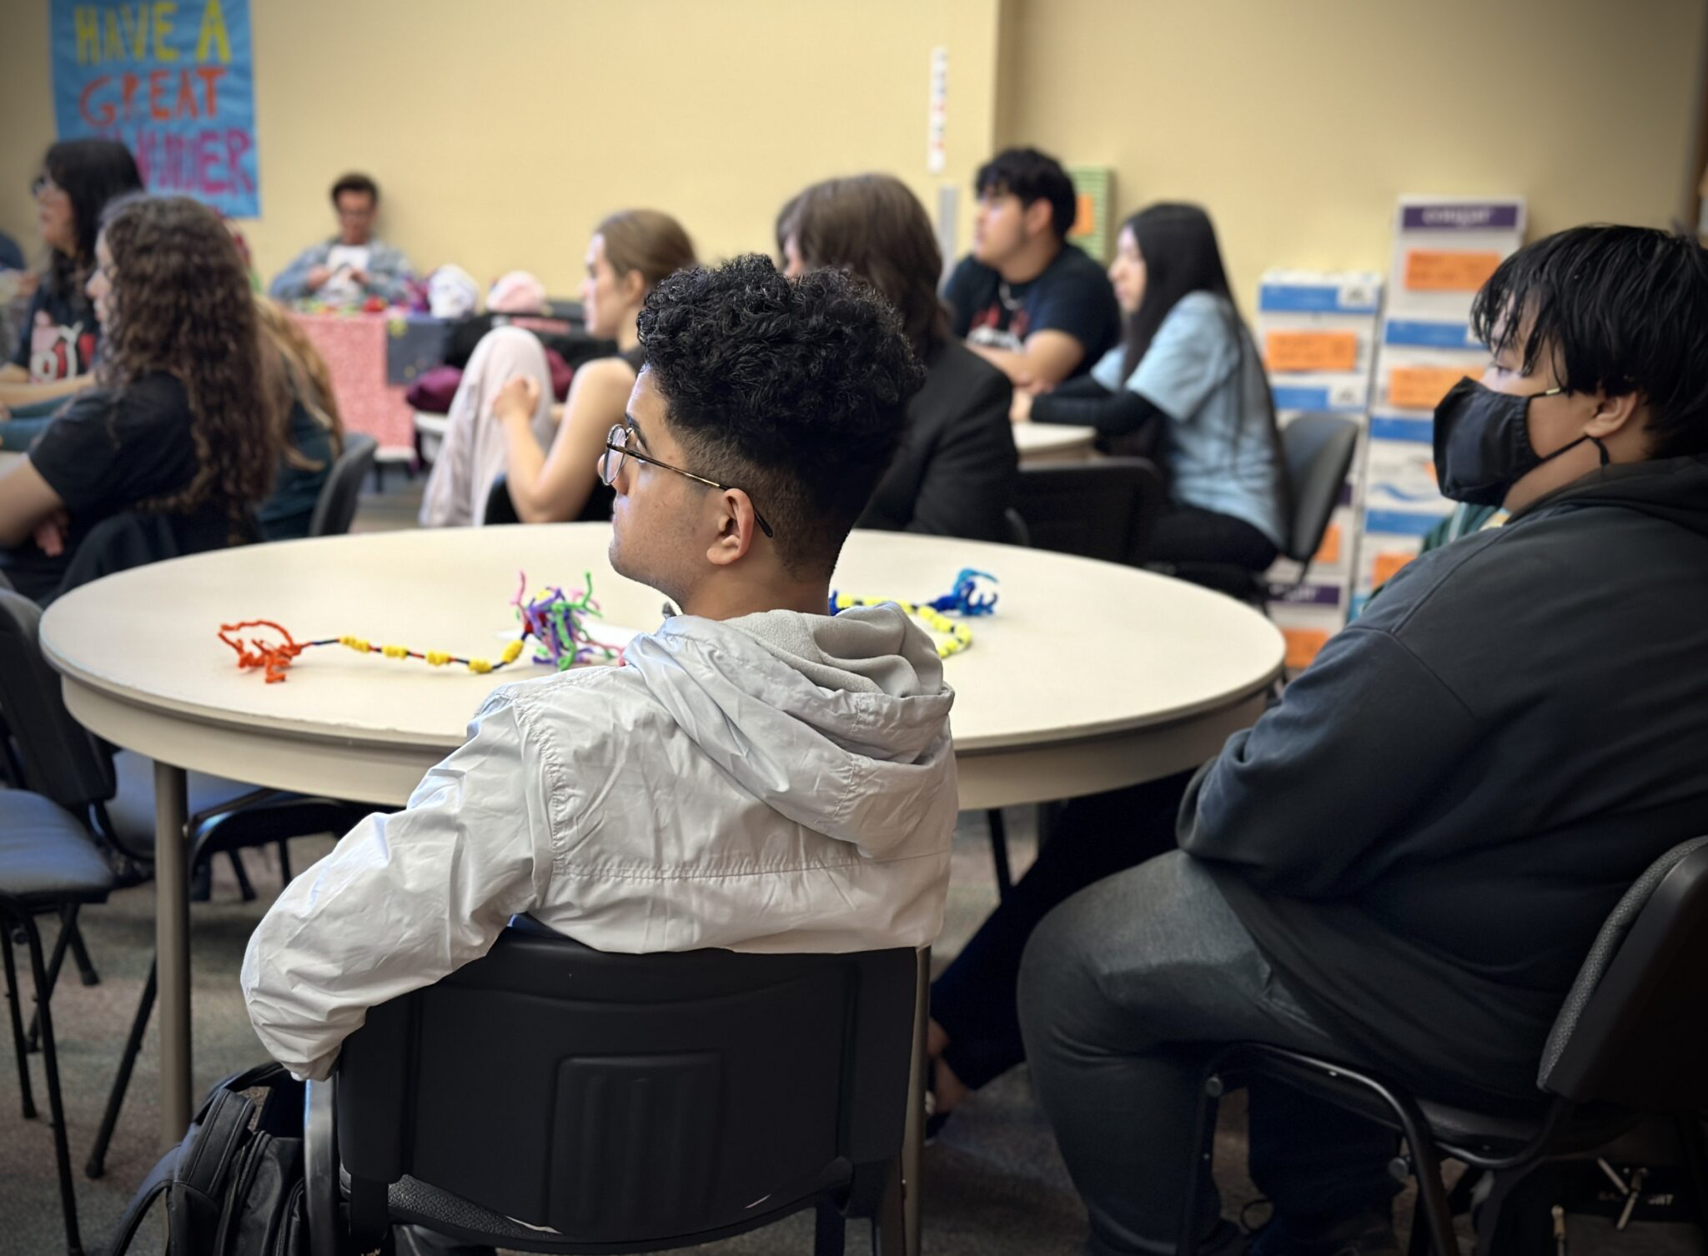
LISTEN
Heppner, OR
-lived experiences
-relevant knowledge
-seeing other people
Knappa, OR
Sisters, OR
Siletz, OR
Portland, OR
Portland, OR

Slide 13
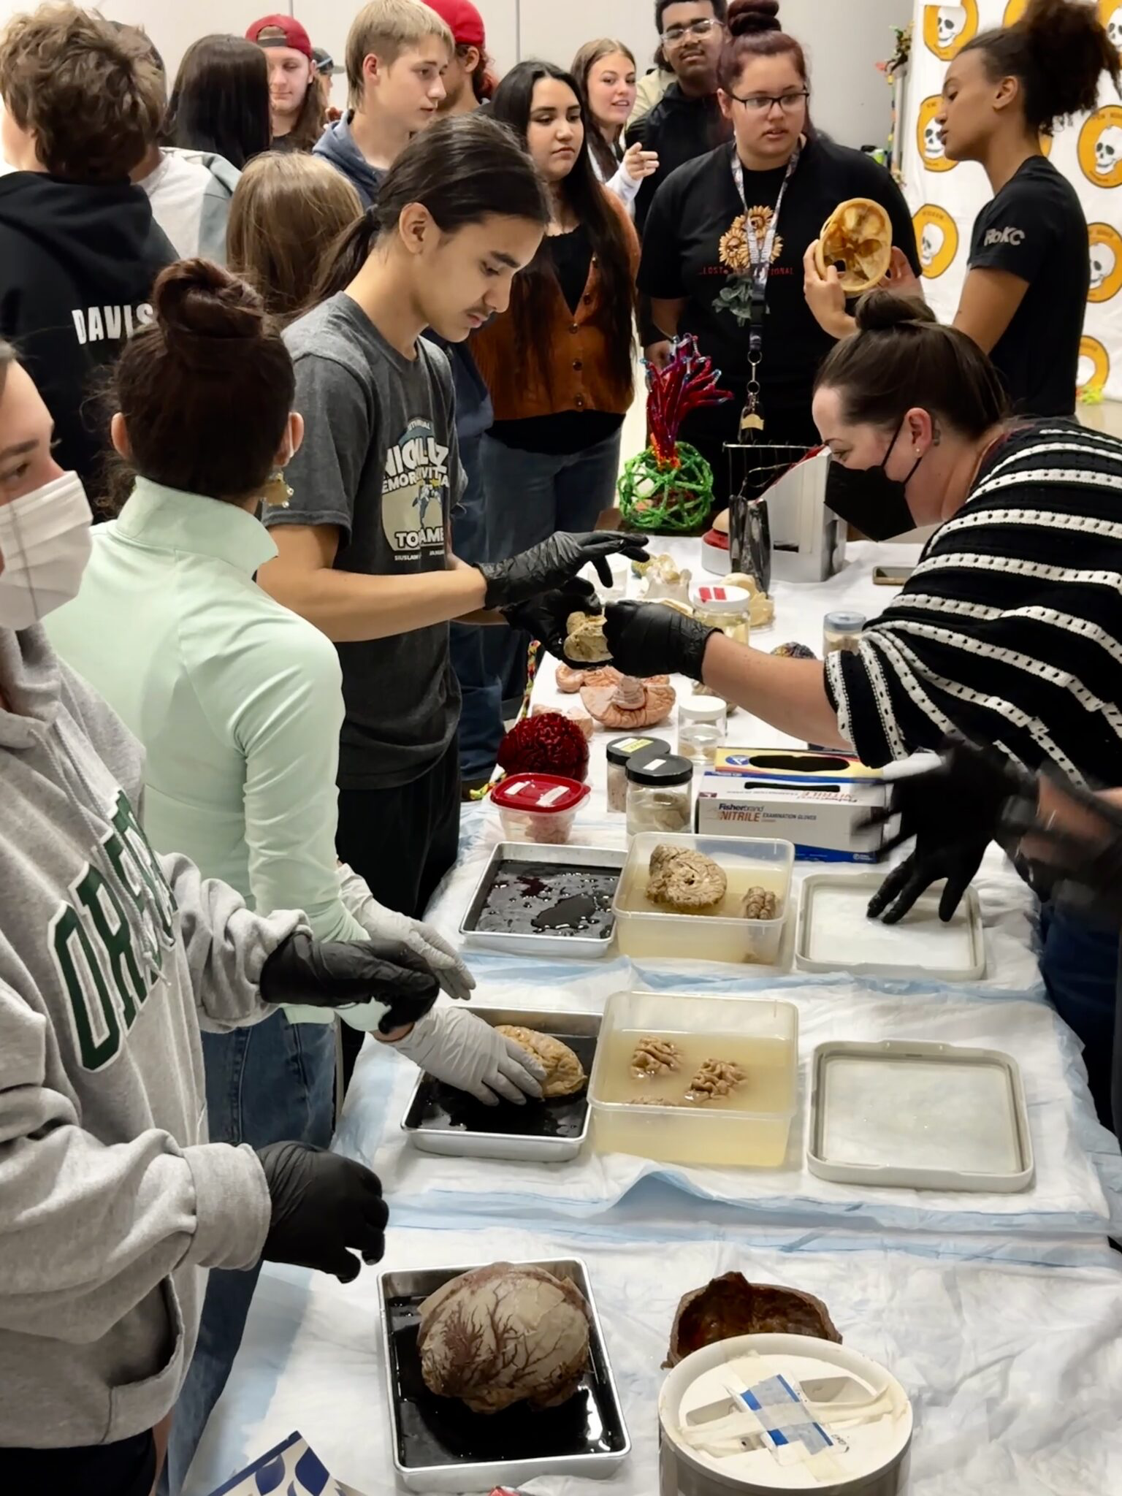
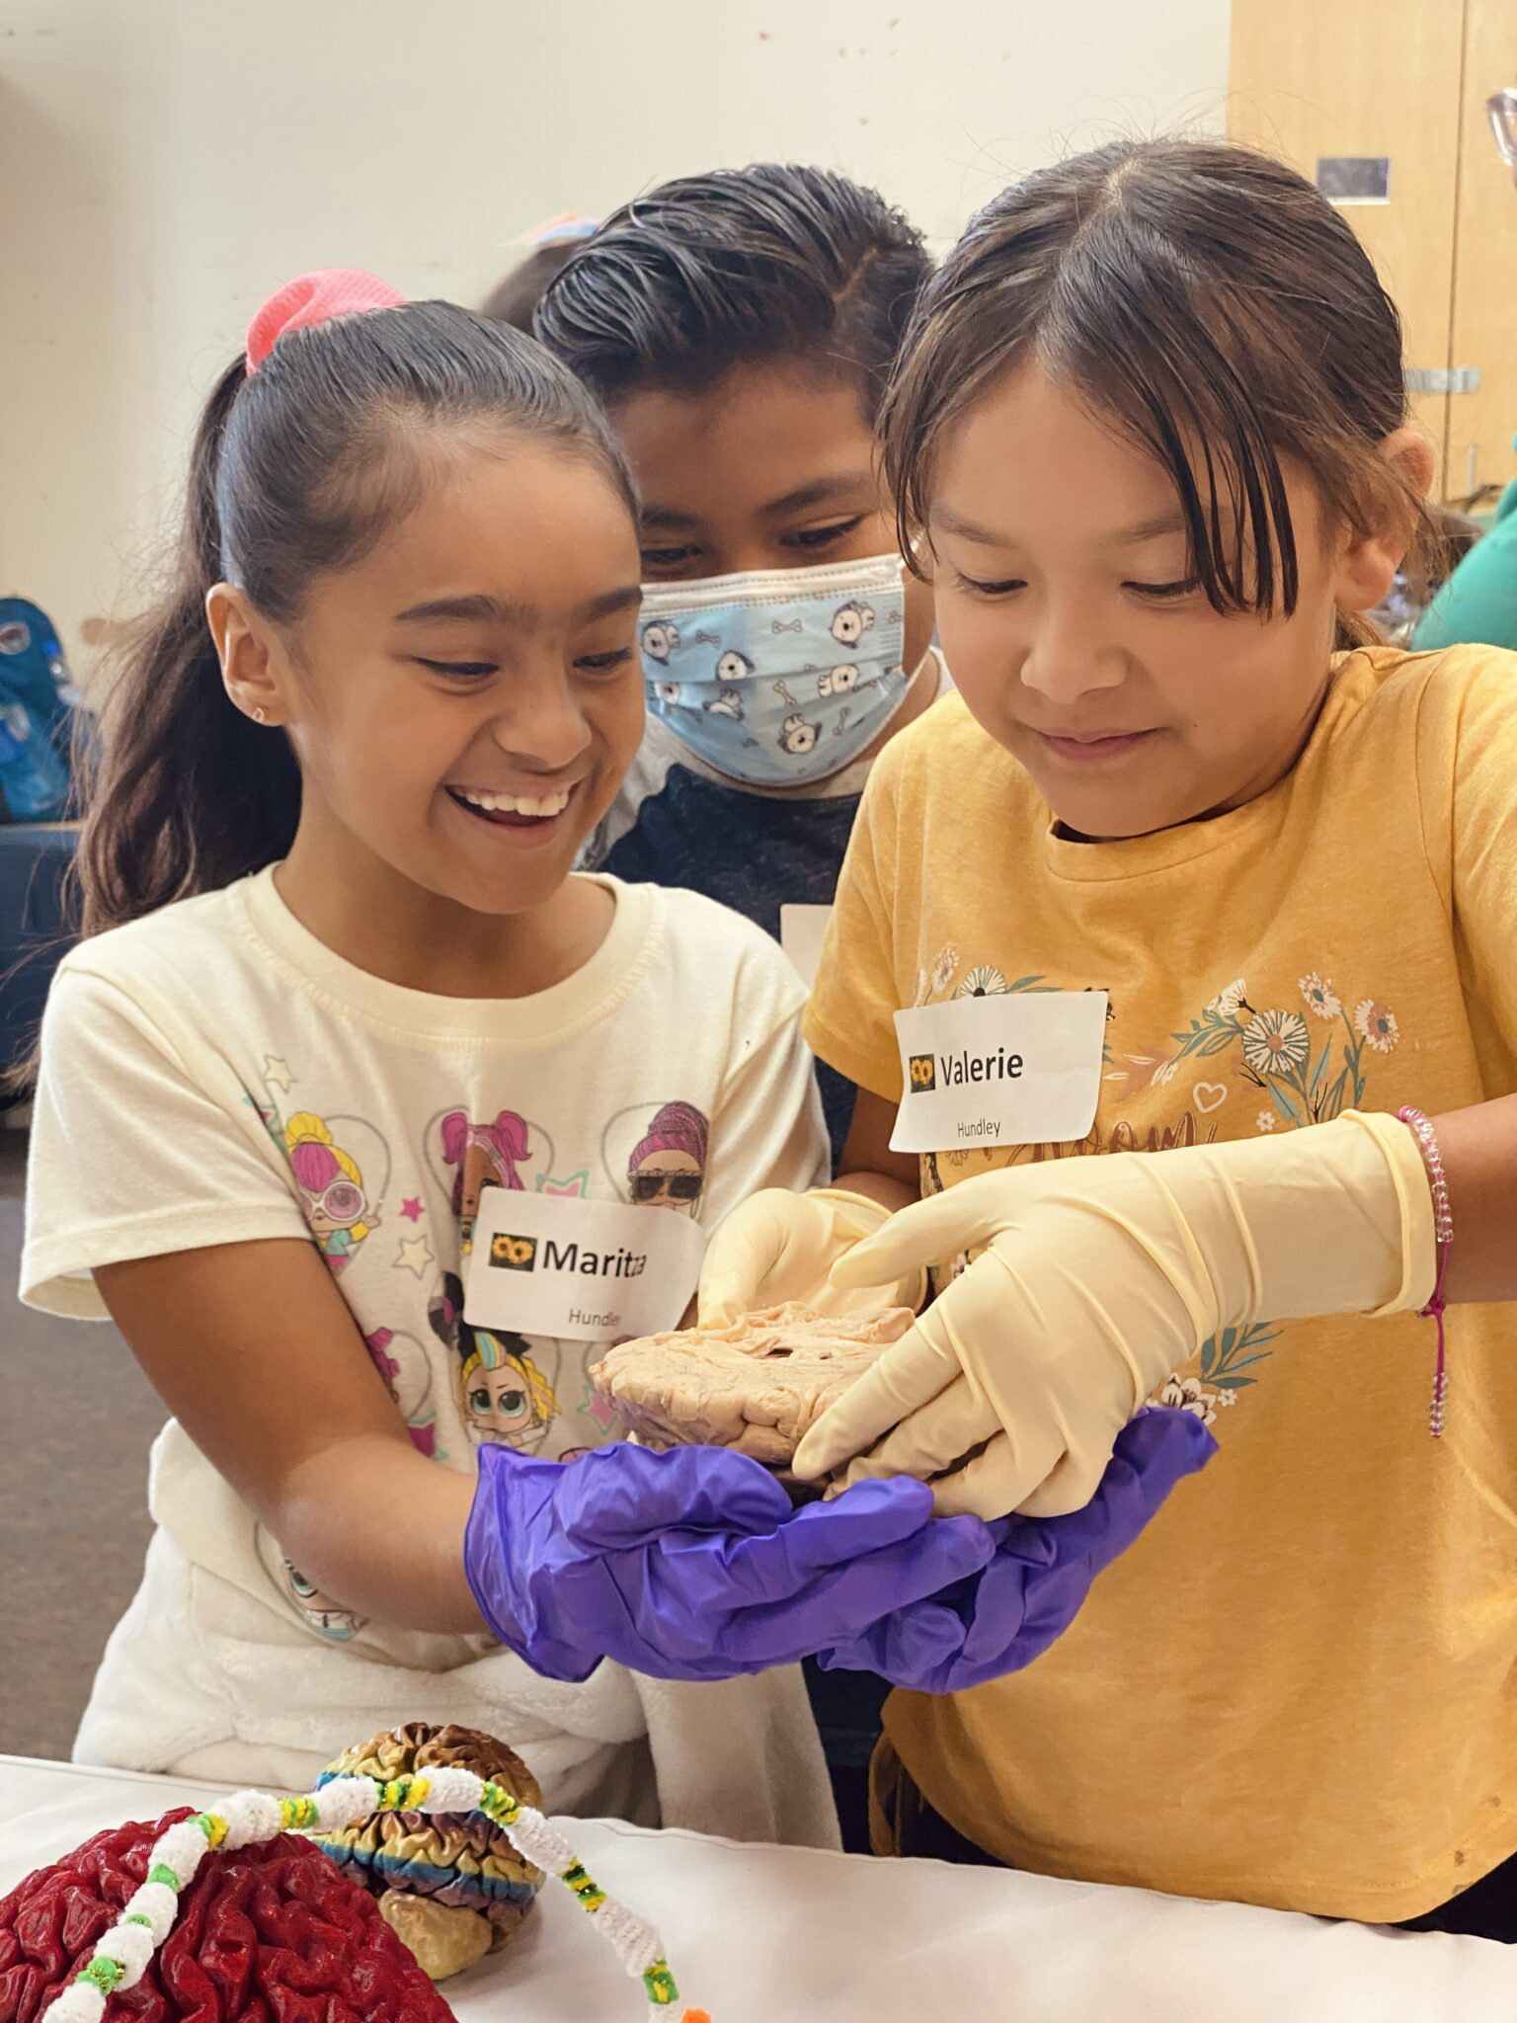
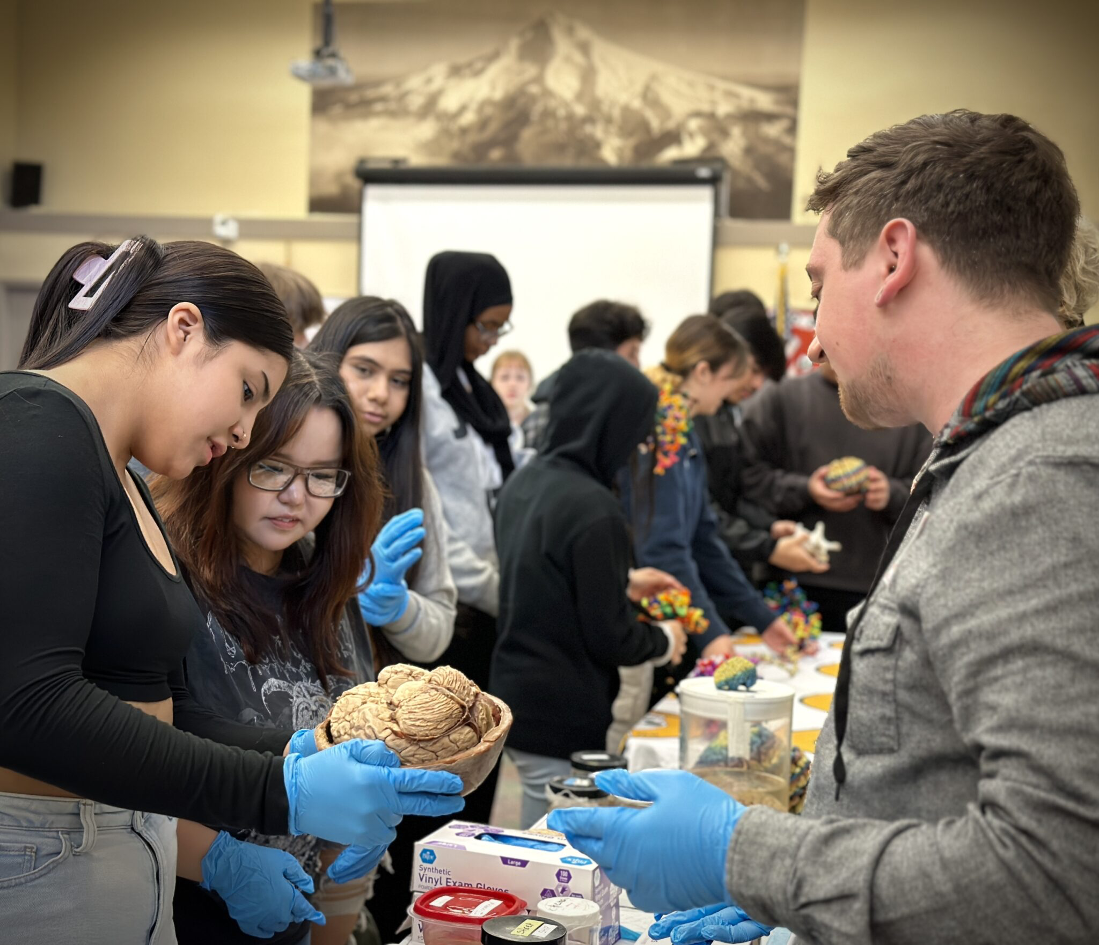
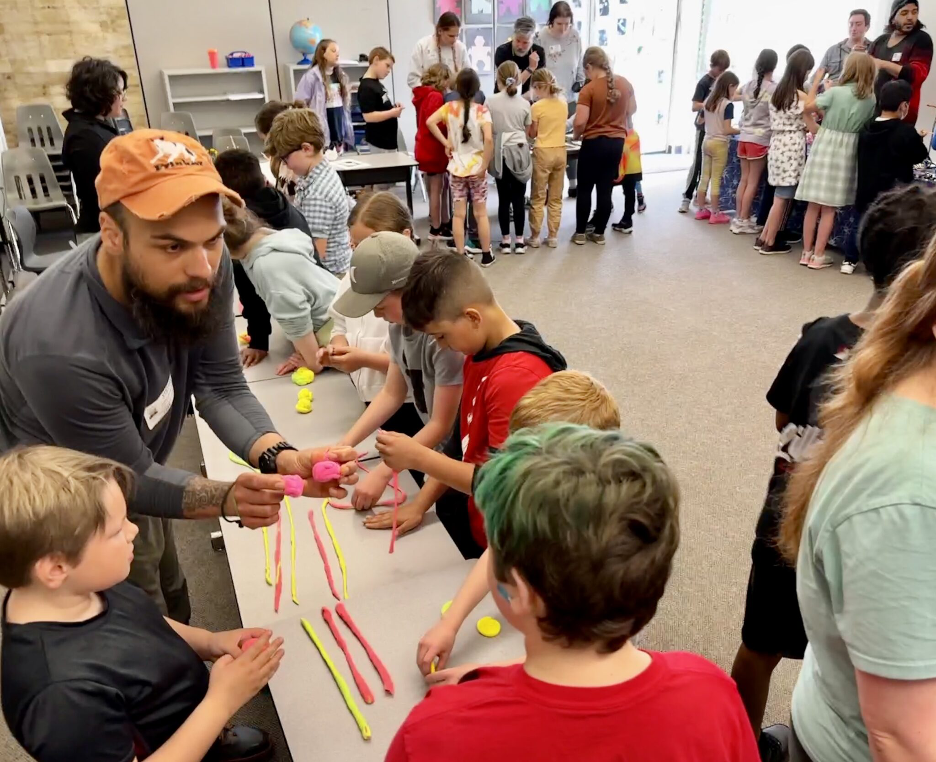
SHARE STORIES
-Empower new voices
-Broaden the conversation
-Make public investment in research relevant
-Invite new participants, perspectives & brains

Slide 14
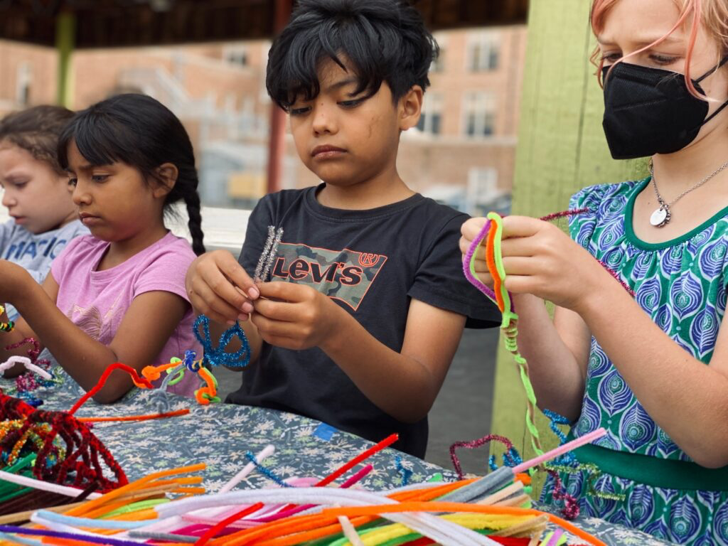
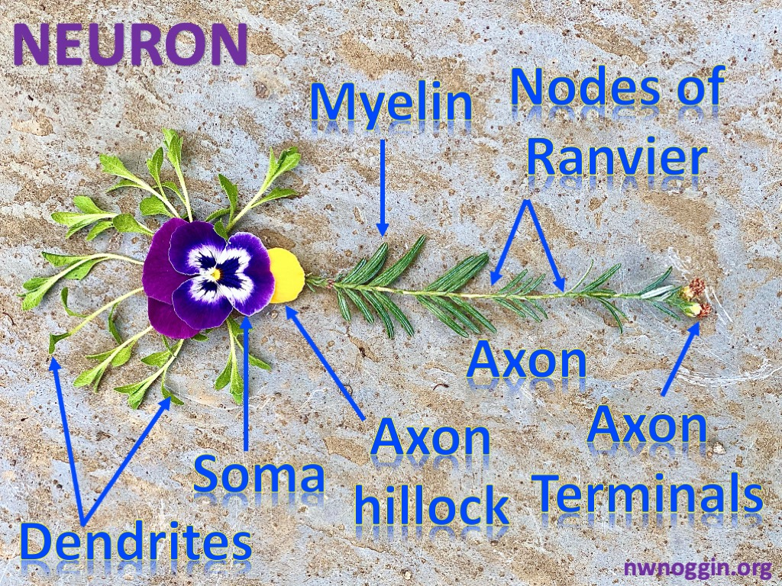
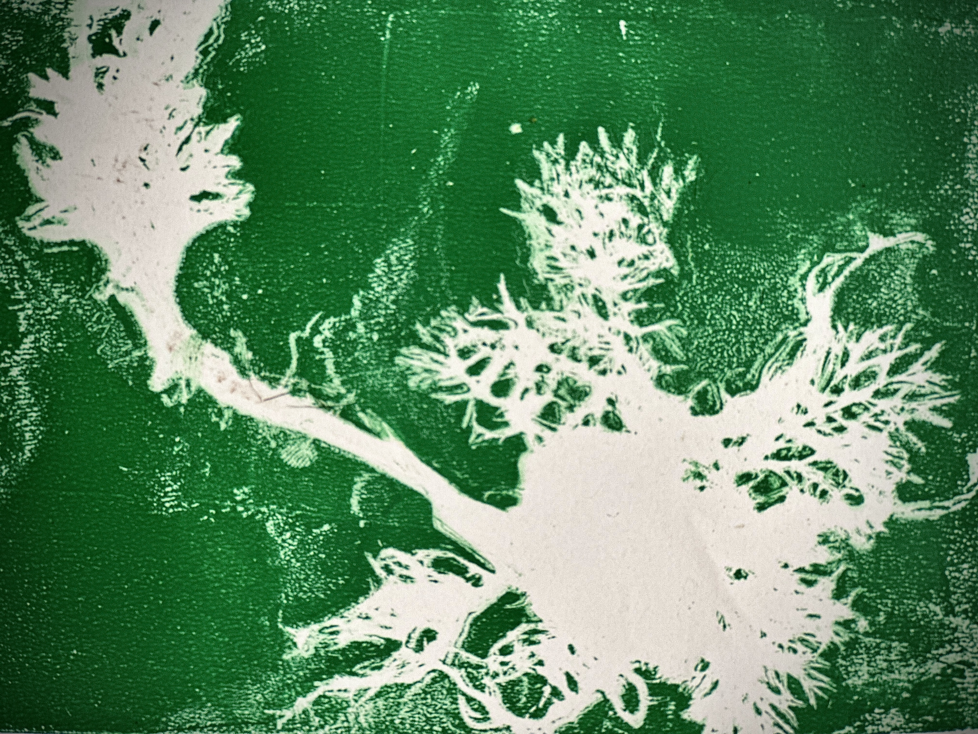
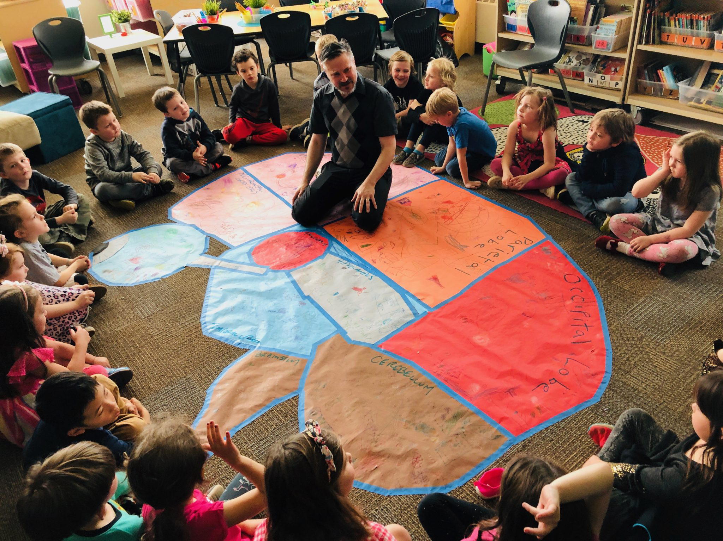
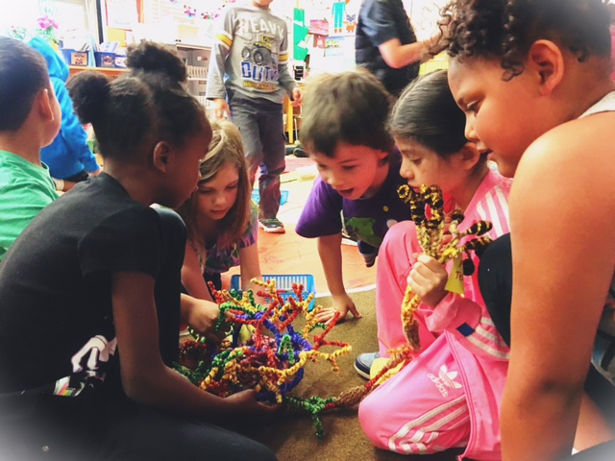
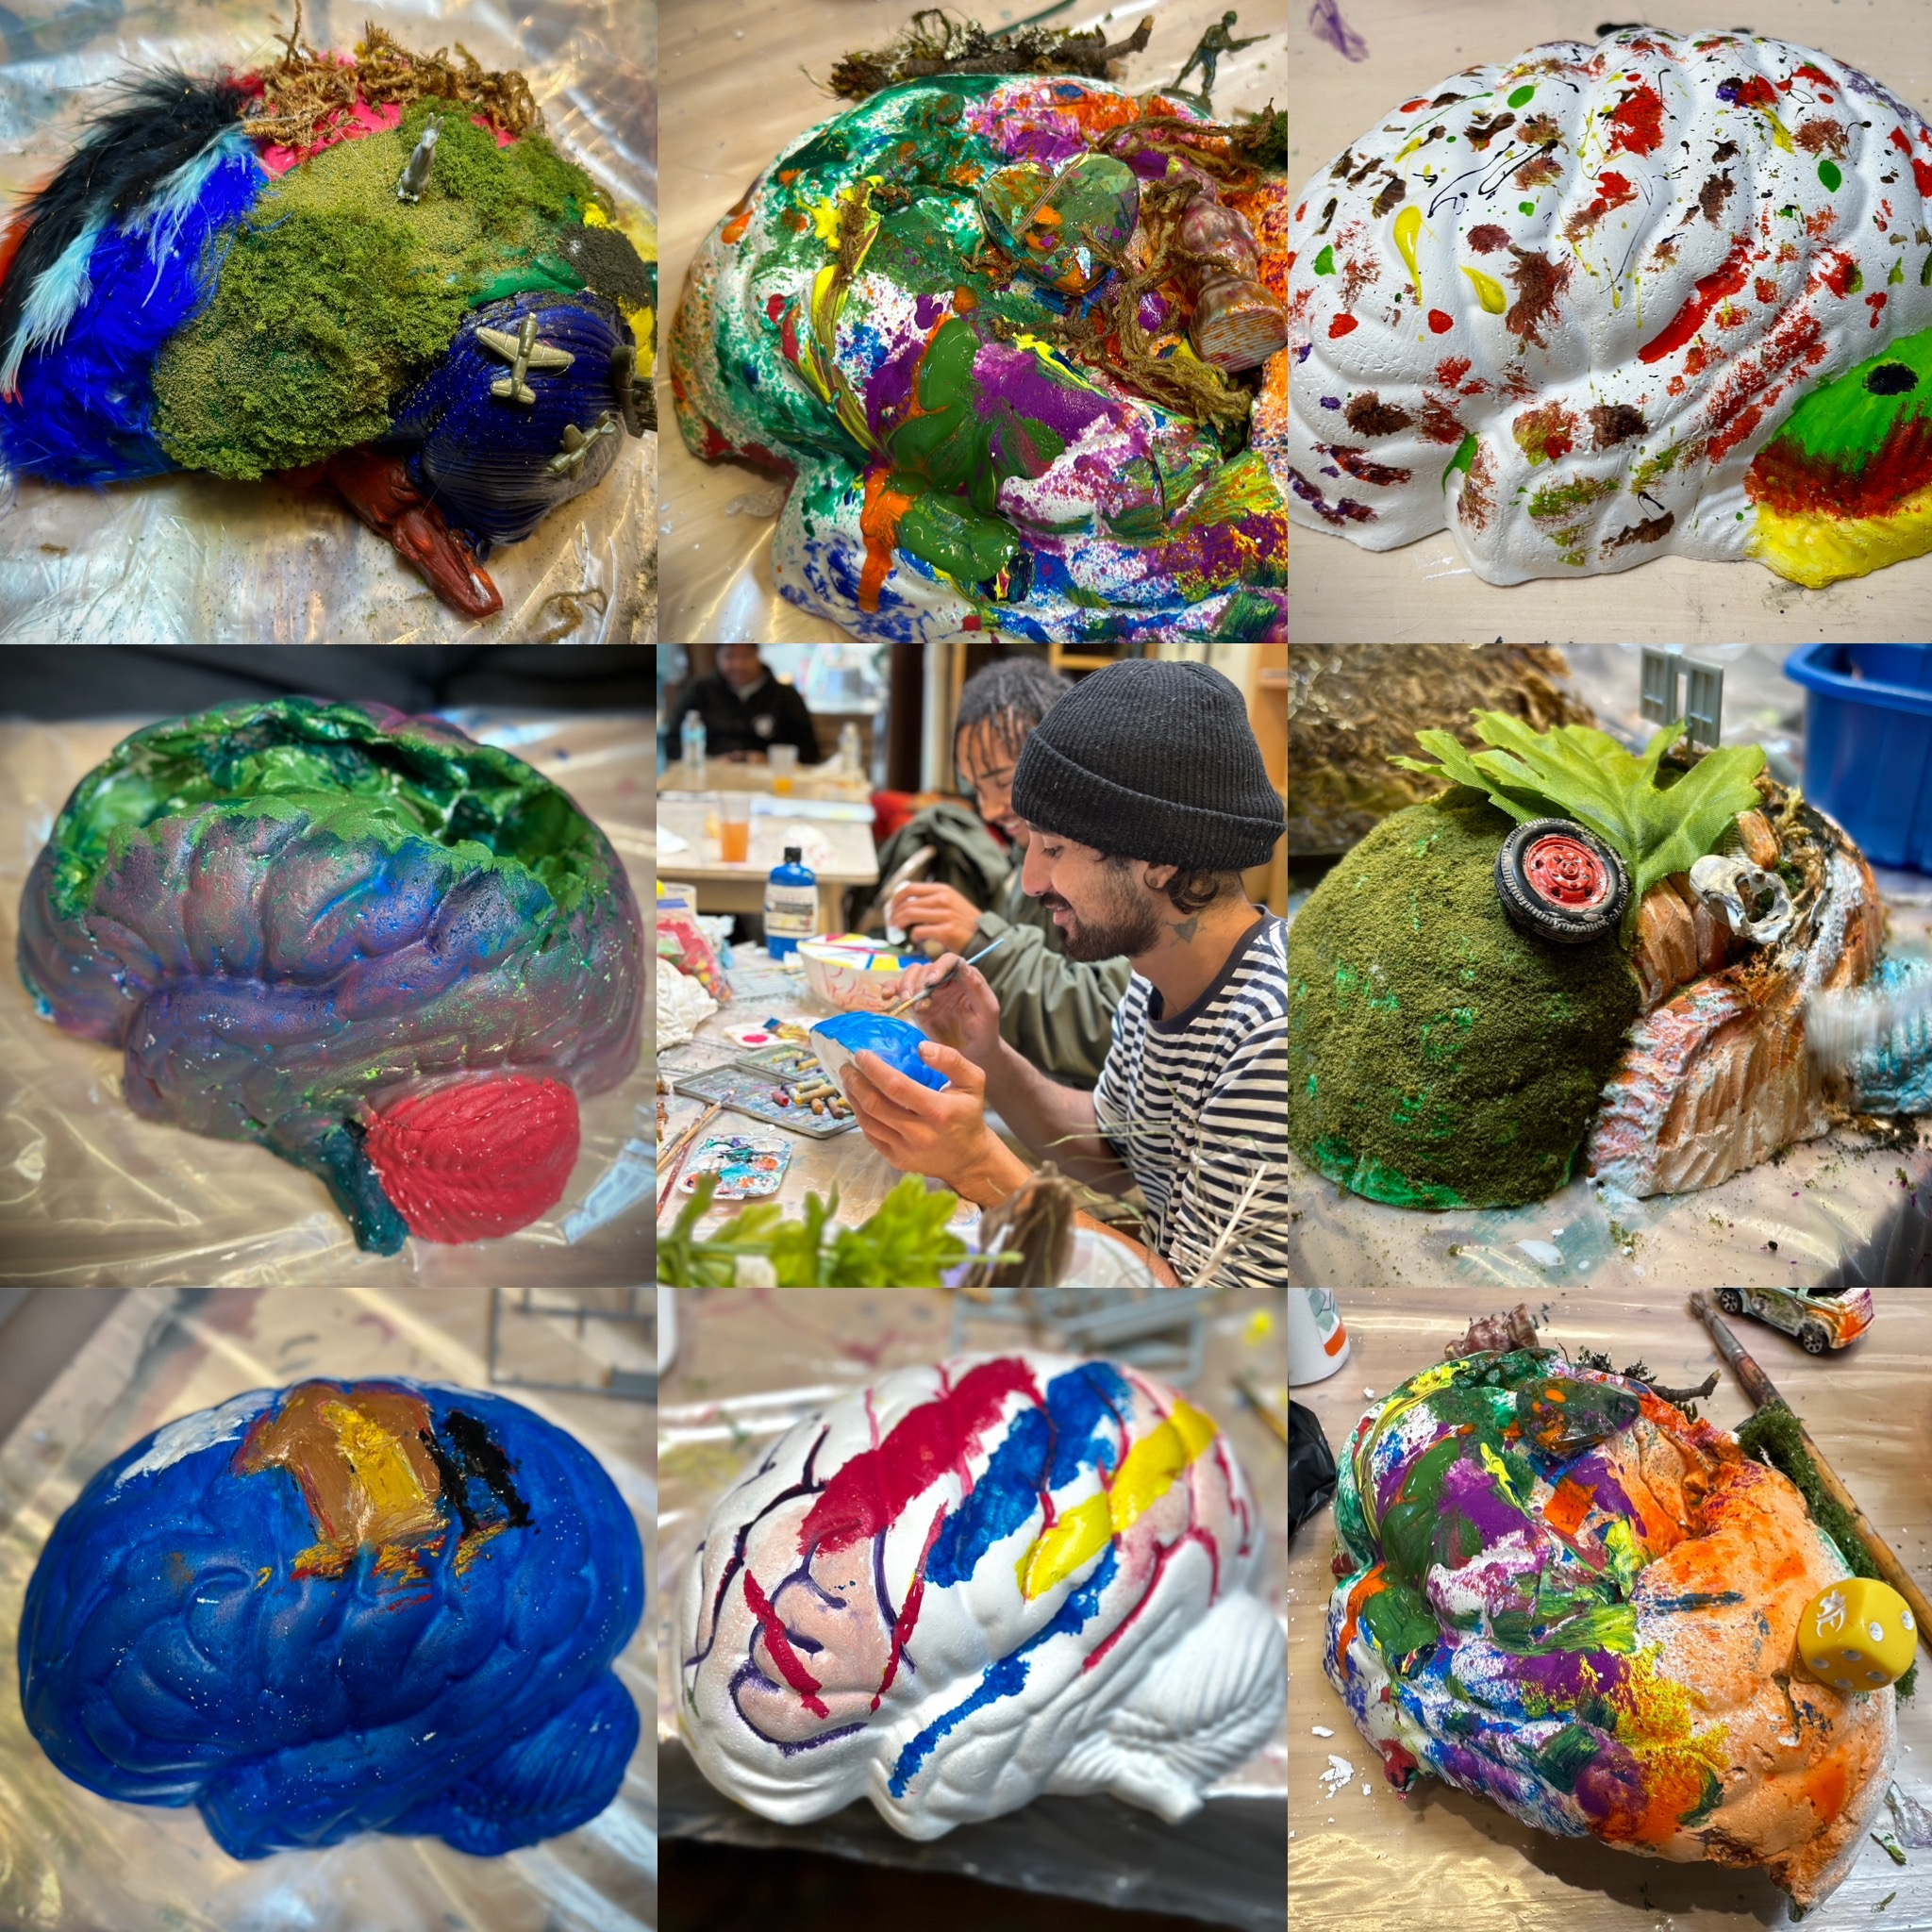
MAKE ART
-Engagement
-Personal relevance
-self-awareness AND EMPATHY

Slide 15
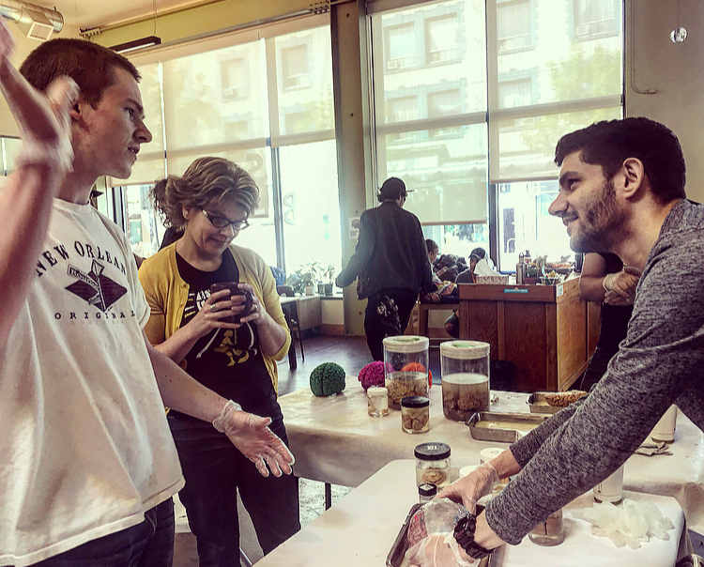
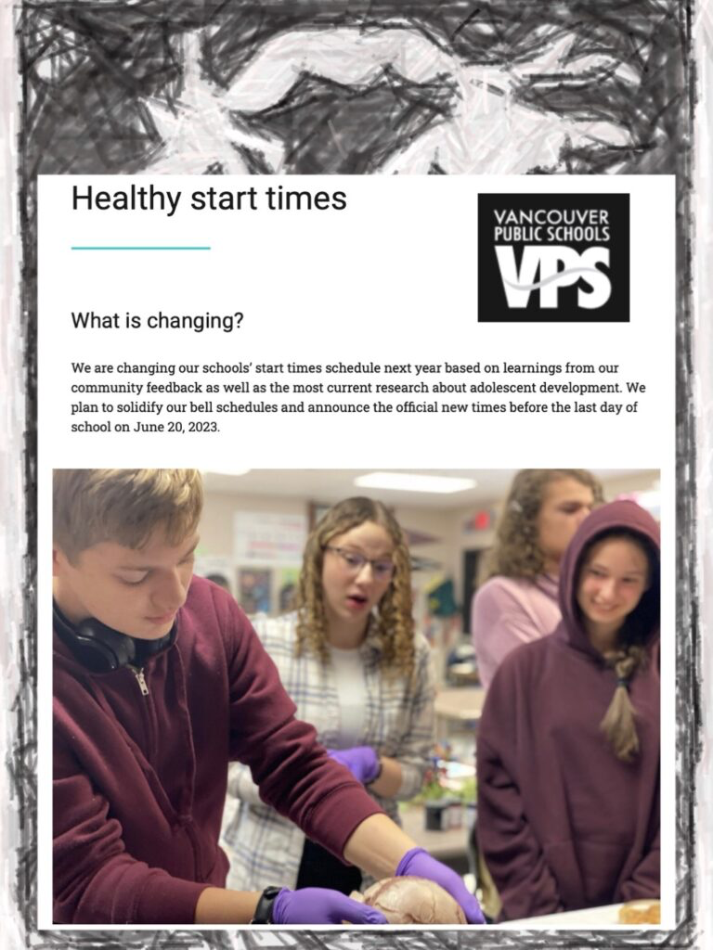
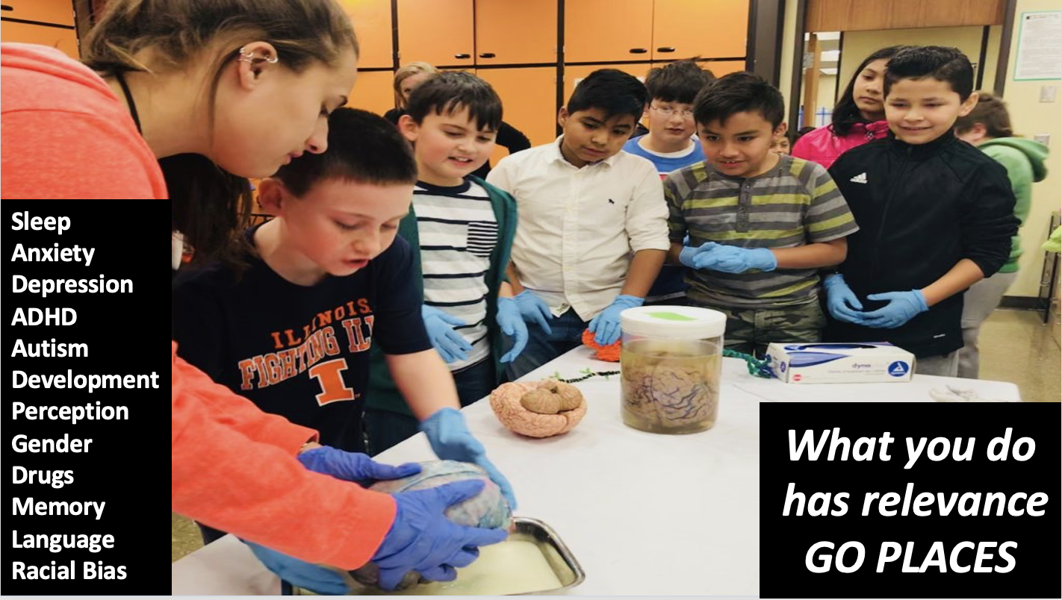
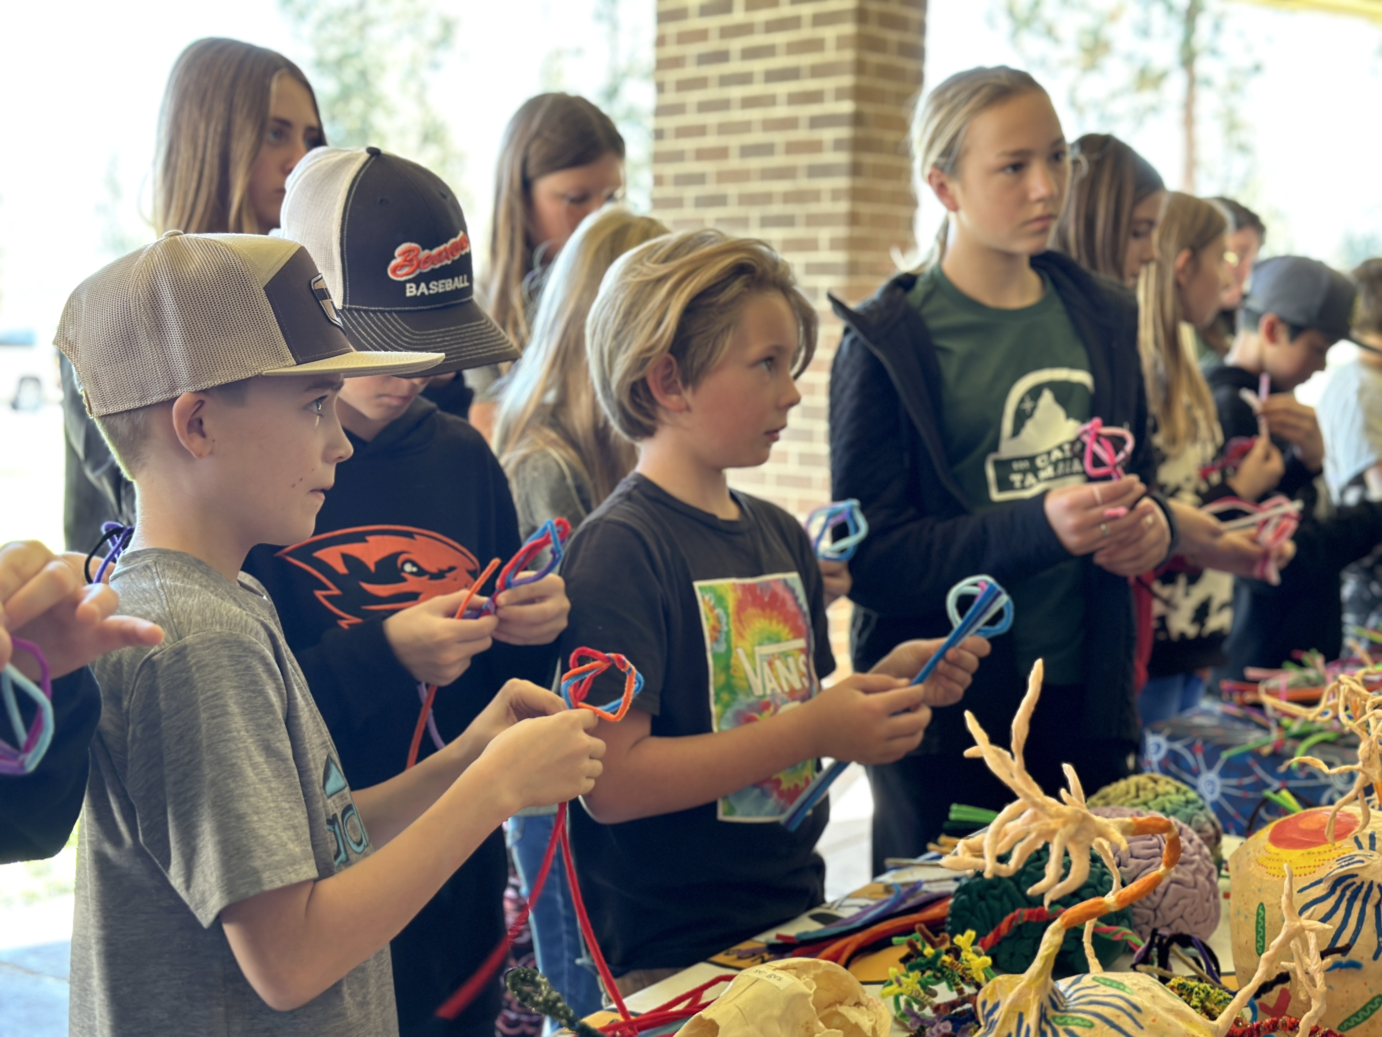
INFORM POLICY
-Research topics are popular!
-Interdisciplinary/STEAM approaches WORK
-1. School start times for adolescents
-2. Permanent standard time
-3. Housing first

Slide 16
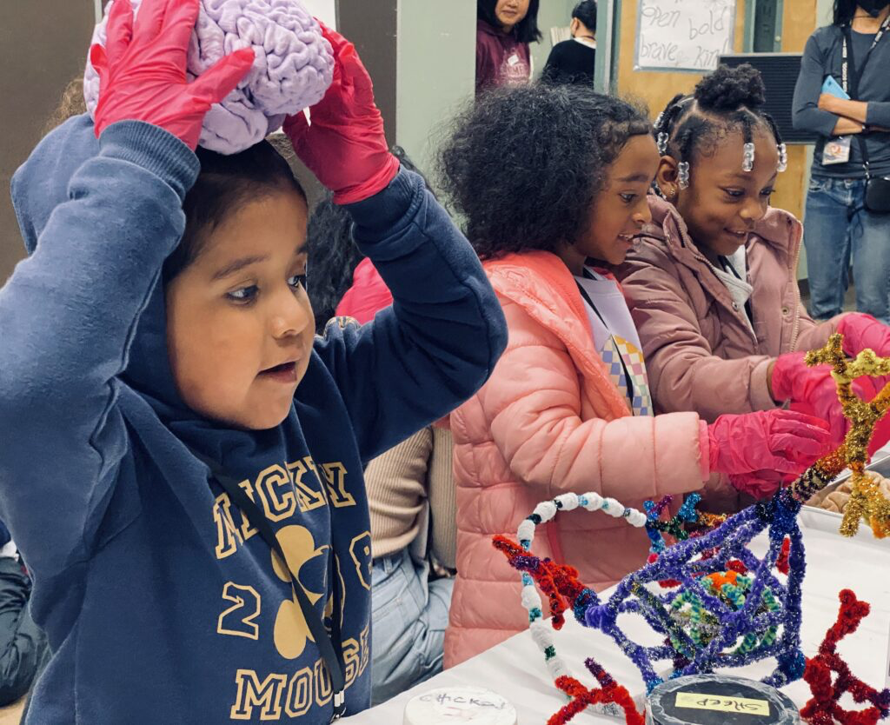
SUPPORT INNOVATION, NOT INSTITUTIONS; MORE ACCESSIBLE GRANTS FOR EDUCATORS, ARTISTS, SMALLER LOCAL NONPROFITS
Shake it up
-existing institutions support themselves. they GET resources, but don’t necessarily innovate
or empower new voices.
-going places to listen, share stories, make art and collaborate engages and inspires more people, genuinely increasing diversity in research and public policy.
-LIKE DEVELOPING BRAINs IN CHANGING CIRCUMSTANCES, RISK and PLASTICITY ARE REQUIRED to ADAPT, Discover, innovate and THRIVE.
70% indirects?!

Slide 17
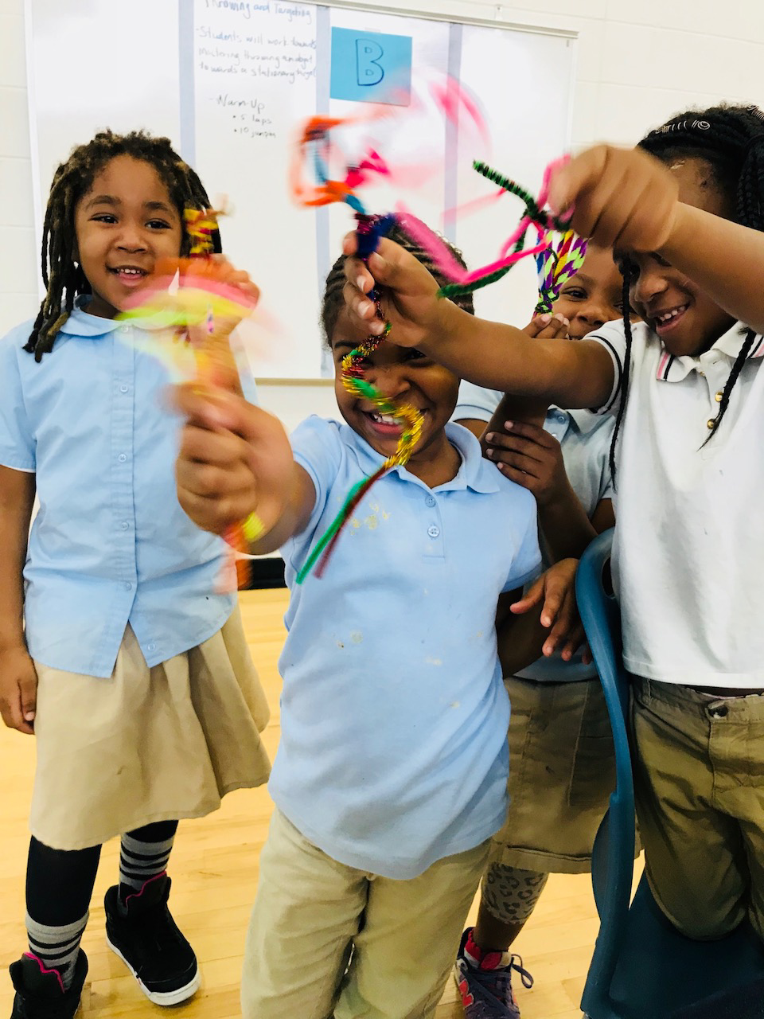
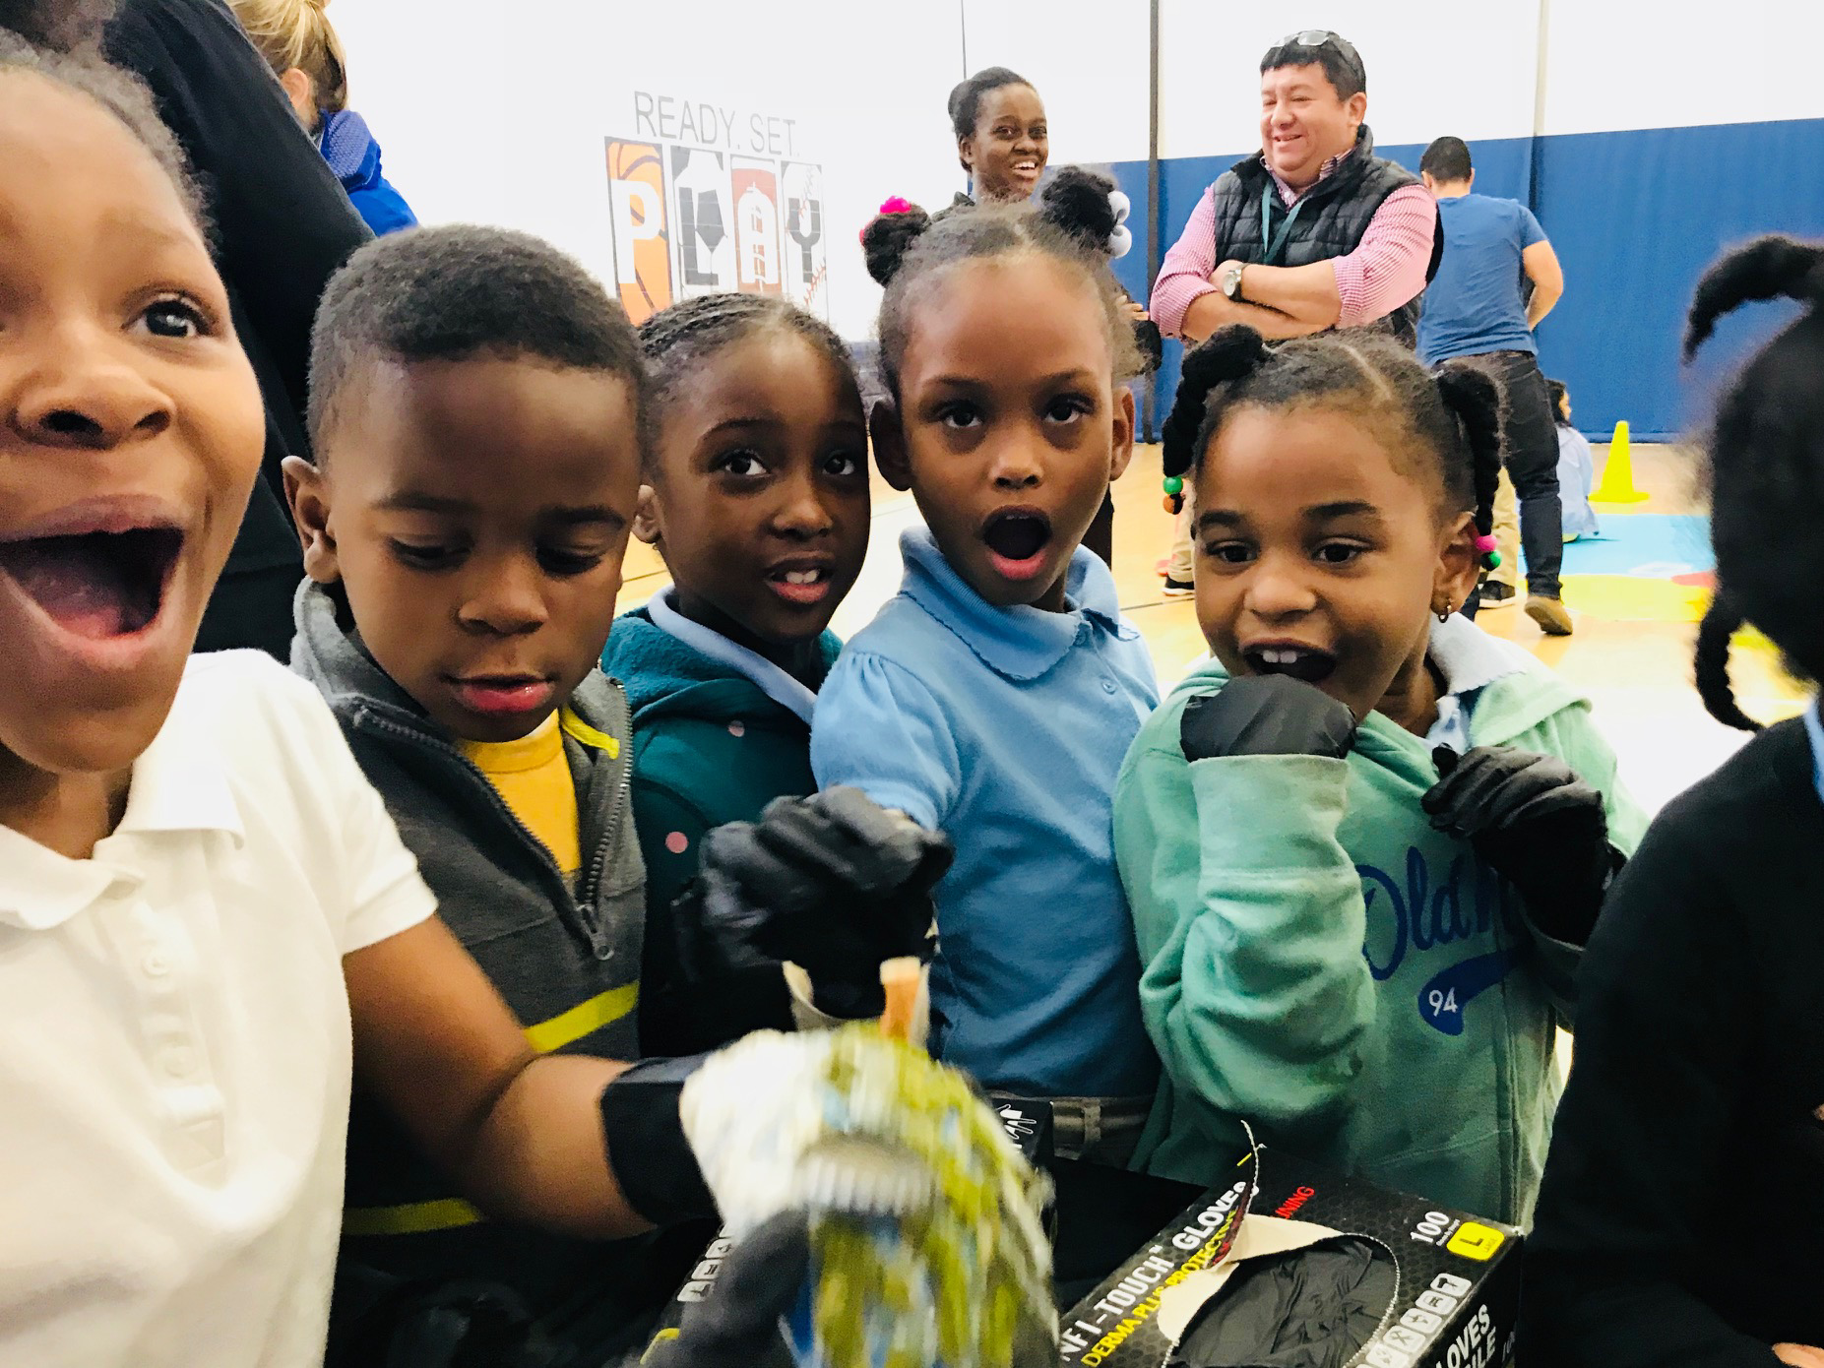
TOMORROW
-NOGGIN IN DC PUBLIC SCHOOLS 🧠🎨💚😃

