Slide 1
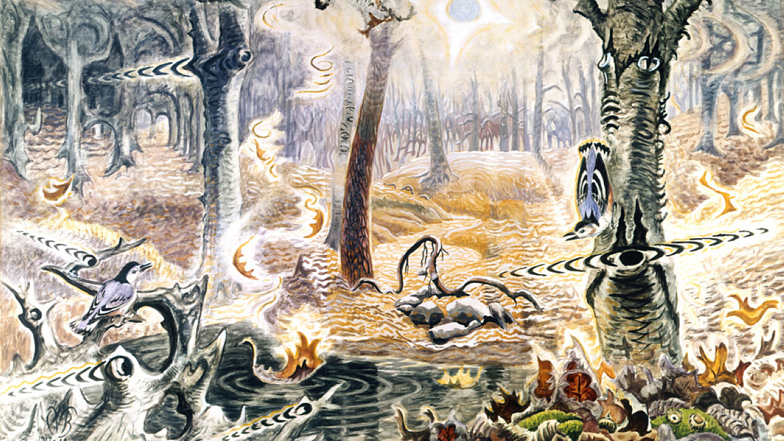
Music, Brains, Drugs & The Beatles
David Hattner, Portland Youth Philharmonic
Bill Griesar, PSU/OHSU/Northwest Noggin
Aaron Eisen, OHSU/PSU/NW Noggin
Jeff Leake, PSU/NW Noggin
Charles Burchfield, Autumnal Fantasy

Slide 2
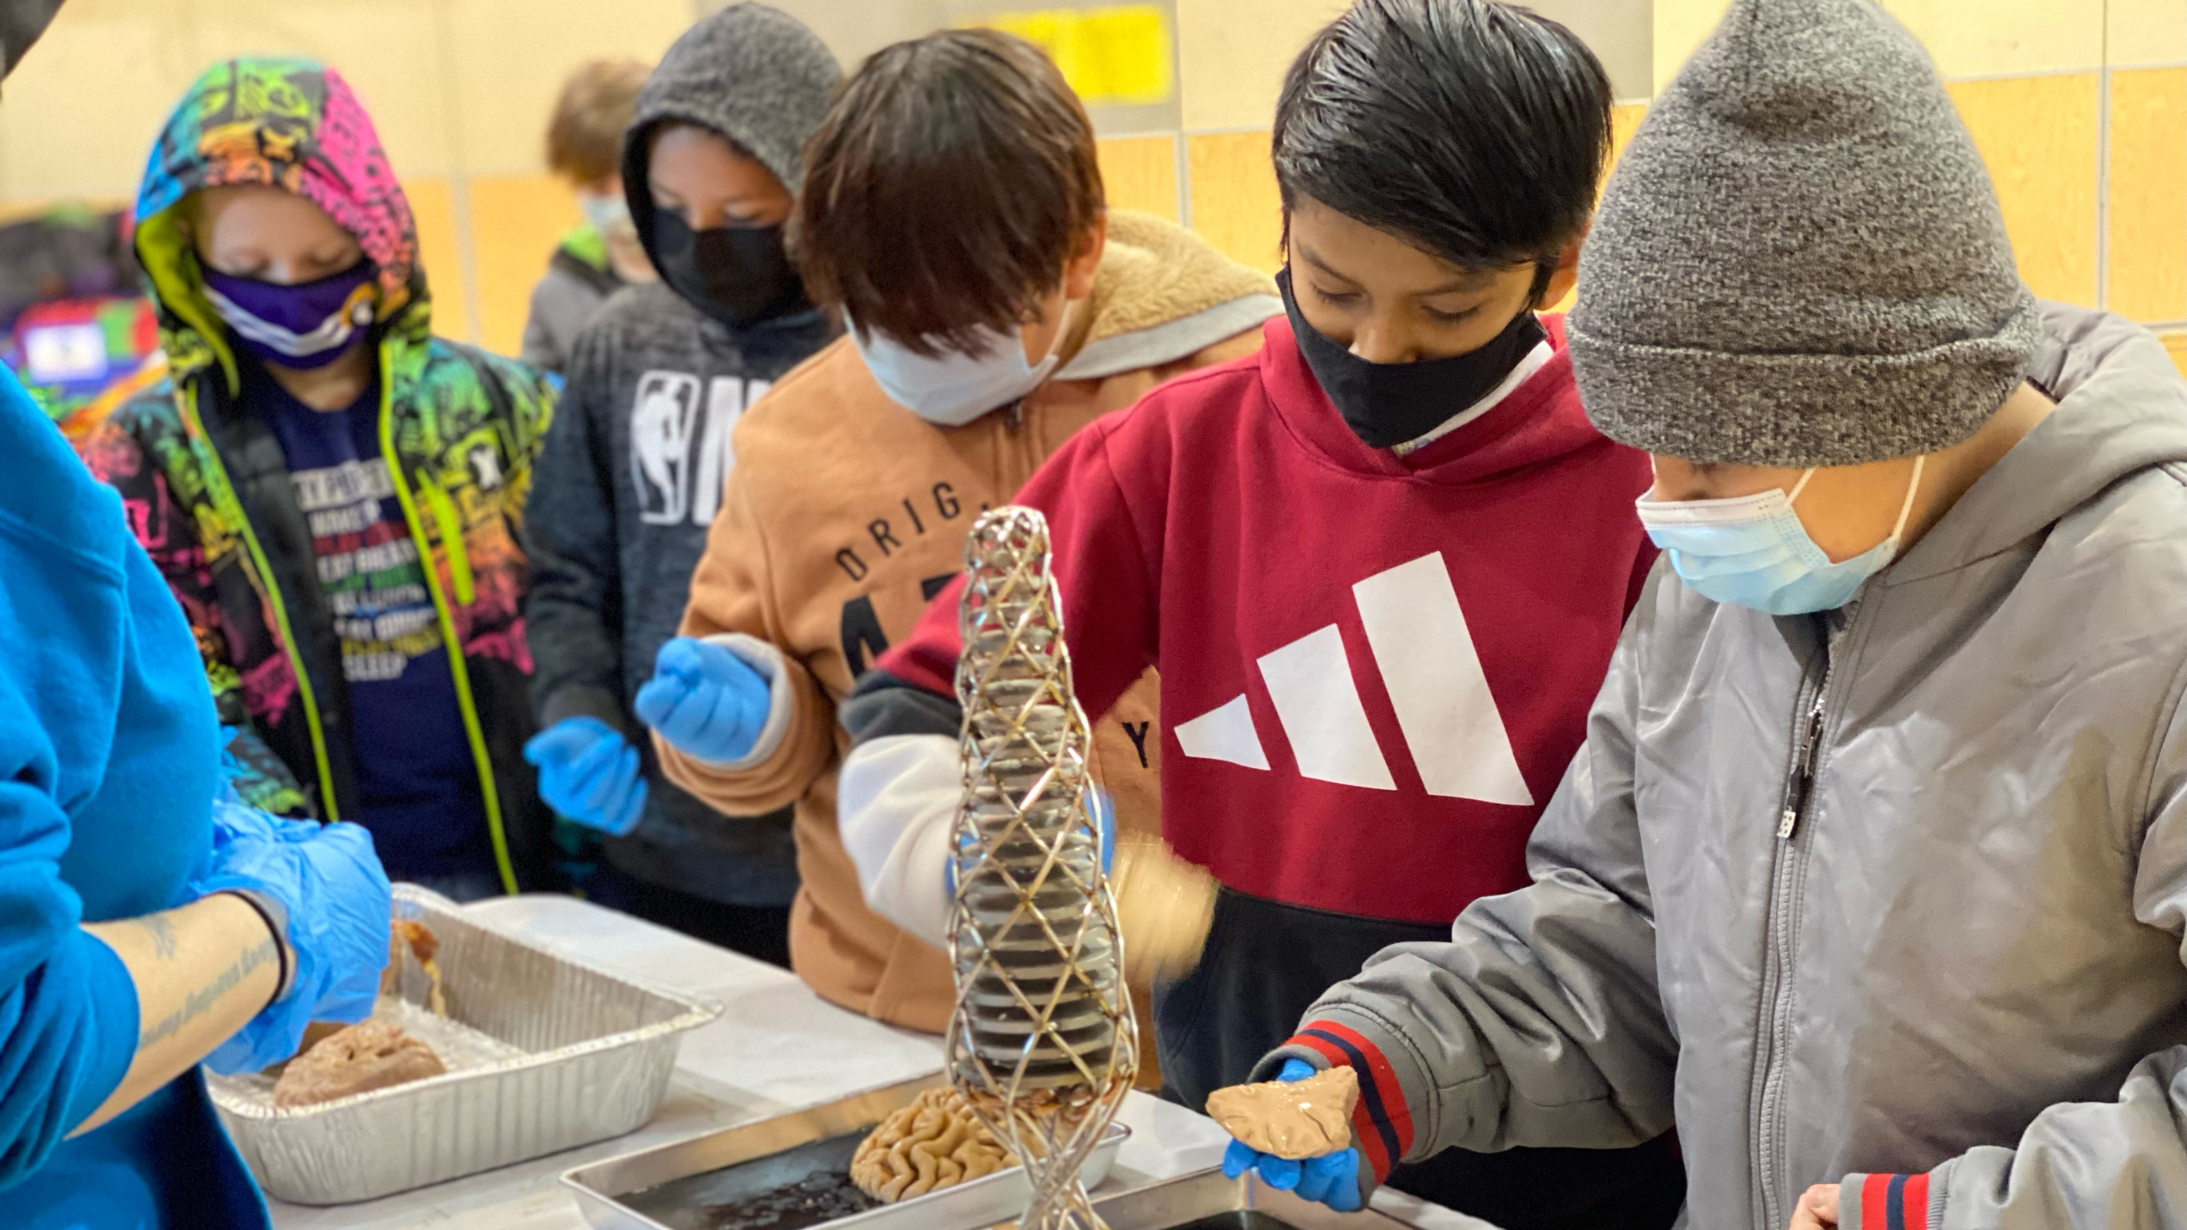
Northwest Noggin
Community outreach 🎨🧠🤝
Interdisciplinary neuroscience
We’ve met 55,000+ people 🤯
ALL VOLUNTEER ❤️
10 years! 😎
nwnoggin.org

Slide 3
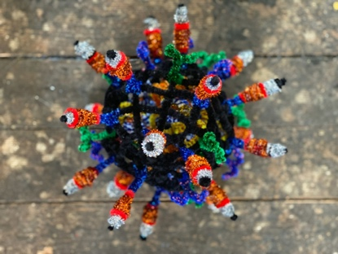
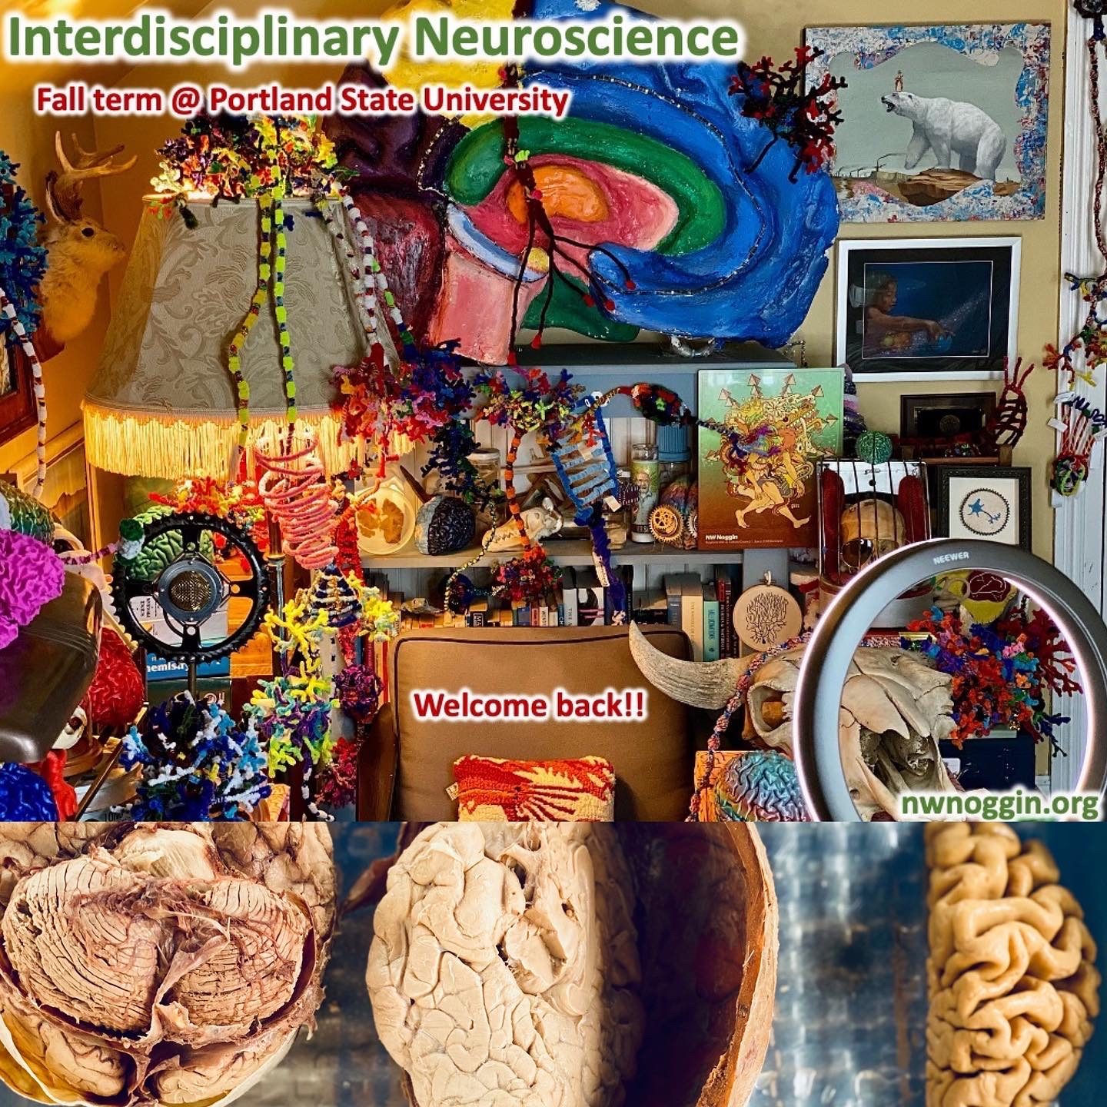
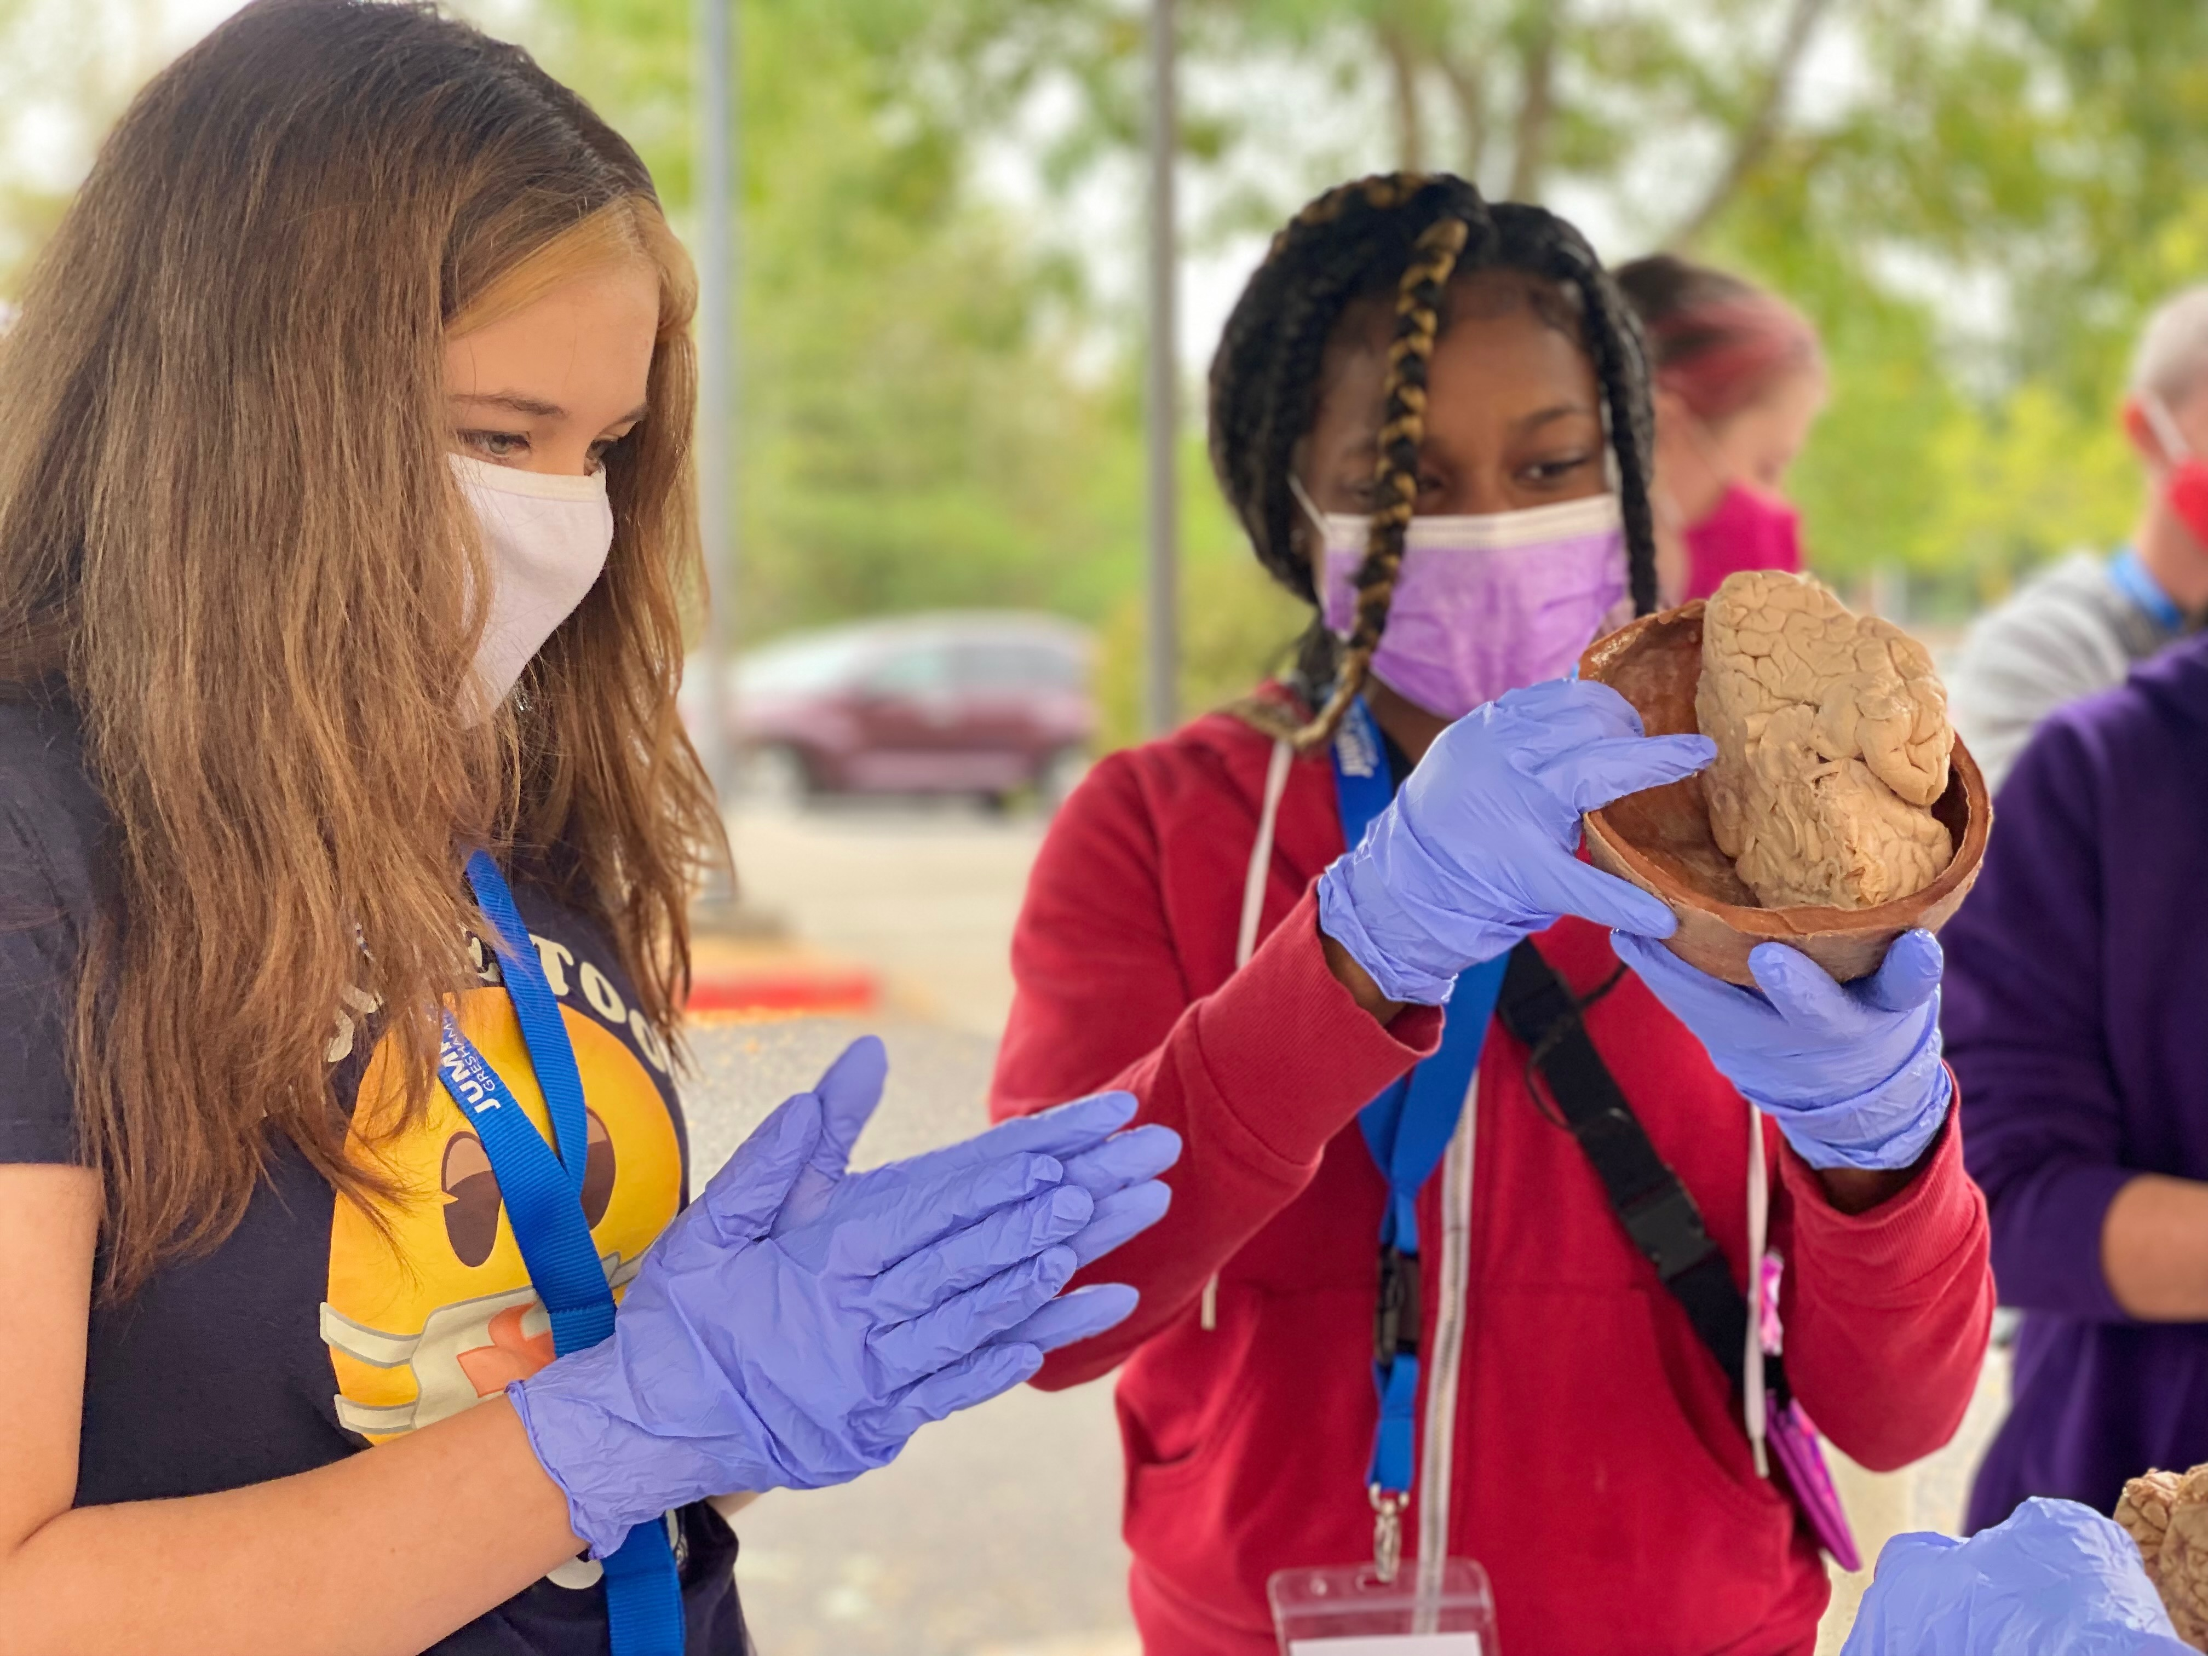
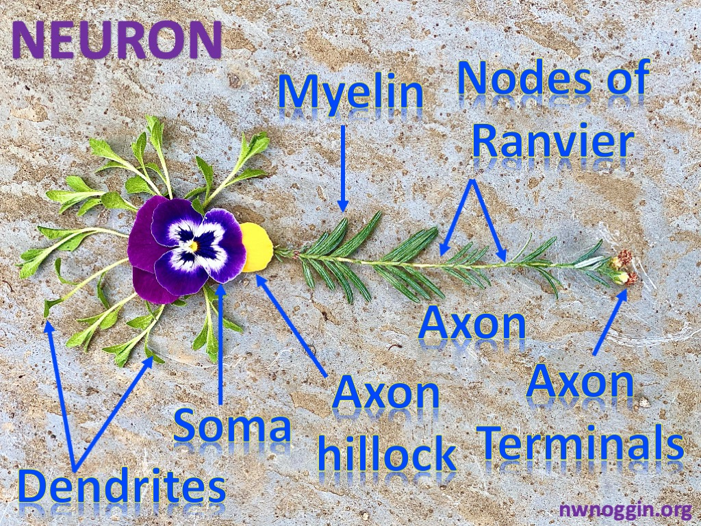
Art & Brains!
nwnoggin.org

Slide 4
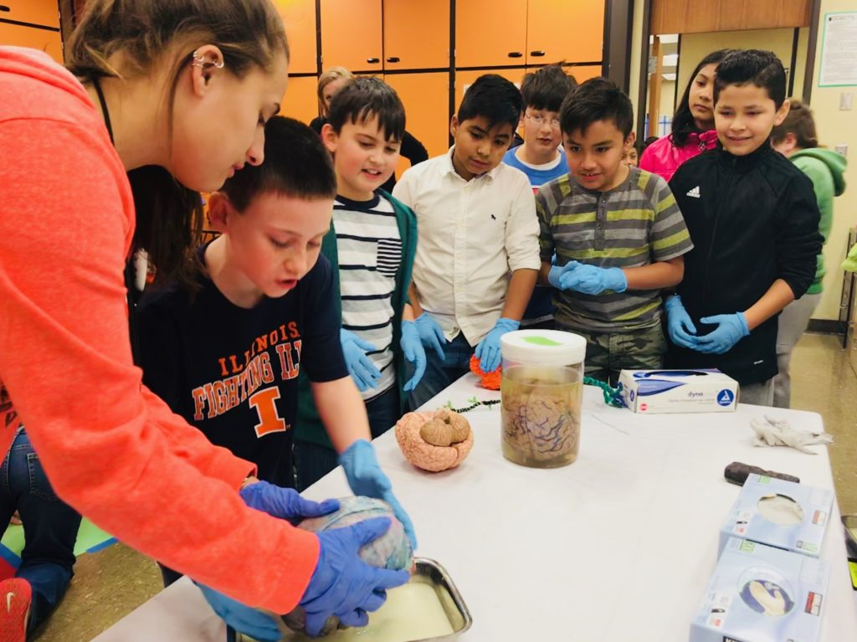
What you do has relevance GO PLACES
Sleep
Anxiety
Depression
ADHD
Autism
Development
Perception
Drugs
Memory
Language
Racial Bias
…

Slide 5
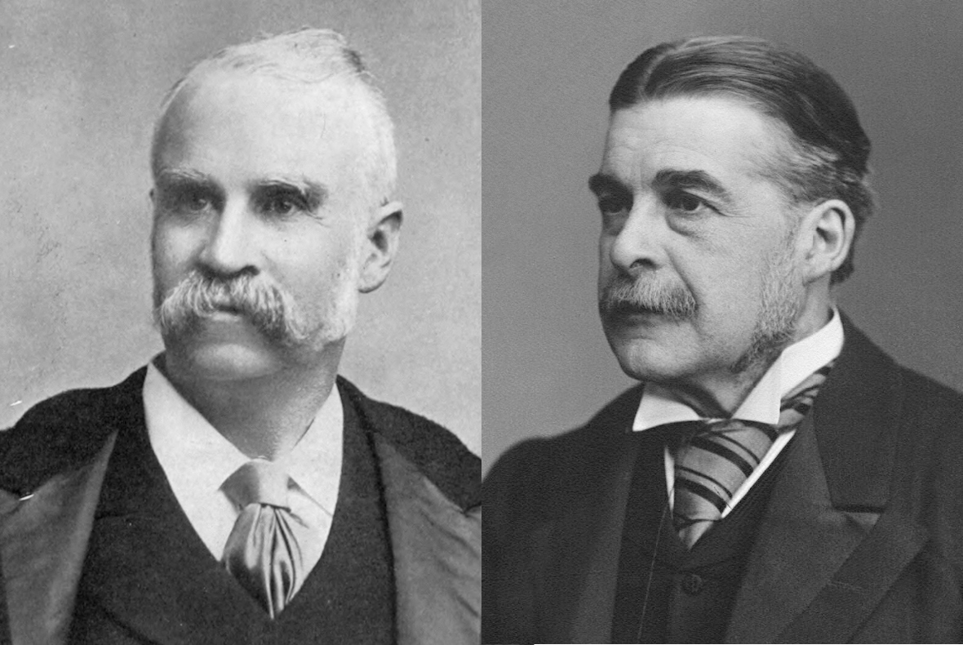
Gilbert & Sullivan

Slide 6
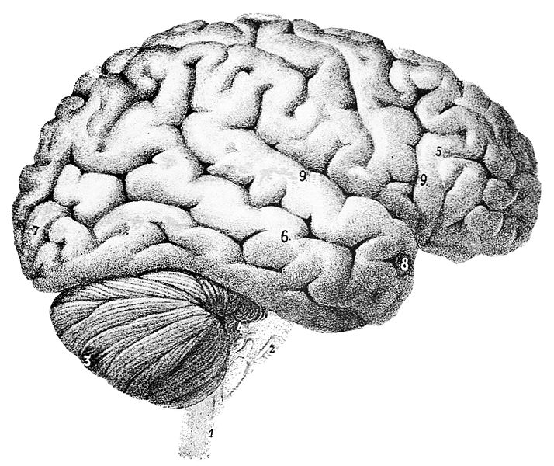
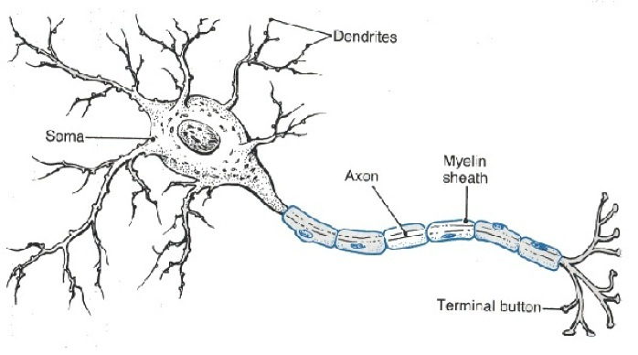
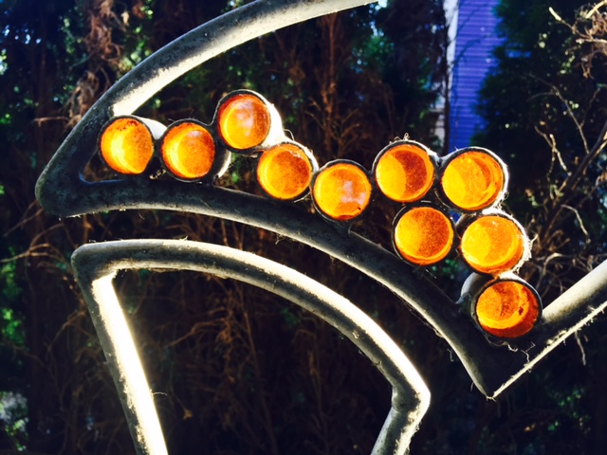
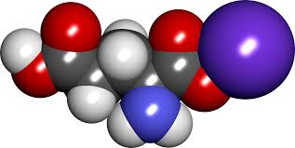
Your brain: made of cells
Neurons
Neurons carry electrical messages
Neurons connect chemically across synapses
Neurotransmitters
SYNAPSE

Slide 7
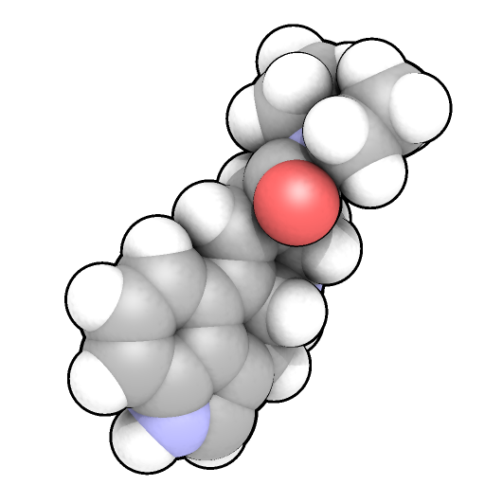
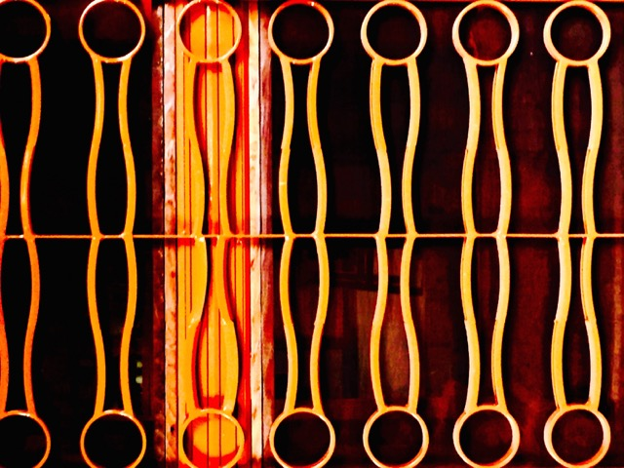
All cells have membranes
Neurotransmitter
or drug
Outside cells, including neurons
Many drugs, including
psychedelics, cannot get
through, but instead act
at RECEPTORS to affect
neuron function…
Drugs (chemicals) attach
(or “bind”) to receptors,
changing the activity of
affected neurons...
RECEPTOR: “Protein machine”
Inside cells

Slide 8
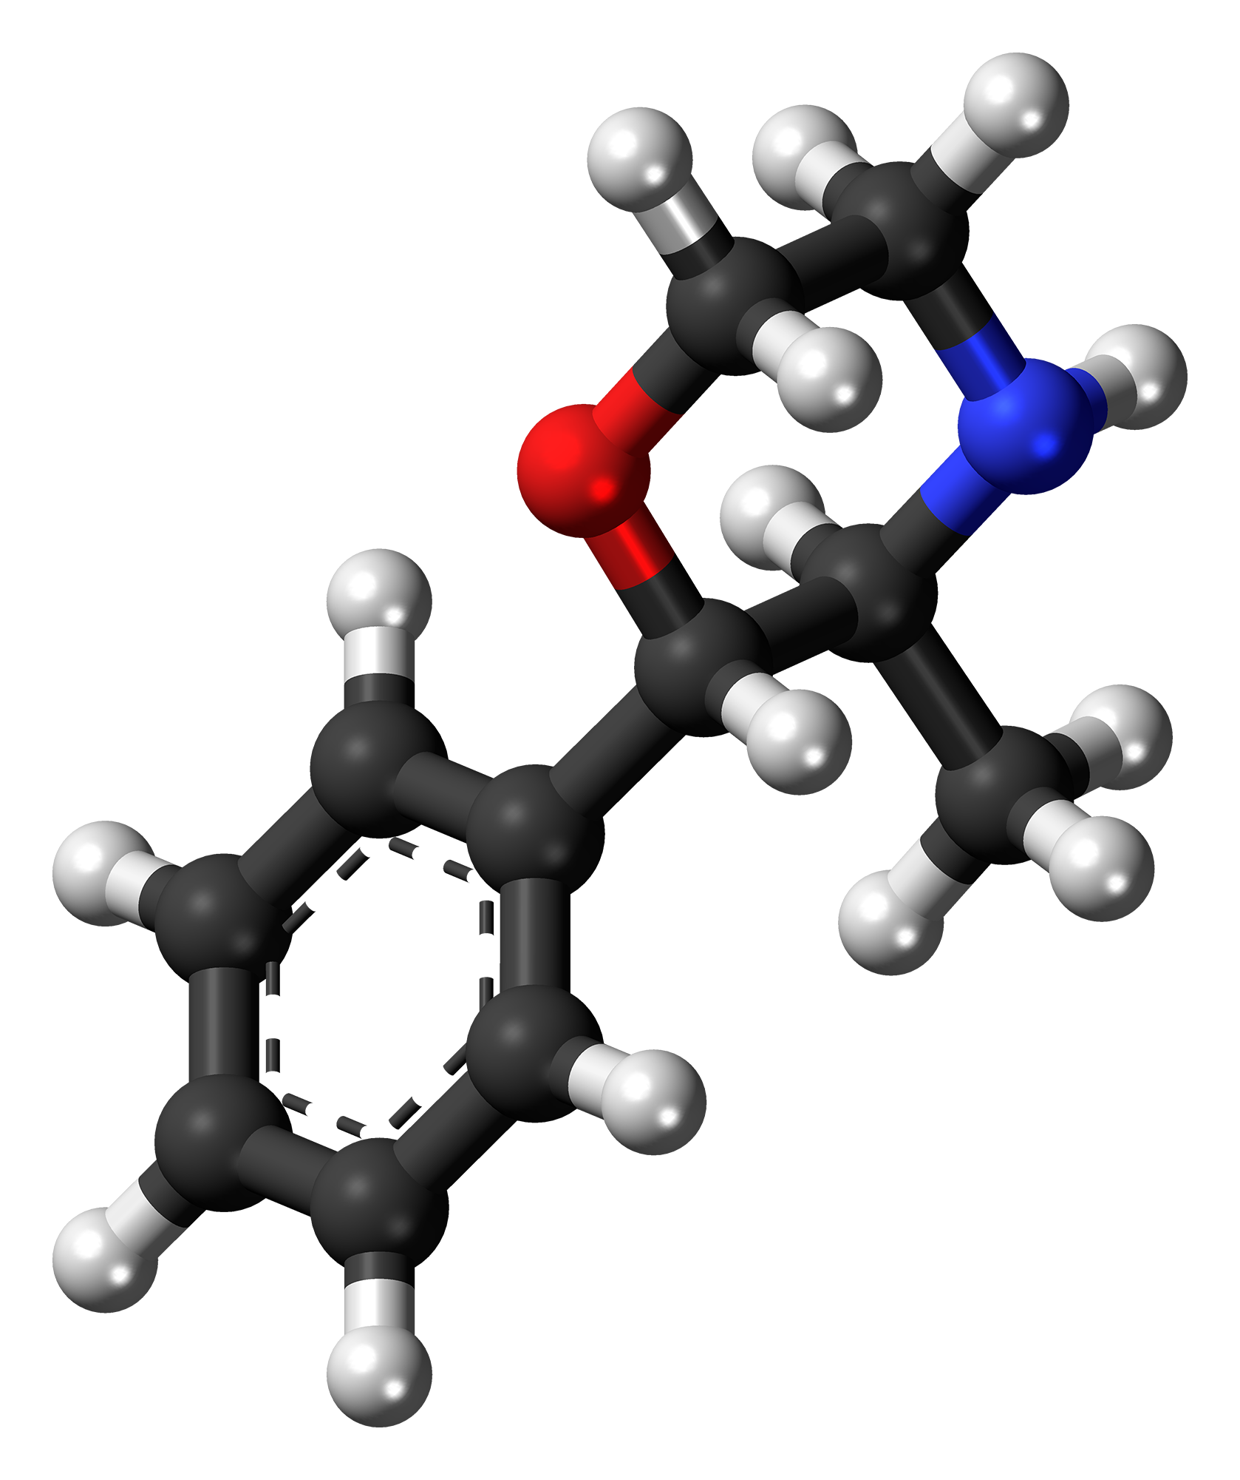
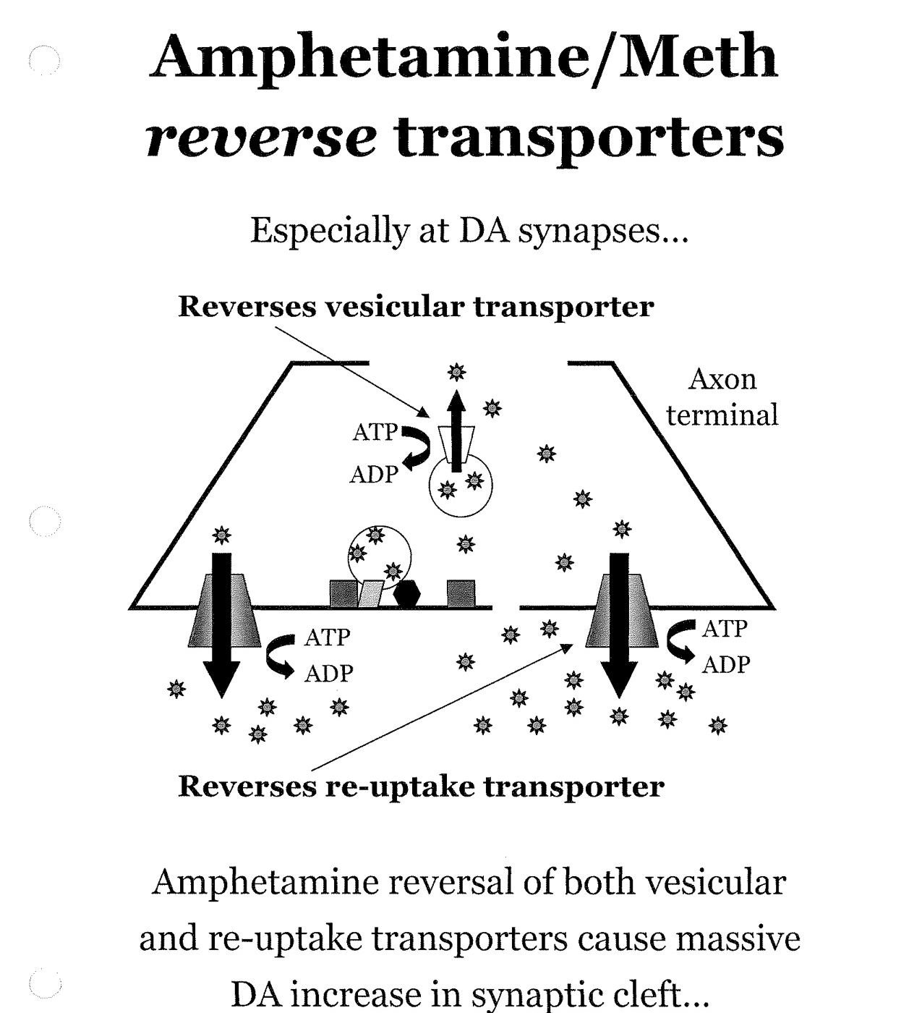
Preludin Phenmetrazine Hydrochloride
“Anorectic” drug
Used to treat obesity
“Sympathomimetic”

Slide 9
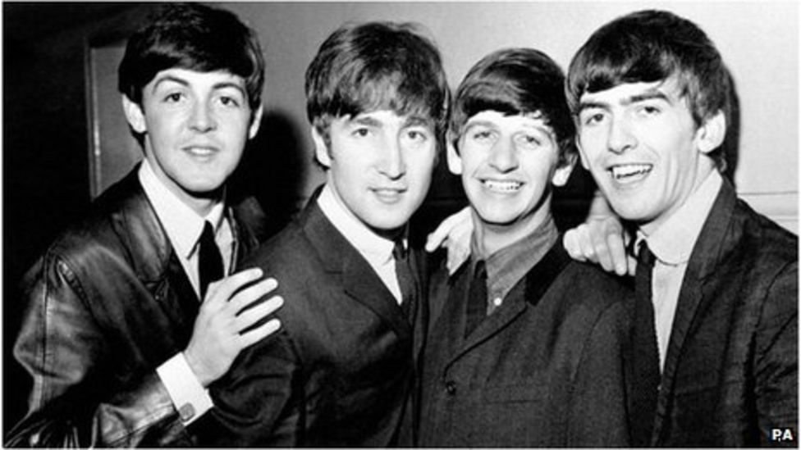
The Beatles 1963
She Loves You
I Want to Hold Your Hand

Slide 10
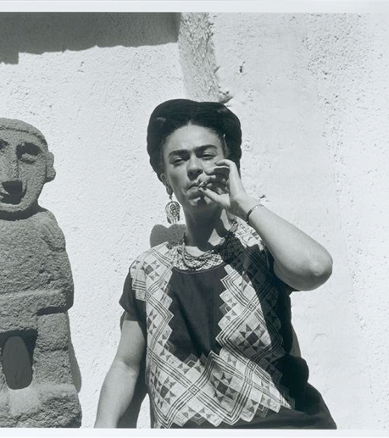
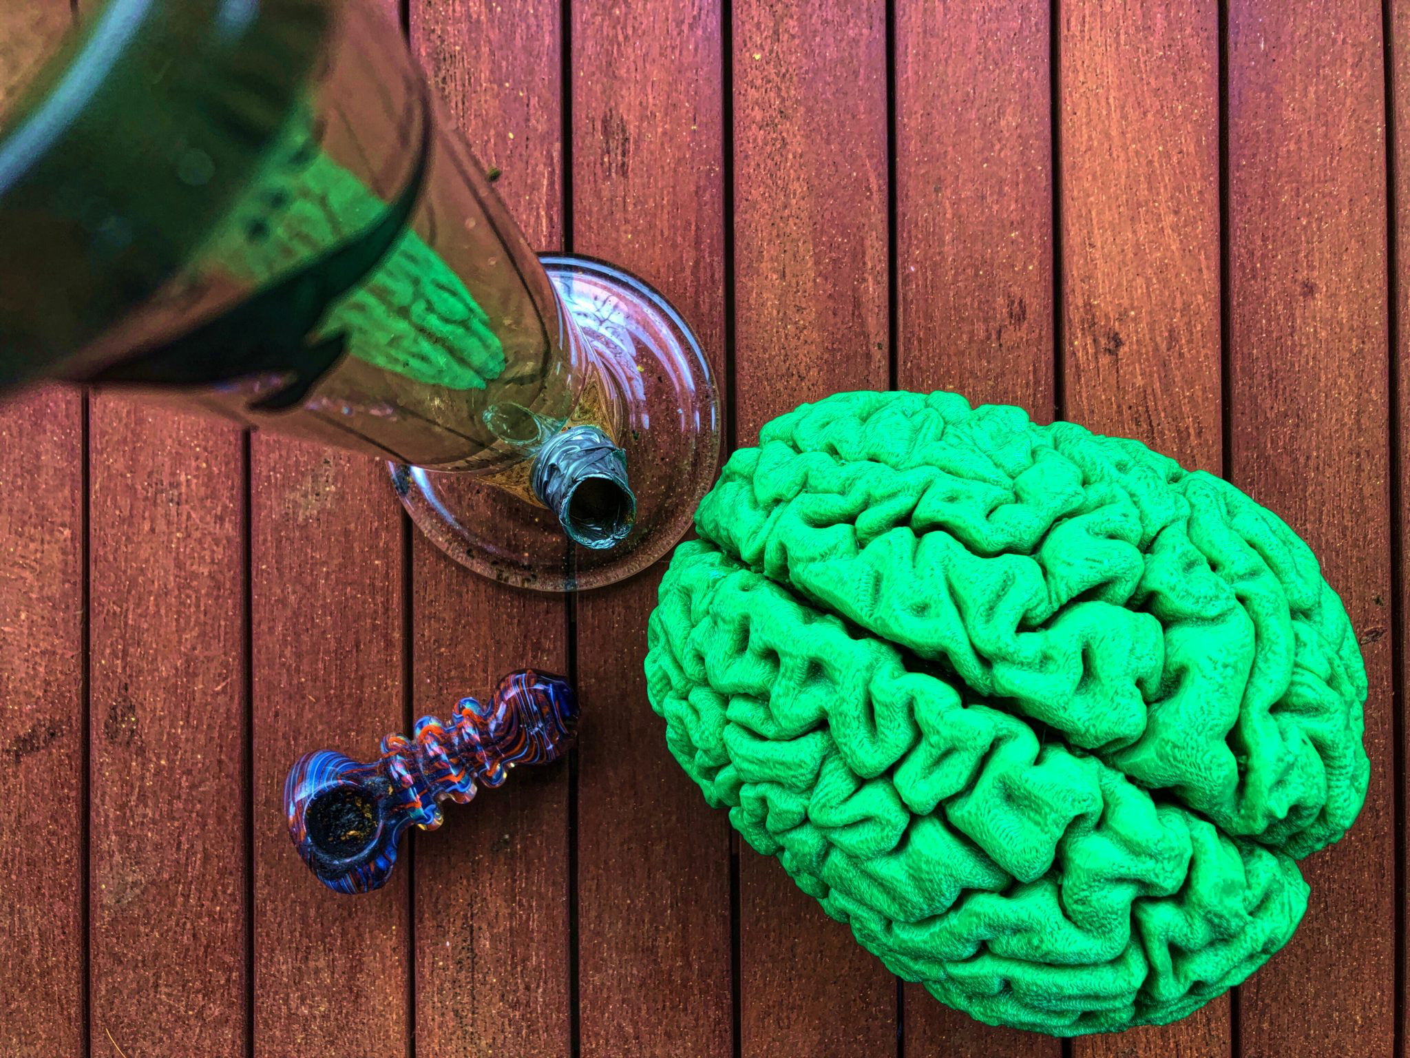
CANNABIS

Slide 11
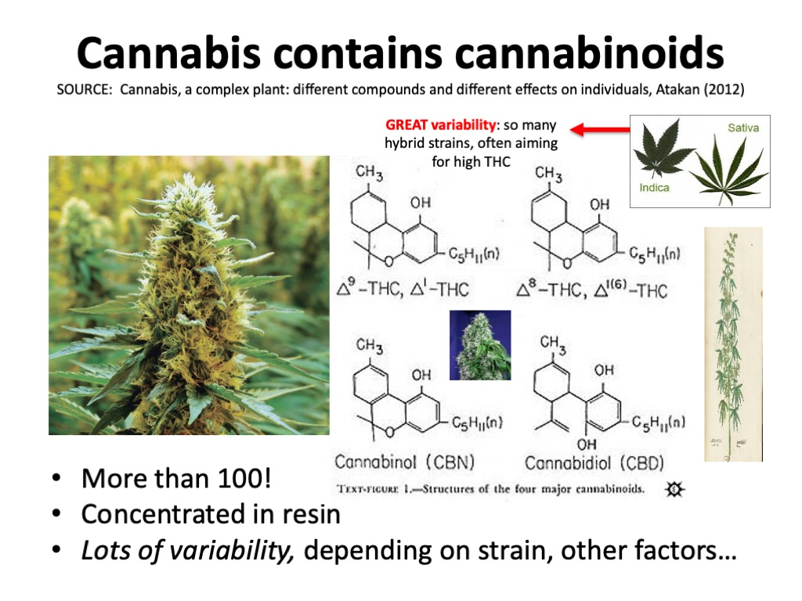

Slide 12
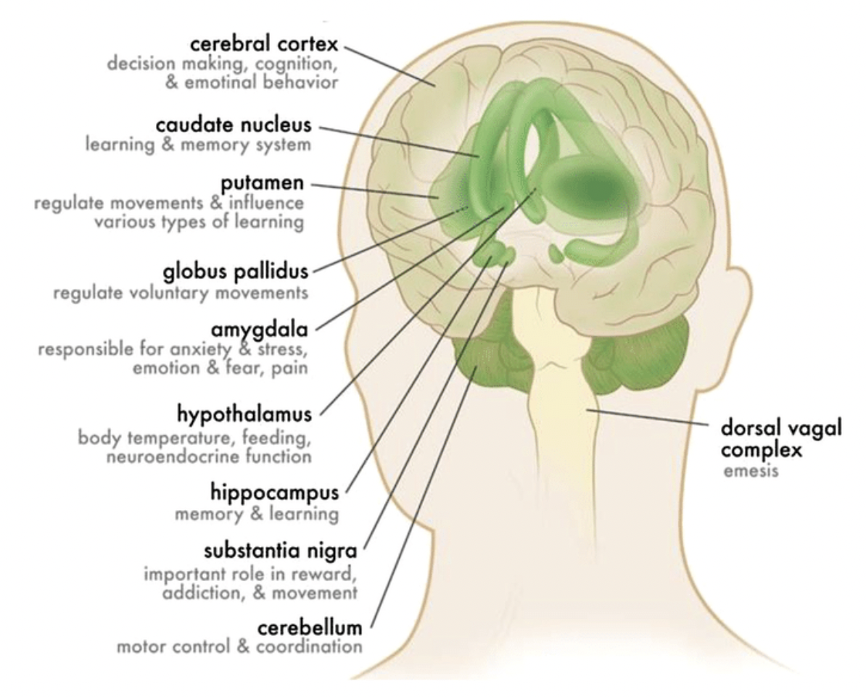
CB1 Receptors
Neocortex
Basal ganglia
Amygdala
Hypothalamus
Hippocampus
Cerebellum
Susan R. B. Weiss, Katia D. Howlett, Ruben D. Baler (2017)

Slide 13
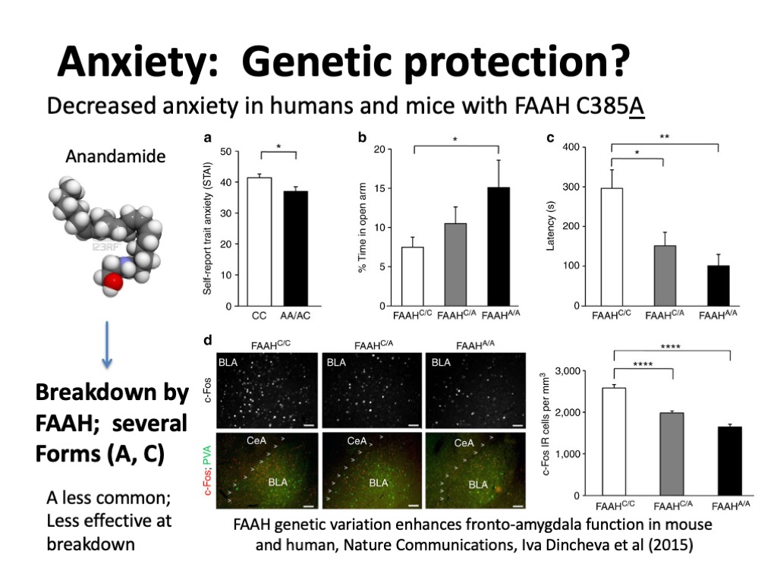

Slide 15
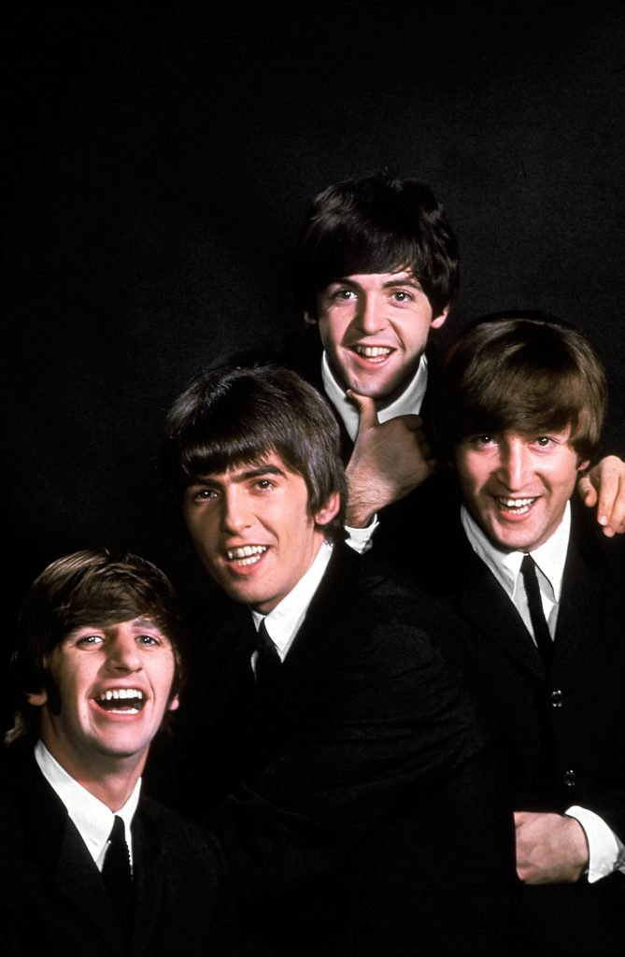
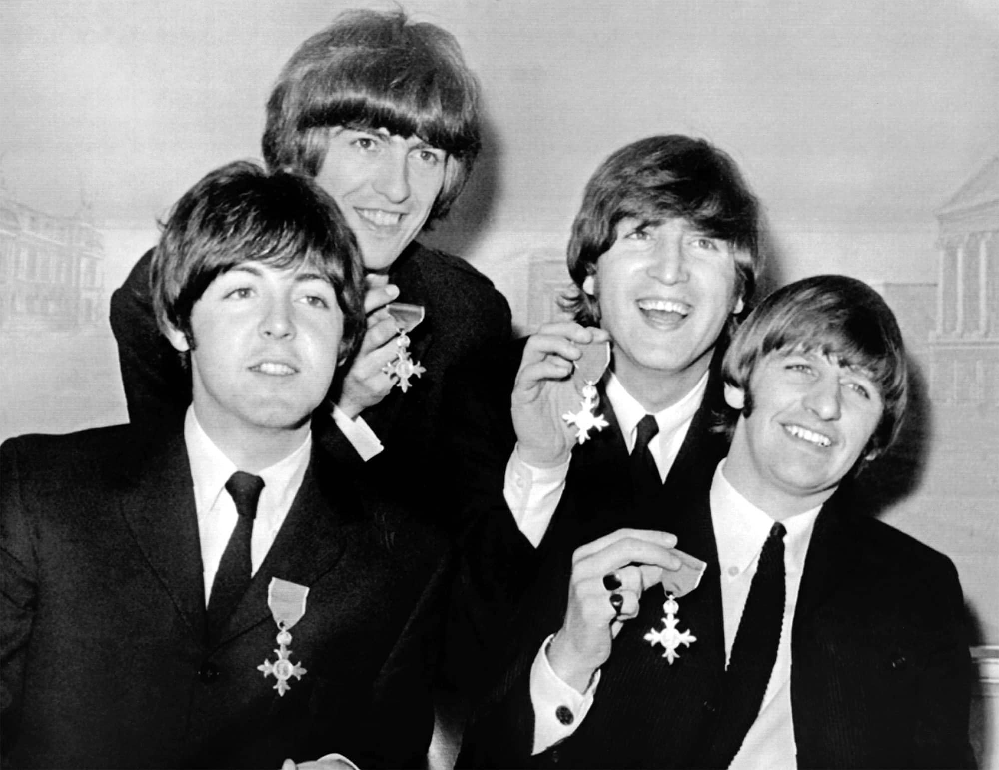
The Beatles
1964
I'm a Loser
I'll Follow the Sun
Nowhere Man
I'm Looking Through You
If I Needed Someone
1965

Slide 16
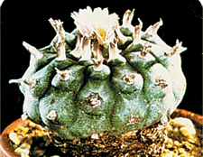
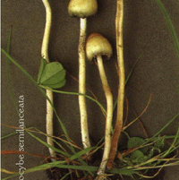
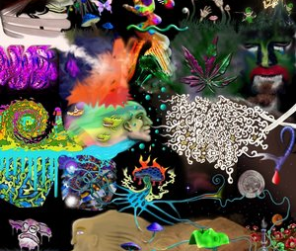
Psychedelics
Chemicals that produce unusual perceptual and cognitive distortions.
Many derived from plants, though some are synthetic.
Mescaline, psilocin, DMT, LSD

Slide 17
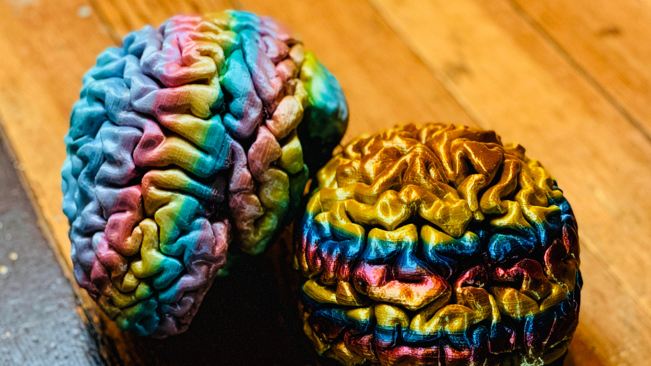
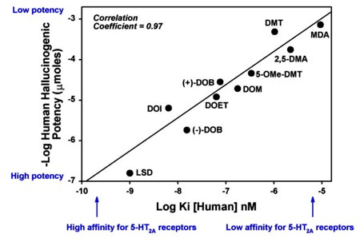
Most psychedelics are agonists at ONE type of SEROTONIN receptor (5-HT2A)
Wenjie Xiao, William
E. Fantegrossi (2006)
Potency linked directly to hallucinogenic effects

Slide 18
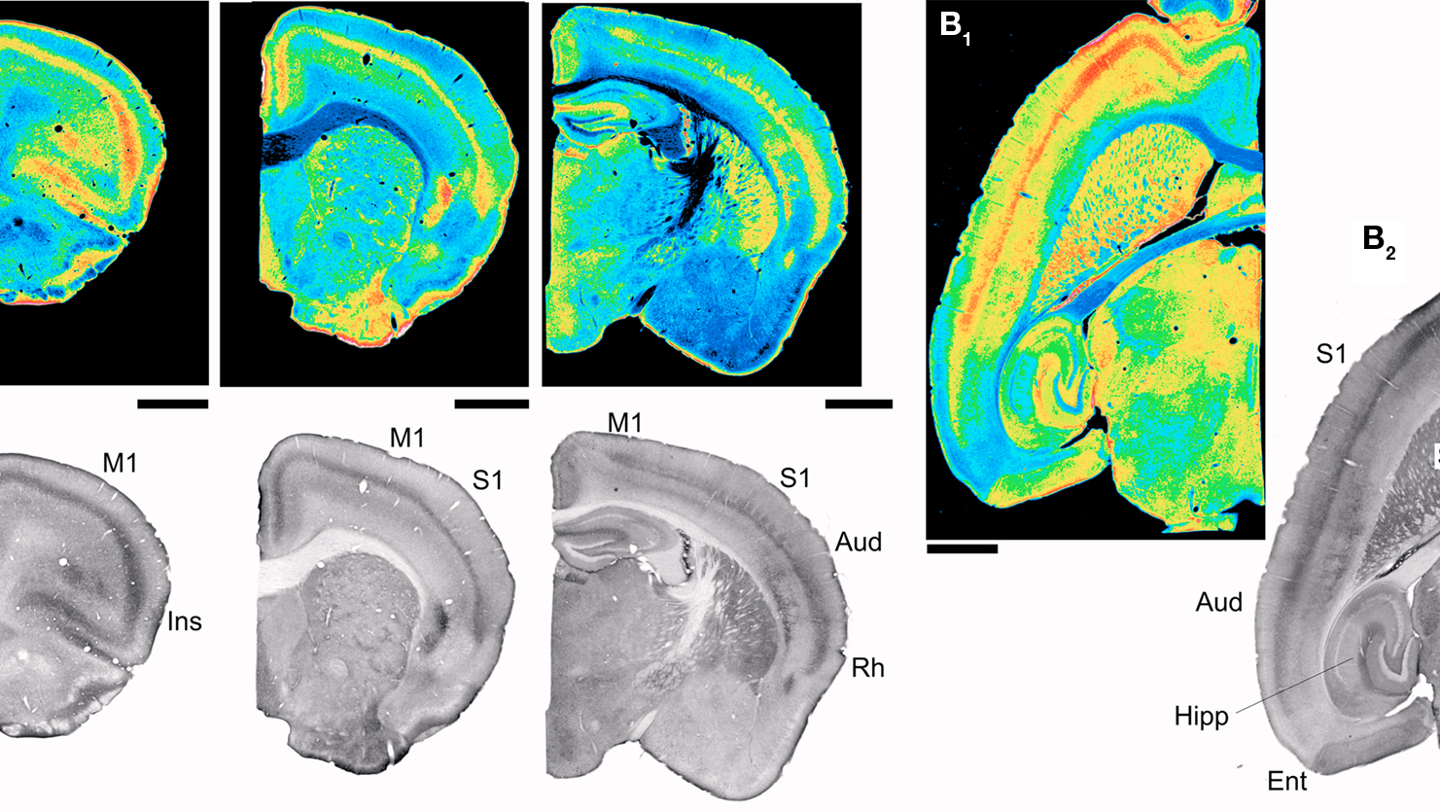
Where are these receptors?
Neocortex
Layer V
Olfactory cortex
Hippocampus
Basal ganglia
Thalamus
Cerebellum
Brainstem
Spinal cord

Slide 19
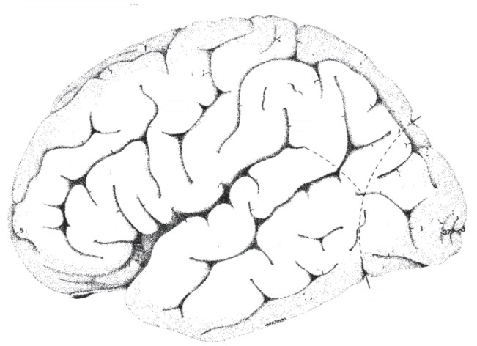
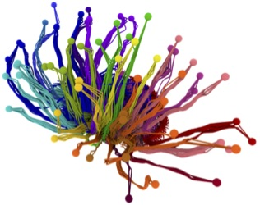
Psychedelics
affect the “gating”
of sensory input
Cortex
Thalamus
Image courtesy of the Allen Institute for Brain Science

Slide 20
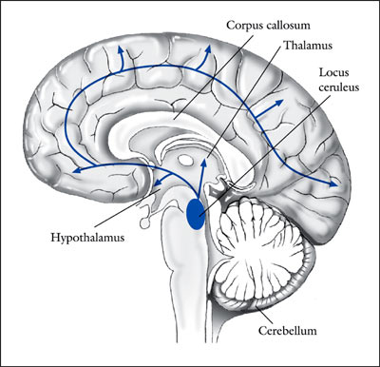
Psychedelics Enhance
Sensory Responses in the Locus Coeruleus (LC) via
5-HT_{2A} Receptors
“...it is of interest that the systemic administration
of LSD, mescaline, or other psychedelic hallucinogens in rats,
although decreasing spontaneous activity, produces a paradoxical
facilitation of the activation of LC neurons by sensory stimuli…”
(Aghajanian 1980; Rasmussen & Aghajanian 1986)
Ordinary
stimuli become
extraordinary

Slide 21
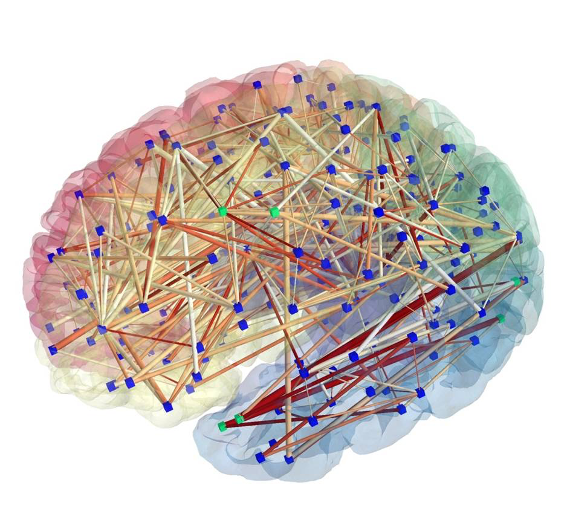
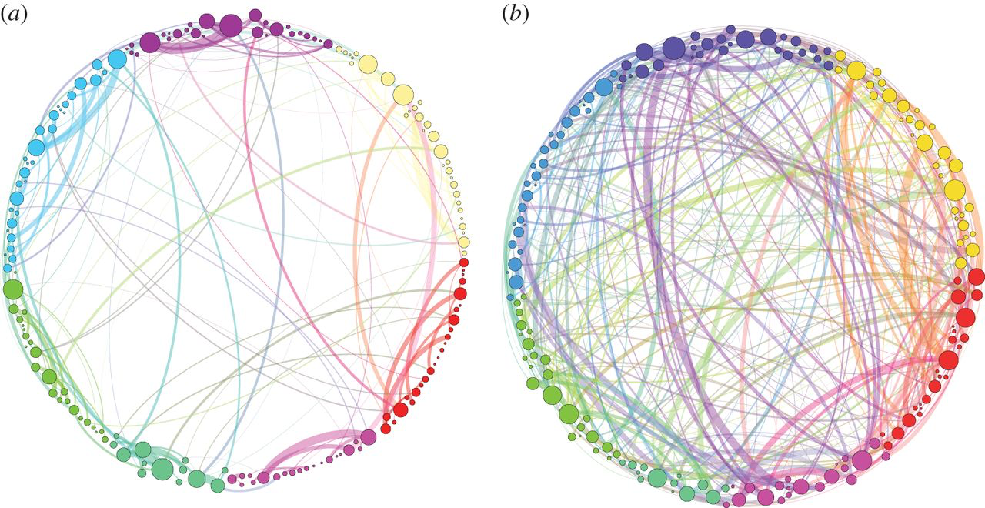
Greater functional connectivity
Homological scaffolds of brain functional networks, G. Petri, et al (2014)
“there is an increased integration between cortical regions in the psilocybin state…One possible by-product of this greater communication across the whole brain is the phenomenon of synesthesia which is often reported in conjunction with the psychedelic state…”

Slide 22
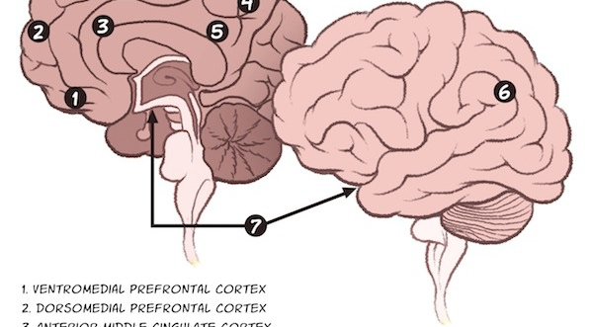
“Default mode” network
Decreased coordination
while on psychedelics
Critical for…
Self-reflection
Self awareness
Rumination
BUT: increased plasticity

Slide 23
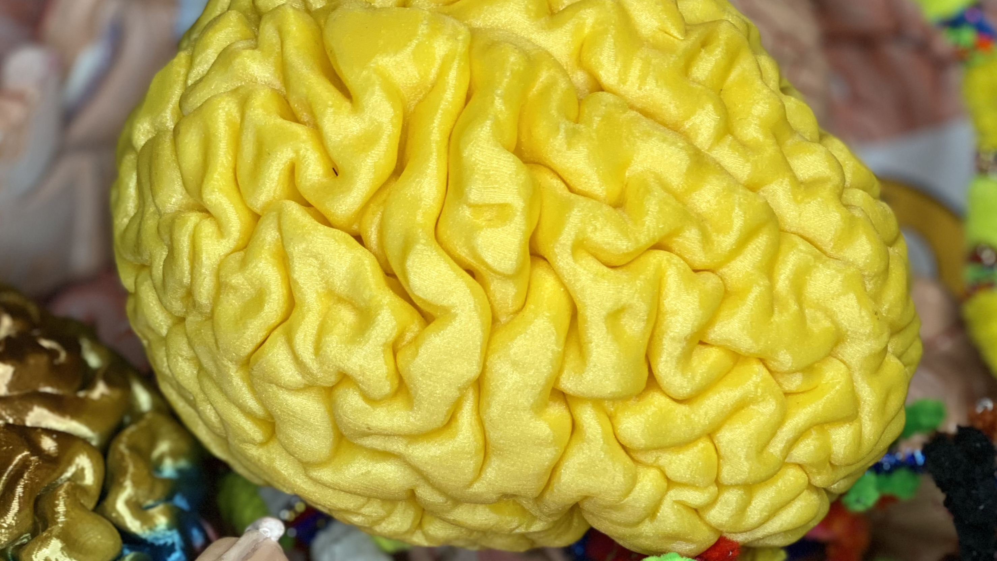
“We all live in a yellow submarine…”

Slide 24
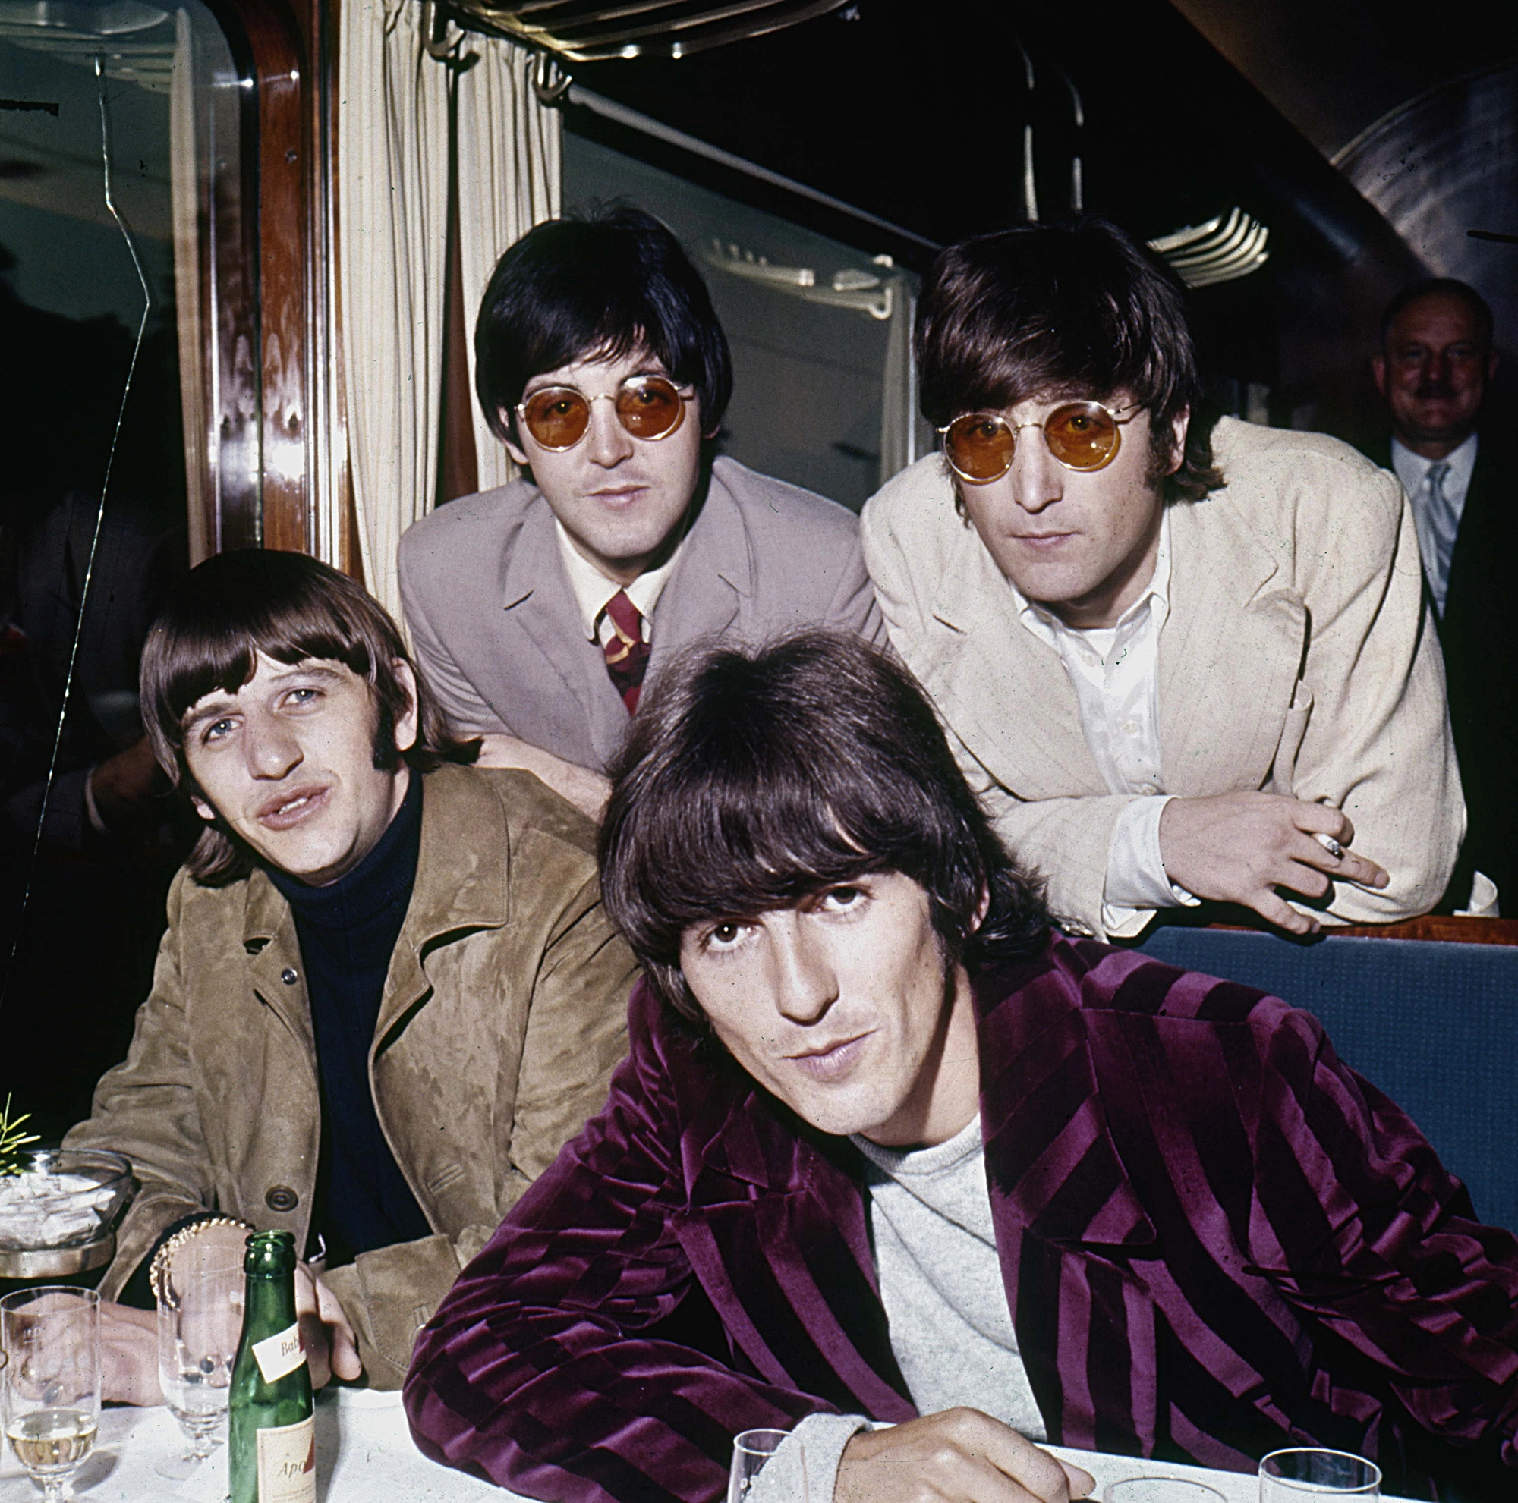
The Beatles
Got To Get You Into my Life
Yellow Submarine
I'm Only Sleeping
Love You Too

Slide 25
Psychedelics & Environments

Slide 26
Psychedelics & Environments

Slide 27
Psychedelics & Environments
Set & Setting

Slide 28
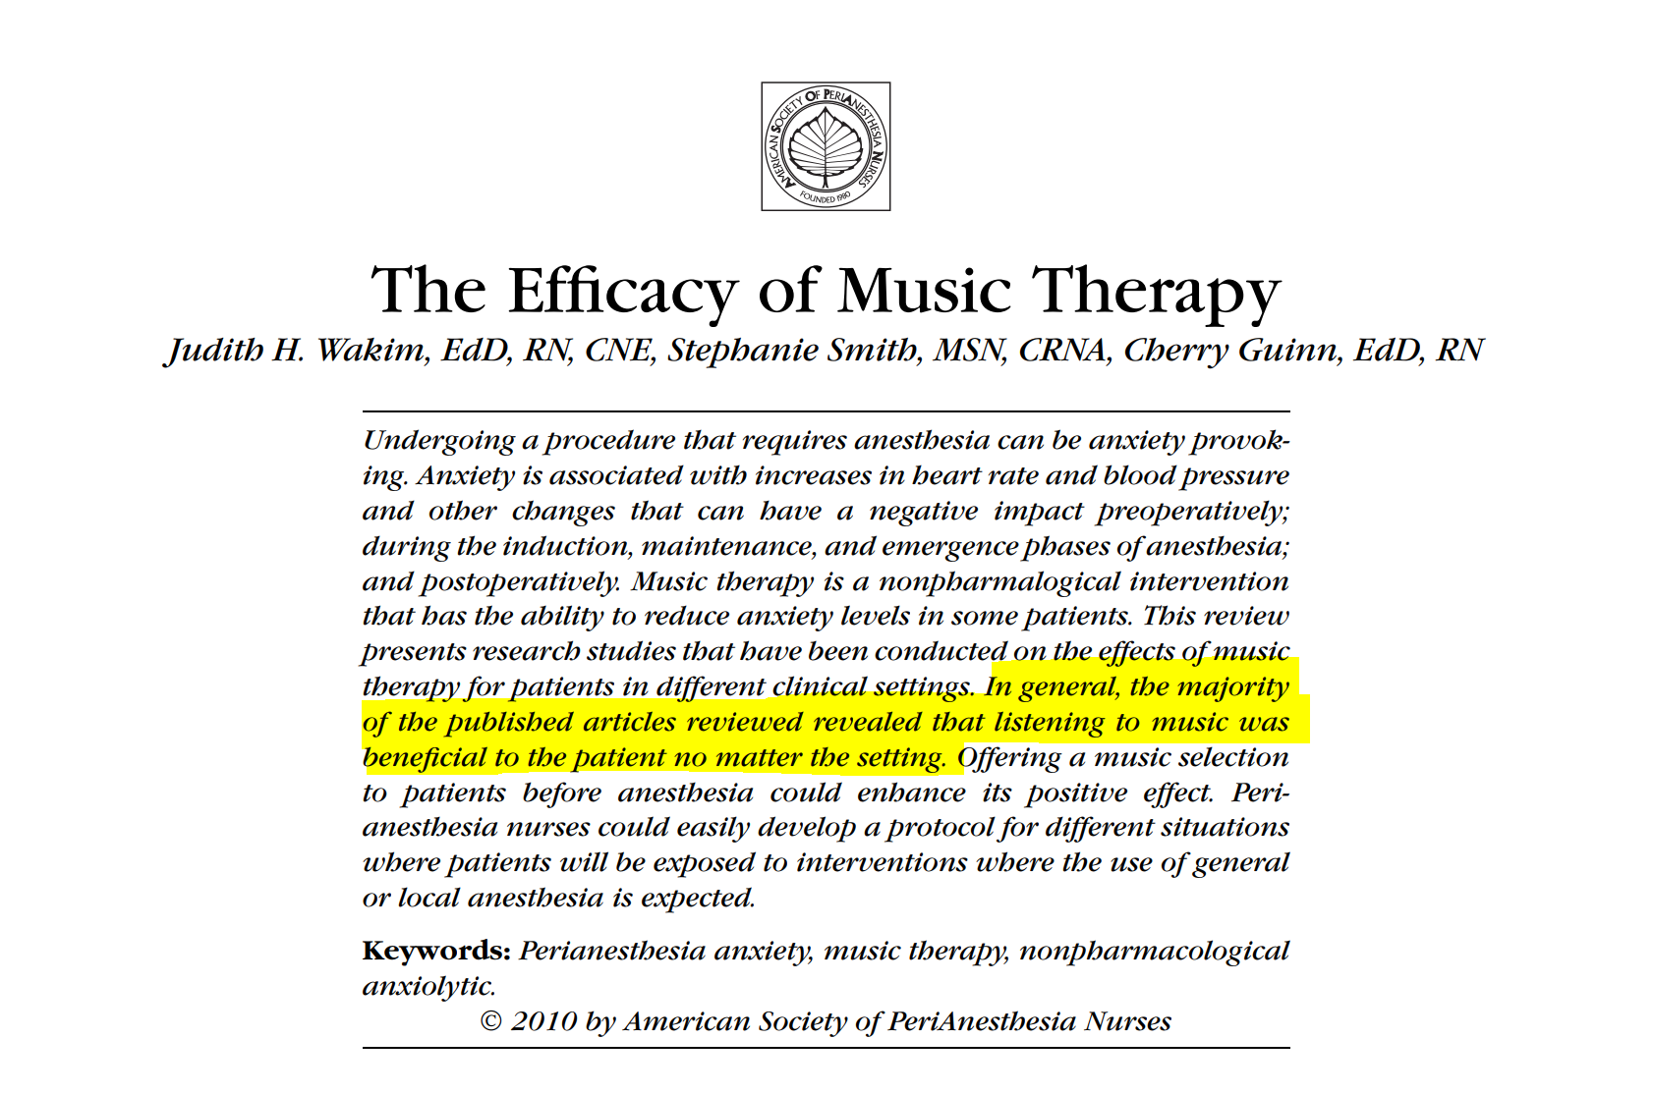
Psychedelics & Environments

Slide 29
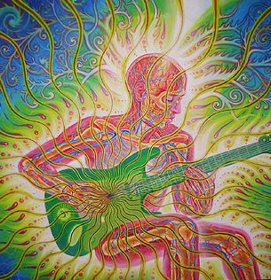
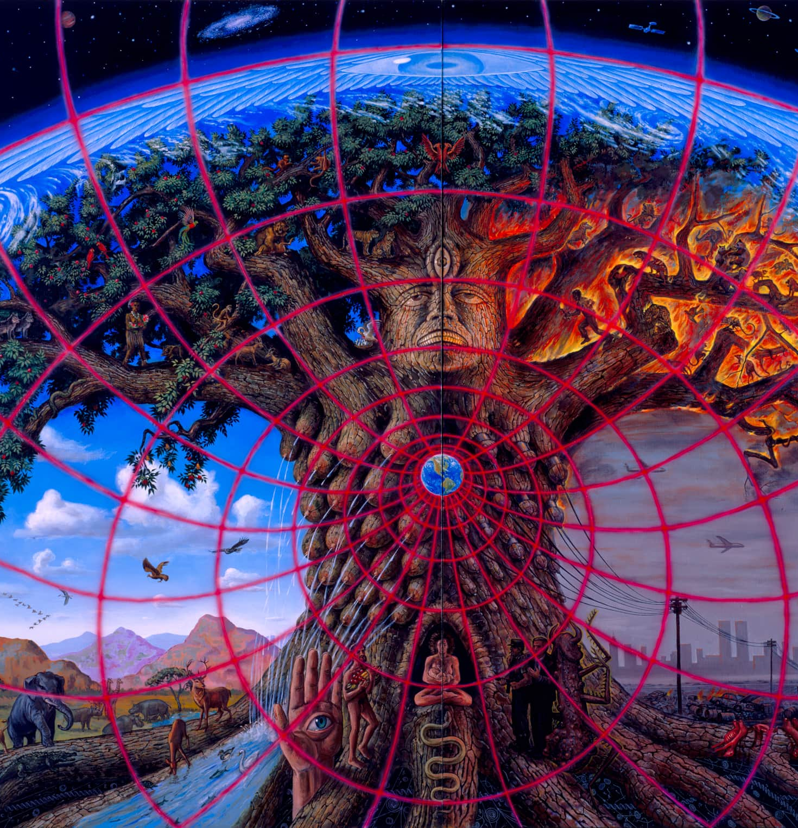

Slide 30
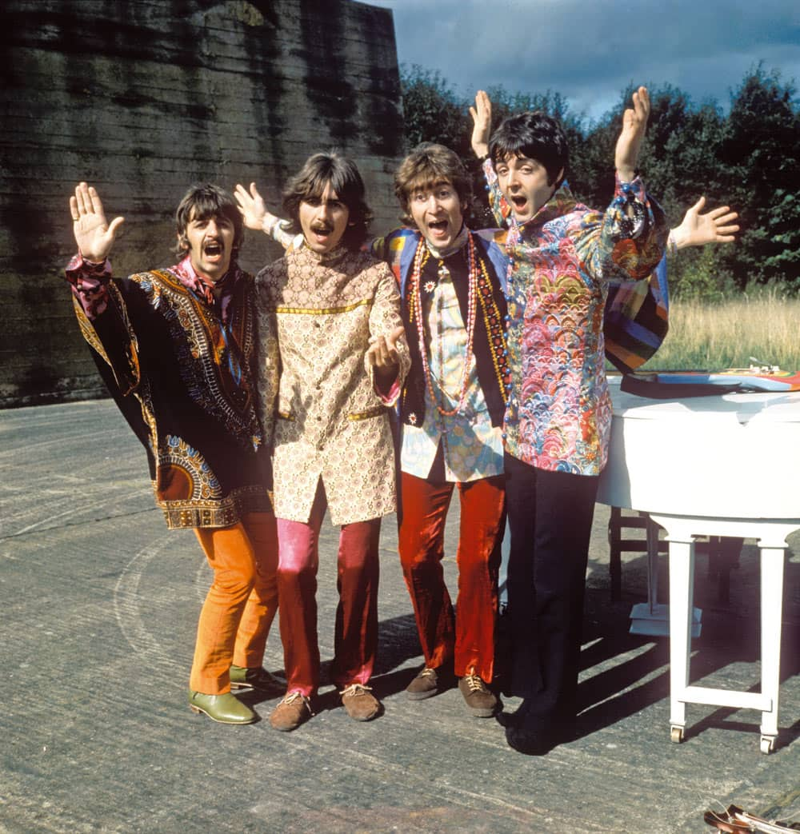
The Beatles
Hey Bulldog
Only a Northern Song
Your Mother Should Know

Slide 31
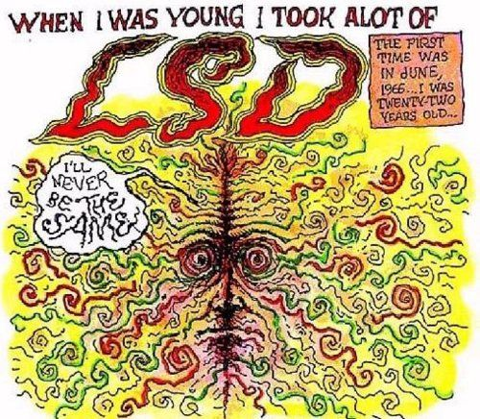
Robert Crumb “LSD”

Slide 32
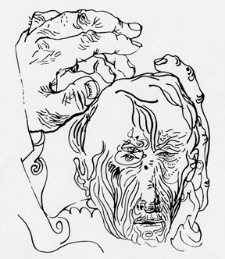
Is there a link between creativity and hallucinogens?
Distortion of body extremities is illustrated in a sophisticated way by a professional painter. This drawing was executed by a well-known Czech artist after the recovery from LSD intoxication.
Mandalas created before (left) and during (right) an LSD session conducted in 1972 at the Maryland Psychiatric Center
In 1952 Lászlo Mátéfi described how an experimental subject under the influence of a hallucinogen experienced a discrepancy between his intention and performance while making a portrait:
I see the object correctly but draw it falsely; my hands won't follow it.... This desire to paint is harder and harder for me to perform since the expanse of my experience pulls me more and more into it. Myself, the drawing, and the surroundings create a unity--and that hinders me because I cannot concentrate on the model. I have the need to bring everything including the painted picture into the surface of the image. Had the painting process been more of a technical success, I would have been able to produce a fantastically good work

Slide 33
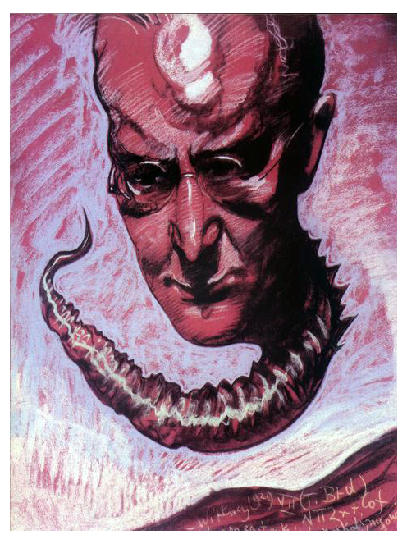
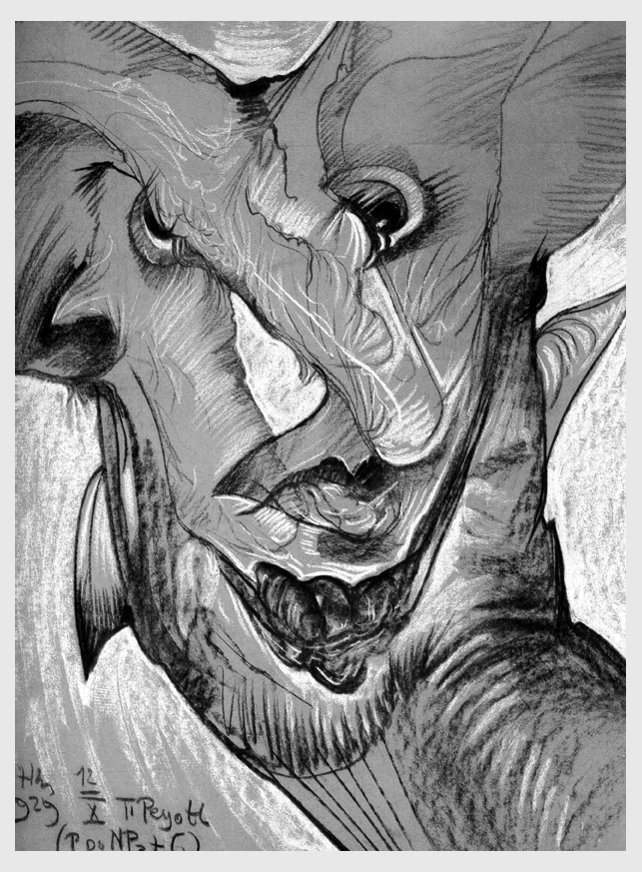
Stanislaw Witkacy “Teodora Bialynickiego-Birul” 1929
Witkacy made this portrait under the influence of mescaline.
Witkacy made this portrait under the influence of peyote.
Stanislaw Witkacy “Neny Stachurskiej” 1929

Slide 34
"I didn't take LSD, I didn't want to be that far from my senses”-Peter Blake
Marijke Dunham, outfits for the Beatles
“Drugs were a big part of it, the aesthetic has a bad name due to that. I mean Van Gogh painted his strange paintings and there’s been no mention of drugs, but drugs definitely had an influence as far as the cause was concerned, with the strange moving lines, definitely … and since I’m not ashamed about it I don’t have to hide it. That’s where it comes from.” -Marijke Dunham
The Beatles – Sgt. Pepper’s Lonely Hearts Club Band
(1967, designed by Peter Blake and Jann Haworth

