Slide 1
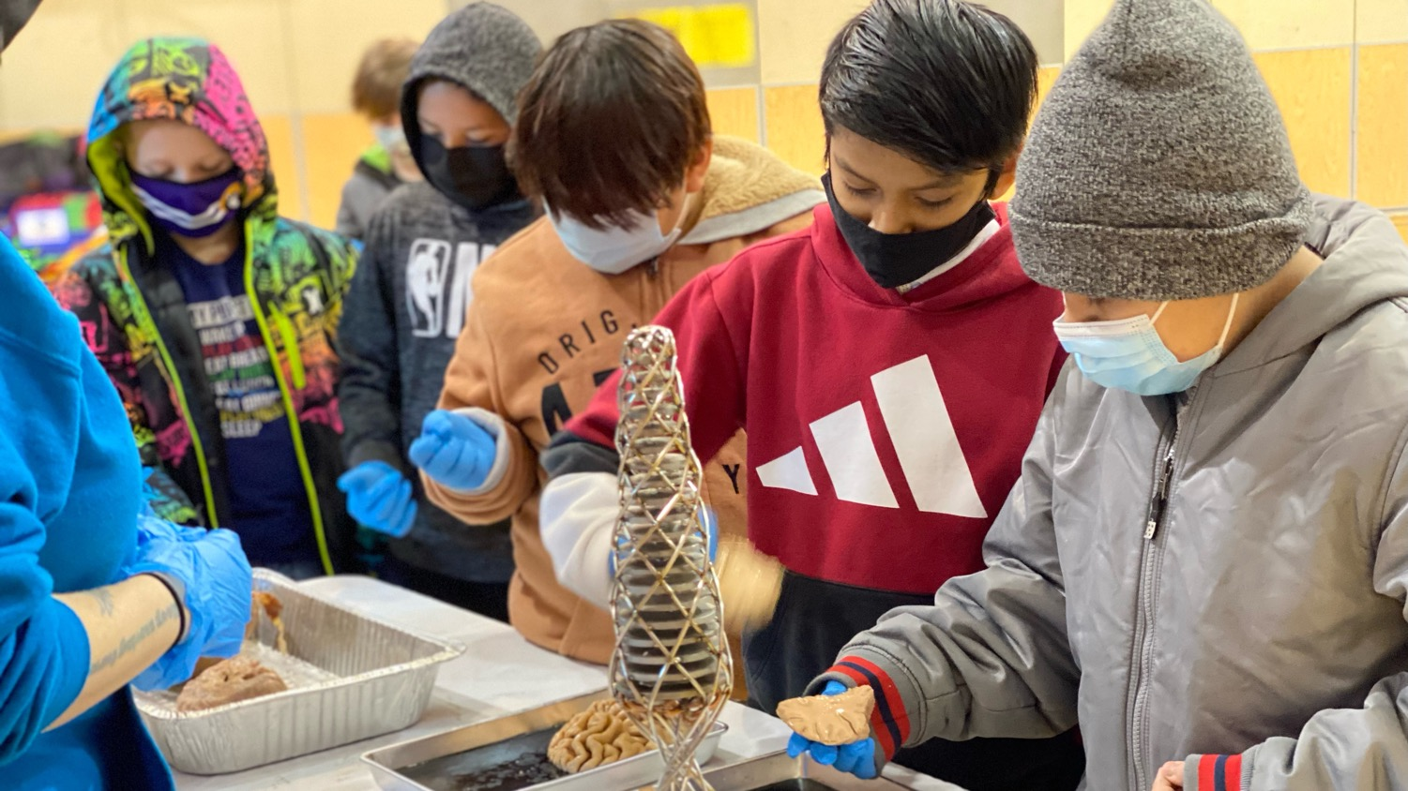
ART & BRAINS: Collaborating with our community for future success
nwnoggin.org

Slide 2



Jeff
Leake
Kanani
Miyamoto
Britta Harbury
Kanani Miyamoto
Artist, Instructor at
PNCA, Pacific University, PCC
Board Member, NW Noggin
Jeff Leake
Artist, Instructor at Portland State University
Co-Founder, NW Noggin
Britta Harbury
Undergraduate
Portland State University
Volunteer, NW Noggin

Slide 3
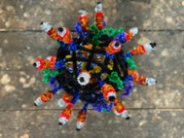
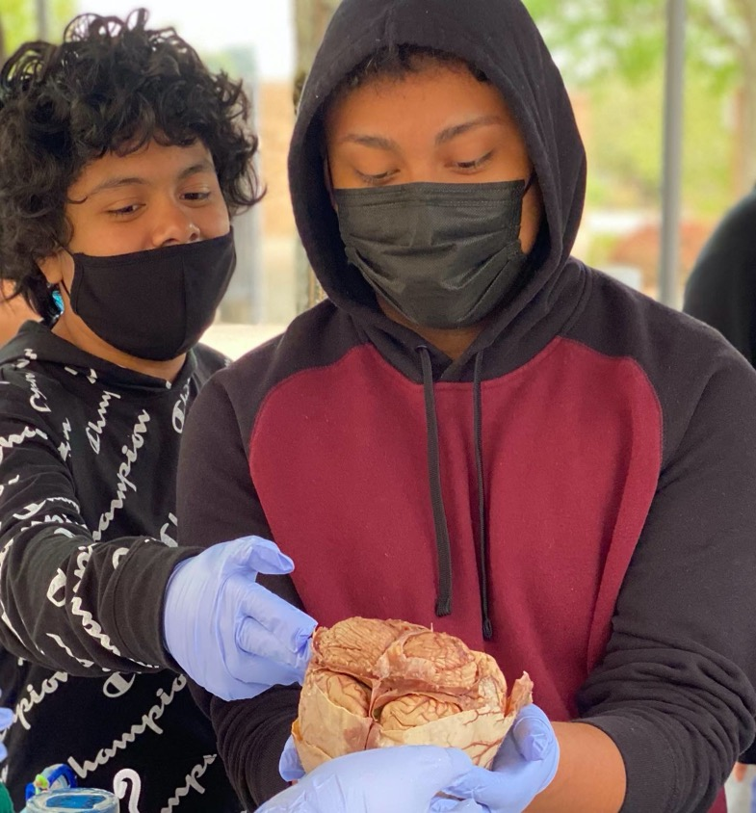
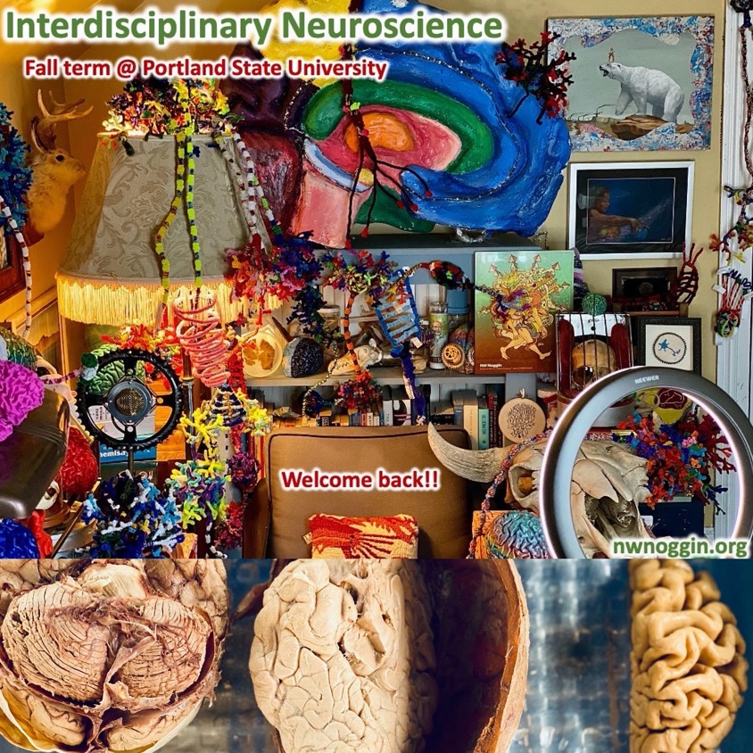
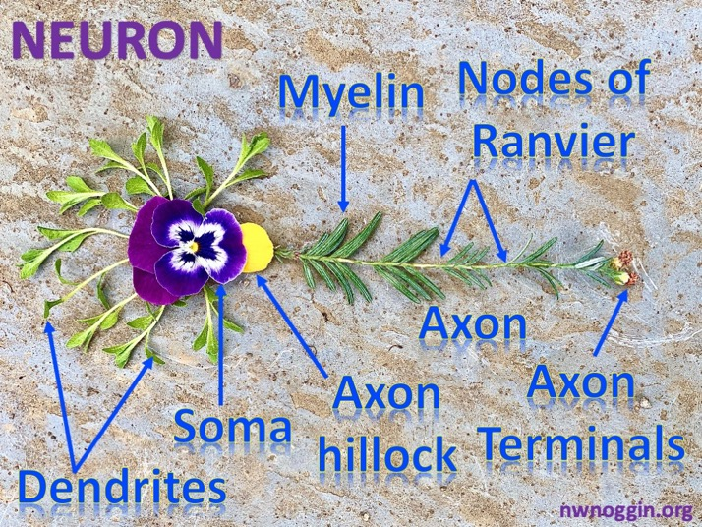
Art & Brains!
nwnoggin.org

Slide 4
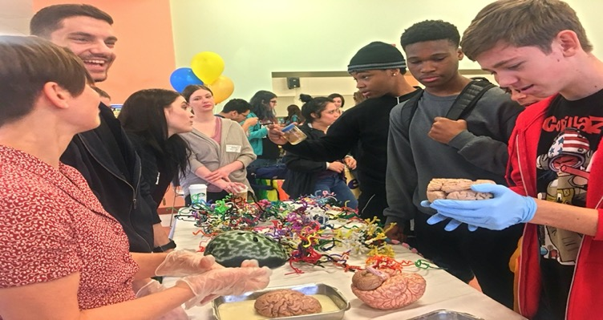
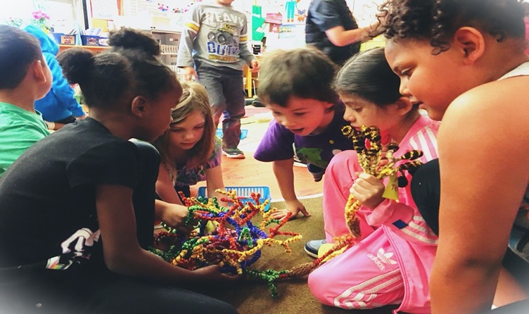
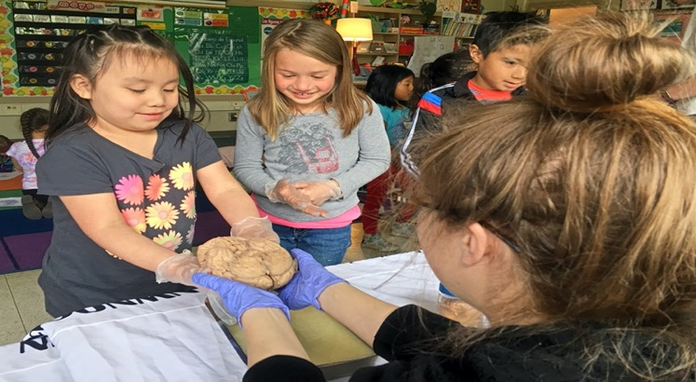
nwnoggin.org
Arts integrated neuroscience outreach for K-12 & community

Slide 5
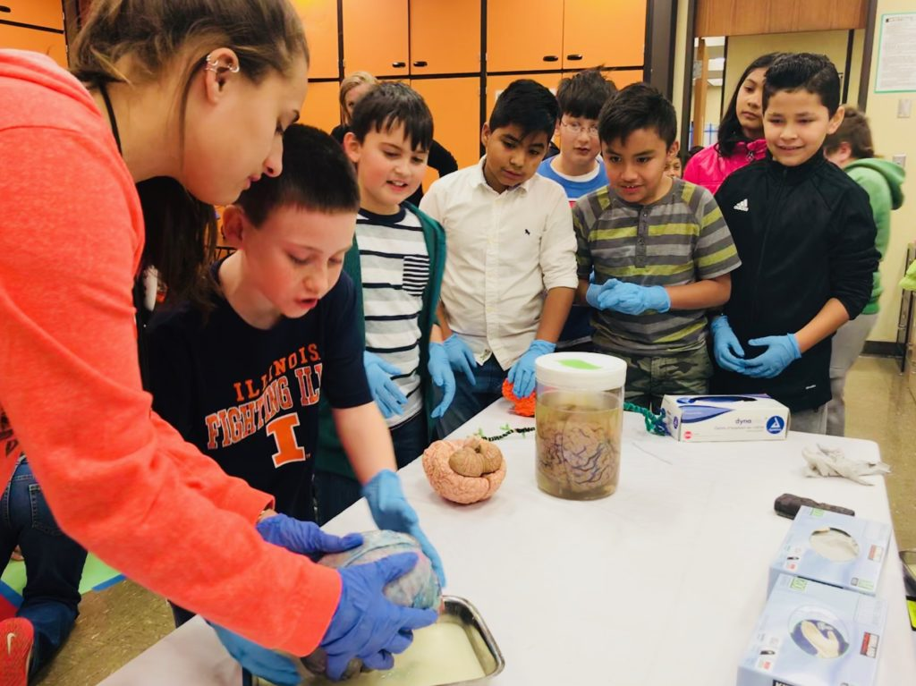
What you do has relevance
GO PLACES
Sleep
Anxiety
Depression
ADHD
Autism
Development
Perception
Drugs
Memory
Language
Racial Bias
…

Slide 6
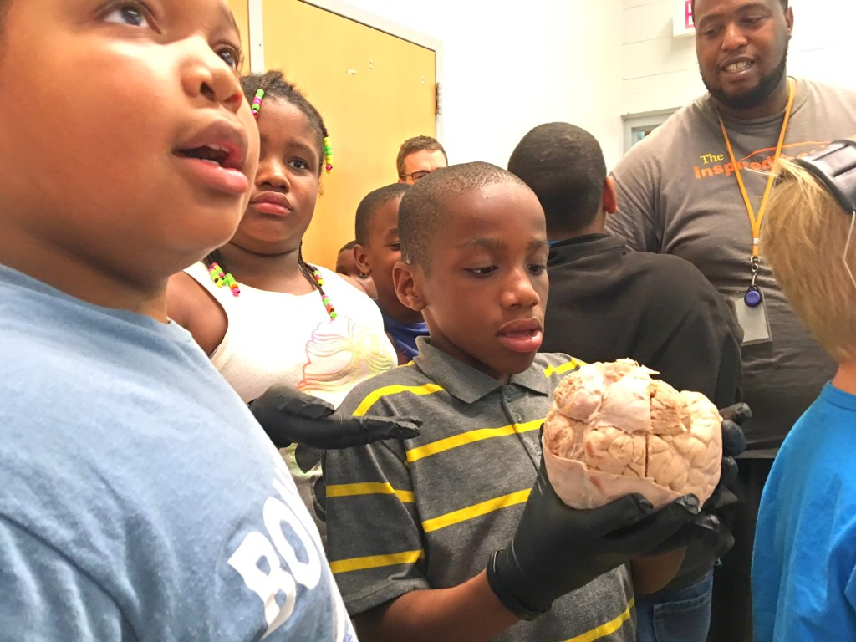
We all pay for research

Slide 7
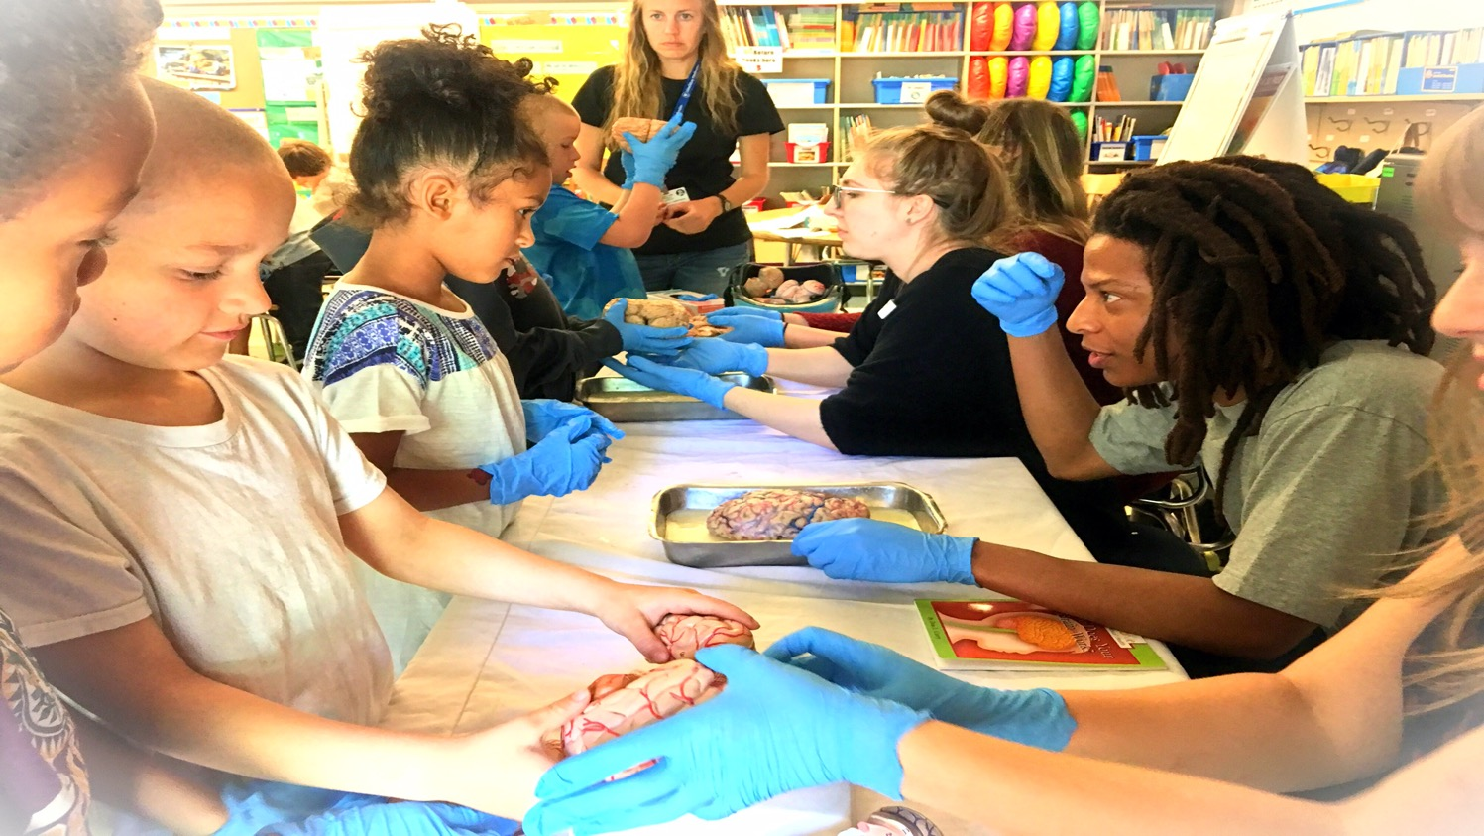
Connections matter
Greater understanding
More support for research
Increased participation
Less confirmation bias
New directions
FUN!

Slide 8
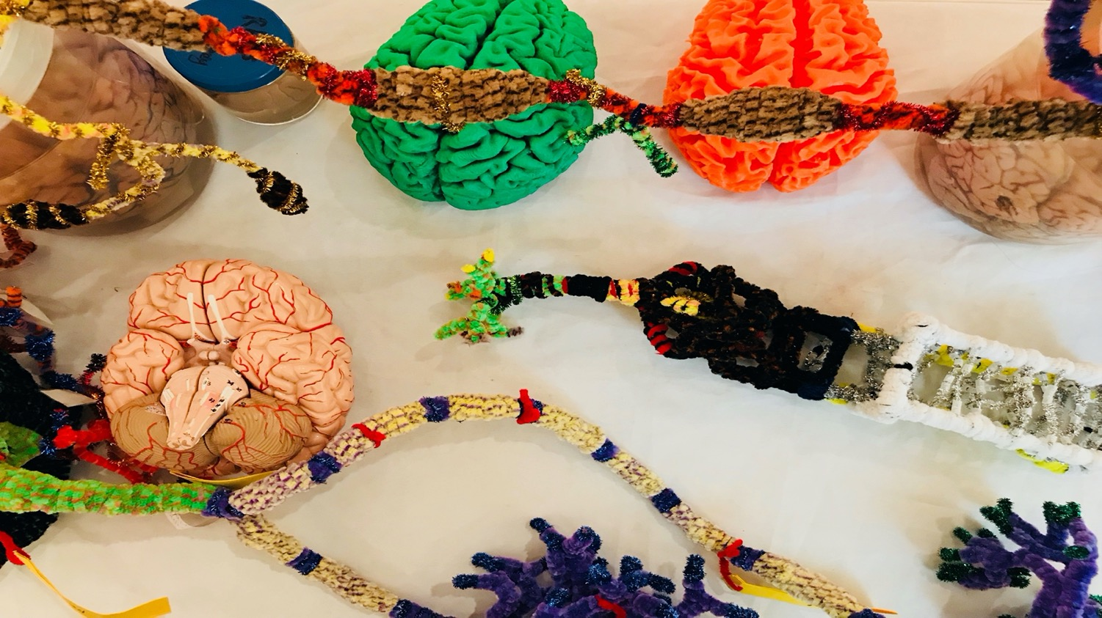
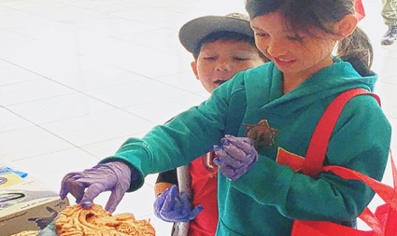
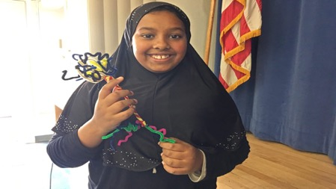

BUILD NEW
CONNECTIONS
Academic priority K-12, urban/rural communities, tribal majority schools
  Not always well-funded, or valued, often ignored, subjected to standardized testing that primarily benefits others. Complex brain development underway, unacknowledged diversity, racism, bias, police brutality, mental health,…
Young graduate researchers, undergraduates (PSU, OHSU,…)
  How does my research relate to the world? How can I explain it? Where can I go from here?
Houseless youth (p:ear), incarcerated youth (MacLaren/Coffee Creek Correctional Facilities)
  “It’s like people see me as an object, not as a human being”
Artists: Painters, Dancers, Storytellers, Musicians, Poets
  How does my work relate to other fields? How do I connect with new audiences?
  How is my practice influenced and enriched by discoveries about the brain?
Community organizations
  TRIO, Area Health Education Centers (AHECs)
Area businesses (BioGift, Intel, Fort George, Floyds/Street 14, Hospitals)
  How can we better connect with everyone in our community?
Members of the public
  Why are my taxes spent on research? Art? What are we discovering? Making?
Oh the places
you’ll go!

Slide 9
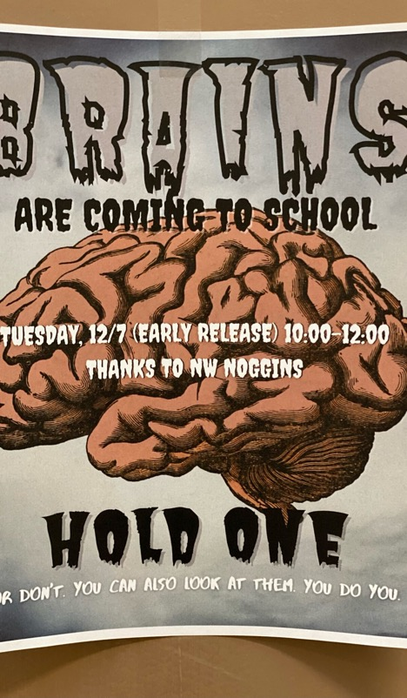
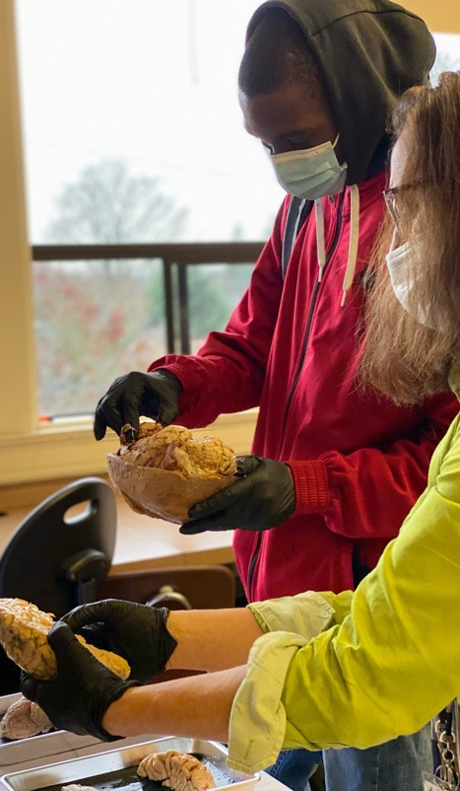
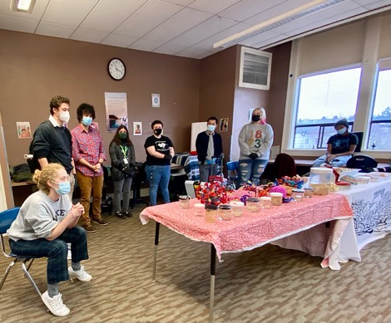
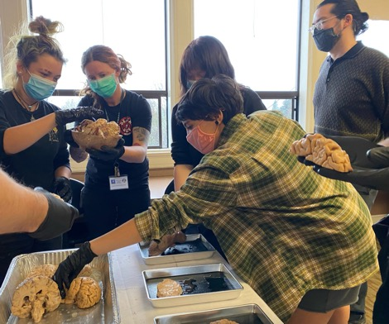
Noggin + TRIO
Alliance High School
Portland, Oregon

Slide 10

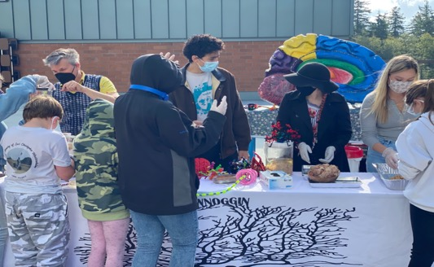
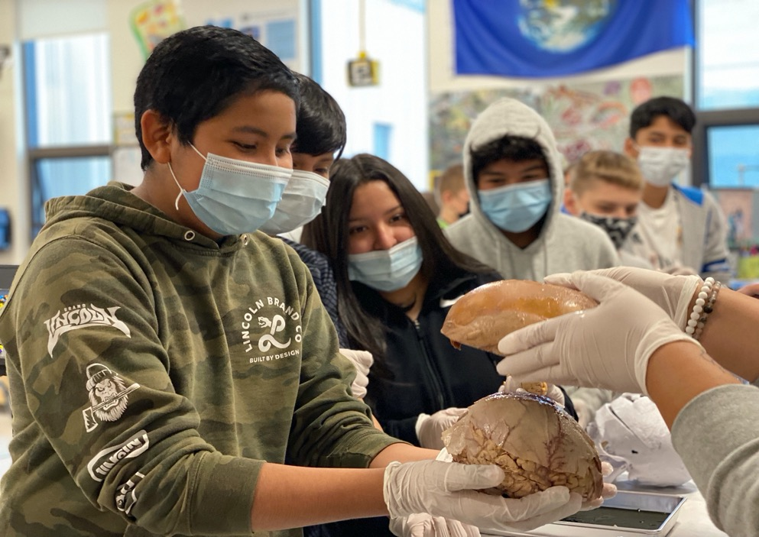
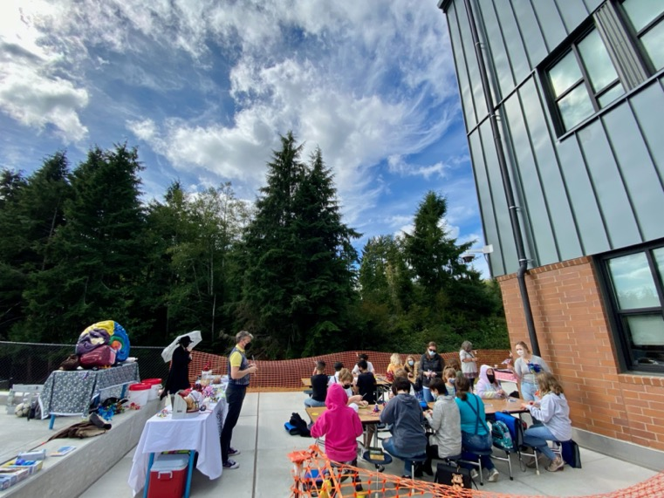
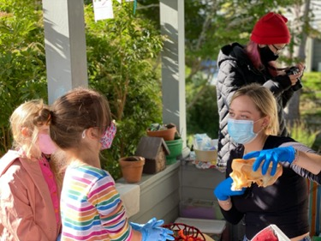
Noggin + TRIO

Slide 11
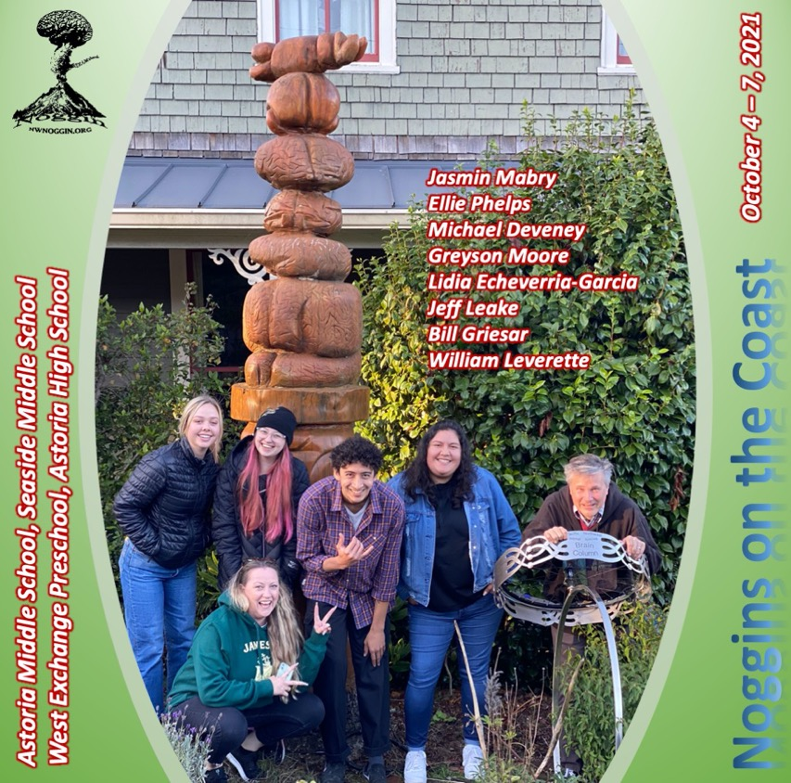

Noggin + TRIO

Slide 12
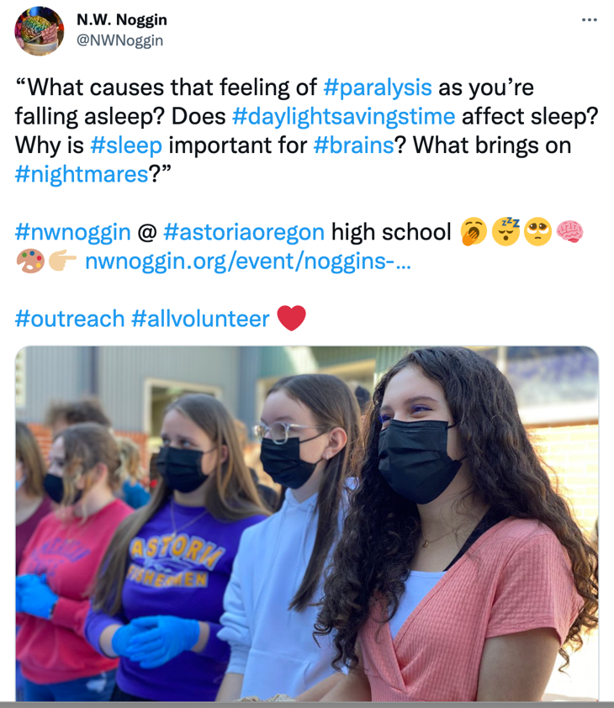
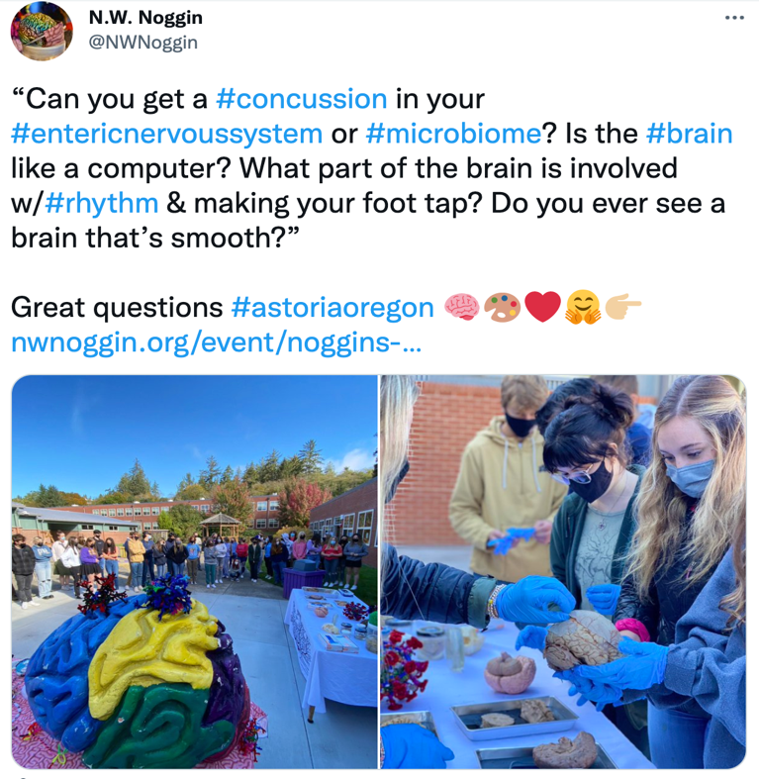
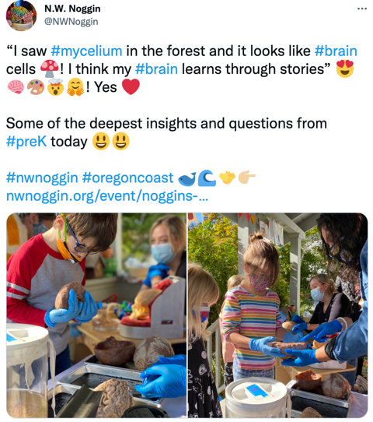
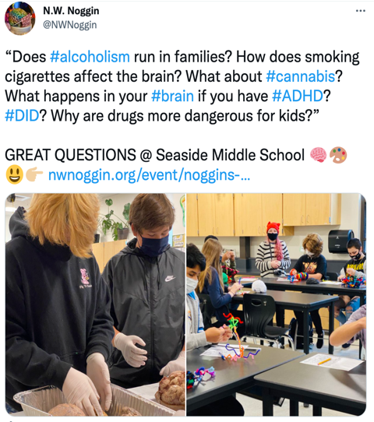

Slide 13
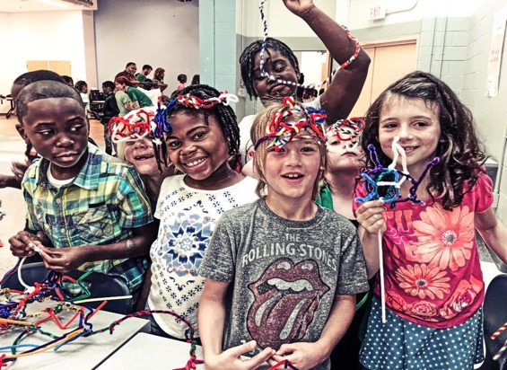
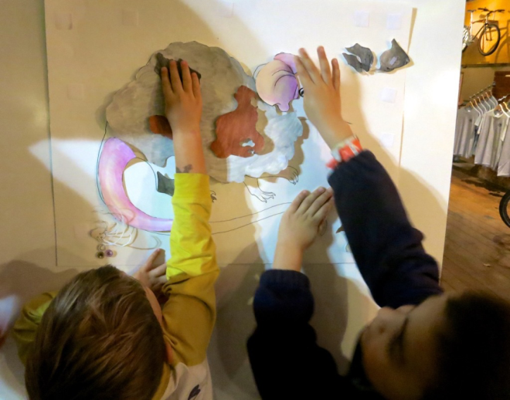
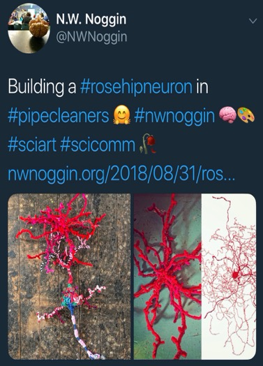
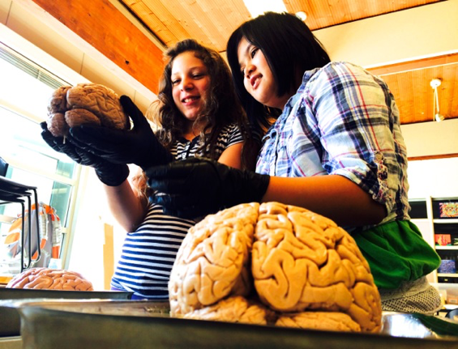
Why art & brains..?
Motivation, engagement, empathy
Exploration, creativity, INNOVATION
Personal relevance of STEAM material
Build your own mouse line!

Slide 14
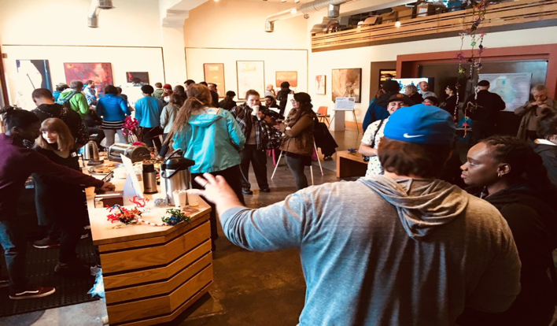
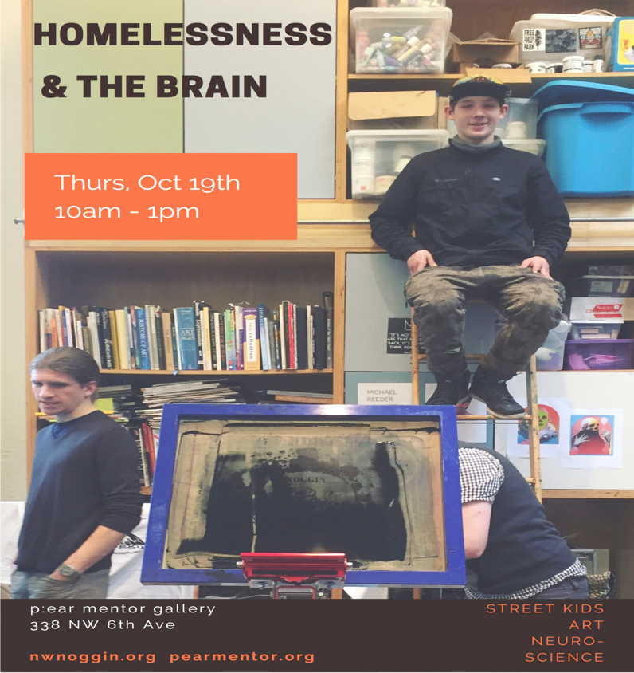
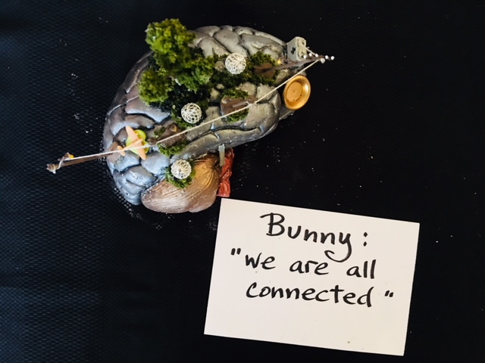
To see other people
Researchers
Clinicians
Policy makers
Houseless youth

Slide 15
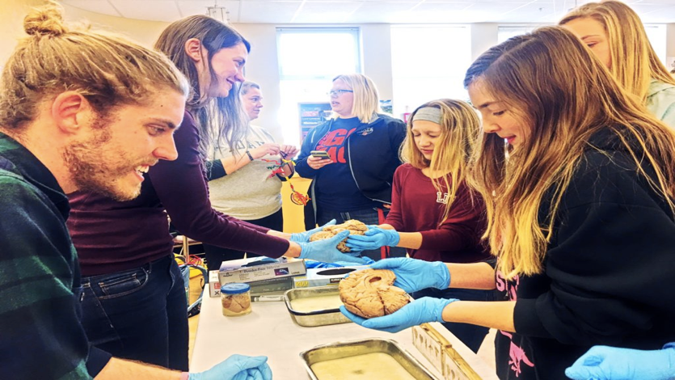

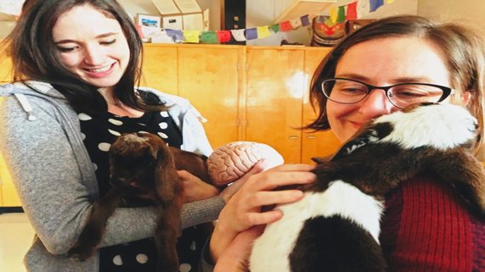
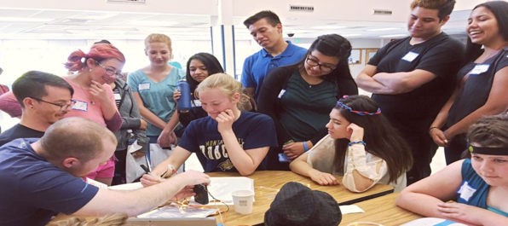
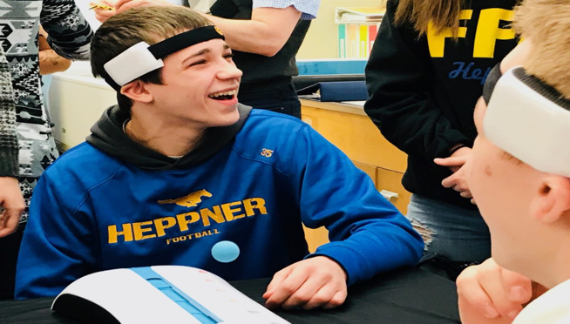
Rural Outreach
Food, housing, baby goats…
TO GO PLACES!
Siletz, Amity & Willamina, OR
Pop: 4,000
Davenport, WA
Pop: 1,700
La Grande, OR
Pop: 13,000
Meservy Meadows, OR Pop: ~40
Heppner & Ione, OR
Pop: 1,240

Slide 16
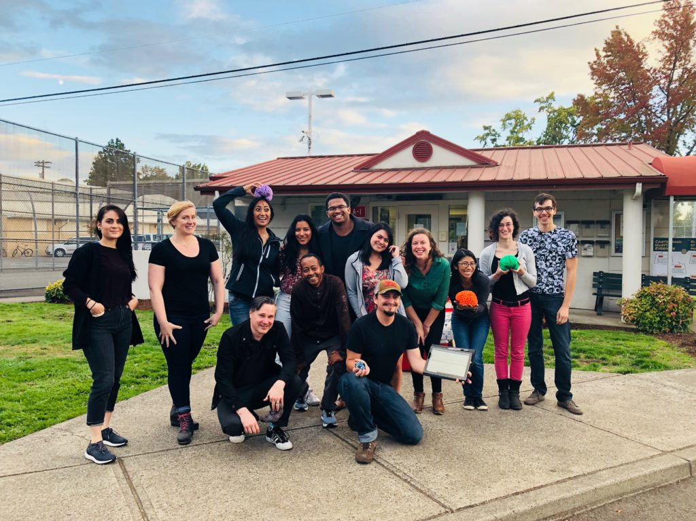
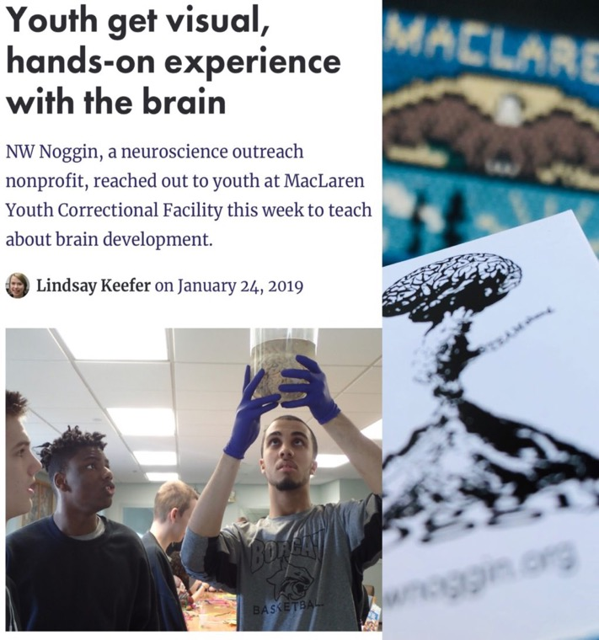
Neuroscience & Law
To listen, learn, empower & make change
MacLaren Youth Correctional Facility

Slide 17
Oregon Mental Health Statistics
51st in prevalence of mental illness
17.57% of youth (12-17) reported at least one major depressive episode in the past year
  51st in the country
13.1% of youth reported having a severe depressive episode in the past year
  48th in the country
4.65% of youth reported having a substance use disorder in the past year
But, only 9.81% of students identified with emotional disturbance identified for and IEP

Slide 18
Mental health issues affect every student in Oregon, either directly or indirectly

Slide 19
Keys to Self-Advocacy
Understand Yourself
  Understand the disorder they have been diagnosed with
  Understanding their personal needs when living with their disorder
Understand Your Rights
Communicate with other members of your community
Be able to take leadership in their community

Slide 20
Neuroscience and Self-Advocacy
Mental illnesses have neurophysiological connections
  Where medication regimens come from
The United States mental healthcare system relies heavily on use of medications
There is power in understanding the biological underpinnings of one’s diagnosis

Slide 21
Example: Bipolar Disorder Symptoms
Affects frontal lobe, basal ganglia
  Involved with behavior, emotions, reactions, motivation
Also affects cerebellum, hippocampus
  Involved with memory, motor skills
Bipolar disorder affects emotional well-being as well as memory function
  Many people are not told upon diagnosis that bipolar disorder affects memory

Slide 22
Example: Bipolar Disorder Medications
Lithium
  Reduces excitatory neurotransmitters, increases inhibitory neurotransmitters
    Can cause cognitive slowing, emotional numbness
    Dopamine is involved with motor function
      Tremors are a common side effect
Atypical Antipsychotics
  Blocks dopamine, inhibits norepinephrine release, activates serotonin receptors
    Blocking dopamine causes muscle issues, some of which can be permanent
    Inhibiting norepinephrine release can improve anxiety
    Activating serotonin receptors can improve mood

Slide 23
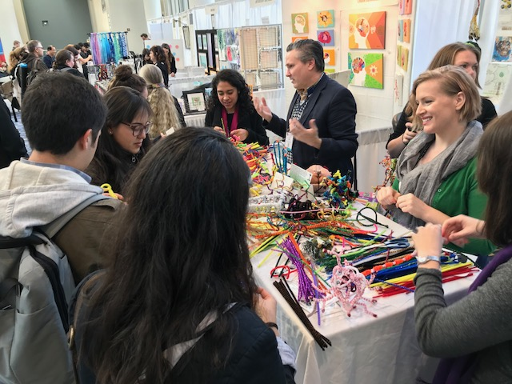
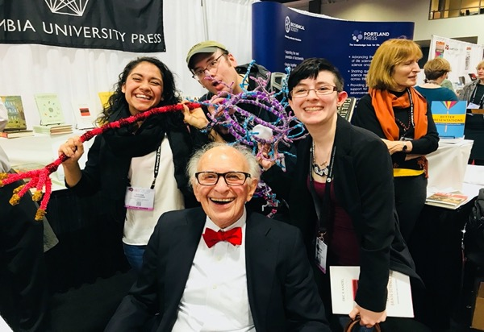
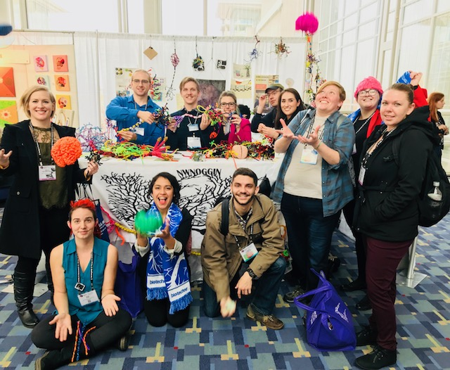
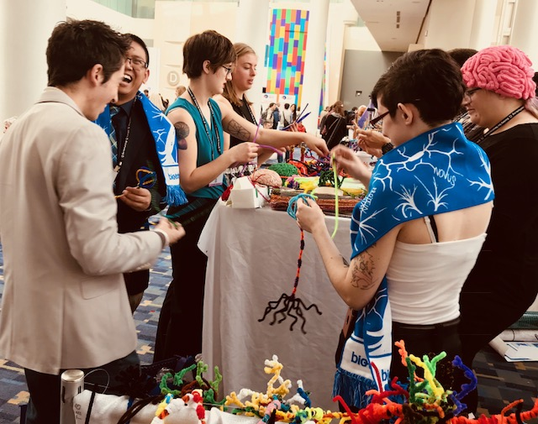
At SfN conferences
Posters, art of neuroscience and…

Slide 24
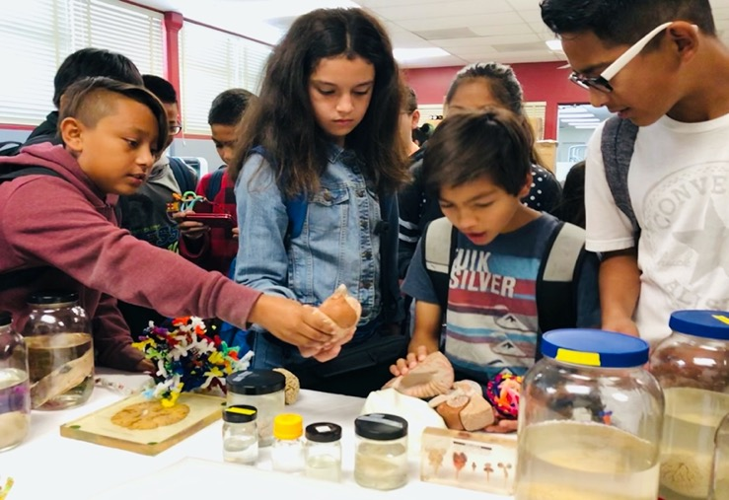
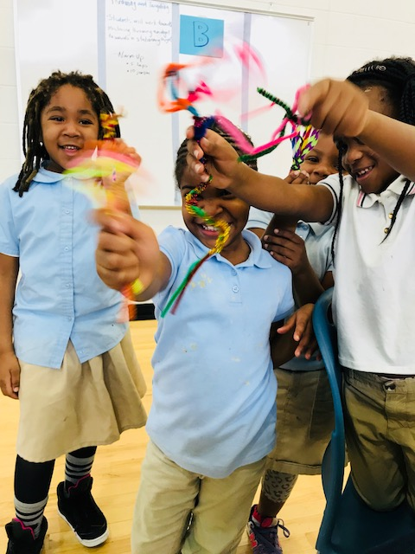
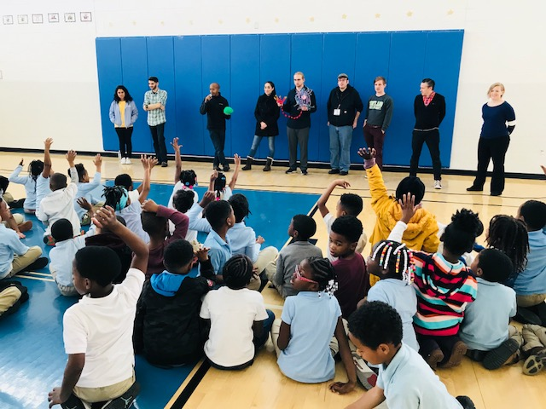
School visits
Turner Elementary, DC
Public outreach and connection

Slide 25
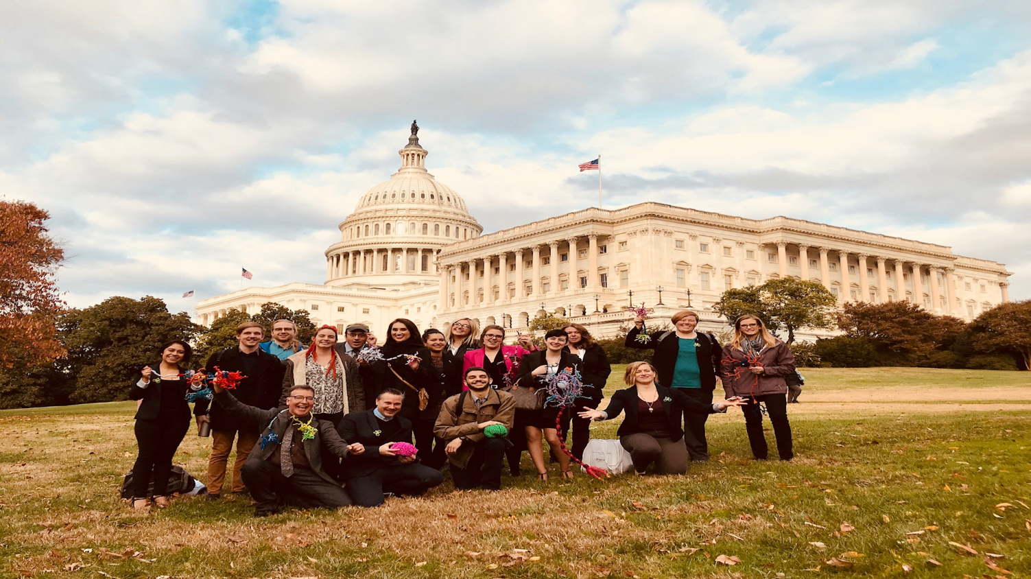
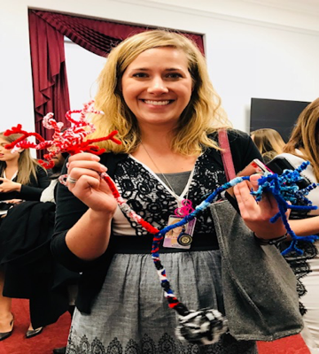
And also, in the U.S., to Capitol Hill
More connections: Congressional office visits
Congressional Neuroscience/STEAM briefing
“Bipartisan”
neuron
Research should inform policy

Slide 26
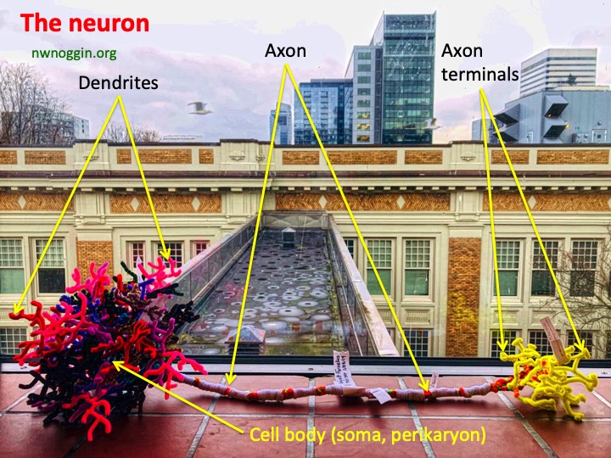

Pipe cleaner brain cells!
MAKE YOUR OWN: Details @ nwnoggin.org

Slide 27


MAKE CONNECTIONS
MAKE ART

Slide 28


Pandemic connections

Slide 29


Public Schools
During COVID-19
#showusyourbraincell

Slide 30

Neurons are a type of brain cell
The majority of neurons share some basic features
Dendrites
(Receive input from other neurons at gaps called synapses)
Axon (Carries electric message)
Cell Body
(or Soma, location of nucleus and cell DNA)
Found Object Brain Cells
Axon Terminals (release of neurotransmitters)

Slide 31




Take a look around you, what things do you see that share those structures?
Cell Body
Axon Terminals
Dendrites
Axon
Can you construct a neuron out of things that you find?
What things for you represent the function of a neuron? Or the function of specific parts of a neuron? Do those things have personal meaning, or say something about you?

Slide 32




Slide 33


#showusyourbraincell

Slide 34


#showusyourbraincell

Slide 35


#showusyourbraincell

Slide 36



ANY BRAIN CELLS
Glial cells
Pyramidal neurons
Photoreceptors
Inner hair cells
Nociceptors
Rhombic lip neurons
Meissner’s corpuscles
#showusyourbraincell

Slide 37


#showusyourbraincell

Slide 38


#showusyourbraincell

Slide 39



#showusyourbraincell

Slide 40


#showusyourbraincell

Slide 41


#showusyourbraincell

Slide 42






#showusyourbraincell

Slide 43


#showusyourbraincell

Slide 44



Make your own – AND SHARE!
#showusyourbraincell

Slide 45




TODAY: Neuron gel prints

