Slide 1
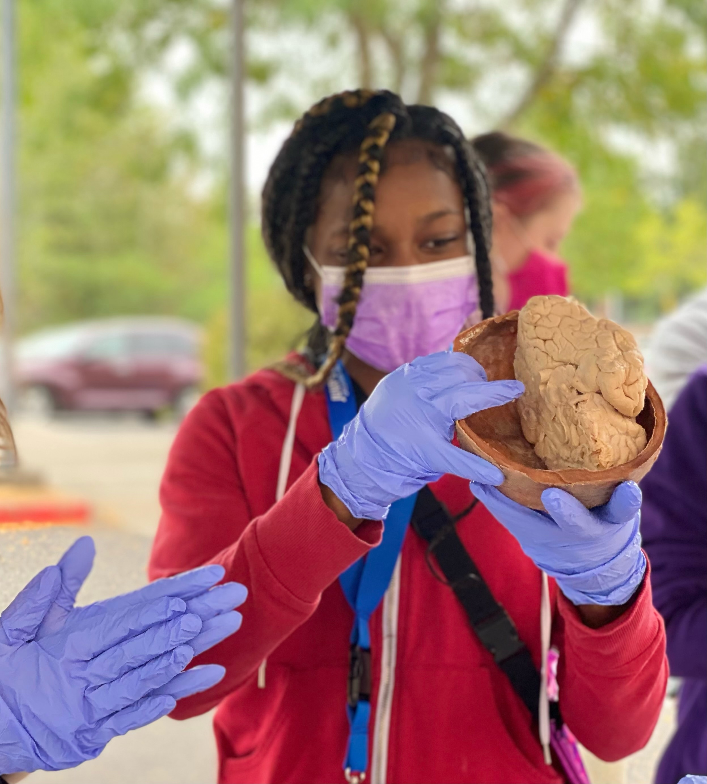
Letting Knowledge Serve through interdisciplinary neuroscience (& a few extra brains!)
NW Noggin
How do we inspire and learn from ALL students? How do we inspire and learn from our ALL in our community?
Northwest Noggin (nwnoggin.org) : community, neuroscience and art

Slide 2
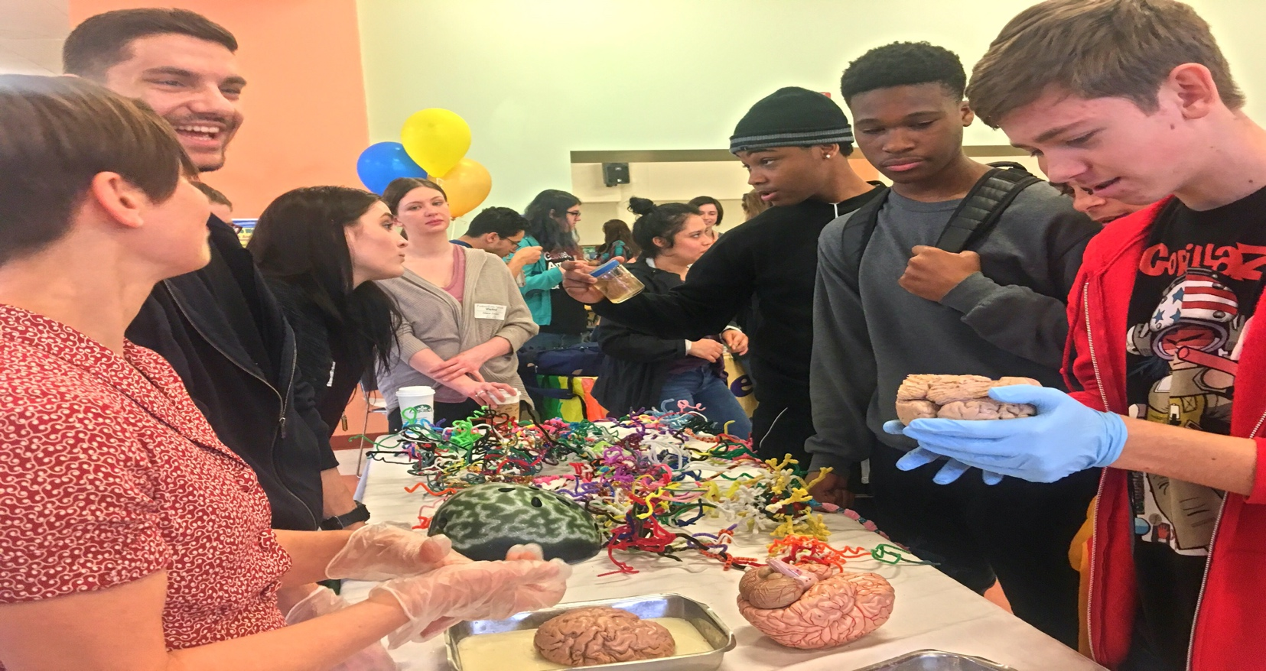
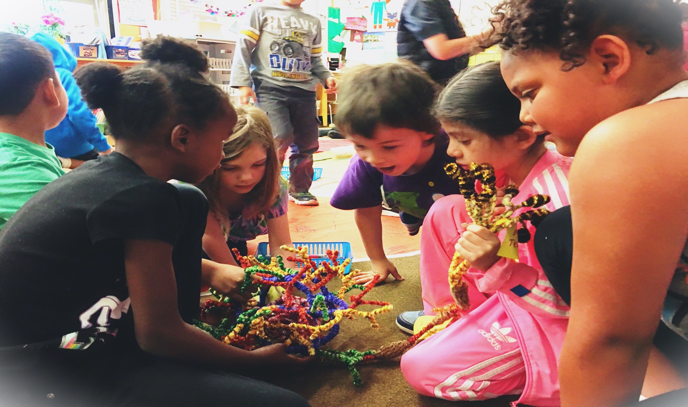
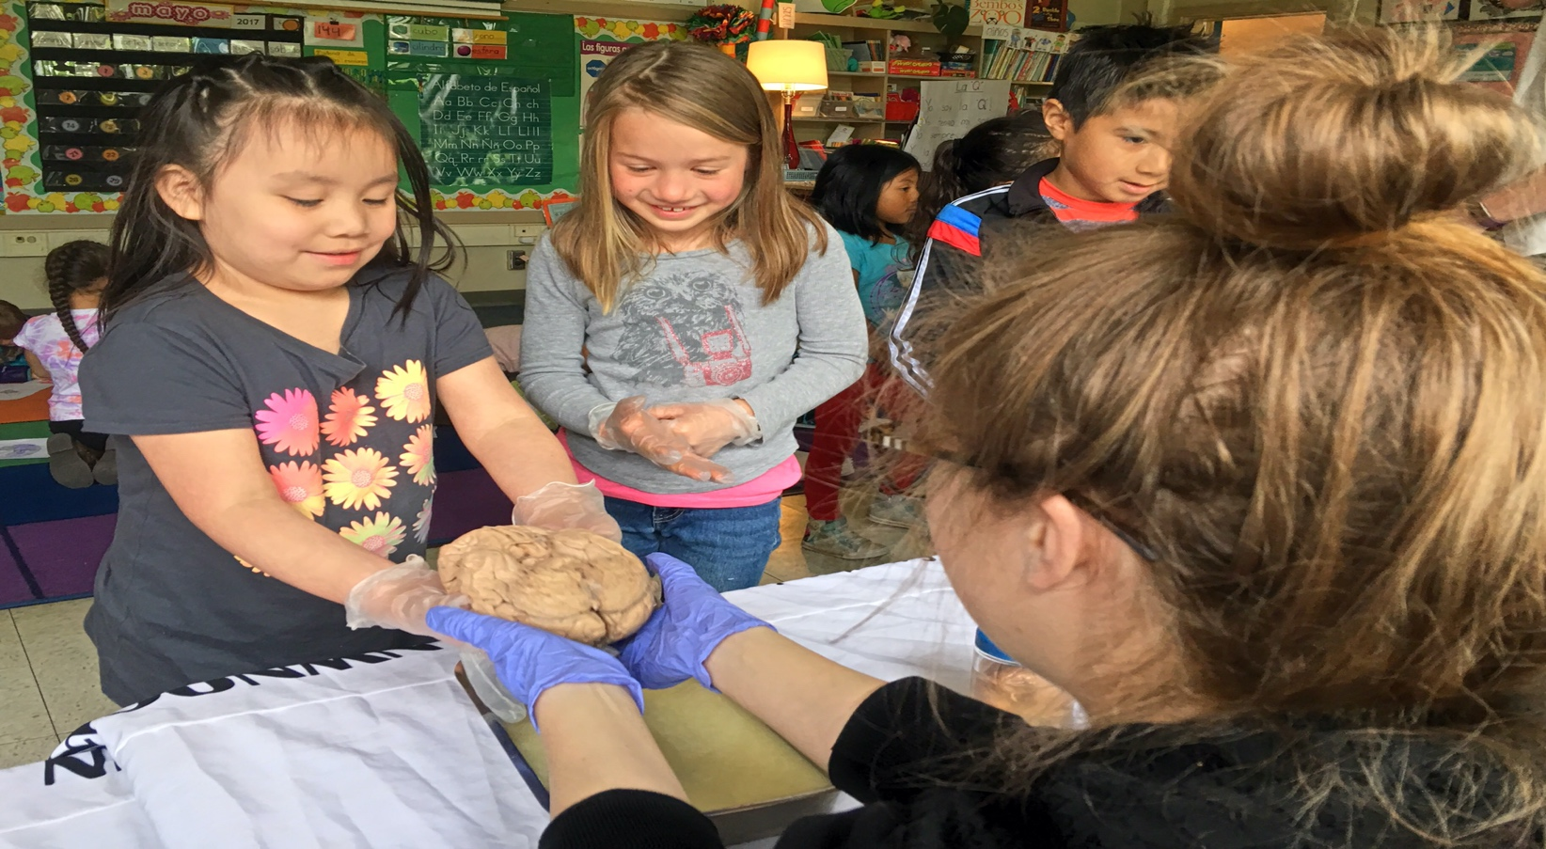
nwnoggin.org
Arts integrated neuroscience outreach for K-12 & community
TEN YEARS!
ALL VOLUNTEER (everyone)
50,000+ community members

Slide 3
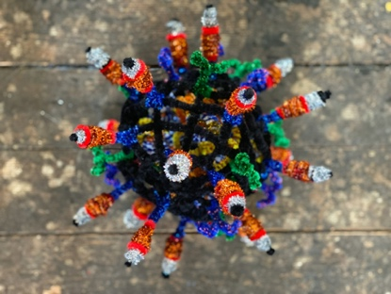
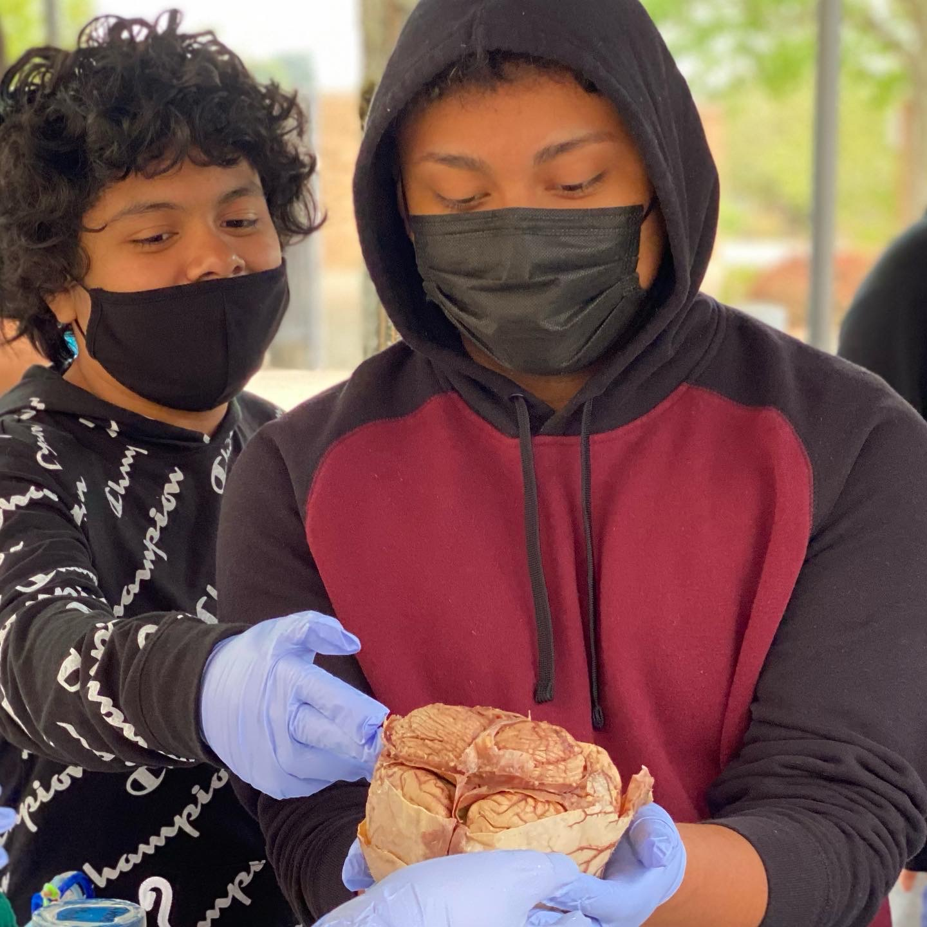
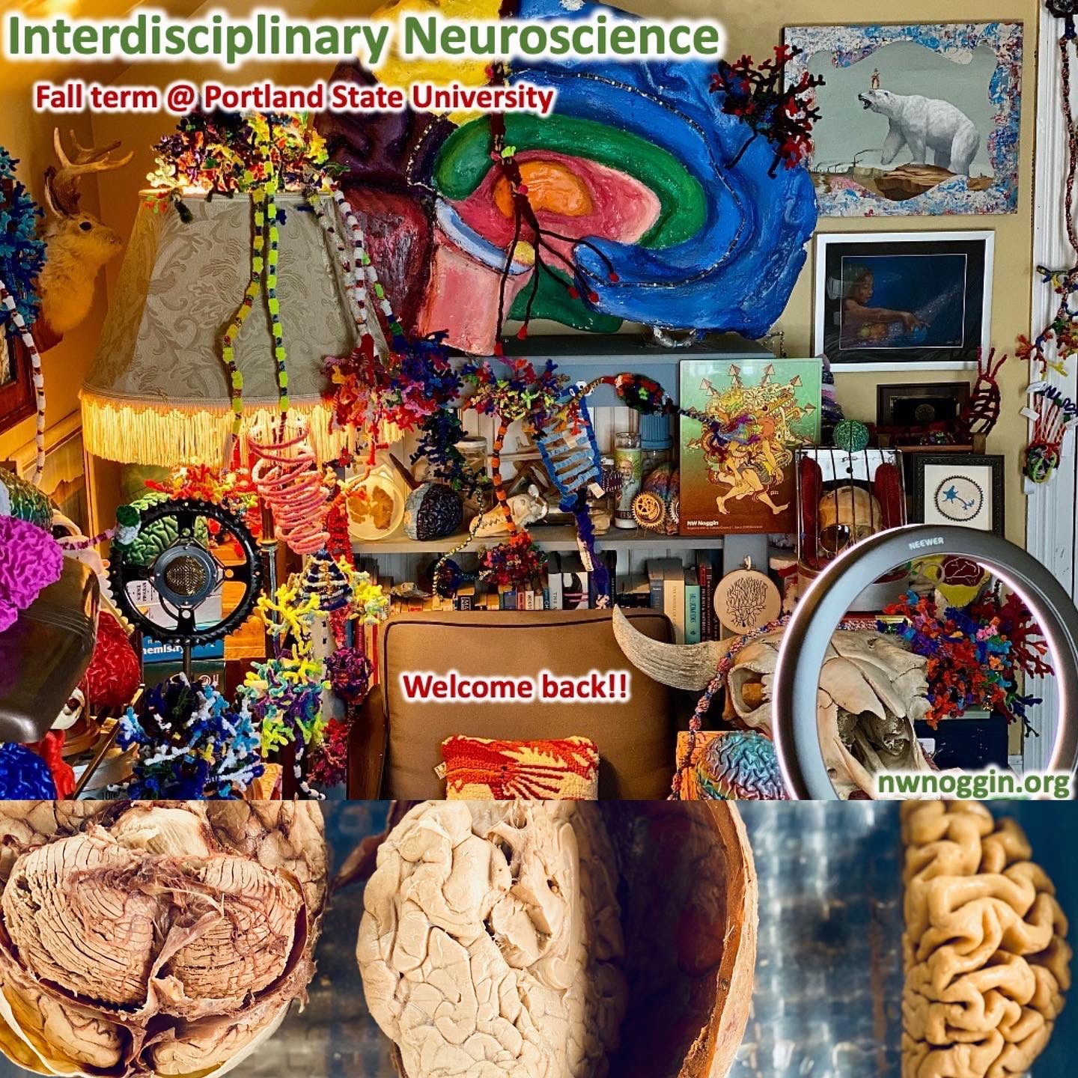
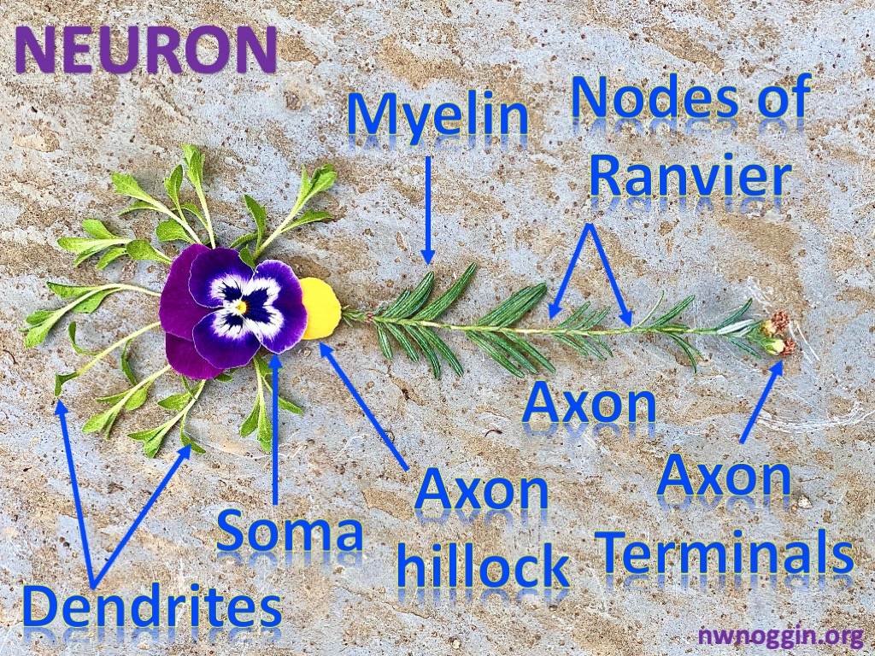
Art & Brains!
nwnoggin.org

Slide 4
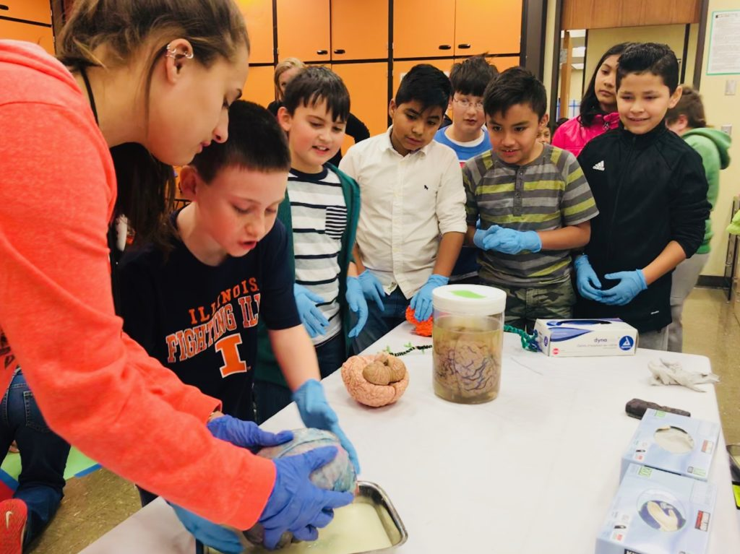
What you do has relevance
GO PLACES
Sleep
Anxiety
Depression
ADHD
Autism
Development
Perception
Drugs
Memory
Language
Racial Bias
…

Slide 5
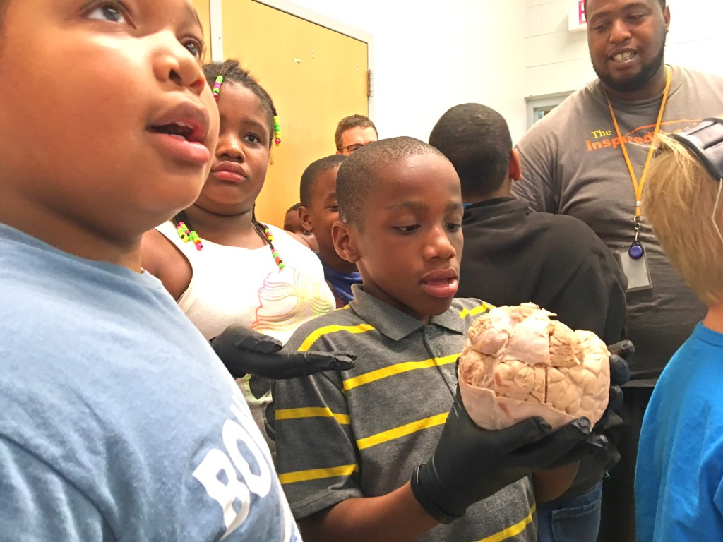
We all pay for research

Slide 6
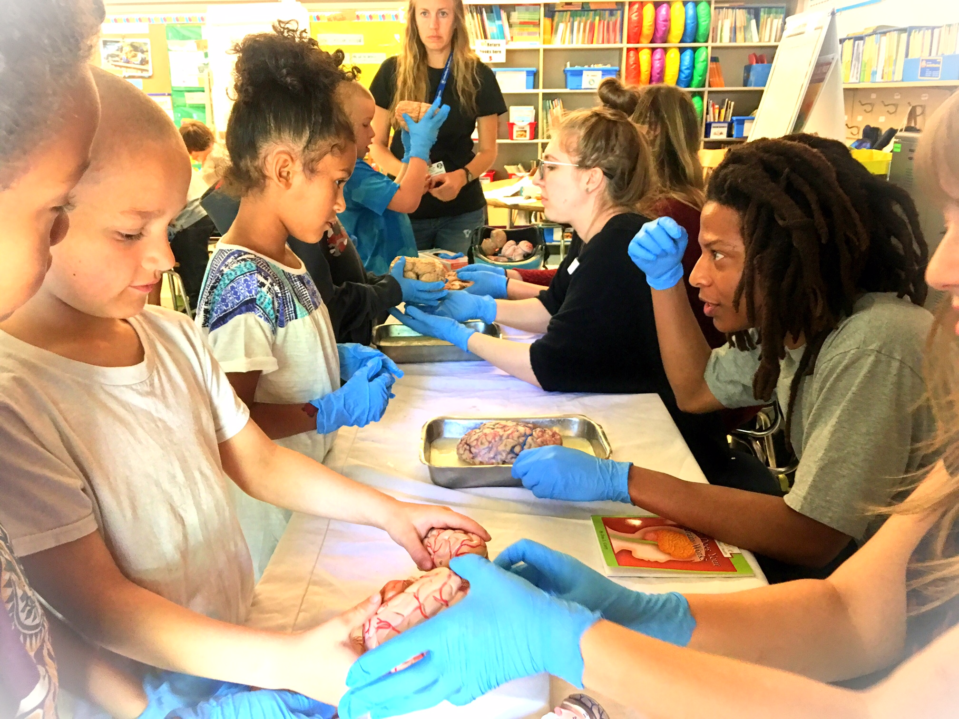
Connections matter
Greater understanding
More support for research
Increased participation
Less confirmation bias
New directions
FUN!

Slide 7
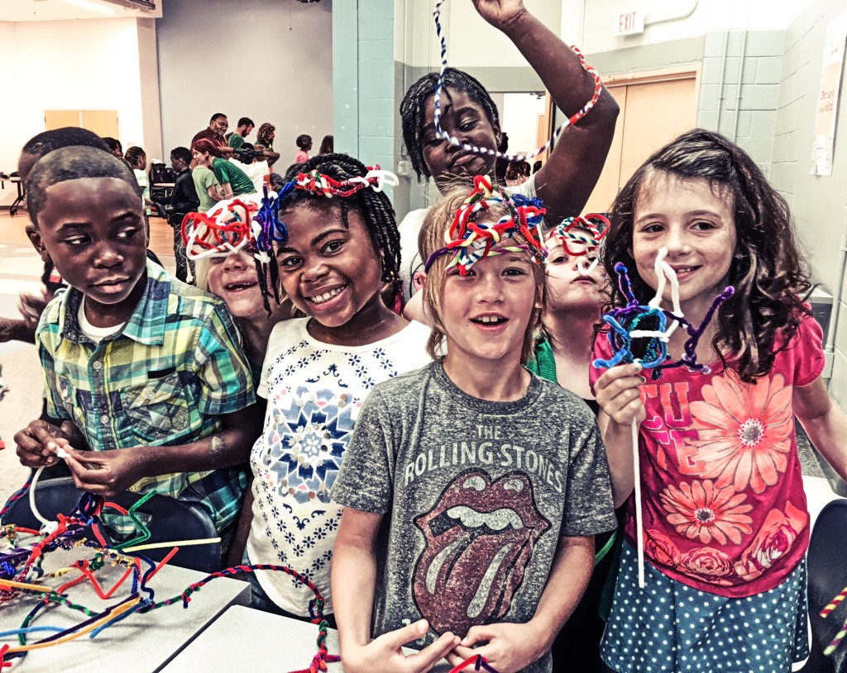
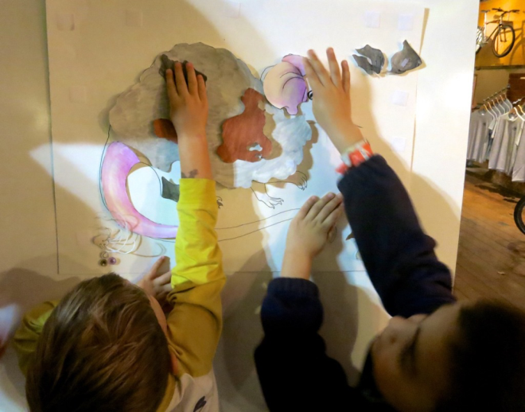
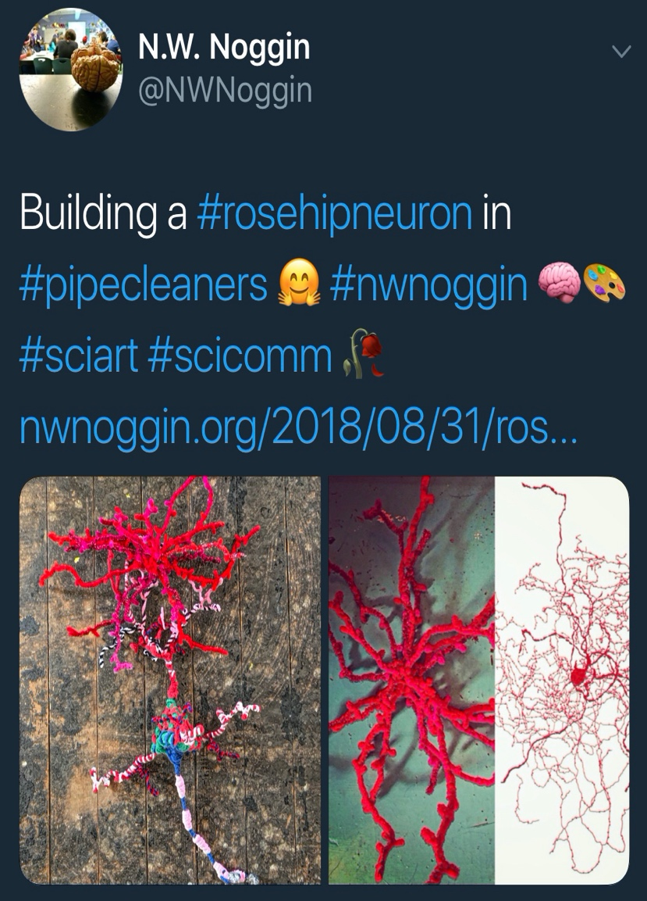
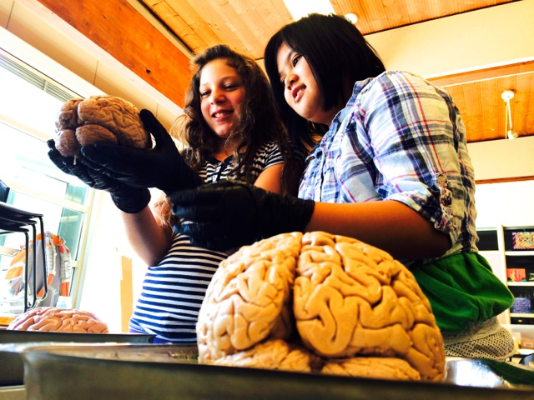
Why art & brains..?
Motivation, engagement, empathy
Exploration, creativity, INNOVATION
Personal relevance of STEAM material
Build your own mouse line!

Slide 8
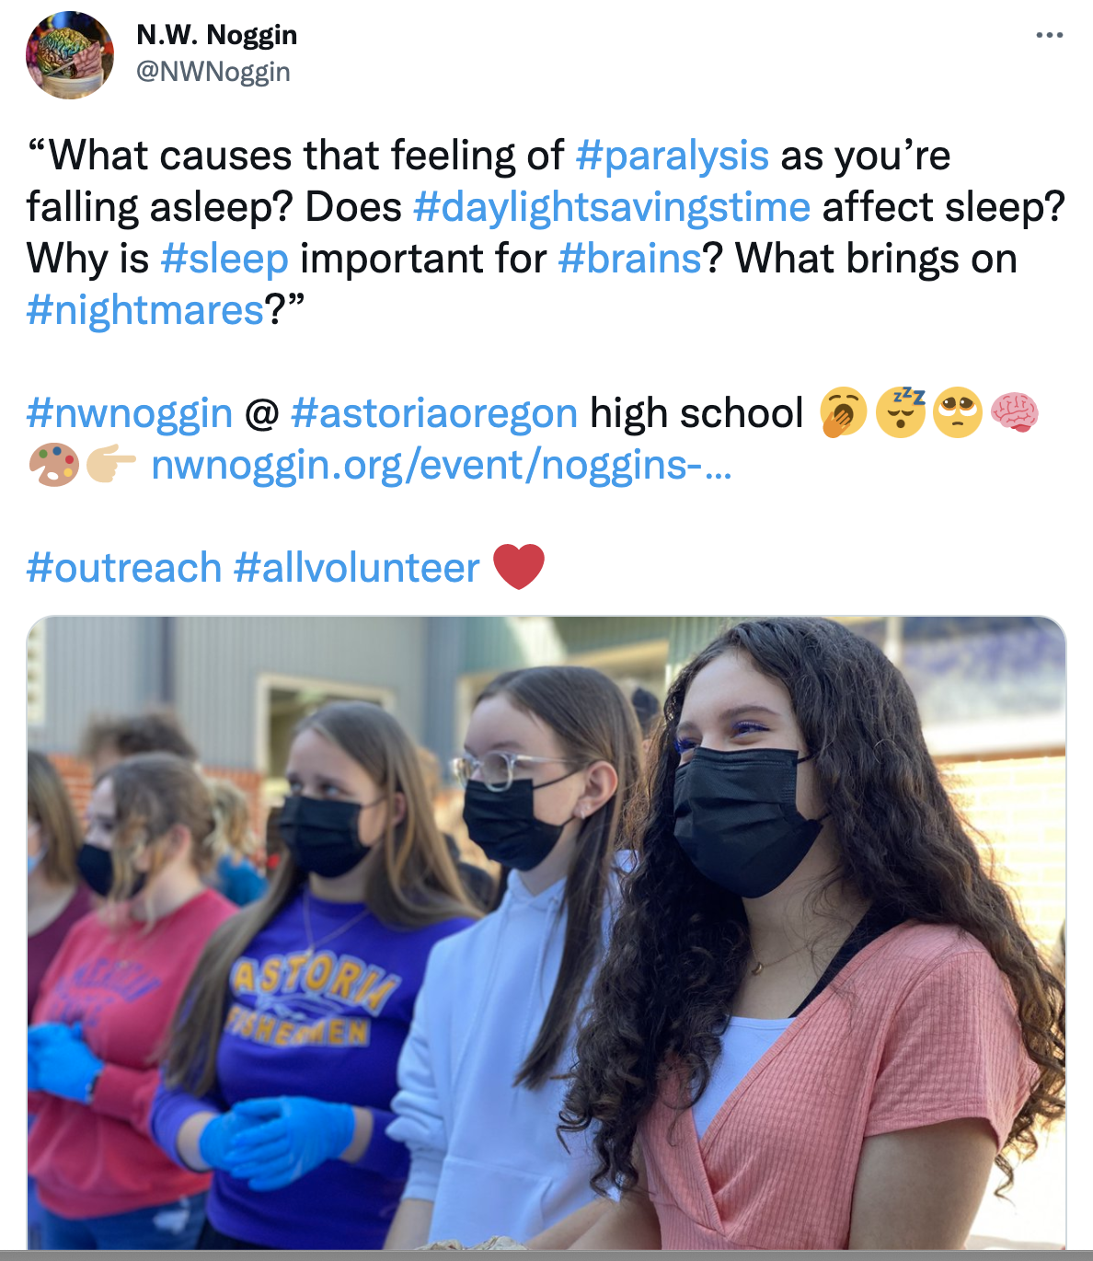
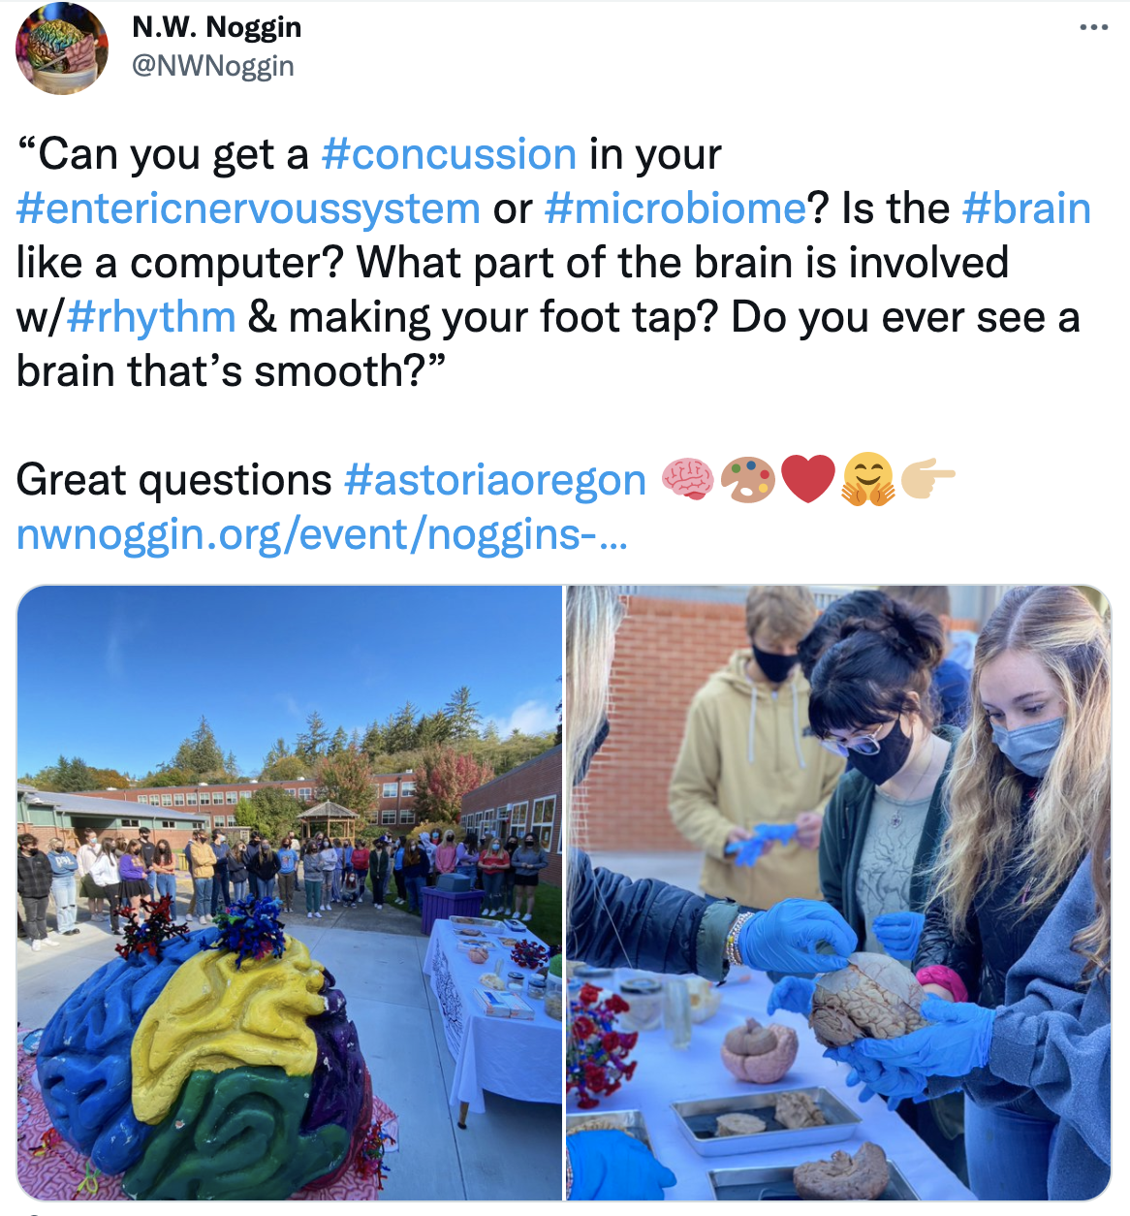
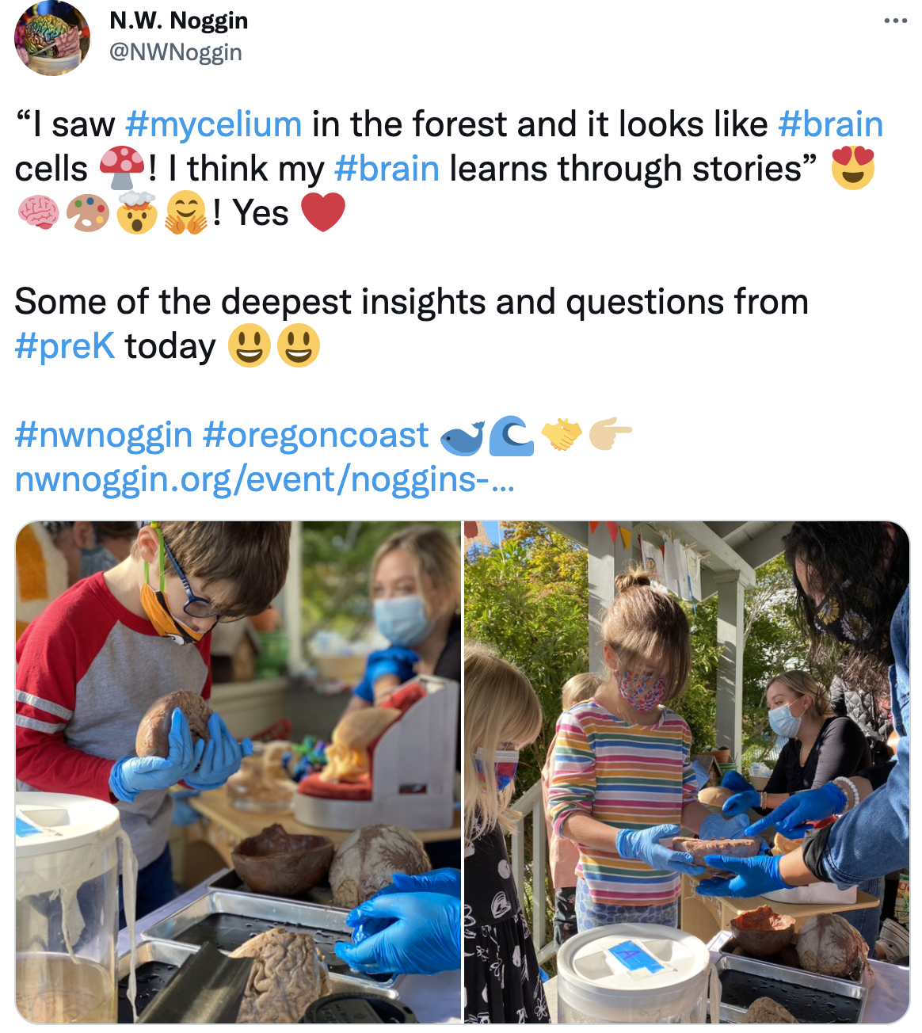
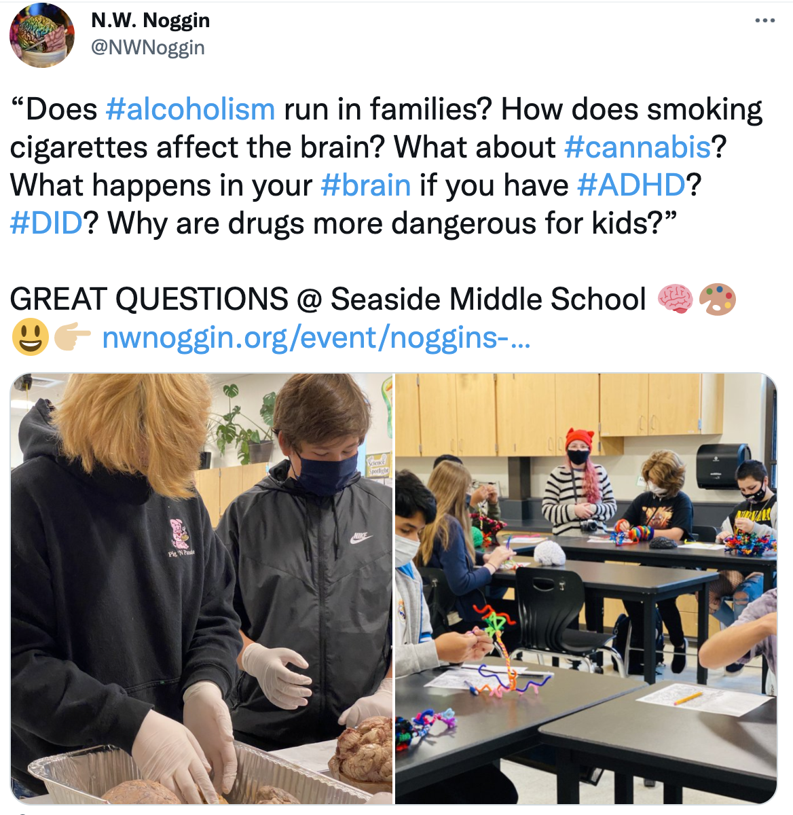

Slide 9
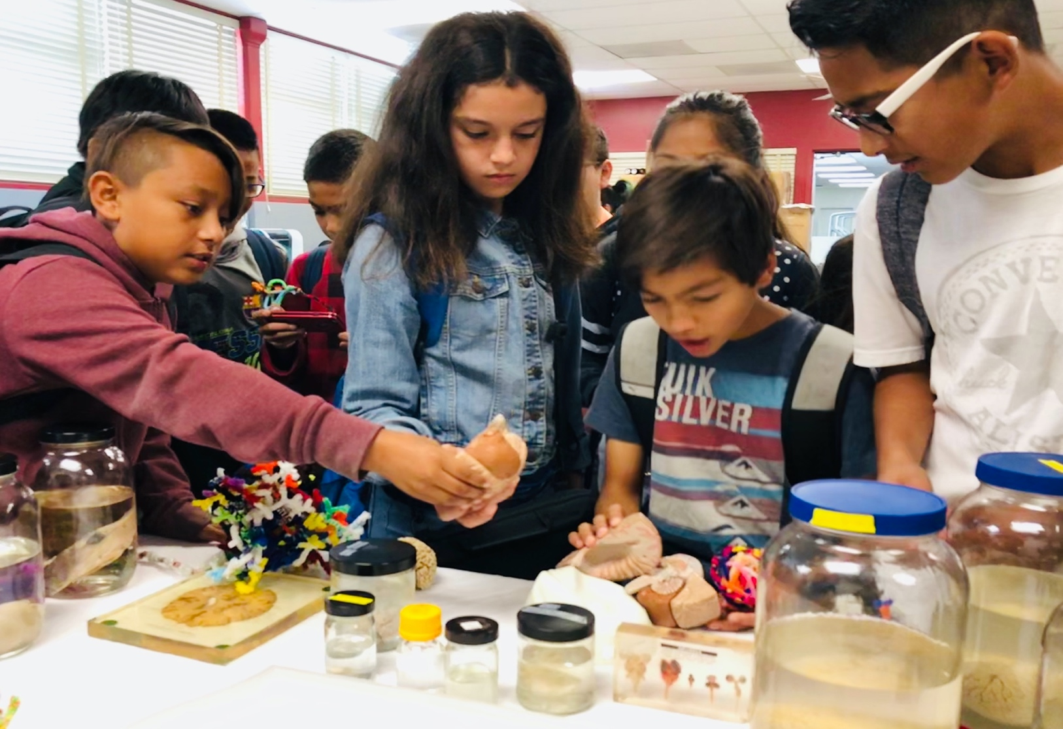
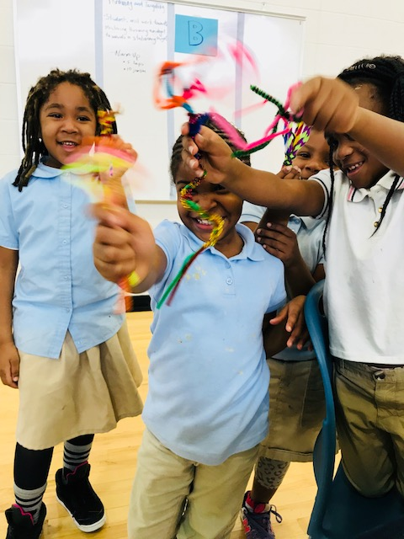
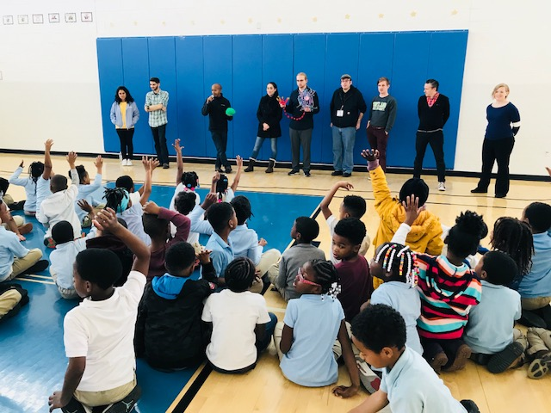
School visits
Turner Elementary, DC
Public outreach and connection

Slide 10
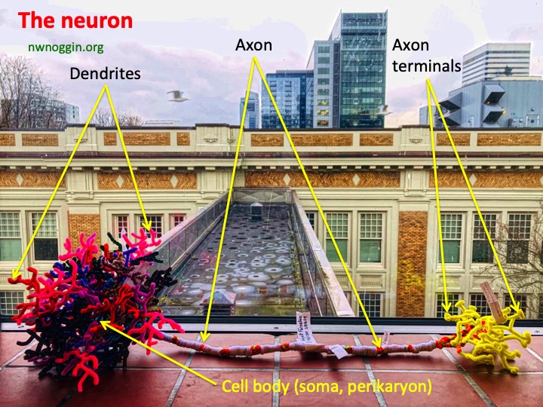
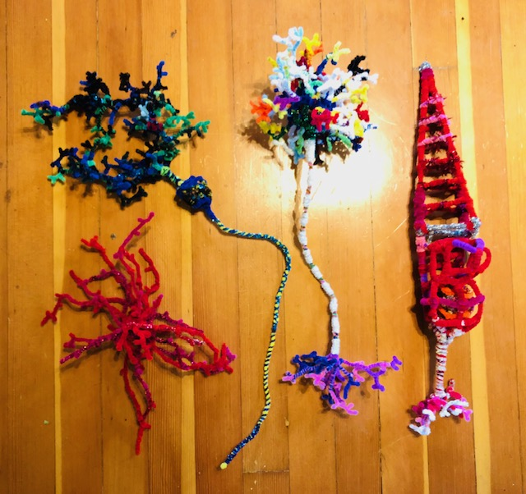
Pipe cleaner brain cells!
MAKE YOUR OWN: Details @ nwnoggin.org

Slide 11
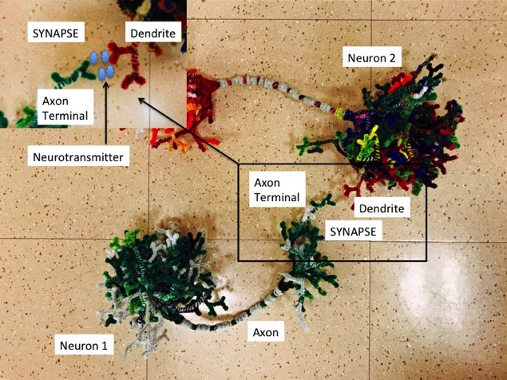
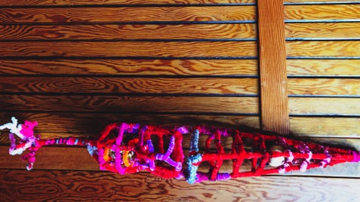
MAKE CONNECTIONS
MAKE ART

Slide 12
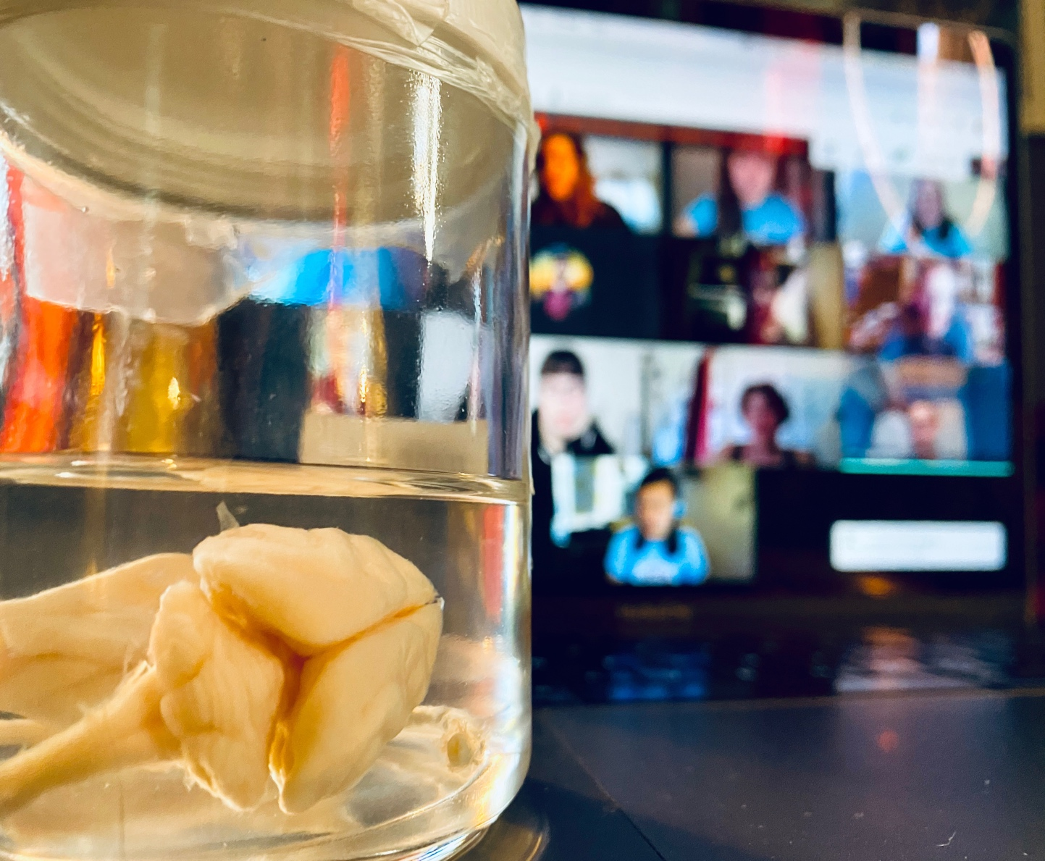
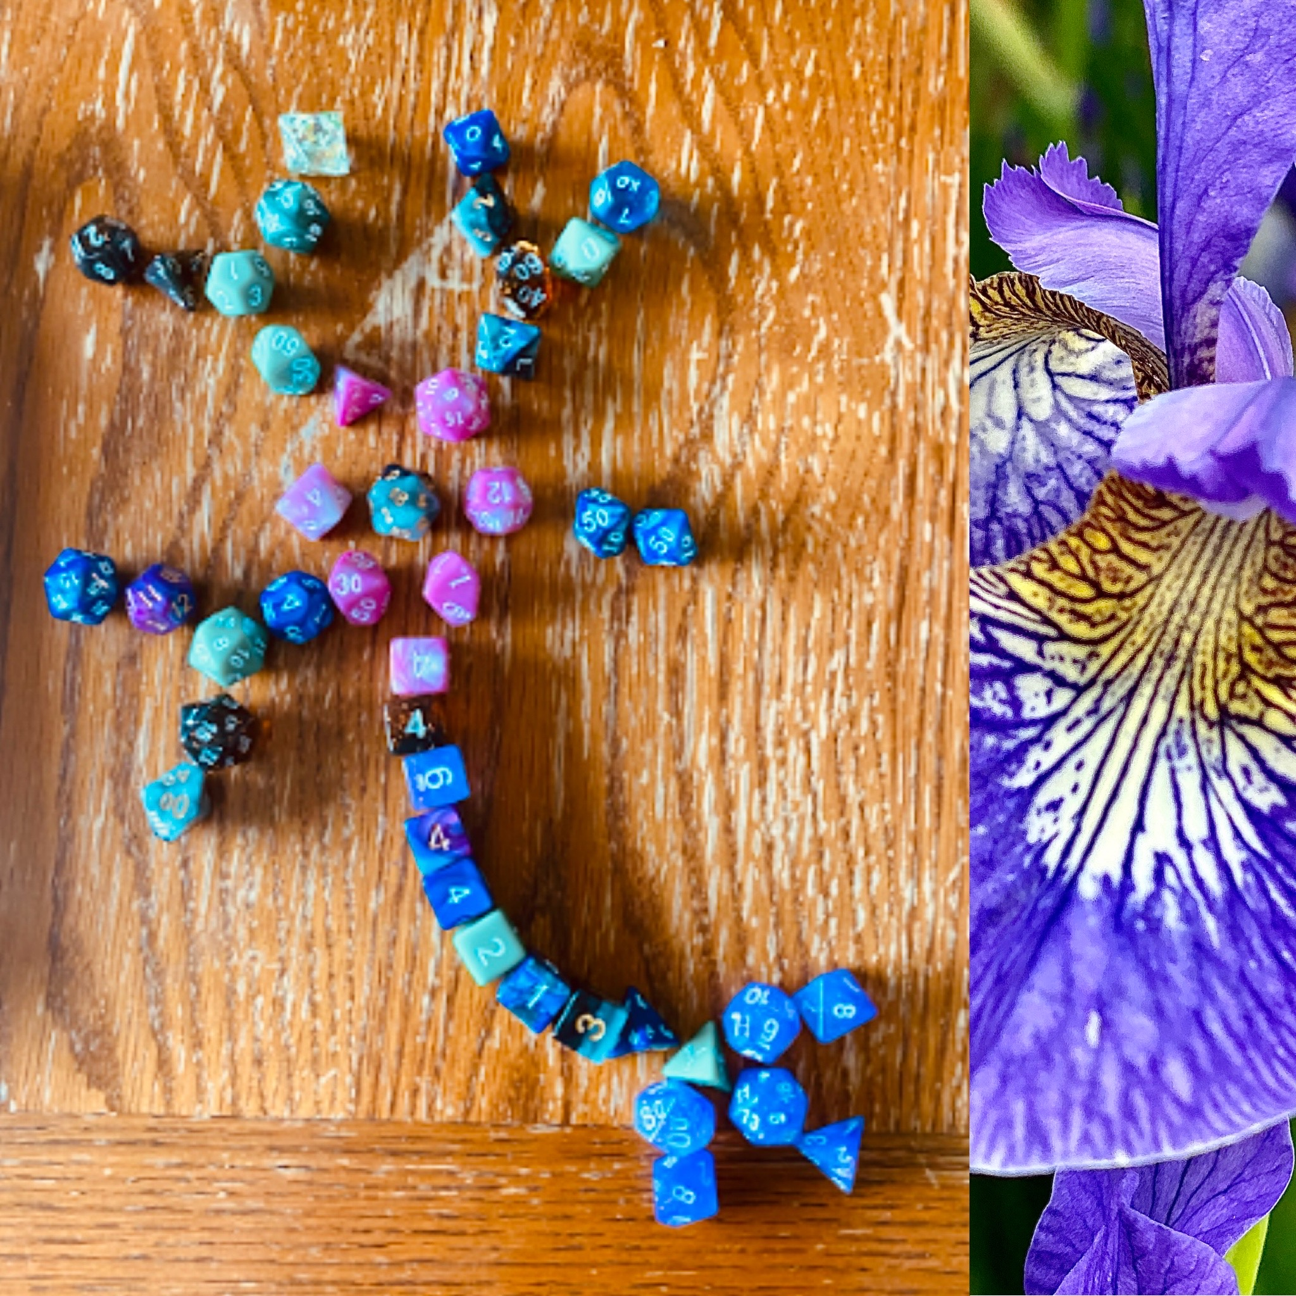
Public Schools
During COVID-19
#showusyourbraincell

Slide 13
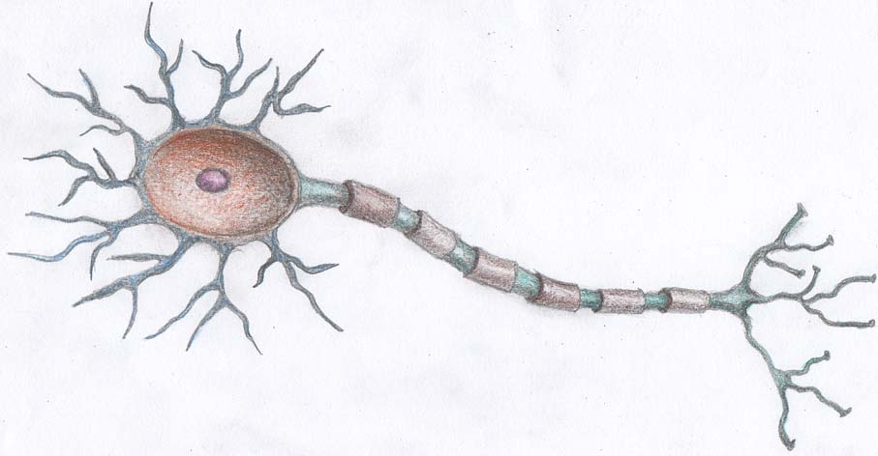
Neurons are a type of brain cell
The majority of neurons share some basic features
Dendrites
(Receive input from other neurons at gaps called synapses)
Axon (Carries electric message)
Cell Body
(or Soma, location of nucleus and cell DNA)
Found Object Brain Cells
Axon Terminals (release of neurotransmitters)

Slide 14
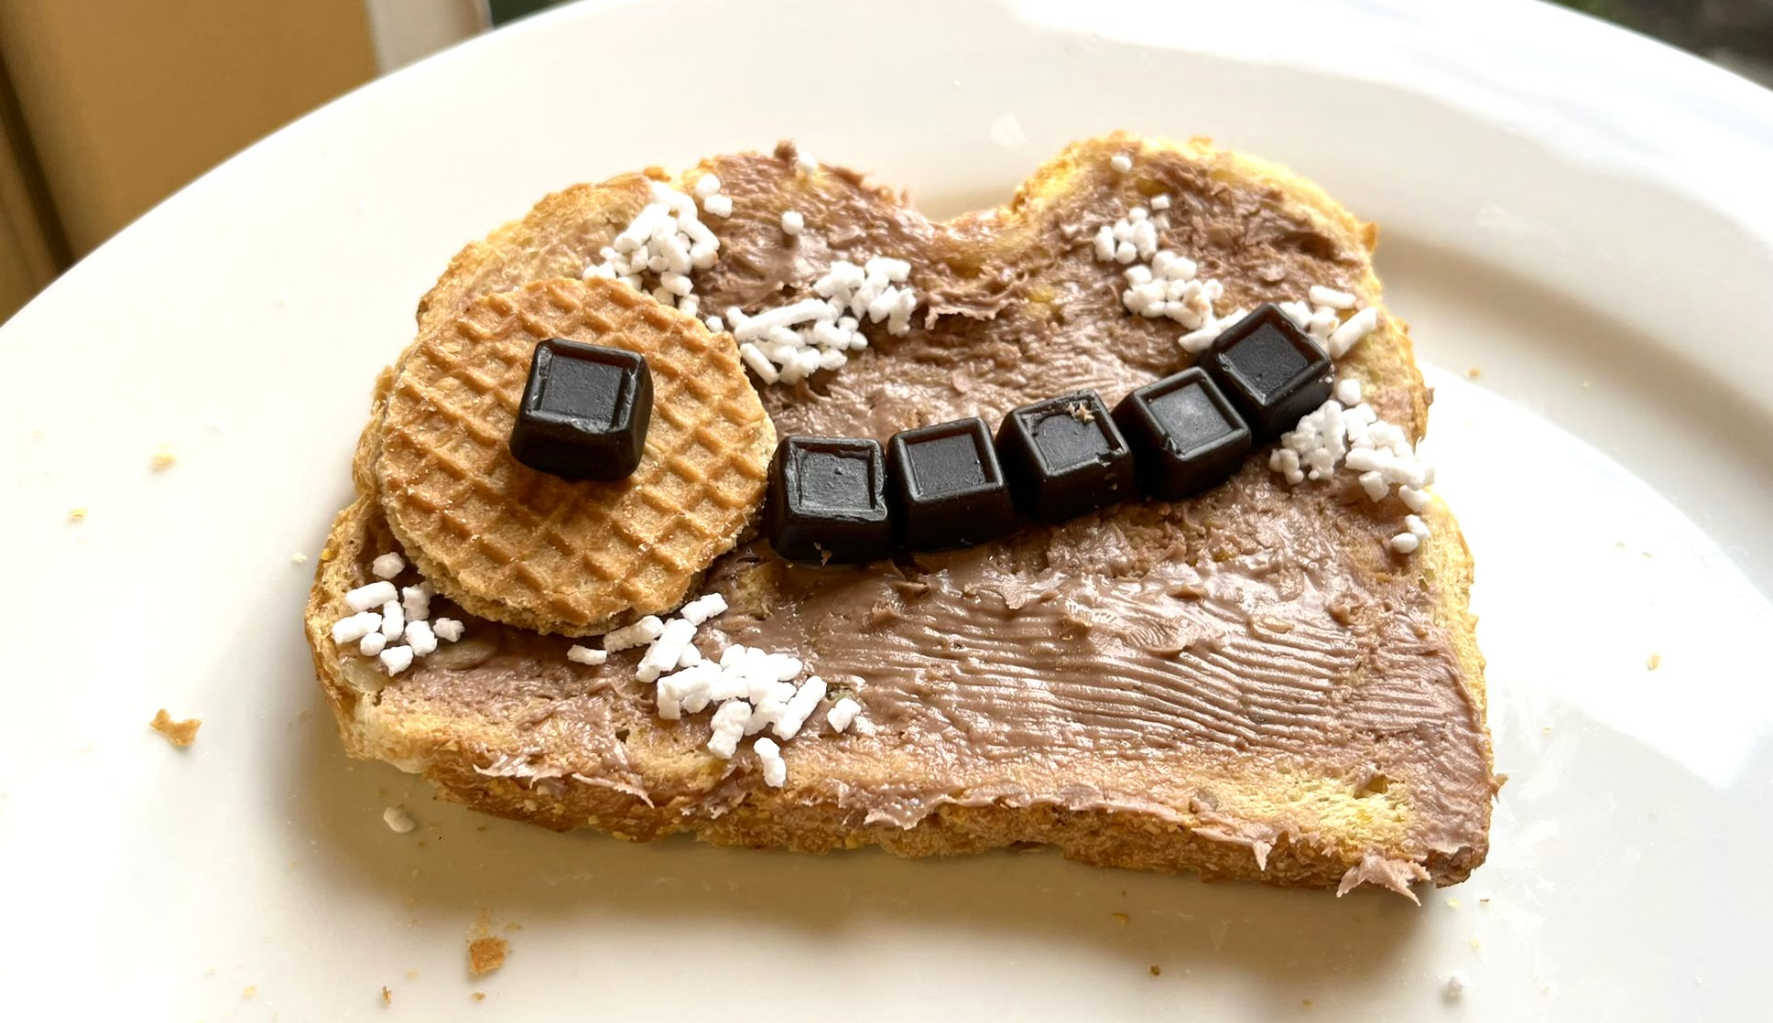
DUTCH NEURON
By Austin Howard
#showusyourbraincell
Hagelslag
AXON
TERMINALS
Stroopfwafel
SOMA
Drop
AXON
Hagelslag
DENDRITES
nwnoggin.org

Slide 15
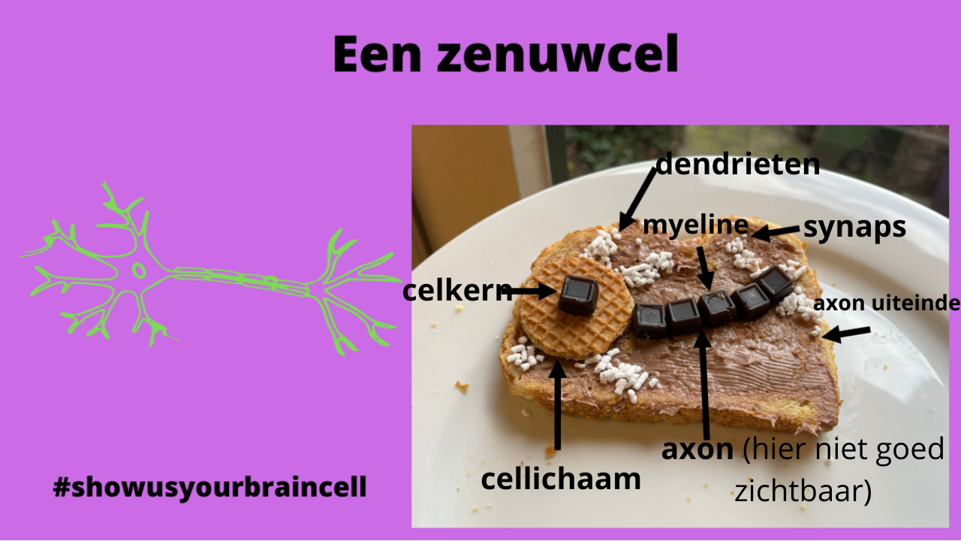
DUTCH NEURON
By Austin Howard

Slide 16
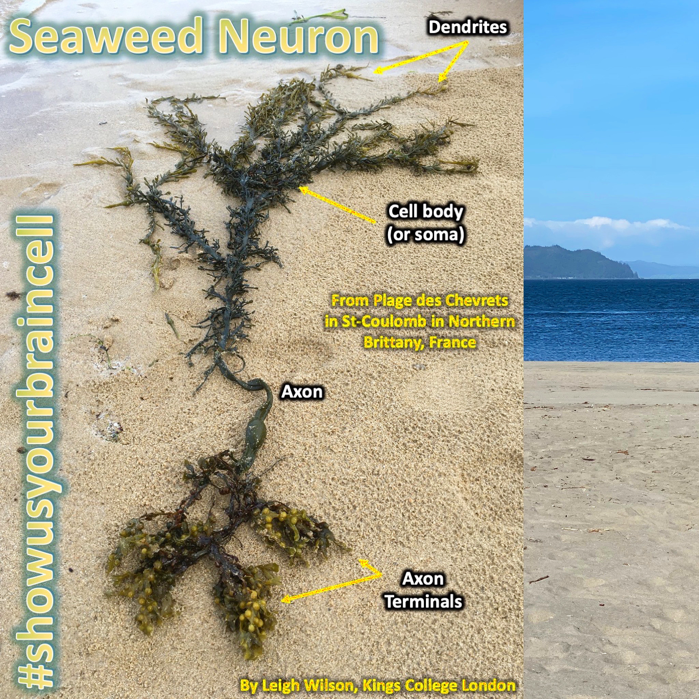
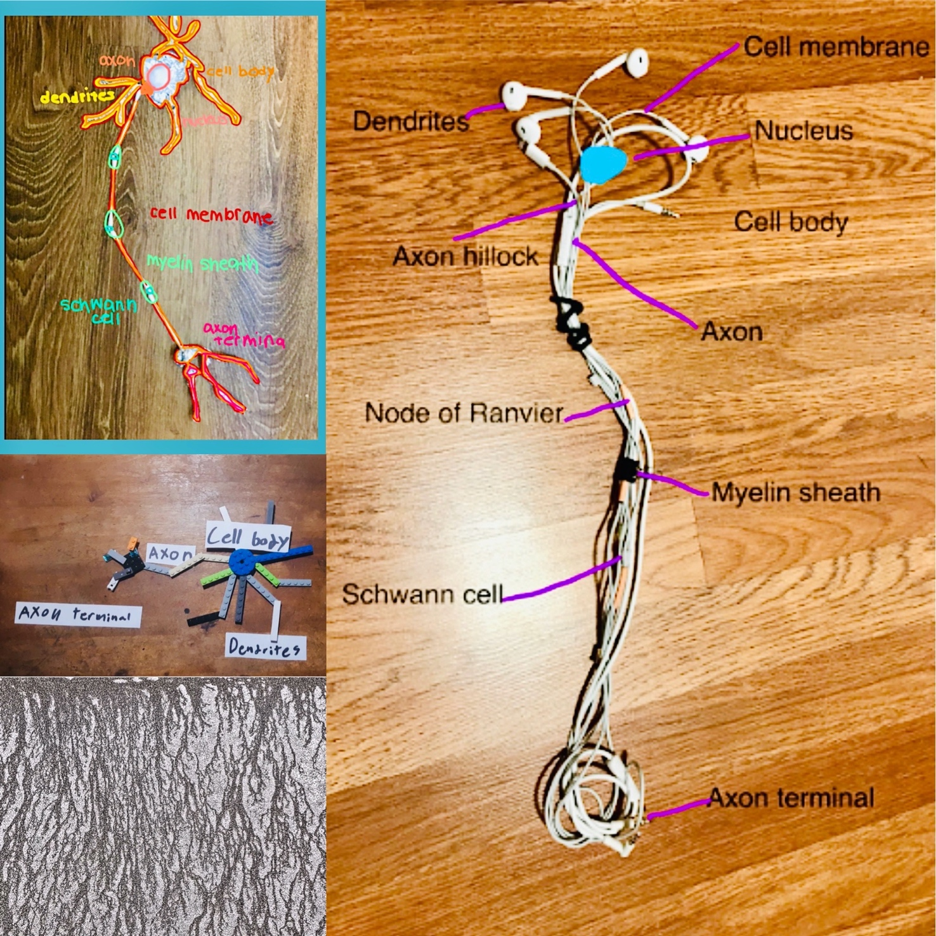
#showusyourbraincell

Slide 17
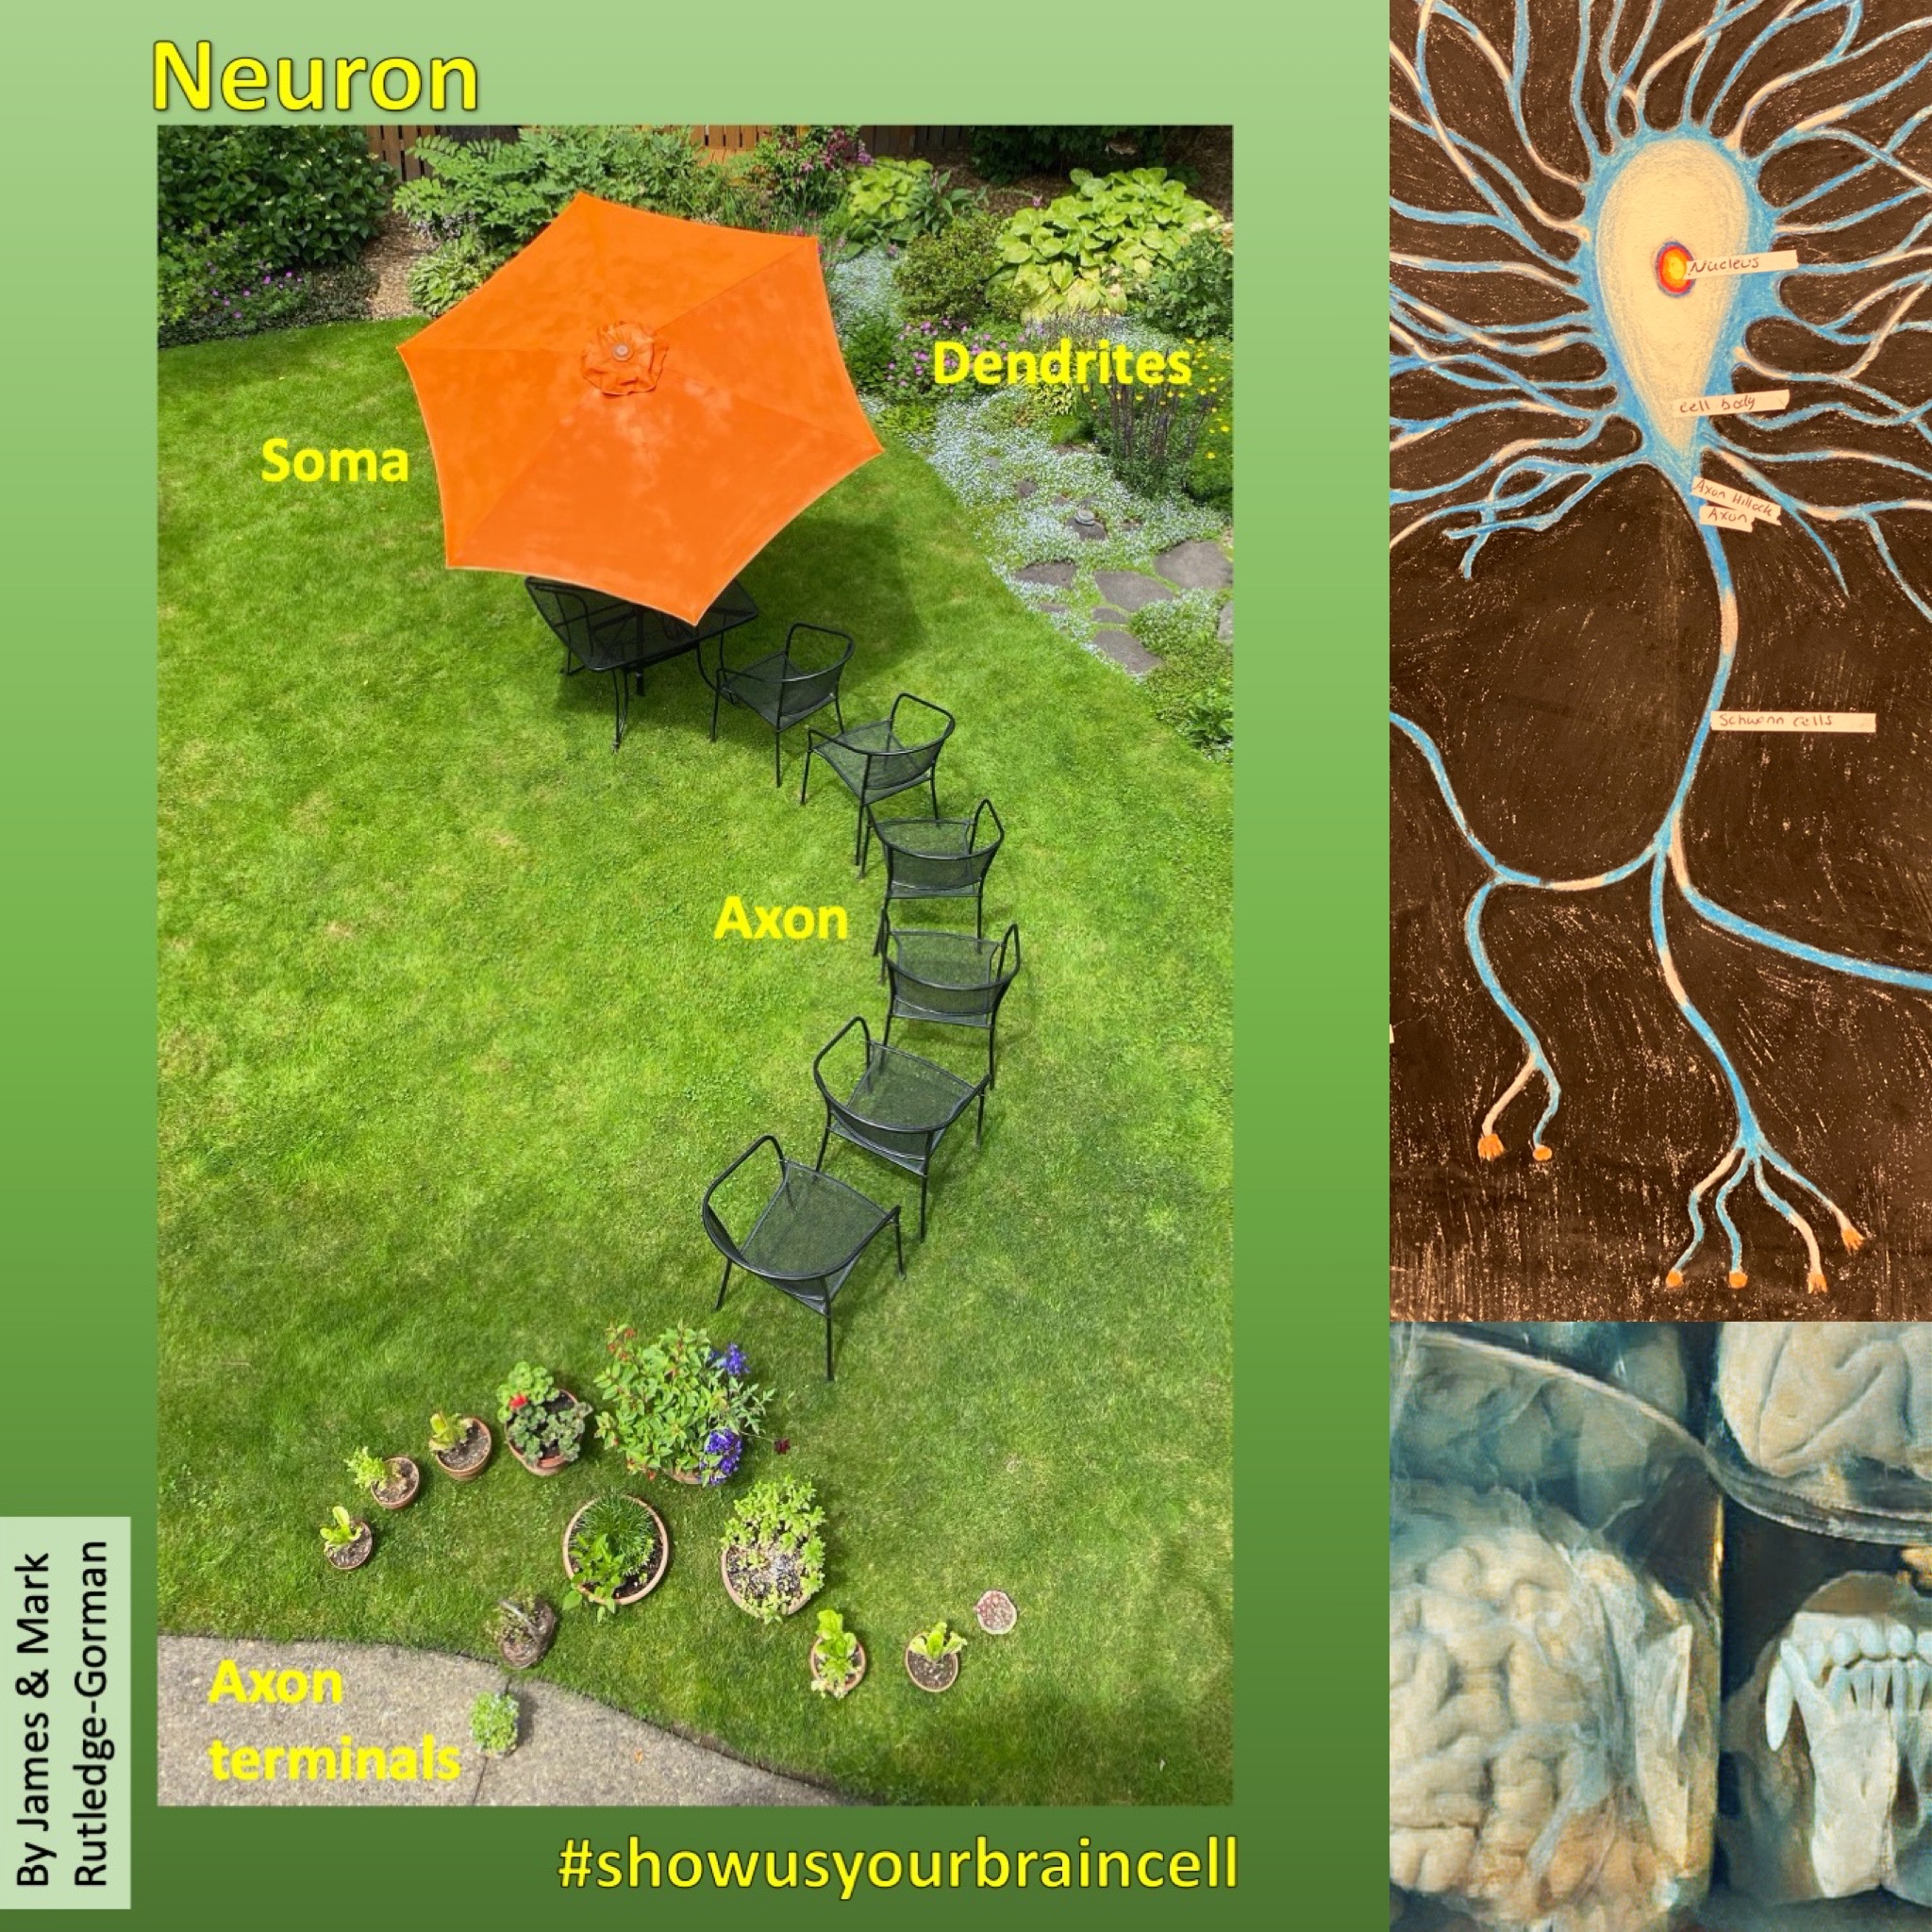
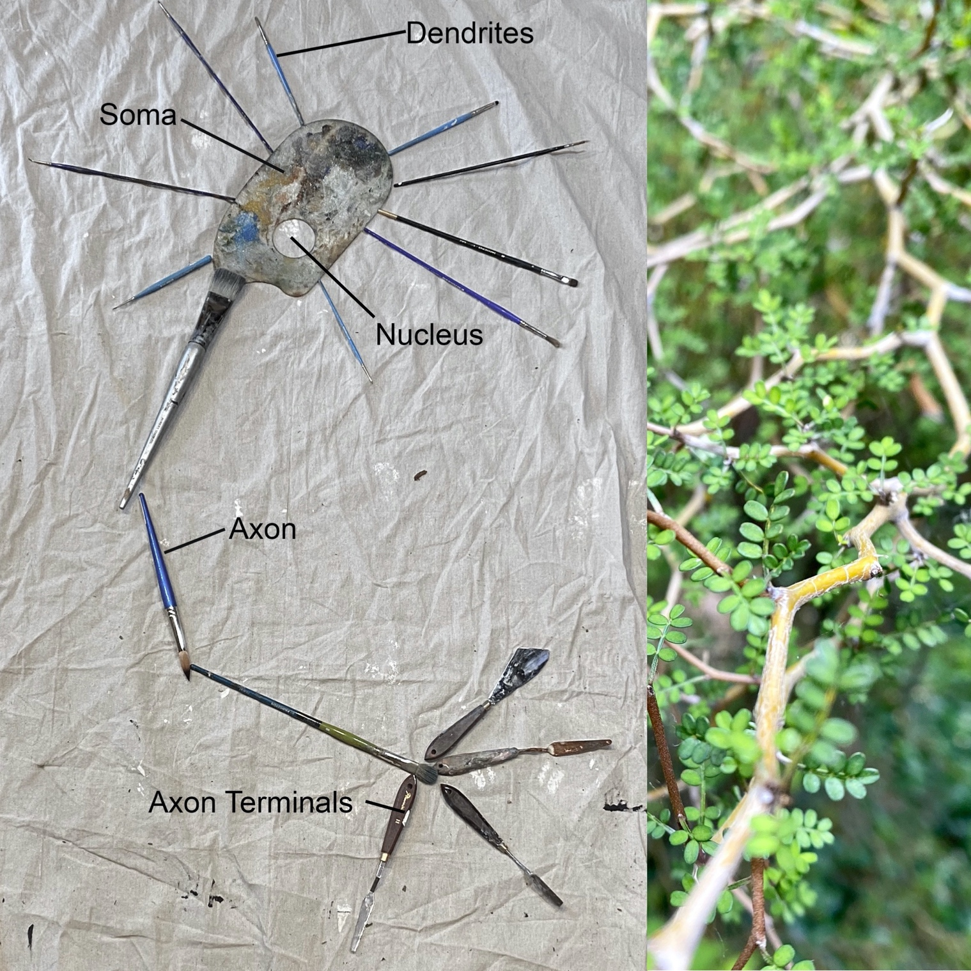
#showusyourbraincell

Slide 18
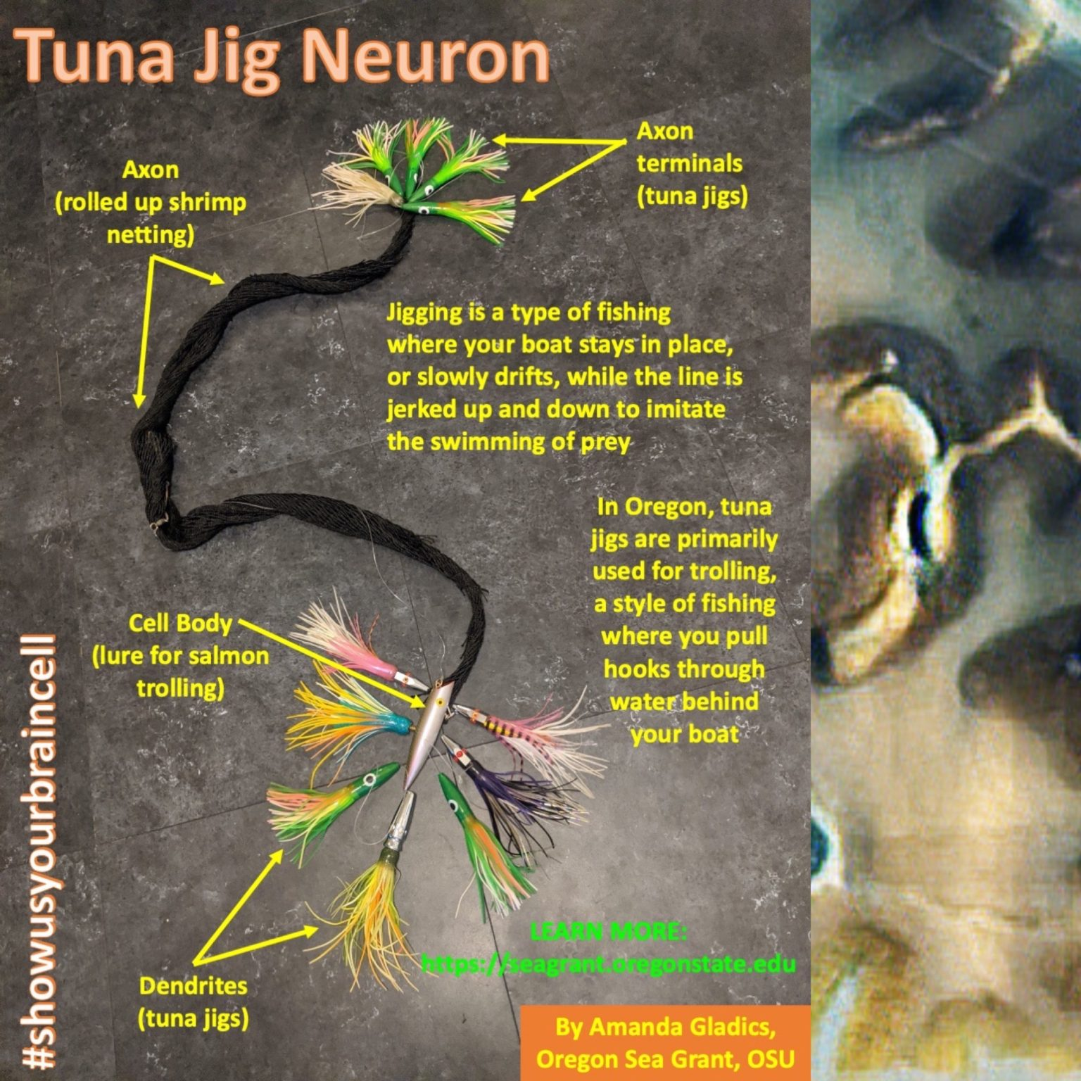
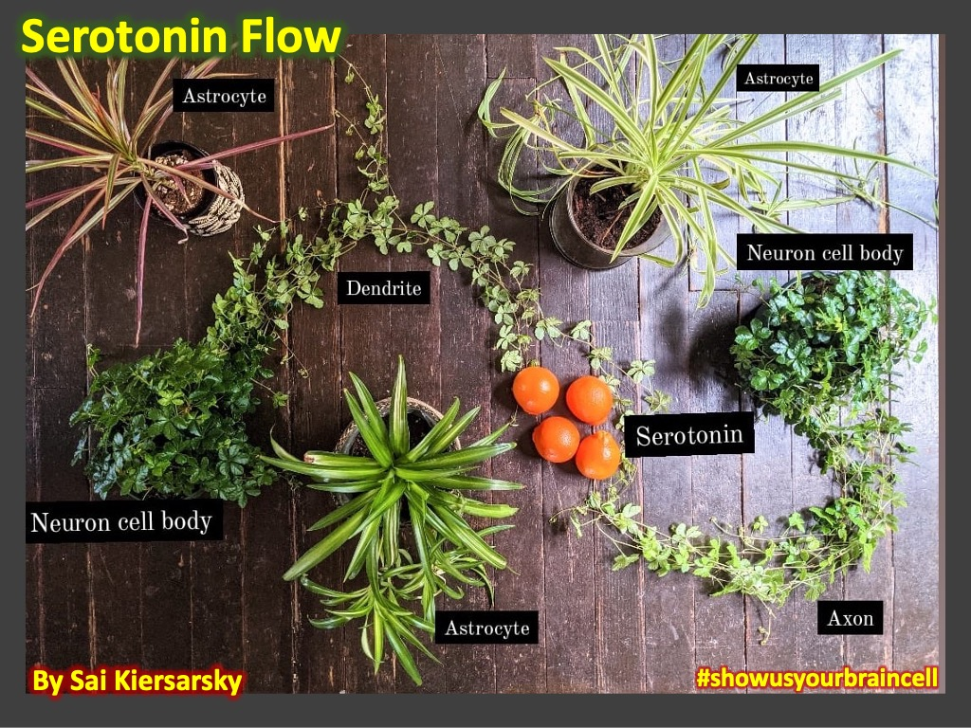
#showusyourbraincell

Slide 19
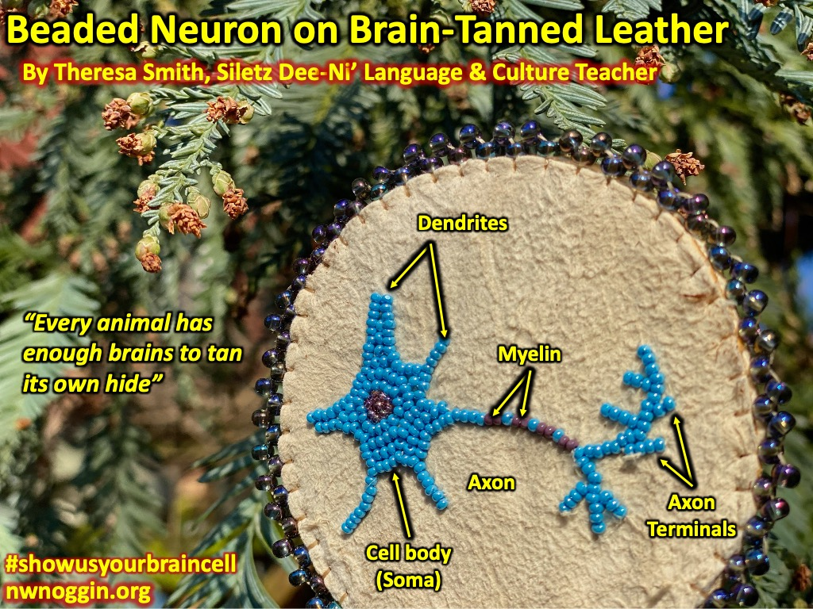
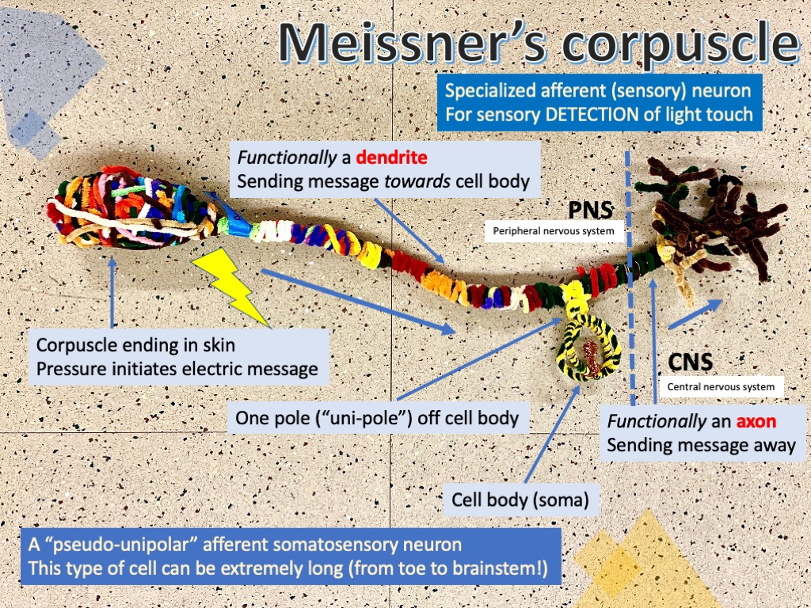
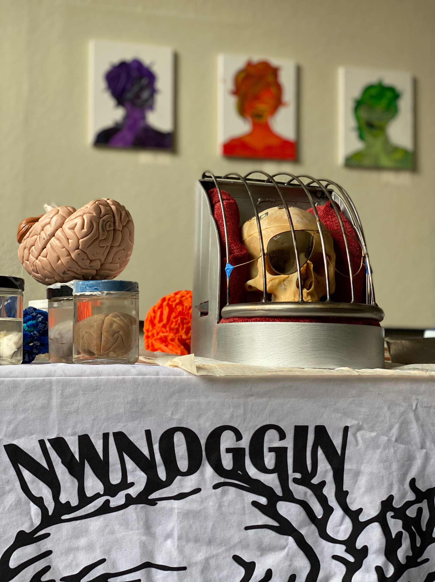
ANY BRAIN CELLS
Glial cells
Pyramidal neurons
Photoreceptors
Inner hair cells
Nociceptors
Rhombic lip neurons
Meissner’s corpuscles
#showusyourbraincell

Slide 20
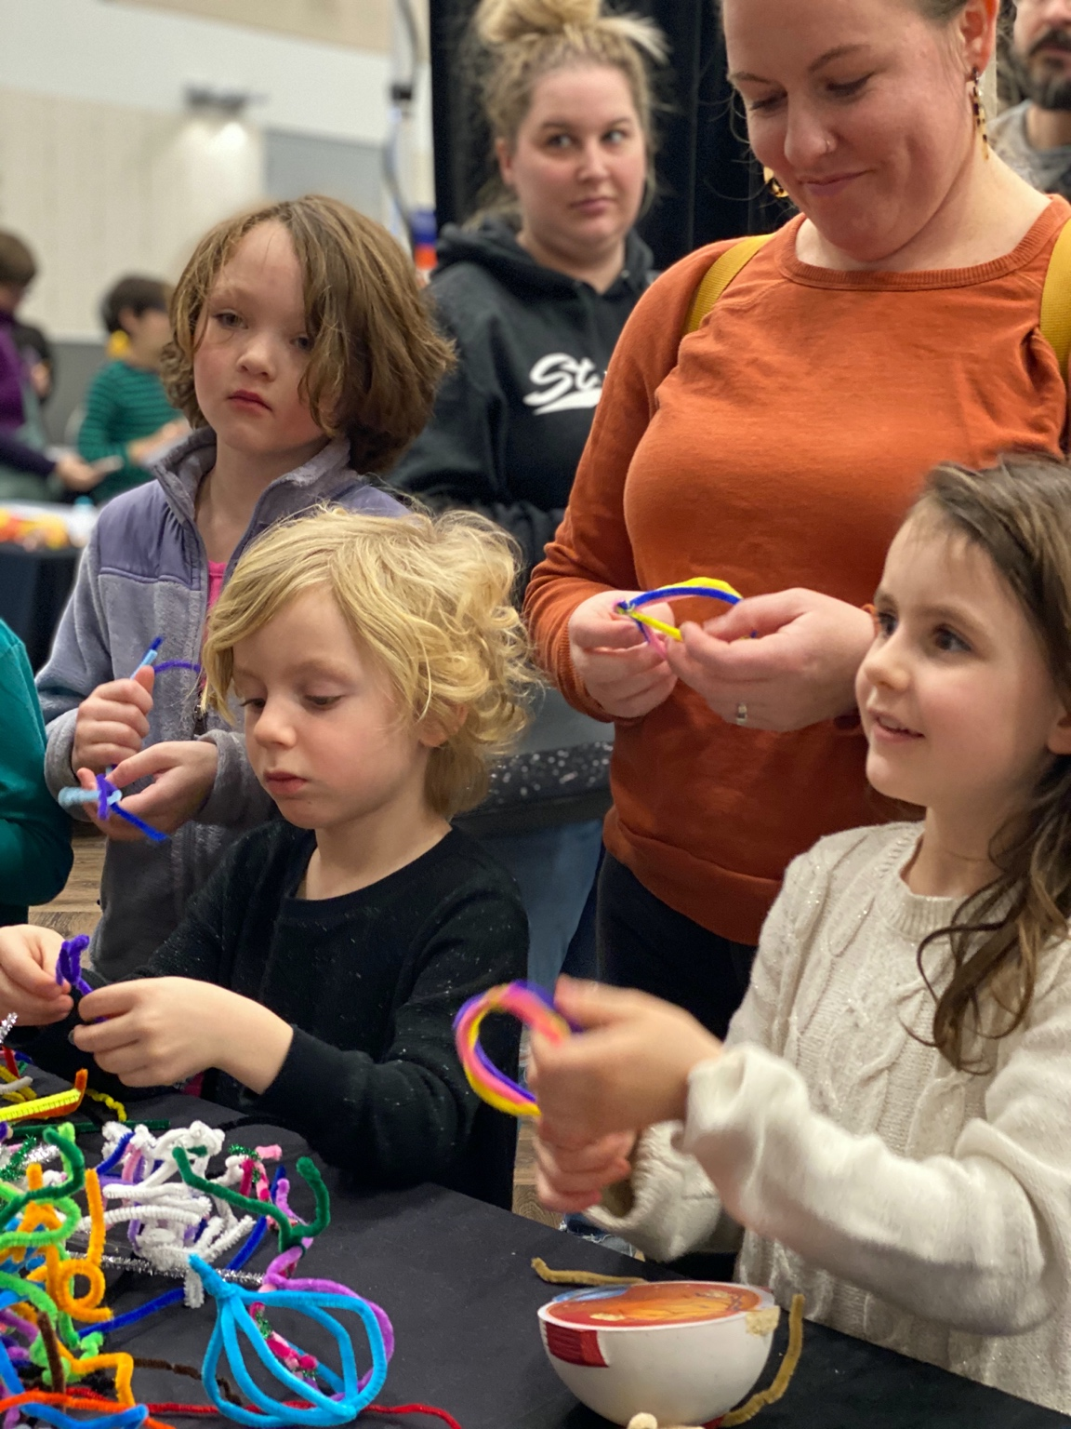
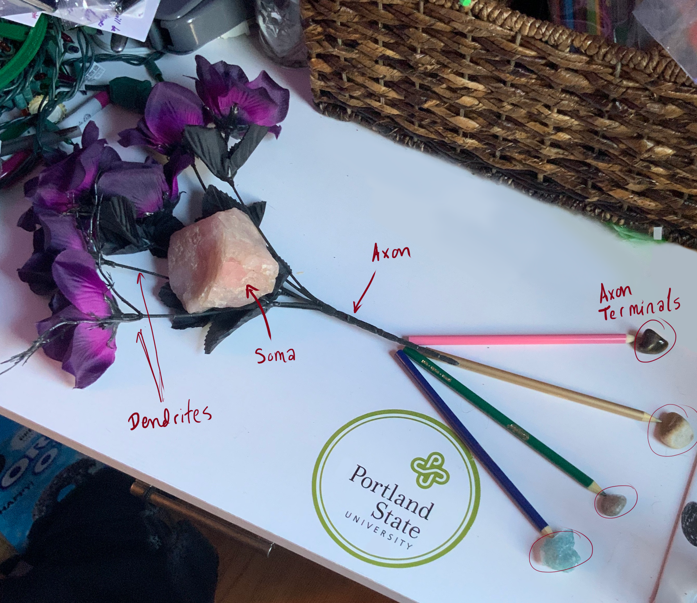
#showusyourbraincell

Slide 21
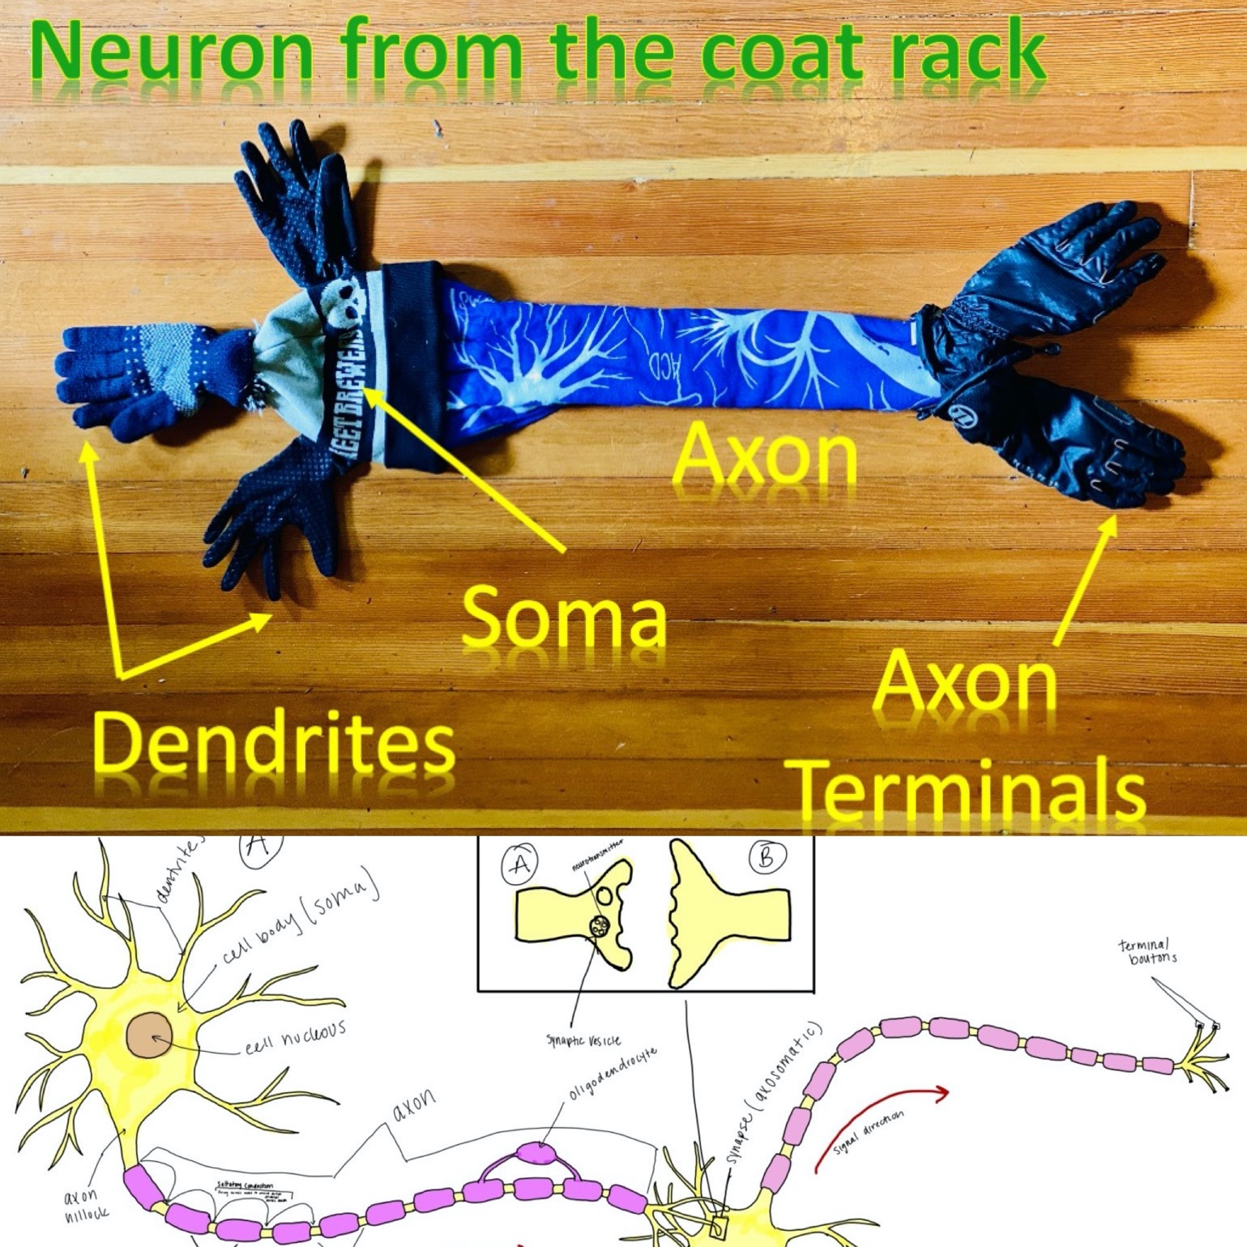
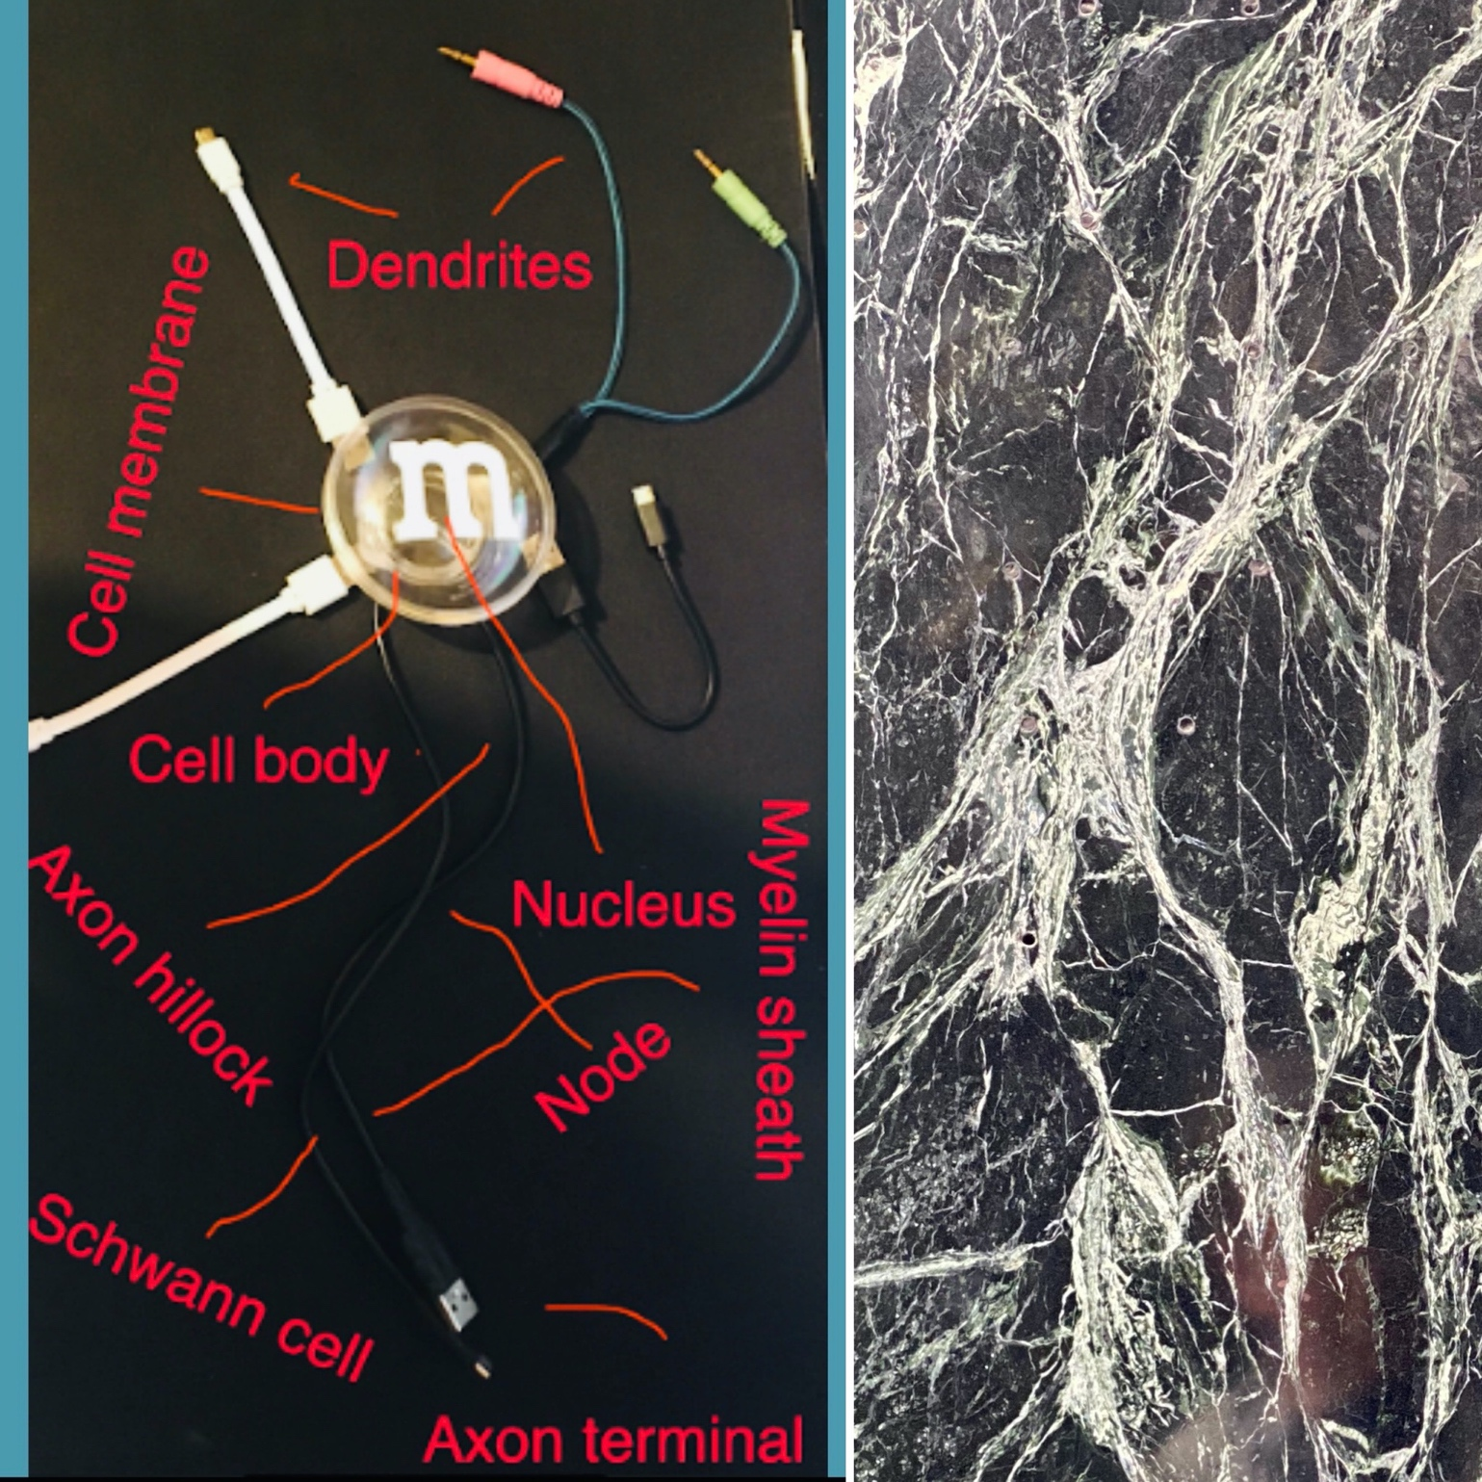
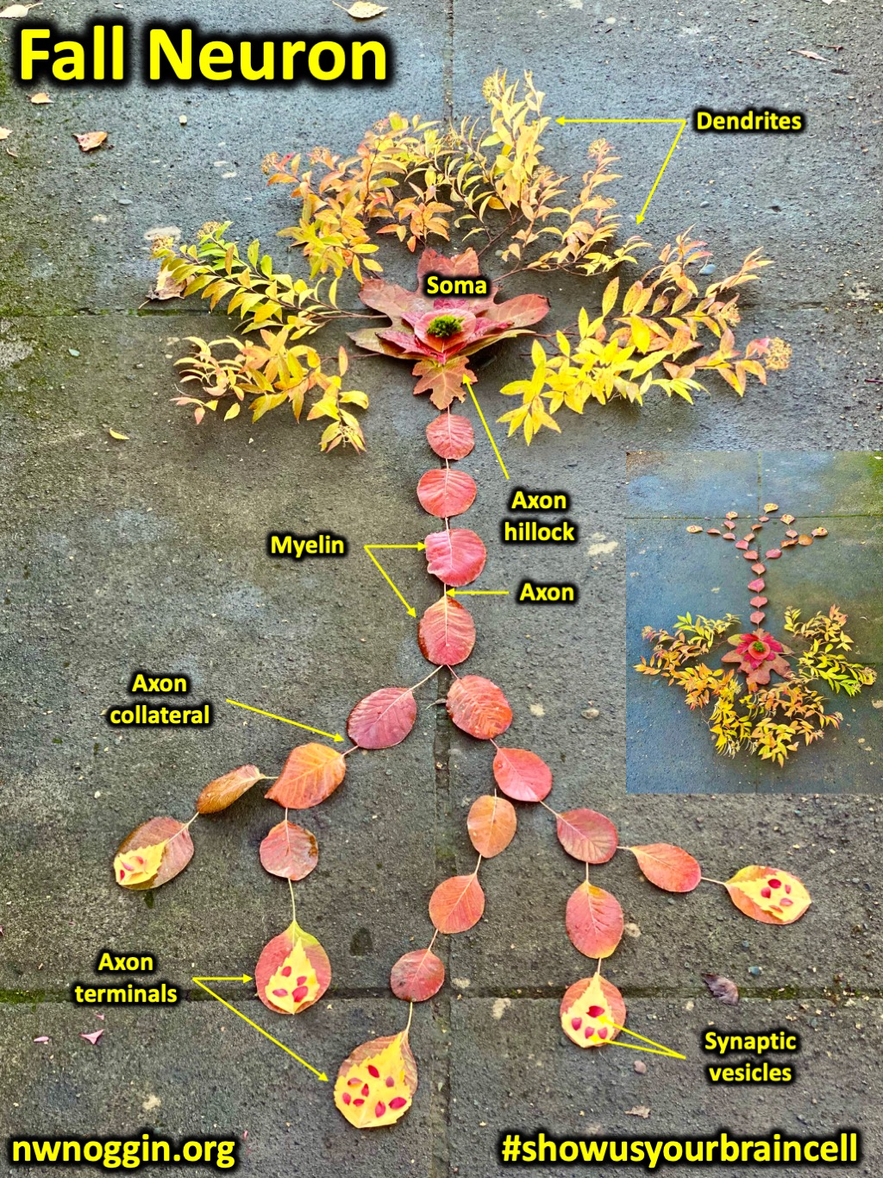
#showusyourbraincell

Slide 22
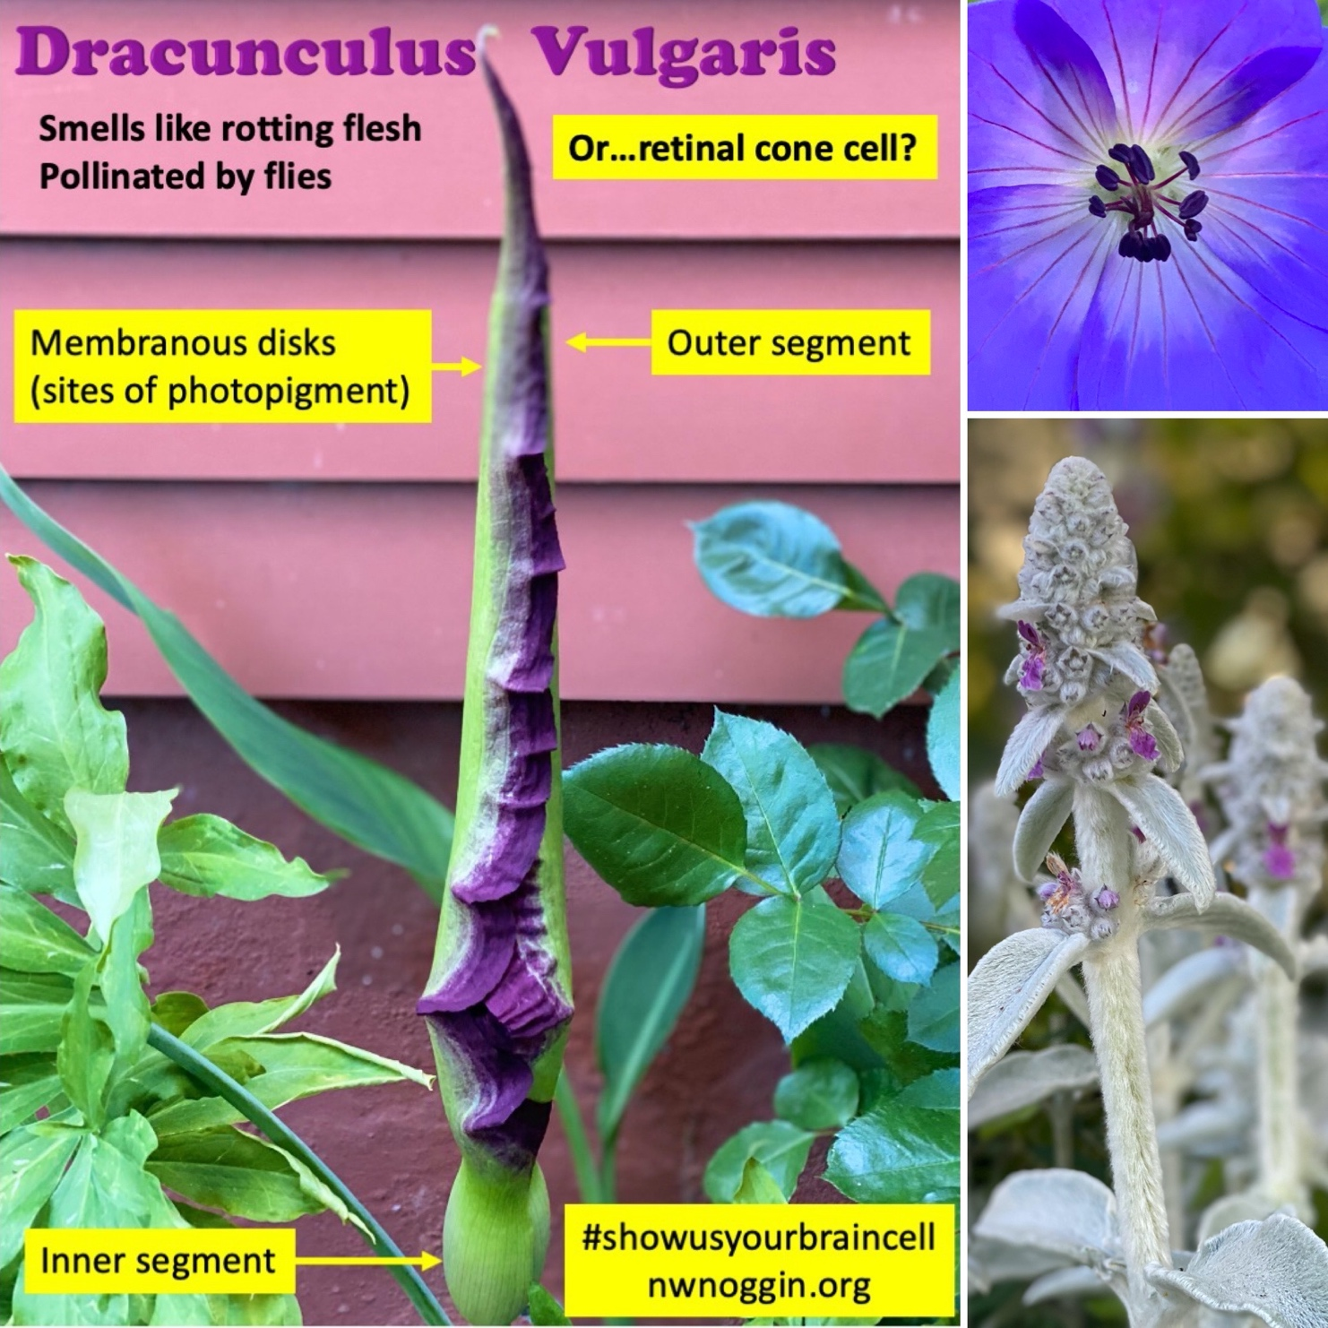
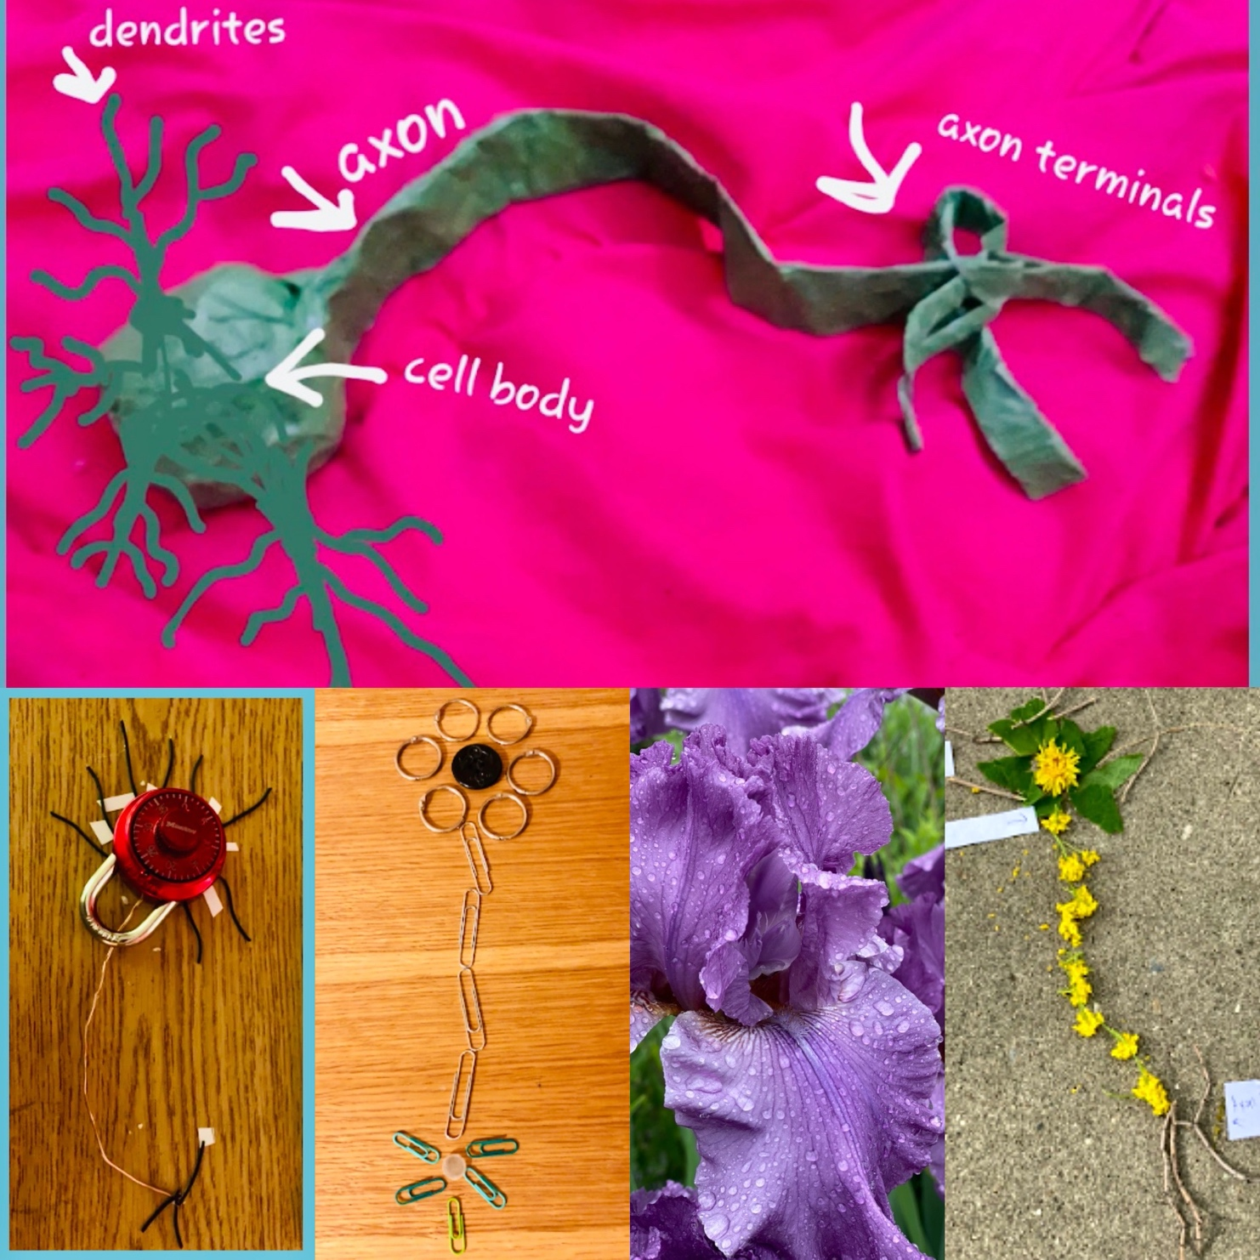
#showusyourbraincell

Slide 23
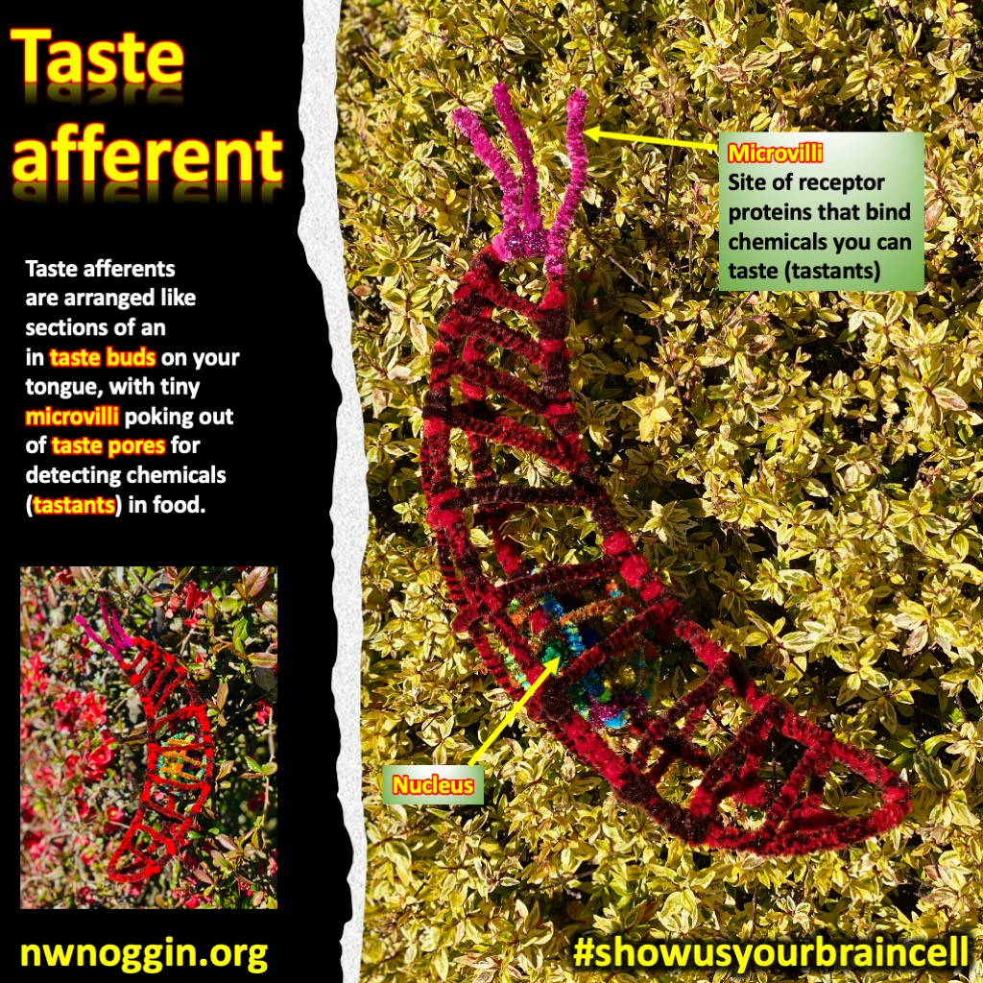
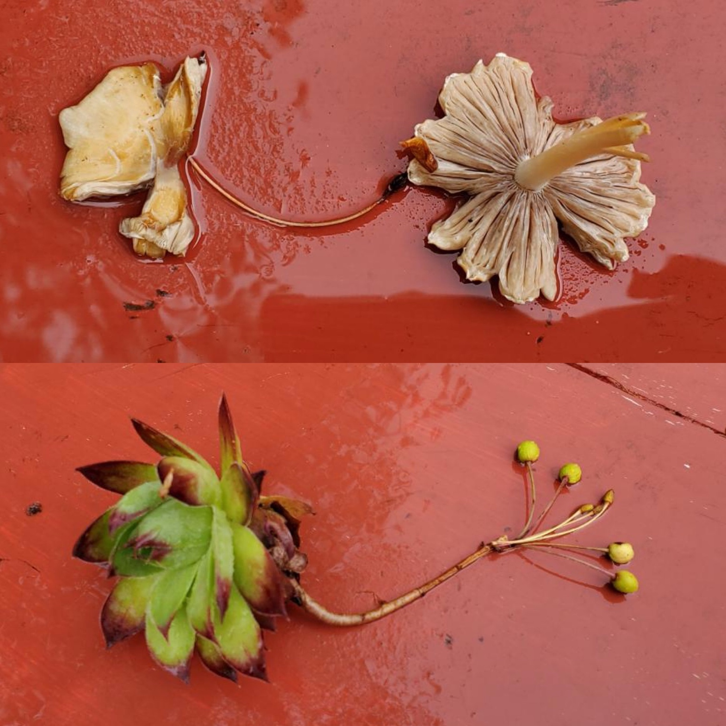
#showusyourbraincell

Slide 24
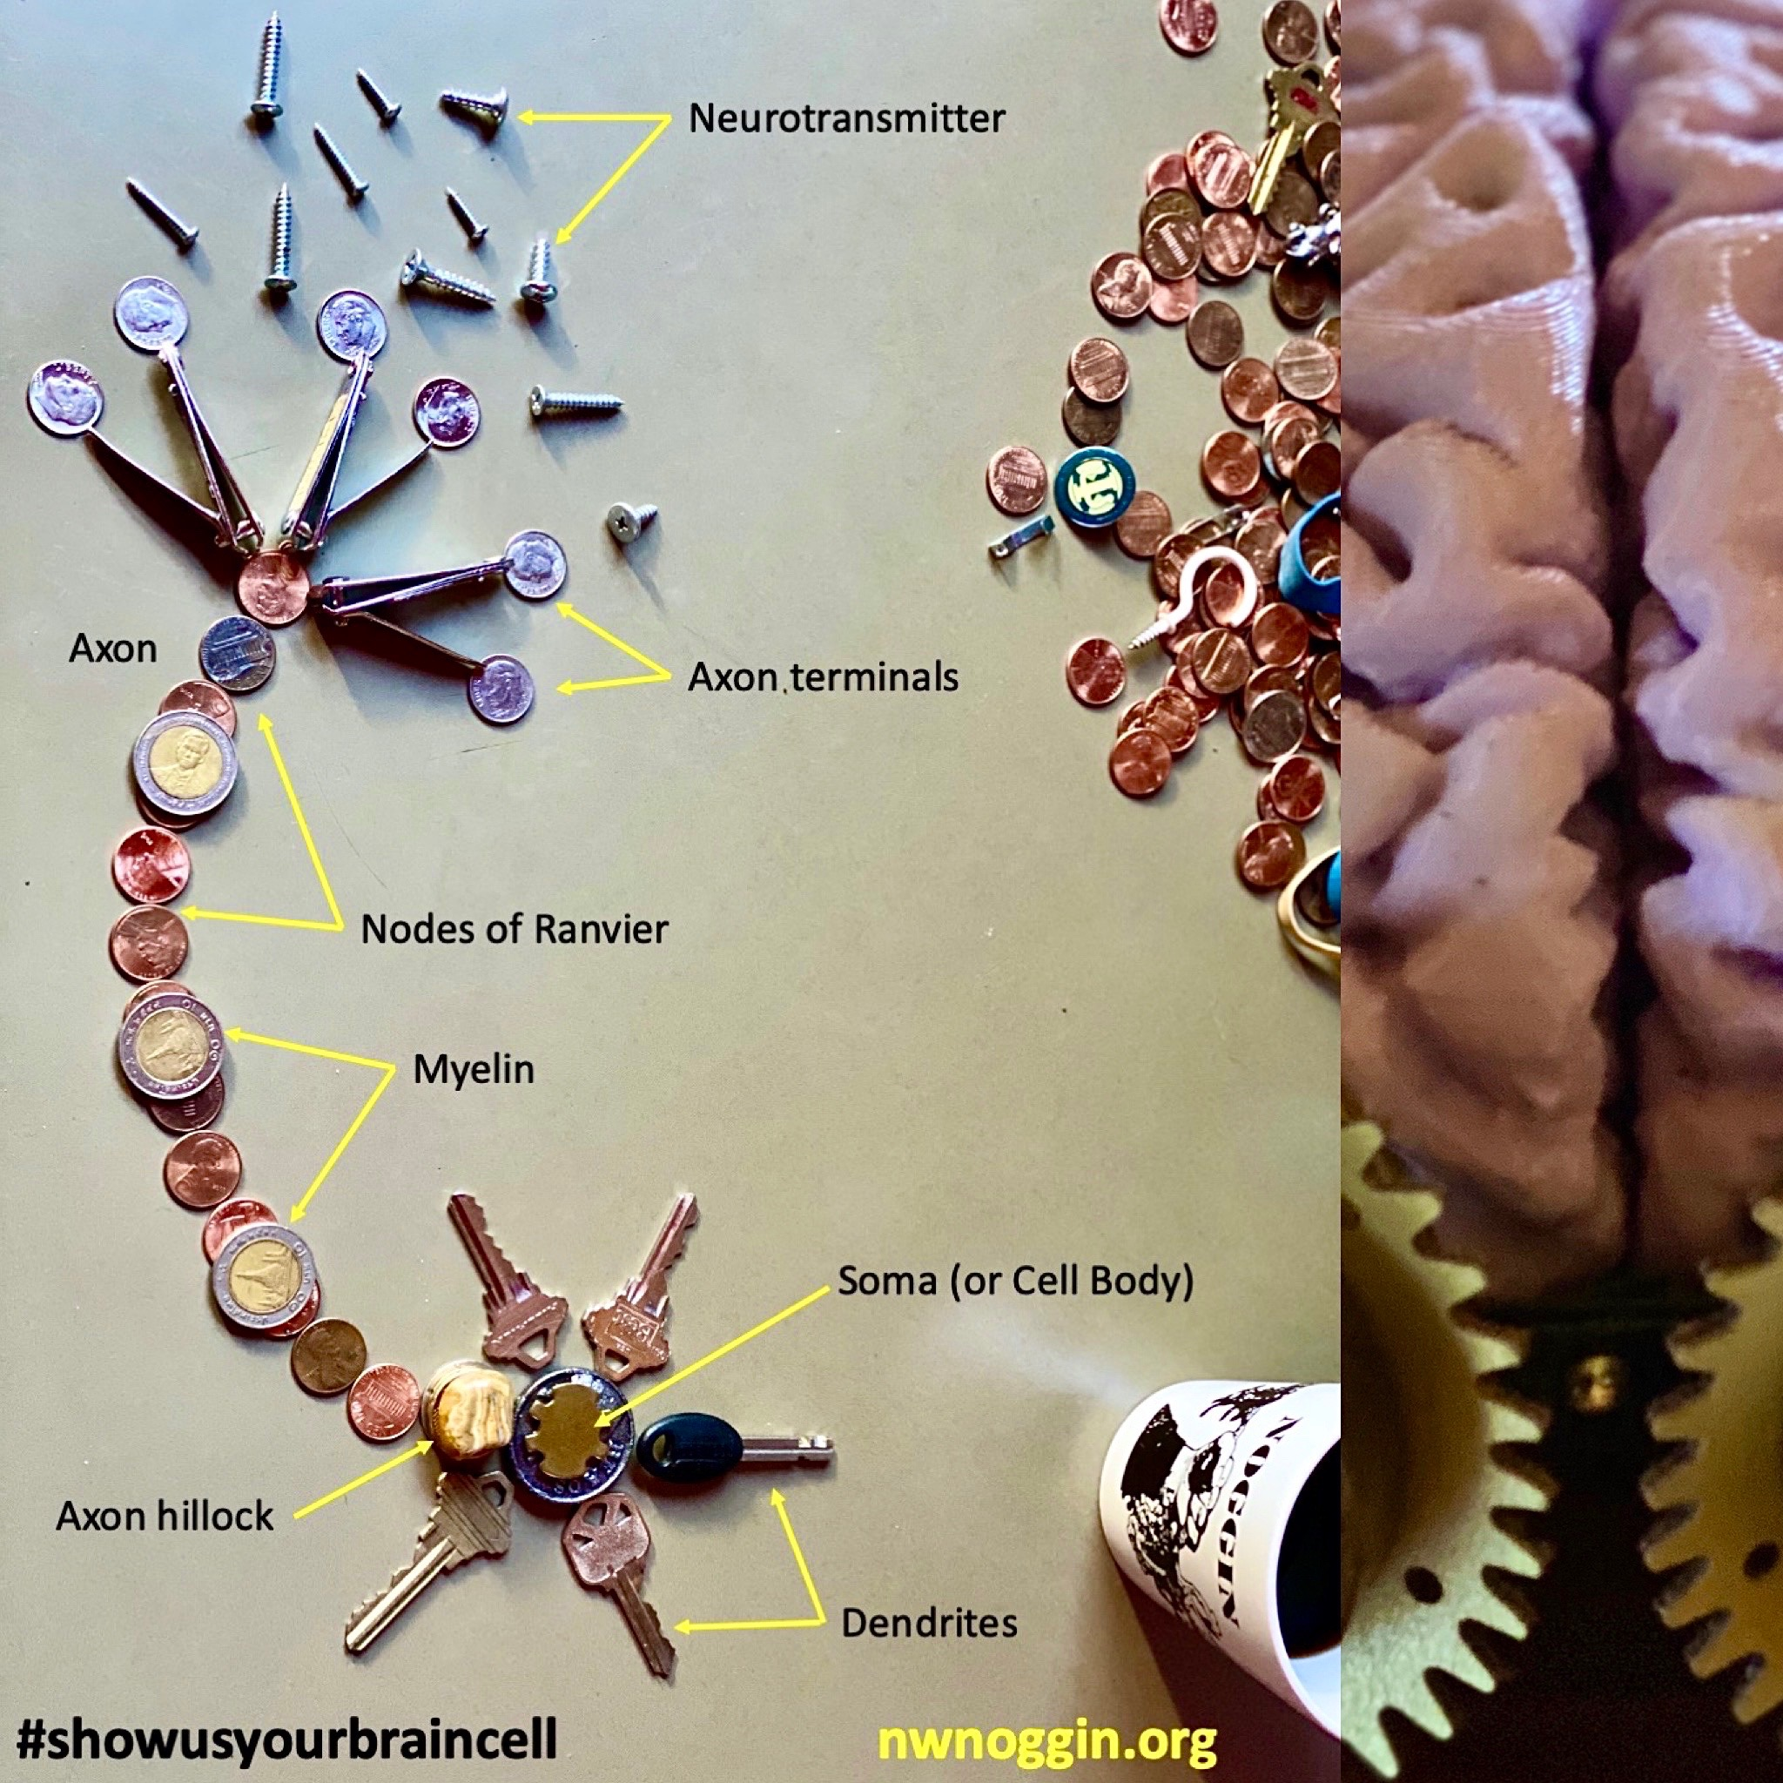

#showusyourbraincell

Slide 25






#showusyourbraincell

Slide 26


#showusyourbraincell

Slide 27



Make your own – AND SHARE!
#showusyourbraincell

