Slide 2
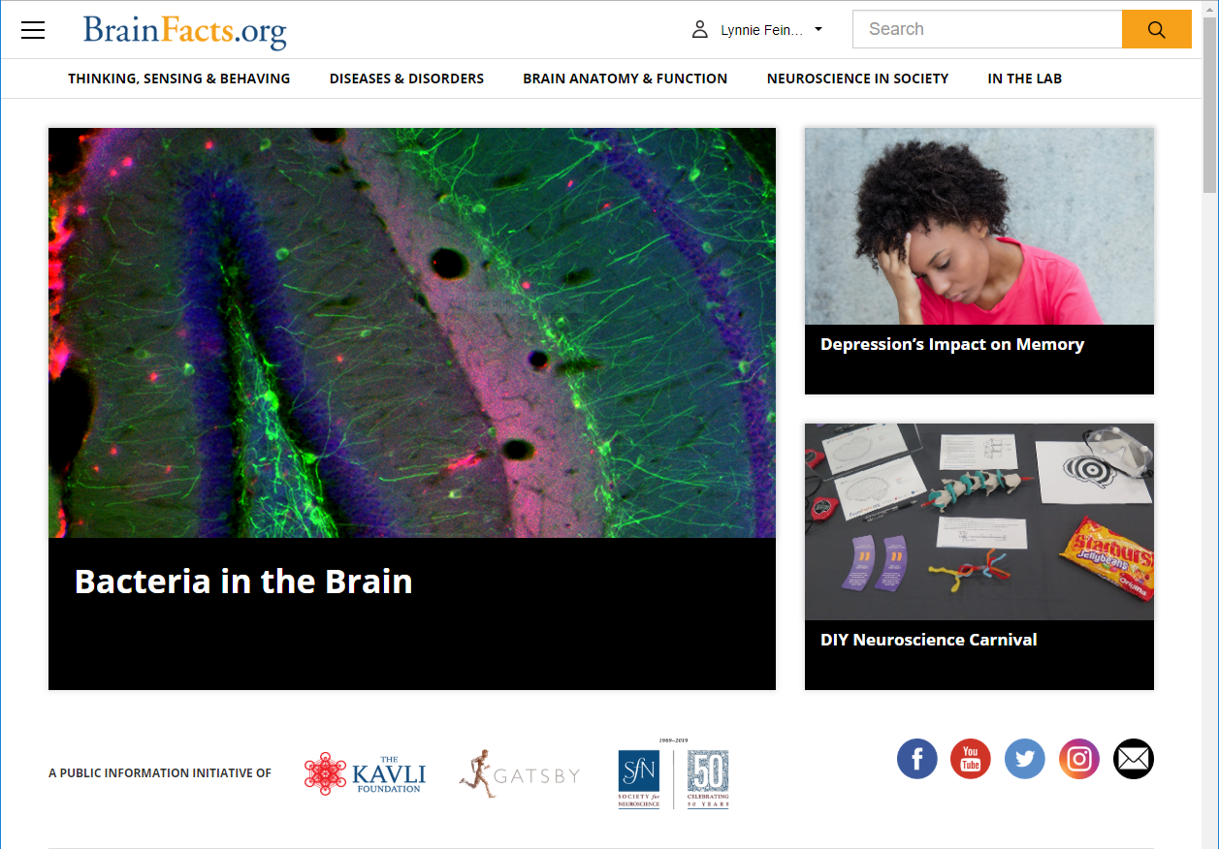

Slide 3
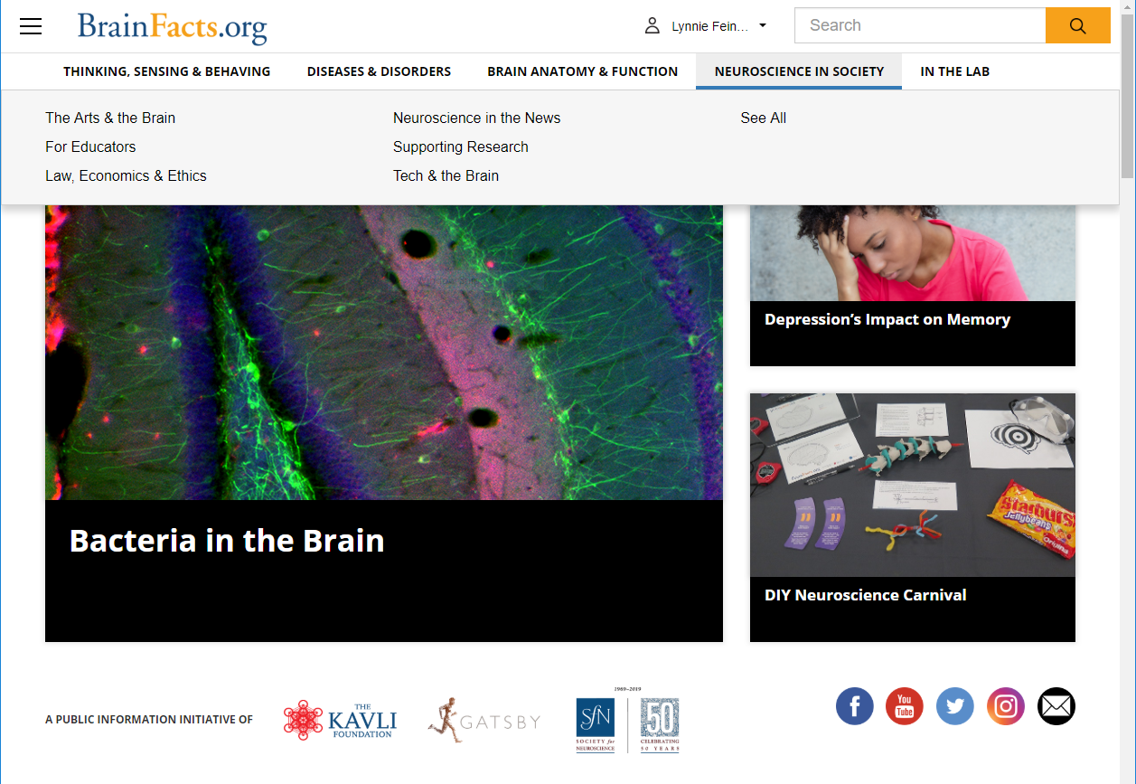

Slide 4
Reconnecting Our Brains,
One Cell at a Time
#showusyourbraincell

Slide 5
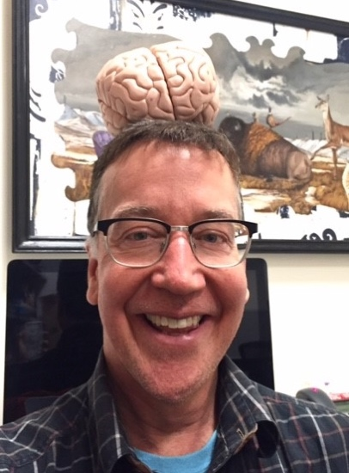


Your Moderator & Speakers
Bill Griesar, PhD
Senior Instructor, Psychology at Portland State University; Neuroscience Coordinator, NW Noggin
Jeff Leake, MA
Artist, University Studies/Psychology Instructor at Portland State University; Arts
Coordinator, NW Noggin
Richard Wingate, DPhil
Head of Anatomy at King’s College London
#showusyourbraincell

Slide 6
Bill Griesar
Jeff Leake
Bill Griesar, Ph.D. is Senior Instructor in Psychology at Portland State University and a co-founder of NW Noggin. He has developed and taught neuroscience courses at Portland State University, Oregon Health & Science University, Clark College, amongst others since 2001. Through NW Noggin (which is entirely volunteer) he’s met with more than 40,000 K-12 students over real brains and art. He’s been recognized as an innovator by the Obama White House and has won numerous teaching awards.
Jeff Leake has dedicated himself to exploring the intersection between art and science. He currently teaches in the Psychology and University Studies departments at Portland State University where he teaches art and neuroscience. He is also the president, co-founder and arts coordinator of NW Noggin. As part of this organization, he has traveled around the country, lecturing and teaching neuroscience through art and was recognized as an innovator by the Obama White House.
Bill Griesar
Senior Instructor at Portland State University
Jeff Leake
Artist, Instructor at Portland State University

Slide 7
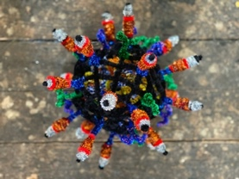
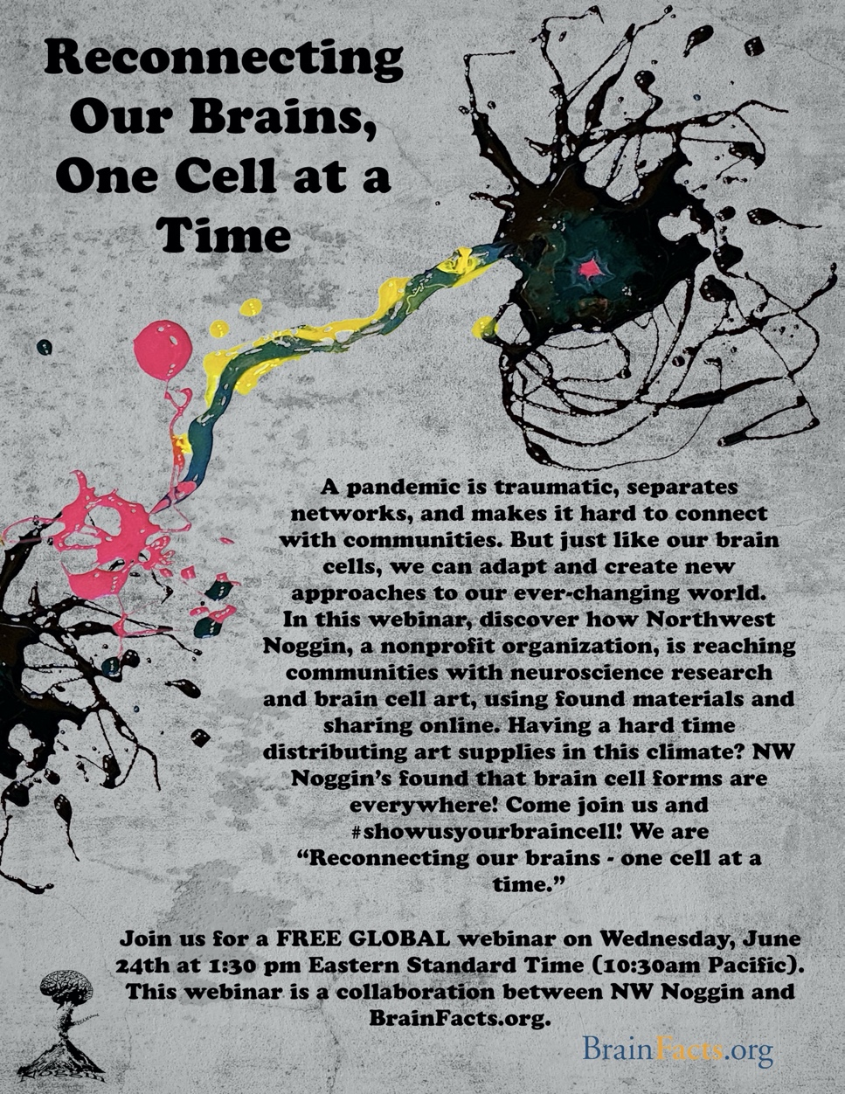
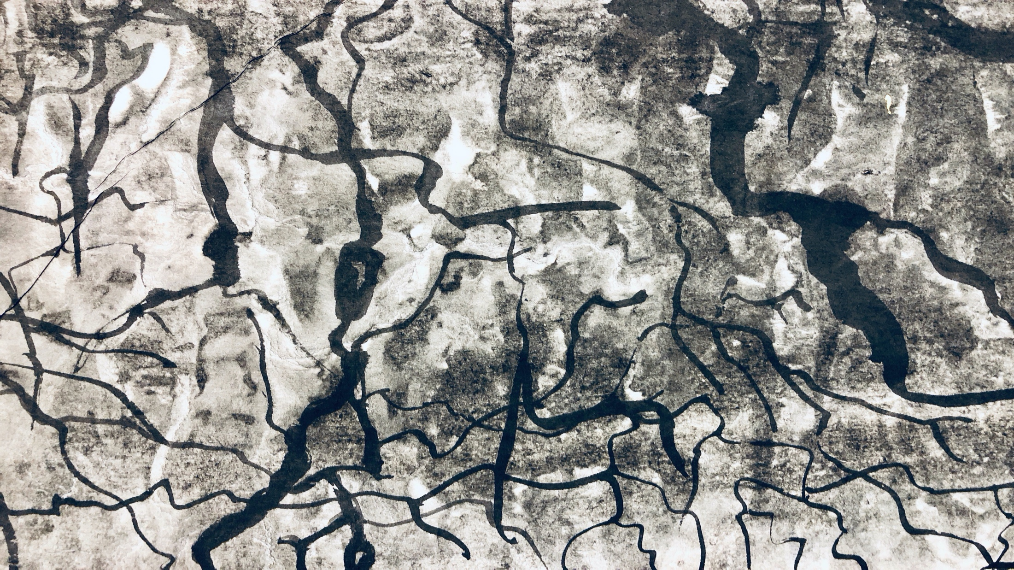
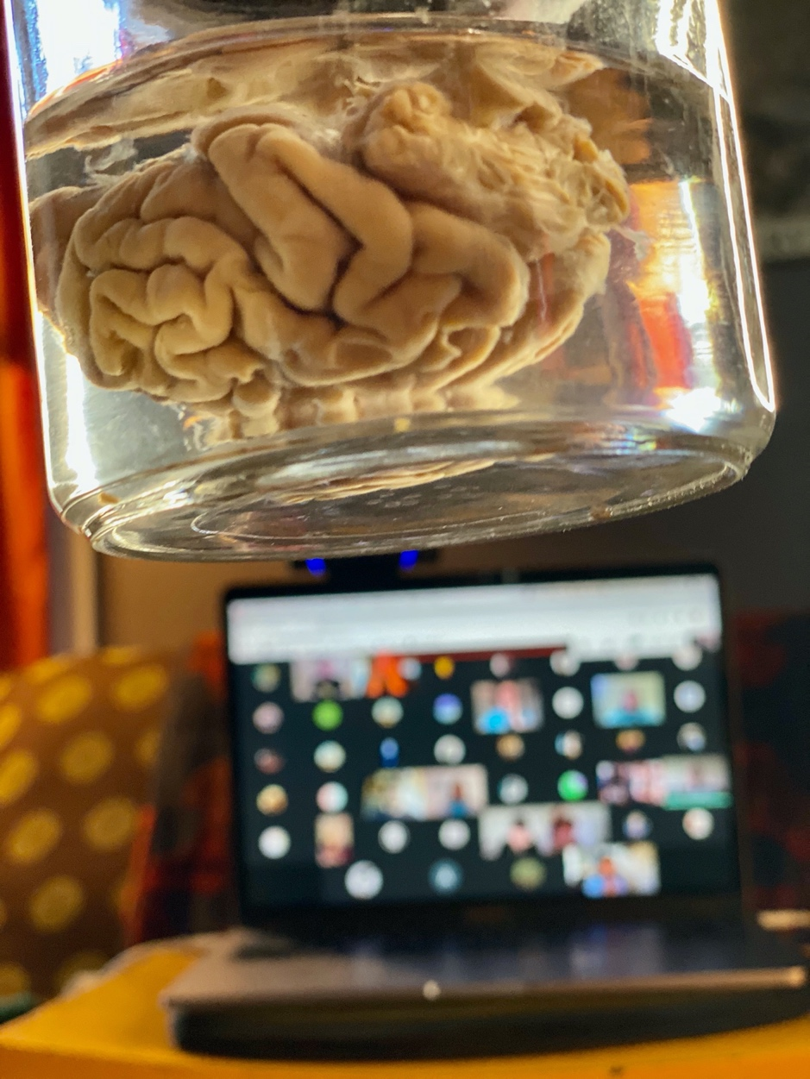
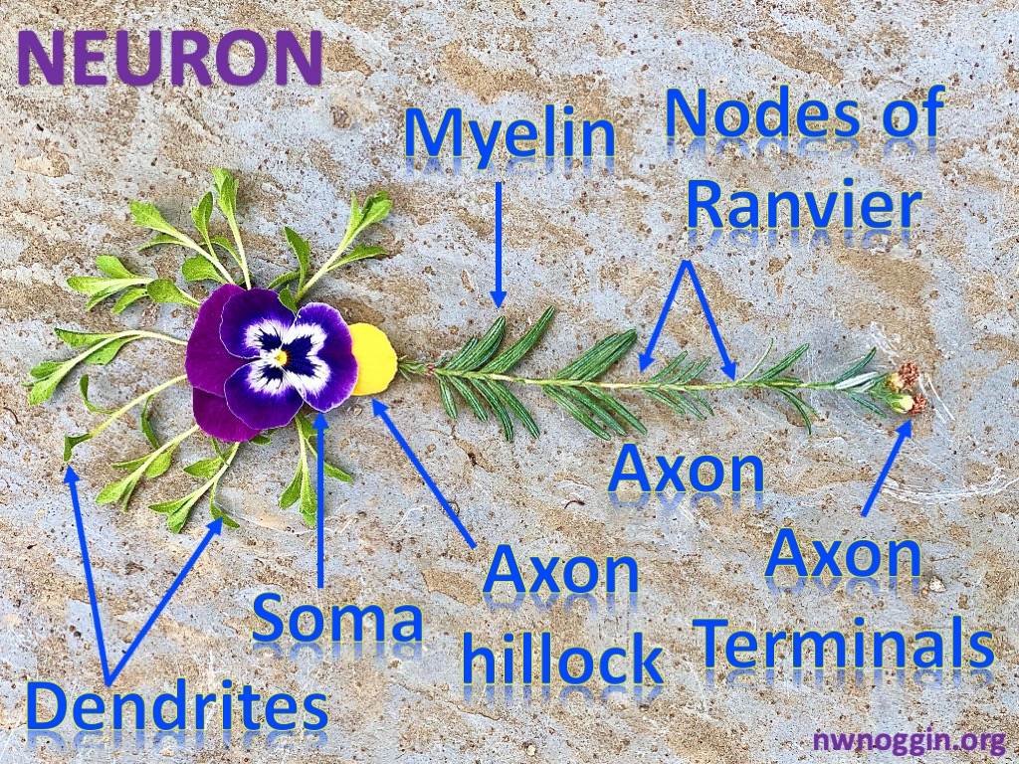
Art & Brains!
Jeff Leake, MA
  Instructor, University Studies, Portland State University
  Co-Founder/Arts Coordinator, nwnoggin.org
Bill Griesar, Ph.D.
  Senior Instructor II, Psychology, Portland State University
  Affiliate Graduate Faculty, Behavioral Neuroscience, OHSU
  Co-Founder/Neuroscience Coordinator, nwnoggin.org

Slide 8
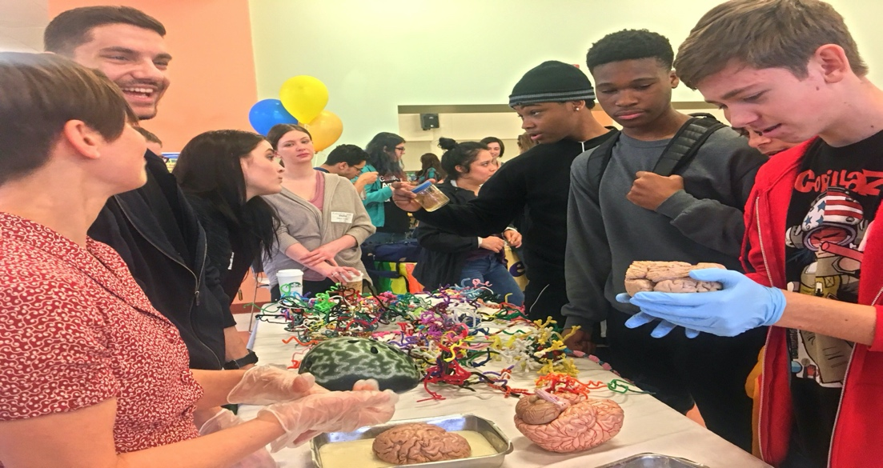
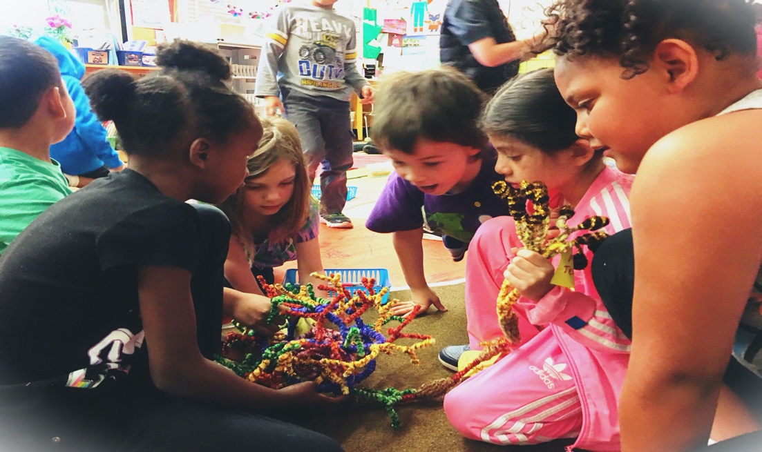
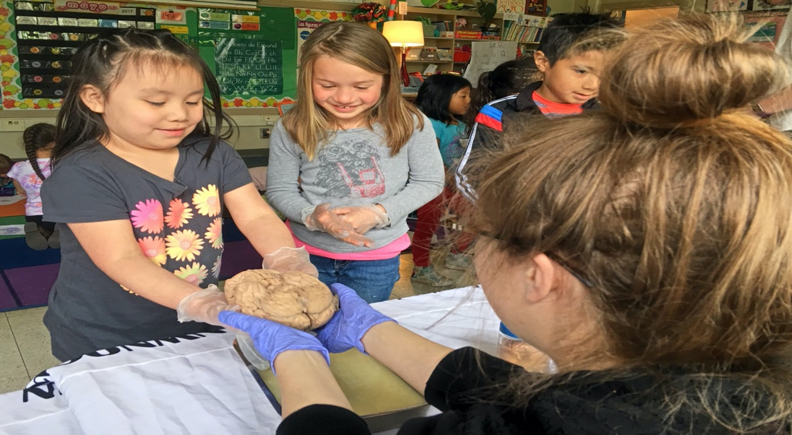
nwnoggin.org
Arts integrated neuroscience outreach for K-12 & community

Slide 9
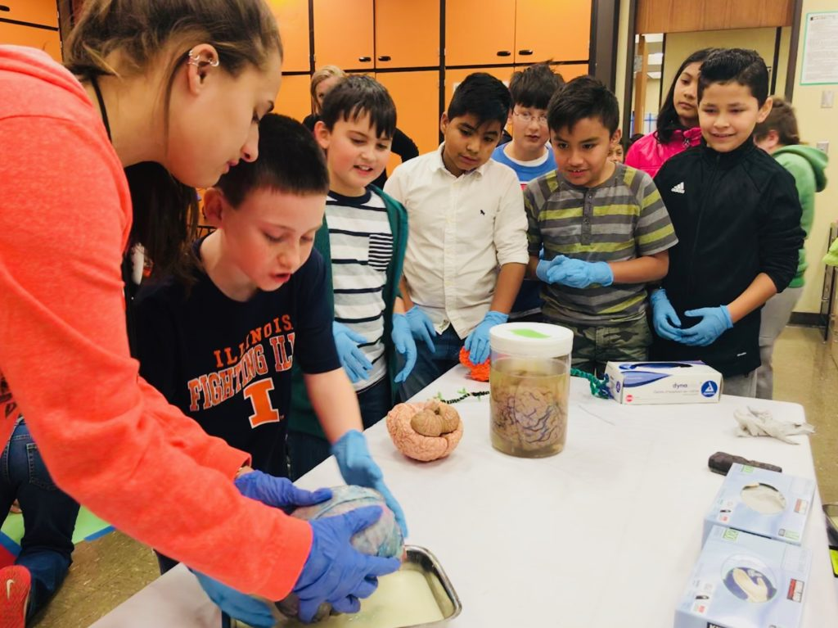
What you do has relevance
GO PLACES
Sleep
Anxiety
Depression
ADHD
Autism
Development
Perception
Drugs
Memory
Language
Racial Bias
…

Slide 10
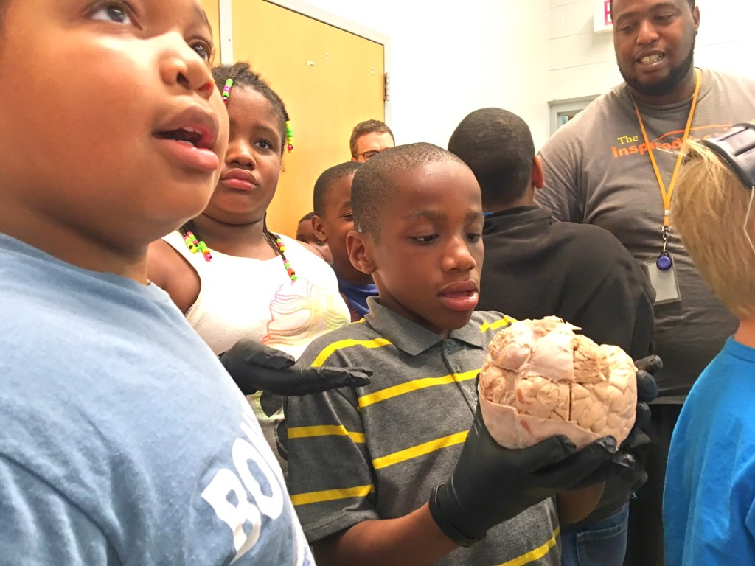
We all pay for research

Slide 11
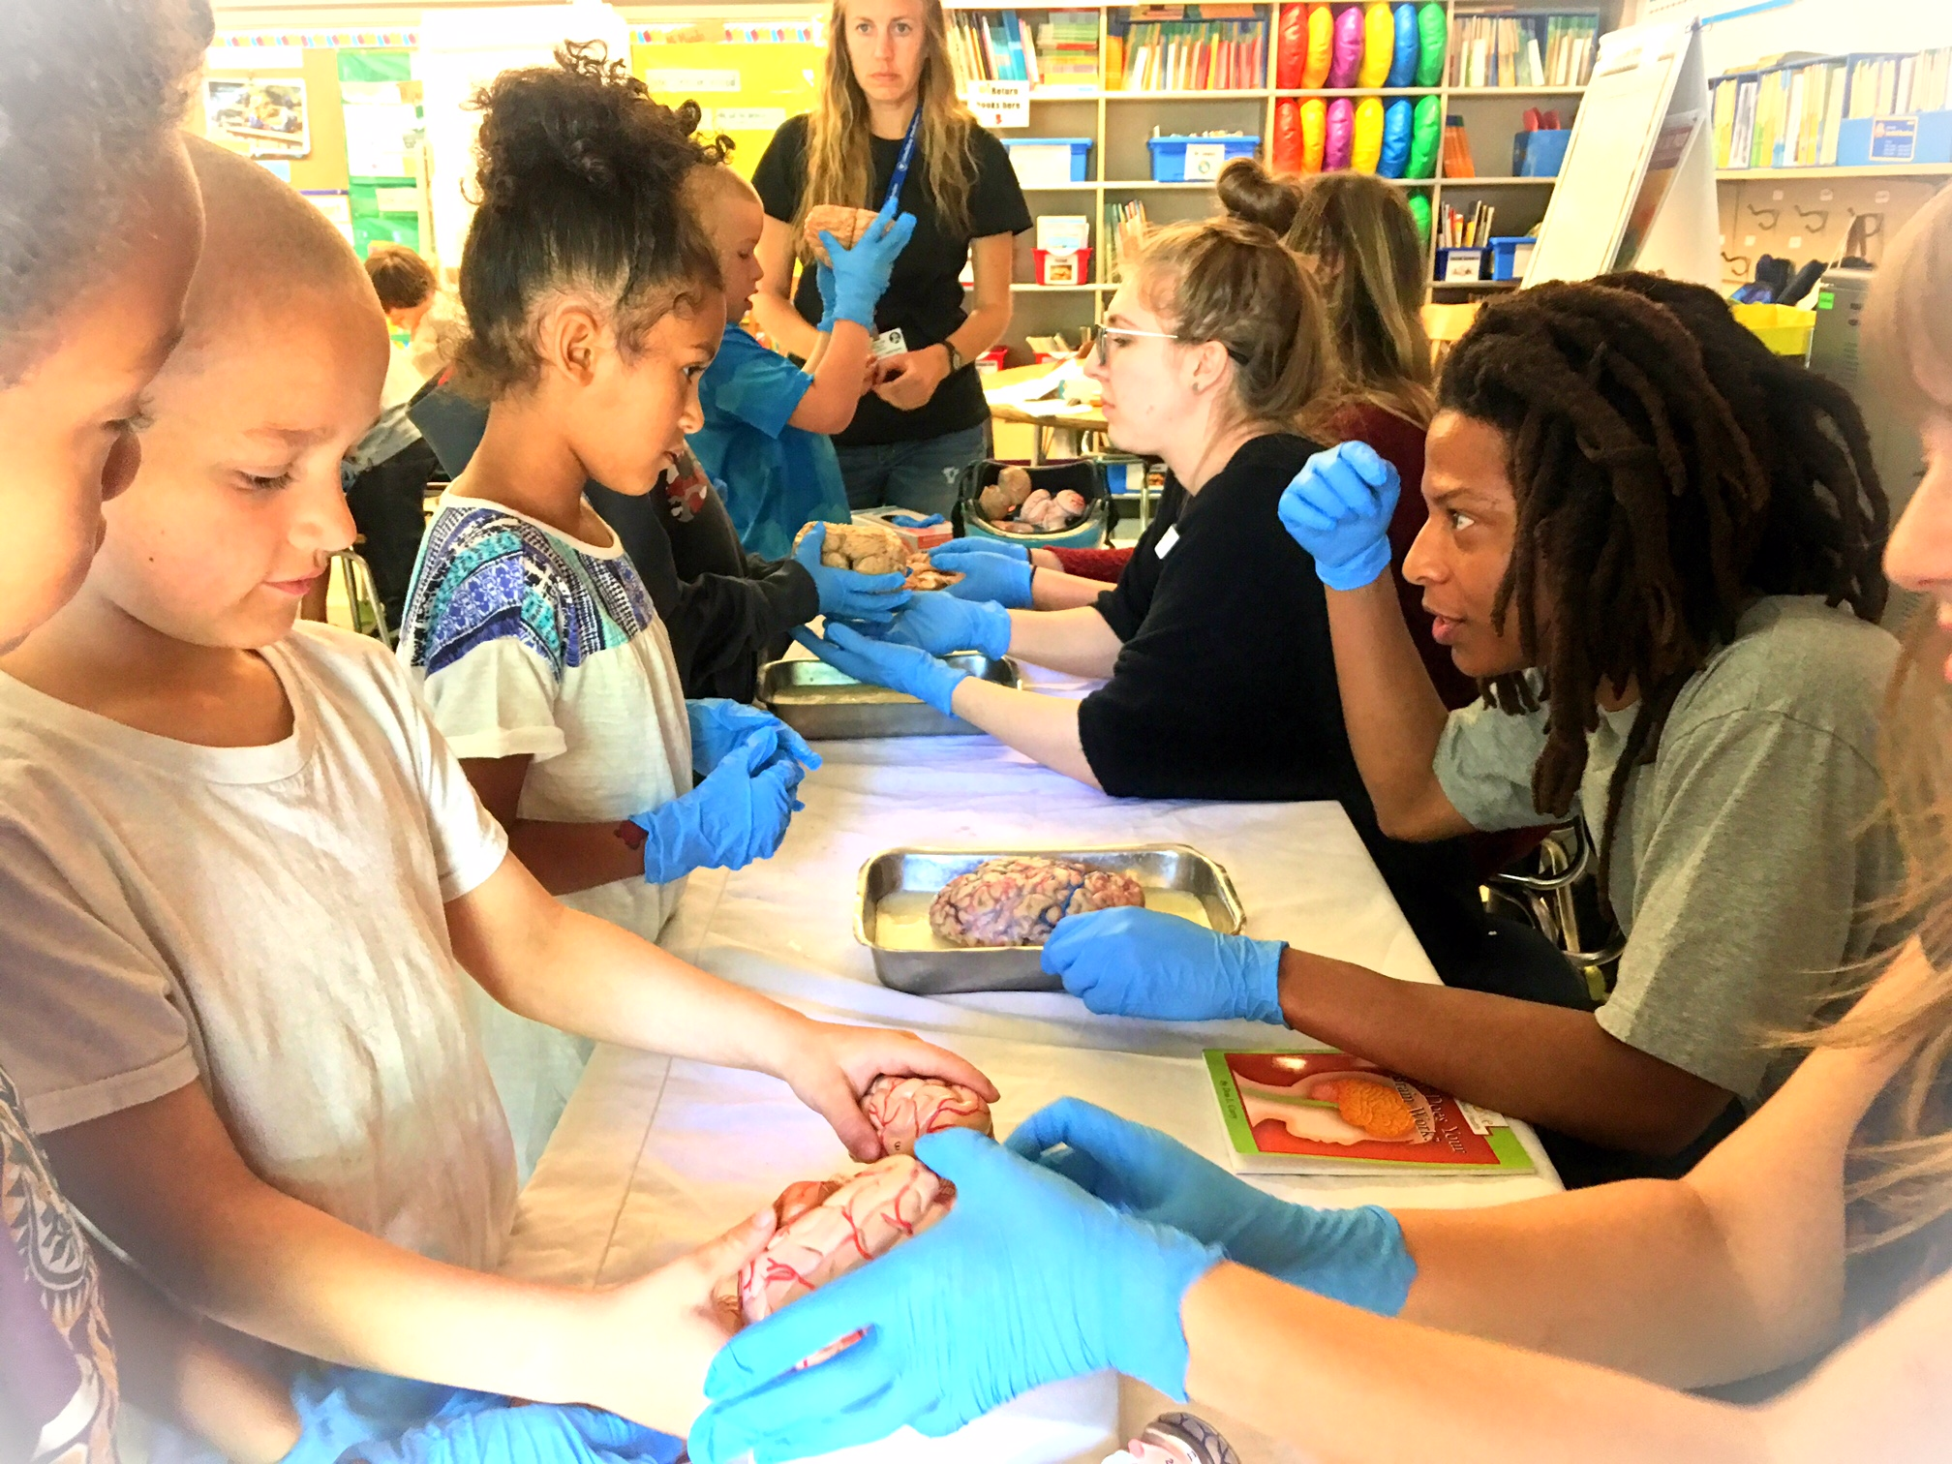
Connections matter
Greater understanding
More support for research
Increased participation
Less confirmation bias
New directions
FUN!

Slide 12
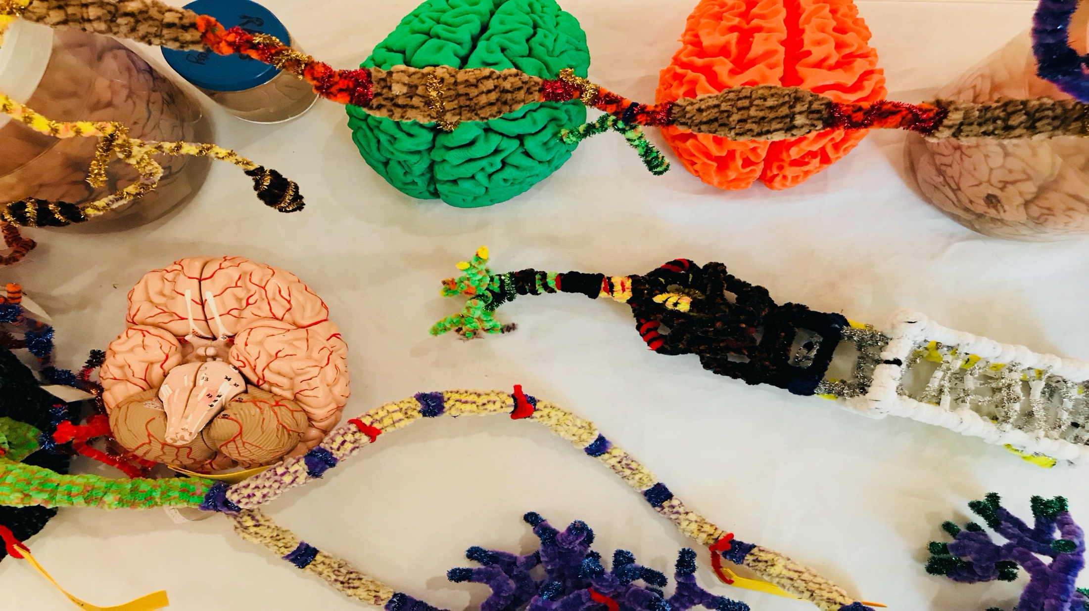
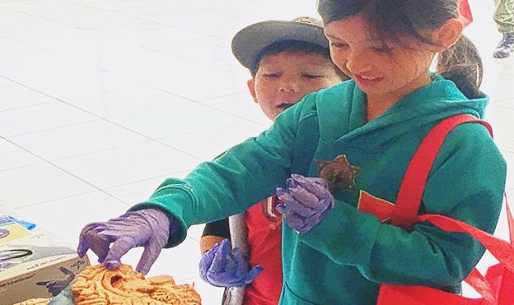
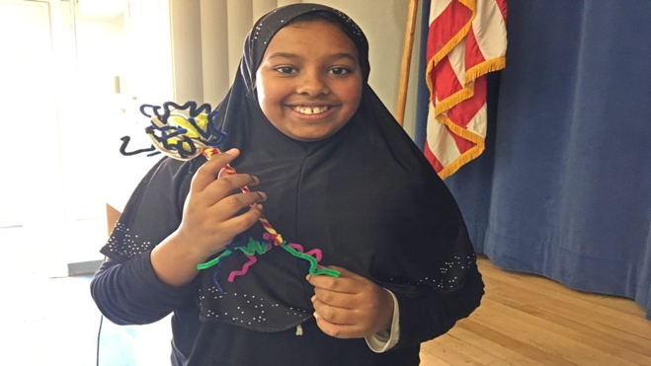
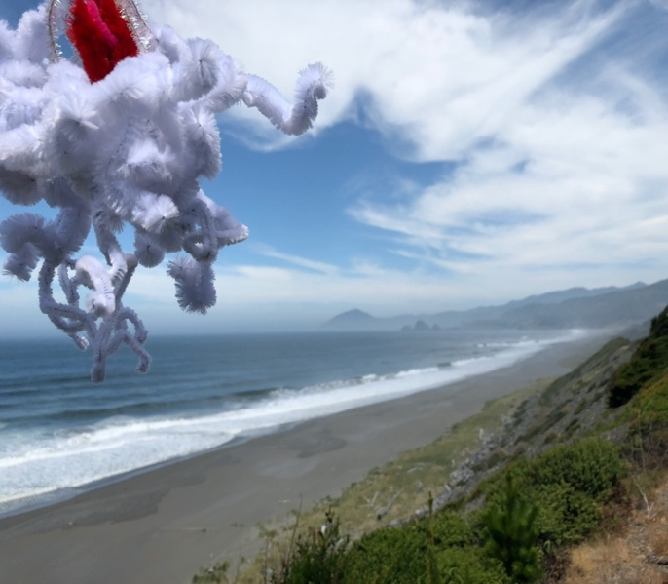
BUILD NEW
CONNECTIONS
Academic priority K-12, urban/rural communities, tribal majority schools
  Not always well-funded, or valued, often ignored, subjected to standardized testing that primarily benefits others. Complex brain development underway, unacknowledged diversity, racism, bias, police brutality, mental health…
Houseless youth (p:ear), incarcerated youth (MacLaren/Coffee Creek Correctional Facilities)
  “It’s like people see me as an object, not as a human being”
Young graduate researchers, undergraduates (PSU, OHSU,…)
  How does my research relate to the world? How can I explain it?
  Where can I go from here? “Alternative careers” in science…
Artists: Painters, Dancers, Storytellers, Musicians, Poets
  How does my work relate to other fields? How do I connect with new audiences?
  How is my practice influenced and enriched by discoveries about the brain?
Area businesses (BioGift, Intel, Fort George, Floyds/Street 14, Hospitals)
  How can we better connect with everyone in our community?
Members of the public
  Why are my taxes spent on research? Art? What are we discovering? Making?
Oh the places
you’ll go!

Slide 13
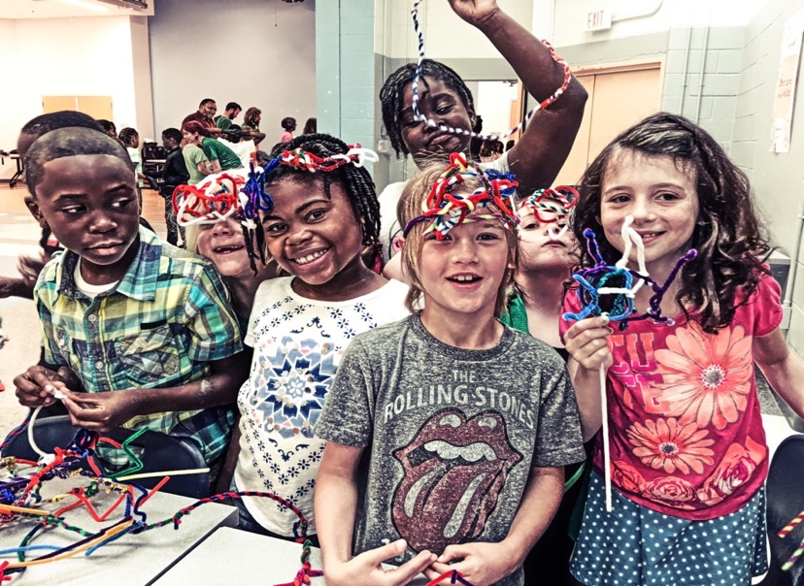
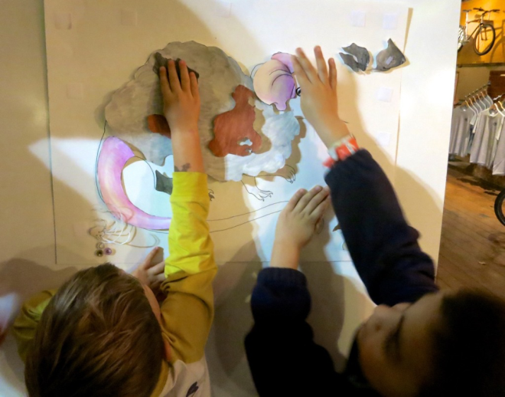
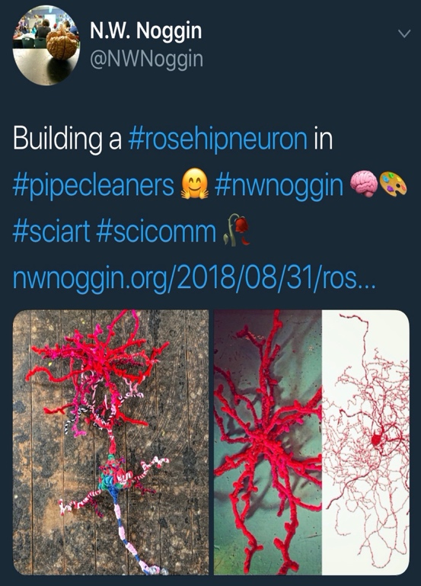
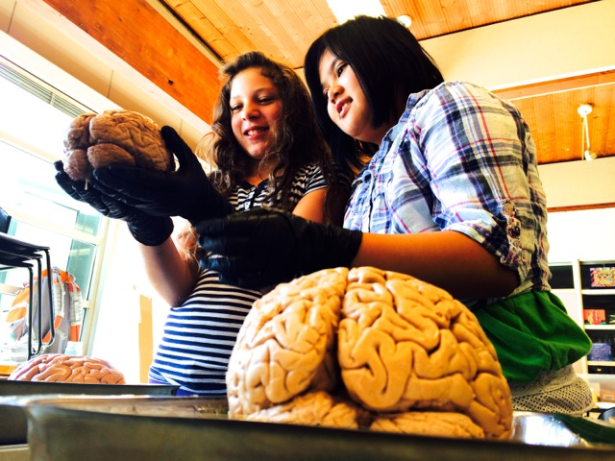
Why art & brains..?
Motivation, engagement, empathy
Exploration, creativity, INNOVATION
Personal relevance of STEAM material
Build your own mouse line!

Slide 14
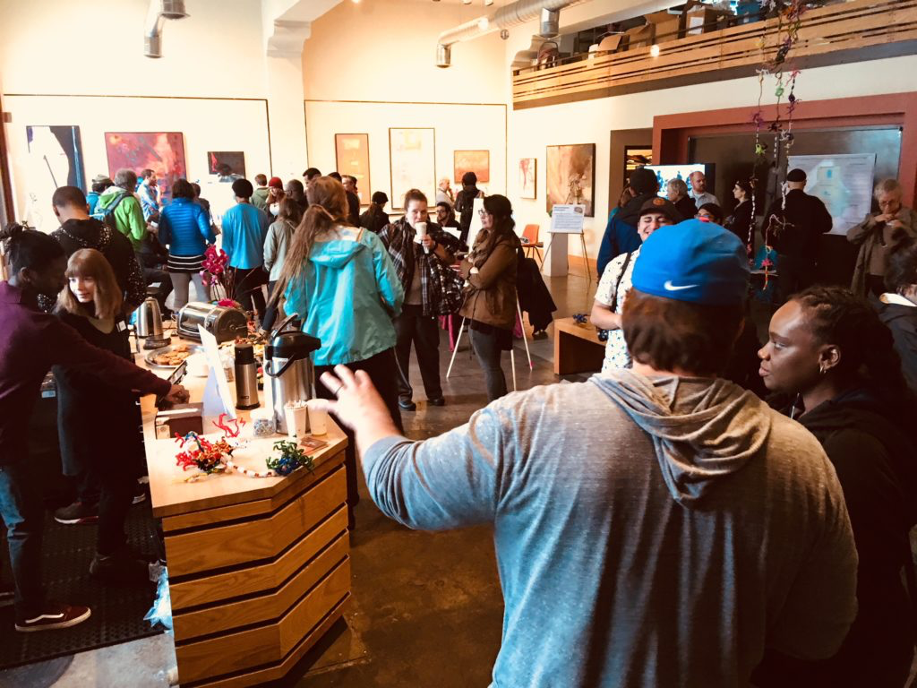
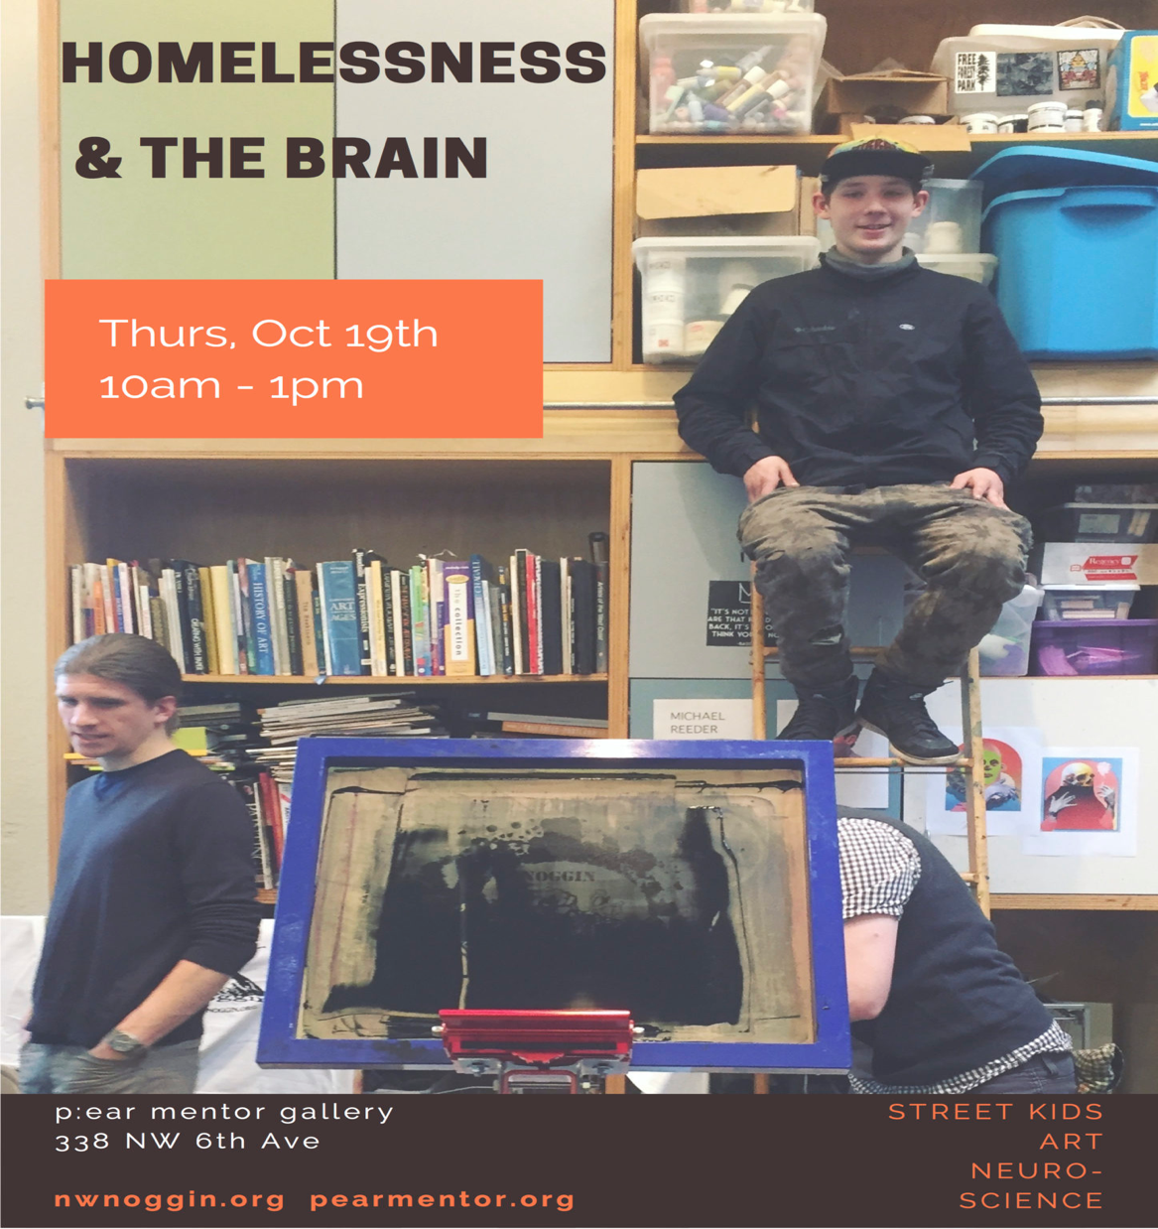
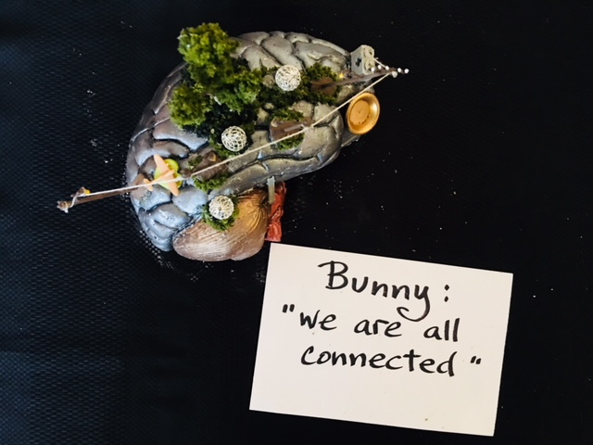
To see other people
Researchers
Clinicians
Policy makers
Houseless youth

Slide 15
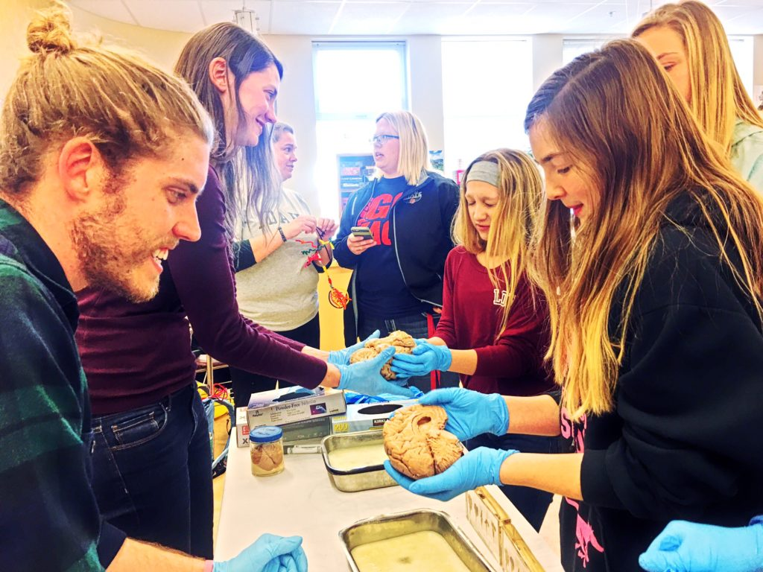

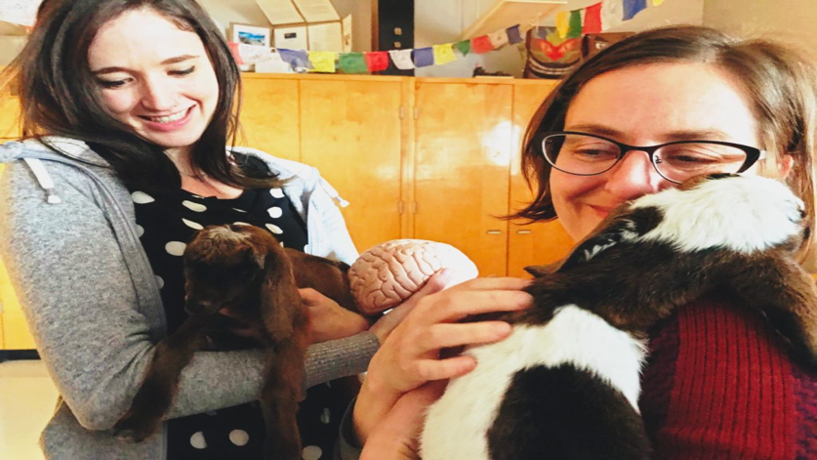
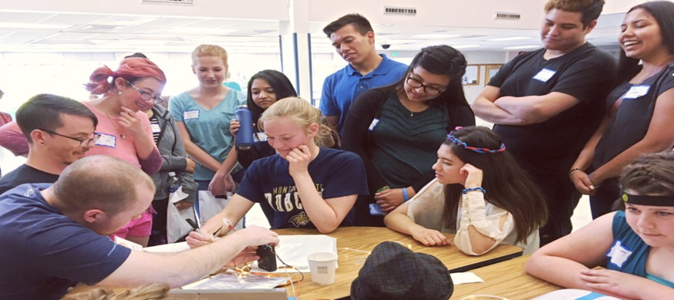
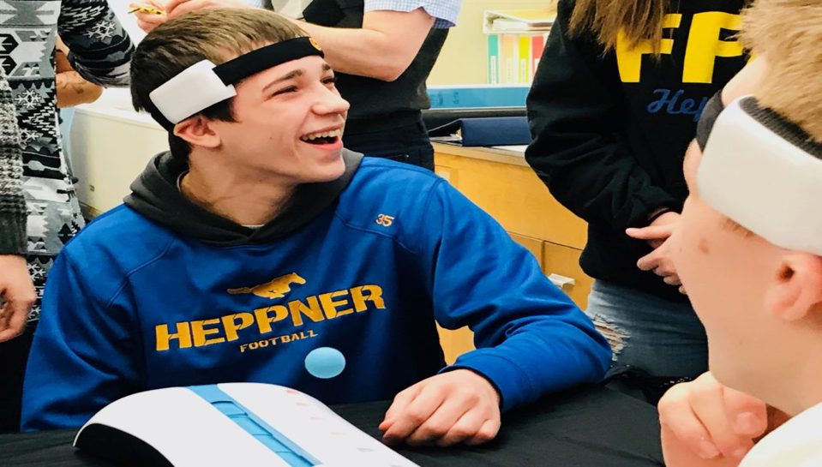
Rural Outreach
Food, housing, baby goats…
TO GO PLACES!
Siletz, Amity & Willamina, OR
Pop: 4,000
Davenport, WA
Pop: 1,700
La Grande, OR
Pop: 13,000
Meservy Meadows, OR Pop: ~40
Heppner & Ione, OR
Pop: 1,240

Slide 16
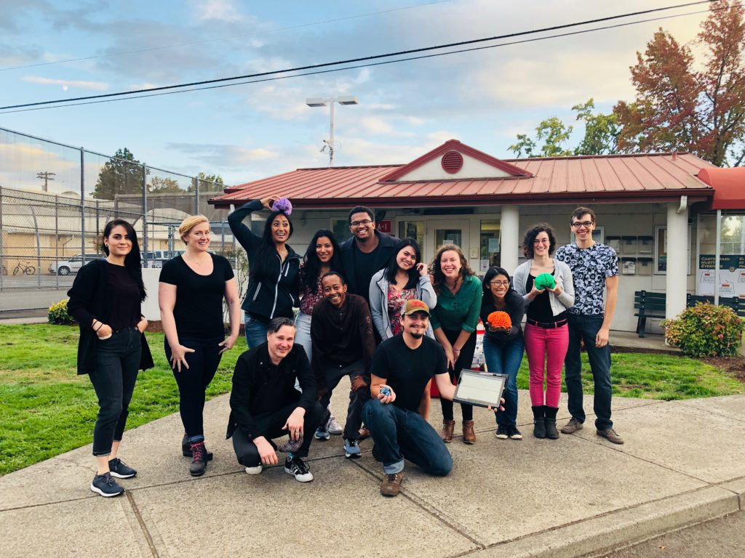
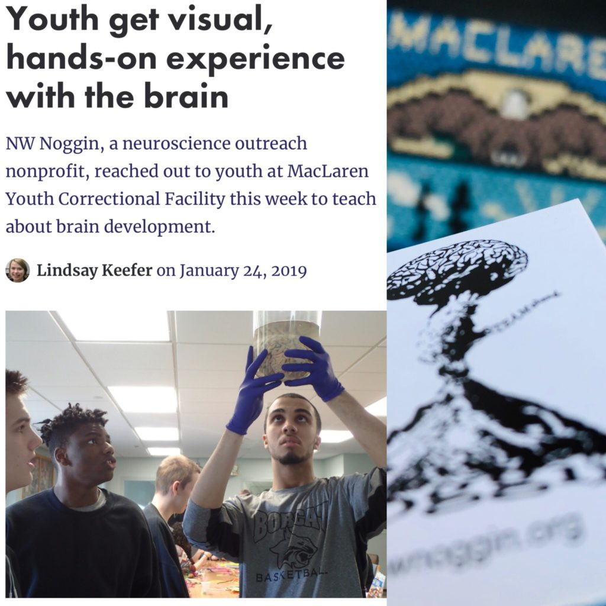
Neuroscience & Law
To listen, learn, empower & make change
MacLaren Youth Correctional Facility

Slide 17
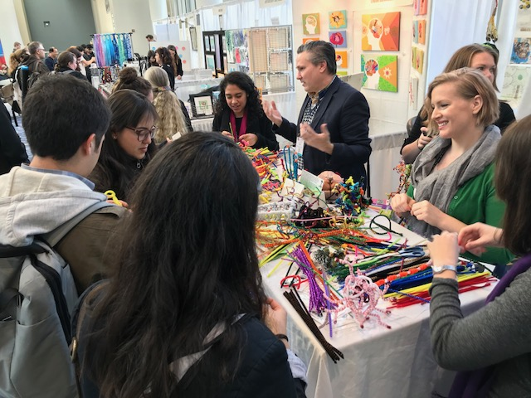
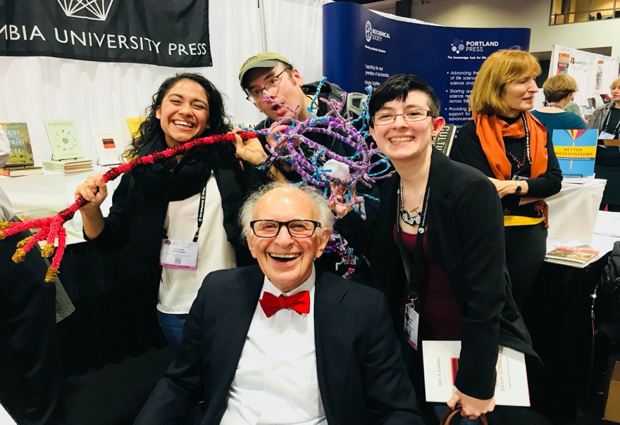
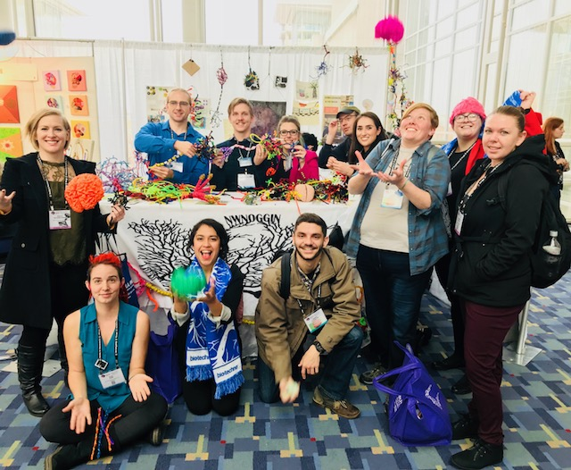
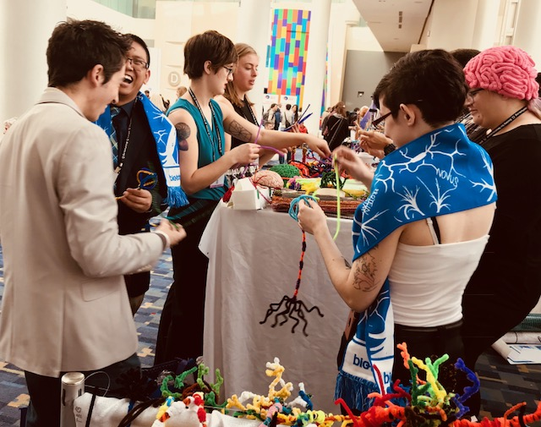
At SfN conferences
Posters, art of neuroscience and…

Slide 18
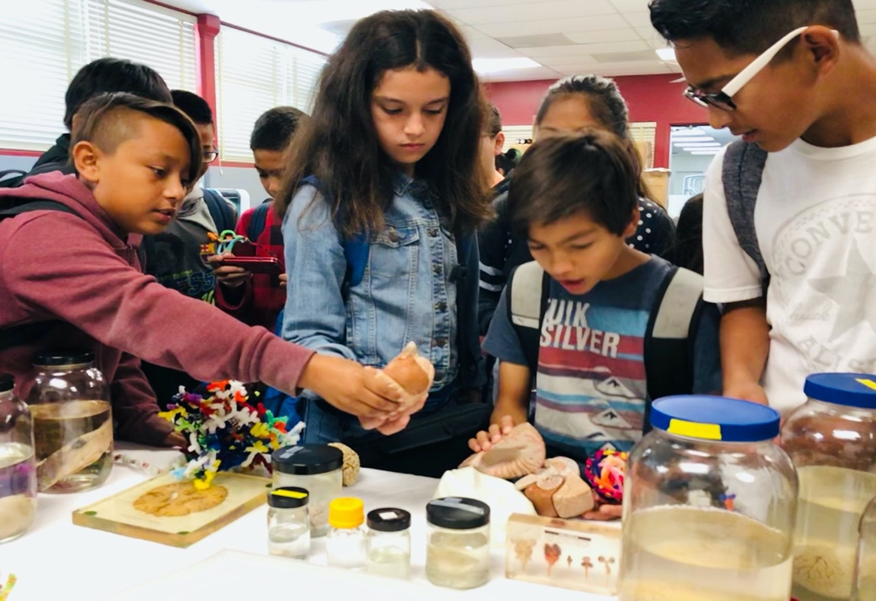
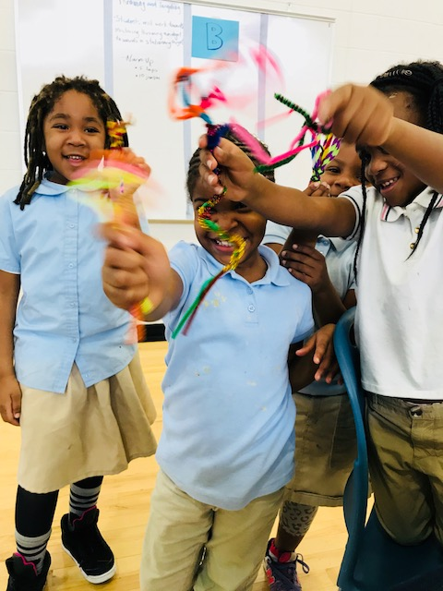
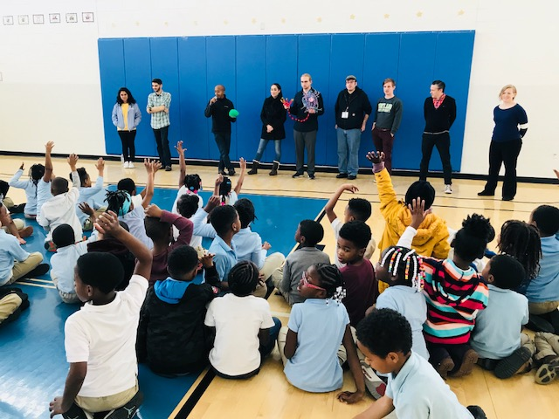
School visits
Turner Elementary, DC
Public outreach and connection

Slide 19
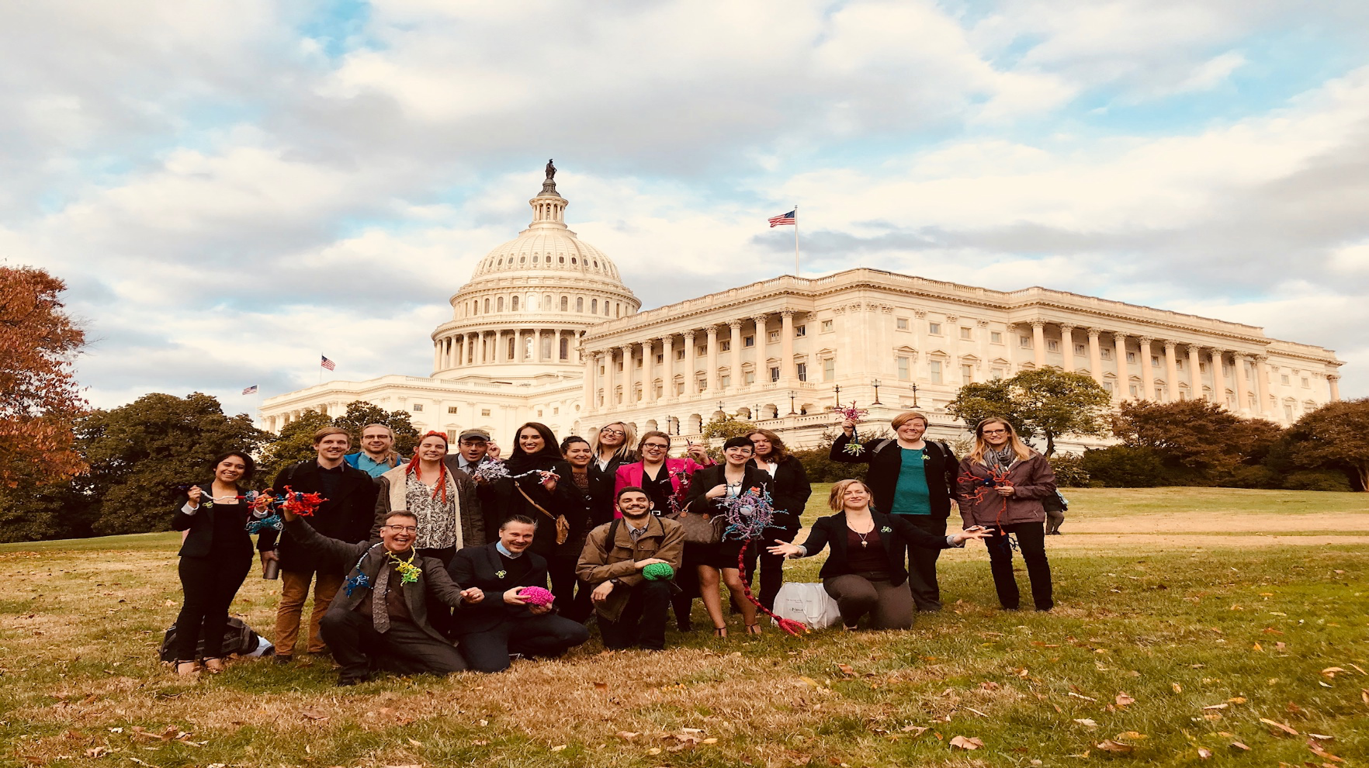
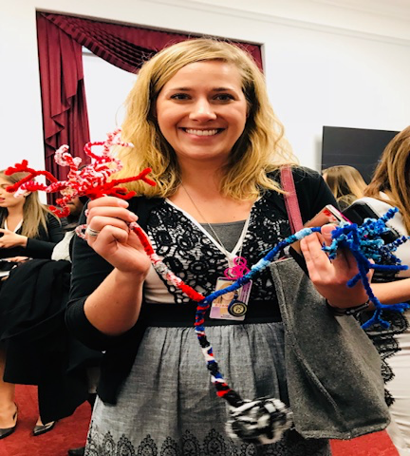
And also, in the U.S., to Capitol Hill
More connections: Congressional office visits
Congressional Neuroscience/STEAM briefing
“Bipartisan”
neuron
Research should inform policy

Slide 20
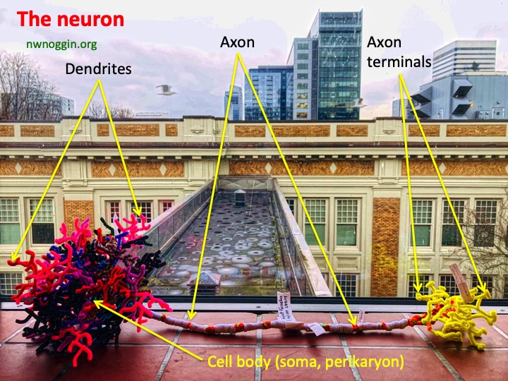
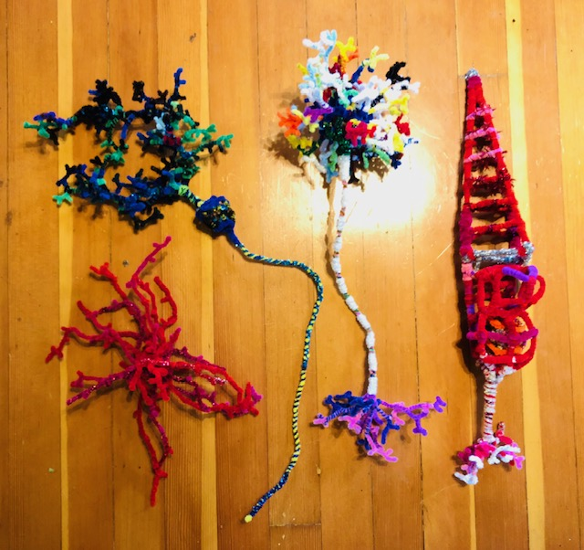
Pipe cleaner brain cells!
MAKE YOUR OWN: Details @ nwnoggin.org

Slide 21
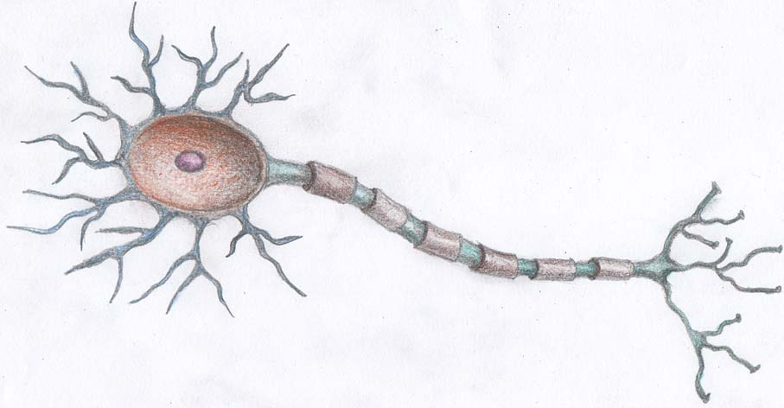
Neurons are a type of brain cell
The majority of neurons share some basic features
Dendrites
(Receive input from other neurons at gaps called synapses)
Axon (Carries electric message)
Cell Body
(or Soma, location of nucleus and cell DNA)
Found Object Brain Cells
Axon Terminals (release of neurotransmitters)

Slide 22
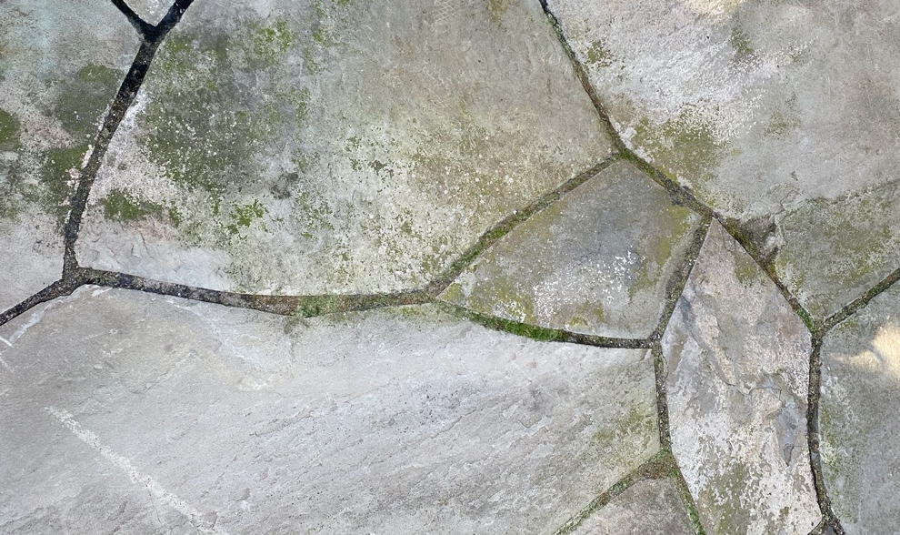
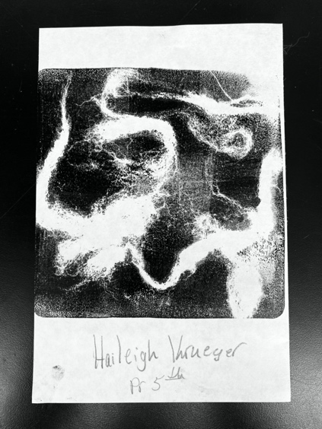
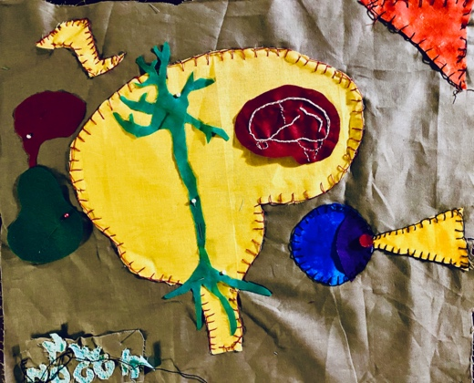
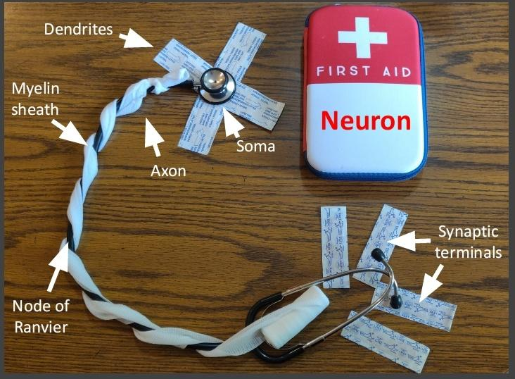
Take a look around you, what things do you see that share those structures?
Cell Body
Axon Terminals
Dendrites
Axon
Can you construct a neuron out of things that you find?
What things for you represent the function of a neuron? Or the function of specific parts of a neuron? Do those things have personal meaning, or say something about you?

Slide 23
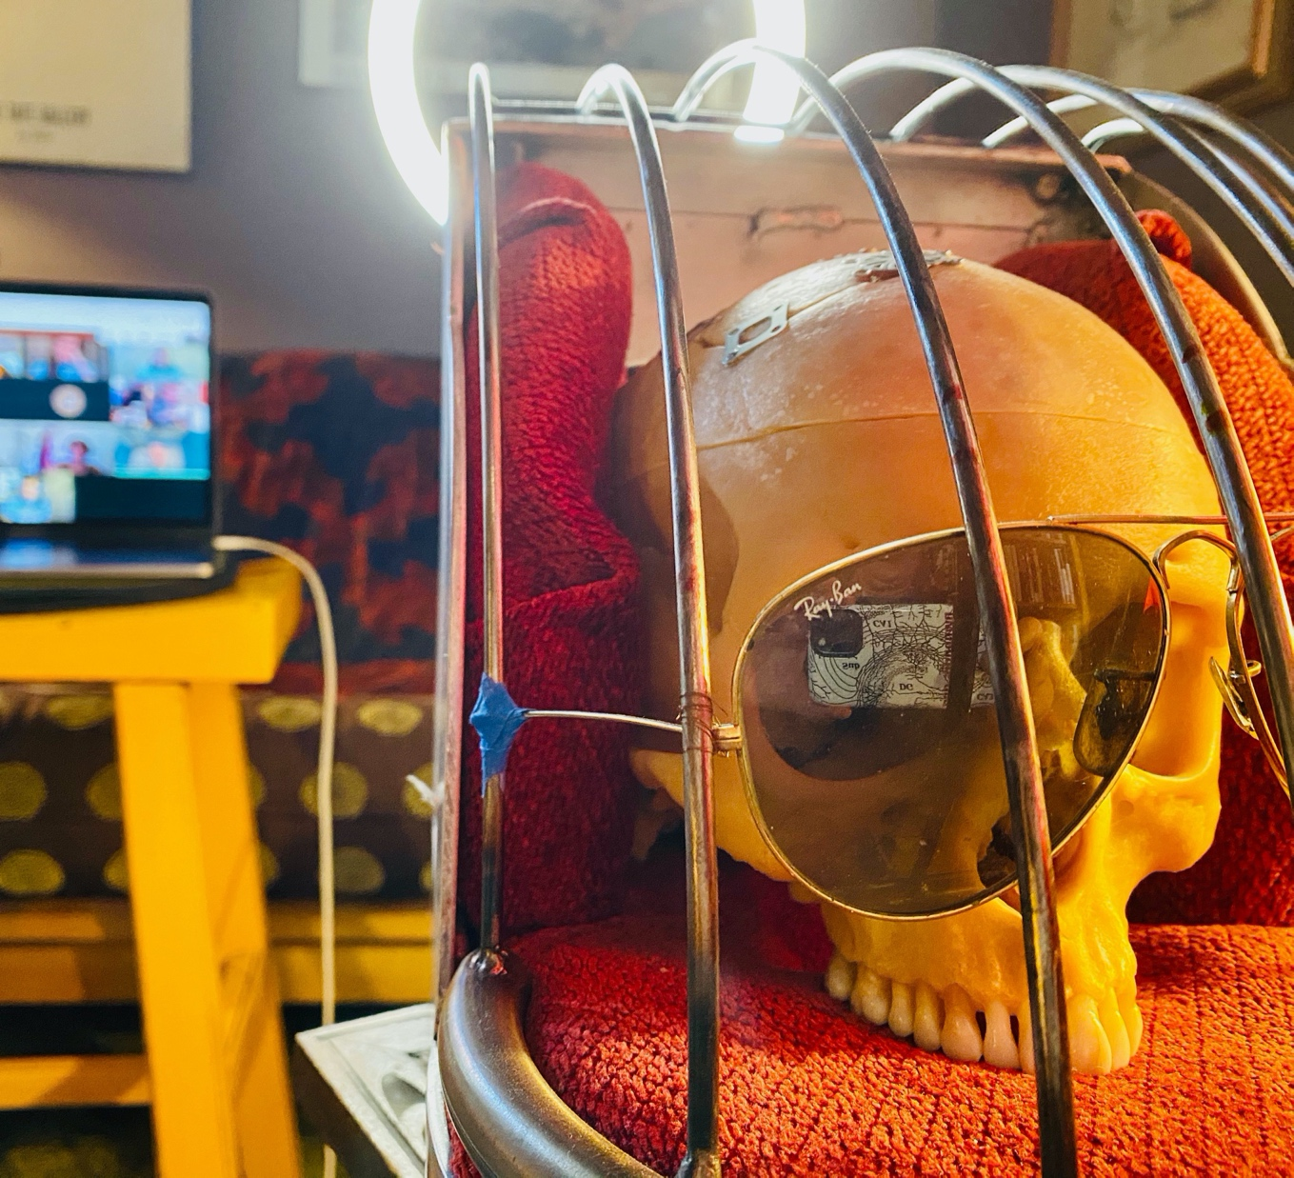
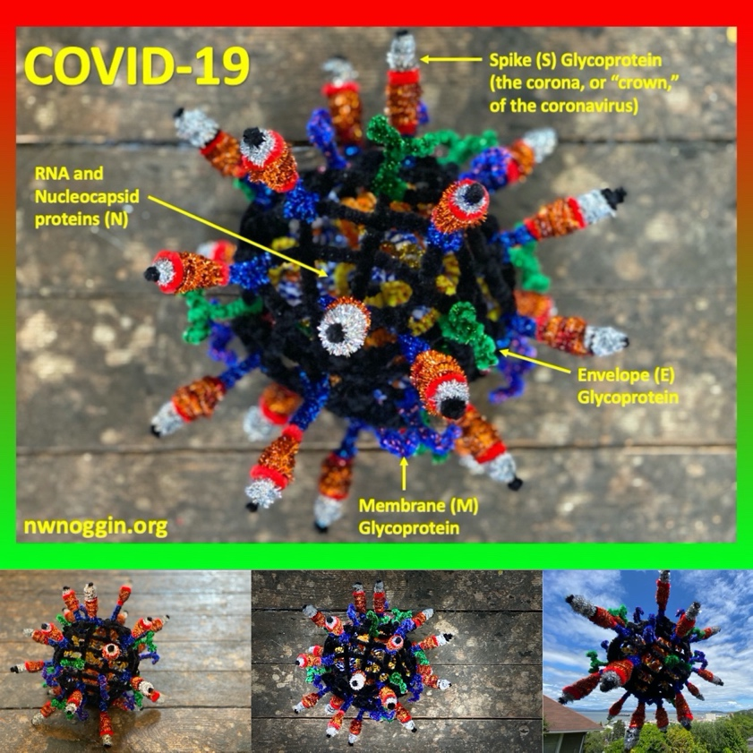
Pandemic connections

Slide 24
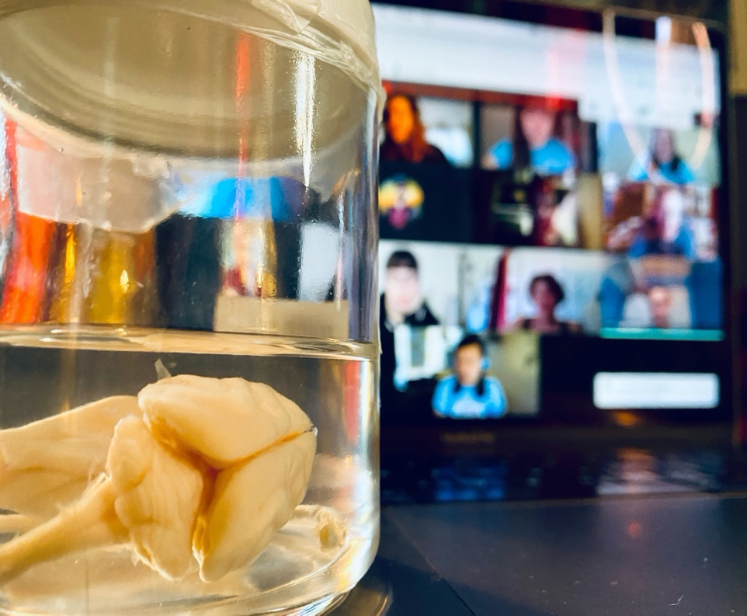

Portland Public Schools
Spring 2020
#showusyourbraincell

Slide 25




Slide 26


#showusyourbraincell

Slide 27


#showusyourbraincell

Slide 28


#showusyourbraincell

Slide 29


ANY BRAIN CELLS
Glial cells
Pyramidal neurons
Photoreceptors
Inner hair cells
Nociceptors
Rhombic lip neurons
Meissner’s corpuscles
#showusyourbraincell

Slide 30


#showusyourbraincell

Slide 31


#showusyourbraincell

Slide 32


#showusyourbraincell

Slide 33


#showusyourbraincell

Slide 34


#showusyourbraincell

Slide 35






Slide 36






#showusyourbraincell

Slide 37


#showusyourbraincell

Slide 38


Make your own – AND SHARE!
#showusyourbraincell

Slide 39
Q&A with Speakers
Bill Griesar, PhD
Senior Instructor
at Portland State University
Jeff Leake
Psychology Professor at Portland State University
Richard Wingate, DPhil
Head of Anatomy at King’s College London

Slide 40




Thank You
Please take the survey after the webinar ends.
Explore the Brain and Mind on http://www.brainfacts.org.
Follow BrainFacts.org
@Brain_Facts_org on Twitter
Brain_Facts_org on Instagram
https://www.facebook.com/BrainFactsOrg

