Slide 1
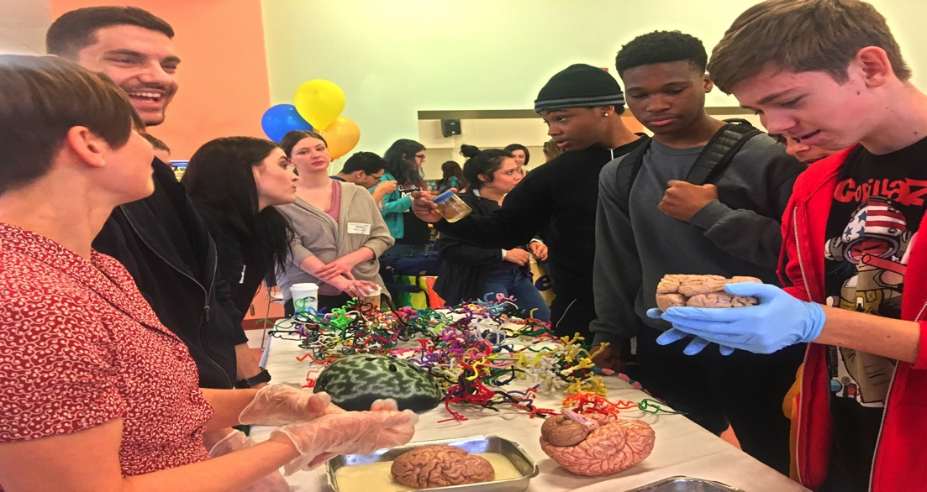
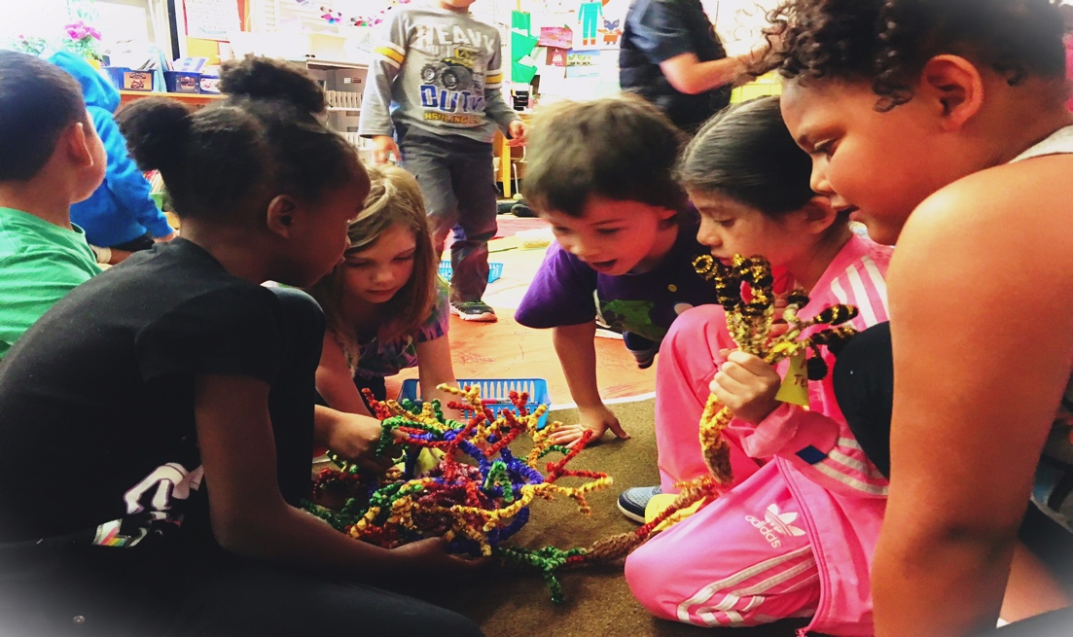
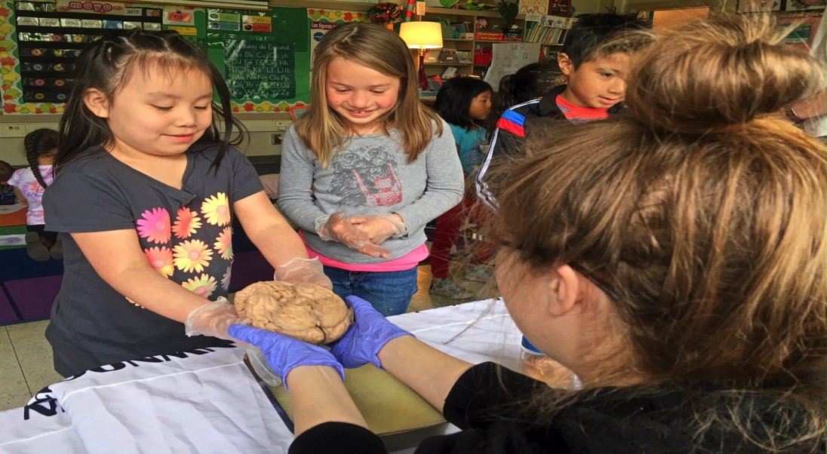
nwnoggin.org
Arts integrated neuroscience outreach for K-12 & community

Slide 2
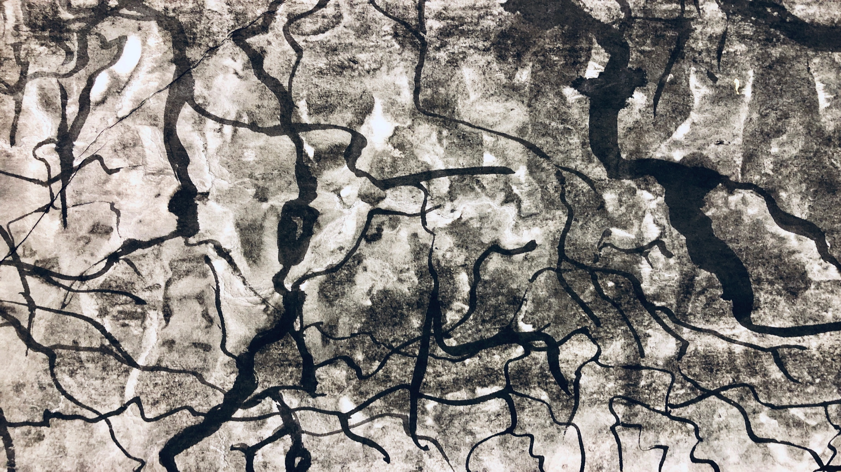
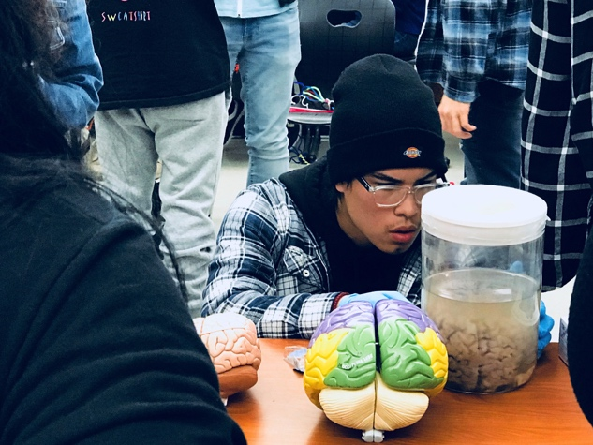
Behavioral Neuroscience Retreat
Bill Griesar, Ph.D.
  Senior Instructor, Psychology, Portland State University
  Affiliate Graduate Faculty, Behavioral Neuroscience, OHSU
  Co-Founder/Neuroscience Coordinator, nwnoggin.org
Action and Potential in Outreach, Teaching & Research

Slide 3
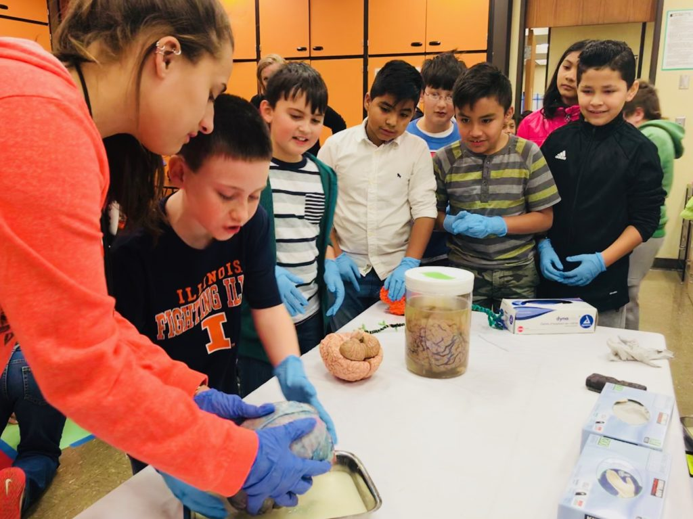
What you do has relevance
GO PLACES
Sleep
Anxiety
Depression
ADHD
Autism
Development
Perception
Drugs
Memory
Language
Bias
…

Slide 4
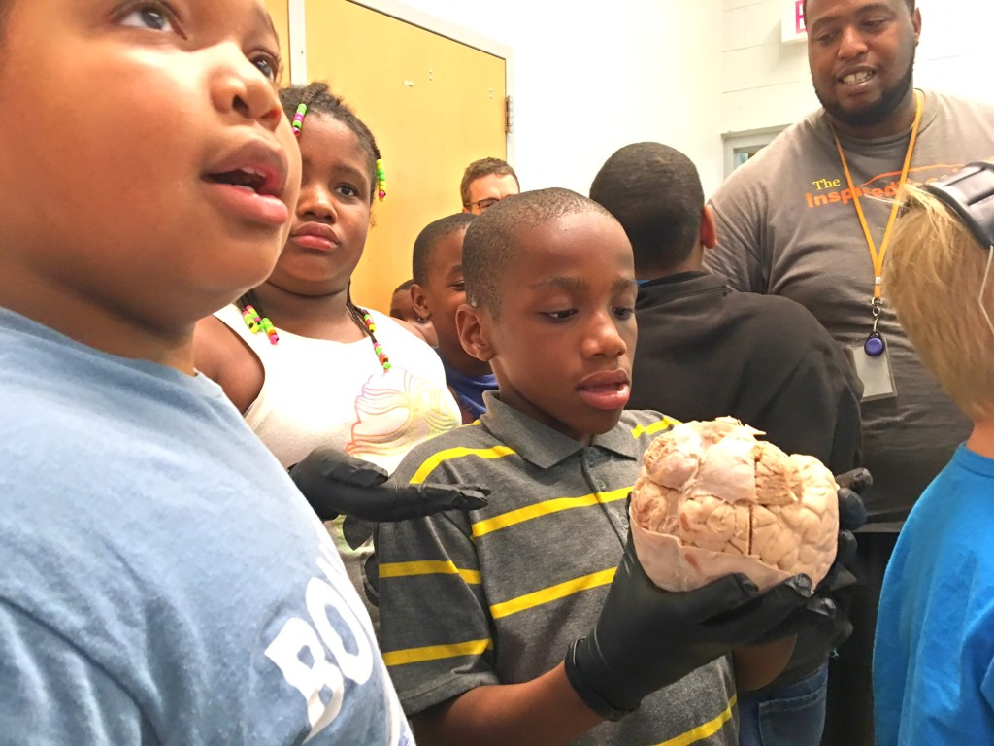
We all pay for research

Slide 5
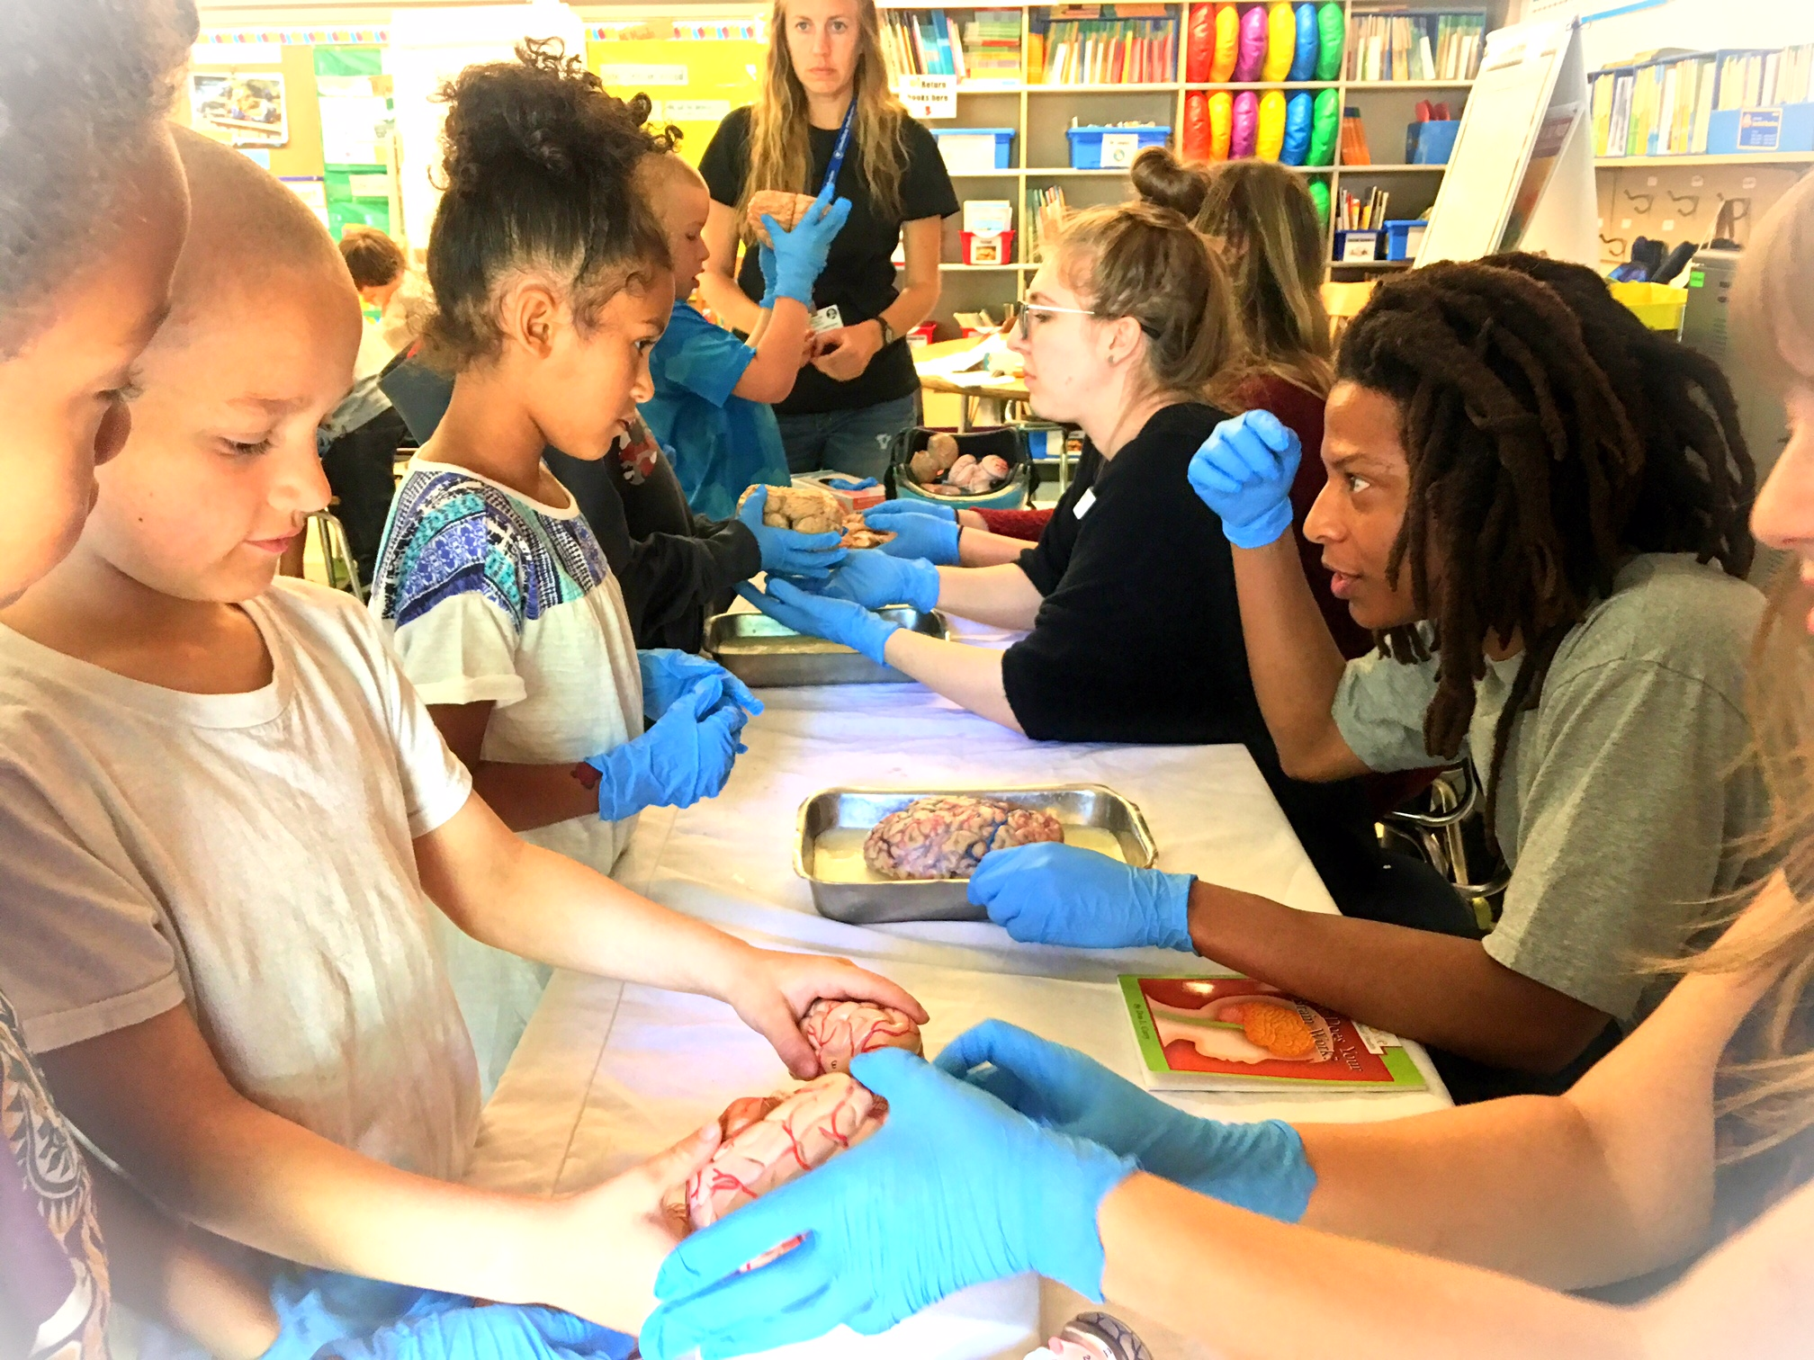
Connections matter
Greater understanding
More support for research
Increased participation
Less confirmation bias
New directions
FUN!

Slide 6
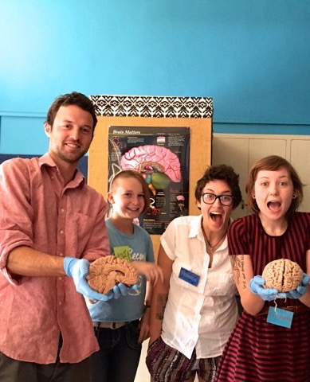
BEHN 650: Teaching Practicum
Two, two week sessions, winter term, four slots…
Are you curious about teaching? Want to work with undergraduates at PSU, the most diverse public university in Oregon? Improve your speaking & presentation skills, & make your research accessible? Are you excited about engaging, inspiring & genuinely connecting with students as a role model & mentor? Are you interested in gaining experience that might help you land a job after your defense..?
Behavioral Neuroscience offers a Teaching Practicum course (BEHN 650) in winter term, which provides short (two week) opportunities for post-quals graduate students with mentor permission to prepare and deliver lectures on your own lab work & current topics in neuroscience research (e.g., drug abuse/dependence, learning & memory, adolescent brain development, neurodegeneration,…), lead discussions, organize online course materials, & develop/score assessments.

Slide 7
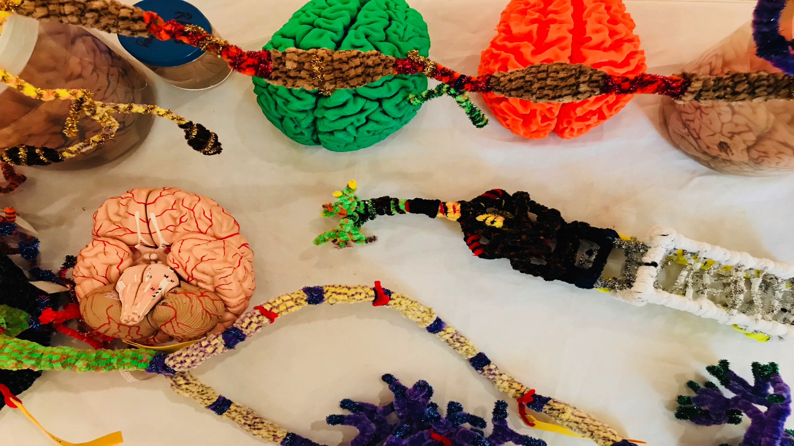
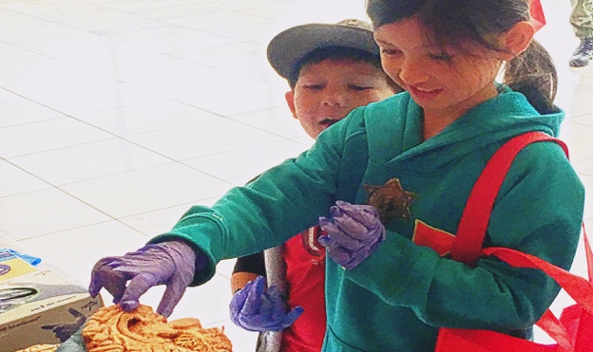
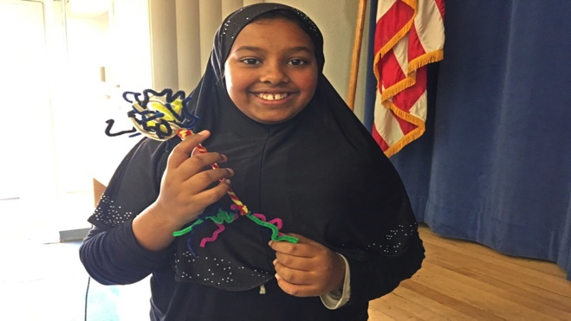
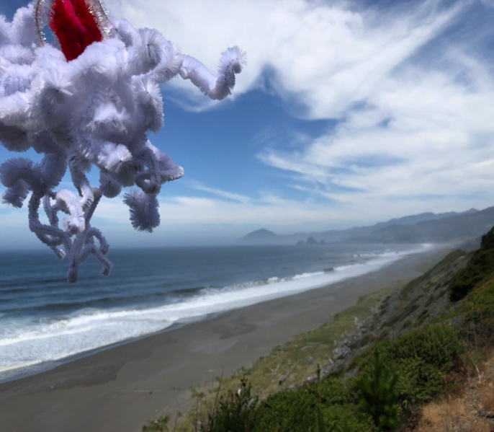
BUILD NEW
CONNECTIONS
Academic priority K-12, urban/rural communities, tribal majority schools
  Not always well-funded, or valued, often ignored, subjected to standardized testing that primarily benefits others. Complex brain development underway, unacknowledged diversity, mental health…
Homeless youth (p:ear), incarcerated youth (MacLaren Correctional Facility)
  “It’s like people see me as an object, not as a human being”
Young graduate researchers, undergraduates (PSU, OHSU,…)
  How does my research relate to the world? How can I explain it?
  Where can I go from here? “Alternative careers” in science…
Artists: Painters, Dancers, Storytellers, Musicians
  How does my work relate to other fields? How do I connect with new audiences?
  How is my practice influenced and enriched by discoveries about the brain?
Area businesses (BioGift, Intel, Velo Cult, Hospitals)
  How can we better connect with everyone in our community?
Members of the public
  Why are my taxes spent on research? Art? What are we discovering? Making?
Oh the places
you’ll go!

Slide 8
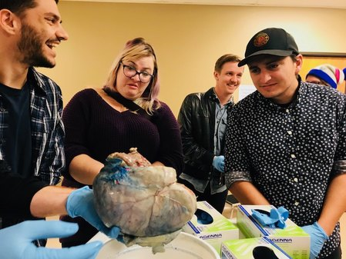
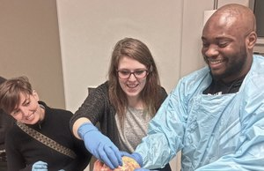
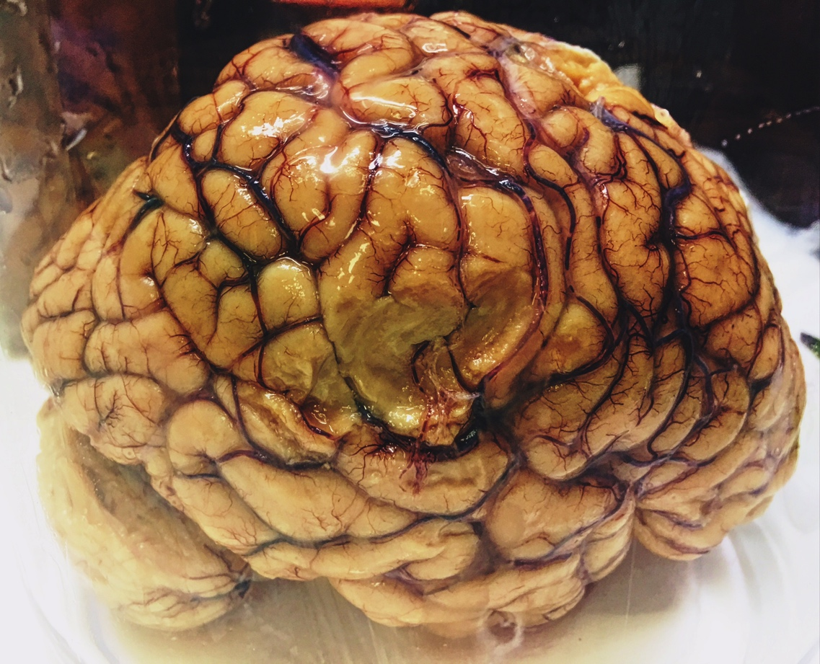
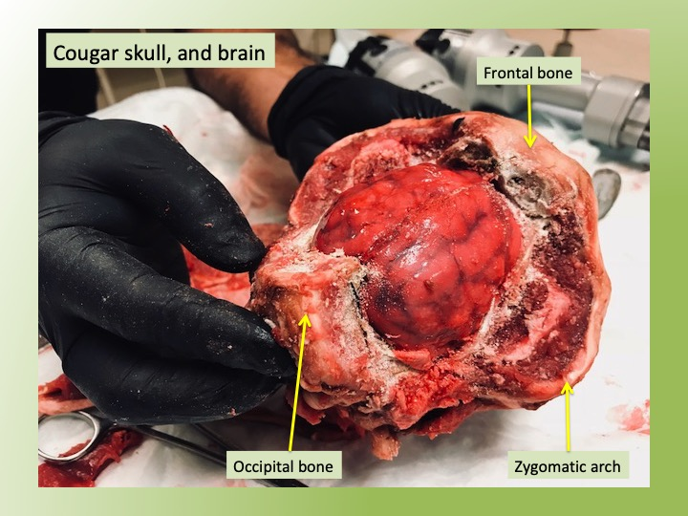
Brains for outreach
BioGift
Body donation
Job opportunities
Neuroanatomy

Slide 9
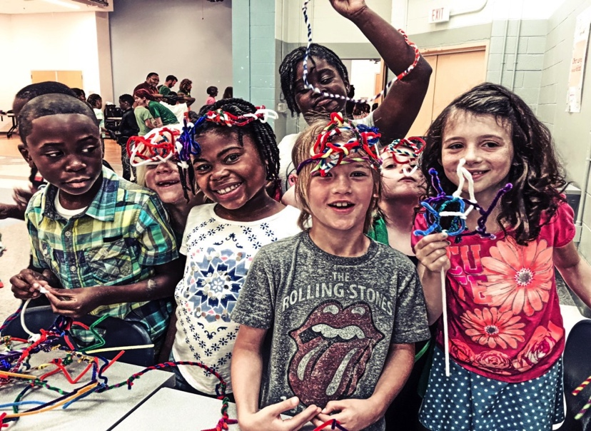
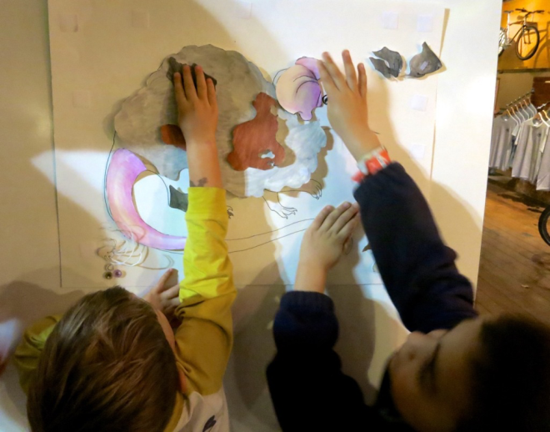
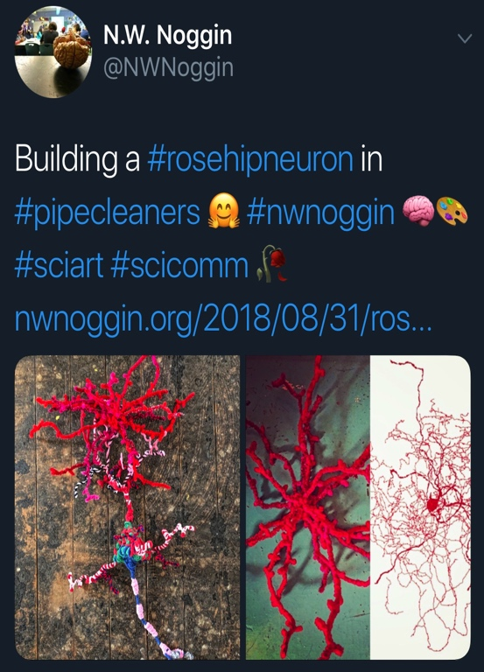
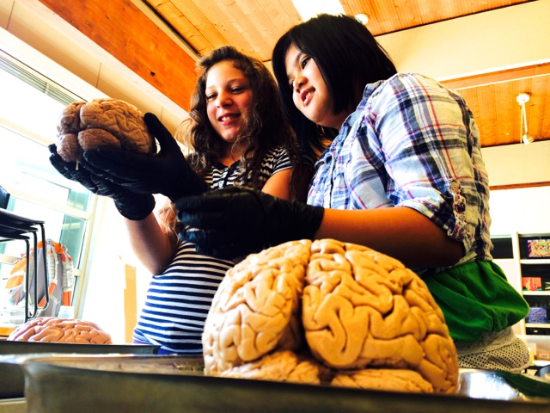
Why art & brains..?
Motivation, engagement, empathy
Exploration, creativity, INNOVATION
Personal relevance of STEAM material
Build your own mouse line!

Slide 10
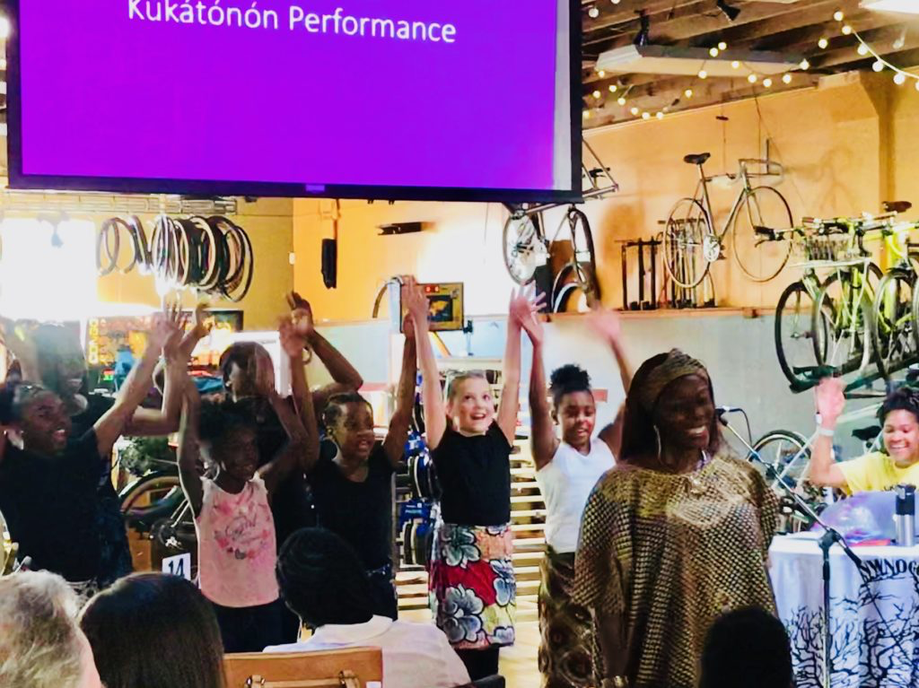
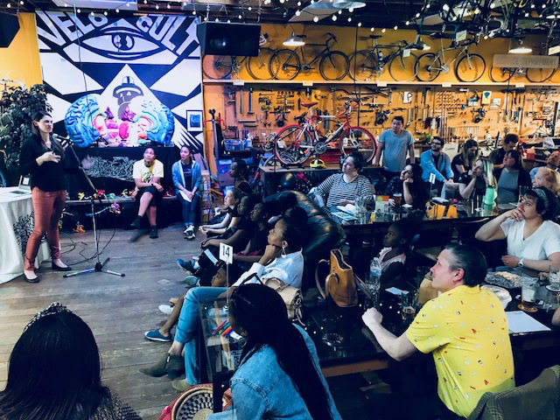
Kúkátónón Dance Troupe @ Velo
For example…
Dancing, mistakes, movement
…and Parkinson’s!

Slide 11
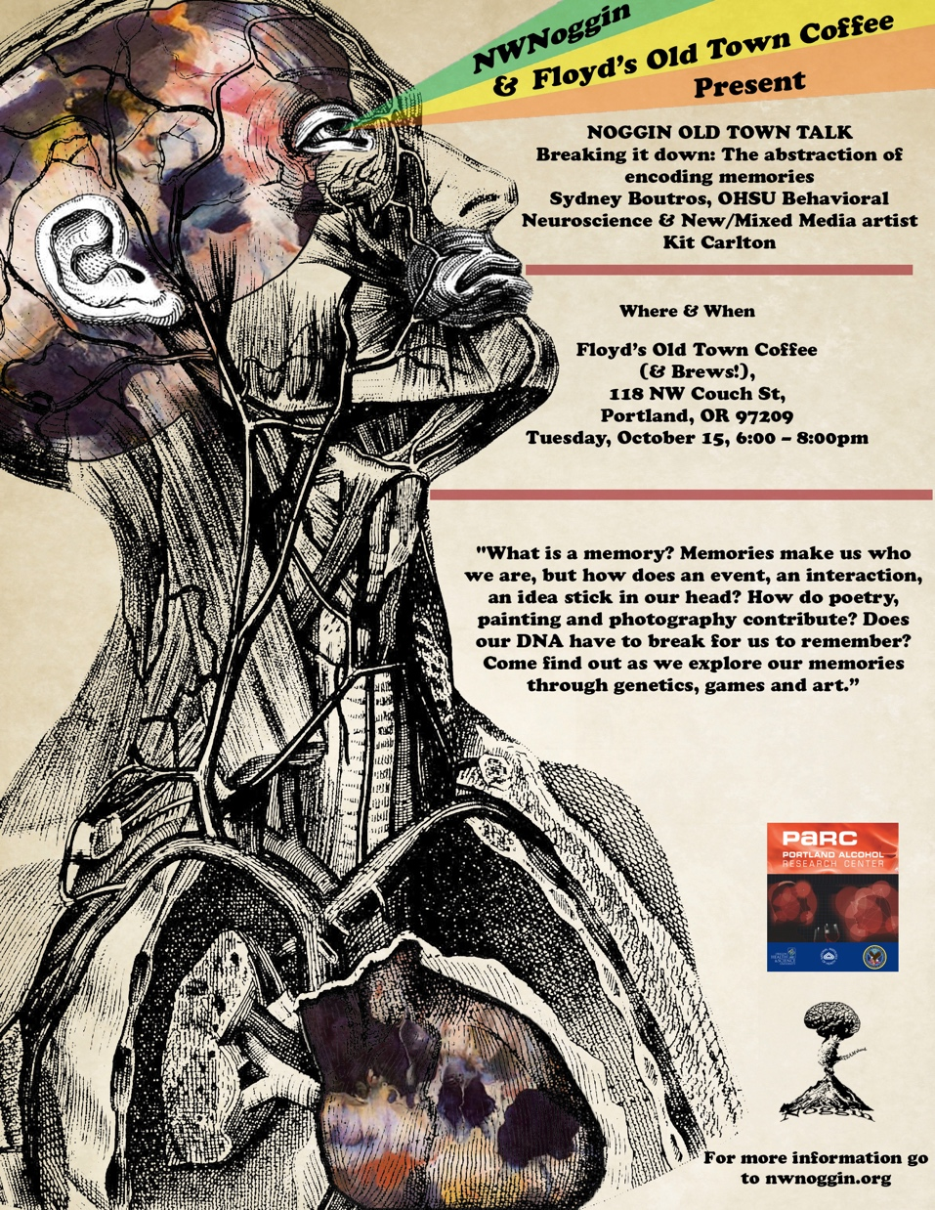
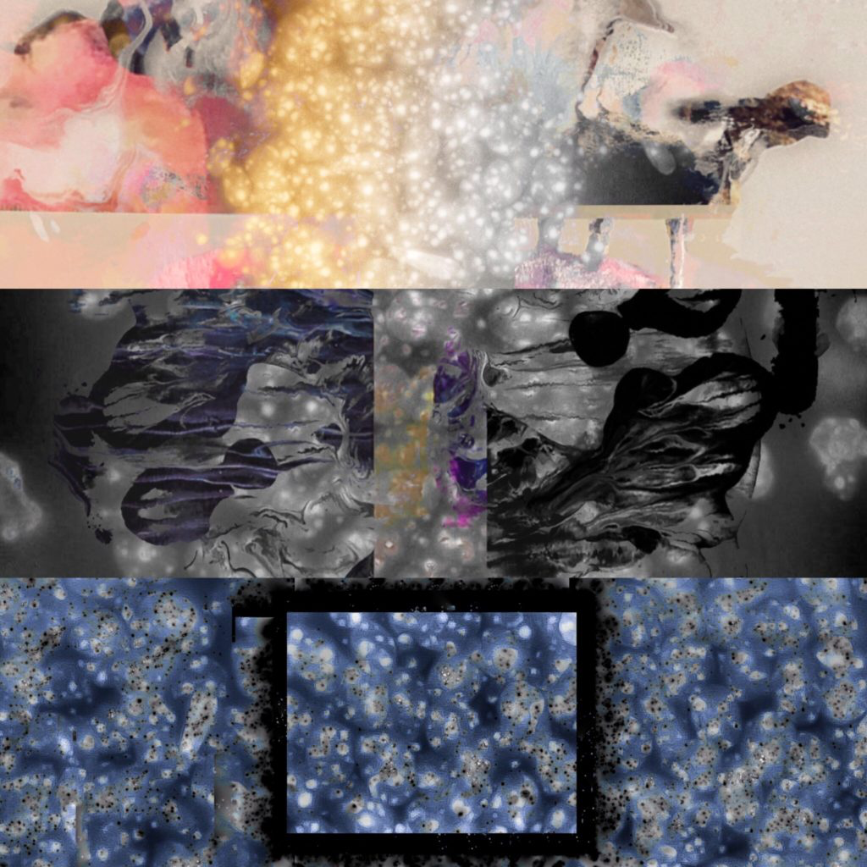
Old Town Talks
JOIN US!
Winter..?
Spring..?
Coming in October (10/15, 6-8pm!)
Floyds Old Town Coffee, Portland OR
Sydney Boutros (OHSU) & artist Kit Carlson

Slide 12
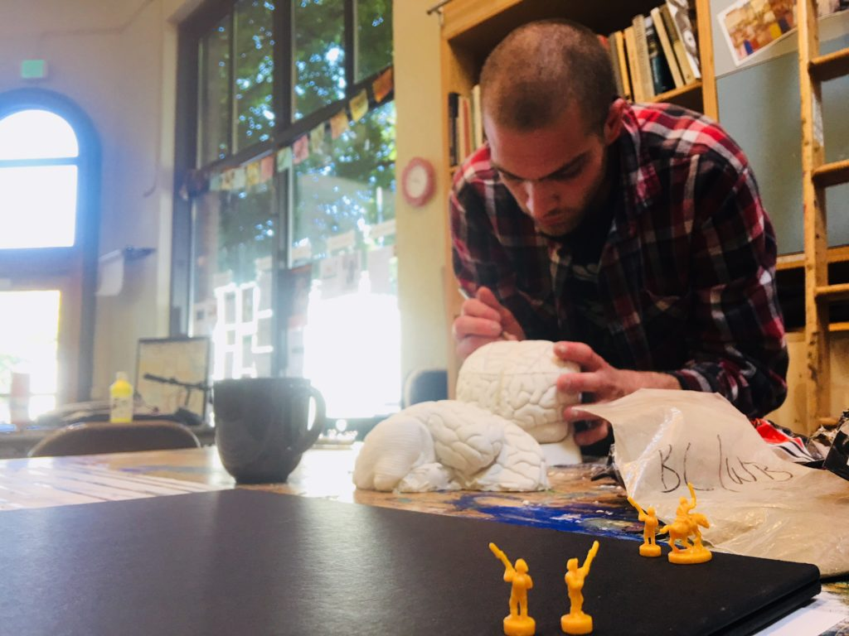
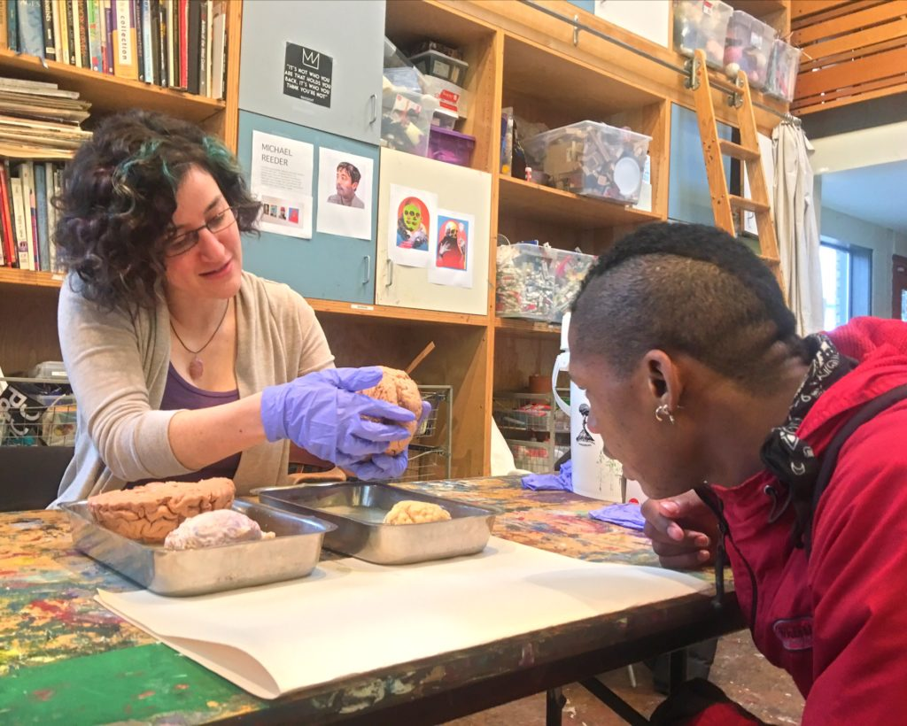
Noggin @ p:ear
  “It’s like people see me as an object, not as a human being”

Slide 13
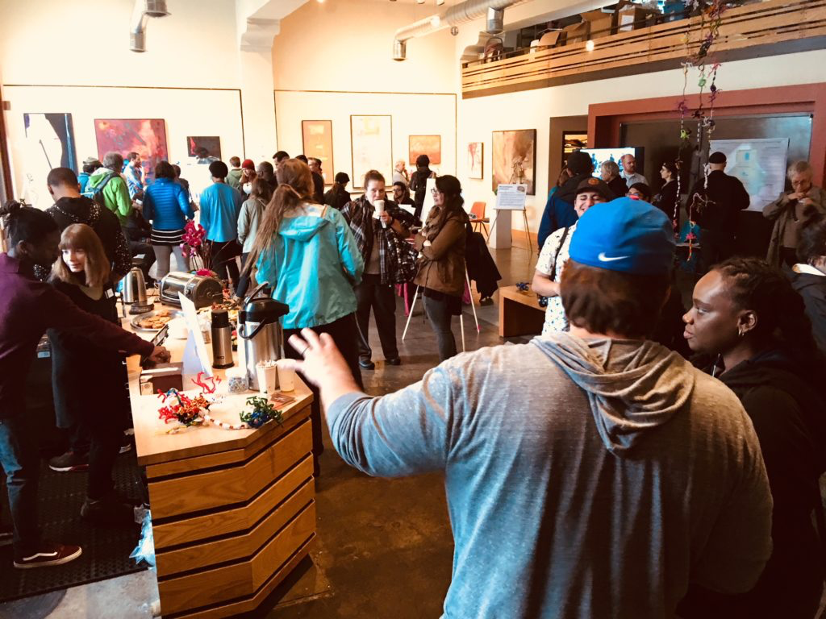
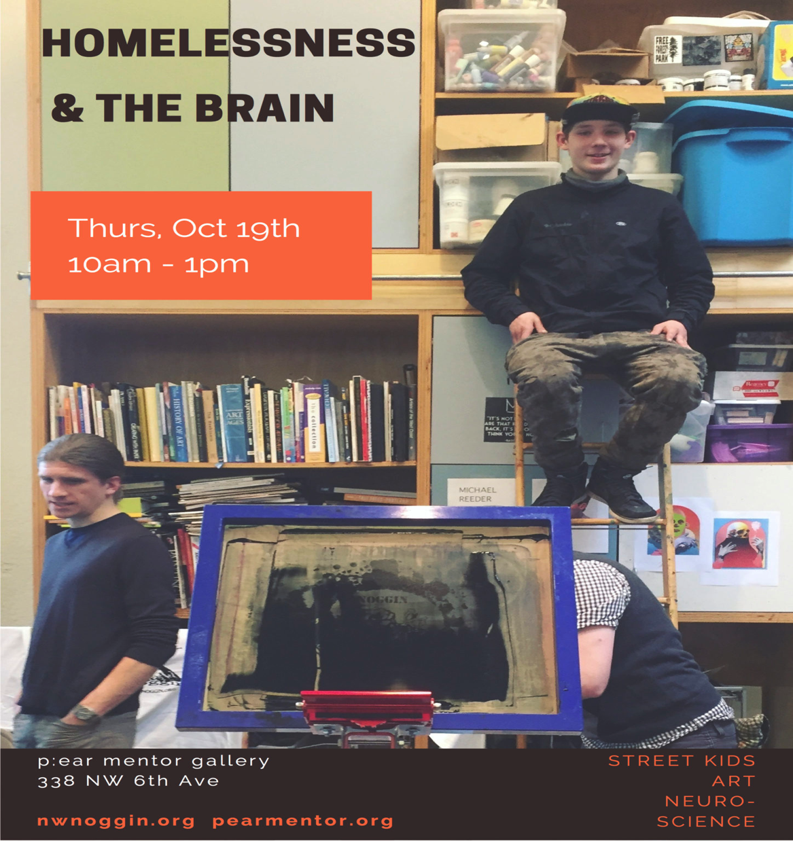
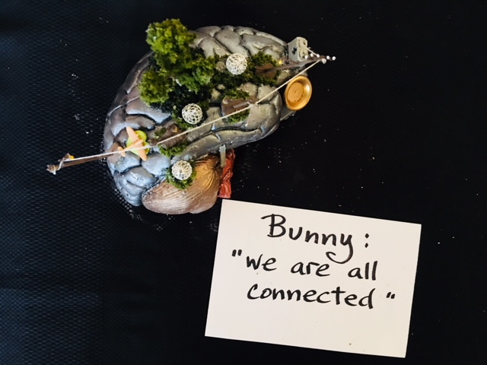
Researchers
Clinicians
Policy makers
Houseless youth

Slide 14
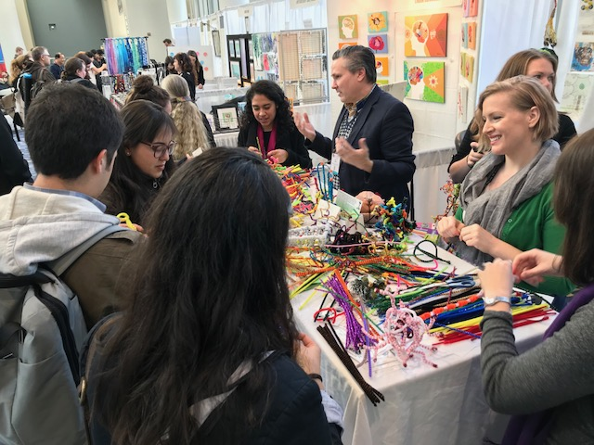
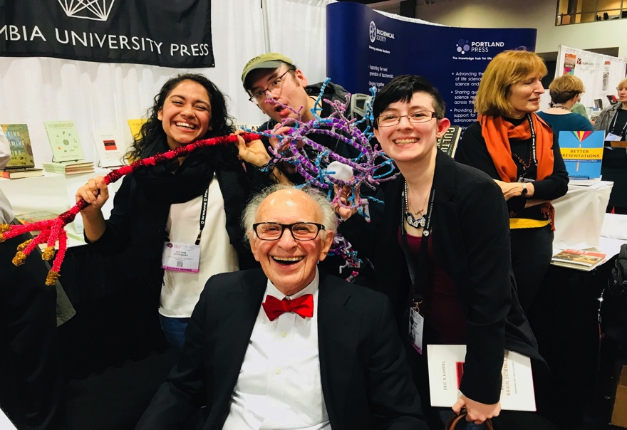
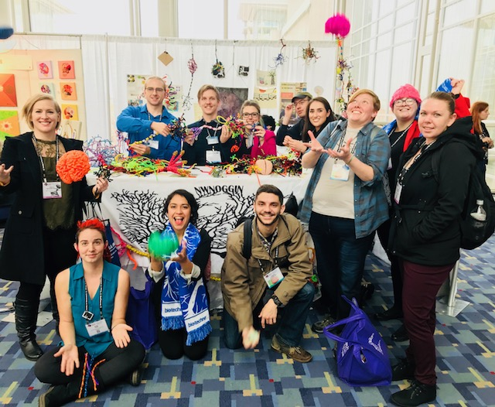
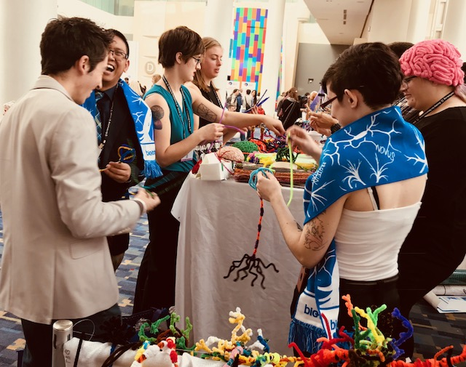
At SfN in DC (2017)
Posters, art of neuroscience and…

Slide 15
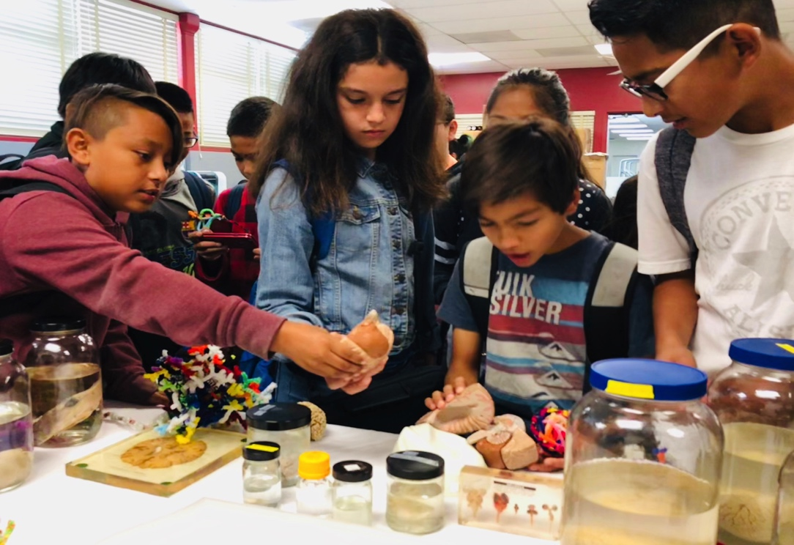
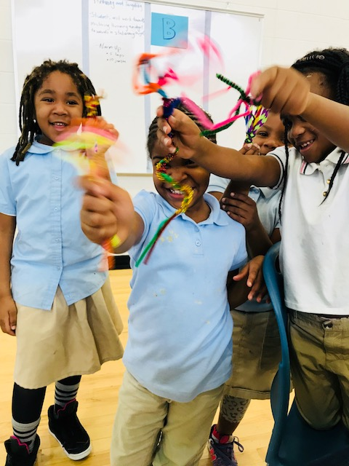
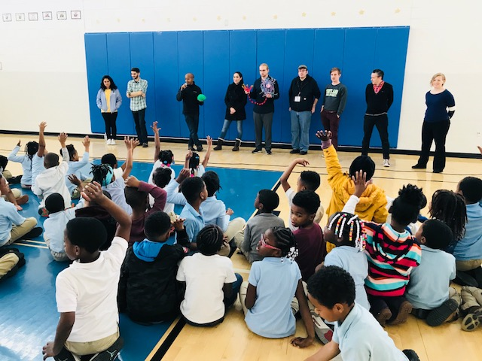
School visits
And during SfN 2018…
San Diego Unified Public Schools!
Turner Elementary, DC

Slide 16
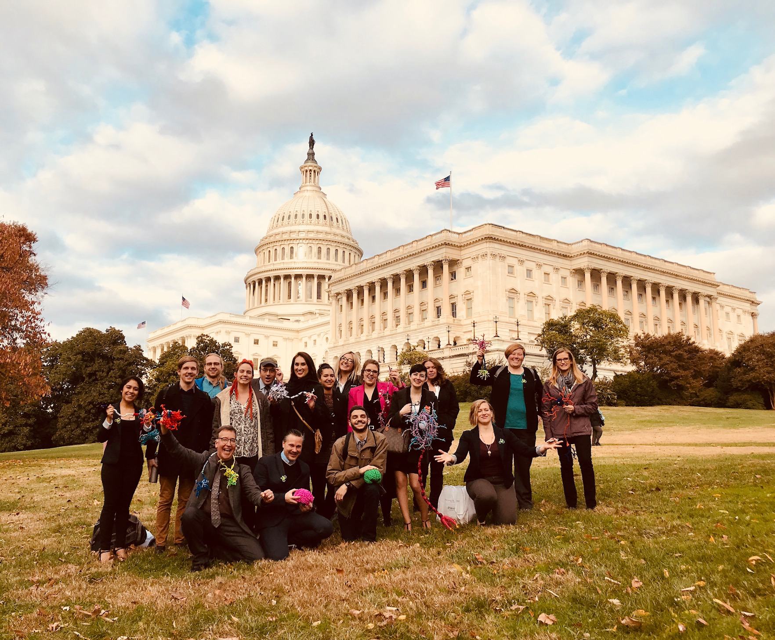
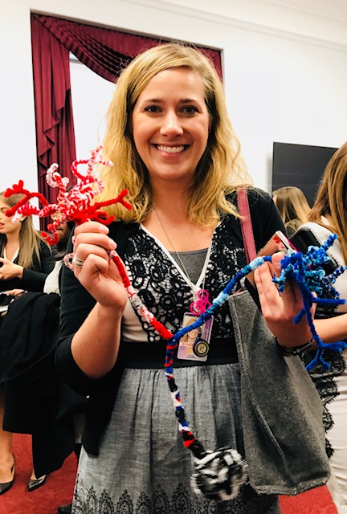
And also…Capitol Hill
More connections: Congressional office visits
Congressional Neuroscience/STEAM briefing
Research should inform policy

Slide 17
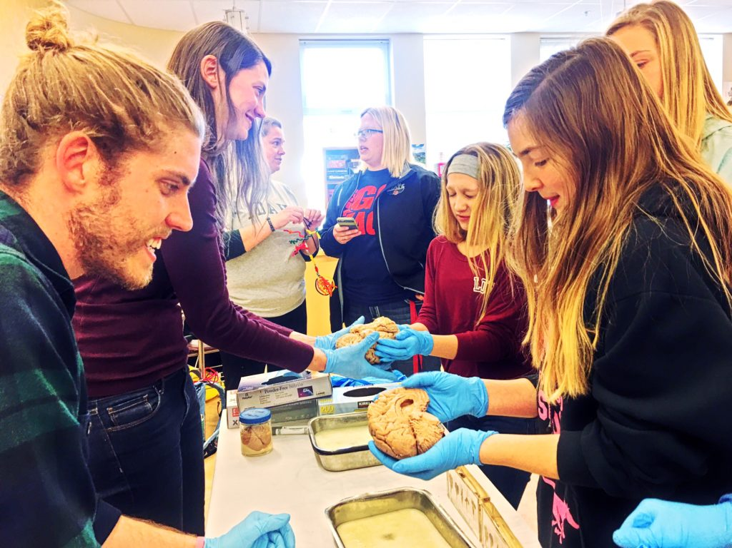
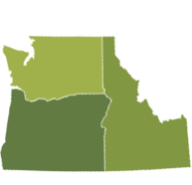
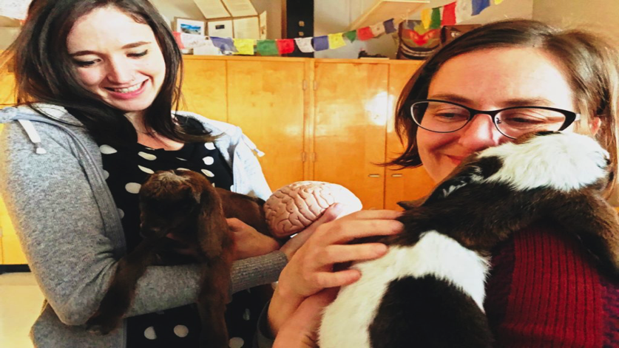
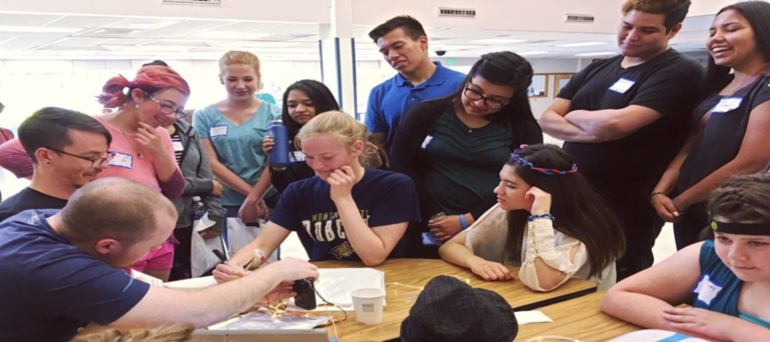
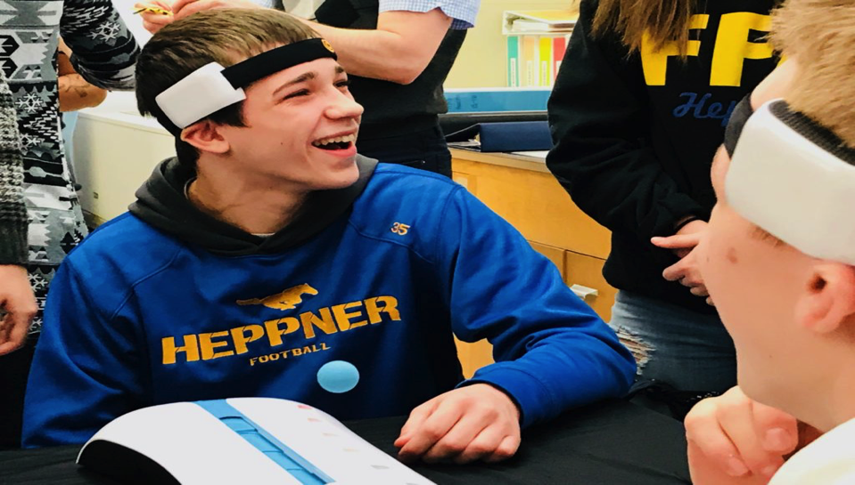
Rural Outreach
Food, housing, baby goats…
LEAVE TOWN!
Siletz, Amity & Willamina, OR
Pop: 4,000
Davenport, WA
Pop: 1,700
La Grande, OR
Pop: 13,000
Meservy Meadows, OR Pop: ~40
Heppner & Ione, OR
Pop: 1,240

Slide 18
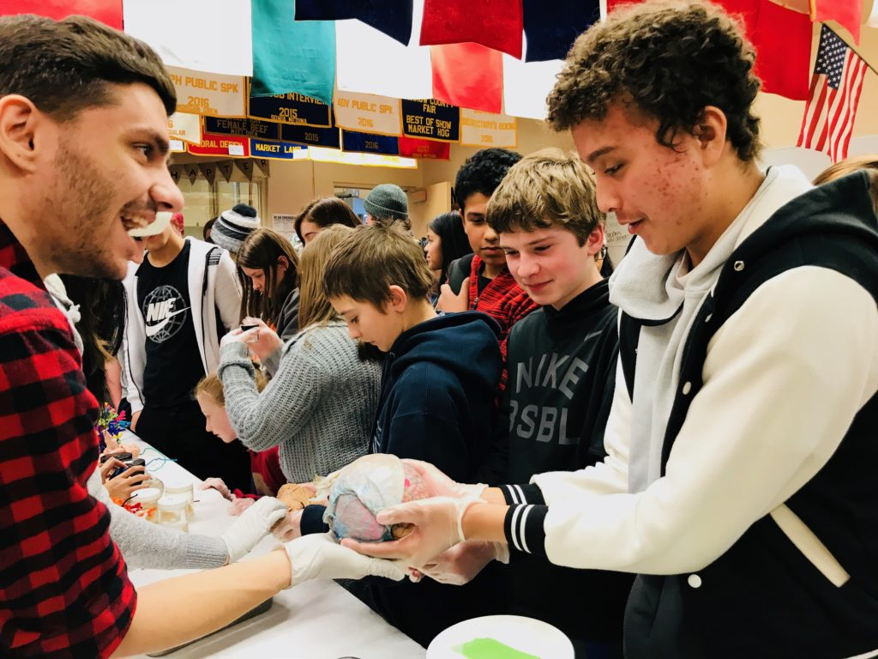
Noggin in Heppner, OR

Slide 19
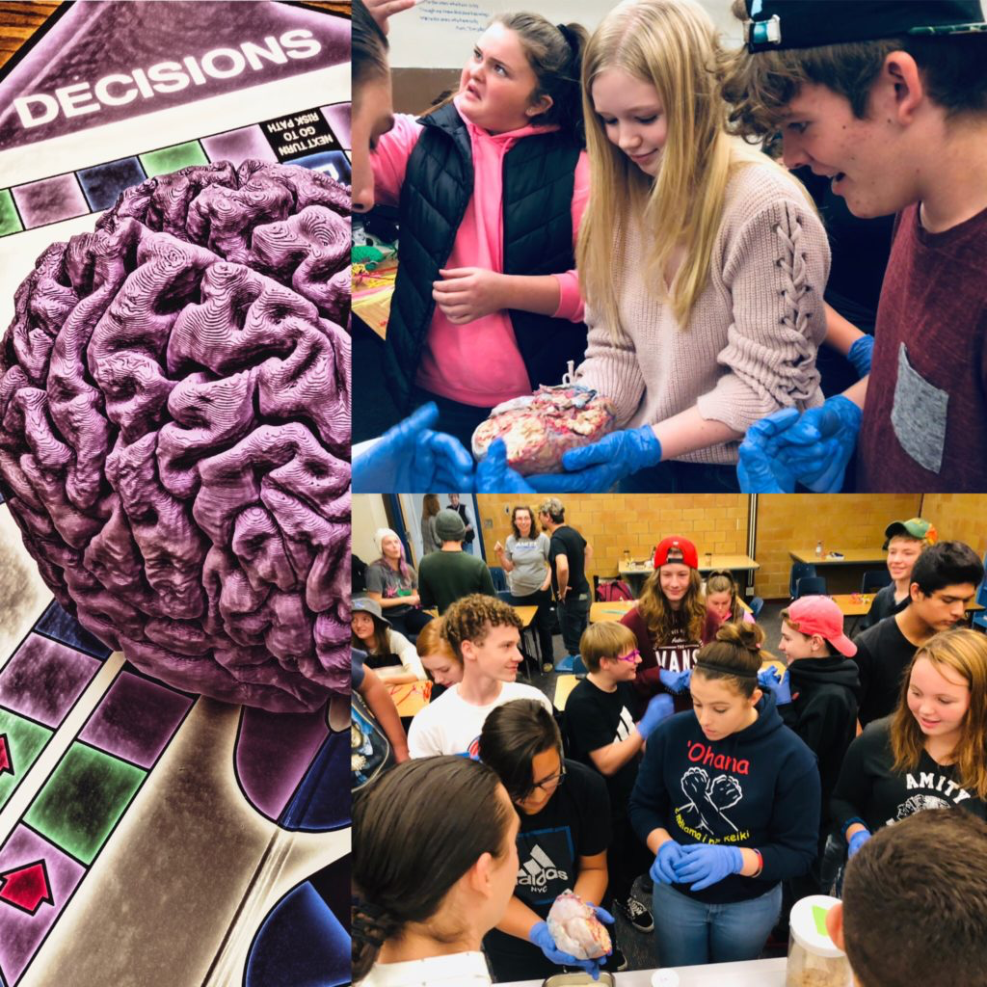
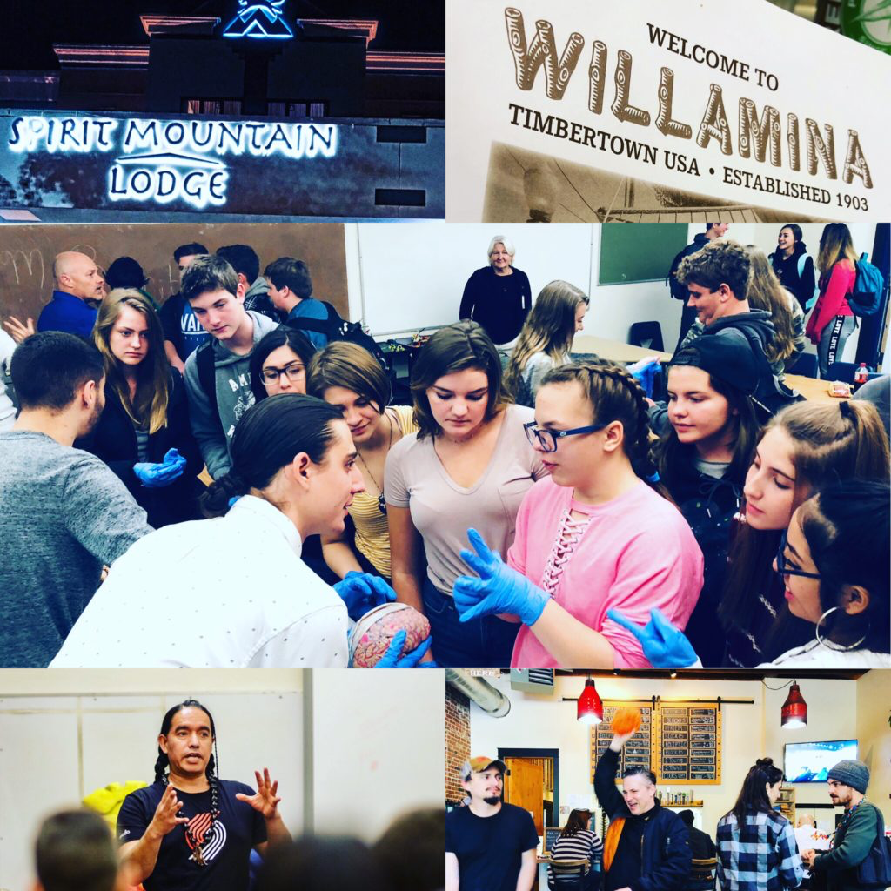
Synapses, Stories & Song
Confederated Tribes of the Grande Ronde, Siletz

Slide 20
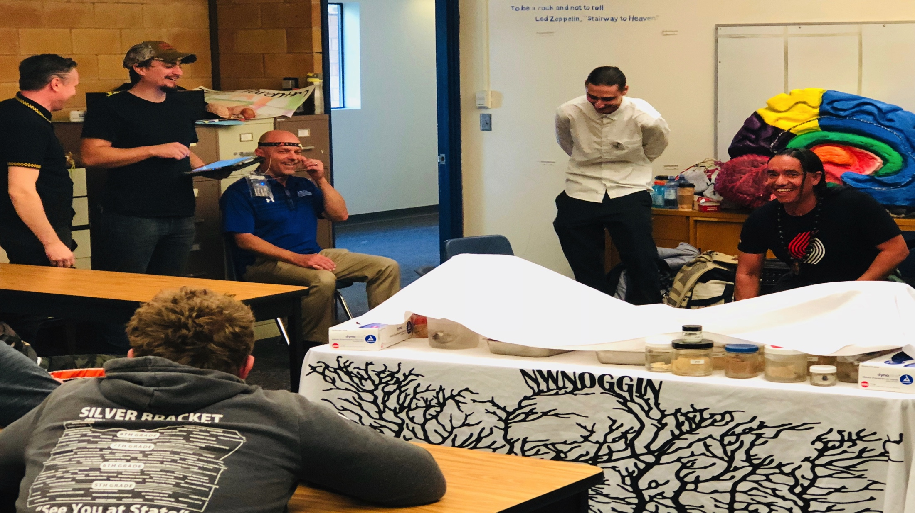
Synapses, Stories & Song

Slide 21
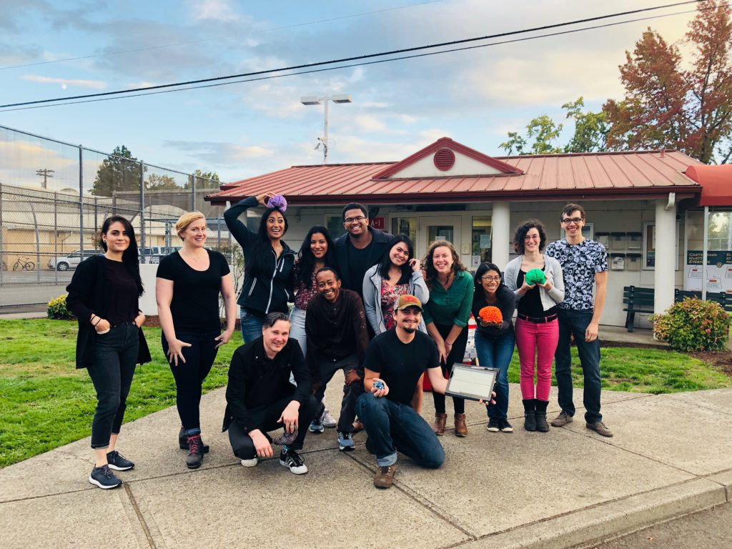
Neuroscience & the Law
MacLaren Youth Correctional Facility

Slide 22
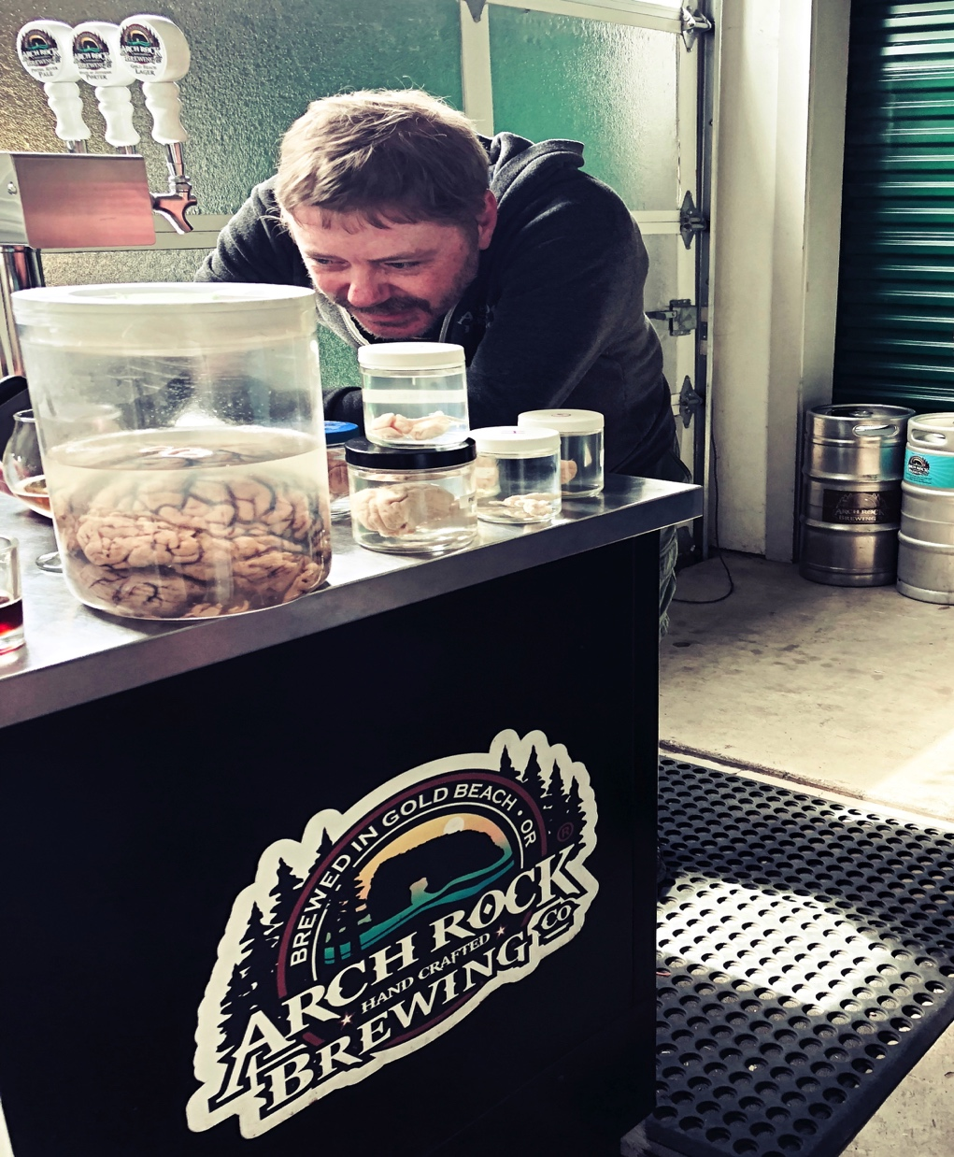

Arch Rock Brewing,
Gold Beach, OR
Alcohol and the brain

Slide 23









Art + Neuroscience = 3D printed brains
Collaboration with Make + Think + Code @ PNCA, Intel, PDX 3D Printing Lab!
Gray matter
White matter

Slide 24




Noggin Fest Saturday October 5!

Slide 25




