Slide 1
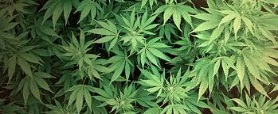
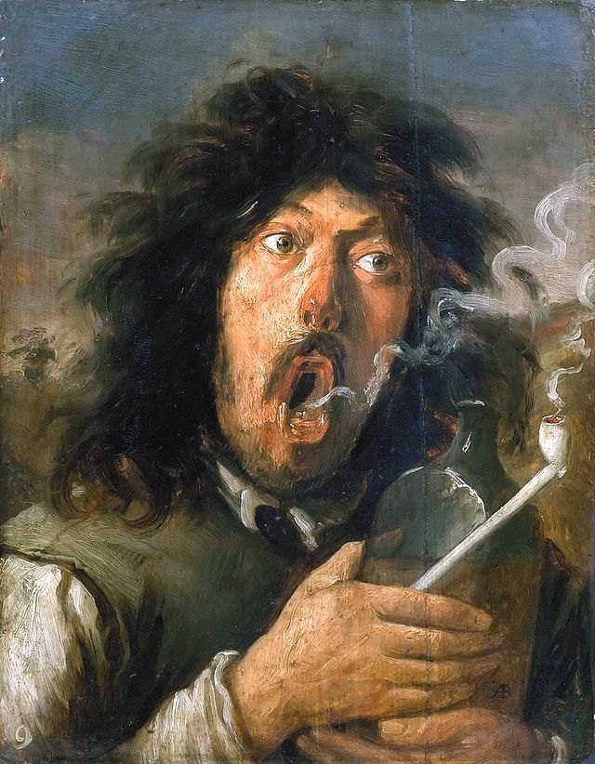
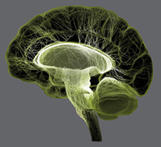
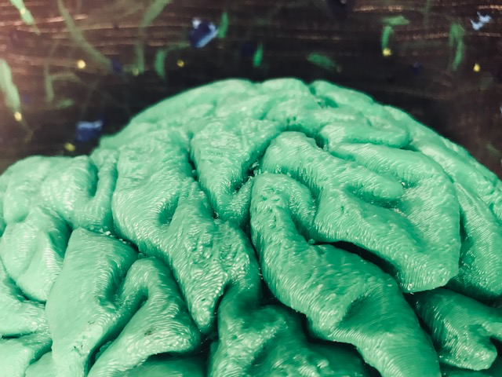
Cannabis, Pain, Bias & Brain
Bill Griesar, Ph.D.
Jeff Leake, MFA
  Psychology, University Studies
    Portland State University
  Behavioral Neuroscience
    Oregon Health & Science University
  NW Noggin, nwnoggin.org
Joos van Craesbeeck
“The Smoker” 1635

Slide 2
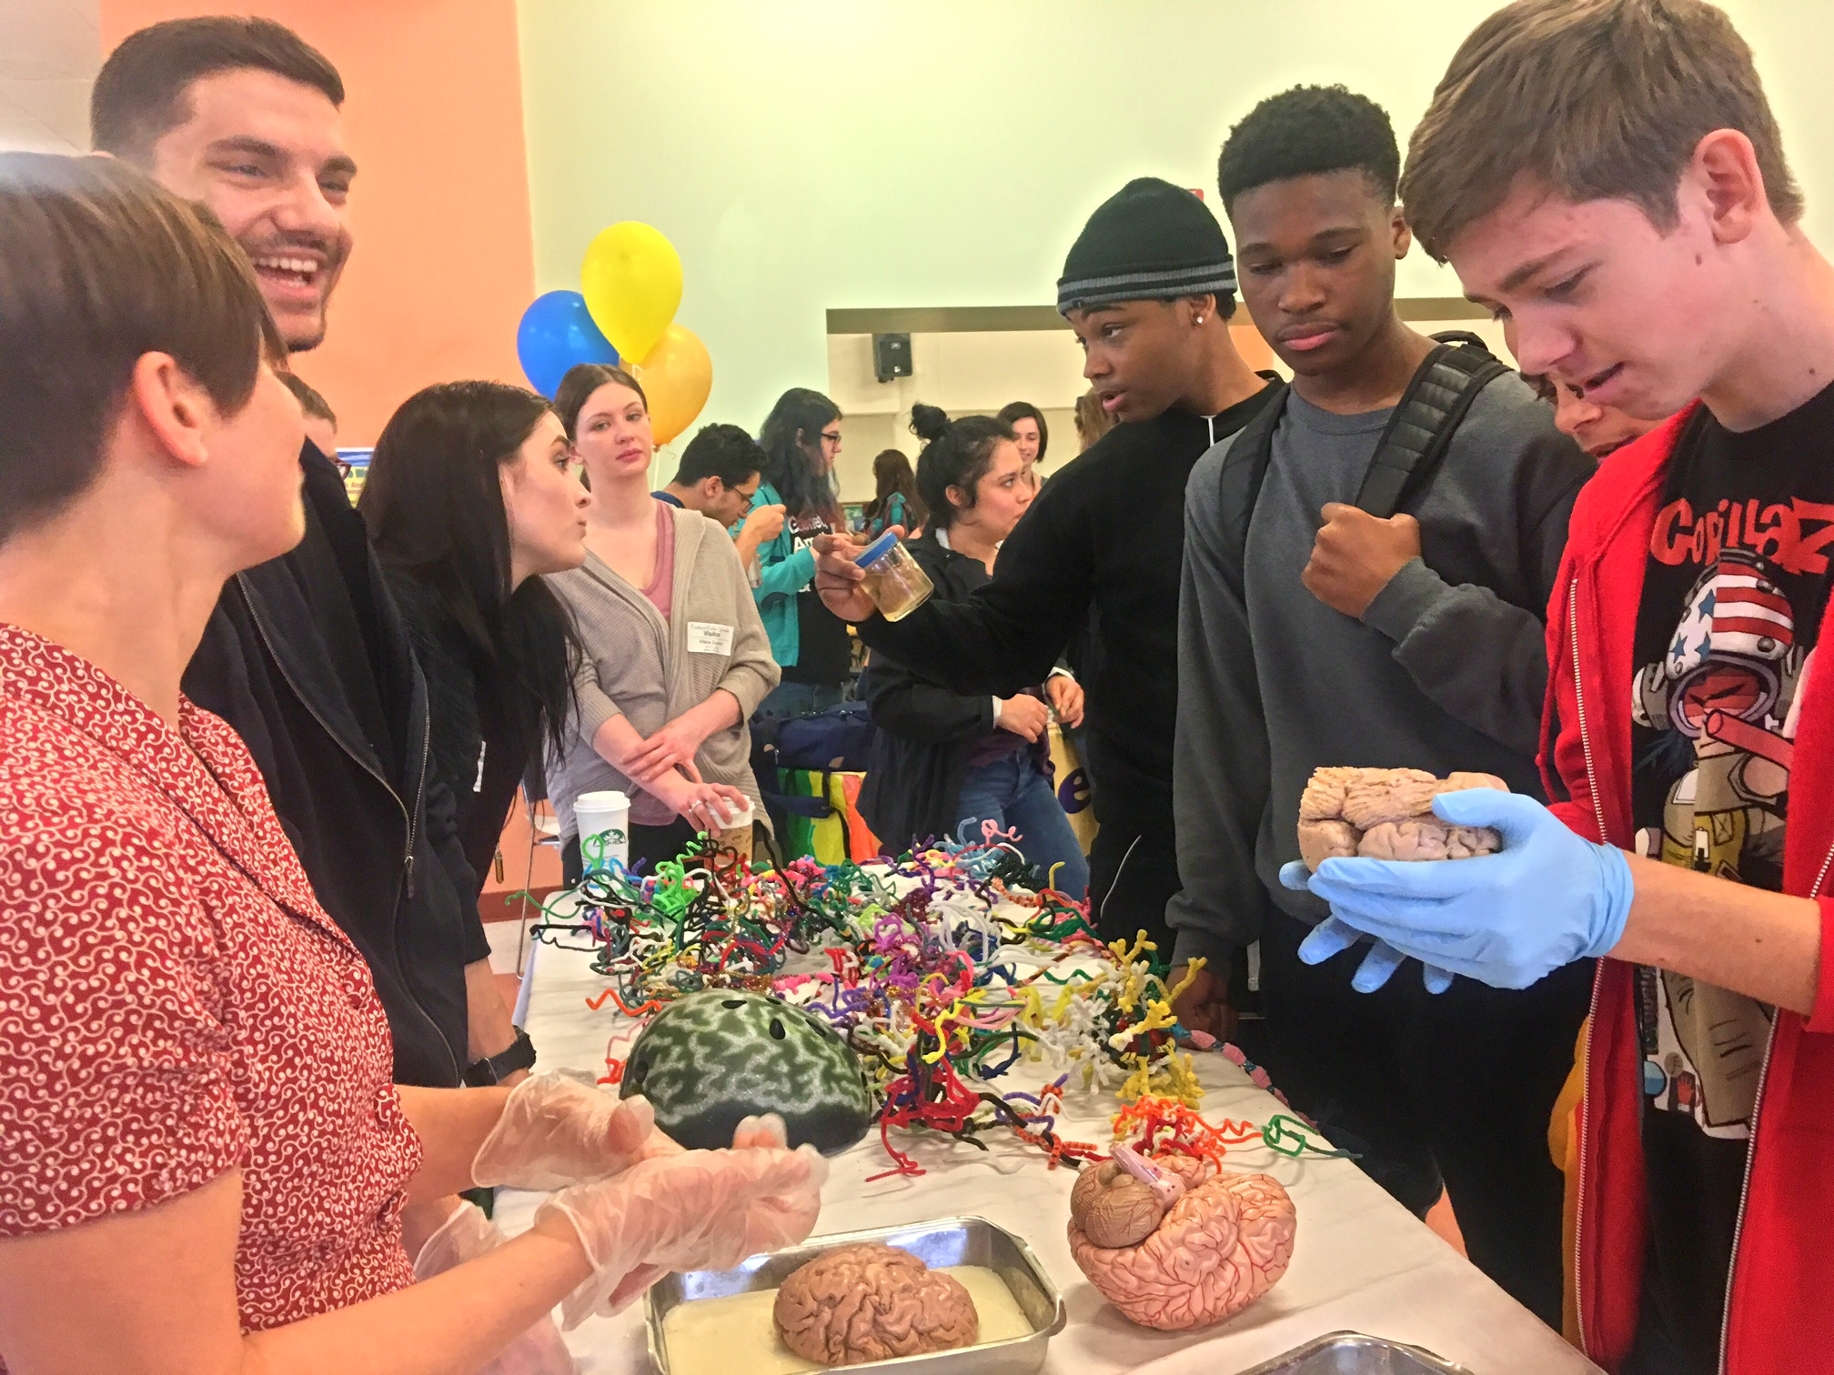
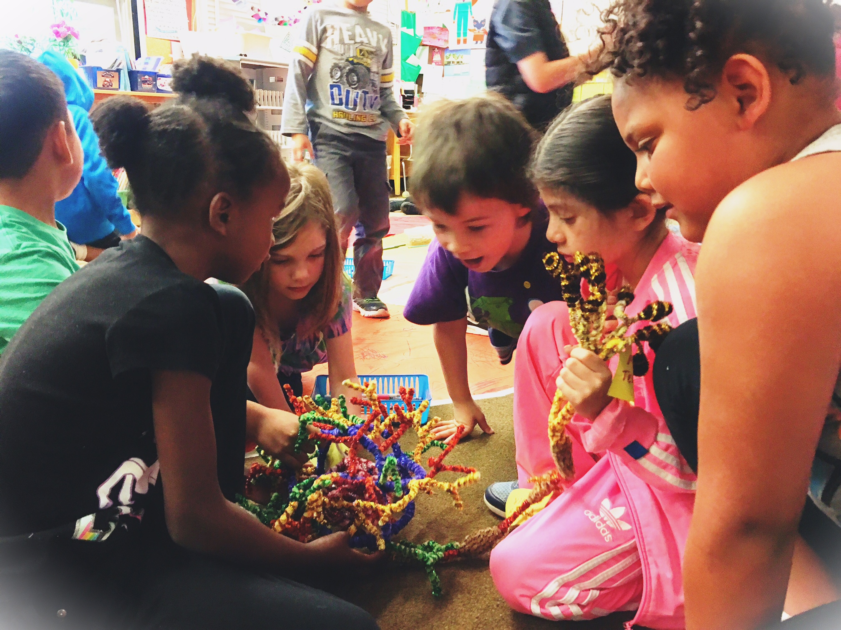
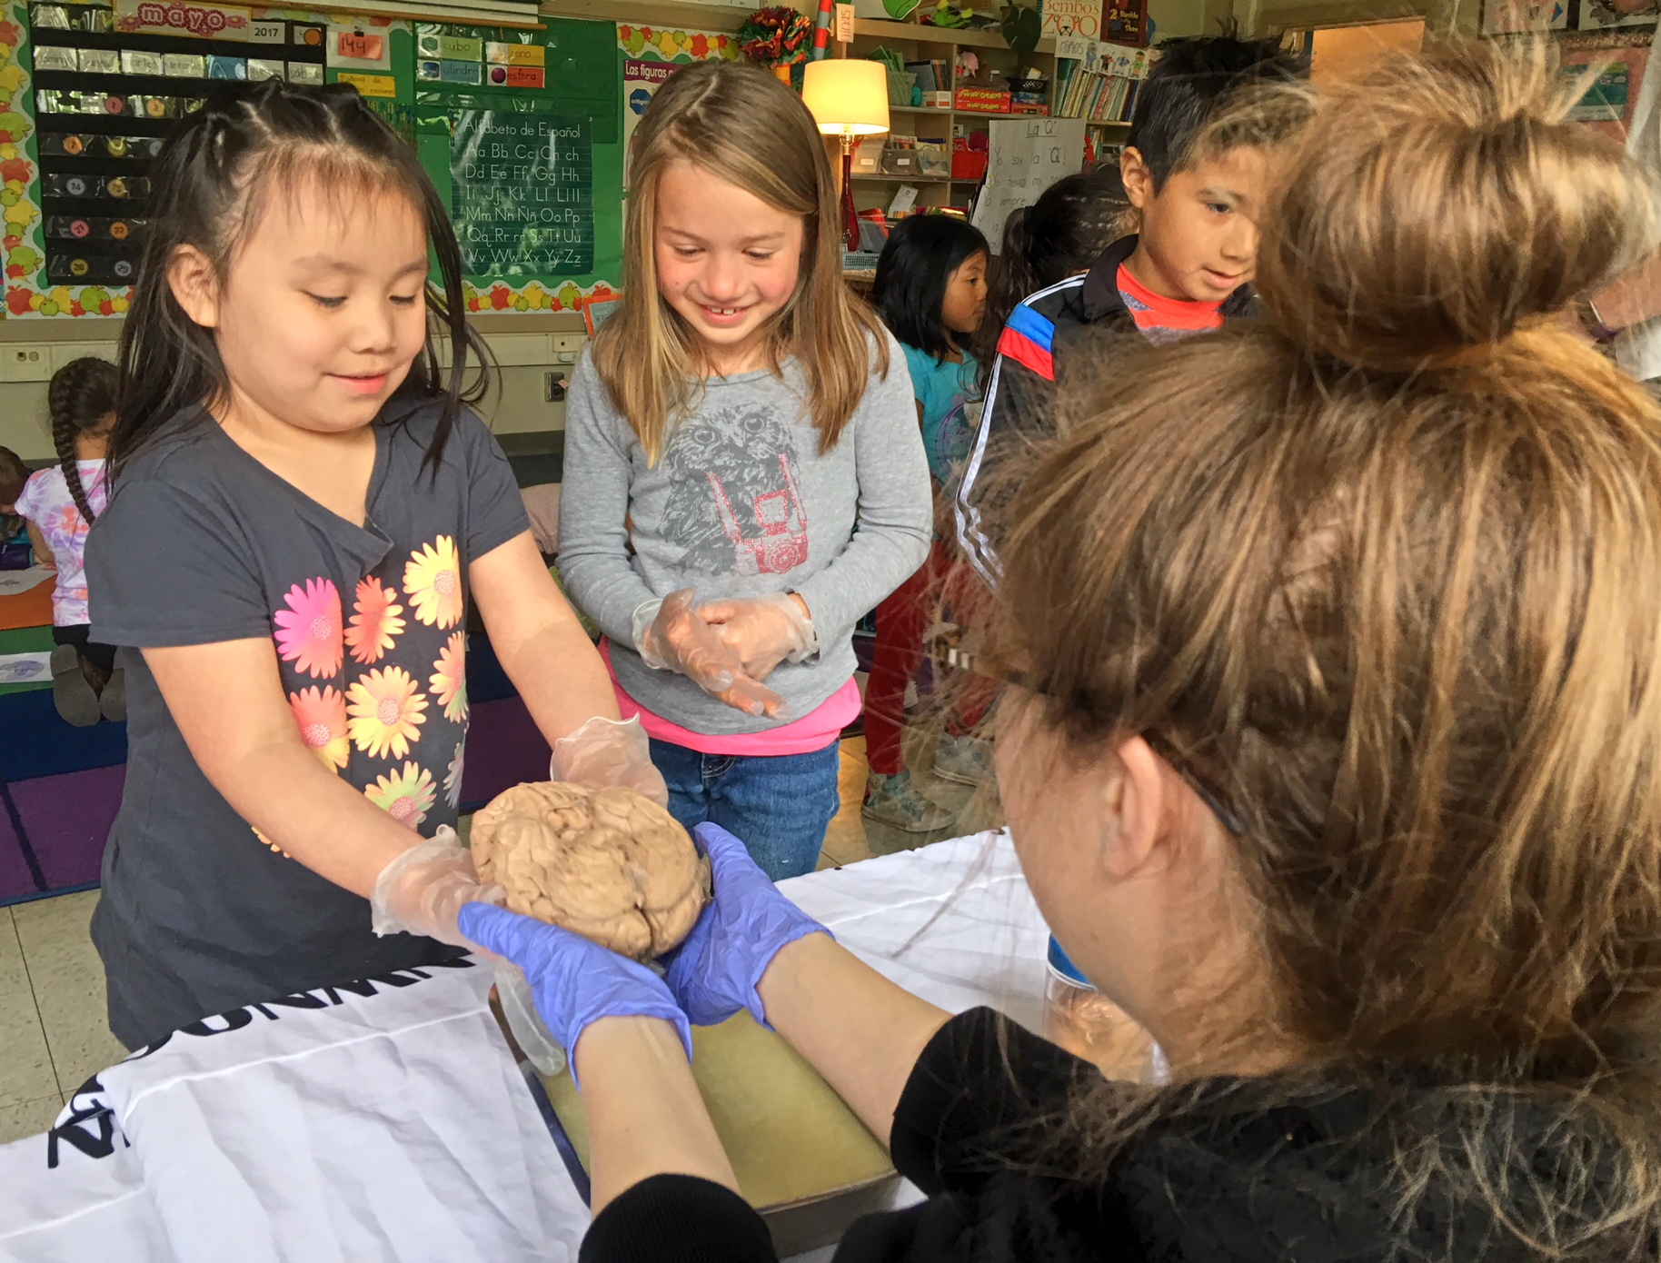
nwnoggin.org
Arts integrated neuroscience outreach for K-12 & community

Slide 3
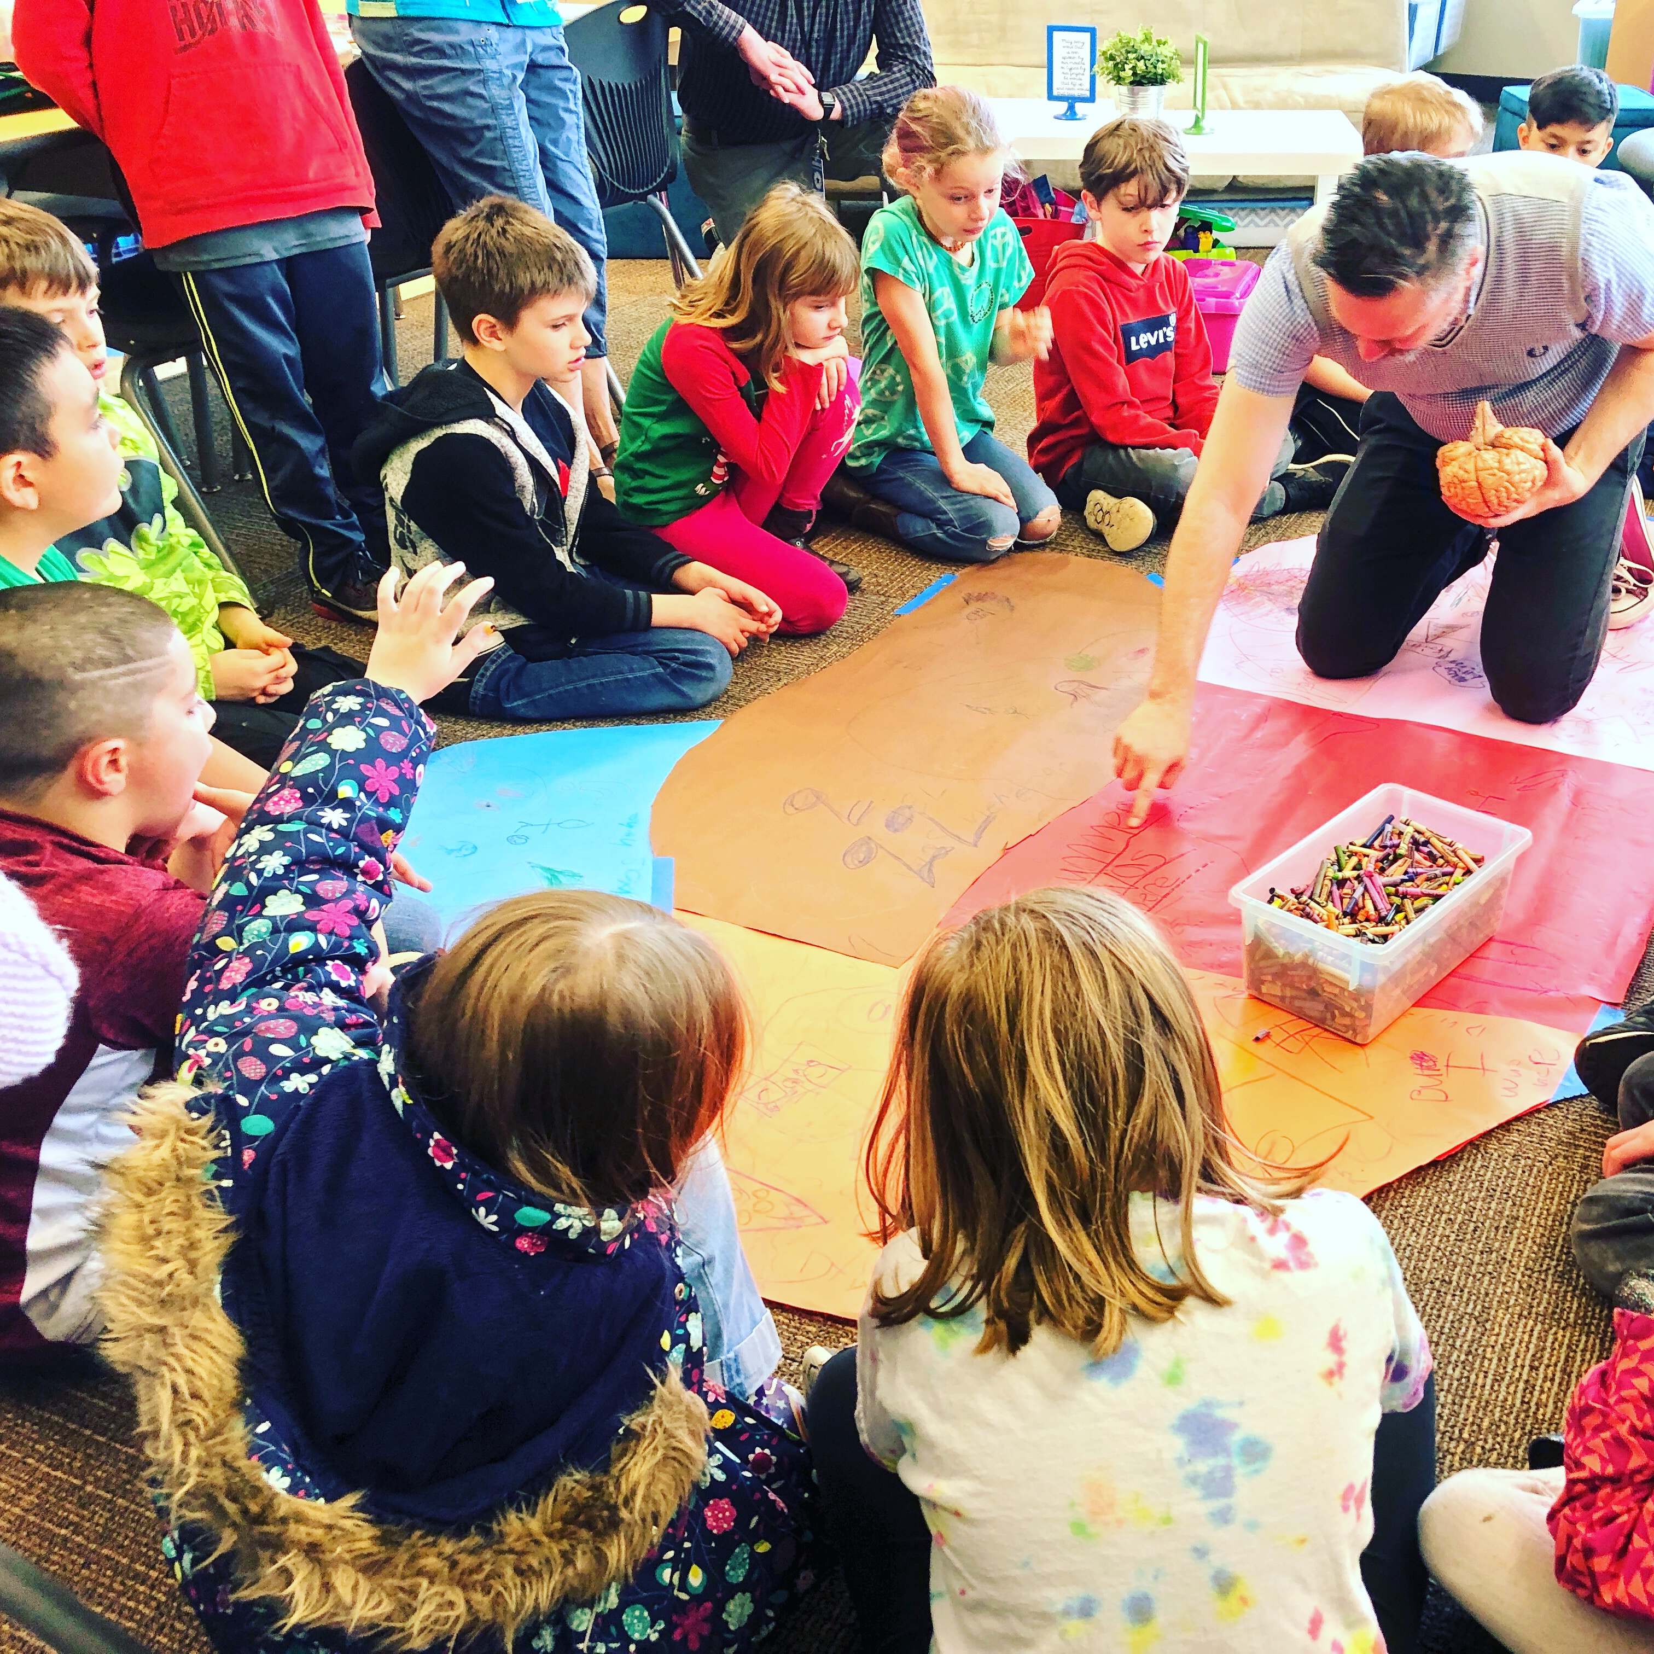
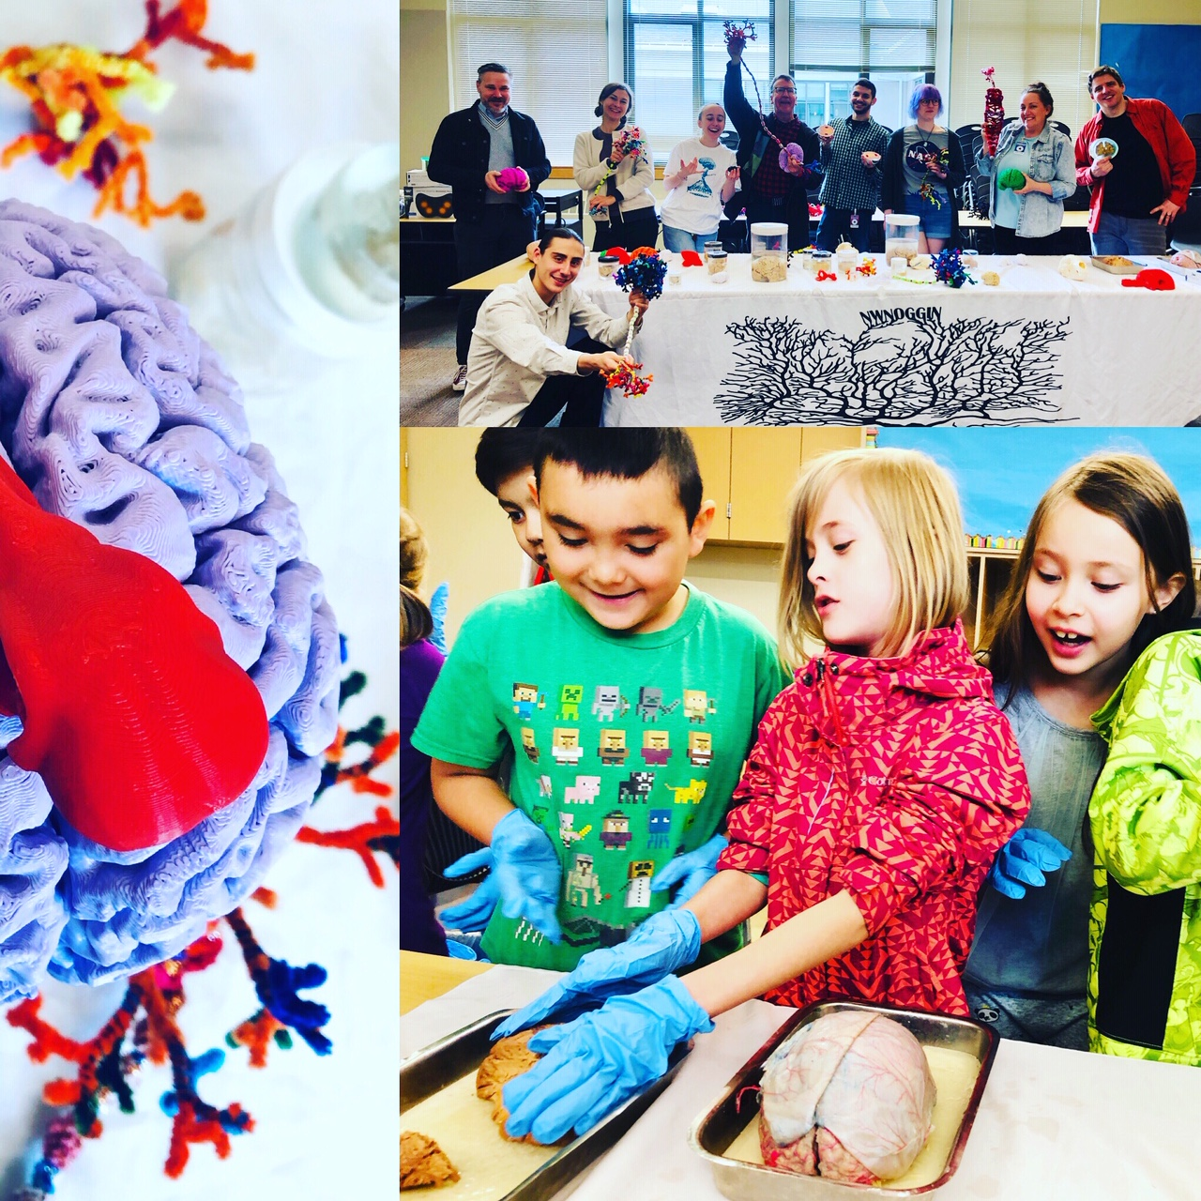
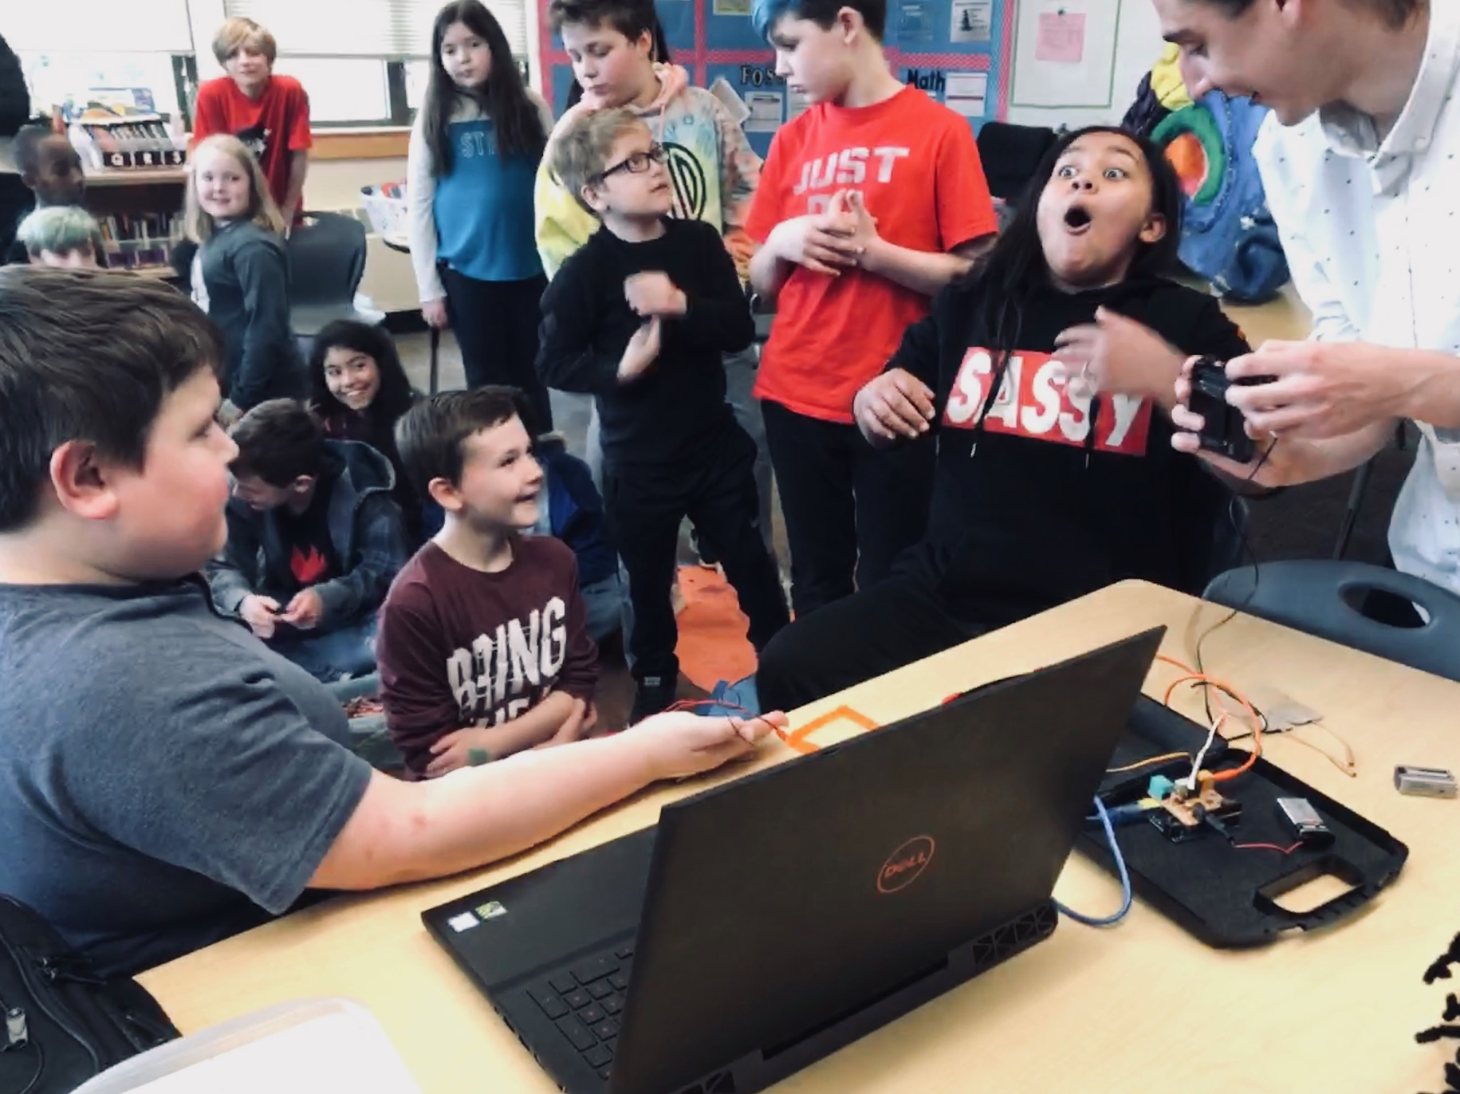
TODAY
@ Ardenwald Elementary!

Slide 4
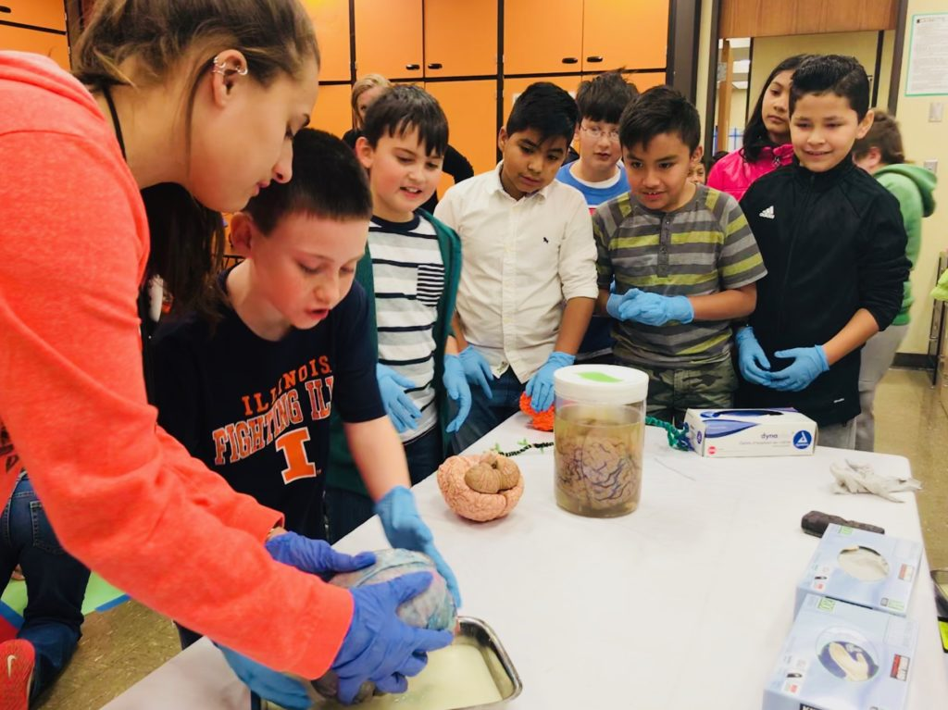
What you do has relevance
GO PLACES
Sleep
Anxiety
Depression
ADHD
Autism
Development
Perception
Drugs
Memory
Language
Bias
…

Slide 5
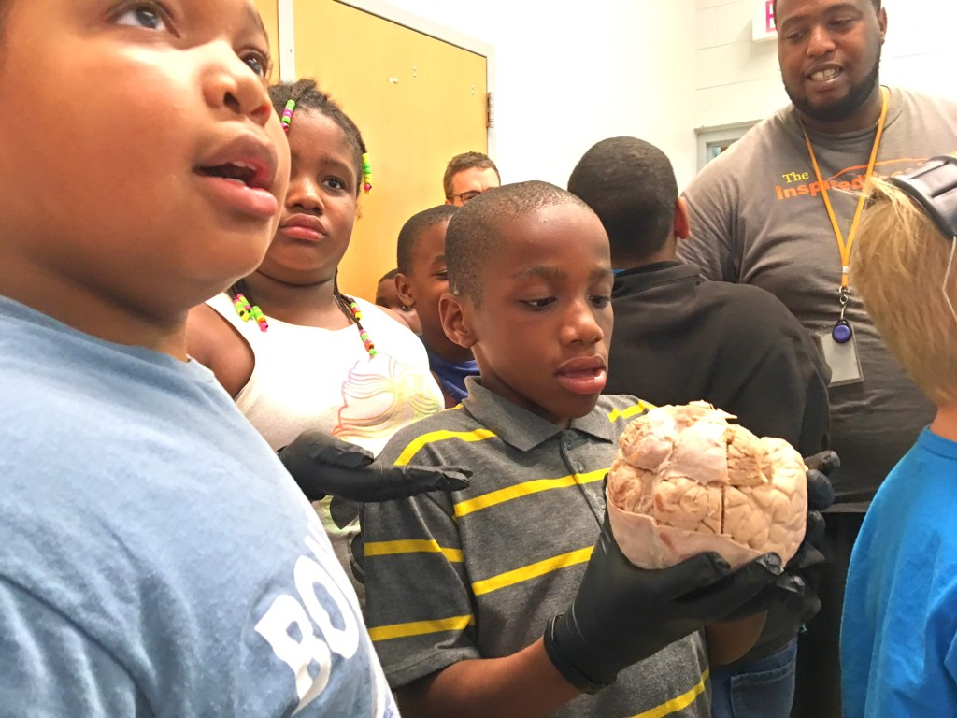
We all pay for research

Slide 6
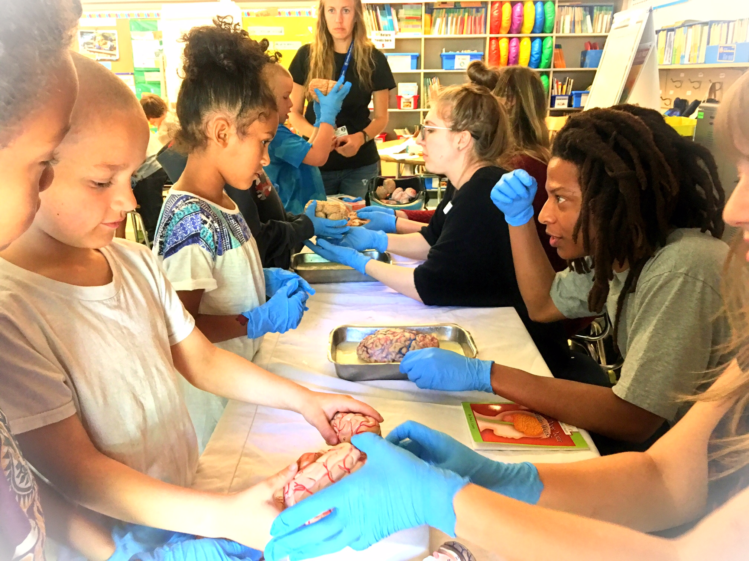
Connections matter
More support
Greater understanding
Less confirmation bias
Increased participation
New ideas, directions
FUN!

Slide 7
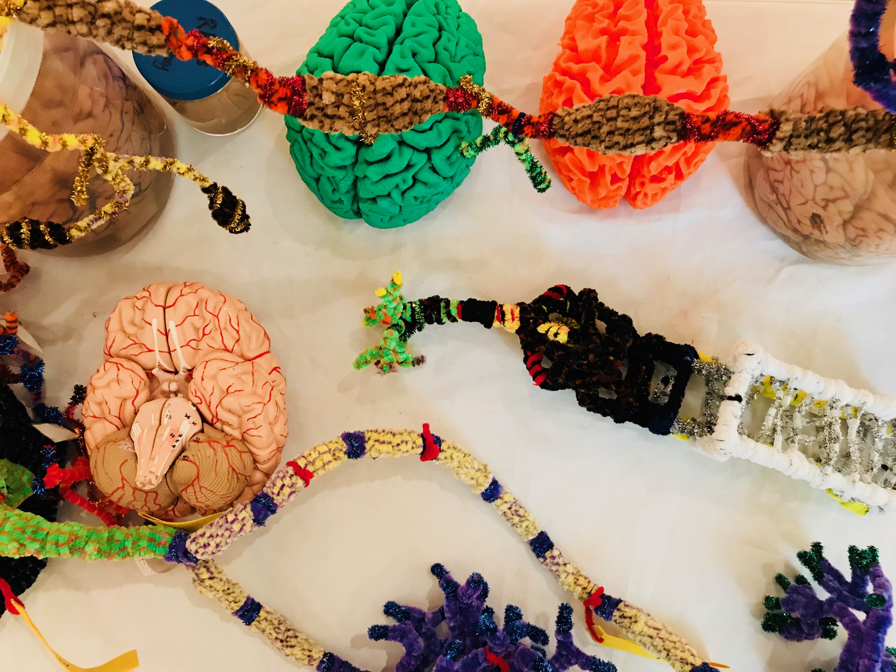
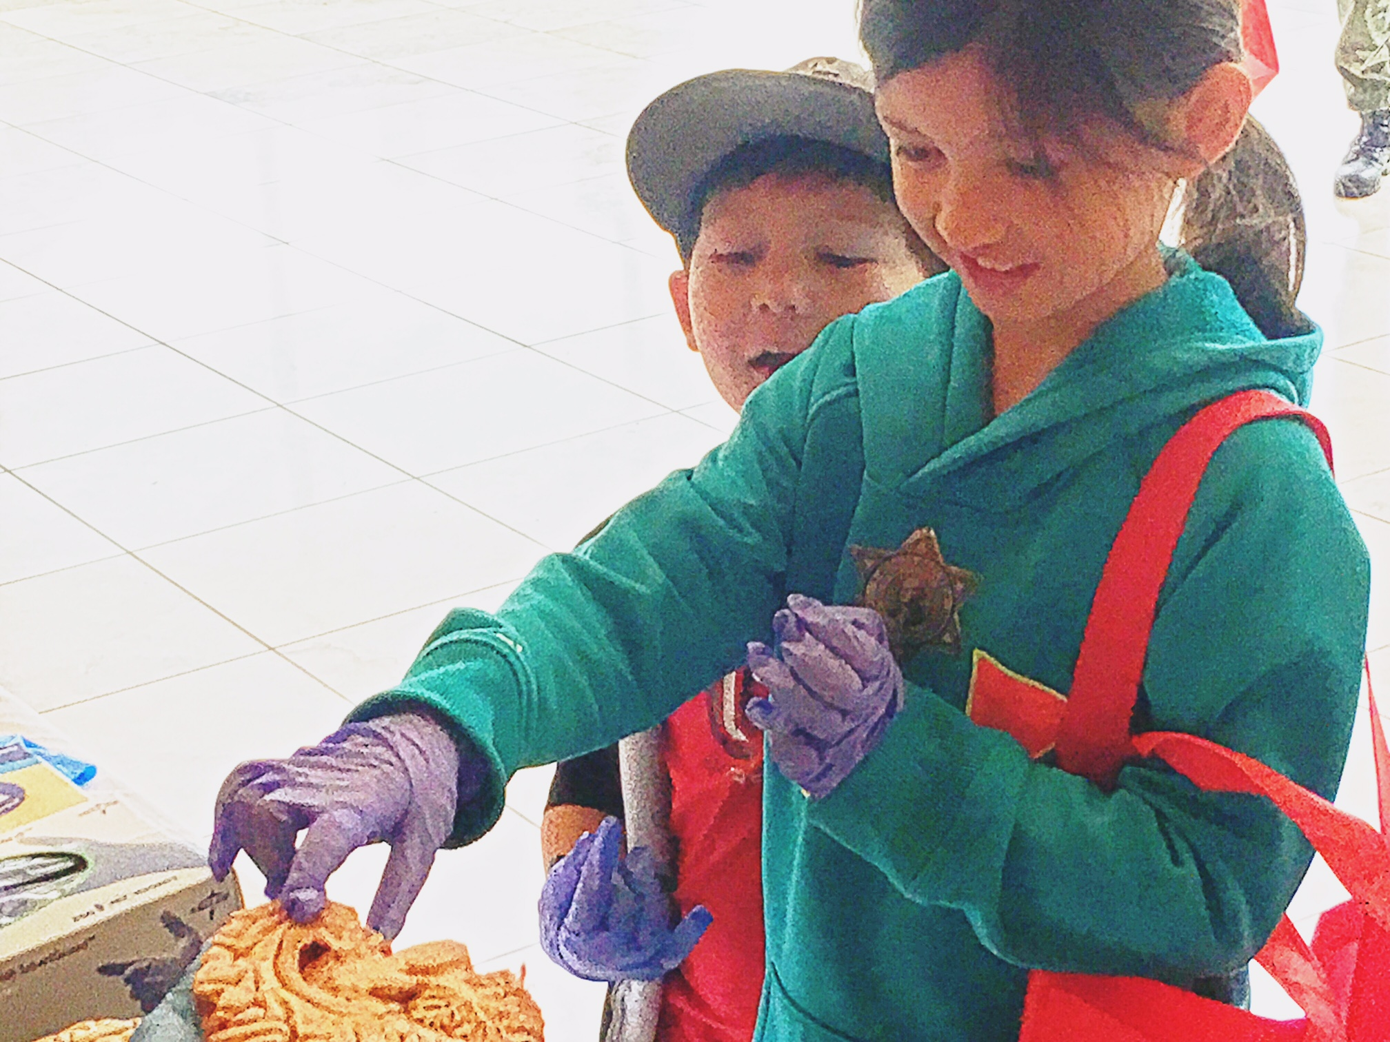
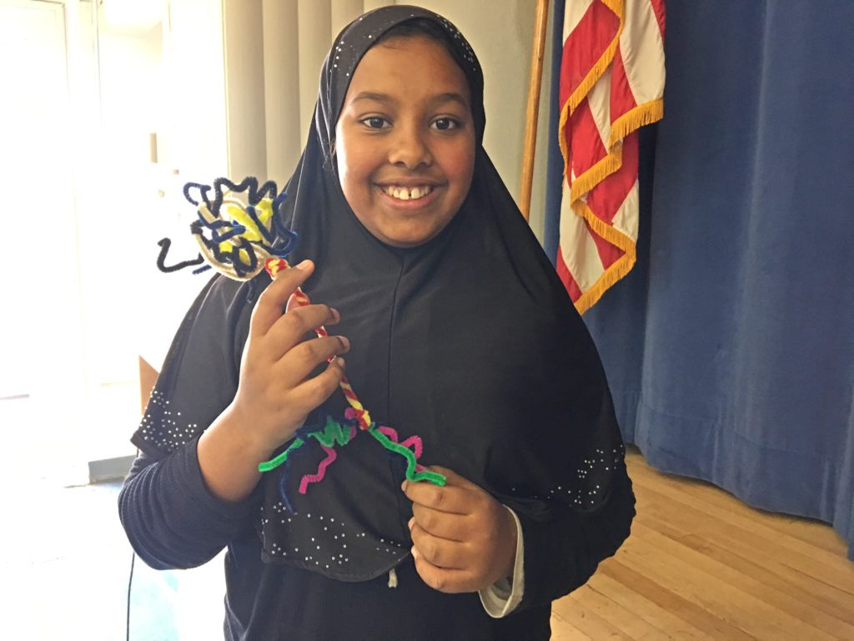
BUILD NEW
CONNECTIONS
Oh the places you’ll go!
Academic priority K-12, urban/rural communities, tribal majority schools
  Not always well-funded or valued, often ignored, subjected to standardized testing that primarily benefits others. Complex brain development underway, unacknowledged diversity, prevalence of mental health issues …
Homeless youth (p:ear), incarcerated youth (MacLaren Correctional Facility)
  “It’s like people see me as an object, not as a human being”
Young graduate researchers, undergraduates (PSU, OHSU, PNCA,…)
  How does my research relate to the world? How can I explain it?
  Where can I go from here? How do I connect kids from K-12 schools?
Artists: Painters, Dancers, Storytellers, Musicians
  How does my work relate to other fields? How do I connect with new audiences?
  How is my practice influenced and enriched by discoveries about the brain?
Area businesses (BioGift, Intel, Velo Cult, Retirement homes, Hospitals)
  How can we better connect with everyone in our community?
Members of the public
  Why are my taxes spent on research? Art? What are we discovering? Making?

Slide 8
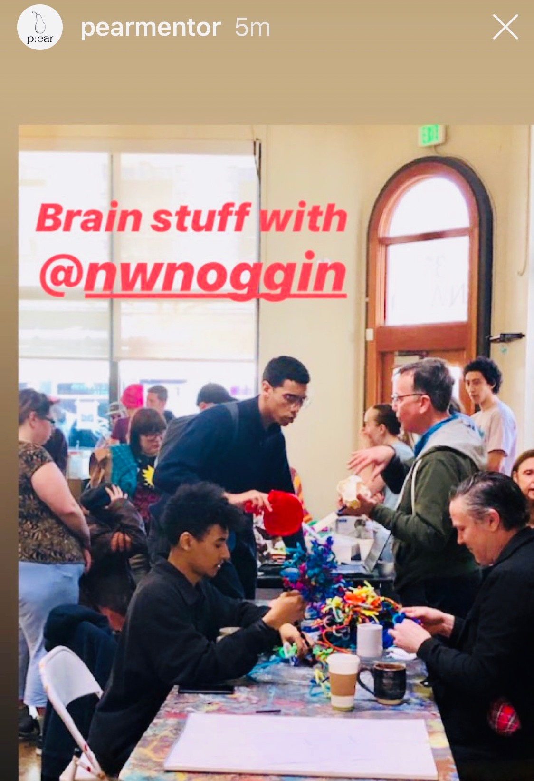
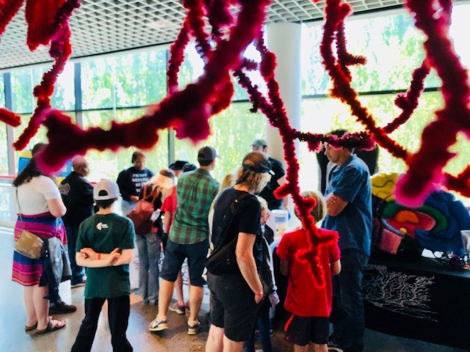
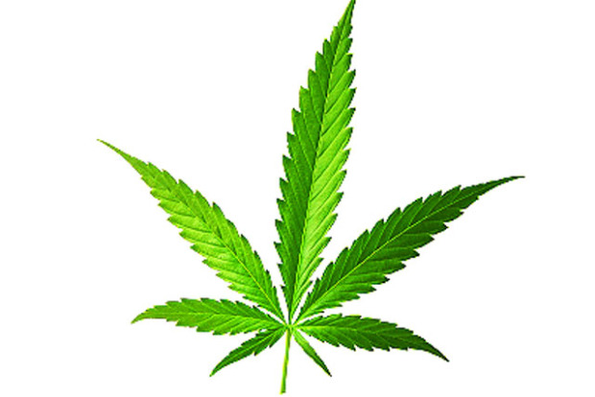
We get many questions about marijuana from students & public!

Slide 9
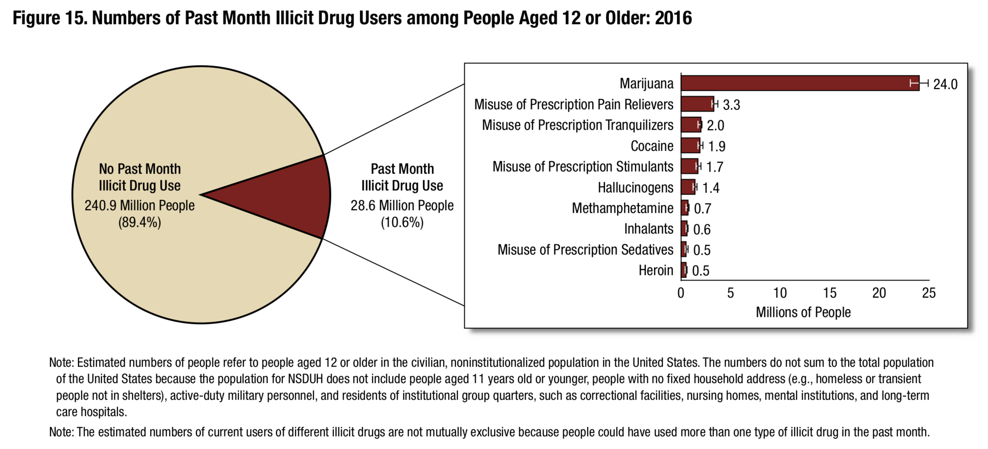
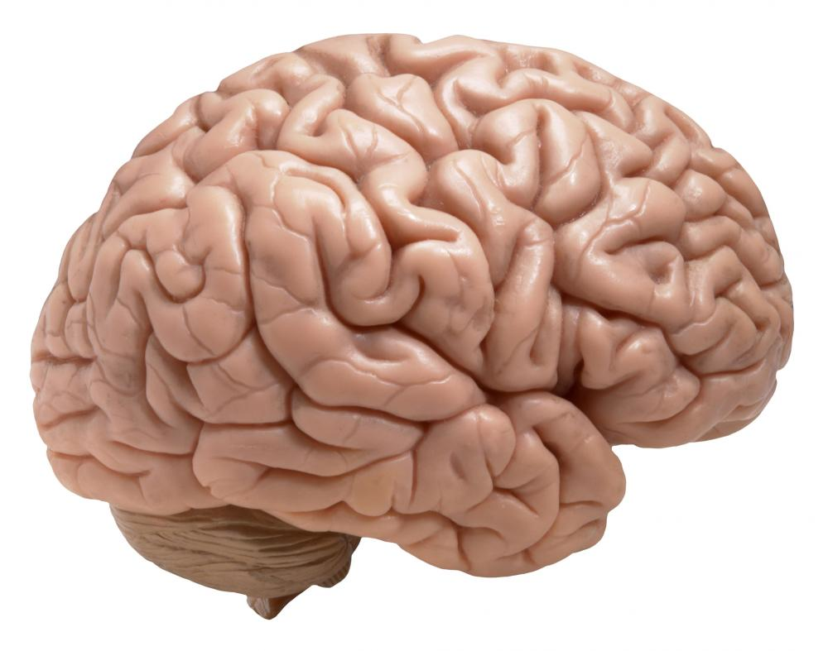
Marijuana: the most commonly used “illicit” drug
￼
SOURCE: Substance Abuse and Mental Health Services Administration, Health & Human Services (2016)
SAMHSA: “Misuse of prescription psychotherapeutic
drugs is second only to marijuana as the nation's most
prevalent illicit drug use issue.”
According to the US government, everyone using marijuana is an illicit misuser

Slide 10
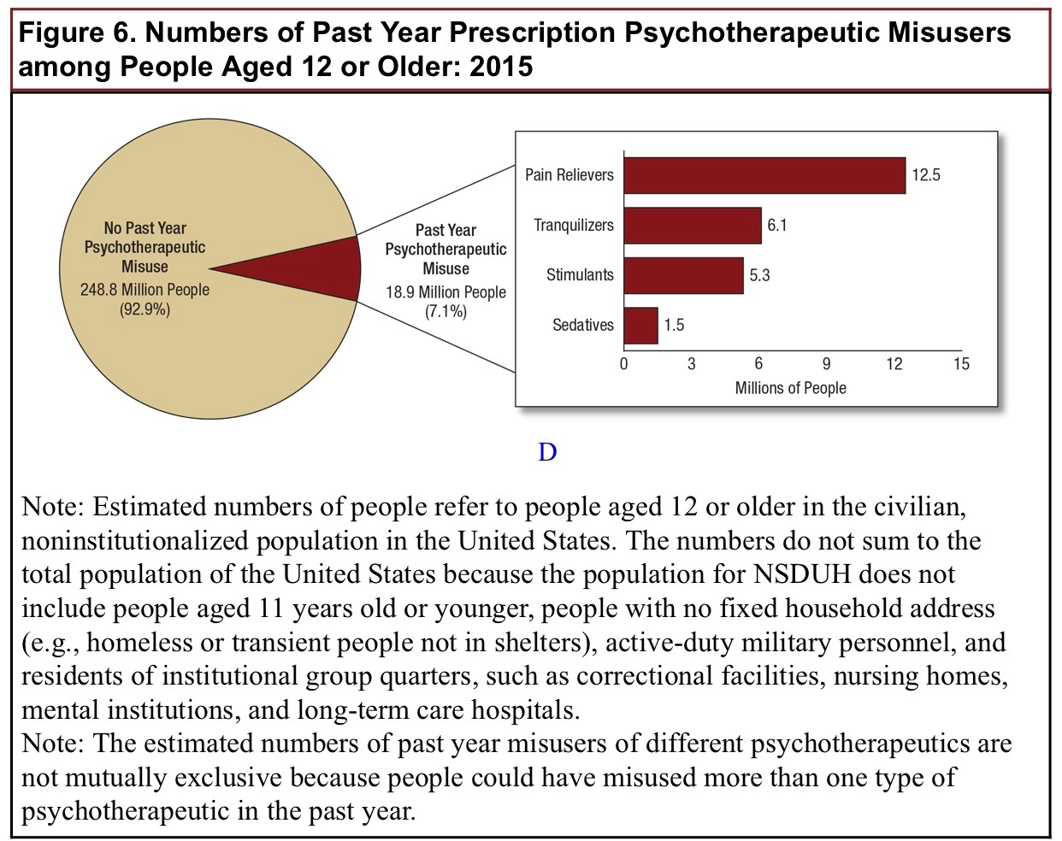
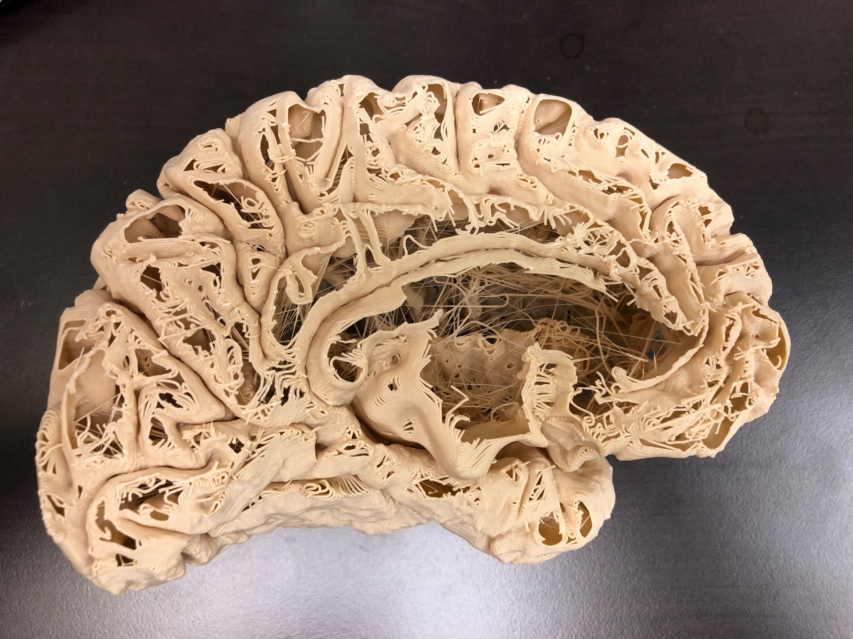
Misuse of Prescription Drugs
The Substance Abuse and Mental Health Services Administration (SAMHSA) estimates that 18.9 million Americans “misused” prescription drugs in 2015, including opioids.

Slide 11
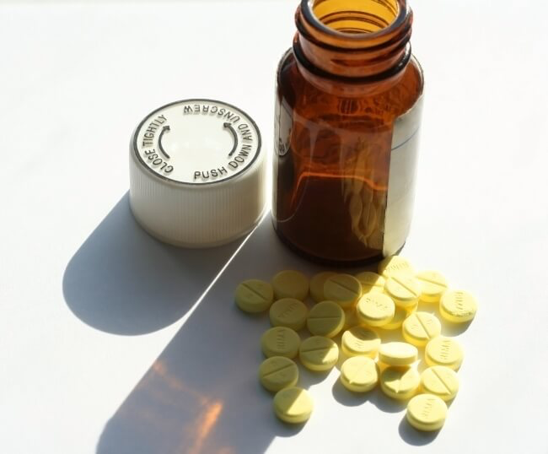
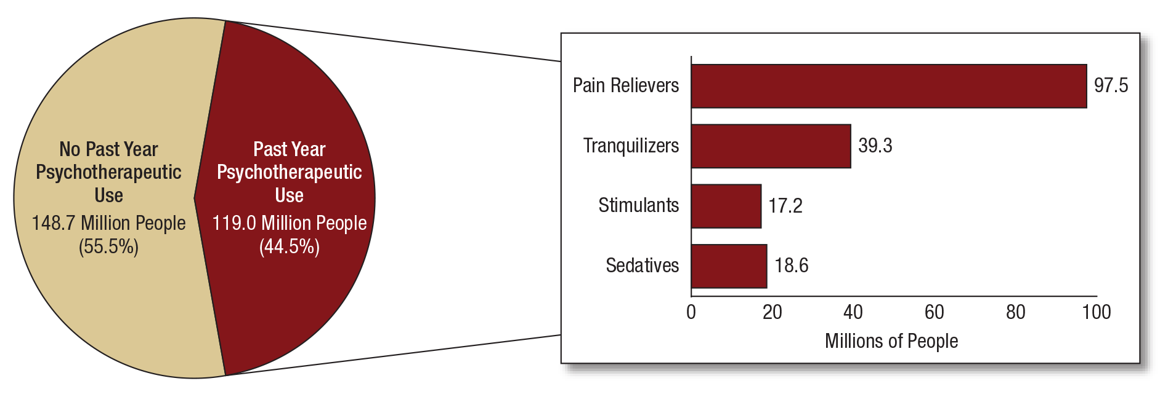
NSDUH Report on Prescription Psychotherapeutics 2015
In 2015, 119.0 million Americans
aged 12 or older used prescription
psychotherapeutic drugs in the past
year, representing 44.5 percent
of this population. (SAMHSA)
Report issued in September, 2016

Slide 12
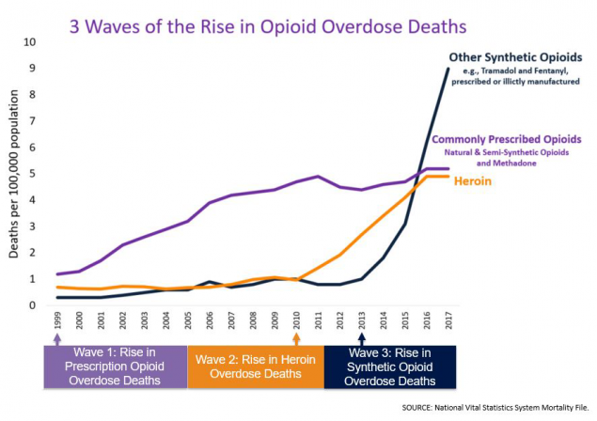
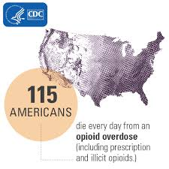
Meanwhile…
Opioids are addictive, and kill
“From 1999-2017, almost 400,000 people died from an overdose involving any opioid, including prescription & illicit opioids.”
-CDC
Source: Centers for Disease Control

Slide 13
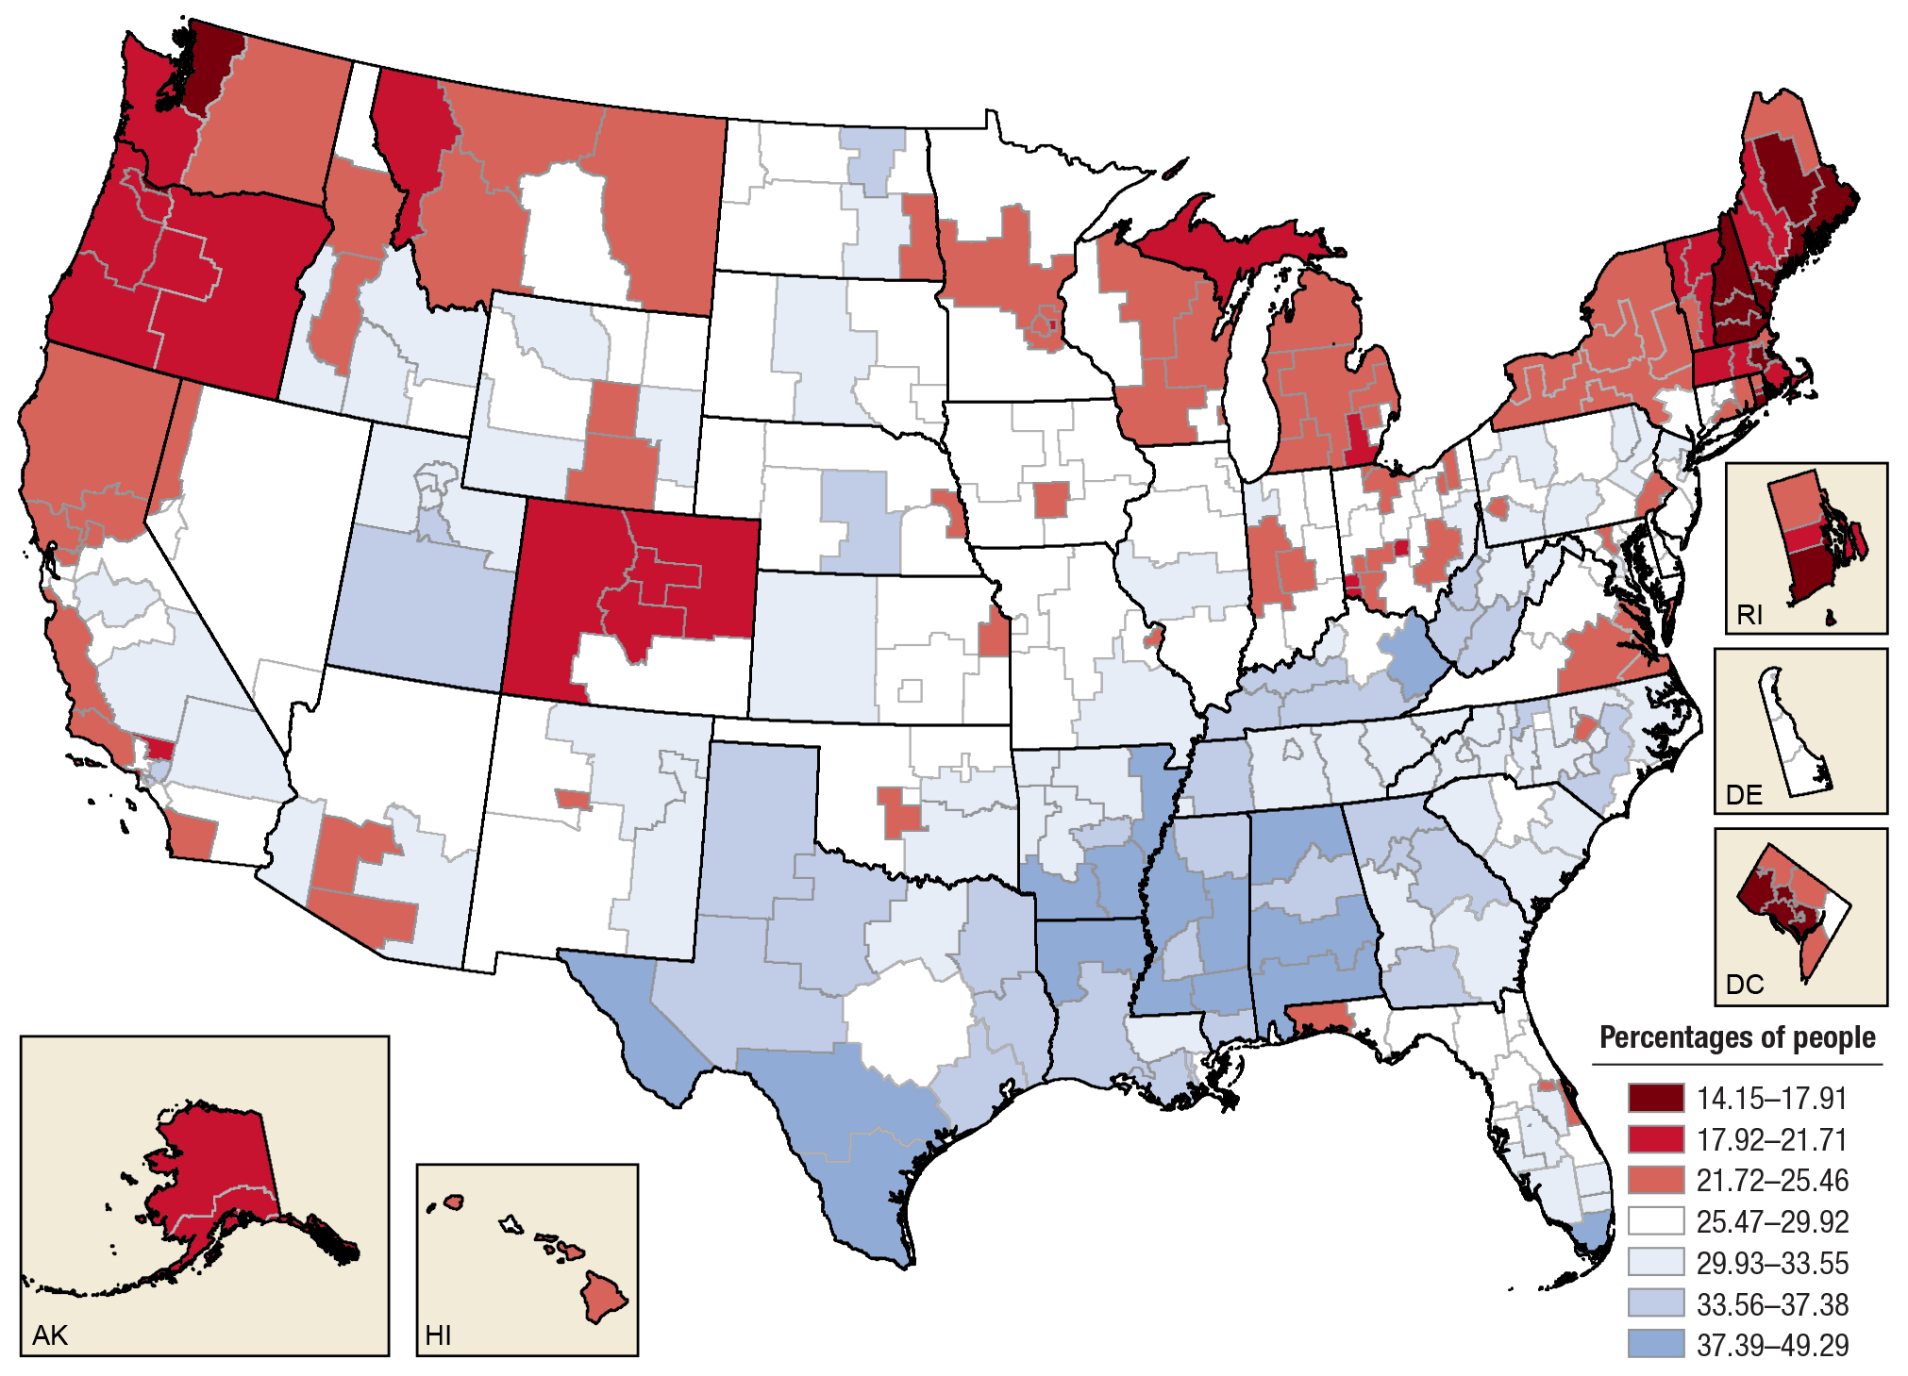
Perceptions of great risk of harm from smoking marijuana once a month among youths aged 12 to 17, by state: percentages, annual averages, 2012 to 2014; SAMHSA
Oregonians aren’t too concerned about
occasional marijuana use
“Epidemiological data indicate that in
the general population marijuana use is not
associated with increased mortality” - NIH

Slide 14
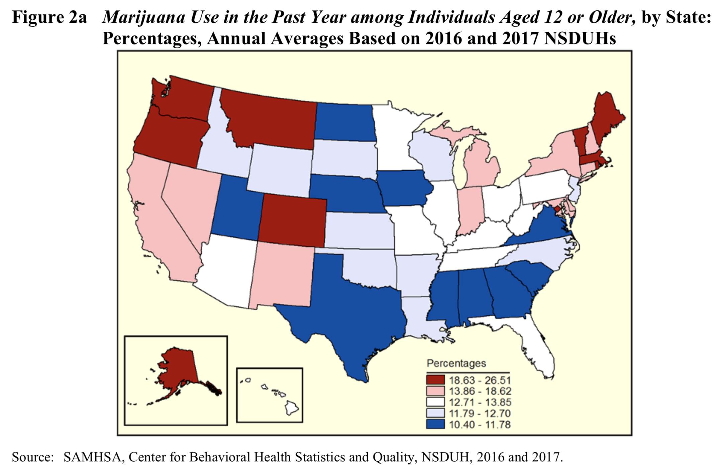
Notice anything..?

Slide 15
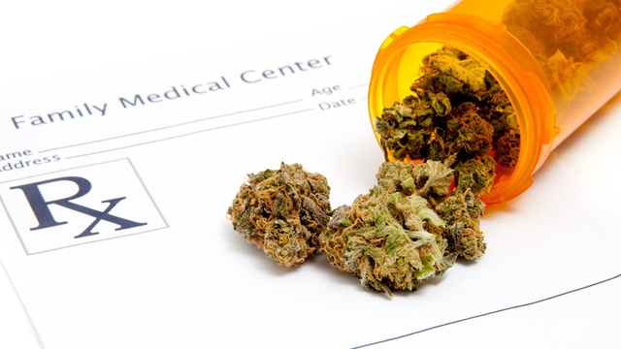
Marijuana is still a Schedule I substance
Controlled Substances Act (1970)
The drug or other substance…
1. …has a high potential for abuse
2. …has no currently accepted medical use
There is a lack of accepted safety for use of the drug…under medical supervision…
Makes it more difficult to conduct research funded
by the National Institute on Drug Abuse (NIDA)

Slide 16
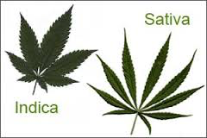
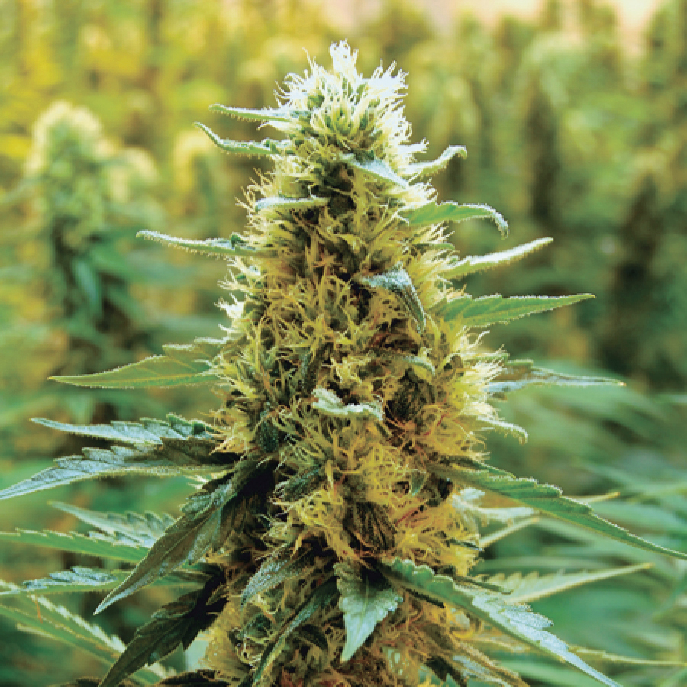
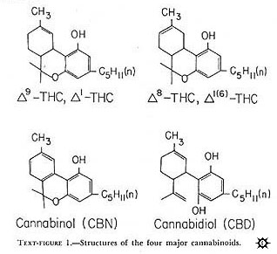
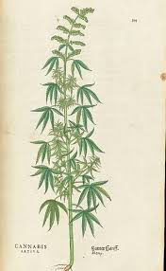
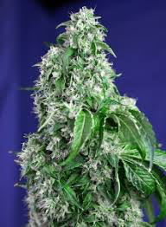
Cannabis contains cannabinoids
SOURCE: Cannabis, a complex plant: different compounds and different effects on individuals, Atakan (2012)
Indicas
Sativas
More than 100!
Concentrated in resin
Lots of variability, depending on strain, other factors…

Slide 17
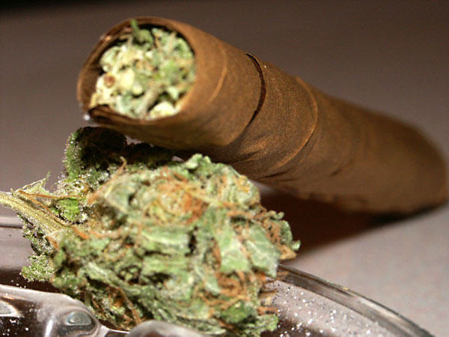
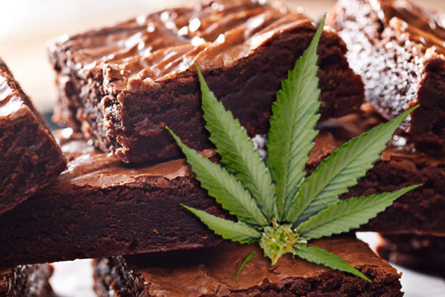
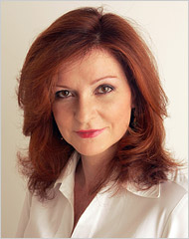
Marijuana is smoked…and eaten
Method of drug administration matters
Burning vaporizes cannabinoids, which reach the brain in seconds.
Oral administration delivers less THC, CBD, CBN, etc. more slowly…
“I strained to remember where I was or even what I was
wearing, touching my green corduroy jeans and staring
at the exposed-brick wall. As my paranoia deepened,
I became convinced that I had died and no one
was telling me…” New York Times, 6/3/13

Slide 18
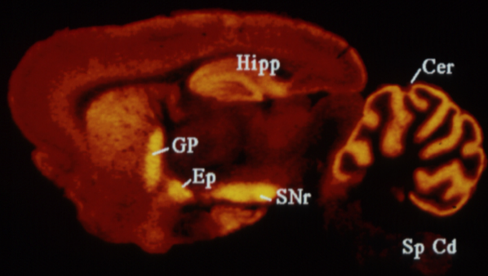
Cannabinoids act at cannabinoid receptors: CB1 and CB2
CB1 Receptors
Abundant!
Cerebellum
Basal ganglia
Hippocampus
Brainstem
Spinal cord
Neocortex
SOURCE: Herkenham et al. (1991) J. Neurosci. 11: 563
CNS expression in areas important for motor coordination, memory, nausea, decision making, pain…

Slide 19
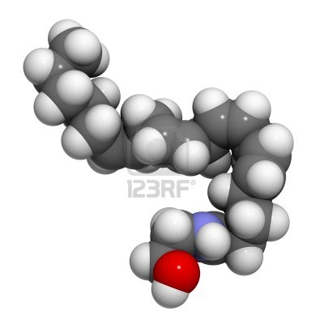
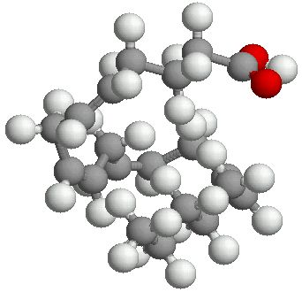
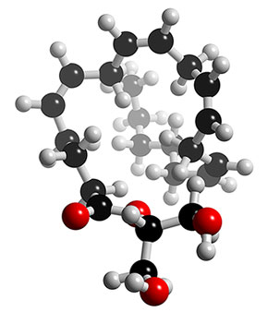
Endogenous cannabinoid neurotransmitters
If we have receptors for cannabinoids like THC, why are they there? What neurotransmitters act at these endogenous receptors..?
Anandamide
Derived from arachidonic acid,
a fatty acid found in membranes
2-AG

Slide 20
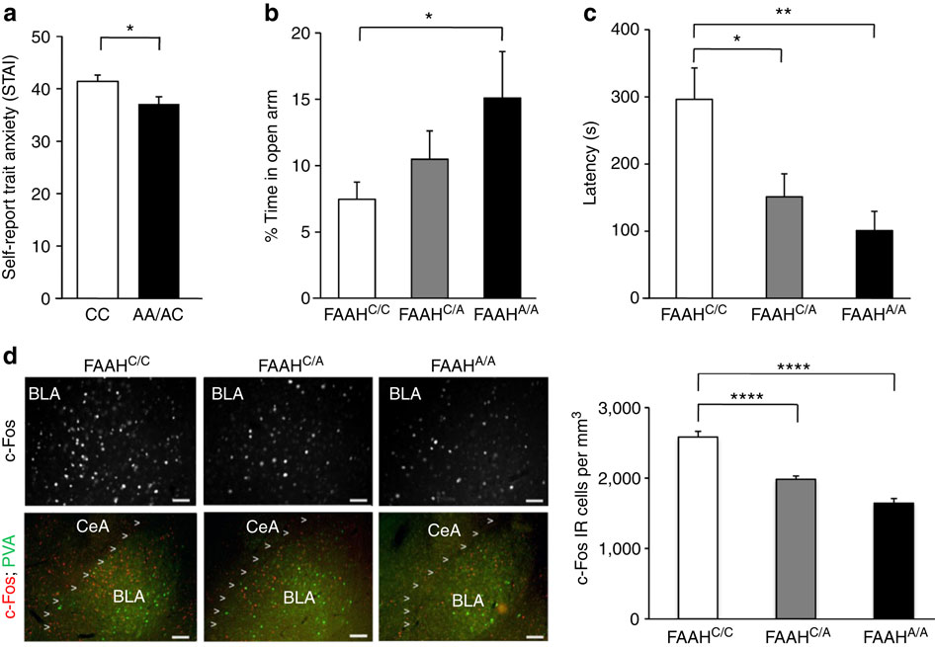
Anxiety: Genetic protection?
Decreased anxiety in humans and mice with FAAH C385A
Anandamide
Breakdown by
FAAH; several
Forms (A, C)
A less common;
Less effective at
breakdown
FAAH genetic variation enhances fronto-amygdala function in mouse
and human, Nature Communications, Iva Dincheva et al (2015)

Slide 21
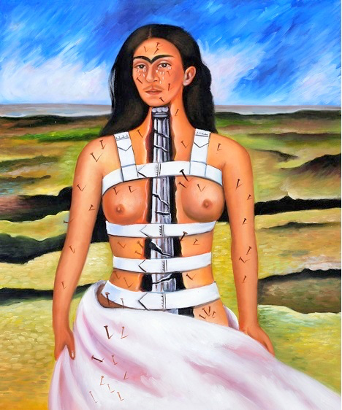
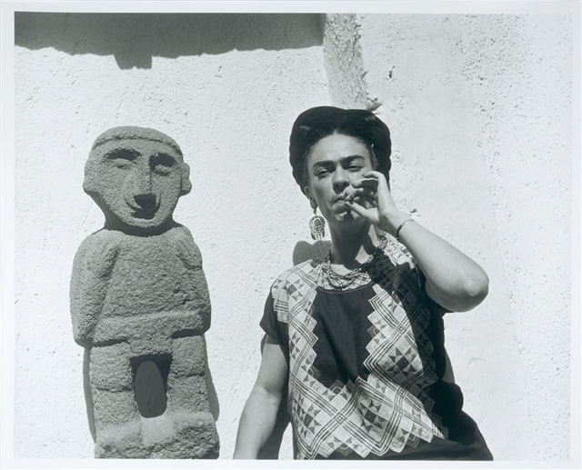
Pain
Artist Frida Kahlo survived a bus
accident in 1925, which broke her
spinal column, collarbone, ribs, pelvis
and right leg, crushed and dislocated
her right foot, dislocated her shoulder,
and left her w/terrible, psychologically
debilitating bouts of chronic pain.

Slide 22
Cannabinoids reduce pain
…inhaled cannabis is consistently effective in reducing chronic non-cancer pain. Oral cannabinoids seem to improve some aspects of chronic pain (sleep, general quality of life), or cancer chronic pain, but they do not seem effective in acute postoperative pain, abdominal chronic pain, or rheumatoid pain…inhaled cannabis seems to be more tolerable and predictable than oral cannabinoids. Cannabis or cannabinoids are not universally effective for pain. Continued research on cannabis constituents and improving bioavailability for oral cannabinoids is needed…” Cannabis and Cannabinoids for Chronic Pain (2017)
Marijuana legalization means fewer opioid prescriptions and deaths (Source)

Slide 23
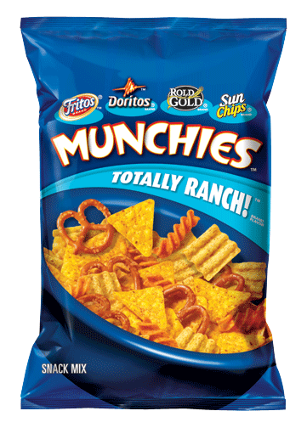

More therapeutic effects
Appetite stimulation
  (e.g., Foltin, 1988; Grotenhermen, 2012)
  Why is this therapeutic?
Nausea relief
  (e.g., Parker et al (2011); “The anti-emetic effect of cannabinoids has been shown across a wide variety of animals that are capable of vomiting in response to a toxic challenge.” Also studies referenced by the National Cancer Institute at cancer.gov; though chronic use linked to hyperemesis syndrome; Soriano-Co M, 2010)

Slide 24
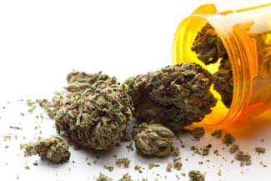
STILL MORE therapeutic effects
Multiple sclerosis
  E.g., “Current status of cannabis treatment of multiple sclerosis,” Deutsch et al (2008)
Epilepsy
  E.g., “The case for medical marijuana in epilepsy,” Maa (2014)
Cancer
  E.g., “The combination of cannabidiol and Δ9-THC enhances the anticancer effects of radiation in an orthotopic murine glioma model,” Scott et al (2014)

Slide 25
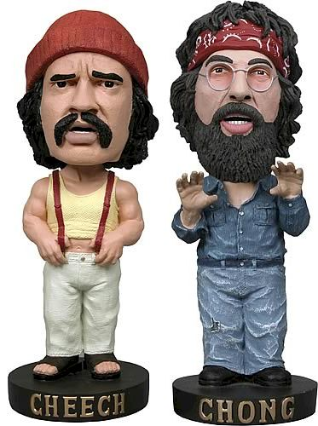
Marijuana impairs cognition, memory, motor coordination
Deficits in acute verbal and spatial memory (e.g., Curran et al, 2002)
Deficits in working/short-term memory (Schoeler 2013)
Cannabis and alcohol both impair skills critical for driving (Sewell RA et al, 2009)
Differential effects on socialization (Atakan, 2012)

Slide 26
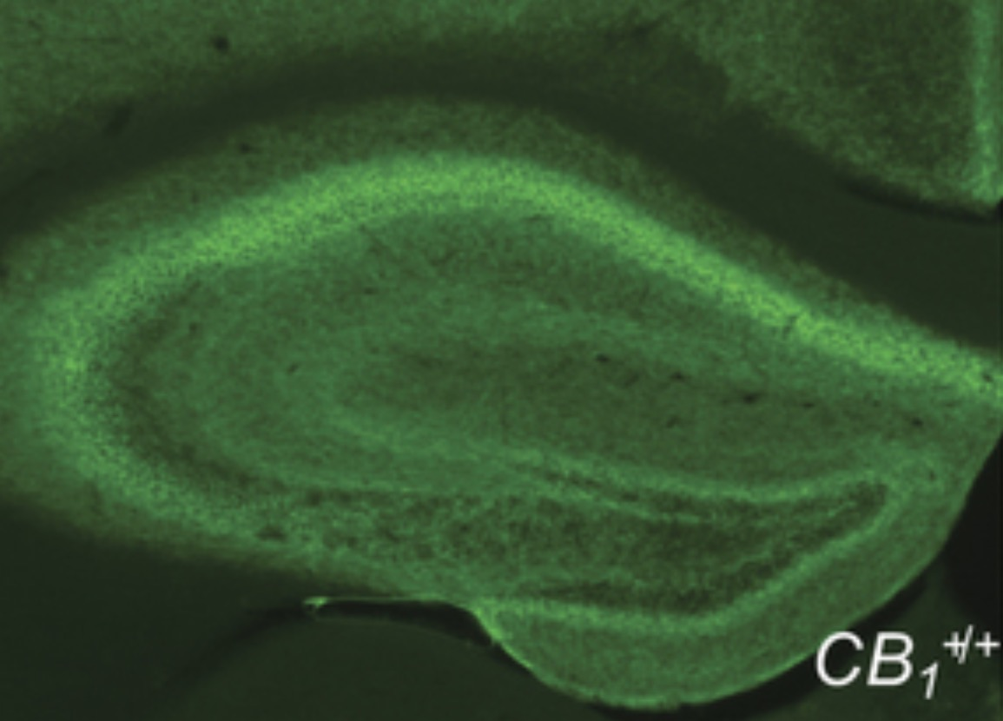
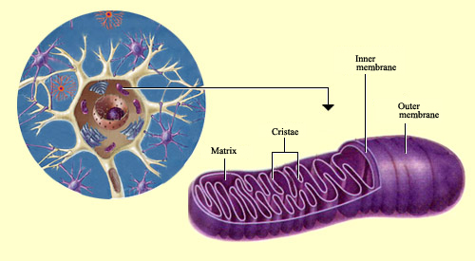
A cannabinoid link between mitochondria and memory
Etienne Hebert-Chatelain, et al
Nature (2016)
Cellular activity depends on mitochondria
Mitochondria site of cellular respiration (ATP)
Mitochondria have many CB1 receptors (mtCB1)
Cannabinoid action at mtCB1 inhibits respiration
Hippocampus starved of energy (less ATP)
A mechanism for amnesia..?

Slide 27



Noggin @ p:ear

Slide 28

Police
at p:ear
“If one really wishes
to know how justice
is administered in a
country, one does
not question the
policemen, the
lawyers, the judges,
or the protected
members of the
middle class. One
goes to the
unprotected – those,
precisely, who need
the law’s protection
most! – and listens
to their testimony.”
–James A. Baldwin

Slide 29
Marijuana and Bias
From Will Kendall, the Art Director at p:ear:
“I witnessed a couple of youth leaving the p:ear space with a green
marijuana container in hand. I asked them to a) keep their weed cancelled
in our space and b) if they did plan on smoking to go at least two blocks from
the p:ear space. They agreed to both requests easily and even had a sense of
appreciation that I was not judging them for what they were about to do.”
“Shortly after leaving both youth came back into p:ear and were quickly
followed by a police officer saying ‘come here,’ and ‘get over here.’ The youth
walked to the far side of our space to avoid interactions with the police but were
followed by the officer who multiple times reached out to try grabbing the youth,
who avoided contact…The youth agreed to go, but as he got outside the officer
immediately tried to physically detain him. It was at this point that the youth
was unreachable as his past trauma was triggered and he was in full fight
mode. Shortly after, more police cars arrived and the youth was
detained by five officers and placed in the back of the car.”

Slide 30



A history of demonization
Harry Anslinger, first Commissioner of Narcotics, Bureau of Narcotics
“Those who are habitually accustomed to use of the drug are said to develop a delirious rage after its administration, during which they are temporarily, at least, irresponsible and liable to commit violent crimes.”

Slide 31


A history of demonization
Jeff Sessions
Attorney General, U.S (2017-2018)
“Good people don’t smoke marijuana…”
“The KKK was OK
until I found out they smoked pot…”
  New York Times
In an inordinate number of American counties,
marijuana arrests are a significant portion of what
the police do every day.
SOURCE

Slide 32


Jeff Sessions’ last act as AG…
“…signed an order making it more difficult for
the Justice Department to investigate & implement
reform at police departments with patterns of abuse,
questionable shootings, racism, & other constitutional
violations…” –Washington Post

Slide 33
Risks of chronic adolescent use
Volkow et al (2014), NEJM
Cognitive impairment: Small drop in IQ (from Meier, M.H. et al. (2012))
Risk of dependence: 9% of those who experiment; 1 in 6 of those who start using in adolescence, and 25 – 50% of those who smoke daily…
Changes in functional connectivity
Increased risk of anxiety and depression, and schizophrenia/psychosis in those with a preexisting genetic vulnerability (But from Volkow article: “It is inherently difficult to establish causality in these types of studies because factors other than marijuana use may be directly associated with the risk of mental illness…”)
School performance: “Early marijuana use is associated with impaired school performance…although reports of shared environmental factors…suggest that the relationship may be more complex…”

Slide 34


Can we trust NIDA-funded marijuana research?
“We had them smoke it in the lab,
then studied their mood and cognition,”
recalls Dr. Hutchinson… “And what they
told me was ‘that was disgusting, what
are you giving me? I would never,
ever smoke that stuff.’” -NPR
-Scientists Frustrated with Low Quality Weed from the Government
-Research grade marijuana supplied by the National Institute on Drug Abuse
is genetically divergent from commercially available Cannabis
NIDA has only one DEA-certified supplier, the University of Mississippi, known for shipping freeze-dried, re-hydrated samples...

Slide 35

Also…we’re still learning
Cannabis use is quantitatively associated with nucleus accumbens and amygdala abnormalities in young adult recreational users.
Nucleus accumbens, amygdala
are part of motivational networks
(what you seek, what you avoid…)
Gilman JM1, Kuster JK, Lee S, Lee MJ, Kim BW,
Makris N, van der Kouwe A, Blood AJ, Breiter HC.,
J Neurosci. 2014 Apr 16;34(16):5529-38 (2014)

Slide 36
But wait - which is it..?
Daily Marijuana Use Is Not Associated with Brain Morphometric Measures in Adolescents or Adults
Barbara J. Weiland, Rachel Thayer,
Brendan E. Depue, Amithrupa Sabbineni,
Angela Bryan, Kent E. Hutchison, The Journal
of Neuroscience, 28 January 2015
Same journal
Different research group
* Controlled for alcohol exposure…

Slide 37

More adolescents use
alcohol than cigarettes
or marijuana
ALCOHOL in adolescence…
Causes many deaths
Causes many injuries
Impairs judgment
Increases the risk of assault
Impacts brain development
SOURCE: Johnston, L.D.; Miech, R.A.; O’Malley, P.M.; et al. Monitoring the Future National Survey: Trends in 30-Day Prevalence of Use of Various Drugs in Grades 8, 10, and 12, 2015. Available at: http://monitoringthefuture.org/data/16data/16drtbl3.pdf.

Slide 38


How we can do better
Marijuana research, de-scheduling, legalization, education
Check our own bias, and privilege
Lower the emotional temperature
Go places, listen, learn and contribute
Invest in more affordable housing, education, enrichment, and open, healing community spaces instead of enforcement

