Slide 1
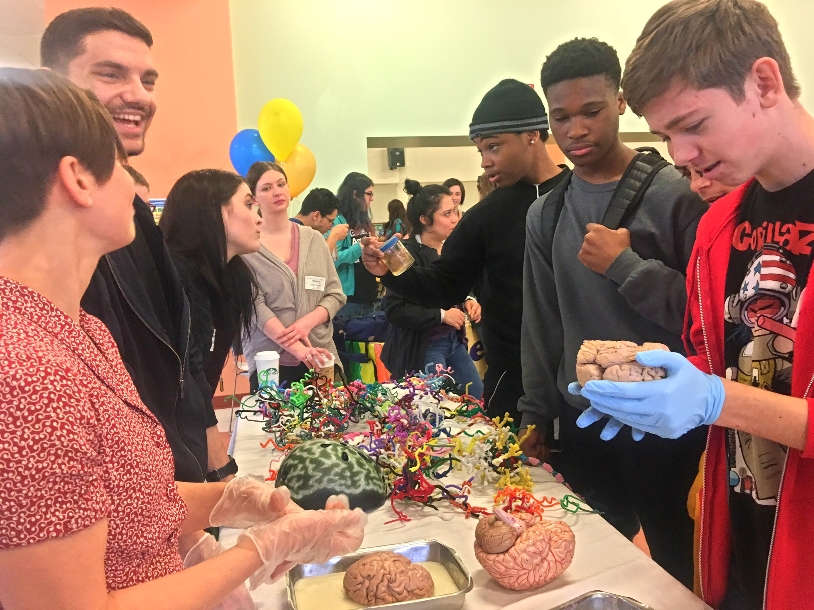
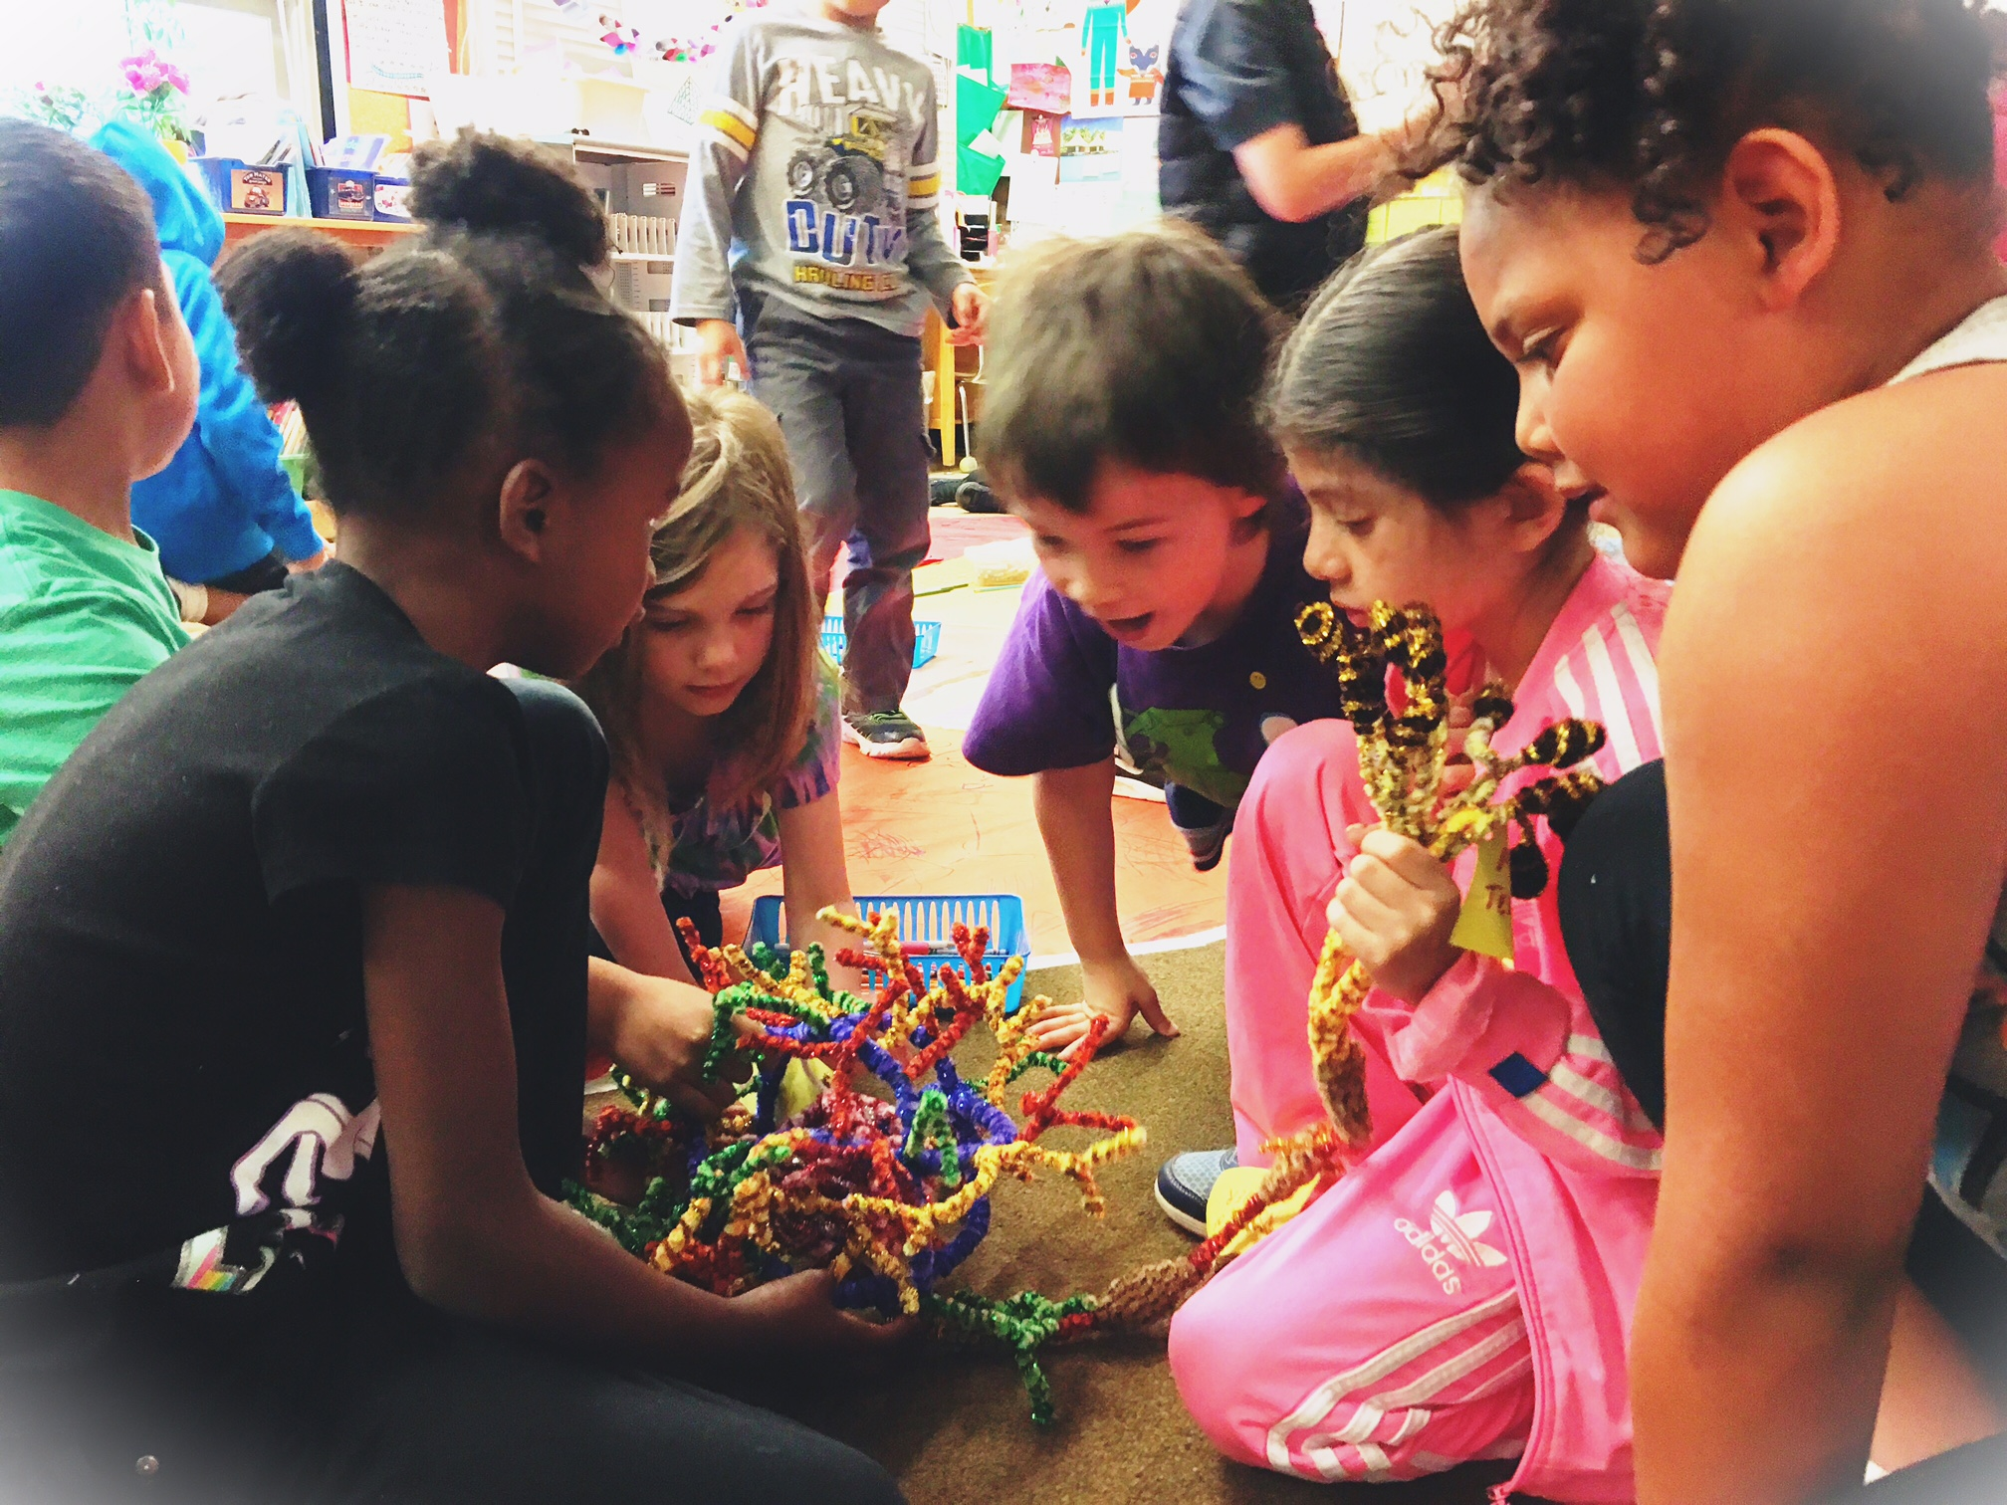
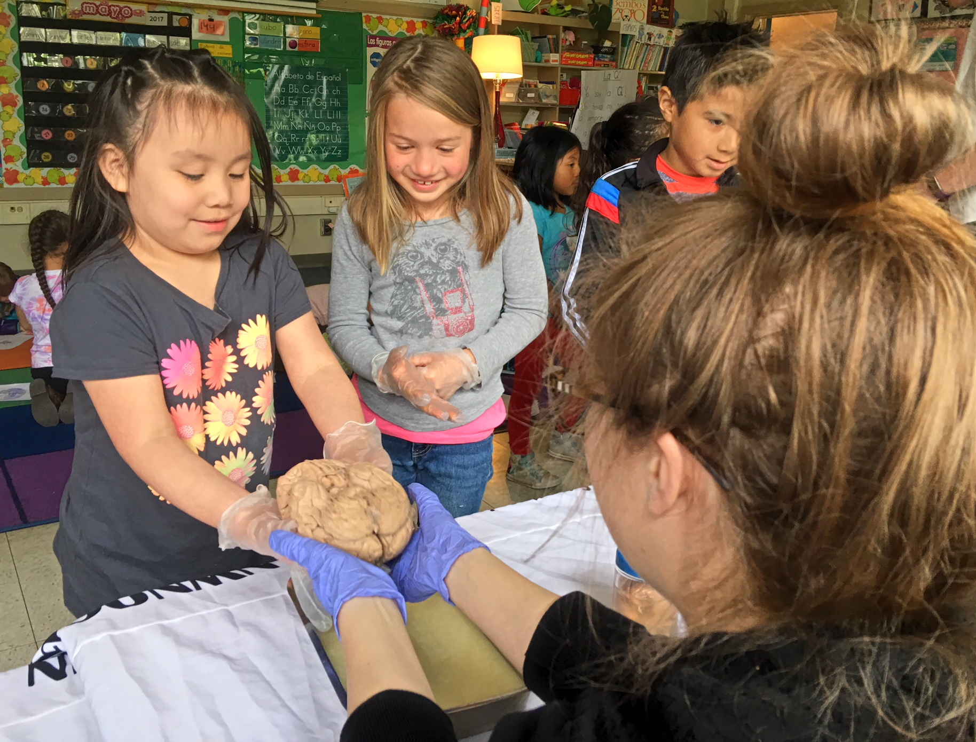
nwnoggin.org
Arts integrated neuroscience outreach for K-12 & community

Slide 2
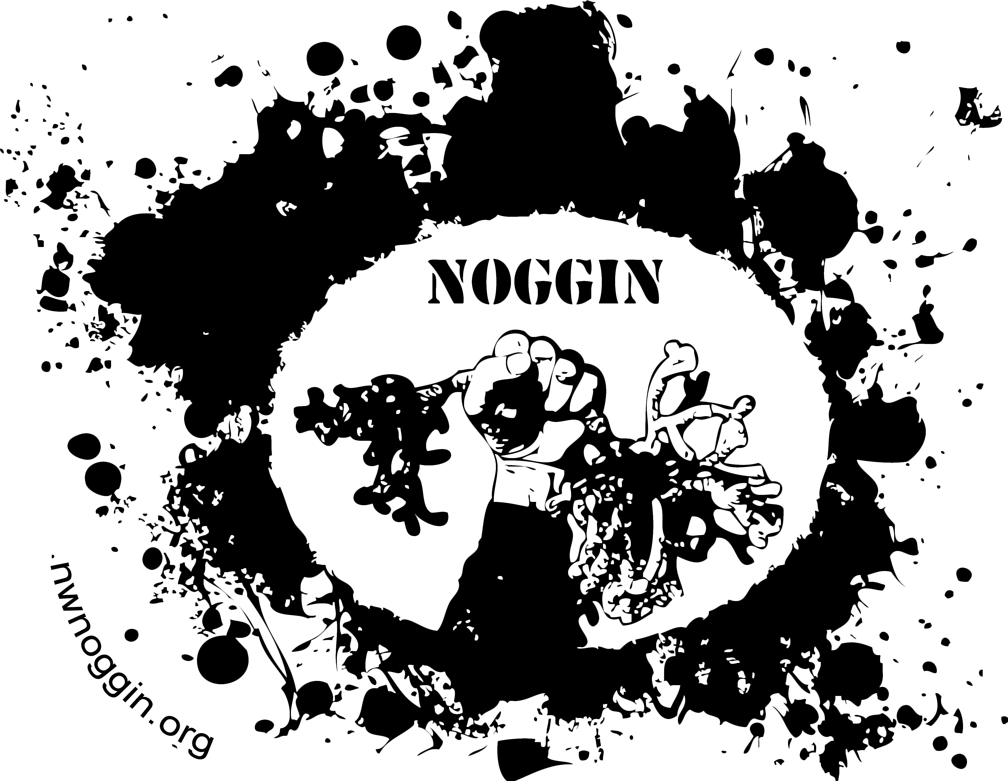
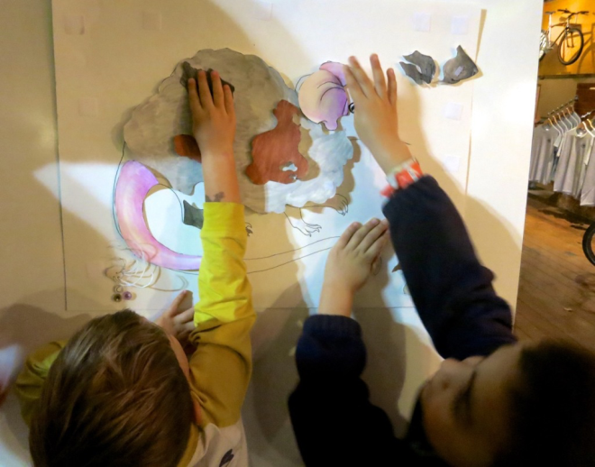
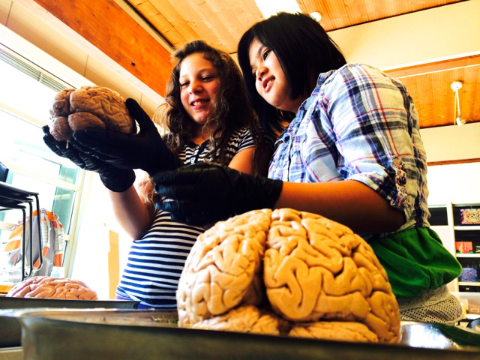
Why art and brains..?
Motivation, engagement, empathy
Exploration, creativity, INNOVATION
Personal relevance of STEAM material
You are made of something physical
Internships, jobs, service, careers

Slide 3
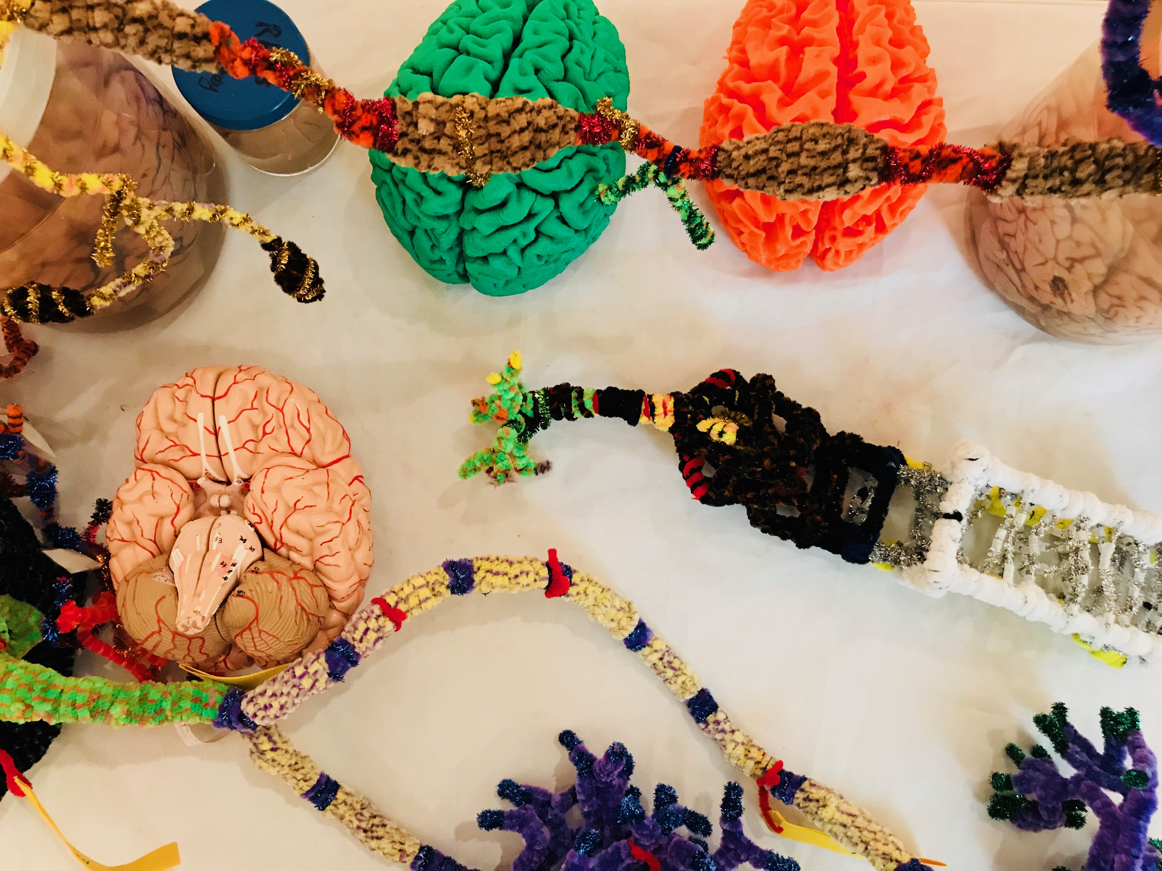
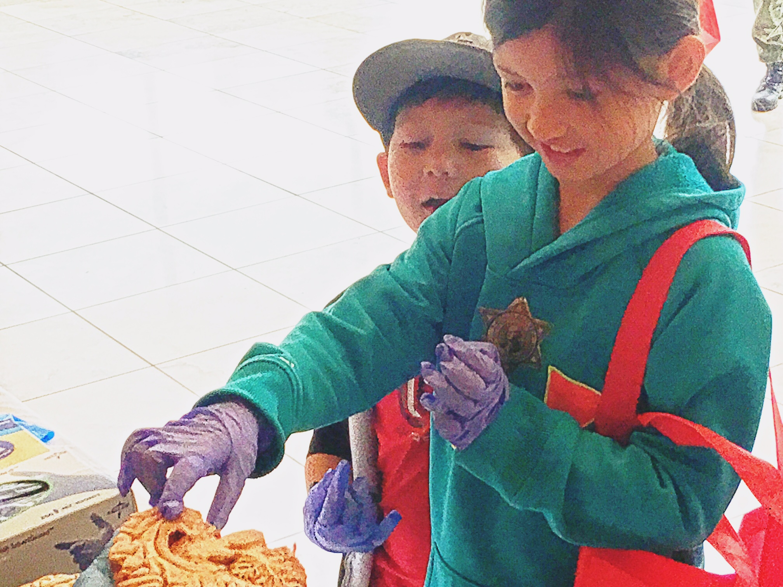
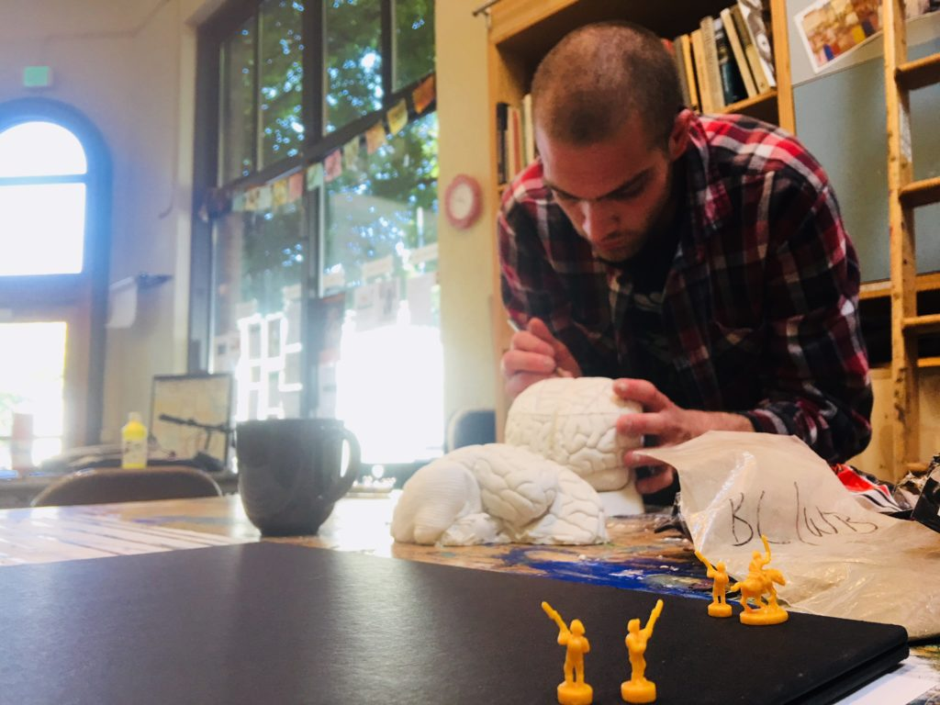
Connections matter
Oh the places you’ll go!
Academic priority K-12, tribal majority schools, rural communities
  Not always well-funded, or valued, often ignored, subjected to standardized testing that primarily benefits others. Complex brain development underway, unacknowledged diversity, prevalence of mental health issues …
Homeless youth (p:ear), MacLaren Youth Correctional Facility
  It’s like people see me as an object, not as a human being
Young graduate researchers, undergraduates (e.g., PSU, OHSU, PNCA,…)
  How does my research relate to the world? How can I explain it?
  Where can I go from here? How do I help kids from K-12 schools?
Artists
  How does my work relate to other fields? How do I connect with new audiences? How is my practice influenced and enriched by discoveries about the brain?
Area businesses (BioGift, Intel, Velo Cult)
  How can we better connect with everyone in our community?
Members of the public
  Why are my taxes spent on research? Art? What are we discovering?

Slide 4
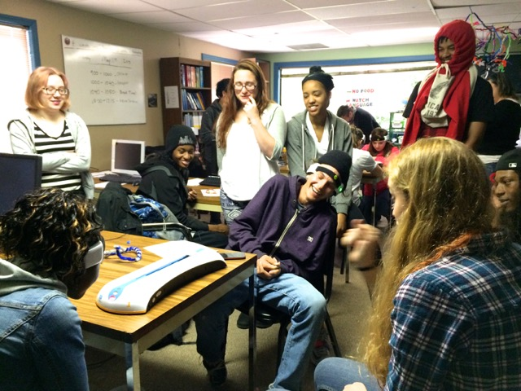
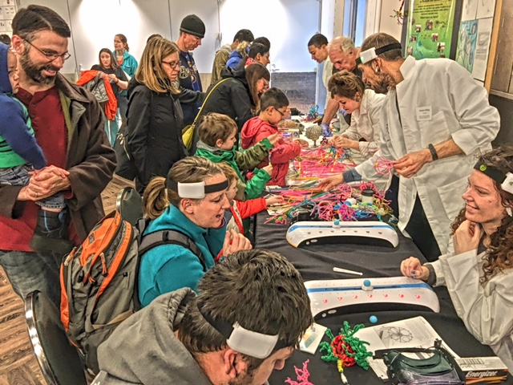
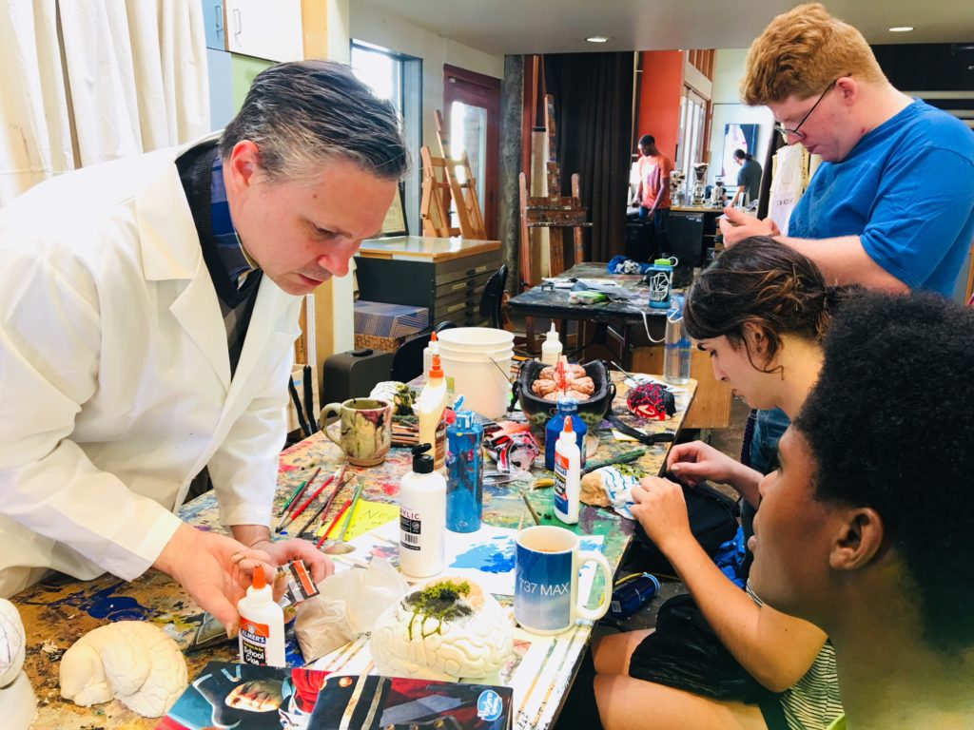
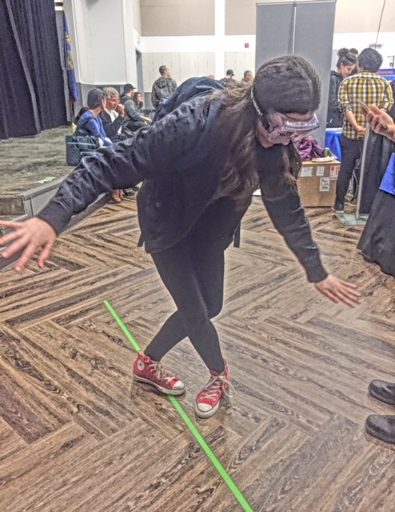
NW Noggin brings art & science to communities which don’t have access to this sort of educational programming
AND WE PARTNER!
There are resources in all our communities…
  Yes! OHSU at OHSU
  Oregon Museum of Science & Industry
  Portland Alcohol Research Center
  p:ear
  Portland Art Museum
  Oregon Youth Authority
  Rural communities: we go places!

Slide 5
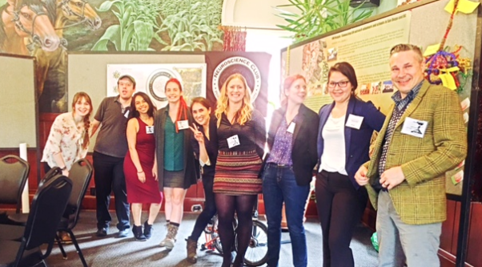
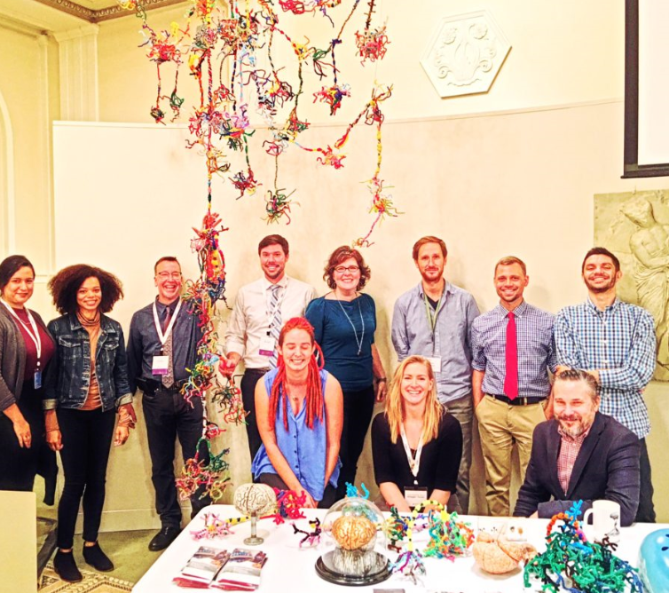
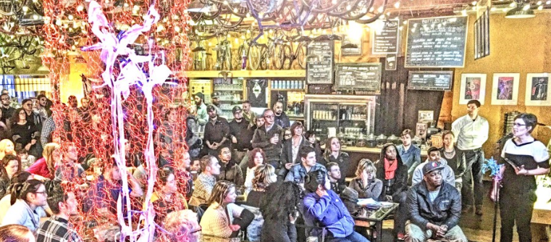
Outreach Creates Opportunity
Cross-disciplinary exposure
Teaching experience
Networking
Career opportunities
Community engagement
ALL VOLUNTEER

Slide 6
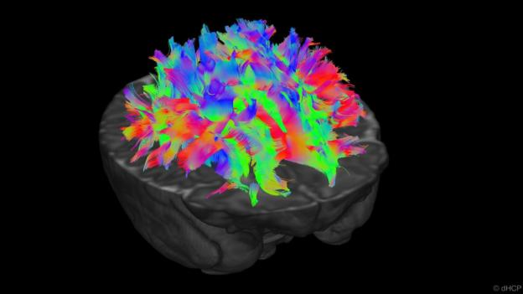
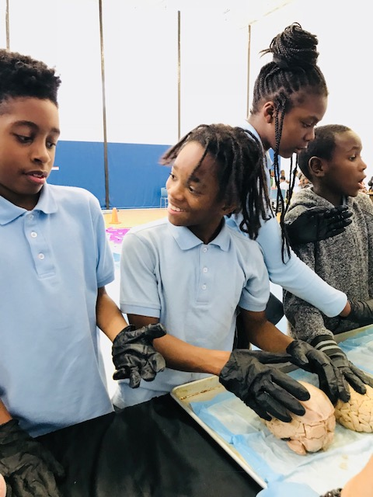
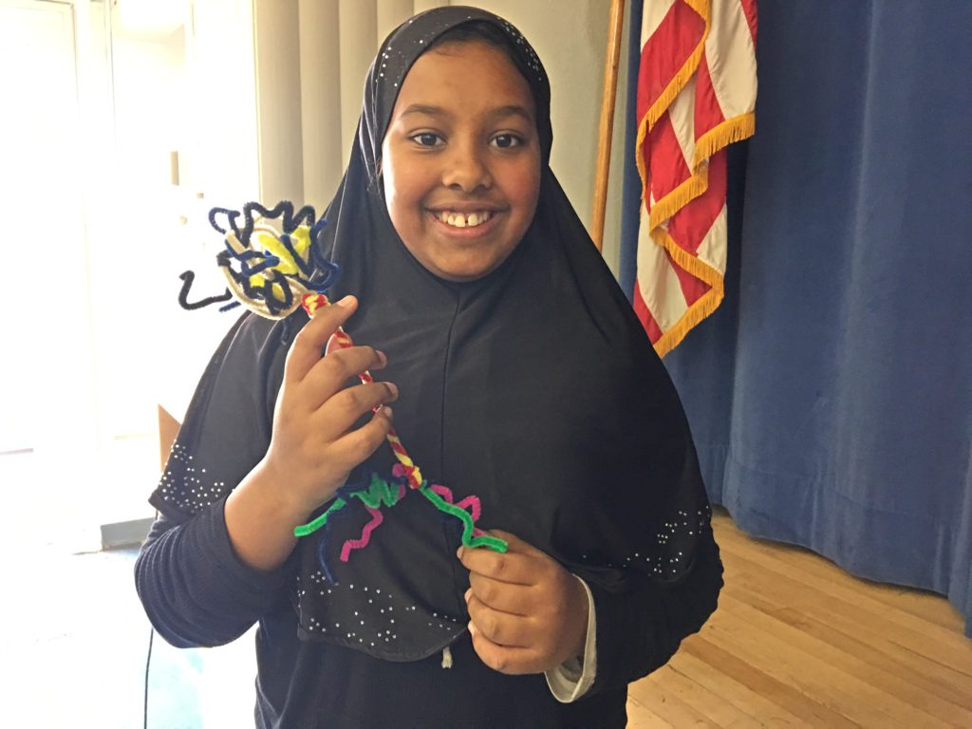
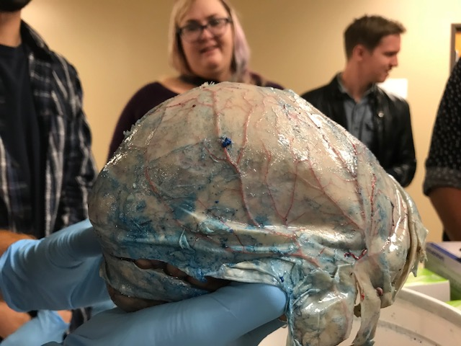
Educate
Engage
Inspire
From Human Connectome Project
More places, more people, more awareness of shared community. The more we create art, and cross disciplines/institutions, the more connections we see.
This is how brains develop: locally linked neurons at the start, but rich, distributed networks develop/collaborate to get things done. We want more kids, more people synapsed to opportunities in education, careers, research, outreach, service and art…

Slide 7
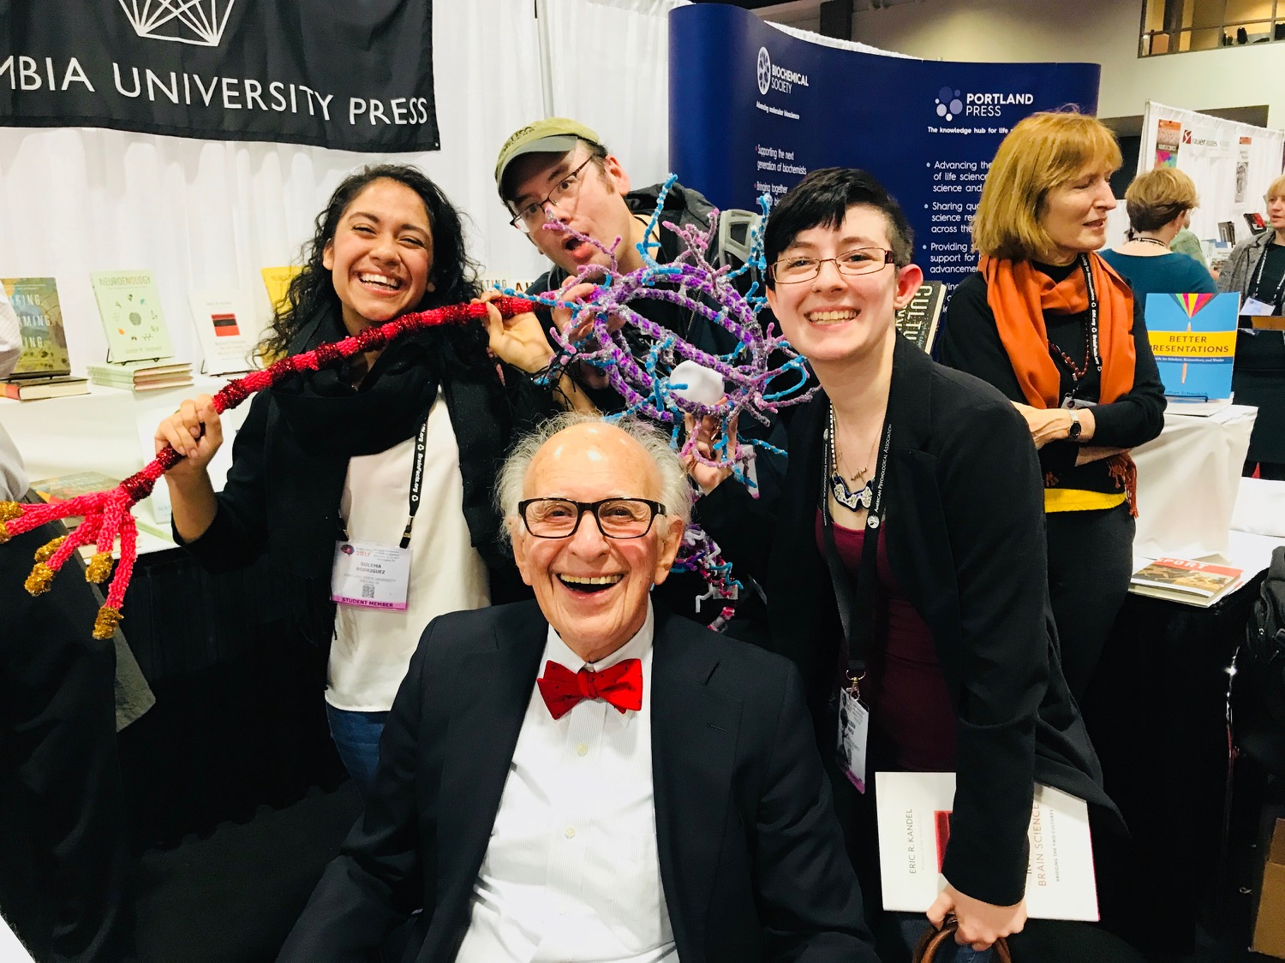
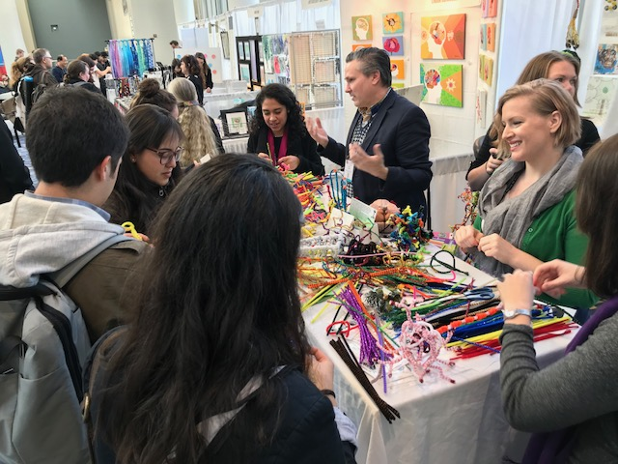
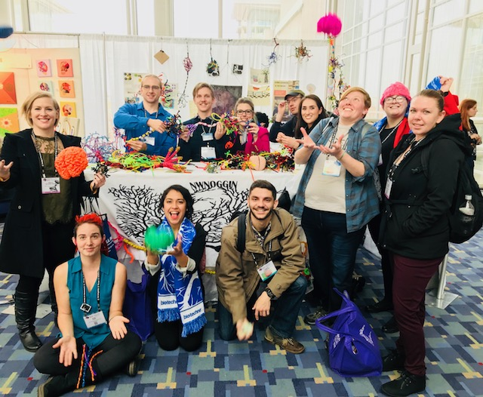
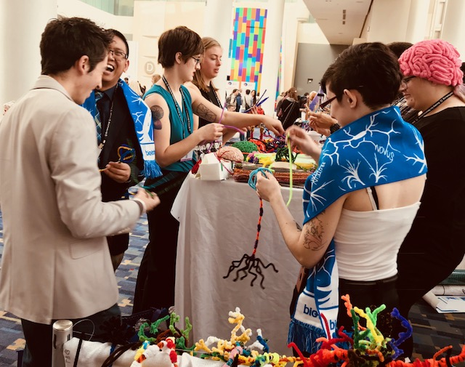
SfN conference 2017
ART OF
NEURO-
SCIENCE

Slide 8
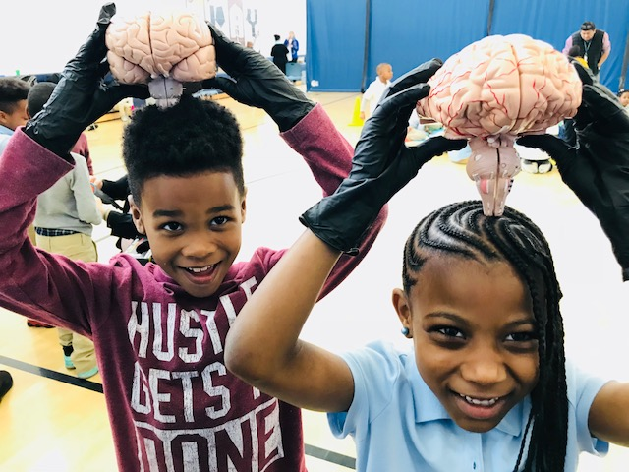
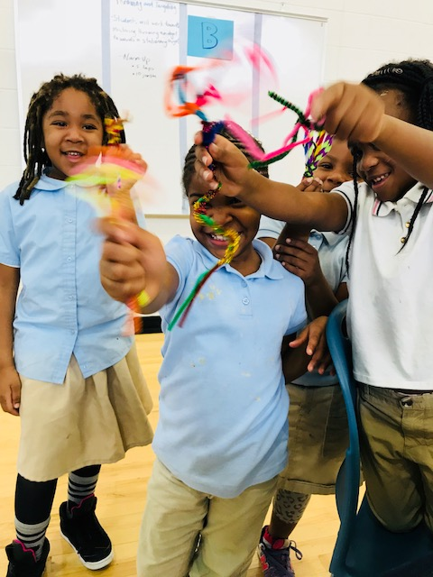
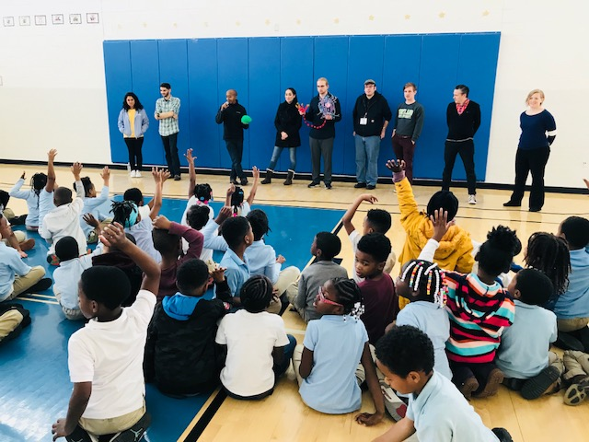
Turner Elementary

Slide 9
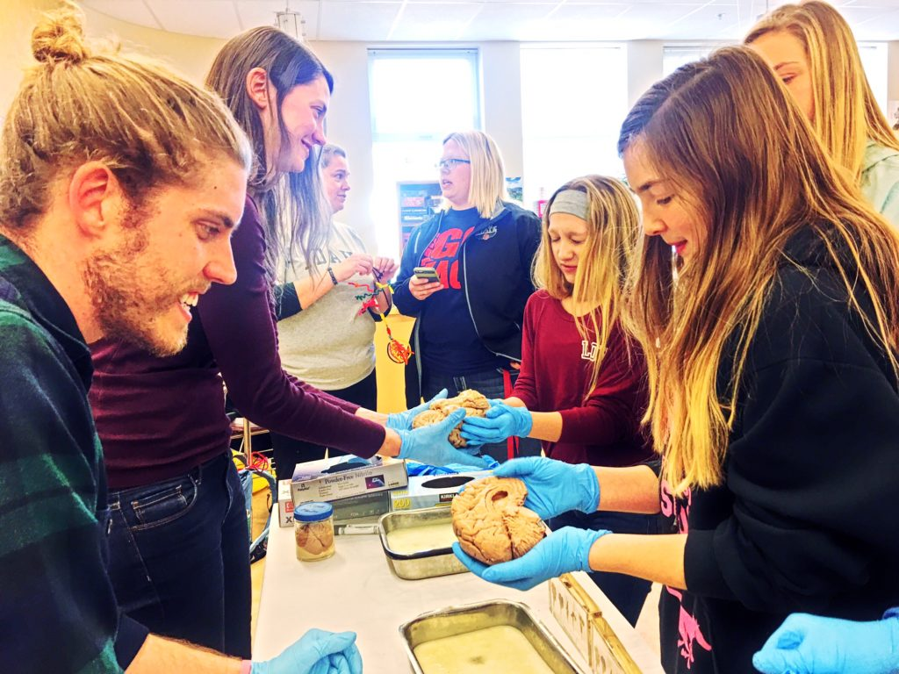
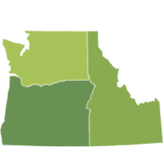
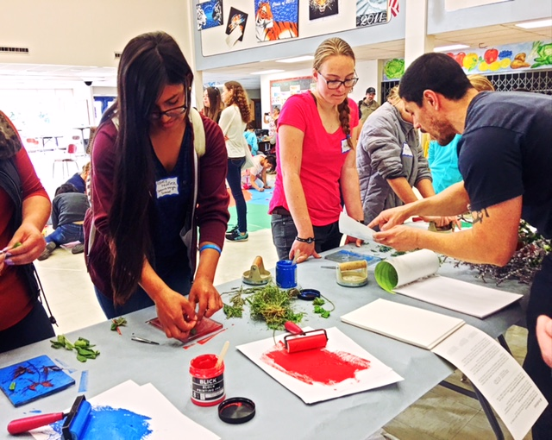
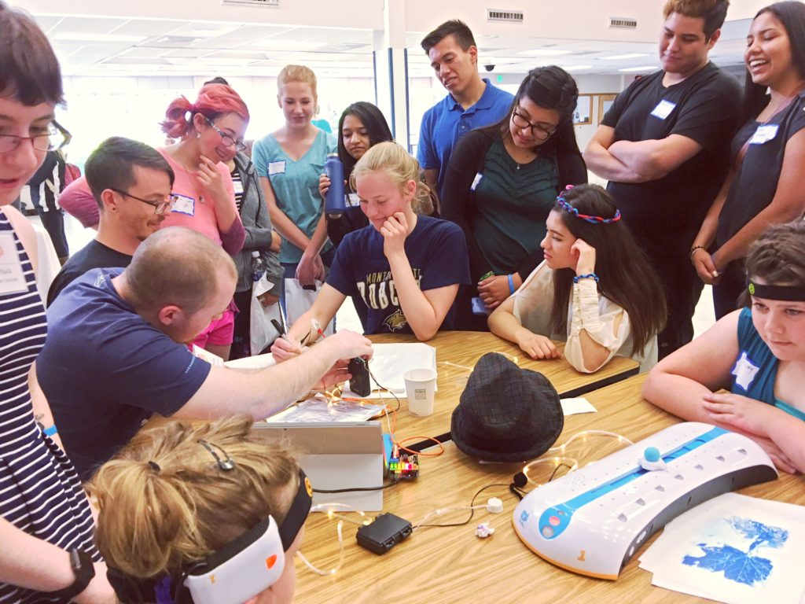
Rural Outreach Events
Siletz, Amity & Willamina, OR
Pop: 4,000
Davenport, WA
Pop: 1,700
La Grande, OR
Pop: 13,000
Meservy Meadows, OR Pop: ~40
Heppner & Ione, OR
Pop: 1,240

Slide 10
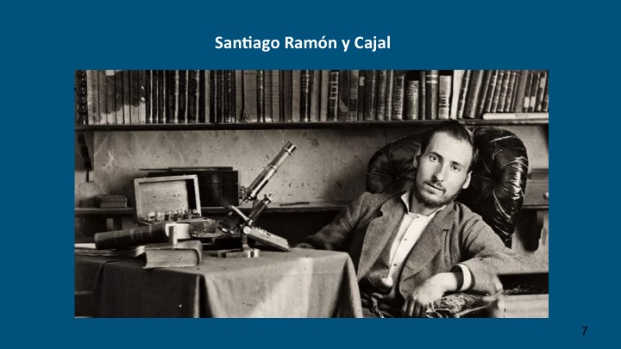
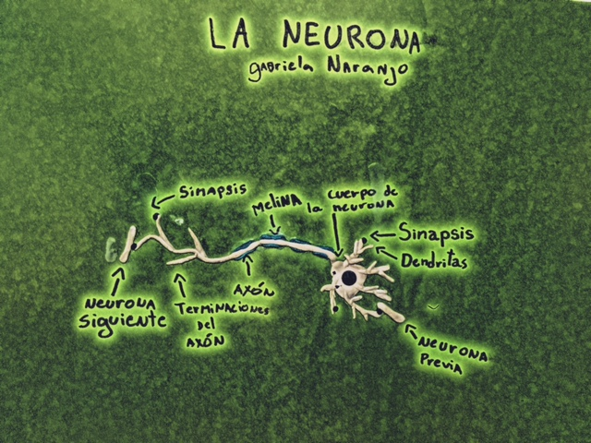
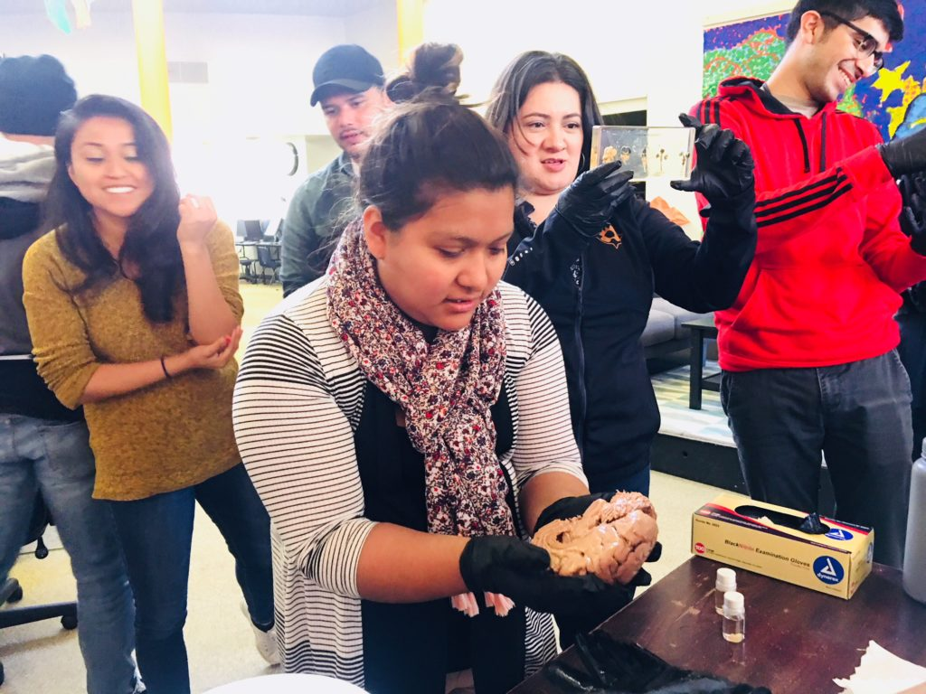
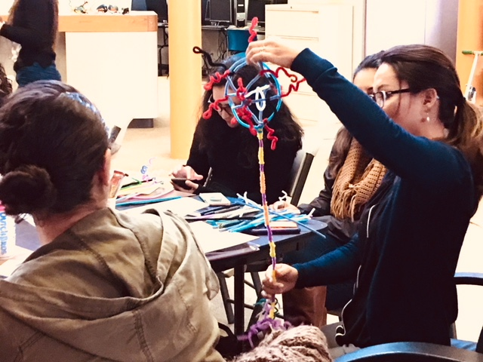
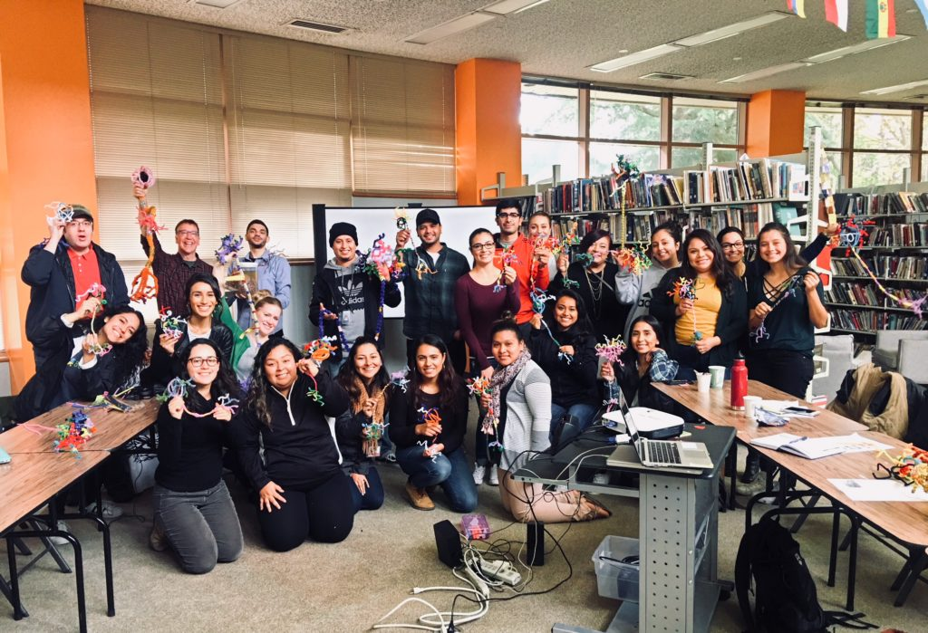
Collaboration with Latino Network
A Latino-led organization to help youth and families reach their full potential
Mentors were interested in adolescent brain changes and how these changes impacted behavior
Highlighted benefits of bilingualism
Bringing neuroscience to under-represented Latinos; empowering people to pursue more

Slide 11
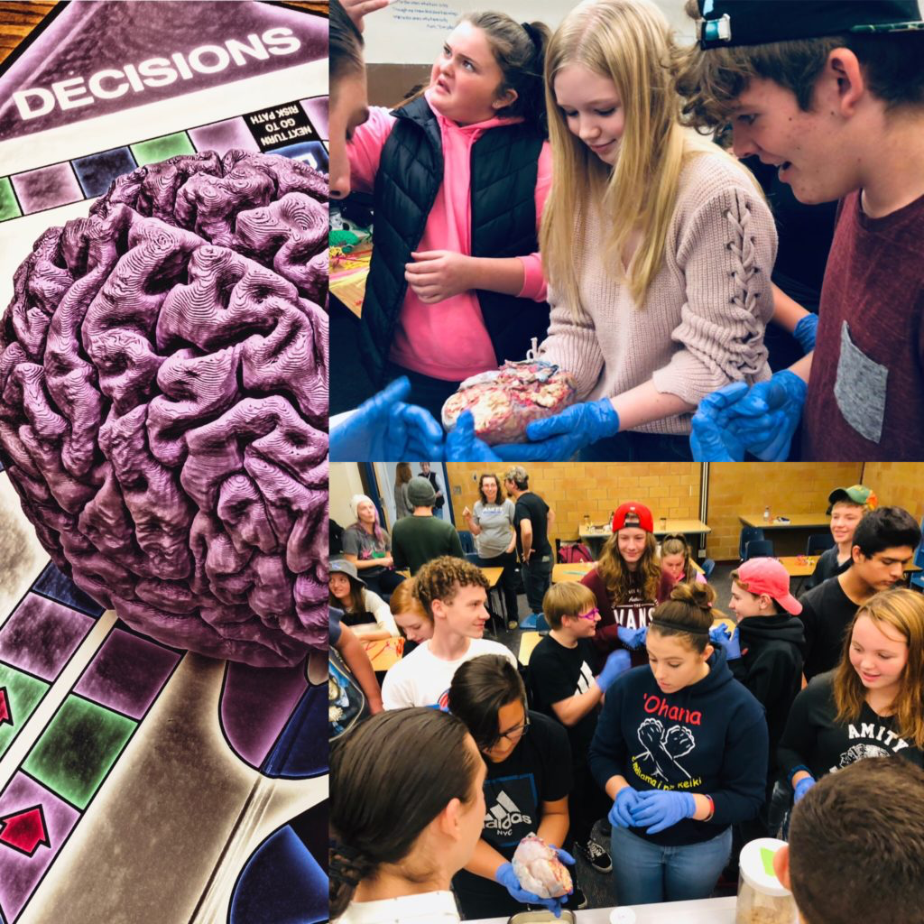
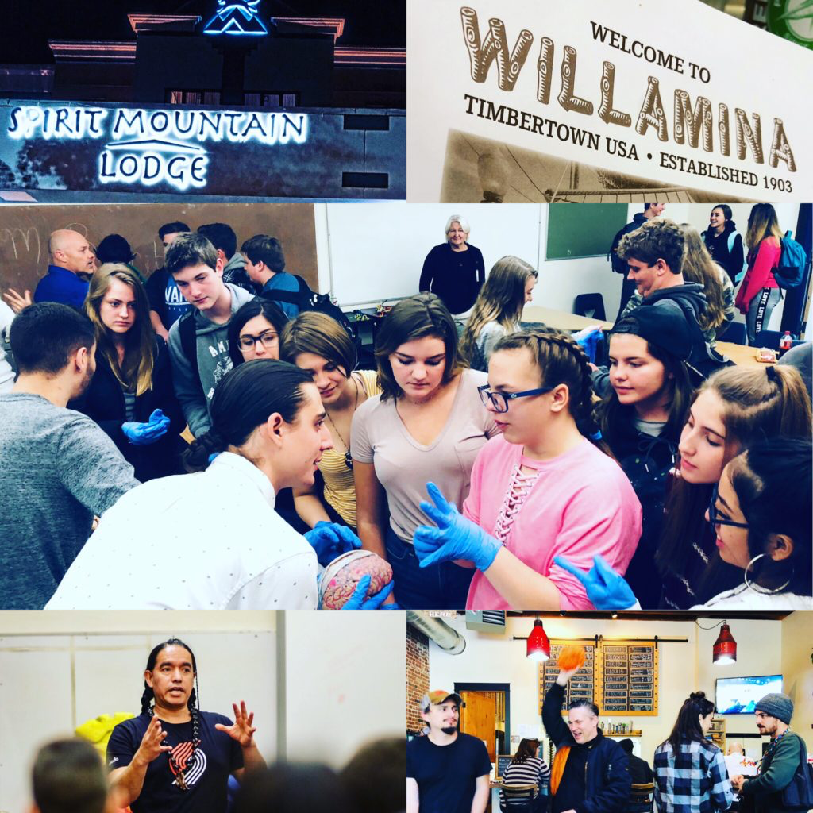
Synapses, Stories & Song
Confederated Tribes of the Grande Ronde
Confederated Tribes of the Siletz

Slide 12
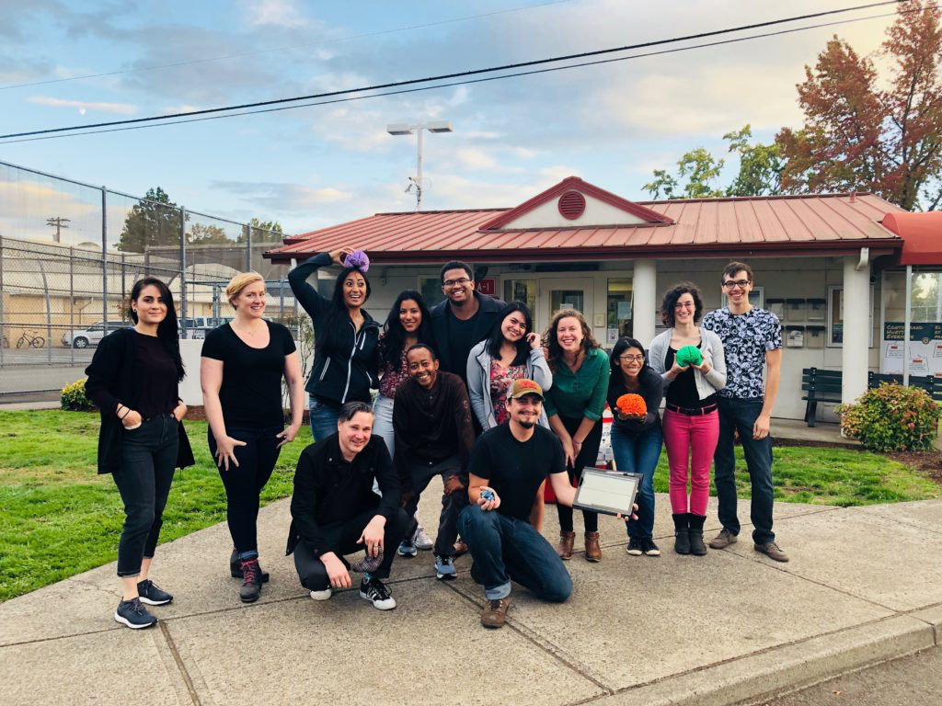
Neuroscience & Law
MacLaren Youth Correctional Facility

Slide 13
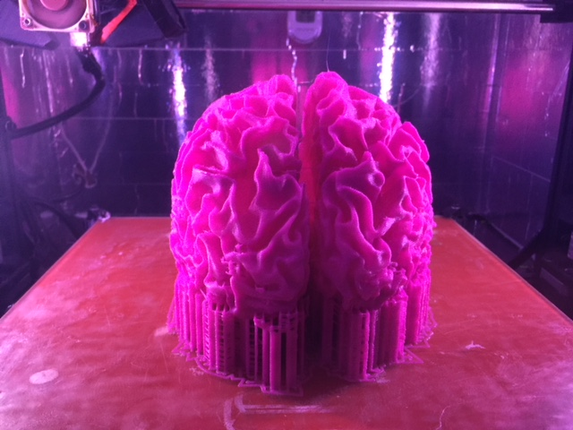
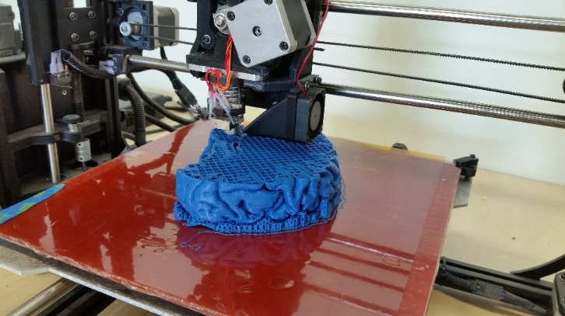
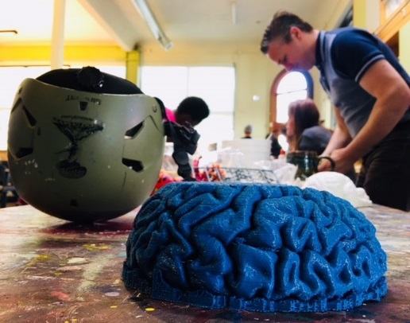
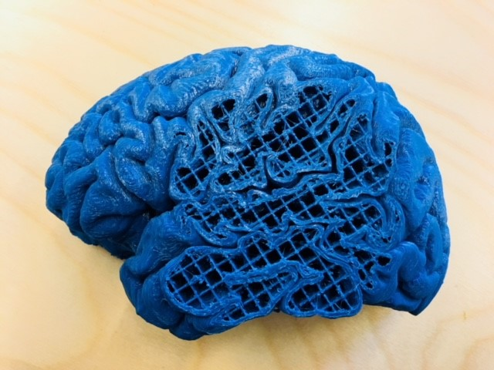
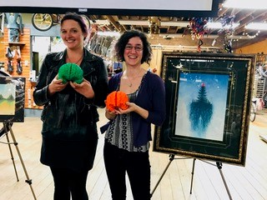
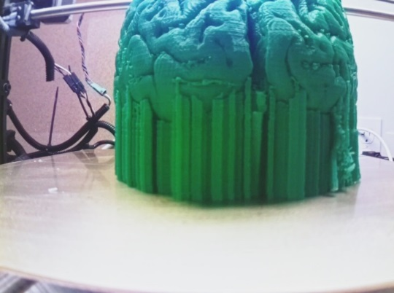
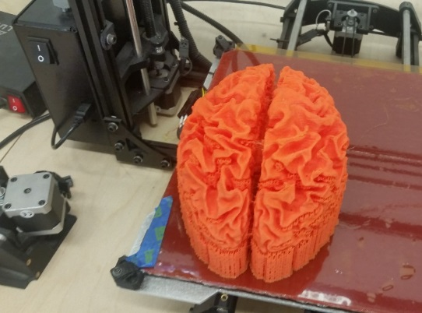
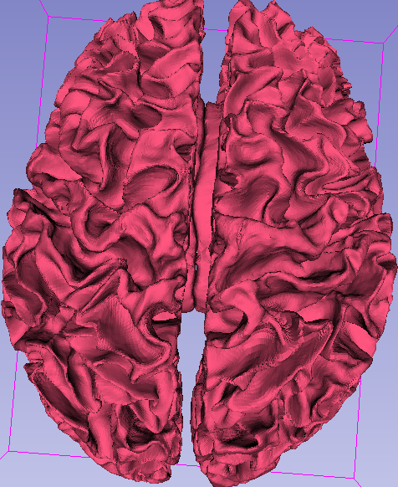
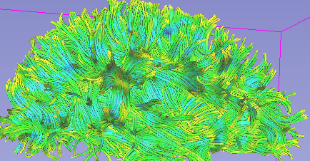
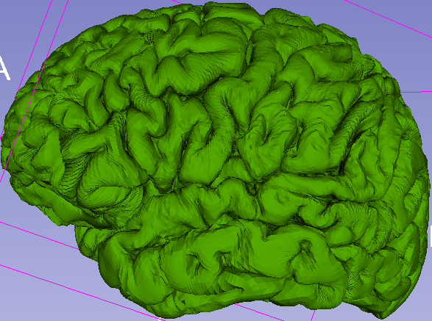
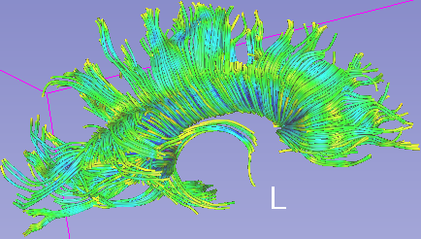
Art + Neuroscience = 3D printed brain models
Collaboration with Make + Think + Code @ PNCA, Intel, PDX 3D Printing Lab!

Slide 14








Expanding Networks Means Wider Connections And Diverse Opportunities

Slide 15




Music & Performance
Accessibility
Community
Memory

Slide 16


Slide 18
nwnoggin.org
Arts integrated neuroscience outreach for K-12 & community

