Slide 1
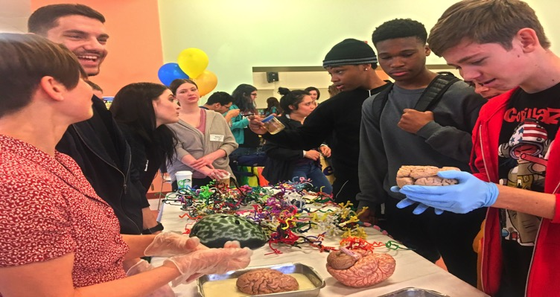
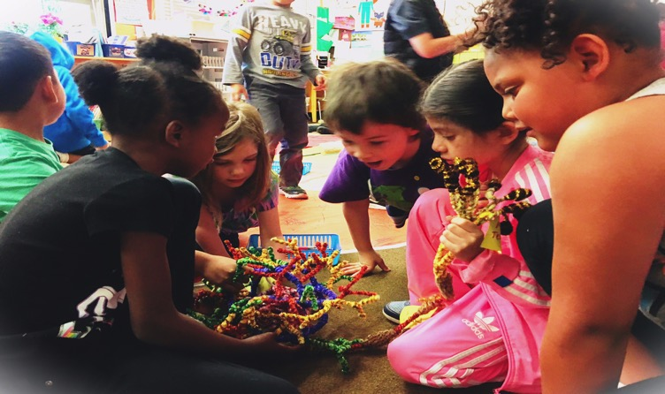
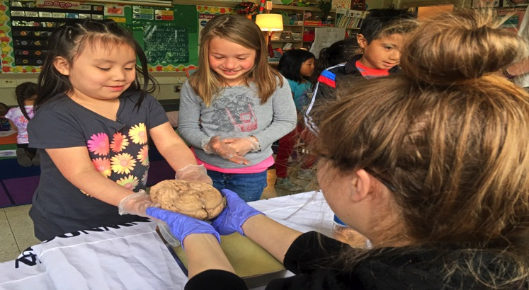
nwnoggin.org
Arts integrated neuroscience outreach for K-12 & community

Slide 2
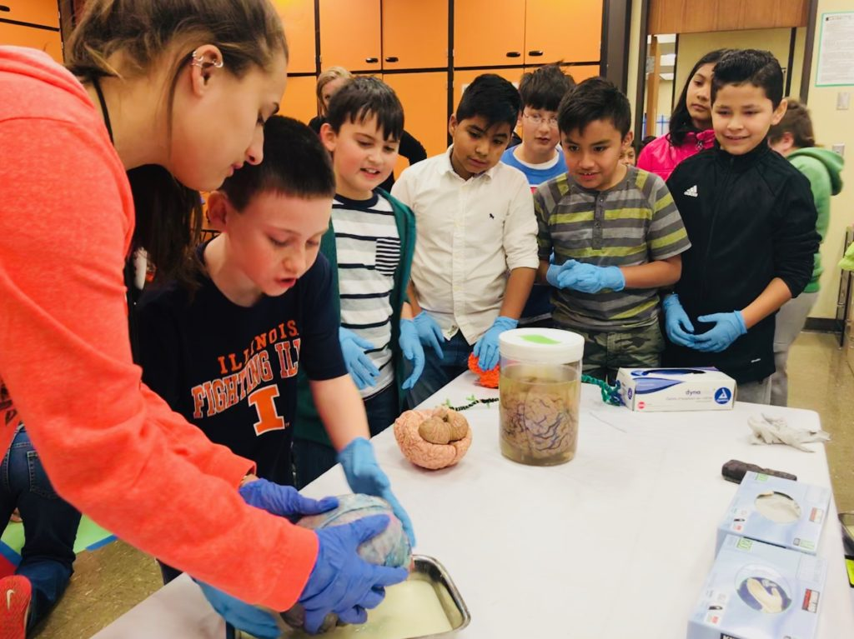
What you do has relevance
GO PLACES
Sleep
Anxiety
Depression
ADHD
Autism
Development
Perception
Drugs
Memory
Language
Bias
…

Slide 3
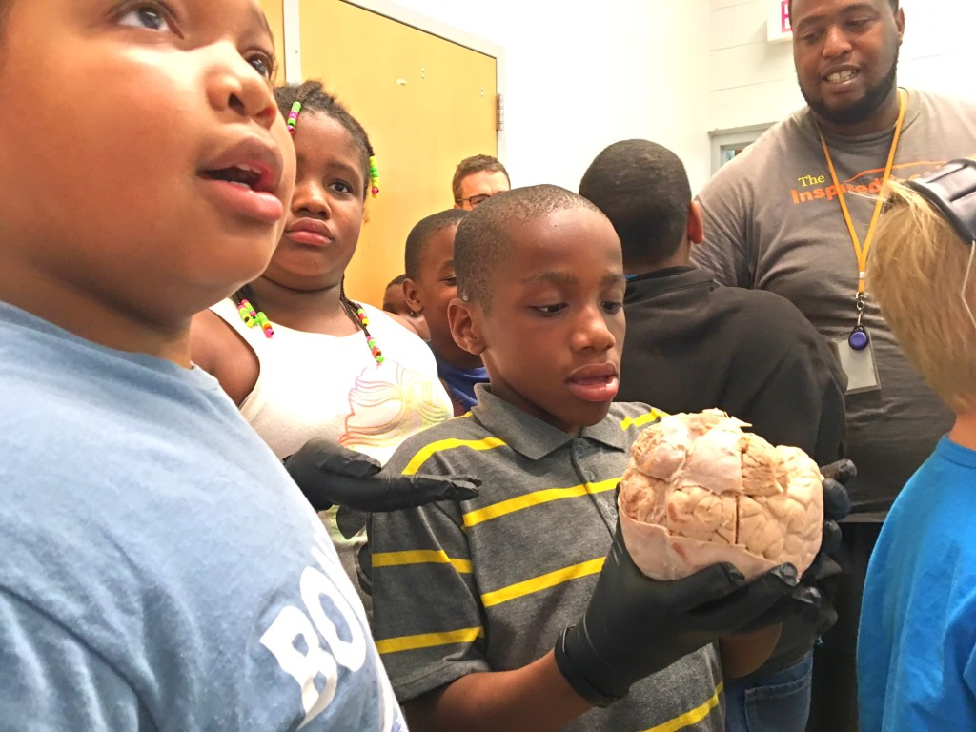
We all pay for research

Slide 4
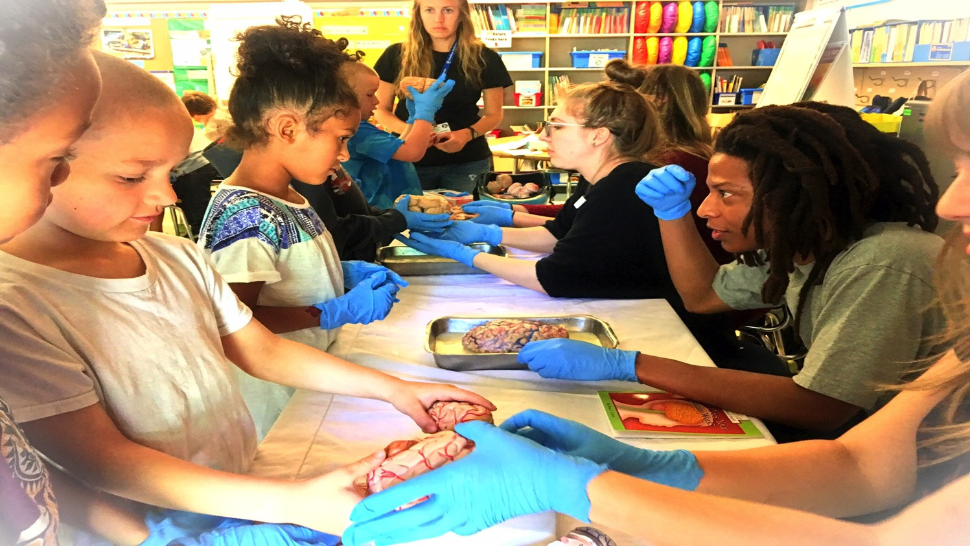
Connections matter
Greater understanding
More support for research
Increased participation
Less confirmation bias
New directions
FUN!

Slide 5
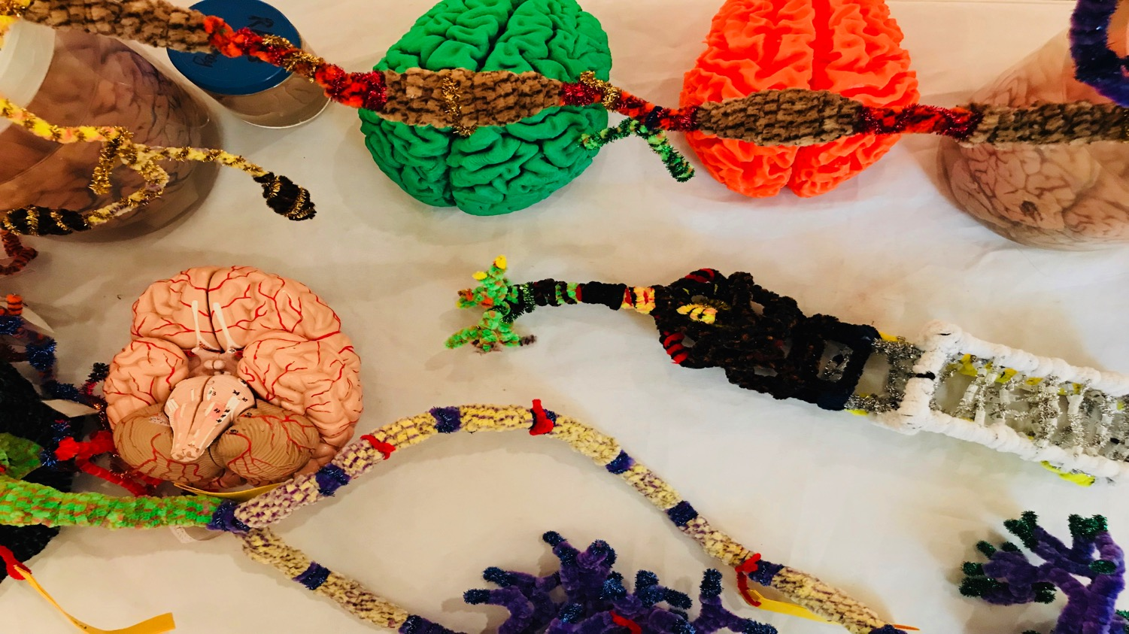
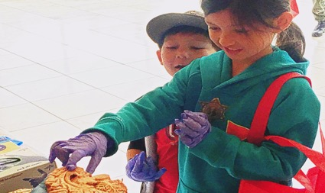
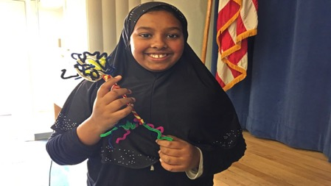
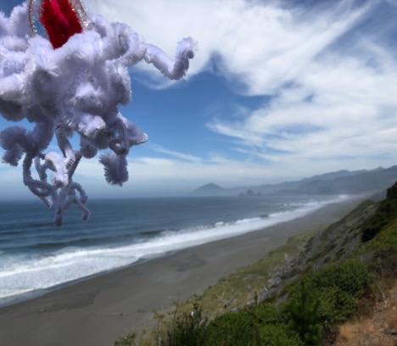
BUILD NEW
CONNECTIONS
Academic priority K-12, urban/rural communities, tribal majority schools
  Not always well-funded, or valued, often ignored, subjected to standardized testing that primarily benefits others. Complex brain development underway, unacknowledged diversity, mental health…
Homeless youth (p:ear), incarcerated youth (MacLaren Correctional Facility)
  “It’s like people see me as an object, not as a human being”
Young graduate researchers, undergraduates (PSU, OHSU,…)
  How does my research relate to the world? How can I explain it?
  Where can I go from here? “Alternative careers” in science…
Artists: Painters, Dancers, Storytellers, Musicians
  How does my work relate to other fields? How do I connect with new audiences?
  How is my practice influenced and enriched by discoveries about the brain?
Area businesses (BioGift, Intel, Velo Cult, Hospitals)
  How can we better connect with everyone in our community?
Members of the public
  Why are my taxes spent on research? Art? What are we discovering? Making?
Oh the places
you’ll go!

Slide 6
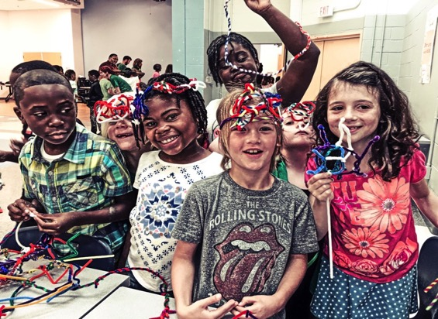
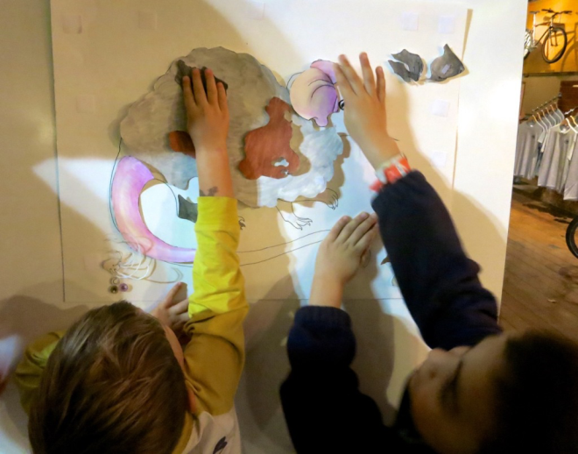
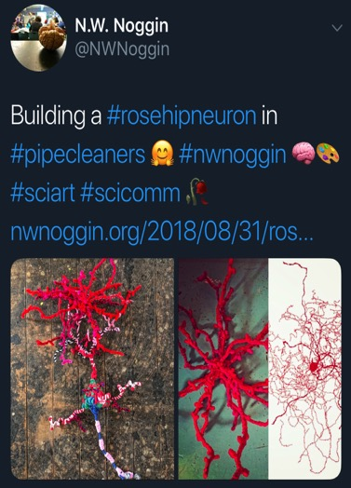
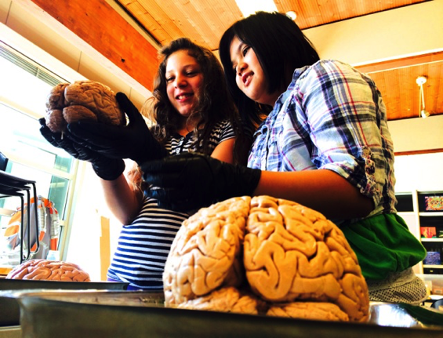
Why art & brains..?
Motivation, engagement, empathy
Exploration, creativity, INNOVATION
Personal relevance of STEAM material
Build your own mouse line!

Slide 7
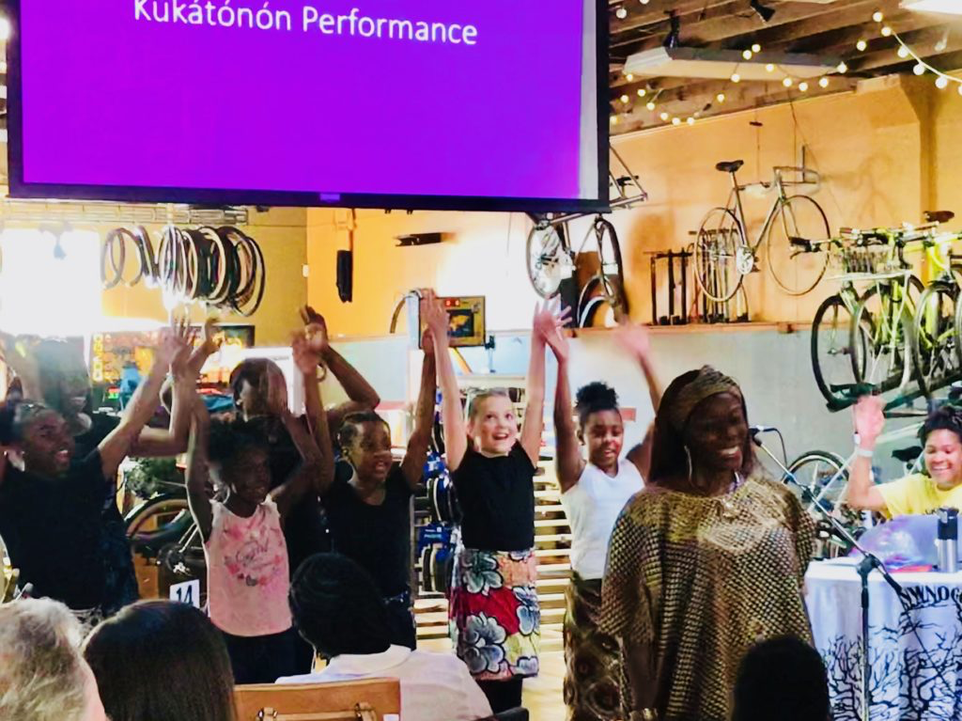
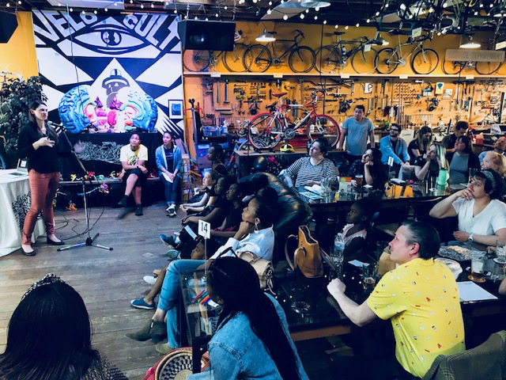
Kúkátónón Dance Troupe @ Velo
For example…
Dancing, mistakes, movement
…and Parkinson’s!

Slide 8
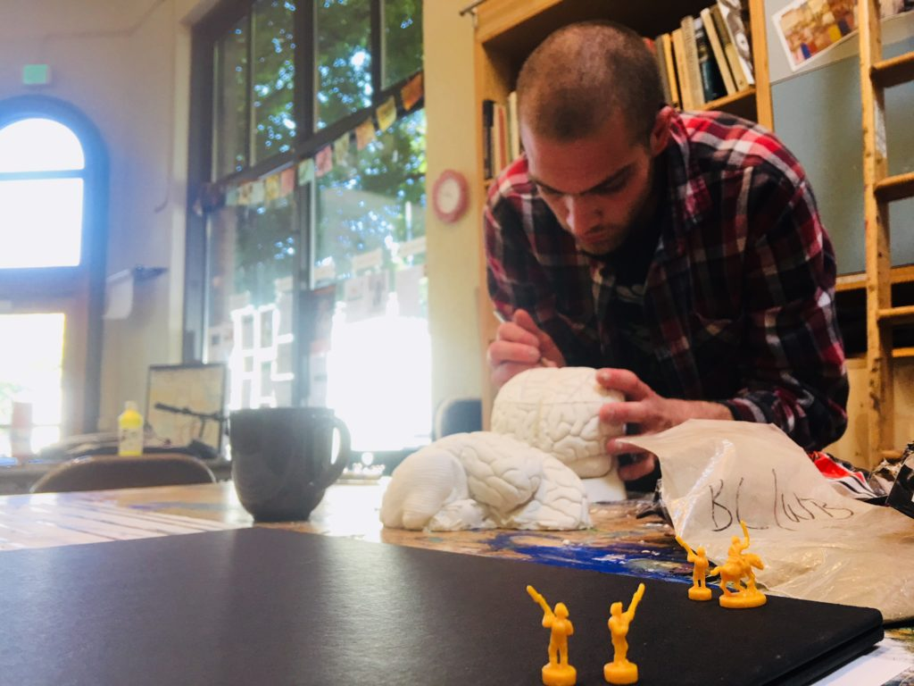
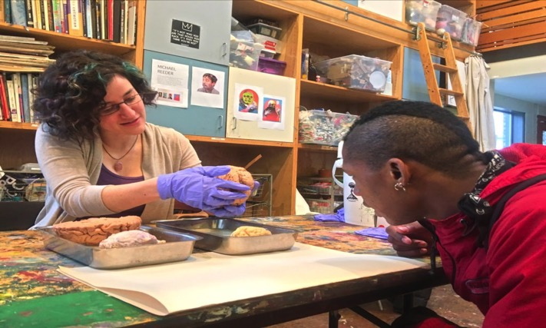
Noggin @ p:ear
  “It’s like people see me as an object, not as a human being”

Slide 9
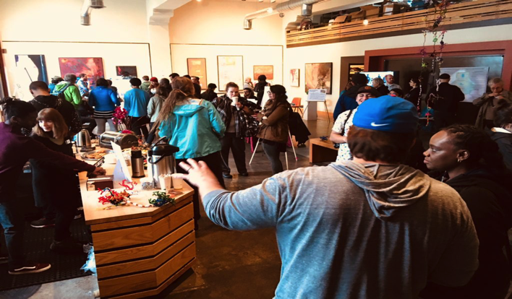
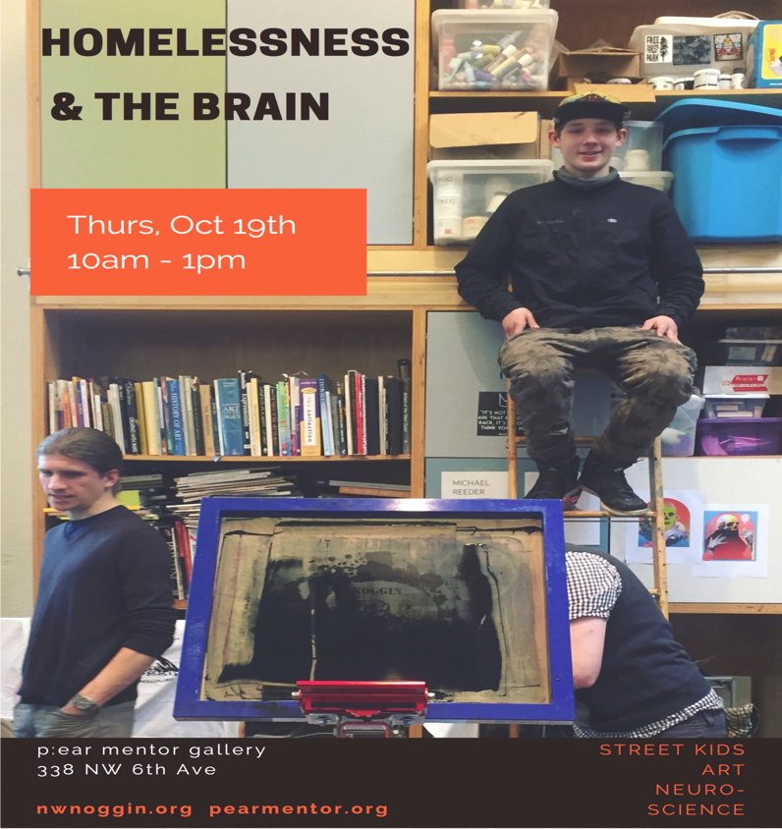
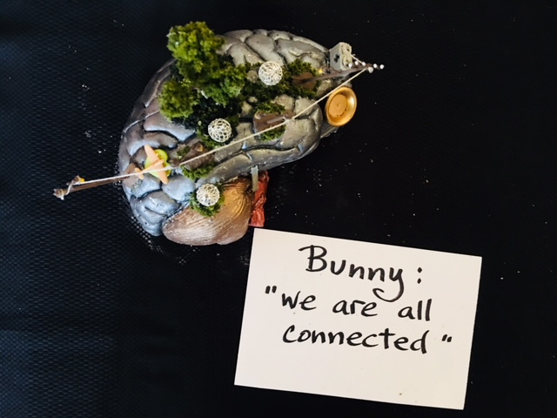
Our poster today
Researchers
Clinicians
Policy makers
Houseless youth

Slide 10
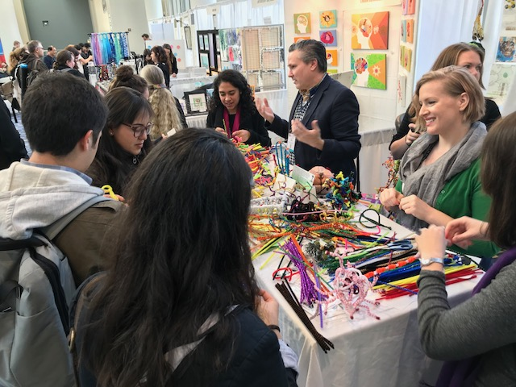
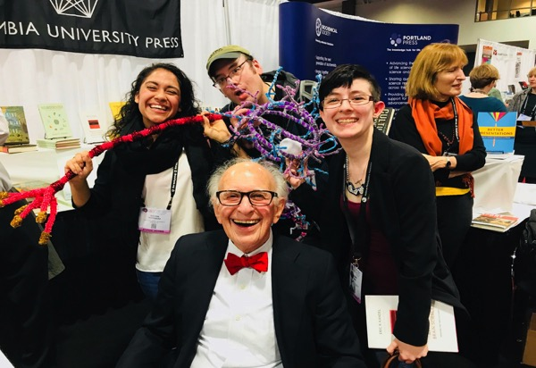
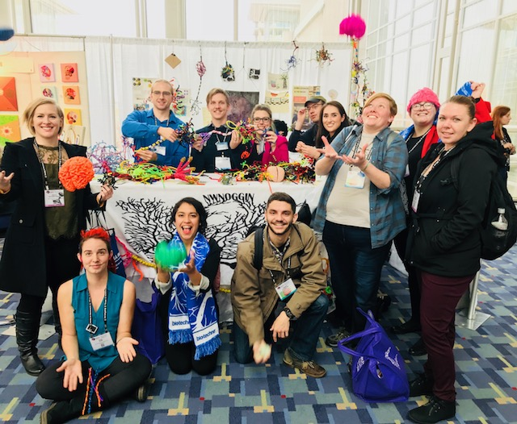
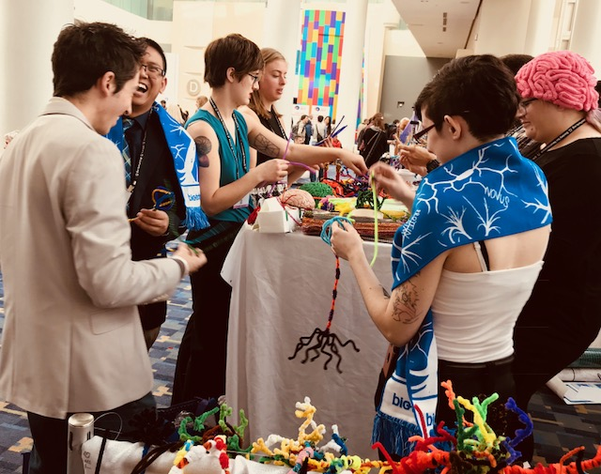
At SfN 2017 in DC
Posters, art of neuroscience and…

Slide 11
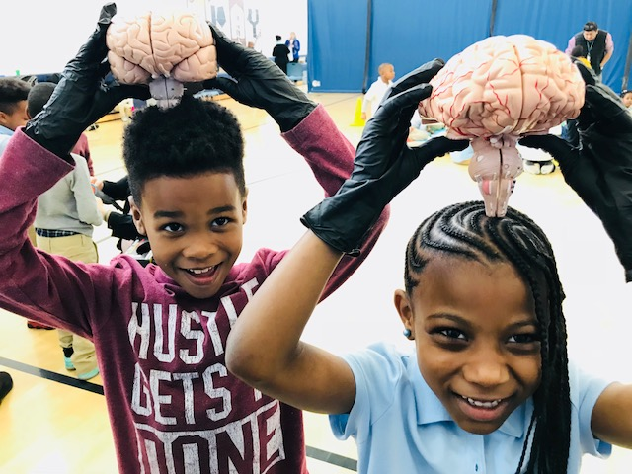
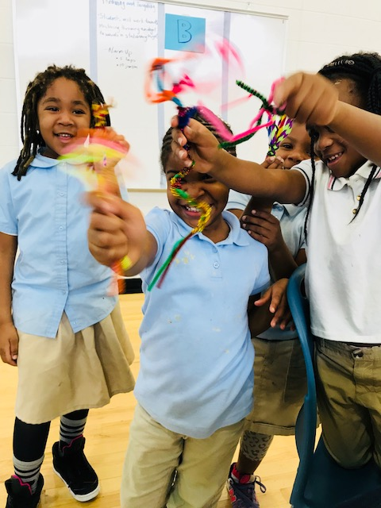
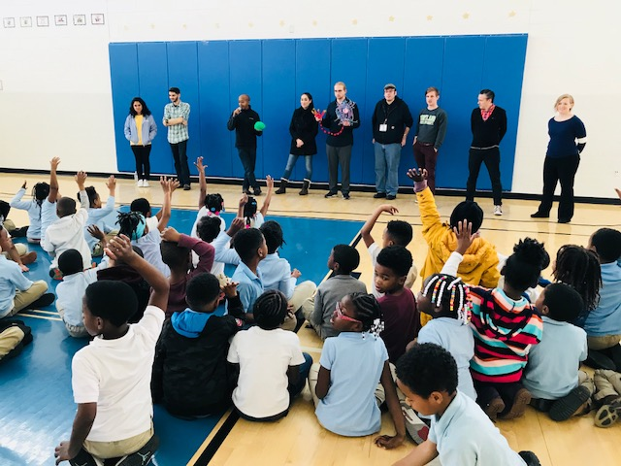
School visits
THIS WEEK…
San Diego Unified Public Schools!
Turner Elementary, DC

Slide 12
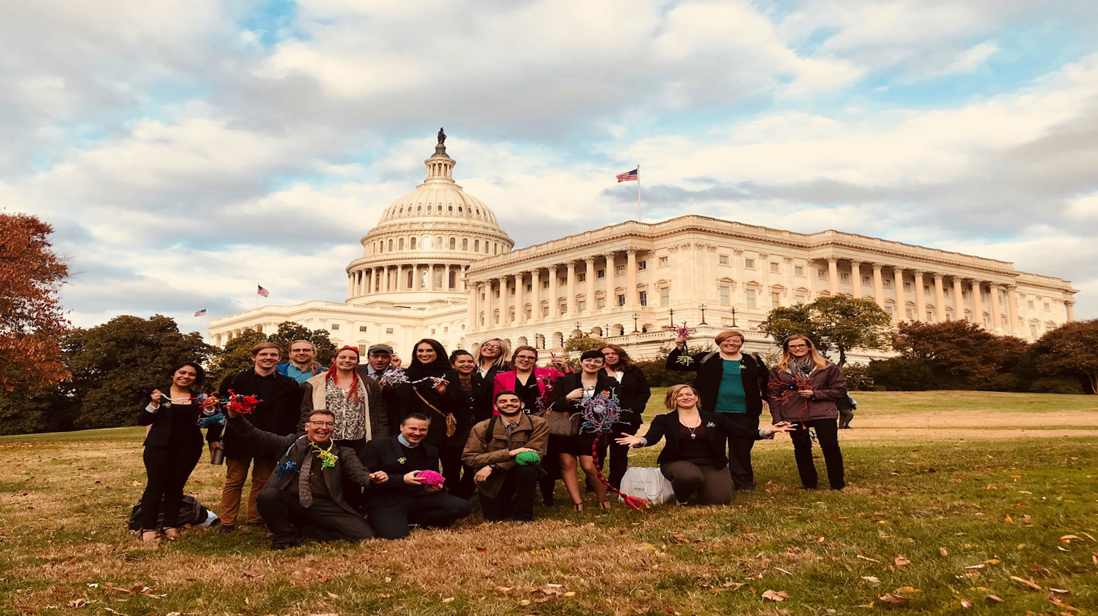
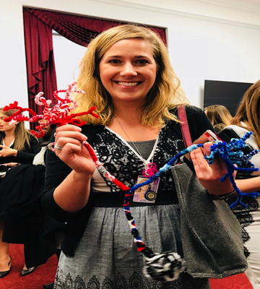
And also…Capitol Hill
More connections: Congressional office visits
Congressional Neuroscience/STEAM briefing
Research should inform policy

Slide 13
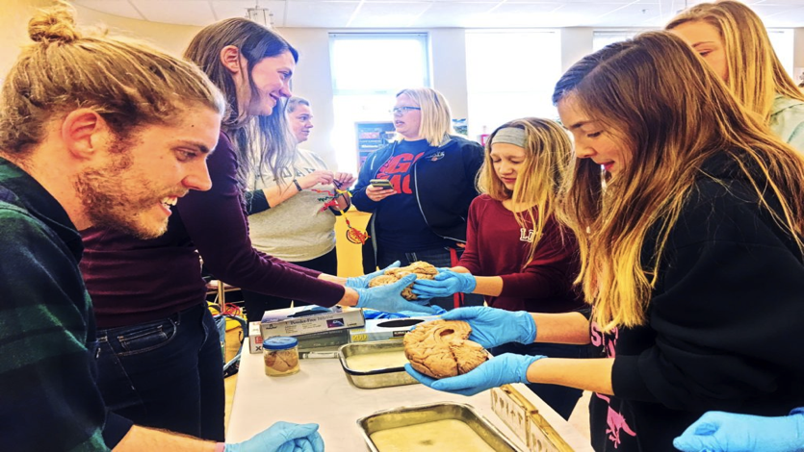
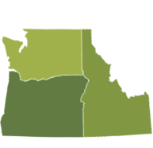
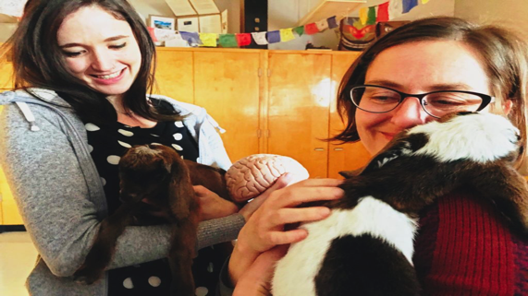
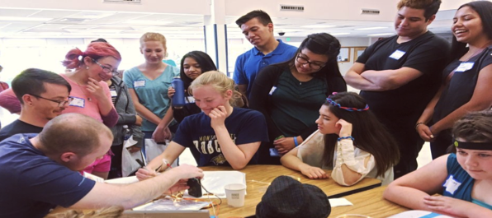
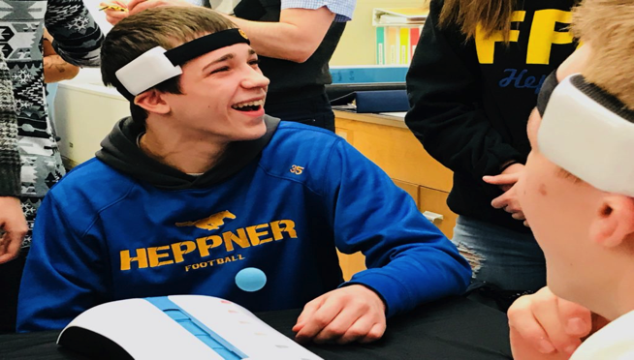
Rural Outreach
Food, housing, baby goats…
LEAVE TOWN!
Siletz, Amity & Willamina, OR
Pop: 4,000
Davenport, WA
Pop: 1,700
La Grande, OR
Pop: 13,000
Meservy Meadows, OR Pop: ~40
Heppner & Ione, OR
Pop: 1,240

Slide 14
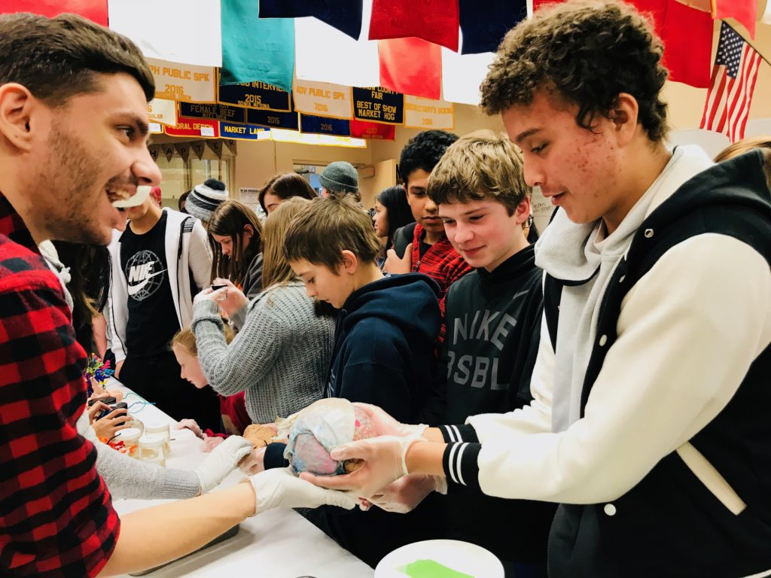
Noggin in Heppner, OR

Slide 15
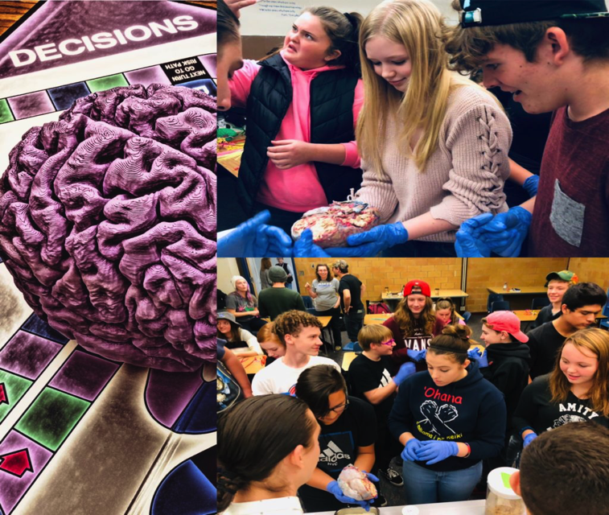
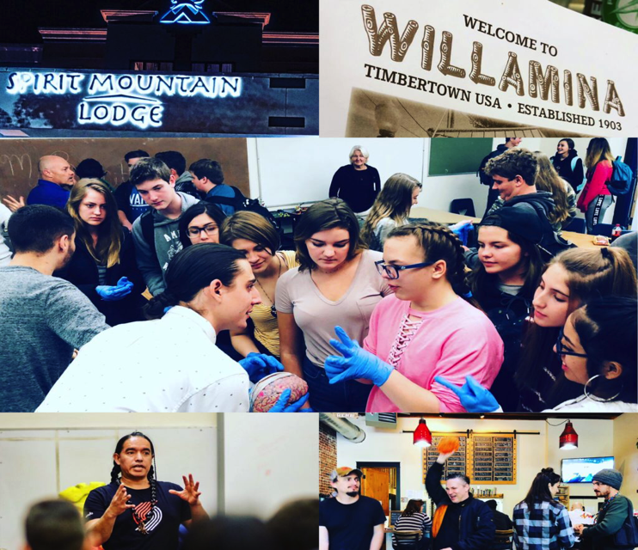
Synapses, Stories & Song
Confederated Tribes of the Grande Ronde, Siletz

Slide 16
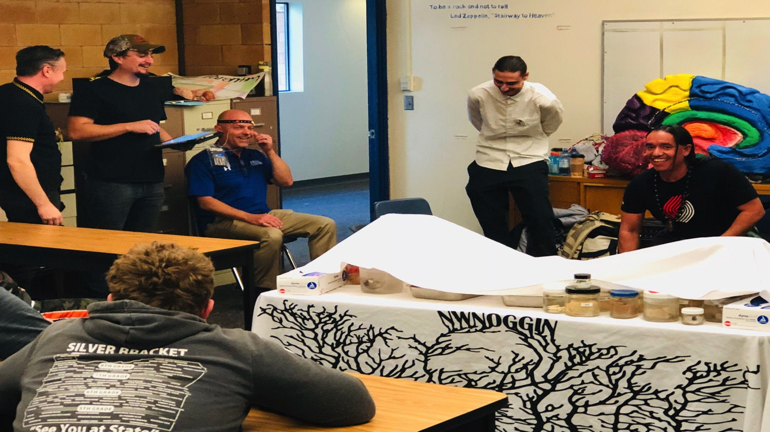
Synapses, Stories & Song

Slide 17
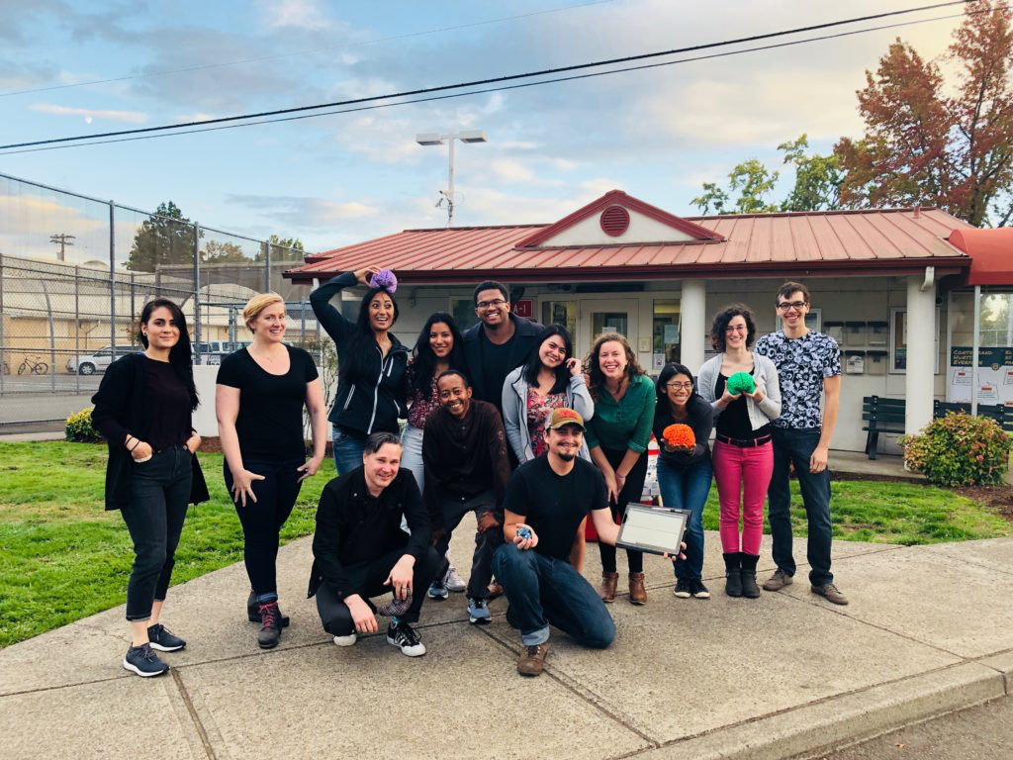
Neuroscience & the Law
MacLaren Youth Correctional Facility

Slide 18
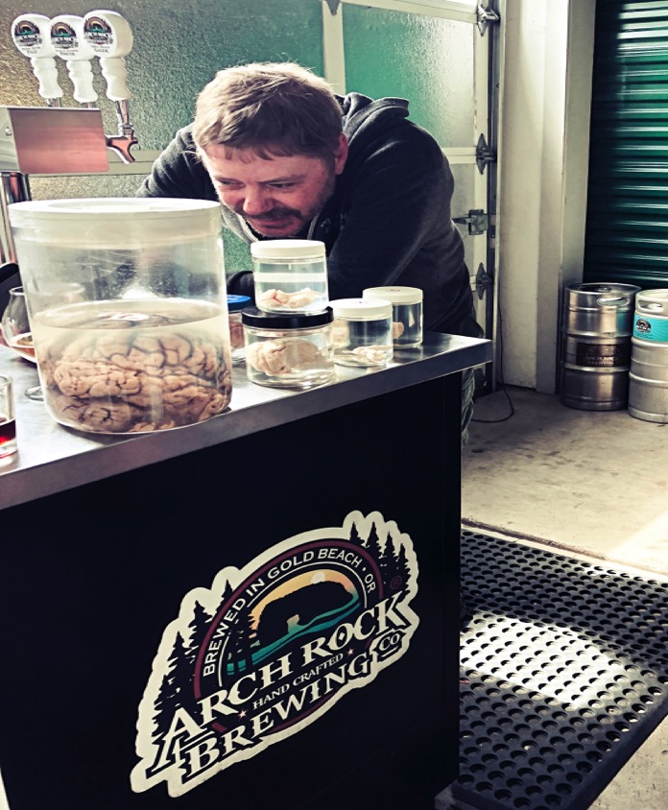
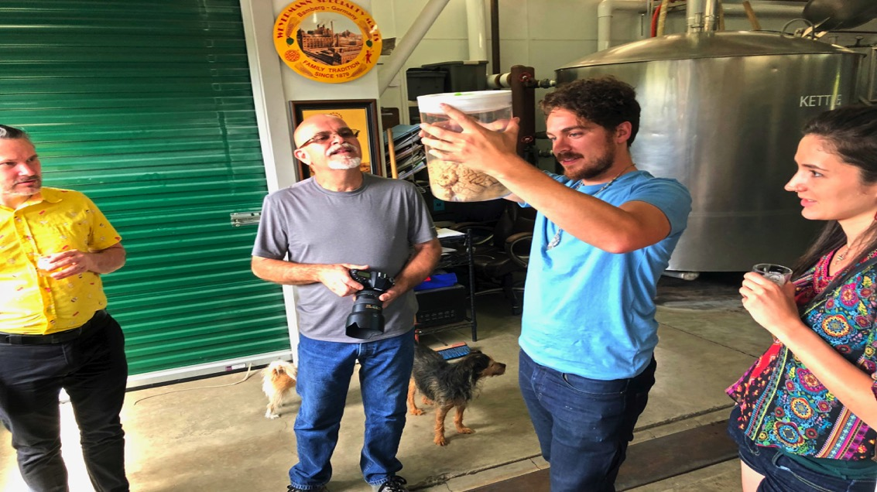
Arch Rock Brewing,
Gold Beach, OR
Alcohol and the brain

Slide 19
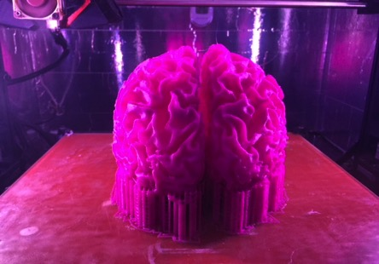
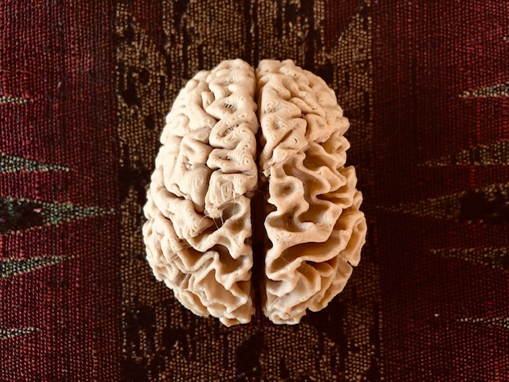
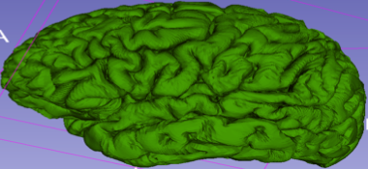
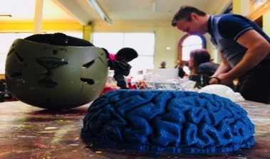
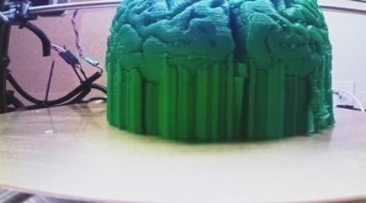
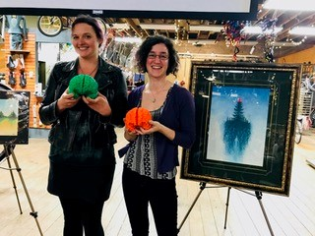
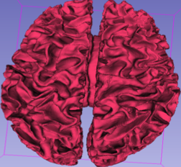
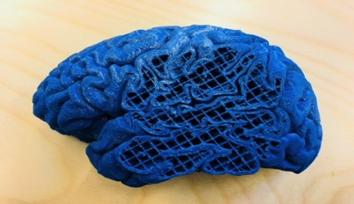

Art + Neuroscience = 3D printed brains
Collaboration with Make + Think + Code @ PNCA, Intel, PDX 3D Printing Lab!
Gray matter
White matter

Slide 20





Slide 21




Connect. And copy!
REACH OUT. PARTNER. GO PLACES.
There are resources in ALL our communities…
Public schools, hospitals, art museums, homeless shelters, youth correctional facilities, pubs, retirement homes,…
And don’t wait for institutions, especially if they focus more on preserving administrative structures instead of fulfilling their mission…

Slide 22


MAKE CONNECTIONS
MAKE ART

Slide 23




