Slide 1
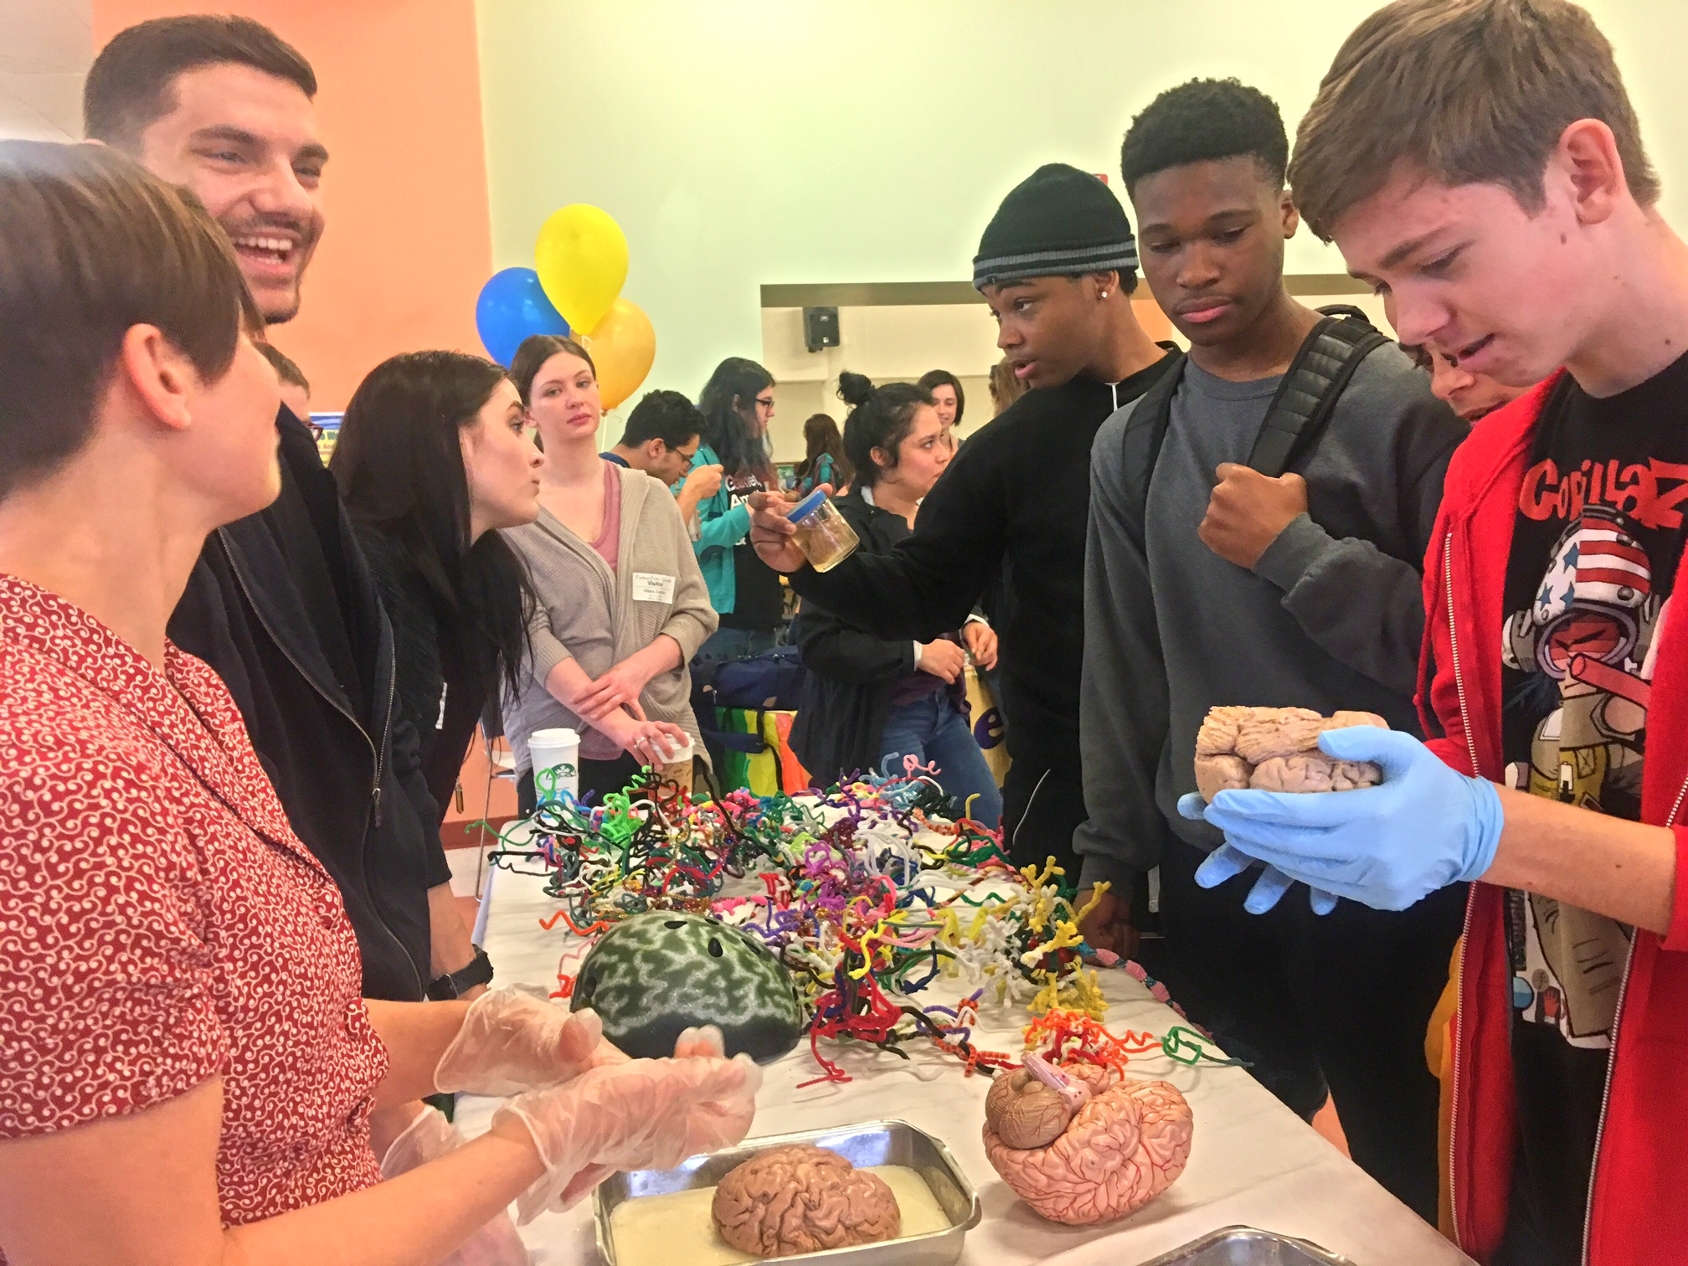
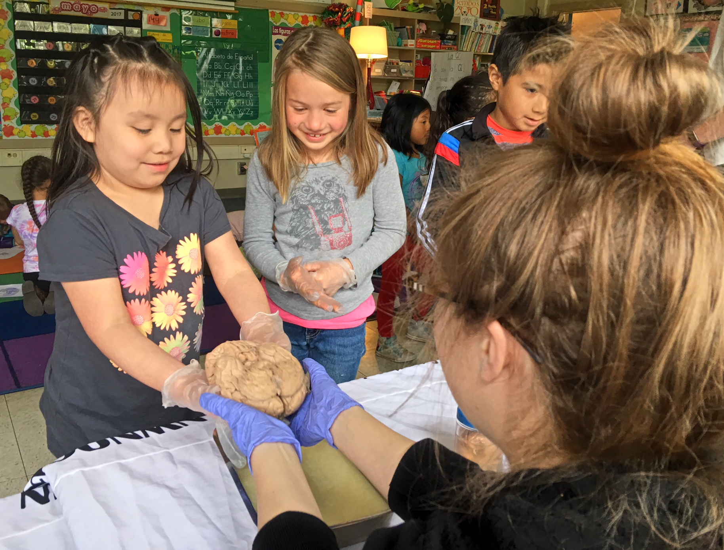
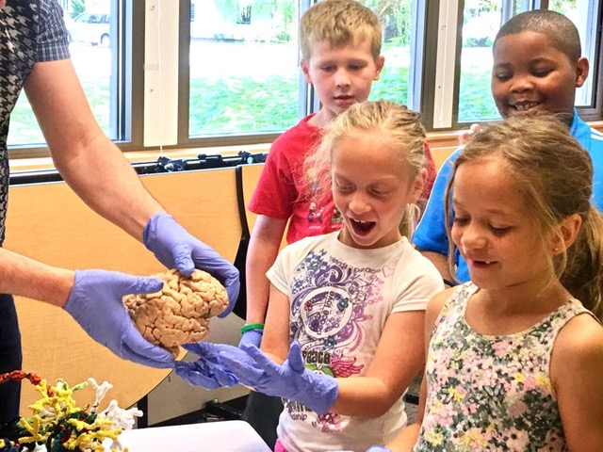
nwnoggin.org
Arts integrated neuroscience outreach for K-12 & community

Slide 2
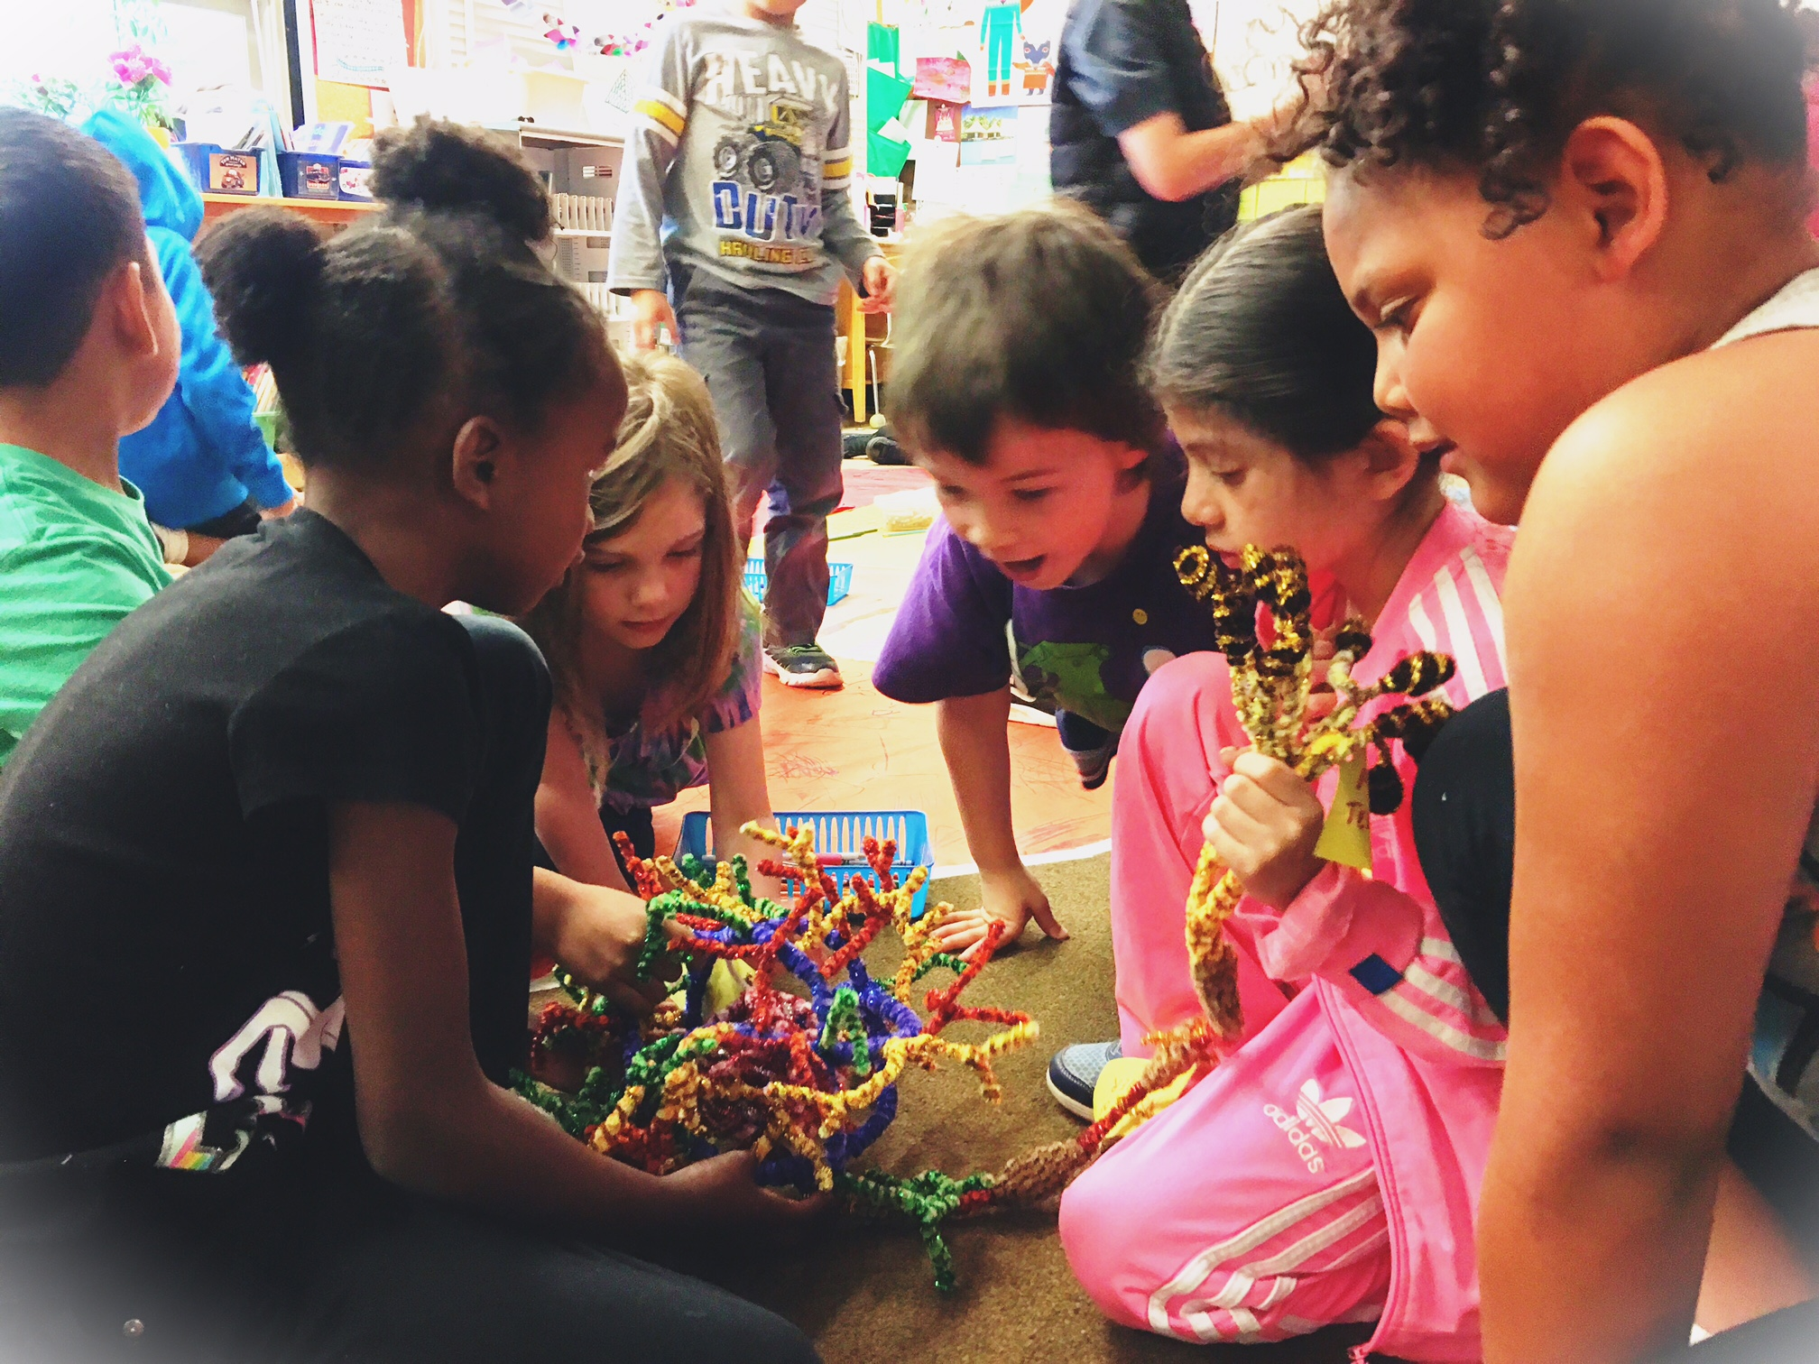
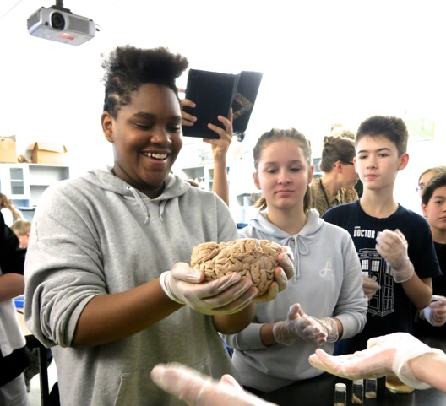
Collaboration and Connection
Improve teaching skills, confidence, creativity, employability…
Work with diverse populations of undergraduates, graduates, academic priority K-12 students. Go places and engage (early, far…)
Learn to explain concepts in neuroscience to the broader community
Build public support for taxpayer backed research efforts
Excite a new generation of scientists and artists!

Slide 3
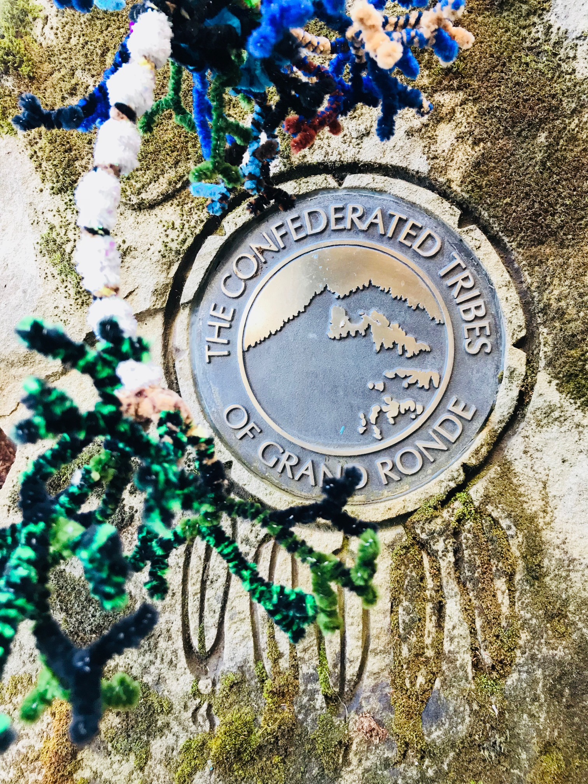
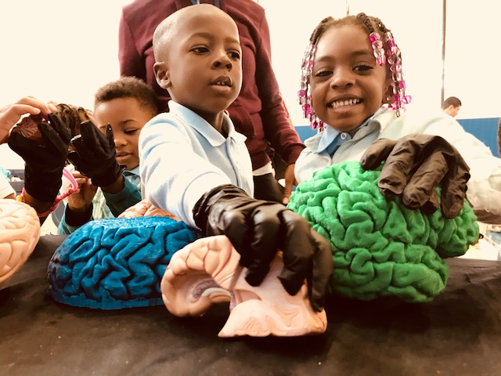
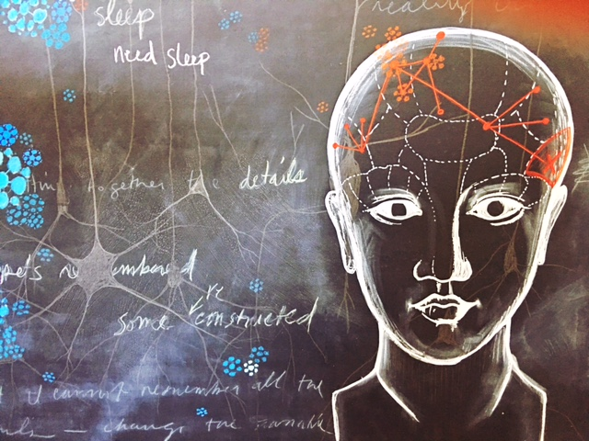
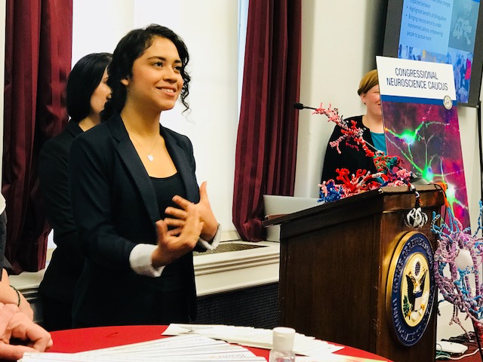
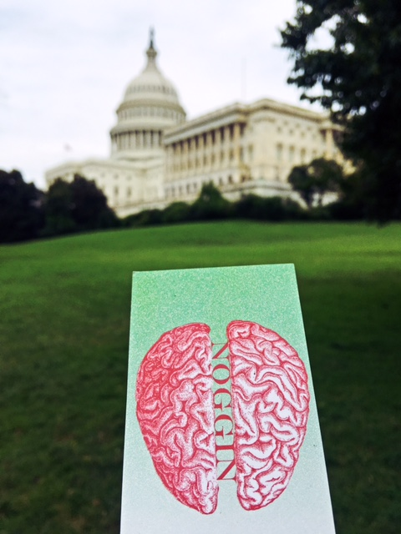
Community engagement
School visits!
  Latino Network collaboration
  Noggin Calendar of Events (nwnoggin.org)
Rural Outreach
  Davenport, La Grande, Heppner/Ione
Noggin Fest
  Alberta Rose Theater
Homelessness & the Brain
  p:ear, policy makers AND homeless youth
#brains2DC
  School visits during SfN
  “Briefing with Brains” in Congress
Spirit Mountain (2018)
  Native storytelling and the brain
  Lincoln County, Winter/spring 2018

Slide 4
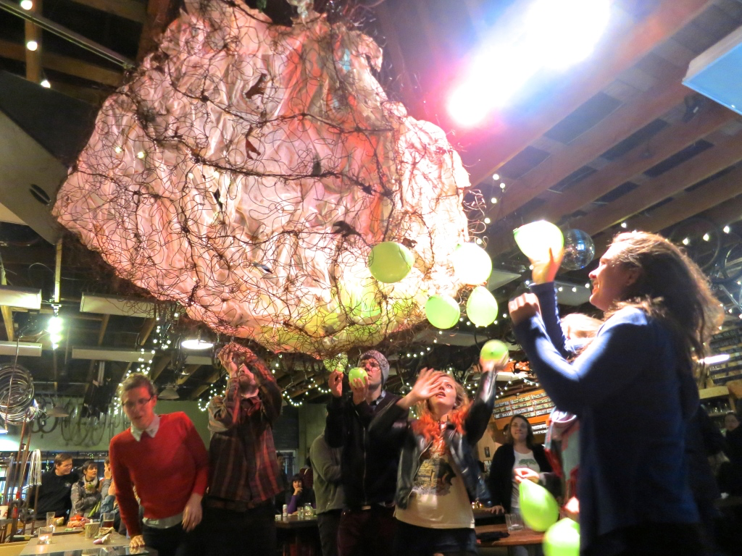
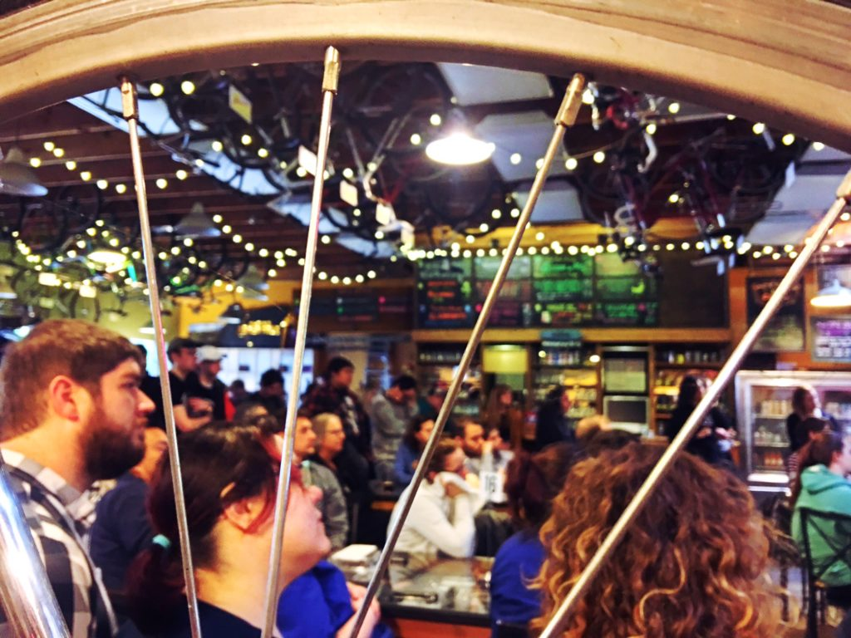
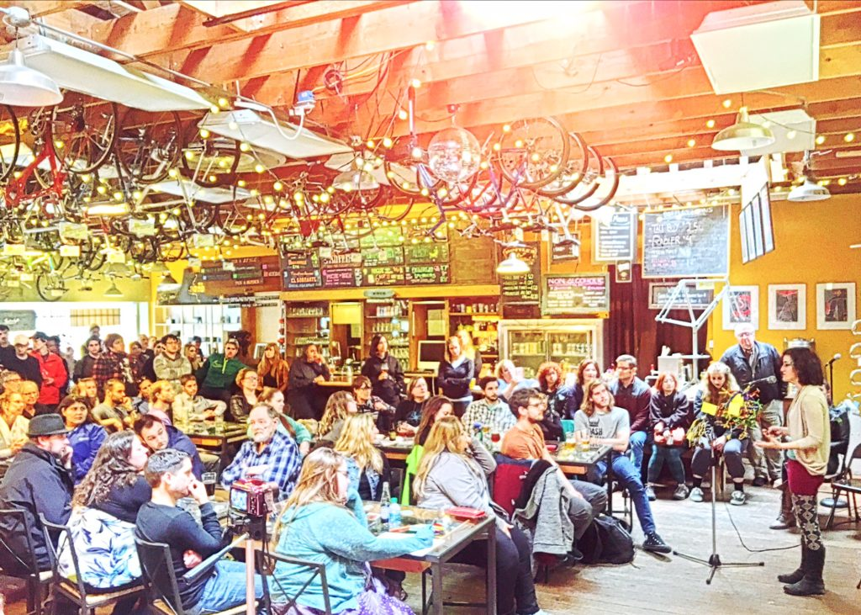
Brains, Bicycles & Beer
Velo Cult
Collaborate with creative artists and art students
Present in a unique, fun, interactive public setting
Build public support for and understanding of brain research

Slide 5
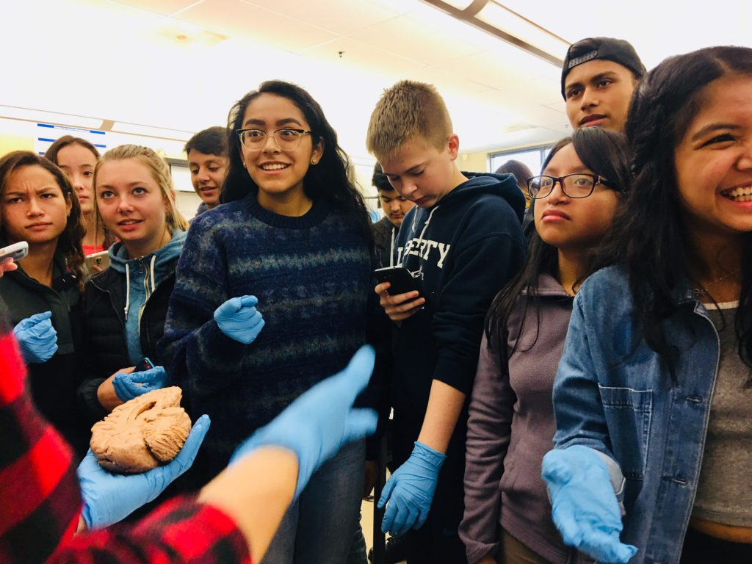
Liberty High School

Slide 6
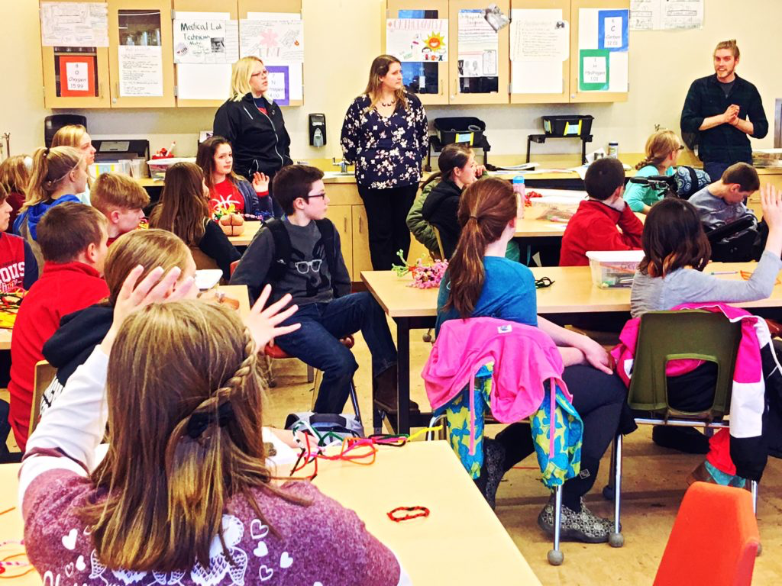
Davenport Middle School

Slide 7
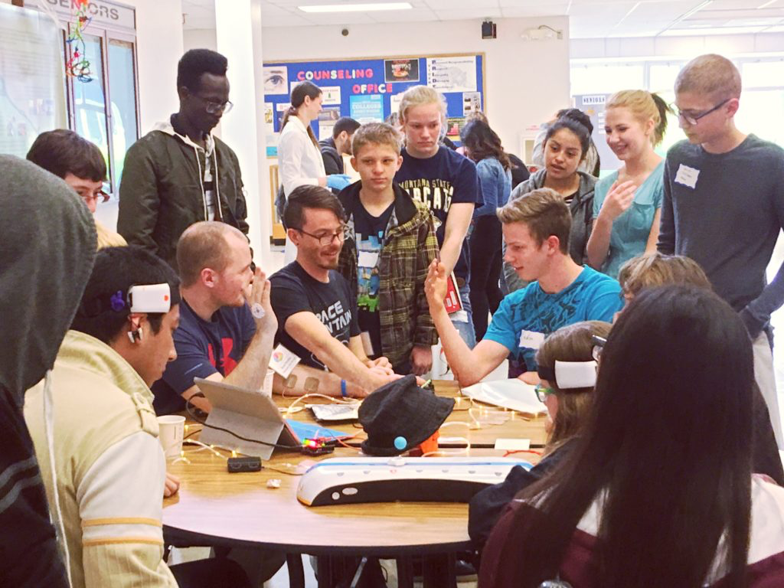
La Grande

Slide 8
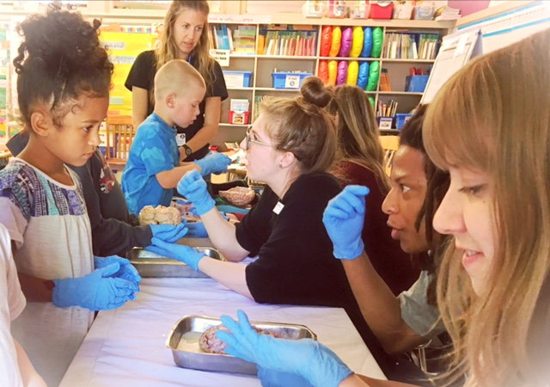
Sitton Elementary

Slide 9
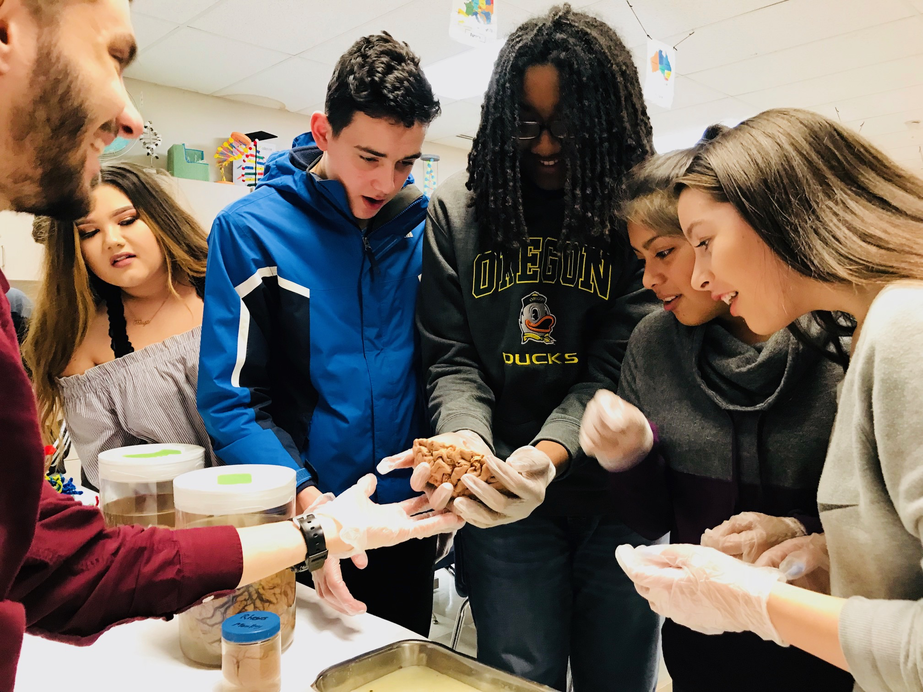
Fort Vancouver High

Slide 10
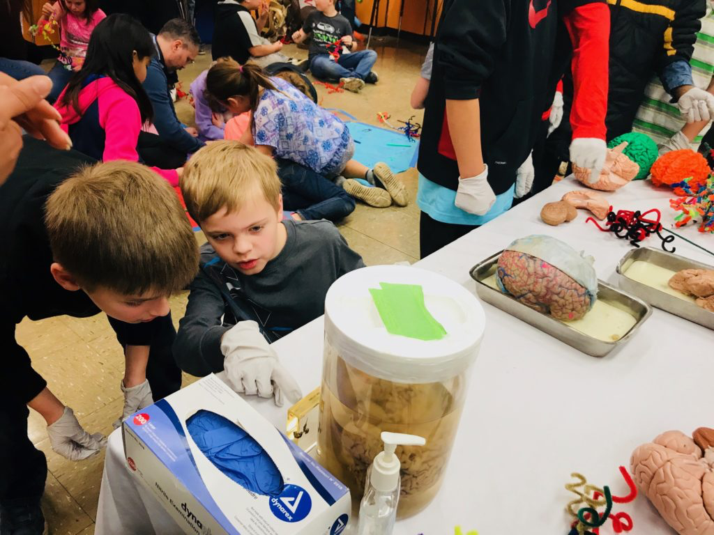
Minter Bridge Elementary

Slide 11
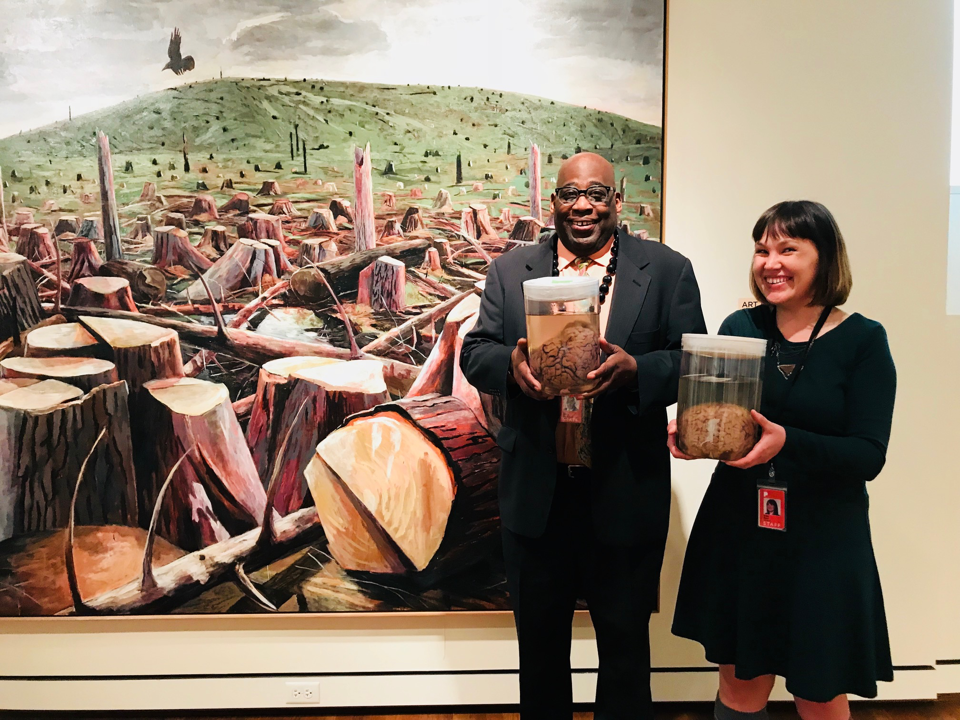
Portland
Art Museum

Slide 12
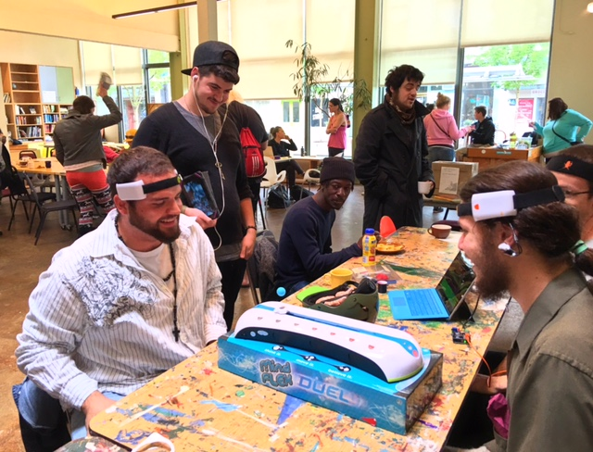
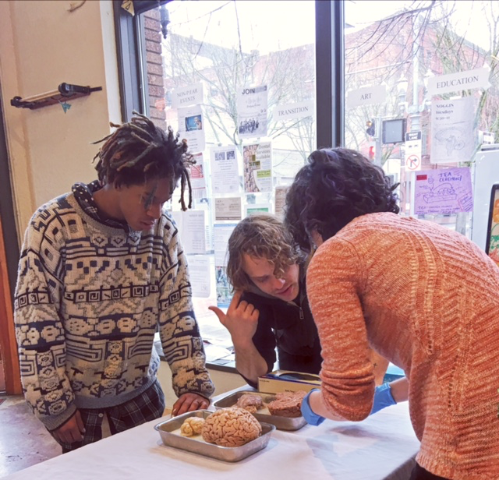
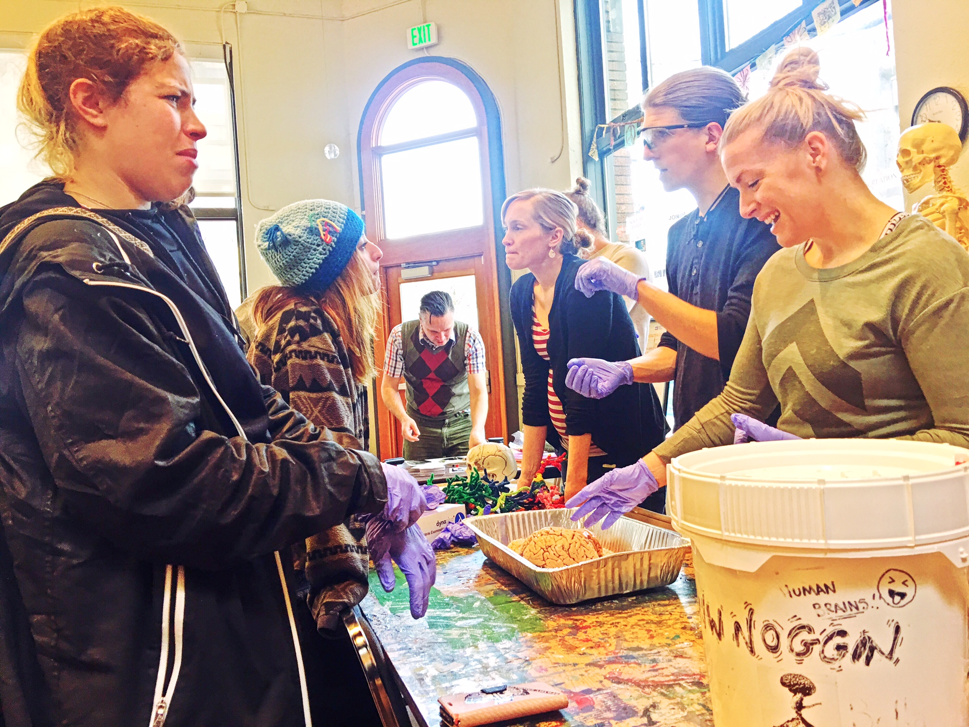
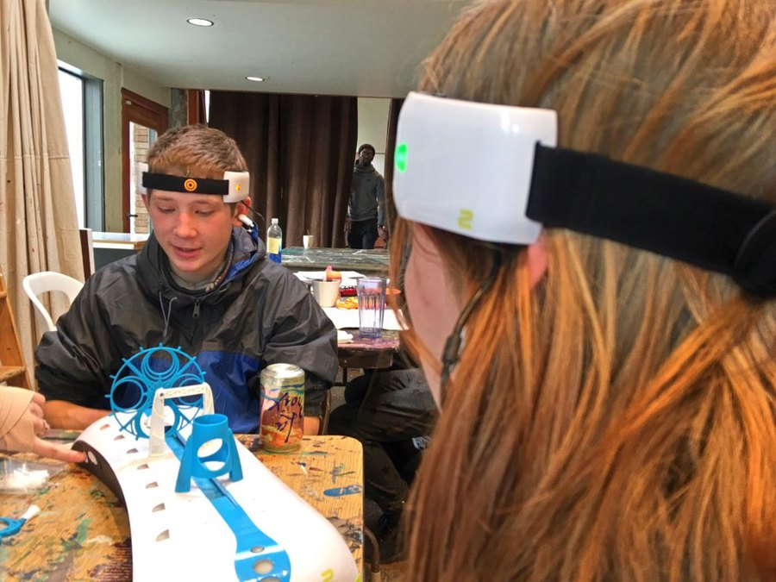
P:ear

Slide 13
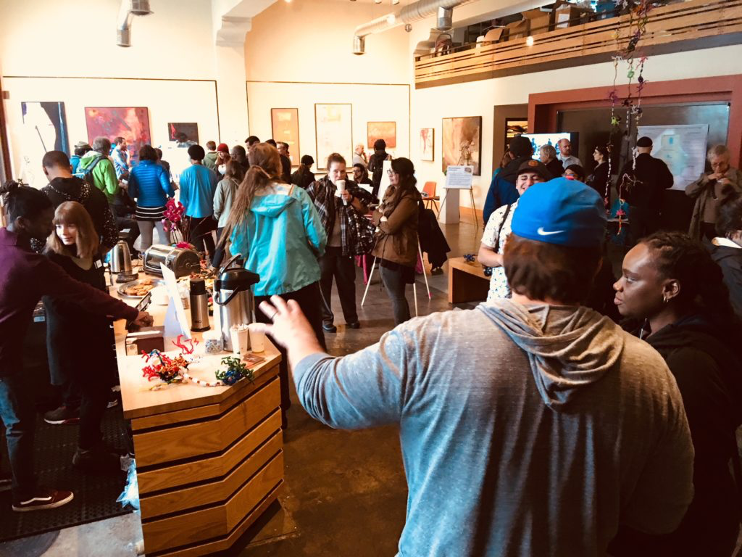
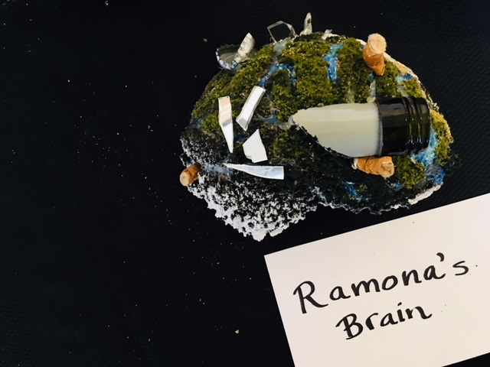
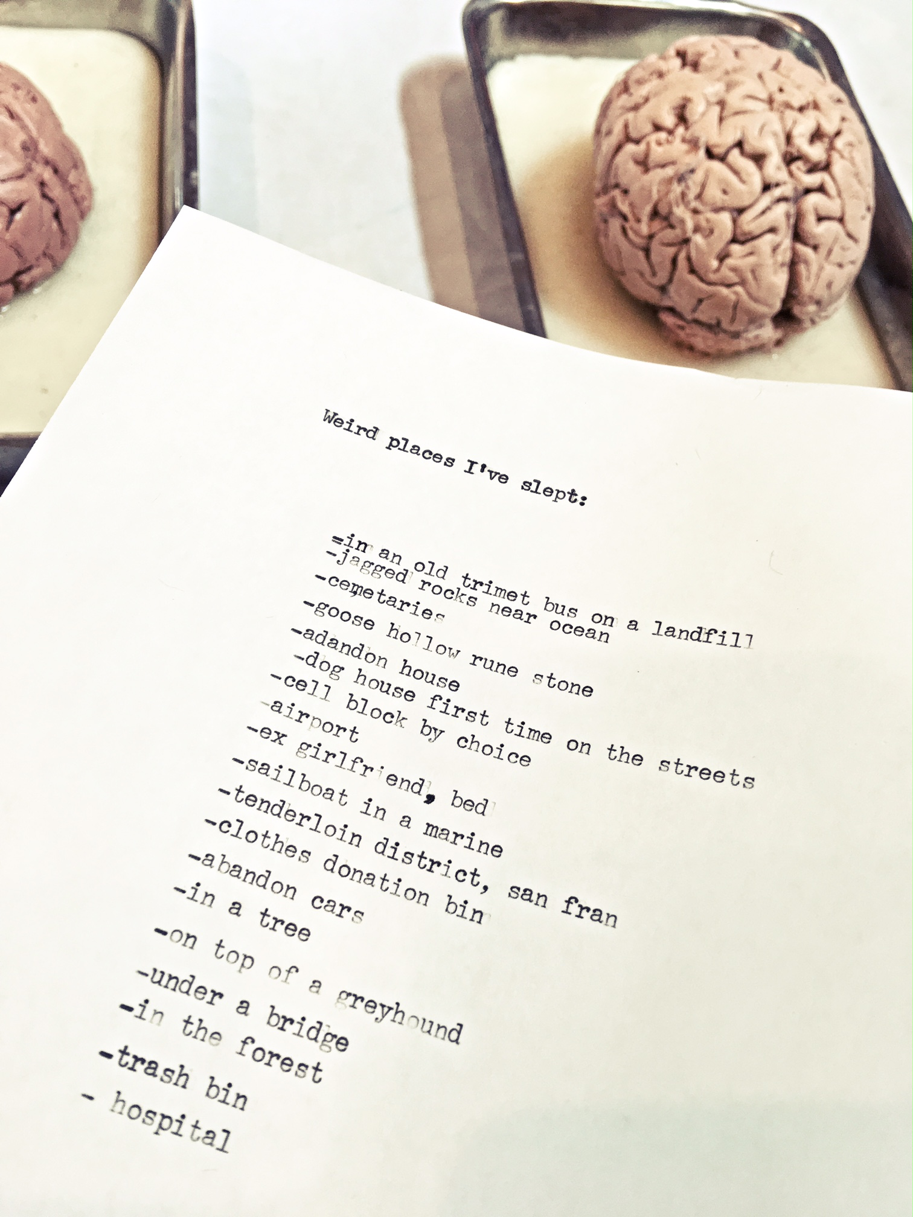
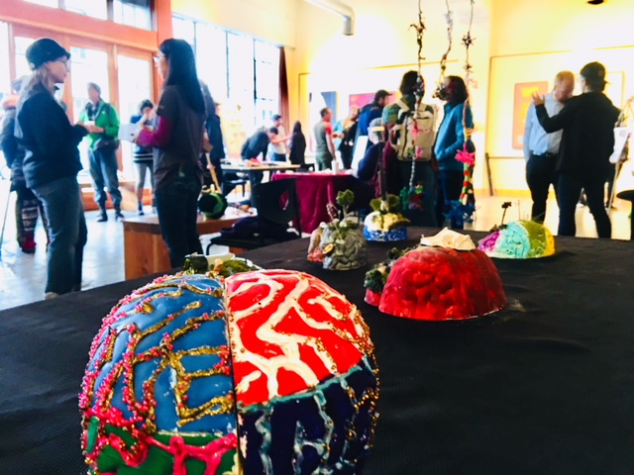
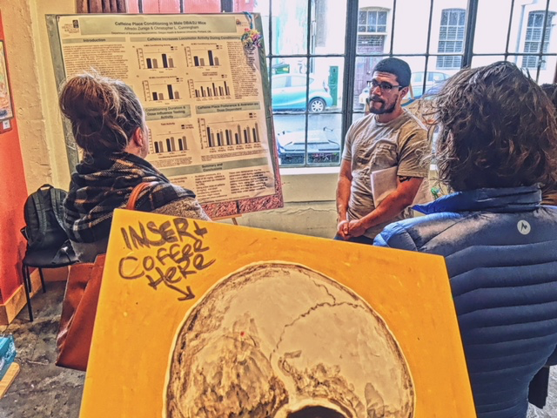
Homelessness & Brain

Slide 14
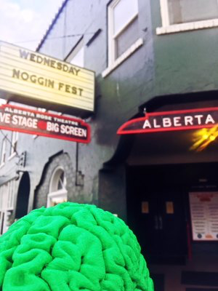
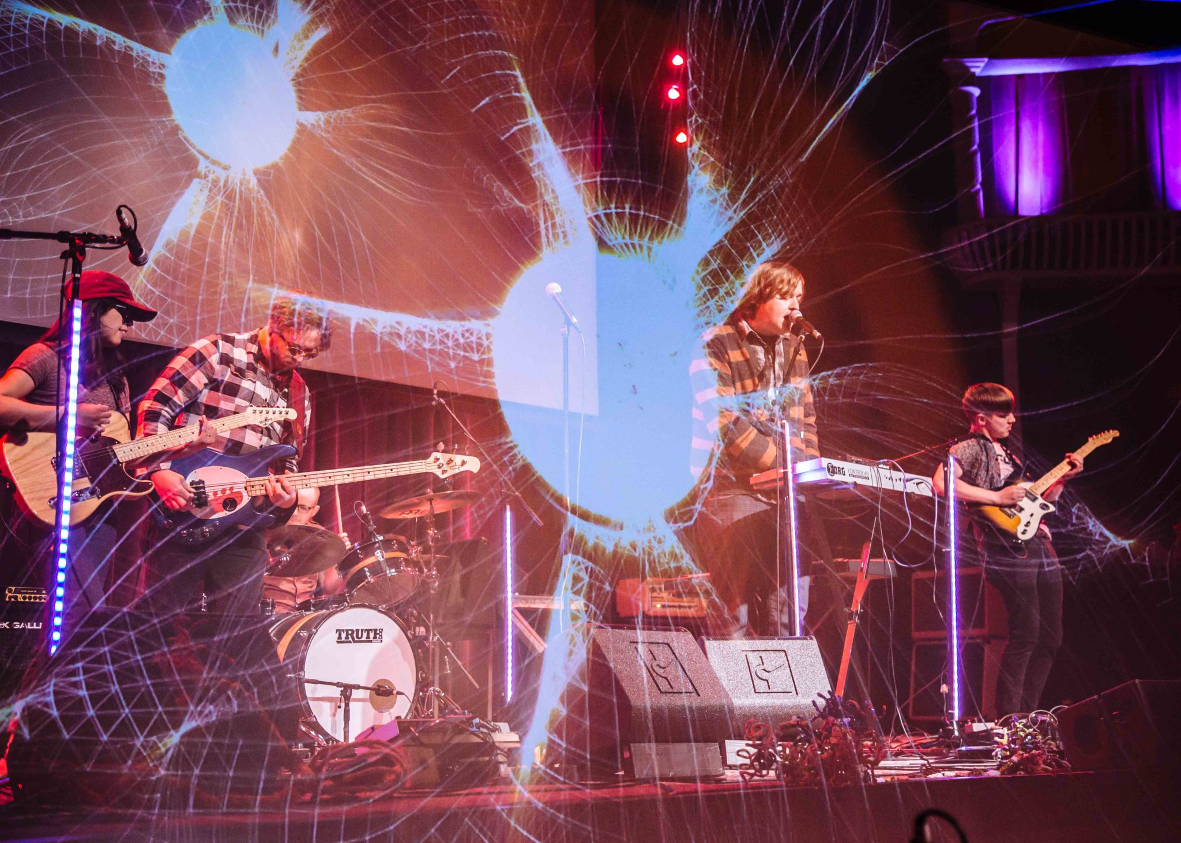
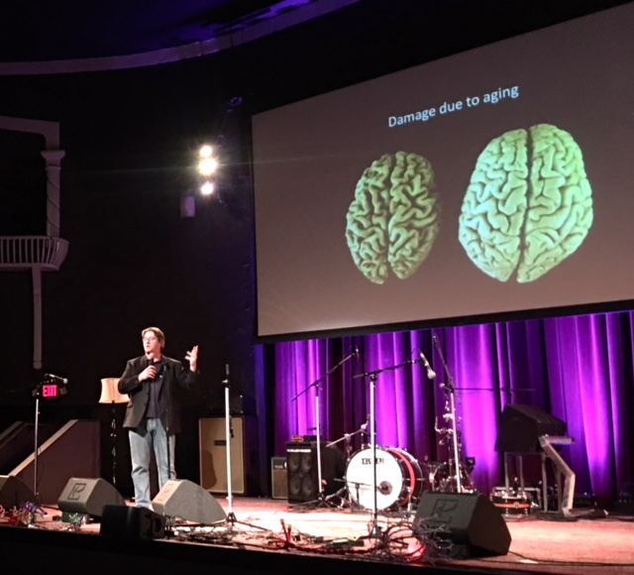
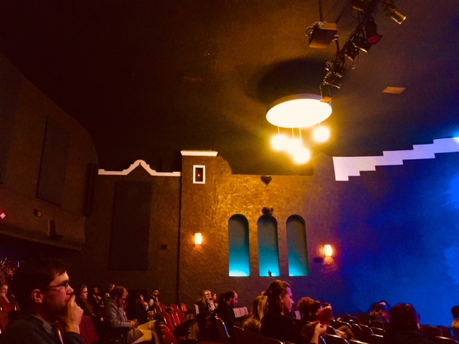
Noggin Fest!

Slide 15
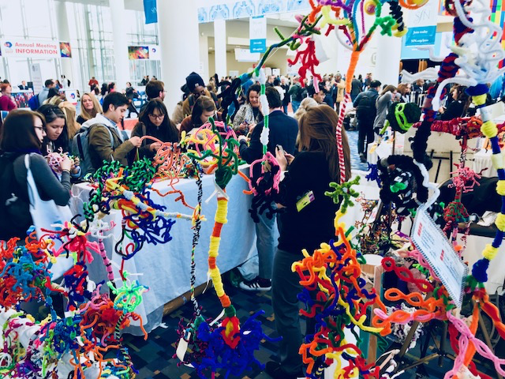
Art of Neuroscience

Slide 16
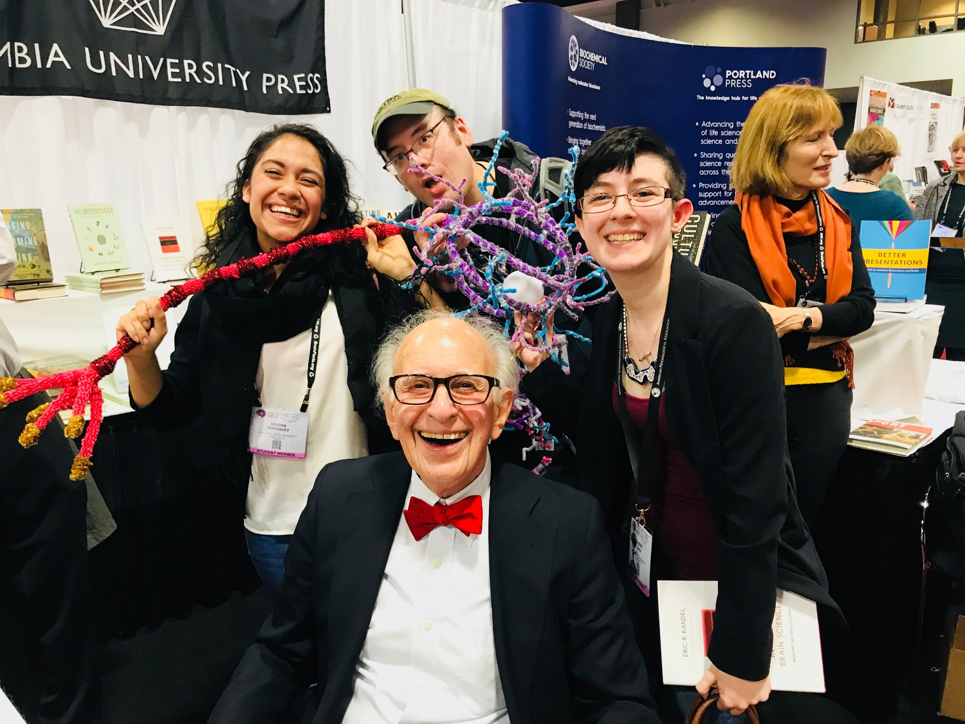
Art…
…and brains ☺

Slide 17
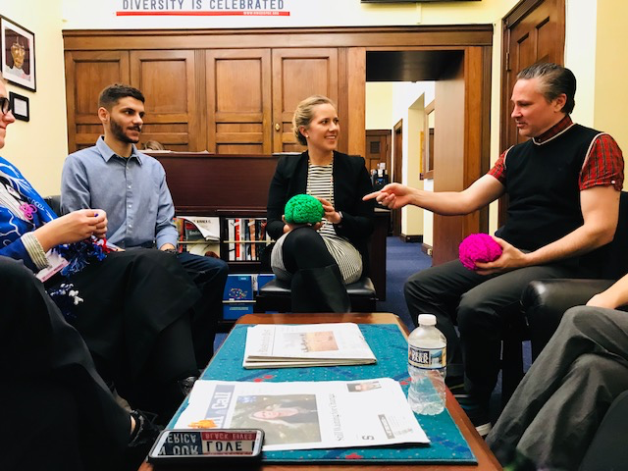
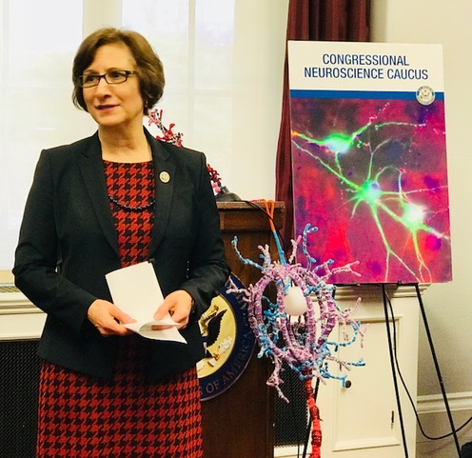
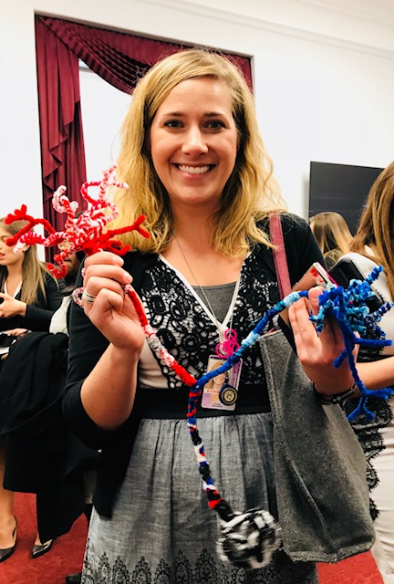
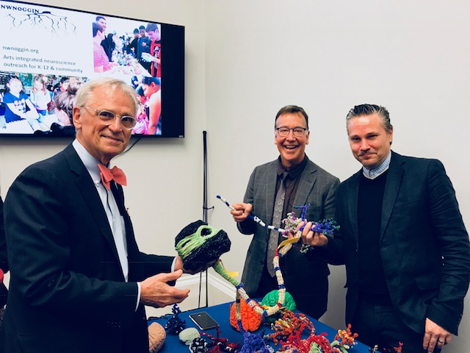
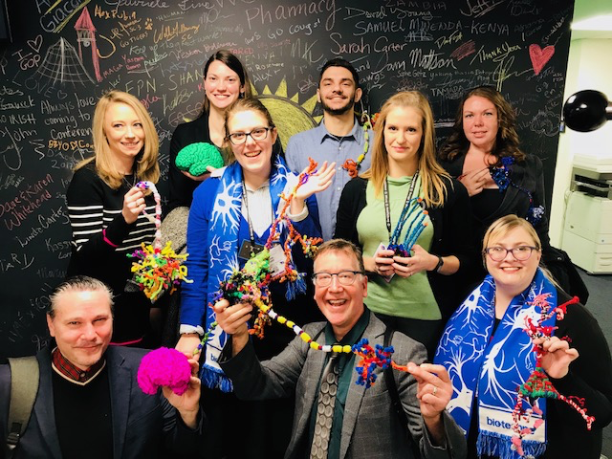
Advocacy

Slide 18
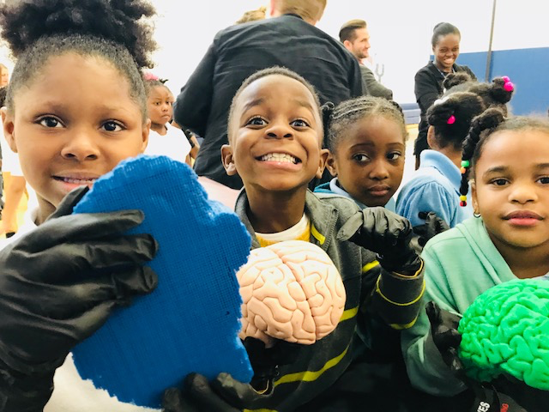
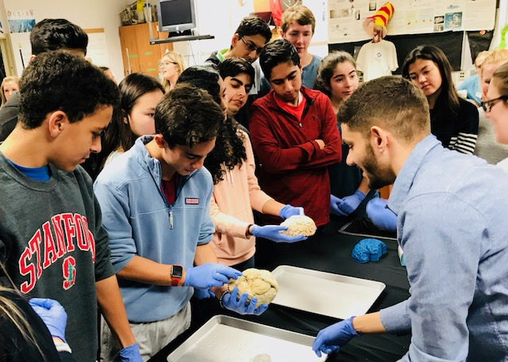
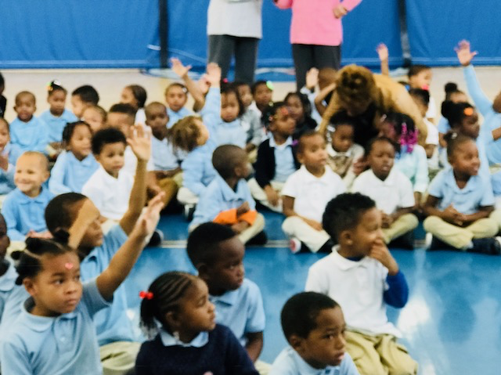
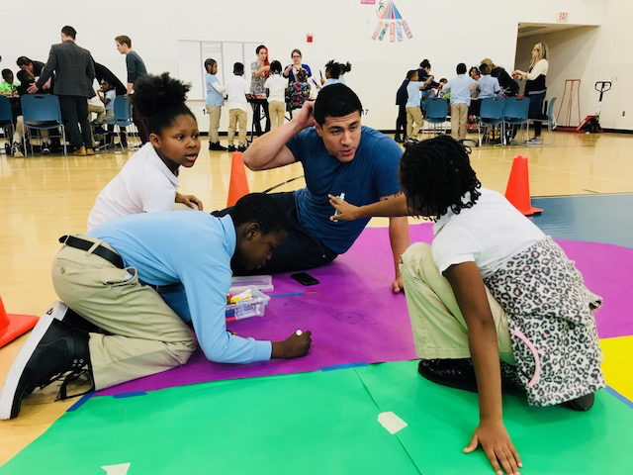
#scitalk plus action

Slide 19
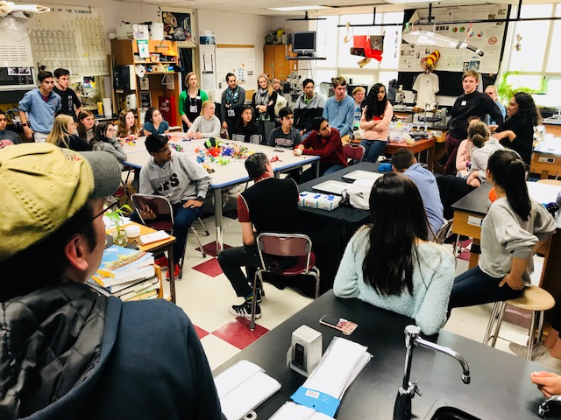
Sidwell Friends

Slide 20
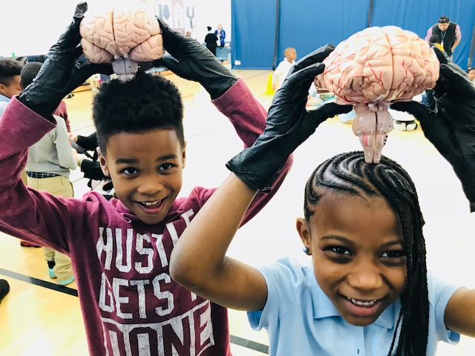
Turner Elementary

Slide 21
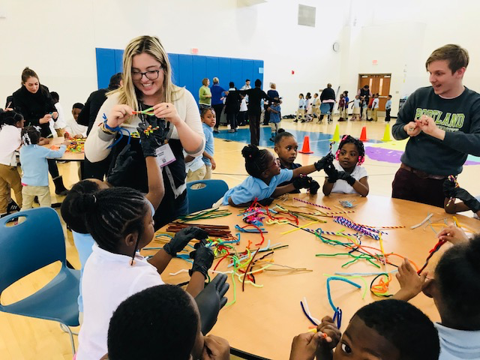
Turner Elementary

Slide 22
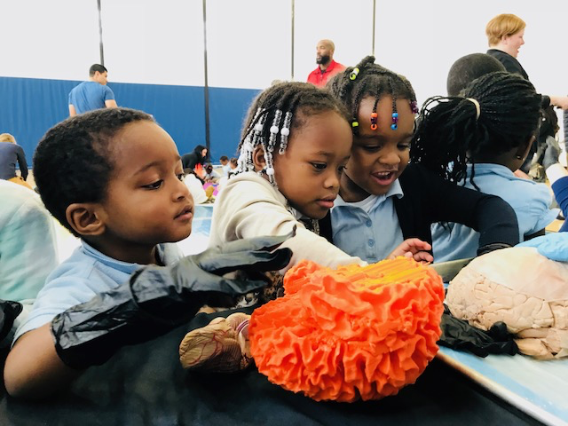
Turner Elementary

Slide 23
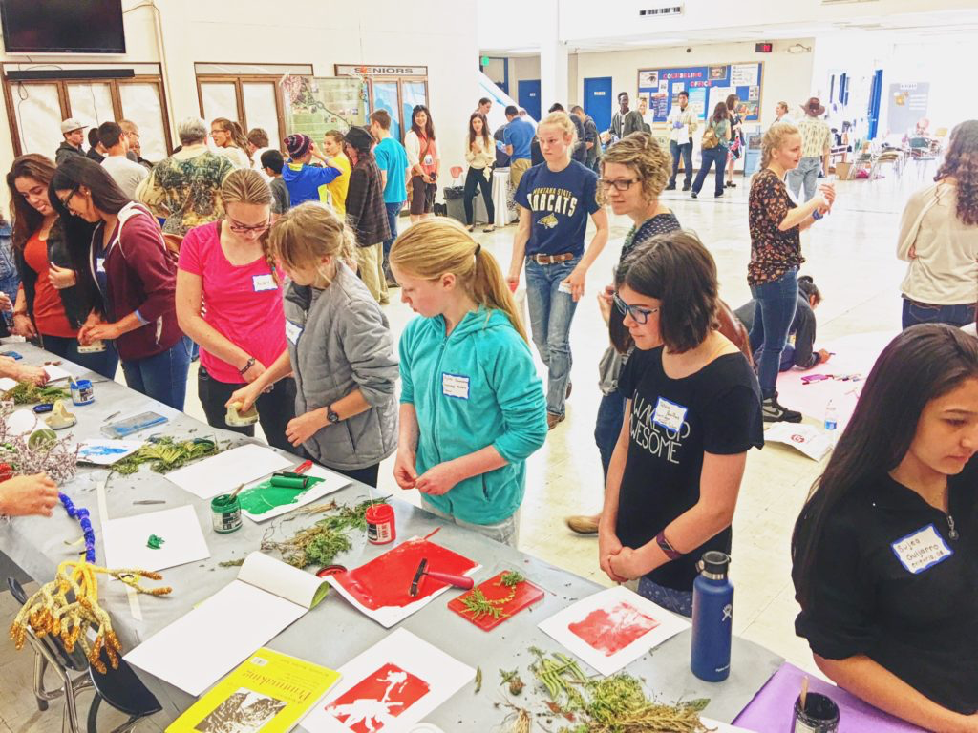
Why Arts Integration?
It’s about how people learn

Slide 24
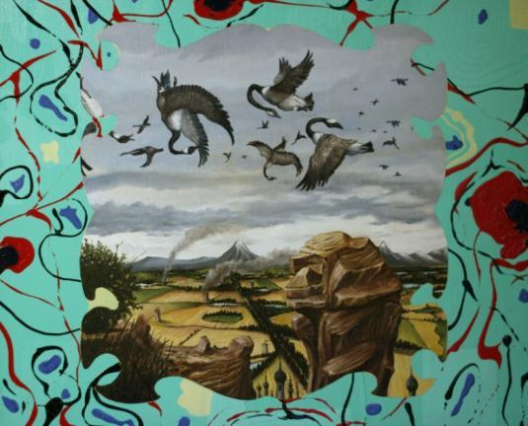



Artists and art students often
reference other fields within their own work

Slide 25

Art projects that…
Are inherently differentiated
Illustrate concepts

Slide 26

Art projects that…
Are multi-modal
Serve as examples of concepts

Slide 27
Art projects that…
Are personally relevant
Allow students
to explore a concept

Slide 28




JOIN US!
nwnoggin.org
Calendar of Events

