Slide 1
Illuminated Wilderness: Memory
ART + SCIENCE
Jeff Leake & Dr. Bill Griesar from NW Noggin
www.nwnoggin.org

Slide 2
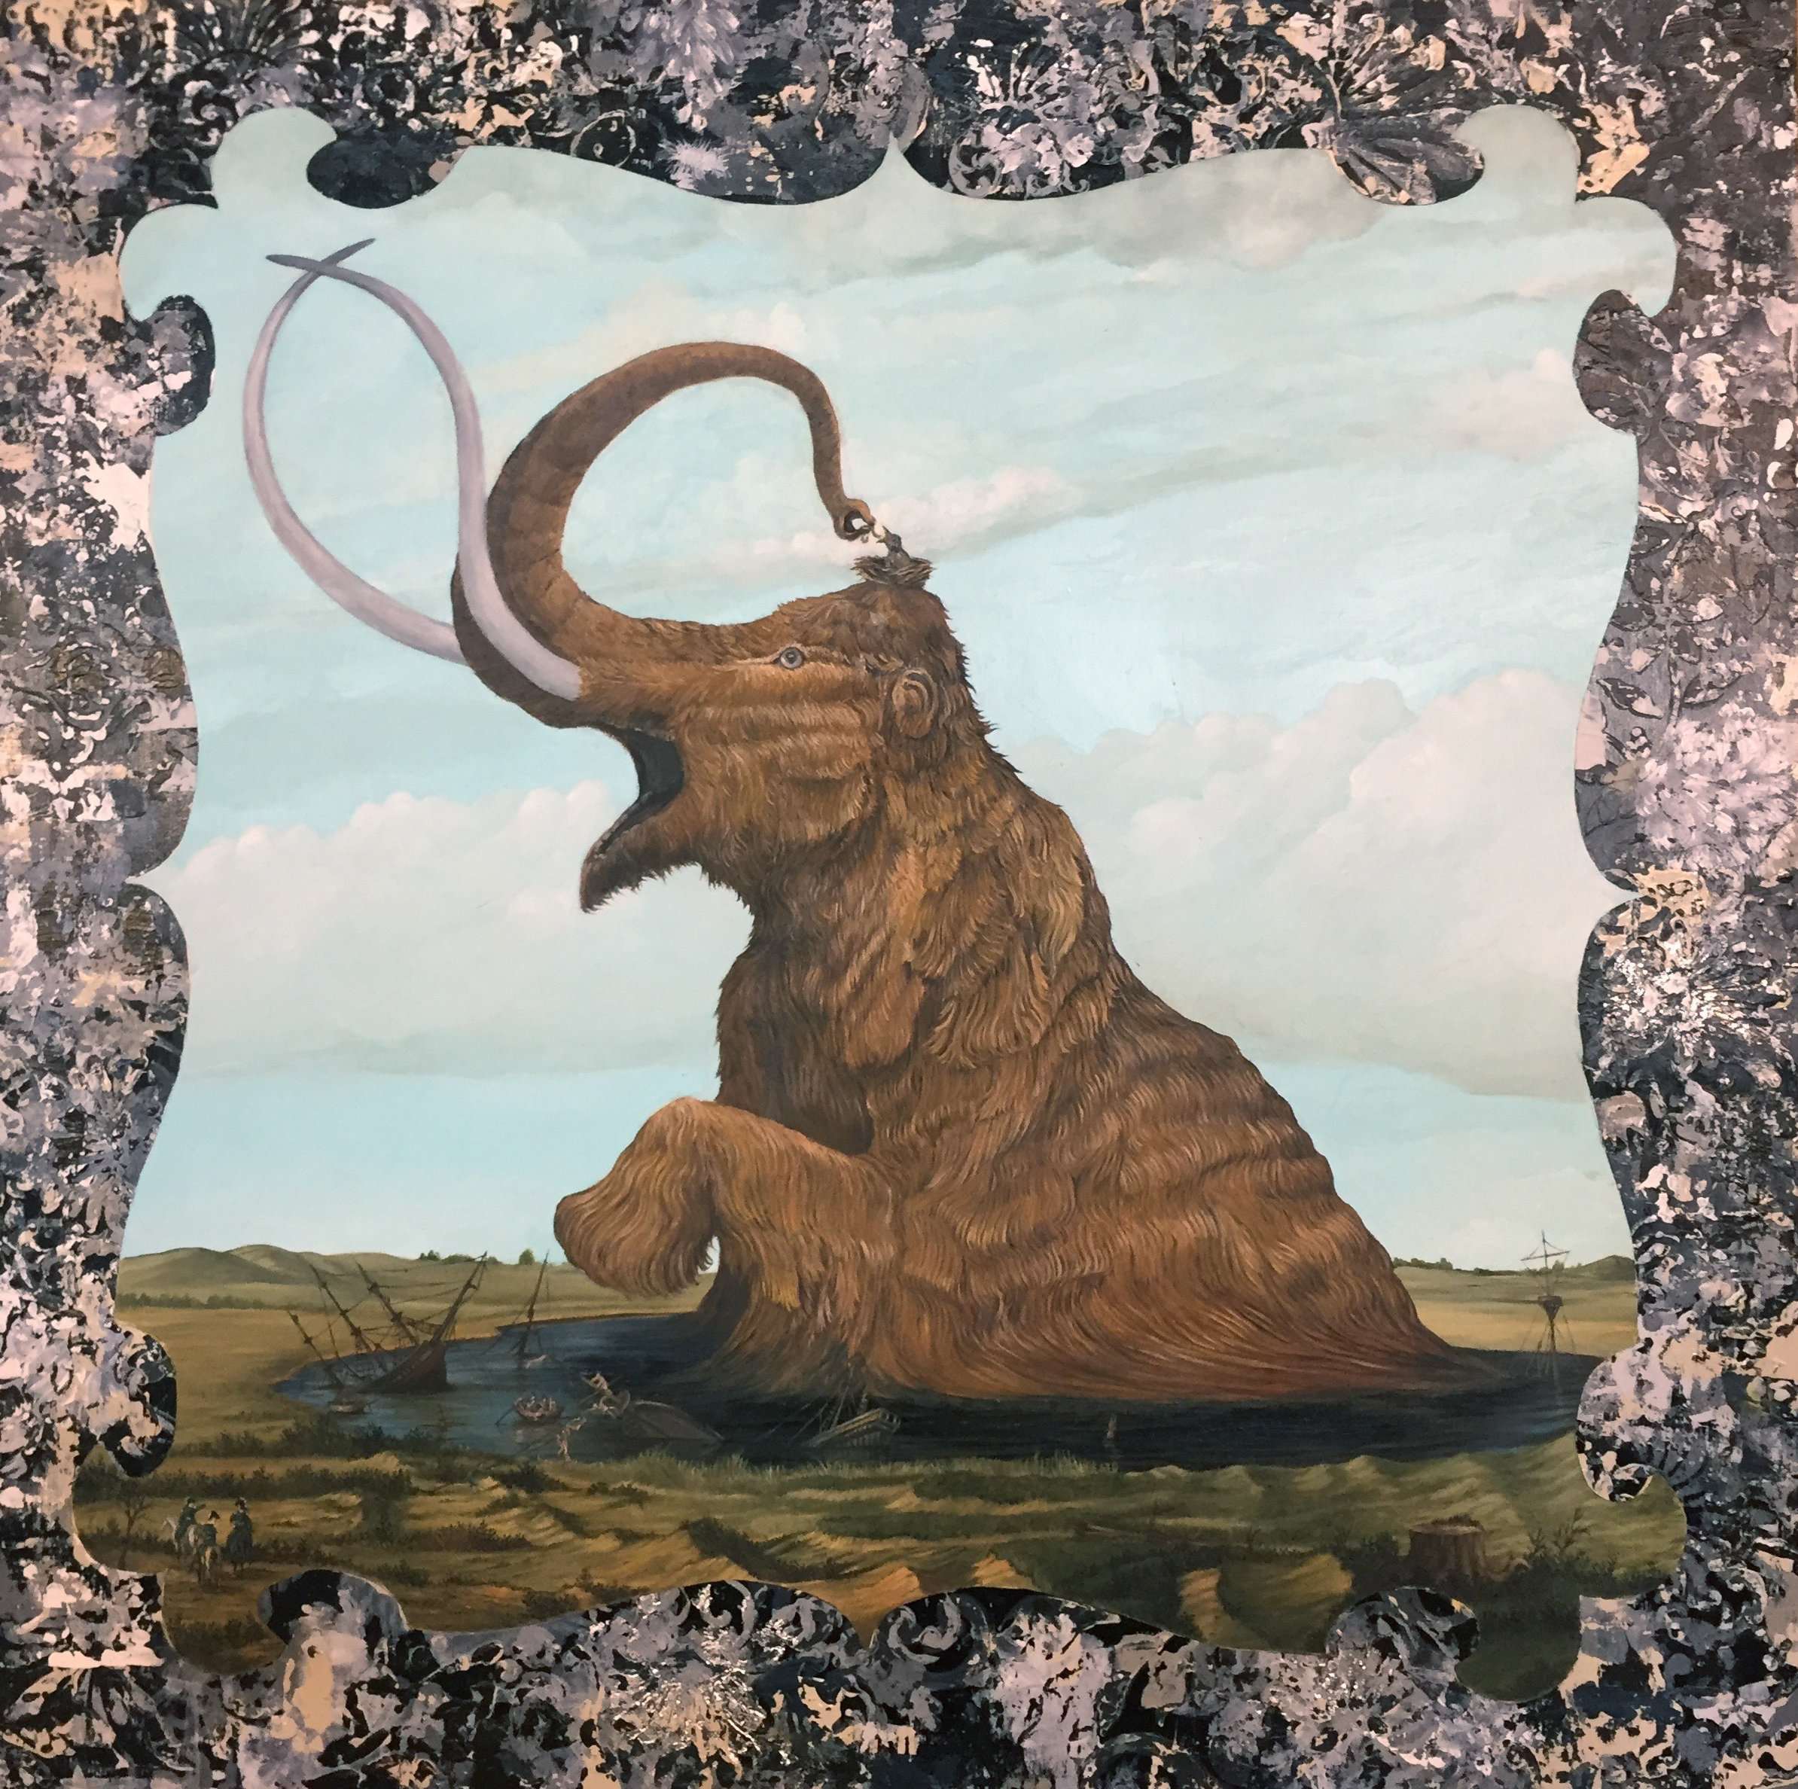
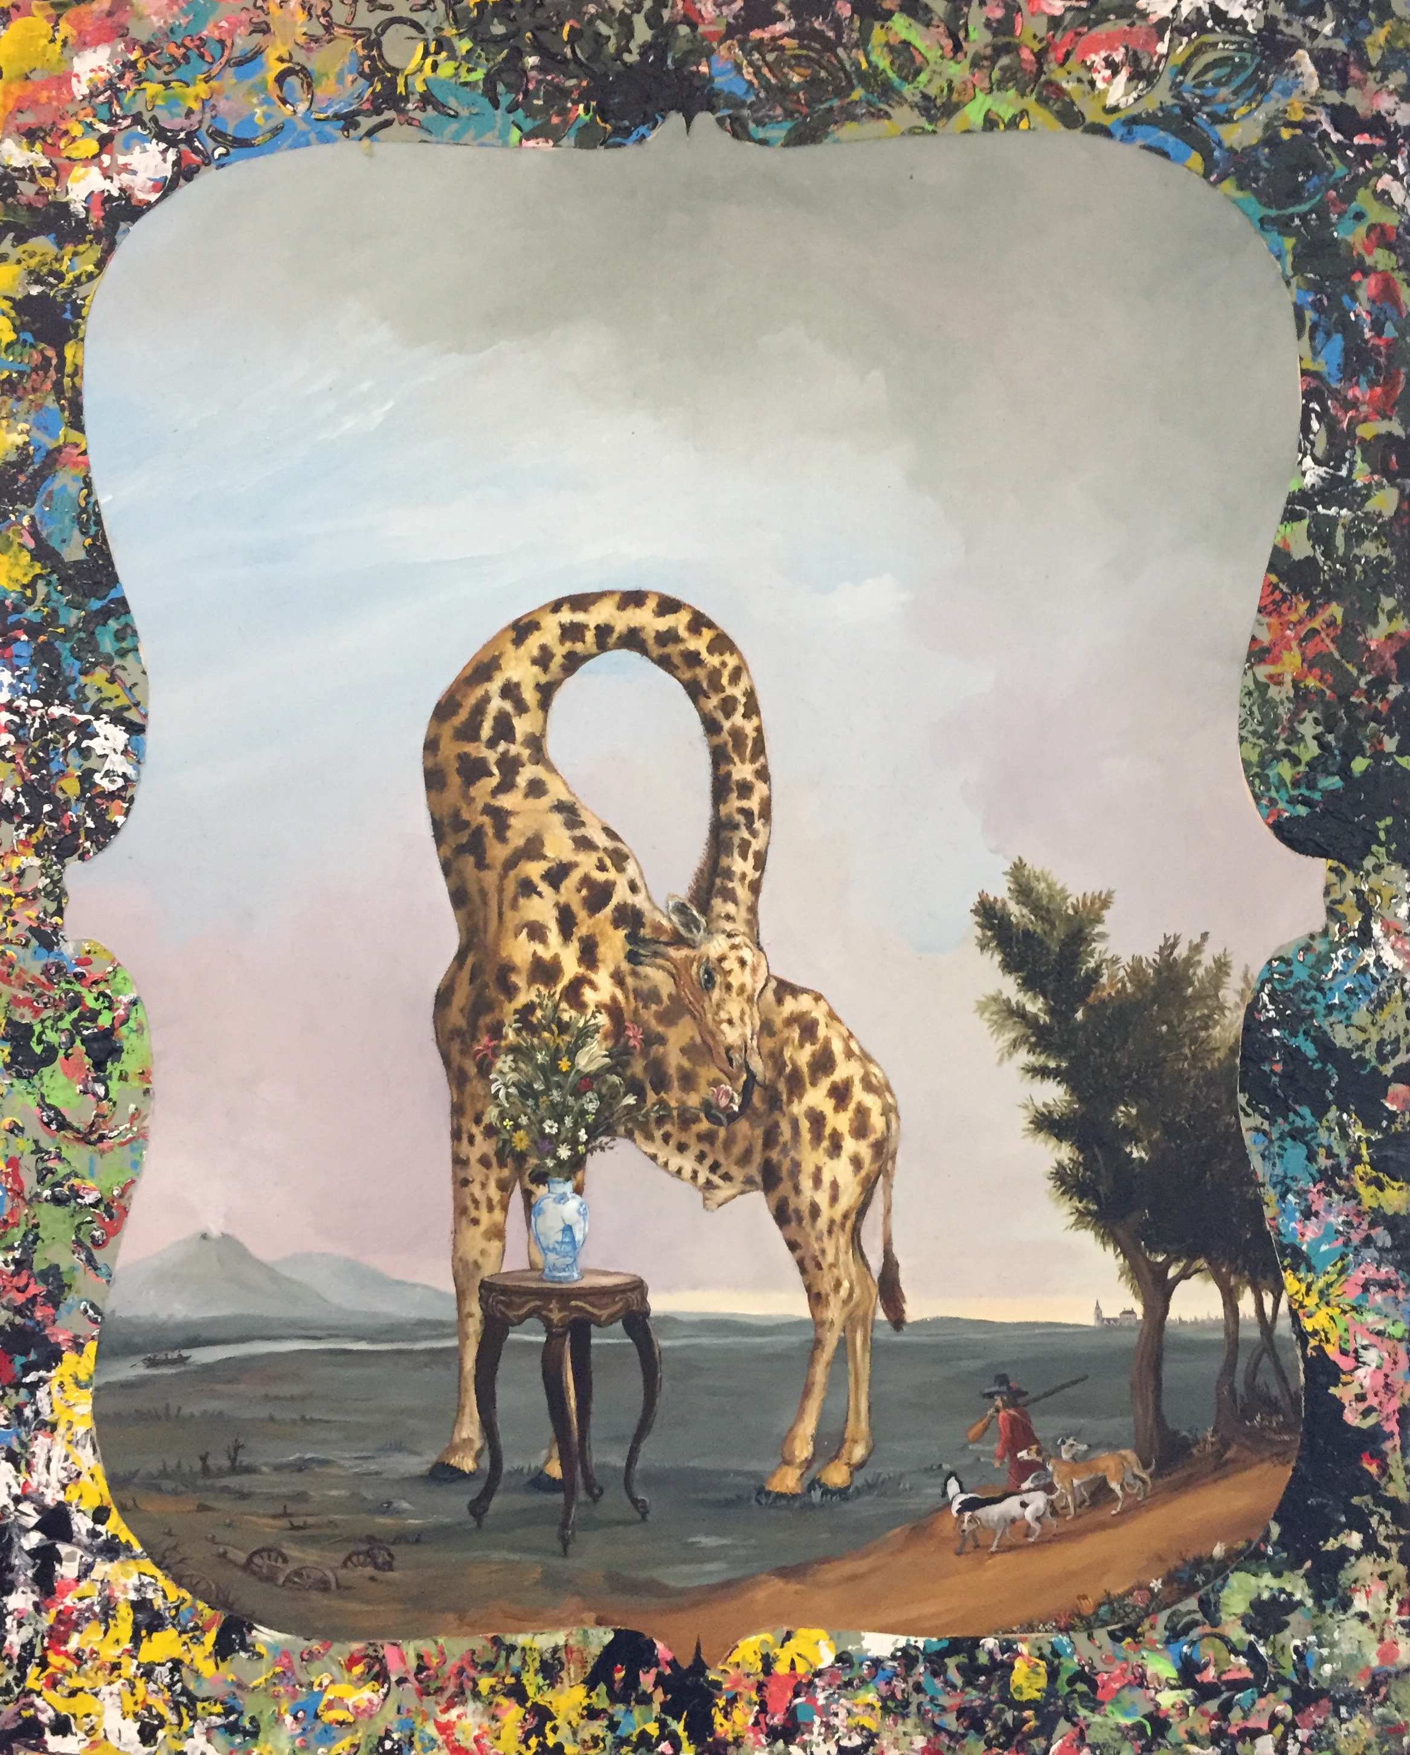
Art & Science
Jeff Leake University Studies, Psychology, Portland State University
nwnoggin.org

Slide 3
What is sciart?
art inspired by science or a conversation between science and art?
What question does Rembrandt ask through his self portraits?
How might science approach that question?
Rembrandt Van Rijn “Self Portrait” 1629
Rembrandt Van Rijn “Self Portrait at the Age of Thirty Four” 1640
Rembrandt Van Rijn “Self Portrait with Two Circles” 1660
“The artist is in a sense, a neuroscientist, exploring the potentials and capacities of the brain, though with different tools. How such creations can arouse aesthetic experiences can only be fully understood in neural terms.” -S Zeki

Slide 4
Art & Science Share many qualities
The left brain right brain myth
The creative process, like the scientific process, from preparation to incubation to illumination to verification-- consists of many interacting cognitive processes and emotions. Depending on the stage of these processes, and what you’re attempting to create, different brain regions are recruited to handle the task.
Science is at it’s core a creative endeavor
Art is an idea that is given concrete form
Glial cells of the spinal cord of a mouse, sketched by Santiago Ramon y Cajal in 1899 (ink and pencil on paper).

Slide 5
Why do it?
Most art to some extent is about the world in which we live. It makes sense for artists to seek out professionals in other fields.
“Transporter” by Rebecca Kamen
Why people should care about the science that is being done needs to be communicated with the public. Artists are particularly good at communicating complex ideas in a succinct and emotive way.
Roxy Paine “Conjoined” 2007
Art, because it is not beholden to physical realities may be able to ask questions in a way that science might not.

Slide 6
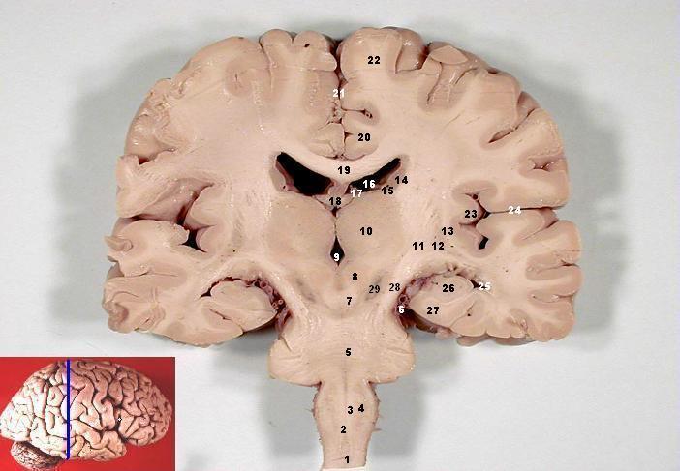
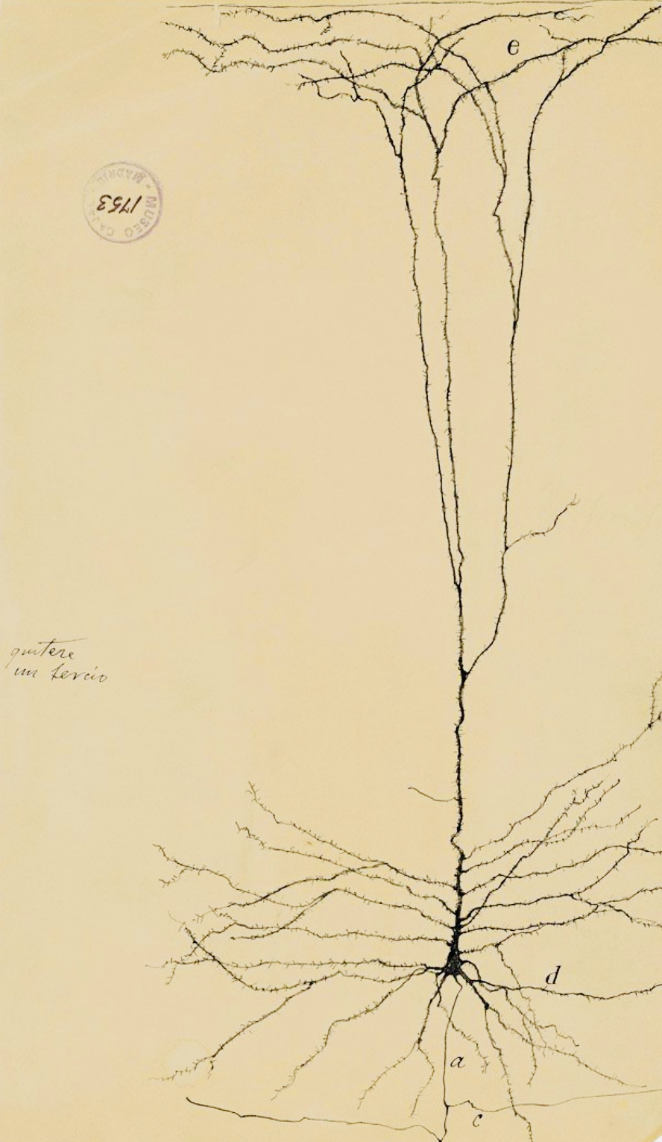
Memory and the Brain
Dr. Bill Griesar Psychology, Portland State University
Behavioral Neuroscience, OHSU
nwnoggin.org

Slide 7
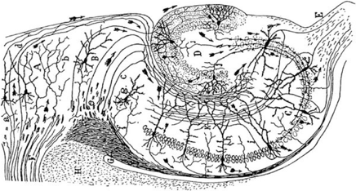
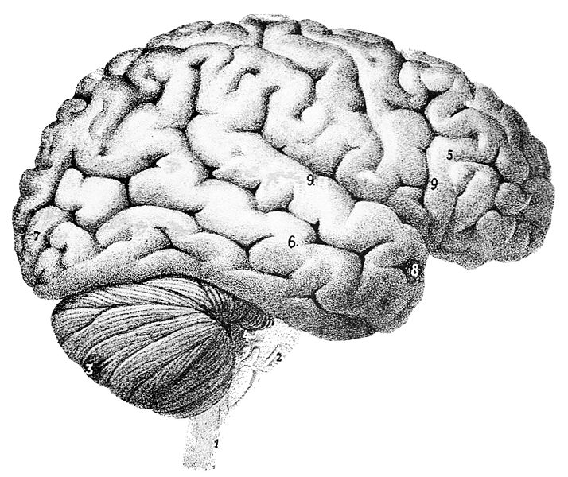
What is memory?
Memory is physical
Remembering an event is a creative act
There are different forms of memory, each dependent on specific areas of the brain…
Biological systems can grow - and decay

Slide 8
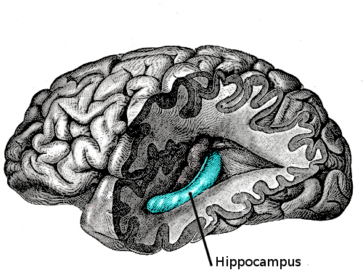
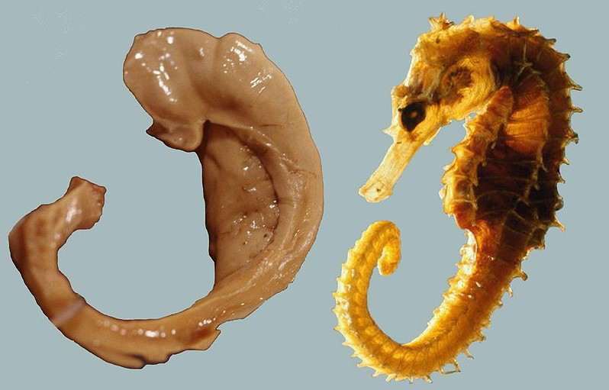
You remember episodes
When you heard a song that has meaning…
Details from own your life - when you first met your partner, your first public presentation in school, that time you broke your arm...
Neocortex
Explicit
Memory
Depends on
neural networks in the
hippocampus, and other
areas of cortex
Hippocampus

Slide 9
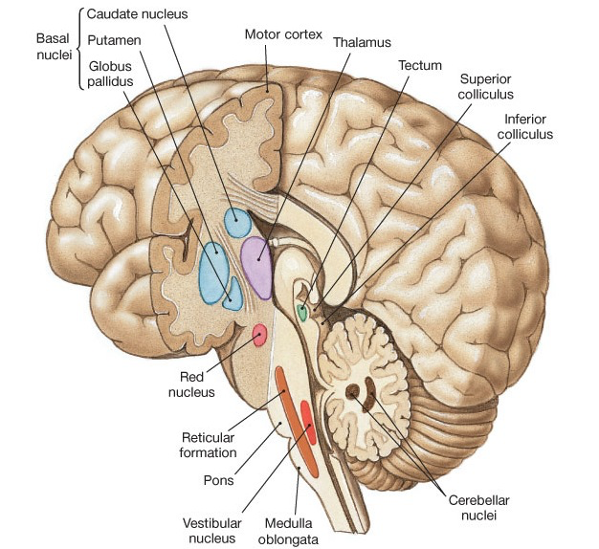
You also remember skills... and you move!
Implicit
Memory
Literally…
Basal ganglia*
Habits
Involuntary mvmt
Timing of mvmt
Cerebellum
Balance
Coordination
Repetitive mvmts
Amygdala/Accumbens*
Emotional mvmts
16 billion neurons
69 billion!

Slide 10
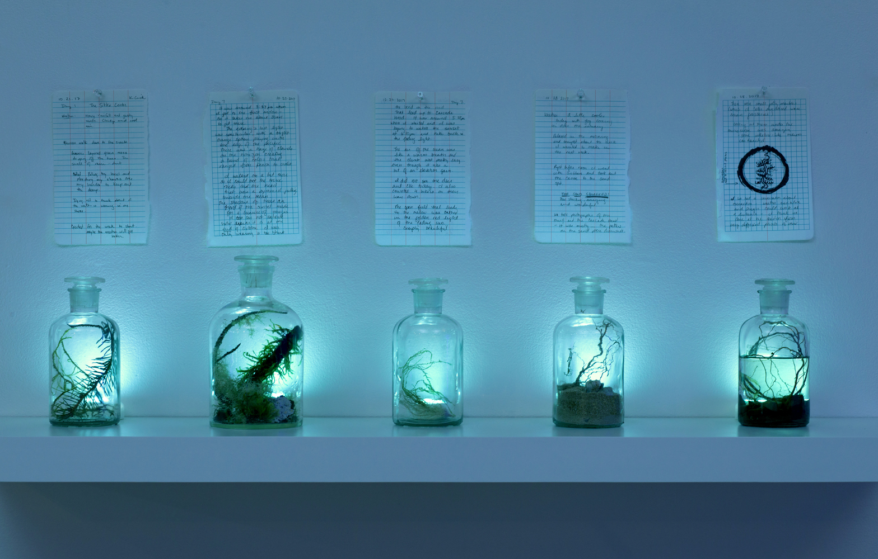
Smell and Memory

Slide 11
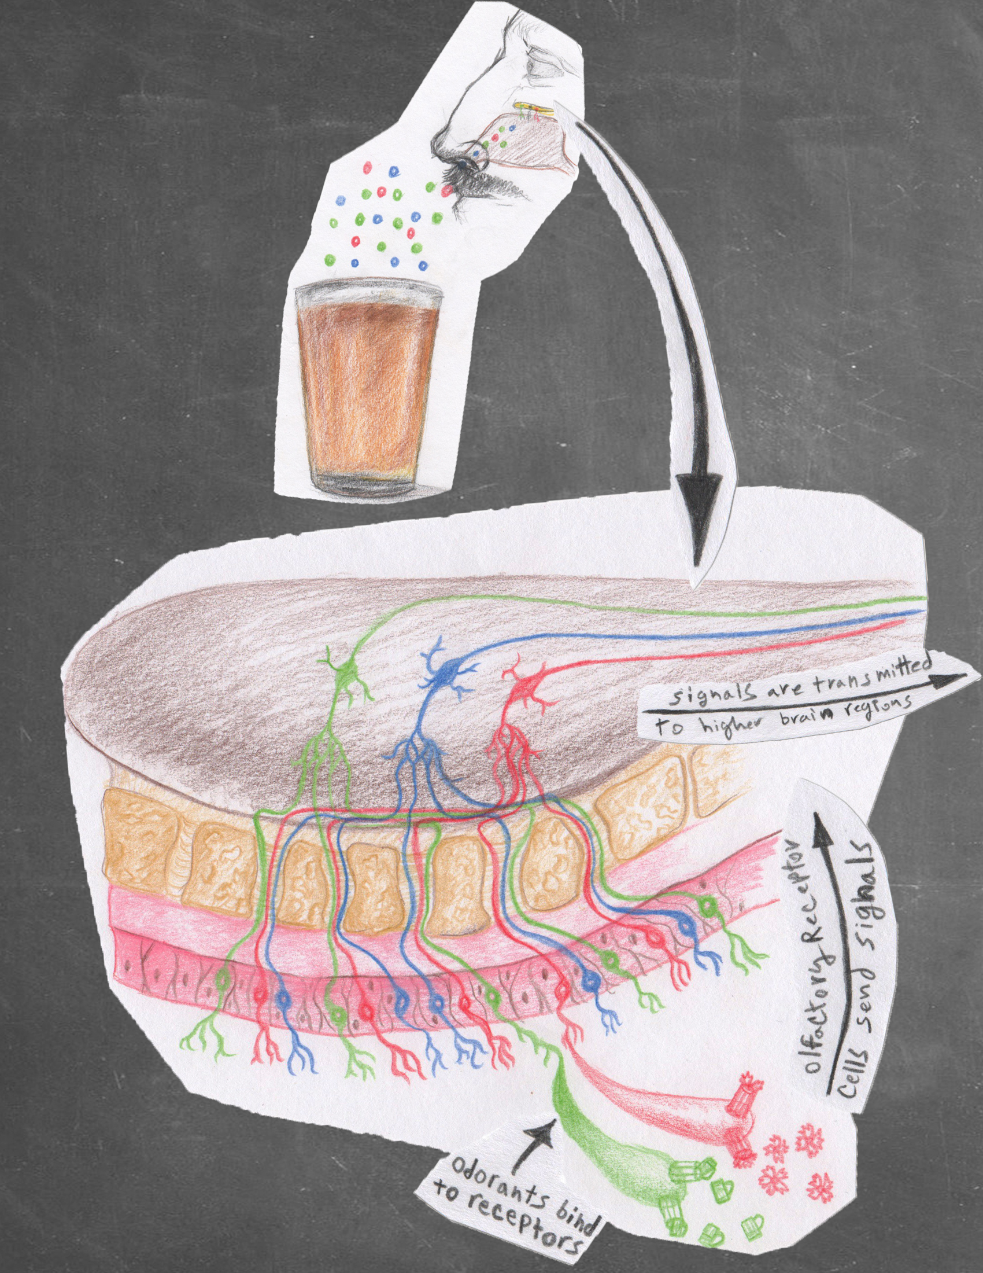
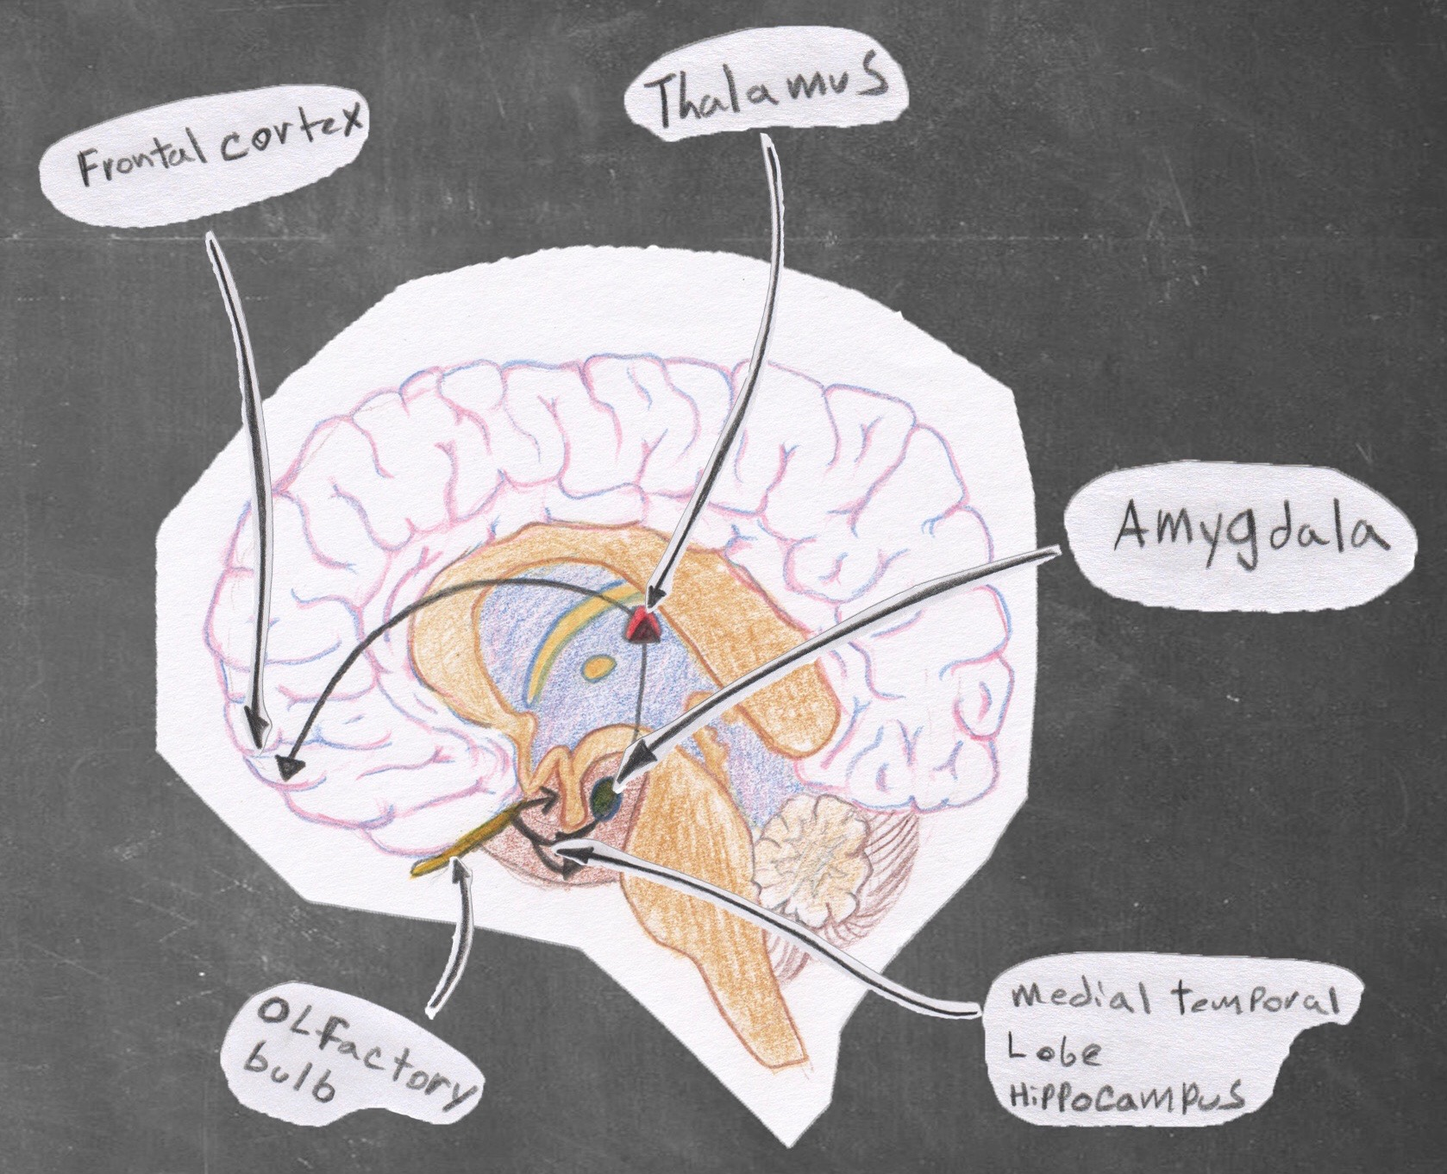
Smell and Memory

Slide 12
While Sleeping
Acetylcholine ↑
Serotonin ↓
Dopamine↓
Norepinephrine ↓

Slide 13
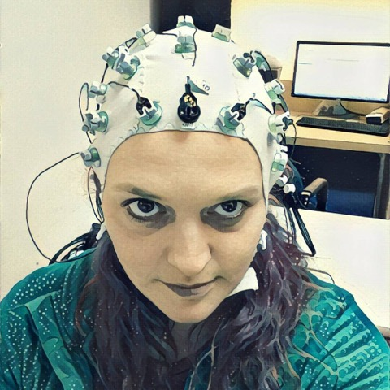
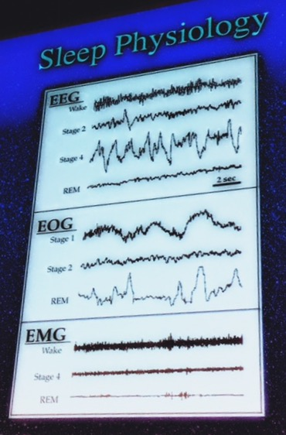
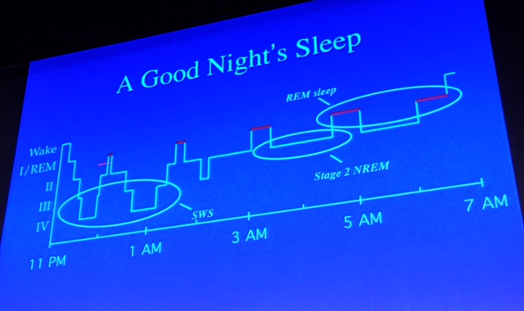
SLEEP
EEG: Sleep Stages
NREM and REM
Neuromodulation
Dopamine
Norepinephrine
Serotonin
Acetylcholine

Slide 14
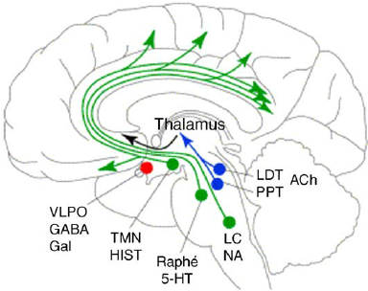
SLEEP: Changes in REM
Amygdala
Anterior cingulate
DLPFC
Dreams can be “hyper-
emotional and bizarre, with
logical constraints removed”
-Robert Stickgold (2017)
Sleep-wake and Other Biological Rhythms: Functional Neuroanatomy (2005)

Slide 15
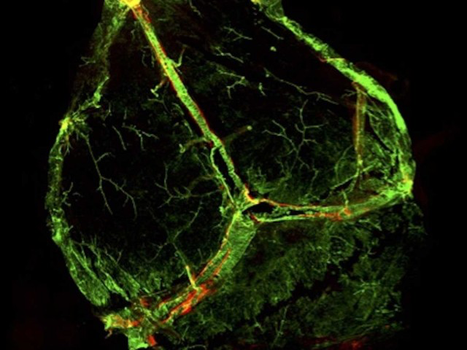
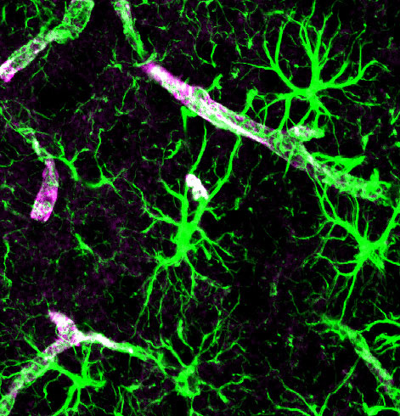
Sleep and the glymphatic system
Lymph (red)
Jeffery Iliff, OHSU
Limited lymphatic
system in the brain
How is waste cleared
from the CNS?
Lack of sleep, lack of
clearance, increased
risk of disease?

Slide 16
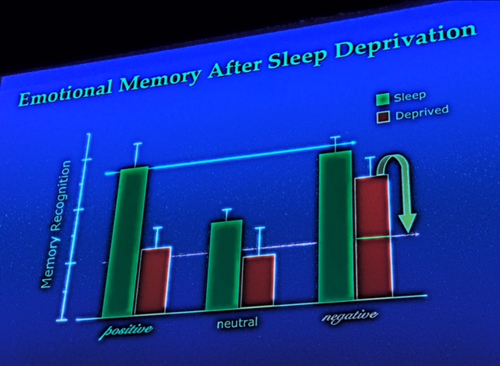
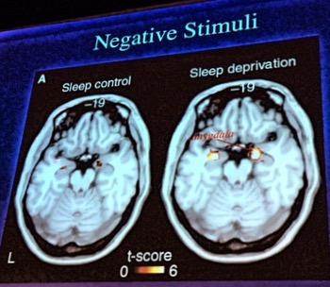
Lack of sleep makes you negative
Yoo et al (2007), Curr Biol
Sleep deprived subjects
selectively better able to
recall negative words than
neutral or positive words
they’d studied earlier
ALSO: greater amygdala response to negative
words than their more alert subjects; and less
functional connectivity with medial OFC…
PREFRONTAL – AMYGDALA DISCONNECT:
Stronger negative emotional response, and less inhibitory control

Slide 17
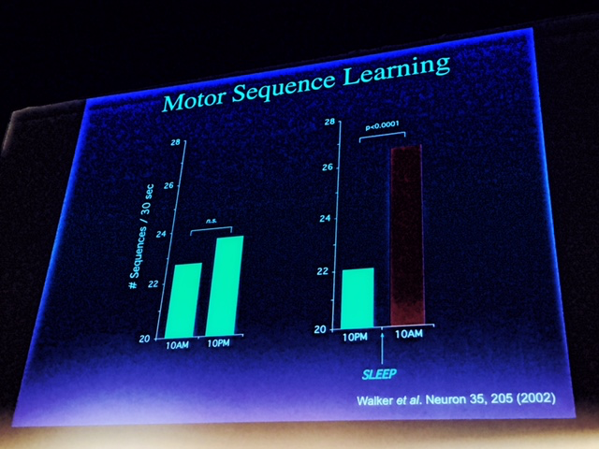
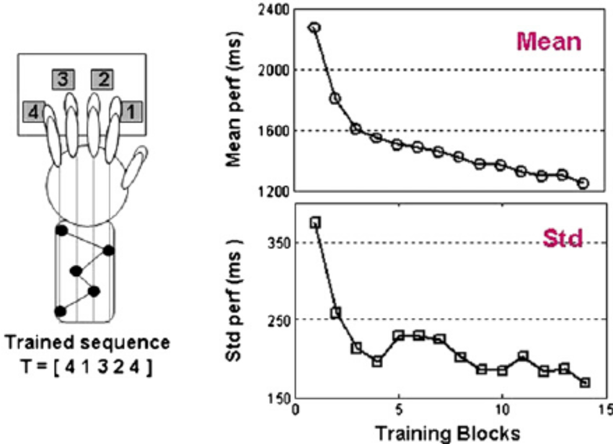
Lack of sleep impairs memory
Sleep enhances implicit (or procedural) memories
Subjects trained on a sequential finger tapping task did
better if allowed to sleep after training, instead of spending
the same amount of post-training time awake…
Walker et al (Neuron (2002))

Slide 18
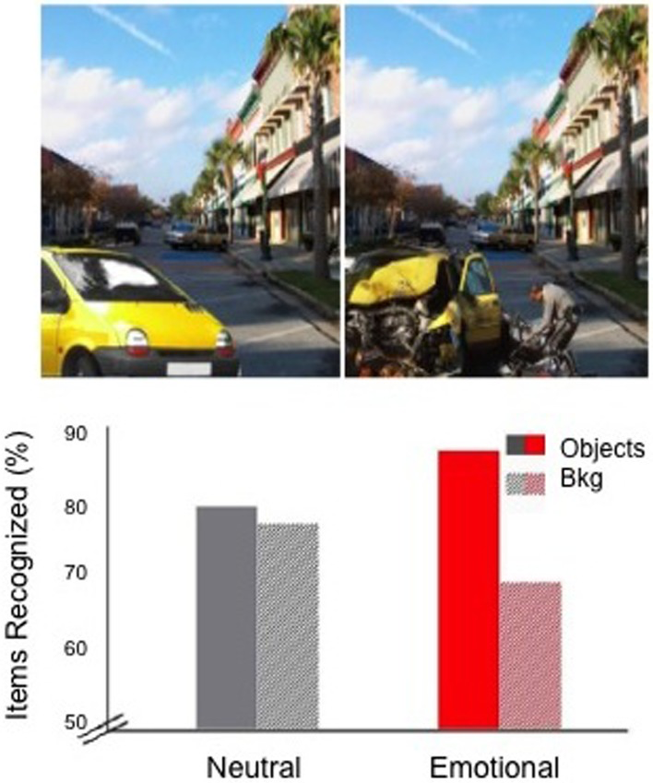
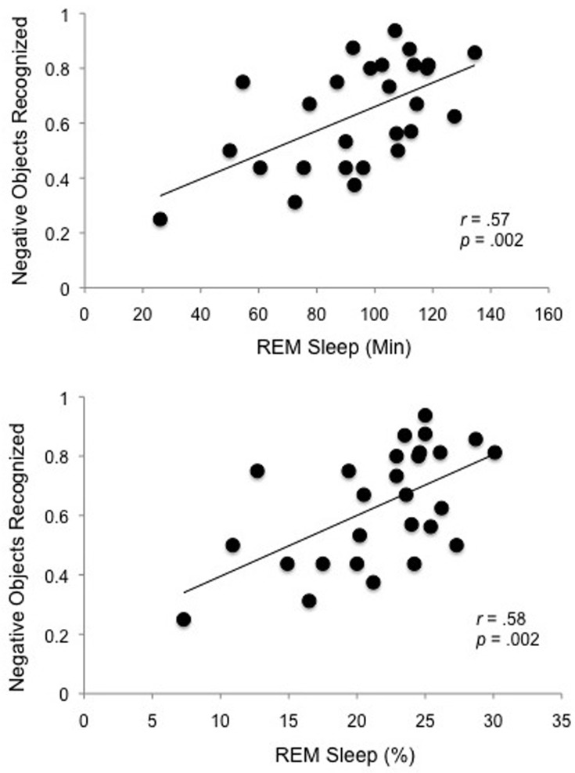
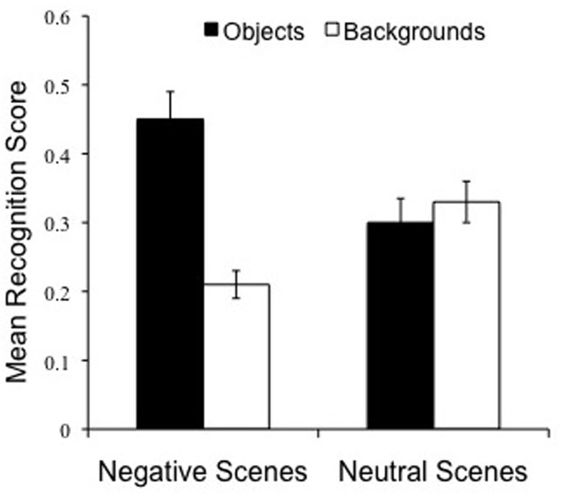
Sleep: get “gist,” drop details
Sleep promotes lasting changes in selective memory for emotional scenes, Payne et al (2012)
Positive association between REM
and selective consolidation of central,
negative aspects of complex scenes
Increase in memory for emotional objects
Decrease in memory for neutral backgrounds

Slide 19
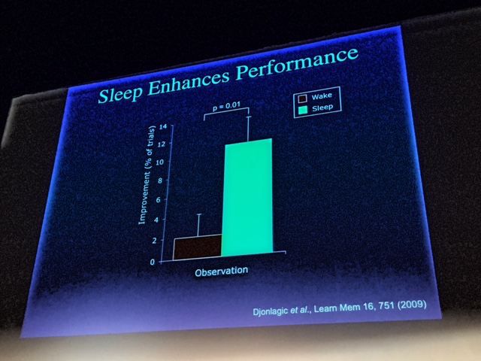
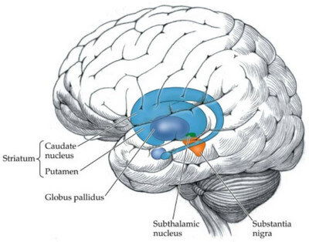
Sleep improves insight
Djonlagic et al (2009)
Weather prediction task Subjects presented with cards,
each probabilistically linked to
a particular outcome (“rain,”
“sun”). Better w/sleep…
Basal
Ganglia

Slide 20
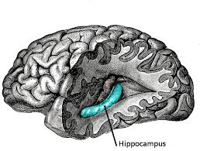
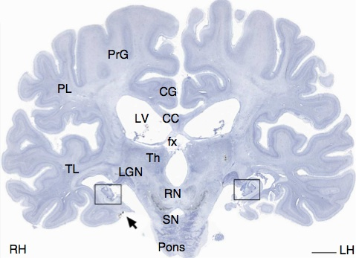
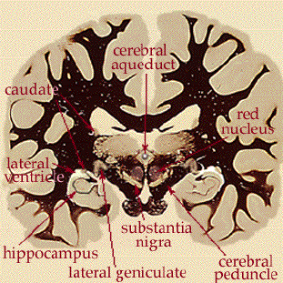
Patient H.M.
Henry Molaison (1926 – 2008)
Intractable epilepsy
Surgery at age 27
Bilateral temporal lobectomy

Slide 21
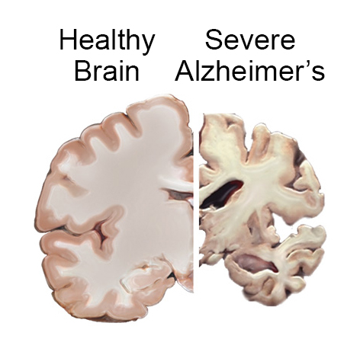
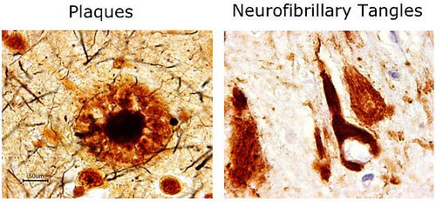
Alzheimer’s disease
A “disconnection syndrome”
Alois Alzheimer (1906)
6th leading cause of death (in US)
Most common form of dementia
Affects 5 million Americans
Beta-amyloid plaques
Tau protein tangles
Aging, inflammation, genetics
Late vs. early onset forms

Slide 22
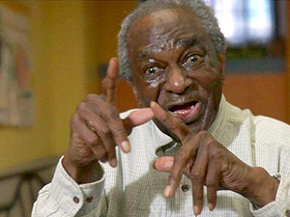
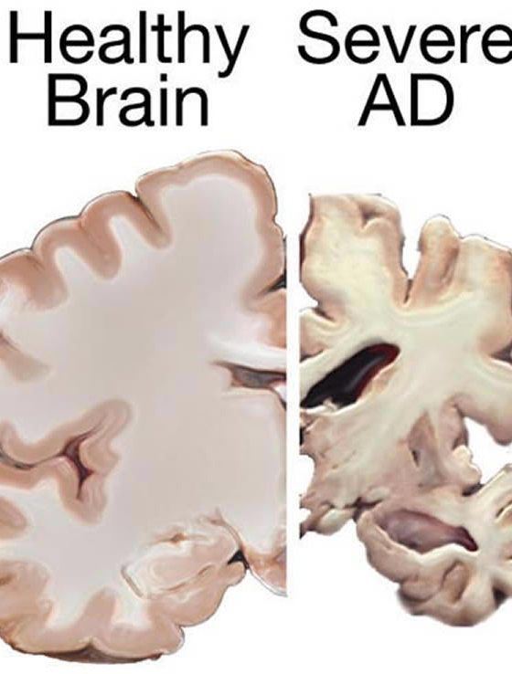
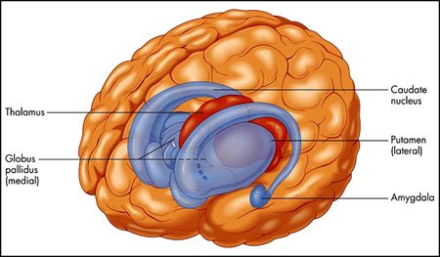
Henry
Dementia involves damage to neocortex and hippocampus
BUT: preservation of subcortical structures critical for involuntary movements, skills, emotions…

Slide 23
Illuminated Wilderness: Memory
ART + SCIENCE
Questions and discussion
Thank you!

