Slide 1
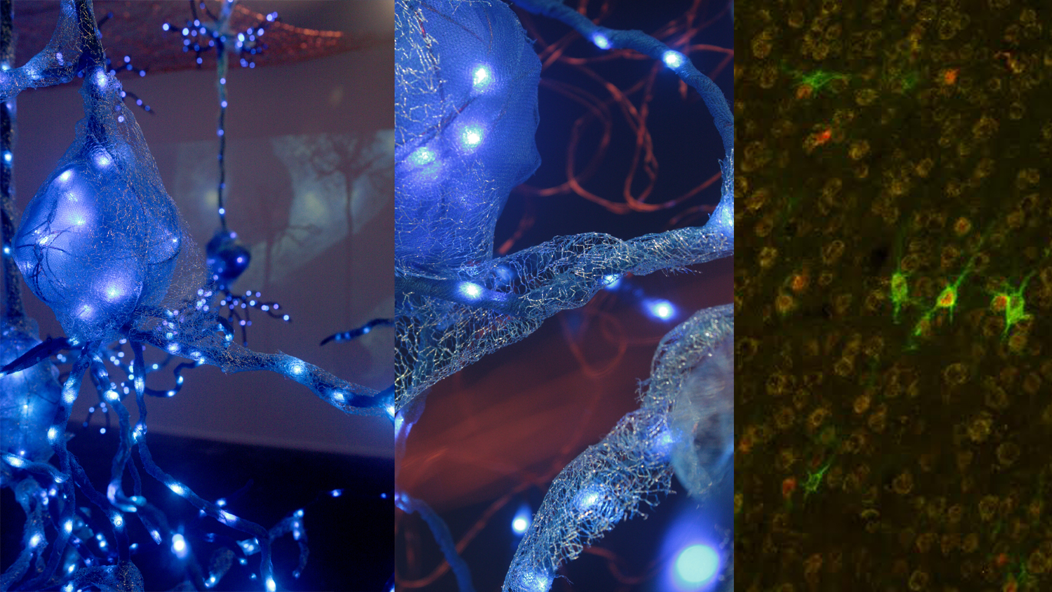

Illuminated Wilderness: Memory
ART + SCIENCE
Kindra Crick
Dr. John Harkness, WSU Vancouver
Jeff Leake & Dr. Bill Griesar from NW Noggin

Slide 2
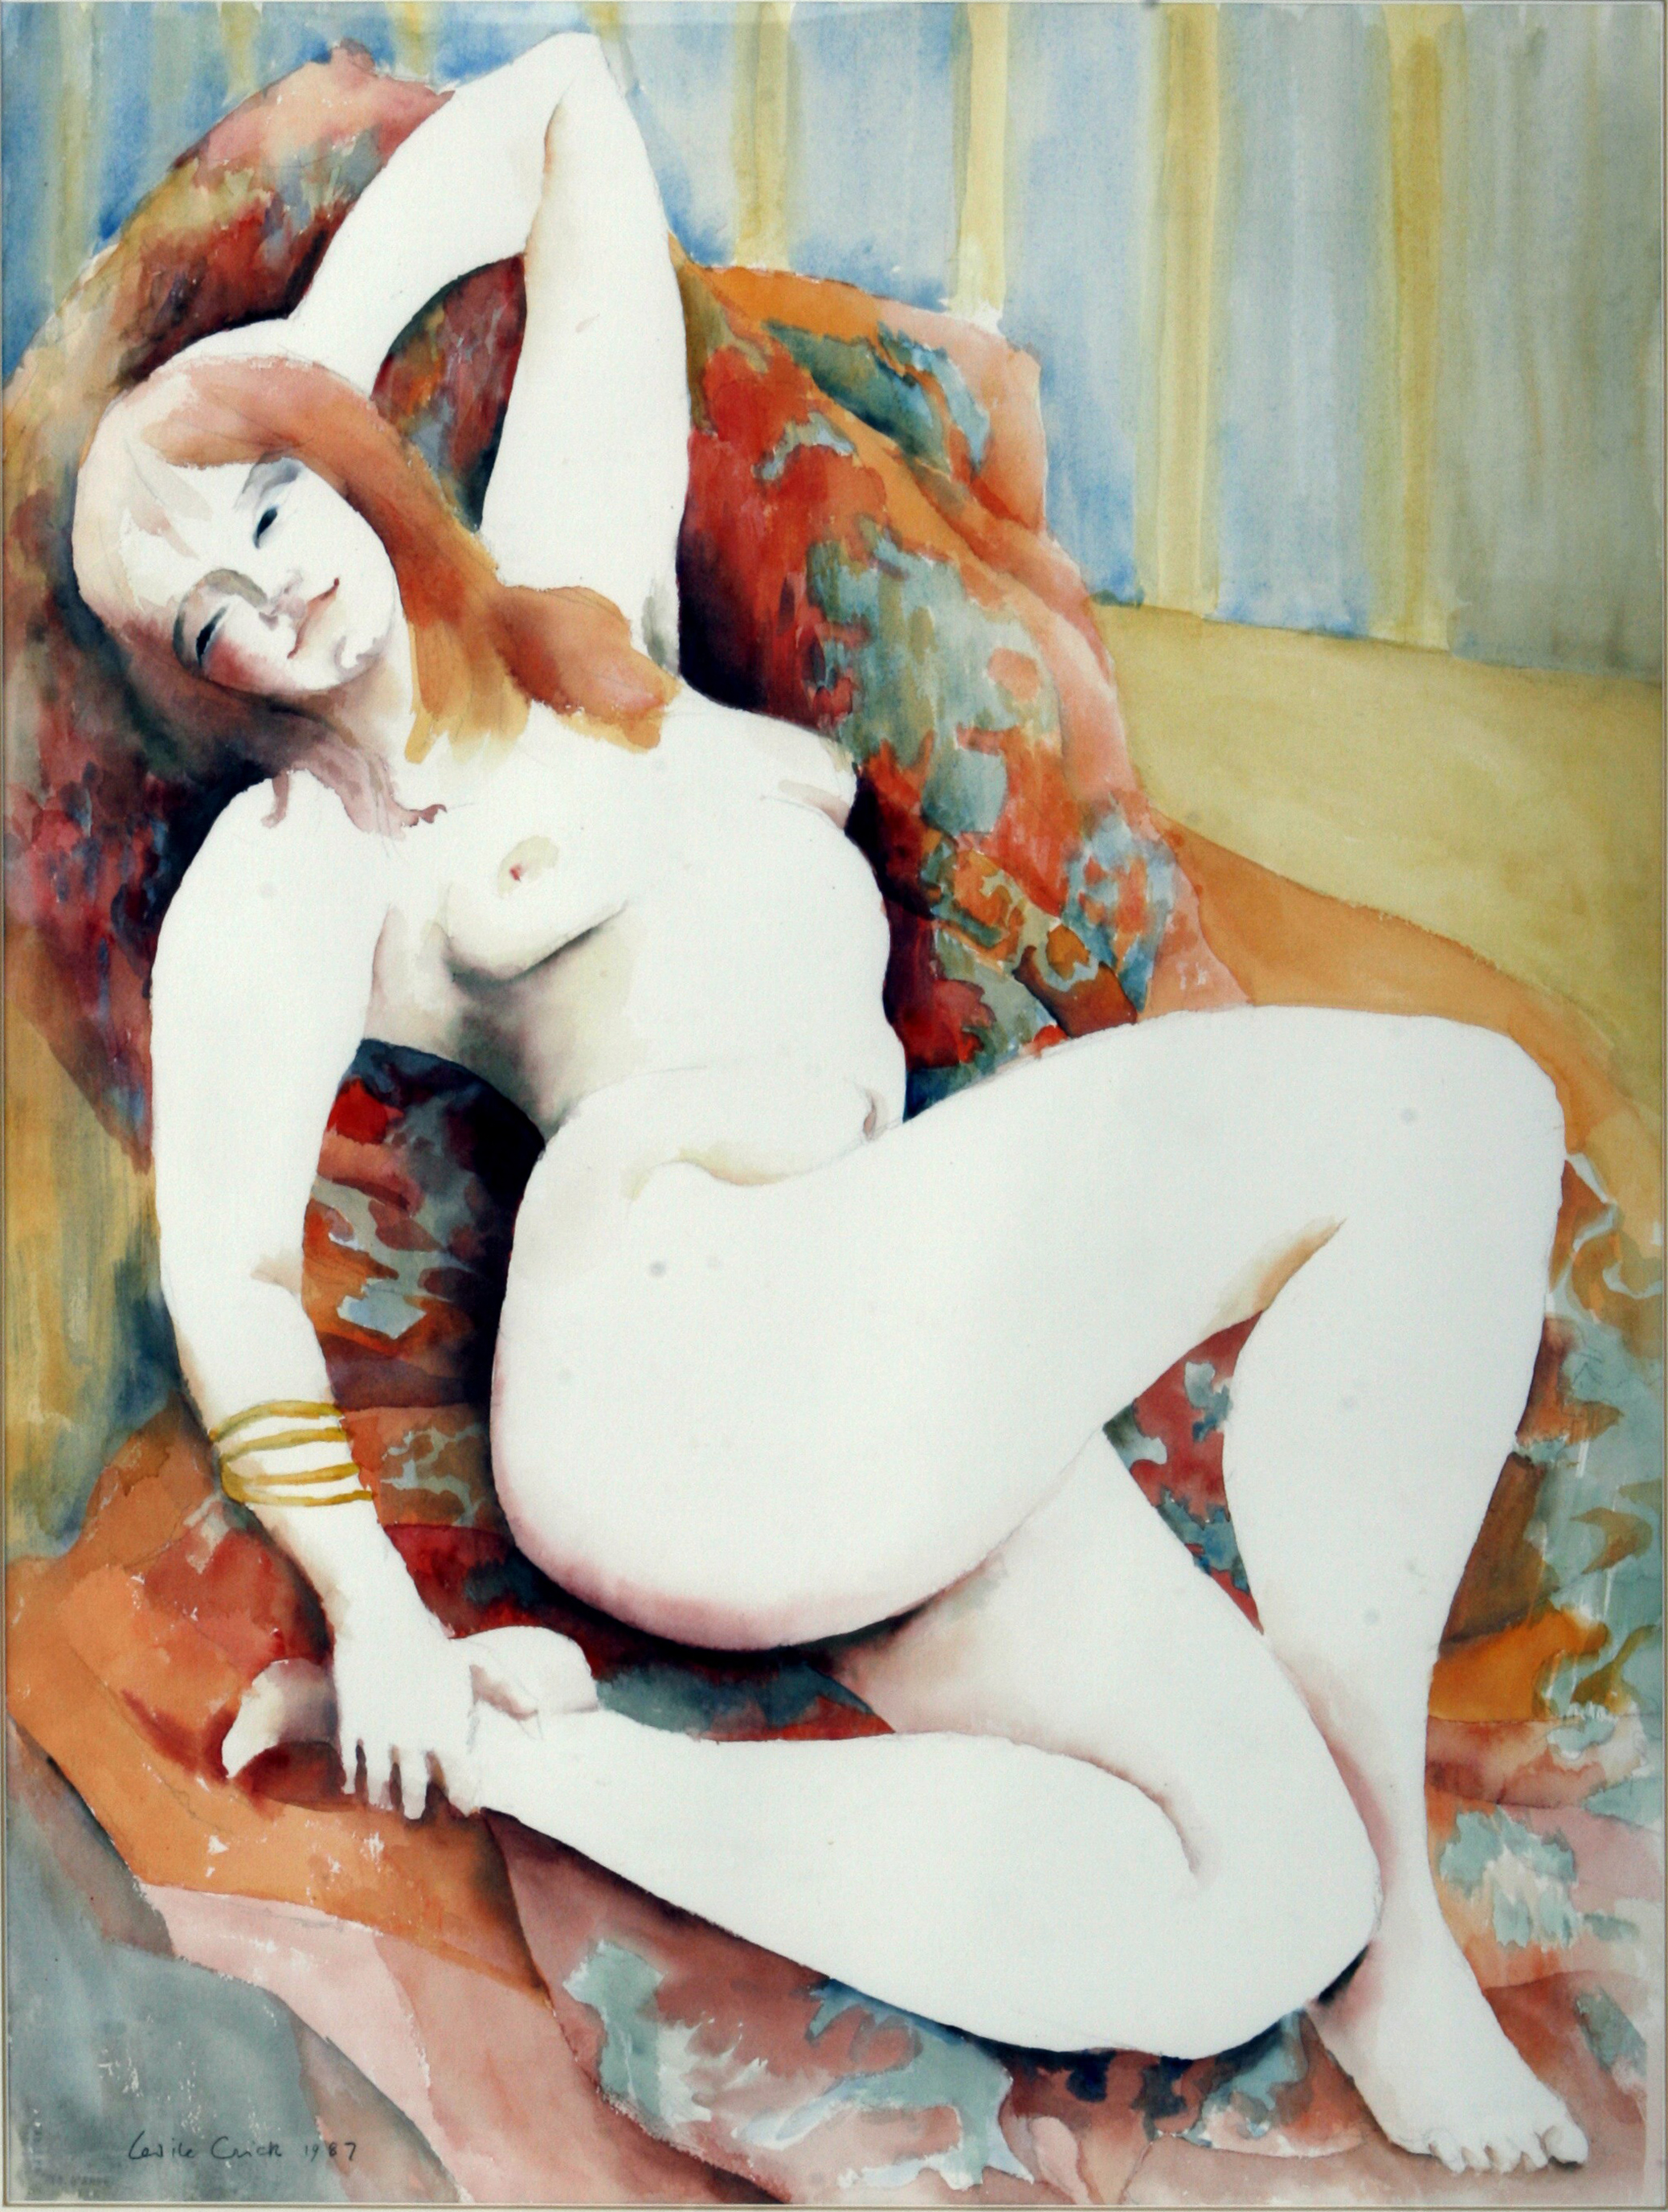
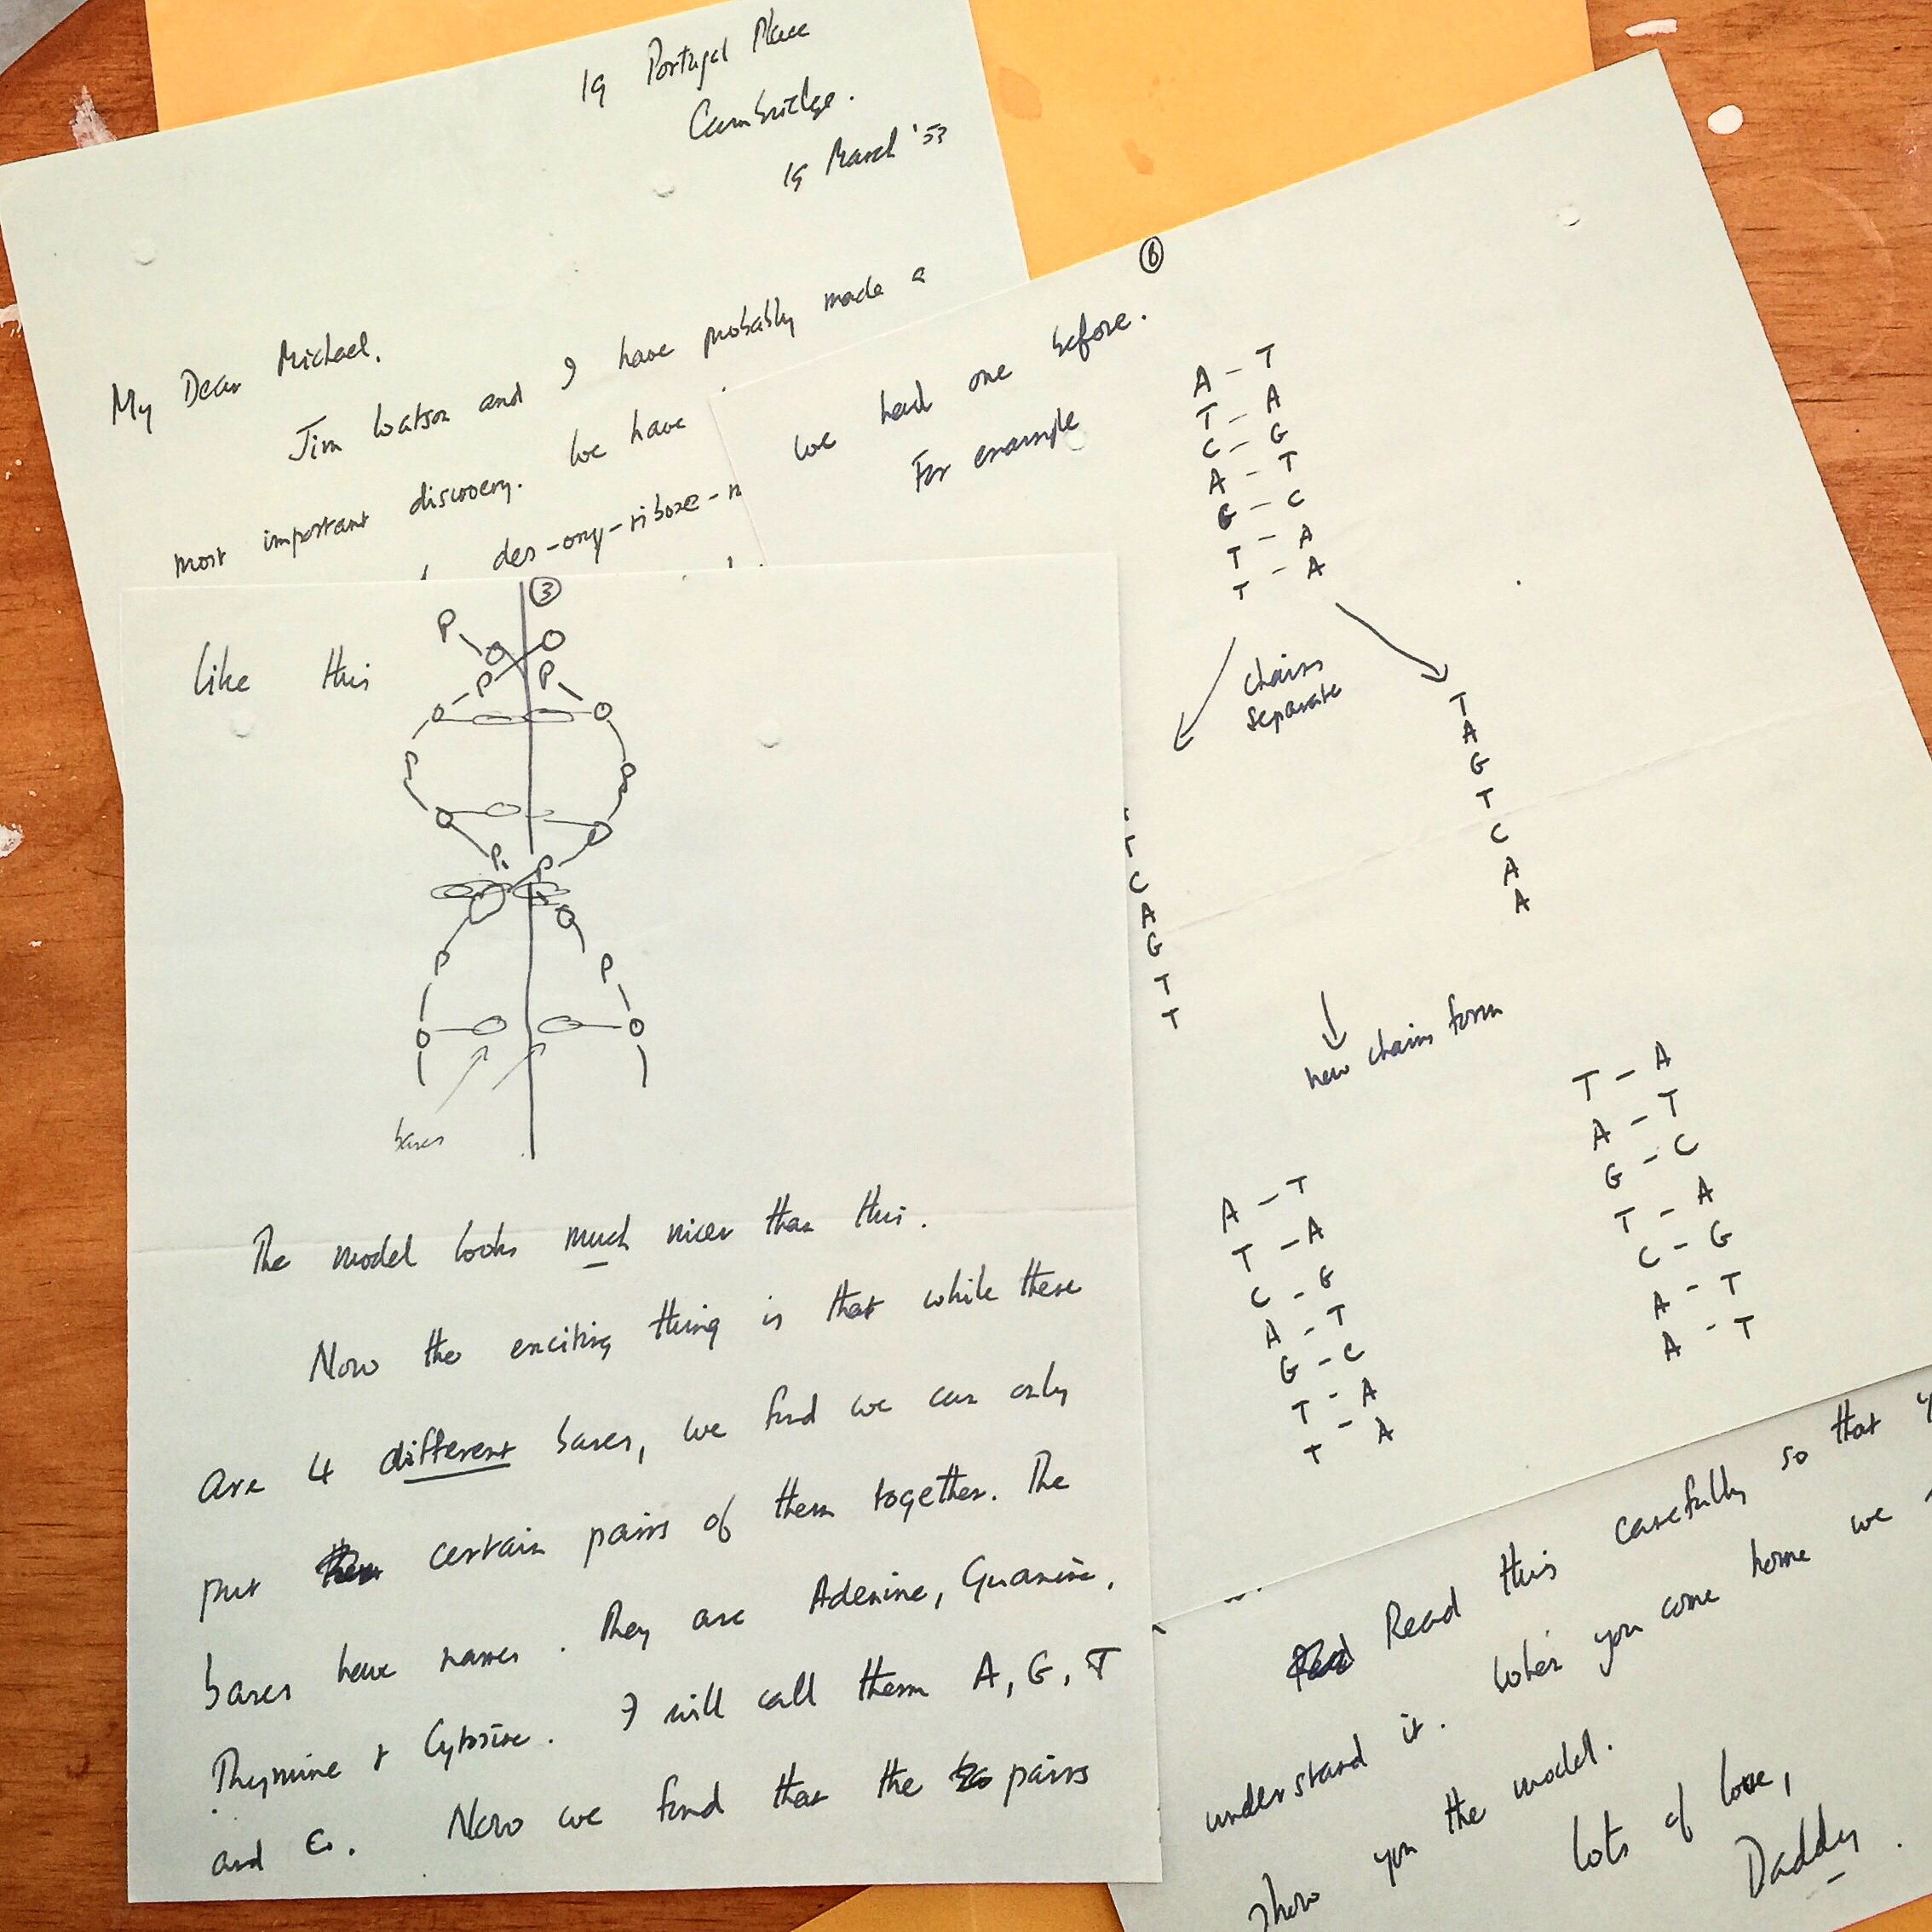

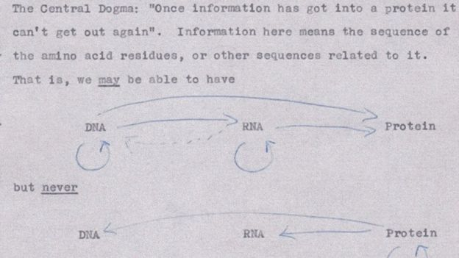
Art + Science
Odile Crick
Francis Crick
Notes:
Artist Odile Crick, who studied at St. Martins School of Art and then at the Royal College of Art where she was top of her class. Influenced by Matisse and painted mostly nudes. Always artists staying over and mingling with the scientists who also came for parties. Friends with numerous artists, including Francoise Gilot and Niki de Saint Phalle when living in La Jolla, CA
Scientist Francis Crick who studied at University College London, studying Physics, joined the war effort and innovated in minesweeping, became a graduate student in biology at Cavendish Laboratory at Cambridge. Graduate work on helical structures of hemoglobin protein, contributed to solving the structure of DNA, hypothesizing that DNA was a code and later in 1958 proposed the ‘Central Dogma of Molecular Biology’ which changed the logic of the field. Moved to city outside San Diego and started studying the brain.

Slide 3
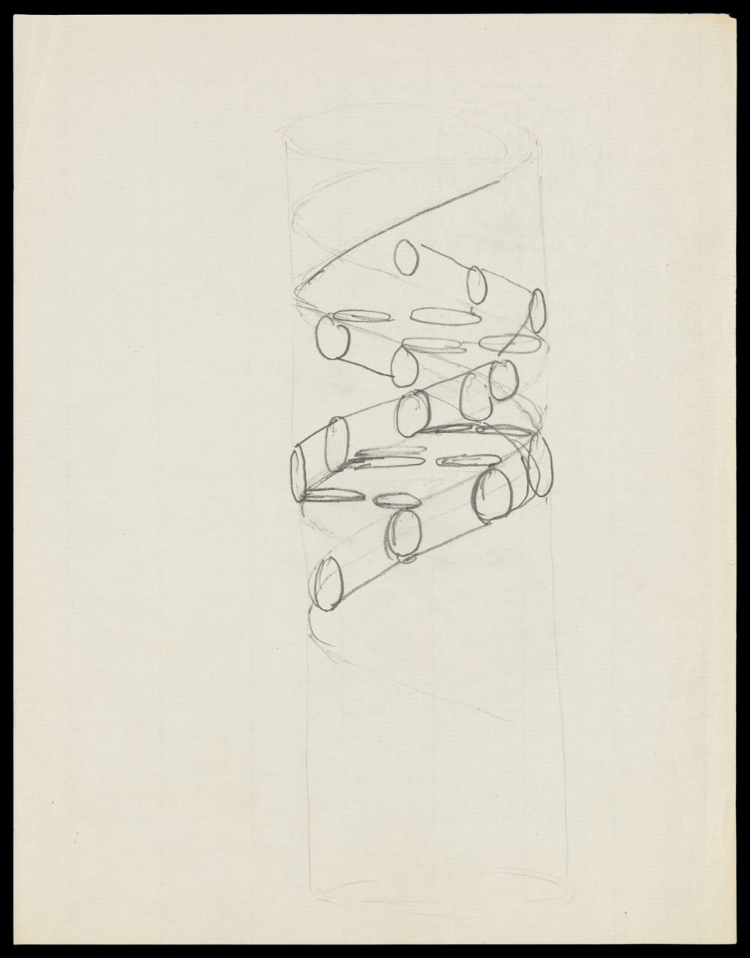
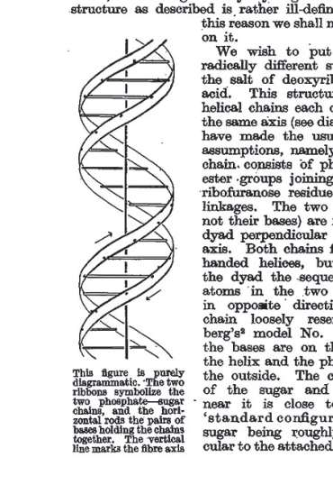
Francis Crick
Odile Crick
Notes:
Built a model – which was wrong
Built and tinkered with a second model (sculpture)
Changed 18 degrees to 36 degrees – the base pairs fit!
Major and minor groove
Helixes twist in opposite directions allowing the base pairs to fit inside
How to communicate an idea simply? Drew a simple sketch (left) and Odile transformed it into the diagram you see on the right. Published in Nature in 1953 along with to other papers.

Slide 4
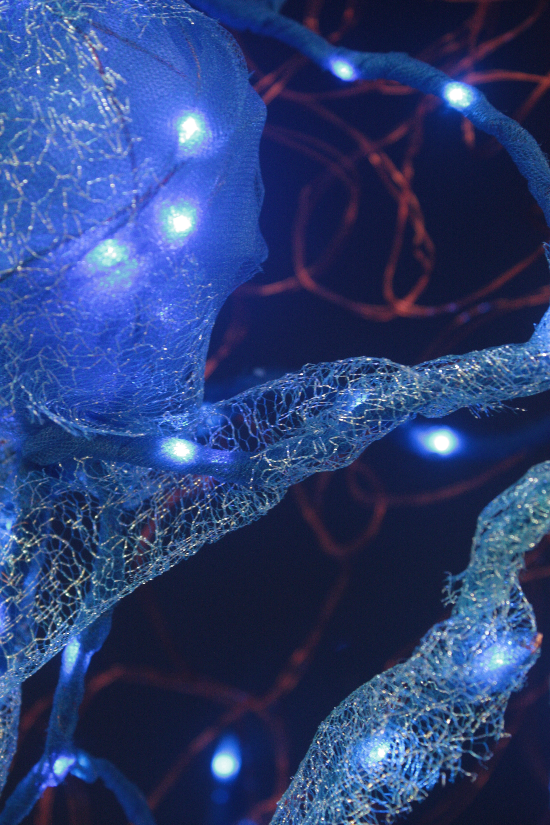
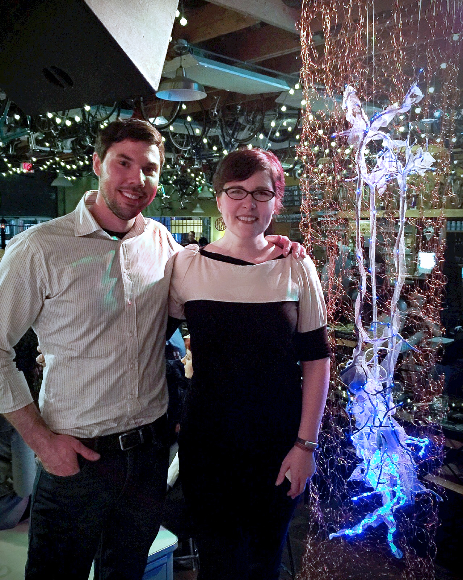
Collaboration
Connected with NW Noggin in 2015
Paired up with Dr. John Harkness
for a NW Noggin Collaboration
Shared interest in memory

Slide 5
Illuminated Wilderness: Memory
ART + SCIENCE
Dr. John Harkness, WSU Vancouver

Slide 6
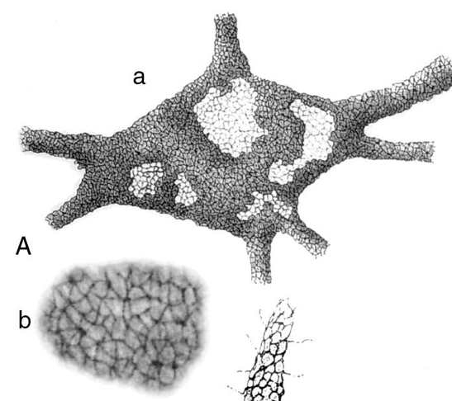
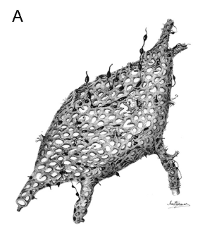
Camillo Golgi
Intracellular reticulum = Golgi apparatus
Peripheral reticulum = perineuronal nets
A “kind of corset of neurokeratin which impeded
the spread of current from cell to cell”
Golgi (1898)

Slide 7
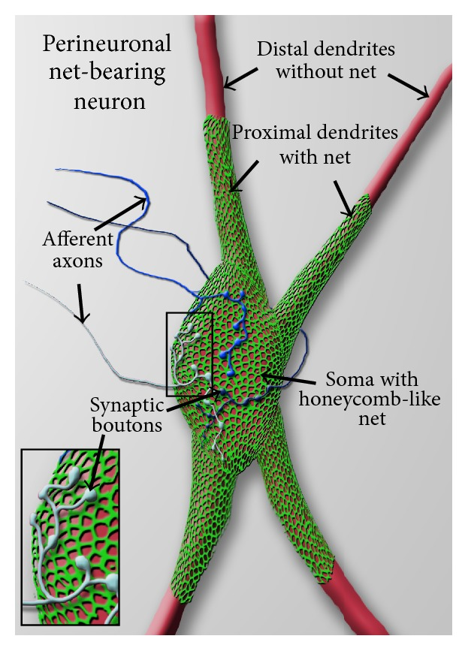
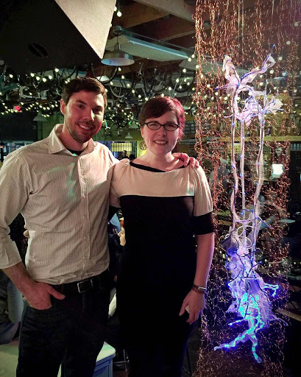
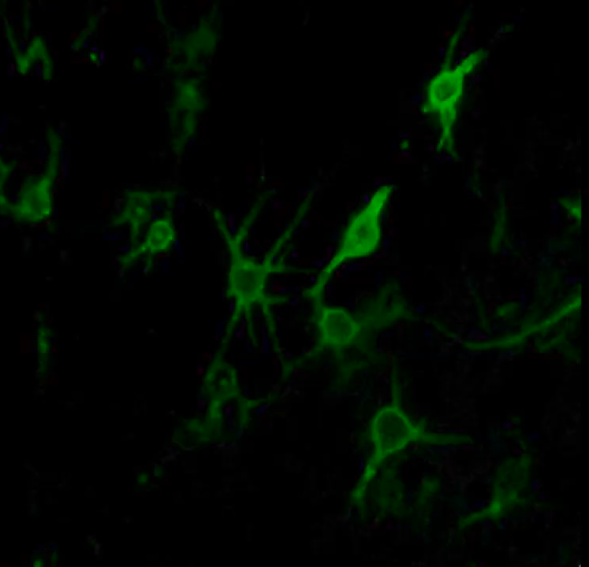
Celio et al. TINS (1998)
Winter et al. Neural Plast (2016)

Slide 8
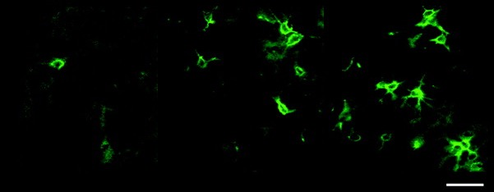
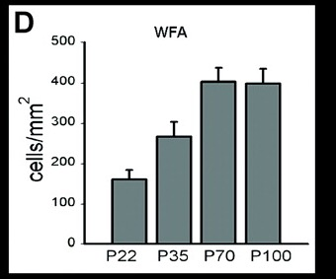
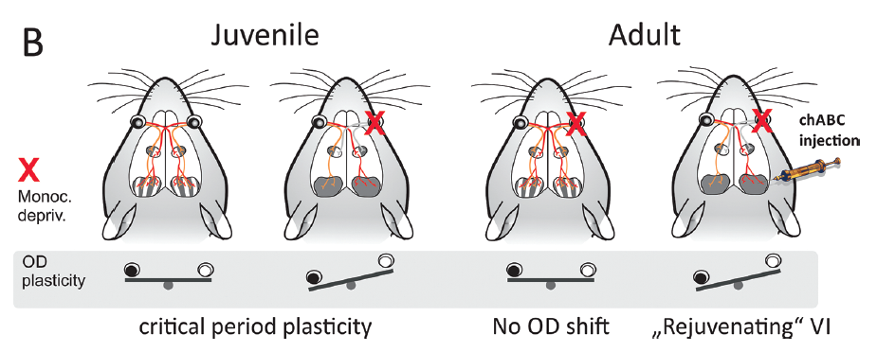
P22
P70
P100
Visual system (Pizzorusso et al., 2002)
Recovery from spinal cord injury (Bradbury et al., 2002; Massey et al., 2006)
PNNs reduced in schizophrenia (Pantazopoulos et al., 2010; Mauney et al., 2013; Shah & Lodge, 2013)

Slide 9
PNNs: Function
Stabilize synaptic contacts
Physical barrier
Capture of inhibitory factors (e.g., Sema3A)
(Vo et al., Mol Cell Neurosci, 2013)
Restrict lateral mobility of receptors
(Frischknecht et al., Nat Neurosci, 2009)
  Protect from oxidative stress
  (Suttkus et al., Am J Neurodegener Dis, 2012; Cabungcal
  et al., PNAS, 2013)
Regulate ionic microenvironment
(Brückner et al., Glia, 1993; Härtig et al., Brain Res, 1999)
J.C.F. Kwok

Slide 10
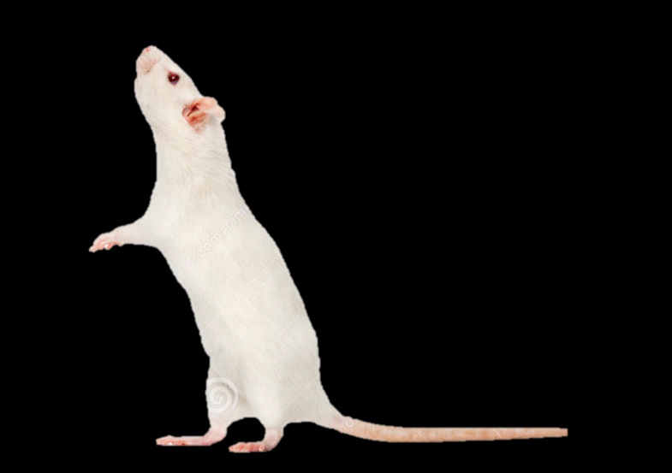
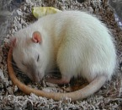
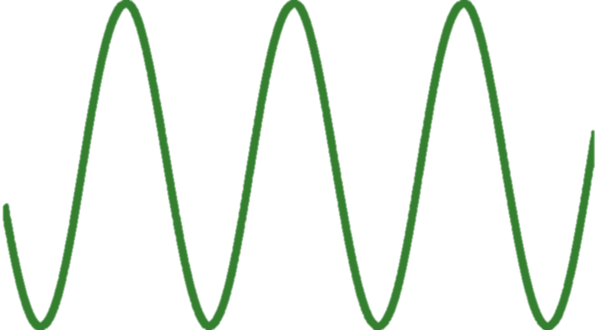
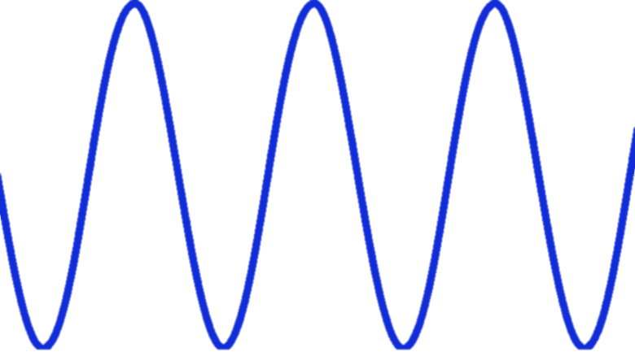
Diurnal changes in PNNs may be
related to oxidative stress
oxidative
Oxidative
stress
PNN
intensity
WAKE
WAKE
WAKE
SLEEP
SLEEP
ZT0
ZT12
ZT0
ZT12
ZT0

Slide 11
Do PNNs fluctuate throughout the day?

Slide 12
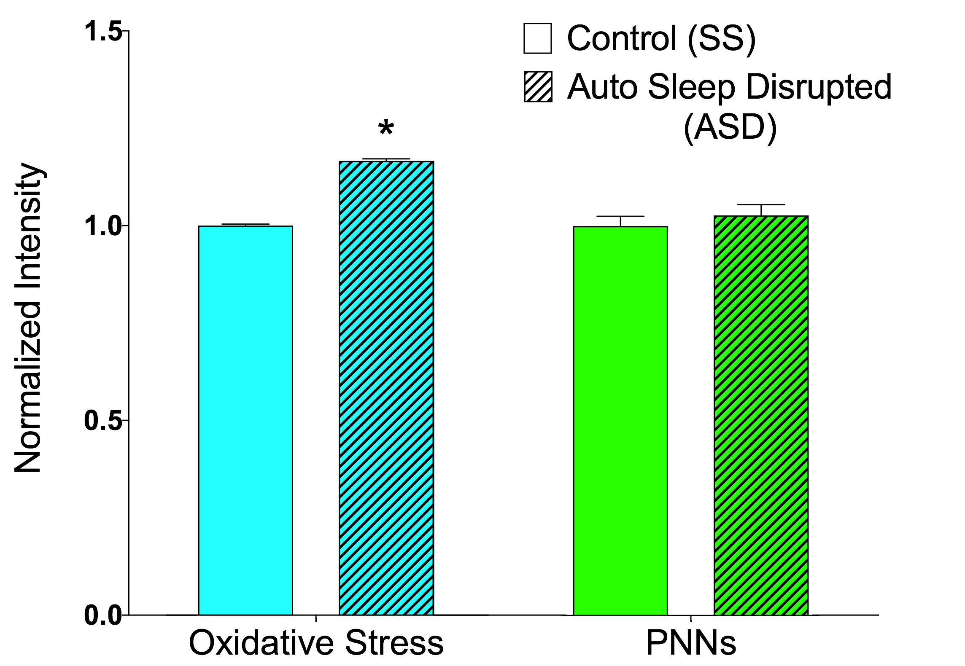
Diurnal Rhythm of PNN Fluctuation
(Harkness, Wisor, Allen, Sorg et al, unpublished)
0 hrs 6 hrs 12 hrs 18 hrs
Diurnal pattern
Sleep disruption pattern
0 hrs 6 hrs 12 hrs 18 hrs

Slide 13
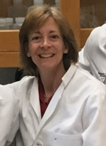
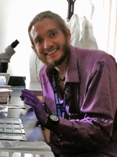
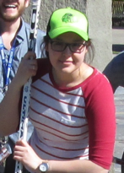
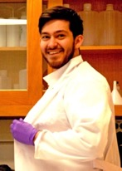
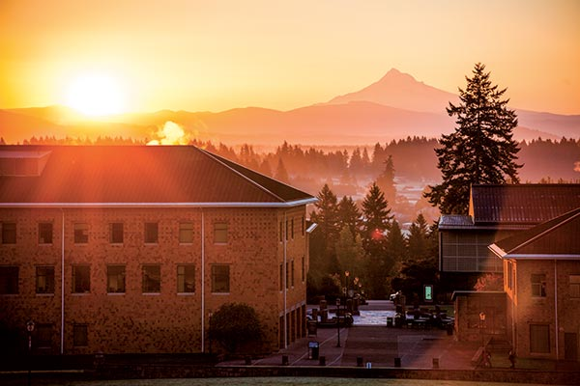

Sorg Lab Members
Barb Sorg, PhD
Jordan Blacktop, PhD
Angela Gonzalez
Jereme Wingert
Holly D’Andrea
Washington State University
Jonathan Wisor, PhD
Will Clegern
Priyanka Bushana
™
Funding
Washington State Commercialization Gap Fund
Postdoc Alcohol and Drug Abuse Research Program, WSU
NIH NIDA DA 033404
NIH NIDA DA 040965

