Slide 1
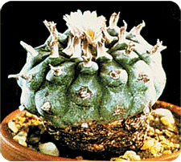
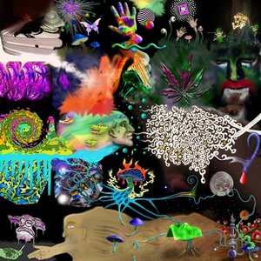
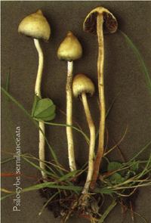
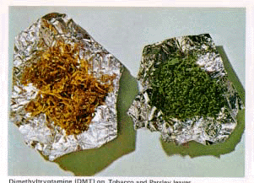
Hallucinogens
Drugs that produce unusual sensory, perceptual
and cognitive distortions
Derived from plants (mushrooms, cacti); but some are synthetic. Include: mescaline, psilocin, DMT, LSD

Slide 2
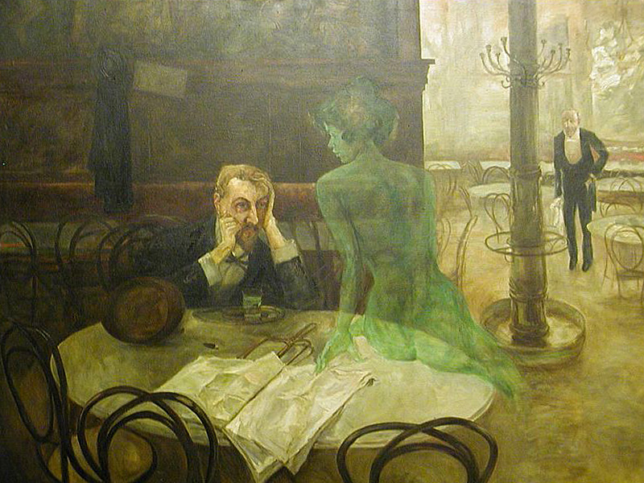
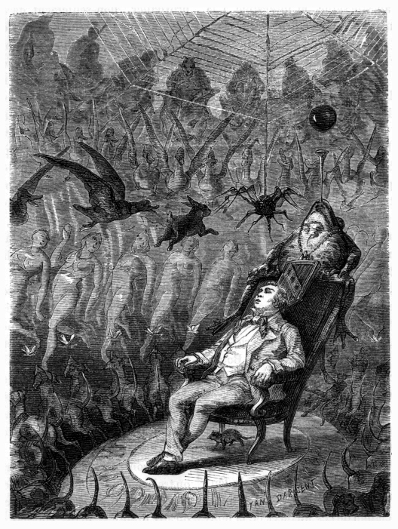
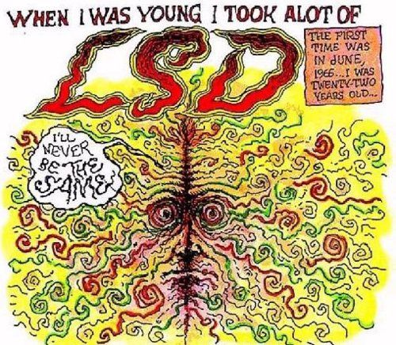
Depictions of the effects of hallucinogens
Viktor Oliva “The absinthe drinker” 1901
Yan Dargent "Le rêve d'un êthêrês" A depiction of ether-induced hallucinations 1865
Robert Crumb “LSD”

Slide 3
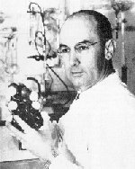
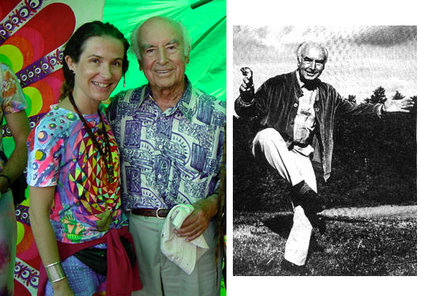
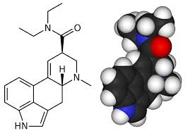
LSD
A synthetic ergot derivative synthesized by Albert Hoffman in 1938 (LSD-25)
after LSD!
before
LSD
Some derivatives toxic; some clinically useful
LSD re-examined in 1943; Hoffman ingested it (by accident) and took an unusual trip! LSD is a very potent drug…
ergot fungus

Slide 4
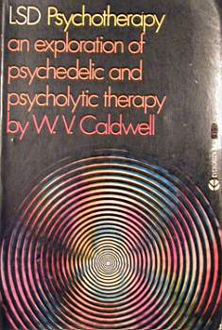
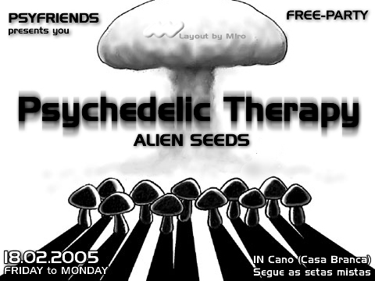
Early applications
LSD initially available to psychiatrists and medical researchers (1940 - 1962)
Psycholytic therapy: Popular in Europe; LSD in psychotherapy to release repressed memories
Psychedelic therapy: Popular in U.S.; LSD in high doses for “spiritual” shock
MK-ULTRA: 1950’s CIA program, secret LSD administration to U.S. citizens; British testing too

Slide 5
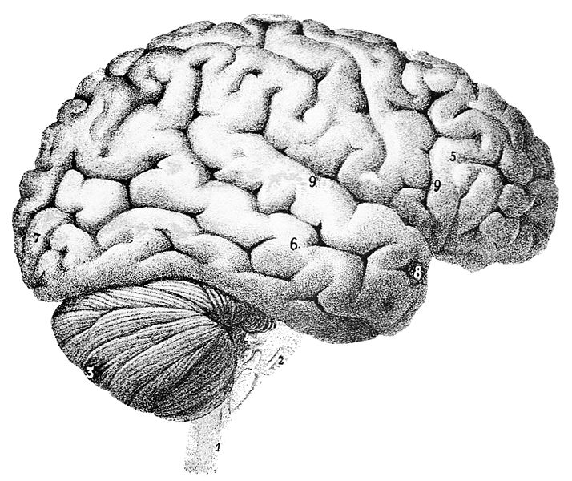
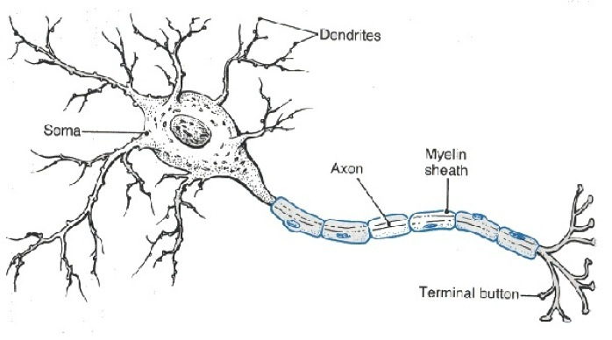
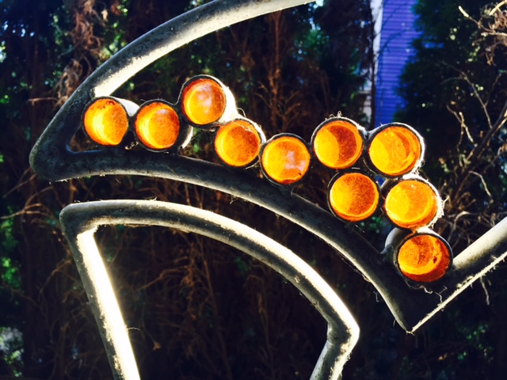
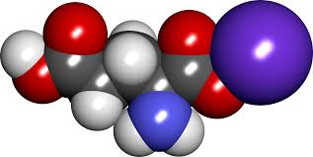
Your brain: made of cells
Neurons
Neurons carry electrical messages
Neurons connect chemically across synapses
Neurotransmitters
SYNAPSE

Slide 6
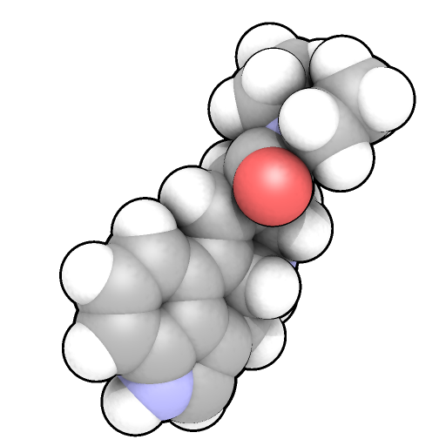
All cells have membranes
Neurotransmitter
or drug
Outside cells, including neurons
Many drugs, including
hallucinogens, cannot get
through, but instead act
at RECEPTORS to affect
neuron function…
Drugs like LSD attach
(or “bind”) to receptors,
changing the activity of
affected neurons...
Inside cells
RECEPTORS: “Protein machines”

Slide 7
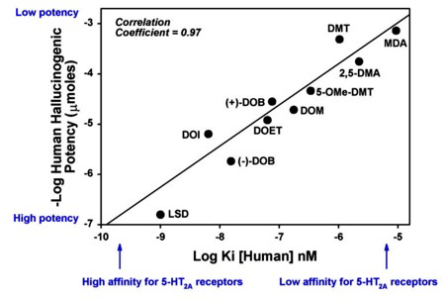
MOST hallucinogens act at ONE type of SEROTONIN receptor (5-HT2A)
5-HT1A
(Shen, 2010)
5-HT2C action plays a role
in modulatory control of effects
(Winter, 1999)
Wenjie Xiao, William E. Fantegrossi (2006)
Potency linked directly to hallucinogenic effects

Slide 8
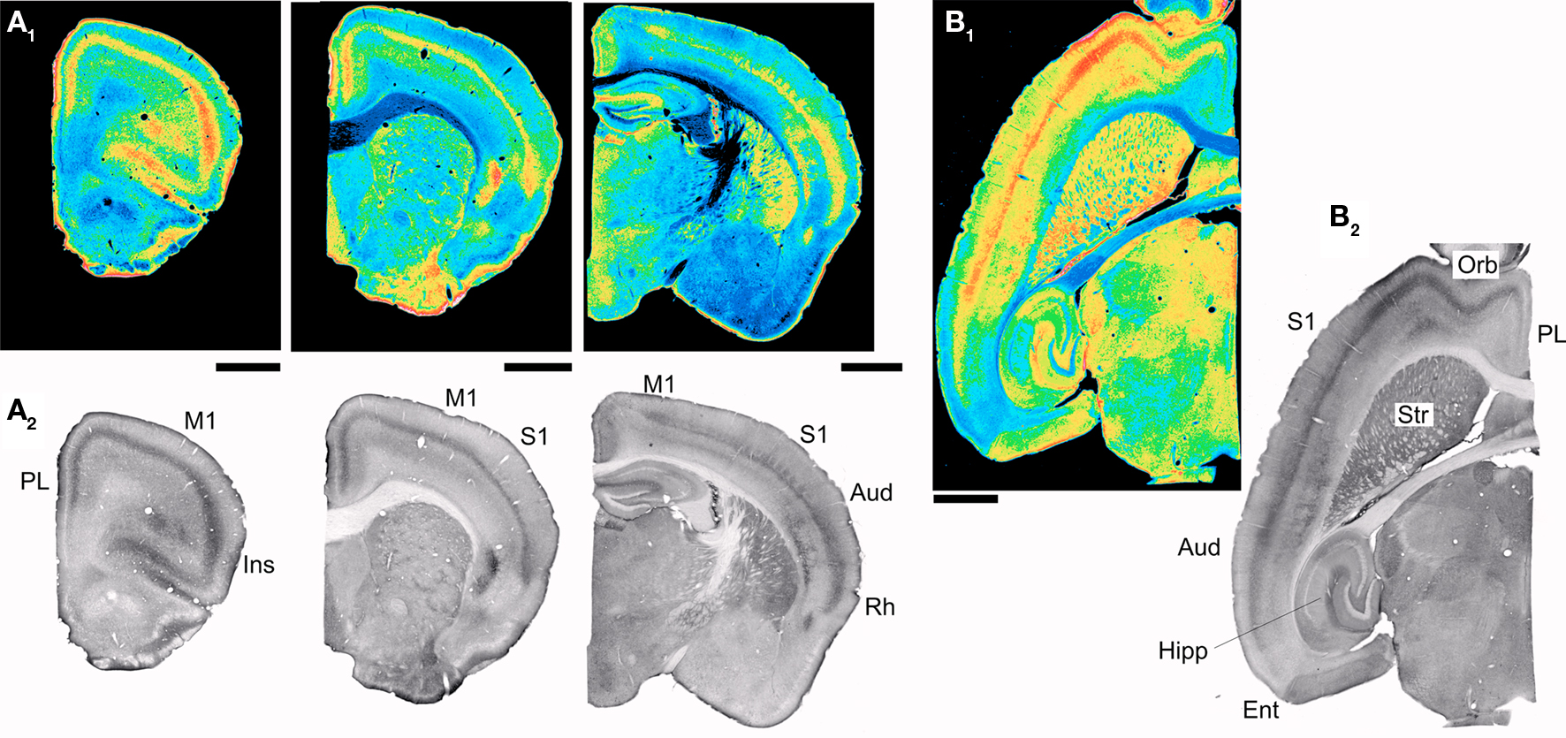
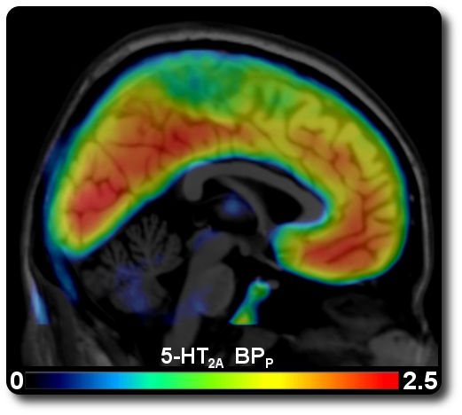
Where are these receptors?
Neocortex
Layer V
Olfactory cortex
Hippocampus
Basal ganglia
Thalamus
Cerebellum
Brainstem
Spinal cord
Virginia Cornea-Hébert (1999)
IMAGE SOURCE: 5-HT2A distribution map (PET); Medical University of Vienna

Slide 9
Changes in perception
“If the doors of perception were cleansed, everything would appear to man as it is, infinite” - William Blake
“The legs, for example, of that chair - how miraculous their tubularity, how supernatural their polished smoothness”
- Aldous Huxley, “The Doors of Perception” (1954)
“I looked around me and noticed details of physiognomy that had never struck me before. Each pore in my companion’s skin was now visible…”
- Solomon Snyder, “Drugs and the Brain”
“I clapped my hands and saw sound waves passing before my eyes”
- Solomon Snyder, “Drugs and the Brain”

Slide 10
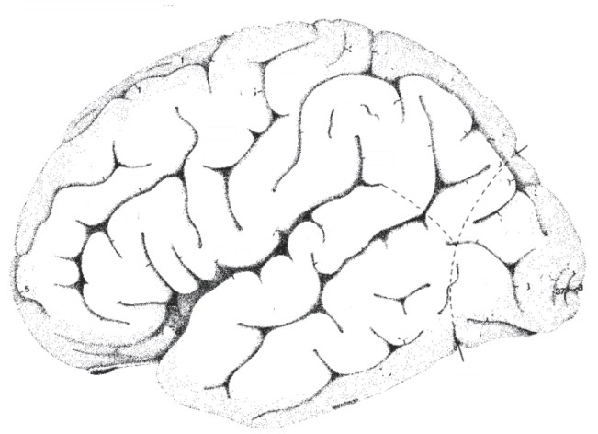
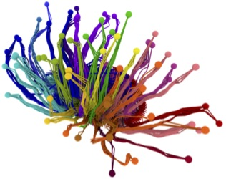
Hallucinogens
affect the “gating”
of sensory input
Cortex
Thalamus
Image courtesy of the
Allen Institute for Brain Science

Slide 11
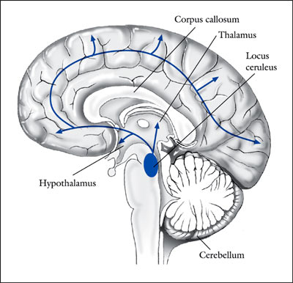
Hallucinogens Enhance
Sensory Responses in the Locus
Coeruleus via 5-HT_{2A} Receptors
Ordinary
stimuli become
extraordinary
“...it is of interest that the systemic administration
of LSD, mescaline, or other psychedelic hallucinogens in rats,
although decreasing spontaneous activity, produces a paradoxical
facilitation of the activation of LC neurons by sensory stimuli…”
(Aghajanian 1980; Rasmussen & Aghajanian 1986)

Slide 12
What else do hallucinogens do?
Neural correlates of the psychedelic state as determined
by fMRI studies with psilocybin, Carhart-Harris et al, PNAS (2011)
Psychedelic drugs have a long history of use in healing ceremonies, but despite
renewed interest in their therapeutic potential, we continue to know very little about
how they work in the brain. Here we used psilocybin, a classic psychedelic found in
magic mushrooms, and fMRI to capture the transition from normal waking
consciousness to the psychedelic state.
Profound changes in consciousness were observed after psilocybin, but surprisingly,
only decreases in cerebral blood flow were seen, maximal in hub regions, such as
thalamus and anterior and posterior cingulate cortex (ACC and PCC). Decreased
activity in ACC/medial prefrontal cortex (mPFC) was a consistent finding and the
magnitude of this decrease predicted the intensity of the subjective effects.
Psilocybin caused a significant decrease in the coupling between the mPFC and PCC.
These results strongly imply that the subjective effects of psychedelic drugs are
caused by decreased activity and connectivity in the brain's key connector hubs,
enabling a state of unconstrained cognition.

Slide 13
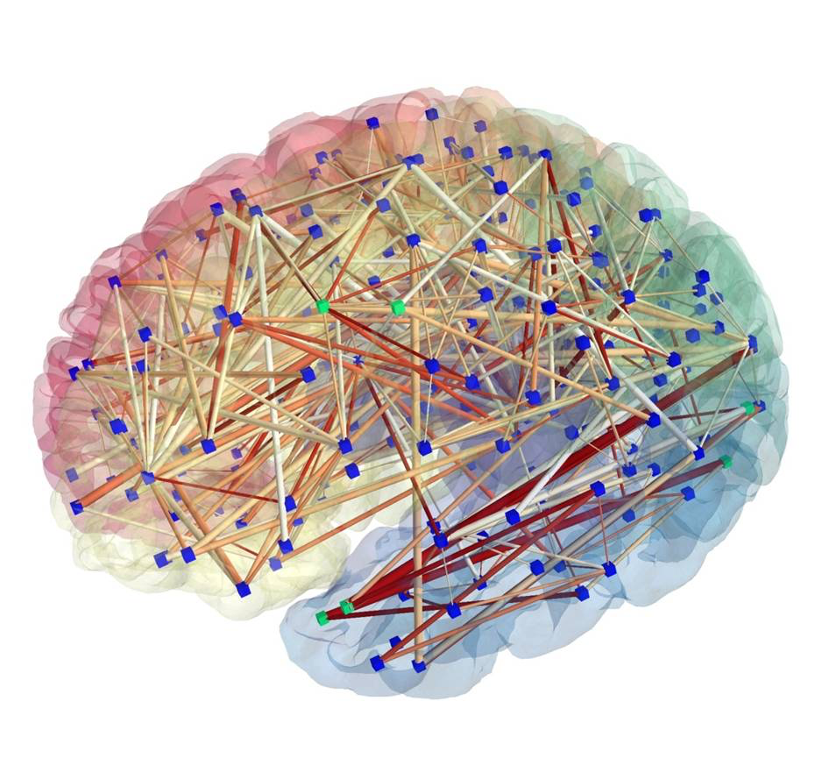
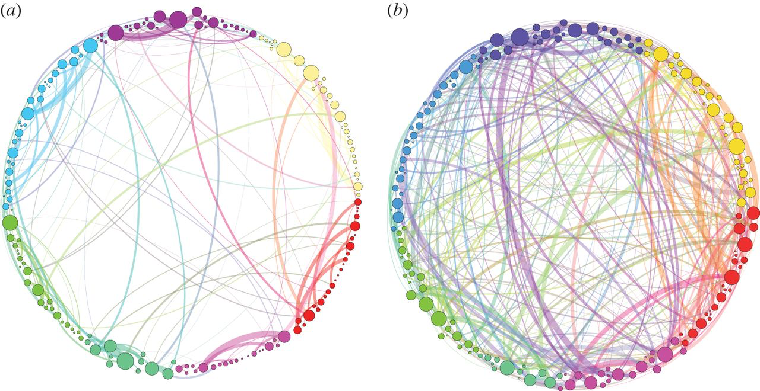
Greater functional connectivity
Homological scaffolds of brain functional networks, G. Petri, et al (2014)
Normal
Psilocybin
“there is an increased integration between cortical regions in the psilocybin state…
One possible by-product of this greater communication across the whole brain is the
phenomenon of synaesthesia which is often reported in conjunction with
the psychedelic state…”

Slide 14
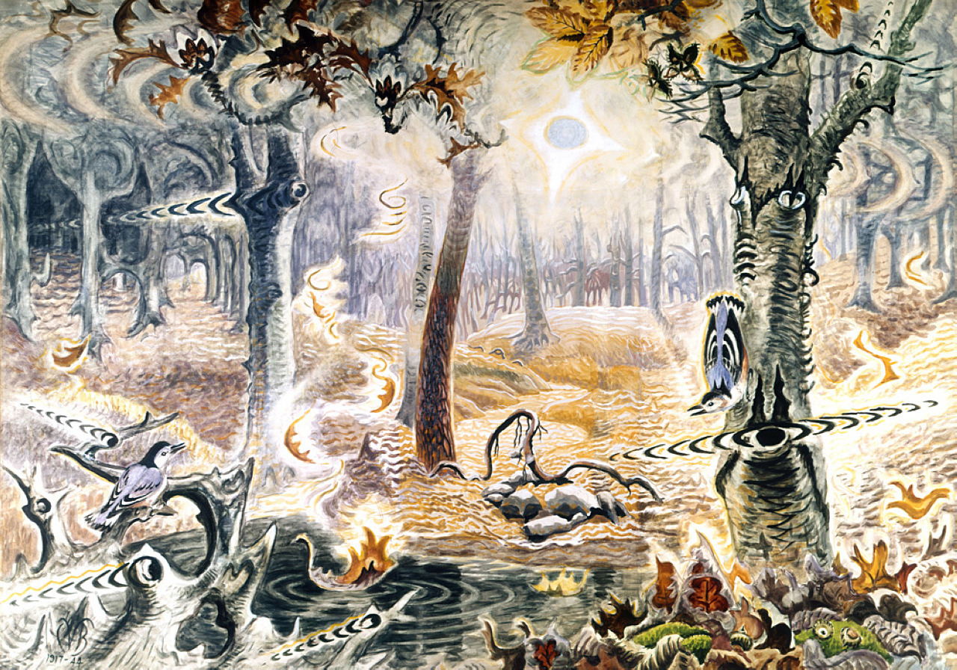
Autumnal Fantasy
Charles Burchfield (1916-1944)

Slide 15
Changes in sense of “self”
“Worse than the demonic transformations of the outer world were the alterations that I perceived in myself…Every exertion of my will, every attempt to put an end to the dissolution of my ego, seemed to be wasted effort.”
-Albert Hoffman (1948)
“The fear, as I analyze it in retrospect, was of being overwhelmed, of disintegrating under a pressure of reality greater than a mind, accustomed to living in a cozy world of symbols, could possibly bear.”
- Aldous Huxley, “The Doors of Perception” (1954)
“Who am I?”
- Solomon Snyder, “Drugs and the Brain”

Slide 16
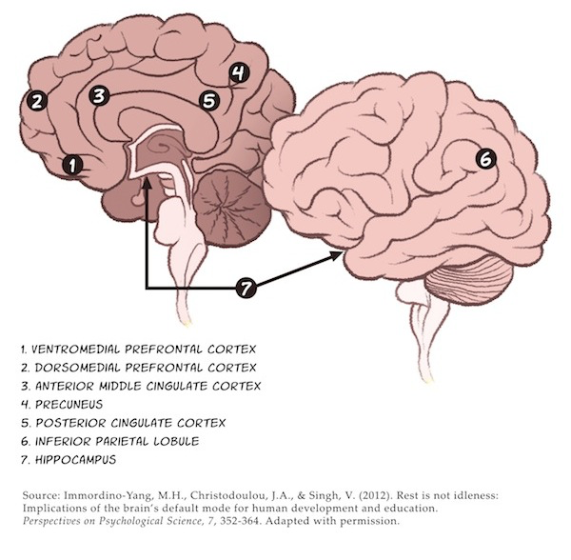
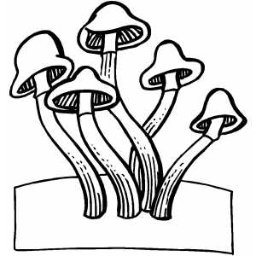
“Default mode” network
Critical for…
Self-reflection
Self awareness
Rumination
Decreased activity
on hallucinogens
(psilocybin)
Carhart-Harris et al, PNAS (2011)

Slide 17
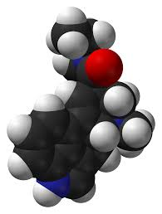
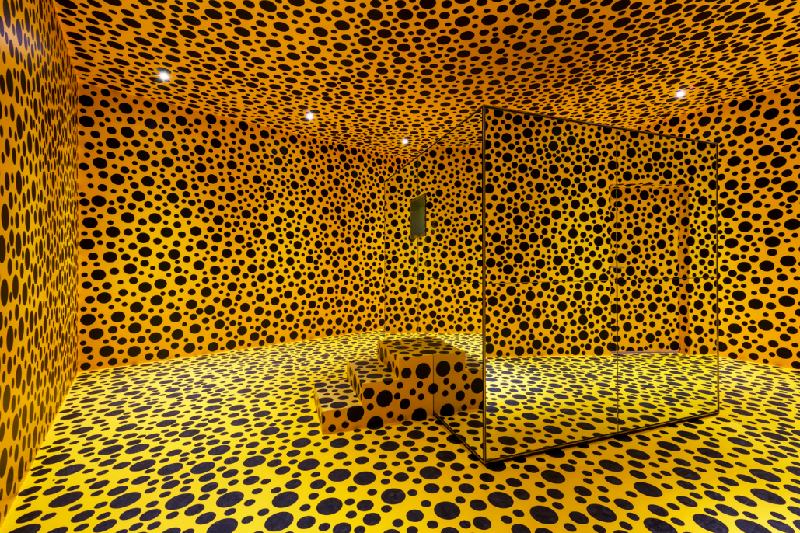
Long-lasting subjective effects of LSD in normal
subjects, Yasmin Schmid & Matthias E. Liechti (2017)
Abstract
Rationale Lysergic acid diethylamide (LSD) and other
serotonergic hallucinogens can induce profound alterations of
consciousness and mystical-type experiences*, with reportedly
long-lasting effects on subjective well-being and personality.
* Perceptual changes and changes in the sense of “self”
Re-orientation to a more novel, salient outside world?
Reduced internal rumination; changed conception of “self”?

Slide 18
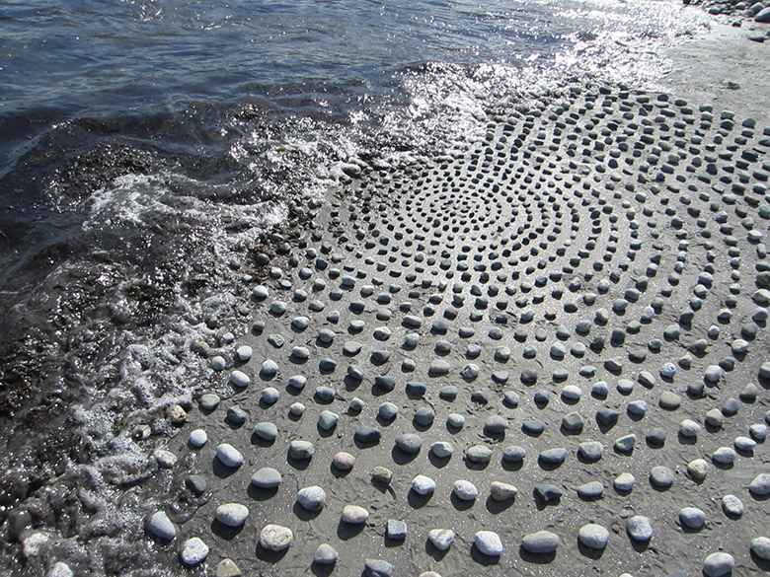
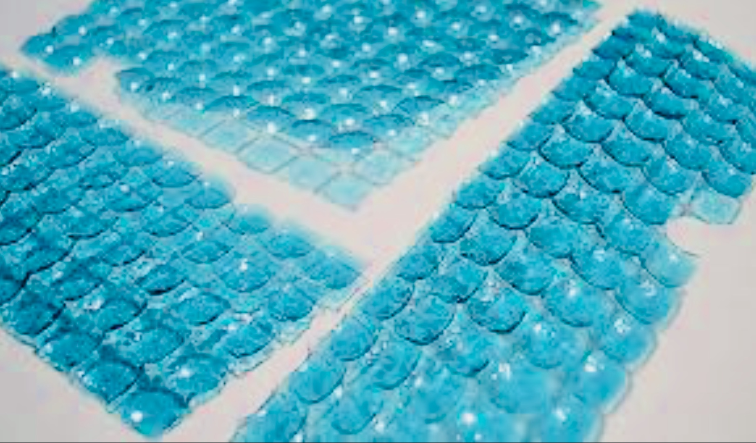
Methods
Schmid & Liechti (2017)
We investigated the lasting effects of a single dose of LSD (200 μg)…administered in a lab setting in 16 healthy participants.
“LSD in oral doses of more than 100 μg produces vivid psychosensory changes, including increased sensory perception, illusionary changes of perceived objects, synesthesia, and enhanced mental imagery. Affectivity is intensified. Thoughts are accelerated, with their scope broadened including new associations and modified interpretation and meanings of relationships and objects. Ego identification is usually weakened.” -From Gasser et al (2014)
Subjective questionnaires before, 1, 12 months after
Persisting Effects Questionnaire (PEQ), Hood’s Mysticism Scale (MS), Death Transcendence (DTS)*, NEO-Five Factor Inventory (NEO-FFI), State-Trait Anxiety (STAI)
*DTS: 25-items, based on the premise that "death is transcended through
identification with phenomena more enduring than oneself."

Slide 19
Results & Conclusions
Schmid & Liechti (2017)
Increased (@ 1 & 12 months): PEG measures of positive attitudes about life/self, positive mood changes, altruistic/positive social effects, positive behavioral changes, life satisfaction
No relevant changes in personality measures
Extremely significant and meaningful experience for subjects
Conclusions In healthy research
subjects, the administration of a
single dose of LSD (200 μg) in a safe
setting was considered a personally
meaningful experience that had long-
lasting subjective positive effects.

