Slide 1
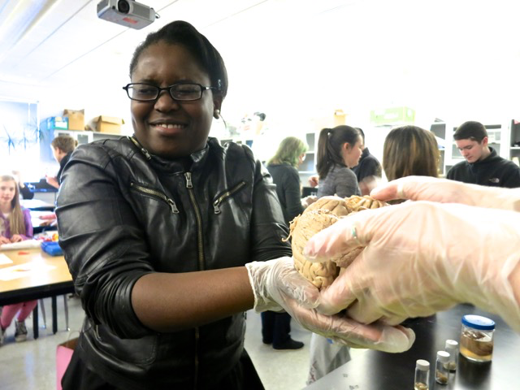
Neuroscience Outreach
Bill Griesar, Ph.D.
Instructor, Psychology, Portland State University
Affiliate Graduate Faculty, Behavioral Neuroscience, OHSU
Neuroscience Coordinator, nwnoggin.org

Slide 2
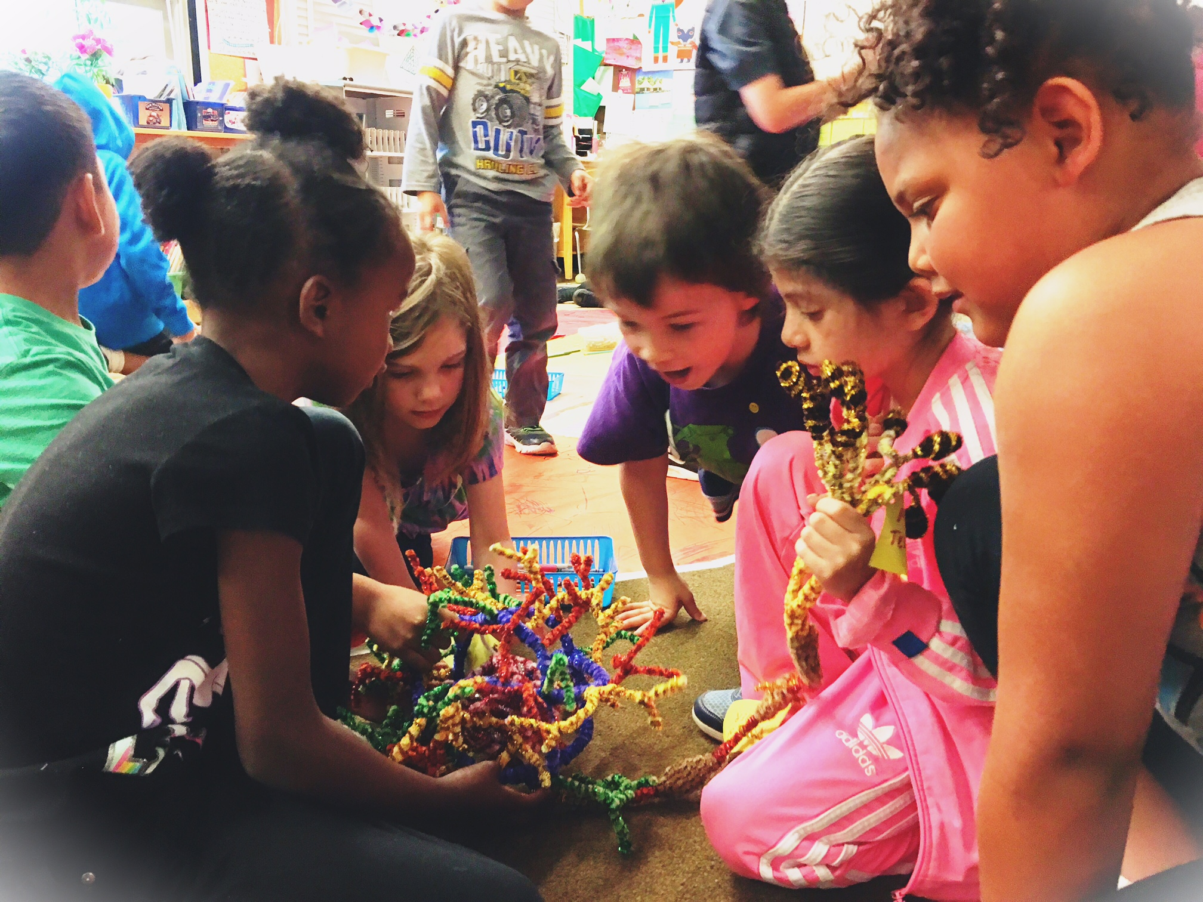
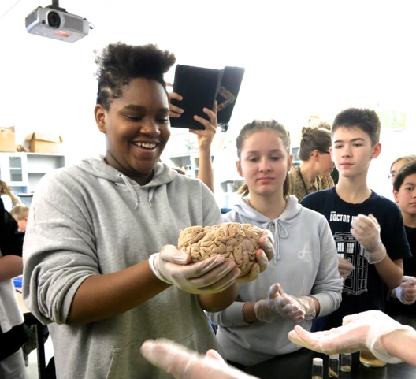
Collaboration and Connection
Improve teaching skills, confidence, creativity, employability…
Work with diverse populations of undergraduates, graduates, and academic priority K-12 students: OHSU, PSU, PNCA, WSUV, PPS, VPS…
Learn to explain concepts in neuroscience to the broader community
Build public support for taxpayer backed research efforts
Excite a new generation of scientists!

Slide 3
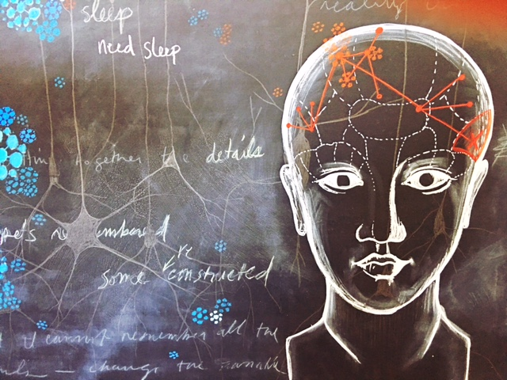
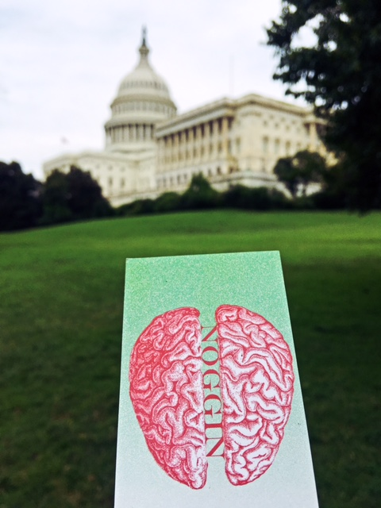
Upcoming Opportunities
School visits!
  Latino Network collaboration; Chile..?
  Noggin Calendar of Events (nwnoggin.org)
Noggin Fest October 11th
  Alberta Rose Theater
Homelessness & the Brain October 19th
  p:ear & policy makers & homeless youth
#brains2DC
  School visits during SfN (11/13 & 11/14)
  “Briefing with Brains” in Congress (11/15)
Spirit Mountain (2018)
  Native storytelling and the brain
  Lincoln County, Winter/spring 2018

Slide 4
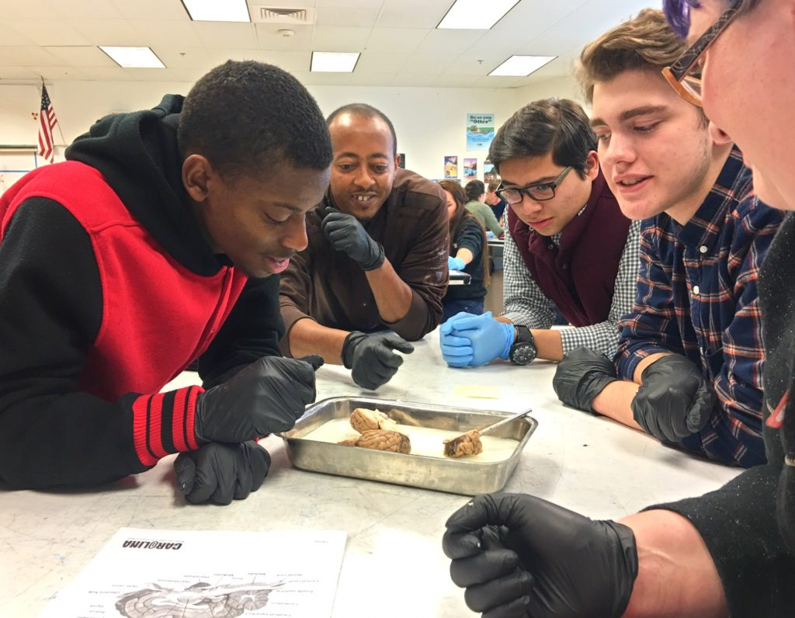
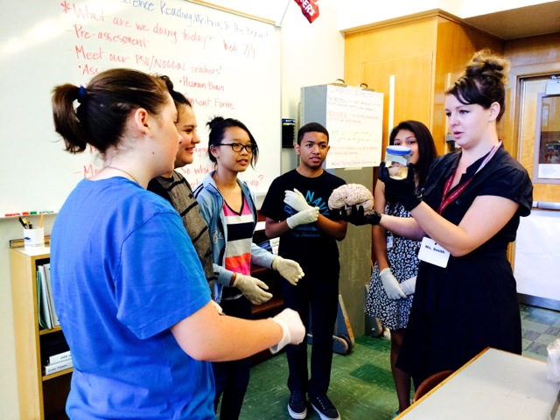
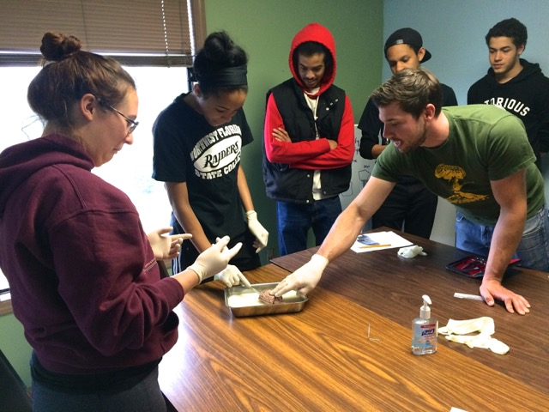
Undergraduate Teaching
BEHN 650: Teaching Practicum
Winter term @ PSU
Email: bgriesar@pdx.edu

Slide 5
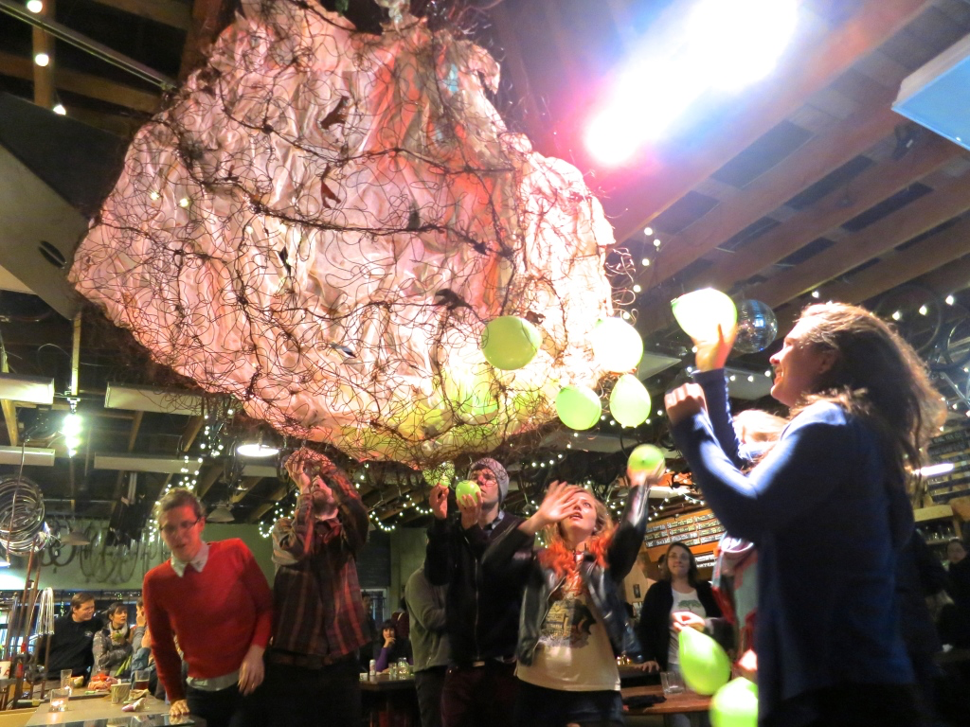
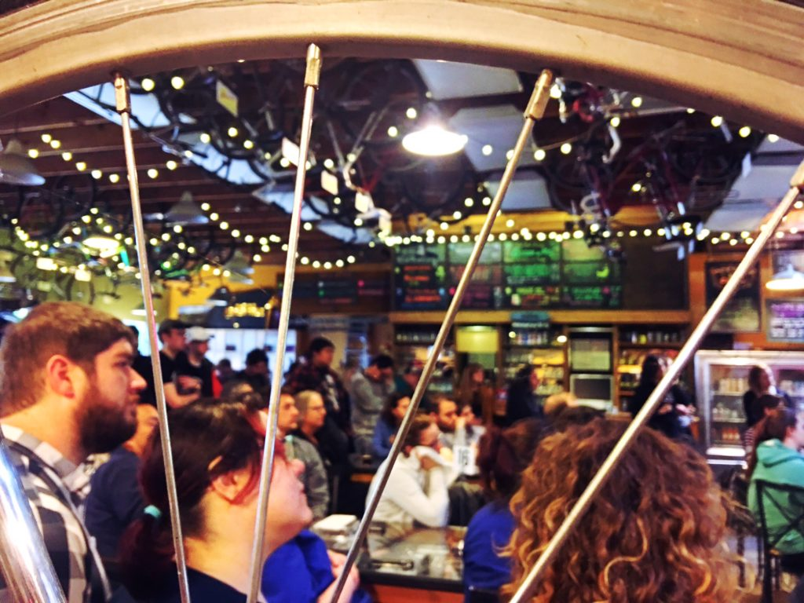
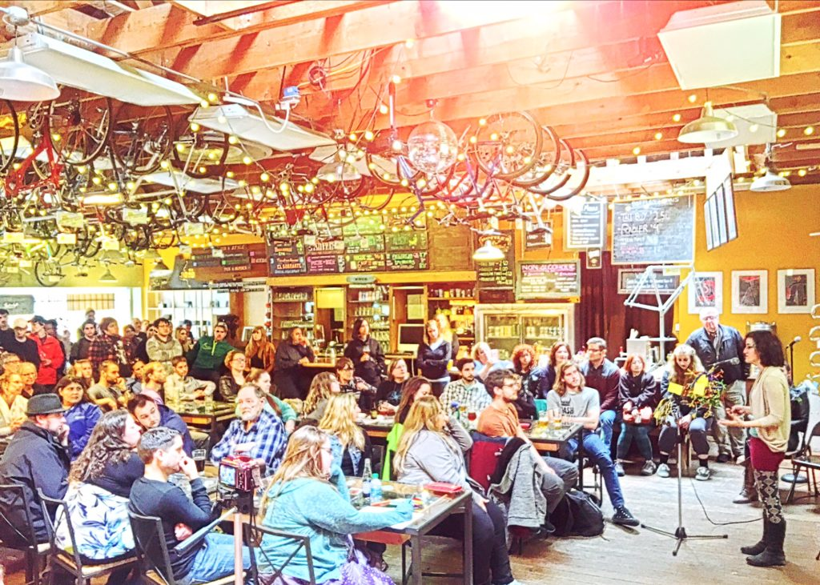
Brains, Bicycles & Beer
Velo Cult
Collaborate with creative artists and art students
Present in a unique, fun, interactive public setting
Build public support for and understanding of brain research

