Slide 1
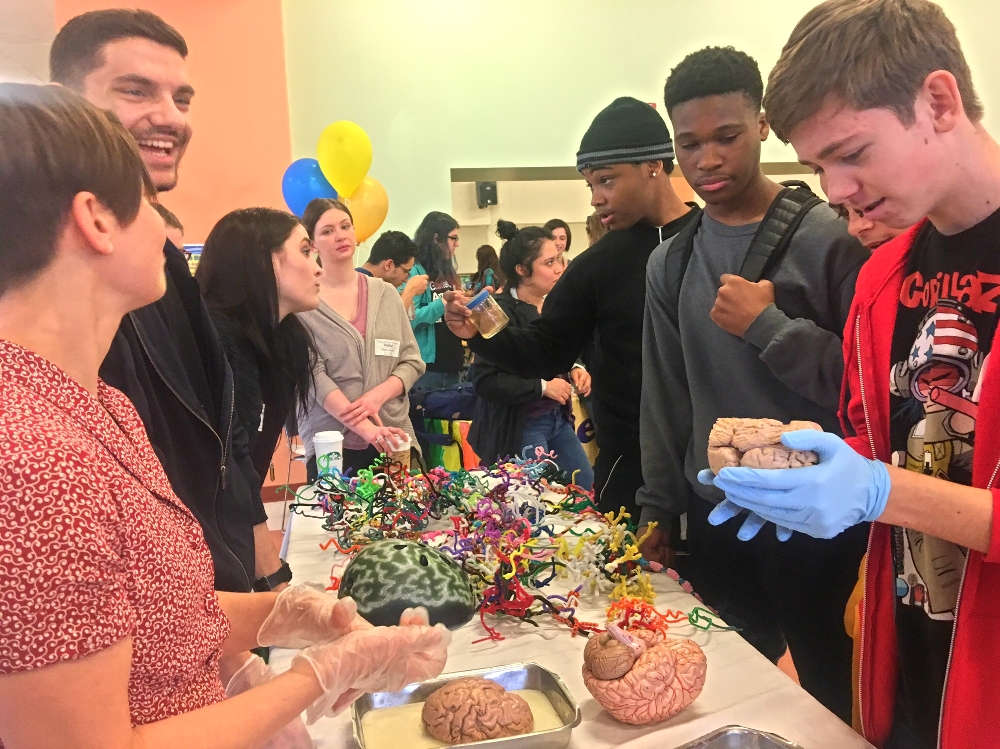
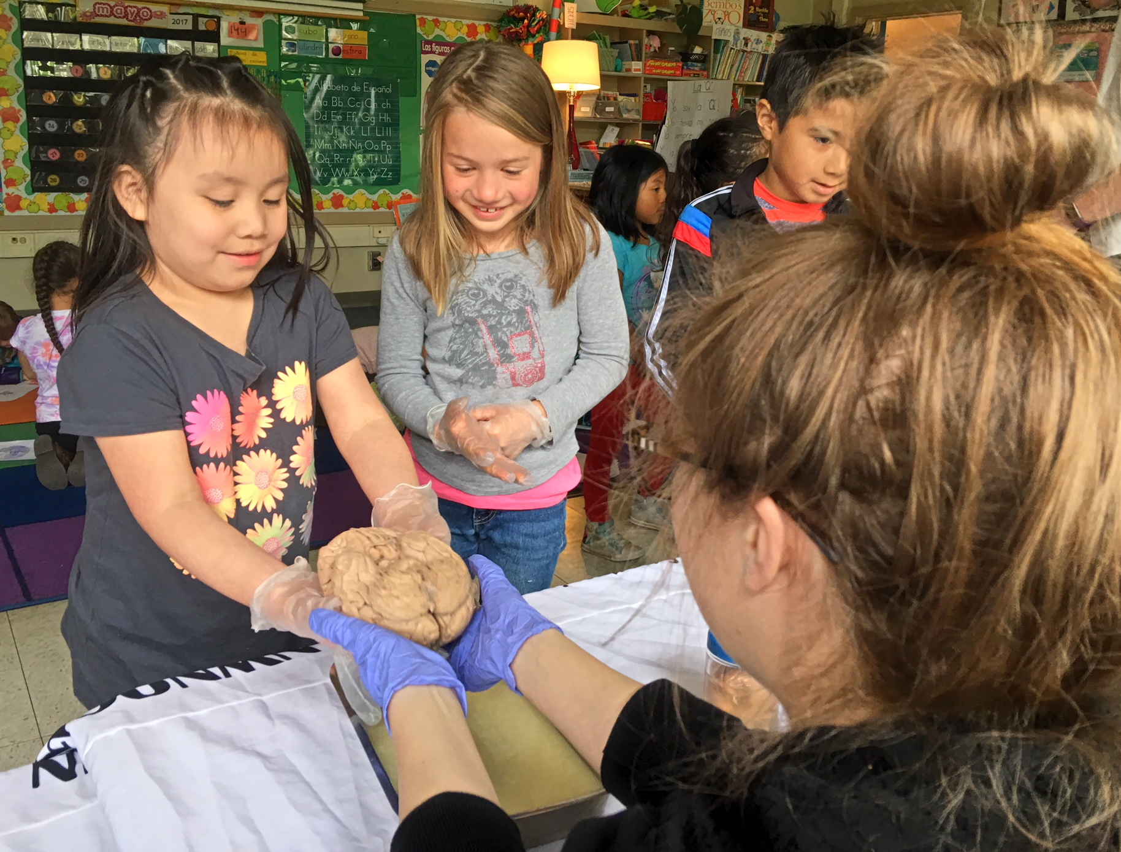
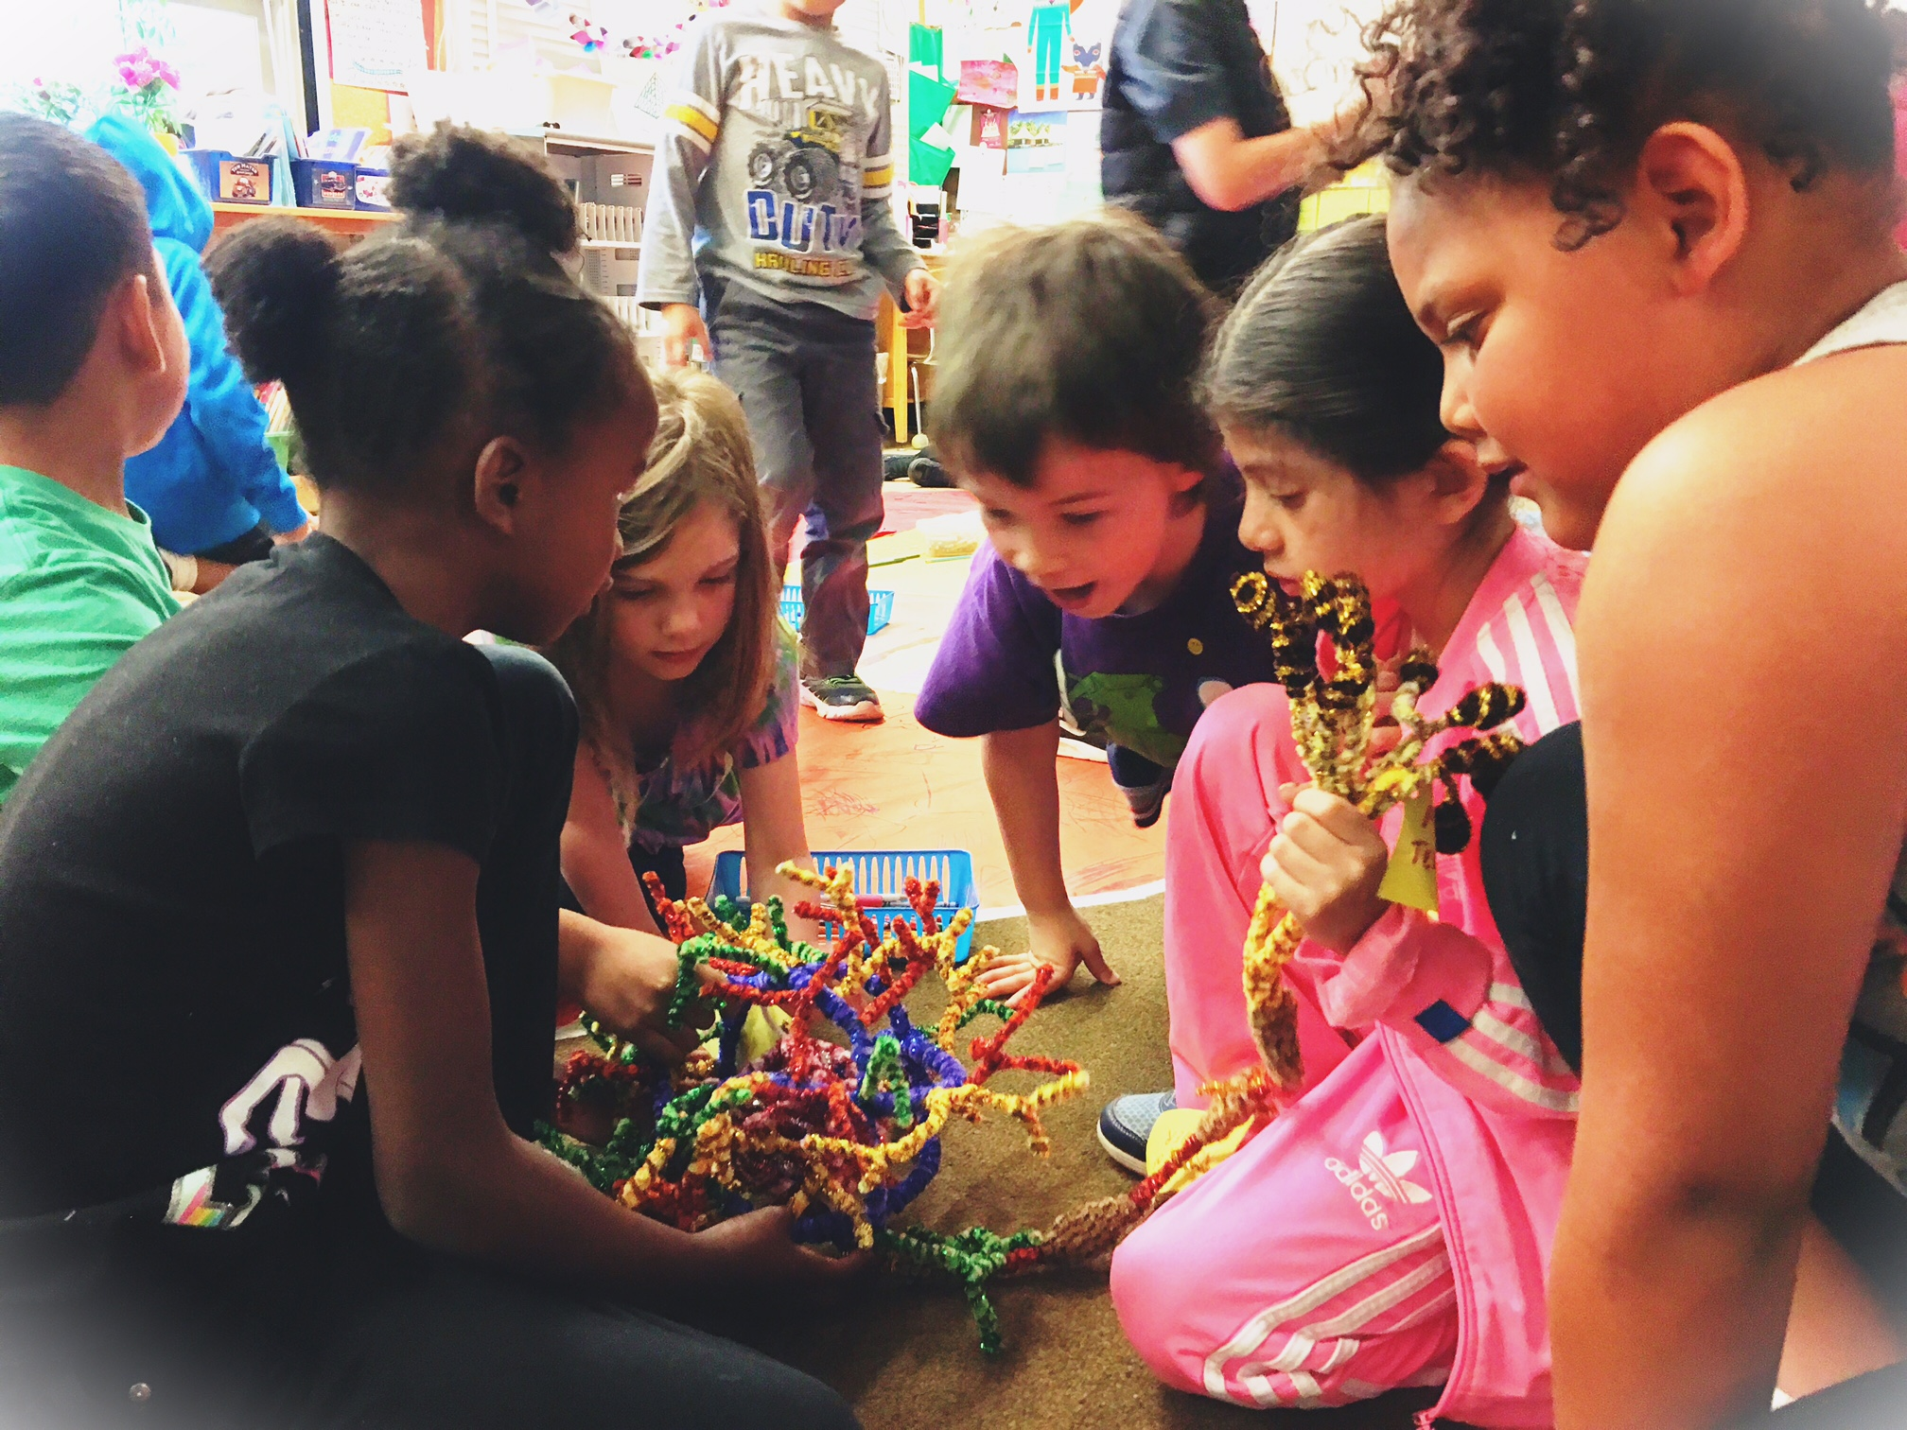
nwnoggin.org
Arts integrated neuroscience outreach for K-12 & community

Slide 2
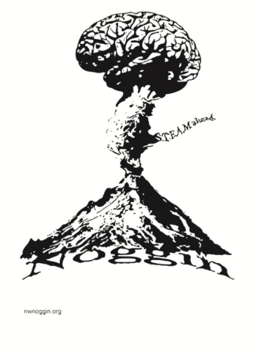
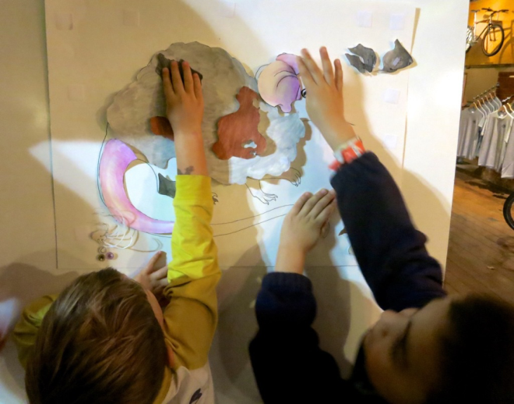
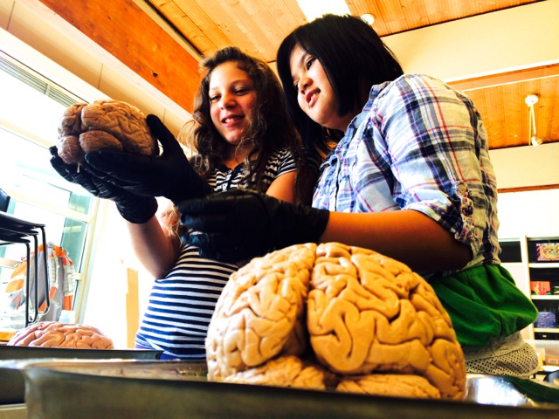
Why art - and brains..?
Motivation and engagement
Exploration, creativity, and discovery
Personal relevance of STEAM material
Internships, jobs and careers

Slide 3
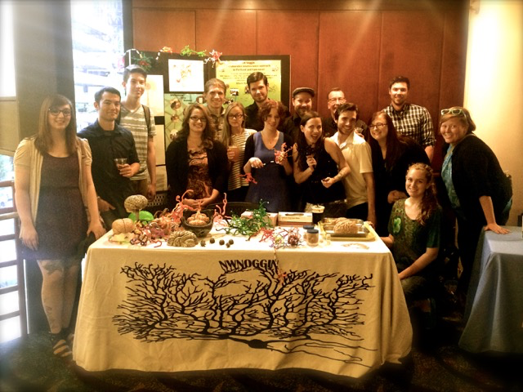
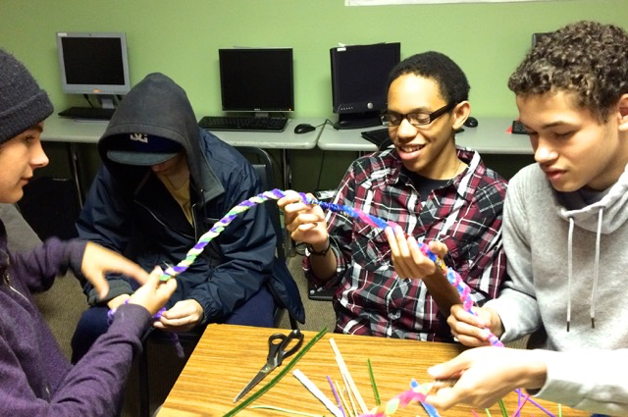
Who is involved?
Academic priority K-12 students
  Portland/Vancouver Public Schools and beyond
Art and neuroscience undergraduates
  Pacific Northwest College of Art, Portland State University.
Art and neuroscience graduate students
  PNCA, PSU, Oregon Health & Science University
Working artists and scientists

Slide 4
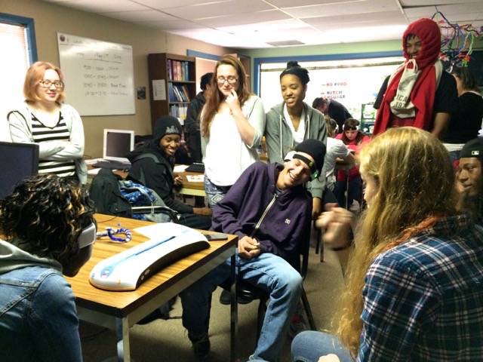
One of our primary goals is to bring this programming to people and places that might not normally have access to it.
This includes:
Primarily academic priority K-12 schools
Sitton Elementary
McCoy Academy

Slide 5
One of our primary goals is to bring this programming to people and places that might not normally have access to it.
This includes:
Bringing science to art museums
& art to science museums

Slide 6
One of our primary goals is to bring this programming to people and places that might not normally have access to it.
This includes:
Conferences, where we not only present at the conference but also visit local public schools
Linda Vista Elementary, San Diego

Slide 7
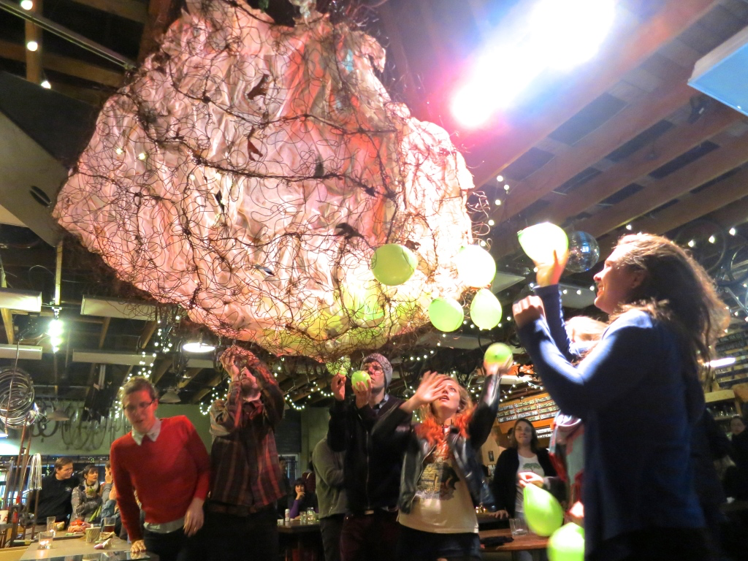
One of our primary goals is to bring this programming to people and places that might not normally have access to it.
This includes:
Public art & science presentations at bike shops, pubs

Slide 8
One of our primary goals is to bring this programming to people and places that might not normally have access to it.
This includes:
Visits to rural communities
the Northeast Oregon Area Health Education Center (NEOAHEC) in La Grande Oregon
Davenport Middle School, Davenport Washington

Slide 9
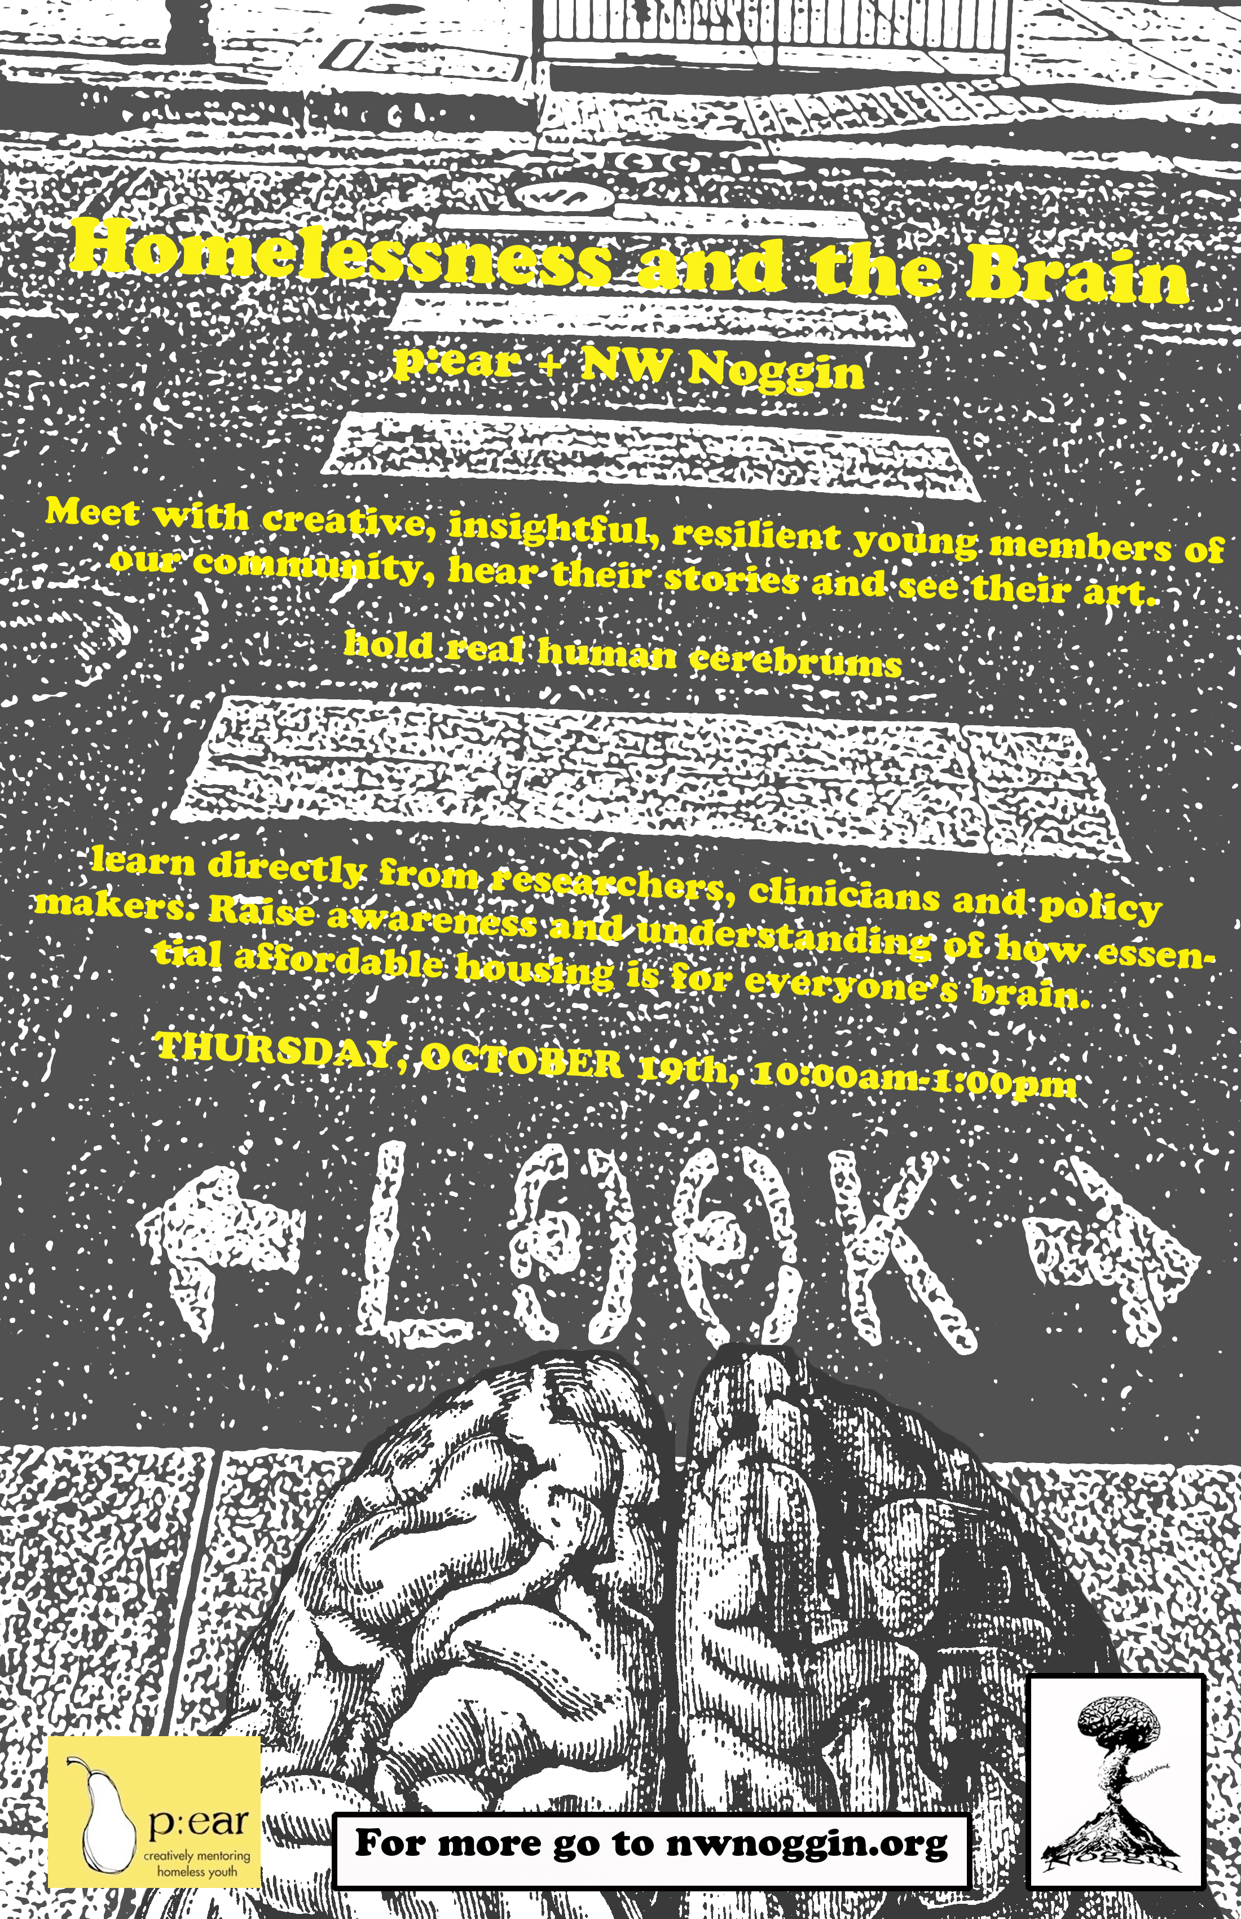
One of our primary goals is to bring this programming to people and places that might not normally have access to it.
This includes:
Homeless youth
P:ear

Slide 10
One of our primary goals is to bring this programming to people and places that might not normally have access to it.
This includes:
Congress!

Slide 11
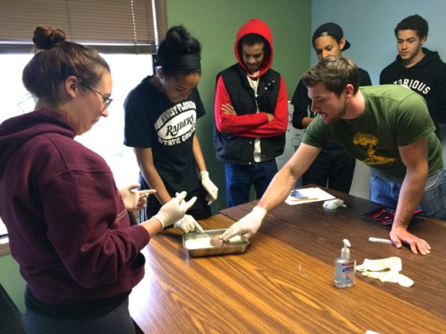
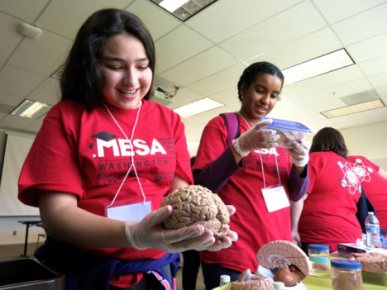

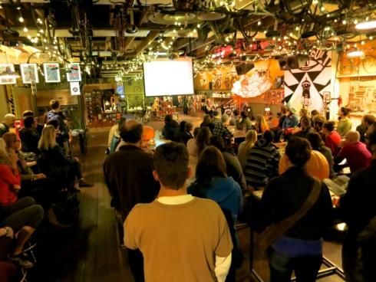
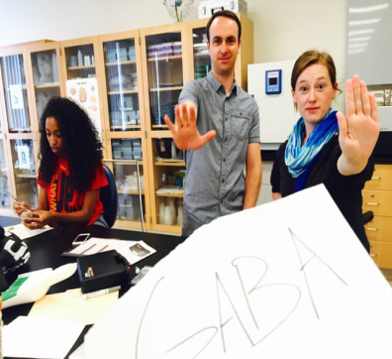
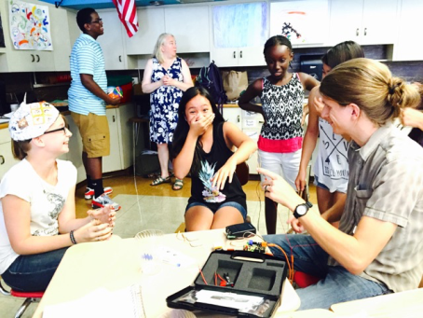
STEAM Outreach: Four types
Classroom visits
Multi-day
instruction
Public events 🍺
Programs such as MESA and SAIL

Slide 12
Why Art Integration?
It’s about how people learn

Slide 13
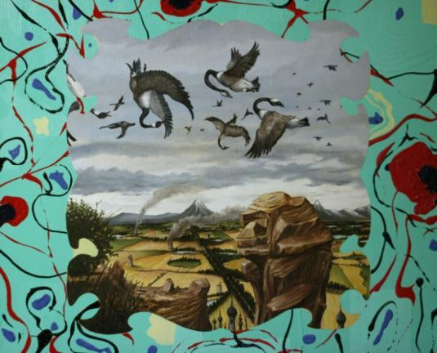
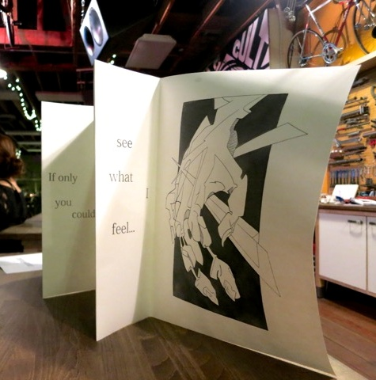
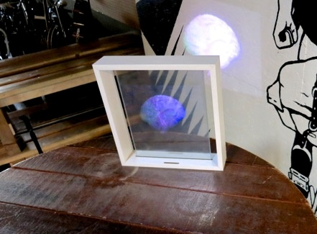
Artists and art students often reference other fields within their own work

Slide 14
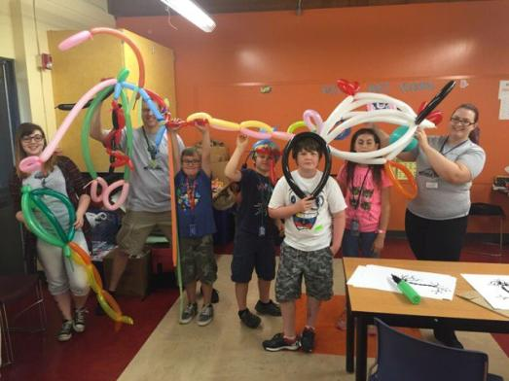
Art projects that…
Are inherently differentiated
Illustrate concepts

Slide 15
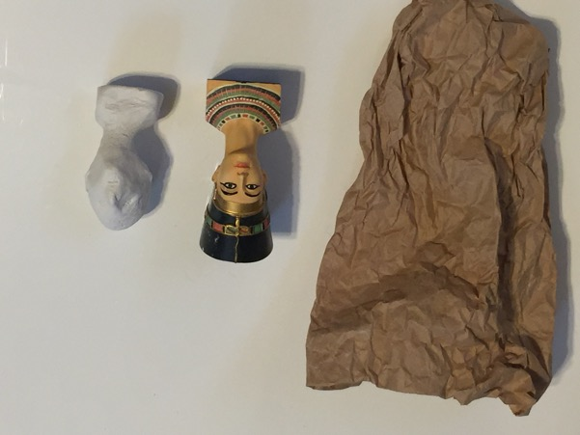
Art projects that…
Are multi-modal
Serve as examples of concepts

Slide 16
Art projects that…
Are personally relevant
Allow students
to explore a concept

Slide 17
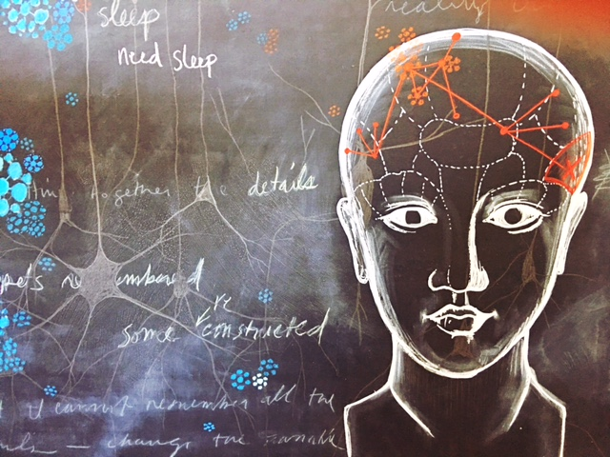
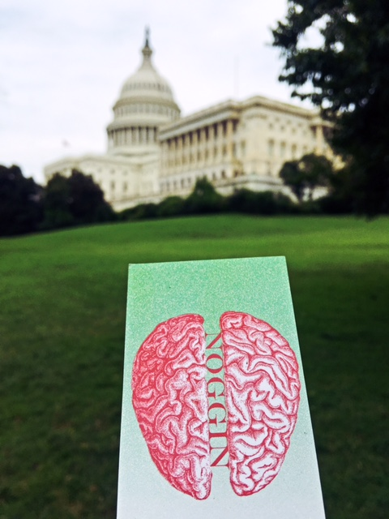
Current Events
School visits!
  Latino Network collaboration; Chile..?
  Noggin Calendar of Events (nwnoggin.org)
Noggin Fest!
  Alberta Rose Theater
Homelessness & the Brain October 19th
  p:ear & policy makers & homeless youth
#brains2DC
  School visits during SfN (11/13 & 11/14)
  “Briefing with Brains” in Congress (11/15)
Spirit Mountain (2018)
  Native storytelling and the brain
  Lincoln County, Winter/spring 2018

