Slide 1
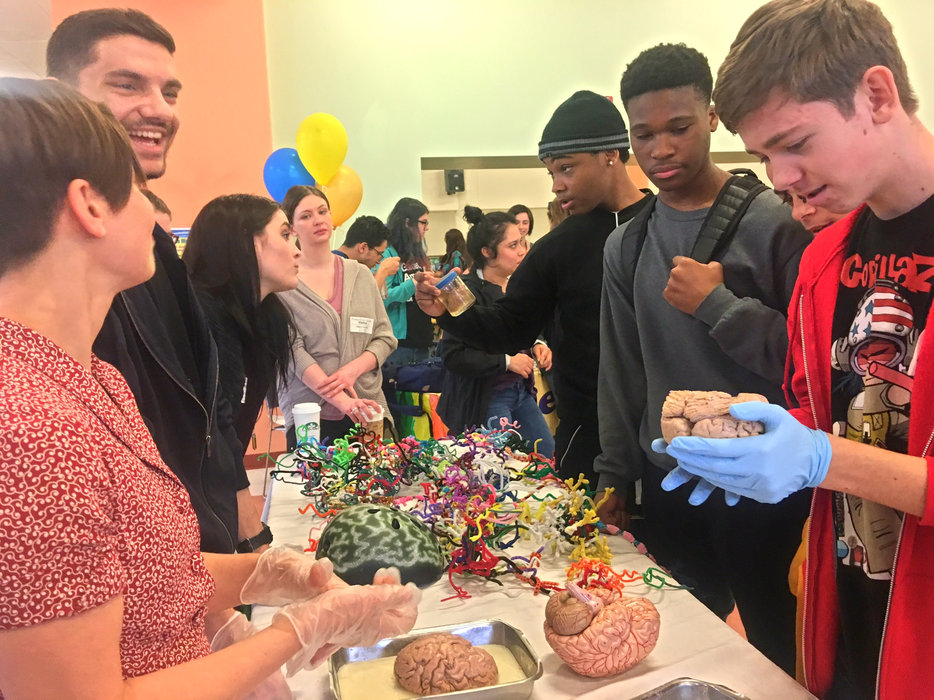
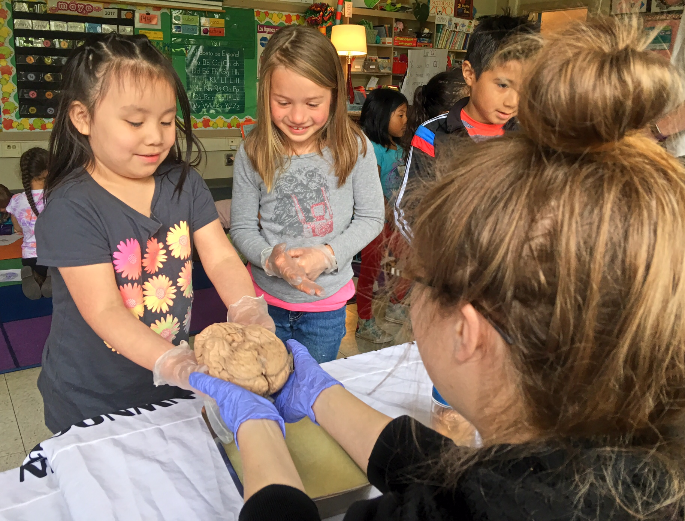
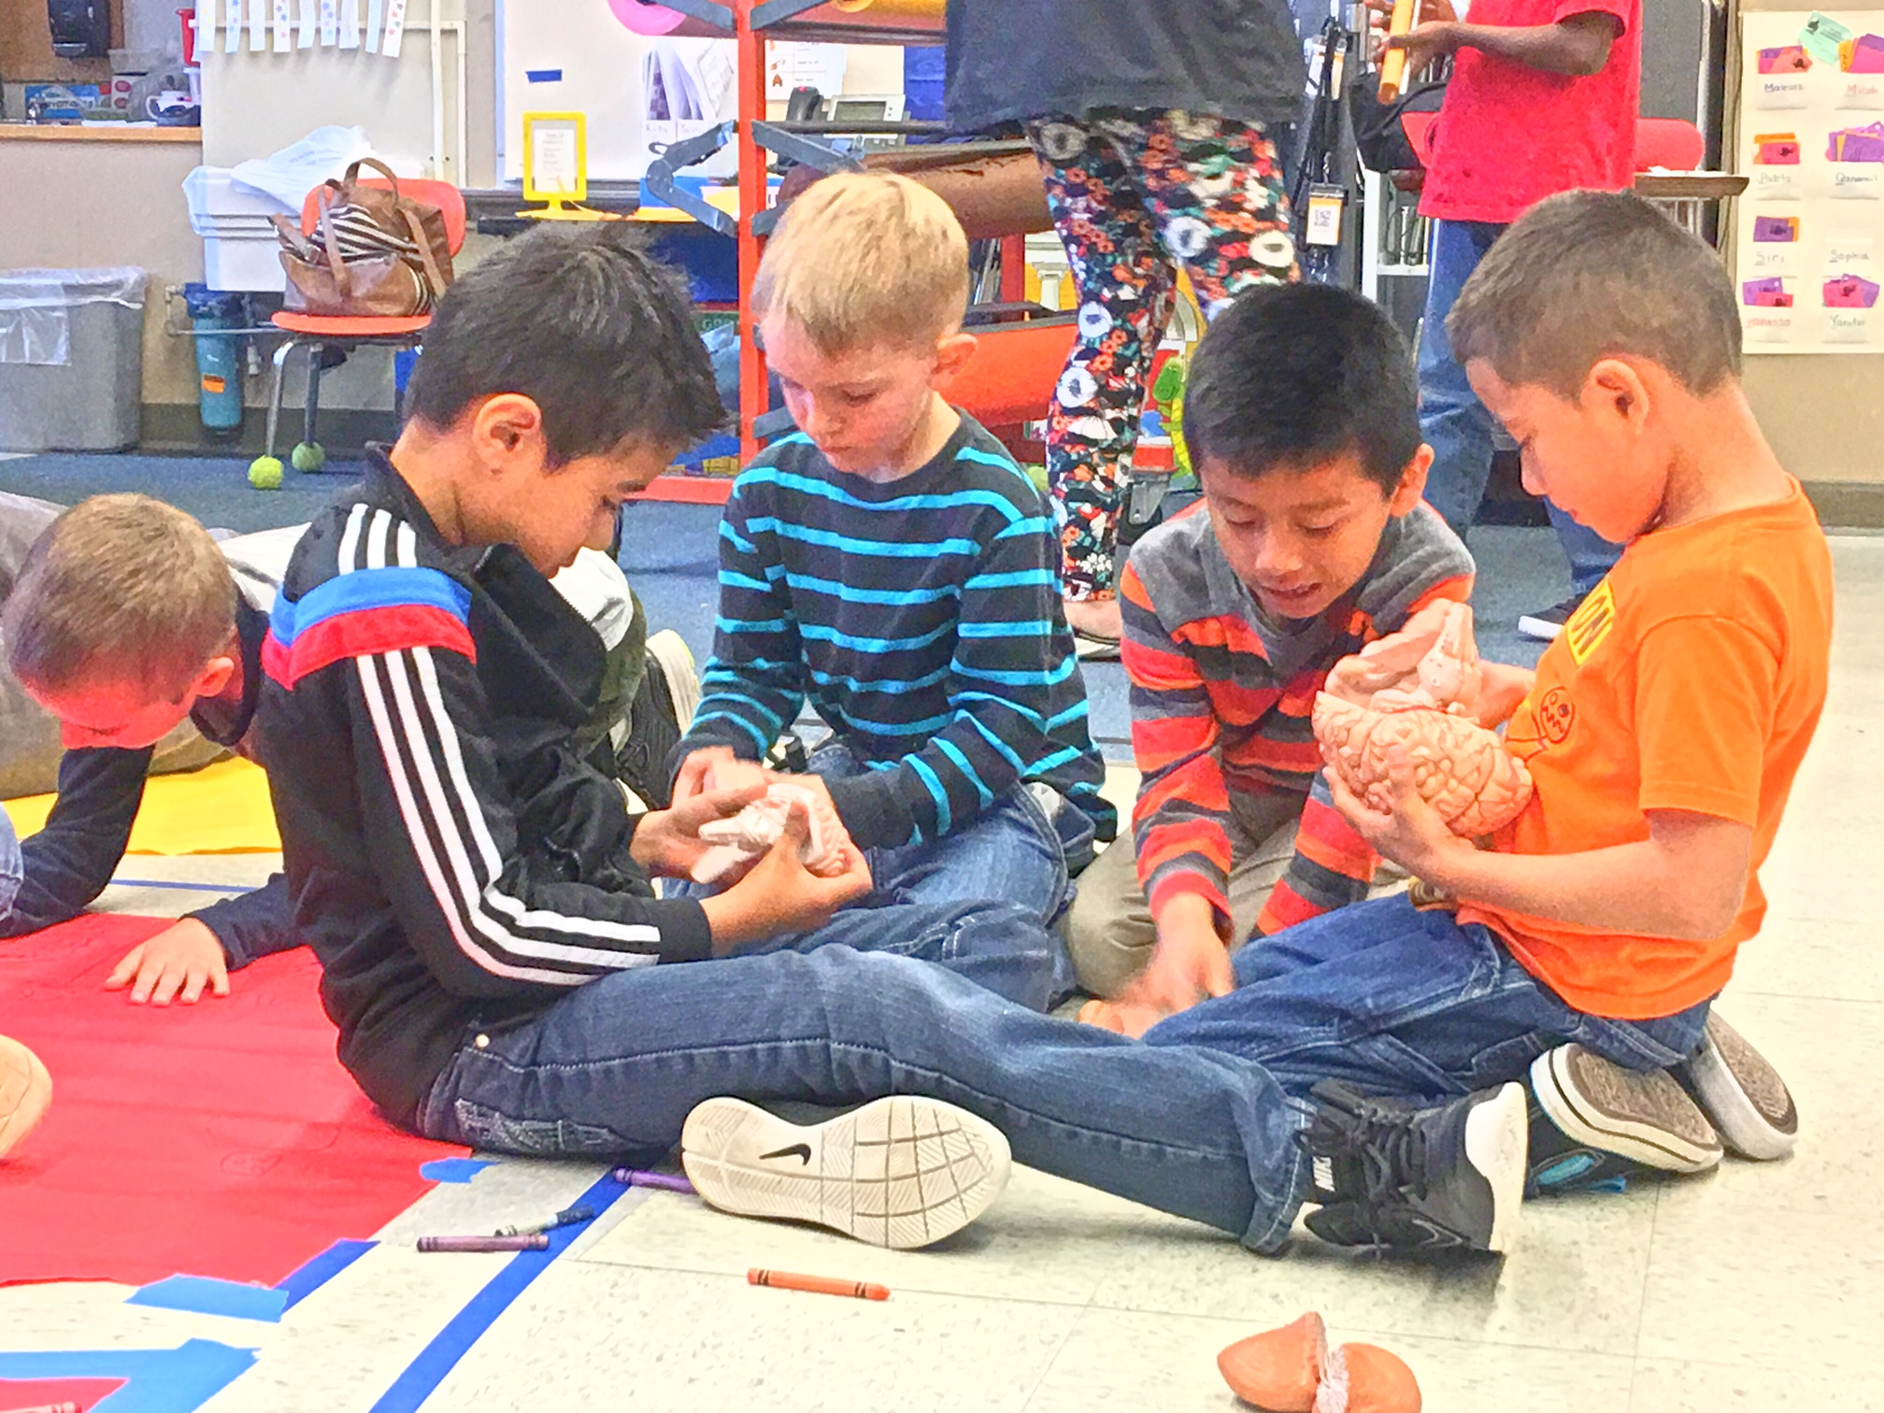
NW Noggin (nwnoggin.org)
Nonprofit!
#brains2DC
Fall 2017
Support for students

Slide 2
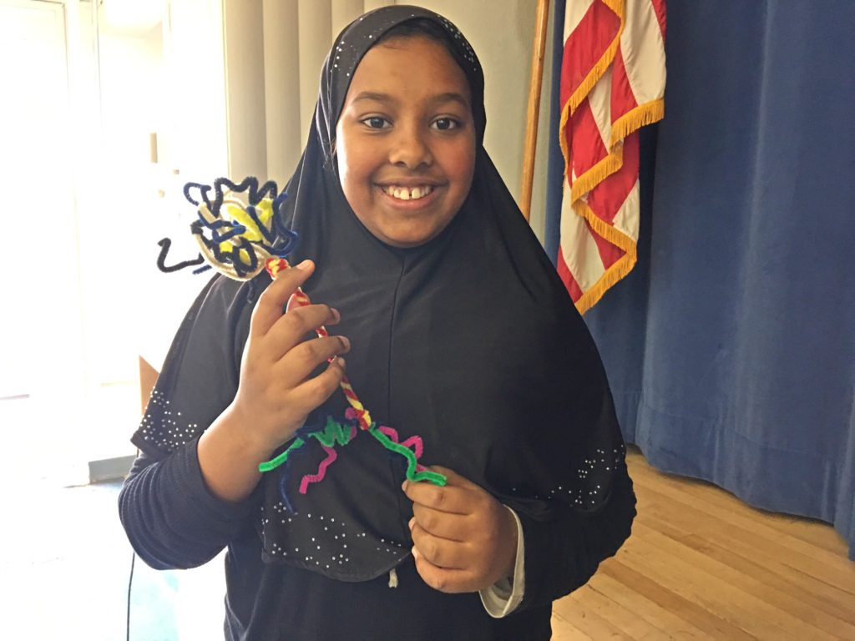
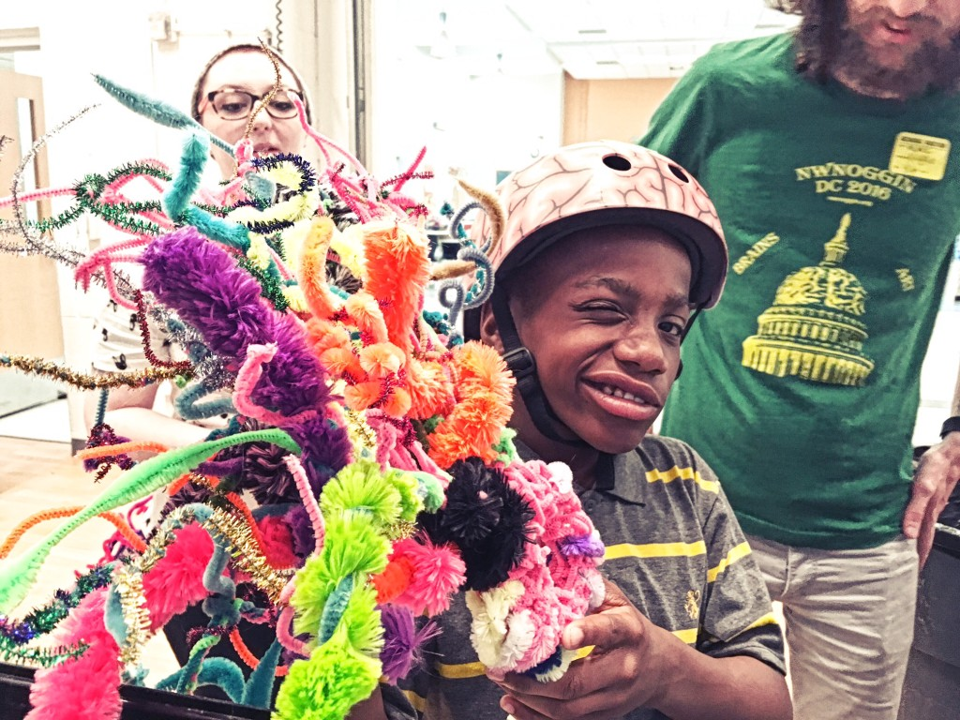
#brains2DC
Society for Neuroscience
-Fifteen undergraduates
-Plus graduate students!
-FIVE posters
School visits!!
-Academic priority
Congress
-Neuroscience/STEAM caucuses
-American Brain Coalition, SfN
-Briefing with brains, art & ice cream!
NIH Ramon y Cajal exhibit tour

Slide 3
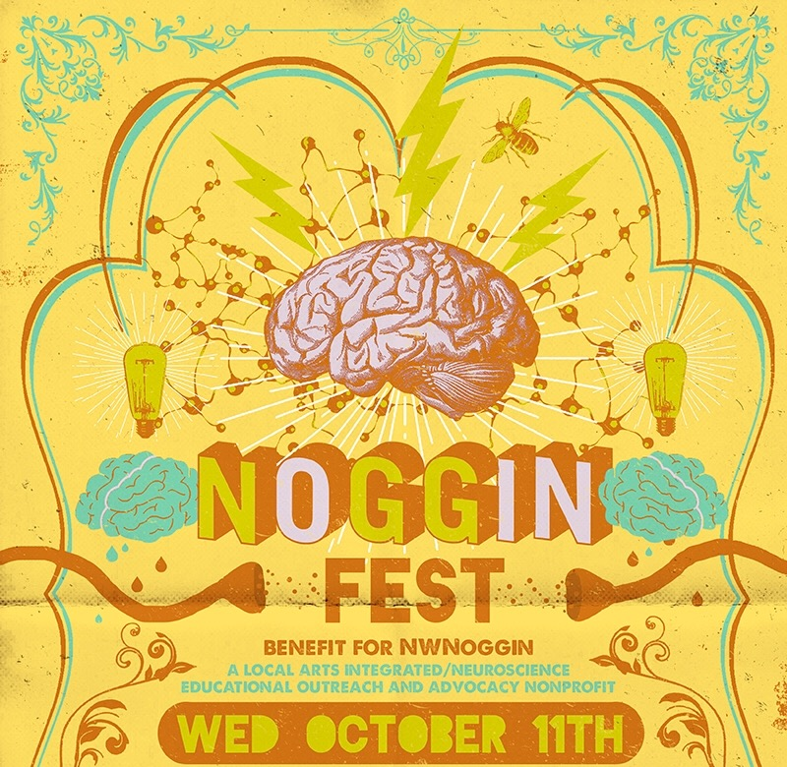
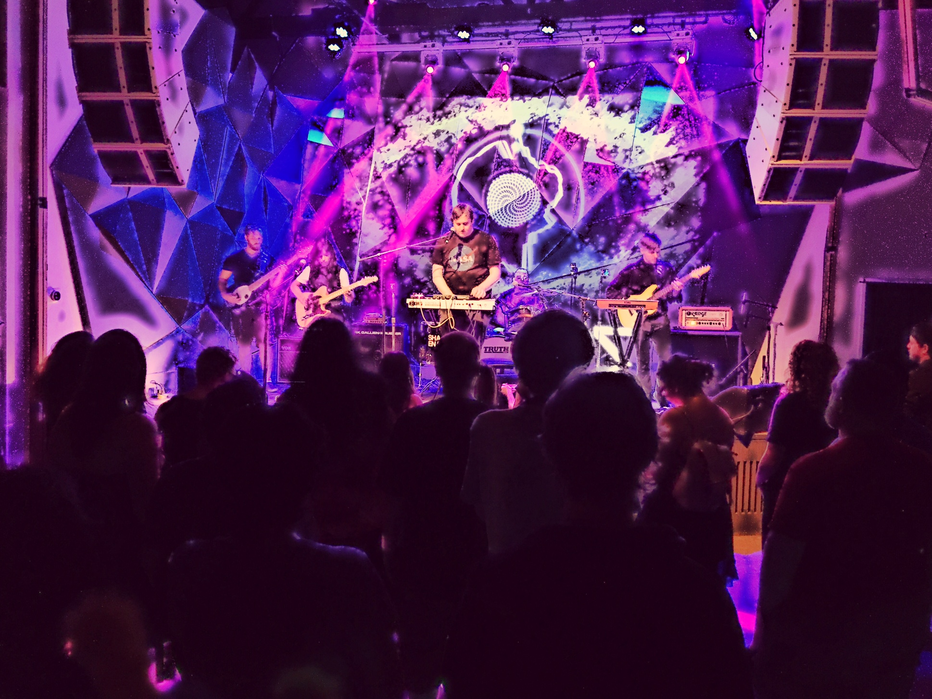
Noggin Fest!
Biggest collaborative art, music and science event in the Pacific Northwest!
Entirely student organized and student run!
Alberta Rose Theater
Wednesday, October 11
6 – 11pm

