Slide 1
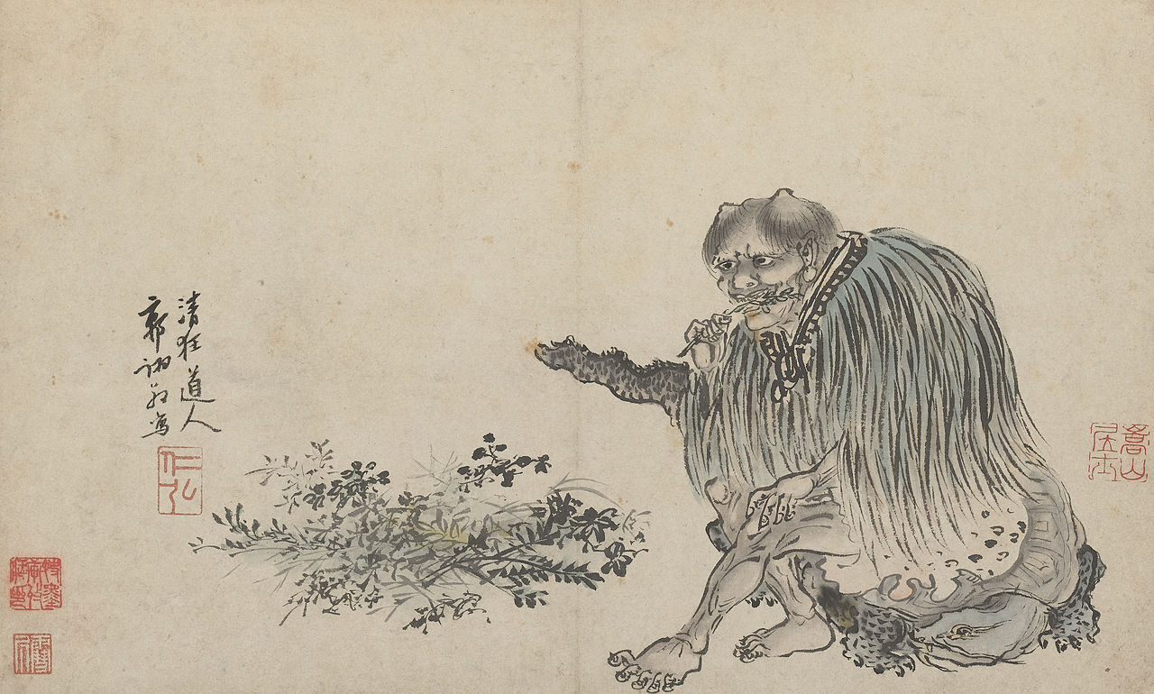
Looking at cannabis use through art
by looking at the visual history of cannabis we can tell a great deal about social attitudes, what those were in the past, how they’ve changed, and also an understanding of where our current viewpoint comes from.
Shennong as depicted in a 1503 painting by Guo Xu
Cannabis is a plant native to Central Asia that has spread all over the world
The world’s oldest stash of marijuana was found in a tomb in China. According to the Journal of Experimental Botany, the cannabis is about 2,700 years old.

Slide 2
Shennong is said to have taught the ancient Chinese not only their practices of agriculture, but also the use of herbal drugs, including cannabis.
One of the earliest recorded mentions of cannabis is medicinal

Slide 3
Middle Ages
700 BCE
1600 CE
2500 BCE
Origin
100 BCE
1000 BCE
2000 BCE
2000 BCE
1500 CE
The spread of cultivated cannabis

Slide 4
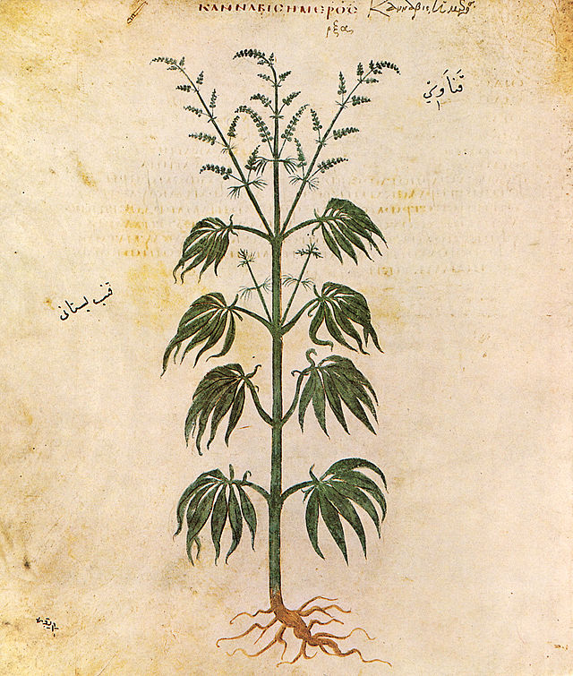
So what was cannabis used for?
Shennong reportedly recommended the use of marijuana, or “ma” as it was referred to, for over a hundred different ailments including female weakness, gout, rheumatism, malaria, constipation and even absent-mindedness.
Bhang use in India begins around 2000 BCE
70 CE Dioscorides, a physician in Nero’s army, lists medical marijuana in his Pharmacopoeia.
Apothecary jar from Egypt around 1500 BCE contained traces of cannabis
made of milk and marijuana it was used as anesthetic or anti-phlegmatic.
Egyptians Use Cannabis for Glaucoma, Inflammation, and Enemas
He suggested using cannabis to treat earache and to suppress lust.

Slide 5
In ancient Greece, cannabis is used as a remedy for earache, edema, and inflammation.
The famous Greek historian Plutarch speaks of the Thracian use of hemp and cannabis–as does Pliny the elder in in his “Natural History” written in the first century AD.
Published in 1633 by John Gerarde the Herball describes a confusing amount of cannabis plants and their potential theraputic uses including using Cannabis to Treat Depression

Slide 6
The long history of medical marijuana
200 BC - Medical Cannabis Used in Ancient Greece
In ancient Greece, cannabis is used as a remedy for earache, edema, and inflammation.
70 - Roman Medical Text Cites Cannabis to Treat Earaches and Suppress Sexual Longing
2700 BCE (reportedly) Cannabis was referred to, for over a hundred different ailments including female weakness, gout, rheumatism, malaria, constipation and absent-mindedness.
1500 - Muslim Doctors Use Marijuana to Reduce Sexuality
1213 BC - Egyptians Use Cannabis for Glaucoma, Inflammation, and Enemas
1621 - Popular English Mental Health Book Recommends Cannabis to Treat Depression
1000 BC - Bhang, a Drink of Cannabis and Milk, Is Used in India as an Anesthetic
1840 - Medical Marijuana Comes to United Kingdom via William O'Shaughnessy and Reportedly Used by Queen Victoria for Menstrual Cramps
600 BC - Indian Medicine Treatise Cites Cannabis as a Cure for Leprosy

Slide 7
What did people think of cannabis use?
1200 CE: Hashish figured prominently in several of the folk tales of 1001 nights
Greek historian Herodotus wrote detailed accounts of Scythian vapor hotbox rituals around 450 BCE.
“The Scythians take cannabis seeds, crawl in under the felt blankets, and throw the seeds on to the glowing stones. The seeds then emit dense smoke and fumes, much more than any vapor-bath in Greece. The Scythians shriek with delight at the fumes.”
In the story of the Hashish Eater a man eats hashish, makes a fool of himself, and gets thrown in jail after waking up in the morning naked and aroused in front of strangers at a public bath.

Slide 8
17th century Dutch “Genre” paintings
David Teniers the Younger, Smokers in a Tavern, 1660
Adriaen van Ostade, Two men smoking in an interior, 1660-80
Adriaen Brouwer, Smokers in a tavern, 1628-30
Hendrick Martensz Sorgh, Smoking and drinking farmers in a tavern, ca. 1650
Joos van Craesbeeck “The Smoker” 1635

Slide 9
Basho the Haiku Master writes:
The cannabis- How wonderful it is! The summer drawing room. Trees and stones, just as they are. Ah, how glorious! The young leaves, the green leaves, Glittering in the sunshine!
Shimizu Taima Shukaku “Hemp Harvest” 1929
Geisha smoking cannabis.

Slide 10
Marijuana is exotic and romantic
Men smoking hash. Published in Frank Leslie's Historical Register of the United States Centennial Exposition, 1876
At the 1876 world exhibition in Chicago, a hash bar was installed as part of the Turkish presentation.
Gaetano Previati: Las Fumadoras De Hachis. (Women Smoking Hashish, 1887)

Slide 11
Sidney Sime Illustrated “HASCHISCH HALLUCINATIONS” by HE Gowers which was published in The Strand Magazine for December 1905
“A servant brought him a cup of coffee. He says the cup seemed a huge tankard, beautifully chased all over with dragons that extended all round the world. The girl appeared to stand for an hour smiling”

Slide 12
Jazz and Marijuana
Thelonius Monk
Cab Calloway
Louis Armstrong
“We always looked at pot as a sort of medicine, a cheap drunk and with much better thoughts than one that’s full of liquor.” Louis Armstrong

Slide 13
“There are 100,000 total marijuana smokers in the U.S., and most are Negroes, Hispanics, Filipinos and entertainers. Their Satanic music, jazz and swing, result from marijuana use. This marijuana causes white women to seek sexual relations with Negroes, entertainers and any others. … The primary reason to outlaw marijuana is its effect on the degenerate races. Marijuana is an addictive drug which produces in its users insanity, criminality and death.”
-HARRY J ANSLINGER Commissioner of the US Bureau of Narcotics 1930-1962

Slide 14
In 1850 cannabis is added to the US Pharmacopeia, it listed marijuana as treatment for numerous afflictions, including: neuralgia, tetanus, typhus, cholera, rabies, dysentery, alcoholism, opiate addiction, anthrax, leprosy, incontinence, gout, convulsive disorders, tonsillitis, insanity, excessive menstrual bleeding, and uterine bleeding, among others.

Slide 15
Middle Ages
700 BCE
1910 CE
1600 CE
2500 BCE
Origin
100 BCE
1000 BCE
2000 BCE
1500 CE
The spread of cultivated cannabis

Slide 16
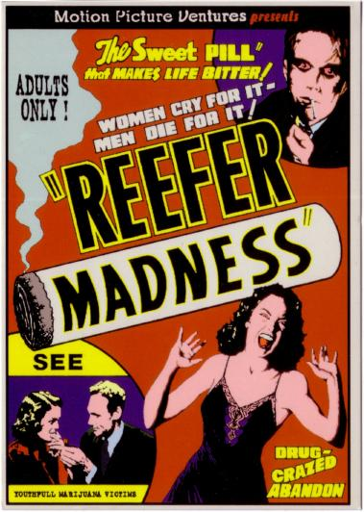
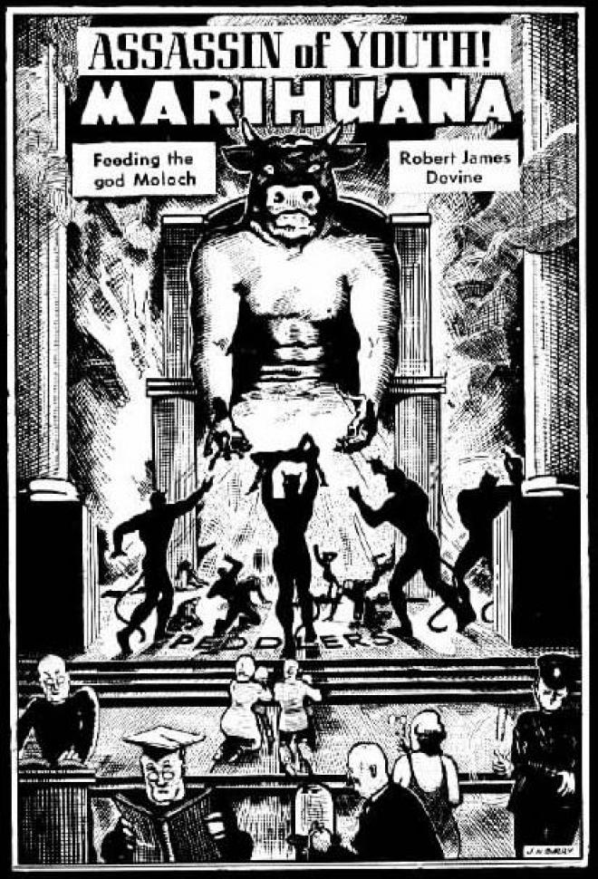
Anti Marijuana sentiment in the 1930’s and 40’s
Delusions and hallucinations
Insanity
Loss of inhibitions
Poor decision making
"How many murders, suicides, robberies, criminal assaults, holdups, burglaries and deeds of maniacal insanity it causes each year, especially among the young, can only be conjectured...No one knows, when he places a marijuana cigarette to his lips, whether he will become a joyous reveler in a musical heaven, a mad insensate, a calm philosopher, or a murderer..." HARRY J ANSLINGER Commissioner of the US Bureau of Narcotics 1930-1962
Enhanced sexual appetite

Slide 17
mortality
In books and magazines…
Uncontrollable violence
"Marijuana inflames the erotic impulses and leads to revolting sex crimes" Daily Mirror (1924)
addiction

Slide 18
Even in the 70’s and 80’s!
Marijuana is a gateway drug

Slide 19
Even today
What properties do all of these ads, books, movies etc… attribute to cannabis?

