Slide 1
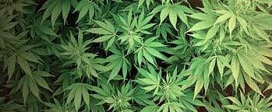
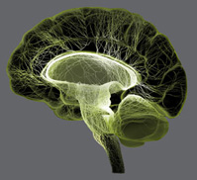
Art, Pain & Cannabinoids
Bill Griesar, Ph.D.
Neuroscience, WSU Vancouver
Psychology, Portland State University
Behavioral Neuroscience, OHSU
NW Noggin
Jeff Leake, M.F.A.
Neuroscience, WSU Vancouver
NW Noggin
Ram Kandasamy
Neuroscience, WSU Vancouver
NW Noggin
Cole Taylor Dawson
Neuroscience, WSU Vancouver
NW Noggin

Slide 2
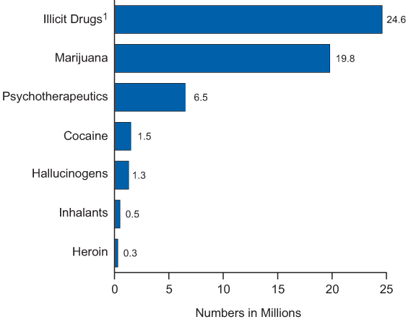
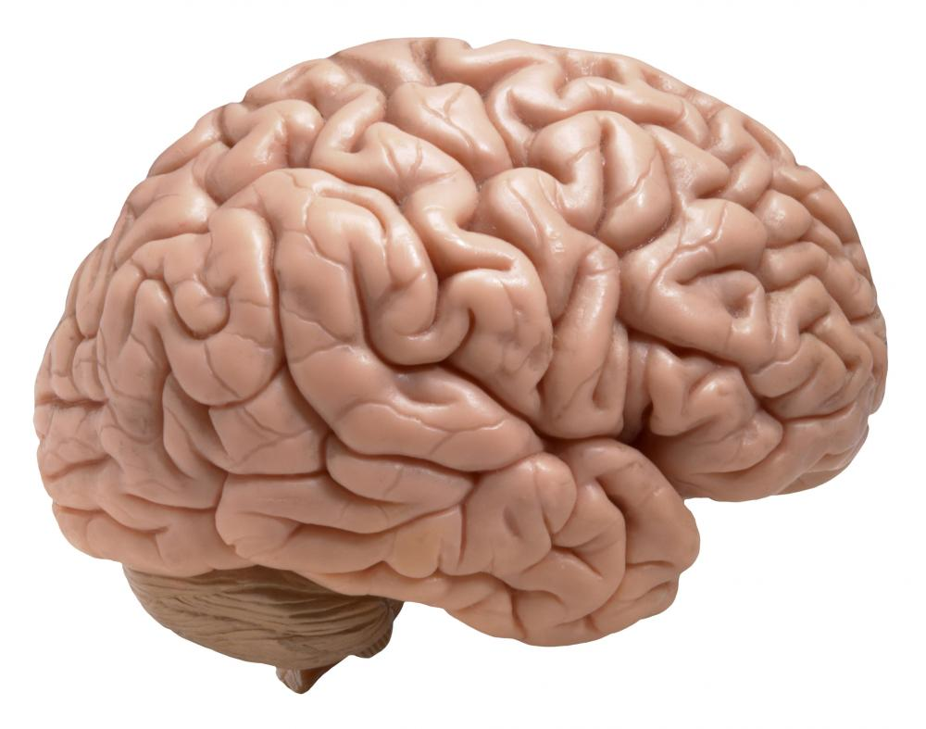
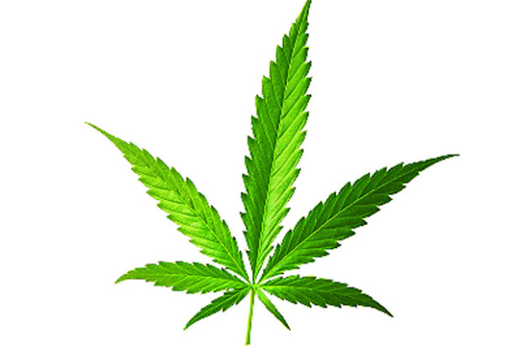
Past Month Illicit Drug Use among Persons 12 or Older: 2014
22.2
￼
The most popular “illicit” drug
18.9 million
In 2015!!
SOURCE: Substance Abuse and Mental Health Services Administration, Health & Human Services (2015)
http://www.samhsa.gov/data/sites/default/files/NSDUHresultsPDFWHTML2013/Web/NSDUHresults2013.htm

Slide 3
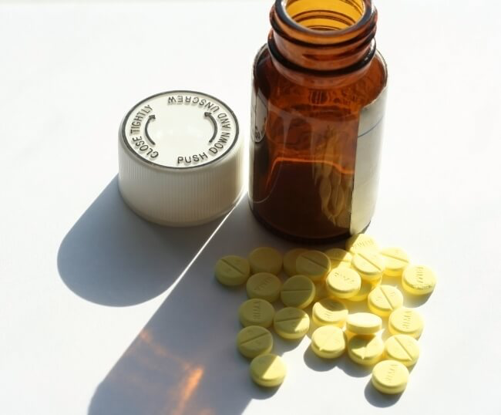
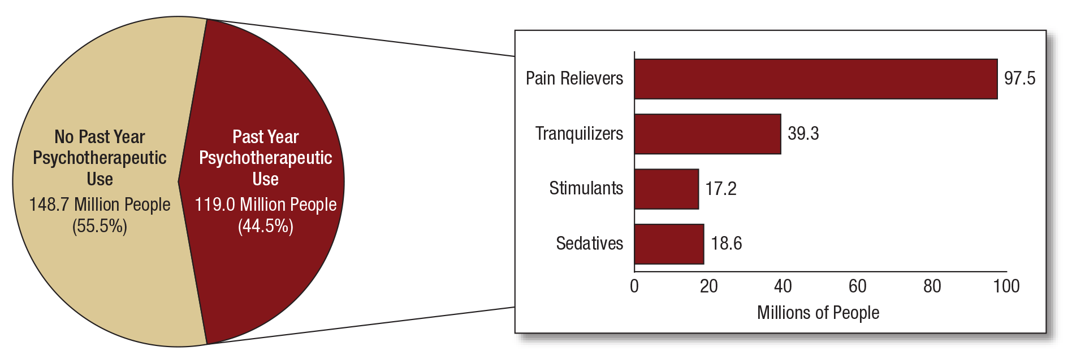
NSDUH Report on Prescription Psychotherapeutics 2015
In 2015, 119.0 million Americans
aged 12 or older used prescription
psychotherapeutic drugs in the past
year, representing 44.5 percent
of the population. (SAMHSA)
Report issued in September, 2016

Slide 4
Marijuana use in the past month among youths aged 12 to 17, by state: percentages, annual averages, 2013-2014; SAMHSA NSDUH

Slide 5
Perceptions of great risk of harm from smoking marijuana once a month among youths aged 12 to 17, by state: percentages, annual averages, 2013-2014; SAMHSA NSDUH

Slide 6
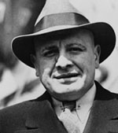
A history of demonization
Harry Anslinger, first Commissioner of Narcotics, Bureau of Narcotics
“Those who are habitually accustomed to use of the drug are said to develop a delirious rage after its administration, during which they are temporarily, at least, irresponsible and liable to commit violent crimes.”

Slide 7
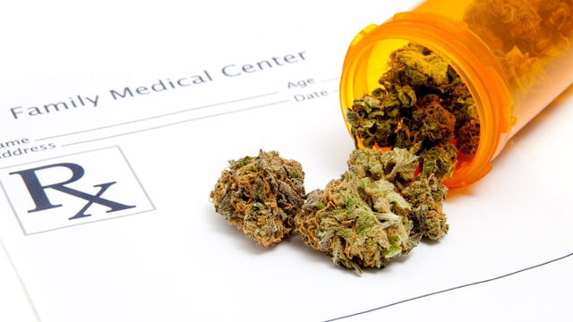
Marijuana is still a Schedule I substance
Controlled Substances Act (1970)
The drug or other substance…
1. …has a high potential for abuse
2. …has no currently accepted medical use
There is a lack of accepted safety for use of the drug…under medical supervision…

Slide 8
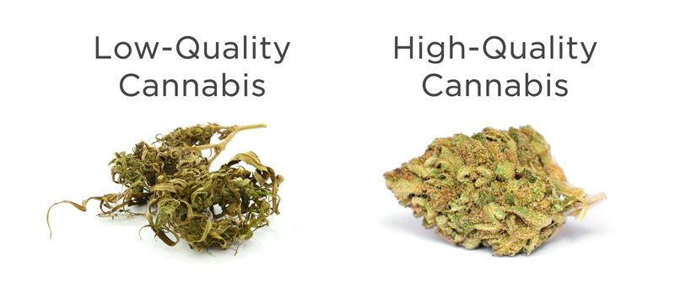
DEA Rejects Attempt To Loosen Federal Restrictions On Marijuana
SOURCE: National Public Radio, August 10, 2016
“We had them smoke it in the lab,
then studied their mood and cognition,”
recalls Dr. Hutchinson*… “And what they
told me was ‘that was disgusting, what
are you giving me? I would never,
ever smoke that stuff.’”
-Scientists Frustrated with Low Quality Weed from the Government,
https://massroots.com/blog/scientists-frustrated-with-low-quality-weed-from-government-want-dispensary-pot
*http://www.colorado.edu/changelab/dr-kent-hutchison
From August 2016: more sources now permitted for research… Up until now, the DEA only certified ONE supplier, the University of Mississippi, known for shipping freeze-dried, re-hydrated samples...

Slide 9
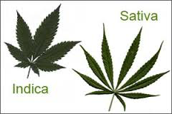
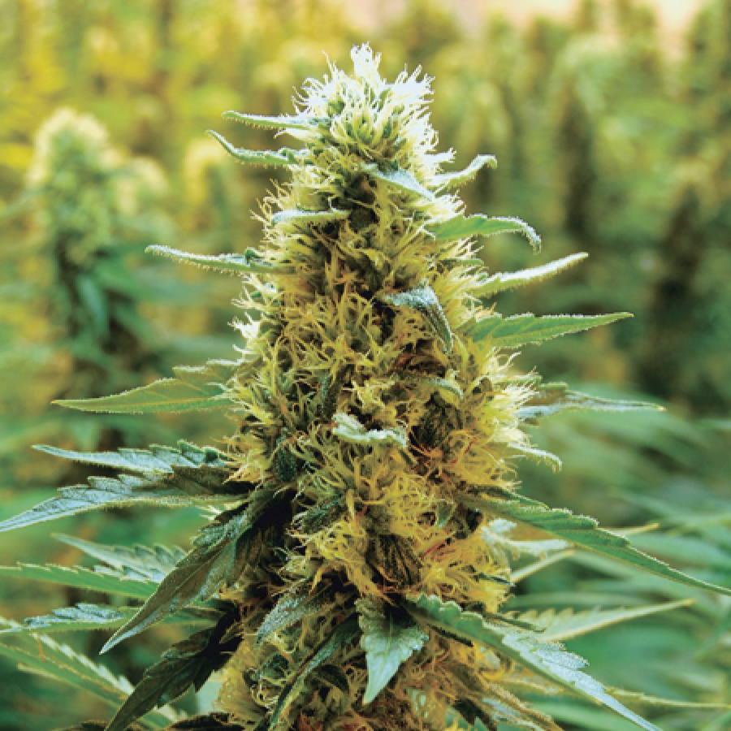
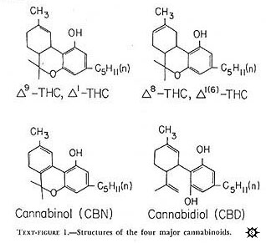
Cannabis contains cannabinoids
SOURCE: Cannabis, a complex plant: different compounds and different effects on individuals, Atakan (2012)
Indicas
Sativas
More than 80!
Concentrated in resin
Lots of variability, depending on strain, other factors…

Slide 10
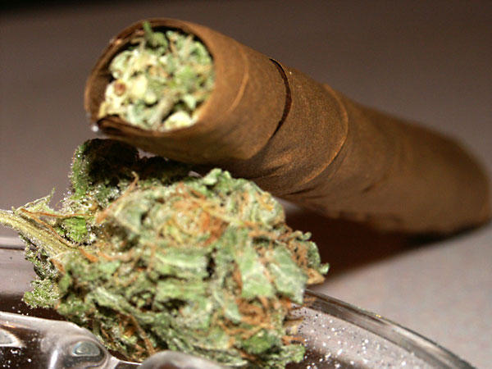
Marijuana is smoked…and eaten
Method of drug administration matters
Burning vaporizes cannabinoids, which reach the brain in seconds.
Oral administration delivers less THC, CBD, CBN, etc. more slowly…
“I strained to remember where I was or even what I was
wearing, touching my green corduroy jeans and staring
at the exposed-brick wall. As my paranoia deepened,
I became convinced that I had died and no one
was telling me…” New York Times, 6/3/13

Slide 11
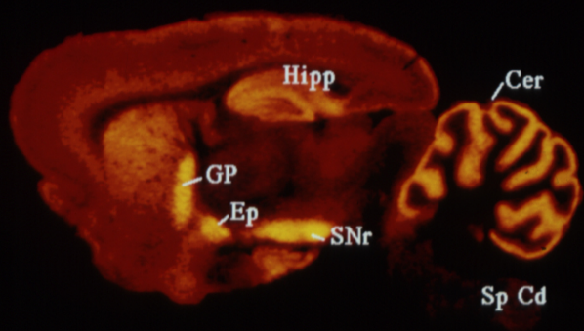
Cannabinoids act at cannabinoid receptors: CB1 and CB2
CB1 Receptors
Abundant!
Cerebellum
Basal ganglia
Hippocampus
Brainstem
Spinal cord
Neocortex
SOURCE: Herkenham et al. (1991) J. Neurosci. 11: 563
CNS expression in areas important for motor coordination, memory, nausea, decision making, pain…

Slide 12
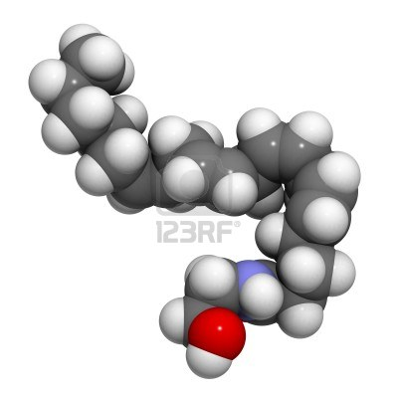
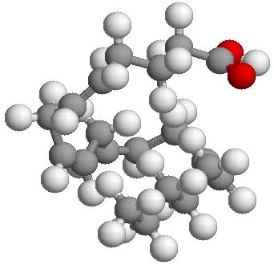
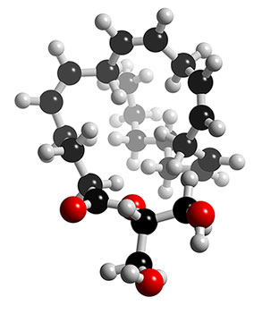
Endogenous cannabinoid neurotransmitters
If we have receptors for cannabinoids like THC, why are they there? What neurotransmitters act at these endogenous receptors..?
Anandamide
Derived from arachidonic acid,
a fatty acid found in membranes
2-AG

Slide 13
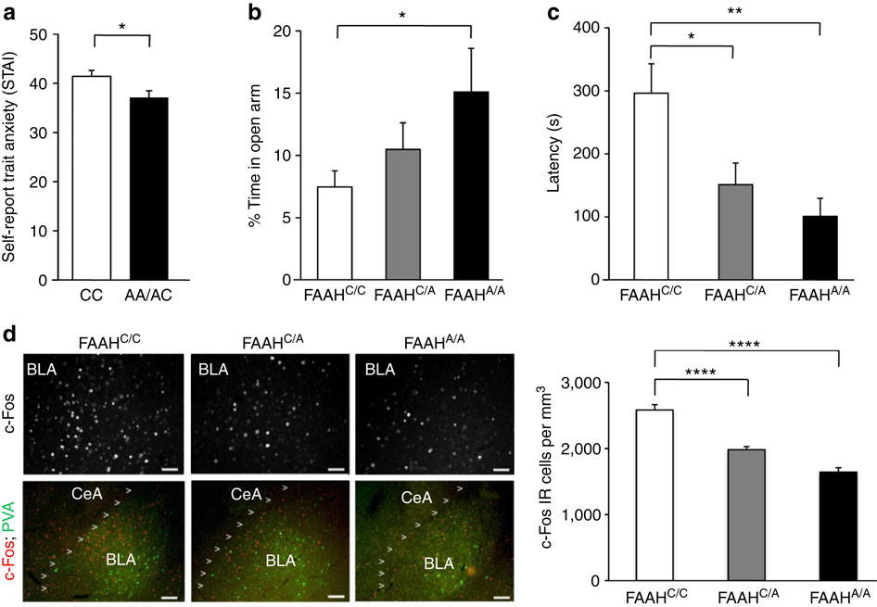
Anxiety: Genetic protection?
Decreased anxiety in humans and mice with FAAH C385A
Anandamide
Breakdown by
FAAH; several
Forms (A, C)
A less common;
Less effective at
breakdown
FAAH genetic variation enhances fronto-amygdala function in mouse
and human, Nature Communications, Iva Dincheva et al (2015)

Slide 14
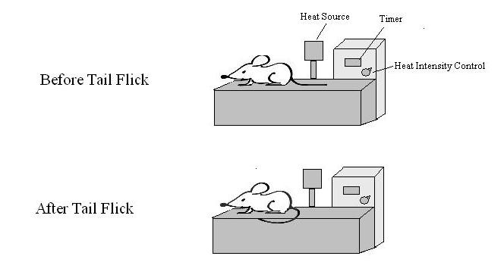
Cannabinoids reduce pain
A large body of literature indicates that cannabinoids suppress behavioral responses to acute and persistent noxious stimulation…(Walker JM, Hohmann AG, 2005)
Co-administration of
cannabinoids and opioids
allows for pain relief with
a lower opioid dose!
(e.g., Wilson AR, Maher L,
Morgan MM, 2008)

Slide 15
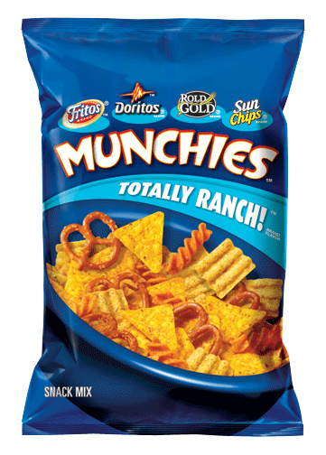
More therapeutic effects
Appetite stimulation
(e.g., Foltin, 1988; Grotenhermen, 2012)
Why is this therapeutic?
Nausea relief
(e.g., Parker et al (2011); “The anti-emetic effect of cannabinoids has been shown across a wide variety of animals that are capable of vomiting in response to a toxic challenge.” Also studies referenced by the National Cancer Institute at cancer.gov; though chronic use linked to hyperemesis syndrome; Soriano-Co M, 2010)

Slide 16
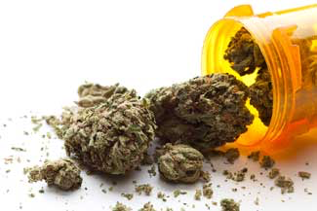
STILL MORE therapeutic effects
Multiple sclerosis
E.g., “Current status of cannabis treatment of multiple sclerosis,” Deutsch et al (2008)
Epilepsy
E.g., “The case for medical marijuana in epilepsy,” Maa (2014)
Cancer
E.g., “The combination of cannabidiol and Δ9-THC enhances the anticancer effects of radiation in an orthotopic murine glioma model,” Scott et al (2014)

Slide 17
Marijuana impairs cognition, memory, motor coordination
Deficits in acute verbal and spatial memory (e.g., Curran et al, 2002)
Deficits in working/short-term memory (Schoeler 2013)
Cannabis and alcohol both impair skills critical for driving (Sewell RA et al, 2009)
Differential effects on socialization (Atakan, 2012)

Slide 18
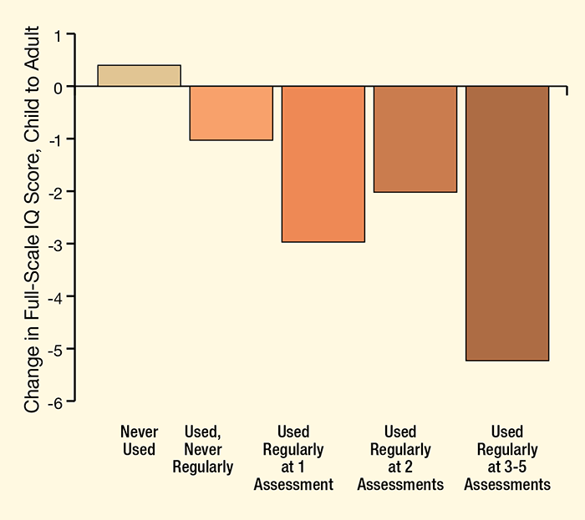
Early chronic marijuana exposure linked to decline in IQ
Regular cannabis use that starts in adolescence strips away IQ, a NIDA-supported 25-year study of 1,000 individuals suggests. Study participants who initiated weekly cannabis use before age 18 dropped IQ points in proportion to how long they persisted in using the drug, while nonusers gained a fraction of a point.
Meier, M.H. et al. Persistent cannabis users show neuropsychological decline from childhood to midlife. PNAS 109(40):E2657–E2664, 2012.

Slide 19
Risks of chronic adolescent use
Volkow et al (2014), NEJM
Cognitive impairment: IQ drop
Risk of dependence: 9% of those who experiment; 1 in 6 of those who start using in adolescence, and 25 – 50% of those who smoke daily…
Changes in functional connectivity
Increased risk of anxiety and depression, and schizophrenia/psychosis in those with a preexisting genetic vulnerability (But from Volkow article: “It is inherently difficult to establish causality in these types of studies because factors other than marijuana use may be directly associated with the risk of mental illness…”)
School performance: “Early marijuana use is associated with impaired school performance…although reports of shared environmental factors…suggest that the relationship may be more complex…”

Slide 20
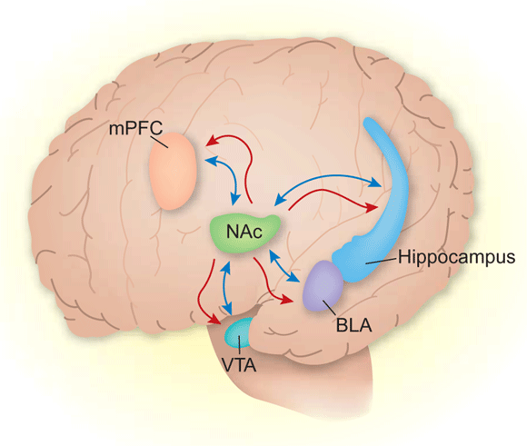
However…we’re still learning
Cannabis use is quantitatively associated with nucleus accumbens and amygdala abnormalities in young adult recreational users.
Nucleus accumbens, amygdala
are part of motivational networks
(what you seek, what you avoid…)
Gilman JM1, Kuster JK, Lee S, Lee MJ, Kim BW,
Makris N, van der Kouwe A, Blood AJ, Breiter HC.,
J Neurosci. 2014 Apr 16;34(16):5529-38 (2014)

Slide 21
But wait - which is it..?
Daily Marijuana Use Is Not Associated with Brain Morphometric Measures in Adolescents or Adults
Barbara J. Weiland, Rachel Thayer,
Brendan E. Depue, Amithrupa Sabbineni,
Angela Bryan, Kent E. Hutchison, The Journal
of Neuroscience, 28 January 2015
Same journal
Different research group
* Controlled for alcohol exposure…

Slide 22
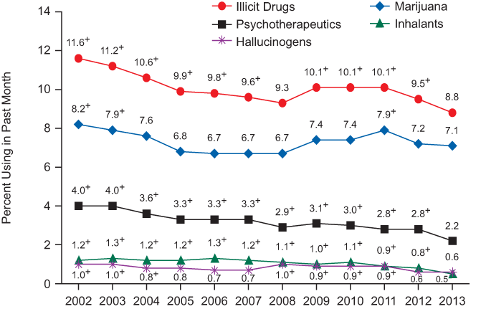
Past Month Illicit Drug Use
Youths Aged 12 to 17: 2002-2013
Substance Abuse and Mental Health Services Administration
National Survey on Drug Use and Health, 2013

Slide 23
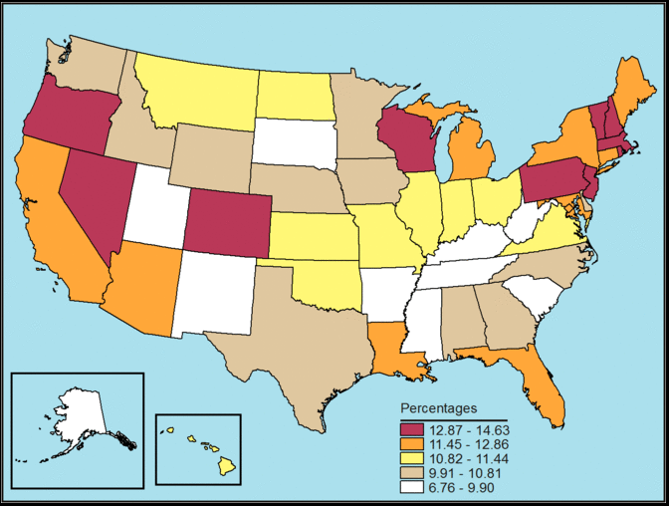
Alcohol Use in the Past Month among Youths Aged 12 to 17, by State; SAMHSA NSDUH
Percentages, Annual Averages Based on 2013 and 2014 NSDUHs

