Slide 1
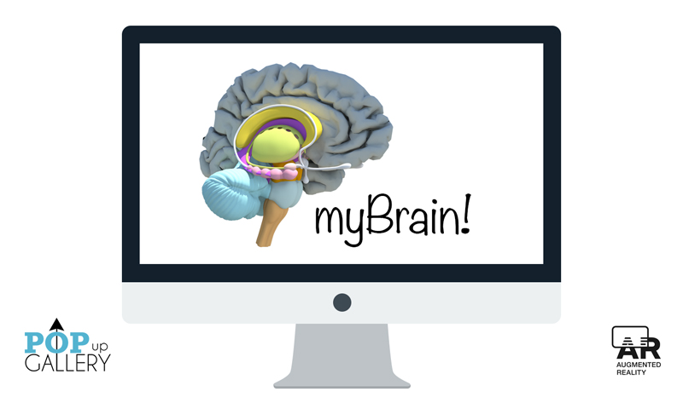
There’s an app for that!
Can neuroanatomy education
lead to lifestyle modification..?
Bill Griesar, PhD, WSUV Neuroscience, NW Noggin
Jeff Leake, MFA, WSUV Neuroscience, NW Noggin
Brittany Wouden, Multimedia Specialist,
Designer of MyNoggin & MyBrain!
Elizabeth Tremaine, Graduate Student, Psychology, PSU
James Reling, Undergraduate, Psychology, PSU
Michael Miller, BS Psychology, PSU

Slide 2
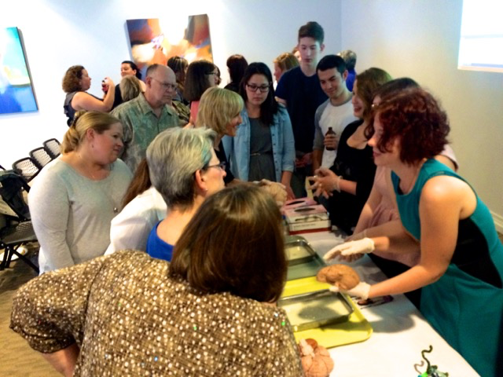
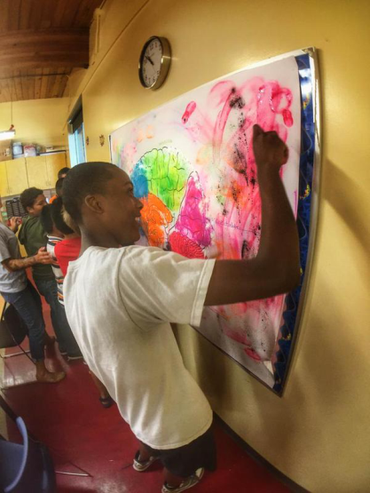
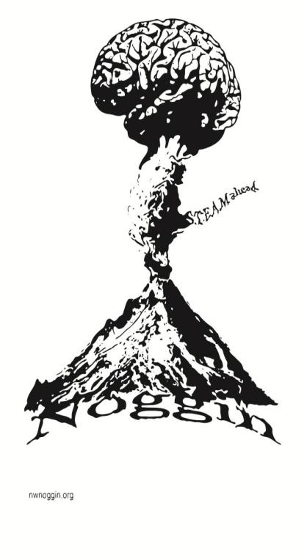
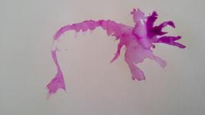
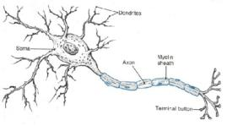
nwnoggin.org
Neuroscience Outreach Group: Growing in Networks…
Bill Griesar, Neuroscience Coordinator
Jeff Leake, Arts Coordinator
Dedicated volunteers from PSU, WSUV, OHSU, PNCA

Slide 3
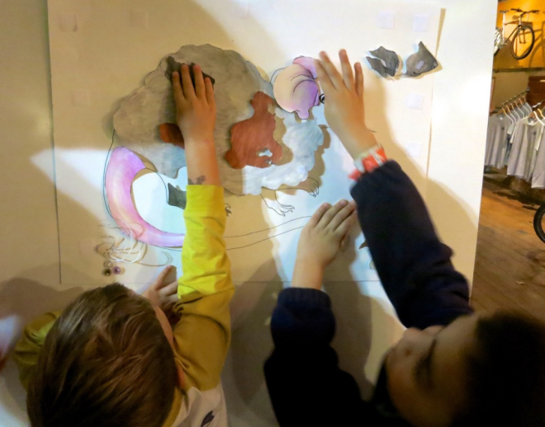
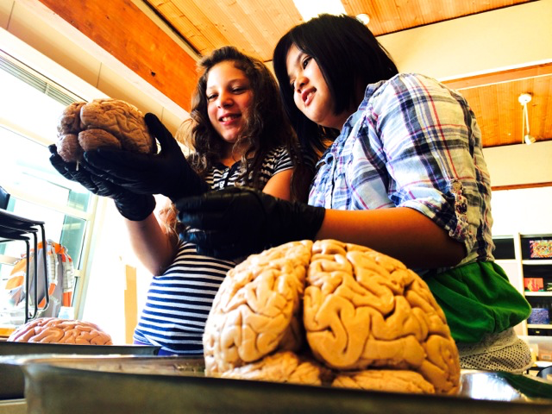
Why art - and brains..?
Motivation and engagement
Exploration, creativity, and discovery
Personal relevance of STEAM material
Internships, jobs and careers

Slide 4
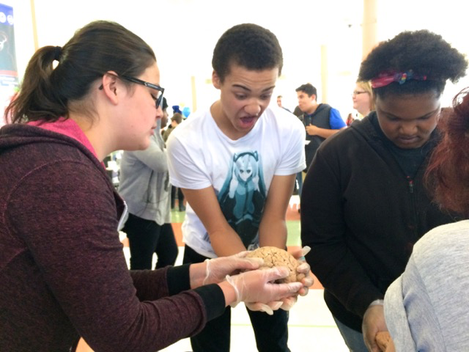

Slide 5
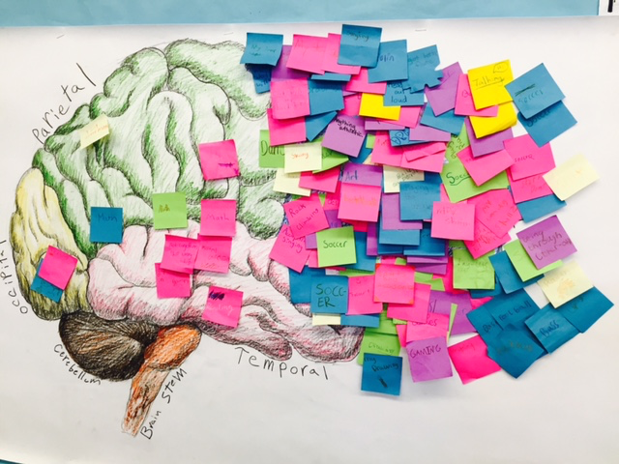
Creative Science School

Slide 6
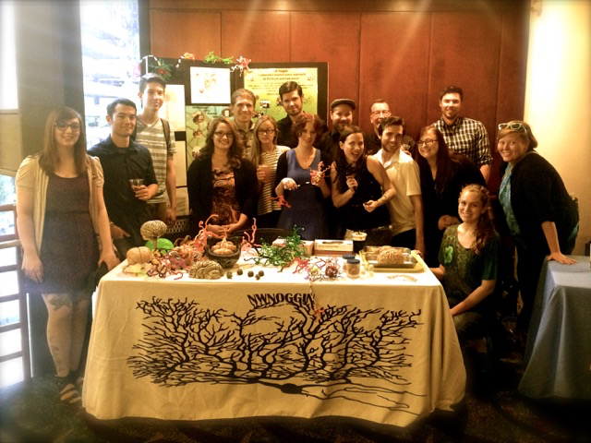
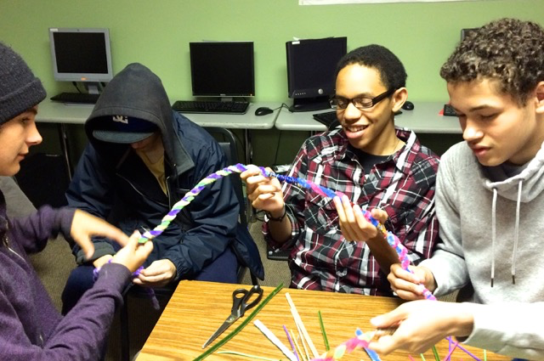
Who is involved?
Academic priority K-12 students
Portland/Vancouver Public Schools
Art and neuroscience undergraduates
Pacific Northwest College of Art, Portland State University, Washington State University Vancouver
Art and neuroscience graduate students
PNCA, PSU, WSUV, Oregon Health & Science University
Working artists and scientists

Slide 7
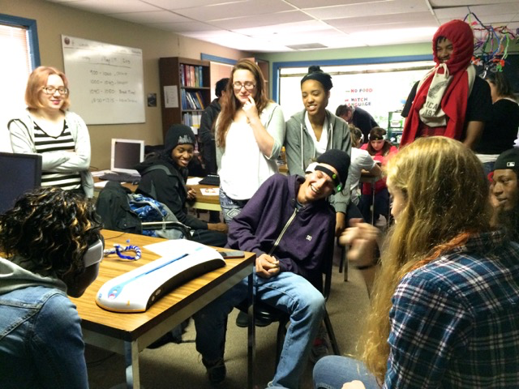
McCoy Academy

Slide 8
Skyview High School

Slide 9
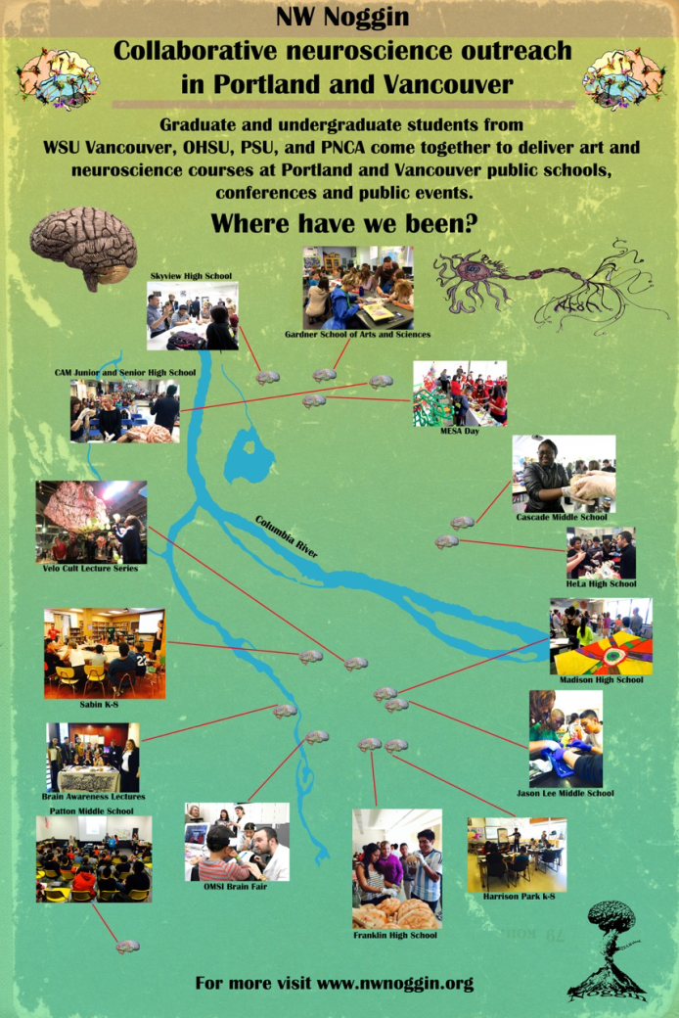
Where do we go?
K-12 schools
Universities
Retirement communities
Hospitals
Science museums
Art museums
Conferences
Homeless shelters
Bike shops, pubs
Thousands reached

Slide 10
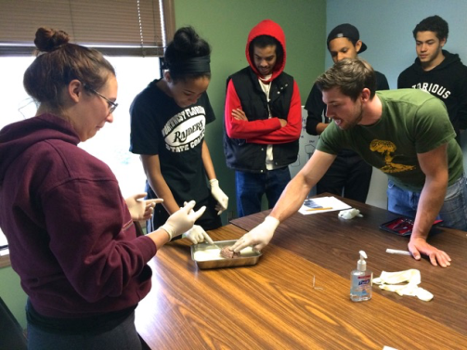
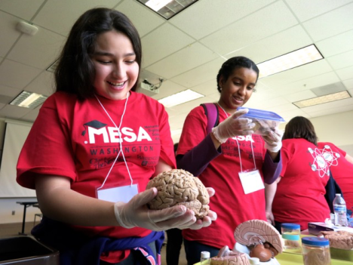
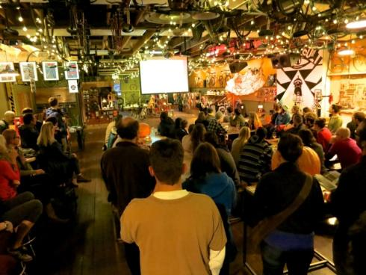
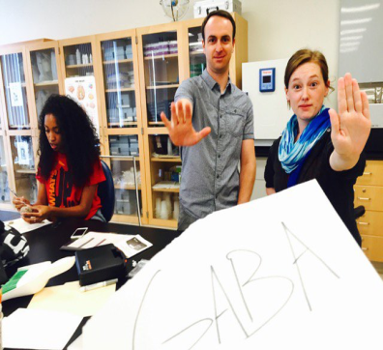
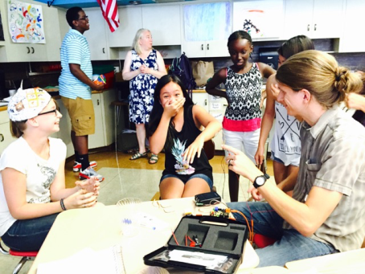
STEAM Outreach: Four types
Classroom visits
Multi-day
instruction
Public events 🍺
Summer Programs (MESA, PPS)

Slide 11
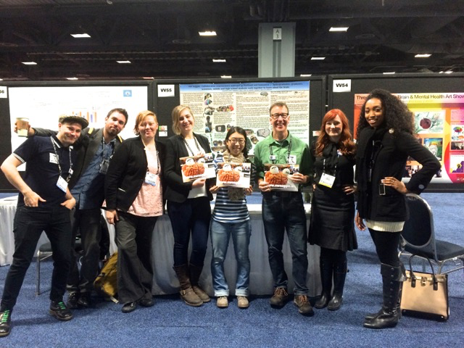
Society for Neuroscience, Washington, DC

Slide 12
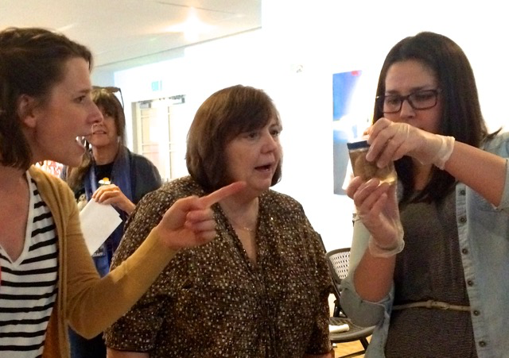
Portland Art Museum

Slide 13
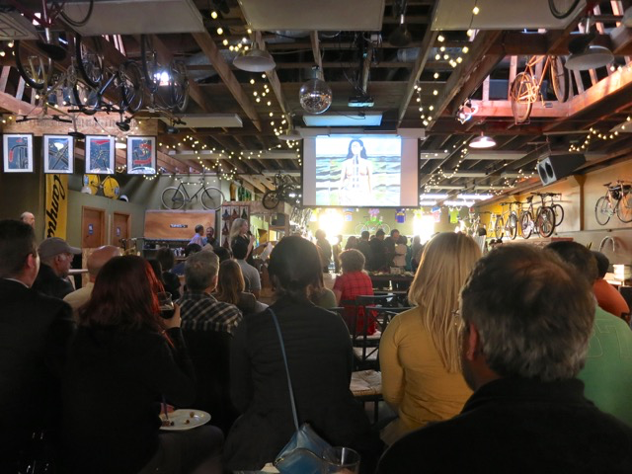
Velo Cult

Slide 14
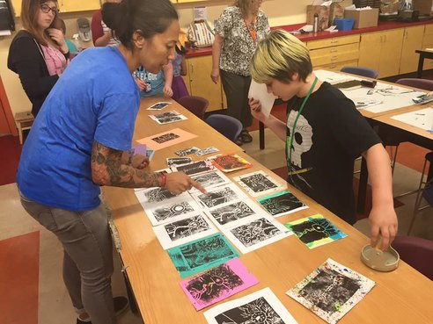
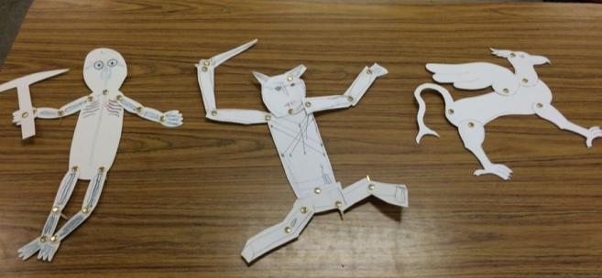
Art projects that…
Serve as examples of concepts
Illustrate concepts
Allow students to explore a concept

Slide 15
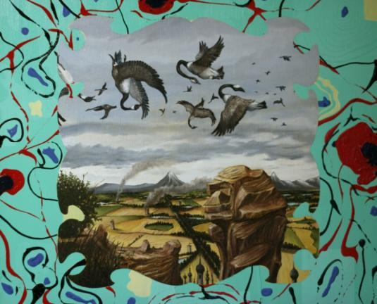
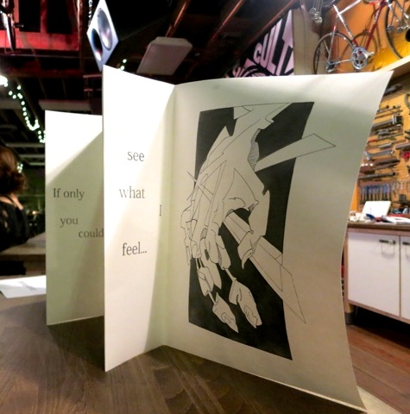
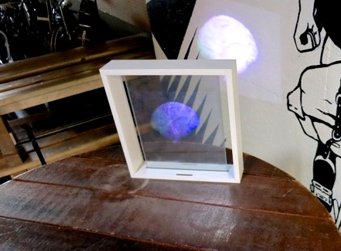
Artists and art students often reference other fields within their own work

Slide 16
nwnoggin.org website

Slide 17
nwnoggin.org website

Slide 18
An Augmented Reality Application For Neuroscience Education.

Slide 19
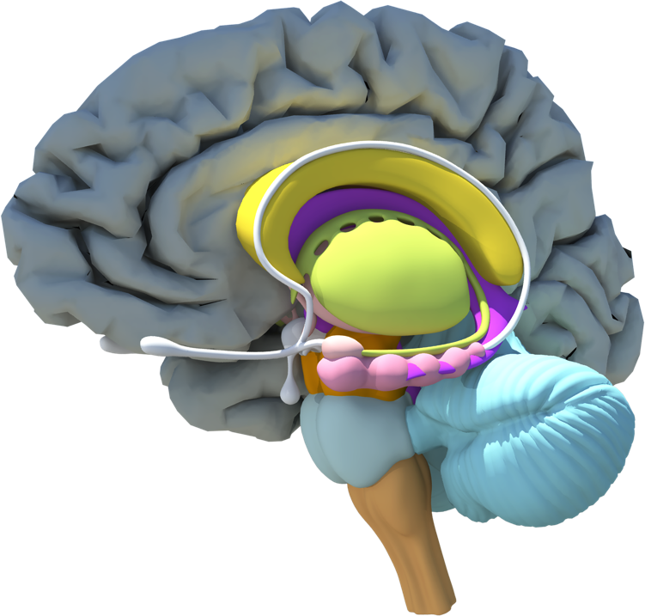
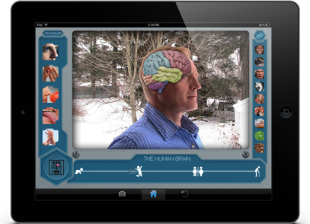
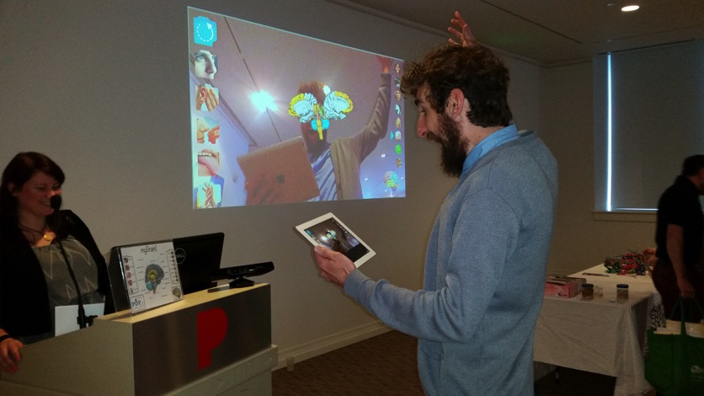
did you know?
Original designs and conceptualization of My Brain! imagined a GUI driven mobile app focused on displaying significant but simple stimulus effects on a 3D model of the brain super imposed on the face.
The 3D cerebrum model used in My Brain! is an accurate brain scan obtained through an MRI used in UCSF's and UCSD's Glassbrain project.

Slide 20
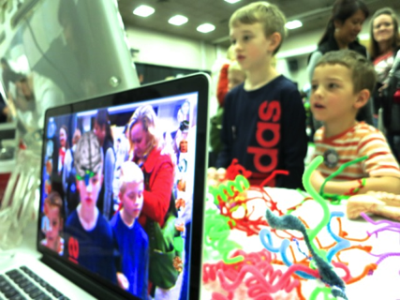
interdisciplinary collaboration.
“Efforts to reach a broader public about scientific discovery contributes to fascination, understanding and support for research and education about behavior, and the brain. Effective integration of technology, art projects and activities into outreach efforts increases engagement, makes learning personally relevant, and allows students to explore concepts by creating objects and images they can share with family and friends.”
- Jeff Leake

Slide 21
Innovative programs... innovative assessments!
We wanted our programs’ assessments to align with our educational approach
Formal, intimidating, paper-and-pen tests? No thanks!
Instead, we wanted to create a fun, engaging, low-stakes way for kids to practice their neuro skills and show us what they’ve learned
Thus, was born!

Slide 22
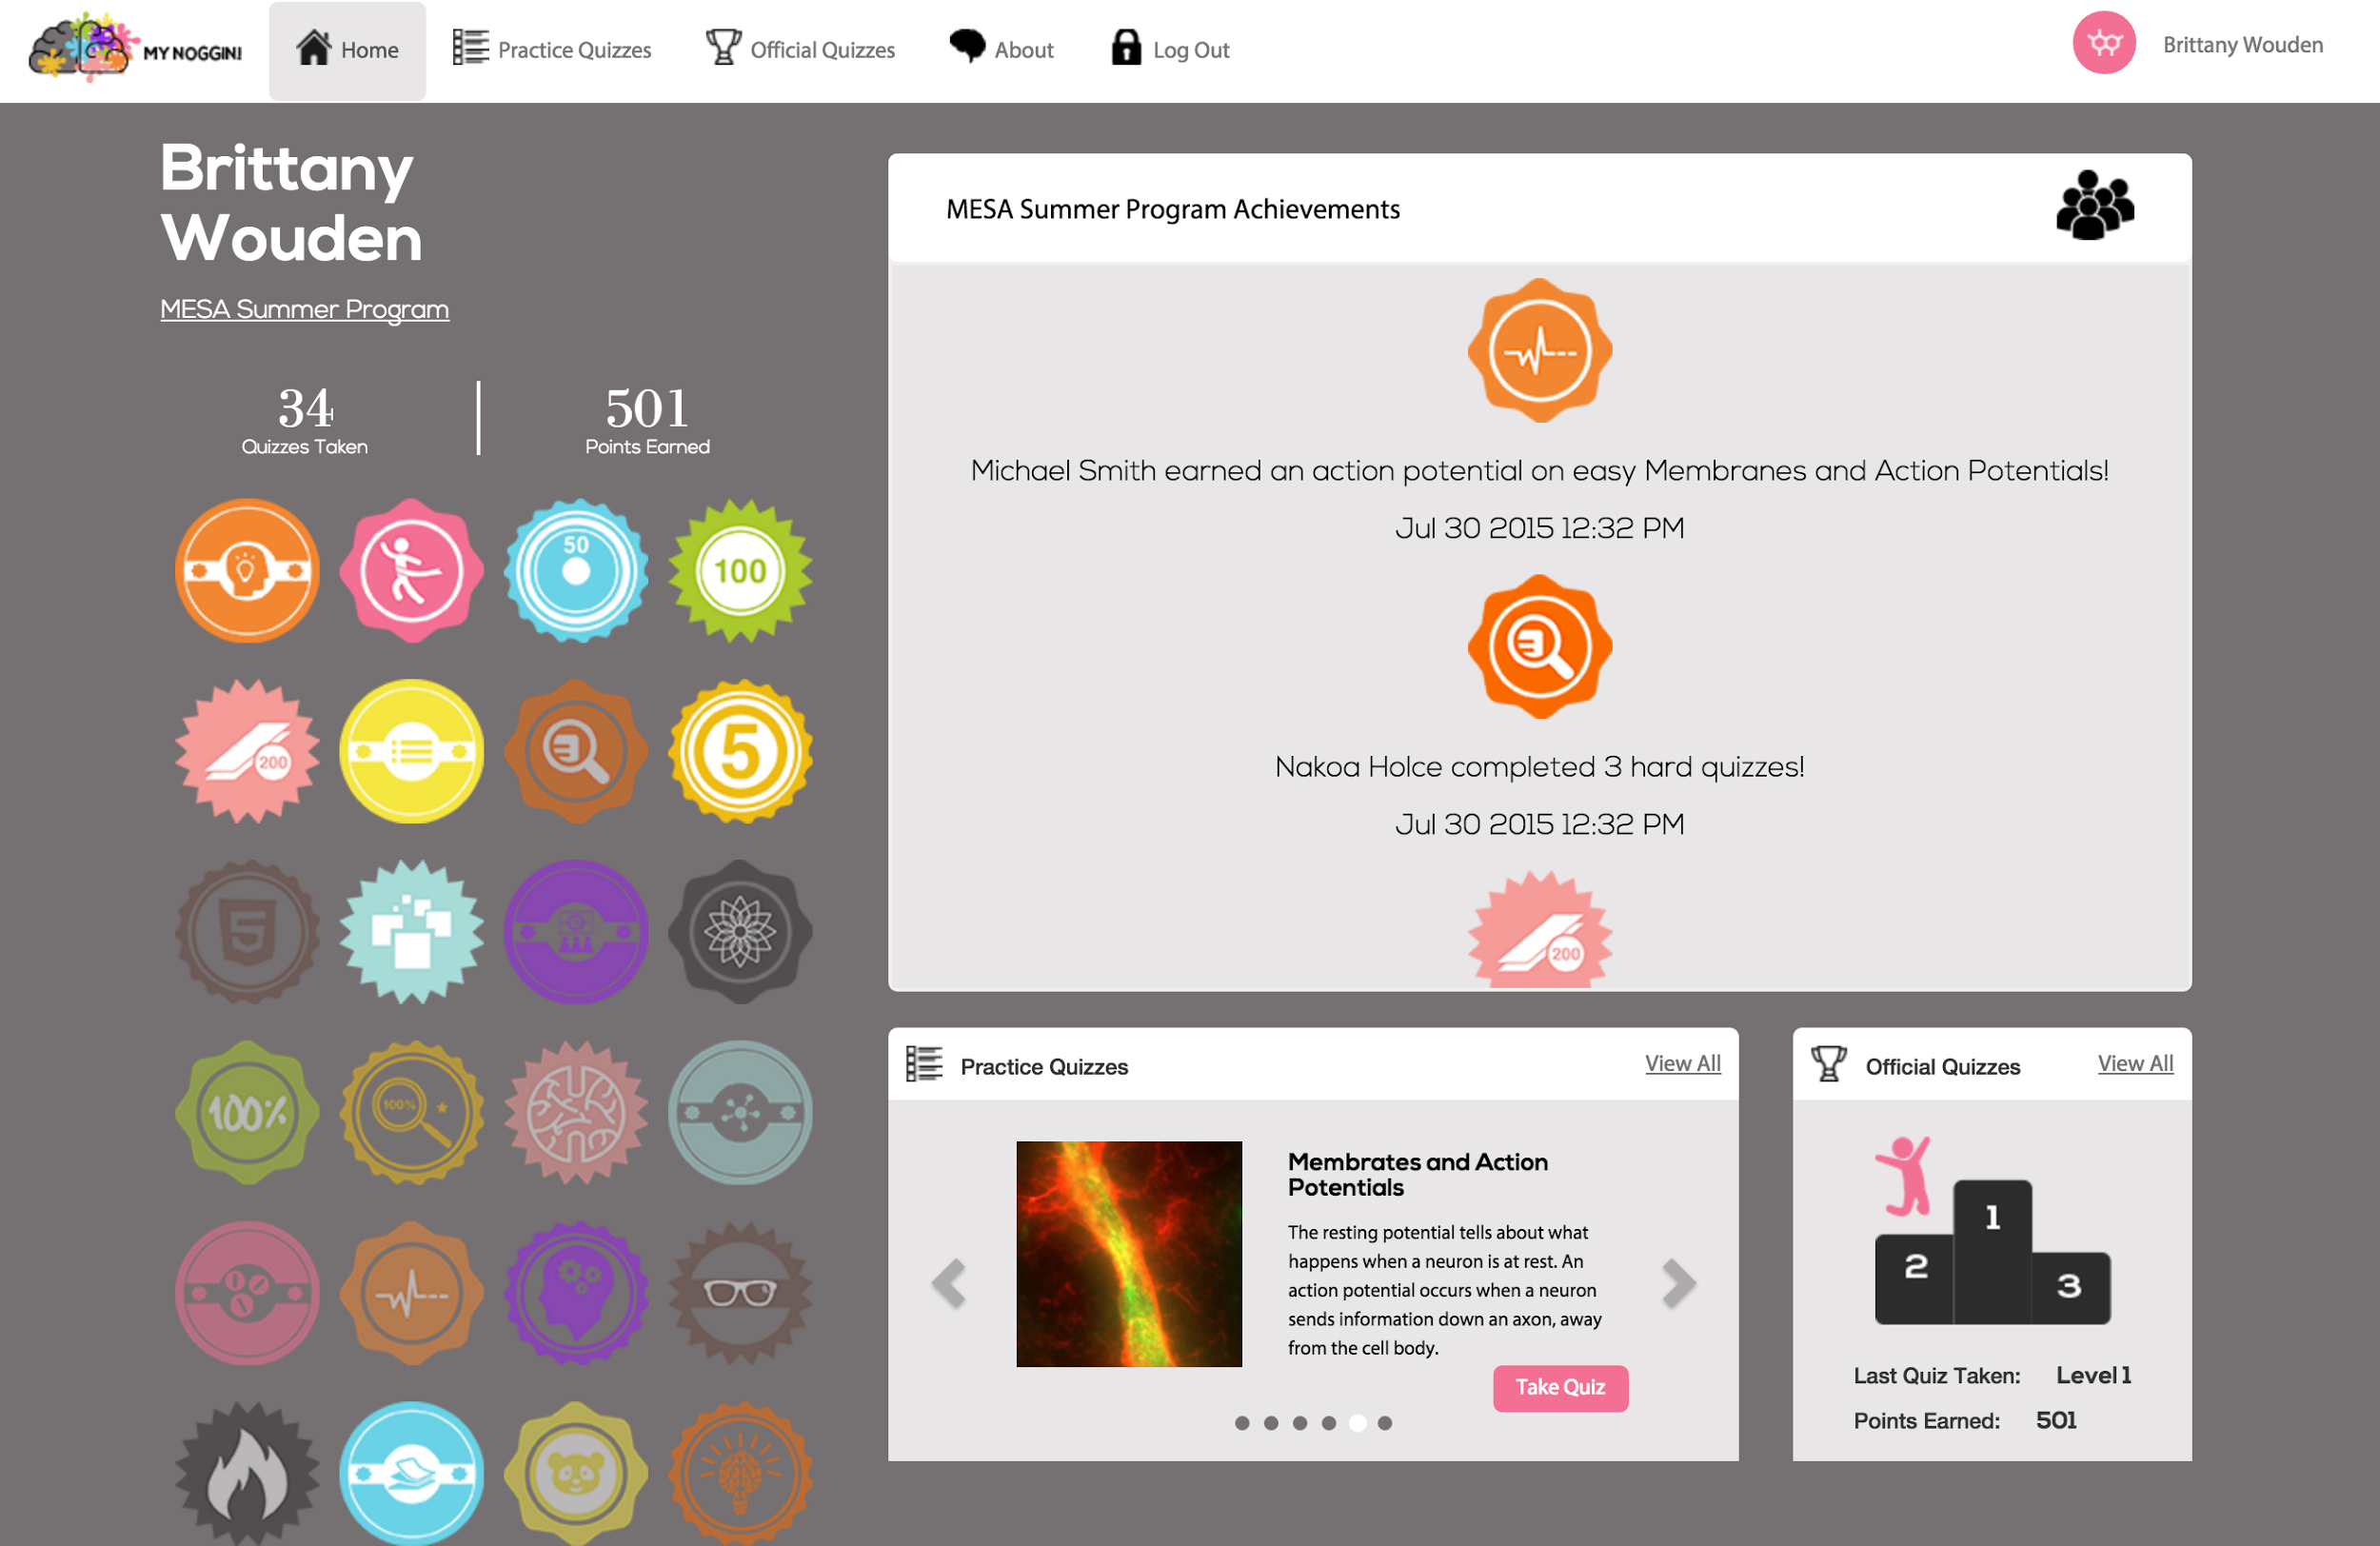

Slide 23
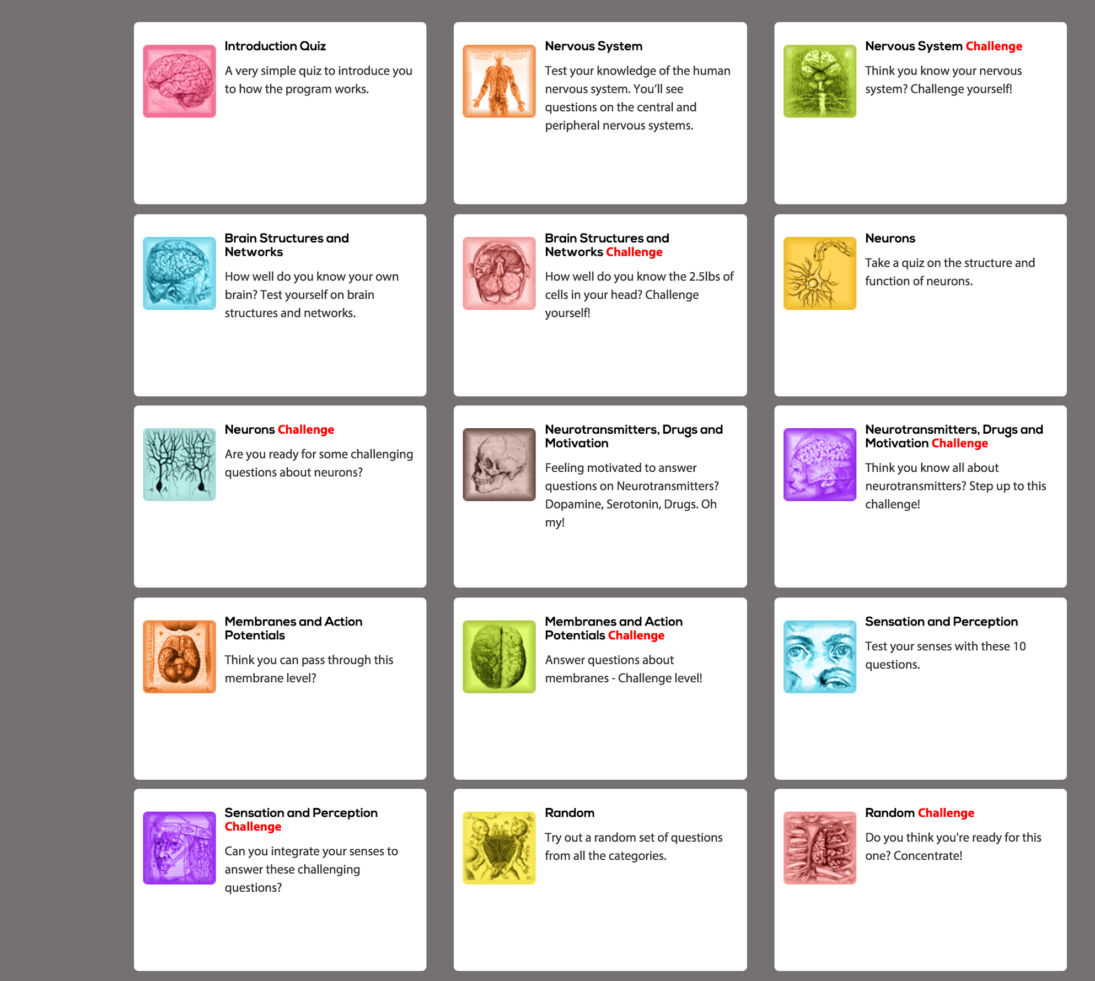

Slide 24
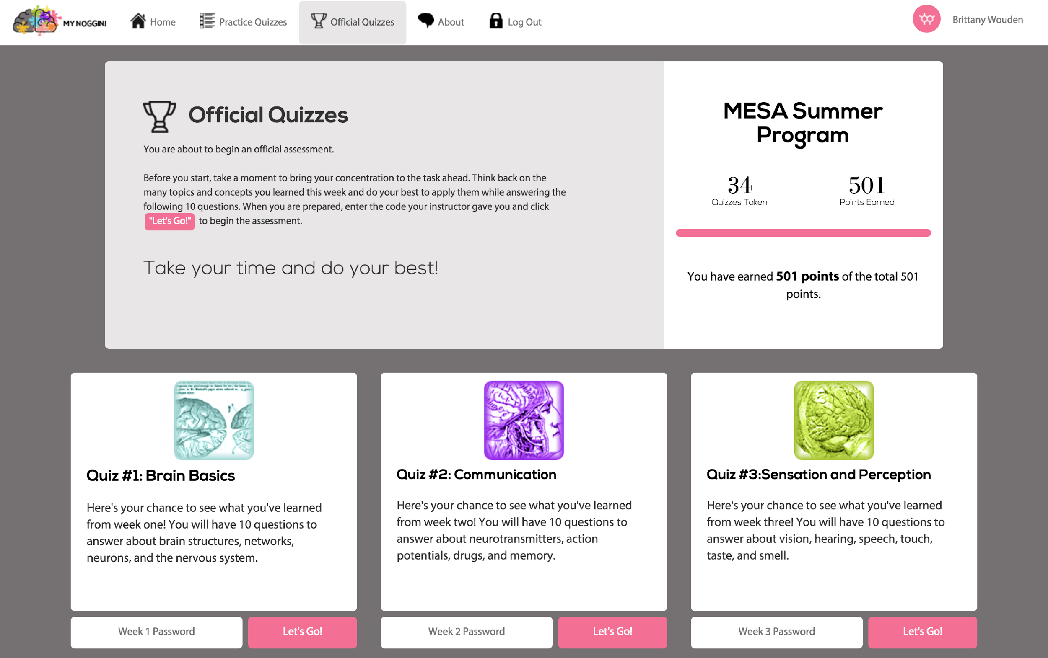

Slide 25
MESA program kids loved it!
All students reported to like MyNoggin (4.4 out of 5)!
All but one student reported that MyNoggin helped them learn class material (4.4 out of 5)!
“...it was a cool way to learn the info, and I liked it better than taking a paper and pencil test.”
“The quizzes can show you what you have learned from class. There are achievements that can motivate people to do the quizzes.”
“It's really challenging. You have to think and remember what you learned that day or a few days ago.”
“MyNoggin has a great system... practicing can be anytime.”

Slide 26
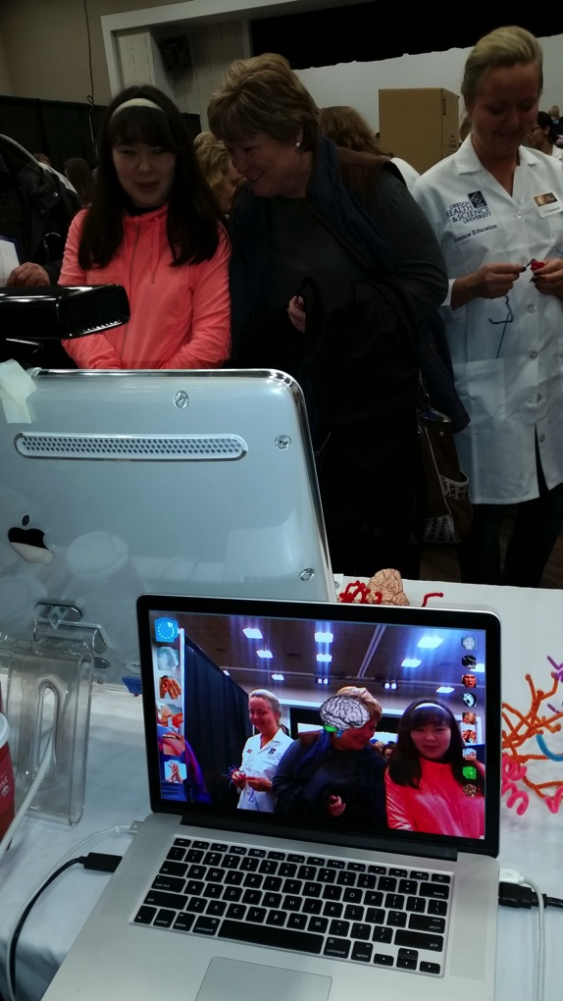
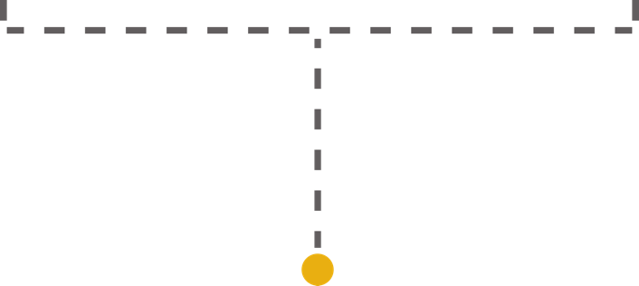
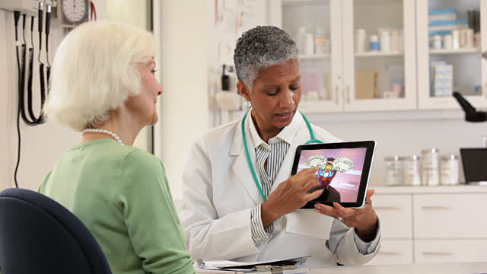
looking ahead: myBrain! for health education

