Slide 1
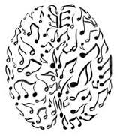
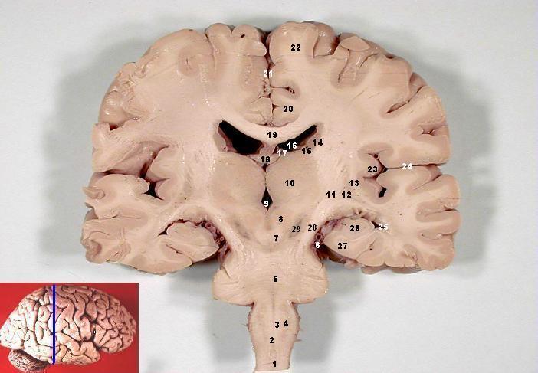
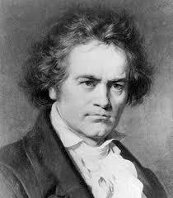
Beethoven, Brains and Bloody Mary’s
Bill Griesar, Ph.D. and Jeff Leake, M.F.A. WSU Vancouver Neuroscience
nwnoggin.org

Slide 2
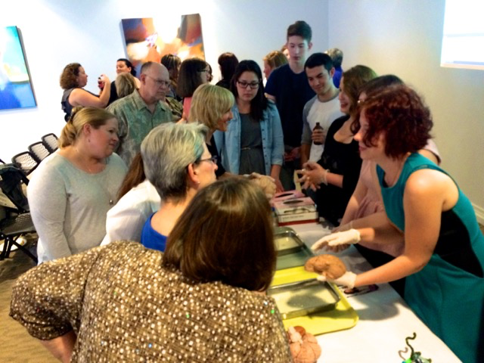
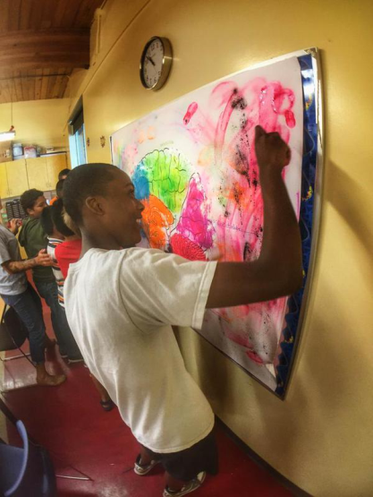
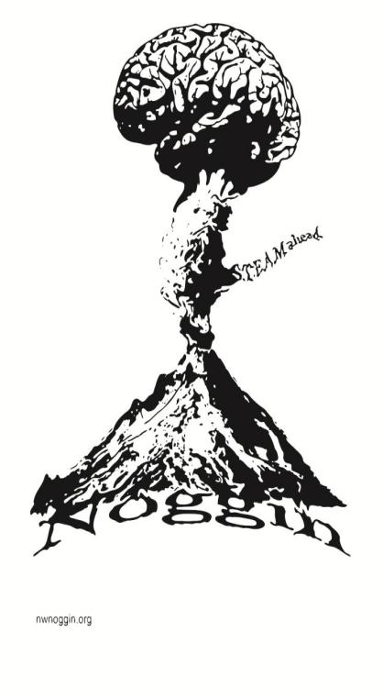
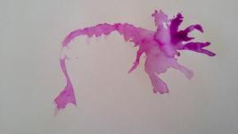
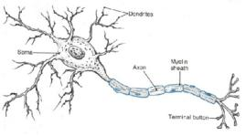
nwnoggin.org
Neuroscience Outreach Group: Growing in Networks…
STEAM Education
STEM (Science, Technology, Engineering, Mathematics)
Plus ART (🎨🎤🎼🎸🎷🎹🎻🎭🎨)
Dedicated volunteers from PSU, WSUV, OHSU, PNCA

Slide 3
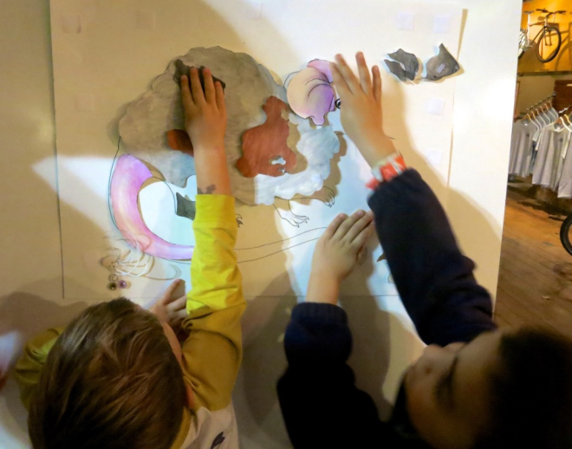
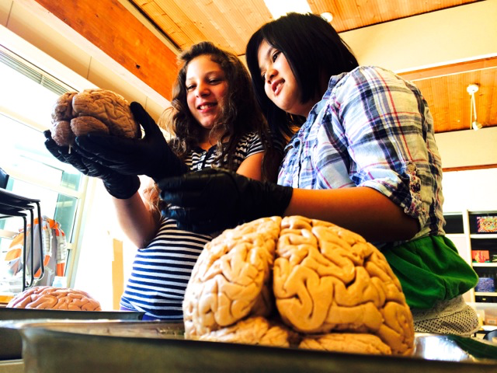
Why art/music - and brains?
Motivation and engagement
Exploration, creativity, and discovery
Personal relevance of STEAM material
Internships, jobs and careers

Slide 4
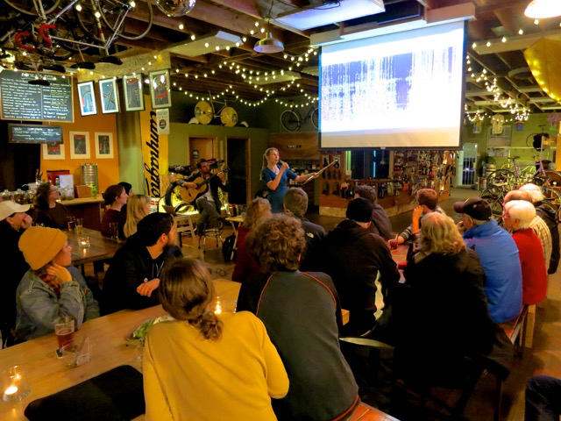
Velo Cult

Slide 5
Skyview High School

Slide 6
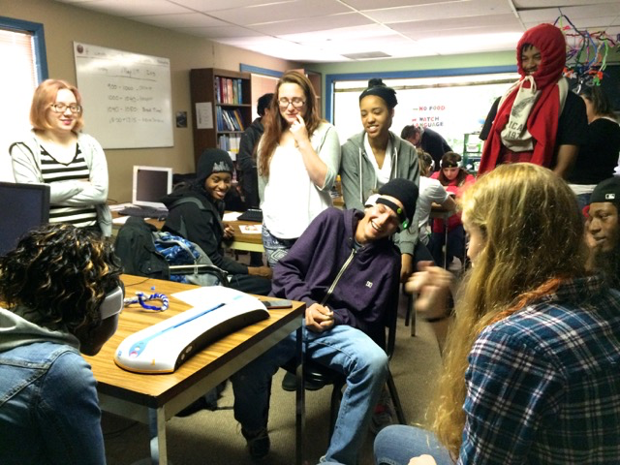
McCoy Academy

Slide 7
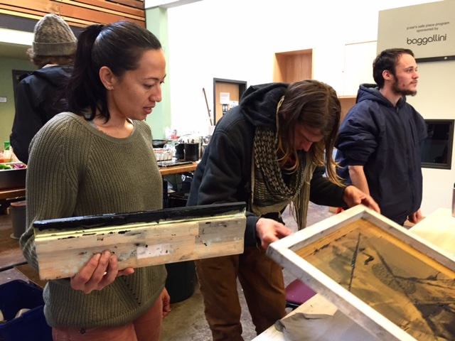
P:ear Homeless Youth Center

Slide 8
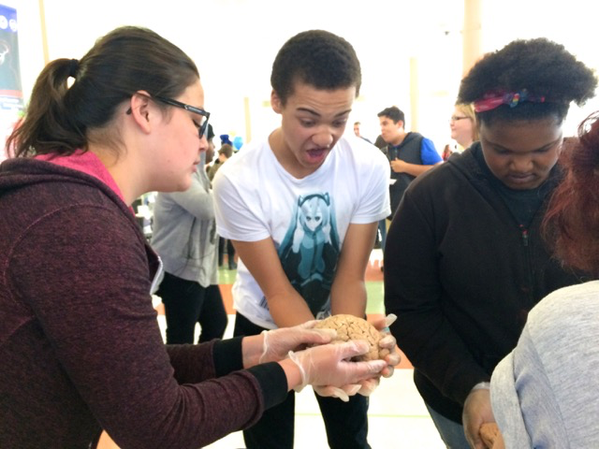
Jefferson High School

Slide 9
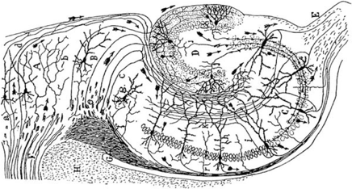
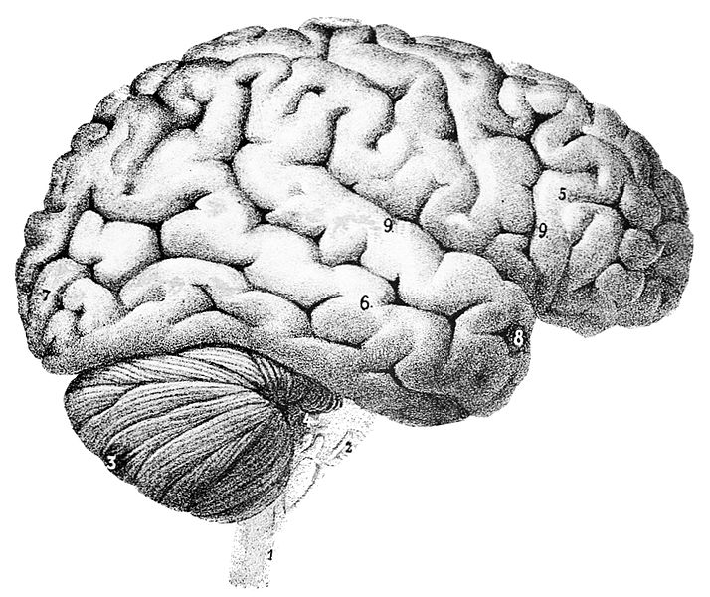
What is memory?
Memory is physical
Remembering an event is a creative act
There are different forms of memory, each dependent on specific areas of the brain…
Biological networks grow - and decay

Slide 10
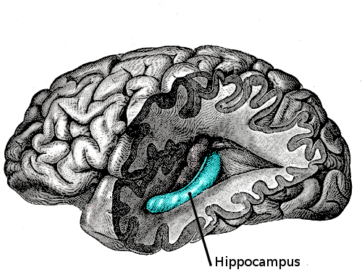
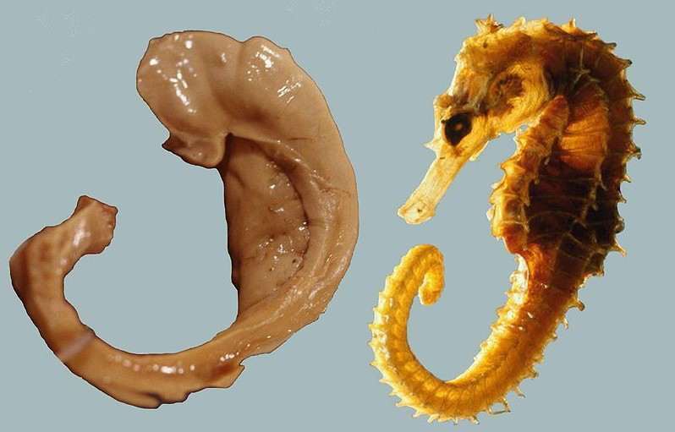
You remember events
When you heard a song that has meaning…
Details of episodes from own your life, like when you first picked up your instrument, or practiced a specific piece...
Neocortex
Depends on
neural networks in the
hippocampus, and other
areas of cortex
Hippocampus

Slide 11
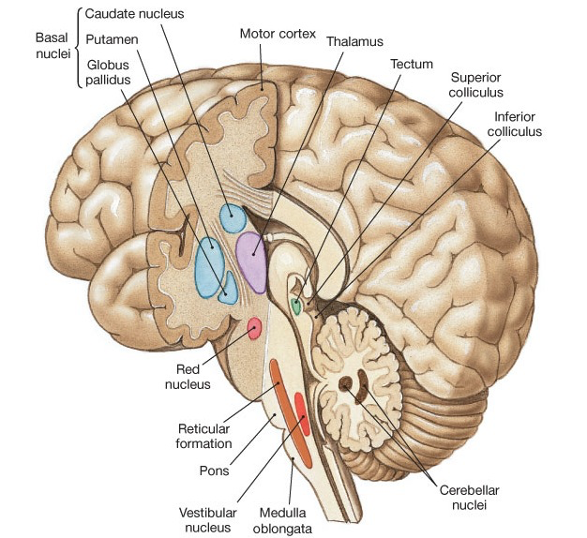
You remember skills... And music also moves you…
Literally…
Basal ganglia
Involuntary mvmt
Timing of mvmt
Cerebellum
Balance
Coordination
Repetitive mvmts
Amygdala/Accumbens
Emotional mvmts

Slide 12
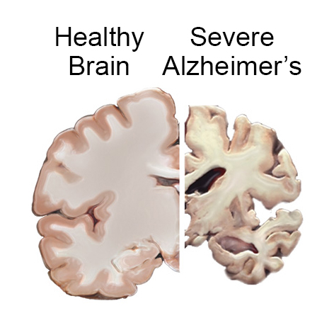
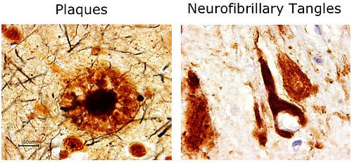
Alzheimer’s disease
A “disconnection syndrome”
Alois Alzheimer (1906)
6th leading cause of death (in US)
Most common form of dementia
Affects 5 million Americans
Major damage in cortex, hippocampus
Beta-amyloid plaques
Tau protein tangles
Aging, inflammation, genetics
Late vs. early onset forms

Slide 13
Have another Bloody Mary 😎🍹

Slide 14
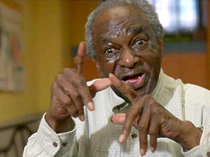
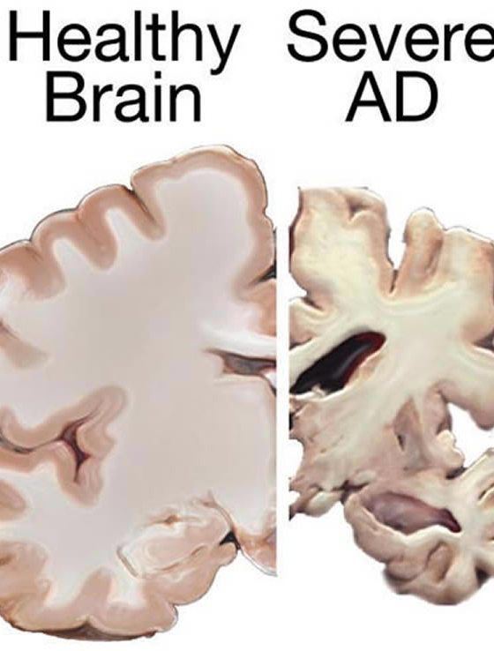
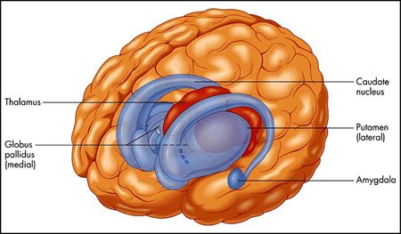
Henry
Dementia involves damage to neocortex and hippocampus
BUT: preservation of subcortical structures critical for involuntary movements, skills, emotions…

Slide 15
From the late great Oliver Sacks…
“There are undoubtedly particular areas of the cortex subserving musical intelligence and sensibility…but emotional response to music is widespread and probably not only cortical but subcortical, so that even in a diffuse cortical disease like Alzheimer’s, music can still be perceived, enjoyed, and responded to.”
“To those lost in dementia…music is no luxury...but a necessity, and can have a power beyond anything to restore them to themselves, and to others, at least for awhile...”

