Slide 1
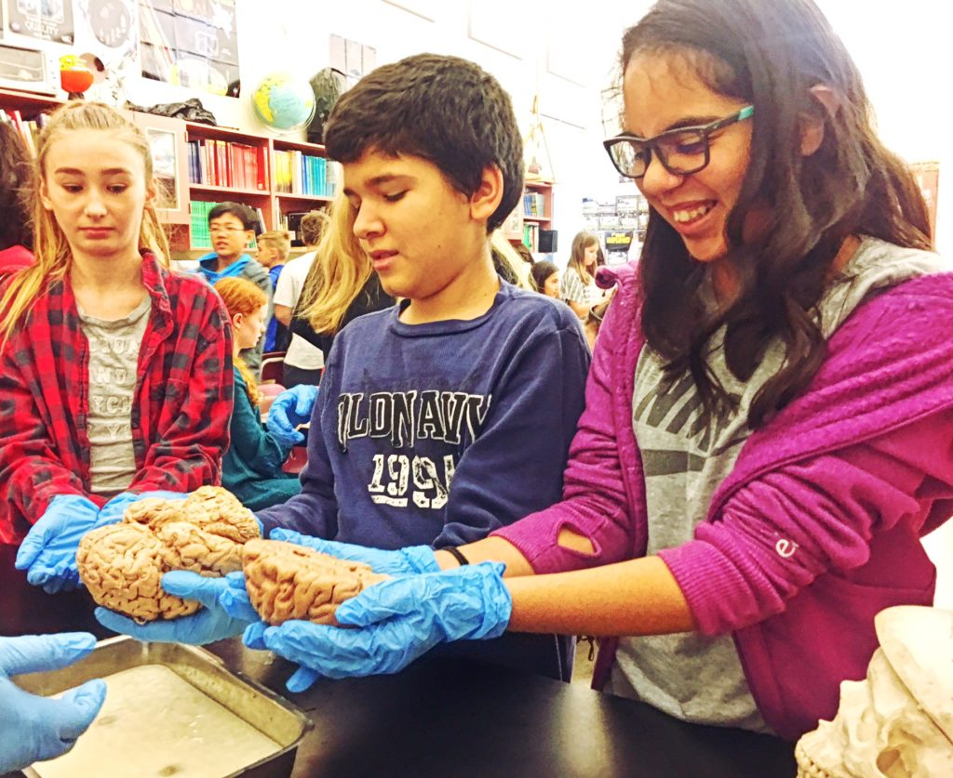
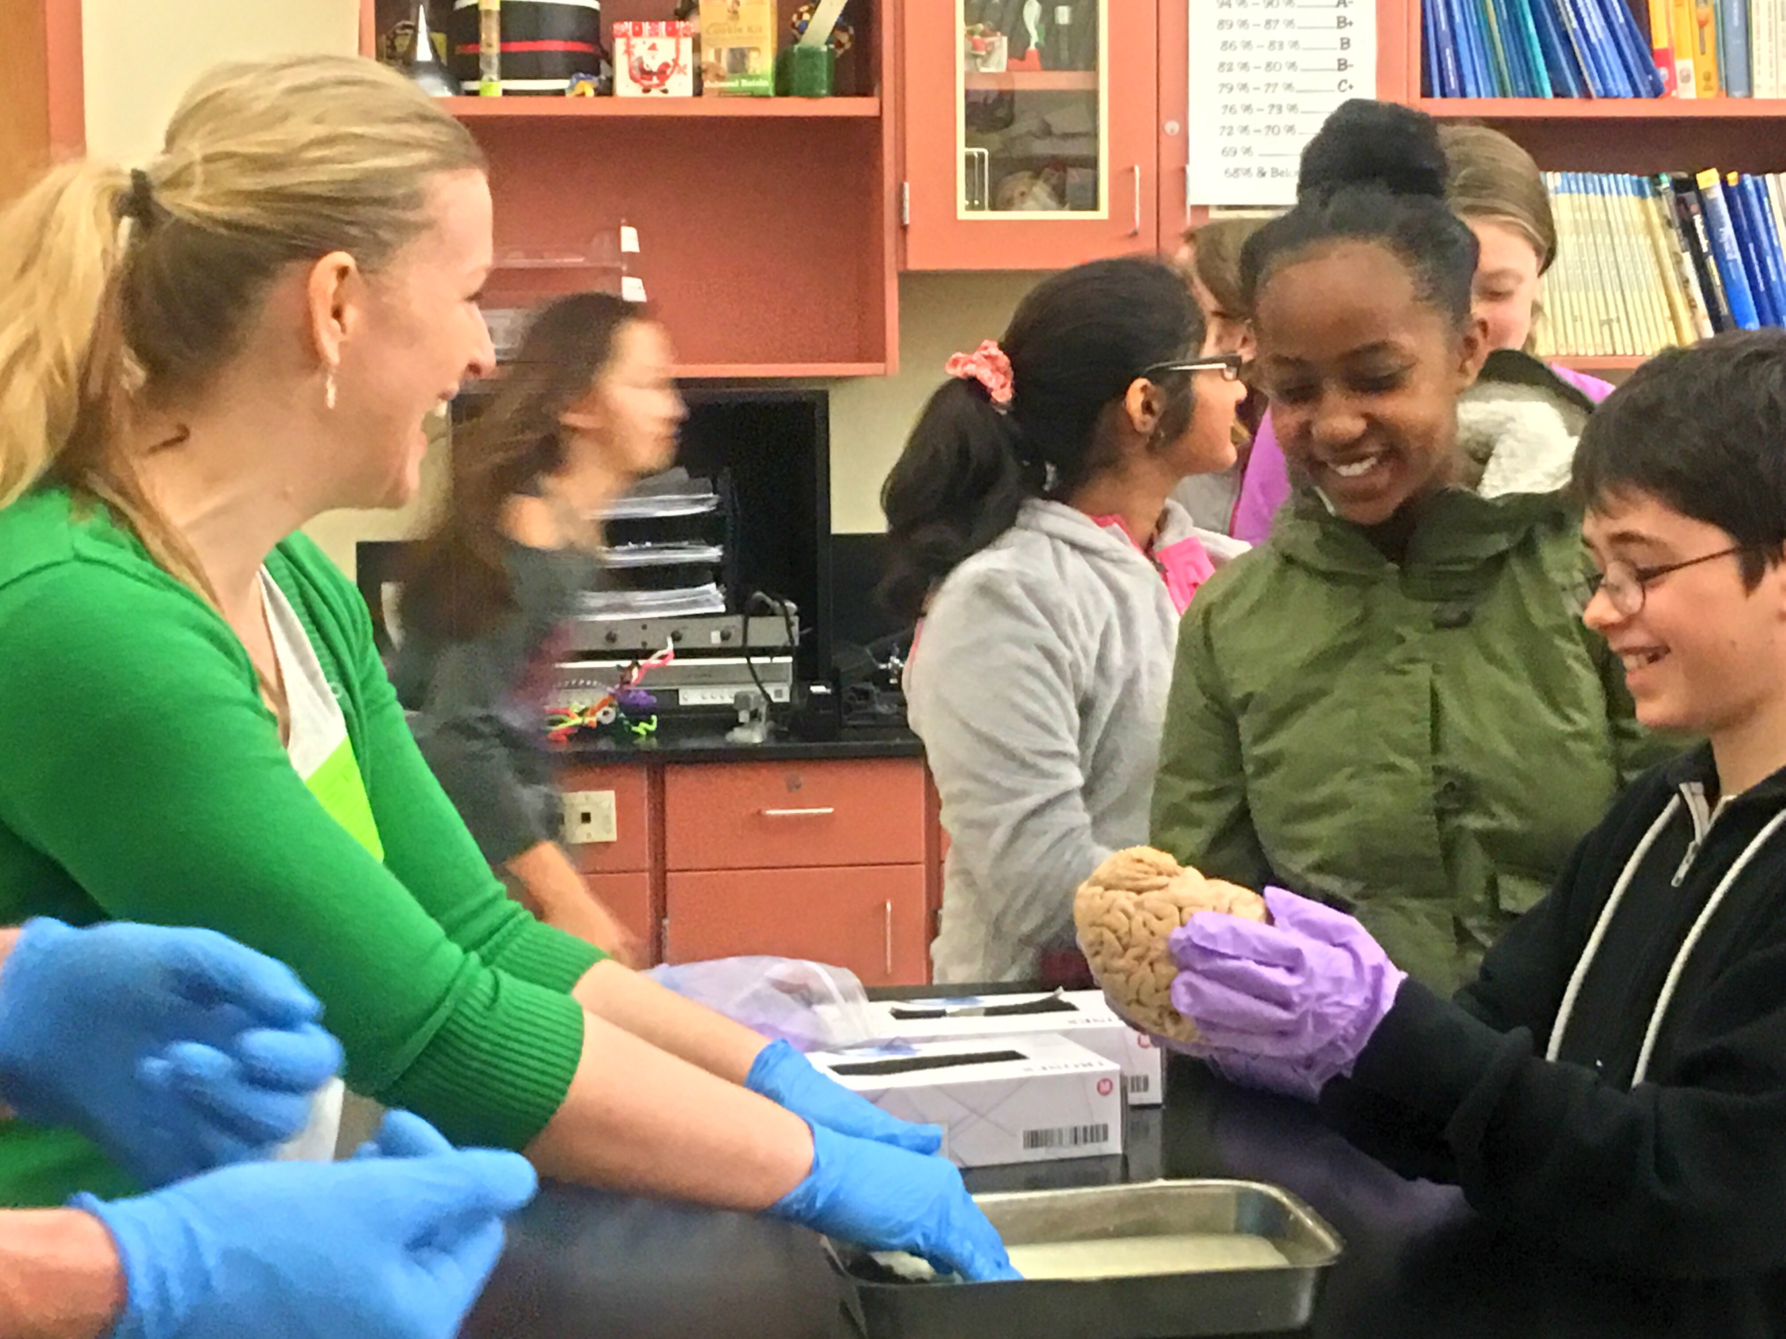
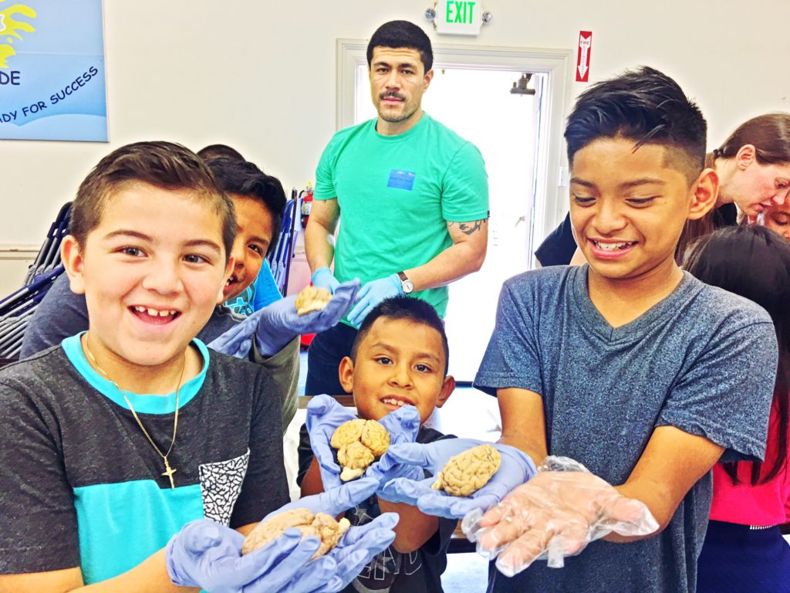
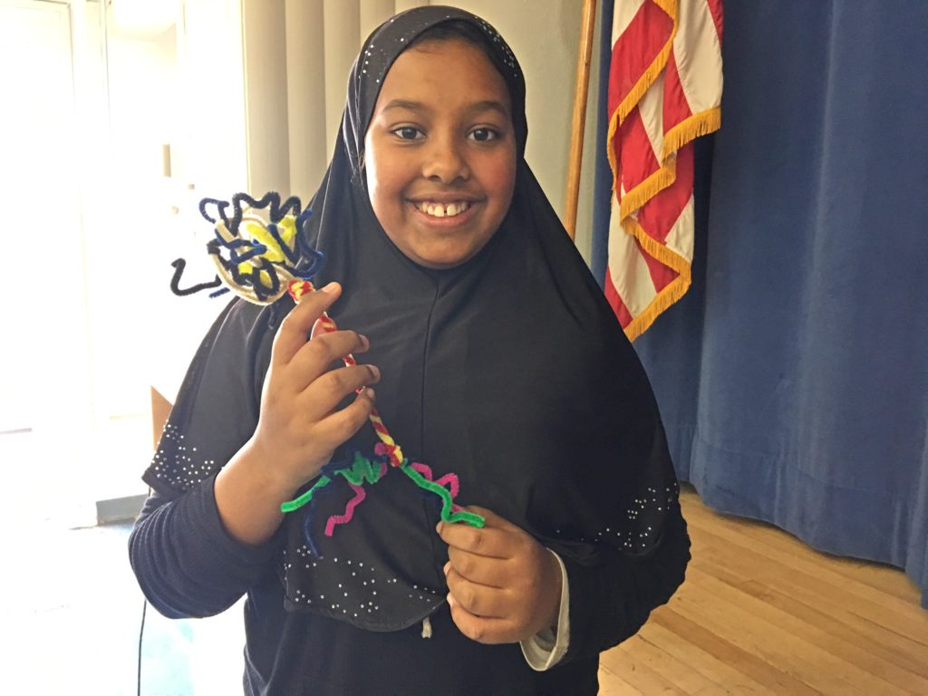
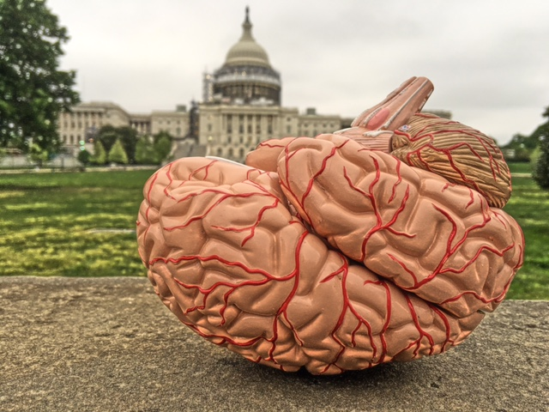
nwnoggin.org

Slide 2

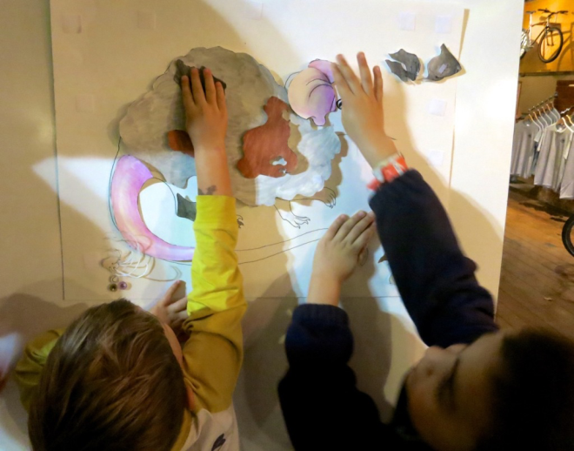
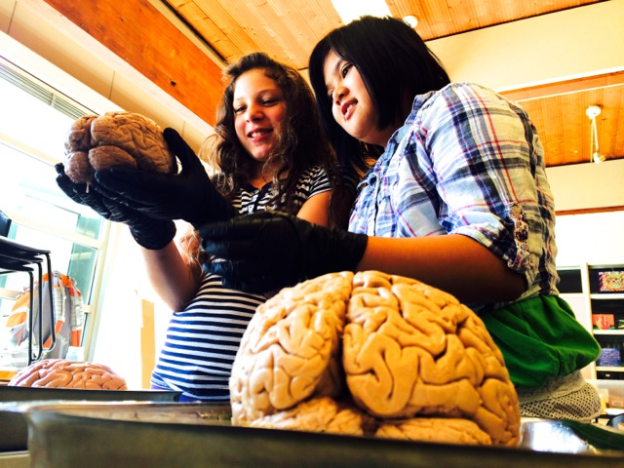
Why art - and brains..?
Motivation and engagement
Exploration, creativity, and discovery
Personal relevance of STEAM material
Internships, jobs and careers

Slide 3
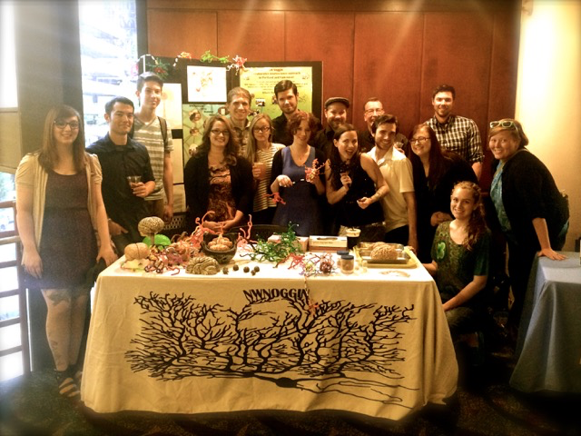
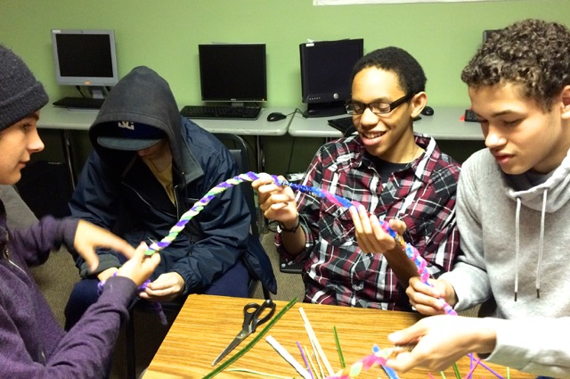
Who is involved?
Academic priority K-12 students
  Portland/Vancouver/Beaverton/Hillsboro Public Schools
Art and neuroscience undergraduates
  Portland State University, Pacific Northwest College of Art, Washington State University Vancouver
Art and neuroscience graduate students
  Oregon Health & Science University, PSU, PNCA, WSUV
Working artists and scientists
Human
development 😏

Slide 4
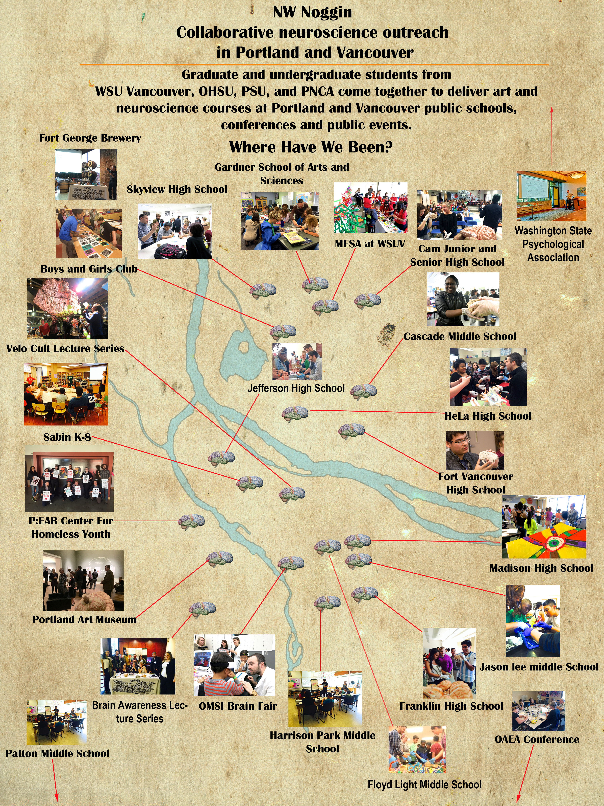
Where do we go?
K-12 public schools
Universities
Retirement homes
Body donation labs
Hospitals
Science museums
Art museums
Conferences
Homeless shelters
Bike shops, pubs
Over 12,000!

Slide 5
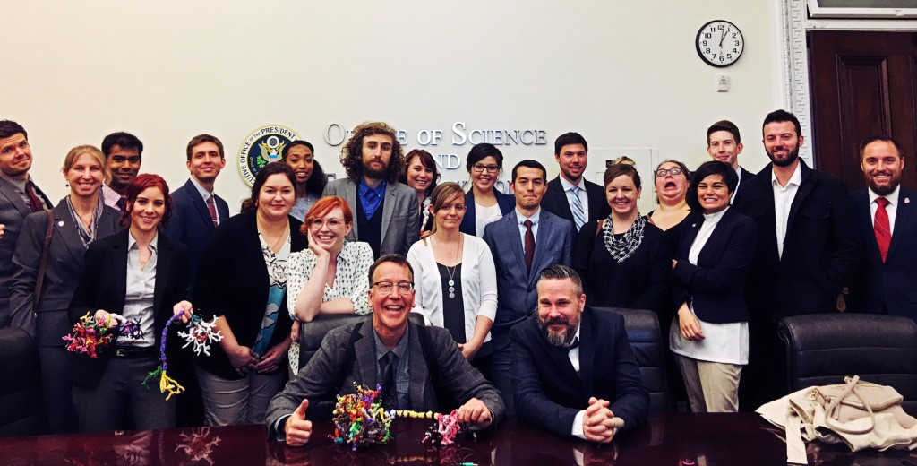
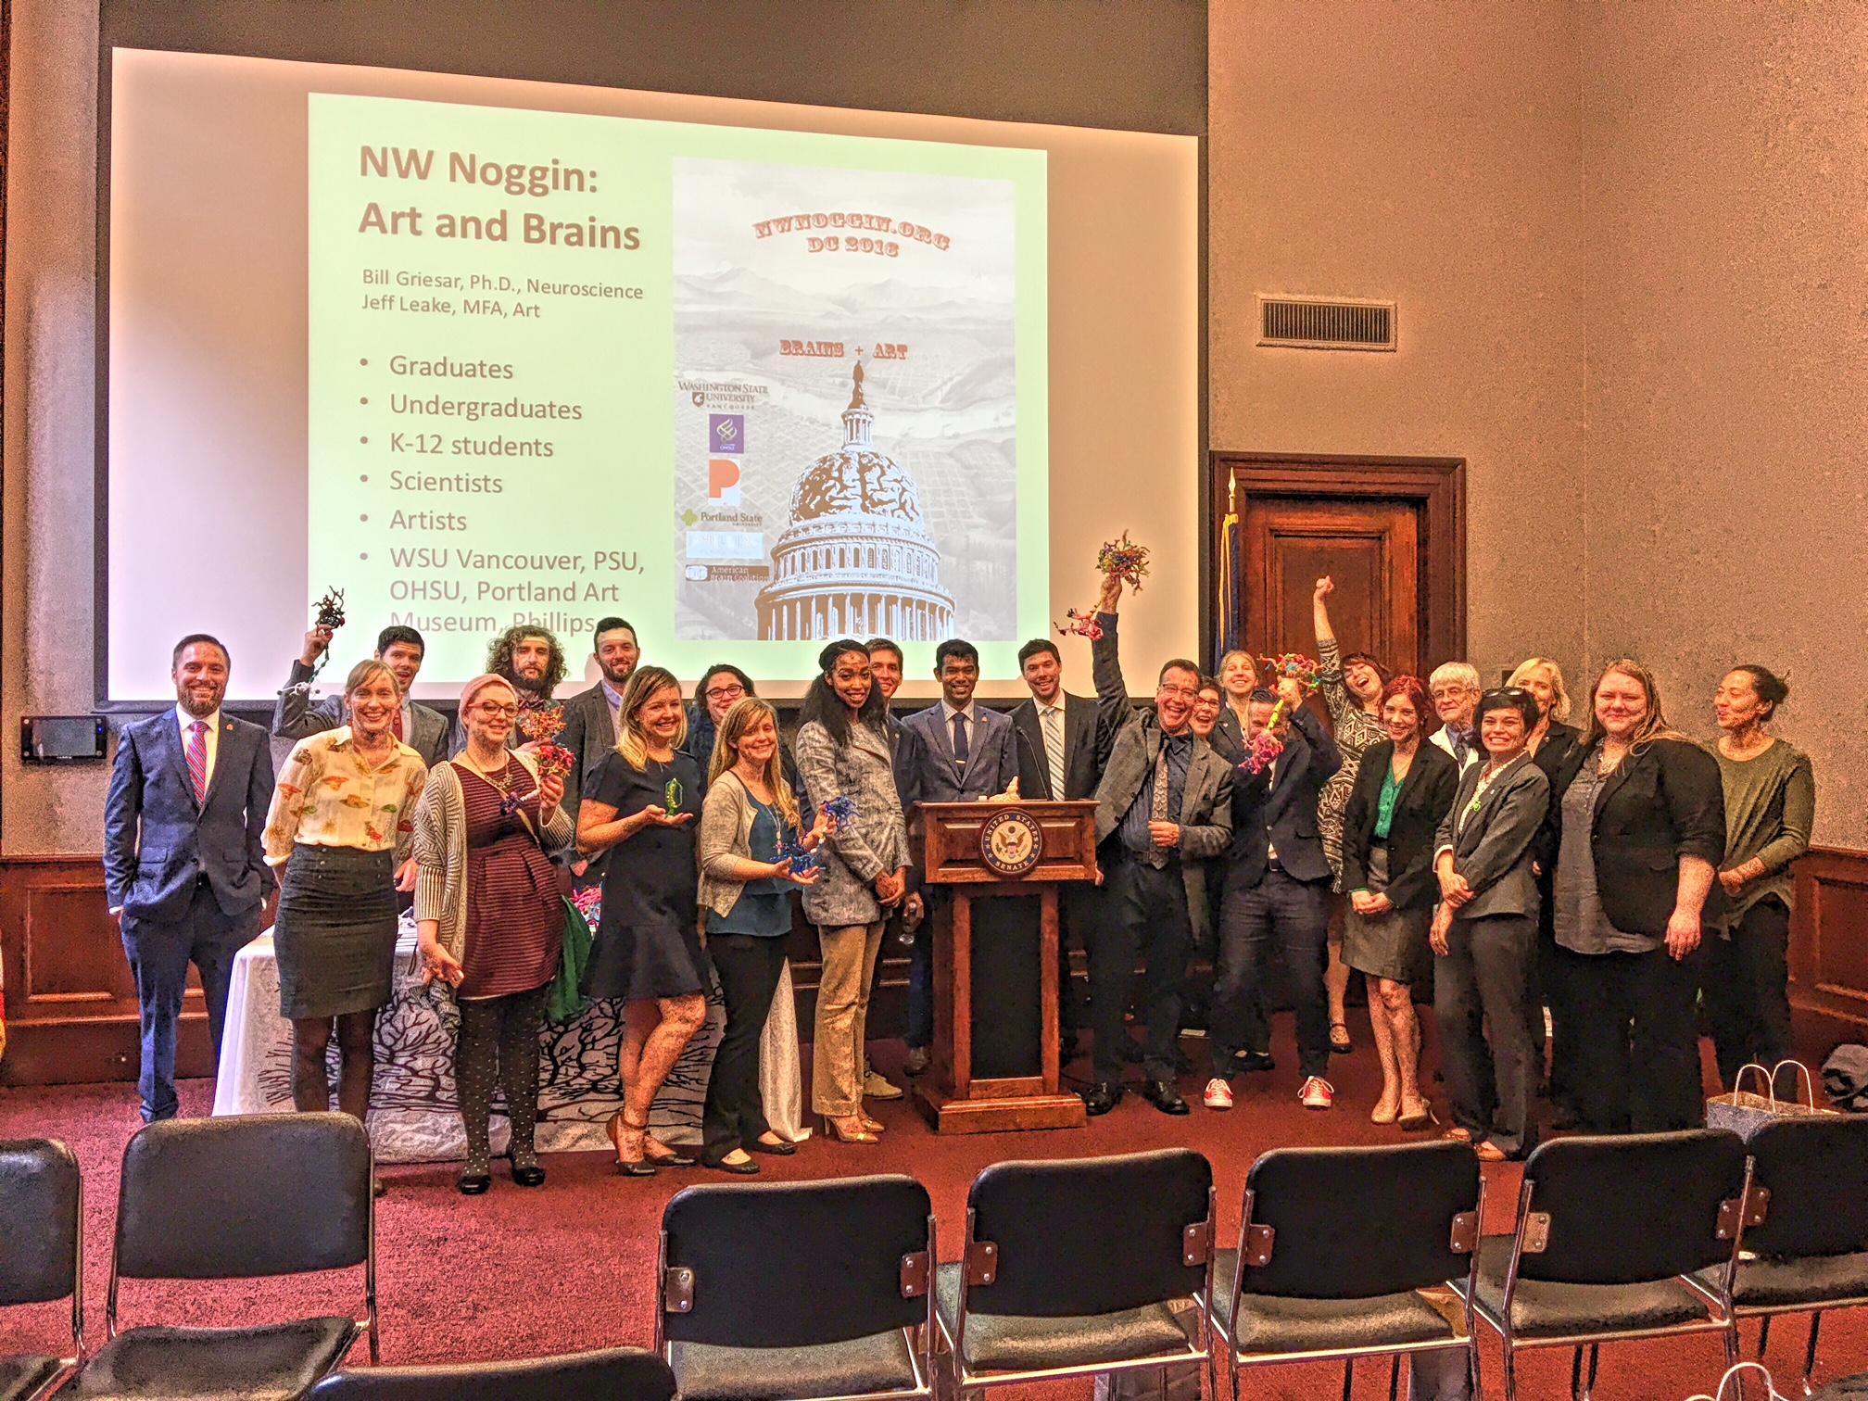

Research should inform policy
April 27, 2016 Using our Brains and Art to Inspire a Future Generation of Scientists (Co-hosted by Congressional Neuroscience Caucus & STEAM Caucus)
Dr. Bill Griesar, Neuroscience Coordinator, NW NOGGIN
Jeff Leake, Arts Coordinator, NW NOGGIN
Earl Blumenauer (D-OR), Congressional Neuroscience Caucus Chair
Suzanne Bonamici (D-OR), Congressional Science, Technology, Education, Arts, Mathematics (STEAM) Caucus Chair

Slide 6
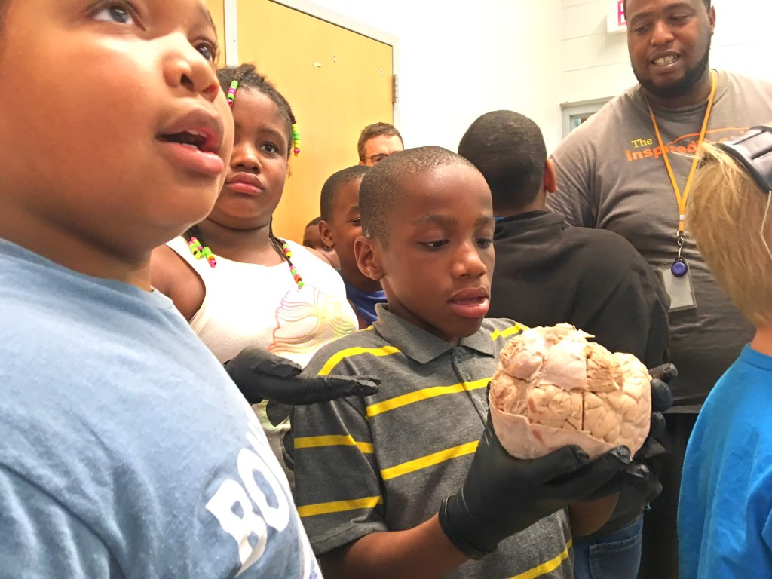
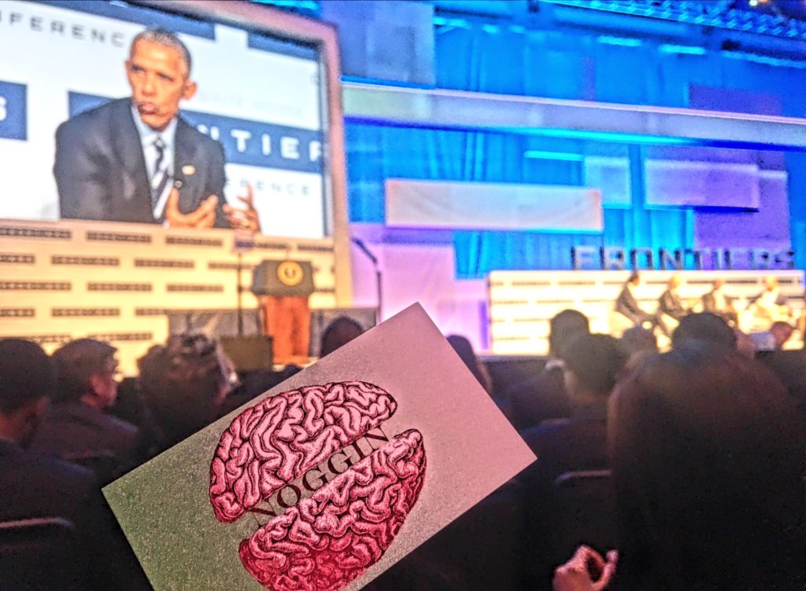
Innovative arts + brains
The Obama White House Frontiers Conference brought together some of the world’s leading innovators in Pittsburgh to discuss how investing in science and technology frontiers will help improve lives, and keep America and Americans on the cutting edge of innovation…
Bill Griesar and Jeff Leake from NW Noggin were among the 500 innovators invited by the White House Office of Science & Technology Policy to attend this inspiring event in fall, 2016.

Slide 7
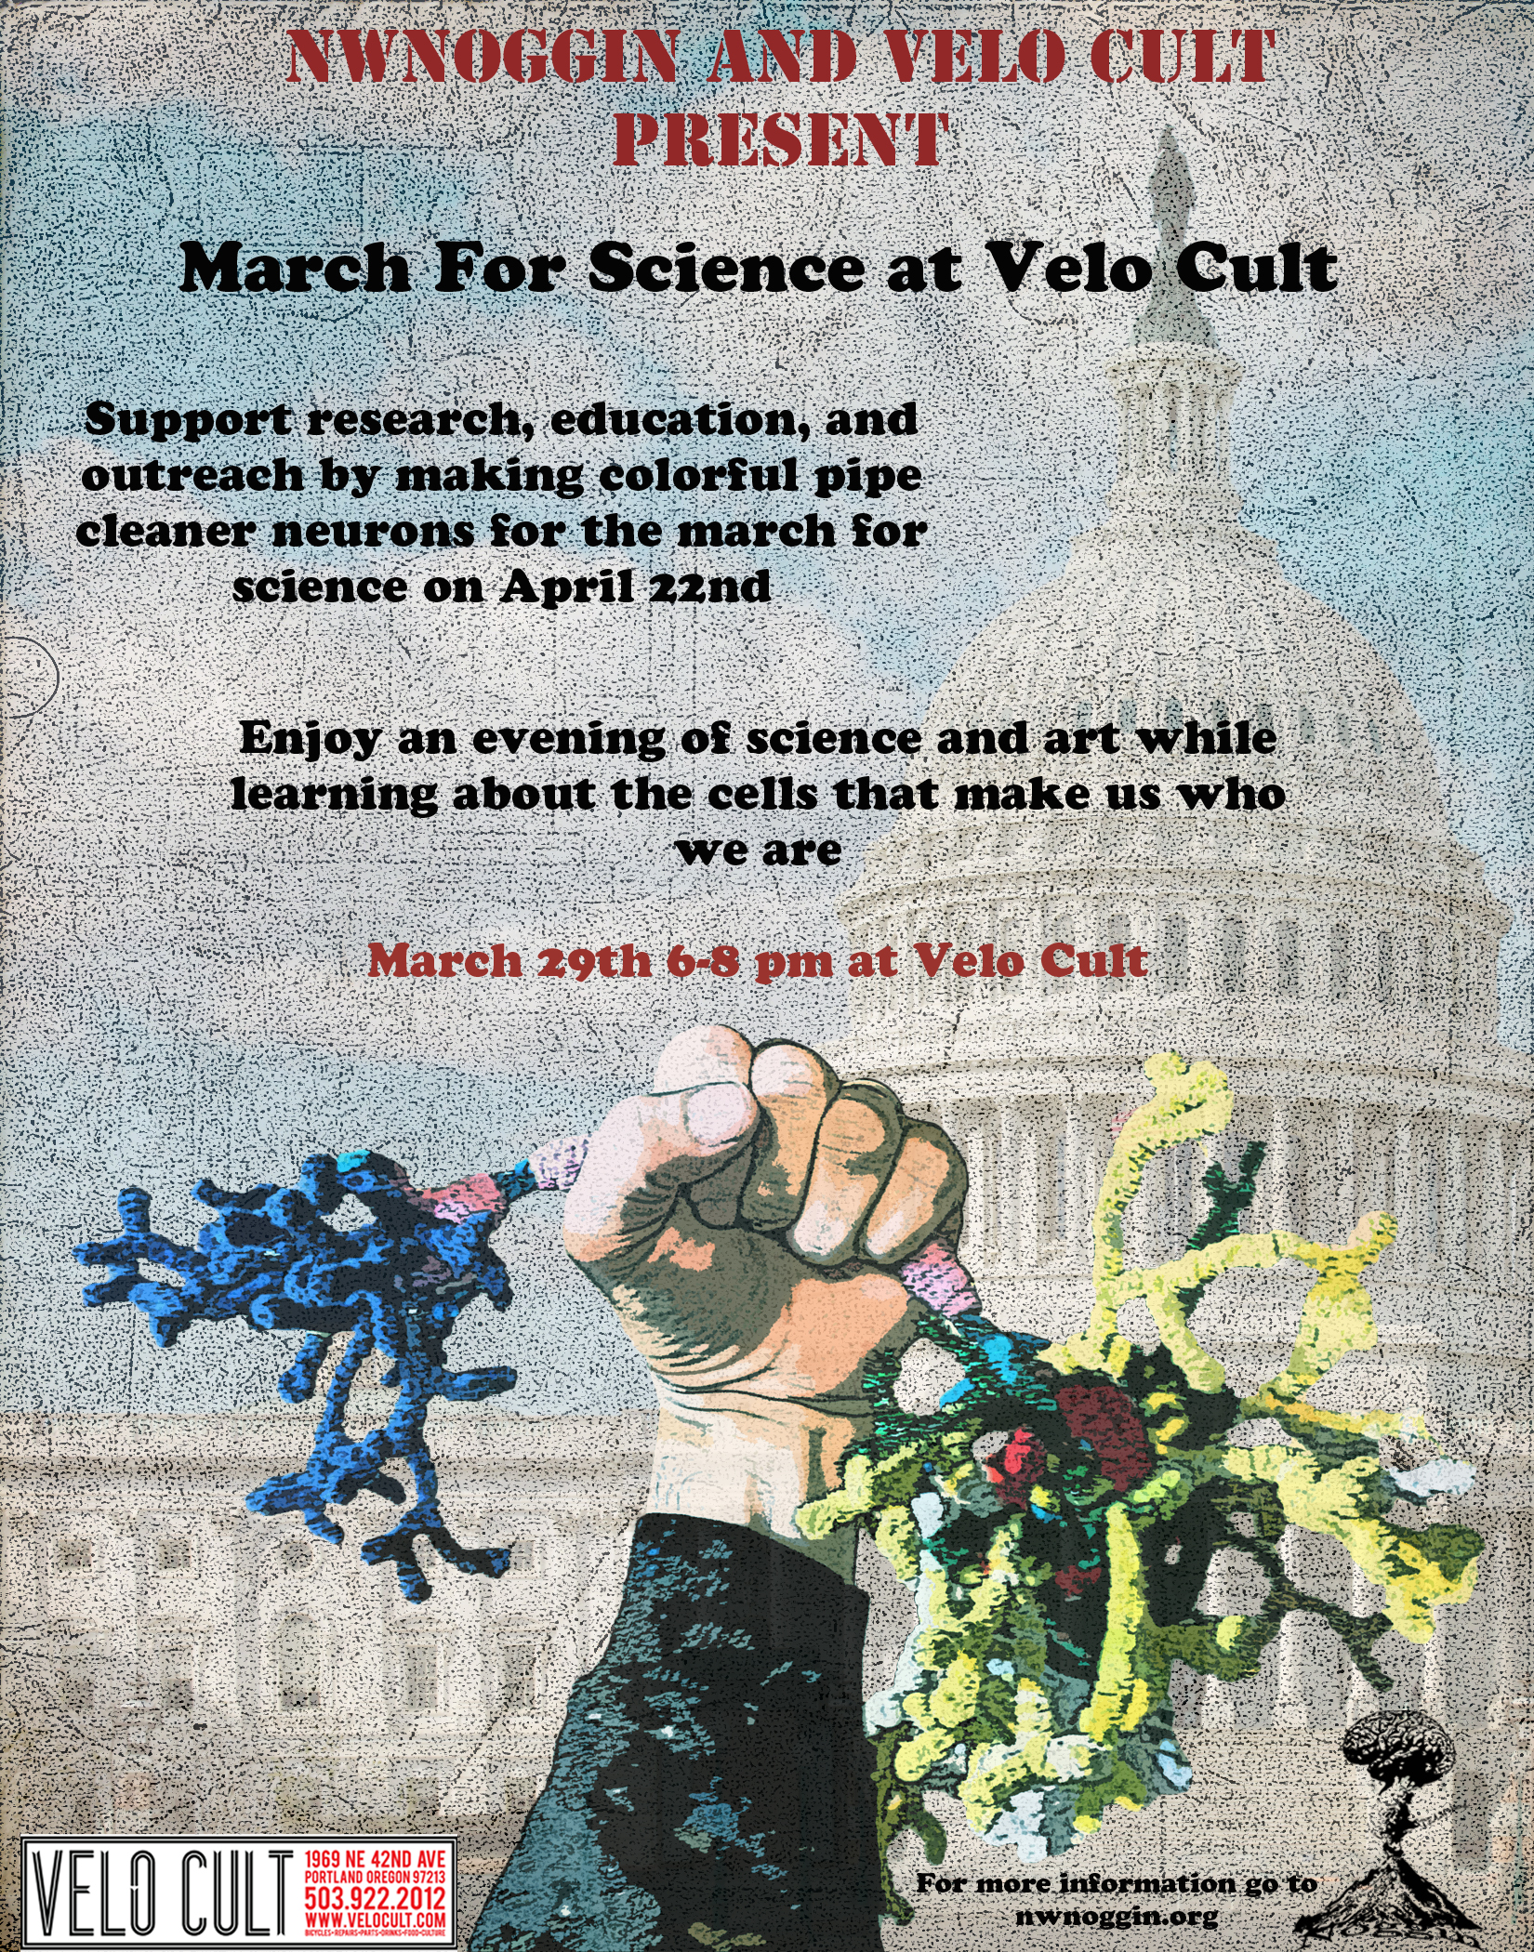

Velo Cult:
March for
Science
WEDNESDAY (3/29)
MAKE YOUR OWN NEURONS!

Slide 8

Support
Portland State University
  Positions, supplies, travel
OHSU (Beh. Neuro, PARC, OBI)
  Supplies, travel, stipends
BioGift Anatomical
  Brains, gloves, formalin
Donations, grants
WSU Vancouver
  ?

Slide 9
Different Types of Neurons A. Purkinje cell B. Granule cell C. Motor neuron D. Tripolar neuron E. Pyramidal Cell F. Chandelier cell G. Spindle neuron H. Stellate cell

