Slide 1
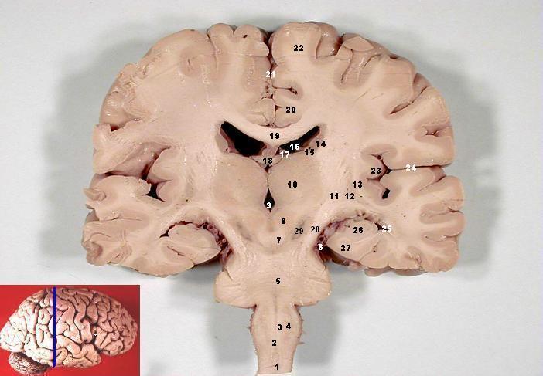
Memory and the Brain
Psychology, Portland State University
Behavioral Neuroscience, OHSU
nwnoggin.org

Slide 2
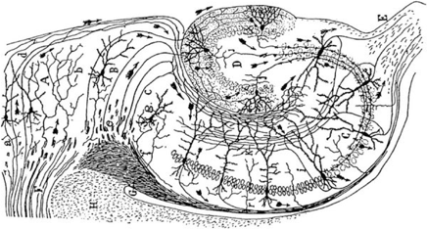
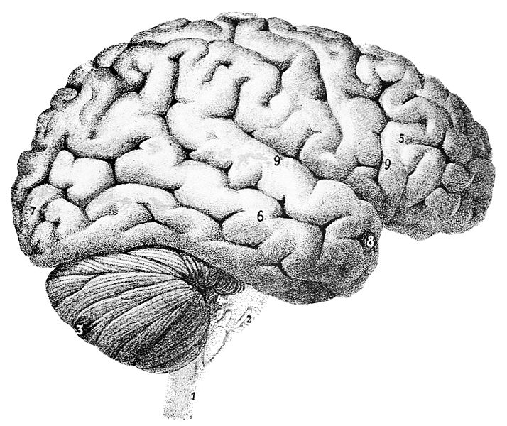
What is memory?
Memory is physical
Remembering an event is a creative act
There are different forms of memory, each dependent on specific areas of the brain…
Biological systems can grow - and decay

Slide 3
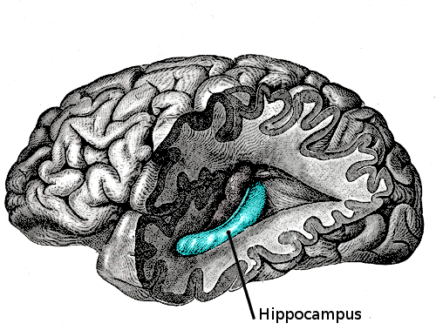
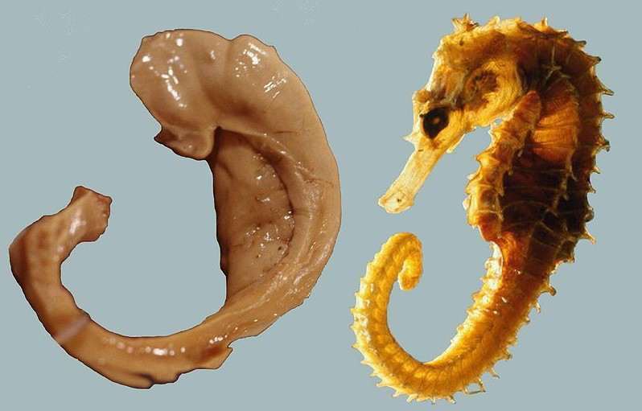
You remember events
When you heard a song that has meaning…
Details of episodes from own your life, like when you first picked up your instrument, or practiced a specific piece...
Neocortex
Depends on
neural networks in the
hippocampus, and other
areas of cortex
Hippocampus

Slide 4
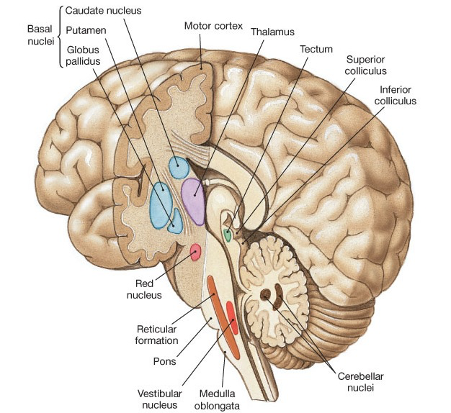
You remember skills... And music also moves you…
Literally…
Basal ganglia
Involuntary mvmt
Timing of mvmt
Cerebellum
Balance
Coordination
Repetitive mvmts
Amygdala/Accumbens
Emotional mvmts

Slide 5
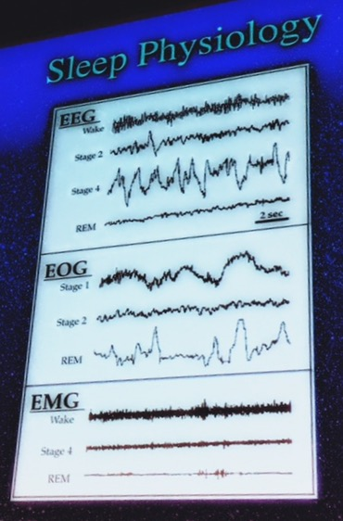
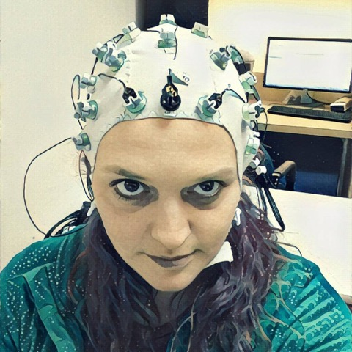
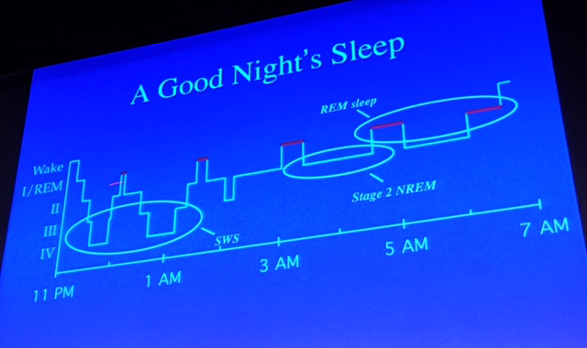
SLEEP
EEG: Sleep Stages
NREM and REM
Neuromodulation
Dopamine
Norepinephrine
Serotonin
Acetylcholine

Slide 6
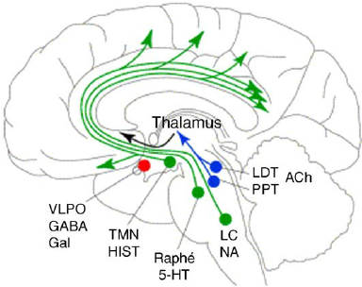
SLEEP: Changes in REM
Amygdala
Anterior cingulate
DLPFC
Dreams can be “hyper-
emotional and bizarre, with
logical constraints removed”
-Robert Stickgold (2017)
Sleep-wake and Other Biological Rhythms: Functional Neuroanatomy (2005)

Slide 7
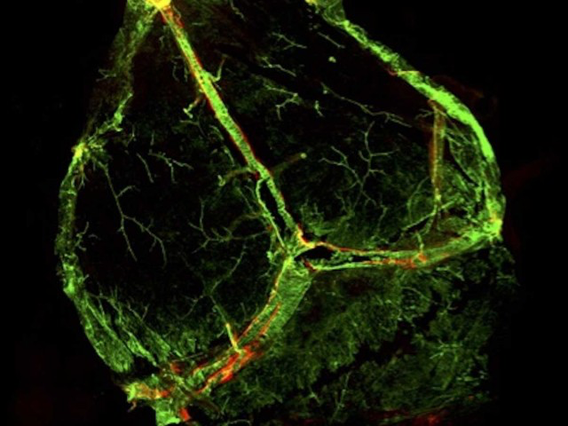
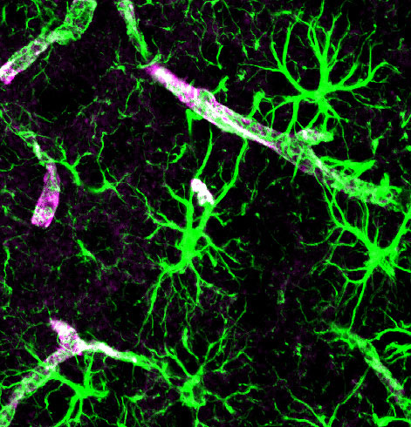
Sleep and the glymphatic system
Lymph (red)
Jeffery Iliff, OHSU
Limited lymphatic
system in the brain
How is waste cleared
from the CNS?
Lack of sleep, lack of
clearance, increased
risk of disease?

Slide 8
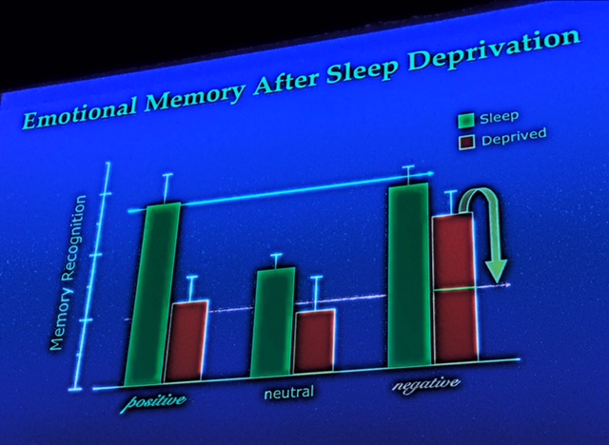
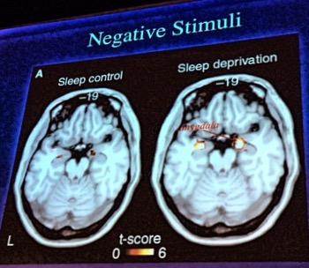
Lack of sleep makes you negative
Yoo et al (2007), Curr Biol
Sleep deprived subjects
selectively better able to
recall negative words than
neutral or positive words
they’d studied earlier
ALSO: greater amygdala response to negative
words than their more alert subjects; and less
functional connectivity with medial OFC…
PREFRONTAL – AMYGDALA DISCONNECT:
Stronger negative emotional response, and less inhibitory control

Slide 9
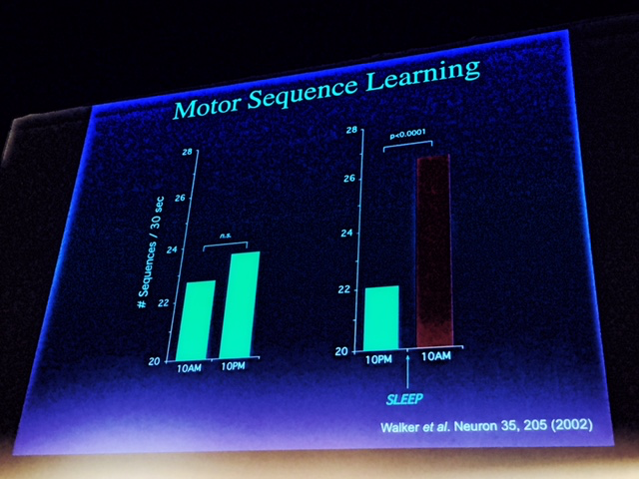
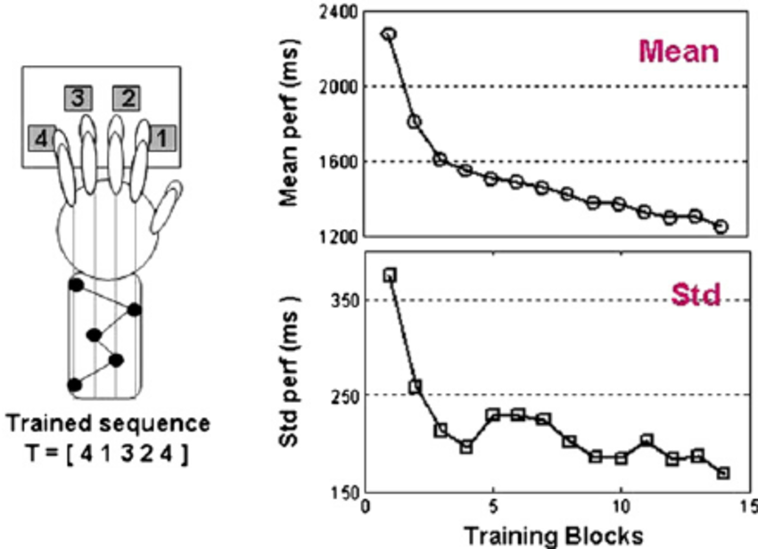
Lack of sleep impairs memory
Sleep enhances procedural memories
Subjects trained on a sequential finger tapping task did
better if allowed to sleep after training, instead of spending
the same amount of post-training time awake…
Walker et al (Neuron (2002))

Slide 10
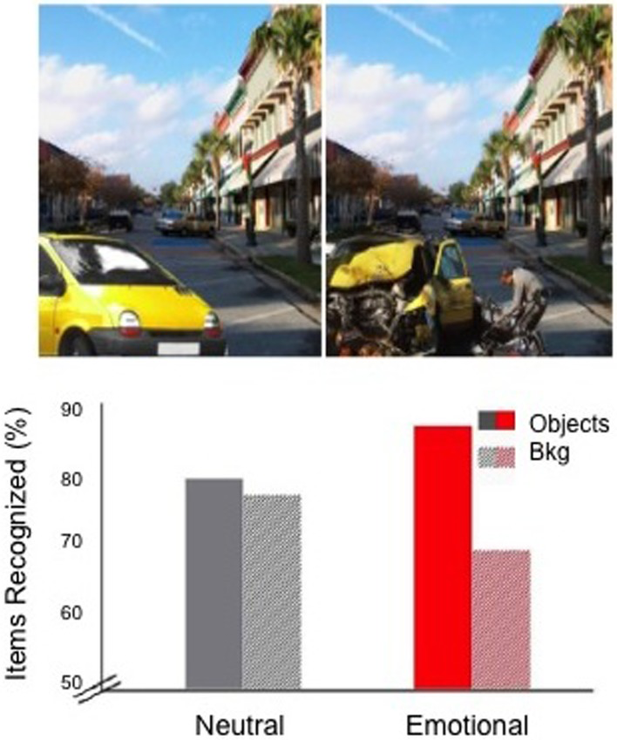
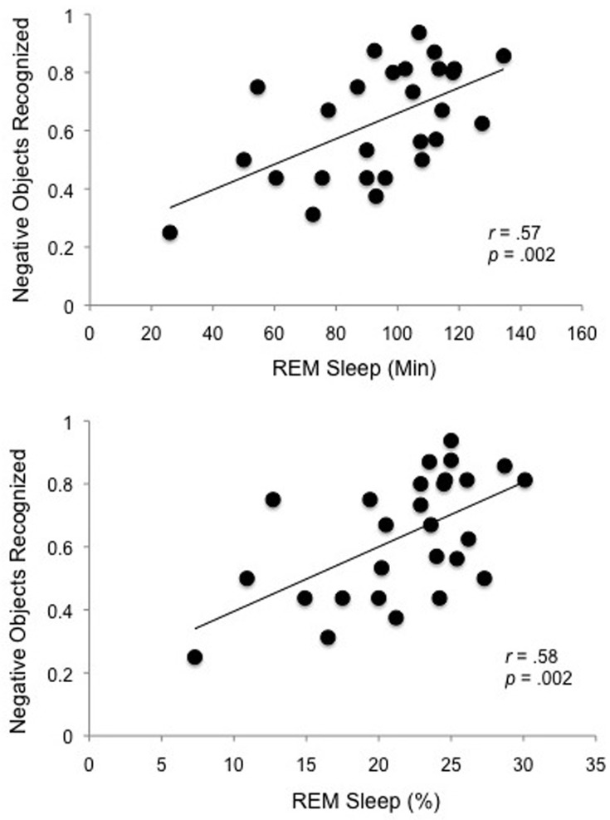
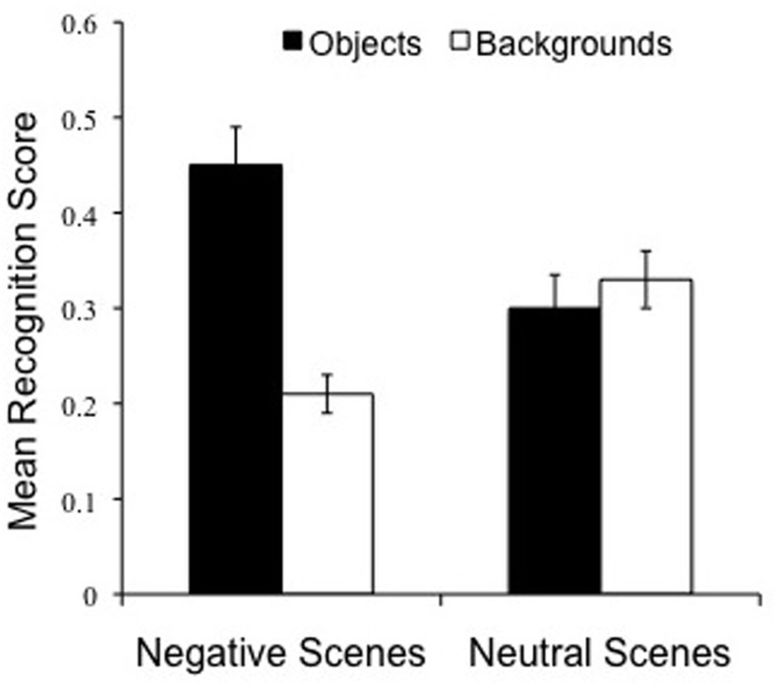
Sleep: get “gist,” drop details
Sleep promotes lasting changes in selective memory for emotional scenes, Payne et al (2012)
Positive association between REM
and selective consolidation of central,
negative aspects of complex scenes
Increase in memory for emotional objects
Decrease in memory for neutral backgrounds

Slide 11
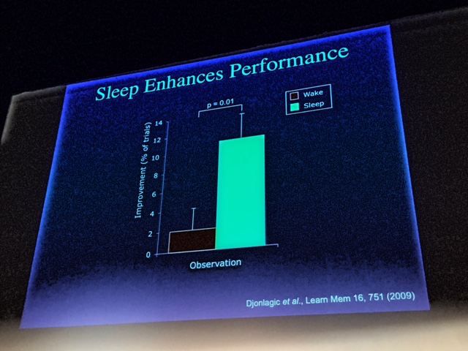
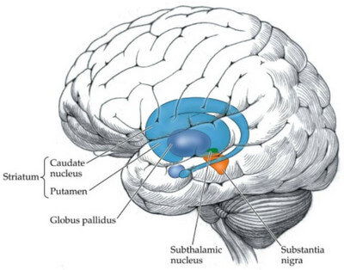
Sleep improves insight
Djonlagic et al (2009)
Weather prediction task Subjects presented with cards,
each probabilistically linked to
a particular outcome (“rain,”
“sun”). Better w/sleep…
Basal
Ganglia

Slide 12
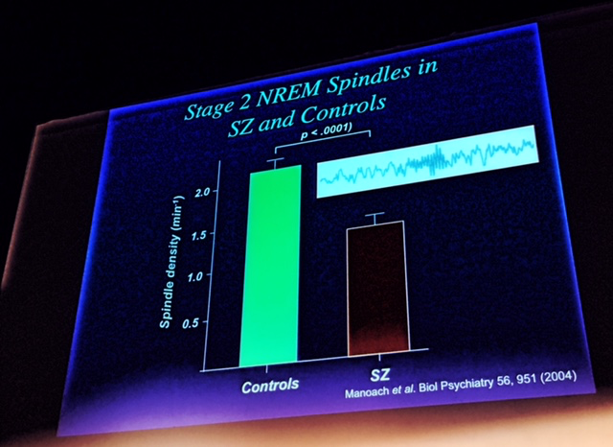
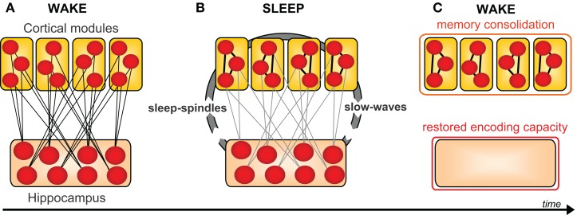
Sleep and schizophrenia
Do NOT improve on
finger tapping task
BUT: Much worse sleep
Fewer sleep spindles

Slide 13
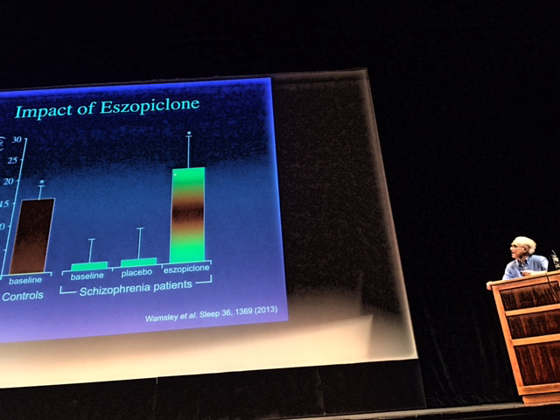
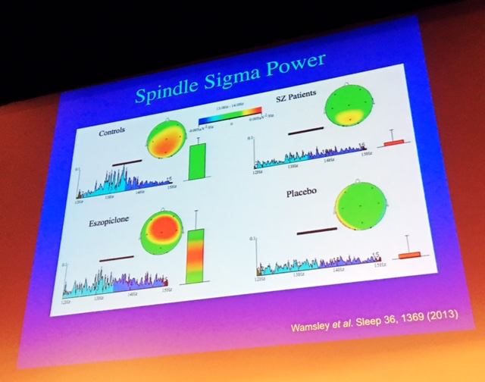
Better sleep = better memory
Eszopiclone improved sleep in schizophrenics, increasing
the incidence of sleep spindles. This also restored the memory
benefits of sleep! (Cenk Tec et al (2014))

Slide 14
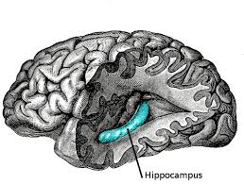
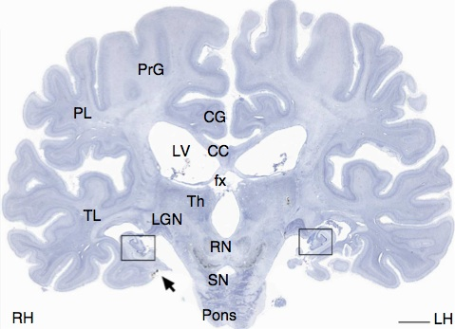
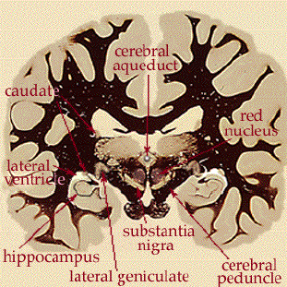
Patient H.M.
Henry Molaison (1926 – 2008)
Intractable epilepsy
Surgery at age 27
Bilateral temporal lobectomy

Slide 15
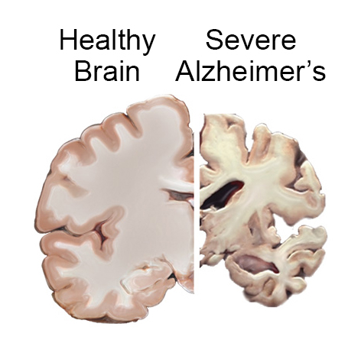
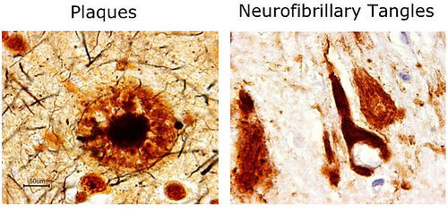
Alzheimer’s disease
A “disconnection syndrome”
Alois Alzheimer (1906)
6th leading cause of death (in US)
Most common form of dementia
Affects 5 million Americans
Beta-amyloid plaques
Tau protein tangles
Aging, inflammation, genetics
Late vs. early onset forms

Slide 16
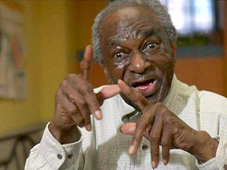
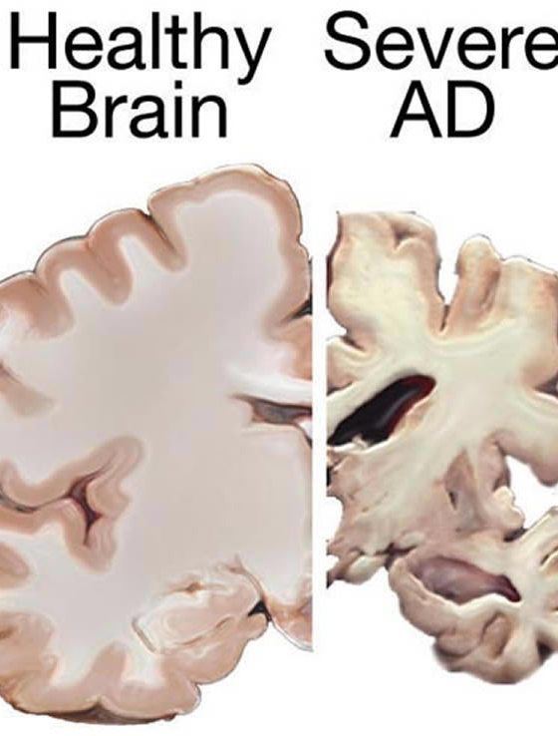
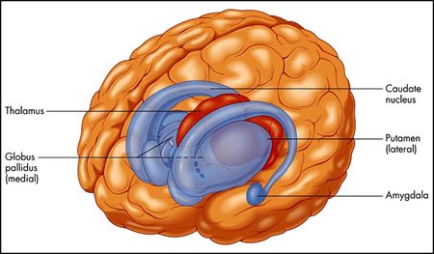
Henry
Dementia involves damage to neocortex and hippocampus
BUT: preservation of subcortical structures critical for involuntary movements, skills, emotions…

