Slide 1
Migraine and Mary Jane:
Results from research
Ram Kandasamy
Integrative Physiology and Neuroscience

Slide 2
Migraine: A complex disorder of the brain
ASIC3
Changes in cortical excitability
Cortical Spreading Depression (CSD)
AURA
Trigger Factors
Genetics/Epigenetics
Environment
Hormones
Age/Gender
Nociceptive activation/transmission
Activation of peripheral nerve endings in the dura
PAIN
Non-headache features
Photo- and phonophobia
Nausea and vomiting
Weariness and fatigue
Changes in mood/irritability
Activation of brainstem/hypothalamus
TNC activation
Central sensitization

Slide 3
Migraine epidemiology
~36 million migraine patients in the US. One in 4 households has at least 1 migraine sufferer.
ASIC3
Migraine affects 14.7% of the world’s population and is among the most disabling.
Migraine is the most common neurological disorder in the world.
Notes:
Migraine stat

Slide 4
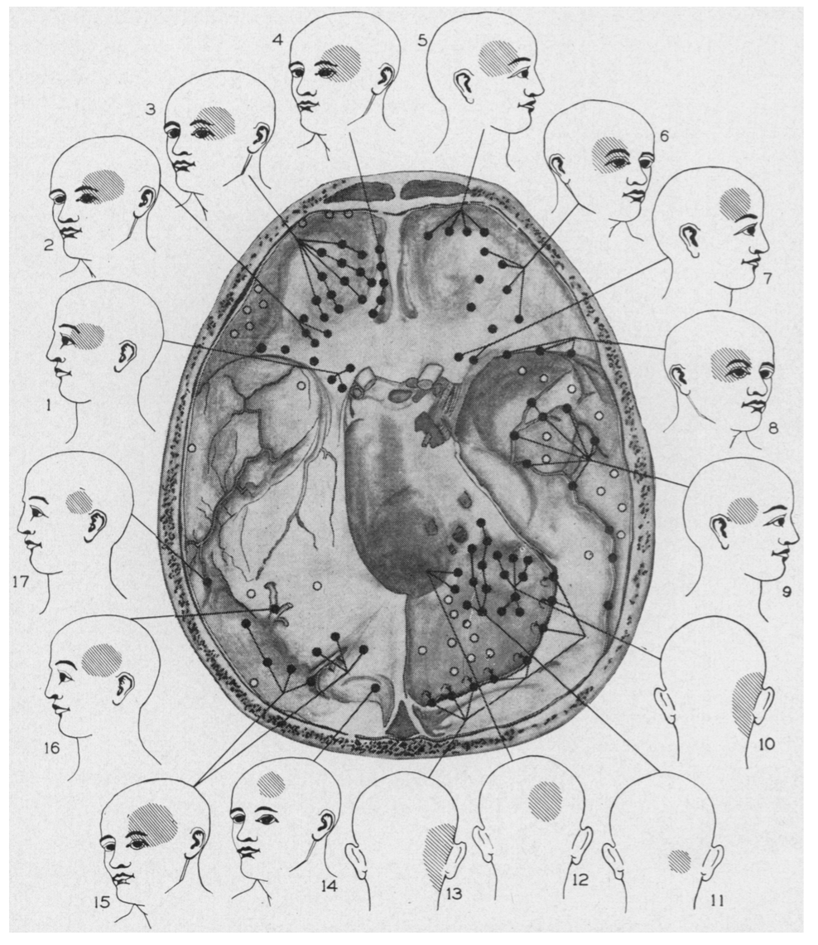
What is the source of migraine pain?
ASIC3
Notes:
Evidence that pain results from activation of dural afferents in humans?

Slide 5
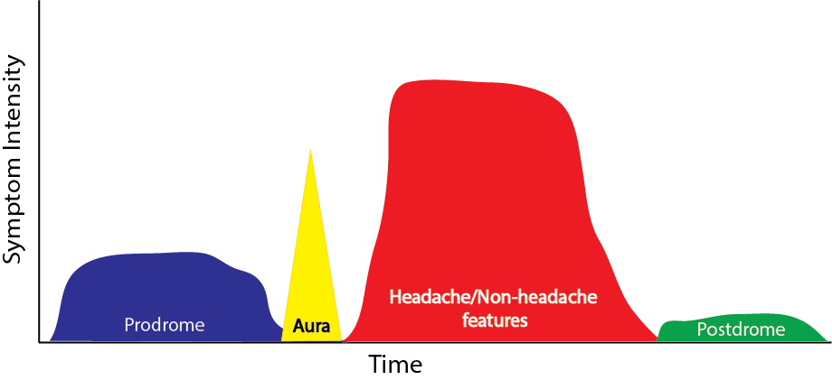
Characteristics of migraine
ASIC3
During an attack
  Nausea, vomiting
  Sweating or cold hands
  Sensitivity to light and sound
  Scalp tenderness or extracephalic allodynia
  Throbbing, unilateral pain
  Can last from 4-72 h
Before an attack
  Yawning
  Fatigue
  Food cravings
  Drowsiness or depression
  Irritability or tension
  Occurs 24-48 h before attack
After an attack
  “Hungover”
  Weakness
  Tiredness
  Mood changes
  Can last for hours to days after attack is over

Slide 6
Treatment options for migraine: A therapeutic dead end
ASIC3
Preventative Medications
Acute Medications
May prevent or reduce the number of migraine attacks
Generally taken on a daily basis
  Antiepileptics
  Beta blockers
  Calcium channel blockers
  Antidepressants
Tend to work relatively quickly to relieve migraine pain and other symptoms
Usually taken during a migraine attack
  Triptans
  NSAIDs (Aspirin)
  Analgesics (Rx and OTC)
  Ergotamine/DHE
  Opioids
  Neuroleptics
  Corticosteroids
  Antiemetics
These medications are effective in less than 50% of migraine patients.

Slide 7
Cannabis and migraine: A long history
ASIC3
Dr. Cledinning in London first prescribed cannabis for migraine in the 1840’s.
Dr. Farlow described marijuana as having “few equals in its power over headaches” in 1889.
Political propaganda and the textile industry led to the Marihuana Tax Act of 1937.
Cannabis preparations were taken off the US Pharmacopoeia in 1941; however, Dr. Fishbein recommended oral cannabis for menstrual migraine in 1942.
Psychedelic hippie counterculture movement + recreational marijuana use = Schedule 1

Slide 8
Cannabinoids and migraine: Reverse drug discovery
ASIC3
Regular cannabis consumption prevents the overall number of headache days.
Smoked cannabis terminates migraine attacks within 5 min of inhalation and restore complete function within 15 min.
Cannabinoid agonists modify central inputs from the dura mater.
Long-term Goal: Determine the anti-migraine potential of cannabinoids.
Central Hypothesis: ∆⁹-tetrahydrocannabinol (THC) has anti-migraine properties.
Notes:
Dr. Clendinning in London treat migraine with cannabis in 1840s
Dr. Greene recommended daily doses of cannabis for migraine in 1872.

Slide 9
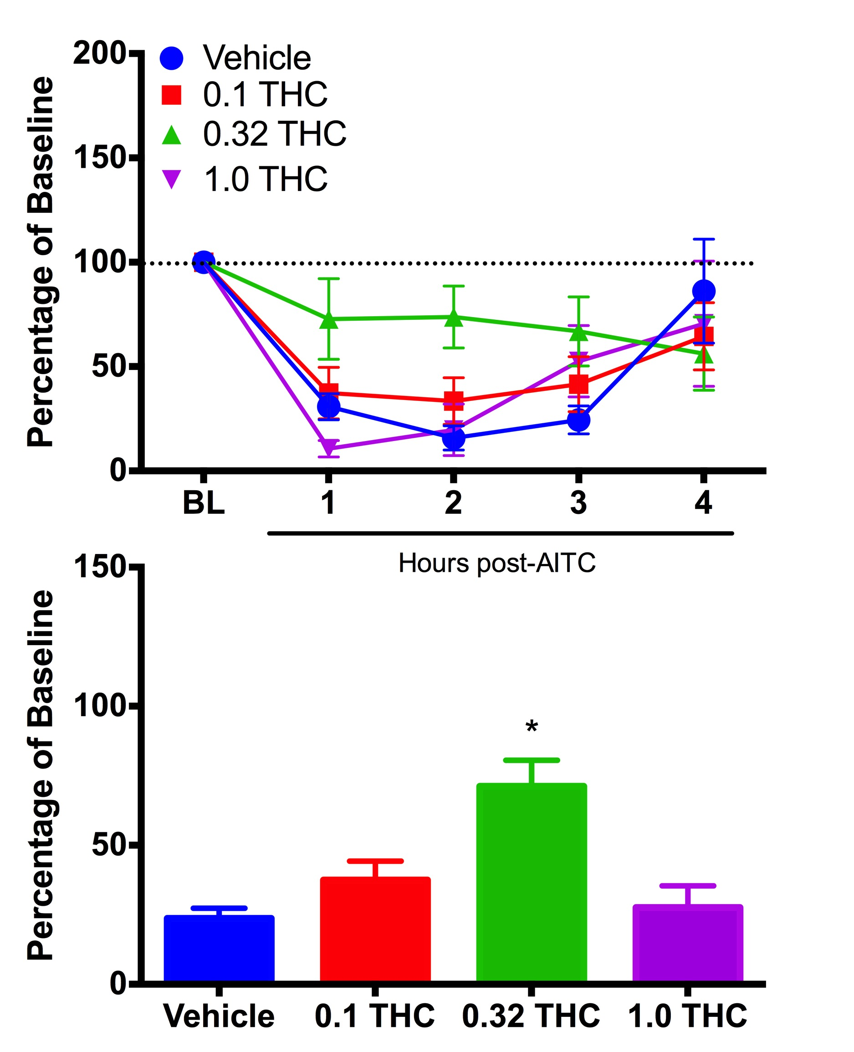
THC prevents migraine pain
ASIC3

Slide 10
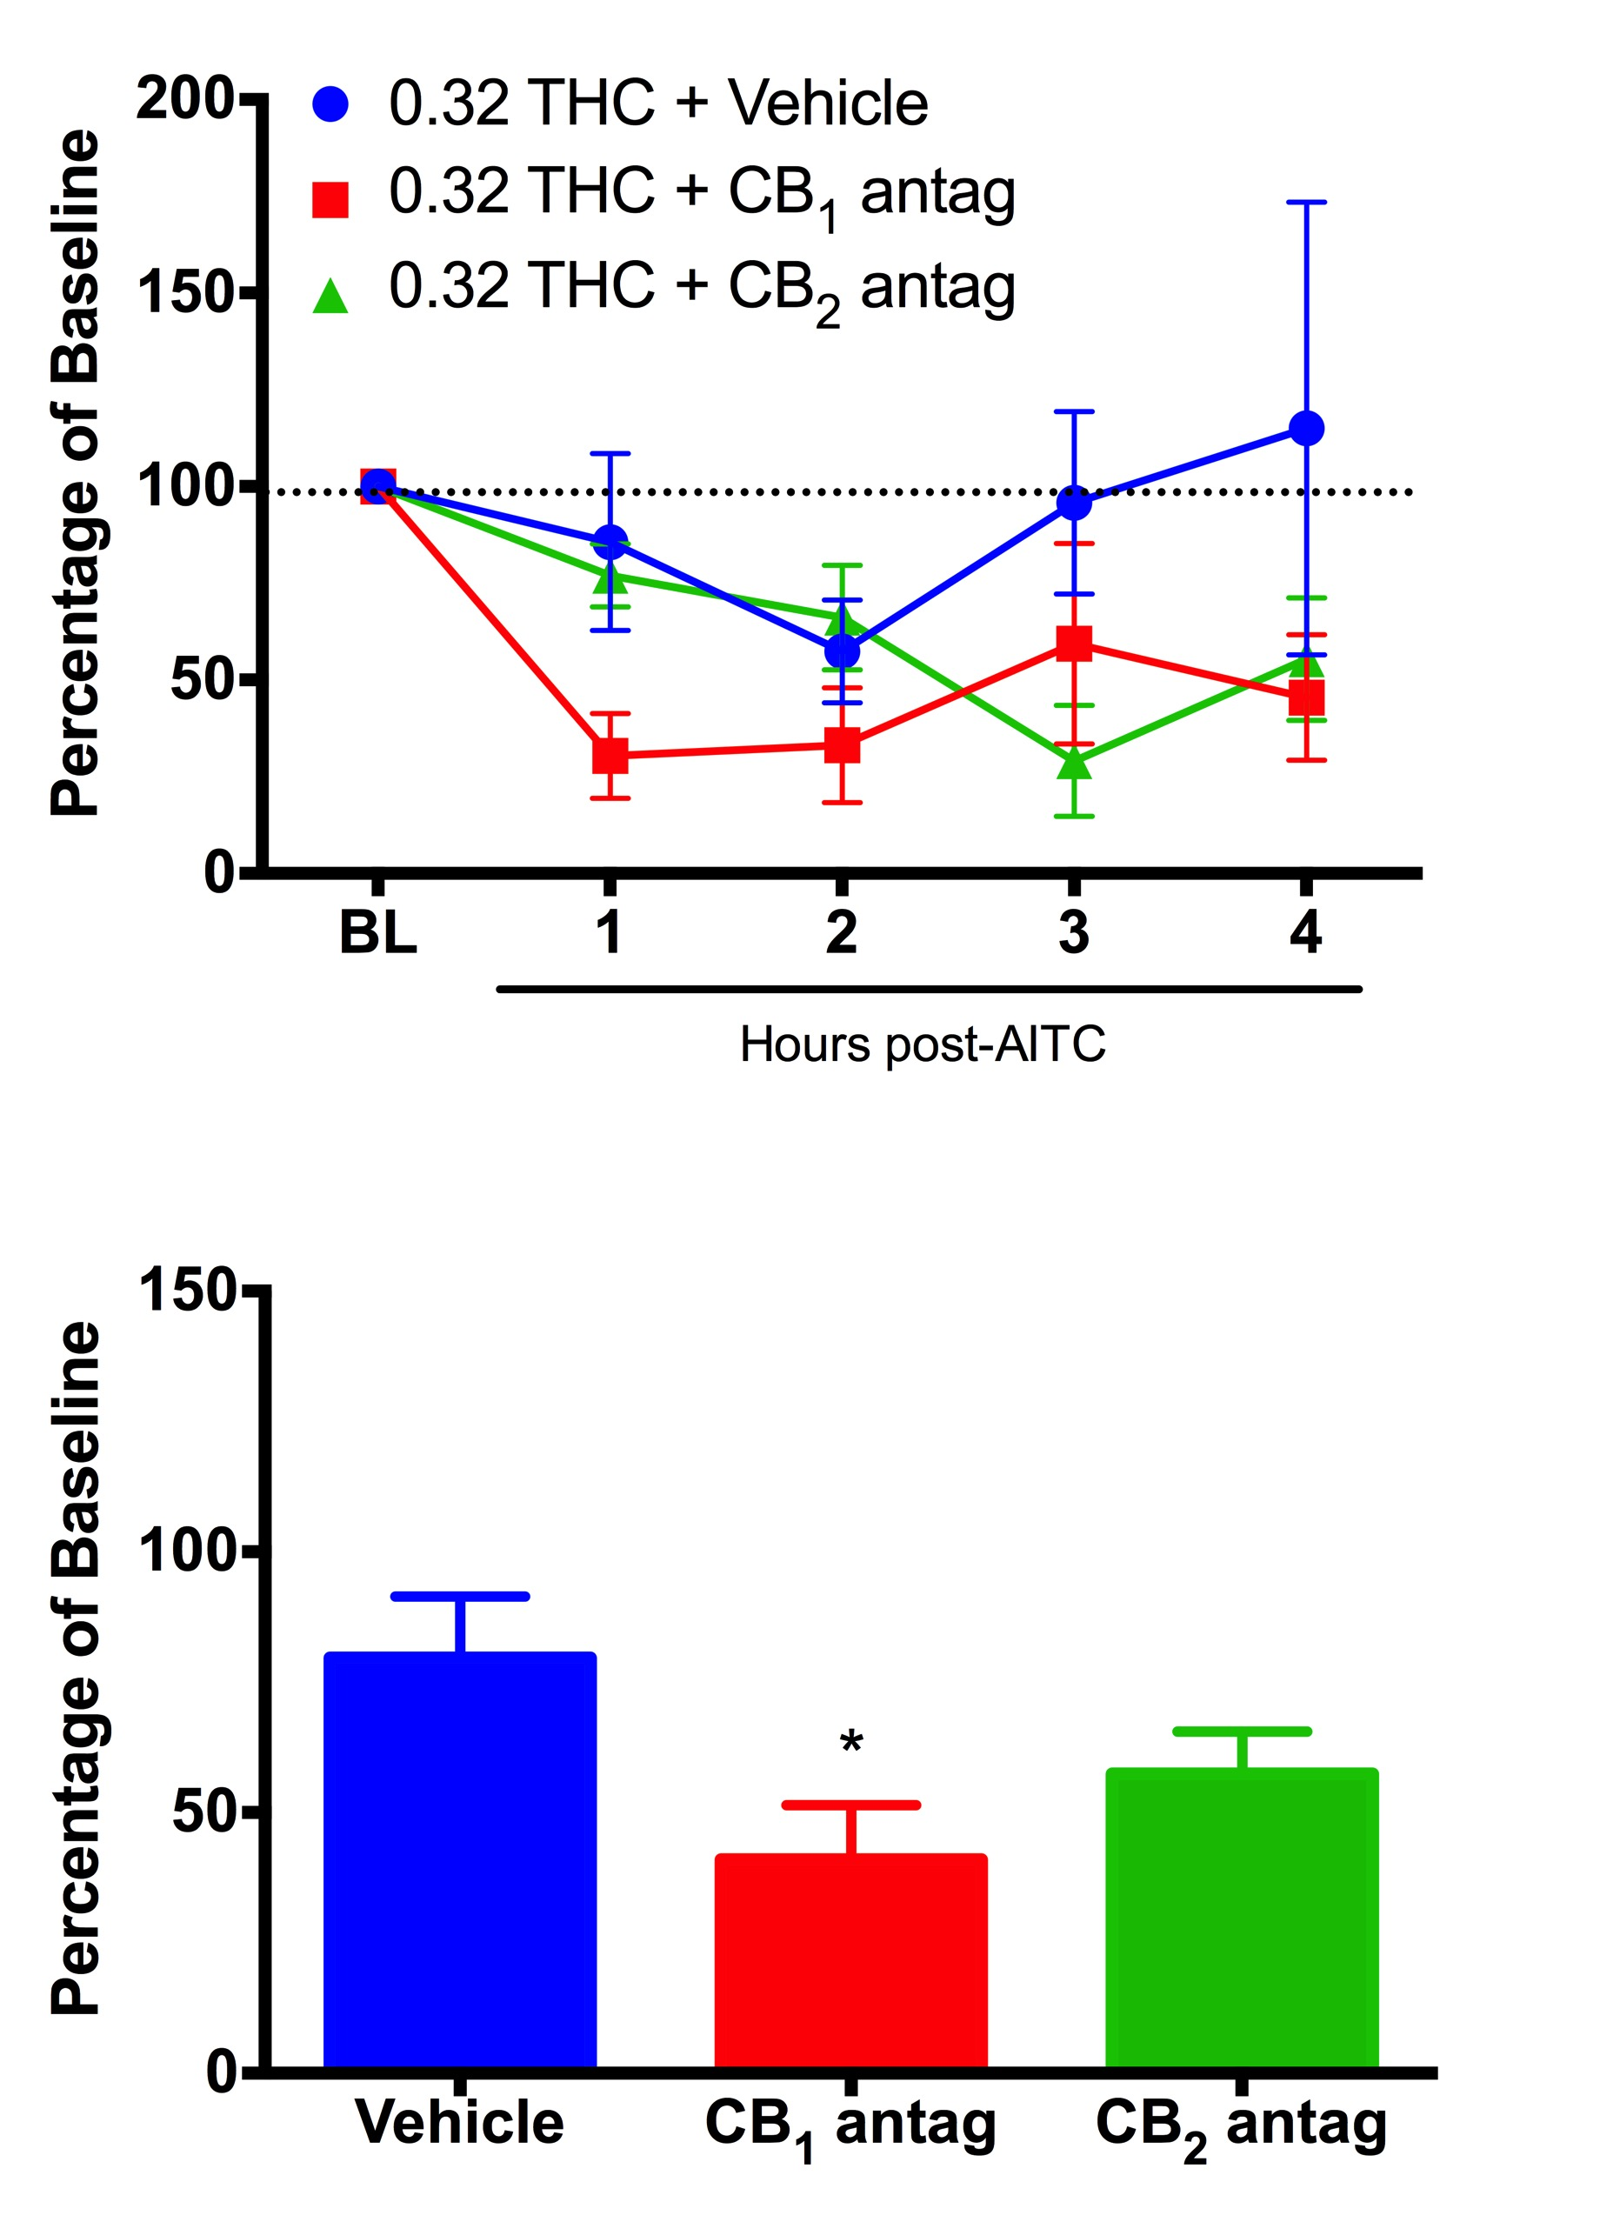
THC prevents migraine pain via the CB1 receptor
ASIC3

Slide 11
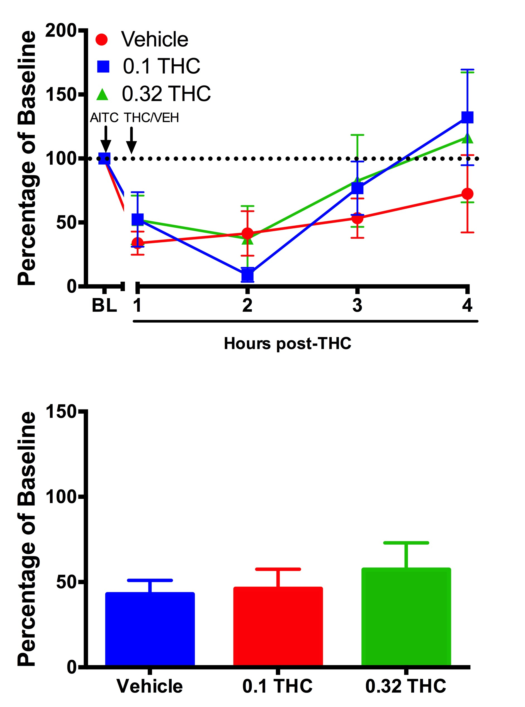
THC does not abort migraine pain
ASIC3

Slide 12
THC reverses migraine pain depending on time and dose
ASIC3
Anecdotal evidence suggests marijuana can abort and prevent migraine attacks.
Preclinical evidence suggests that THC reverses migraine pain depending on dose and time administered.
Future research:
  Investigate endogenous cannabinoids
  Explore the CB1 receptor as a therapeutic target
  Determine whether psychoactivity of Cannabis can be limited
Notes:
=

Slide 13
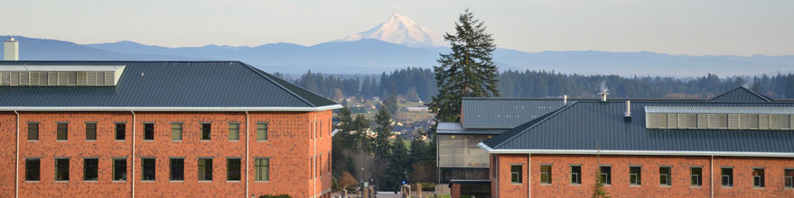
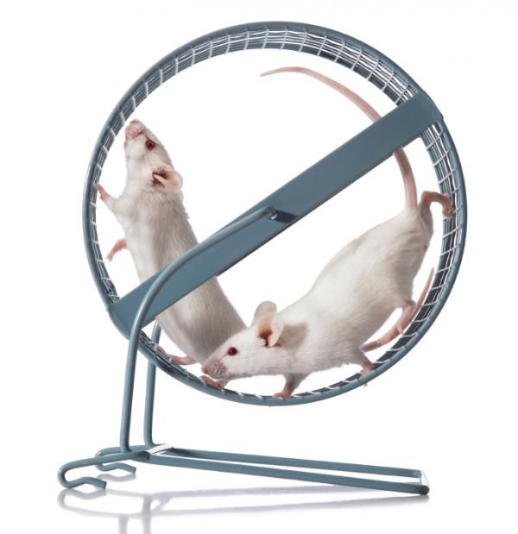
Acknowledgments
Morgan Lab (WSU Vancouver):
Dr. Michael M. Morgan
Shauna Taff
Jonas Calsbeek
Andrea Lee
Cole Dawson
Tammy Hilgendorf
Ellie Furth
Department of Integrative Physiology and Neuroscience
Department of Psychology
  Funding:
  State of Washington Initiative Measure No. 171 (RK)
  State of Washington Initiative Measure No. 502 (MMM)
  NIH DA027625 (MMM); NIH NS095097 (MMM)

