Slide 1
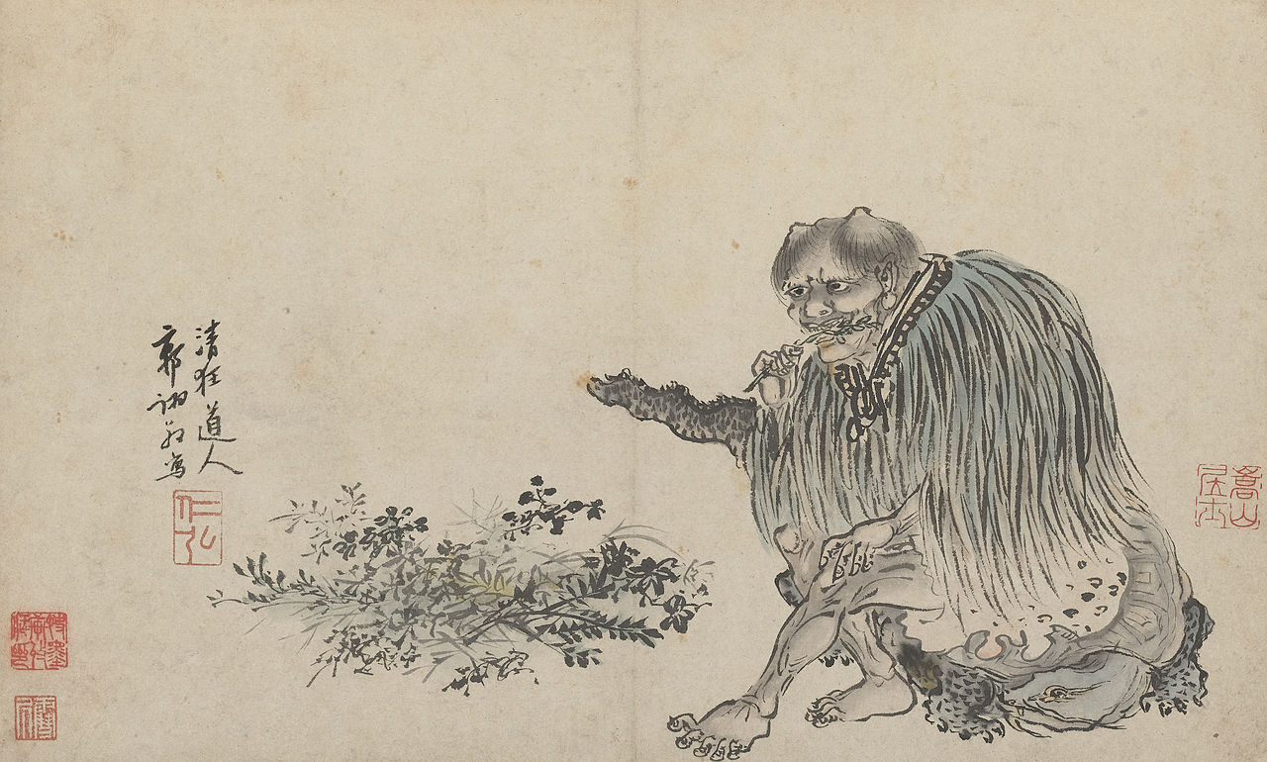
Looking at cannabis use through visual culture
by looking at the visual history of cannabis we can tell a great deal about social attitudes, what those were in the past, how they’ve changed, and also an understanding of where our current viewpoint comes from.
Shennong as depicted in a 1503 painting by Guo Xu
Shennong is said to have taught the ancient Chinese not only their practices of agriculture, but also the use of herbal drugs, including cannabis.

Slide 2
Middle Ages
700 BCE
1600 CE
2500 BCE
Origin
100 BCE
1000 BCE
2000 BCE
2000 BCE
1500 CE
The spread of cultivated cannabis
Cannabis is a plant native to Central Asia that has spread all over the world

Slide 3
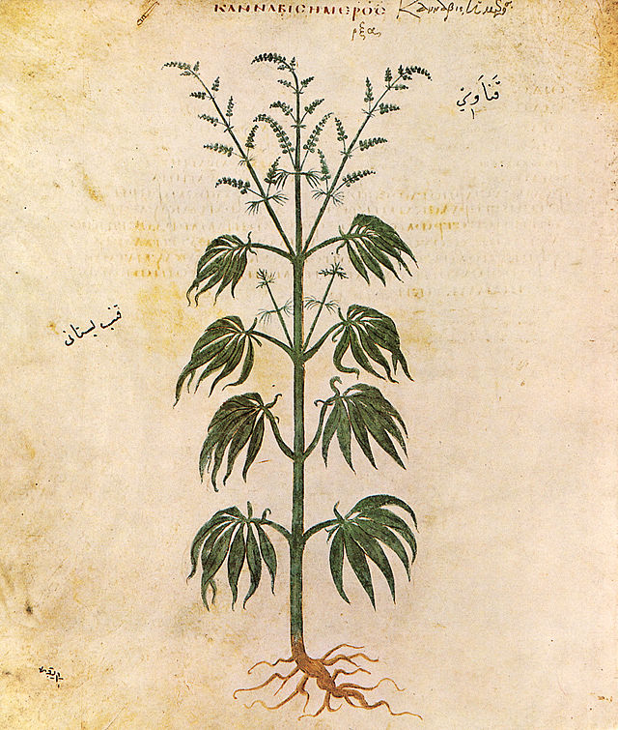
So what was cannabis used for?
Shenung reportedly recommended the use of marijuana, or “ma” as it was referred to, for over a hundred different ailments including gout, rheumatism, malaria, constipation and even absent-mindedness.
Bhang use in India begins around 2000 BCE
70 CE Dioscorides, a physician in Nero’s army, lists medical marijuana in his Pharmacopoeia.
Apothecary jar from Egypt around 1500 BCE contained traces of cannabis
made of milk and marijuana it was used as anesthetic or anti-phlegmatic.
Egyptians Use Cannabis for Glaucoma, and Inflammation
He suggested using cannabis to treat earache and to suppress lust.

Slide 4
What did people think of cannabis use?
1200 CE: Hashish figured prominently in several of the folk tales of 1001 nights
Greek historian Herodotus wrote detailed accounts of Scythian vapor hotbox rituals around 450 BCE.
In the story of the Hashish Eater a man eats hashish, makes a fool of himself, and gets thrown in jail after waking up in the morning naked and aroused in front of strangers at a public bath.
“The Scythians take cannabis seeds, crawl in under the felt blankets, and throw the seeds on to the glowing stones. The seeds then emit dense smoke and fumes, much more than any vapor-bath in Greece. The Scythians shriek with delight at the fumes.”
Joos van Craesbeeck “The Smoker” 1635

Slide 5
Middle Ages
700 BCE
1910 CE
1600 CE
2500 BCE
Origin
100 BCE
1000 BCE
2000 BCE
1500 CE
The spread of cultivated cannabis

Slide 6
Anti Marijuana sentiment in the 1930’s and 40’s
In the 70’s and 80’s
Even today
"How many murders, suicides, robberies, criminal assaults, holdups, burglaries and deeds of maniacal insanity it causes each year, especially among the young, can only be conjectured...No one knows, when he places a marijuana cigarette to his lips, whether he will become a joyous reveler in a musical heaven, a mad insensate, a calm philosopher, or a murderer..." HARRY J ANSLINGER Commissioner of the US Bureau of Narcotics 1930-1962

